Slide 1
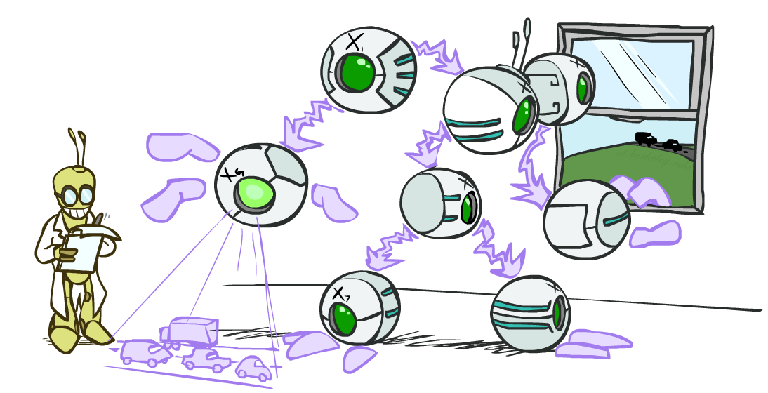
CS 188: Artificial Intelligence
Bayes Nets: Exact Inference
Instructors: Angela Liu and Yanlai Yang
University of California, Berkeley
(Slides adapted from Stuart Russell and Dawn Song)
Notes:
Please retain proper attribution, including the reference to ai.berkeley.edu. Thanks!

Slide 2
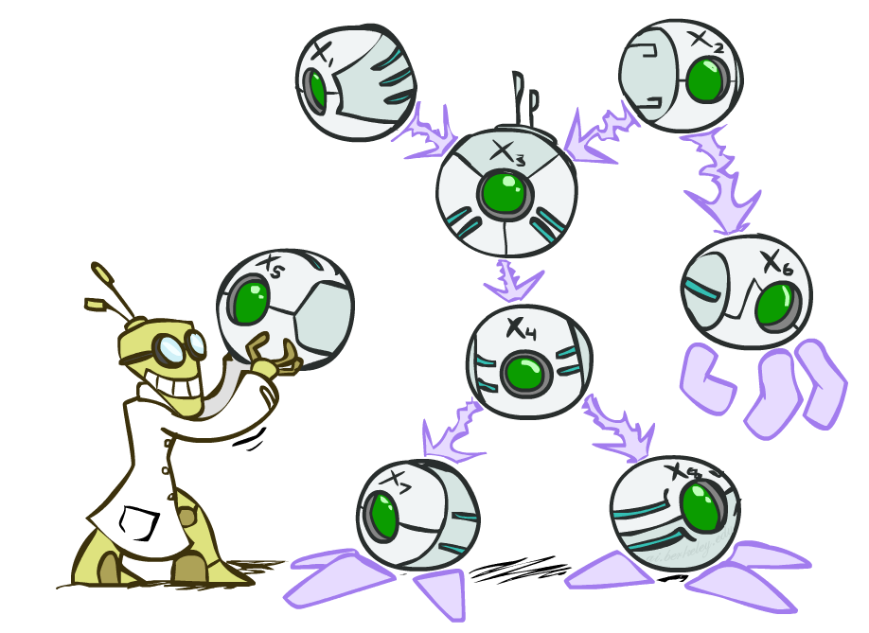
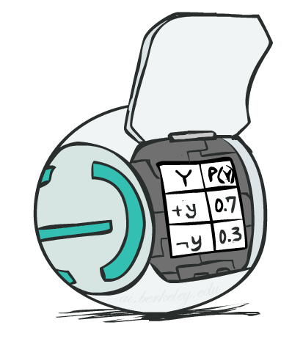
Bayes Net Semantics
A Bayes net is an efficient encoding of a probabilistic model of a domain
A directed, acyclic graph, one node per random variable
A conditional probability table (CPT) for each node
A collection of distributions over X, one for each combination of parents’ values
Bayes’ nets implicitly encode joint distributions
As a product of local conditional distributions
To see what probability a BN gives to a full assignment, multiply all the relevant conditionals together:

Slide 3
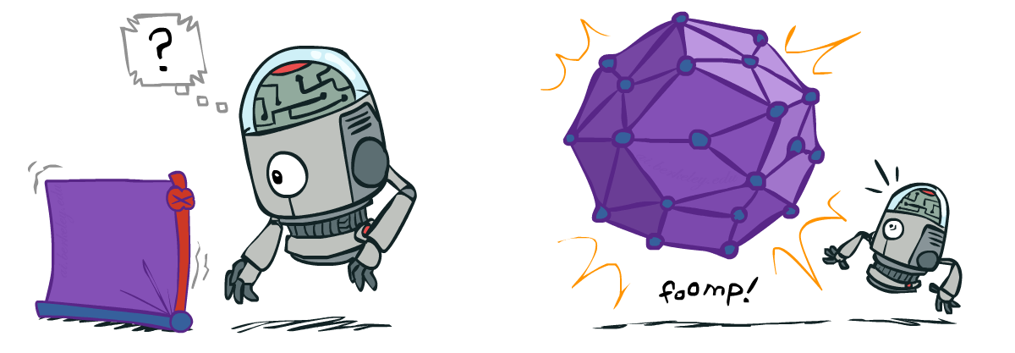
Size of a Bayes Net
How big is a joint distribution over N Boolean variables?
2^{N}
How big is an N-node net if nodes have up to k parents?
O(N * 2^{k+1})
Both give you the power to calculate
BNs: Huge space savings!
Also easier to elicit local CPTs
Also faster to answer queries (this lecture!)

Slide 4
Causality?
BNs need not actually be causal
Sometimes no causal net exists over the domain (especially if variables are missing)
E.g. consider the variables Traffic and Rain
+r | 1/4
-r | 3/4
+t | 9/16
-t | 7/16
R
T
+r | +t | 3/4
 | -t | 1/4
+t | +r | 1/3
 | -r | 2/3
T
R
-r | +t | 1/2
 | -t | 1/2
-t | +r | 1/7
 | -r | 6/7

Slide 5
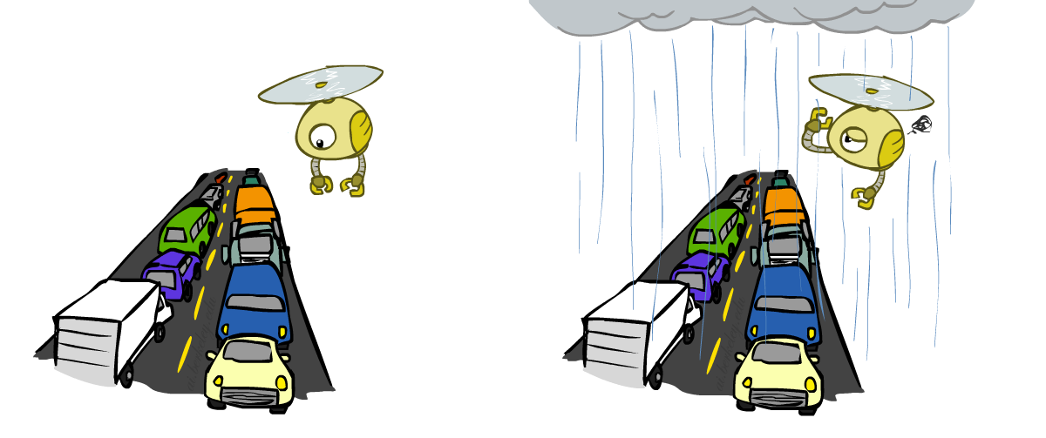
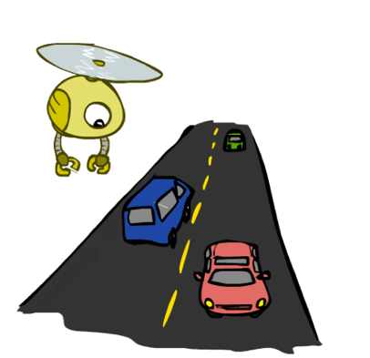
Example: Traffic
Causal direction
R
+r | 1/4
-r | 3/4
+r | +t | 3/16
+r | -t | 1/16
-r | +t | 6/16
-r | -t | 6/16
+r | +t | 3/4
 | -t | 1/4
T
-r | +t | 1/2
 | -t | 1/2

Slide 6
Example: Reverse Traffic
Reverse causality?
T
+t | 9/16
-t | 7/16
+r | +t | 3/16
+r | -t | 1/16
-r | +t | 6/16
-r | -t | 6/16
+t | +r | 1/3
 | -r | 2/3
R
-t | +r | 1/7
 | -r | 6/7

Slide 7
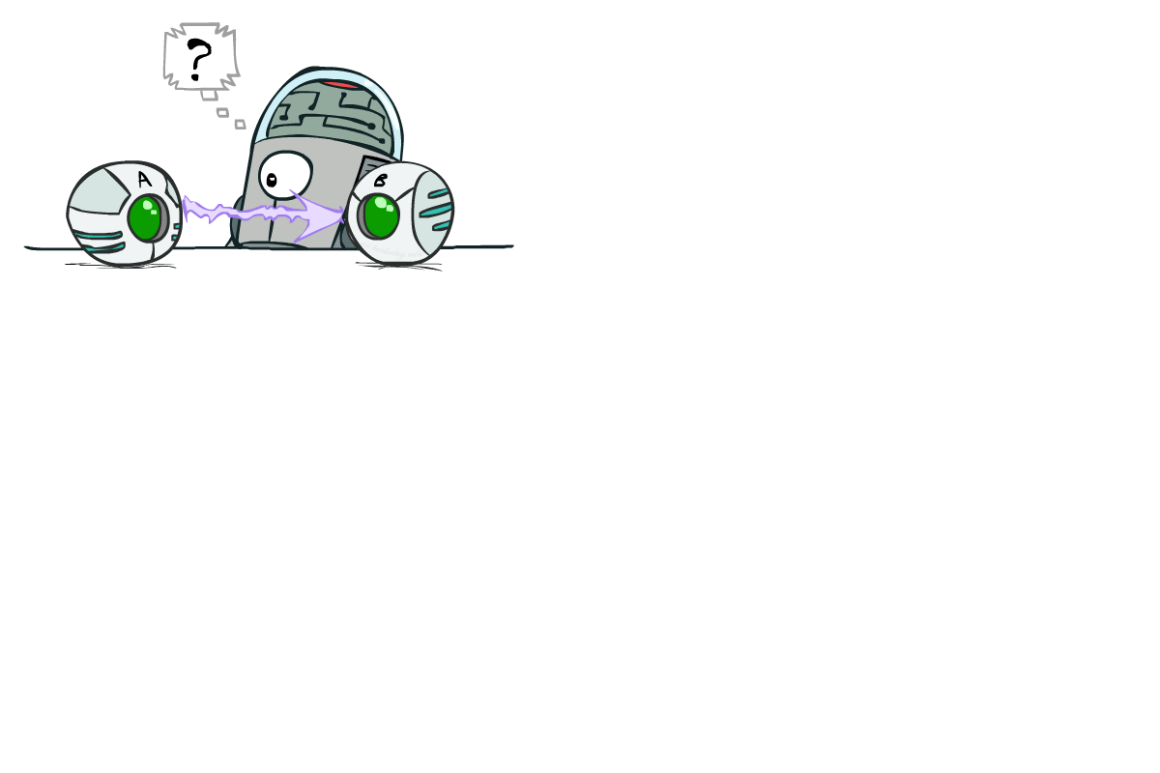
Causality?
When Bayes’ nets reflect the true causal patterns:
Often simpler (nodes have fewer parents)
Often easier to think about
Often easier to estimate probabilities from data
BNs need not actually be causal
Sometimes no causal net exists over the domain (especially if variables are missing)
E.g. consider the variables Traffic and Drips
End up with arrows that reflect correlation, not causation
What do the arrows really mean?
Topology may happen to encode causal structure
Topology really encodes conditional independence

Slide 8
Inference by Enumeration in Bayes Net
Reminder of inference by enumeration:
Any probability of interest can be computed by summing entries from the joint distribution: P(Q | e) = α ∑_{h} P(Q , h, e)
Entries from the joint distribution can be obtained from a BN by multiplying the corresponding conditional probabilities
P(B | j, m) = α ∑_{e,a} P(B, e, a, j, m)
= α ∑_{e,a} P(B) P(e) P(a|B,e) P(j|a) P(m|a)
Problem: sums of exponentially many products!
B
E
A
J
M

Slide 9
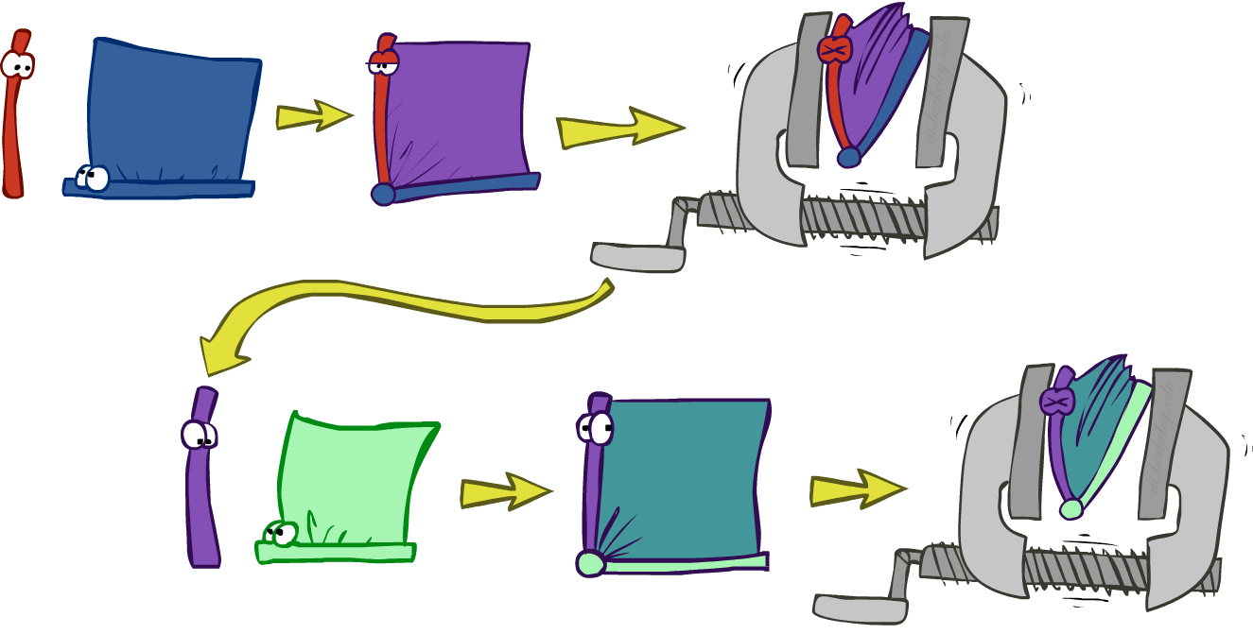
Variable elimination: The basic ideas
Move summations inwards as far as possible
P(B | j, m) = α ∑_{e,a} P(B) P(e) P(a|B,e) P(j|a) P(m|a)
= α P(B) ∑_{e} P(e) ∑_{a} P(a|B,e) P(j|a) P(m|a)
Do the calculation from the inside out
I.e., sum over a first, then sum over e
Challenge: P(a|B,e) isn’t a single number, it’s a table of different numbers (depending on the values of B and e)
Solution: use arrays of numbers with appropriate operations on them; these are called factors

Slide 10
Factor Zoo I
Joint distribution: P(X,Y)
Entries P(x,y) for all x, y
|X|x|Y| matrix
Sums to 1
Projected joint: P(x,Y)
A slice of the joint distribution
Entries P(x,y) for one x, all y
|Y|-element vector
Sums to P(x)
P(A,J)
A \ J | true | false
true | 0.09 | 0.01
false | 0.045 | 0.855
P(a,J) = P_{a}(J)
A \ J | true | false
true | 0.09 | 0.01
Number of variables (capitals) = dimensionality of the table

Slide 11
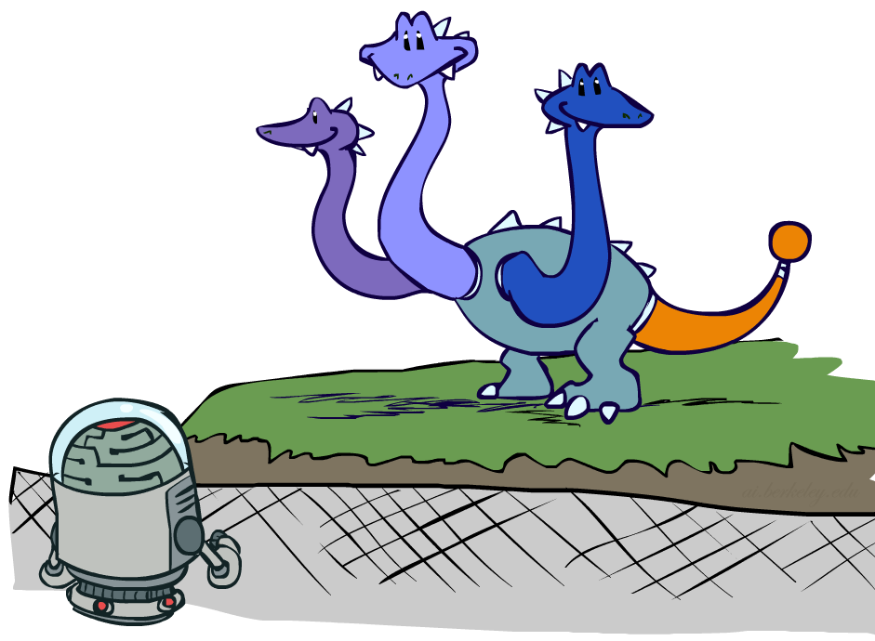
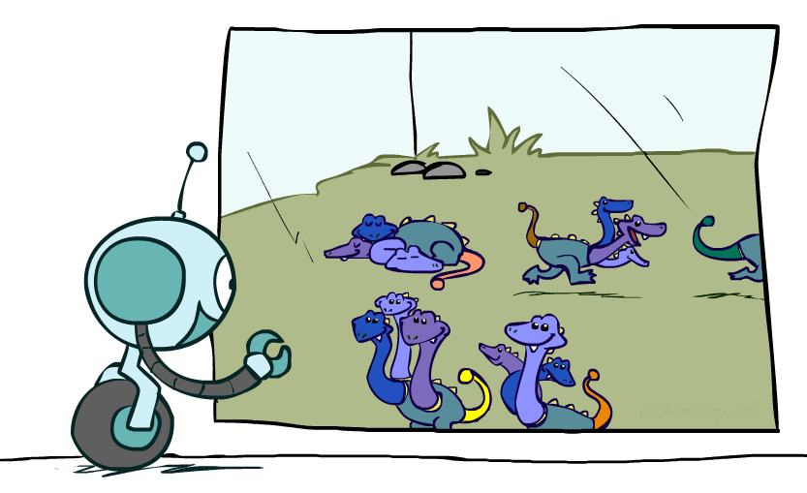
Factor Zoo II
P(J|a)
Single conditional: P(Y | x)
Entries P(y | x) for fixed x, all y
Sums to 1
Family of conditionals:
P(X |Y)
Multiple conditionals
Entries P(x | y) for all x, y
Sums to |Y|
A \ J | true | false
true | 0.9 | 0.1
P(J|A)
A \ J | true | false
true | 0.9 | 0.1
false | 0.05 | 0.95
} - P(J|a)
} - P(J|¬a)

Slide 12
Operation 1: Pointwise product
First basic operation: pointwise product of factors (not matrix multiply!)
New factor has union of variables of the two original factors
Each entry is the product of the corresponding entries from the original factors
Example: P(J|A) x P(A) = P(A,J)
P(J|A)
P(A,J)
P(A)
A \ J | true | false
true | 0.9 | 0.1
false | 0.05 | 0.95
A \ J | true | false
true | 0.09 | 0.01
false | 0.045 | 0.855
true | 0.1
false | 0.9
x
=

Slide 13
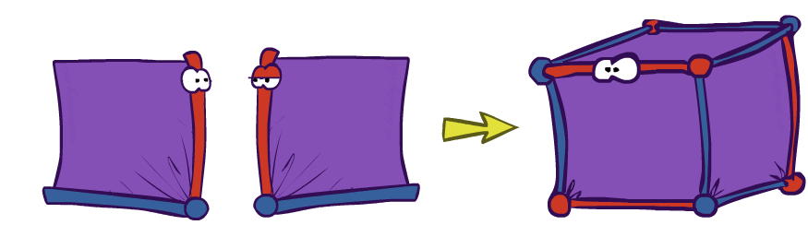
Example: Making larger factors
Example: P(A,J) x P(M|A) = P(A,J,M)
Factor blowup can make VE very expensive!
P(A,J,M)
P(A,J)
P(M | A)
J \ M | true | false
true
false |  | 0.846
A \ J | true | false
true | 0.09 | 0.01
false | 0.045 | 0.855
A \ M | true | false
true | 0.7 | 0.3
false | 0.01 | 0.99
J \ M | true | false
true
false |  | 0.003
x
=
A=false
A=true

Slide 14
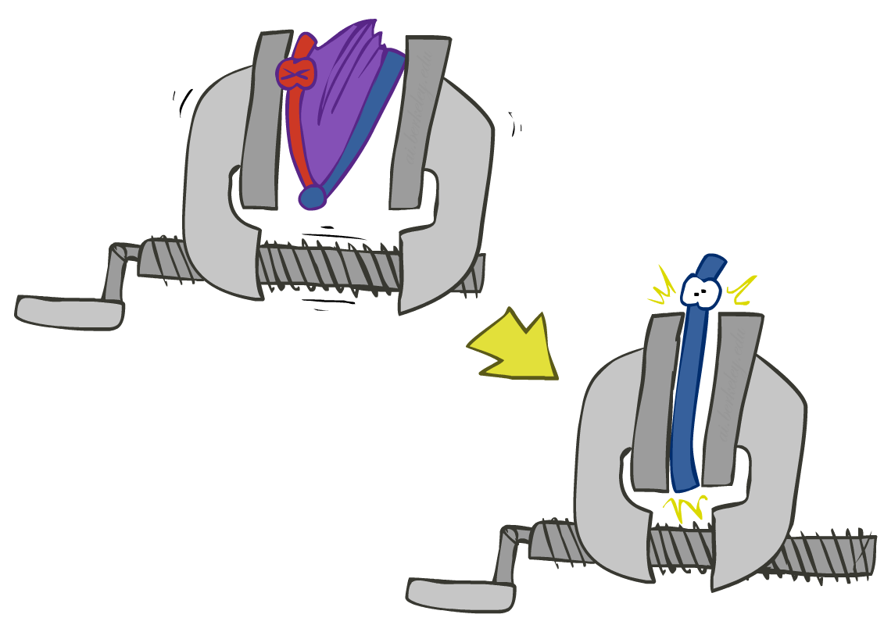
Operation 2: Summing out a variable
Second basic operation: summing out (or eliminating) a variable from a factor
Shrinks a factor to a smaller one
Example: ∑_{j} P(A,J) = P(A,j) + P(A,¬j) = P(A)
P(A,J)
P(A)
A \ J | true | false
true | 0.09 | 0.01
false | 0.045 | 0.855
Sum out J
true | 0.1
false | 0.9

Slide 15
Variable Elimination

Slide 16
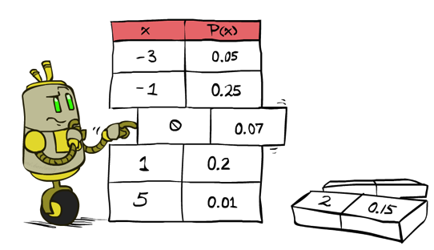
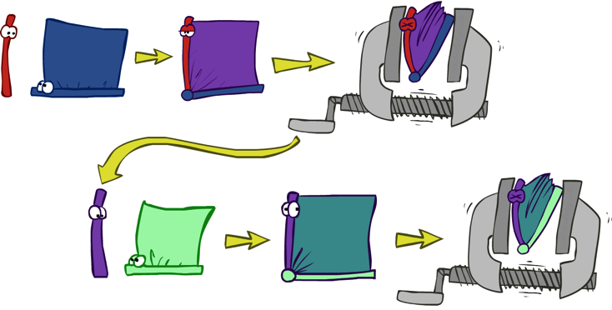
Variable Elimination
Query: P(Q|E₁=e₁,.., E_{k}=e_{k})
Start with initial factors:
Local CPTs (but instantiated by evidence)
While there are still hidden variables (not Q or evidence):
Pick a hidden variable H_{j}
Eliminate (sum out) H_{j} from the product of all factors mentioning H_{j}
Join all remaining factors and normalize
X α

Slide 17
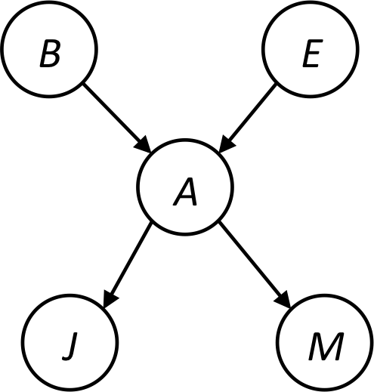
Example
Query P(B | j,m)
P(B) P(E) P(A|B,E) P(j|A) P(m|A)
Choose A
P(A|B,E)
P(j|A)
P(m|A)
P(j,m|B,E)
P(B) P(E) P(j,m|B,E)

Slide 18
Example
P(B) P(E) P(j,m|B,E)
Choose E
P(E)
P(j,m|B,E)
P(j,m|B)
P(B) P(j,m|B)
Finish with B
P(B)
P(j,m|B)
P(j,m,B)
Normalize
P(B | j,m)

Slide 19
Summing out from a product of factors
Project the factors each way first, then sum the products
Example: ∑_{a} P(a|B,e) x P(j|a) x P(m|a)
= P(a|B,e) x P(j|a) x P(m|a) +
P(¬a|B,e) x P(j|¬a) x P(m|¬a)

Slide 20
Order matters
Z
Order the terms Z, A, B C, D
P(D) = α ∑_{z,a,b,c} P(z) P(a|z) P(b|z) P(c|z) P(D|z)
= α ∑_{z} P(z) ∑_{a} P(a|z) ∑_{b} P(b|z) ∑_{c} P(c|z) P(D|z)
Largest factor has 2 variables (D,Z)
Order the terms A, B C, D, Z
P(D) = α ∑_{a,b,c,z} P(a|z) P(b|z) P(c|z) P(D|z) P(z)
= α ∑_{a} ∑_{b} ∑_{c} ∑_{z} P(a|z) P(b|z) P(c|z) P(D|z) P(z)
Largest factor has 4 variables (A,B,C,D)
In general, with n leaves, factor of size 2^{n}
A
B
C
D

Slide 21
VE: Computational and Space Complexity
The computational and space complexity of variable elimination is determined by the largest factor (and it’s space that kills you)
The elimination ordering can greatly affect the size of the largest factor.
E.g., previous slide’s example 2^{n} vs. 2
Does there always exist an ordering that only results in small factors?
No!

Slide 22
Worst Case Complexity? Reduction from SAT
0.5
0.5
0.5
0.5
Variables: W, X, Y, Z
CNF clauses:
C₁ = W v X v Y
C₂ = Y v Z v ¬ W
C₃ = X v Y v ¬Z
Sentence S = C₁ ∧ C₂ ∧ C₃
P(S) > 0 iff S is satisfiable
=> NP-hard
P(S) = K x 0.5^{n} where K is the number of satisfying assignments for clauses
=> #P-hard
W
X
Y
Z
¬
¬
C₁
C₂
C₃
S
Notes:
Make this model simpler (no reason for fan-in constraint)

Slide 23
Polytrees
A polytree is a directed graph with no undirected cycles
For poly-trees the complexity of variable elimination is linear in the network size if you eliminate from the leave towards the roots

Slide 24
Bayes Nets
Part I: Representation
Part II: Exact inference
Enumeration (always exponential complexity)
Variable elimination (worst-case exponential complexity, often better)
Inference is NP-hard in general
Part III: Independence
Part IV: Approximate Inference

