Slide 1
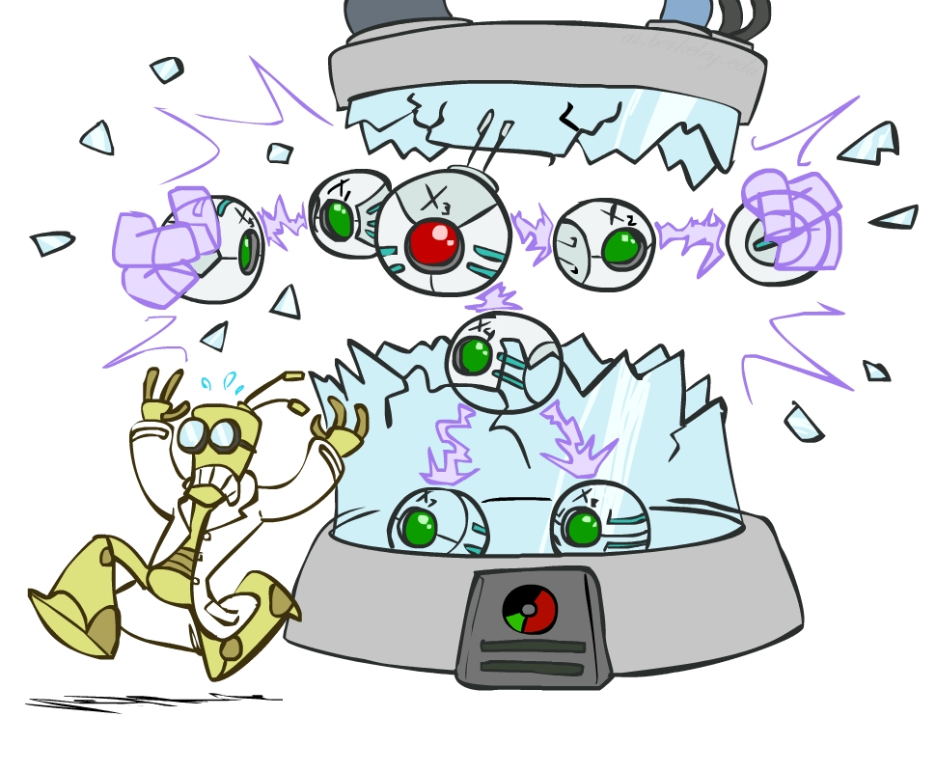
CS 188: Artificial Intelligence
Bayes Nets: Independence
Instructors: Angela Liu and Yanlai Yang
University of California, Berkeley
(Slides adapted from Pieter Abbeel, Dan Klein, Anca Dragan, Stuart Russell and Dawn Song)
Notes:
Please retain proper attribution, including the reference to ai.berkeley.edu. Thanks!

Slide 2


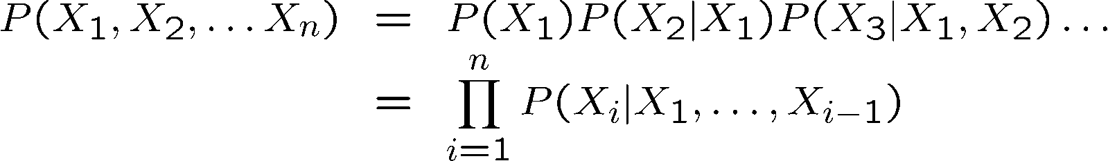

Probability Recap
Conditional probability
Product rule
Chain rule
X, Y independent if and only if:
X and Y are conditionally independent given Z if and only if:

Slide 3

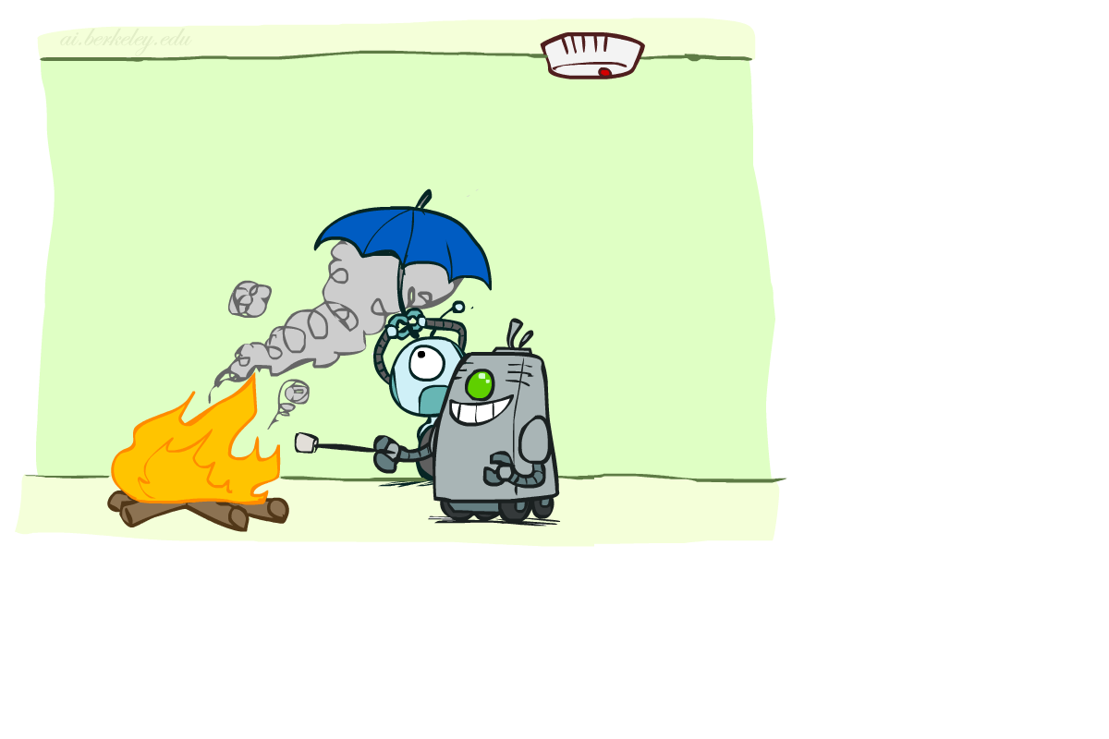

Conditional Independence
X and Y are independent if
X and Y are conditionally independent given Z
(Conditional) independence is a property of a distribution
Example:
Notes:
Alarm not independent of fire, but independent given smoke (whole point of fire alarm!)
Trade off between having more edges/direct dependencies and a simpler/cheaper model

Slide 4


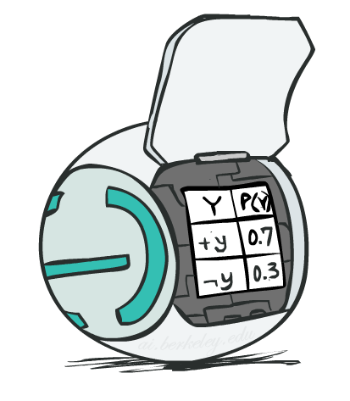
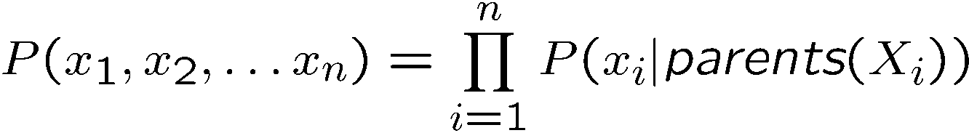
Bayes Net Semantics
A directed, acyclic graph, one node per random variable
A conditional probability table (CPT) for each node
  A collection of distributions over X, one for each combination of parents’ values
Bayes’ nets implicitly encode joint distributions
  As a product of local conditional distributions
  To see what probability a BN gives to a full assignment, multiply all the relevant conditionals together:

Slide 5
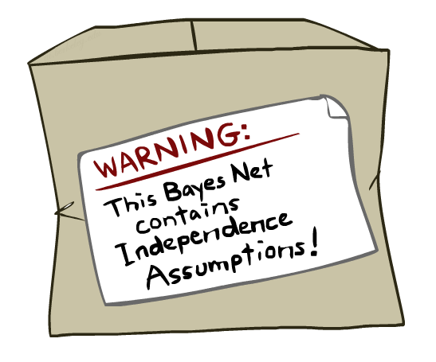
Bayes Nets: Assumptions
Assumptions we are required to make to define the Bayes net when given the graph:
Beyond above “chain rule → Bayes net” conditional independence assumptions
  Often additional conditional independences
  They can be read off the graph
Important for modeling: understand assumptions made when choosing a Bayes net graph
Notes:
Important for modeling: understanding which assumptions you are making!
These are independence assumptions that are *from the graph*. There can be more (due to the tables).

Slide 6
Example
X
Y
Z
W
Conditional independence assumptions directly from simplifications in chain rule:
Additional implied conditional independence assumptions?

Slide 7
Independence in a BN
Important question about a BN:
  Are two nodes independent given certain evidence?
  If yes, can prove using algebra (tedious in general)
  If no, can prove with a counter example
  Example:
  Question: are X and Z necessarily independent?
    Answer: no. Example: low pressure causes rain, which causes traffic.
    X can influence Z, Z can influence X (via Y)
    Addendum: they could be independent: how?
X
Y
Z

Slide 8
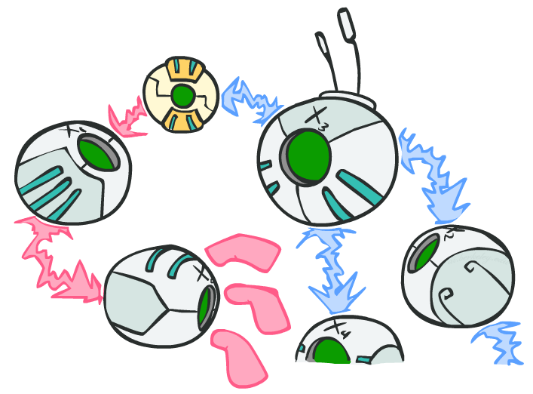
D-separation: Outline

Slide 9
D-separation: Outline
Study independence properties for triples
  Why triples?
Analyze complex cases in terms of member triples
D-separation: a condition / algorithm for answering such queries
Notes:
3 possible triples

Slide 10
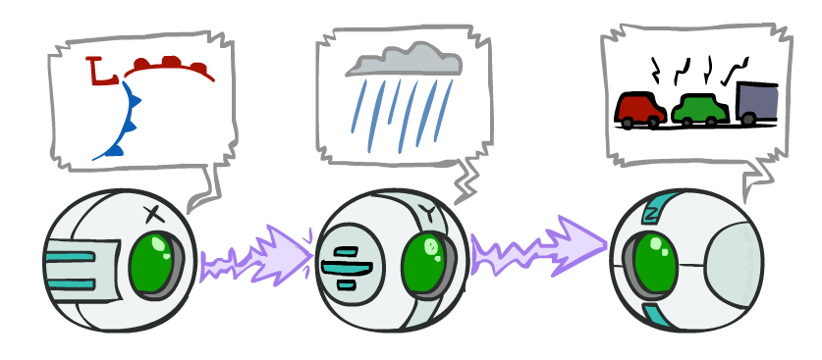
Causal Chains
This configuration is a “causal chain”
Guaranteed X independent of Z ?
No!
  One example set of CPTs for which X is not independent of Z is sufficient to show this independence is not guaranteed.
  Example:
    Low pressure causes rain causes traffic,
    high pressure causes no rain causes no
    traffic
    In numbers:
    P( +y | +x ) = 1, P( -y | - x ) = 1,
    P( +z | +y ) = 1, P( -z | -y ) = 1
X: Low pressure Y: Rain Z: Traffic

Slide 11
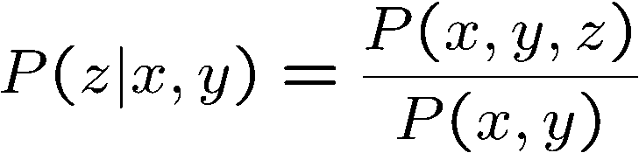
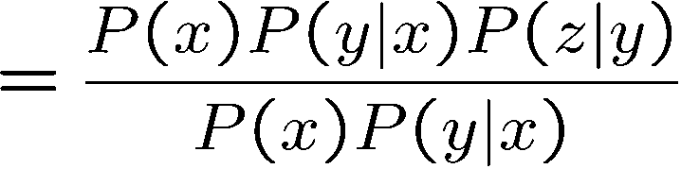

Causal Chains
This configuration is a “causal chain”
Guaranteed X independent of Z given Y?
  Evidence along the chain “blocks” the influence
X: Low pressure Y: Rain Z: Traffic
Yes!

Slide 12
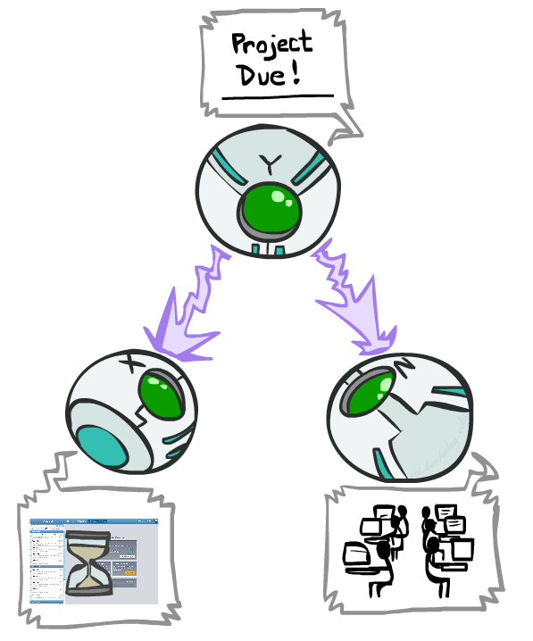
Common Causes
This configuration is a “common cause”
Guaranteed X independent of Z ?
No!
  One example set of CPTs for which X is not independent of Z is sufficient to show this independence is not guaranteed.
  Example:
    Project due causes both forums busy
    and lab full
    In numbers:
    P( +x | +y ) = 1, P( -x | -y ) = 1,
    P( +z | +y ) = 1, P( -z | -y ) = 1
Y: Project due
X: Forums busy
Z: Lab full

Slide 13
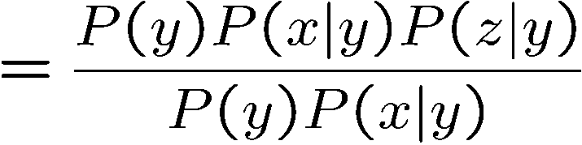
Common Cause
This configuration is a “common cause”
Guaranteed X and Z independent given Y?
  Observing the cause blocks influence between effects.
Y: Project due
X: Forums busy
Z: Lab full
Yes!

Slide 14
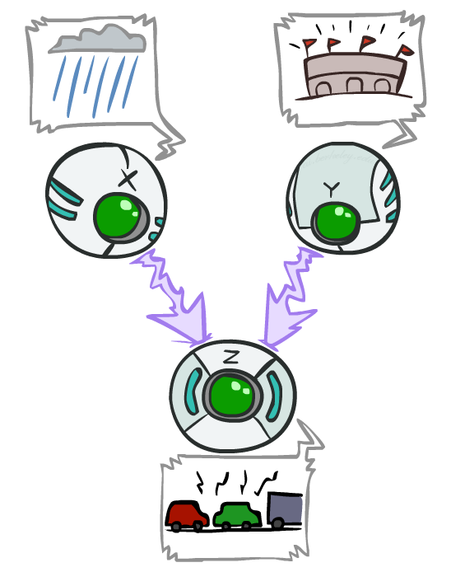
Common Effect
Last configuration: two causes of one effect (v-structures)
Are X and Y independent?
  Yes: the ballgame and the rain cause traffic, but they are not correlated
Proof:
X: Raining
Y: Ballgame
Z: Traffic

Slide 15
Common Effect
Last configuration: two causes of one effect (v-structures)
Are X and Y independent?
  Yes: the ballgame and the rain cause traffic, but they are not correlated
  (Proved previously)
Are X and Y independent given Z?
  No: seeing traffic puts the rain and the ballgame in competition as explanation.
This is backwards from the other cases
  Observing an effect activates influence between possible causes.
X: Raining
Y: Ballgame
Z: Traffic

Slide 16
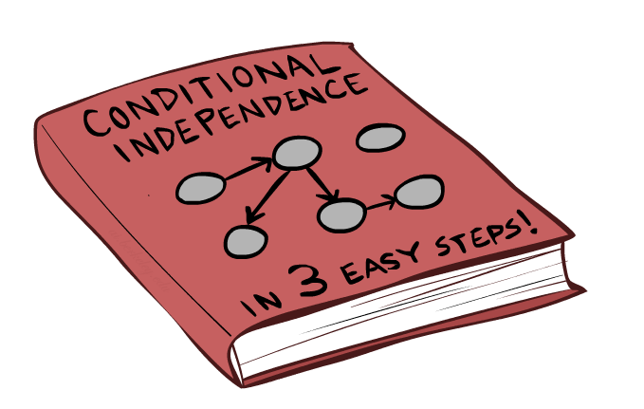
The General Case

Slide 17
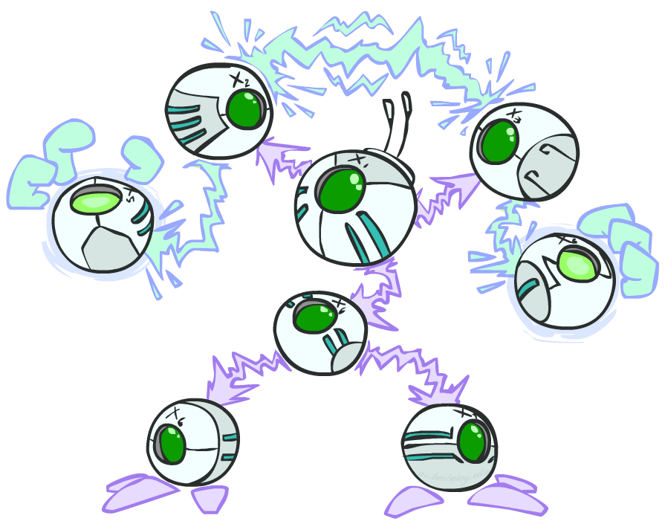
The General Case
General question: in a given BN, are two variables independent (given evidence)?
Solution: analyze the graph
Any complex example can be broken
into repetitions of the three canonical cases

Slide 18
Active / Inactive Paths
Question: Are X and Y conditionally independent given evidence variables {Z}?
  Yes, if X and Y “d-separated” by Z
  Consider all (undirected) paths from X to Y
  No active paths = independence!
A path is active if each triple is active:
  Causal chain A -> B -> C where B is unobserved (either direction)
  Common cause A <- B -> C where B is unobserved
  Common effect (aka v-structure)
  A -> B <- C where B or one of its descendants is observed
All it takes to block a path is a single inactive segment
Active Triples
Inactive Triples

Slide 19
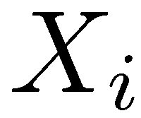
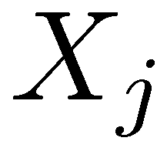

D-Separation
?
Query:
Check all (undirected!) paths between and
  If one or more active, then independence not guaranteed
  (but can still be independent)
  Otherwise (i.e. if all paths are inactive),
  then independence is guaranteed

Slide 20


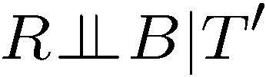
Example
Active Triples
Inactive Triples
Yes
R
B
T
T’
Notes:
T’: traffic report

Slide 21
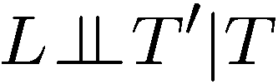


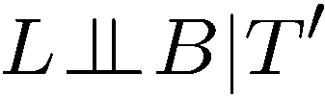

Example
Active Triples
Inactive Triples
L
Yes
R
B
Yes
D
T
Yes
T’

Slide 22



Example
Variables:
  R: Raining
  T: Traffic
  D: Roof drips
  S: I’m sad
Questions:
Active Triples
Inactive Triples
R
T
D
S
Yes

Slide 23
Special Cases
Every variable, given its parents, is conditionally independent of its non-descendants
Every variable, given its Markov Blanket, is conditionally independent of everything else

Slide 24

Structure Implications
Given a Bayes net structure, can run d-separation algorithm to build a complete list of conditional independences that are necessarily true of the form
This list determines the set of probability distributions that can be represented

Slide 25
Topology Limits Distributions
Given some graph topology G, only certain joint distributions can be encoded
The graph structure guarantees certain (conditional) independences
(There might be more independence)
Adding arcs increases the set of distributions, but has several costs
Full conditioning can encode any distribution
Y
Y
X
Z
X
Z
Y
X
Z
Y
X
Z
Y
Y
Y
X
Z
X
Z
X
Z
Y
Y
Y
X
Z
X
Z
X
Z

Slide 26
Bayes Nets Representation Summary
Bayes nets compactly encode joint distributions (by making use of conditional independences!)
Guaranteed independencies of distributions can be deduced from BN graph structure
D-separation gives precise conditional independence guarantees from graph alone
A Bayes net’s joint distribution may have further (conditional) independence that is not detectable by only the topology until you inspect its specific distribution

Slide 27

Bayes Nets
Representation
Probabilistic Inference
Conditional Independences
Sampling
Learning from data

