Slide 1
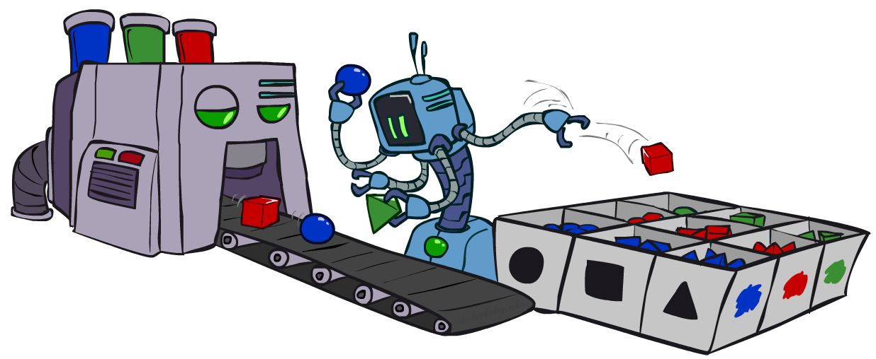
CS 188: Artificial Intelligence
Bayes Nets: Approximate Inference
Instructors: Angela Liu and Yanlai Yang
University of California, Berkeley
(Slides adapted from Stuart Russell and Dawn Song)
Notes:
Please retain proper attribution, including the reference to ai.berkeley.edu. Thanks!

Slide 2

Sampling
Basic idea
  Draw N samples from a sampling distribution S
  Compute an approximate posterior probability
  Show this converges to the true probability P
Why sample?
  Often very fast to get a decent approximate answer
  The algorithms are very simple and general (easy to apply to fancy models)
  They require very little memory (O(n))
  They can be applied to large models, whereas exact algorithms blow up

Slide 3


Sampling basics: discrete (categorical) distribution
To simulate a biased d-sided coin:
  Step 1: Get sample u from uniform distribution over [0, 1)
    E.g. random() in python
  Step 2: Convert this sample u into an outcome for the given distribution by associating each outcome x with a P(x)-sized sub-interval of [0,1)
Example
  If random() returns u = 0.83, then the sample is C = blue
  E.g, after sampling 8 times:
C | P(C)
red | 0.6
green | 0.1
blue | 0.3
0.0 ≤ u < 0.6, → C=red
0.6 ≤ u < 0.7, → C=green
0.7 ≤ u < 1.0, → C=blue
0.6
0.1
0.3

Slide 4
Sampling in Bayes Nets
Prior Sampling
Rejection Sampling
Likelihood Weighting
Gibbs Sampling

Slide 5
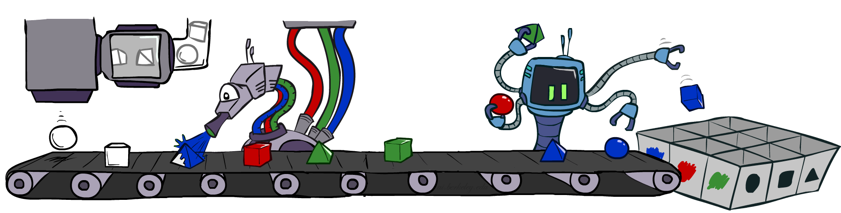
Prior Sampling

Slide 6
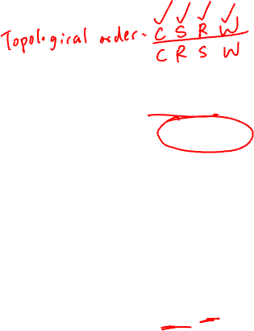
Prior Sampling
P(C)
c | 0.5
¬c | 0.5
Cloudy
P(S | C)
Cloudy
P(R | C)
c | s | 0.1
 | ¬s | 0.9
¬c | s | 0.5
 | ¬s | 0.5
c | r | 0.8
 | ¬r | 0.2
¬c | r | 0.2
 | ¬r | 0.8
Sprinkler
Sprinkler
Rain
Rain
P(W | S,R)
WetGrass
WetGrass
Samples:
s | r | w | 0.99
 |  | ¬w | 0.01
 | ¬r | w | 0.90
 |  | ¬w | 0.10
¬s | r | w | 0.90
 |  | ¬w | 0.10
 | ¬r | w | 0.01
 |  | ¬w | 0.99
c, ¬s, r, w
¬c, s, ¬r, w
…

Slide 7
Prior Sampling
For i=1, 2, …, n (in topological order)
  Sample X_{i} from P(X_{i} | parents(X_{i}))
Return (x₁, x₂, …, x_{n})

Slide 8
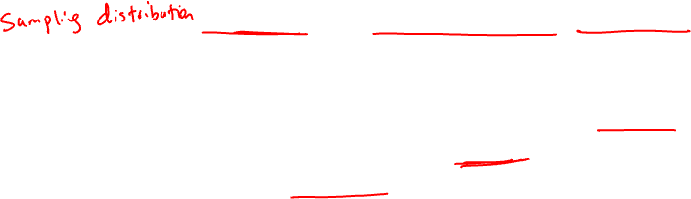
Prior Sampling
This process generates samples with probability:
  S_{PS}(x₁,…,x_{n}) =
…i.e. the BN’s joint probability
Let the number of samples of an event be N_{PS}(x₁,…,x_{n})
Estimate from N samples is Q_{N}(x₁,…,x_{n}) = N_{PS}(x₁,…,x_{n})/N
Then lim_{N→∞} Q_{N}(x₁,…,x_{n}) = lim_{N→∞} N_{PS}(x₁,…,x_{n})/N
= S_{PS}(x₁,…,x_{n})
= P(x₁,…,x_{n})
I.e., the sampling procedure is consistent
∏_{i} P(x_{i} | parents(X_{i})) = P(x₁,…,x_{n})

Slide 9
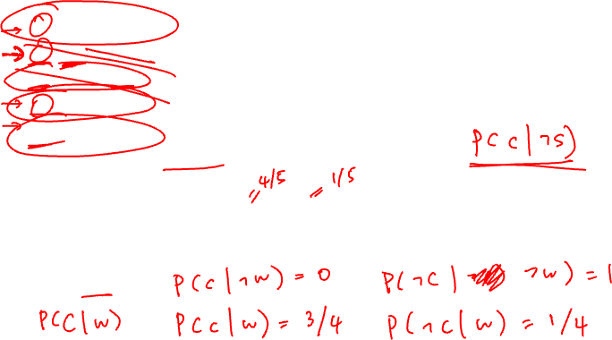
Example
We’ll get a bunch of samples from the BN:
  c, ¬s, r, w
  c, s, r, w
  ¬c, s, r, ¬w
  c, ¬s, r, w
  ¬c, ¬s, ¬r, w
If we want to know P(W)
  We have counts <w:4, ¬w:1>
  Normalize to get P(W) = <w:0.8, ¬w:0.2>
  This will get closer to the true distribution with more samples
  Can estimate anything else, too
    P(C | ¬ w)?
C
S
R
W

Slide 10
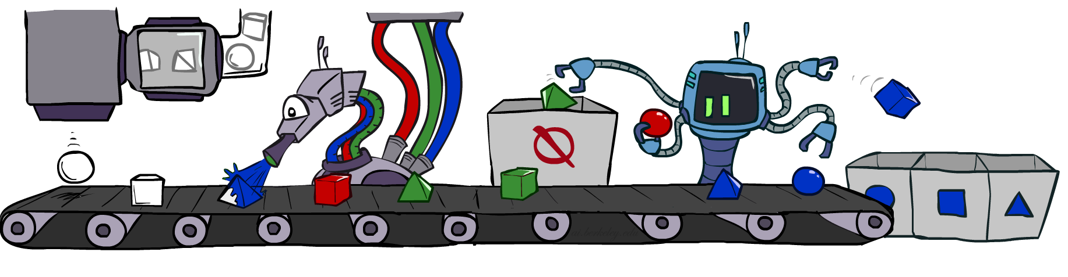
Rejection Sampling

Slide 11
Rejection Sampling
A simple application of prior sampling for estimating conditional probabilities
  Let’s say we want P(C| r, w) = α P(C, r, w)
  For these counts, samples with ¬r or ¬w are not relevant
  So count the C outcomes for samples with r, w and reject all other samples
This is called rejection sampling
  It is also consistent for conditional probabilities (i.e., correct in the limit)
C
S
R
W
  c, ¬s, r, w
  c, s, ¬r
  ¬c, s, r, ¬w
  c, ¬s, ¬r
  ¬c, ¬s, r, w

Slide 12

Rejection Sampling
Input: evidence e₁,..,e_{k}
For i=1, 2, …, n
  Sample X_{i} from P(X_{i} | parents(X_{i}))
  If x_{i} not consistent with evidence
    Reject: Return, and no sample is generated in this cycle
Return (x₁, x₂, …, x_{n})

Slide 13
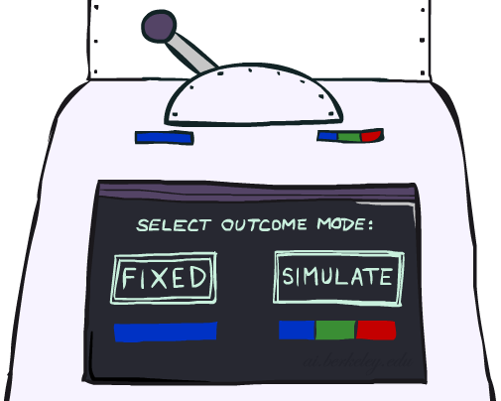
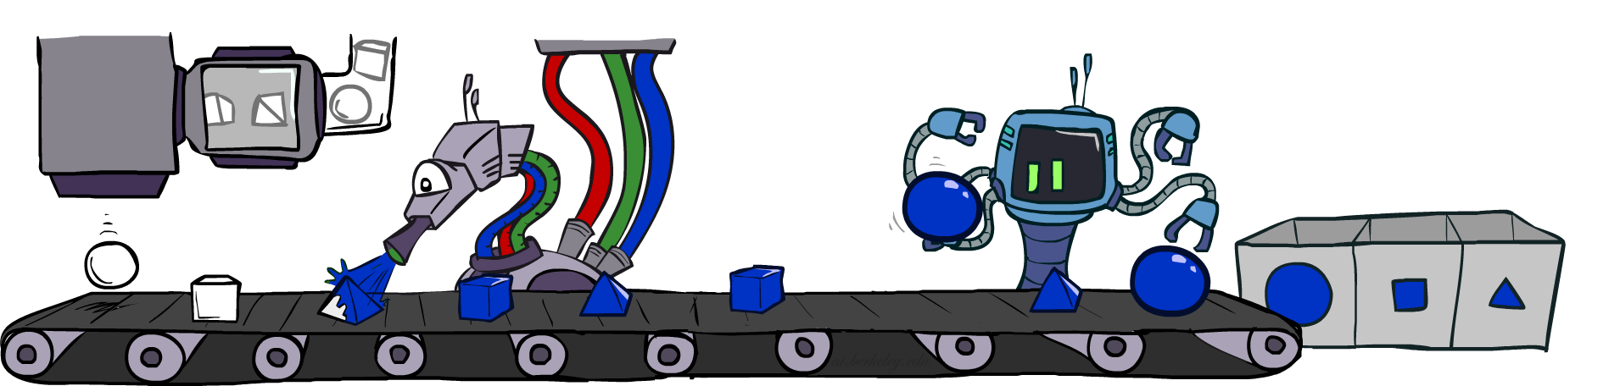
Likelihood Weighting

Slide 14
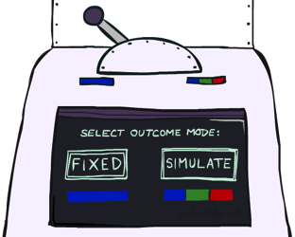


Likelihood Weighting
Problem with rejection sampling:
  If evidence is unlikely, rejects lots of samples
  Evidence not exploited as you sample
  Consider P(Shape|Color=blue)
Idea: fix evidence variables, sample the rest
  Problem: sample distribution not consistent!
  Solution: weight each sample by probability of evidence variables given parents
  pyramid, green
  pyramid, red
  sphere, blue
  cube, red
  sphere, green
  pyramid, blue
  pyramid, blue
  sphere, blue
  cube, blue
  sphere, blue
Shape
Color
Shape
Color

Slide 15
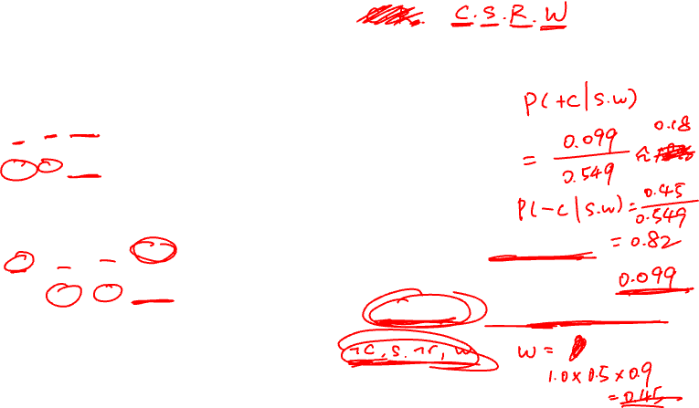
Likelihood Weighting
P(C)
c | 0.5
¬c | 0.5
P(S | C)
Cloudy
P(R | C)
Cloudy
c | s | 0.1
 | ¬s | 0.9
¬c | s | 0.5
 | ¬s | 0.5
c | r | 0.8
 | ¬r | 0.2
¬c | r | 0.2
 | ¬r | 0.8
Sprinkler
Sprinkler
Rain
Rain
P(W | S,R)
WetGrass
WetGrass
Want to estimate P (C | s, w)
Samples:
s | r | w | 0.99
 |  | ¬w | 0.01
 | ¬r | w | 0.90
 |  | ¬w | 0.10
¬s | r | w | 0.90
 |  | ¬w | 0.10
 | ¬r | w | 0.01
 |  | ¬w | 0.99
c
, s, , w
r
w = 1.0
x 0.1
x 0.99

Slide 16
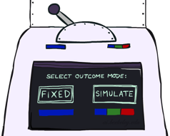
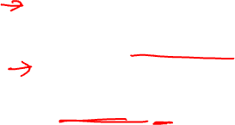
Likelihood Weighting
Input: evidence e₁,..,e_{k}
w = 1.0
for i=1, 2, …, n
  if X_{i} is an evidence variable
    x_{i} = observed value_{i} for X_{i}
    Set w = w * P(x_{i} | parents(X_{i}))
  else
    Sample x_{i} from P(X_{i} | parents(X_{i}))
return (x₁, x₂, …, x_{n}), w

Slide 17

Likelihood Weighting
Sampling distribution if Z sampled and e fixed evidence
S_{WS}(z,e) = ∏_{j} P(z_{j} | parents(Z_{j}))
Now, samples have weights
w(z,e) = ∏_{k} P(e_{k} | parents(E_{k}))
Together, weighted sampling distribution is consistent
S_{WS}(z,e) ⋅ w(z,e) = ∏_{j} P(z_{j} | parents(Z_{j})) ∏_{k} P(e_{k} | parents(E_{k}))
= P(z,e)
Likelihood weighting is an example of importance sampling
  Would like to estimate some quantity based on samples from P
  P is hard to sample from, so use Q instead
  Weight each sample x by P(x)/Q(x)
Cloudy
C
S
R
W

Slide 18
Likelihood Weighting
Likelihood weighting is good
  All samples are used
  The values of downstream variables are influenced by upstream evidence
Likelihood weighting still has weaknesses
  The values of upstream variables are unaffected by downstream evidence
    E.g., suppose evidence is a video of a traffic accident
  With evidence in k leaf nodes, weights will be O(2^{-k})
  With high probability, one lucky sample will have much larger weight than the others, dominating the result
We would like each variable to “see” all the evidence!

Slide 19
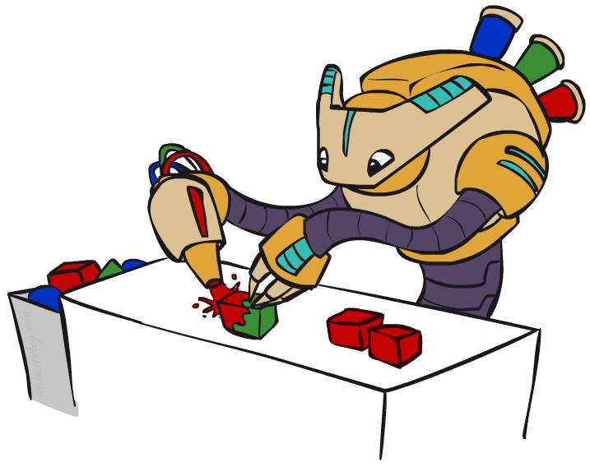
Gibbs Sampling

Slide 20

Gibbs Sampling Example: P( S | r)
Step 1: Fix evidence
  R = true
Step 3: Repeat
  Choose a non-evidence variable X
  Resample X from P(X | all other variables)
Step 2: Initialize other variables
  Randomly
C
C
S
r
S
r
W
W
C
C
C
C
C
C
S
r
S
r
S
r
S
r
S
r
S
r
W
W
W
W
W
W
Sample from P(S | c, r, ¬w)
Sample from P(C | s, r)
Sample from P(W | s, r)
Notes:
Better animation

Slide 21
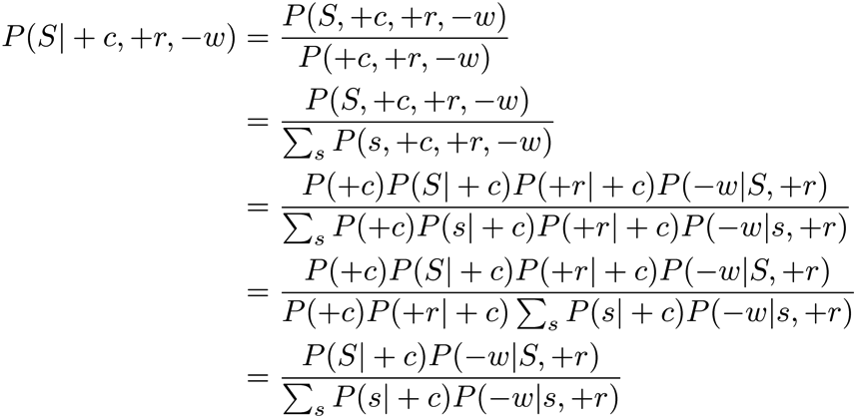
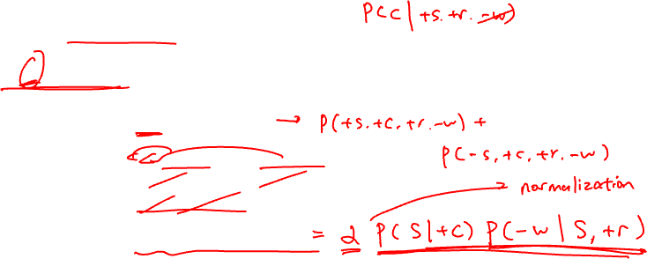
Resampling of One Variable
Sample from P(S | +c, +r, -w)
Many things cancel out – only CPTs with S remain!
More generally: only CPTs that have resampled variable need to be considered, and joined together
C
S
+r
W

Slide 22
Resampling of One Variable
  Repeat many times
    Sample a non-evidence variable X_{i} from
    P(X_{i} | x₁,..,x_{i-1},x_{i+1},..,x_{n}) = P(X_{i} | markov_blanket(X_{i}))
    = α P(X_{i} | parents (X_{i})) ∏_{j} P(y_{j} | parents(Y_{j}))

Slide 23
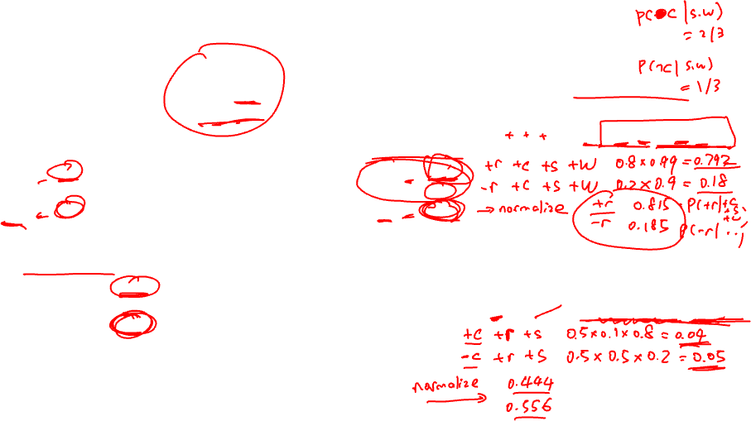
Gibbs Sampling
P(C)
Want to estimate P (C | s, w)
c | 0.5
¬c | 0.5
(Arbitrarily) Pick R to resample
P (R | c, s, w) = α P(R | c) P (w | s,R)
P(S | C)
Cloudy
P(R | C)
Cloudy
c | s | 0.1
 | ¬s | 0.9
¬c | s | 0.5
 | ¬s | 0.5
c | r | 0.8
 | ¬r | 0.2
¬c | r | 0.2
 | ¬r | 0.8
Sprinkler
Sprinkler
Rain
Rain
P(W | S,R)
WetGrass
WetGrass
(Arbitrarily) Pick C to resample
s | r | w | 0.99
 |  | ¬w | 0.01
 | ¬r | w | 0.90
 |  | ¬w | 0.10
¬s | r | w | 0.90
 |  | ¬w | 0.10
 | ¬r | w | 0.01
 |  | ¬w | 0.99
P (C | r, s, w) = α P(C) P(s | C) P (r | C)
Samples:
c, s, r, w
c, s, r, w
¬ c, s, r, w

Slide 24
Why would anyone do this?
Both upstream and downstream variables condition on evidence!
In contrast: likelihood weighting only conditions on upstream evidence, and hence weights obtained in likelihood weighting can sometimes be very small.

Slide 25
More details on Gibbs sampling
Gibbs sampling belongs to a family of sampling methods called Markov chain Monte Carlo (MCMC)
Theorem: In the limit of repeating this infinitely many times, the resulting samples come from the correct distribution.*
*: Provided all Gibbs distributions are bounded away from 0 and 1 and variable selection is fair

Slide 26

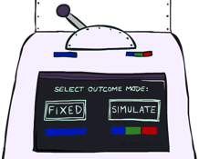
Bayes Net Sampling Summary
Prior Sampling
Likelihood Weighting
Rejection Sampling
Gibbs Sampling

