Slide 1

CS 188: Artificial Intelligence
Markov Models
Instructors: Angela Liu and Yanlai Yang
University of California, Berkeley
(Slides adapted from Pieter Abbeel, Dan Klein, Anca Dragan, Stuart Russell and Dawn Song)
Notes:
Please retain proper attribution, including the reference to ai.berkeley.edu. Thanks!
Note: pretty short lecture, good one to present mini-contest results or anything else not exactly lecture.

Slide 2
Uncertainty and Time
Often, we want to reason about a sequence of observations where the state of the underlying system is changing
  Speech recognition
  Robot localization
  User attention
  Medical monitoring
  Global climate
Need to introduce time into our models

Slide 3
Markov Models (aka Markov chain/process)
  Value of X at a given time is called the state (usually discrete, finite)
  The transition model P(X_{t} | X_{t-1}) specifies how the state evolves over time
  Stationarity assumption: transition probabilities are the same at all times
  Markov assumption: “future is independent of the past given the present”
    X_{t+1} is independent of X₀,…, X_{t-1} given X_{t}
    This is a first-order Markov model (a kth-order model allows dependencies on k earlier steps)
  Current observation independent of all else given current state
  Joint distribution P(X₀,…, X_{T}) = P(X₀) ∏_{t} P(X_{t} | X_{t-1})
X₀
X₁
X₂
X₃
P(X₀)
P(X_{t} | X_{t-1})

Slide 4
Quiz: are Markov models a special case of Bayes nets?
Yes and no!
Yes:
  Directed acyclic graph, joint = product of conditionals
No:
  Infinitely many variables (unless we truncate)
  Repetition of transition model not part of standard Bayes net syntax

Slide 5
Example: Random walk in one dimension
-4
-3
-2
-1
0
1
2
3
4
State: location on the unbounded integer line
Initial probability: starts at 0
Transition model: P(X_{t} = k| X_{t-1}= k±1) = 0.5
Applications: particle motion in crystals, stock prices, gambling, genetics, etc.
Questions:
  How far does it get as a function of t?
    Expected distance is O(√t)
  Does it get back to 0 or can it go off for ever and not come back?
    In 1D and 2D, returns w.p. 1; in 3D, returns w.p. 0.34053733

Slide 6
Example: n-gram models
State: word at position t in text (can also build letter n-grams)
Transition model (probabilities come from empirical frequencies):
  Unigram (zero-order): P(Word_{t} = i)
    “logical are as are confusion a may right tries agent goal the was . . .”
  Bigram (first-order): P(Word_{t} = i | Word_{t-1}= j)
    “systems are very similar computational approach would be represented . . .”
  Trigram (second-order): P(Word_{t} = i | Word_{t-1}= j, Word_{t-2}= k)
    “planning and scheduling are integrated the success of naive bayes model is . . .”
Applications: text classification, language classification, speech recognition

Slide 7
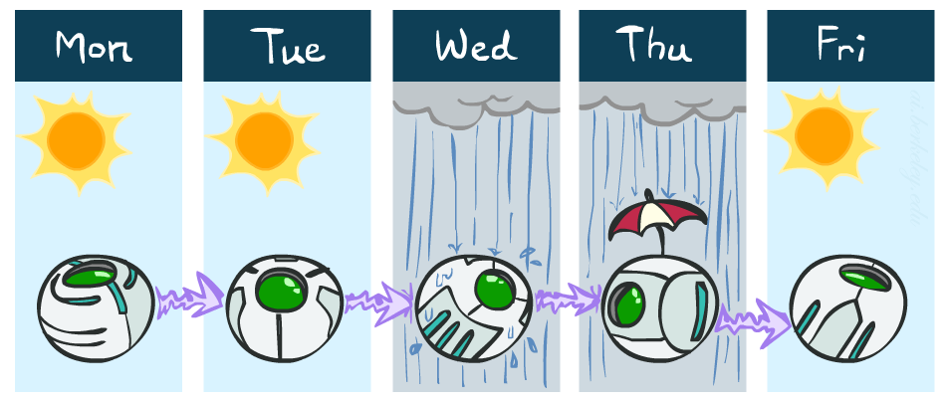
Example: Weather
States {rain, sun}
Initial distribution P(X₀)
  Transition model P(X_{t} | X_{t-1})
P(X₀)
sun | rain
0.5 | 0.5
Two new ways of representing the same CPT
0.9
0.3
0.9
X_{t-1} | P(X_{t}|X_{t-1})
 | sun | rain
sun | 0.9 | 0.1
rain | 0.3 | 0.7
rain
sun
sun
sun
0.1
0.3
rain
rain
0.7
0.7
0.1

Slide 8
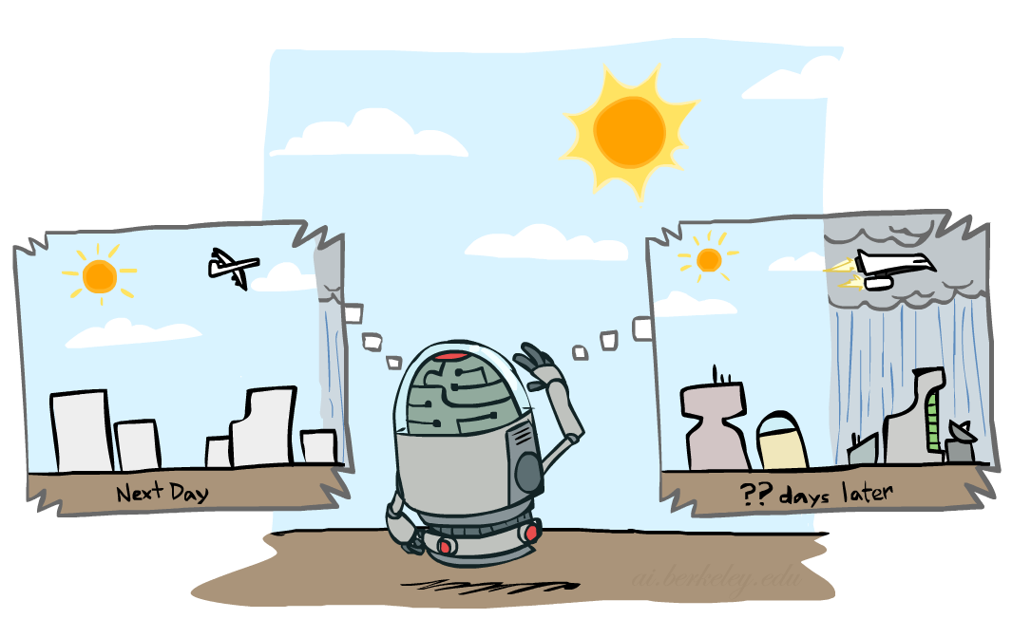
Weather prediction
X_{t-1} | P(X_{t}|X_{t-1})
 | sun | rain
sun | 0.9 | 0.1
rain | 0.3 | 0.7
Time 0: <0.5,0.5>
What is the weather like at time 1?
  P(X₁) = ∑_{x0} P(X₁,X₀=x₀)
  = ∑_{x0} P(X₀=x₀) P(X₁| X₀=x₀)
  = 0.5<0.9,0.1> + 0.5<0.3,0.7> = <0.6,0.4>

Slide 9
Weather prediction, contd.
X_{t-1} | P(X_{t}|X_{t-1})
 | sun | rain
sun | 0.9 | 0.1
rain | 0.3 | 0.7
Time 1: <0.6,0.4>
What is the weather like at time 2?
  P(X₂) = ∑_{x1} P(X₂,X₁=x₁)
  = ∑_{x1} P(X₁=x₁) P(X₂| X₁=x₁)
  = 0.6<0.9,0.1> + 0.4<0.3,0.7> = <0.66,0.34>

Slide 10
Weather prediction, contd.
X_{t-1} | P(X_{t}|X_{t-1})
 | sun | rain
sun | 0.9 | 0.1
rain | 0.3 | 0.7
Time 2: <0.66,0.34>
What is the weather like at time 3?
  P(X₃) = ∑_{x2} P(X₃,X₂=x₂)
  = ∑_{x2} P(X₂=x₂) P(X₃| X₂=x₂)
  = 0.66<0.9,0.1> + 0.34<0.3,0.7> = <0.696,0.304>

Slide 11
Mini-Forward algorithm
What is the state at time t?
  P(X_{t}) = ∑_{xt-1} P(X_{t},X_{t-1}=x_{t-1})
  = ∑_{xt-1} P(X_{t-1}=x_{t-1}) P(X_{t}| X_{t-1}=x_{t-1})
Iterate this update starting at t=0
  This is called a recursive update: P_{t} = g(P_{t-1}) = g(g(g(g( …P₀))))
Probability from previous iteration
Transition model

Slide 12
And the same thing in linear algebra
What is the weather like at time 2?
  P(X₂) = 0.6<0.9,0.1> + 0.4<0.3,0.7> = <0.66,0.34>
In matrix-vector form:
  P(X₂) = ( ) ( ) = ( )
I.e., multiply by T^{T}, transpose of transition matrix
X_{t-1} | P(X_{t}|X_{t-1})
 | sun | rain
sun | 0.9 | 0.1
rain | 0.3 | 0.7
0.9 0.3
0.1 0.7
0.6
0.4
0.66
0.34

Slide 13

Stationary Distributions
The limiting distribution is called the stationary distribution P∞ of the chain
It satisfies P∞ = P_{∞+1} = T^{T} P∞
Solving for P∞ in the example:
  ( ) ( ) = ( )
  0.9p + 0.3(1-p) = p
  p = 0.75
  Stationary distribution is <0.75,0.25> regardless of starting distribution
0.9 0.3
0.1 0.7
p
1-p
p
1-p

Slide 14
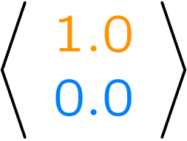
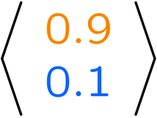
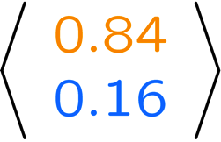
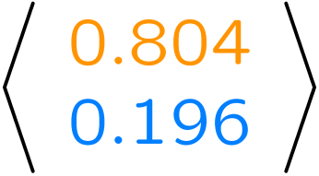
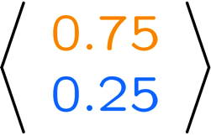
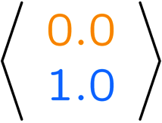
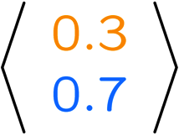
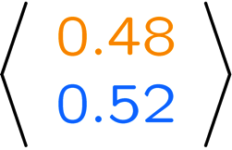
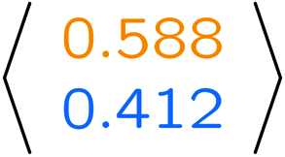
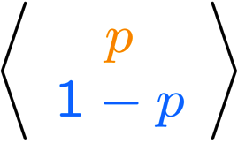
Example Run of Mini-Forward Algorithm
From initial observation of sun
From initial observation of rain
From yet another initial distribution P(X₁):
P(X₁)
P(X₂)
P(X₃)
P(X₄)
P(X∞)
P(X₁)
P(X₂)
P(X₃)
P(X₄)
P(X∞)
…
P(X₁)
P(X∞)
[Demo: L13D1,2,3]

Slide 15

Application of Stationary Distribution: Web Link Analysis
PageRank over a web graph
  Each web page is a possible value of a state
  Initial distribution: uniform over pages
  Transitions:
    With prob. c, uniform jump to a random page
    With prob. 1-c, follow a random outlink
Stationary distribution
  Will spend more time on highly reachable pages
  Google 1.0 returned the set of pages containing all your keywords in decreasing rank, now all search engines use link analysis along with many other factors (rank actually getting less important over time)
Notes:
Before: most search engines were merely based on how well a page matches your search words.
Note: currently dominated by clickstreams

Slide 16

Hidden Markov Models

Slide 17
Hidden Markov Models
Usually the true state is not observed directly
Hidden Markov models (HMMs)
  Underlying Markov chain over states X
  You observe evidence E at each time step
  X_{t} is a single discrete variable; E_{t} may be continuous and may consist of several variables
X₀
X₁
X₂
X₃
X₅
E₁
E₂
E₃
E₅

Slide 18

Example: Weather HMM
An HMM is defined by:
  Initial distribution: P(X₀)
  Transition model: P(X_{t}| X_{t-1})
  Sensor model: P(E_{t}| X_{t})
W_{t-1} | P(W_{t}|W_{t-1})
 | sun | rain
sun | 0.9 | 0.1
rain | 0.3 | 0.7
Weather_{t-1}
Weather_{t}
Weather_{t+1}
W_{t} | P(U_{t}|W_{t})
 | true | false
sun | 0.2 | 0.8
rain | 0.9 | 0.1
Umbrella_{t-1}
Umbrella_{t}
Umbrella_{t+1}
Notes:
demo

Slide 19
HMM as probability model
  Joint distribution for Markov model: P(X₀,…, X_{T}) = P(X₀) ∏_{t=1:T} P(X_{t} | X_{t-1})
  Joint distribution for hidden Markov model: P(X₀,X₁,…, X_{T},E_{T}) = P(X₀) ∏_{t=1:T} P(X_{t} | X_{t-1}) P(E_{t} | X_{t})
  Future states are independent of the past given the present
  Current evidence is independent of everything else given the current state
  Are evidence variables independent of each other?
X₀
X₁
X₂
X₃
X₅
Useful notation:
X_{a:b} = X_{a} , X_{a+1}, …, X_{b}
E₁
E₂
E₃
E₅
Notes:
Add conditional independence consequences here

Slide 20
Real HMM Examples
Speech recognition HMMs:
  Observations are acoustic signals (continuous valued)
  States are specific positions in specific words (so, tens of thousands)
Machine translation HMMs:
  Observations are words (tens of thousands)
  States are translation options
Robot tracking:
  Observations are range readings (continuous)
  States are positions on a map (continuous)
Molecular biology:
  Observations are nucleotides ACGT
  States are coding/non-coding/start/stop/splice-site etc.

Slide 21
Inference tasks
Filtering: P(X_{t}|e_{1:t})
  belief state—input to the decision process of a rational agent
Prediction: P(X_{t+k}|e_{1:t}) for k > 0
  evaluation of possible action sequences; like filtering without the evidence
Smoothing: P(X_{k}|e_{1:t}) for 0 ≤ k < t
  better estimate of past states, essential for learning
Most likely explanation: arg max_{x1:t} P(x_{1:t} | e_{1:t})
  speech recognition, decoding with a noisy channel

Slide 22
Inference tasks
Filtering: P(X_{t}|e_{1:t})
Prediction: P(X_{t+k}|e_{1:t})
X₁
X₂
X₃
X₄
X₁
X₂
X₃
X₄
e₁
e₂
e₃
e₄
e₁
e₂
e₃
Smoothing: P(X_{k}|e_{1:t}), k<t
Explanation: P(X_{1:t}|e_{1:t})
X₁
X₂
X₃
X₄
X₁
X₂
X₃
X₄
e₁
e₂
e₃
e₄
e₁
e₂
e₃
e₄

Slide 23
Filtering / Monitoring
Filtering, or monitoring, or state estimation, is the task of maintaining the distribution f_{1:t} = P(X_{t}|e_{1:t}) over time
We start with f₀ in an initial setting, usually uniform
Filtering is a fundamental task in engineering and science
The Kalman filter (continuous variables, linear dynamics, Gaussian noise) was invented in 1960 and used for trajectory estimation in the Apollo program; core ideas used by Gauss for planetary observations
Notes:
Dan has some demo for this

Slide 24
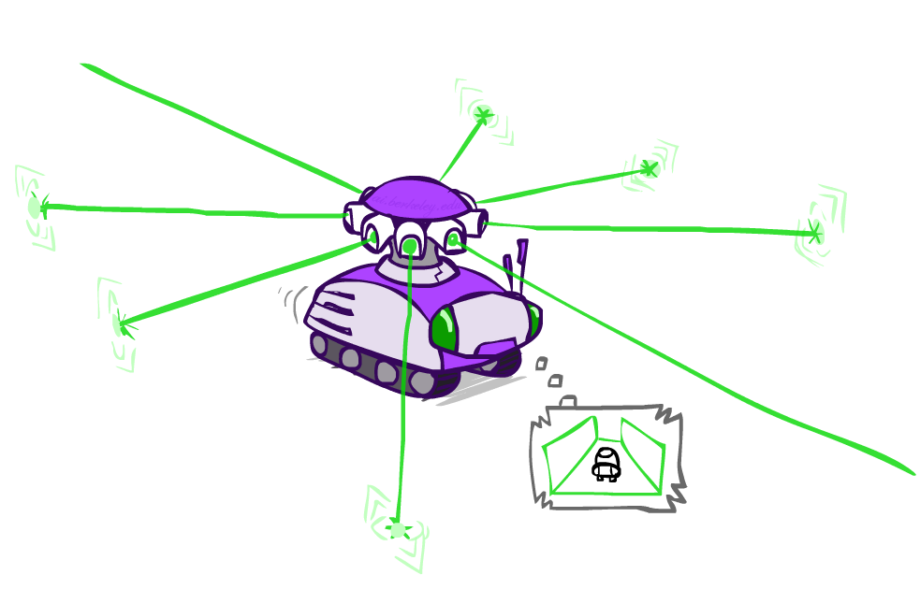
Example: Robot Localization
Example from Michael Pfeiffer
Prob
0
1
t=0
Sensor model: four bits for wall/no-wall in each direction, never more than 1 mistake
Transition model: action may fail with small prob.

Slide 25
Example: Robot Localization
Prob
0
1
t=1
Lighter grey: was possible to get the reading,
but less likely (required 1 mistake)

Slide 26
Example: Robot Localization
Prob
0
1
t=2

Slide 27
Example: Robot Localization
Prob
0
1
t=3

Slide 28
Example: Robot Localization
Prob
0
1
t=4

Slide 29
Example: Robot Localization
Prob
0
1
t=5

Slide 30




Inference: Base Cases
X₁
X₁
X₂
E₁

Slide 31
Filtering algorithm
Aim: devise a recursive filtering algorithm of the form
  P(X_{t+1}|e_{1:t+1}) = g(e_{t+1}, P(X_{t}|e_{1:t}) )
P(X_{t+1}|e_{1:t+1}) =

Slide 32
Filtering algorithm
Aim: devise a recursive filtering algorithm of the form
  P(X_{t+1}|e_{1:t+1}) = g(e_{t+1}, P(X_{t}|e_{1:t}) )
P(X_{t+1}|e_{1:t+1}) = P(X_{t+1}|e_{1:t}, e_{t+1})
= α P(e_{t+1}|X_{t+1}, e_{1:t}) P(X_{t+1}| e_{1:t})
= α P(e_{t+1}|X_{t+1}) P(X_{t+1}| e_{1:t})
  = α P(e_{t+1}|X_{t+1}) ∑_{xt} P(x_{t} | e_{1:t}) P(X_{t+1}| x_{t}, e_{1:t})
  = α P(e_{t+1}|X_{t+1}) ∑_{xt} P(x_{t} | e_{1:t}) P(X_{t+1}| x_{t})
Apply Bayes’ rule
Apply conditional independence
Condition on X_{t}
Apply conditional
independence
Normalize
Update
Predict

Slide 33
Filtering algorithm
P(X_{t+1}|e_{1:t+1}) = α P(e_{t+1}|X_{t+1}) ∑_{xt} P(x_{t} | e_{1:t}) P(X_{t+1}| x_{t})
f_{1:t+1} = Forward(f_{1:t} , e_{t+1})
Cost per time step: O(|X|²) where |X| is the number of states
Time and space costs are constant, independent of t
O(|X|²) is infeasible for models with many state variables
We get to invent really cool approximate filtering algorithms
Normalize
Update
Predict

Slide 34
And the same thing in linear algebra
Transition matrix T, observation matrix O_{t}
  Observation matrix has state likelihoods for E_{t} along diagonal
  E.g., for U₁ = true, O₁ = ( )
Filtering algorithm becomes
  f_{1:t+1} = α O_{t+1}T^{T} f_{1:t}
0.2 0
0 0.9
X_{t-1} | P(X_{t}|X_{t-1})
 | sun | rain
sun | 0.9 | 0.1
rain | 0.3 | 0.7
W_{t} | P(U_{t}|W_{t})
 | true | false
sun | 0.2 | 0.8
rain | 0.9 | 0.1

Slide 35
Example: Weather HMM
0.6
0.4
0.45
0.55
predict
predict
update
update
W_{t-1} | P(W_{t}|W_{t-1})
 | sun | rain
sun | 0.9 | 0.1
rain | 0.3 | 0.7
f(sun) = 0.5
f(rain) = 0.5
f(sun) = 0.25
f(rain) = 0.75
f(sun) = 0.154
f(rain) = 0.846
Weather₀
Weather₁
Weather₂
W_{t} | P(U_{t}|W_{t})
 | true | false
sun | 0.2 | 0.8
rain | 0.9 | 0.1
P(W₀)
sun | rain
0.5 | 0.5
Umbrella₁
Umbrella₂
Notes:
Fix numbers

Slide 36
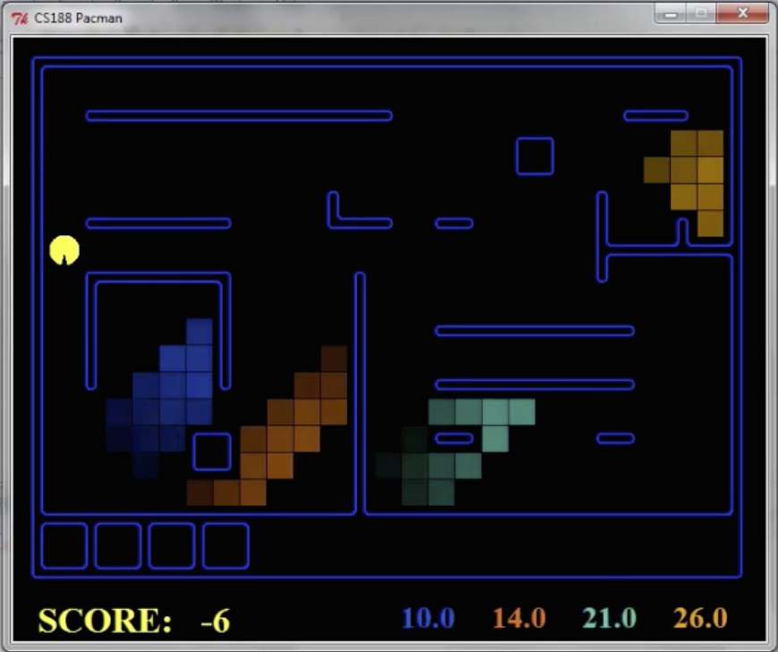
Pacman – Hunting Invisible Ghosts with Sonar
[Demo: Pacman – Sonar – No Beliefs(L14D1)]

Slide 37

Most Likely Explanation

Slide 38
Inference tasks
Filtering: P(X_{t}|e_{1:t})
  belief state—input to the decision process of a rational agent
Prediction: P(X_{t+k}|e_{1:t}) for k > 0
  evaluation of possible action sequences; like filtering without the evidence
Smoothing: P(X_{k}|e_{1:t}) for 0 ≤ k < t
  better estimate of past states, essential for learning
Most likely explanation: arg max_{x1:t} P(x_{1:t} | e_{1:t})
  speech recognition, decoding with a noisy channel

Slide 39
Most likely explanation = most probable path
arg max_{x1:t} P(x_{1:t} | e_{1:t})
= arg max_{x1:t} α P(x_{1:t} , e_{1:t})
= arg max_{x1:t} P(x_{1:t} , e_{1:t})
= arg max_{x1:t} P(x₀) ∏_{t} P(x_{t} | x_{t-1}) P(e_{t} | x_{t})
State trellis: graph of states and transitions over time
Each arc represents some transition x_{t-1} → x_{t}
Each arc has weight P(x_{t} | x_{t-1}) P(e_{t} | x_{t}) (arcs to initial states have weight P(x₀) )
The product of weights on a path is proportional to that state sequence’s probability
Forward algorithm computes sums of paths, Viterbi algorithm computes best paths
sun
sun
sun
sun
rain
rain
rain
rain
X₀ X₁ … X_{T}

Slide 40
Forward / Viterbi algorithms
sun
sun
sun
sun
rain
rain
rain
rain
X₀ X₁ … X_{T}
Forward Algorithm (sum)
For each state at time t, keep track of the total probability of all paths to it
Viterbi Algorithm (max)
For each state at time t, keep track of the maximum probability of any path to it
f_{1:t+1} = Forward(f_{1:t} , e_{t+1})
= α P(e_{t+1}|X_{t+1}) ∑_{xt} P(X_{t+1}| x_{t}) f_{1:t}
m_{1:t+1} = Viterbi(m_{1:t} , e_{t+1})
= P(e_{t+1}|X_{t+1}) max_{xt} P(X_{t+1}| x_{t}) m_{1:t}

Slide 41
Viterbi algorithm contd.
W_{t-1} | P(W_{t}|W_{t-1})
 | sun | rain
sun | 0.9 | 0.1
rain | 0.3 | 0.7
0.5
sun
0.18
0.72
0.18
0.5
sun
sun
sun
0.09
0.076
0.0136080
0.09
0.01
0.09
0.06
0.24
0.06
0.5
rain
rain
rain
rain
0.5
0.315
0.022
0.0138495
0.63
0.07
0.63
W_{t} | P(U_{t}|W_{t})
 | true | false
sun | 0.2 | 0.8
rain | 0.9 | 0.1
X₀ X₁ X₂ X_{T}
U₁=true U₂=false U₃=true
Time complexity?
O(|X|² T)
Space complexity?
O(|X| T)
Number of paths?
O(|X|^{T})

Slide 42
Viterbi in negative log space
W_{t-1} | P(W_{t}|W_{t-1})
 | sun | rain
sun | 0.9 | 0.1
rain | 0.3 | 0.7
1.0
sun
2.47
sun
0.72
sun
2.47
sun
S
3.47
6.64
3.47
4.06
2.06
4.06
1.0
rain
rain
rain
rain
0.67
3.84
0.67
W_{t} | P(U_{t}|W_{t})
 | true | false
sun | 0.2 | 0.8
rain | 0.9 | 0.1
G
argmax of product of probabilities
= argmin of sum of negative log probabilities
= minimum-cost path
Viterbi is essentially breadth-first graph search
What about A*?

