Slide 1

CS 188: Artificial Intelligence
Viterbi Algorithm and Particle Filters
Instructors: Angela Liu and Yanlai Yang
University of California, Berkeley
(Slides adapted from Pieter Abbeel, Dan Klein, Anca Dragan, Stuart Russell and Dawn Song)
Notes:
Please retain proper attribution, including the reference to ai.berkeley.edu. Thanks!

Slide 2
Markov Chains
X₀
X₁
X₂
X₃
P(X₀)
P(X_{t} | X_{t-1})
  Stationarity assumption: transition probabilities are the same at all times
  Markov assumption: “future is independent of the past given the present”
  Mini-Forward Algorithm: P(X_{t}) = ∑_{xt-1} P(X_{t-1}=x_{t-1}) P(X_{t}| X_{t-1}=x_{t-1})
  Equivalently: P_{t+1} = T^{T} P_{t}
  Stationary Distribution: P∞ = T^{T} P∞
  Stationary distribution does not depend on the starting distribution

Slide 3
Hidden Markov Models
X₀
X₁
X₂
X₃
X₅
E₁
E₂
E₃
E₅
Sensor models are the same at all times
Current evidence is independent of everything else given the current state
Filtering: calculate the distribution f_{1:t} = P(X_{t}|e_{1:t}) .
Forward Algorithm: Predict (Time Elapse), Update, Normalize.
Forward Algorithm: P(X_{t+1}|e_{1:t+1}) = α P(e_{t+1}|X_{t+1}) ∑_{xt} P(x_{t} | e_{1:t}) P(X_{t+1}| x_{t})
Equivalently: f_{1:t+1} = α O_{t+1}T^{T} f_{1:t}
Most likely explanation: arg max_{x1:t} P(x_{1:t} | e_{1:t})

Slide 4

Example: Weather HMM
0.6
0.4
0.45
0.55
predict
predict
update
update
W_{t-1} | P(W_{t}|W_{t-1})
 | sun | rain
sun | 0.9 | 0.1
rain | 0.3 | 0.7
f(sun) = 0.5
f(rain) = 0.5
f(sun) = 0.25
f(rain) = 0.75
f(sun) = 0.154
f(rain) = 0.846
Weather₀
Weather₁
Weather₂
W_{t} | P(U_{t}|W_{t})
 | true | false
sun | 0.2 | 0.8
rain | 0.9 | 0.1
P(W₀)
sun | rain
0.5 | 0.5
Umbrella₁
Umbrella₂
Notes:
Fix numbers

Slide 5

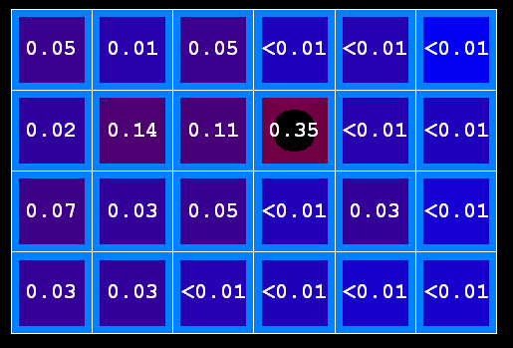

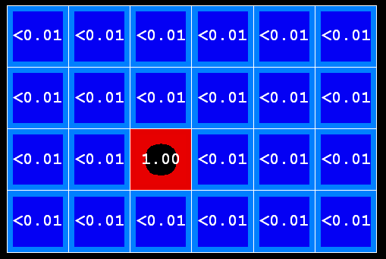
Example: Passage of Time
As time passes, uncertainty “accumulates”
(Transition model: ghosts usually go clockwise)
T = 1
T = 2
T = 5

Slide 6



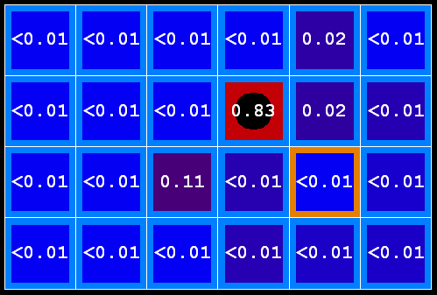
Example: Observation
As we get observations, beliefs get reweighted, uncertainty “decreases”
Before observation
After observation

Slide 7
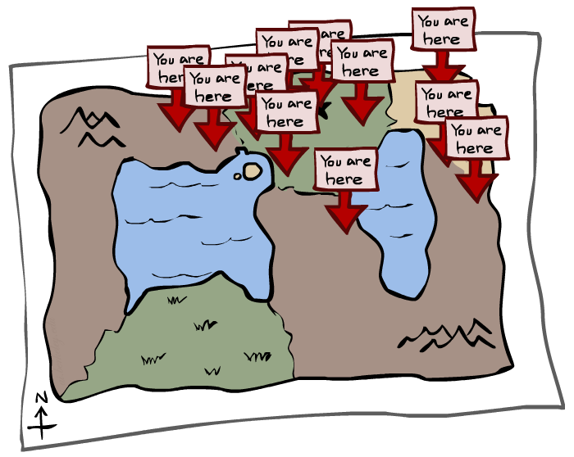
Particle Filtering

Slide 8
We need a new algorithm!
When size of the state space is large, exact inference becomes infeasible
Likelihood weighting also fails completely – number of samples needed grows exponentially with T
X₀
X₁
X₂
X₃
E₁
E₂
E₃

Slide 9
Particle Filtering
Solution: approximate inference
  Track samples of X, not all values
  Samples are called particles
  Time per step is linear in the number of samples
  But: number needed may be large
  In memory: list of particles, not states
0.0
0.1
0.0
0.0
0.0
0.2
0.0
0.2
0.5

Slide 10
Representation: Particles
Our representation of P(X) is now a list of N << |X| particles
P(x) approximated by number of particles with value x
  So, many x may have P(x) = 0 !
  More particles => more accuracy
For now, all particles have a weight of 1
Particles:
(3,3)
(2,3)
(3,3)
(3,2)
(3,3)
(3,2)
(1,2)
(3,3)
(3,3)
(2,3)

Slide 11

Particle Filtering: Prediction Step
Each particle is moved by sampling its next position from the transition model
  This is like prior sampling – samples’ frequencies reflect the transition probabilities
  Here, most samples move clockwise, but some move in another direction or stay in place
This captures the passage of time
  If enough samples, close to exact values before and after (consistent)
Particles:
(3,3)
(2,3)
(3,3)
(3,2)
(3,3)
(3,2)
(1,2)
(3,3)
(3,3)
(2,3)
Particles:
(3,2)
(2,3)
(3,2)
(3,1)
(3,3)
(3,2)
(1,3)
(2,3)
(3,2)
(2,2)

Slide 12
Particle Filtering: Update step
Particles:
(3,2)
(2,3)
(3,2)
(3,1)
(3,3)
(3,2)
(1,3)
(2,3)
(3,2)
(2,2)
After observing e_{t+1} :
  As in likelihood weighting, weight each sample based on the evidence
    w^{(j)} = P(e_{t+1}| x_{t+1}^{(j)})
  Normalize the weights: particles that fit the data better get higher weights, others get lower weights
Particles:
(3,2) w=.9
(2,3) w=.2
(3,2) w=.9
(3,1) w=.4
(3,3) w=.4
(3,2) w=.9
(1,3) w=.1
(2,3) w=.2
(3,2) w=.9
(2,2) w=.4

Slide 13
Particle Filtering: Resample
Particles:
(3,2) w=.9
(2,3) w=.2
(3,2) w=.9
(3,1) w=.4
(3,3) w=.4
(3,2) w=.9
(1,3) w=.1
(2,3) w=.2
(3,2) w=.9
(2,2) w=.4
Rather than tracking weighted samples, we resample
N times, we choose from our weighted sample distribution (i.e., draw with replacement)
Now the update is complete for this time step, continue with the next one (with weights reset to 1)
(New) Particles:
(3,2)
(2,2)
(3,2)
(2,3)
(3,3)
(3,2)
(1,3)
(2,3)
(3,2)
(3,2)

Slide 14
Particle Filtering: Resample
t=2
t=7
The problem of likelihood weighting: sample state trajectories go off into low-probability regions; too few “reasonable” samples
Solution: kill the bad ones, make more of the good ones
This way the population of samples stays in the high-probability region

Slide 15
Summary: Particle Filtering
Particles: track samples of states rather than an explicit distribution
Prediction
Update/Weight
Resample
Particles:
(3,3)
(2,3)
(3,3)
(3,2)
(3,3)
(3,2)
(1,2)
(3,3)
(3,3)
(2,3)
Particles:
(3,2)
(2,3)
(3,2)
(3,1)
(3,3)
(3,2)
(1,3)
(2,3)
(3,2)
(2,2)
Particles:
(3,2) w=.9
(2,3) w=.2
(3,2) w=.9
(3,1) w=.4
(3,3) w=.4
(3,2) w=.9
(1,3) w=.1
(2,3) w=.2
(3,2) w=.9
(2,2) w=.4
(New) Particles:
(3,2)
(2,2)
(3,2)
(2,3)
(3,3)
(3,2)
(1,3)
(2,3)
(3,2)
(3,2)
Consistency: see proof in AIMA Ch. 14
[Demos: ghostbusters particle filtering (L15D3,4,5)]

Slide 16

Particle Filter Localization (Sonar)
[Video: global-sonar-uw-annotated.avi]
Notes:
Around 55s switches to another mode of the multimodal distribution

Slide 17

Particle Filter SLAM
[Demo: PARTICLES-SLAM-fastslam.avi]

Slide 18
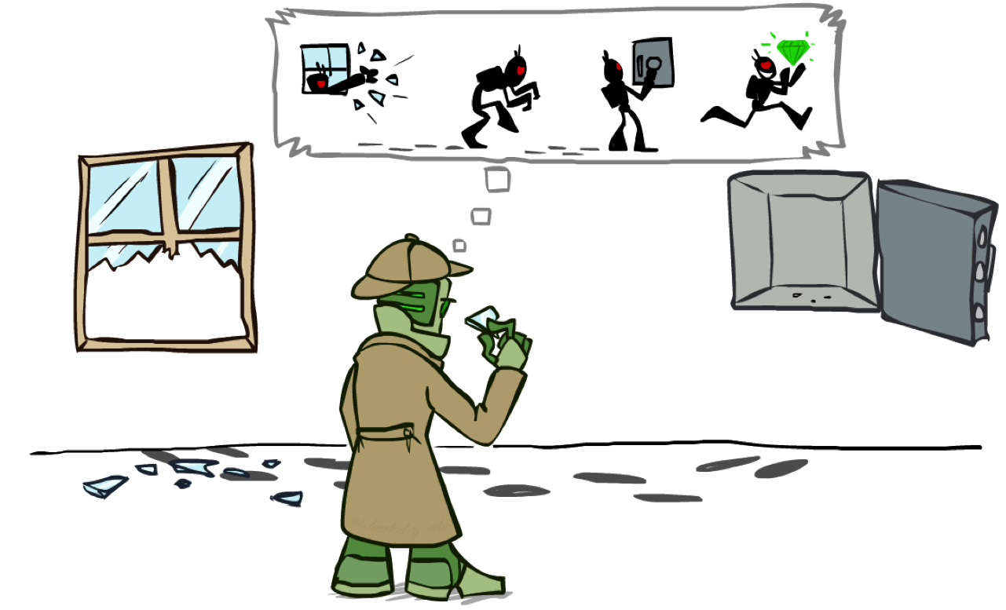
Most Likely Explanation

Slide 19
Most Likely Explanation
Most likely explanation: arg max_{x1:t} P(x_{1:t} | e_{1:t})

Slide 20
Most likely explanation = most probable path
State trellis: graph of states and transitions over time
arg max_{x1:t} P(x_{1:t} | e_{1:t}) = arg max_{x1:t} P(x₀) ∏_{t} P(x_{t} | x_{t-1}) P(e_{t} | x_{t})
Each arc represents some transition x_{t-1} → x_{t}
Each arc has weight P(x_{t} | x_{t-1}) P(e_{t} | x_{t}) (arcs to initial states have weight P(x₀) )
The product of weights on a path is proportional to that state sequence’s probability
Forward algorithm computes sums of paths, Viterbi algorithm computes best paths
sun
sun
sun
sun
rain
rain
rain
rain
X₀ X₁ … X_{T}

Slide 21
Viterbi algorithm
W_{t-1} | P(W_{t}|W_{t-1})
 | sun | rain
sun | 0.9 | 0.1
rain | 0.3 | 0.7
0.5
sun
sun
0.72
sun
0.18
sun
0.01
0.09
0.24
0.06
0.5
rain
rain
rain
rain
0.07
0.63
W_{t} | P(U_{t}|W_{t})
 | true | false
sun | 0.2 | 0.8
rain | 0.9 | 0.1
X₀ X₁ X₂ X_{T}
U₁=true U₂=false U₃=true
Each arc has weight P(x_{t} | x_{t-1}) P(e_{t} | x_{t}) (arcs to initial states have weight P(x₀) )
The product of weights on a path is proportional to that state sequence’s probability
The best way to go to a state S in timestep t+1 is first going to some state S’ in timestep t with the best way, and then go from S’ to S at timestep t+1.

Slide 22
Viterbi algorithm contd.
W_{t-1} | P(W_{t}|W_{t-1})
 | sun | rain
sun | 0.9 | 0.1
rain | 0.3 | 0.7
0.5
sun
0.18
0.72
0.18
0.5
sun
sun
sun
0.09
0.076
0.0136080
0.09
0.01
0.09
0.06
0.24
0.06
0.5
rain
rain
rain
rain
0.5
0.315
0.022
0.0138495
0.63
0.07
0.63
W_{t} | P(U_{t}|W_{t})
 | true | false
sun | 0.2 | 0.8
rain | 0.9 | 0.1
X₀ X₁ X₂ X_{T}
U₁=true U₂=false U₃=true
Each arc has weight P(x_{t} | x_{t-1}) P(e_{t} | x_{t}) (arcs to initial states have weight P(x₀) )
The product of weights on a path is proportional to that state sequence’s probability
The best way to go to a state S in timestep t+1 is first going to some state S’ in timestep t with the best way, and then go from S’ to S at timestep t+1.

Slide 23
Viterbi algorithm contd.
W_{t-1} | P(W_{t}|W_{t-1})
 | sun | rain
sun | 0.9 | 0.1
rain | 0.3 | 0.7
0.5
sun
0.18
0.72
0.18
0.5
sun
sun
sun
0.09
0.076
0.0136080
0.09
0.01
0.09
0.06
0.24
0.06
0.5
rain
rain
rain
rain
0.5
0.315
0.022
0.0138495
0.63
0.07
0.63
W_{t} | P(U_{t}|W_{t})
 | true | false
sun | 0.2 | 0.8
rain | 0.9 | 0.1
X₀ X₁ X₂ X_{T}
U₁=true U₂=false U₃=true
Time complexity?
O(|X|² T)
Space complexity?
O(|X| T)
Number of paths?
O(|X|^{T})

Slide 24
Viterbi in negative log space
W_{t-1} | P(W_{t}|W_{t-1})
 | sun | rain
sun | 0.9 | 0.1
rain | 0.3 | 0.7
1.0
sun
2.47
sun
0.72
sun
2.47
sun
S
3.47
6.64
3.47
4.06
2.06
4.06
1.0
rain
rain
rain
rain
0.67
3.84
0.67
W_{t} | P(U_{t}|W_{t})
 | true | false
sun | 0.2 | 0.8
rain | 0.9 | 0.1
G
argmax of product of probabilities
= argmin of sum of negative log probabilities

Slide 25
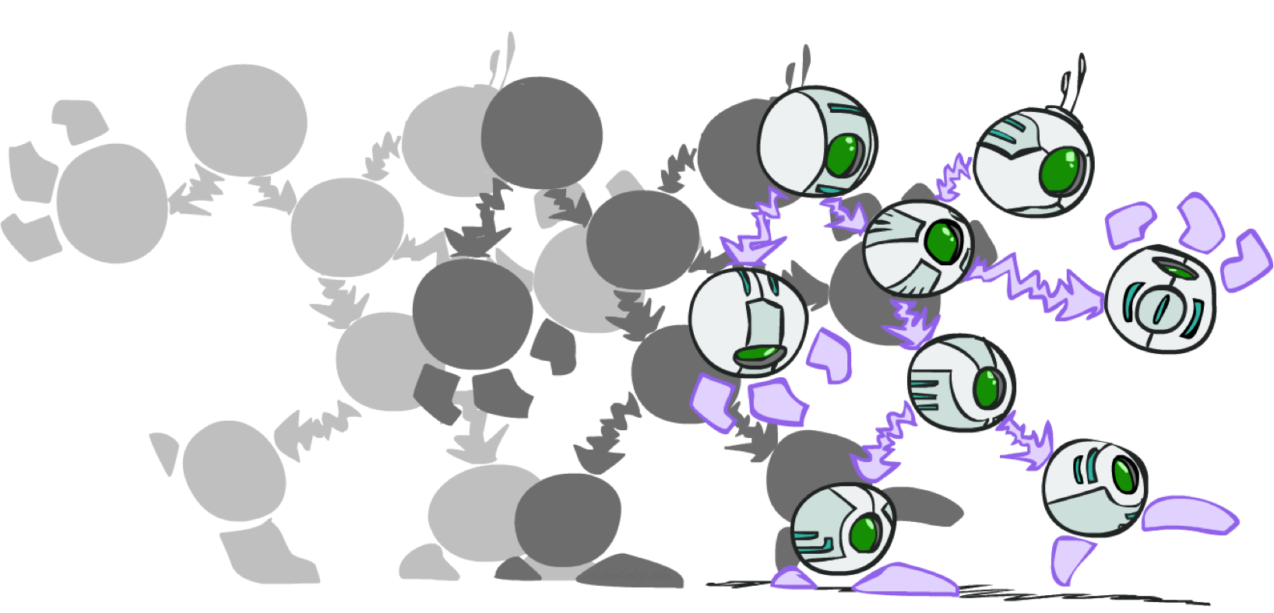
Dynamic Bayes Nets

Slide 26

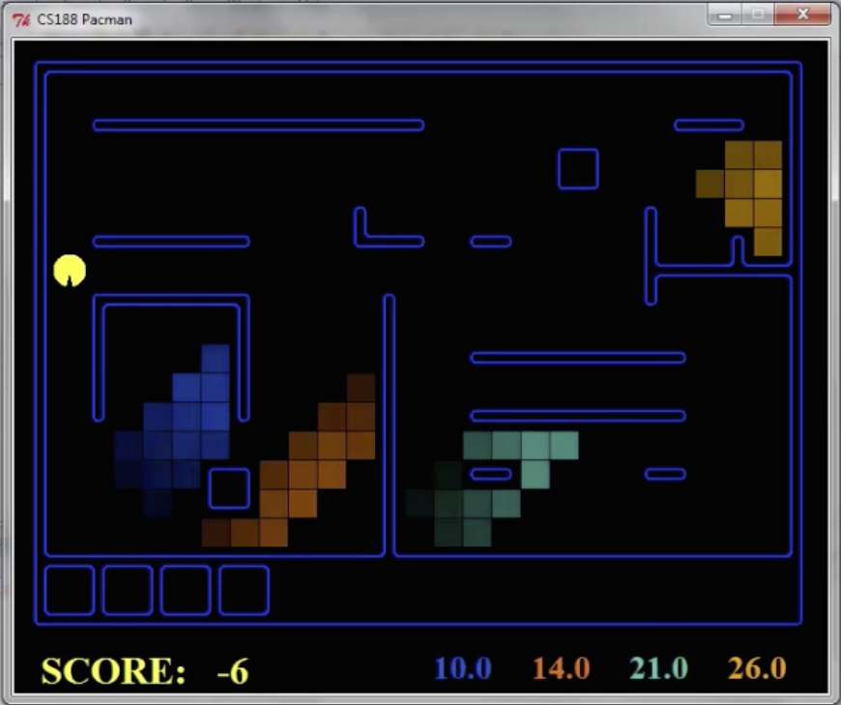
Dynamic Bayes Nets (DBNs)
We want to track multiple variables over time, using multiple sources of evidence
Idea: Repeat a fixed Bayes net structure at each time
Variables at time t can have parents at time t-1
t =1
t =2
t =3
G₁ª
G₂ª
G₃ª
G₁^{b}
G₂^{b}
G₃^{b}
E₁ª
E₁^{b}
E₂ª
E₂^{b}
E₃ª
E₃^{b}

Slide 27
DBNs and HMMs
Every HMM is a single-variable DBN
Every discrete DBN is an HMM
  HMM state is Cartesian product of DBN state variables
Sparse dependencies => exponentially fewer parameters in DBN
  E.g., 20 state variables, 3 parents each;
  DBN has 20 x 2³ = 160 parameters, HMM has 2²⁰ x 2²⁰ =~ 10¹² parameters
X_{t}
X_{t+1}
Y_{t}
Y_{t+1}
XYZ_{t}
XYZ_{t+1}
Z_{t}
Z_{t+1}

Slide 28
Exact Inference in DBNs
Variable elimination applies to dynamic Bayes nets
Offline: “unroll” the network for T time steps, then eliminate variables to find P(X_{T}|e_{1:T})
Online: eliminate all variables from the previous time step; store factors for current time only
Problem: largest factor contains all variables for current time (plus a few more)
t =1
t =2
t =3
G₁ª
G₂ª
G₃ª
G₃^{b}
G₁^{b}
G₂^{b}
G₃^{b}
E₁ª
E₁^{b}
E₂ª
E₂^{b}
E₃ª
E₃^{b}

Slide 29
DBN Particle Filters
A particle is a complete sample for a time step
Initialize: Generate prior samples for the t=1 Bayes net
  Example particle: G₁ª = (3,3) G₁^{b} = (5,3)
Elapse time: Sample a successor for each particle
  Example successor: G₂ª = (2,3) G₂^{b} = (6,3)
Observe: Weight each entire sample by the likelihood of the evidence conditioned on the sample
  Likelihood: P(E₂ª |G₂ª ) * P(E₂^{b} |G₂^{b} )
Resample: Select prior samples (tuples of values) in proportion to their likelihood
G₁ª
G₂ª
G₃ª
G₃^{b}
G₁^{b}
G₂^{b}
G₃^{b}
E₂ª
E₂^{b}
E₃ª
E₃^{b}

