Slide 1
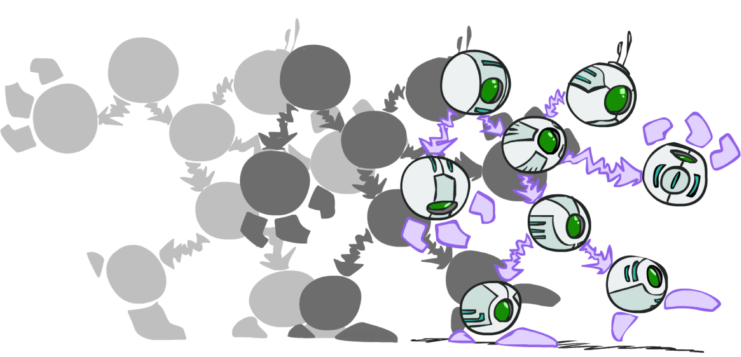
Dynamic Bayes Nets

Slide 2
Hidden Markov Models
X₀
X₁
X₂
X₃
X₅
E₁
E₂
E₃
E₅
Sensor models are the same at all times
Current evidence is independent of everything else given the current state
Filtering: calculate the distribution f_{1:t} = P(X_{t}|e_{1:t}) .
Forward Algorithm: Predict (Time Elapse), Update, Normalize.
Forward Algorithm: P(X_{t+1}|e_{1:t+1}) = α P(e_{t+1}|X_{t+1}) ∑_{xt} P(x_{t} | e_{1:t}) P(X_{t+1}| x_{t})
Equivalently: f_{1:t+1} = α O_{t+1}T^{T} f_{1:t}
Most likely explanation: arg max_{x1:t} P(x_{1:t} | e_{1:t})

Slide 3

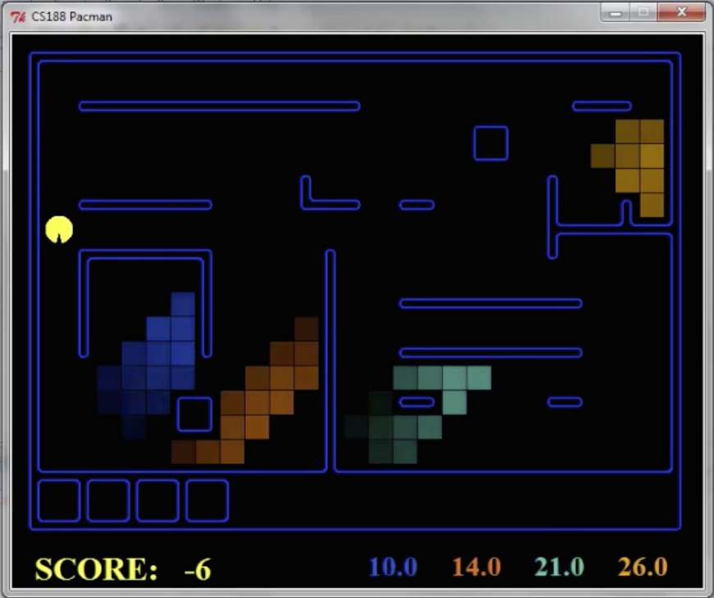
Dynamic Bayes Nets (DBNs)
We want to track multiple variables over time, using multiple sources of evidence
Idea: Repeat a fixed Bayes net structure at each time
Variables at time t can have parents at time t-1
t =1
t =2
t =3
G₁ª
G₂ª
G₃ª
G₁^{b}
G₂^{b}
G₃^{b}
E₁ª
E₁^{b}
E₂ª
E₂^{b}
E₃ª
E₃^{b}

Slide 4
DBNs and HMMs
Every HMM is a single-variable DBN
Every discrete DBN is an HMM
  HMM state is Cartesian product of DBN state variables
Sparse dependencies => exponentially fewer parameters in DBN
  E.g., 20 state variables, 3 parents each;
  DBN has 20 x 2³ = 160 parameters, HMM has 2²⁰ x 2²⁰ =~ 10¹² parameters
X_{t}
X_{t+1}
Y_{t}
Y_{t+1}
XYZ_{t}
XYZ_{t+1}
Z_{t}
Z_{t+1}

Slide 5
Exact Inference in DBNs
Variable elimination applies to dynamic Bayes nets
Offline: “unroll” the network for T time steps, then eliminate variables to find P(X_{T}|e_{1:T})
Online: eliminate all variables from the previous time step; store factors for current time only
Problem: largest factor contains all variables for current time (plus a few more)
t =1
t =2
t =3
G₁ª
G₂ª
G₃ª
G₃^{b}
G₁^{b}
G₂^{b}
G₃^{b}
E₁ª
E₁^{b}
E₂ª
E₂^{b}
E₃ª
E₃^{b}

Slide 6
DBN Particle Filters
A particle is a complete sample for a time step
Initialize: Generate prior samples for the t=1 Bayes net
  Example particle: G₁ª = (3,3) G₁^{b} = (5,3)
Elapse time: Sample a successor for each particle
  Example successor: G₂ª = (2,3) G₂^{b} = (6,3)
Observe: Weight each entire sample by the likelihood of the evidence conditioned on the sample
  Likelihood: P(E₂ª |G₂ª ) * P(E₂^{b} |G₂^{b} )
Resample: Select prior samples (tuples of values) in proportion to their likelihood
G₁ª
G₂ª
G₃ª
G₃^{b}
G₁^{b}
G₂^{b}
G₃^{b}
E₂ª
E₂^{b}
E₃ª
E₃^{b}

Slide 7
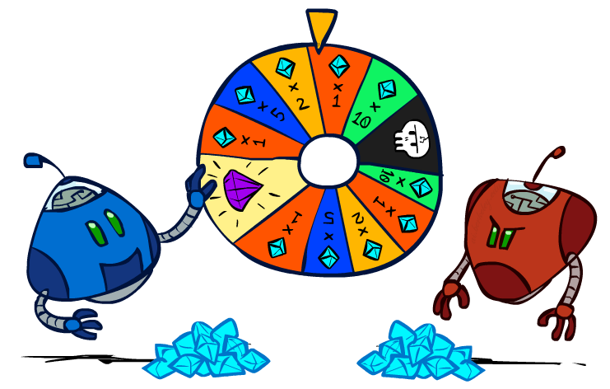
CS 188: Artificial Intelligence
Rational Decisions
Instructors: Angela Liu and Yanlai Yang
University of California, Berkeley
(Slides adapted Stuart Russell and Dawn Song)
Notes:
Please retain proper attribution and the reference to ai.berkeley.edu. Thanks!

Slide 8

Utilities

Slide 9

Maximum Expected Utility
Principle of maximum expected utility:
  A rational agent should choose the action that maximizes its expected utility, given its knowledge
Questions:
  Where do utilities come from?
  How do we know such utilities even exist?
  How do we know that averaging even makes sense?
  What if our behavior (preferences) can’t be described by utilities?

Slide 10
The need for numbers
0
40
20
30
x²
0
1600
400
900
For worst-case minimax reasoning, terminal value scale doesn’t matter
  We just want better states to have higher evaluations (get the ordering right)
  The optimal decision is invariant under any monotonic transformation
For average-case expectimax reasoning, we need magnitudes to be meaningful

Slide 11

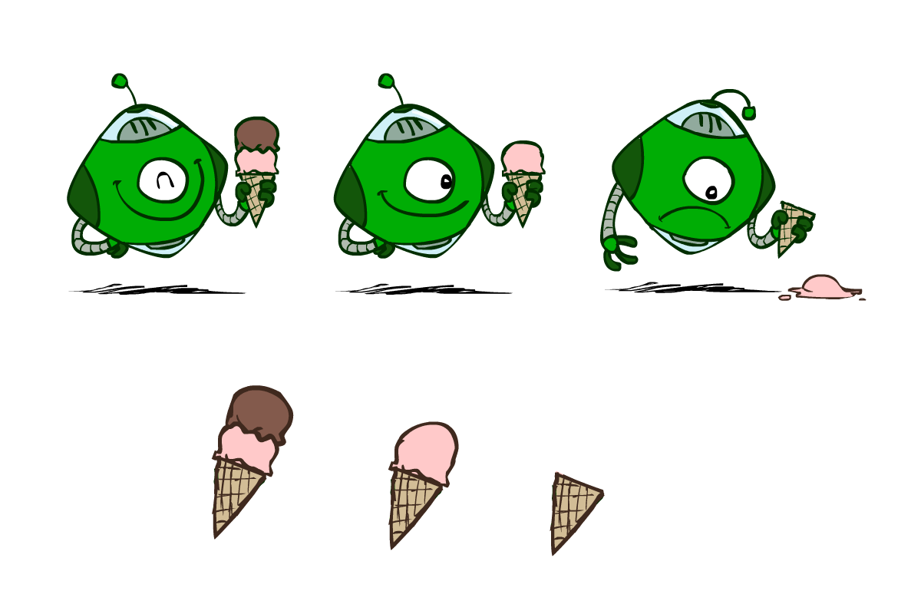
Utilities
Utilities are functions from outcomes (states of the world) to real numbers that describe an agent’s preferences
Where do utilities come from?
  In a game, may be simple (+1/-1)
  Utilities summarize the agent’s goals
  Theorem: any “rational” preferences can be summarized as a utility function
We hard-wire utilities and let behaviors emerge
  Why don’t we let agents pick utilities?
  Why don’t we prescribe behaviors?

Slide 12

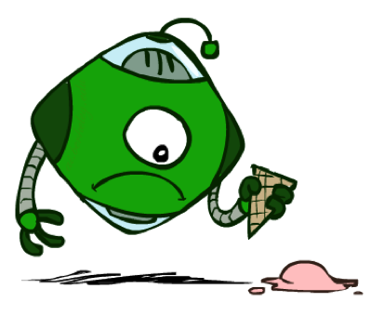

Utilities: Uncertain Outcomes
Getting ice cream
Get Single
Get Double
Oops
Whew!

Slide 13
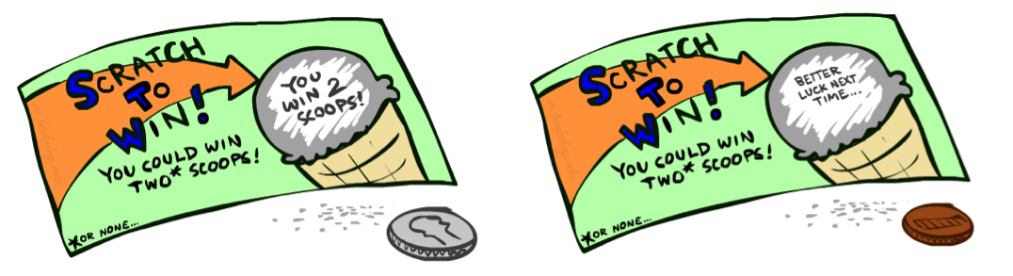
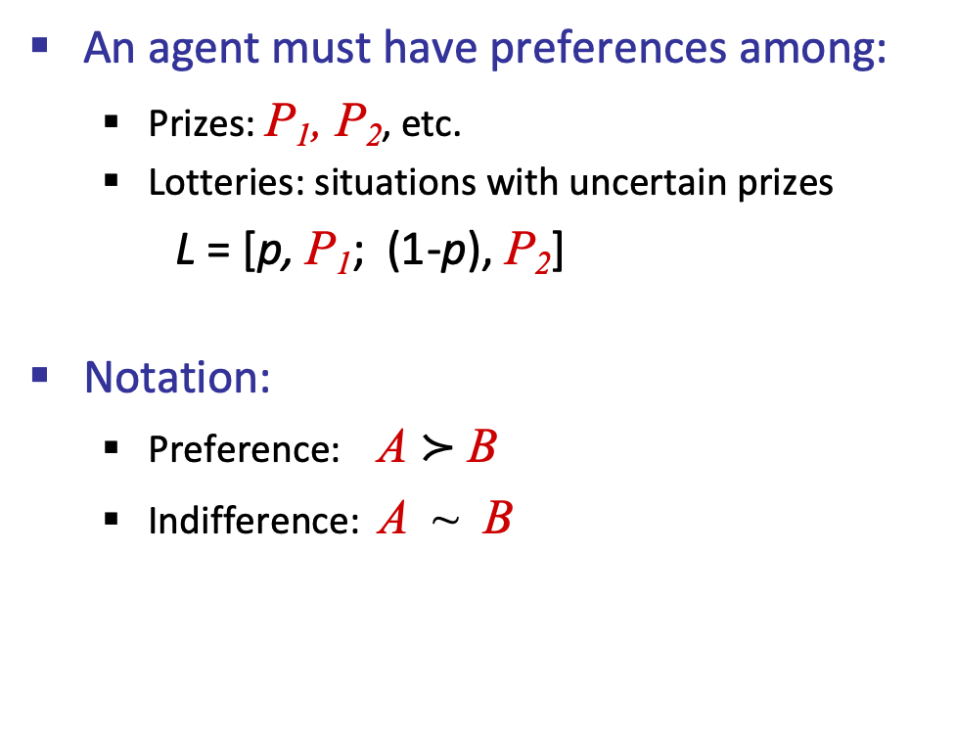
Preferences
A Prize
A Lottery
An agent must have preferences among:
  Prizes: P₁, P₂, etc.
  Lotteries: situations with uncertain prizes
  L = [p, P₁; (1-p), P₂]
Notation:
  Preference: A $≻$ B
  Indifference: A ~ B
P₁
p 1-p
P₁ P₂

Slide 14
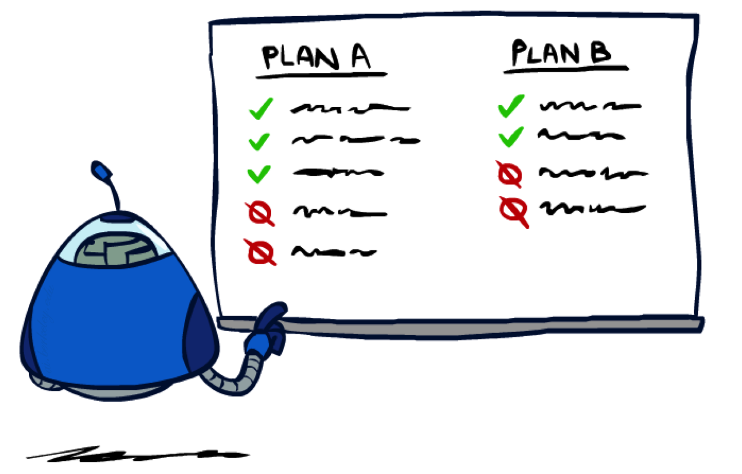
Rationality

Slide 15
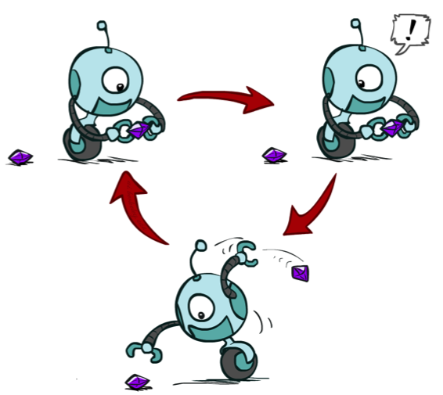
Rational Preferences
We want some constraints on preferences before we call them rational, such as:
For example: an agent with intransitive preferences can
be induced to give away all of its money
  If B > C, then an agent with C would pay (say) 1 cent to get B
  If A > B, then an agent with B would pay (say) 1 cent to get A
  If C > A, then an agent with A would pay (say) 1 cent to get C
  Axiom of Transitivity: (A $≻$ B) ∧ (B $≻$ C) ⇒ (A $≻$ C)
Notes:
Apple, banana, carrot

Slide 16

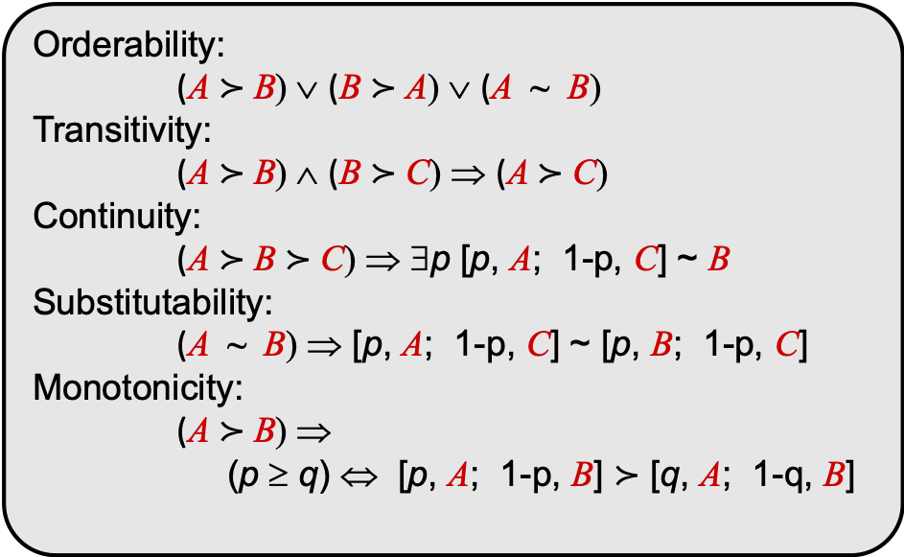
Rational Preferences
The Axioms of Rationality
Orderability:
(A $≻$ B) ∨ (B $≻$ A) ∨ (A ~ B)
Transitivity:
(A $≻$ B) ∧ (B $≻$ C) ⇒ (A $≻$ C)
Continuity:
(A $≻$ B $≻$ C) ⇒ ∃p [p, A; 1-p, C] ~ B
Substitutability:
(A ~ B) ⇒ [p, A; 1-p, C] ~ [p, B; 1-p, C]
Monotonicity:
(A $≻$ B) ⇒
(p ≥ q) ⇔ [p, A; 1-p, B] $≻$ [q, A; 1-q, B]
Theorem: Rational preferences imply behavior describable as maximization of expected utility

Slide 17
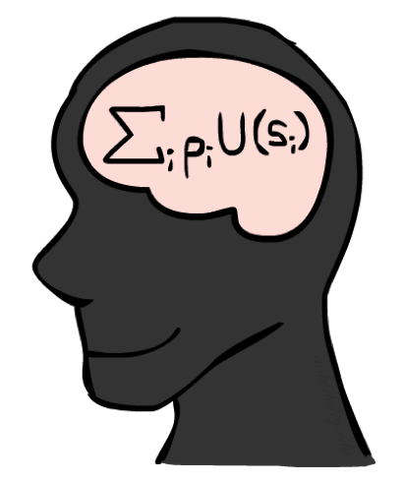
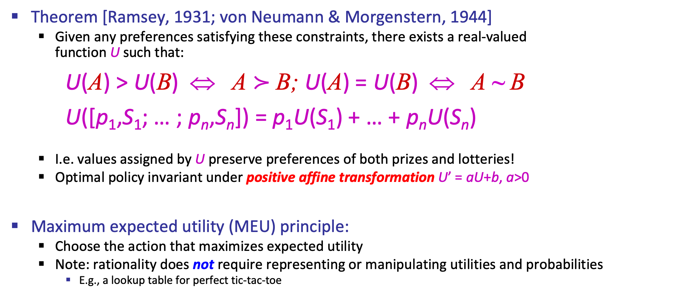
MEU Principle
Theorem [Ramsey, 1931; von Neumann & Morgenstern, 1944]
  Given any preferences satisfying these constraints, there exists a real-valued
  function U such that:
U(A) > U(B) ⇔ A $≻$ B; U(A) = U(B) ⇔ A ~ B
U([p₁,S₁; … ; p_{n},S_{n}]) = p₁U(S₁) + … + p_{n}U(S_{n})
  I.e. values assigned by U preserve preferences of both prizes and lotteries!
  Optimal policy invariant under positive affine transformation U’ = aU+b, a>0
Maximum expected utility (MEU) principle:
  Choose the action that maximizes expected utility
  Note: rationality does not require representing or manipulating utilities and probabilities
    E.g., a lookup table for perfect tic-tac-toe

Slide 18
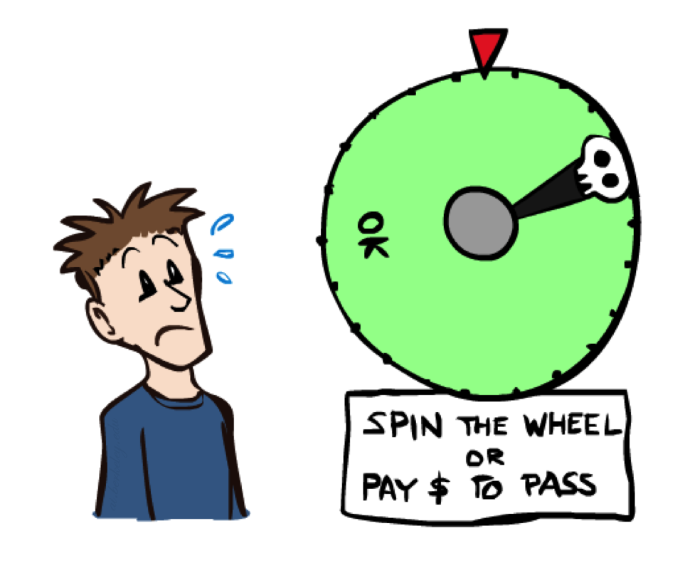
Human Utilities

Slide 19


Human Utilities
Utilities map states to real numbers. Which numbers?
Standard approach to assessment (elicitation) of human utilities:
  Compare a prize A to a standard lottery L_{p} between
    “best possible prize” u_{T} with probability p
    “worst possible catastrophe” u⊥ with probability 1-p
  Adjust lottery probability p until indifference: A ~ L_{p}
  Resulting p is a utility in [0,1]
Pay $50
0.999999 0.000001
No change
Instant death

Slide 20
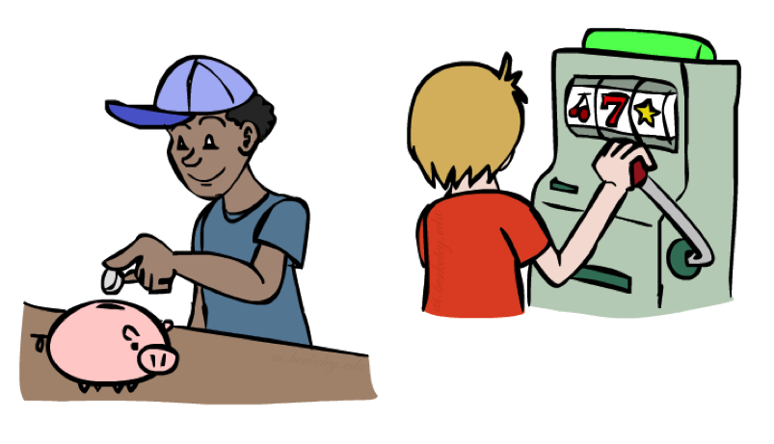
Money
Money does not behave as a utility function, but we can talk about the utility of having money (or being in debt)
Given a lottery L = [p, $X; (1-p), $Y]
  The expected monetary value EMV(L) = pX + (1-p)Y
  The utility is U(L) = pU($X) + (1-p)U($Y)
  Typically, U(L) < U( EMV(L) )
  In this sense, people are risk-averse
  E.g., how much would you pay for a lottery ticket L=[0.5, $10,000; 0.5, $0]?
  The certainty equivalent of a lottery CE(L) is the cash amount such that CE(L) ~ L
  The insurance premium is EMV(L) - CE(L)
  If people were risk-neutral, this would be zero!
Notes:
Draw Jensen’s for utility curve

Slide 21
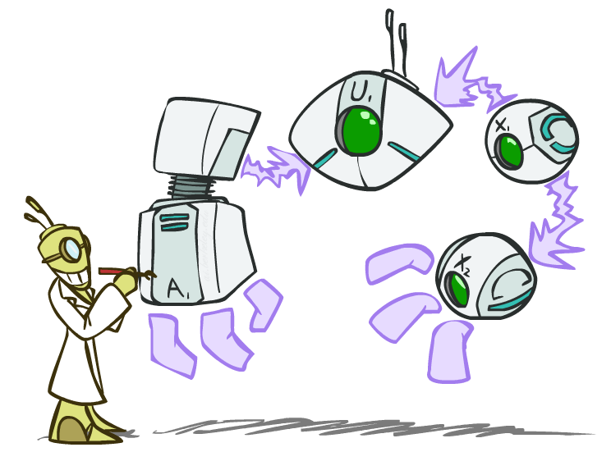
Decision Networks
Notes:
Now that we know that a rational agent chooses the action that maximizes expected utility, how do we calculate the agent’s action given the agent’s state, the environment and utility function?
We will use decision networks to help us.

Slide 22
Decision Networks
In its most general form, a decision network represents information about
Its current state
Its possible actions
The state that will result from its actions
The utility of that state
Decision network = Bayes net + Actions + Utilities

Slide 23

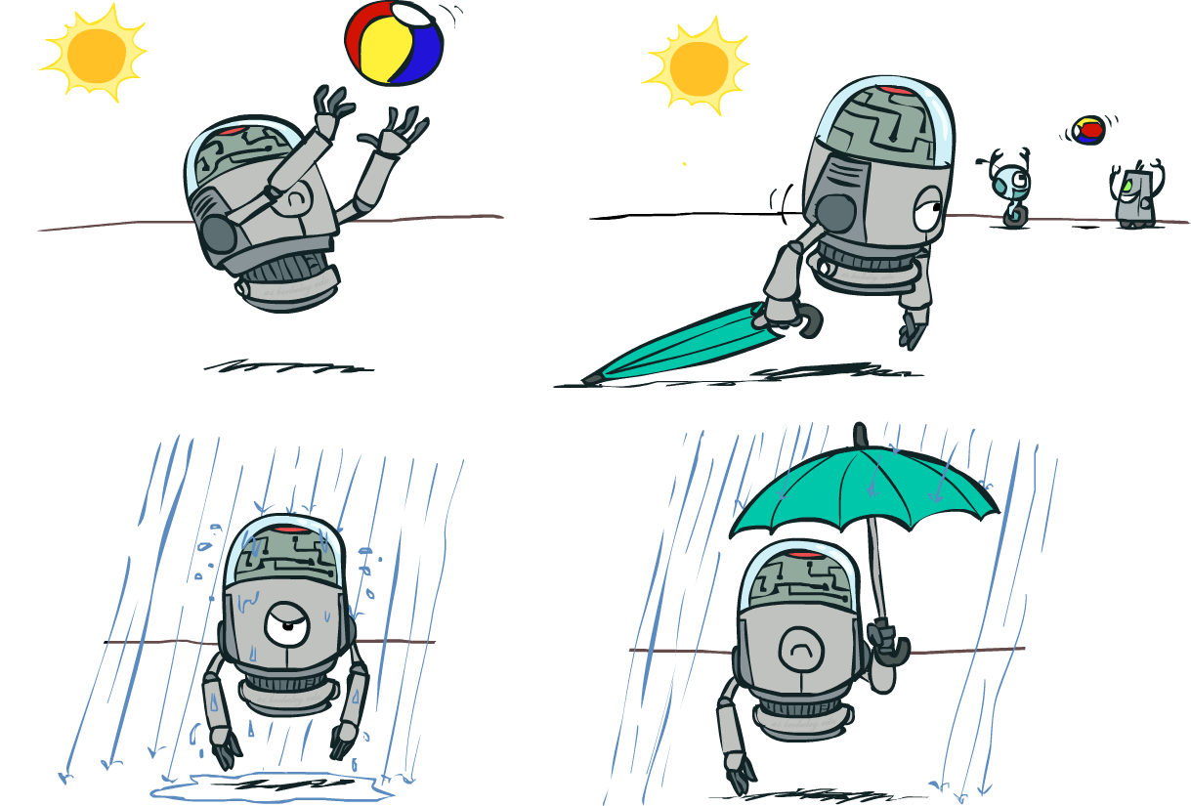


Decision Networks
Umbrella
U
Weather
Forecast
Notes:
There exists a ghostbusters demo

Slide 24
Decision Networks
Decision network = Bayes net + Actions + Utilities
  Chance nodes (just like BNs)
  Action nodes (rectangles, cannot have parents, will have value fixed by algorithm)
  Utility nodes (diamond, depends on action and chance nodes)
Decision algorithm:
  Fix evidence e
  For each possible action a
    Fix action node to a
    Compute posterior P(W|e,a) for parents W of U
    Compute expected utility ∑_{w} P(w|e,a) U(a,w)
  Return action with highest expected utility
Umbrella
U
Weather
Bayes net inference!
Forecast
Notes:
There exists a ghostbusters demo

Slide 25
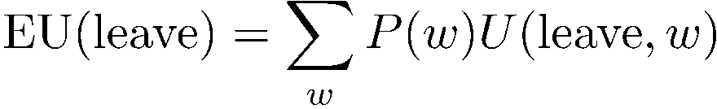
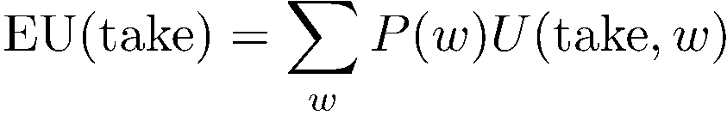

Maximum Expected Utility
Umbrella = leave
Umbrella
U
Umbrella = take
Weather
A | W | U(A,W)
leave | sun | 100
leave | rain | 0
take | sun | 20
take | rain | 70
W | P(W)
sun | 0.7
rain | 0.3
Optimal decision = leave
Notes:
Q: What other decision-making algorithm in this class do decision networks remind you of?
There exists a ghostbusters demo

Slide 26






Decisions as Outcome Trees
{}
take
leave
Umbrella
Weather | {}
Weather | {}
U
sun
sun
Weather
rain
rain
U(t,s)
U(t,r)
U(l,s)
U(l,r)
Almost exactly like expectimax!
What’s changed?

Slide 27

Example: Take an umbrella?
A | W | U(A,W)
leave | sun | 100
leave | rain | 0
take | sun | 20
take | rain | 70
Umbrella
U
W | P(W)
sun | 0.7
Weather
W | P(F=bad|W)
sun | 0.17
rain | 0.77
Forecast
=bad

Slide 28
Example: Take an umbrella?
Decision algorithm:
  Fix evidence e
  For each possible action a
    Fix action node to a
    Compute posterior P(W|e) for parents W of U
    Compute expected utility of action a: ∑_{w} P(w|e) U(a,w)
  Return the action with highest expected utility
Bayes net inference!
A | W | U(A,W)
leave | sun | 100
leave | rain | 0
take | sun | 20
take | rain | 70
Umbrella
Umbrella = leave
U
EU(leave|F=bad) = ∑_{w} P(w|F=bad) U(leave,w)
W | P(W)
sun | 0.7
Weather
We have:
W | P(W|F=bad)
sun | 0.34
rain | 0.66
W | P(F=bad|W)
sun | 0.17
rain | 0.77
Forecast
=bad

Slide 29
Example: Take an umbrella?
Decision algorithm:
  Fix evidence e
  For each possible action a
    Fix action node to a
    Compute posterior P(W|e,a) for parents W of U
    Compute expected utility of action a: ∑_{w} P(w|e,a) U(a,w)
  Return action with highest expected utility
A | W | U(A,W)
leave | sun | 100
leave | rain | 0
take | sun | 20
take | rain | 70
Bayes net inference!
Umbrella
U
W | P(W)
sun | 0.7
Umbrella = leave
EU(leave|F=bad) = ∑_{w} P(w|F=bad) U(leave,w)
Weather
= 0.34x100 + 0.66x0 = 34
W | P(W|F=bad)
sun | 0.34
rain | 0.66
Umbrella = take
EU(take|F=bad) = ∑_{w} P(w|F=bad) U(take,w)
= 0.34x20 + 0.66x70 = 53
W | P(F=bad|W)
sun | 0.17
rain | 0.77
Forecast
=bad
Optimal decision = take!

Slide 30

Decisions as Outcome Trees
Umbrella
{b}
take
leave
U
W | {b}
W | {b}
Weather
sun
sun
rain
rain
U(t,s)
U(t,r)
U(l,s)
U(l,r)
Forecast
=bad

Slide 31
Decision network with utilities on outcome states
Wet | FeelStupid | U
dry | false | 100
wet | true | 0
dry | true | 20
damp | false | 70
Umbrella
Wet
W | P(W)
sun | 0.7
U
FeelStupid
Weather
W | P(F=bad|W)
sun | 0.17
rain | 0.77
Here, U is a true utility.
With an action node as parent, it is
sometimes called a Q-value
Forecast
=bad
Notes:
In this case, rather than representing a utility function on outcome states, the utility node represents the expected utility associated with each action.

