Slide 1
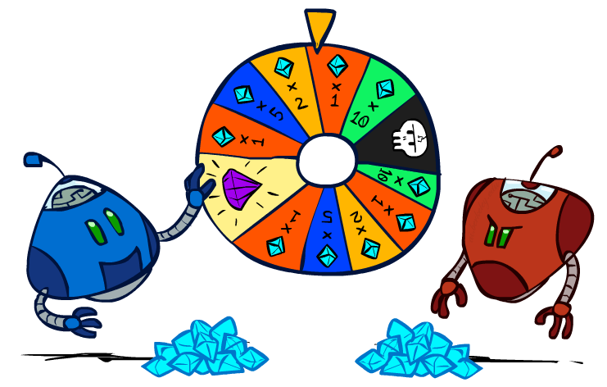
CS 188: Artificial Intelligence
Decision Networks + VPI
Instructors: Angela Liu and Yanlai Yang
University of California, Berkeley
(Slides adapted Stuart Russell and Dawn Song)
Notes:
Please retain proper attribution and the reference to ai.berkeley.edu. Thanks!

Slide 2
Decision Networks
Decision network = Bayes net + Actions + Utilities
  Chance nodes (just like BNs)
  Action nodes (rectangles, cannot have parents, will have value fixed by algorithm)
  Utility nodes (diamond, depends on action and chance nodes)
Decision algorithm:
  Fix evidence e
  For each possible action a
    Fix action node to a
    Compute posterior P(W|e,a) for parents W of U
    Compute expected utility ∑_{w} P(w|e,a) U(a,w)
  Return action with highest expected utility
Umbrella
U
Weather
Bayes net inference!
Forecast
Notes:
There exists a ghostbusters demo

Slide 3
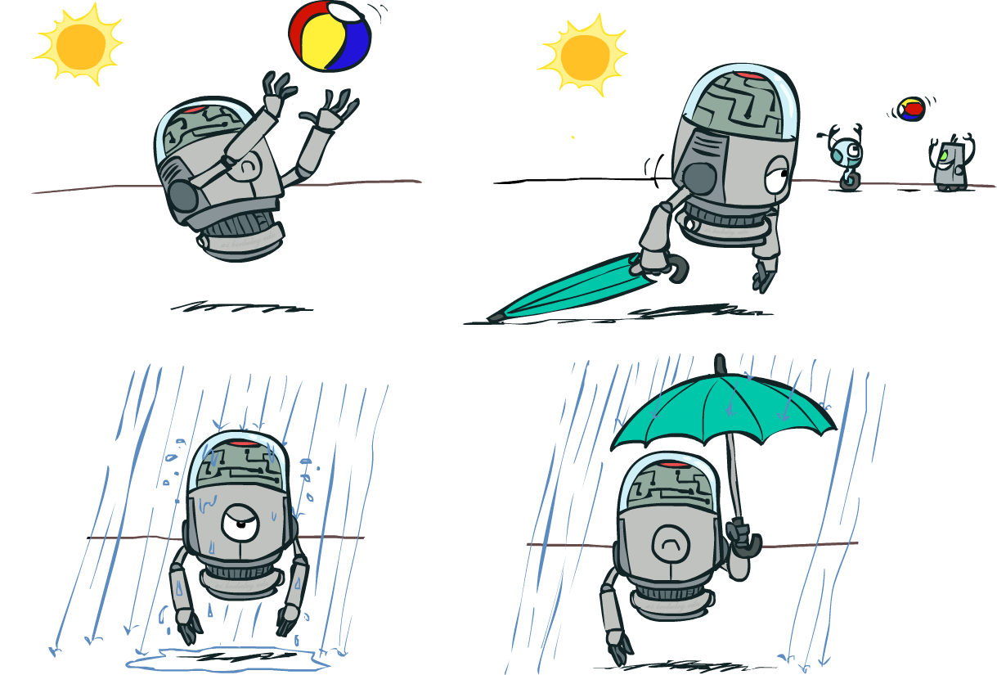
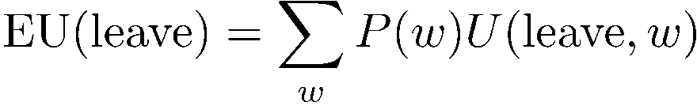
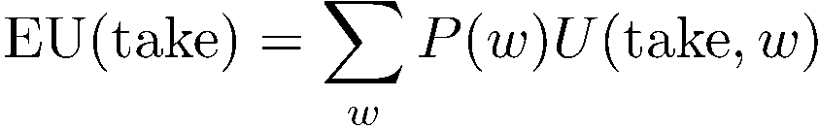

Maximum Expected Utility
Umbrella = leave
Umbrella
U
Umbrella = take
Weather
A | W | U(A,W)
leave | sun | 100
leave | rain | 0
take | sun | 20
take | rain | 70
W | P(W)
sun | 0.7
rain | 0.3
Optimal decision = leave
Notes:
Q: What other decision-making algorithm in this class do decision networks remind you of?
There exists a ghostbusters demo

Slide 4

Example: Take an umbrella?
Decision algorithm:
  Fix evidence e
  For each possible action a
    Fix action node to a
    Compute posterior P(W|e,a) for parents W of U
    Compute expected utility of action a: ∑_{w} P(w|e,a) U(a,w)
  Return action with highest expected utility
A | W | U(A,W)
leave | sun | 100
leave | rain | 0
take | sun | 20
take | rain | 70
Bayes net inference!
Umbrella
U
W | P(W)
sun | 0.7
Umbrella = leave
EU(leave|F=bad) = ∑_{w} P(w|F=bad) U(leave,w)
Weather
= 0.34x100 + 0.66x0 = 34
W | P(W|F=bad)
sun | 0.34
rain | 0.66
Umbrella = take
EU(take|F=bad) = ∑_{w} P(w|F=bad) U(take,w)
= 0.34x20 + 0.66x70 = 53
W | P(F=bad|W)
sun | 0.17
rain | 0.77
Forecast
=bad
Optimal decision = take!

Slide 5
Example: Take an umbrella?
Decision algorithm:
  Fix evidence e
  For each possible action a
    Fix action node to a
    Compute posterior P(W|e,a) for parents W of U
    Compute expected utility of action a: ∑_{w} P(w|e,a) U(a,w)
  Return action with highest expected utility
A | W | U(A,W)
leave | sun | 100
leave | rain | 0
take | sun | 20
take | rain | 70
Bayes net inference!
Umbrella
U
W | P(W)
sun | 0.7
Umbrella = leave
EU(leave|F=good) = ∑_{w} P(w|F=good) U(leave,w)
Weather
= 0.89x100 + 0.11x0 = 89
W | P(W|F=good)
sun | 0.89
rain | 0.11
Umbrella = take
EU(take|F=good) = ∑_{w} P(w|F=good) U(take,w)
= 0.89x20 + 0.11x70 = 26
W | P(F=good|W)
sun | 0.83
rain | 0.23
Forecast
=bad
Optimal decision = leave!

Slide 6
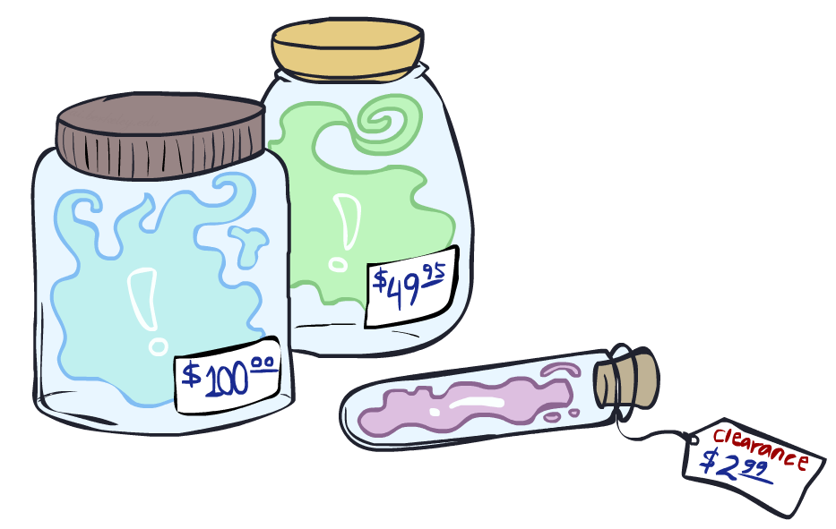
Value of Information

Slide 7
A question to motivate VPI
How do you tell if you want to take a specific class next semester?

Slide 8
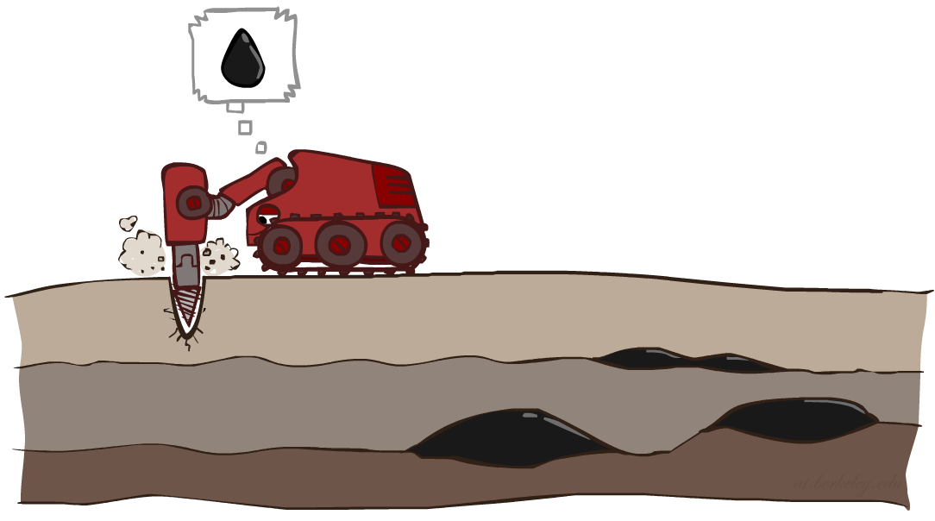
Value of Perfect Information
Idea: compute value of acquiring evidence
  Can be done directly from decision network
Example: buying oil drilling rights
  Two blocks A and B, exactly one has oil, worth k
  You can drill in one location
  Prior probabilities 0.5 each, & mutually exclusive
  Drilling in either A or B has EU = k/2, MEU = k/2
Question: what’s the value of information of O?
  Value of knowing which of A or B has oil
  Value is expected gain in MEU from new info
  If we know OilLoc, MEU is k (either way)
  Gain in MEU from knowing OilLoc?
  VPI(OilLoc) = k – k/2 = k/2
  Fair price of information: k/2
D | O | U
a | a | k
a | b | 0
b | a | 0
b | b | k
DrillLoc
U
O | P
a | 1/2
b | 1/2
OilLoc

Slide 9
Value of information
Before you see the forecast (no evidence)
  MEU(ø) = max_{a}EU(a) = 70
What if you look at the forecast?
If Forecast=bad
  MEU(F=bad) = max_{a}EU(a | F=bad) = 53
If Forecast=good
  MEU(F=good) = max_{a}EU(a | F=good) = 89
But, we don’t know what the forecast will be ahead of time!
So we need a distribution of P(F)
Expected utility given forecast
  = 0.35 x 53 + 0.65 x 89 = 76.4
Value of information = 76.4-70 = 6.4
Umbrella
U
Weather
Forecast
leave
take
Bayes net inference!
  70
  35
observe F
  0.65
  0.35
F | P(F)
good | 0.65
bad | 0.35
Umbrella
Umbrella
U
U
Weather
Weather
good
bad
leave
take
leave
take
  89
  25
  34
  53

Slide 10
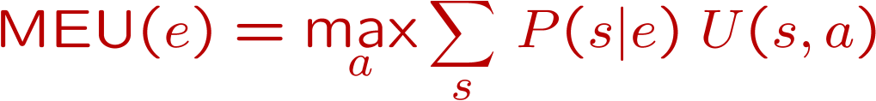
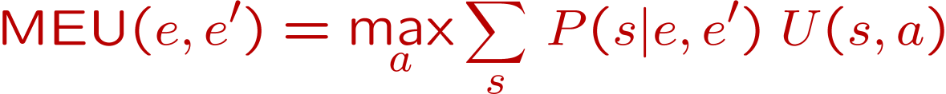
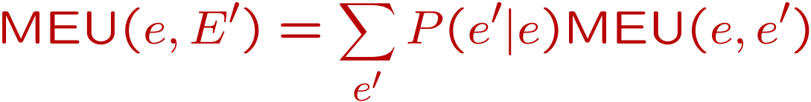
Value of Information
{+e}
Assume we have evidence E=e. Value if we act now:
Assume we see that E’ = e’. Value if we act then:
BUT E’ is a random variable whose value is
unknown, so we don’t know what e’ will be
Expected value if E’ is revealed and then we act:
Value of information: how much MEU goes up
by revealing E’ first then acting, over acting now:
a
P(s | +e)
U
{+e, +e’}
a
P(s | +e, +e’)
U
{+e}
P(+e’ | +e)
P(-e’ | +e)
{+e, +e’}
{+e, -e’}
a

Slide 11
Value of Information
{+e}
a
P(s | +e)
U
{+e, +e’}
a
P(s | +e, +e’)
U
{+e}
P(+e’ | +e)
P(-e’ | +e)
{+e, +e’}
{+e, -e’}
a

Slide 12
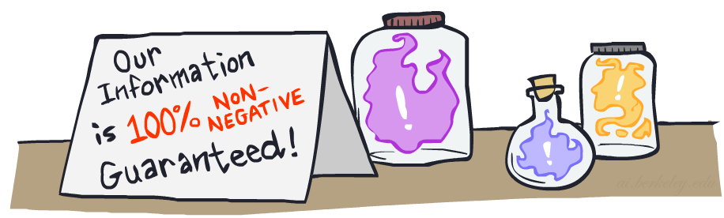
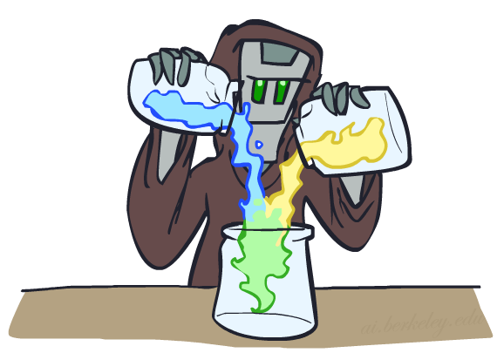
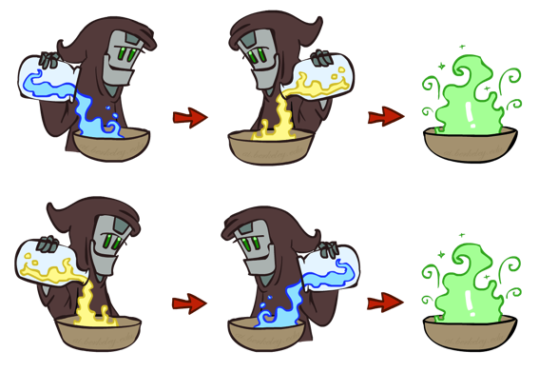
VPI Properties
VPI is non-negative! VPI(E_{i} | e) ≥ 0
VPI is not (usually) additive: VPI(E_{i} , E_{j} | e) ≠ VPI(E_{i} | e) + VPI(E_{j} | e)
VPI is order-independent: VPI(E_{i} , E_{j} | e) = VPI(E_{j} , E_{i} | e)

Slide 13

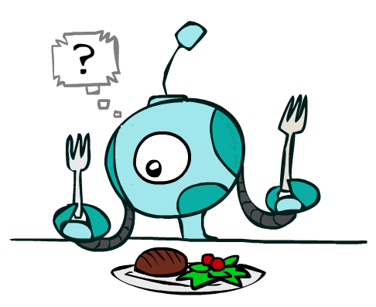
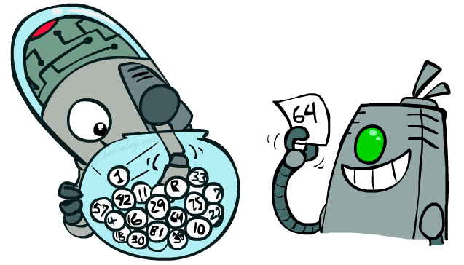
Quick VPI Questions
The soup of the day is either clam chowder or split pea, but you wouldn’t order either one. What’s the value of knowing which it is?
There are two kinds of plastic forks at a picnic. One kind is slightly sturdier. What’s the value of knowing which?
You’re playing the lottery. The prize will be $0 or $100. You can play any number between 1 and 100 (chance of winning is 1%). What is the value of knowing the winning number?
Notes:
0, positive, 99

Slide 14
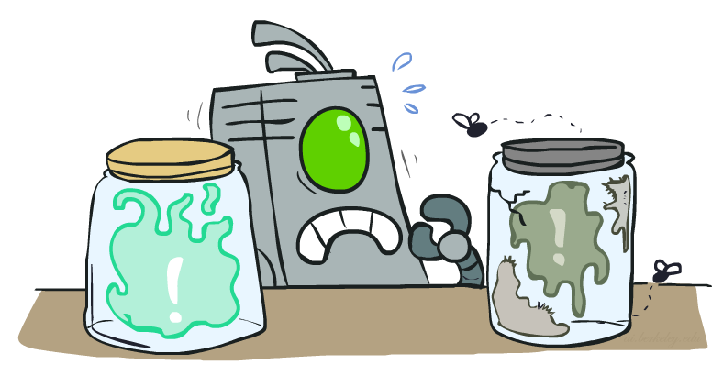
Value of Imperfect Information?
No such thing
Information corresponds to the observation of a node in the decision network
If data is “noisy” that just means we don’t observe the original variable, but another variable which is a noisy version of the original one

Slide 15
VPI Question
VPI(OilLoc) ?
VPI(ScoutingReport) ?
VPI(Scout) ?
VPI(Scout | ScoutingReport) ?
Generally:
  If Parents(U) Z | CurrentEvidence)
  Then VPI( Z | CurrentEvidence) = 0
DrillLoc
U
Scout
OilLoc
Scouting
Report

Slide 16
Decisions with unknown preferences
In reality the assumption that we can write down our exact preferences for the machine to optimize is false
A machine optimizing the wrong preferences causes problems

Slide 17
Decisions with unknown preferences
In reality the assumption that we can write down our exact preferences for the machine to optimize is false
A machine optimizing the wrong preferences causes problems
A machine that is explicitly uncertain about the human’s preferences will defer to the human (e.g., allow itself to be switched off)

Slide 18
Off-switch problem (example)
R
P(U)
act
switch self off
wait
U = ?
H
U=0
-40
0
+60
U
EU(act) = +10
EU(wait) = (0.4 * 0) + (0.6 * 30)
= +18
go ahead
switch robot off
R
U=0
P(U)
act
switch self off
wait
U = ?
U=0
-40
0
+60
U

Slide 19
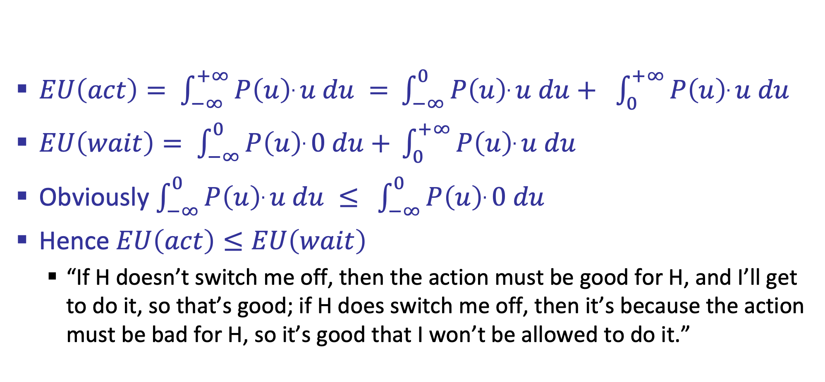
Off-switch problem (general proof)
$EU\left(act\right)= \int_{−∞}^{+∞}{P\left(u\right).u du = }$ $\int_{−∞}^{0}{P\left(u\right).u du+ }$ $\int_{0}^{+∞}{P\left(u\right).u du }$
$EU\left(wait\right)= \int_{−∞}^{0}{P\left(u\right).0 du+ }\int_{0}^{+∞}{P\left(u\right).u du }$
Obviously $\int_{−∞}^{0}{P\left(u\right).u du ≤ }$ $\int_{−∞}^{0}{P\left(u\right).0 du}$
Hence $EU\left(act\right)≤EU\left(wait\right)$
  “If H doesn’t switch me off, then the action must be good for H, and I’ll get to do it, so that’s good; if H does switch me off, then it’s because the action must be bad for H, so it’s good that I won’t be allowed to do it.”

Slide 20

CS 188: Artificial Intelligence
Markov Decision Processes
Instructor: Angela Liu and Yanlai Yang
University of California, Berkeley
[These slides adapted from Dan Klein and Pieter Abbeel]
Notes:
Please retain proper attribution, including the reference to ai.berkeley.edu. Thanks!

Slide 21

Sequential decisions under uncertainty
So far, decision problem is one-shot --- concerning only one action
Sequential decision problem: agent’s utility depends on a sequence of actions

Slide 22





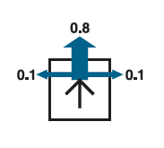
Example: Grid World
A maze-like problem
  The agent lives in a grid
  Walls block the agent’s path
Noisy movement: actions do not always go as planned
  80% of the time, the action North takes the agent North
  (if there is no wall there)
  10% of the time, North takes the agent West; 10% East
  If there is a wall in the direction the agent would have been taken, the agent stays put
The agent receives rewards each time step
  Small “living” reward r each step (can be negative)
  Big rewards come at the end (good or bad)
Goal: maximize sum of rewards

Slide 23


Markov Decision Process (MDP)
Environment history: [s₀, a₀, s₁, a₁, …, s_{t}]
“Markov” generally means that given the present state, the future and the past are independent
For Markov decision processes, “Markov” means action outcomes depend only on the current state
This is just like search, where the successor function could only depend on the current state (not the history)
Andrey Markov (1856-1922)

Slide 24
Markov Decision Process (MDP)
An MDP is defined by:
  A set of states s ∈ S
  A set of actions a ∈ A
  A transition model T(s, a, s’)
    Probability that a from s leads to s’, i.e., P(s’| s, a)
  A reward function R(s, a, s’) for each transition
  A start state
  Possibly a terminal state (or absorbing state)
  Utility function which is additive (discounted) rewards
MDPs are fully observable but probabilistic search problems
[Demo – gridworld manual intro (L8D1)]

Slide 25



Grid World Actions
Deterministic Grid World
Stochastic Grid World
Notes:
When you plan you will have to take these into account

Slide 26

Policies
A policy π gives an action for each state, π: S → A
In deterministic single-agent search problems, we wanted an optimal plan, or sequence of actions, from start to a goal
For MDPs, we want an optimal policy π*: S → A
  An optimal policy maximizes expected utility
  An explicit policy defines a reflex agent

Slide 27
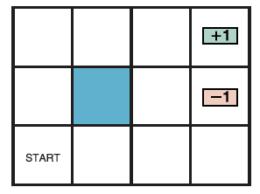
Optimal policy for r>0
r > 0

Slide 28
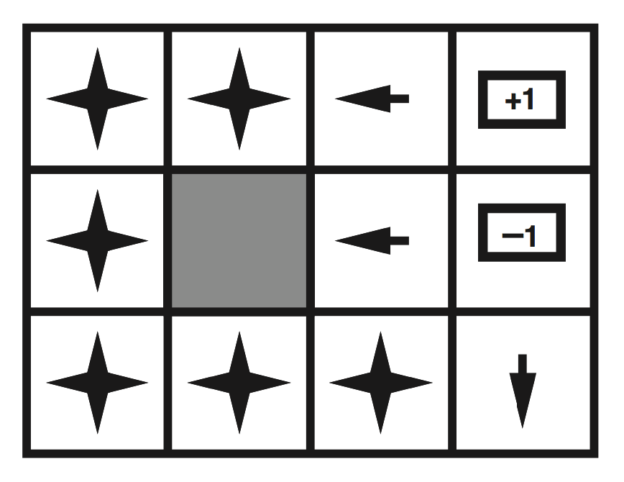
Optimal policy for r>0
r > 0

Slide 29
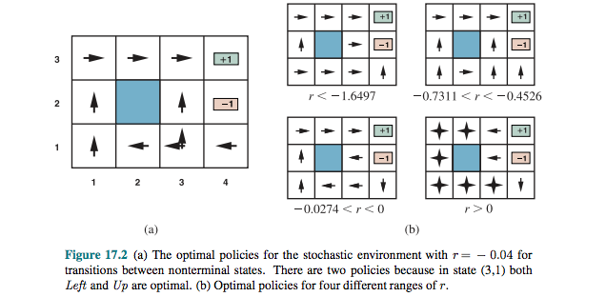
Sample Optimal Policies

Slide 30
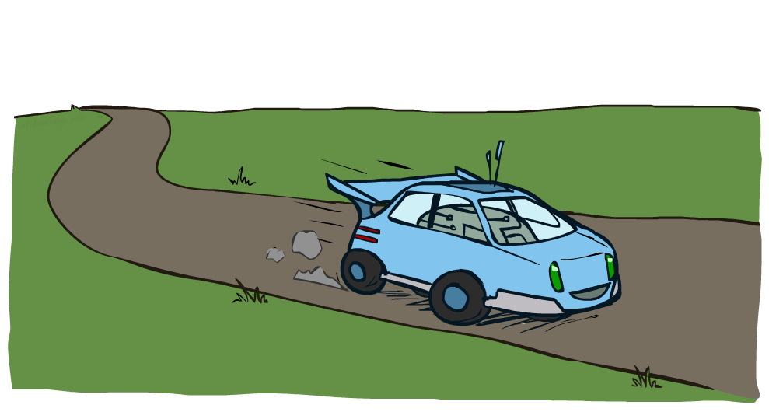
Example: Racing

Slide 31


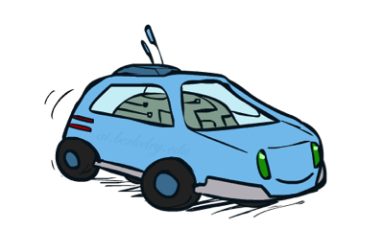
Example: Racing
A robot car wants to travel far, quickly
Three states: Cool, Warm, Overheated
Two actions: Slow, Fast
Going faster gets double reward
0.5
+1
1.0
Fast
Slow
-10
+1
0.5
Warm
Slow
Fast
0.5
+2
Cool
0.5
Overheated
+1
1.0
+2

Slide 32




Racing Search Tree

Slide 33


MDP Search Trees
Each MDP state projects an expectimax-like search tree
s
s is a state
a
(s, a) is a q-state
s, a
(s,a,s’) called a transition
T(s,a,s’) = P(s’|s,a)
R(s,a,s’)
s,a,s’
s’

Slide 34

Utilities of Sequences

Slide 35
Utilities of Sequences
What preferences should an agent have over reward sequences?
More or less?
Now or later?
[1, 2, 2]
or
[2, 3, 4]
[0, 0, 1]
or
[1, 0, 0]

Slide 36




Discounting
It’s reasonable to maximize the sum of rewards
It’s also reasonable to prefer rewards now to rewards later
One solution: values of rewards decay exponentially
Worth Now
Worth Next Step
Worth In Two Steps

Slide 37
Discounting
Worth r now
Worth γr next step
Worth γ²r in two steps
Discounting with γ conveniently solves the problem of infinite reward streams!
  Geometric series: 1 + γ + γ² + … = 1/(1 - γ)
  Assume rewards bounded by ± R_{max}
  Then r₀ + γr₁ + γ²r₂ + … is bounded by ± R_{max}/(1 - γ)
(Another solution: environment contains a terminal state; and agent reaches it with probability 1)

Slide 38

Discounting
How to discount?
  Each time we descend a level, we multiply in the discount once
Why discount?
  Reward now is better than later
  Can also think of it as a 1-gamma chance of ending the process at every step
  Also helps our algorithms converge
Example: discount of 0.5
  U([1,2,3]) = 1*1 + 0.5*2 + 0.25*3
  U([1,2,3]) < U([3,2,1])

Slide 39


Quiz: Discounting
Given:
  Actions: East, West, and Exit (only available in exit states a, e)
  Transitions: deterministic
Quiz 1: For γ = 1, what is the optimal policy?
Quiz 2: For γ = 0.1, what is the optimal policy?
Quiz 3: For which γ are West and East equally good when in state d?
<-
<-
<-
<-
<-
->
1γ=10 γ³

Slide 40
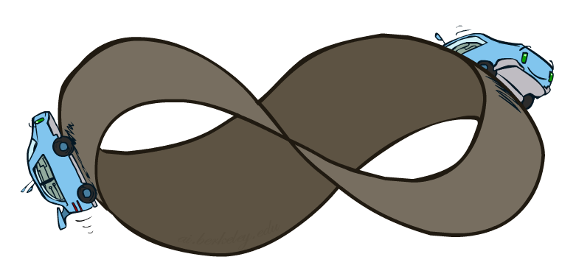
Infinite Utilities?!
Problem: What if the game lasts forever? Do we get infinite rewards?
Solutions:
  Finite horizon: (similar to depth-limited search)
    Terminate episodes after a fixed T steps (e.g. life)
    Gives nonstationary policies (π depends on time left)
Discounting with γ solves the problem of infinite reward streams!
  Geometric series: 1 + γ + γ² + … = 1/(1 - γ)
  Assume rewards bounded by ± R_{max}
  Then r₀ + γr₁ + γ²r₂ + … is bounded by ± R_{max}/(1 - γ)
Absorbing state: guarantee that for every policy, a terminal state will eventually be reached (like “overheated” for racing)

