Slide 1

CS 188: Artificial Intelligence
Markov Decision Processes
Instructor: Angela Liu and Yanlai Yang
University of California, Berkeley
[These slides adapted from Dan Klein and Pieter Abbeel]
Notes:
Please retain proper attribution, including the reference to ai.berkeley.edu. Thanks!

Slide 2





Markov Decision Process (MDP)
An MDP is defined by:
  A set of states s ∈ S
  A set of actions a ∈ A
  A transition model T(s, a, s’)
    Probability that a from s leads to s’, i.e., P(s’| s, a)
  A reward function R(s, a, s’) for each transition
  A start state
  Possibly a terminal state (or absorbing state)
  Utility function which is additive (discounted) rewards
MDPs are fully observable but probabilistic search problems
[Demo – gridworld manual intro (L8D1)]

Slide 3

Policies
A policy π gives an action for each state, π: S → A
In deterministic single-agent search problems, we wanted an optimal plan, or sequence of actions, from start to a goal
For MDPs, we want an optimal policy π*: S → A
  An optimal policy maximizes expected utility
  An explicit policy defines a reflex agent

Slide 4
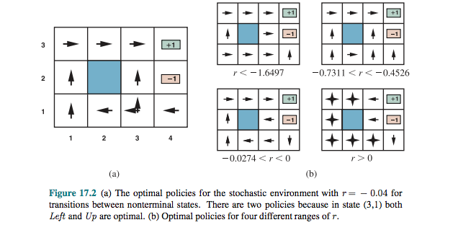
Sample Optimal Policies

Slide 5
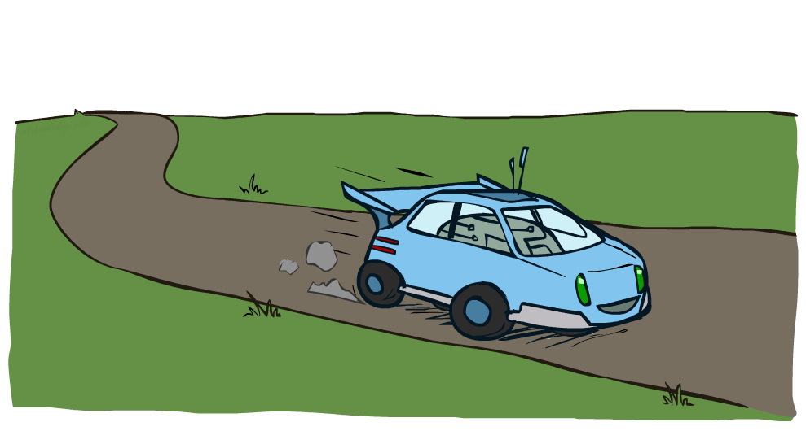
Example: Racing

Slide 6


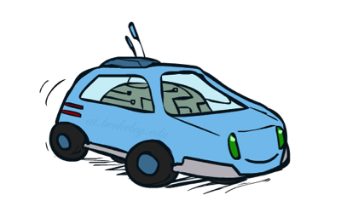
Example: Racing
A robot car wants to travel far, quickly
Three states: Cool, Warm, Overheated
Two actions: Slow, Fast
Going faster gets double reward
0.5
+1
1.0
Fast
Slow
-10
+1
0.5
Warm
Slow
Fast
0.5
+2
Cool
0.5
Overheated
+1
1.0
+2

Slide 7




Racing Search Tree

Slide 8



MDP Search Trees
Each MDP state projects an expectimax-like search tree
s
s is a state
a
(s, a) is a q-state
s, a
(s,a,s’) called a transition
T(s,a,s’) = P(s’|s,a)
R(s,a,s’)
s,a,s’
s’

Slide 9

Utilities of Sequences

Slide 10
Utilities of Sequences
What preferences should an agent have over reward sequences?
More or less?
Now or later?
[1, 2, 2]
or
[2, 3, 4]
[0, 0, 1]
or
[1, 0, 0]

Slide 11




Discounting
It’s reasonable to maximize the sum of rewards
It’s also reasonable to prefer rewards now to rewards later
One solution: values of rewards decay exponentially
Worth Now
Worth Next Step
Worth In Two Steps

Slide 12

Discounting
How to discount?
  Each time we descend a level, we multiply in the discount once
Why discount?
  Reward now is better than later
  Can also think of it as a 1-gamma chance of ending the process at every step
  Also helps our algorithms converge
Example: discount of 0.5
  U([1,2,3]) = 1*1 + 0.5*2 + 0.25*3
  U([1,2,3]) < U([3,2,1])

Slide 13


Quiz: Discounting
Given:
  Actions: East, West, and Exit (only available in exit states a, e)
  Transitions: deterministic
Quiz 1: For γ = 1, what is the optimal policy?
Quiz 2: For γ = 0.1, what is the optimal policy?
Quiz 3: For which γ are West and East equally good when in state d?
<-
<-
<-
<-
<-
->
1γ=10 γ³

Slide 14
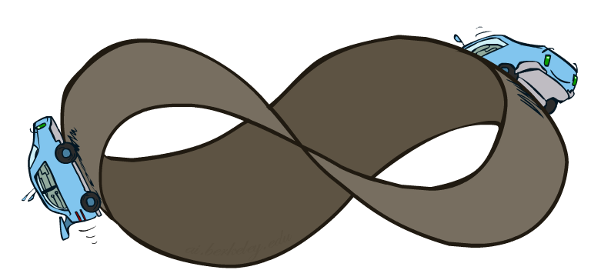
Infinite Utilities?!
Problem: What if the game lasts forever? Do we get infinite rewards?
Solutions:
  Finite horizon: (similar to depth-limited search)
    Terminate episodes after a fixed T steps (e.g. life)
    Gives nonstationary policies (π depends on time left)
Discounting with γ solves the problem of infinite reward streams!
  Geometric series: 1 + γ + γ² + … = 1/(1 - γ)
  Assume rewards bounded by ± R_{max}
  Then r₀ + γr₁ + γ²r₂ + … is bounded by ± R_{max}/(1 - γ)
Absorbing state: guarantee that for every policy, a terminal state will eventually be reached (like “overheated” for racing)

Slide 15
Recap: Defining MDPs
Markov decision processes:
  Set of states S
  Start state s₀
  Set of actions A
  Transitions P(s’|s,a) (or T(s,a,s’))
  Rewards R(s,a,s’) (and discount γ)
MDP quantities so far:
  Policy = Choice of action for each state
  Utility = sum of (discounted) rewards
s
a
s, a
s,a,s’
s’

Slide 16
Solving MDPs

Slide 17
Recall: Racing MDP
A robot car wants to travel far, quickly
Three states: Cool, Warm, Overheated
Two actions: Slow, Fast
Going faster gets double reward
0.5
+1
1.0
Fast
Slow
-10
+1
0.5
Warm
Slow
Fast
0.5
+2
Cool
0.5
Overheated
+1
1.0
+2

Slide 18
Racing Search Tree

Slide 19




Racing Search Tree

Slide 20
Racing Search Tree
We’re doing way too much work with expectimax!
Problem: States are repeated
  Idea: Only compute needed quantities once
Problem: Tree goes on forever
  Idea: Do a depth-limited computation, but with increasing depths until change is small
  Note: deep parts of the tree eventually don’t matter if γ < 1

Slide 21
Optimal Quantities
The value (utility) of a state s:
  V*(s) = expected utility starting in s and acting optimally
The value (utility) of a q-state (s,a):
  Q*(s,a) = expected utility starting out having taken action a from state s and (thereafter) acting optimally
The optimal policy:
  π*(s) = optimal action from state s
s
s is a state
a
(s, a) is a q-state
s, a
s,a,s’
(s,a,s’) is a
transition
s’

Slide 22

The Bellman Equations
How to be optimal:
Step 1: Take correct first action
Step 2: Keep being optimal

Slide 23
Values of States
Recursive definition of value:
s
a
s, a
s,a,s’
s’

Slide 24

Gridworld V* Values
Noise = 0.2
Discount = 0.9
Living reward = 0

Slide 25

Gridworld Q* Values
Noise = 0.2
Discount = 0.9
Living reward = 0

Slide 26





Time-Limited Values
Key idea: time-limited values
Define V_{k}(s) to be the optimal value of s if the game ends in k more time steps
  Equivalently, it’s what a depth-k expectimax would give from s
[Demo – time-limited values (L8D4)]

Slide 27

k=0
Noise = 0.2
Discount = 0.9
Living reward = 0
Notes:
Assuming zero living reward
Values are changing as much as the iterations increase

Slide 28

k=1
Noise = 0.2
Discount = 0.9
Living reward = 0
Notes:
Assuming zero living reward

Slide 29

k=2
Noise = 0.2
Discount = 0.9
Living reward = 0
Notes:
Assuming zero living reward

Slide 30

k=3
Noise = 0.2
Discount = 0.9
Living reward = 0
Notes:
Assuming zero living reward

Slide 31

k=4
Noise = 0.2
Discount = 0.9
Living reward = 0
Notes:
Assuming zero living reward

Slide 32

k=5
Noise = 0.2
Discount = 0.9
Living reward = 0
Notes:
Assuming zero living reward

Slide 33

k=6
Noise = 0.2
Discount = 0.9
Living reward = 0
Notes:
Assuming zero living reward

Slide 34

k=7
Noise = 0.2
Discount = 0.9
Living reward = 0
Notes:
Assuming zero living reward

Slide 35

k=8
Noise = 0.2
Discount = 0.9
Living reward = 0
Notes:
Assuming zero living reward

Slide 36

k=9
Noise = 0.2
Discount = 0.9
Living reward = 0
Notes:
Assuming zero living reward

Slide 37

k=10
Noise = 0.2
Discount = 0.9
Living reward = 0
Notes:
Assuming zero living reward

Slide 38

k=11
Noise = 0.2
Discount = 0.9
Living reward = 0
Notes:
Assuming zero living reward

Slide 39

k=12
Noise = 0.2
Discount = 0.9
Living reward = 0
Notes:
Assuming zero living reward

Slide 40

k=100
Noise = 0.2
Discount = 0.9
Living reward = 0
Notes:
Assuming zero living reward

Slide 41





Computing Time-Limited Values

Slide 42

Value Iteration

Slide 43
Value Iteration
Start with V₀(s) = 0: no time steps left means an expected reward sum of zero
Given vector of V_{k}(s) values, do one ply of expectimax from each state:
Repeat until convergence, which yields V*
Complexity of each iteration: O(S²A)
Theorem: will converge to unique optimal values
  Basic idea: approximations get refined towards optimal values
  Policy may converge long before values do
V_{k+1}(s)
a
s, a
s,a,s’
V_{k}(s’)

Slide 44
Value Iteration
Bellman equations characterize the optimal values:
Value iteration computes them:
V(s)
a
s, a
s,a,s’
V(s’)

Slide 45
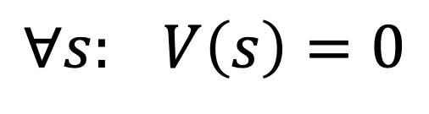
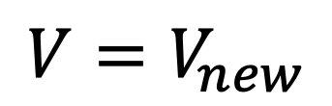
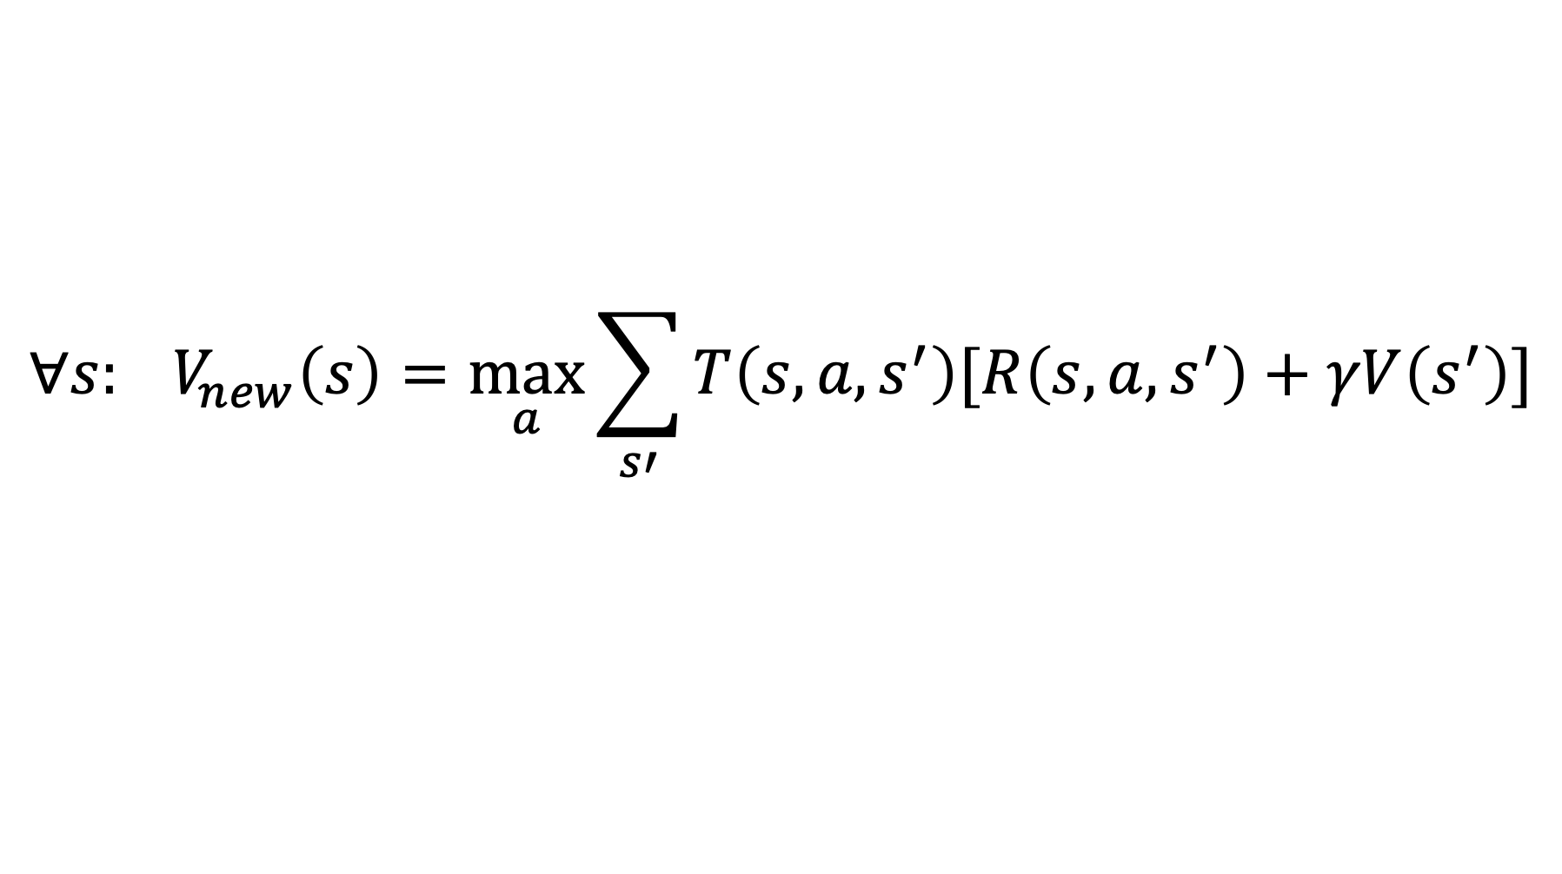
Value Iteration (again ☺ )
s
a
Init:
Iterate:
s, a
$$∀s: V\left(s\right)=0$$
s,a,s’
s’
$$∀s: V_{new}\left(s\right)=\max_{a}{\sum_{s′}{T\left(s,a,s^{′}\right)[R\left(s,a,s^{′}\right)+γV\left(s^{′}\right)]}}$$
$$V=V_{new}$$
Note: can even directly assign to V(s), which will not compute the sequence of V_{k} but will still converge to V*

Slide 46

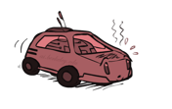

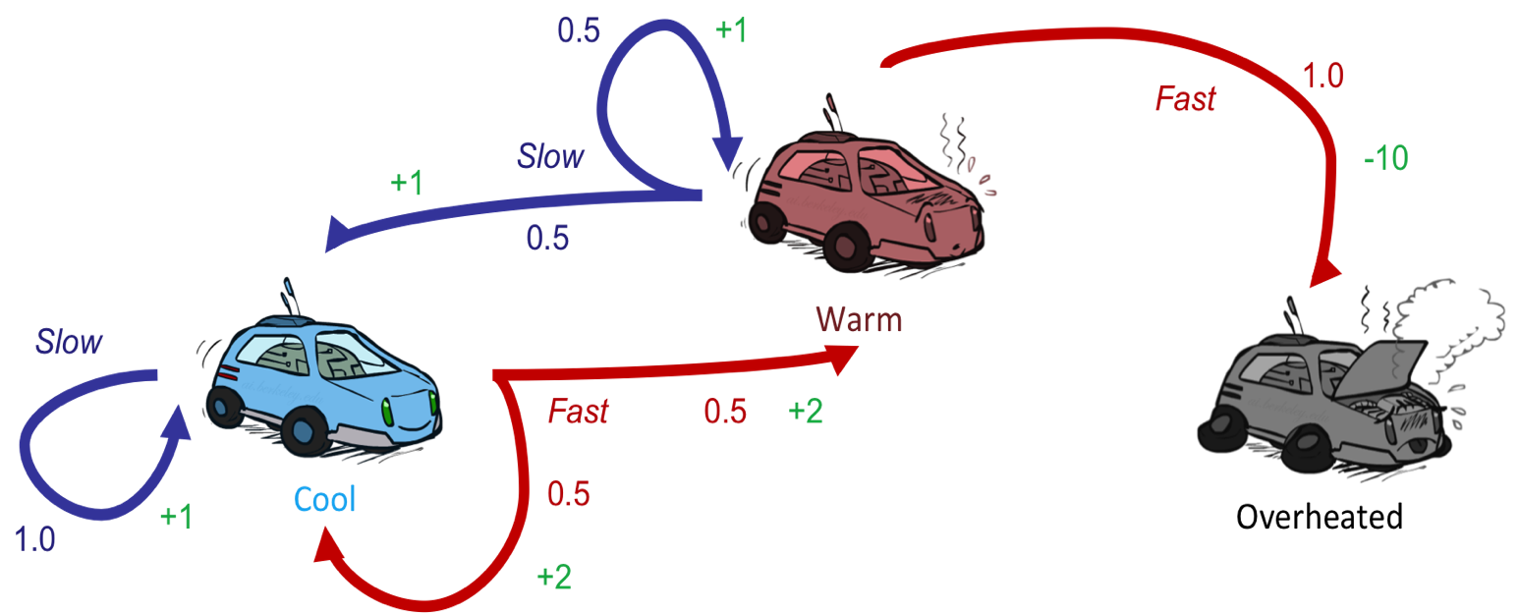



Example: Value Iteration
S: 1
F: .5*2+.5*2=2
Assume no discount!
0 0 0

Slide 47
Example: Value Iteration
2
S: .5*1+.5*1=1
F: -10
Assume no discount!
0 0 0

Slide 48
Example: Value Iteration
2
1
0
Assume no discount!
0 0 0
Notes:
At overheated, there is nowhere to go so this is the terminal state that just has value 0

Slide 49
Example: Value Iteration
S: 1+2=3
F: .5*(2+2)+.5*(2+1)=3.5
2
1
0
Assume no discount!
0 0 0

Slide 50
Example: Value Iteration
3.5
2.5
0
2
1
0
Assume no discount!
0 0 0

Slide 51


Convergence*
How do we know the V_{k} vectors are going to converge? (assuming 0 < γ < 1)
Proof Sketch:
  For any state V_{k} and V_{k+1} can be viewed as depth k+1 expectimax results in nearly identical search trees
  The difference is that on the bottom layer, V_{k+1} has actual rewards while V_{k} has zeros
  That last layer is at best all R_{MAX}
  It is at worst R_{MIN}
  But everything is discounted by γ^{k} that far out
  So V_{k} and V_{k+1} are at most γ^{k} max|R| different
  So as k increases, the values converge

Slide 52
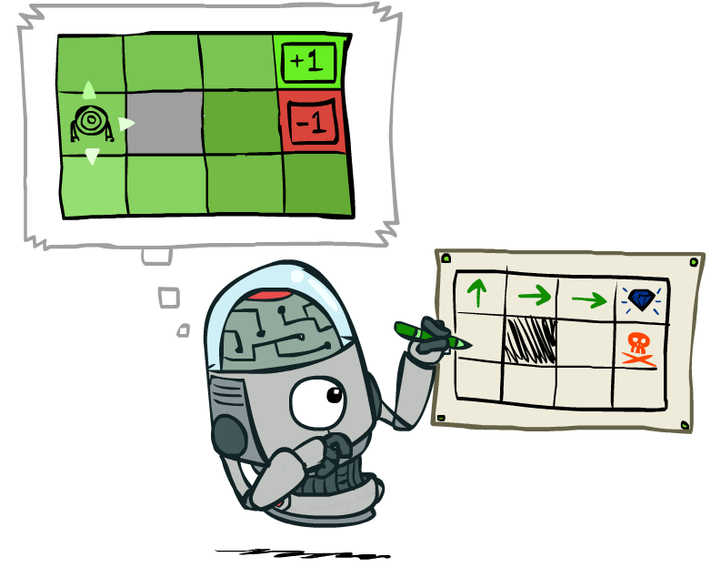
Policy Extraction

Slide 53
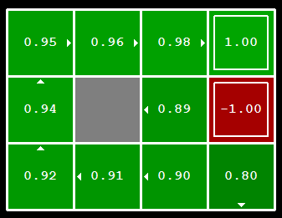


Computing Actions from Values
Let’s imagine we have the optimal values V*(s)
How should we act?
  It’s not obvious!
We need to do a mini-expectimax (one step)
This is called policy extraction, since it gets the policy implied by the values

Slide 54
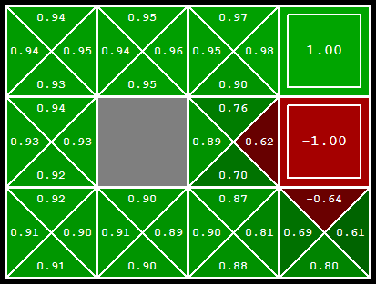
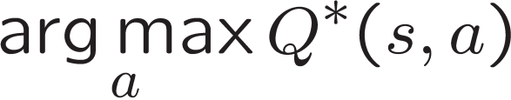
Computing Actions from Q-Values
Let’s imagine we have the optimal
q-values:
How should we act?
  Completely trivial to decide!
Important lesson: actions are easier to select from q-values than values!

Slide 55
Problems with Value Iteration
Value iteration repeats the Bellman updates:
Problem 1: It’s slow – O(S²A) per iteration
Problem 2: The “max” at each state rarely changes
Problem 3: The policy often converges long before the values
s
a
s, a
s,a,s’
s’

Slide 56
k=12
Noise = 0.2
Discount = 0.9
Living reward = 0
Notes:
Assuming zero living reward

Slide 57
k=100
Noise = 0.2
Discount = 0.9
Living reward = 0
Notes:
Assuming zero living reward

