Slide 1

CS 188: Artificial Intelligence
Markov Decision Processes II
Instructor: Angela Liu and Yanlai Yang
University of California, Berkeley
[These slides adapted from Dan Klein and Pieter Abbeel]
Notes:
Please retain proper attribution, including the reference to ai.berkeley.edu. Thanks!

Slide 2
Values of States
Recursive definition of value:
s
a
s, a
s,a,s’
s’

Slide 3
Value Iteration
Start with V₀(s) = 0: no time steps left means an expected reward sum of zero
Given vector of V_{k}(s) values, do one ply of expectimax from each state:
Repeat until convergence, which yields V*
Complexity of each iteration: O(S²A)
Theorem: will converge to unique optimal values
  Basic idea: approximations get refined towards optimal values
  Policy may converge long before values do
V_{k+1}(s)
a
s, a
s,a,s’
V_{k}(s’)

Slide 4

k=0
Noise = 0.2
Discount = 0.9
Living reward = 0
Notes:
Assuming zero living reward
Values are changing as much as the iterations increase

Slide 5

k=1
Noise = 0.2
Discount = 0.9
Living reward = 0
Notes:
Assuming zero living reward

Slide 6

k=2
Noise = 0.2
Discount = 0.9
Living reward = 0
Notes:
Assuming zero living reward

Slide 7

k=3
Noise = 0.2
Discount = 0.9
Living reward = 0
Notes:
Assuming zero living reward

Slide 8

k=4
Noise = 0.2
Discount = 0.9
Living reward = 0
Notes:
Assuming zero living reward

Slide 9

k=5
Noise = 0.2
Discount = 0.9
Living reward = 0
Notes:
Assuming zero living reward

Slide 10

k=6
Noise = 0.2
Discount = 0.9
Living reward = 0
Notes:
Assuming zero living reward

Slide 11

k=7
Noise = 0.2
Discount = 0.9
Living reward = 0
Notes:
Assuming zero living reward

Slide 12

k=8
Noise = 0.2
Discount = 0.9
Living reward = 0
Notes:
Assuming zero living reward

Slide 13

k=9
Noise = 0.2
Discount = 0.9
Living reward = 0
Notes:
Assuming zero living reward

Slide 14

k=10
Noise = 0.2
Discount = 0.9
Living reward = 0
Notes:
Assuming zero living reward

Slide 15

k=11
Noise = 0.2
Discount = 0.9
Living reward = 0
Notes:
Assuming zero living reward

Slide 16

k=12
Noise = 0.2
Discount = 0.9
Living reward = 0
Notes:
Assuming zero living reward

Slide 17

k=100
Noise = 0.2
Discount = 0.9
Living reward = 0
Notes:
Assuming zero living reward

Slide 18
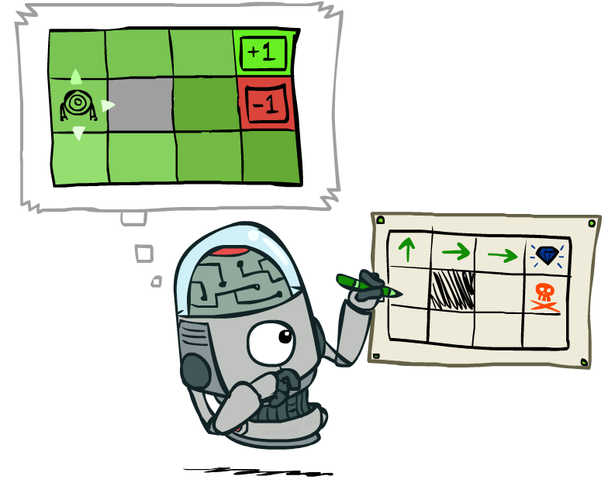
Policy Extraction

Slide 19
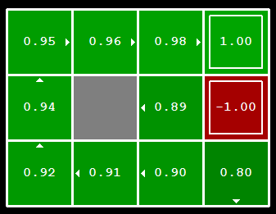


Computing Actions from Values
Let’s imagine we have the optimal values V*(s)
How should we act?
  It’s not obvious!
We need to do a mini-expectimax (one step)
This is called policy extraction, since it gets the policy implied by the values

Slide 20
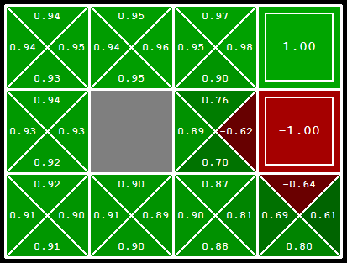
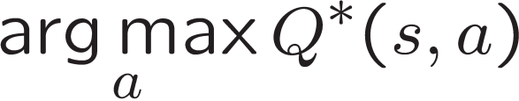
Computing Actions from Q-Values
Let’s imagine we have the optimal
q-values:
How should we act?
  Completely trivial to decide!
Important lesson: actions are easier to select from q-values than values!

Slide 21
Problems with Value Iteration
Value iteration repeats the Bellman updates:
Problem 1: It’s slow – O(S²A) per iteration
Problem 2: The “max” at each state rarely changes
Problem 3: The policy often converges long before the values
s
a
s, a
s,a,s’
s’
Notes:
Demo steps through value iteration; snapshots of values shown on next slides.

Slide 22
k=12
Noise = 0.2
Discount = 0.9
Living reward = 0
Notes:
Assuming zero living reward

Slide 23
k=100
Noise = 0.2
Discount = 0.9
Living reward = 0
Notes:
Assuming zero living reward

Slide 24
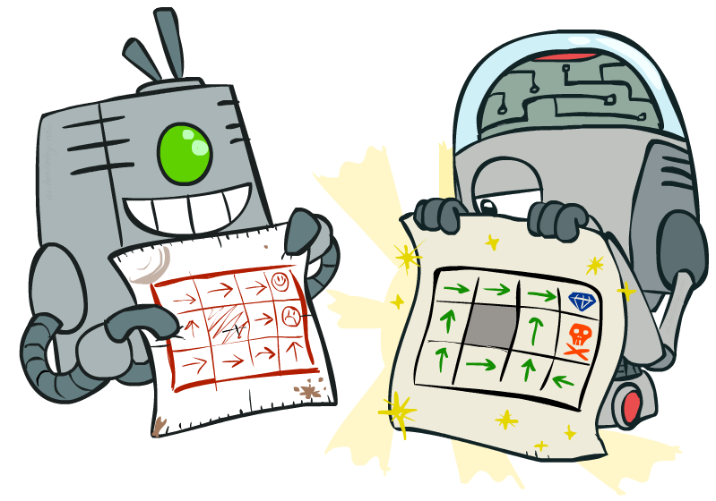
Policy Methods

Slide 25
Policy Iteration
Alternative approach for optimal values:
  Step 1: Policy Evaluation: calculate utilities for some fixed policy (not optimal utilities!) until convergence
  Step 2: Policy Improvement: update policy using one-step look-ahead with resulting converged (but not optimal!) utilities as future values
  Repeat steps until policy converges
This is Policy Iteration
  It’s still optimal!
  Can converge (much) faster under some conditions

Slide 26

Policy Evaluation

Slide 27
Fixed Policies
Do the optimal action
Do what π says to do
s
s
a
π(s)
s, a
s, π(s)
s,a,s’
s, π(s),s’
s’
s’
Expectimax trees max over all actions to compute the optimal values
If we fixed some policy π(s), then the tree would be simpler – only one action per state
  … though the tree’s value would depend on which policy we fixed

Slide 28
Utilities for a Fixed Policy
Another basic operation: compute the utility of a state s under a fixed (generally non-optimal) policy
Define the utility of a state s, under a fixed policy π:
  V^{π}(s) = expected total discounted rewards starting in s and following π
Recursive relation (one-step look-ahead / Bellman equation):
s
π(s)
s, π(s)
s, π(s),s’
s’

Slide 29

Policy Evaluation
s
How do we calculate the V’s for a fixed policy π?
Idea 1: Turn recursive Bellman equations into updates
(like value iteration)
Efficiency: O(S²) per iteration
Idea 2: Without the maxes, the Bellman equations are just a linear system
  Solve with Matlab (or your favorite linear system solver)
π(s)
s, π(s)
s, π(s),s’
s’

Slide 30
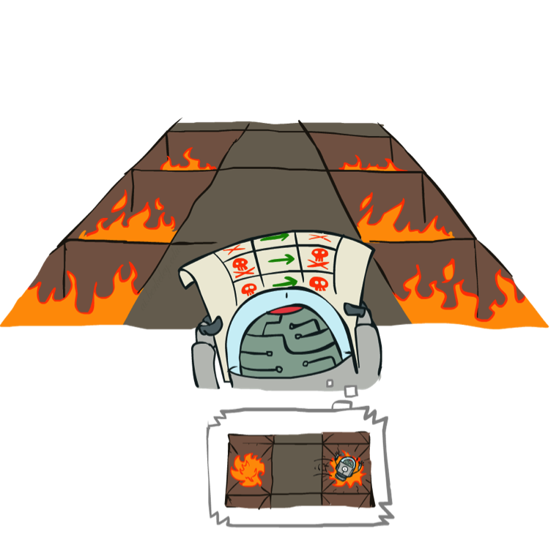
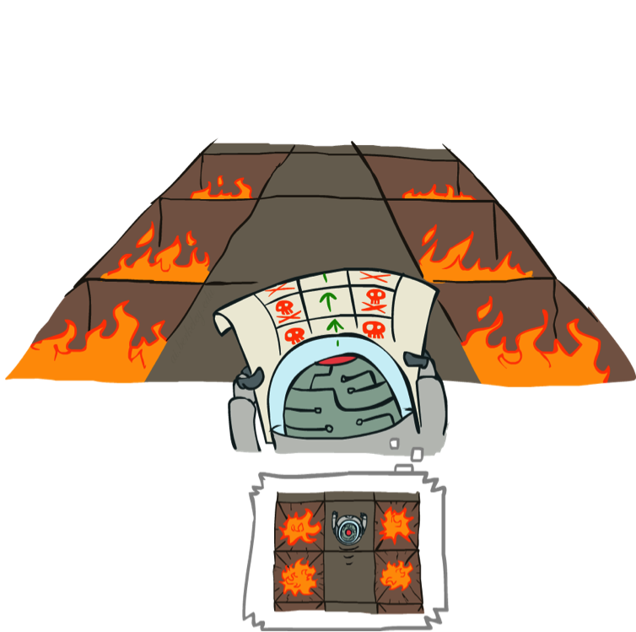
Example: Policy Evaluation
Always Go Right
Always Go Forward

Slide 31
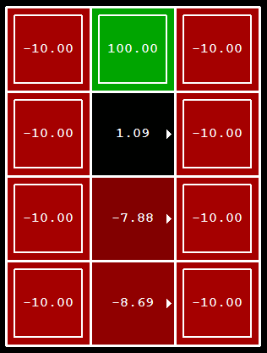
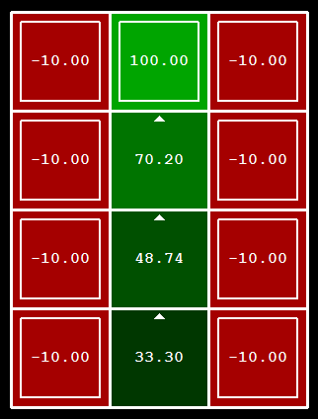
Example: Policy Evaluation
Always Go Right
Always Go Forward

Slide 32

Policy Iteration

Slide 33
Policy Iteration
Evaluation: For fixed current policy π, find values with policy evaluation:
  Iterate until values converge:
Improvement: For fixed values, get a better policy using policy extraction
  One-step look-ahead:

Slide 34

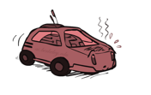

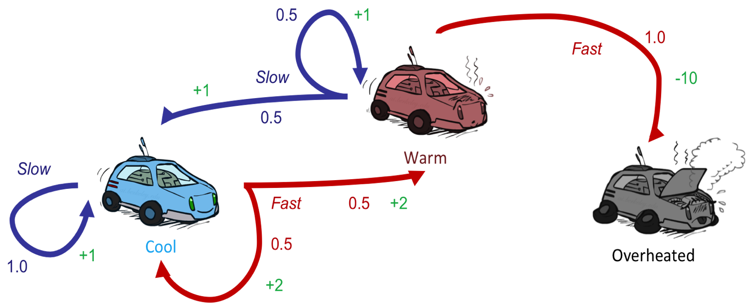











Example: Policy Iteration
$$π_{0}$$
$$S$$
$$F$$
$$∅$$
Policy Evaluation:
$$V^{π_{0}}\left(B\right)=1+0.9⋅V^{π_{0}}(B)$$
$${→V}^{π_{0}}\left(B\right)=10$$
$$V^{π_{0}}\left(W\right)=−10+0.9⋅V^{π_{0}}(O)$$
$${→V}^{π_{0}}\left(W\right)=−10$$
$$V^{π_{0}}\left(O\right)=0$$
Assume discount = 0.9
Policy Improvement:
$$S: 1+0.9⋅10=10$$
$$π_{1}$$
$$F: 0.5\left(2+0.9⋅10\right)+0.5\left(2+0.9⋅−10\right)=0$$

Slide 35




Example: Policy Iteration
$$π_{0}$$
$$S$$
$$F$$
$$∅$$
Policy Evaluation:
$$V^{π_{0}}\left(B\right)=1+0.9⋅V^{π_{0}}(B)$$
$${→V}^{π_{0}}\left(B\right)=10$$
$$V^{π_{0}}\left(W\right)=−10+0.9⋅V^{π_{0}}(O)$$
$${→V}^{π_{0}}\left(W\right)=−10$$
$$V^{π_{0}}\left(O\right)=0$$
Assume discount = 0.9
Policy Improvement:
$$S: 0.5\left(1+0.9⋅10\right)+0.5\left(1+0.9⋅−10\right)=0$$
$$π_{1}$$
$$S$$
$$S$$
$$∅$$
$$F:−10+0.9⋅0=−10$$

Slide 36




Example: Policy Iteration
$$π_{1}$$
$$S$$
$$S$$
$$∅$$
Policy Evaluation:
$$V^{π_{0}}\left(B\right)=1+0.9⋅V^{π_{0}}(B)$$
$${→V}^{π_{0}}\left(B\right)=10$$
$$V^{π_{0}}\left(W\right)=0.5\left(1+0.9⋅V^{π_{0}}\left(B\right)\right)+0.5\left(1+0.9⋅V^{π_{0}}\left(W\right)\right)$$
$${→V}^{π_{0}}\left(W\right)=10$$
$$V^{π_{0}}\left(O\right)=0$$
Assume discount = 0.9
Policy Improvement:
$$S: 1+0.9⋅10=10$$
$$π_{2}$$
$$F: 0.5\left(2+0.9⋅10\right)+0.5\left(2+0.9⋅10\right)=11$$

Slide 37

Example: Policy Iteration
$$π_{1}$$
$$S$$
$$S$$
$$∅$$
Policy Evaluation:
$$V^{π_{0}}\left(B\right)=1+0.9⋅V^{π_{0}}(B)$$
$${→V}^{π_{0}}\left(B\right)=10$$
$$V^{π_{0}}\left(W\right)=0.5\left(1+0.9⋅V^{π_{0}}\left(B\right)\right)+0.5\left(1+0.9⋅V^{π_{0}}\left(W\right)\right)$$
$${→V}^{π_{0}}\left(W\right)=10$$
$$V^{π_{0}}\left(O\right)=0$$
Assume discount = 0.9
Policy Improvement:
$$S: 0.5\left(1+0.9⋅10\right)+0.5\left(1+0.9⋅10\right)=10$$
$$π_{2}$$
$$F$$
$$S$$
$$∅$$
$$F:−10+0.9⋅0=−10$$

Slide 38






Example: Policy Iteration
$$π_{2}$$
$$F$$
$$S$$
$$∅$$
Policy Evaluation:
$${→V}^{π_{0}}\left(B\right)=15.5$$
$$V^{π_{0}}\left(B\right)=0.5\left(2+0.9⋅V^{π_{0}}\left(B\right)\right)+0.5\left(2+0.9⋅V^{π_{0}}\left(W\right)\right)$$
$$V^{π_{0}}\left(W\right)=0.5\left(1+0.9⋅V^{π_{0}}\left(B\right)\right)+0.5\left(1+0.9⋅V^{π_{0}}\left(W\right)\right)$$
$${→V}^{π_{0}}\left(W\right)=14.5$$
$$V^{π_{0}}\left(O\right)=0$$
Assume discount = 0.9
Policy Improvement:
$$S: 1+0.9⋅15.5=14.95$$
$$π_{3}$$
$$F: 0.5\left(2+0.9⋅15.5\right)+0.5\left(2+0.9⋅14.5\right)=15.5$$

Slide 39
Example: Policy Iteration
$$π_{2}$$
$$F$$
$$S$$
$$∅$$
Policy Evaluation:
$${→V}^{π_{0}}\left(B\right)=15.5$$
$$V^{π_{0}}\left(B\right)=0.5\left(2+0.9⋅V^{π_{0}}\left(B\right)\right)+0.5\left(2+0.9⋅V^{π_{0}}\left(W\right)\right)$$
$$V^{π_{0}}\left(W\right)=0.5\left(1+0.9⋅V^{π_{0}}\left(B\right)\right)+0.5\left(1+0.9⋅V^{π_{0}}\left(W\right)\right)$$
$${→V}^{π_{0}}\left(W\right)=14.5$$
$$V^{π_{0}}\left(O\right)=0$$
Assume discount = 0.9
Policy Improvement:
$$S: 0.5\left(1+0.9⋅15.5\right)+0.5\left(1+0.9⋅14.5\right)=14.5$$
$$π_{3}$$
$$F$$
$$S$$
$$∅$$
$$F:−10+0.9⋅0=−10$$

Slide 40






















Example: Value Iteration
$$V_{0}$$
$$0$$
$$0$$
$$0$$
$$V_{1}$$
$$2$$
$$1$$
$$0$$
$$V_{2}$$
$$3.35$$
$$2.35$$
$$0$$
Assume discount = 0.9
$$V_{3}$$
$$4.565$$
$$3.565$$
$$0$$
$$V_{4}$$
$$5.6585$$
$$4.6585$$
$$0$$
$$…$$
$$V_{91}$$
$$15.499$$
$$14.499$$
$$0$$

Slide 41
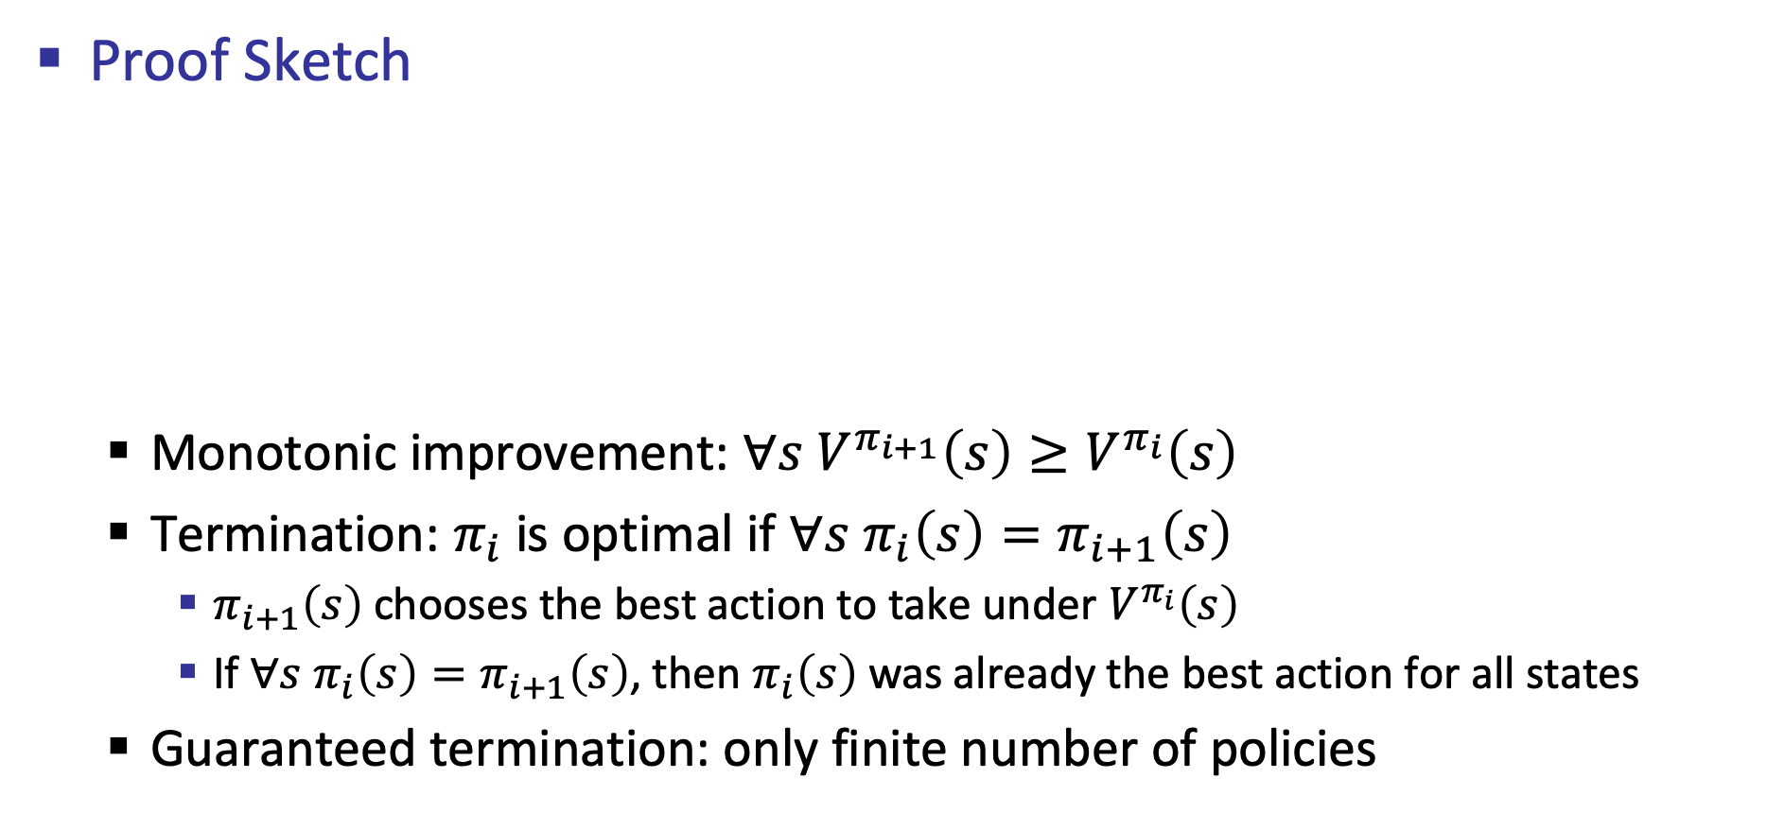
Convergence*
Proof Sketch
  Monotonic improvement: $∀s V^{π_{i+1}}\left(s\right)≥V^{π_{i}}\left(s\right)$
  Termination: $π_{i}$ is optimal if $∀s π_{i}\left(s\right)=π_{i+1}\left(s\right)$
    $π_{i+1}\left(s\right)$ chooses the best action to take under $V^{π_{i}}\left(s\right)$
    If $∀s π_{i}\left(s\right)=π_{i+1}\left(s\right)$, then $π_{i}\left(s\right)$ was already the best action for all states
  Guaranteed termination: only finite number of policies

Slide 42
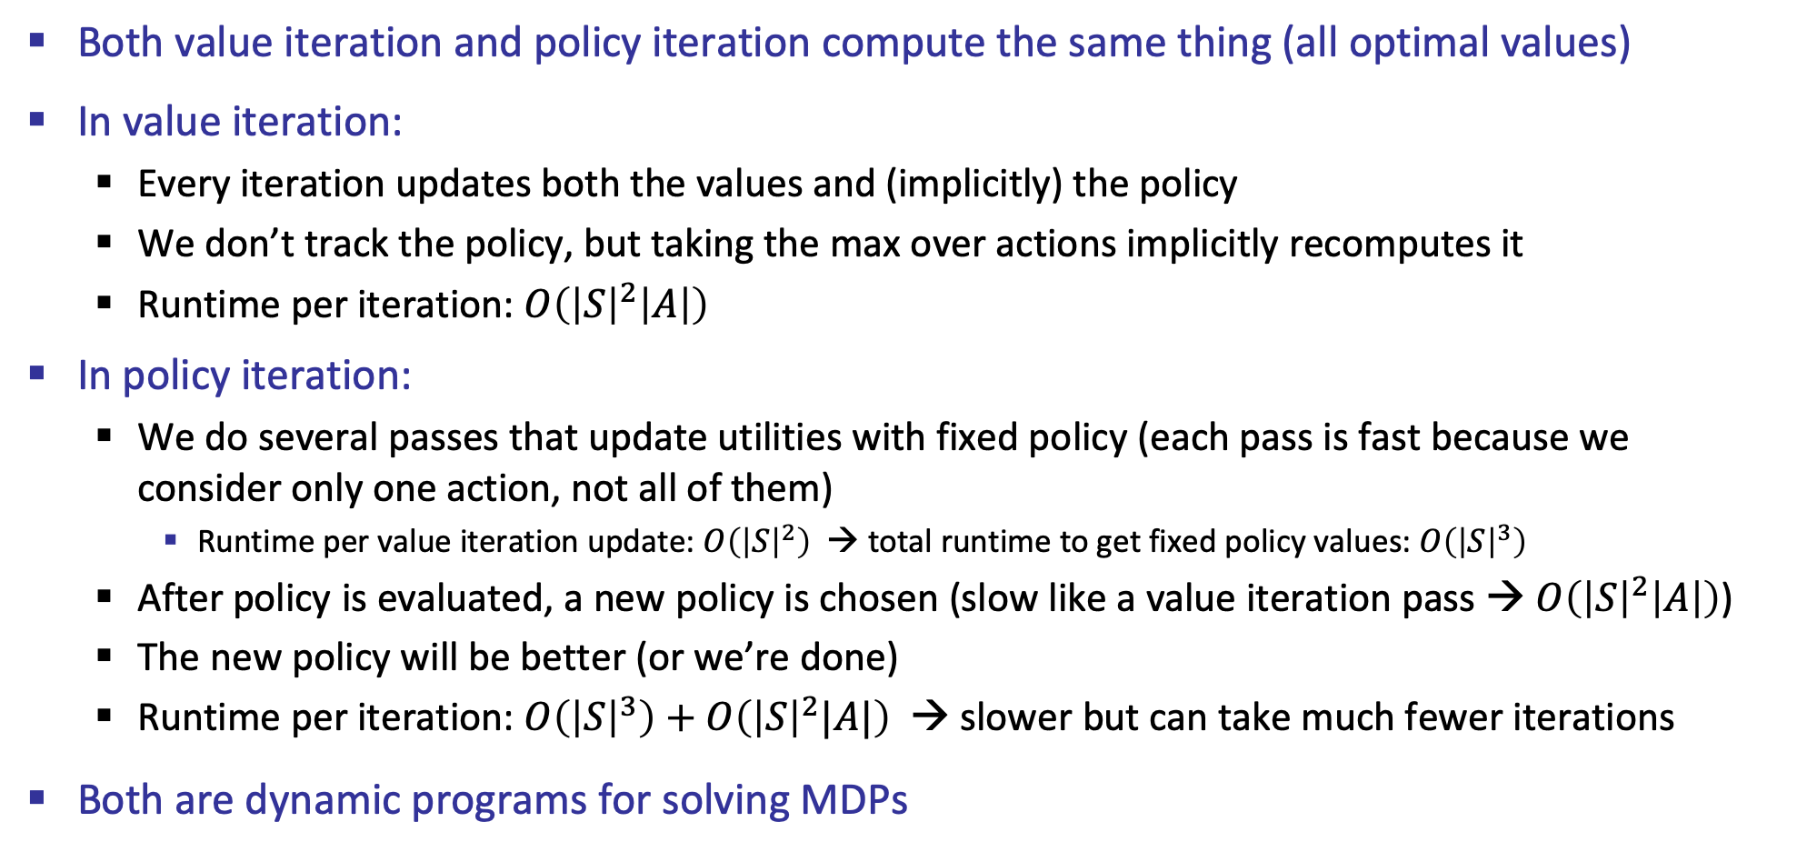
Comparison
Both value iteration and policy iteration compute the same thing (all optimal values)
In value iteration:
  Every iteration updates both the values and (implicitly) the policy
  We don’t track the policy, but taking the max over actions implicitly recomputes it
  Runtime per iteration: $O\left({\left|S\right|}^{2}\left|A\right|\right)$
In policy iteration:
  We do several passes that update utilities with fixed policy (each pass is fast because we consider only one action, not all of them)
    Runtime per value iteration update: $O\left({\left|S\right|}^{2}\right)$ → total runtime to get fixed policy values: $O\left({\left|S\right|}^{3}\right)$
  After policy is evaluated, a new policy is chosen (slow like a value iteration pass → $O\left({\left|S\right|}^{2}\left|A\right|\right)$)
  The new policy will be better (or we’re done)
  Runtime per iteration: $O\left({\left|S\right|}^{3}\right)+O\left({\left|S\right|}^{2}|A|\right)$ → slower but can take much fewer iterations
Both are dynamic programs for solving MDPs

Slide 43
Summary: MDP Algorithms
So you want to….
  Compute optimal values: use value iteration or policy iteration
  Compute values for a particular policy: use policy evaluation
  Turn your values into a policy: use policy extraction (one-step lookahead)
These all look the same!
  They basically are – they are all variations of Bellman updates
  They all use one-step lookahead expectimax fragments
  They differ only in whether we plug in a fixed policy or max over actions

