Slide 1
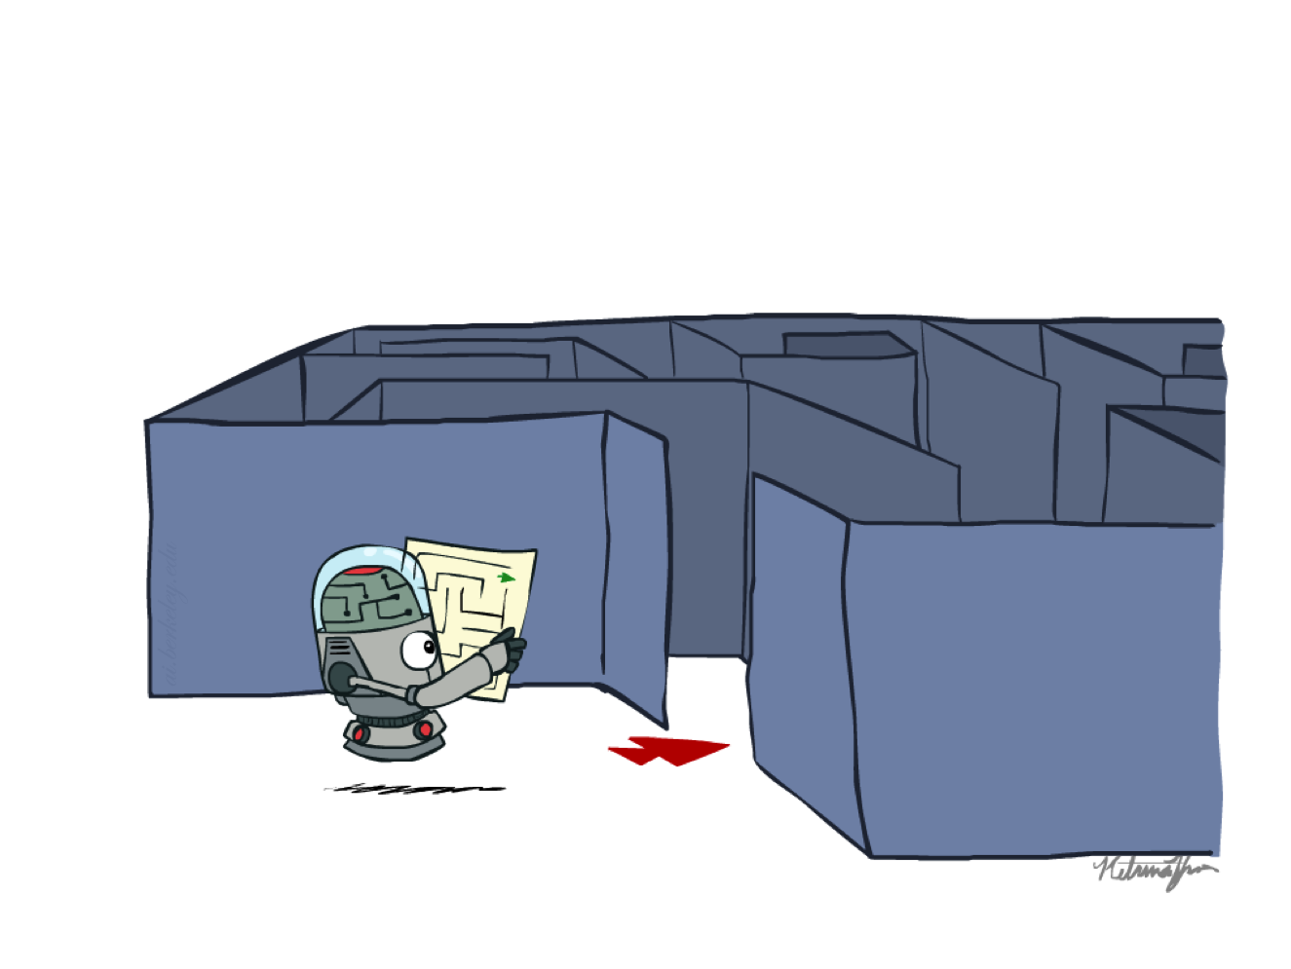
CS 188: Artificial Intelligence
Search
Instructors: Angela Liu and Yanlai Yang
University of California, Berkeley
[slides adapted from Dan Klein, Pieter Abbeel, Stuart Russel, Dawn Song]
Notes:
Please retain proper attribution, including the reference to ai.berkeley.edu. Thanks!

Slide 2
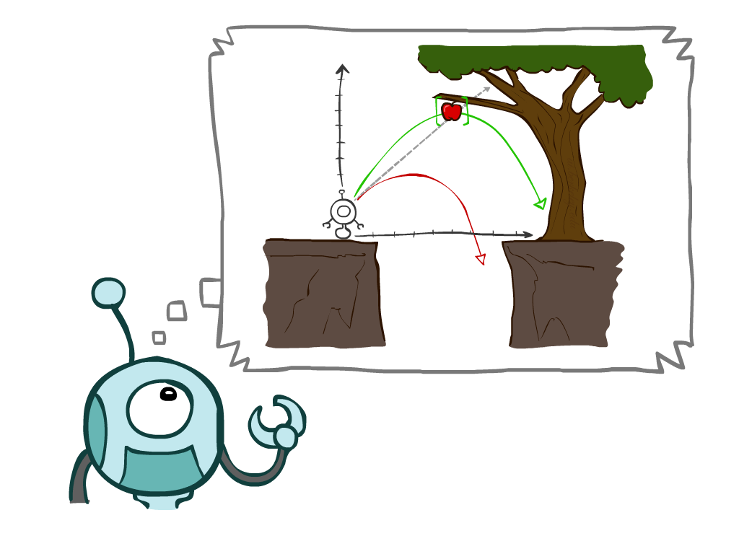
Today
Finish discussion of agents and environments
Search Problems
Uninformed Search Methods
  Depth-First Search
  Breadth-First Search
  Uniform-Cost Search
Notes:
General theme in the class:
A goal we have in mind.
A mathematical abstraction to formalize this
Algorithms that operate on these abstractions

Slide 3
Environment types
 | Pacman | Backgammon | Diagnosis | Taxi
Fully or partially observable
Single-agent or multiagent
Deterministic or stochastic
Static or dynamic
Discrete or continuous
Known physics?
Known perf. measure?

Slide 4
Agent design
The environment type largely determines the agent design
  Partially observable => agent requires memory (internal state)
  Stochastic => agent may have to prepare for contingencies
  Multi-agent => agent may need to behave randomly
  Static => agent has time to compute a rational decision
  Continuous time => continuously operating controller
  Unknown physics => need for exploration
  Unknown perf. measure => observe/interact with human principal

Slide 5
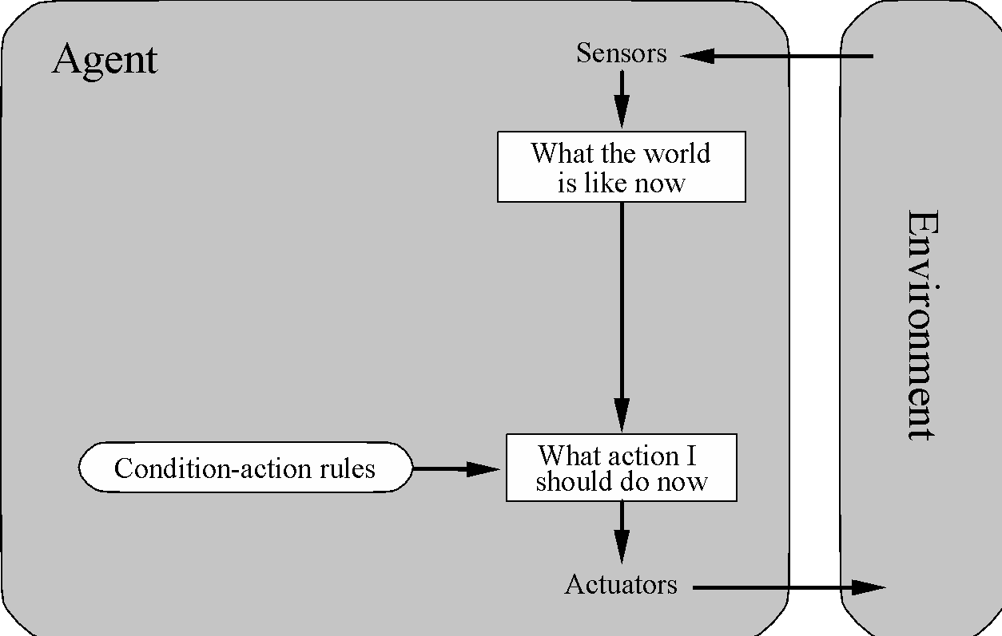
Simple reflex agents

Slide 6
Pacman agent program in Python
class GoWestAgent(Agent):
def getAction(self, percept):
if Directions.WEST in percept.getLegalPacmanActions():
return Directions.WEST
else:
return Directions.STOP

Slide 7
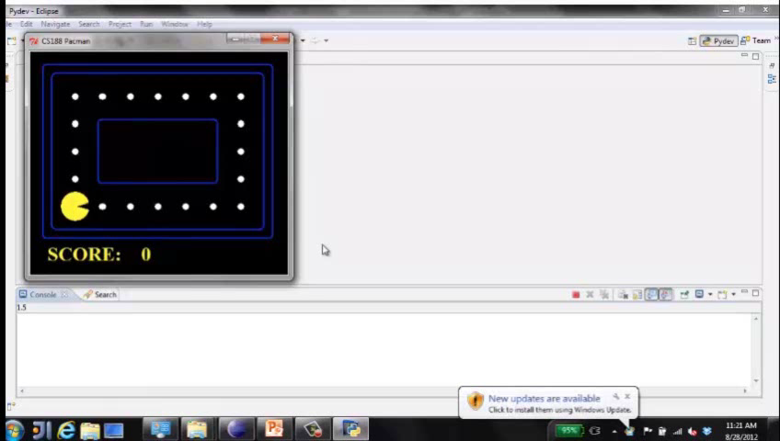
Eat adjacent dot, if any
Notes:
Optimal in some environments!

Slide 8
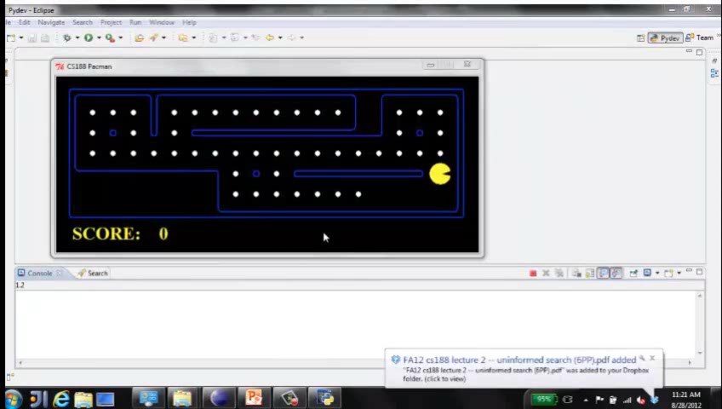
Eat adjacent dot, if any
Notes:
Not so great in others

Slide 9
Pacman agent contd.
Can we (in principle) extend this reflex agent to behave well in all standard Pacman environments?
  No – Pacman is not quite fully observable (power pellet duration)
  Otherwise, yes – we can (in principle) make a lookup table…..
  How large would it be?
Notes:
106 locations so 106^3 * 2^106 (ignoring power pellet stuff) =~ 10^38 states
Worse if the map is not fixed – all possible physics? No – can simply say 3^150 or whatever

Slide 10
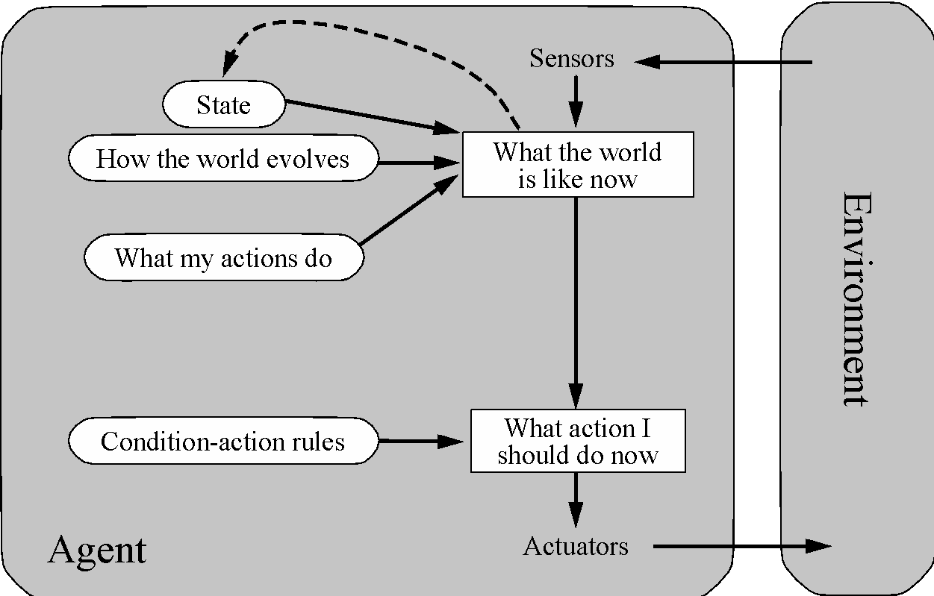
Model-based agents

Slide 11
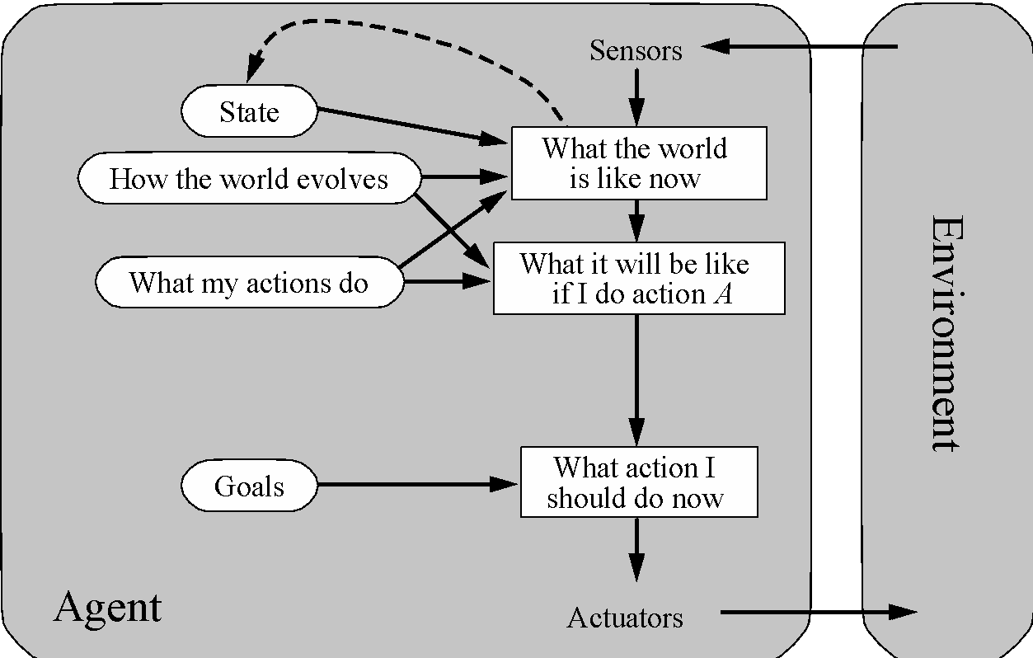
Goal-based agents
Notes:
Act to achieve a goal
Pro: use goal to index into actions that might achieve it, eg “Have milk” -> “buy milk”
Con: cannot handle tradeoffs among goals, failure probability etc.

Slide 12
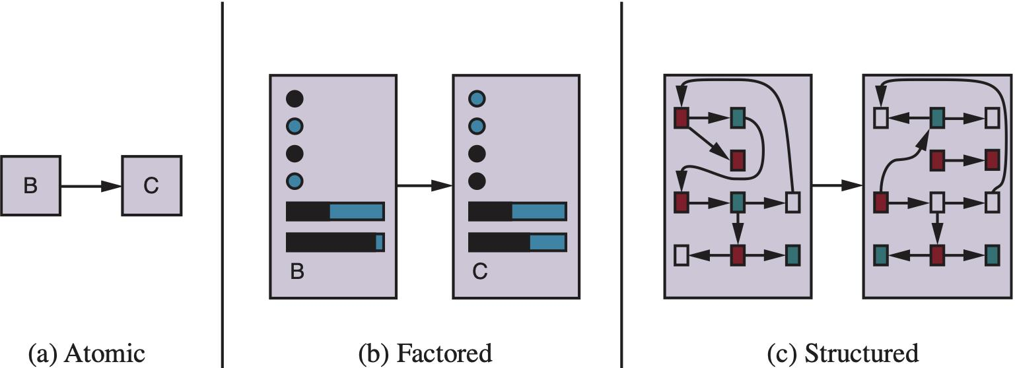
Spectrum of representations

Slide 13
Outline of the course
unknown
RL
known
deterministic
stochastic
atomic
Search
MDPs
factored
CSPs
Bayes nets
structured
First-order logic

Slide 14
CS 188: Artificial Intelligence
Search
Instructors: Angela Liu and Yanlai Yang
University of California, Berkeley
[slides adapted from Dan Klein, Pieter Abbeel, Stuart Russel, Dawn Song]
Notes:
Please retain proper attribution, including the reference to ai.berkeley.edu. Thanks!

Slide 15
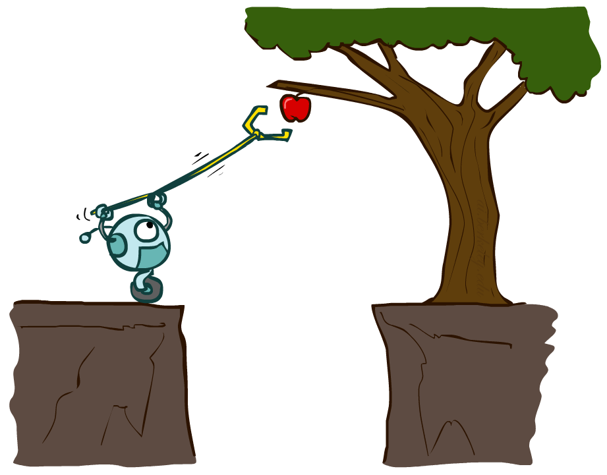
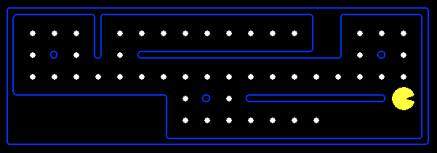
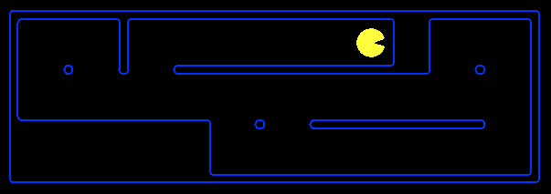
Planning Agents
Planning agents decide based on evaluating future action sequences
Search algorithms typically assume
  Known, deterministic transition model
  Discrete states and actions
  Fully observable
  Atomic representation
Usually have a definite goal
Optimal: Achieve goal at least cost

Slide 16
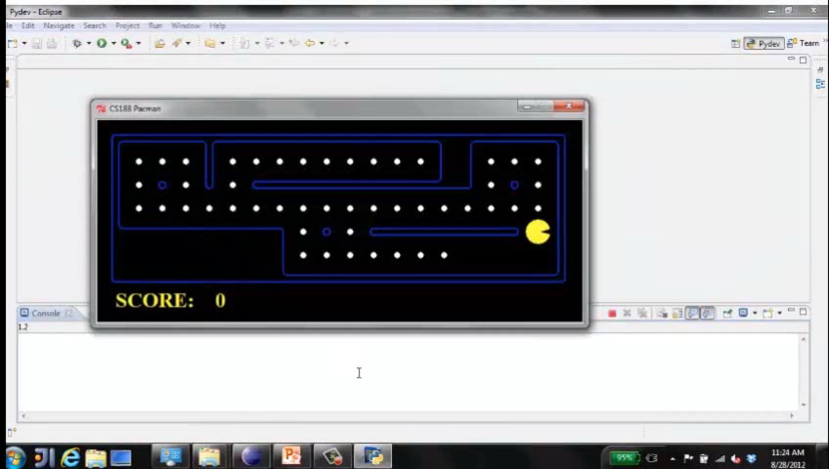
Move to nearest dot and eat it
Notes:
“Move to nearest dot” requires repeated invocation of a search algorithm. It’s good but not perfect. Remember that final score: 907

Slide 17
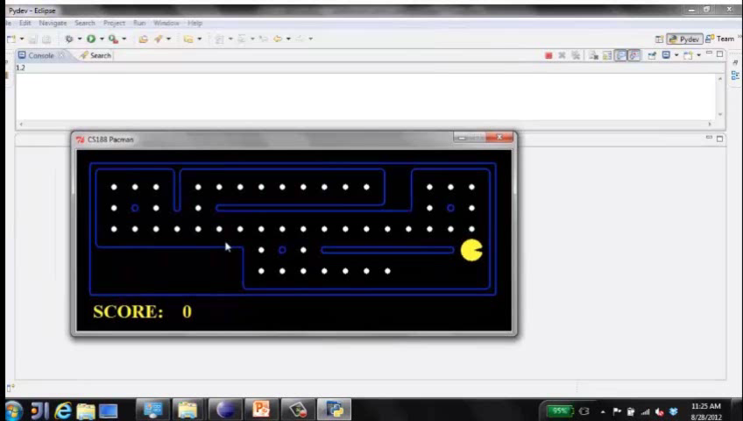
Precompute optimal plan, execute it
Notes:
All computation done up front: slower, but better: 914.

Slide 18

Search Problems

Slide 19

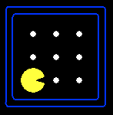





Search Problems
A search problem consists of:
  A state space S
  An initial state s₀
  Actions A(s) in each state
  Transition model Result(s,a)
  A goal test G(s)
    s has no dots left
  Action cost c(s,a,s’)
    +1 per step; -10 food; -500 win; +500 die; -200 eat ghost
A solution is an action sequence that reaches a goal state
An optimal solution has least cost among all solutions
-9
N
E
-9
Notes:
Often comes back on exams
Goal test – sometimes more than one state that satisfies having achieved the goal, for example, “eat all the dots”
Abstraction

Slide 20

Search Problems Are Models

Slide 21
Example: Traveling in Romania
State space:
  Cities
Initial state:
  Arad
Actions:
  Go to adjacent city
Transition model:
  Reach adjacent city
Goal test:
  s = Bucharest?
Action cost:
  Road distance from s to s’
Solution?

Slide 22
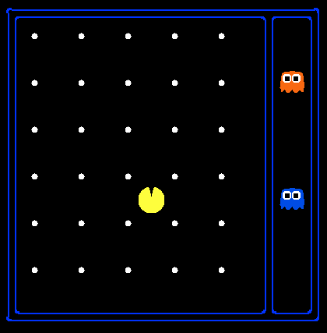
State Space Sizes
World state:
  Agent positions: 120
  Food count: 30
  Ghost positions: 12
  Agent facing: NSEW
How many
  World states?
  120x(2³⁰)x(12²)x4
  States for pathing?
  120
  States for eat-all-dots?
  120x(2³⁰)
Notes:
90 * (2^30-1) + 30 * 2^29 = 145 billion
2^29 = 536 870 912

Slide 23
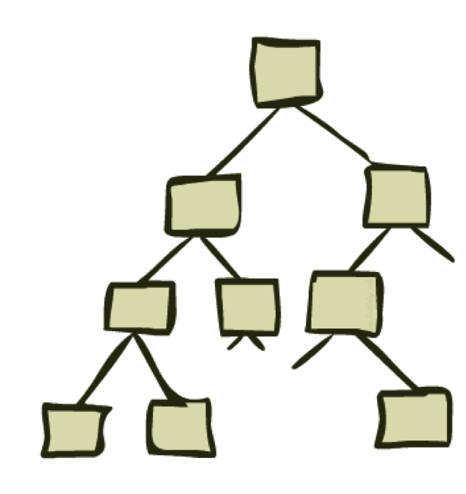
State Space Graphs and Search Trees

Slide 24
State Space Graphs
State space graph: A mathematical representation of a search problem
  Nodes are (abstracted) world configurations
  Arcs represent transitions (labeled with actions)
  The goal test is a set of goal nodes (maybe only one)
In a state space graph, each state occurs only once!
We can rarely build this full graph in memory (it’s too big), but it’s a useful idea

Slide 25
State Space Graphs
State space graph: A mathematical representation of a search problem
  Nodes are (abstracted) world configurations
  Arcs represent successors (action results)
  The goal test is a set of goal nodes (maybe only one)
In a state space graph, each state occurs only once!
We can rarely build this full graph in memory (it’s too big), but it’s a useful idea
a
G
b
c
e
d
f
S
h
p
q
r
Tiny state space graph for a tiny search problem

Slide 26
State Space Graphs vs. Search Trees
State Space Graph
Each NODE in in the search tree is an entire PATH in the state space graph.
Search Tree
S
a
G
d
e
p
b
c
q
b
c
e
h
r
d
e
f
a
a
h
r
p
q
f
S
h
We construct the tree on demand – and we construct as little as possible.
p
q
f
q
c
G
p
q
r
q
c
G
a
a

Slide 27

Quiz: State Space Graphs vs. Search Trees
Consider this 4-state graph:
How big is its search tree (from S)?
a
S
G
b

Slide 28
Quiz: State Space Graphs vs. Search Trees
Consider this 4-state graph:
How big is its search tree (from S)?
a
s
a
b
S
G
b
G
a
G
b
a
G
b
G
…
…
Important: Those who don’t know history are doomed to repeat it!

Slide 29
Quiz: State Space Graphs vs. Search Trees
Consider a rectangular grid:
How many states within d steps of start?
How many states in search tree of depth d?

Slide 30
Tree Search

Slide 31
Search Example: Romania

Slide 32
Creating the search tree

Slide 33
Creating the search tree

Slide 34
Creating the search tree

Slide 35
General Tree Search
Main variations:
  Which leaf node to expand next
  Whether to check for repeated states
  Data structures for frontier, expanded nodes

Slide 36
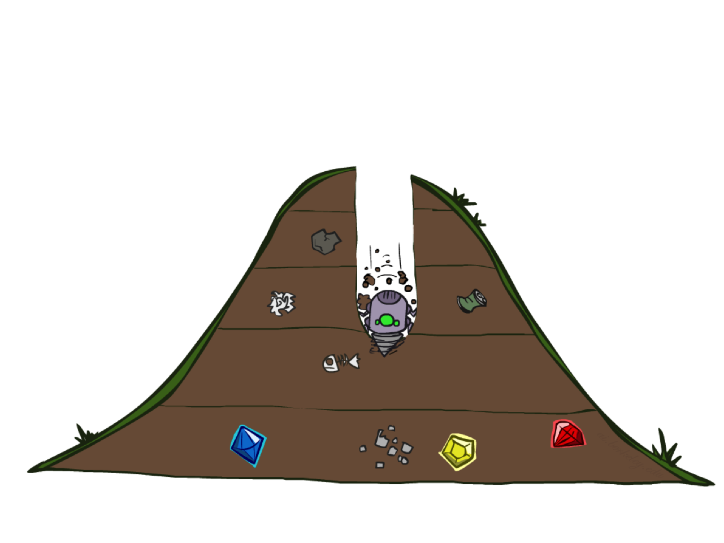
Depth-First Search

Slide 37
Depth-First Search
Strategy: expand a deepest node first
Implementation: Frontier is a LIFO stack
a
G
a
c
b
c
b
e
d
e
d
f
f
S
h
h
p
p
r
q
r
q
S
d
e
p
b
c
e
h
r
q
a
a
h
r
p
q
f
p
q
f
q
c
G
q
c
G
a
a

Slide 38
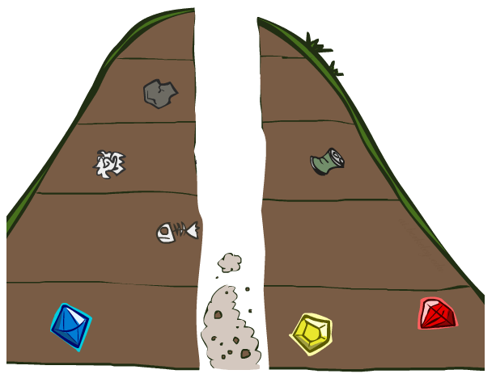
Search Algorithm Properties

Slide 39
Search Algorithm Properties
Complete: Guaranteed to find a solution if one exists?
Optimal: Guaranteed to find the least cost path?
Time complexity?
Space complexity?
Cartoon of search tree:
  b is the branching factor
  m is the maximum depth
  solutions at various depths
Number of nodes in entire tree?
  1 + b + b² + …. b^{m} = O(b^{m})
1 node
b
…
b nodes
b² nodes
m tiers
b^{m} nodes

Slide 40
Depth-First Search (DFS) Properties
What nodes does DFS expand?
  Some left prefix of the tree down to depth m.
  Could process the whole tree!
  If m is finite, takes time O(b^{m})
How much space does the frontier take?
  Only has siblings on path to root, so O(bm)
Is it complete?
  m could be infinite
  preventing cycles may help
Is it optimal?
  No, it finds the “leftmost” solution, regardless of depth or cost
1 node
b
…
b nodes
b² nodes
m tiers
b^{m} nodes

Slide 41
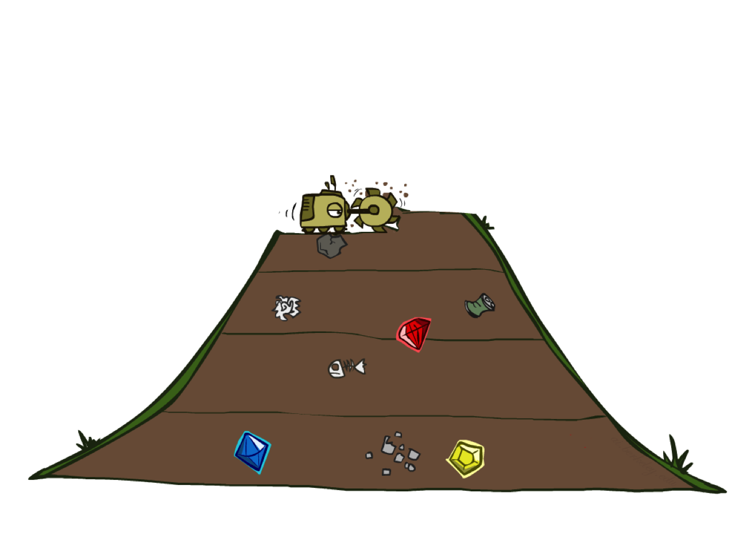
Breadth-First Search

Slide 42
Breadth-First Search
Strategy: expand a shallowest node first
Implementation: Frontier is a FIFO queue
a
G
b
c
d
e
f
S
h
p
q
r
S
d
e
p
Search
Tiers
b
c
e
h
r
q
a
a
h
r
p
q
f
p
q
f
q
c
G
q
c
G
a
a

Slide 43
Breadth-First Search (BFS) Properties
What nodes does BFS expand?
  Processes all nodes above shallowest solution
  Let depth of shallowest solution be s
  Search takes time O(b^{s})
How much space does the frontier take?
  Has roughly the last tier, so O(b^{s})
Is it complete?
  s must be finite if a solution exists, so yes!
Is it optimal?
  If costs are equal (e.g., 1)
1 node
b
…
b nodes
s tiers
b² nodes
b^{s} nodes
b^{m} nodes

Slide 44
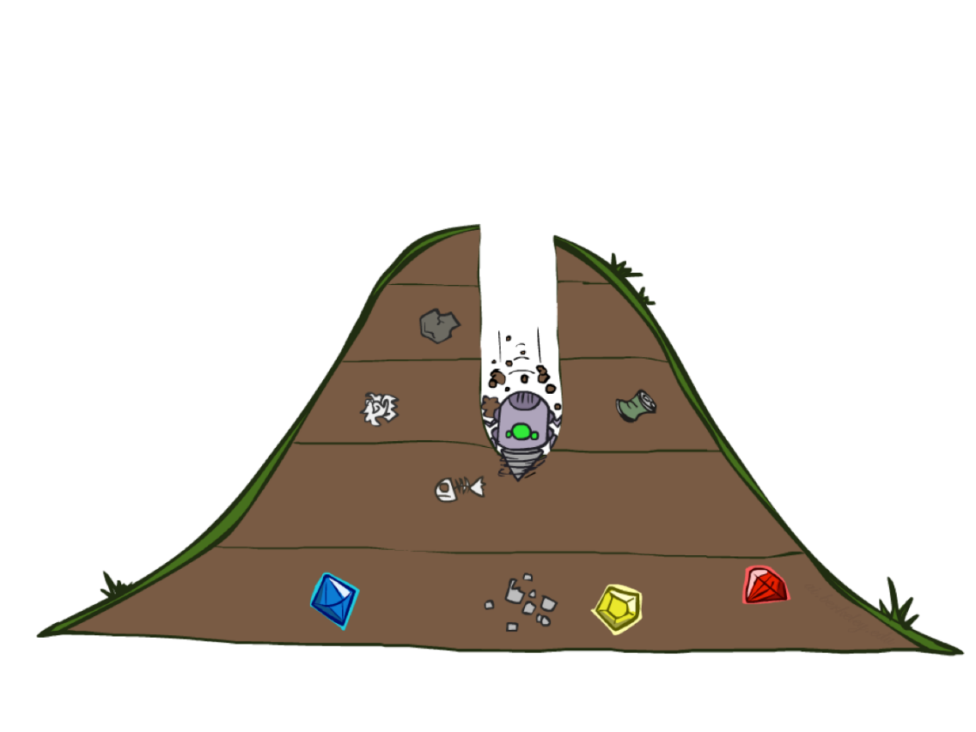
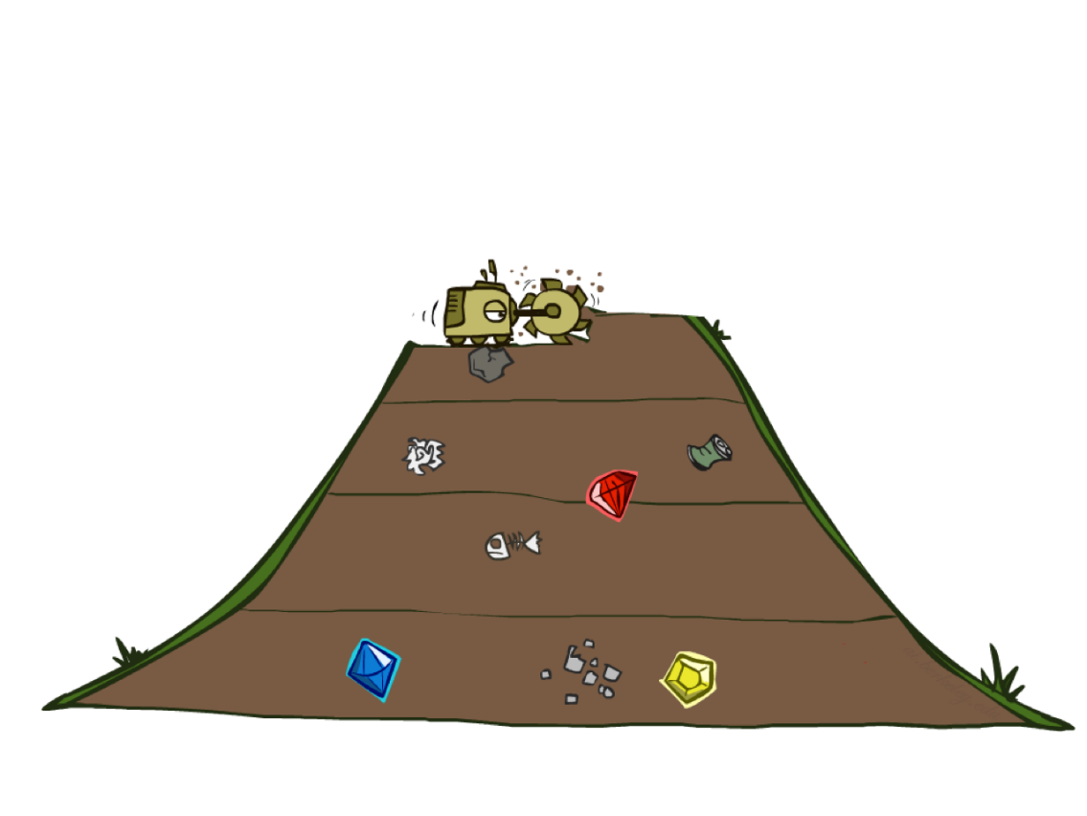
Quiz: DFS vs BFS

Slide 45
Quiz: DFS vs BFS
When will BFS outperform DFS?
When will DFS outperform BFS?
[Demo: dfs/bfs maze water (L2D6)]
Notes:
BFS best when there is a shallow solution, s << m
DFS best when solutions all at m, and fairly common at m

Slide 46
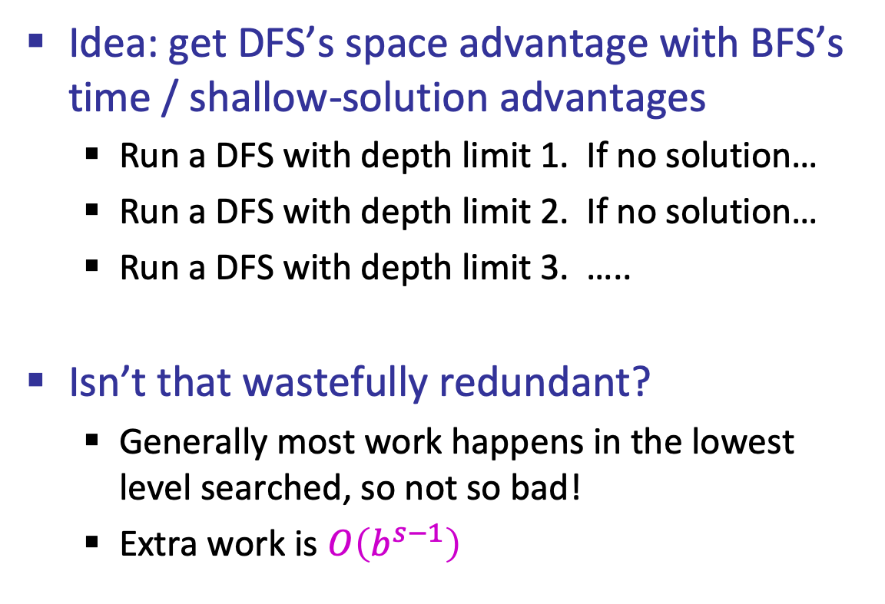
Iterative Deepening
Idea: get DFS’s space advantage with BFS’s time / shallow-solution advantages
  Run a DFS with depth limit 1. If no solution…
  Run a DFS with depth limit 2. If no solution…
  Run a DFS with depth limit 3. …..
Isn’t that wastefully redundant?
  Generally most work happens in the lowest level searched, so not so bad!
  Extra work is $O\left(b^{s−1}\right)$
b
…
Notes:
1 + (1+b) + (1+b+b²) + … + (1+b+…+b^{s}) = (s+1) + sb + (s-1)b² + … + b^{s} = O(b^{s})

Slide 47
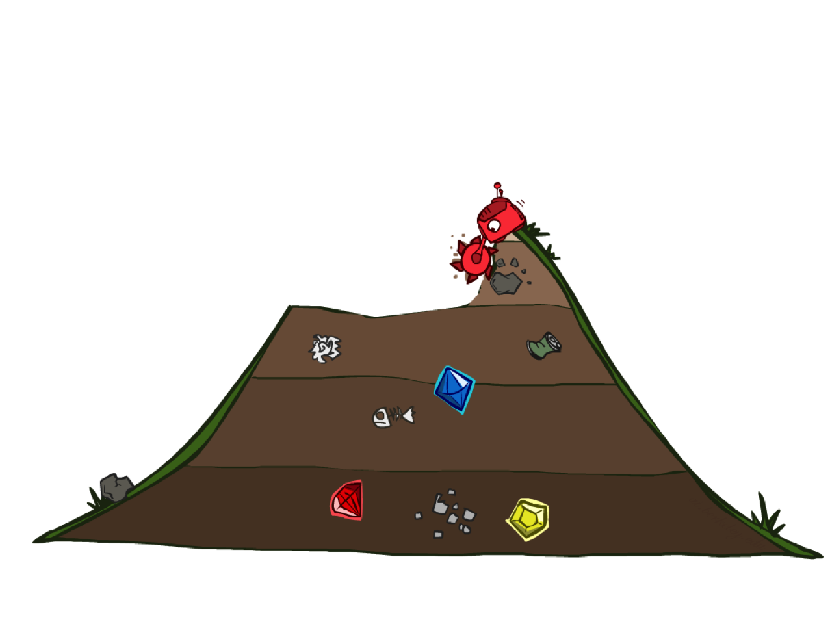
Uniform Cost Search

Slide 48
Uniform Cost Search
2
G
a
g(n) = cost from root to n
Strategy: expand lowest g(n)
Frontier is a priority queue sorted by g(n)
b
c
1
8
2
2
e
3
d
f
9
8
2
S
h
1
1
p
q
r
15
0
S
d
3
e
9
p
1
b
4
e
5
h
17
r
11
q
16
c
11
Cost contours
a
6
a
h
13
r
7
p
q
f
p
q
f
8
q
c
G
q
c
a
11
G
10
a

Slide 49
Uniform Cost Search (UCS) Properties
What nodes does UCS expand?
  Expands all nodes with cost less than cheapest solution!
  If that solution costs C* and arcs cost at least ε , then the “effective depth” is roughly C*/ε
  Takes time O(b^{C*/ε}) (exponential in effective depth)
How much space does the frontier take?
  Has roughly the last tier, so O(b^{C*/ε})
Is it complete?
  Assuming C* is finite and ε > 0, yes!
Is it optimal?
  Yes! (Proof next lecture via A*)
b
g ≤ 1
…
C*/ε “tiers”
g ≤ 2
g ≤ 3

Slide 50
Summary
Assume known, discrete, observable, deterministic, atomic
Search problems defined by S, s₀, A(s), Result(s,a), G(s), c(s,a,s’)
Search algorithms find action sequences that reach goal states
  Optimal => minimum-cost
Search algorithm properties:
  Depth-first: incomplete, suboptimal, space-efficient
  Breadth-first: complete, (sub)optimal, space-prohibitive
  Iterative deepening: complete, (sub)optimal, space-efficient
  Uniform-cost: complete, optimal, space-prohibitive

Slide 51
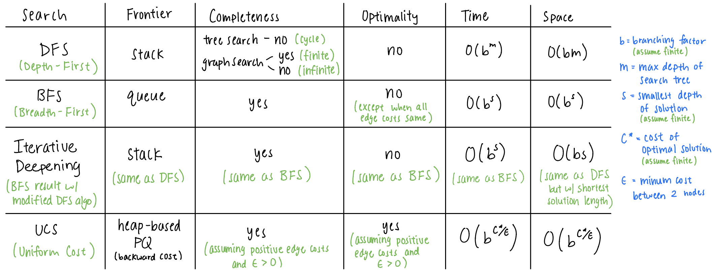
Bonus Search Algo Summary

