Slide 1
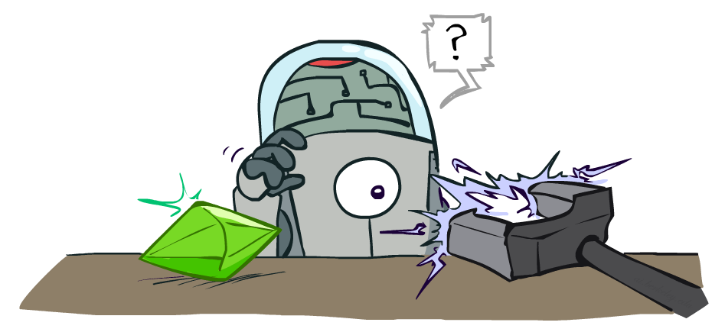
CS 188: Artificial Intelligence
Reinforcement Learning
Instructors: Angela Liu and Yanlai Yang
University of California, Berkeley
(Slides adapted from Pieter Abbeel, Dan Klein, Anca Dragan, Stuart Russell and Dawn Song)
Notes:
Please retain proper attribution, including the reference to ai.berkeley.edu. Thanks!

Slide 2
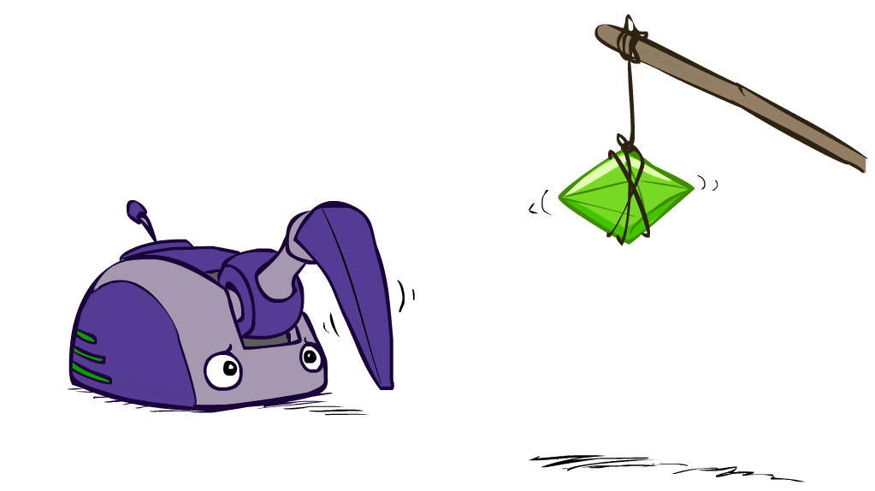
Reinforcement Learning

Slide 3
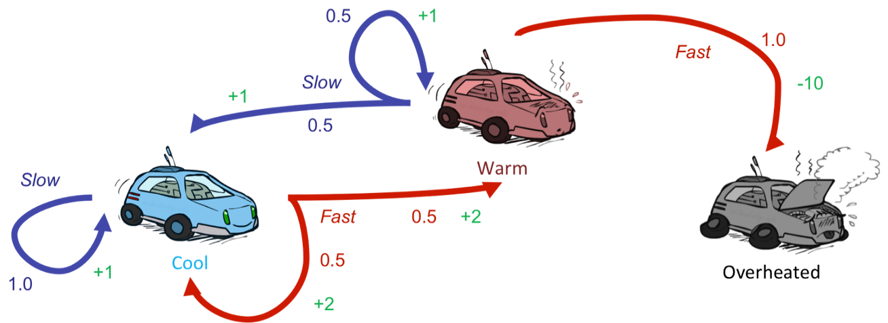
Reinforcement Learning
Still assume a Markov decision process (MDP):
A set of states s ∈ S
A set of actions (per state) A
A model T(s,a,s’)
A reward function R(s,a,s’)
Still looking for a policy π(s)
New twist: don’t know T or R
I.e. we don’t know which states are good or what the actions do
Must actually try actions and states out to learn

Slide 4
Reinforcement Learning
Agent
State: s
Reward: r
Actions: a
Environment
Basic idea:
Receive feedback in the form of rewards
Agent’s utility is defined by the reward function
Must (learn to) act so as to maximize expected rewards
All learning is based on observed samples of outcomes!

Slide 5
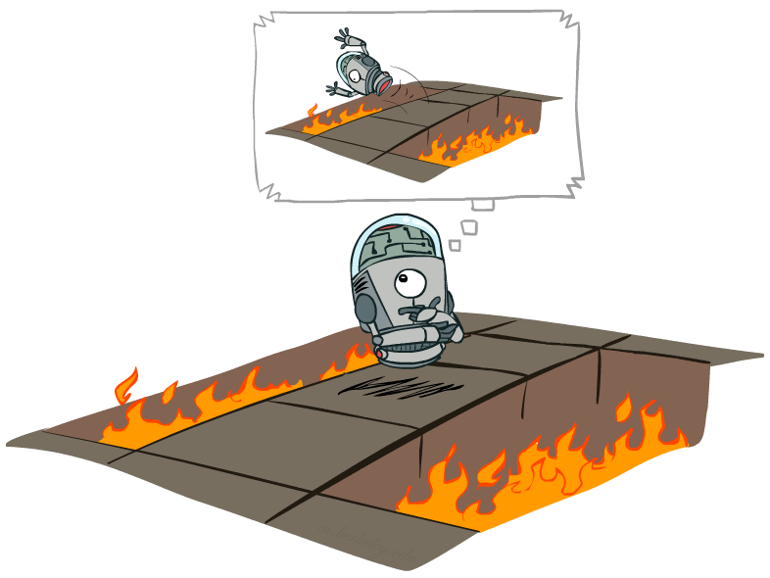
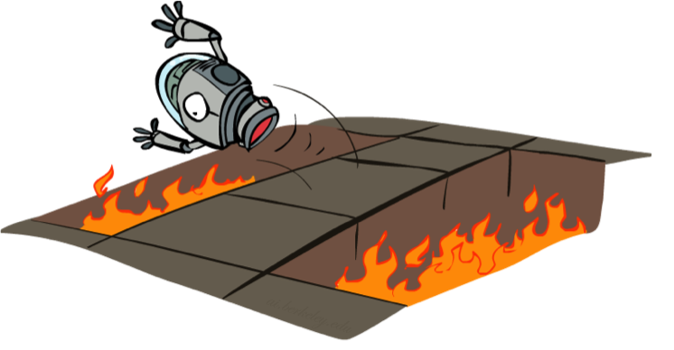
Offline (MDPs) vs. Online (RL)
Offline Solution
Online Learning

Slide 6
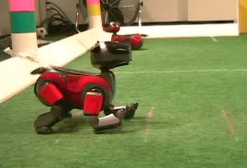
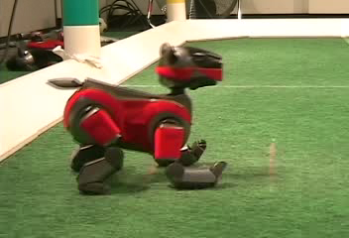
Example: Learning to Walk
Initial
A Learning Trial
After Learning [1K Trials]
[Kohl and Stone, ICRA 2004]

Slide 7
Example: Learning to Walk
Initial
[Kohl and Stone, ICRA 2004]
[Video: AIBO WALK – initial]

Slide 8
Example: Learning to Walk
Training
[Kohl and Stone, ICRA 2004]
[Video: AIBO WALK – training]

Slide 9
Example: Learning to Walk
Finished
[Kohl and Stone, ICRA 2004]
[Video: AIBO WALK – finished]

Slide 10
DeepMind Atari (©Two Minute Lectures)

Slide 11
The Crawler!
[Demo: Crawler Bot (L10D1)] [You, in Project 3]
Notes:
Hard because at times it gets not reward as it is repositioning its arm

Slide 12
Video of Demo Crawler Bot

Slide 13
Reinforcement Learning -- Overview
Passive Reinforcement Learning (= how to learn from experiences)
Model-based Passive RL
Learn the MDP model from experiences, then solve the MDP
Model-free Passive RL
Forego learning the MDP model, directly learn V or Q:
Value learning – learns value of a fixed policy; 2 approaches: Direct Evaluation & TD Learning
Q learning – learns Q values of the optimal policy (uses a Q version of TD Learning)
Active Reinforcement Learning (= agent also needs to decide how to collect experiences)
Key challenges:
How to efficiently explore?
How to trade off exploration <> exploitation
Applies to both model-based and model-free. In CS188 we’ll cover only in context of Q-learning

Slide 14
Reinforcement Learning -- Overview
Passive Reinforcement Learning (= how to learn from experiences)
Model-based Passive RL
Learn the MDP model from experiences, then solve the MDP
Model-free Passive RL
Forego learning the MDP model, directly learn V or Q:
Value learning – learns value of a fixed policy; 2 approaches: Direct Evaluation & TD Learning
Q learning – learns Q values of the optimal policy (uses a Q version of TD Learning)
Active Reinforcement Learning (= agent also needs to decide how to collect experiences)
Key challenges:
How to efficiently explore?
How to trade off exploration <> exploitation
Applies to both model-based and model-free. In CS188 we’ll cover only in context of Q-learning

Slide 15
Model-Based Reinforcement Learning

Slide 16
Model-Based Reinforcement Learning
Model-Based Idea:
Learn an approximate model based on experiences
Solve for values as if the learned model were correct
Step 1: Learn empirical MDP model
Count outcomes s’ for each s, a
Normalize to give an estimate of
Discover each when we experience (s, a, s’)
Step 2: Solve the learned MDP
For example, use value iteration, as before
(and repeat as needed)

Slide 17
Example: Model-Based RL
Input Policy π
Observed Episodes (Training)
Learned Model
Episode 1
Episode 2
T(s,a,s’).
T(B, east, C) = 1.00
T(C, east, D) = 0.75
T(C, east, A) = 0.25
…
R(s,a,s’).
R(B, east, C) = -1
R(C, east, D) = -1
R(D, exit, x) = +10
…
 | A
B | C | D
 | E
B, east, C, -1
C, east, D, -1
D, exit, x, +10
B, east, C, -1
C, east, D, -1
D, exit, x, +10
Episode 3
Episode 4
E, north, C, -1
C, east, D, -1
D, exit, x, +10
E, north, C, -1
C, east, A, -1
A, exit, x, -10
Assume: γ = 1

Slide 18
Reinforcement Learning -- Overview
Passive Reinforcement Learning (= how to learn from experiences)
Model-based Passive RL
Learn the MDP model from experiences, then solve the MDP
Model-free Passive RL
Forego learning the MDP model, directly learn V or Q:
Value learning – learns value of a fixed policy; 2 approaches: Direct Evaluation & TD Learning
Q learning – learns Q values of the optimal policy (uses a Q version of TD Learning)
Active Reinforcement Learning (= agent also needs to decide how to collect experiences)
Key challenges:
How to efficiently explore?
How to trade off exploration <> exploitation
Applies to both model-based and model-free. In CS188 we’ll cover only in context of Q-learning

Slide 19
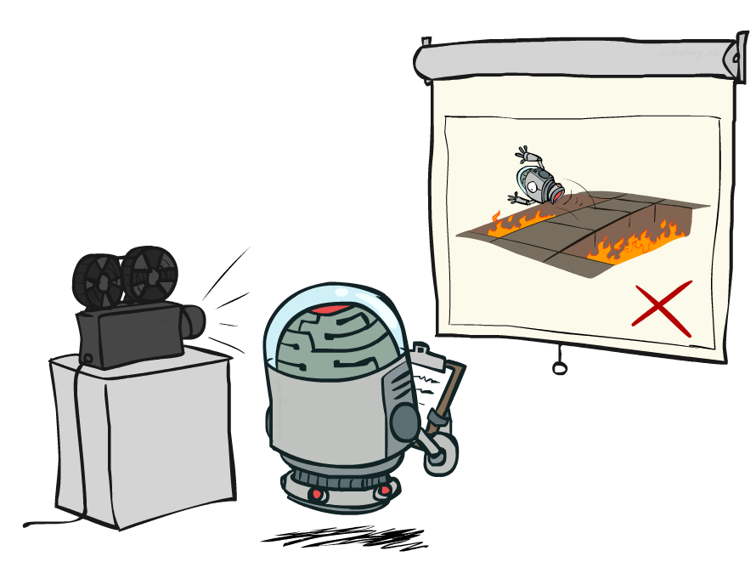
Passive Model-Free Reinforcement Learning

Slide 20
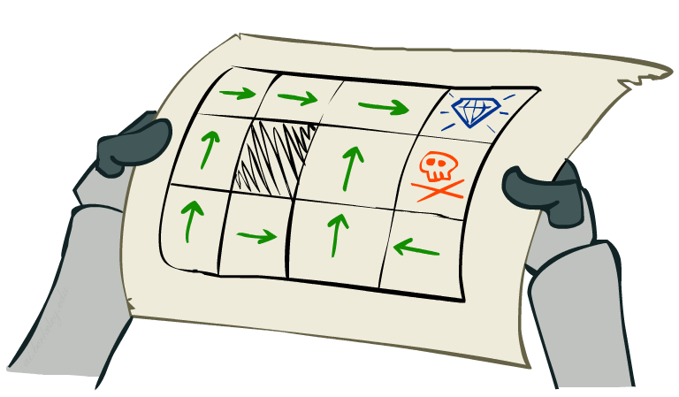
Passive Model-Free Reinforcement Learning
Simplified task: policy evaluation
Input: a fixed policy π(s)
You don’t know the transitions T(s,a,s’)
You don’t know the rewards R(s,a,s’)
Goal: learn the state values
In this case:
Learner is “along for the ride”
No choice about what actions to take
Just execute the policy and learn from experience
This is NOT offline planning! You actually take actions in the world.

Slide 21
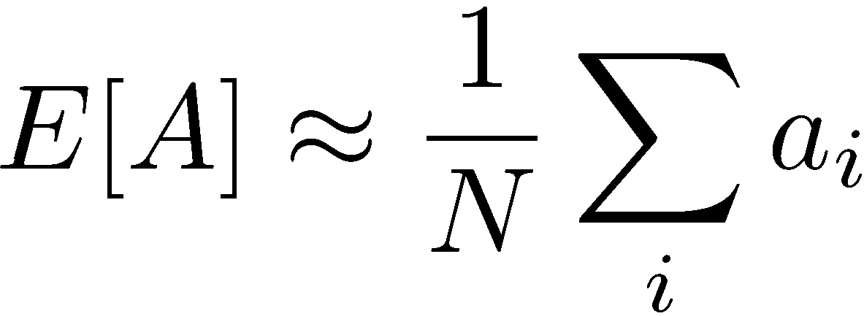
Analogy: Expected Age
Goal: Compute expected age of cs188 students
Known P(A)
Without P(A), instead collect samples [a₁, a₂, … a_{N}]
Unknown P(A): “Model Based”
Unknown P(A): “Model Free”
Why does this work? Because eventually you learn the right model.
Why does this work? Because samples appear with the right frequencies.

Slide 22
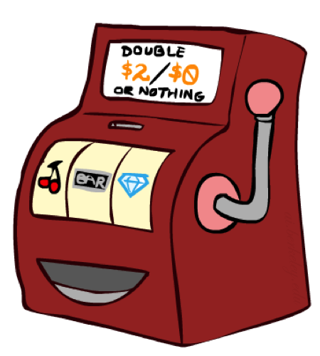
Direct Evaluation
Goal: Compute values for each state under π
Idea: Average together observed sample values
Act according to π
Every time you visit a state, write down what the sum of discounted rewards turned out to be
Average those samples
This is called direct evaluation

Slide 23
Example: Direct Evaluation
Input Policy π
Observed Episodes (Training)
Output Values
Episode 1
Episode 2
 | A
B | C | D
 | E
 | A
B | C | D
 | E
B, east, C, -1
C, east, D, -1
D, exit, x, +10
B, east, C, -1
C, east, D, -1
D, exit, x, +10
-10
+8
+4
+10
Episode 3
Episode 4
-2
E, north, C, -1
C, east, D, -1
D, exit, x, +10
E, north, C, -1
C, east, A, -1
A, exit, x, -10
If B and E both go to C under this policy, how can their values be different?
Assume: γ = 1

Slide 24
Problems with Direct Evaluation
What’s good about direct evaluation?
It’s easy to understand
It doesn’t require any knowledge of T, R
It eventually computes the correct average values, using just sample transitions
What bad about it?
It wastes information about state connections
Each state must be learned separately
So, it takes a long time to learn
Output Values
 | A
B | C | D
 | E
-10
+8
+4
+10
-2
If B and E both go to C under this policy, how can their values be different?

Slide 25
Reinforcement Learning -- Overview
Passive Reinforcement Learning (= how to learn from experiences)
Model-based Passive RL
Learn the MDP model from experiences, then solve the MDP
Model-free Passive RL
Forego learning the MDP model, directly learn V or Q:
Value learning – learns value of a fixed policy; 2 approaches: Direct Evaluation & TD Learning
Q learning – learns Q values of the optimal policy (uses a Q version of TD Learning)
Active Reinforcement Learning (= agent also needs to decide how to collect experiences)
Key challenges:
How to efficiently explore?
How to trade off exploration <> exploitation
Applies to both model-based and model-free. In CS188 we’ll cover only in context of Q-learning

Slide 26
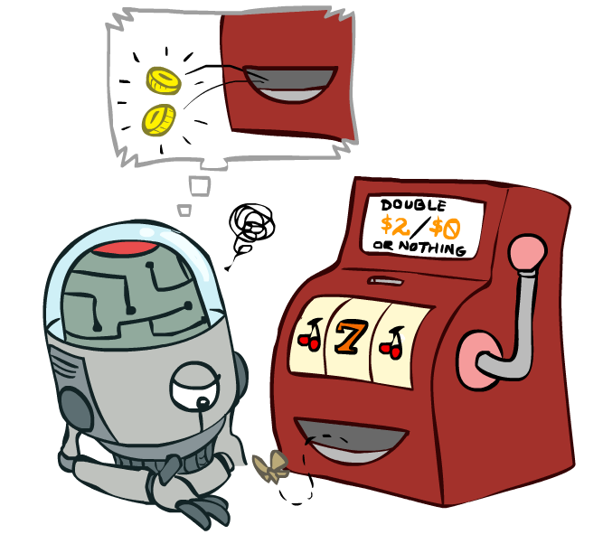
Temporal Difference Value Learning

Slide 27
Why Not Use Policy Evaluation?
s
Simplified Bellman updates calculate V for a fixed policy:
Each round, replace V with a one-step-look-ahead layer over V
This approach fully exploited the connections between the states
Unfortunately, we need T and R to do it!
Key question: how can we do this update to V without knowing T and R?
In other words, how to we take a weighted average without knowing the weights?
π(s)
s, π(s)
s, π(s),s’
s’

Slide 28
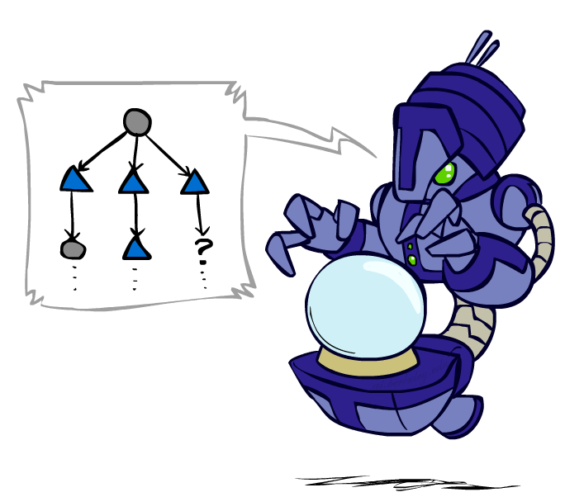
Sample-Based Policy Evaluation?
We want to improve our estimate of V by computing these averages:
Idea: Take samples of outcomes s’ (by doing the action!) and average
s
π(s)
s, π(s)
s, π(s),s’
s₁'
s₂'
s'
s₃'
Almost! But we can’t rewind time to get sample after sample from state s.
Notes:
If we could do this, we would be implementing the policy evaluation update

Slide 29
Temporal Difference Value Learning
Big idea: learn from every experience!
Update V(s) each time we experience a transition (s, a, s’, r)
Likely outcomes s’ will contribute updates more often
Temporal difference learning of values
Policy still fixed, still doing evaluation!
Move values toward value of whatever successor occurs: running average
s
π(s)
s, π(s)
s’
Sample of V(s):
Update to V(s):
Same update:

Slide 30
Exponential Moving Average
Exponential moving average
The running interpolation update:
Makes recent samples more important
Forgets about the past (distant past values were wrong anyway)
Decreasing learning rate (alpha) can give converging averages
Notes:
More recent samples are better because the estimates for vk are better

Slide 31
Example: Temporal Difference Value Learning
States
Observed Transitions
B, east, C, -2
C, east, D, -2
 | A
B | C | D
 | E
 | 0
0 | 0 | 8
 | 0
 | 0
-1 | 0 | 8
 | 0
 | 0
-1 | 3 | 8
 | 0
Assume: γ = 1, α = 1/2

Slide 32
Problems with TD Value Learning
TD value leaning is a model-free way to do policy evaluation, mimicking Bellman updates with running sample averages
However, if we want to turn values into a (new) policy, we’re sunk:
Idea: learn Q-values, not values
Makes action selection model-free too!
s
a
s, a
s,a,s’
s’

Slide 33
Reinforcement Learning -- Overview
Passive Reinforcement Learning (= how to learn from experiences)
Model-based Passive RL
Learn the MDP model from experiences, then solve the MDP
Model-free Passive RL
Forego learning the MDP model, directly learn V or Q:
Value learning – learns value of a fixed policy; 2 approaches: Direct Evaluation & TD Learning
Q learning – learns Q values of the optimal policy (uses a Q version of TD Learning)
Active Reinforcement Learning (= agent also needs to decide how to collect experiences)
Key challenges:
How to efficiently explore?
How to trade off exploration <> exploitation
Applies to both model-based and model-free. In CS188 we’ll cover only in context of Q-learning

Slide 34
Q-Value Iteration
Value iteration: find successive (depth-limited) values
Start with V₀(s) = 0, which we know is right
Given V_{k}, calculate the depth k+1 values for all states:
But Q-values are more useful, so compute them instead
Start with Q₀(s,a) = 0, which we know is right
Given Q_{k}, calculate the depth k+1 q-values for all q-states:

Slide 35
Q-Learning
Q-Learning: sample-based Q-value iteration
Learn Q(s,a) values as you go
Receive a sample (s,a,s’,r)
Consider your old estimate:
Consider your new sample estimate:
Incorporate the new estimate into a running average:
no longer policy evaluation!
[Demo: Q-learning – gridworld (L10D2)]
[Demo: Q-learning – crawler (L10D3)]

Slide 36
Q-Learning Properties
Amazing result: Q-learning converges to optimal policy -- even if you’re acting suboptimally!
This is called off-policy learning
Caveats:
You have to explore enough
You have to eventually make the learning rate
small enough
… but not decrease it too quickly
Basically, in the limit, it doesn’t matter how you select actions (!)

Slide 37
Video of Demo Q-Learning -- Gridworld

Slide 38
Video of Demo Q-Learning -- Crawler

Slide 39
Reinforcement Learning -- Overview
Passive Reinforcement Learning (= how to learn from experiences)
Model-based Passive RL
Learn the MDP model from experiences, then solve the MDP
Model-free Passive RL
Forego learning the MDP model, directly learn V or Q:
Value learning – learns value of a fixed policy; 2 approaches: Direct Evaluation & TD Learning
Q learning – learns Q values of the optimal policy (uses a Q version of TD Learning)
Active Reinforcement Learning (= agent also needs to decide how to collect experiences)
Key challenges:
How to efficiently explore?
How to trade off exploration <> exploitation
Applies to both model-based and model-free. In CS188 we’ll cover only in context of Q-learning

Slide 40
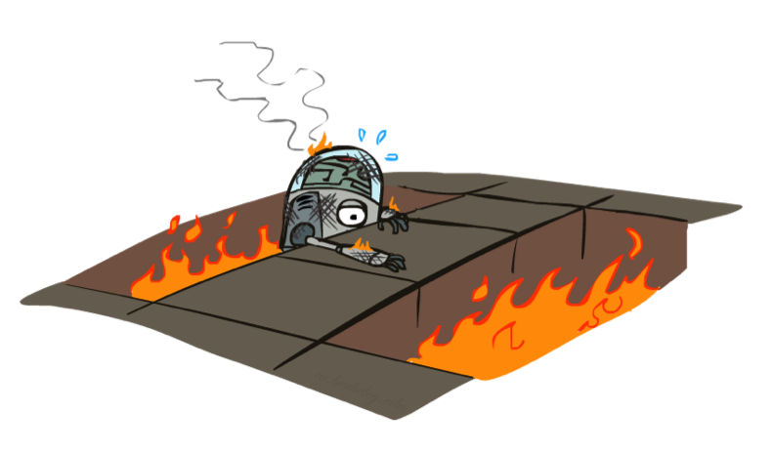
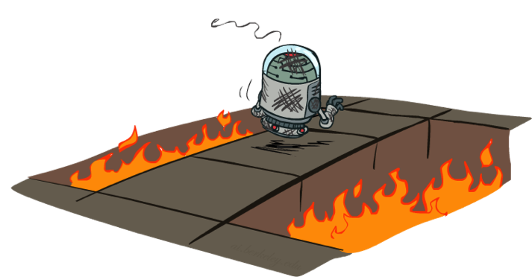
Active Reinforcement Learning

Slide 41
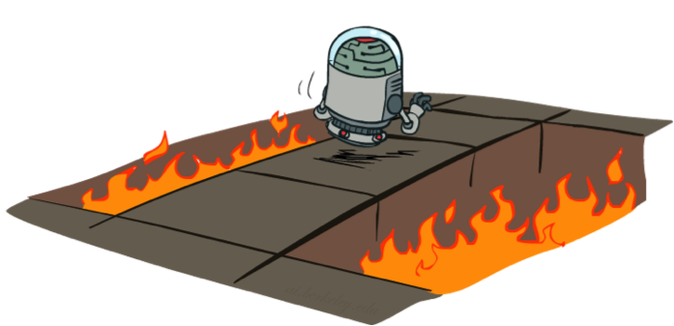
Active Reinforcement Learning
Full reinforcement learning: optimal policies (like value iteration)
You don’t know the transitions T(s,a,s’)
You don’t know the rewards R(s,a,s’)
You choose the actions now
Goal: learn the optimal policy / values
In this case:
Learner makes choices!
Fundamental tradeoff: exploration vs. exploitation
This is NOT offline planning! You actually take actions in the world and find out what happens…

Slide 42
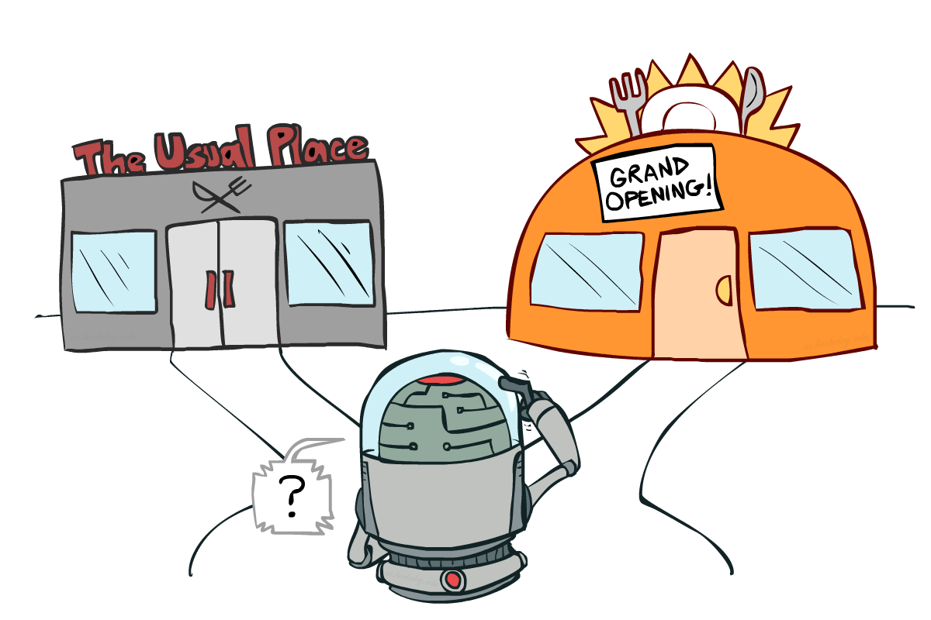
Exploration vs. Exploitation
Notes:
might be missing out on your favorite restaurant till end of time

Slide 43
Video of Demo Q-learning – Manual Exploration – Bridge Grid

Slide 44
How to Explore?
Several schemes for forcing exploration
Simplest: random actions (ε-greedy)
Every time step, flip a coin
With (small) probability ε, act randomly
With (large) probability 1-ε, act on current policy
Problems with random actions?
You do eventually explore the space, but keep thrashing around once learning is done
One solution: lower ε over time
Another solution: exploration functions
[Demo: Q-learning – manual exploration – bridge grid (L10D5)] [Demo: Q-learning – epsilon-greedy -- crawler (L10D3)]
Notes:
you eventually learn the right thing but still thrash around

Slide 45
Video of Demo Q-learning – Epsilon-Greedy – Crawler

Slide 46
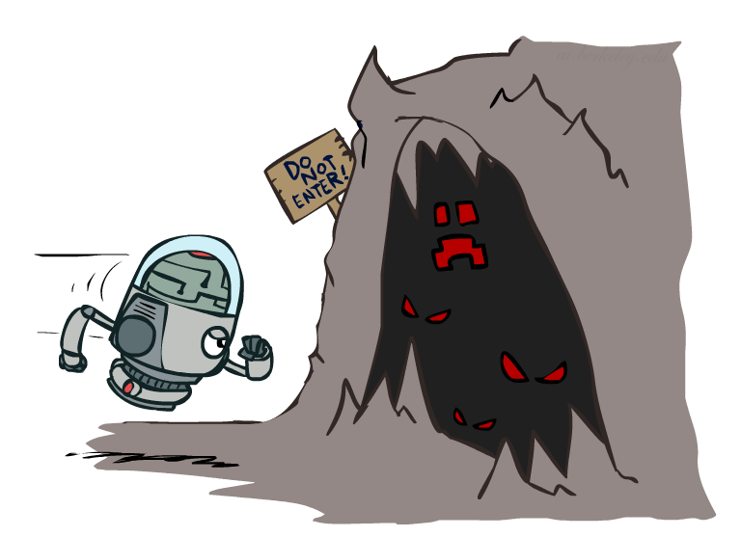
Exploration Functions
When to explore?
Random actions: explore a fixed amount
Better idea: explore areas whose badness is not
(yet) established, eventually stop exploring
Exploration function
Takes a value estimate u and a visit count n, and
returns an optimistic utility, e.g.
Note: this propagates the “bonus” back to states that lead to unknown states as well!
Regular Q-Update:
Modified Q-Update:
[Demo: exploration – Q-learning – crawler – exploration function (L10D4)]
Notes:
Optimism in the face of uncertainty

Slide 47
Video of Demo Q-learning – Exploration Function – Crawler

Slide 48
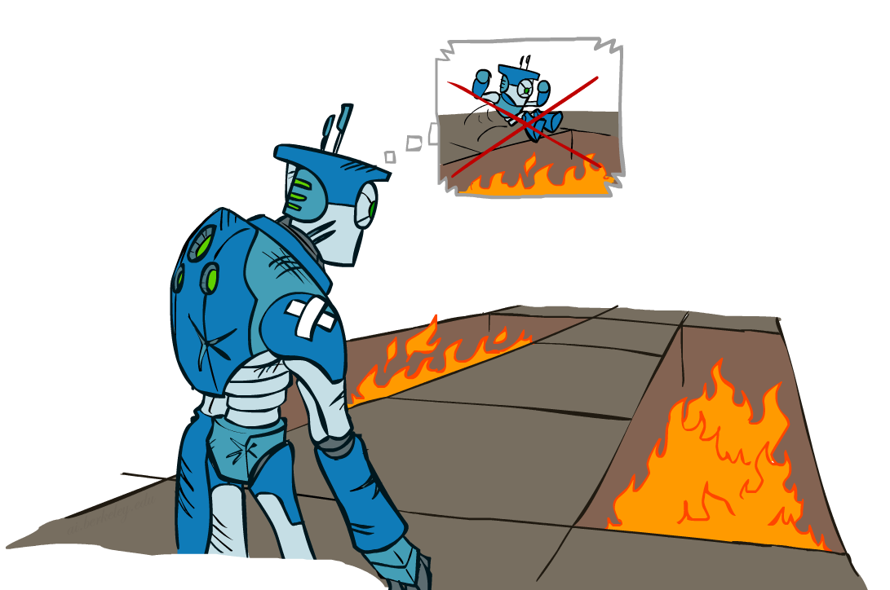
Regret
Even if you learn the optimal policy, you still make mistakes along the way!
Regret is a measure of your total mistake cost: the difference between your (expected) rewards, including youthful suboptimality, and optimal (expected) rewards
Minimizing regret goes beyond learning to be optimal – it requires optimally learning to be optimal
Example: random exploration and exploration functions both end up optimal, but random exploration has higher regret

Slide 49
Model-Based Learning
Input Policy π
 | A
B | C | D
 | E
act according to current optimal
also explore!

Slide 50
Reinforcement Learning -- Overview
Passive Reinforcement Learning (= how to learn from experiences)
Model-based Passive RL
Learn the MDP model from experiences, then solve the MDP
Model-free Passive RL
Forego learning the MDP model, directly learn V or Q:
Value learning – learns value of a fixed policy; 2 approaches: Direct Evaluation & TD Learning
Q learning – learns Q values of the optimal policy (uses a Q version of TD Learning)
Active Reinforcement Learning (= agent also needs to decide how to collect experiences)
Key challenges:
How to efficiently explore?
How to trade off exploration <> exploitation
Applies to both model-based and model-free. In CS188 we’ll cover only in context of Q-learning

