Slide 1
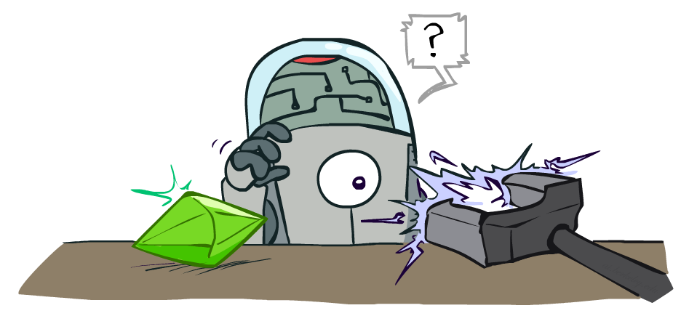
CS 188: Artificial Intelligence
Reinforcement Learning II
Instructors: Angela Liu and Yanlai Yang
University of California, Berkeley
(Slides adapted from Pieter Abbeel, Dan Klein, Anca Dragan, Stuart Russell and Dawn Song)
Notes:
Please retain proper attribution, including the reference to ai.berkeley.edu. Thanks!

Slide 2
Reinforcement Learning -- Overview
Passive Reinforcement Learning (= how to learn from experiences)
Model-based Passive RL
Learn the MDP model from experiences, then solve the MDP
Model-free Passive RL
Forego learning the MDP model, directly learn V or Q:
Value learning – learns value of a fixed policy; 2 approaches: Direct Evaluation & TD Learning
Q learning – learns Q values of the optimal policy (uses a Q version of TD Learning)
Active Reinforcement Learning (= agent also needs to decide how to collect experiences)
Key challenges:
How to efficiently explore?
How to trade off exploration <> exploitation
Applies to both model-based and model-free. In CS188 we’ll cover only in context of Q-learning

Slide 3
Model-Based Reinforcement Learning
Model-Based Idea:
Learn an approximate model based on experiences
Solve for values as if the learned model were correct
Step 1: Learn empirical MDP model
Count outcomes s’ for each s, a
Normalize to give an estimate of
Discover each when we experience (s, a, s’)
Step 2: Solve the learned MDP
For example, use value iteration, as before
(and repeat as needed)

Slide 4
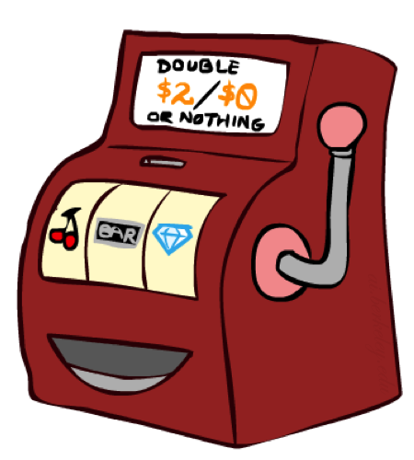
Direct Evaluation
Goal: Compute values for each state under π
Idea: Average together observed sample values
Act according to π
Every time you visit a state, write down what the sum of discounted rewards turned out to be
Average those samples
This is called direct evaluation

Slide 5
Temporal Difference Value Learning
s
Model-free (temporal difference) learning
Experience world through episodes
Update estimates each transition
Over time, updates will mimic Bellman updates
a
s, a
r
s’
a’
s’, a’
s’’

Slide 6
Temporal Difference Value Learning
Policy Evaluation in MDPs:
Big idea: learn from every experience!
Update V(s) each time we experience a transition (s, a, s’, r)
Likely outcomes s’ will contribute updates more often
Temporal difference learning of values
Move values toward value of whatever successor occurs: running average
s
π(s)
s, π(s)
s’
Sample of V(s):
Update to V(s):

Slide 7
Exponential Moving Average
Exponential moving average
The running interpolation update:
Makes recent samples more important
Forgets about the past (distant past values were wrong anyway)
Decreasing learning rate (alpha) can give converging averages
Notes:
More recent samples are better because the estimates for vk are better

Slide 8
Example: Temporal Difference Value Learning
States
Observed Transitions
B, east, C, -2
C, east, D, -2
 | A
B | C | D
 | E
 | 0
0 | 0 | 8
 | 0
 | 0
-1 | 0 | 8
 | 0
 | 0
-1 | 3 | 8
 | 0
Assume: γ = 1, α = 1/2

Slide 9
Problems with TD Value Learning
TD value leaning is a model-free way to do policy evaluation, mimicking Bellman updates with running sample averages
However, if we want to turn values into a (new) policy, we’re sunk:
Idea: learn Q-values, not values
Makes action selection model-free too!
s
a
s, a
s,a,s’
s’

Slide 10
Reinforcement Learning -- Overview
Passive Reinforcement Learning (= how to learn from experiences)
Model-based Passive RL
Learn the MDP model from experiences, then solve the MDP
Model-free Passive RL
Forego learning the MDP model, directly learn V or Q:
Value learning – learns value of a fixed policy; 2 approaches: Direct Evaluation & TD Learning
Q learning – learns Q values of the optimal policy (uses a Q version of TD Learning)
Active Reinforcement Learning (= agent also needs to decide how to collect experiences)
Key challenges:
How to efficiently explore?
How to trade off exploration <> exploitation
Applies to both model-based and model-free. In CS188 we’ll cover only in context of Q-learning

Slide 11
Q-Value Iteration
Value iteration: find successive (depth-limited) values
Start with V₀(s) = 0, which we know is right
Given V_{k}, calculate the depth k+1 values for all states:
But Q-values are more useful, so compute them instead
Start with Q₀(s,a) = 0, which we know is right
Given Q_{k}, calculate the depth k+1 q-values for all q-states:

Slide 12
Q-Learning
Q-Learning: sample-based Q-value iteration
Learn Q(s,a) values as you go
Receive a sample (s,a,s’,r)
Consider your old estimate:
Consider your new sample estimate:
Incorporate the new estimate into a running average:
no longer policy evaluation!
[Demo: Q-learning – gridworld (L10D2)]
[Demo: Q-learning – crawler (L10D3)]

Slide 13
Q-Learning Properties
Amazing result: Q-learning converges to optimal policy -- even if you’re acting suboptimally!
This is called off-policy learning
Caveats:
You have to explore enough
You have to eventually make the learning rate
small enough
… but not decrease it too quickly
Basically, in the limit, it doesn’t matter how you select actions (!)

Slide 14
Video of Demo Q-Learning -- Crawler

Slide 15
Reinforcement Learning -- Overview
Passive Reinforcement Learning (= how to learn from experiences)
Model-based Passive RL
Learn the MDP model from experiences, then solve the MDP
Model-free Passive RL
Forego learning the MDP model, directly learn V or Q:
Value learning – learns value of a fixed policy; 2 approaches: Direct Evaluation & TD Learning
Q learning – learns Q values of the optimal policy (uses a Q version of TD Learning)
Active Reinforcement Learning (= agent also needs to decide how to collect experiences)
Key challenges:
How to efficiently explore?
How to trade off exploration <> exploitation
Applies to both model-based and model-free. In CS188 we’ll cover only in context of Q-learning

Slide 16
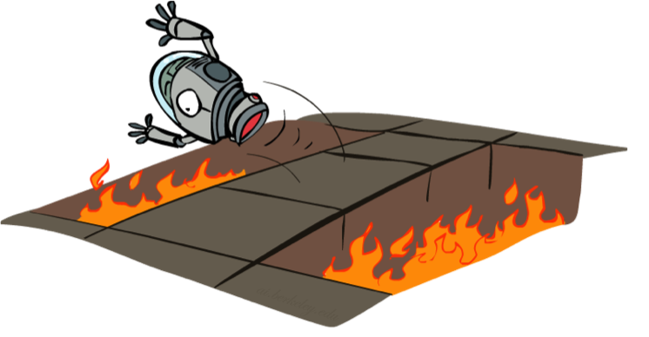
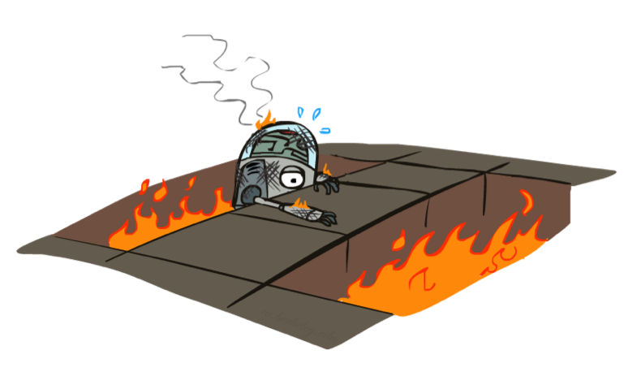
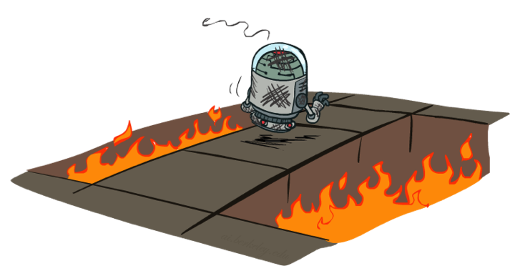
Active Reinforcement Learning

Slide 17
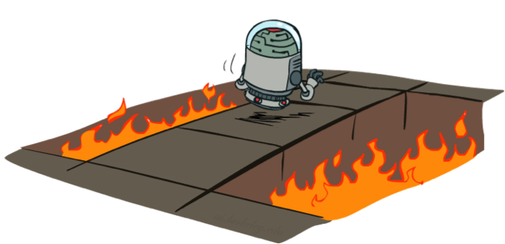
Active Reinforcement Learning
Full reinforcement learning: optimal policies (like value iteration)
You don’t know the transitions T(s,a,s’)
You don’t know the rewards R(s,a,s’)
You choose the actions now
Goal: learn the optimal policy / values
In this case:
Learner makes choices!
Fundamental tradeoff: exploration vs. exploitation
This is NOT offline planning! You actually take actions in the world and find out what happens…

Slide 18
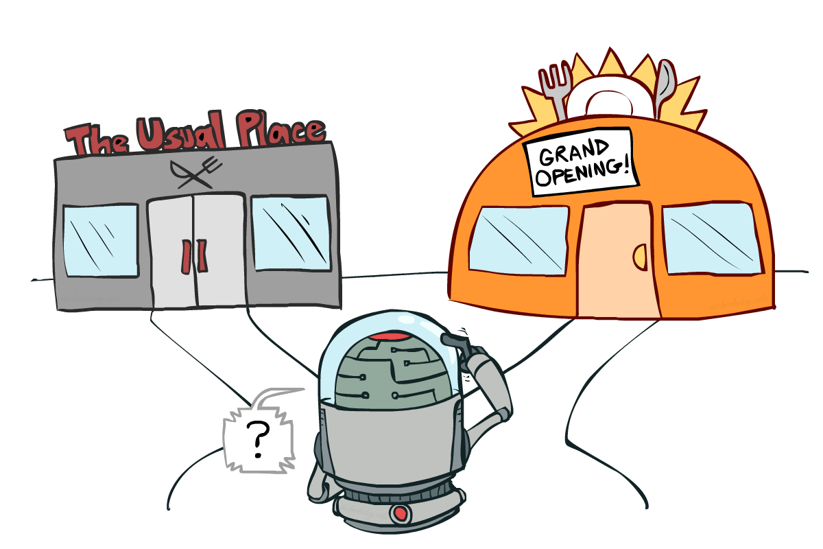
Exploration vs. Exploitation
Notes:
might be missing out on your favorite restaurant till end of time

Slide 19
Video of Demo Q-learning – Manual Exploration – Bridge Grid

Slide 20
How to Explore?
Several schemes for forcing exploration
Simplest: random actions (ε-greedy)
Every time step, flip a coin
With (small) probability ε, act randomly
With (large) probability 1-ε, act on current policy
Problems with random actions?
You do eventually explore the space, but keep thrashing around once learning is done
One solution: lower ε over time
Another solution: exploration functions
[Demo: Q-learning – manual exploration – bridge grid (L10D5)] [Demo: Q-learning – epsilon-greedy -- crawler (L10D3)]
Notes:
you eventually learn the right thing but still thrash around

Slide 21
Video of Demo Q-learning – Epsilon-Greedy – Crawler

Slide 22
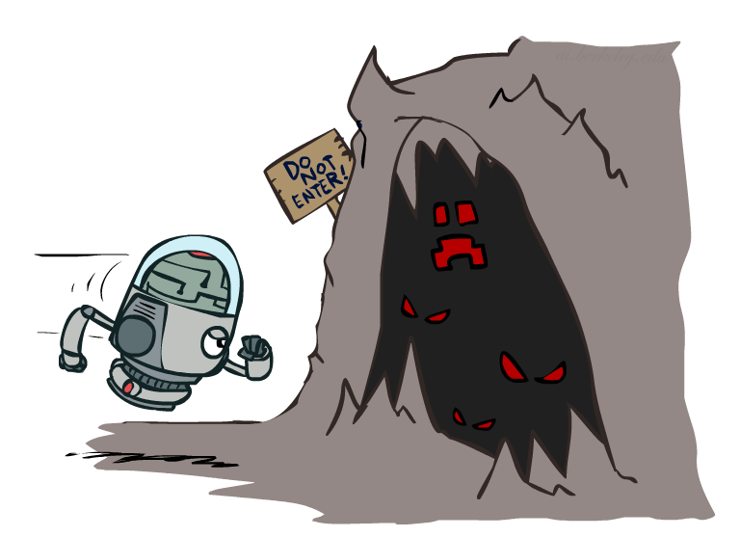
Exploration Functions
When to explore?
Random actions: explore a fixed amount
Better idea: explore areas whose badness is not
(yet) established, eventually stop exploring
Exploration function
Takes a value estimate u and a visit count n, and
returns an optimistic utility, e.g.
Note: this propagates the “bonus” back to states that lead to unknown states as well!
Regular Q-Update:
Modified Q-Update:
[Demo: exploration – Q-learning – crawler – exploration function (L10D4)]
Notes:
Optimism in the face of uncertainty

Slide 23
Video of Demo Q-learning – Exploration Function – Crawler

Slide 24
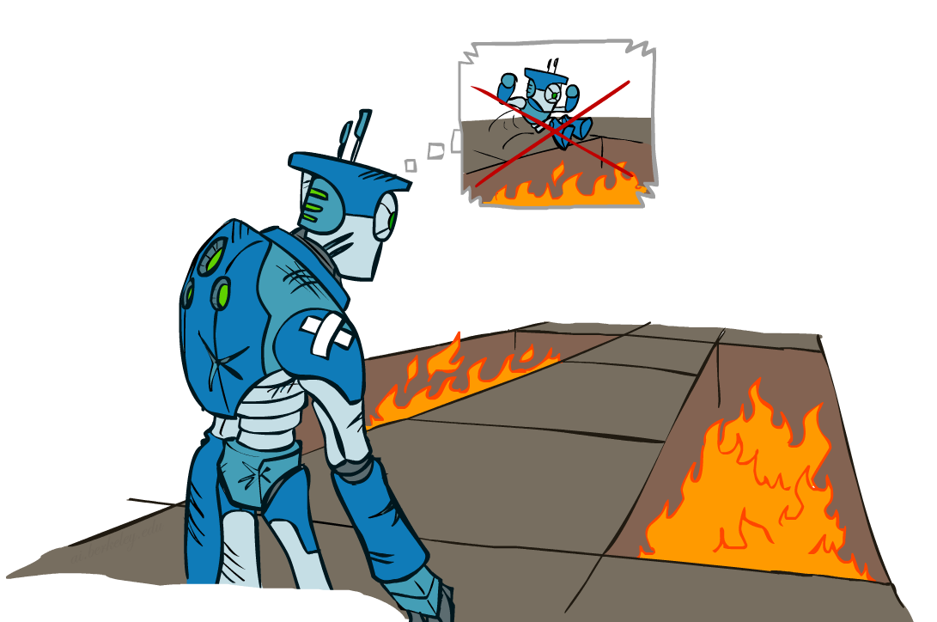
Regret
Even if you learn the optimal policy, you still make mistakes along the way!
Regret is a measure of your total mistake cost: the difference between your (expected) rewards, including youthful suboptimality, and optimal (expected) rewards
Minimizing regret goes beyond learning to be optimal – it requires optimally learning to be optimal
Example: random exploration and exploration functions both end up optimal, but random exploration has higher regret

Slide 25
Reinforcement Learning -- Overview
Passive Reinforcement Learning (= how to learn from experiences)
Model-based Passive RL
Learn the MDP model from experiences, then solve the MDP
Model-free Passive RL
Forego learning the MDP model, directly learn V or Q:
Value learning – learns value of a fixed policy; 2 approaches: Direct Evaluation & TD Learning
Q learning – learns Q values of the optimal policy (uses a Q version of TD Learning)
Active Reinforcement Learning (= agent also needs to decide how to collect experiences)
Key challenges:
How to efficiently explore?
How to trade off exploration <> exploitation
Applies to both model-based and model-free. In CS188 we’ll cover only in context of Q-learning

Slide 26
Reinforcement Learning -- Overview
Passive Reinforcement Learning (= how to learn from experiences)
Model-based Passive RL
Learn the MDP model from experiences, then solve the MDP
Model-free Passive RL
Forego learning the MDP model, directly learn V or Q:
Value learning – learns value of a fixed policy; 2 approaches: Direct Evaluation & TD Learning
Q learning – learns Q values of the optimal policy (uses a Q version of TD Learning)
Active Reinforcement Learning (= agent also needs to decide how to collect experiences)
Key challenges:
How to efficiently explore?
How to trade off exploration <> exploitation
Applies to both model-based and model-free. In CS188 we’ll cover only in context of Q-learning
Approximate Reinforcement Learning (= to handle large state spaces)
Approximate Q-Learning
Policy Search

Slide 27
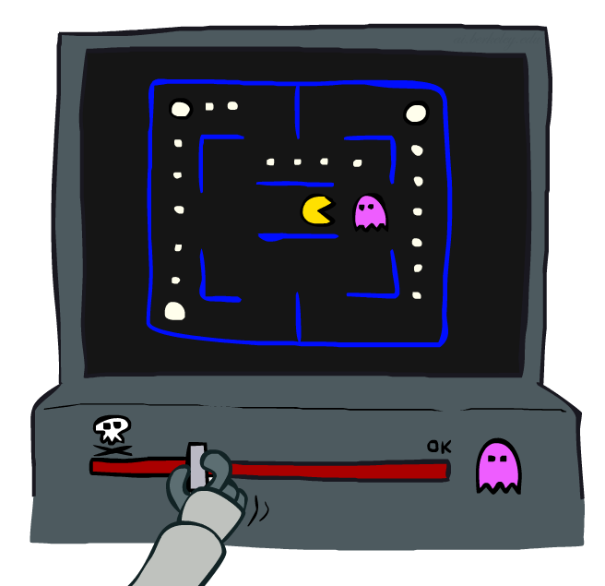
Approximate Q-Learning

Slide 28
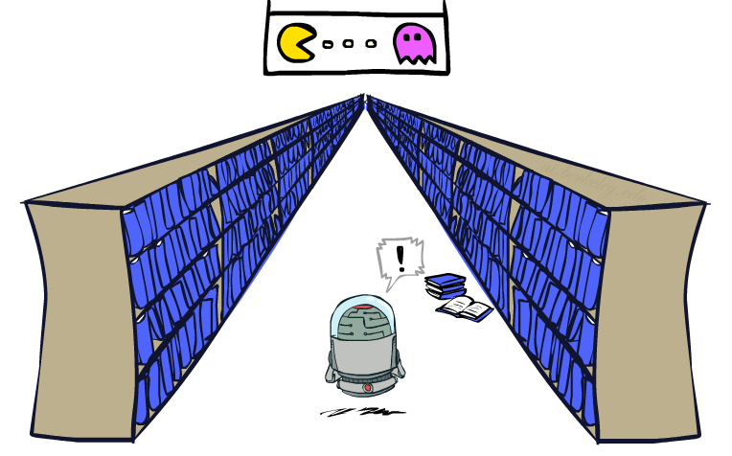
Generalizing Across States
Basic Q-Learning keeps a table of all q-values
In realistic situations, we cannot possibly learn about every single state!
Too many states to visit them all in training
Too many states to hold the q-tables in memory
Instead, we want to generalize:
Learn about some small number of training states from experience
Generalize that experience to new, similar situations
This is a fundamental idea in machine learning, and we’ll see it over and over again

Slide 29
Example: Pacman
Let’s say we discover through experience that this state is bad:
In naïve q-learning, we know nothing about this state:
Or even this one!
[Demo: Q-learning – pacman – tiny – watch all (L11D4)]
[Demo: Q-learning – pacman – tiny – silent train (L11D6)]
[Demo: Q-learning – pacman – tricky – watch all (L11D5)]

Slide 30
Feature-Based Representations
Solution: describe a state using a vector of features (properties)
Features are functions from states to real numbers (often 0/1) that capture important properties of the state
Example features:
Distance to closest ghost
Distance to closest dot
Number of ghosts
1 / (dist to dot)²
Is Pacman in a tunnel? (0/1)
…… etc.
Is it the exact state on this slide?
Can also describe a q-state (s, a) with features (e.g. action moves closer to food)

Slide 31
Linear Value Functions
Using a feature representation, we can write a q function (or value function) for any state using a few weights:
Advantage: our experience is summed up in a few powerful numbers
Disadvantage: states may share features but actually be very different in value!

Slide 32
Approximate Q-Learning
Q-learning with linear Q-functions:
Intuitive interpretation:
Adjust weights of active features
E.g., if something unexpectedly bad happens, blame the features that were on: disprefer all states with that state’s features
Formal justification: online least squares
Exact Q’s
Approximate Q’s

Slide 33
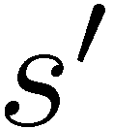
Example: Q-Pacman
[Demo: approximate Q-learning pacman (L11D8)]
Notes:
now when you run into ghosts you can figure out ghosts are bad; dots are good

Slide 34
Video of Demo Approximate Q-Learning -- Pacman

Slide 35
Reinforcement Learning -- Overview
Passive Reinforcement Learning (= how to learn from experiences)
Model-based Passive RL
Learn the MDP model from experiences, then solve the MDP
Model-free Passive RL
Forego learning the MDP model, directly learn V or Q:
Value learning – learns value of a fixed policy; 2 approaches: Direct Evaluation & TD Learning
Q learning – learns Q values of the optimal policy (uses a Q version of TD Learning)
Active Reinforcement Learning (= agent also needs to decide how to collect experiences)
Key challenges:
How to efficiently explore?
How to trade off exploration <> exploitation
Applies to both model-based and model-free. In CS188 we’ll cover only in context of Q-learning
Approximate Reinforcement Learning (= to handle large state spaces)
Approximate Q-Learning
Policy Search

Slide 36
Policy Search

Slide 37
Policy Search
Problem: often the feature-based policies that work well (win games, maximize utilities) aren’t the ones that approximate V / Q best
E.g. your value functions from project 2 were probably horrible estimates of future rewards, but they still produced good decisions
Q-learning’s priority: get Q-values close (modeling)
Action selection priority: get ordering of Q-values right (prediction)
Solution: learn policies that maximize rewards, not the values that predict them
Policy search: start with an ok solution (e.g. Q-learning) then fine-tune by hill climbing on feature weights

Slide 38
Policy Search
Simplest policy search:
Start with an initial linear value function or Q-function
Nudge each feature weight up and down and see if your policy is better than before
Problems:
How do we tell the policy got better?
Need to run many sample episodes!
If there are a lot of features, this can be impractical
Better methods exploit lookahead structure, sample wisely, change multiple parameters…

Slide 39
To Summarize …
Known MDP: Offline Solution
Goal Technique
Compute V*, Q*, π* Value / policy iteration
Evaluate a fixed policy π Policy evaluation
Unknown MDP: Model-Based
Unknown MDP: Model-Free
Goal Technique
Compute V*, Q*, π* VI/PI on approx. MDP
Evaluate a fixed policy π PE on approx. MDP
Goal Technique
Compute V*, Q*, π* Q-learning
Evaluate a fixed policy π Value Learning

Slide 40
Next Time
Machine Learning!
Learning CPTs in Bayes Nets from data
From Perceptron to Neural Networks
Optimization

