Slide 1
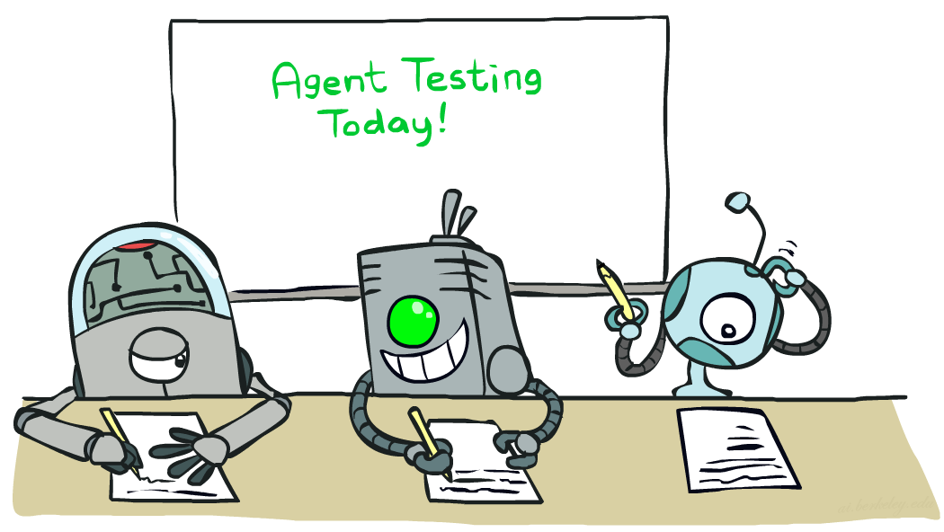

CS 188: Artificial Intelligence
ML Basics, Naïve Bayes
Instructor: Pieter Abbeel -- University of California, Berkeley
[These slides were created by Dan Klein, Pieter Abbeel, Anca Dragang, Sergey Levine, with some materials from A. Farhadi. All CS188 materials are at http://ai.berkeley.edu.]
Notes:
Please retain proper attribution, including the reference to ai.berkeley.edu. Thanks!

Slide 2
Reinforcement Learning -- Overview
Passive Reinforcement Learning (= how to learn from experiences)
  Model-based Passive RL
    Learn the MDP model from experiences, then solve the MDP
  Model-free Passive RL
    Forego learning the MDP model, directly learn V or Q:
      Value learning – learns value of a fixed policy; 2 approaches: Direct Evaluation & TD Learning
      Q learning – learns Q values of the optimal policy (uses a Q version of TD Learning)
Active Reinforcement Learning (= agent also needs to decide how to collect experiences)
  Key challenges:
    How to efficiently explore?
    How to trade off exploration <> exploitation
  Applies to both model-based and model-free. In CS188 we’ll cover only in context of Q-learning
Approximate Reinforcement Learning (= to handle large state spaces)
  Approximate Q-Learning
  Policy Search

Slide 3




Example: Pacman
Let’s say we discover through experience that this state is bad:
In naïve q-learning, we know nothing about this state:
Or even this one!
[Demo: Q-learning – pacman – tiny – watch all (L11D4)]
[Demo: Q-learning – pacman – tiny – silent train (L11D6)]
[Demo: Q-learning – pacman – tricky – watch all (L11D5)]

Slide 4
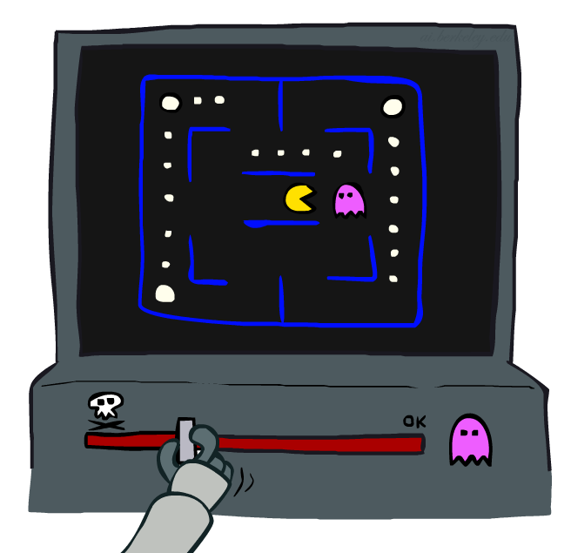
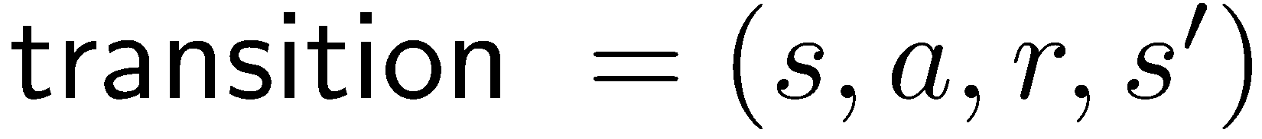
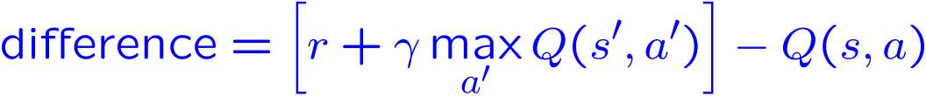
Approximate Q-Learning
Q-learning with linear Q-functions:
Exact Q’s
Approximate Q’s

Slide 5

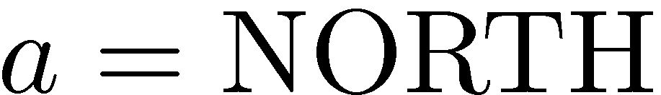
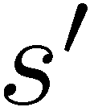
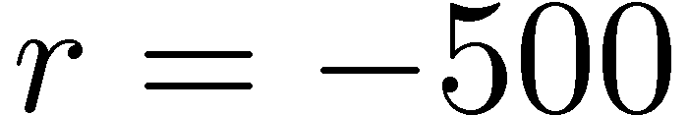


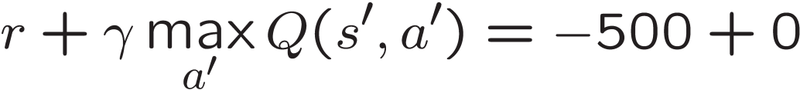
Example: Q-Pacman
[Demo: approximate Q-learning pacman (L11D8)]
Notes:
now when you run into ghosts you can figure out ghosts are bad; dots are good

Slide 6

Video of Demo Approximate Q-Learning -- Pacman

Slide 7
Reinforcement Learning -- Overview
Passive Reinforcement Learning (= how to learn from experiences)
  Model-based Passive RL
    Learn the MDP model from experiences, then solve the MDP
  Model-free Passive RL
    Forego learning the MDP model, directly learn V or Q:
      Value learning – learns value of a fixed policy; 2 approaches: Direct Evaluation & TD Learning
      Q learning – learns Q values of the optimal policy (uses a Q version of TD Learning)
Active Reinforcement Learning (= agent also needs to decide how to collect experiences)
  Key challenges:
    How to efficiently explore?
    How to trade off exploration <> exploitation
  Applies to both model-based and model-free. In CS188 we’ll cover only in context of Q-learning
Approximate Reinforcement Learning (= to handle large state spaces)
  Approximate Q-Learning
  Policy Search

Slide 8
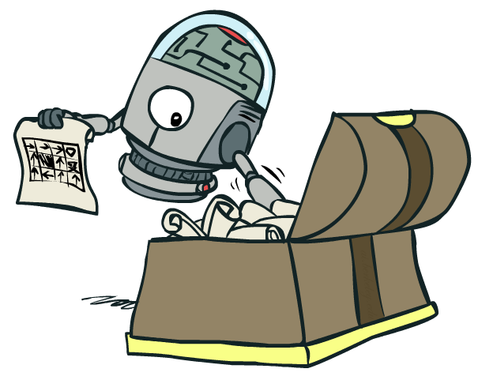
Policy Search

Slide 9
Policy Search
Problem: often the feature-based policies that work well (win games, maximize utilities) aren’t the ones that approximate V / Q best
  E.g. your value functions from project 2 were probably horrible estimates of future rewards, but they still produced good decisions
  Q-learning’s priority: get Q-values close (modeling)
  Action selection priority: get ordering of Q-values right (prediction)
Solution: learn policies that maximize rewards, not the values that predict them
Policy search: start with an ok solution (e.g. Q-learning) then fine-tune by hill climbing on feature weights

Slide 10
Policy Search
Simplest policy search:
  Start with an initial linear value function or Q-function
  Nudge each feature weight up and down and see if your policy is better than before
Problems:
  How do we tell the policy got better?
  Need to run many sample episodes!
  If there are a lot of features, this can be impractical
Better methods exploit lookahead structure, sample wisely, change multiple parameters…

Slide 11
To Summarize …
Known MDP: Offline Solution
Goal Technique
Compute V*, Q*, π* Value / policy iteration
Evaluate a fixed policy π Policy evaluation
Unknown MDP: Model-Based
Unknown MDP: Model-Free
Goal Technique
Compute V*, Q*, π* VI/PI on approx. MDP
Evaluate a fixed policy π PE on approx. MDP
Goal Technique
Compute V*, Q*, π* Q-learning
Evaluate a fixed policy π Value Learning

Slide 12
Machine Learning

Slide 13
Machine Learning
Up until now: how use a model to make optimal decisions
Machine learning: how to acquire a model from data / experience
  Learning parameters (e.g. probabilities)
  Learning structure (e.g. BN graphs)
  Learning hidden concepts (e.g. clustering)
Today: model-based classification with Naive Bayes

Slide 14
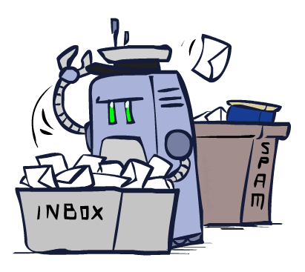
Classification

Slide 15
Example: Spam Filter
Input: an email
Output: spam/ham
Setup:
  Get a large collection of example emails, each labeled “spam” or “ham”
  Note: someone has to hand label all this data!
  Want to learn to predict labels of new, future emails
Features: The attributes used to make the ham / spam decision
  Words: FREE!
  Text Patterns: $dd, CAPS
  Non-text: SenderInContacts, WidelyBroadcast
  …
Dear Sir.
First, I must solicit your confidence in this transaction, this is by virture of its nature as being utterly confidencial and top secret. …
TO BE REMOVED FROM FUTURE MAILINGS, SIMPLY REPLY TO THIS MESSAGE AND PUT "REMOVE" IN THE SUBJECT.
99 MILLION EMAIL ADDRESSES
FOR ONLY $99
Ok, Iknow this is blatantly OT but I'm beginning to go insane. Had an old Dell Dimension XPS sitting in the corner and decided to put it to use, I know it was working pre being stuck in the corner, but when I plugged it in, hit the power nothing happened.

Slide 16




Example: Digit Recognition
Input: images / pixel grids
Output: a digit 0-9
Setup:
  Get a large collection of example images, each labeled with a digit
  Note: someone has to hand label all this data!
  Want to learn to predict labels of new, future digit images
Features: The attributes used to make the digit decision
  Pixels: (6,8)=ON
  Shape Patterns: NumComponents, AspectRatio, NumLoops
  …
0
1
2
1
??

Slide 17
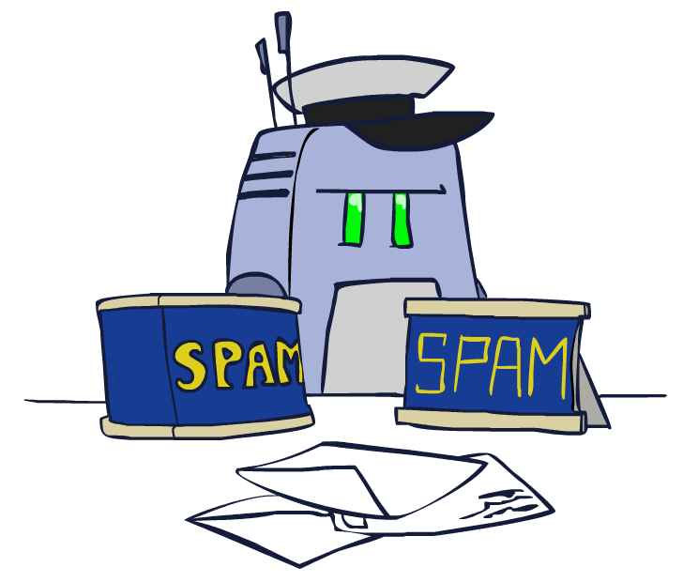
Model-Based Classification

Slide 18
Model-Based Classification
Model-based approach
  Build a model (e.g. Bayes’ net) where both the label and features are random variables
  Instantiate any observed features
  Query for the distribution of the label conditioned on the features
Challenges
  What structure should the BN have?
  How should we learn its parameters?

Slide 19



Naïve Bayes for Digits
Naïve Bayes: Assume all features are independent effects of the label
Simple digit recognition version:
  One feature (variable) F_{ij} for each grid position <i,j>
  Feature values are on / off, based on whether intensity
  is more or less than 0.5 in underlying image
  Each input maps to a feature vector, e.g.
  Here: lots of features, each is binary valued
Naïve Bayes model:
What do we need to learn?
Y
F₁
F₂
F_{n}
Notes:
Note: small CPTs, so not a lot of parameters to be learned

Slide 20
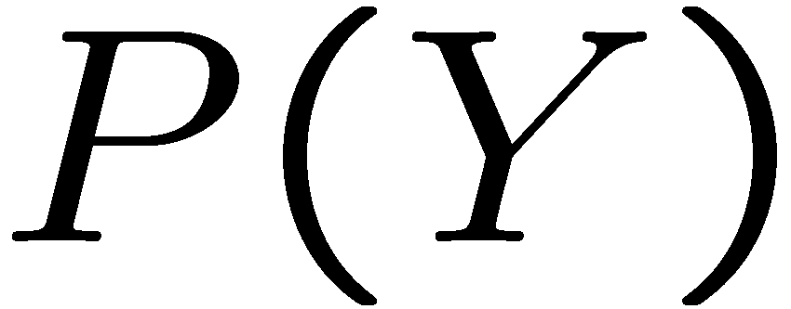


Naïve Bayes for Digits: Conditional Probabilities
1 | 0.1
2 | 0.1
3 | 0.1
4 | 0.1
5 | 0.1
6 | 0.1
7 | 0.1
8 | 0.1
9 | 0.1
0 | 0.1
1 | 0.01
2 | 0.05
3 | 0.05
4 | 0.30
5 | 0.80
6 | 0.90
7 | 0.05
8 | 0.60
9 | 0.50
0 | 0.80
1 | 0.05
2 | 0.01
3 | 0.90
4 | 0.80
5 | 0.90
6 | 0.90
7 | 0.25
8 | 0.85
9 | 0.60
0 | 0.80

Slide 21

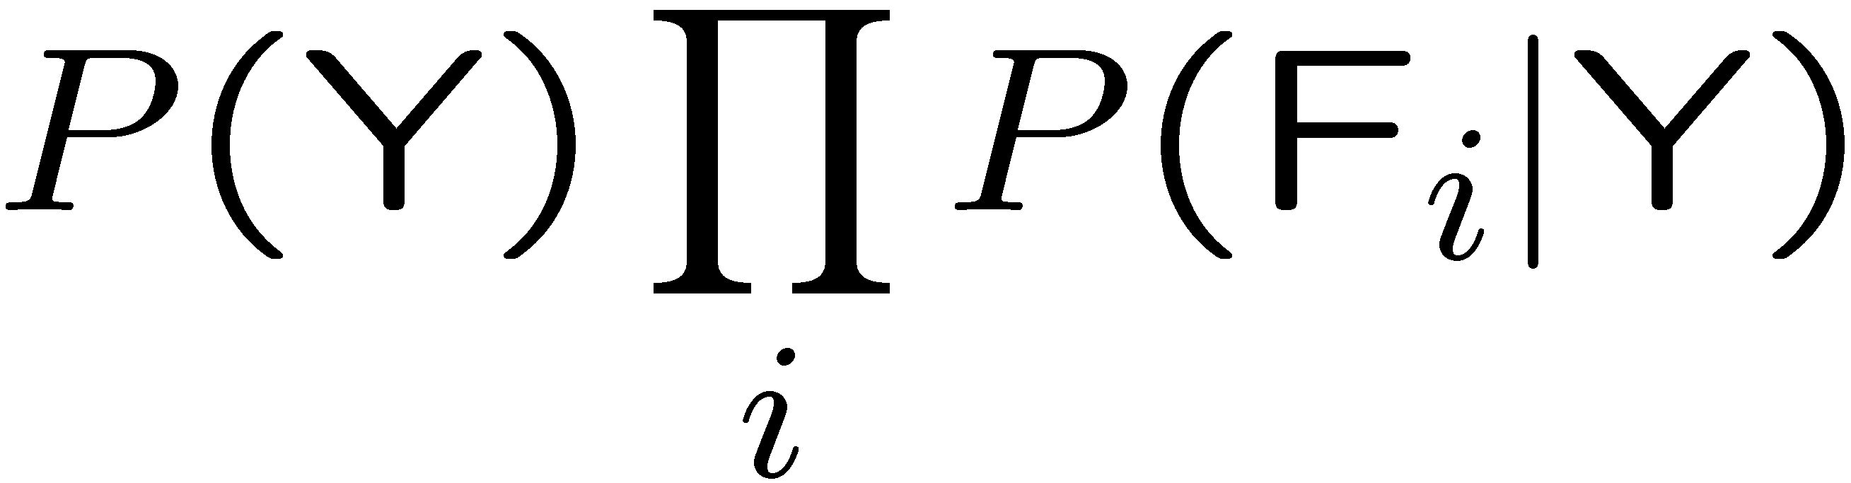
General Naïve Bayes
A general Naive Bayes model:
We only have to specify how each feature depends on the class
Total number of parameters is linear in n
Model is very simplistic, but often works anyway
Y
|Y| parameters
F₁
F₂
F_{n}
|Y| x |F|^{n} values
n x |F| x |Y| parameters

Slide 22
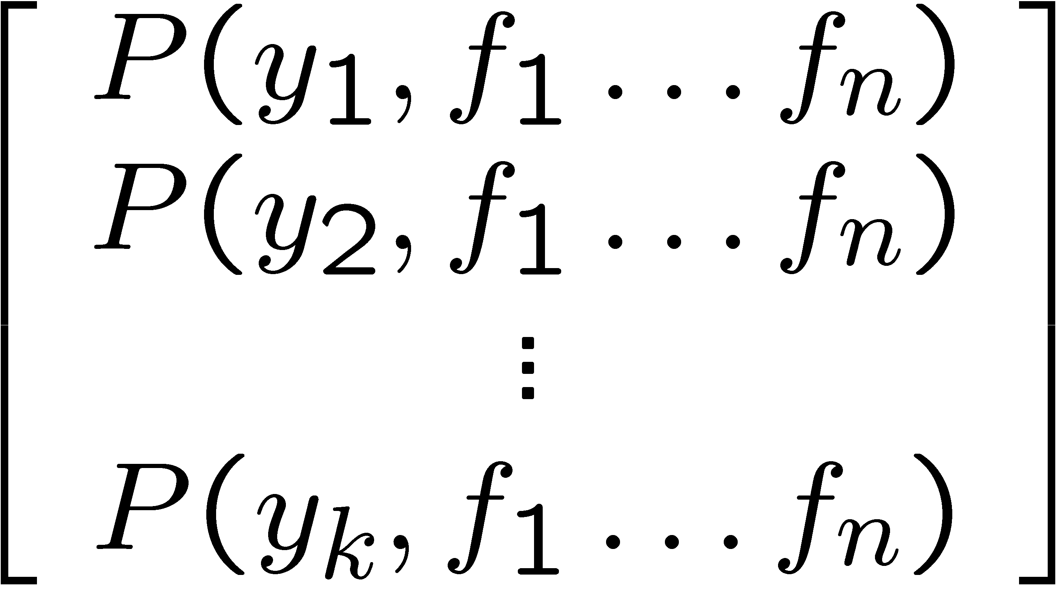
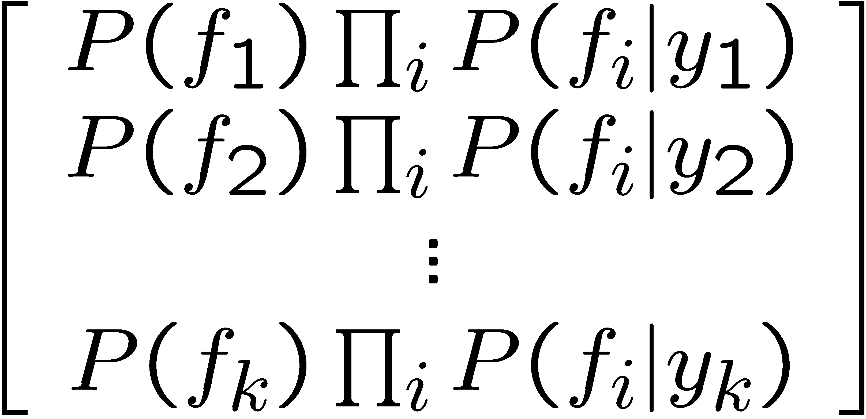
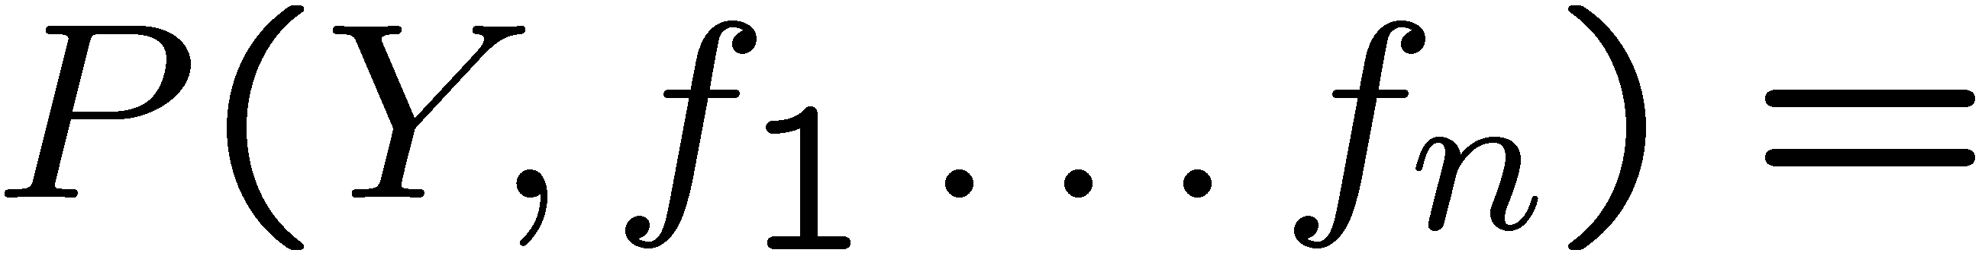
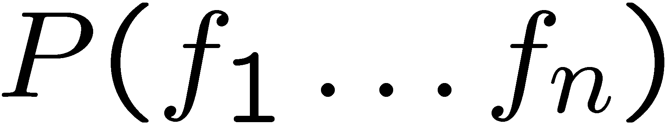
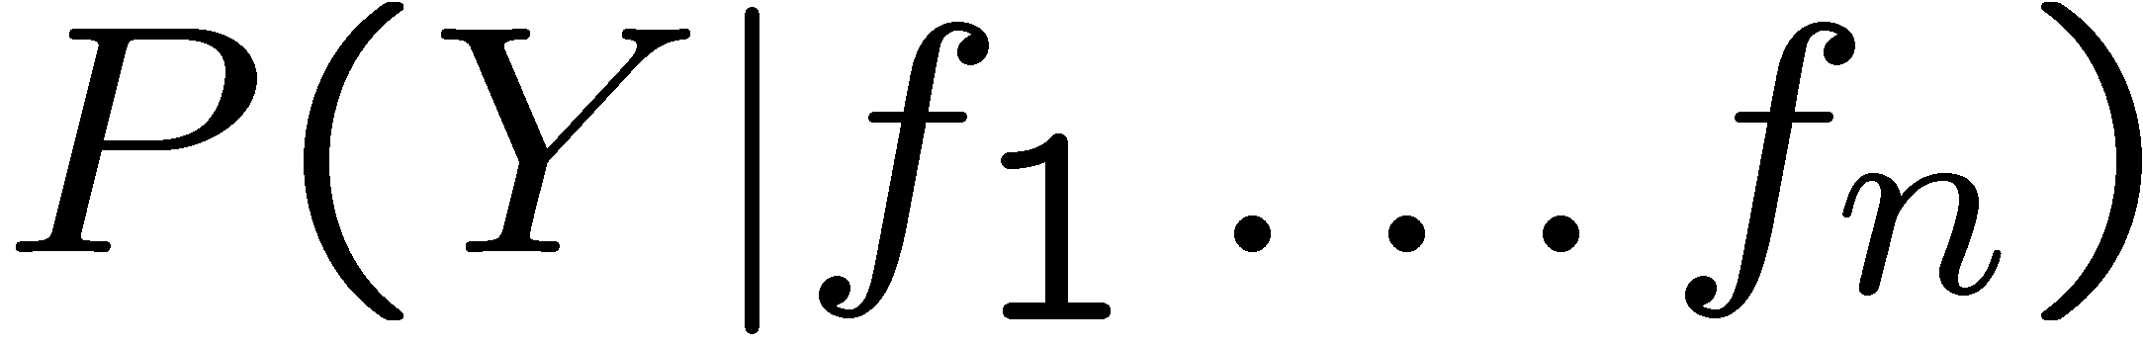
Inference for Naïve Bayes
Goal: compute posterior distribution over label variable Y
  Step 1: get joint probability of label and evidence for each label
  Step 2: sum to get probability of evidence
  Step 3: normalize by dividing Step 1 by Step 2
+

Slide 23
A Spam Filter
Naïve Bayes spam filter
Data:
  Collection of emails, labeled spam or ham
  Note: someone has to hand label all this data!
  Split into training, held-out, test sets
Classifiers
  Learn on the training set
  (Tune it on a held-out set)
  Test it on new emails
Dear Sir.
First, I must solicit your confidence in this transaction, this is by virture of its nature as being utterly confidencial and top secret. …
TO BE REMOVED FROM FUTURE MAILINGS, SIMPLY REPLY TO THIS MESSAGE AND PUT "REMOVE" IN THE SUBJECT.
99 MILLION EMAIL ADDRESSES
FOR ONLY $99
Ok, Iknow this is blatantly OT but I'm beginning to go insane. Had an old Dell Dimension XPS sitting in the corner and decided to put it to use, I know it was working pre being stuck in the corner, but when I plugged it in, hit the power nothing happened.

Slide 24
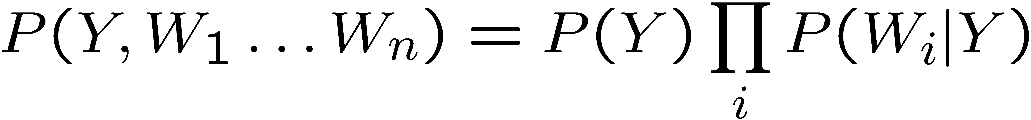
Naïve Bayes for Text
Bag-of-words Naïve Bayes:
  Features: W_{i} is the word at positon i
  As before: predict label conditioned on feature variables (spam vs. ham)
  As before: assume features are conditionally independent given label
  New: each W_{i} is identically distributed
Generative model:
“Tied” distributions and bag-of-words
  Usually, each variable gets its own conditional probability distribution P(F|Y)
  In a bag-of-words model
    Each position is identically distributed
    All positions share the same conditional probs P(W|Y)
    Why make this assumption?
  Called “bag-of-words” because model is insensitive to word order or reordering
how many variables are there?
how many values?
Word at position i, not i^{th} word in the dictionary!
Oh sorry I was still on mute
Was sorry oh mute still I

Slide 25

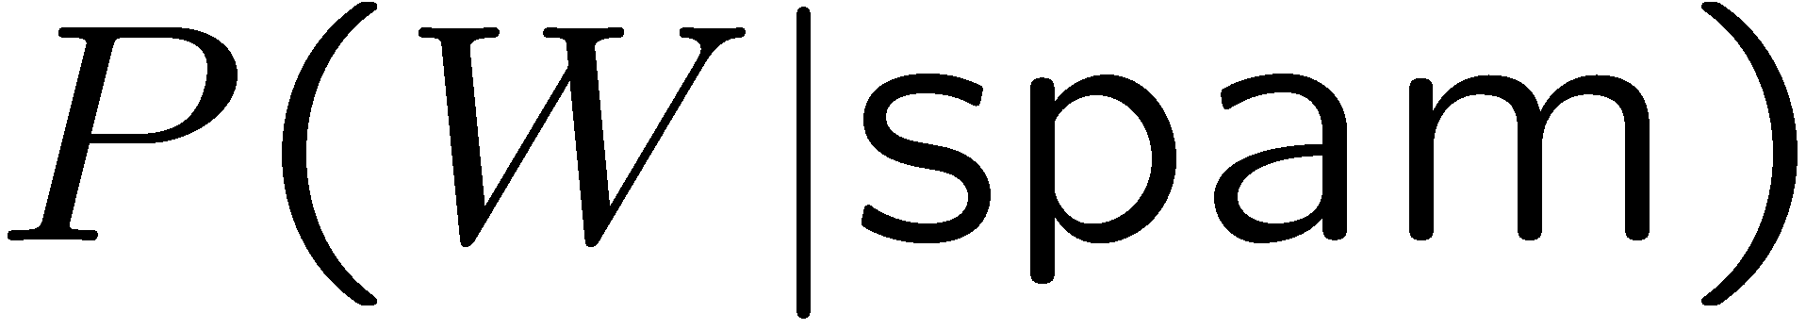
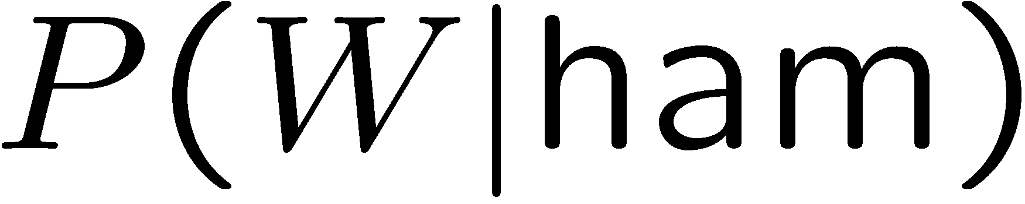
Example: Spam Filtering
Model:
What are the parameters?
ham : 0.66
spam: 0.33
the : 0.0156
to : 0.0153
and : 0.0115
of : 0.0095
you : 0.0093
a : 0.0086
with: 0.0080
from: 0.0075
...
the : 0.0210
to : 0.0133
of : 0.0119
2002: 0.0110
with: 0.0108
from: 0.0107
and : 0.0105
a : 0.0100
...

Slide 26
General Naïve Bayes
What do we need in order to use Naïve Bayes?
  Inference method
    Start with a bunch of probabilities: P(Y) and the P(F_{i}|Y) tables
    Use standard inference to compute P(Y|F₁…F_{n})
    Nothing new here
  Estimates of local conditional probability tables
    P(Y), the prior over labels
    P(F_{i}|Y) for each feature (evidence variable)
    These probabilities are collectively called the parameters of the model and denoted by θ
    Up until now, we assumed these appeared by magic, but…
    …they typically come from training data counts

Slide 27
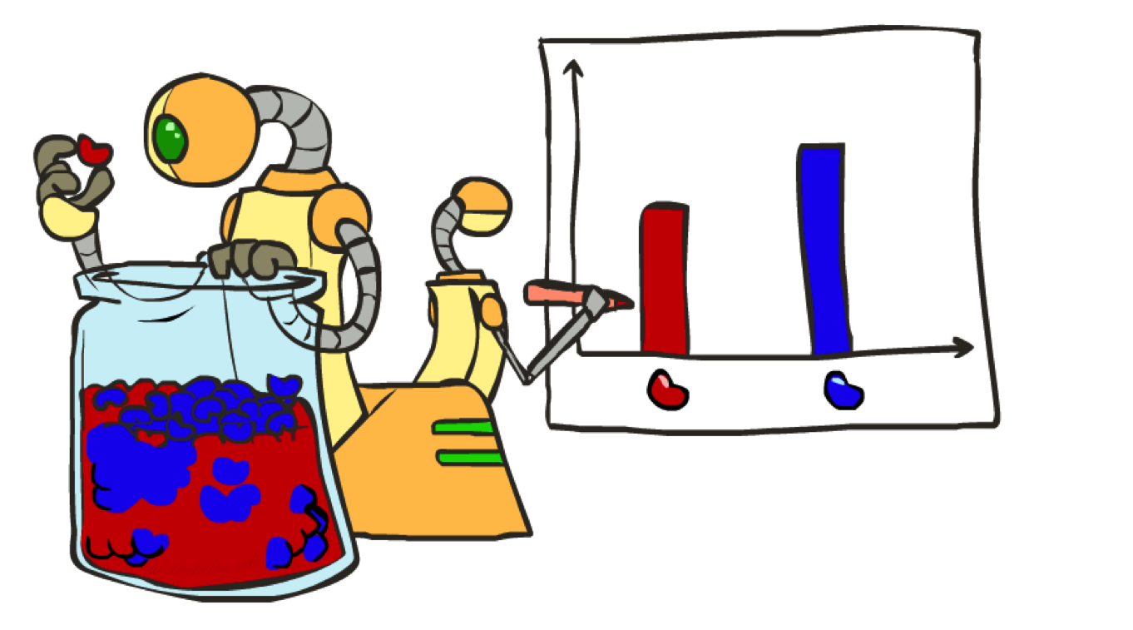
Parameter Estimation

Slide 28
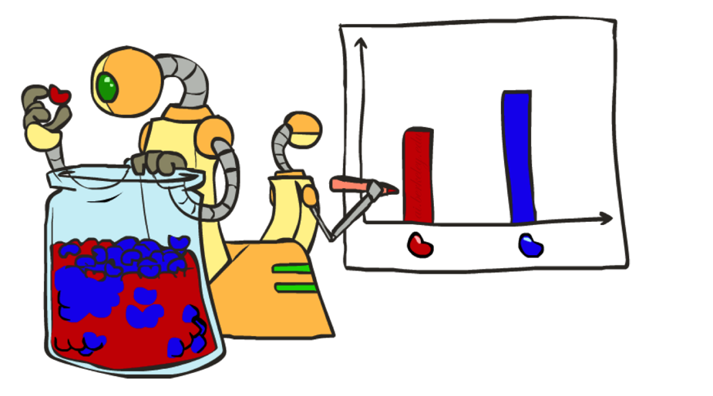
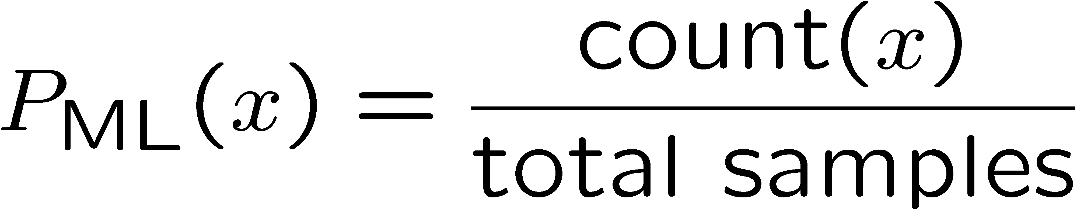

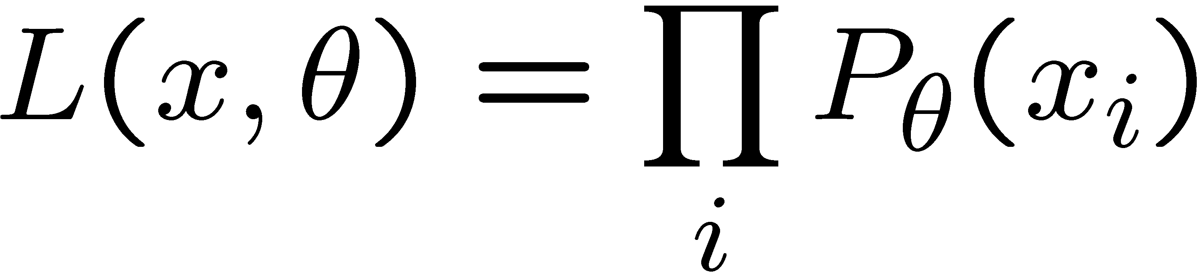





Parameter Estimation with Maximum Likelihood
Estimating the distribution of a random variable
Option 1: ask a human
Option 2: use training data (learning!)
  E.g.: for each outcome x, look at the empirical rate of that value:
  This is the estimate of the parameters that maximizes the likelihood of the data
r
b
b
b
r
r
b
b
b
r
r
b
b
b
b
r
r
b

Slide 29
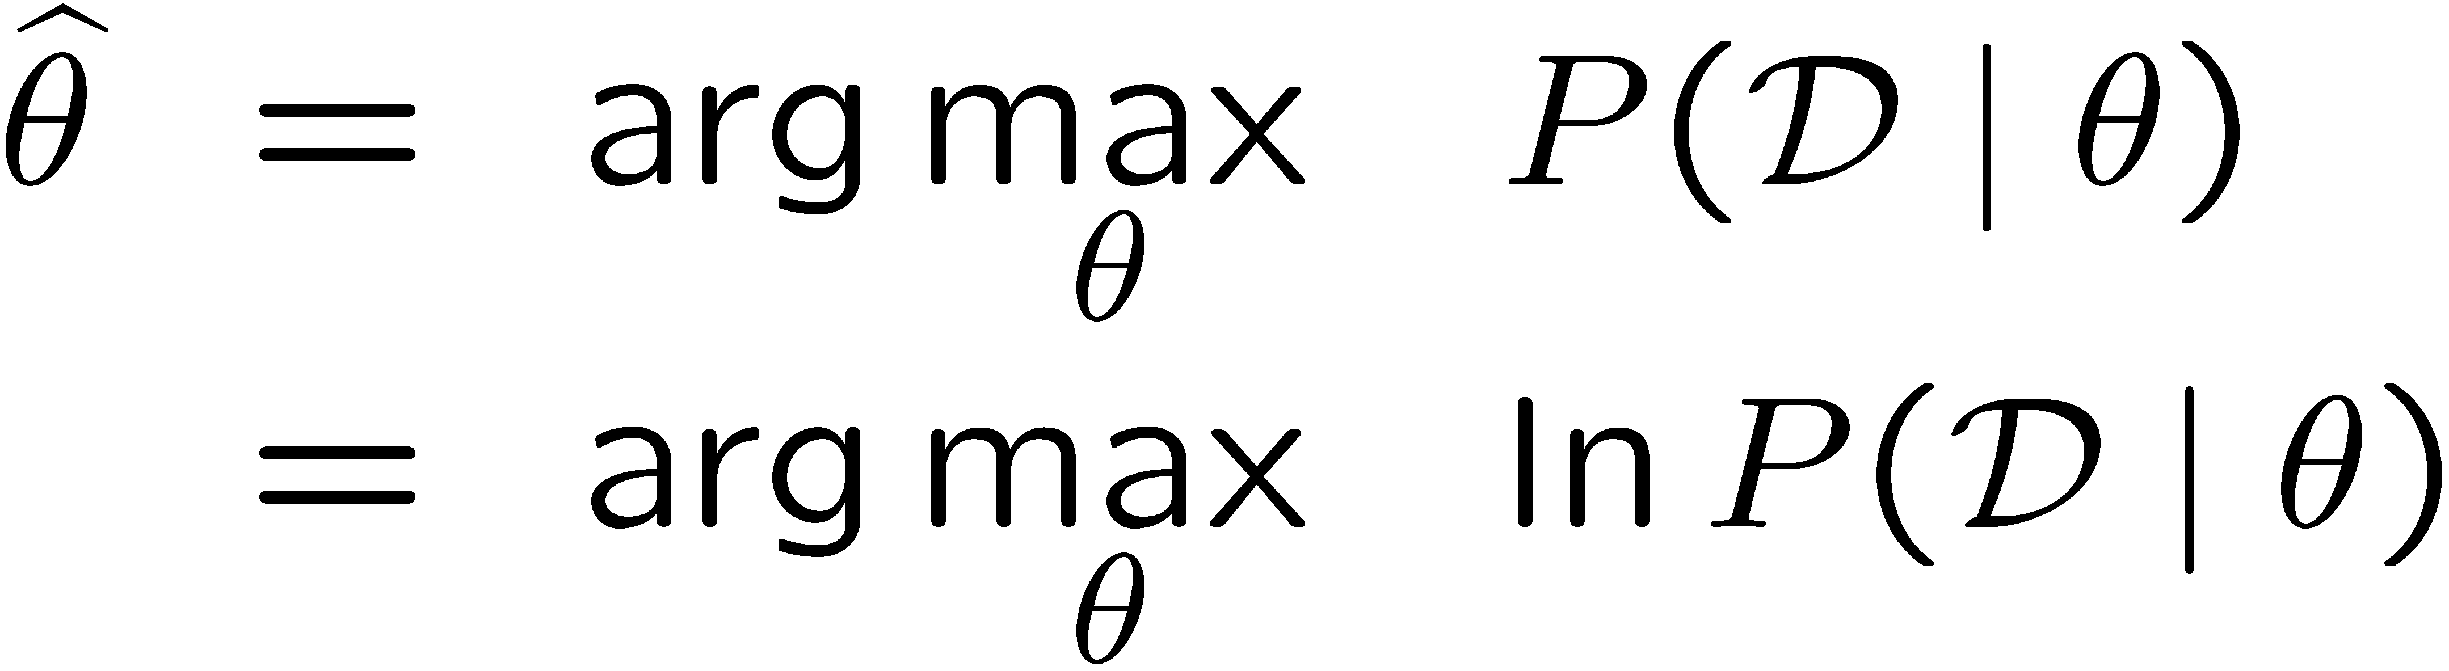
Parameter Estimation with Maximum Likelihood
Data: Observed set D of α_{H} Heads and α_{T} Tails
Hypothesis space: Binomial distributions
Learning: finding θ is an optimization problem
  What’s the objective function?
MLE: Choose θ to maximize probability of D

Slide 30
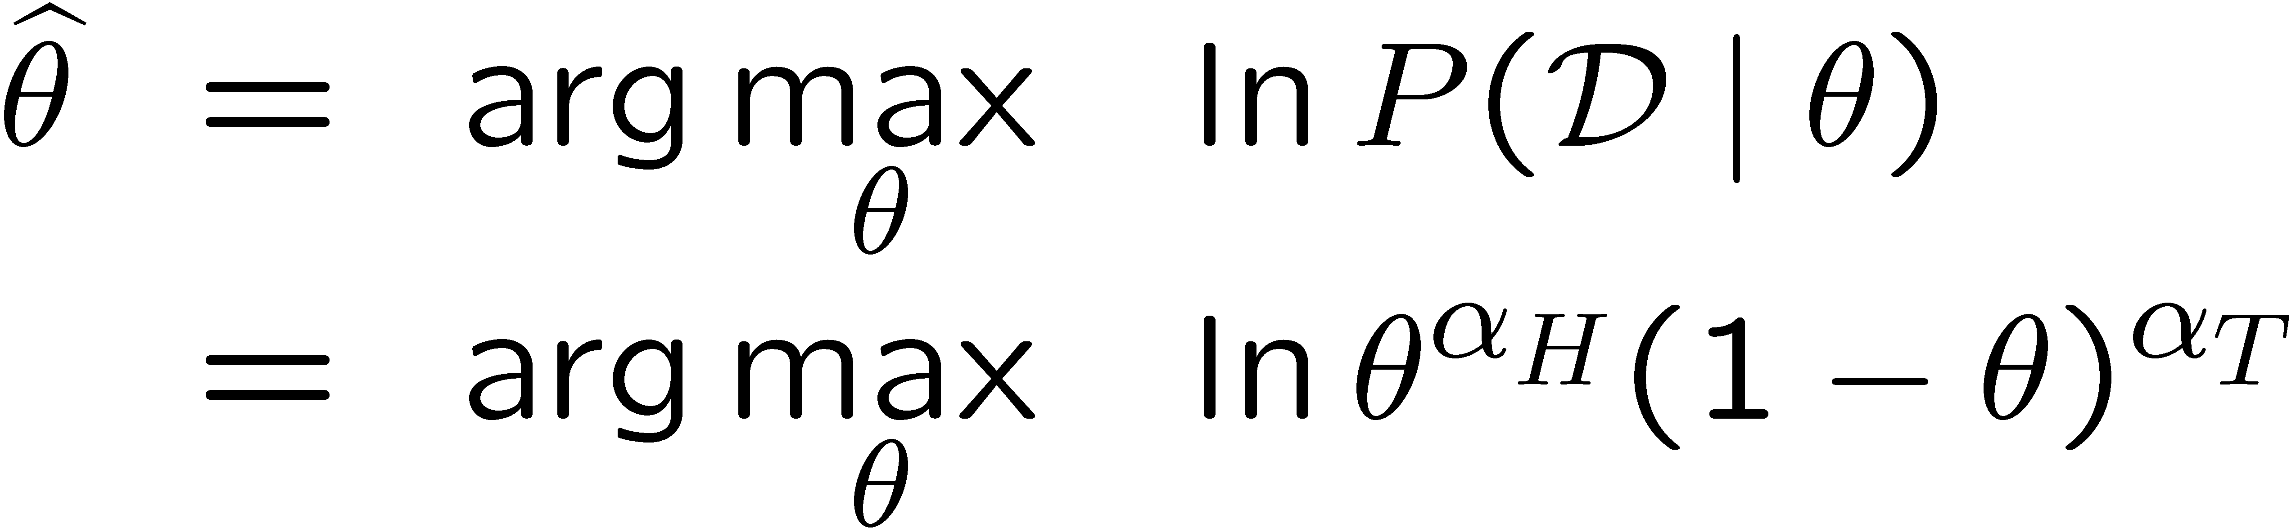
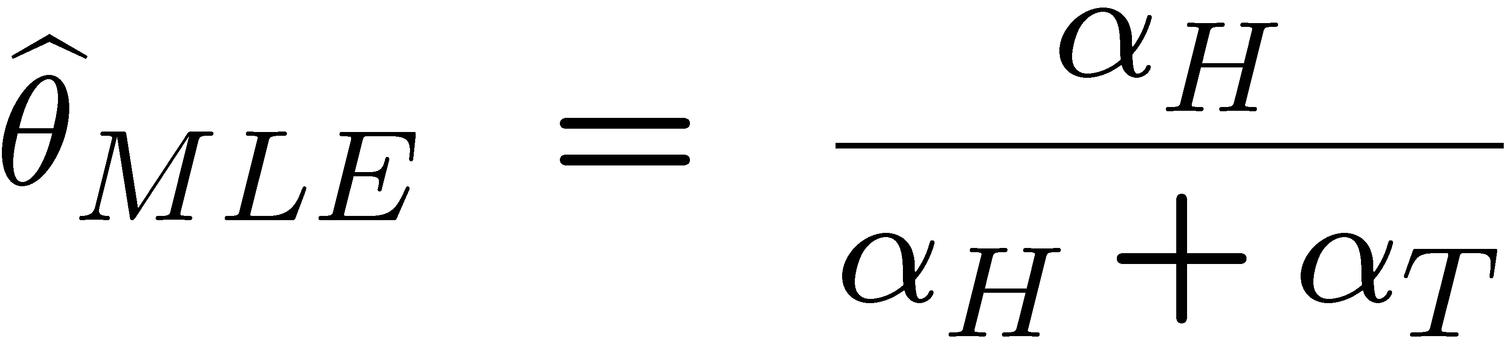
Parameter Estimation with Maximum Likelihood
Set derivative to zero, and solve!

Slide 31
Parameter Estimation with Maximum Likelihood
How do we estimate the conditional probability tables?
  Maximum Likelihood, which corresponds to counting
Need to be careful though … let’s see what can go wrong..

Slide 32

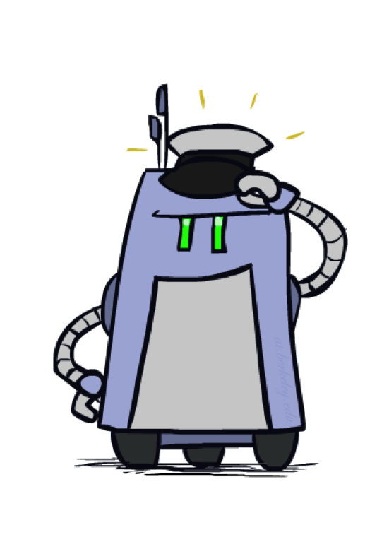
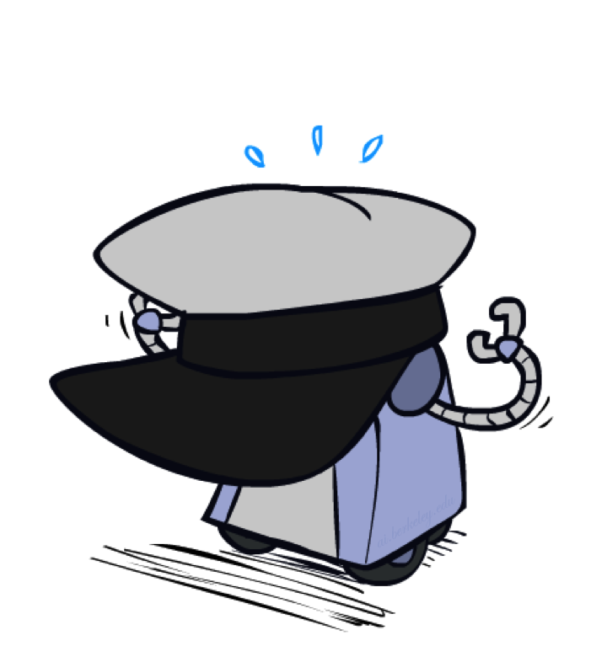
Underfitting and Overfitting

Slide 33












Example: Overfitting
2 wins!!

Slide 34
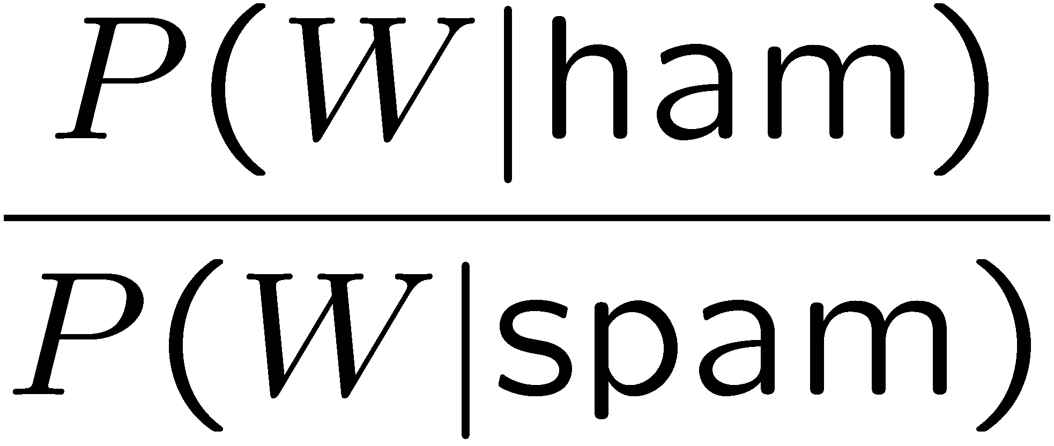
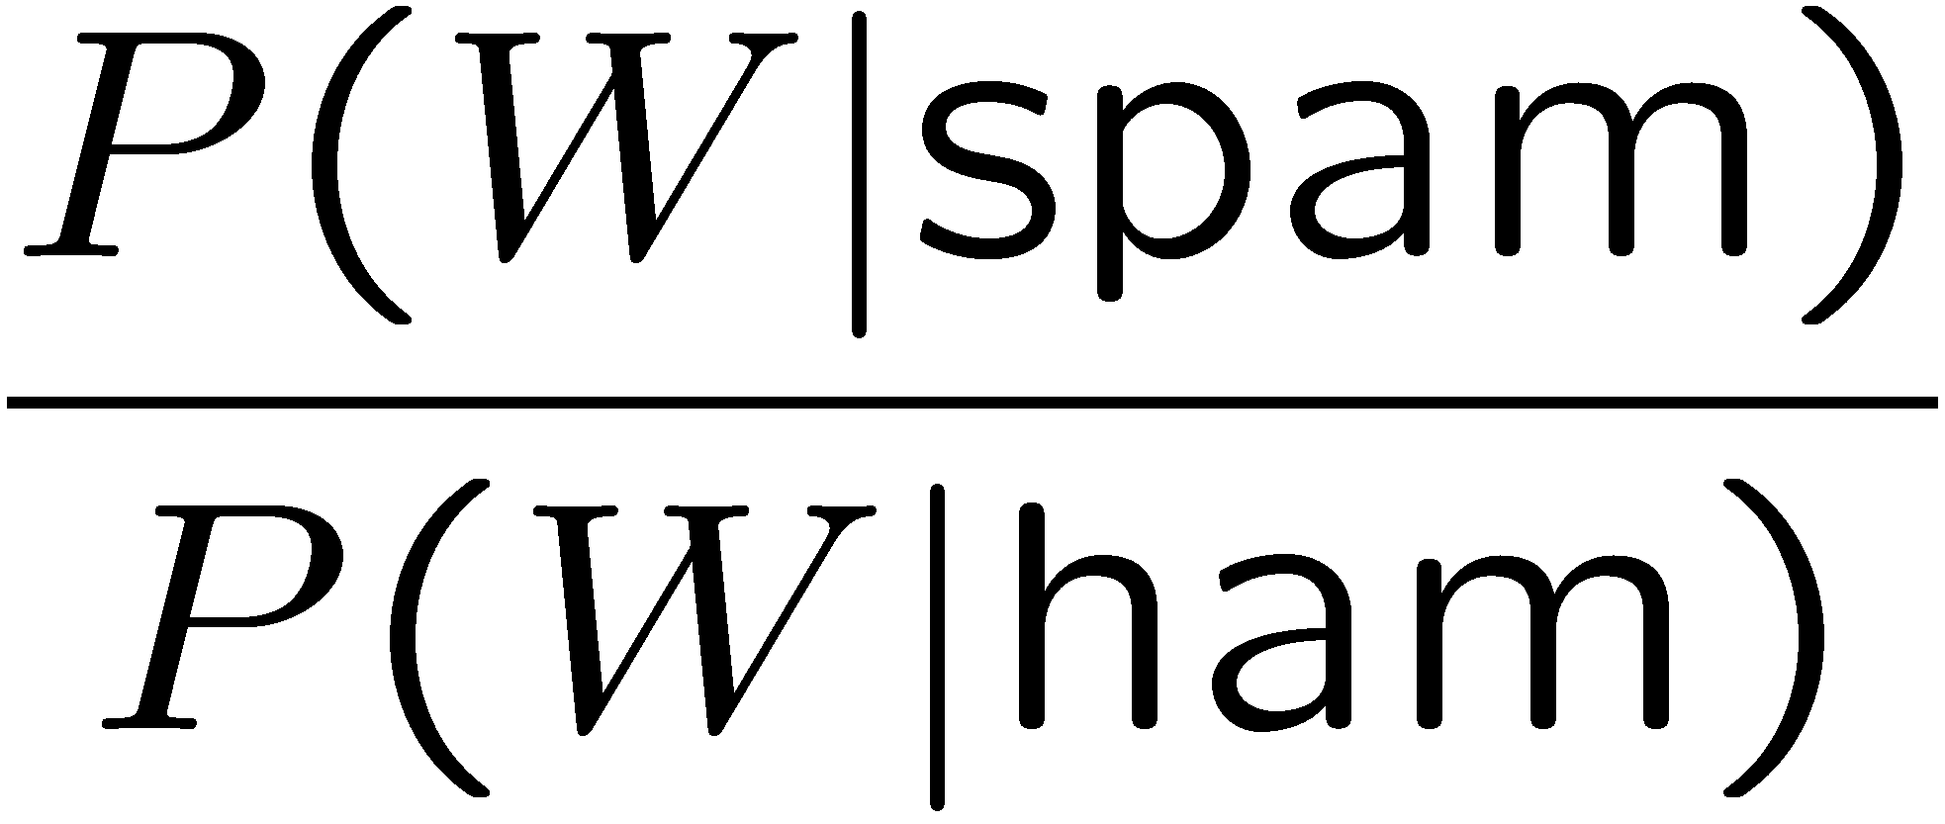
Example: Overfitting
relative probabilities (odds ratios):
south-west : inf
nation : inf
morally : inf
nicely : inf
extent : inf
seriously : inf
...
screens : inf
minute : inf
guaranteed : inf
$205.00 : inf
delivery : inf
signature : inf
...
What went wrong here?

Slide 35
Overfitting
30
25
20
Degree 15 polynomial
15
10
5
0
-5
-10
-15
0
2
4
6
8
10
12
14
16
18
20

Slide 36
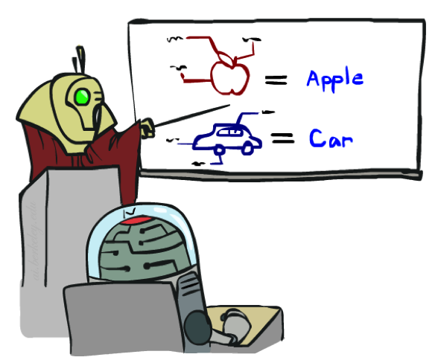
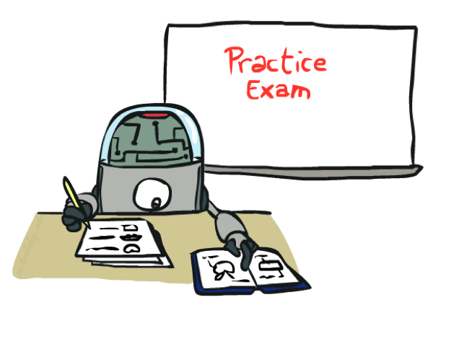
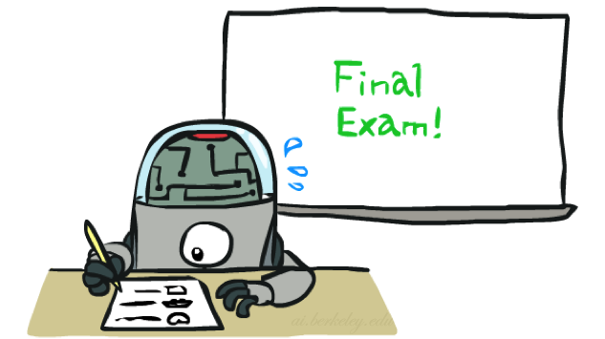
Training and Testing

Slide 37

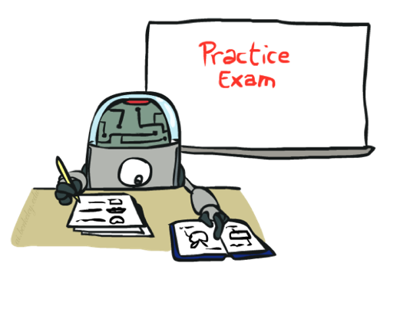
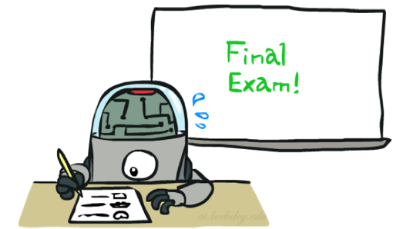
Important Concepts
Data: labeled instances, e.g. emails marked spam/ham
  Training set
  Held out set
  Test set
Features: attribute-value pairs which characterize each x
Experimentation cycle
  Learn parameters (e.g. model probabilities) on training set
  (Tune hyperparameters on held-out set)
  Compute accuracy on test set
  Very important: never “peek” at the test set!
Evaluation
  Accuracy: fraction of instances predicted correctly
Overfitting and generalization
  Want a classifier which does well on test data
  Overfitting: fitting the training data very closely, but not generalizing well
  Underfitting: fits the training set poorly
Training
Data
Held-Out
Data
Test
Data

Slide 38
Generalization and Overfitting
Relative frequency parameters will overfit the training data!
  Just because we never saw a 3 with pixel (15,15) on during training doesn’t mean we won’t see it at test time
  Unlikely that every occurrence of “minute” is 100% spam
  Unlikely that every occurrence of “seriously” is 100% ham
  What about all the words that don’t occur in the training set at all?
  In general, we can’t go around giving unseen events zero probability
As an extreme case, imagine using the entire email as the only feature
  Would get the training data perfect (if deterministic labeling)
  Wouldn’t generalize at all
  Just making the bag-of-words assumption gives us some generalization, but isn’t enough
To generalize better: we need to smooth or regularize the estimates

Slide 39
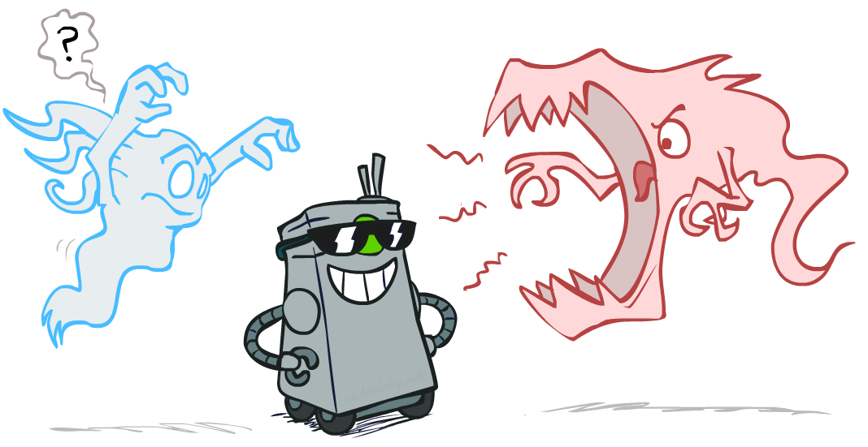
Smoothing

Slide 40

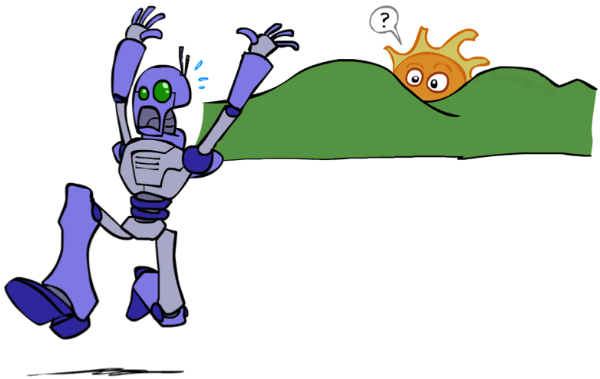
Unseen Events

Slide 41
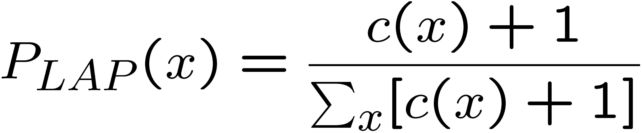
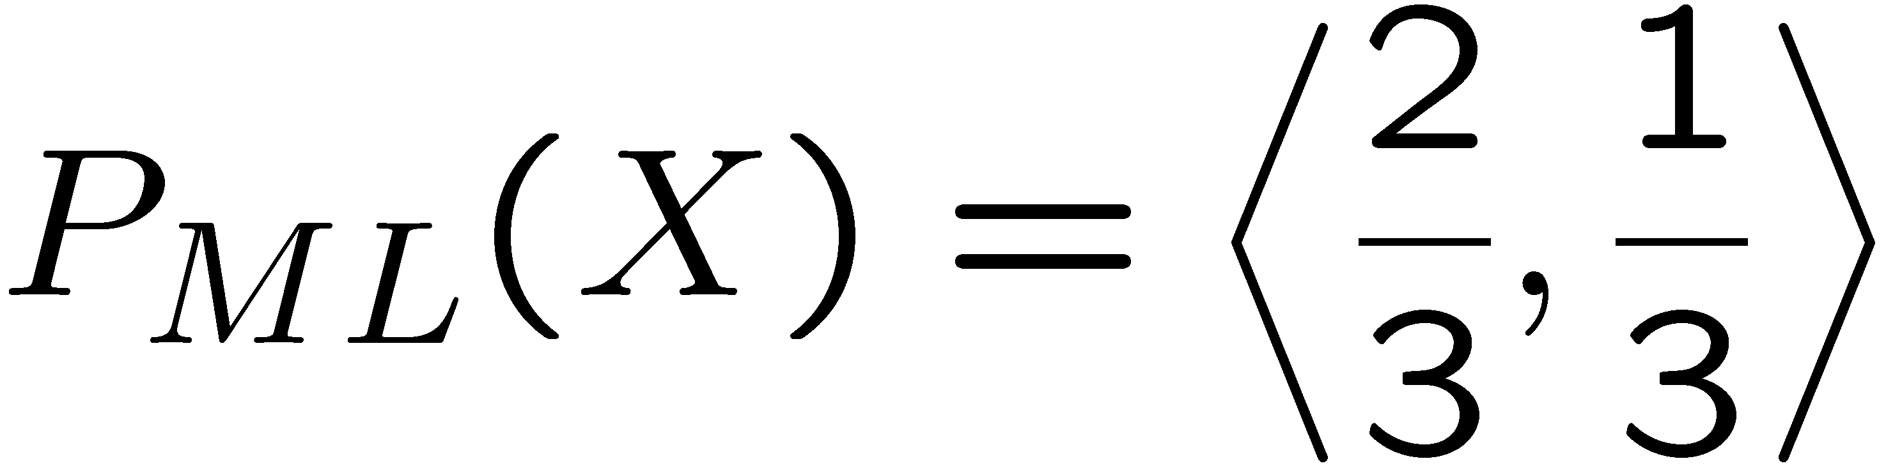
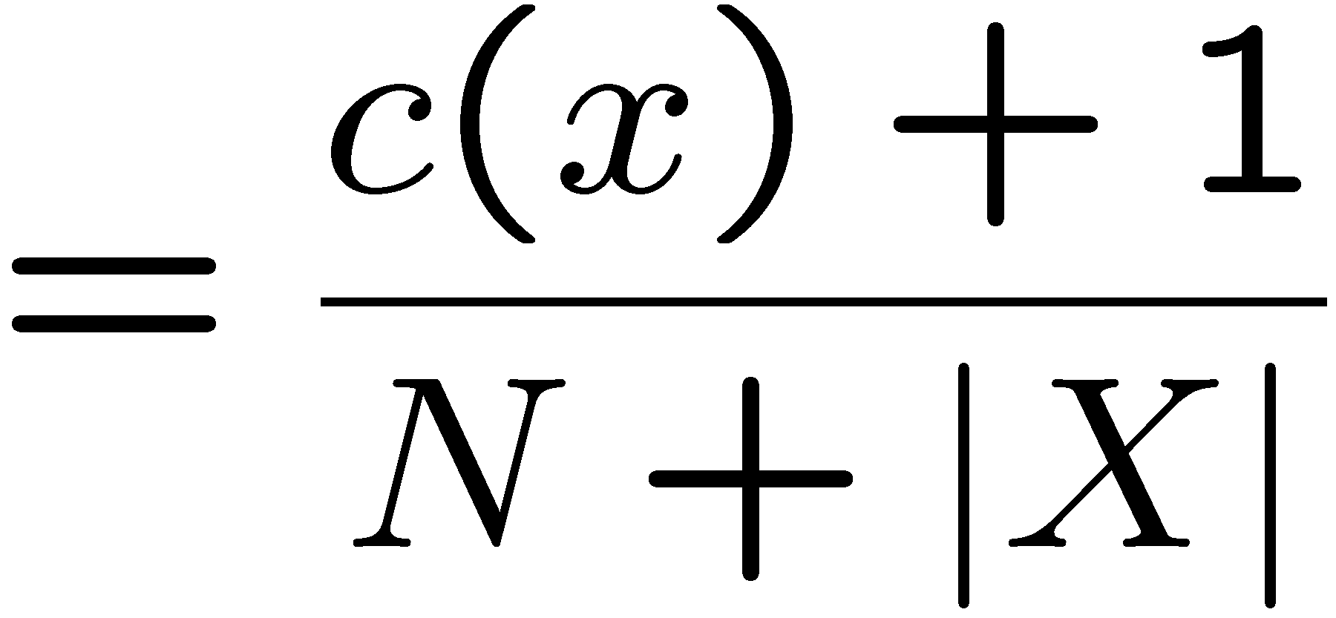
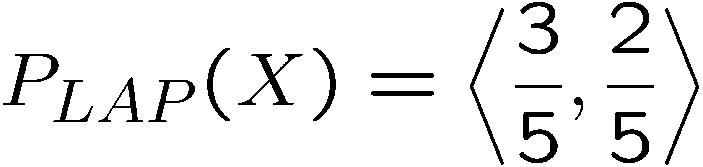
Laplace Smoothing
Laplace’s estimate:
  Pretend you saw every outcome once more than you actually did
  Can derive this estimate with Dirichlet priors (see cs281a)
r
r
b

Slide 42
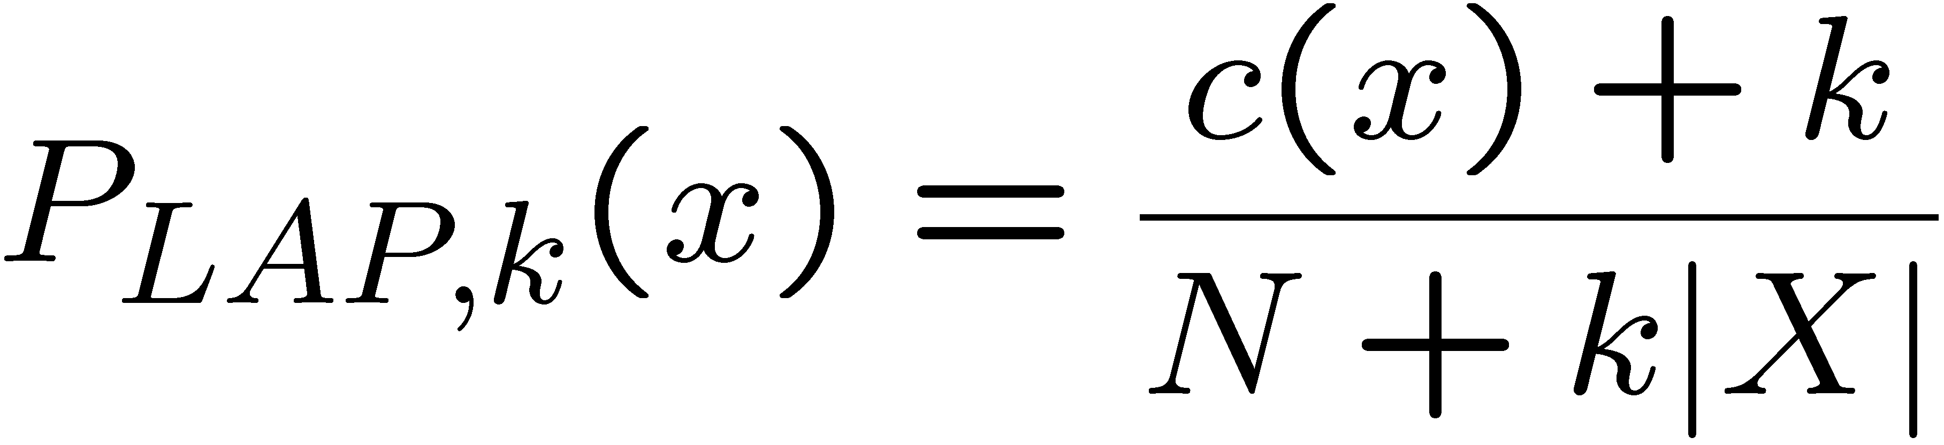
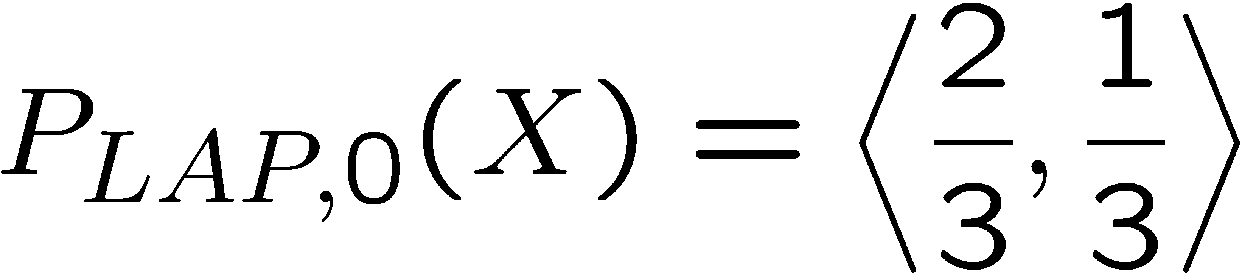
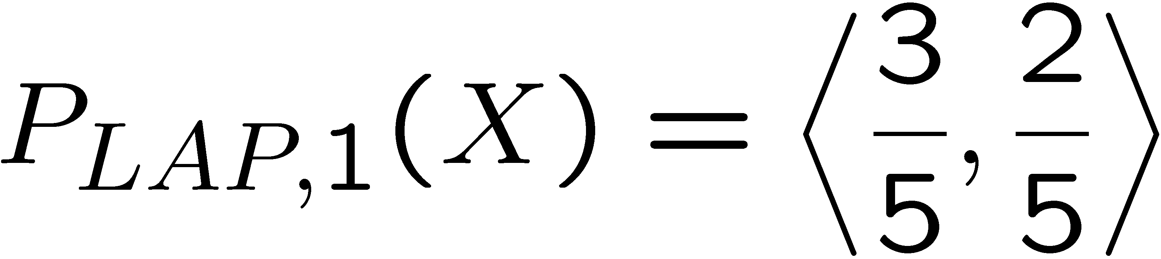
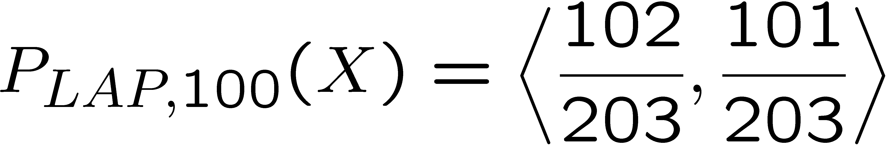
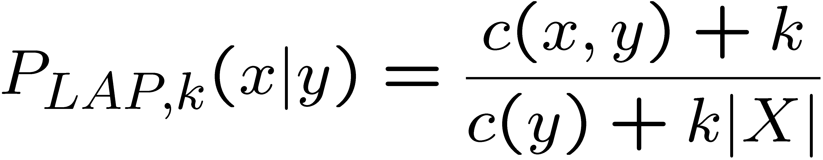
Laplace Smoothing
Laplace’s estimate (extended):
  Pretend you saw every outcome k extra times
  What’s Laplace with k = 0?
  k is the strength of the prior
Laplace for conditionals:
  Smooth each condition independently:
r
r
b

Slide 43
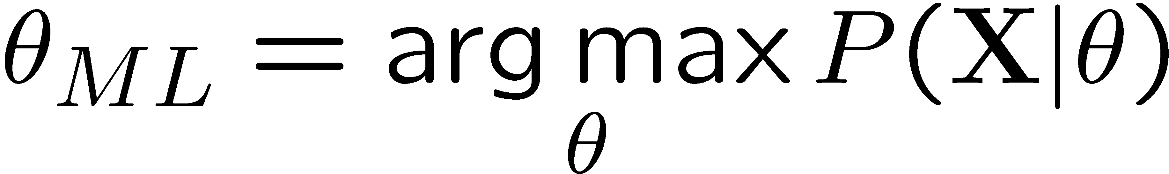
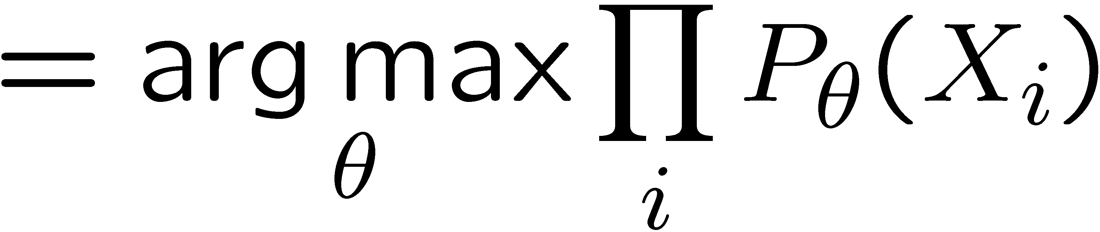



Laplace Smoothing Can Be More Formally Derived
Relative frequencies are the maximum likelihood estimates
Another option is to consider the most likely parameter value given the data
“right” choice of P(theta) -> Laplace estimates

Slide 44
Real NB: Smoothing
For real classification problems, smoothing is critical
New odds ratios:
helvetica : 11.4
seems : 10.8
group : 10.2
ago : 8.4
areas : 8.3
...
verdana : 28.8
Credit : 28.4
ORDER : 27.2
<FONT> : 26.9
money : 26.5
...
Do these make more sense?

Slide 45

Tuning

Slide 46








Tuning on Held-Out Data
Now we’ve got two kinds of unknowns
  Parameters: the probabilities P(X|Y), P(Y)
  Hyperparameters: e.g. the amount / type of smoothing to do, k, α
What should we learn where?
  Learn parameters from training data
  Tune hyperparameters on different data
    Why?
  For each value of the hyperparameters, train and test on the held-out data
  Choose the best value and do a final test on the test data

Slide 47
Practical Tip: Baselines
First step: get a baseline
  Baselines are very simple “straw man” procedures
  Help determine how hard the task is
  Help know what a “good” accuracy is
Weak baseline: most frequent label classifier
  Gives all test instances whatever label was most common in the training set
  E.g. for spam filtering, might label everything as ham
  Accuracy might be very high if the problem is skewed
  E.g. calling everything “ham” gets 66%, so a classifier that gets 70% isn’t very good…
For real research, usually use previous work as a (strong) baseline

Slide 48
Summary
Bayes rule lets us do diagnostic queries with causal probabilities
The naïve Bayes assumption takes all features to be independent given the class label
We can build classifiers out of a naïve Bayes model using training data
Smoothing estimates is important in real systems

