Slide 1

CS 188: Artificial Intelligence
Naïve Bayes, Perceptrons
Instructors: Angela Liu and Yanlai Yang
University of California, Berkeley
(Slides adapted from Pieter Abbeel, Dan Klein, Anca Dragan, Stuart Russell and Dawn Song)

Slide 2
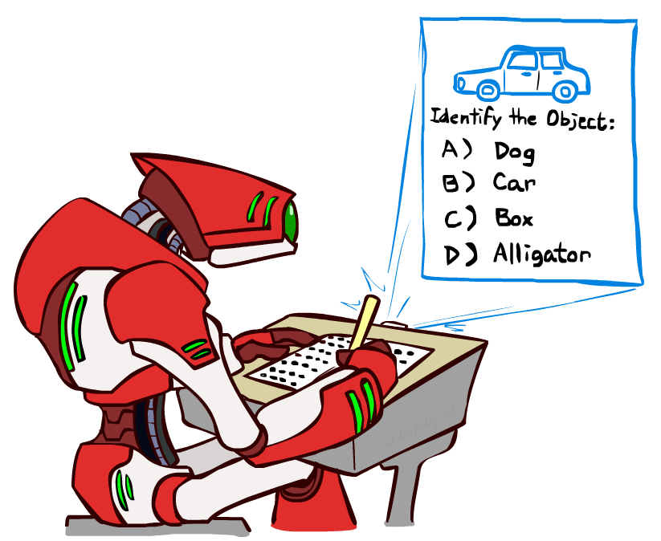


Last Time
Classification: given inputs x, predict labels (classes) y
Naïve Bayes
Y
F₁
F₂
F_{n}

Slide 3
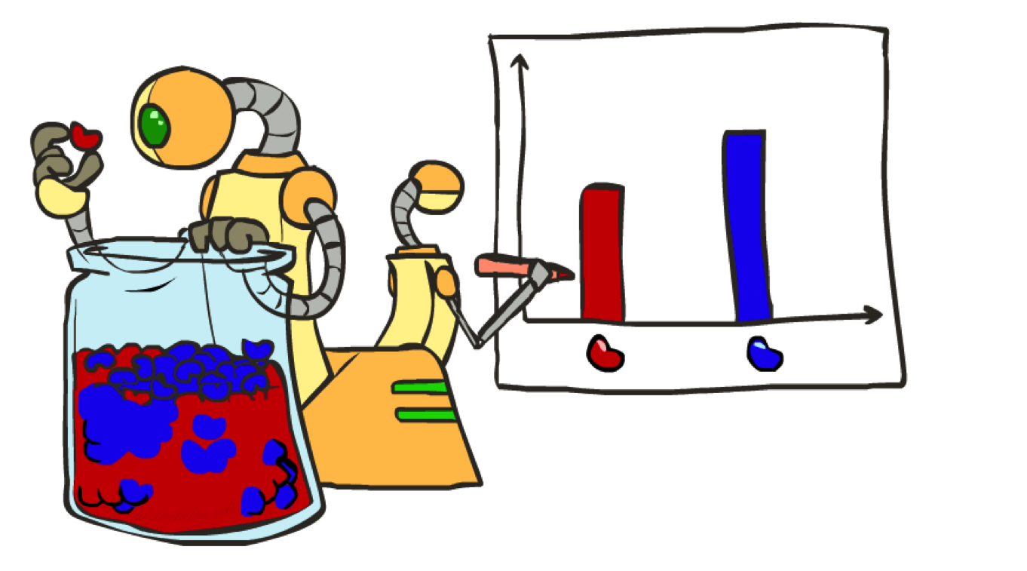
Parameter Estimation

Slide 4
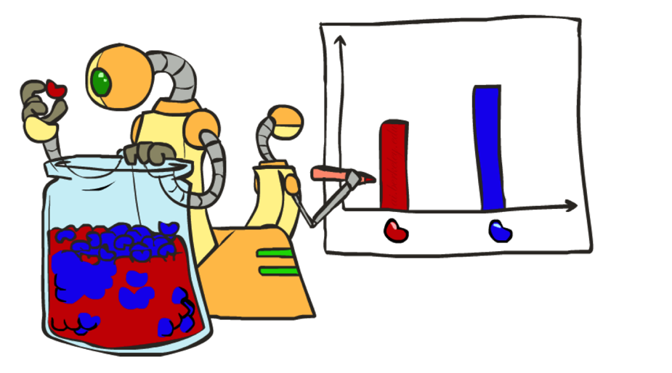
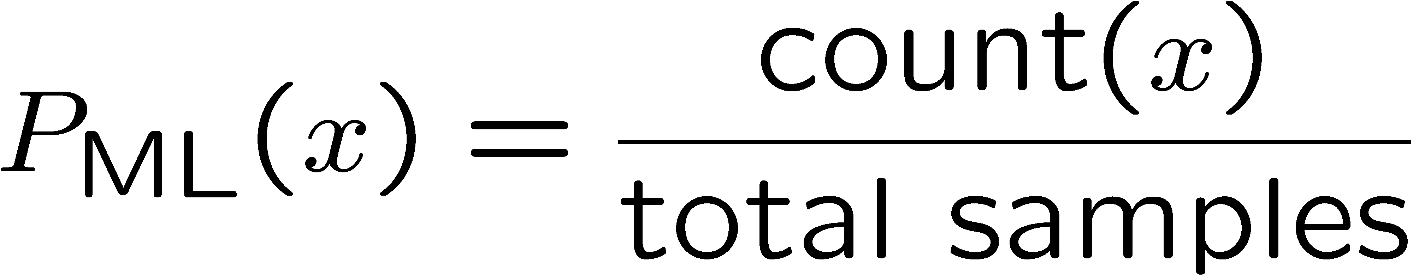

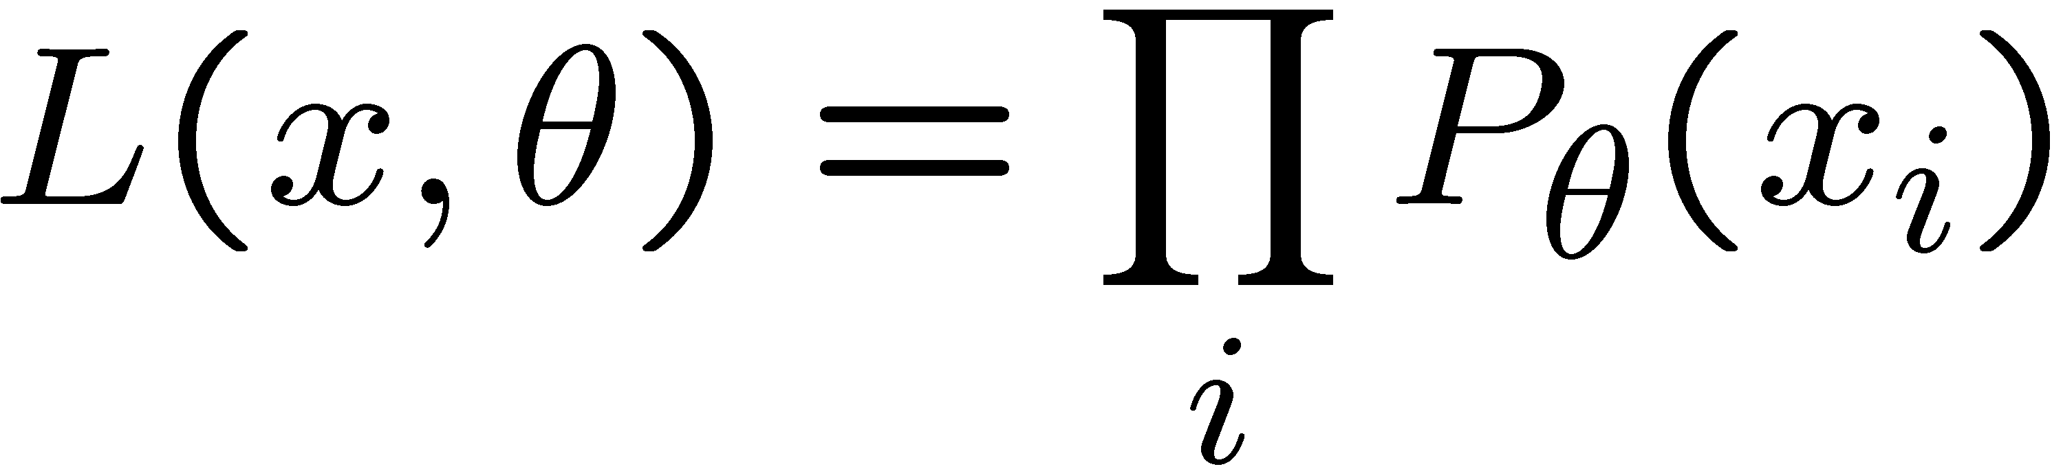





Parameter Estimation with Maximum Likelihood
Estimating the distribution of a random variable
  E.g.: for each outcome x, look at the empirical rate of that value:
  This is the estimate of the parameters that maximizes the likelihood of the data
r
b
b
b
r
r
b
b
b
r
r
b
b
b
b
r
r
b

Slide 5
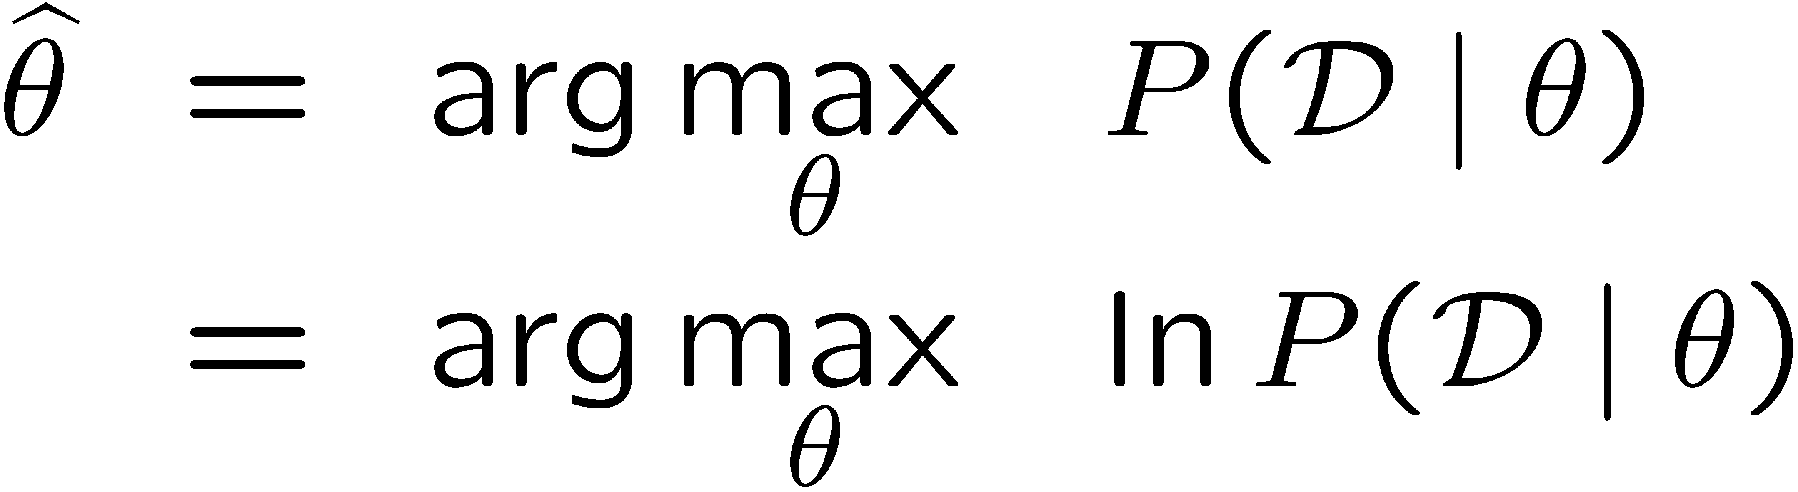
Parameter Estimation with Maximum Likelihood
Data: Observed set D of α_{H} Heads and α_{T} Tails
Hypothesis space: Binomial distributions
Learning: finding θ is an optimization problem
  What’s the objective function?
MLE: Choose θ to maximize probability of D

Slide 6
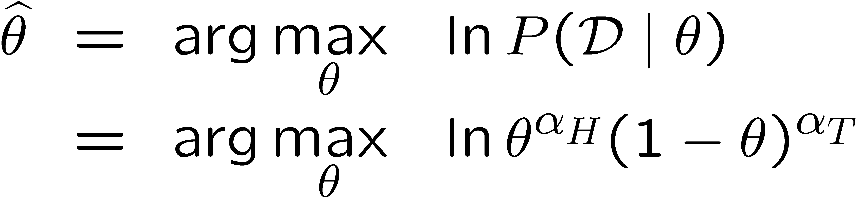
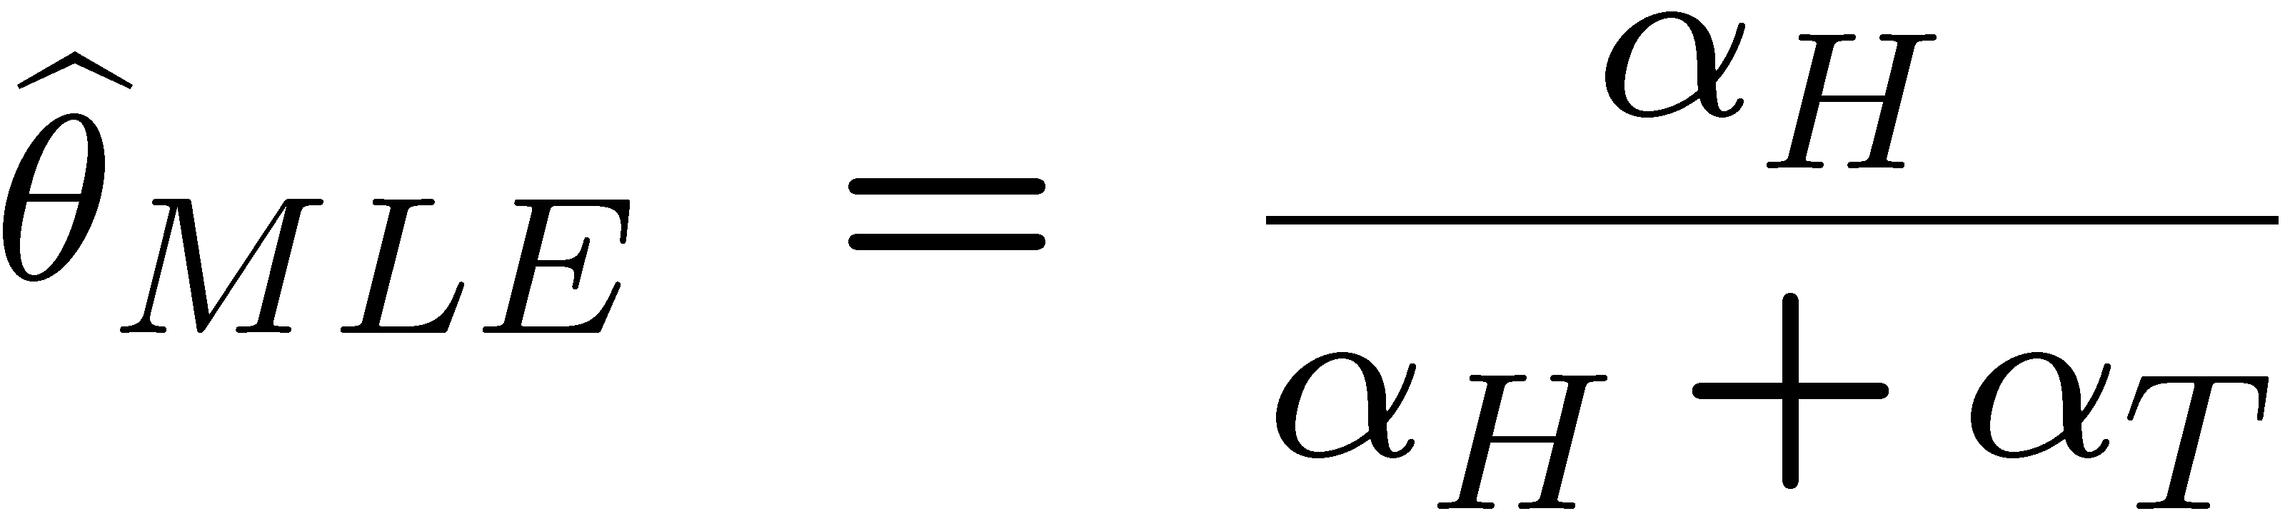
Parameter Estimation with Maximum Likelihood
Set derivative to zero, and solve!

Slide 7
Parameter Estimation with Maximum Likelihood
How do we estimate the conditional probability tables?
  Maximum Likelihood, which corresponds to counting
Need to be careful though … let’s see what can go wrong..

Slide 8



Underfitting and Overfitting

Slide 9












Example: Overfitting
2 wins!!

Slide 10
Overfitting
30
25
20
Degree 15 polynomial
15
10
5
0
-5
-10
-15
0
2
4
6
8
10
12
14
16
18
20

Slide 11
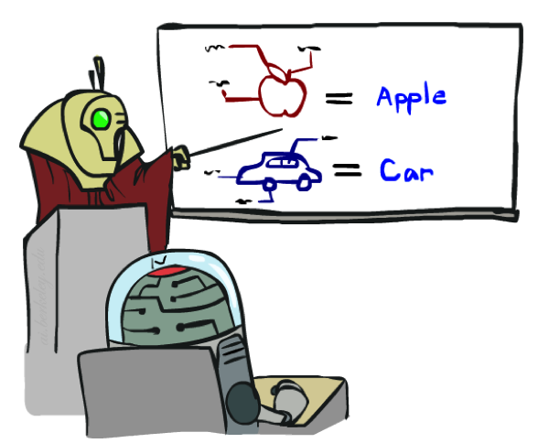

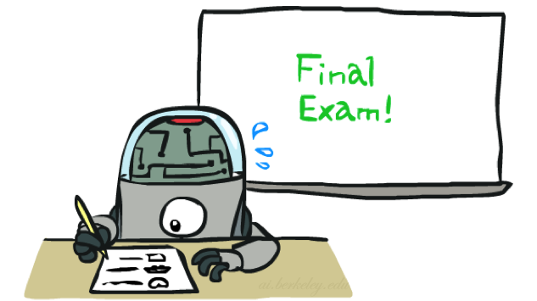
Training and Testing

Slide 12


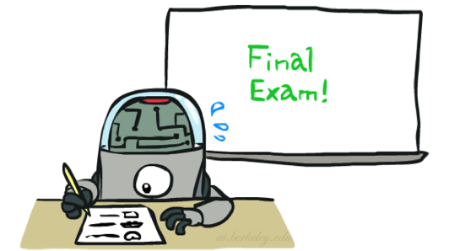
Important Concepts
Data: labeled instances, e.g. emails marked spam/ham
  Training set
  Held out set
  Test set
Features: attribute-value pairs which characterize each x
Experimentation cycle
  Learn parameters (e.g. model probabilities) on training set
  (Tune hyperparameters on held-out set)
  Compute accuracy on test set
  Very important: never “peek” at the test set!
Evaluation
  Accuracy: fraction of instances predicted correctly
Overfitting and generalization
  Want a classifier which does well on test data
  Overfitting: fitting the training data very closely, but not generalizing well
  Underfitting: fits the training set poorly
Training
Data
Held-Out
Data
Test
Data

Slide 13
Generalization and Overfitting
Relative frequency parameters will overfit the training data!
  Just because we never saw a 3 with pixel (15,15) on during training doesn’t mean we won’t see it at test time
  Unlikely that every occurrence of “minute” is 100% spam
  Unlikely that every occurrence of “seriously” is 100% ham
  What about all the words that don’t occur in the training set at all?
  In general, we can’t go around giving unseen events zero probability
As an extreme case, imagine using the entire email as the only feature
  Would get the training data perfect (if deterministic labeling)
  Wouldn’t generalize at all
  Just making the bag-of-words assumption gives us some generalization, but isn’t enough
To generalize better: we need to smooth or regularize the estimates

Slide 14
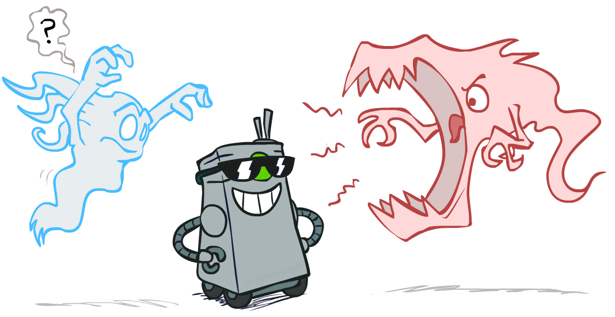
Smoothing

Slide 15

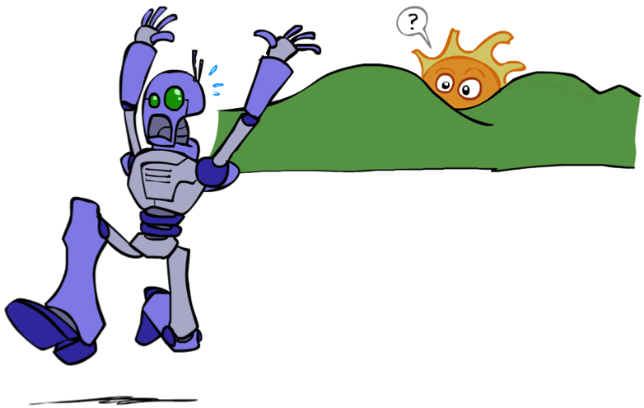
Unseen Events

Slide 16
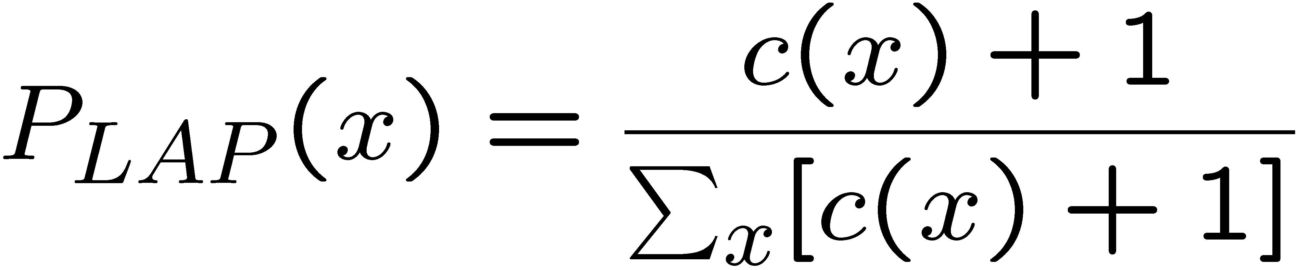
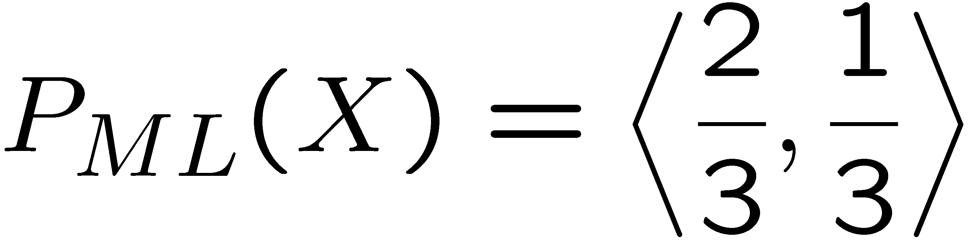
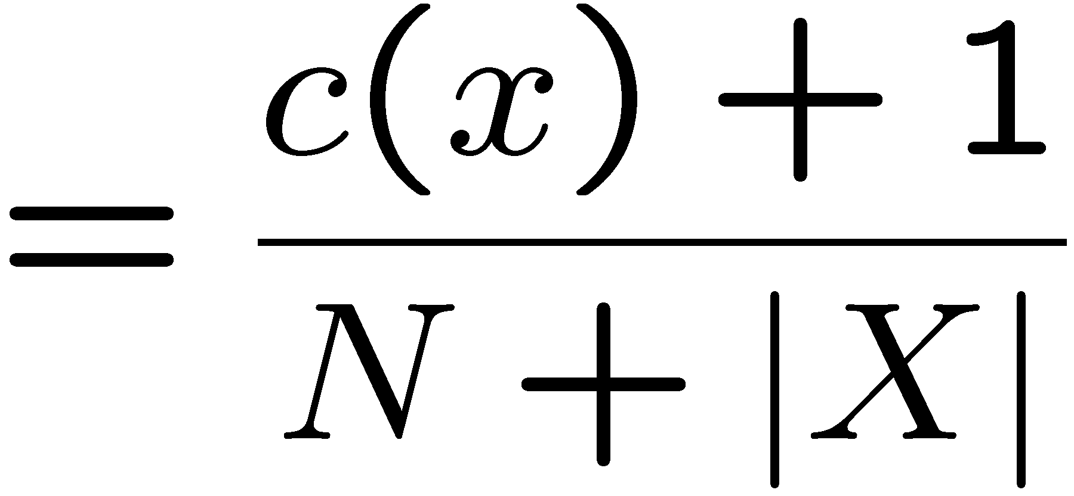
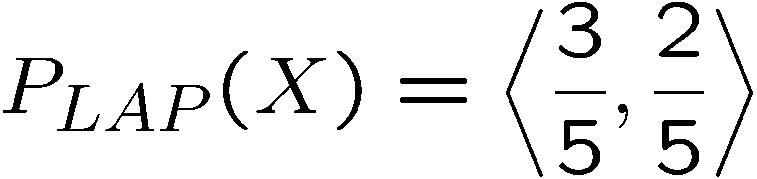
Laplace Smoothing
Laplace’s estimate:
  Pretend you saw every outcome once more than you actually did
  Can derive this estimate with Dirichlet priors (see cs281a)
r
r
b

Slide 17
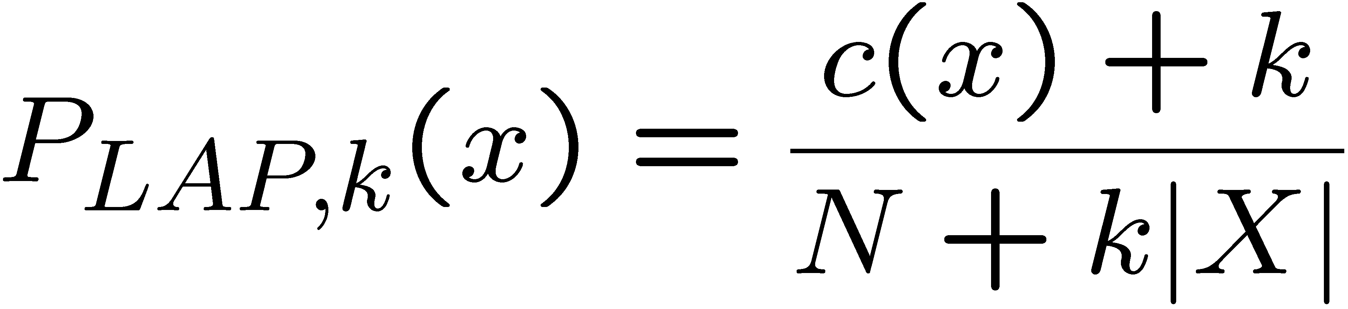
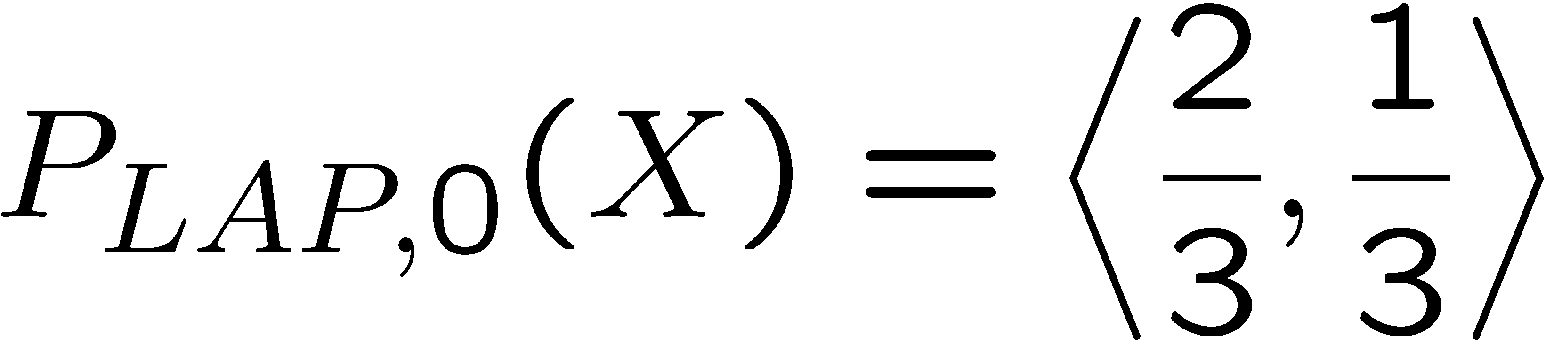
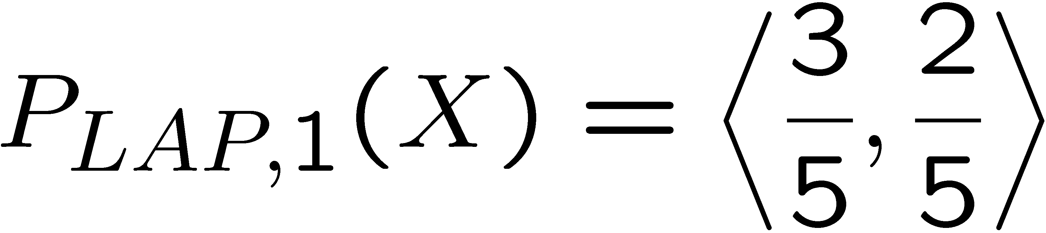
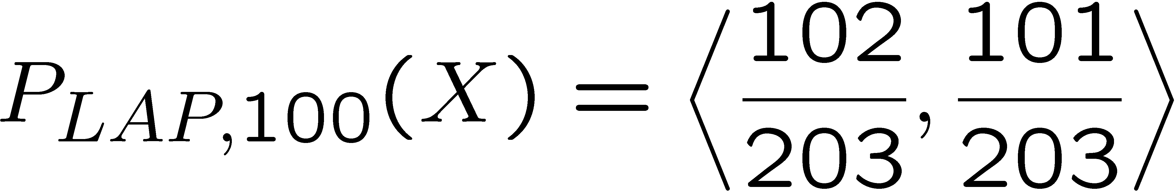
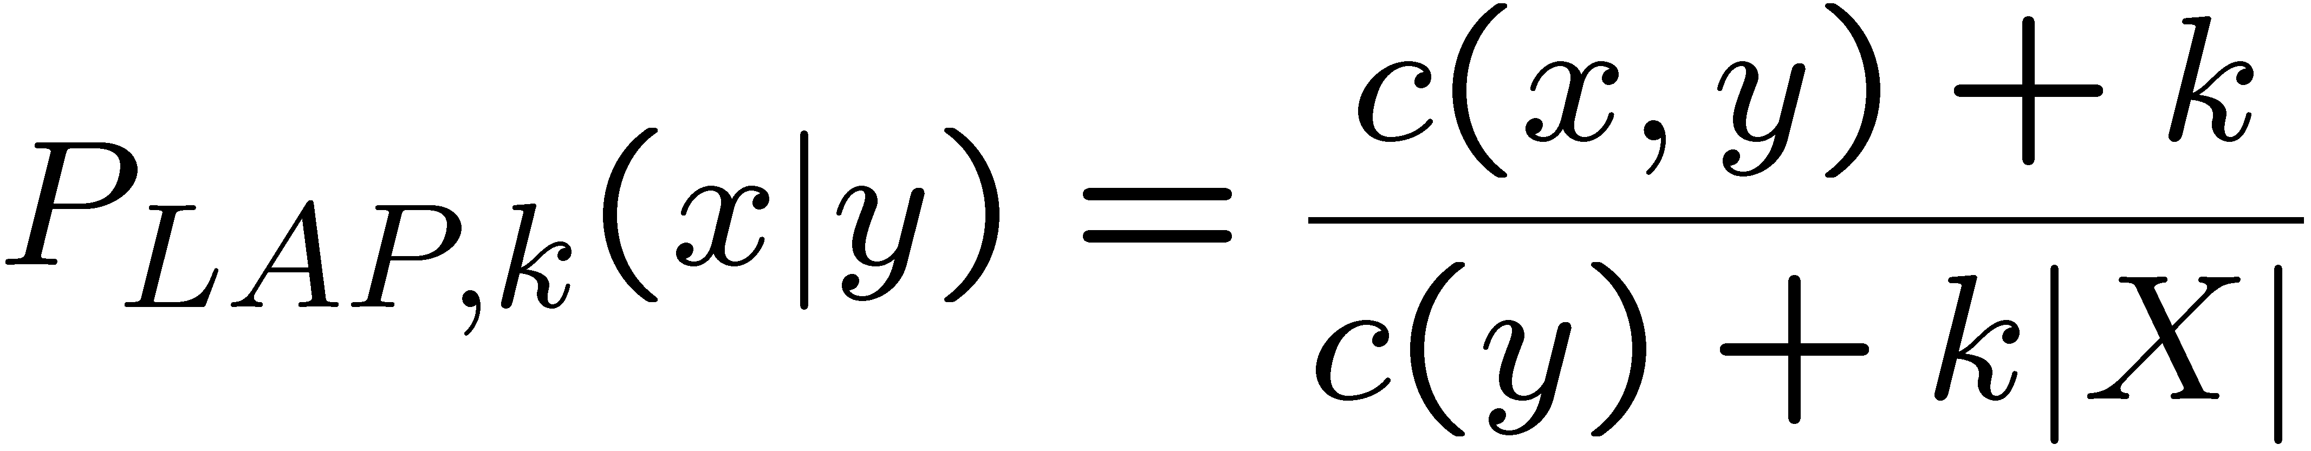
Laplace Smoothing
Laplace’s estimate (extended):
  Pretend you saw every outcome k extra times
  What’s Laplace with k = 0?
  k is the strength of the prior
Laplace for conditionals:
  Smooth each condition independently:
r
r
b

Slide 18
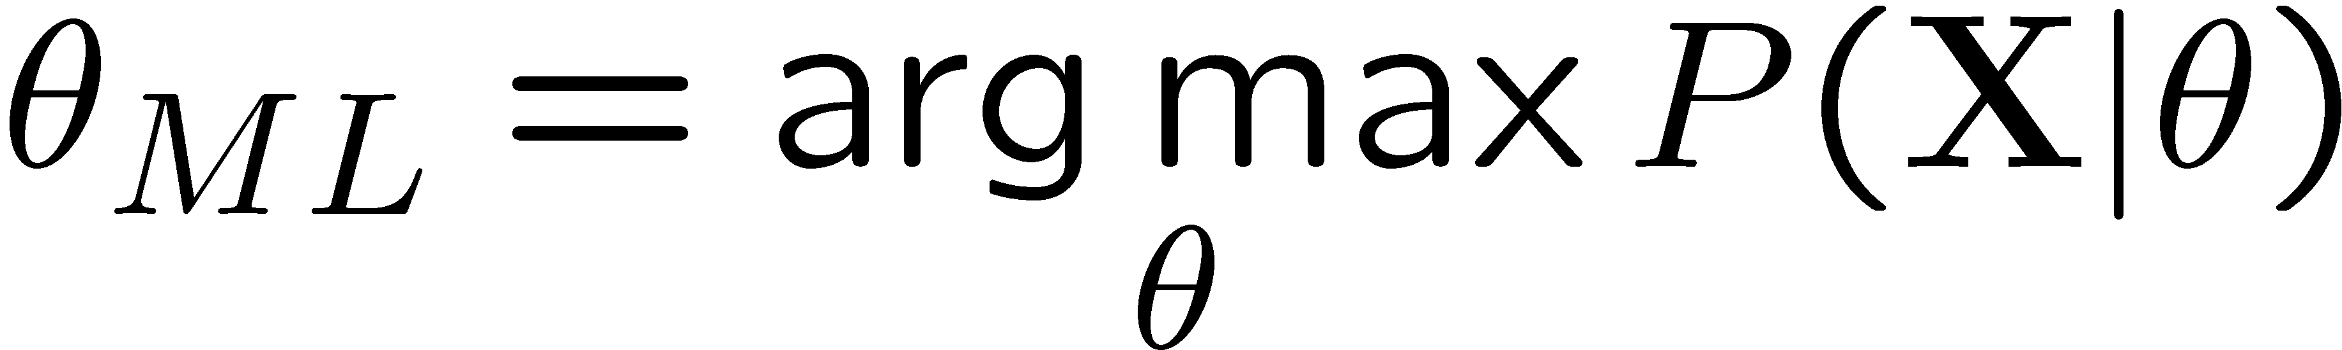
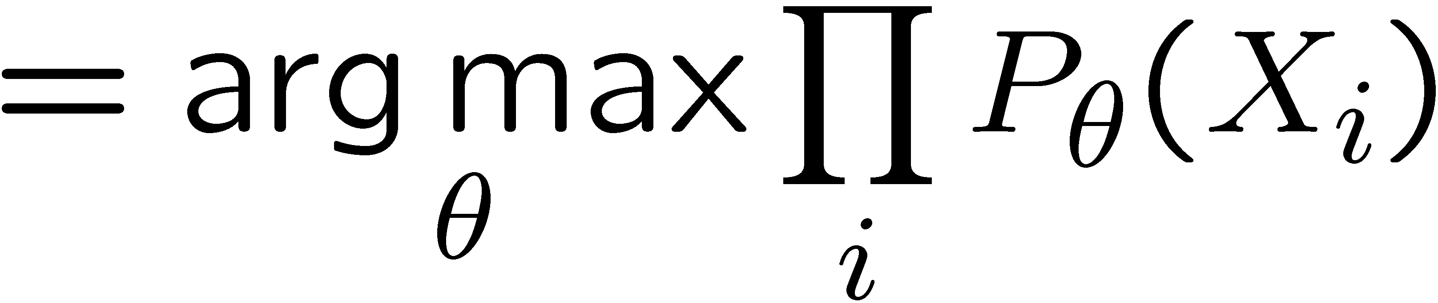
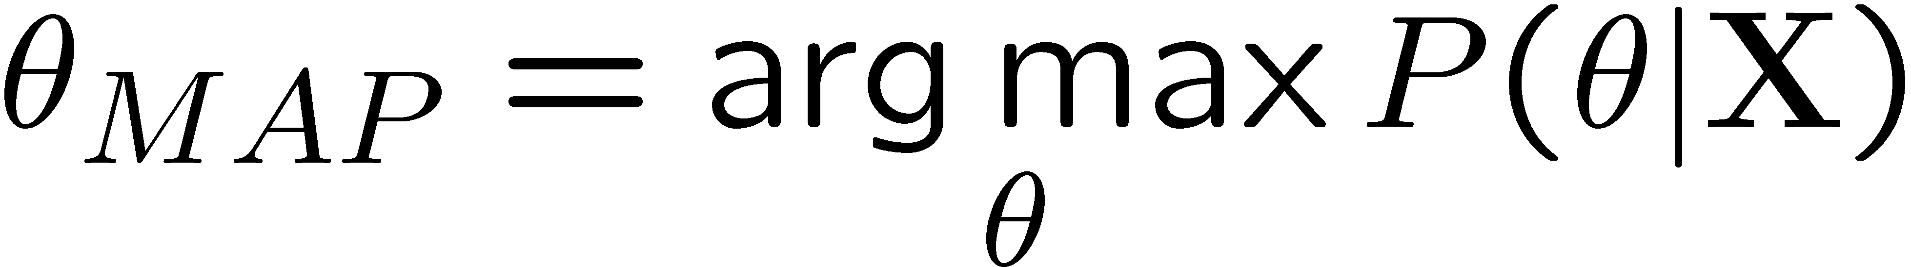
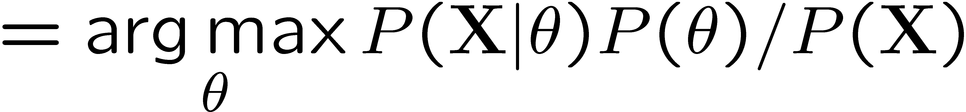
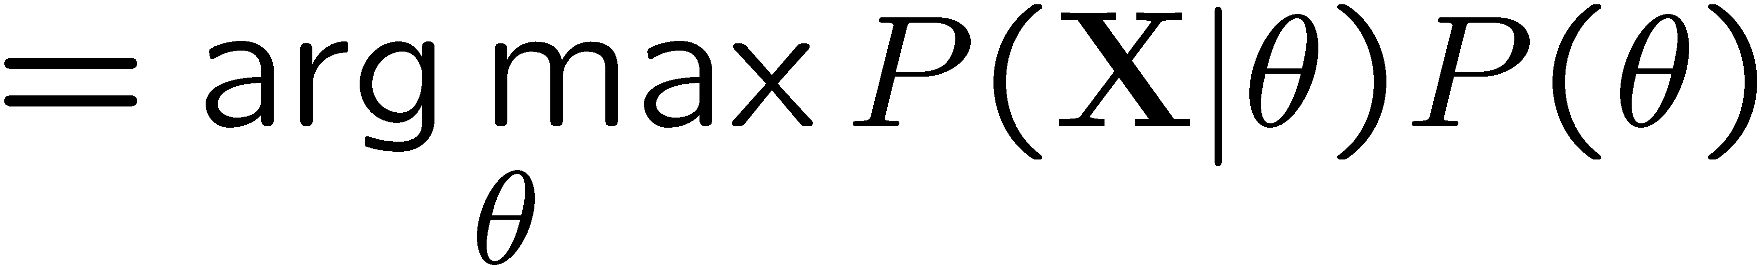
Formal Derivation
Relative frequencies are the maximum likelihood estimates
Another option is to consider the most likely parameter value given the data
“right” choice of P(theta) -> Laplace estimates

Slide 19
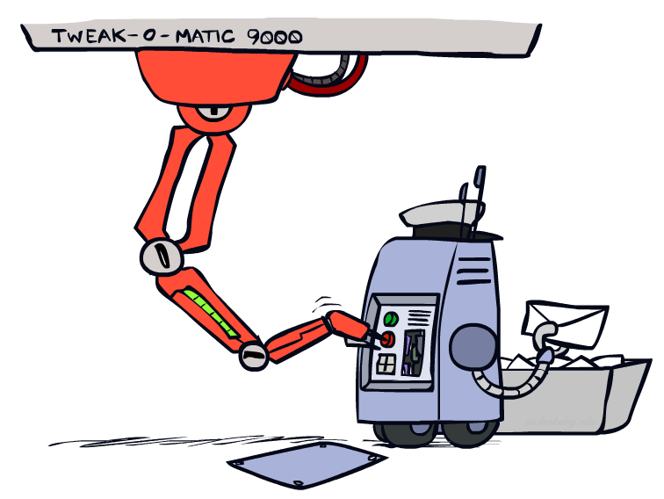
Tuning

Slide 20








Tuning on Held-Out Data
Now we’ve got two kinds of unknowns
  Parameters: the probabilities P(X|Y), P(Y)
  Hyperparameters: e.g. the amount / type of smoothing to do, k, α
What should we learn where?
  Learn parameters from training data
  Tune hyperparameters on different data
    Why?
  For each value of the hyperparameters, train and test on the held-out data
  Choose the best value and do a final test on the test data

Slide 21
Practical Tip: Baselines
First step: get a baseline
  Baselines are very simple “straw man” procedures
  Help determine how hard the task is
  Help know what a “good” accuracy is
Weak baseline: most frequent label classifier
  Gives all test instances whatever label was most common in the training set
  E.g. for spam filtering, might label everything as ham
  Accuracy might be very high if the problem is skewed
  E.g. calling everything “ham” gets 66%, so a classifier that gets 70% isn’t very good…
For real research, usually use previous work as a (strong) baseline

Slide 22
Summary
Bayes rule lets us do diagnostic queries with causal probabilities
The naïve Bayes assumption takes all features to be independent given the label
We can build classifiers out of a naïve Bayes model using training data
Smoothing estimates is important in real systems

Slide 23
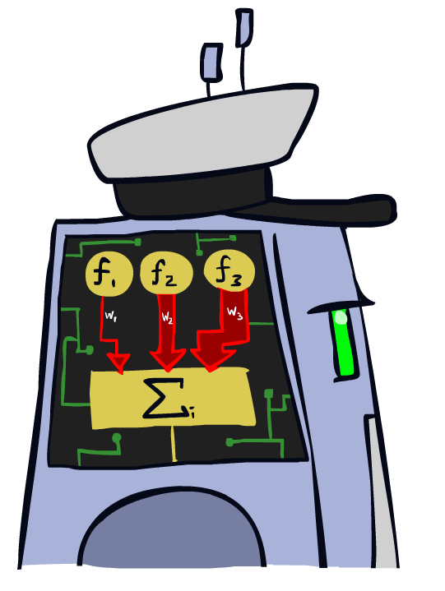
Linear Classifiers

Slide 24
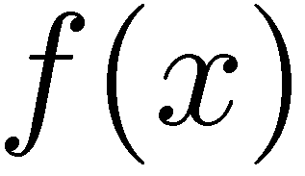

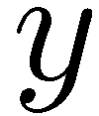

Feature Vectors
Hello,
Do you want free printr cartriges? Why pay more when you can get them ABSOLUTELY FREE! Just
# free : 2
YOUR_NAME : 0
MISSPELLED : 2
FROM_FRIEND : 0
...
SPAM
or
+
PIXEL-7,12 : 1
PIXEL-7,13 : 0
...
NUM_LOOPS : 1
...
“2”

Slide 25
Some (Simplified) Biology
Very loose inspiration: human neurons

Slide 26
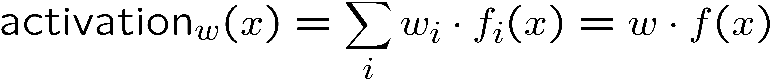
Linear Classifiers
Inputs are feature values
Each feature has a weight
Sum is the activation
If the activation is:
  Positive, output +1
  Negative, output -1
w₁
f₁
Σ
w₂
>0?
f₂
w₃
f₃

Slide 27

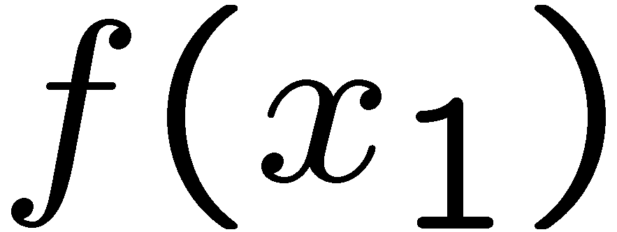
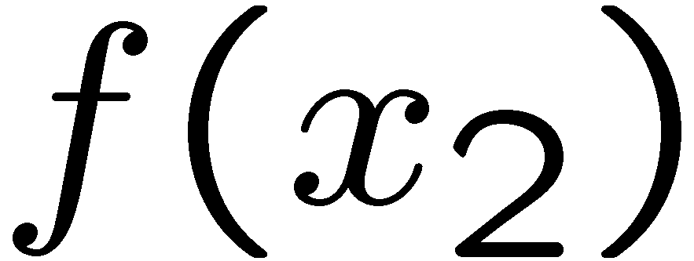
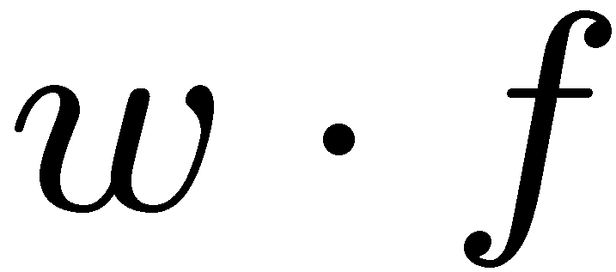
Weights
Binary case: compare features to a weight vector
Learning: figure out the weight vector from examples
# free : 4
YOUR_NAME :-1
MISSPELLED : 1
FROM_FRIEND :-3
...
# free : 2
YOUR_NAME : 0
MISSPELLED : 2
FROM_FRIEND : 0
...
# free : 0
YOUR_NAME : 1
MISSPELLED : 1
FROM_FRIEND : 1
...
Dot product positive means the positive class

Slide 28
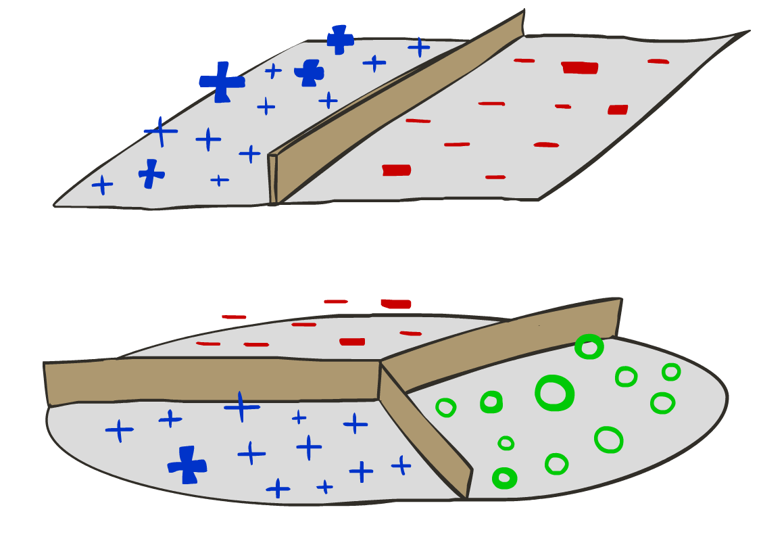
Decision Rules

Slide 29

Binary Decision Rule
In the space of feature vectors
  Examples are points
  Any weight vector is a hyperplane
  One side corresponds to Y=+1
  Other corresponds to Y=-1
money
2
1
BIAS : -3
free : 4
money : 2
...
0
0
1
free

Slide 30
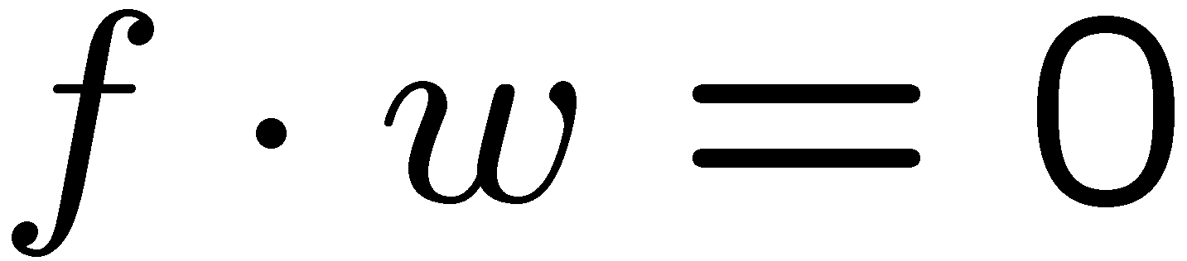
Binary Decision Rule
In the space of feature vectors
  Examples are points
  Any weight vector is a hyperplane
  One side corresponds to Y=+1
  Other corresponds to Y=-1
money
2
+1 = SPAM
1
BIAS : -3
free : 4
money : 2
...
0
-1 = HAM
0
1
free

Slide 31
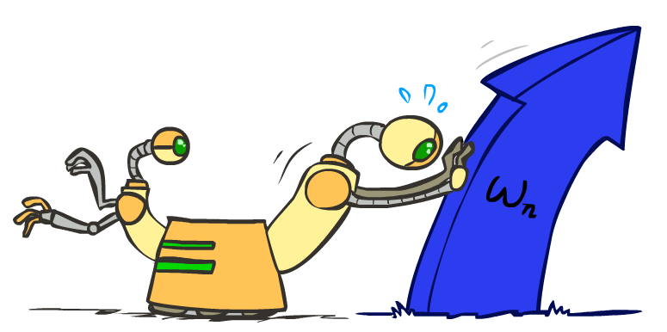
Weight Updates

Slide 32
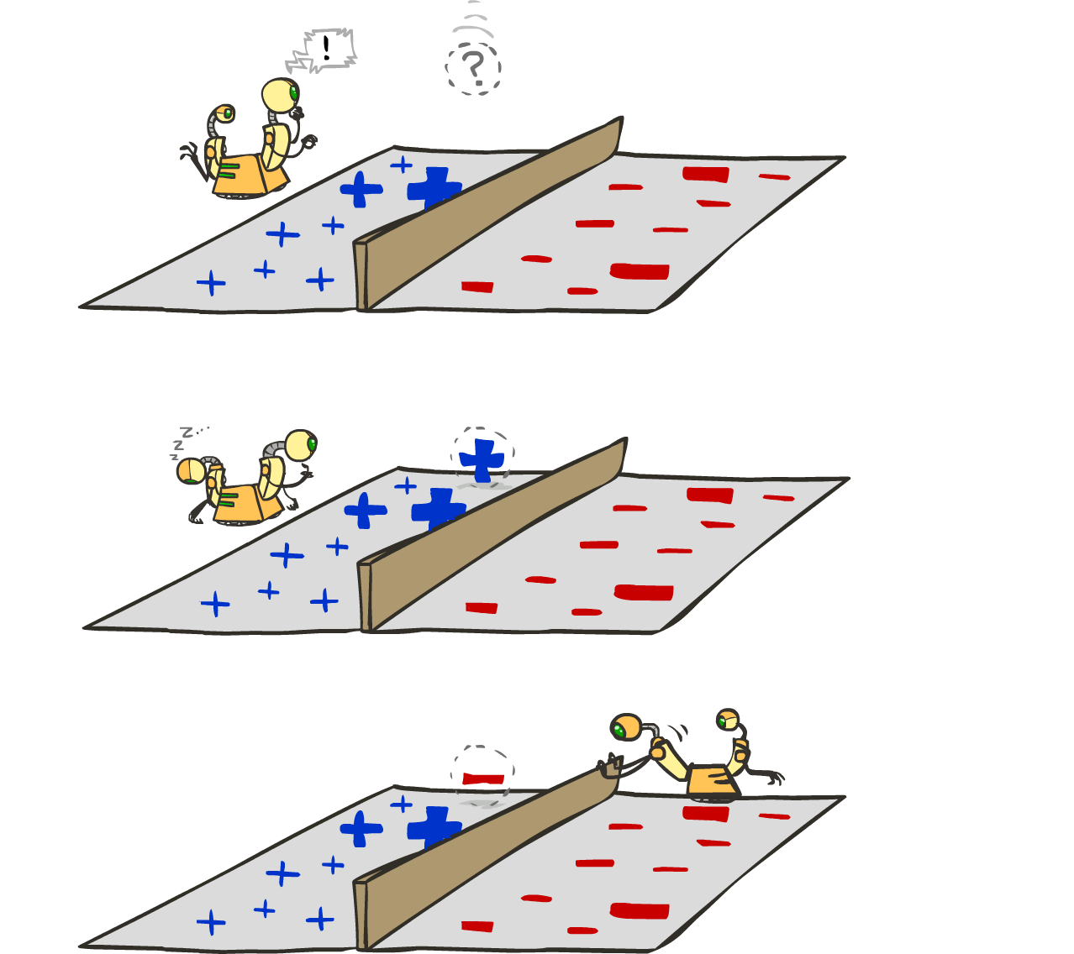
Learning: Binary Perceptron
Start with weights = 0
For each training instance:
  Classify with current weights
  If correct (i.e., y=y*), no change!
  If wrong: adjust the weight vector
Notes:
http://isl.ira.uka.de/neuralNetCourse/2004/VL_11_5/Perceptron.html

Slide 33
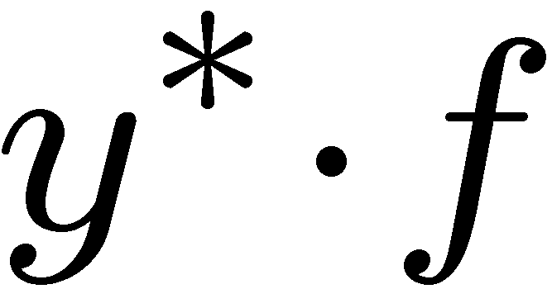
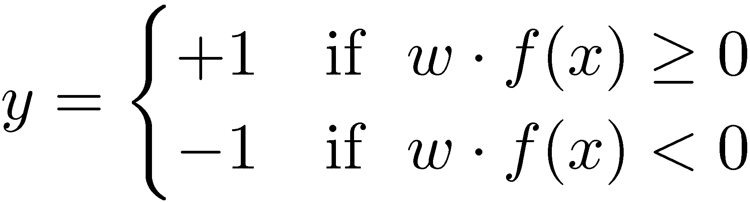

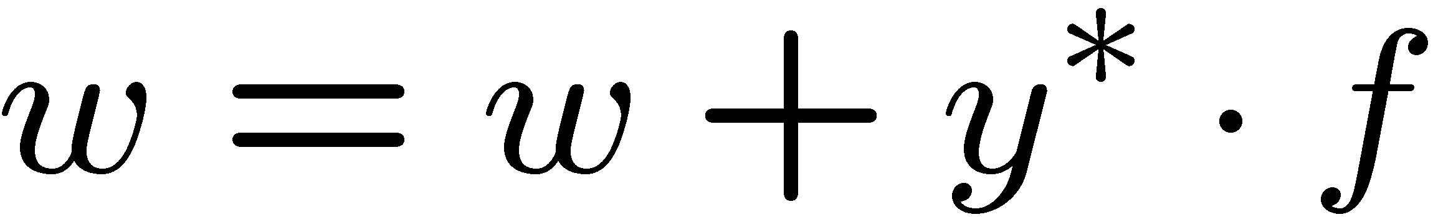
Learning: Binary Perceptron
Start with weights = 0
For each training instance:
  Classify with current weights
  If correct (i.e., y=y*), no change!
  If wrong: adjust the weight vector by adding or subtracting the feature vector. Subtract if y* is -1.
Before: w f
After: wf + y*f f
f f >=0
Notes:
http://isl.ira.uka.de/neuralNetCourse/2004/VL_11_5/Perceptron.html

Slide 34
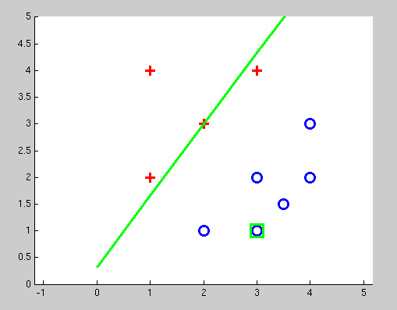
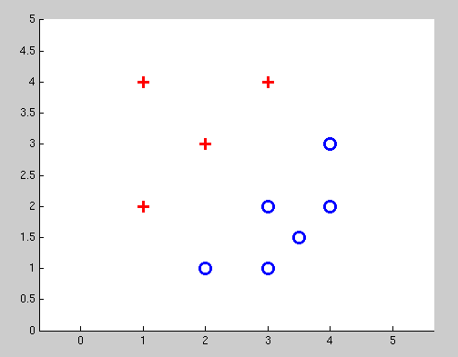
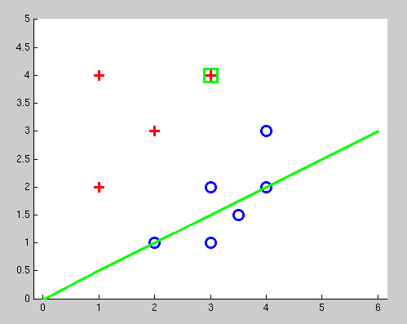
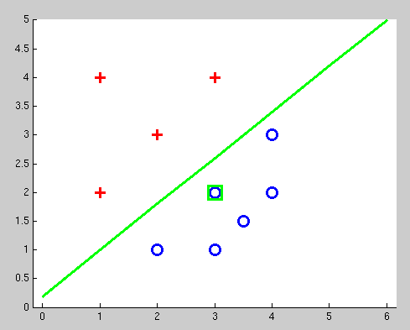
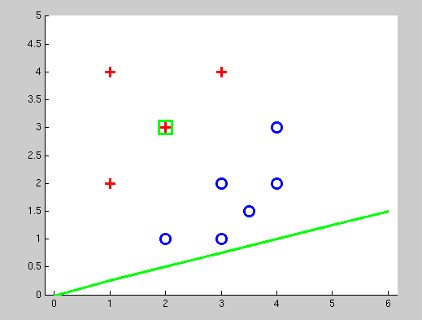
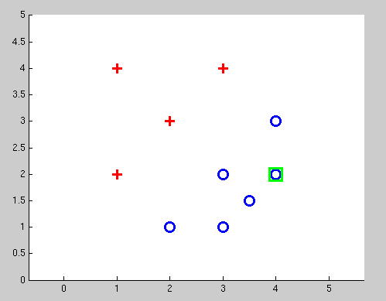
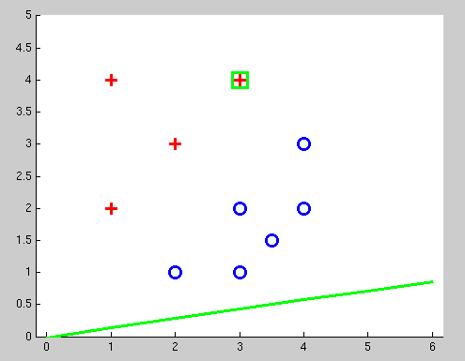
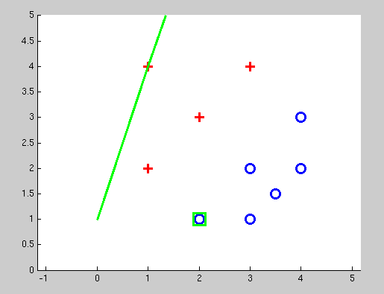
Examples: Perceptron
Separable Case

Slide 35









Multiclass Decision Rule
If we have multiple classes:
  A weight vector for each class:
  Score (activation) of a class y:
  Prediction highest score wins
Binary = multiclass where the negative class has weight zero
Notes:
Picture only true for equal size ws; if we had a really big or really small w1 yellow are would change

Slide 36





Learning: Multiclass Perceptron
Start with all weights = 0
Pick up training examples one by one
Predict with current weights
If correct, no change!
If wrong: lower score of wrong answer, raise score of right answer

Slide 37
Properties of Perceptrons
Separable
Separability: true if some parameters get the training set perfectly correct
Convergence: if the training is separable, perceptron will eventually converge (binary case)
Non-Separable

Slide 38





Problems with the Perceptron
Noise: if the data isn’t separable, weights might thrash
  Averaging weight vectors over time can help (averaged perceptron)
Mediocre generalization: finds a “barely” separating solution
Overtraining: test / held-out accuracy usually rises, then falls
  Overtraining is a kind of overfitting

Slide 39



Example: Multiclass Perceptron
“win the vote”
[1 1 0 1 1]
“win the election”
[1 1 0 0 1]
“win the game”
[1 1 1 0 1]
3
0
1
-2
0
3
0
-2
BIAS : 1
win : 0
game : 0
vote : 0
the : 0
...
0
-1
0
-1
-1
1
0
1
-1
0
BIAS : 0
win : 0
game : 0
vote : 0
the : 0
...
1
1
0
1
1
0
0
-1
1
0
BIAS : 0
win : 0
game : 0
vote : 0
the : 0
...

