Slide 1

CS 188: Artificial Intelligence
Perceptrons, Linear/Logistic Regression
Instructors: Angela Liu and Yanlai Yang
University of California, Berkeley
(Slides adapted from Pieter Abbeel, Dan Klein, Anca Dragan, Stuart Russell and Dawn Song)

Slide 2
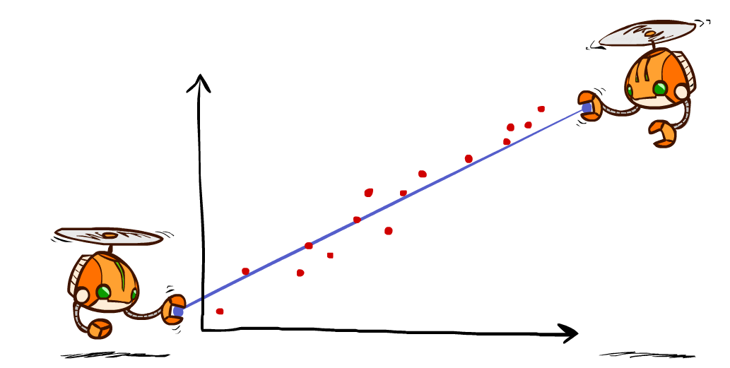
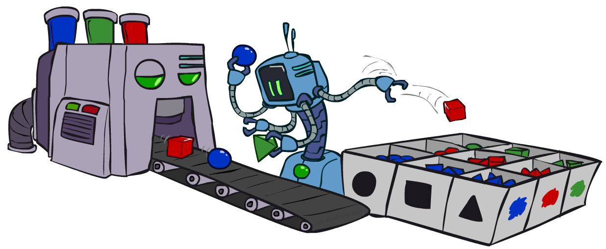
Supervised Learning
Regression
learning a function with real-valued output value
Classification
learning a function with discrete output value

Slide 3
Linear Regression
Model: Linear functions

Slide 4
Linear Regression
(x, y), x: house size, y: house price
Berkeley house prices, 2009

Slide 5
Linear regression = fitting a straight line/hyperplane
40
h_{w}(x)
20
0
0
x
20
Prediction: h_{w}(x) = w₀ + w₁x
Berkeley house prices, 2009

Slide 6
Prediction error
Error on one instance: y – h_{w}(x)
Error or “residual”
Observation y
Prediction h_{w}(x)
0
x
0
20

Slide 7
Find w
Define loss function
Find w* to minimize loss function

Slide 8
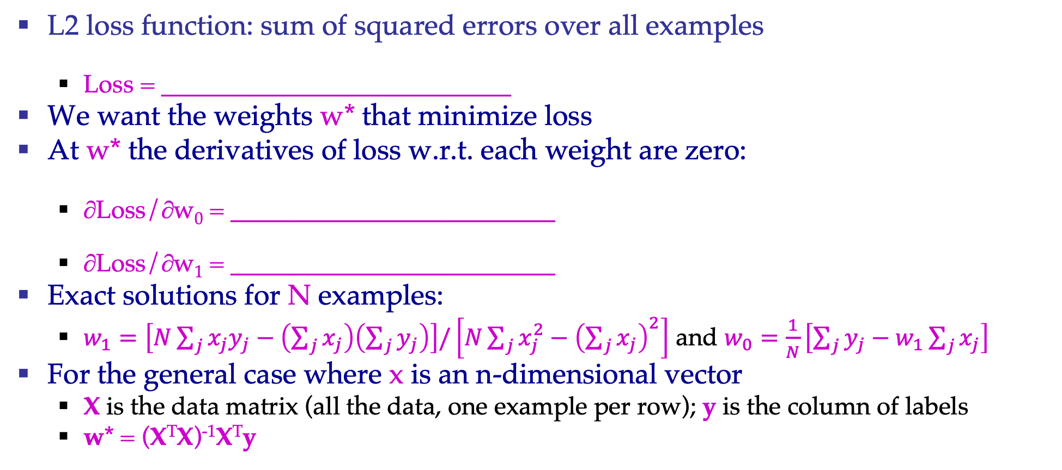
Least squares: Minimizing squared error
L2 loss function: sum of squared errors over all examples
  Loss = ____________________________
We want the weights w* that minimize loss
At w* the derivatives of loss w.r.t. each weight are zero:
  ∂Loss/∂w₀ = __________________________
  ∂Loss/∂w₁ = __________________________
Exact solutions for N examples:
  $w_{1}=\left[N\sum_{j}{x_{j}y_{j}}−\left(\sum_{j}{x_{j}}\right)\left(\sum_{j}{y_{j}}\right)\right]/\left[N\sum_{j}{x_{j}^{2}}−{\left(\sum_{j}{x_{j}}\right)}^{2}\right]$ and $w_{0}=\frac{1}{N}\left[\sum_{j}{y_{j}}−w_{1}\sum_{j}{x_{j}}\right]$
For the general case where x is an n-dimensional vector
  X is the data matrix (all the data, one example per row); y is the column of labels
  w* = (X^{T}X)⁻¹X^{T}y

Slide 9
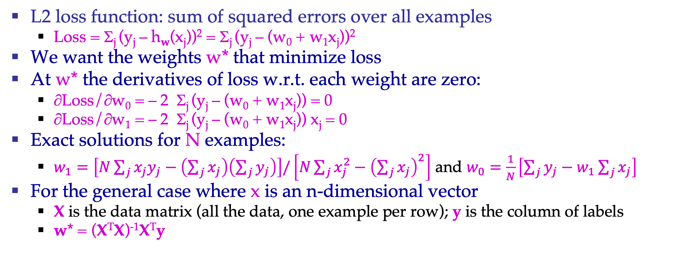
Least squares: Minimizing squared error
L2 loss function: sum of squared errors over all examples
  Loss = Σ_{j} (y_{j} – h_{w}(x_{j}))² = Σ_{j} (y_{j} – (w₀ + w₁x_{j}))²
We want the weights w* that minimize loss
At w* the derivatives of loss w.r.t. each weight are zero:
  ∂Loss/∂w₀ = – 2 Σ_{j} (y_{j} – (w₀ + w₁x_{j})) = 0
  ∂Loss/∂w₁ = – 2 Σ_{j} (y_{j} – (w₀ + w₁x_{j})) x_{j} = 0
Exact solutions for N examples:
  $w_{1}=\left[N\sum_{j}{x_{j}y_{j}}−\left(\sum_{j}{x_{j}}\right)\left(\sum_{j}{y_{j}}\right)\right]/\left[N\sum_{j}{x_{j}^{2}}−{\left(\sum_{j}{x_{j}}\right)}^{2}\right]$ and $w_{0}=\frac{1}{N}\left[\sum_{j}{y_{j}}−w_{1}\sum_{j}{x_{j}}\right]$
For the general case where x is an n-dimensional vector
  X is the data matrix (all the data, one example per row); y is the column of labels
  w* = (X^{T}X)⁻¹X^{T}y

Slide 10
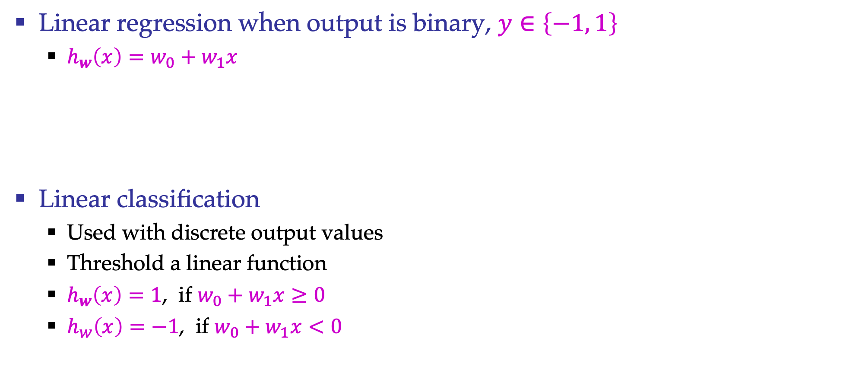


Regression vs Classification
Linear regression when output is binary, $y∈\left\{−1, 1\right\}$
  $h_{w}\left(x\right)=w_{0}+w_{1}x$
Linear classification
  Used with discrete output values
  Threshold a linear function
  $h_{w}\left(x\right)=1$, if $w_{0}+w_{1}x≥0$
  $h_{w}\left(x\right)=−1$, if $w_{0}+w_{1}x<0$
y
$$w_{0}+w_{1}x$$
1
x
y
$$w_{0}+w_{1}x$$
$$g\left(w_{0}+w_{1}x \right)$$
1
x

Slide 11
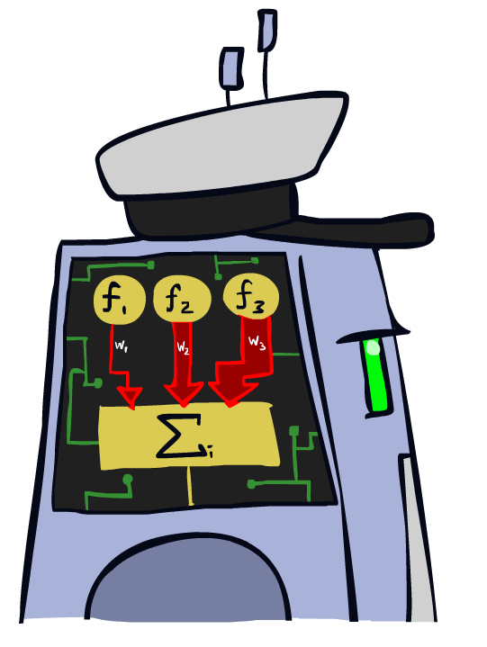
Linear Classifiers

Slide 12
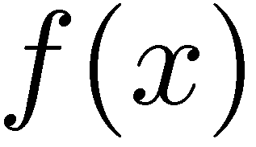

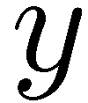

Feature Vectors
Hello,
Do you want free printr cartriges? Why pay more when you can get them ABSOLUTELY FREE! Just
# free : 2
YOUR_NAME : 0
MISSPELLED : 2
FROM_FRIEND : 0
...
SPAM
or
+
PIXEL-7,12 : 1
PIXEL-7,13 : 0
...
NUM_LOOPS : 1
...
“2”

Slide 13
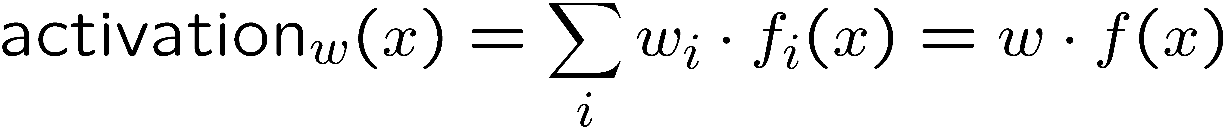
Linear Classifiers
Inputs are feature values
Each feature has a weight
Sum is the activation
If the activation is:
  Positive, output +1
  Negative, output -1
w₁
f₁
Σ
w₂
>0?
f₂
w₃
f₃

Slide 14


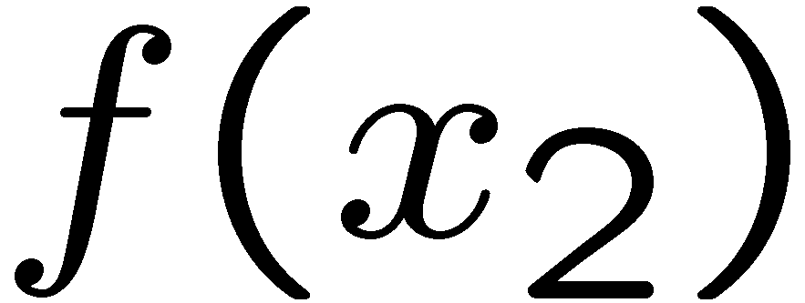
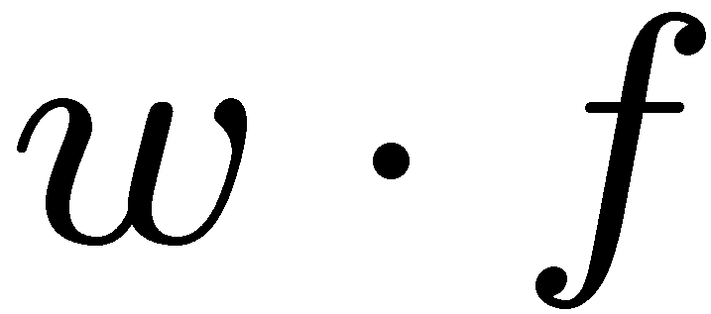
Weights
Binary case: compare features to a weight vector
Learning: figure out the weight vector from examples
# free : 4
YOUR_NAME :-1
MISSPELLED : 1
FROM_FRIEND :-3
...
# free : 2
YOUR_NAME : 0
MISSPELLED : 2
FROM_FRIEND : 0
...
# free : 0
YOUR_NAME : 1
MISSPELLED : 1
FROM_FRIEND : 1
...
Dot product positive means the positive class

Slide 15
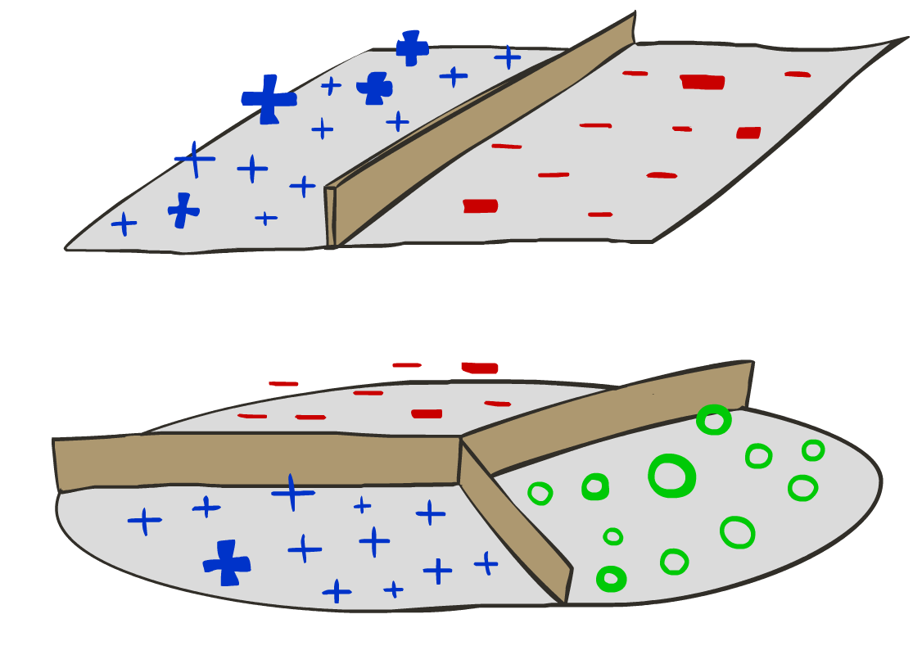
Decision Rules

Slide 16

Binary Decision Rule
In the space of feature vectors
  Examples are points
  Any weight vector is a hyperplane
  One side corresponds to Y=+1
  Other corresponds to Y=-1
money
2
1
BIAS : -3
free : 4
money : 2
...
0
0
1
free

Slide 17
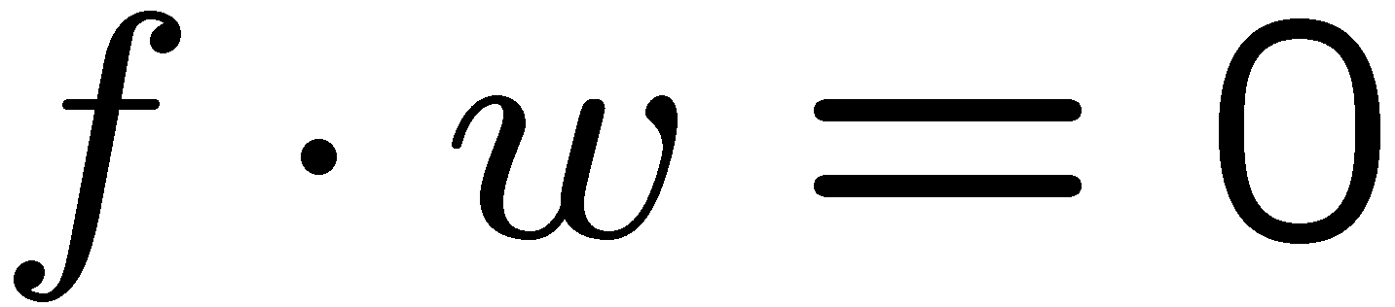
Binary Decision Rule
In the space of feature vectors
  Examples are points
  Any weight vector is a hyperplane
  One side corresponds to Y=+1
  Other corresponds to Y=-1
money
2
+1 = SPAM
1
BIAS : -3
free : 4
money : 2
...
0
-1 = HAM
0
1
free

Slide 18

Weight Updates

Slide 19
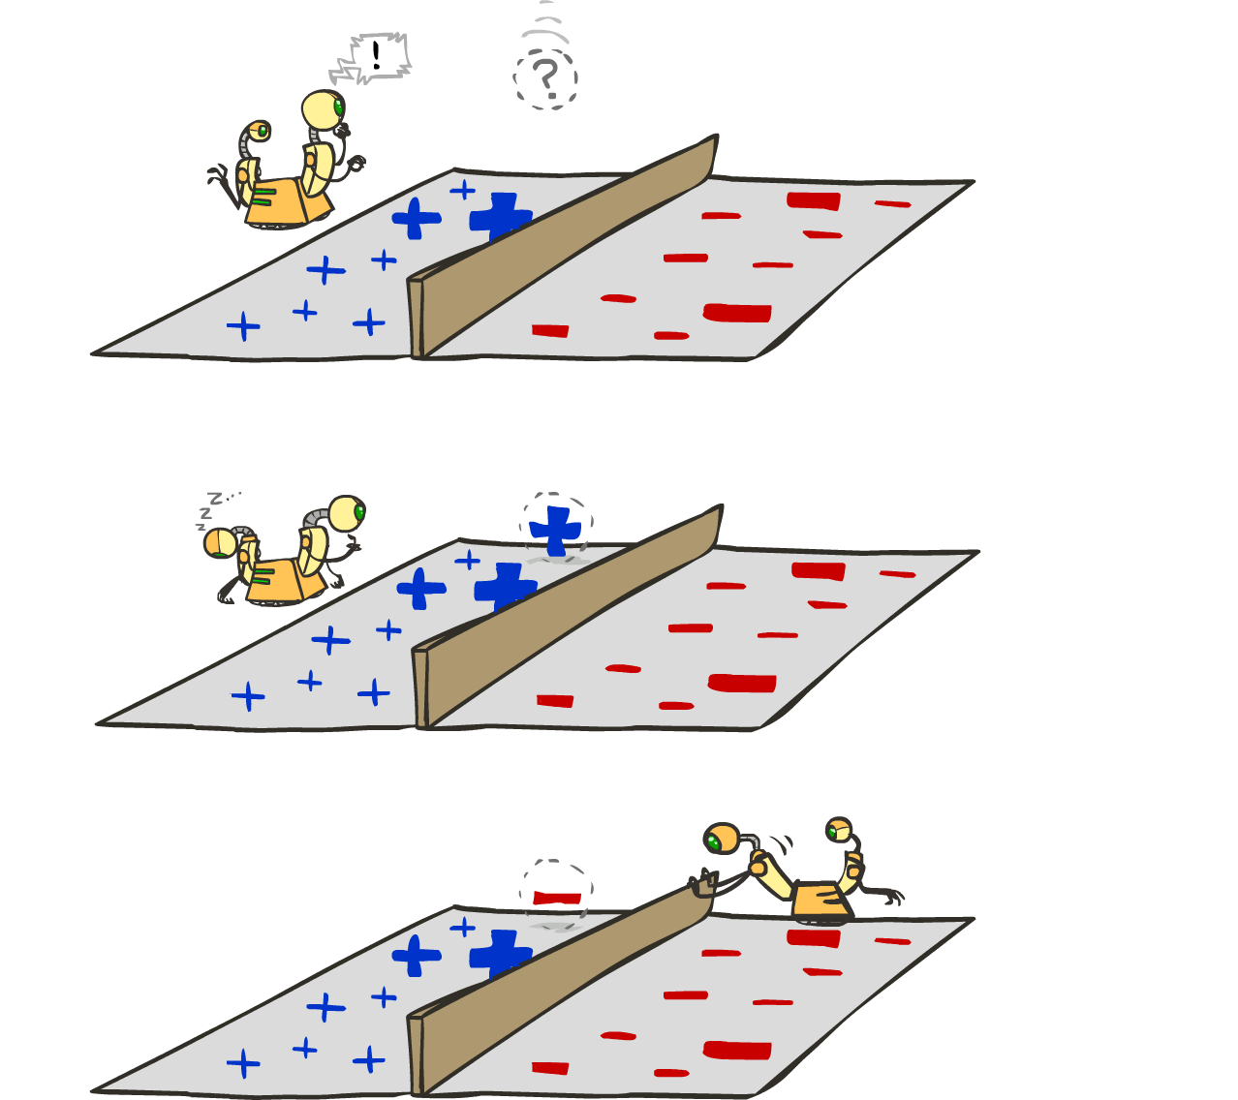
Learning: Binary Perceptron
Start with weights = 0
For each training instance:
  Classify with current weights
  If correct (i.e., y=y*), no change!
  If wrong: adjust the weight vector
Notes:
http://isl.ira.uka.de/neuralNetCourse/2004/VL_11_5/Perceptron.html

Slide 20

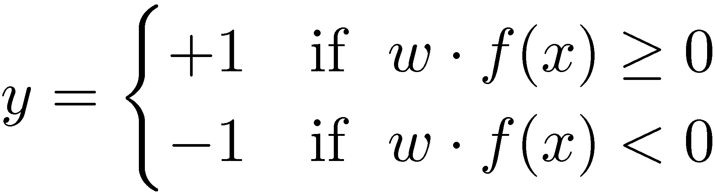

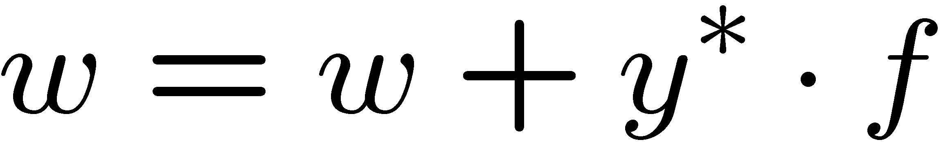
Learning: Binary Perceptron
Start with weights = 0
For each training instance:
  Classify with current weights
  If correct (i.e., y=y*), no change!
  If wrong: adjust the weight vector by adding or subtracting the feature vector. Subtract if y* is -1.
Before: w f
After: wf + y*f f
f f >=0

Slide 21
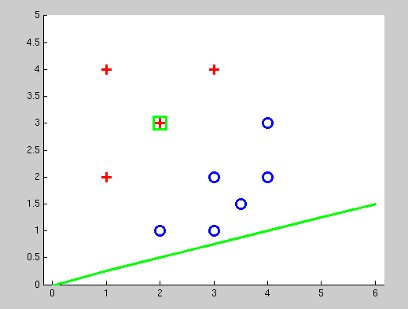
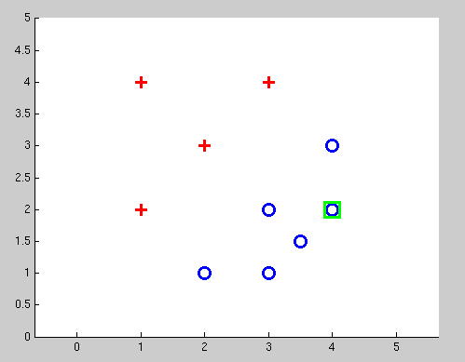
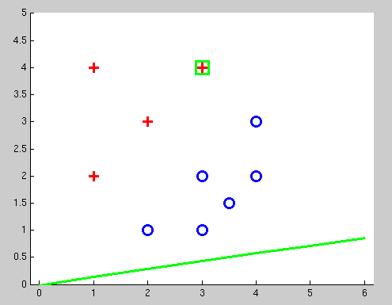
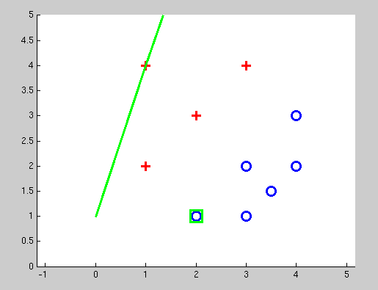
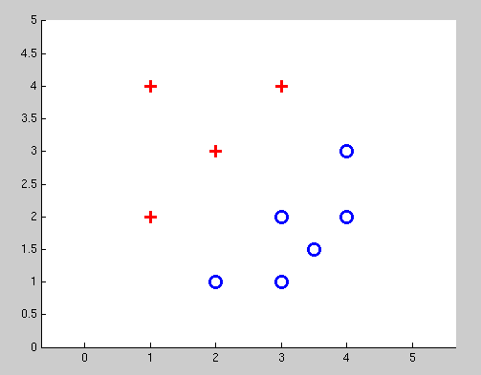
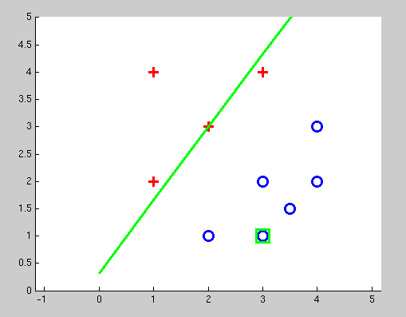
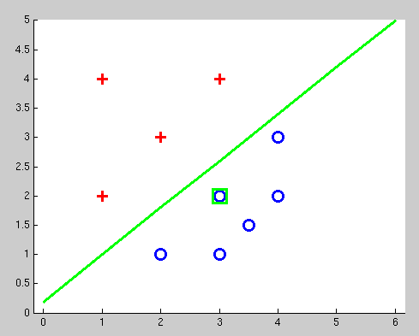
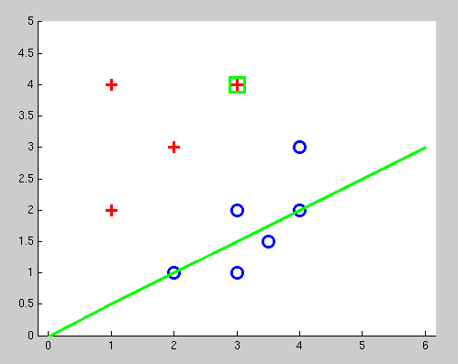
Examples: Perceptron
Separable Case

Slide 22


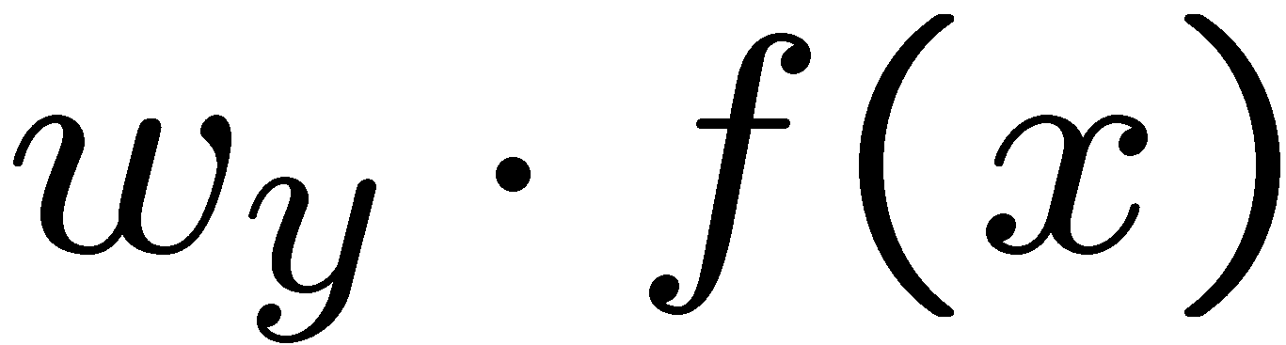



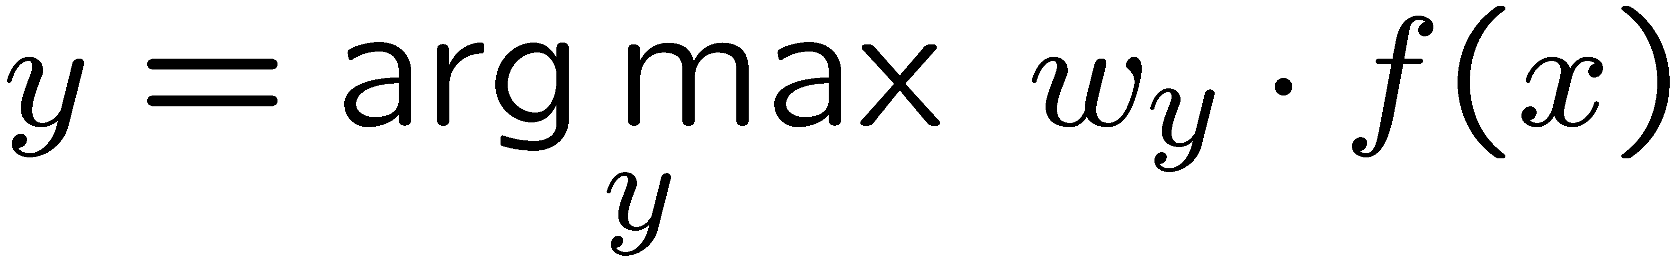
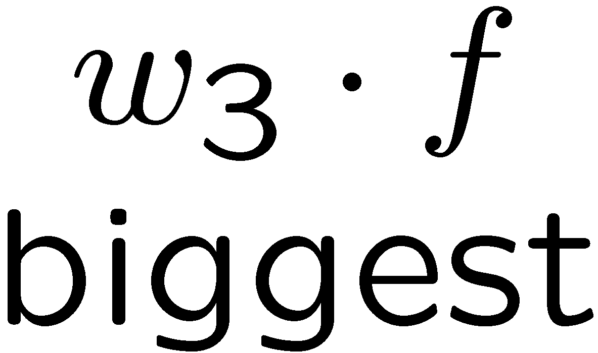
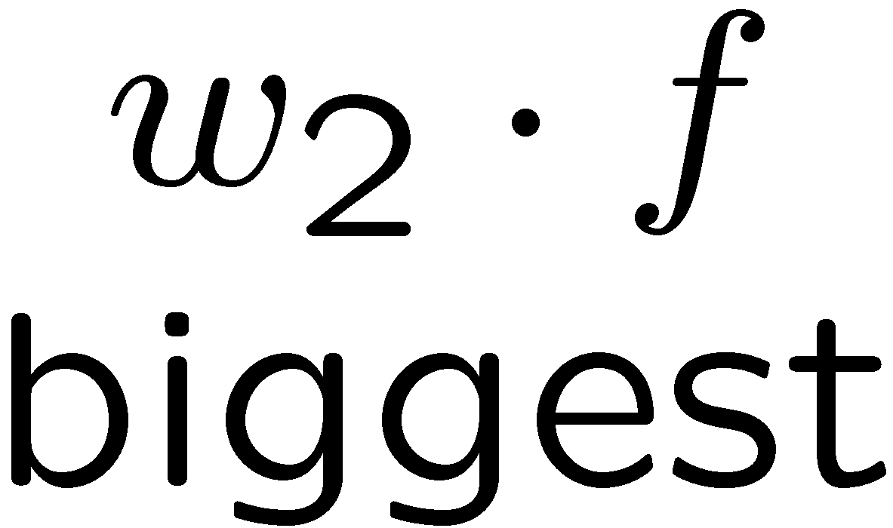
Multiclass Decision Rule
If we have multiple classes:
  A weight vector for each class:
  Score (activation) of a class y:
  Prediction highest score wins
Binary = multiclass where the negative class has weight zero

Slide 23



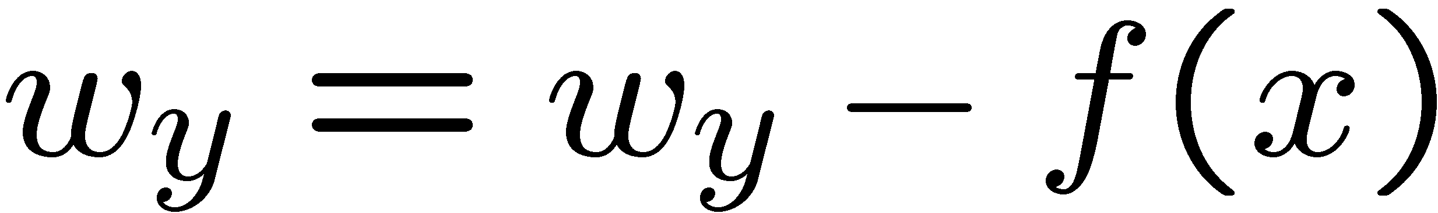
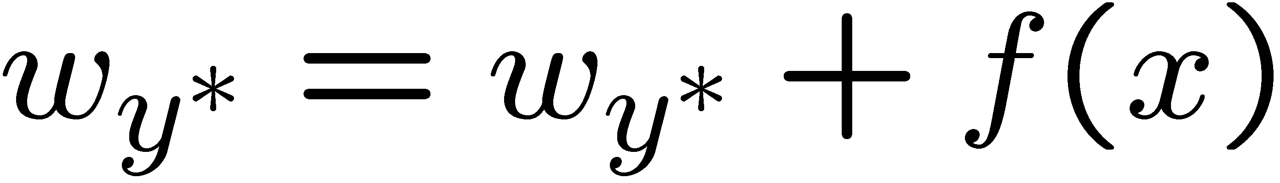
Learning: Multiclass Perceptron
Start with all weights = 0
Pick up training examples one by one
Predict with current weights
If correct, no change!
If wrong: lower score of wrong answer, raise score of right answer

Slide 24



Example: Multiclass Perceptron
“win the vote”
[1 1 0 1 1]
“win the election”
[1 1 0 0 1]
“win the game”
[1 1 1 0 1]
3
0
1
-2
0
3
0
-2
BIAS : 1
win : 0
game : 0
vote : 0
the : 0
...
0
-1
0
-1
-1
1
0
1
-1
0
BIAS : 0
win : 0
game : 0
vote : 0
the : 0
...
1
1
0
1
1
0
0
-1
1
0
BIAS : 0
win : 0
game : 0
vote : 0
the : 0
...

Slide 25
Properties of Perceptrons
Separable
Separability: true if some parameters get the training set perfectly correct
Convergence: if the training is separable, perceptron will eventually converge (binary case)
Non-Separable

Slide 26
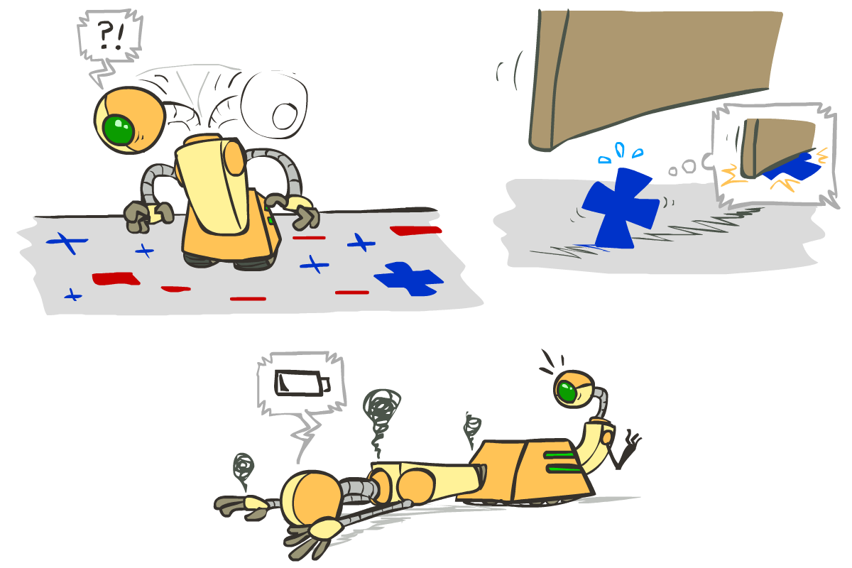





Problems with the Perceptron
Noise: if the data isn’t separable, weights might thrash
  Averaging weight vectors over time can help (averaged perceptron)
Mediocre generalization: finds a “barely” separating solution
Overtraining: test / held-out accuracy usually rises, then falls
  Overtraining is a kind of overfitting

Slide 27

Improving the Perceptron

Slide 28
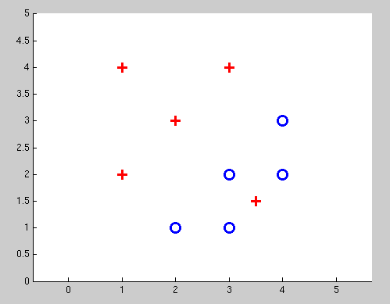
Non-Separable Case: Deterministic Decision
Even the best linear boundary makes at least one mistake

Slide 29
Non-Separable Case: Probabilistic Decision
0.9 | 0.1
0.7 | 0.3
0.5 | 0.5
0.3 | 0.7
0.1 | 0.9

Slide 30
How to get probabilistic decisions?
Perceptron scoring:
If very positive → want probability going to 1
If very negative → want probability going to 0
Sigmoid function

Slide 31



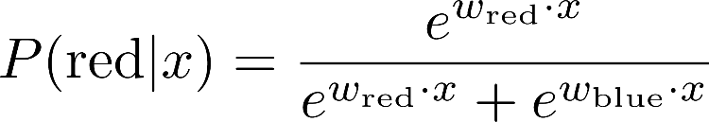
A 1D Example
definitely blue
not sure
definitely red
probability increases exponentially as we move away from boundary
normalizer

Slide 32
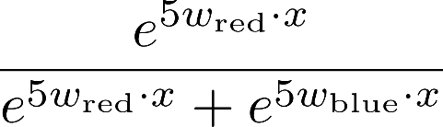
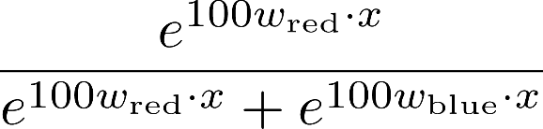

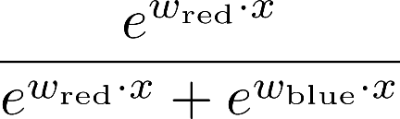
The Soft Max

Slide 33
Best w?
Maximum likelihood estimation:
with:
= Logistic Regression

Slide 34
Separable Case: Deterministic Decision – Many Options

Slide 35
Separable Case: Probabilistic Decision – Clear Preference
0.7 | 0.3
0.5 | 0.5
0.7 | 0.3
0.3 | 0.7
0.5 | 0.5
0.3 | 0.7

Slide 36
Multiclass Logistic Regression
Recall Perceptron:
  A weight vector for each class:
  Score (activation) of a class y:
  Prediction highest score wins
How to make the scores into probabilities?
original activations
softmax activations

Slide 37
Best w?
Maximum likelihood estimation:
with:
= Multi-Class Logistic Regression

Slide 38
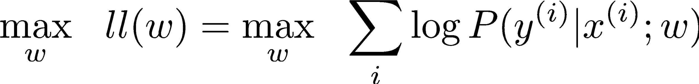
Optimization
Optimization
  i.e., how do we solve:

Slide 39

Hill Climbing
Recall from CSPs lecture: simple, general idea
  Start wherever
  Repeat: move to the best neighboring state
  If no neighbors better than current, quit
What’s particularly tricky when hill-climbing for multiclass logistic regression?
  Optimization over a continuous space
    Infinitely many neighbors!
    How to do this efficiently?

Slide 40
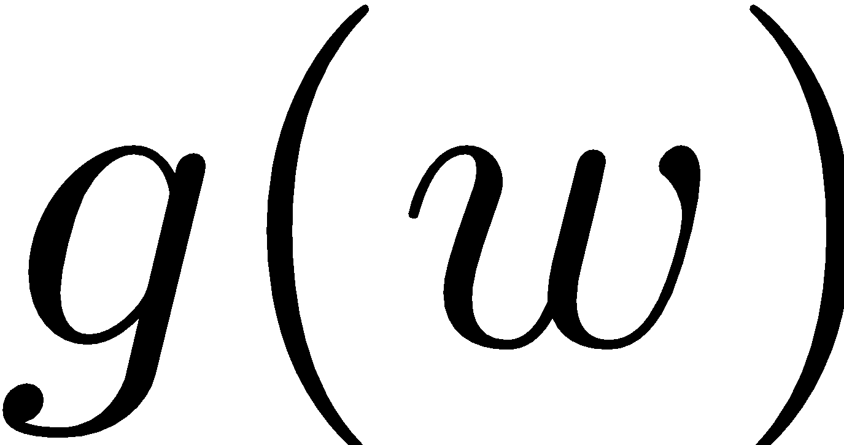
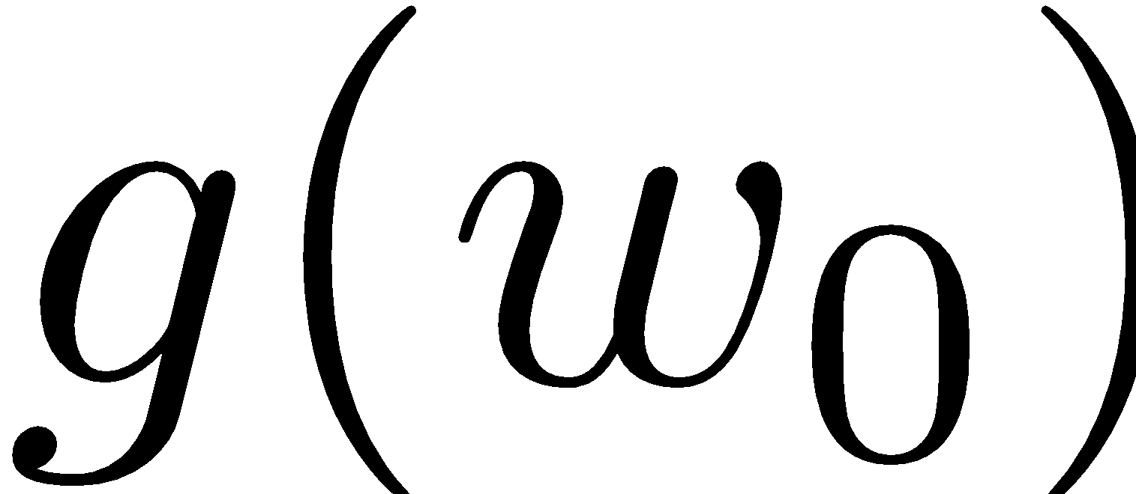


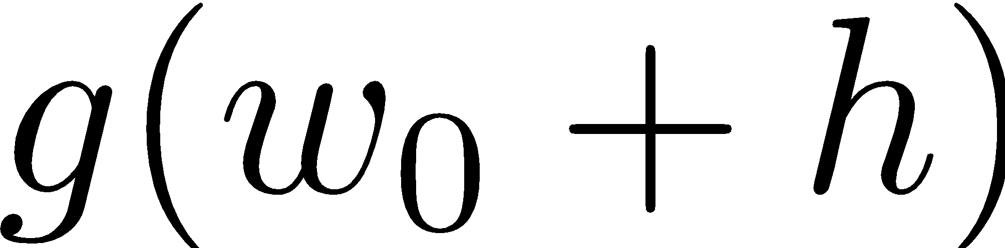
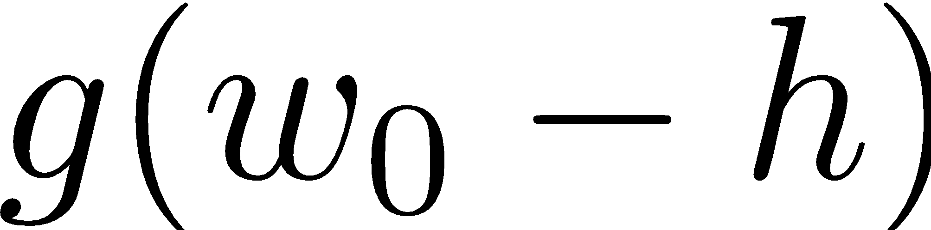
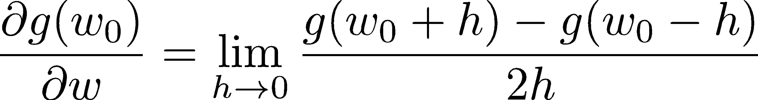
1-D Optimization
Could evaluate and
  Then step in best direction
Or, evaluate derivative:
  Tells which direction to step into

Slide 41
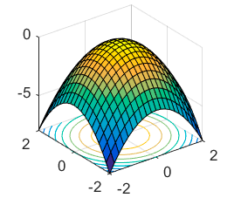
2-D Optimization
Source: offconvex.org

Slide 42
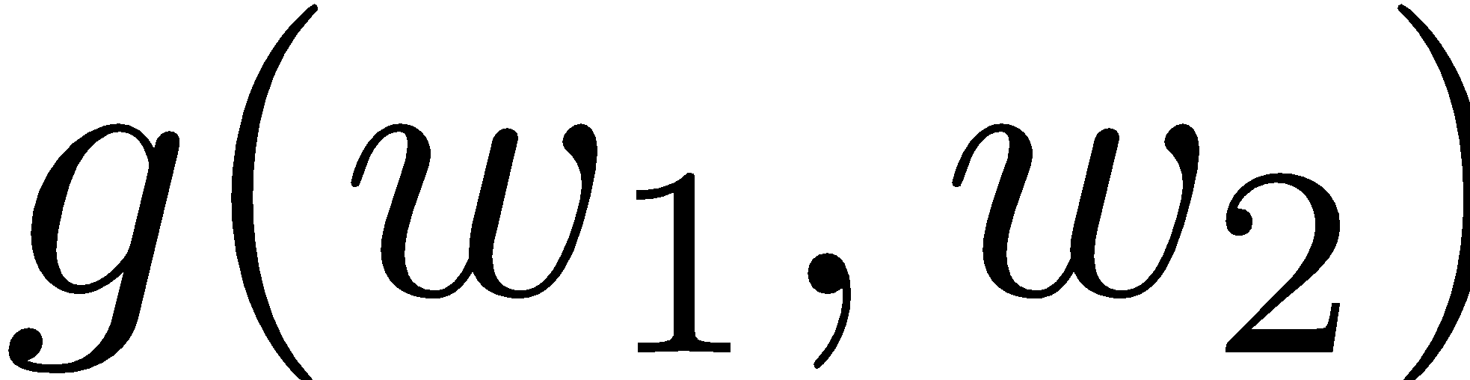
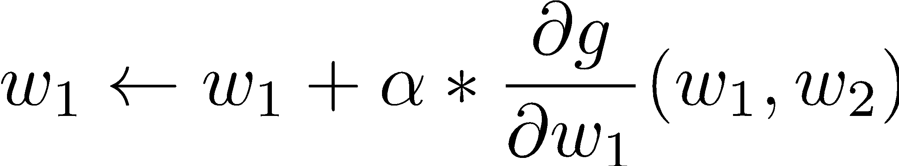
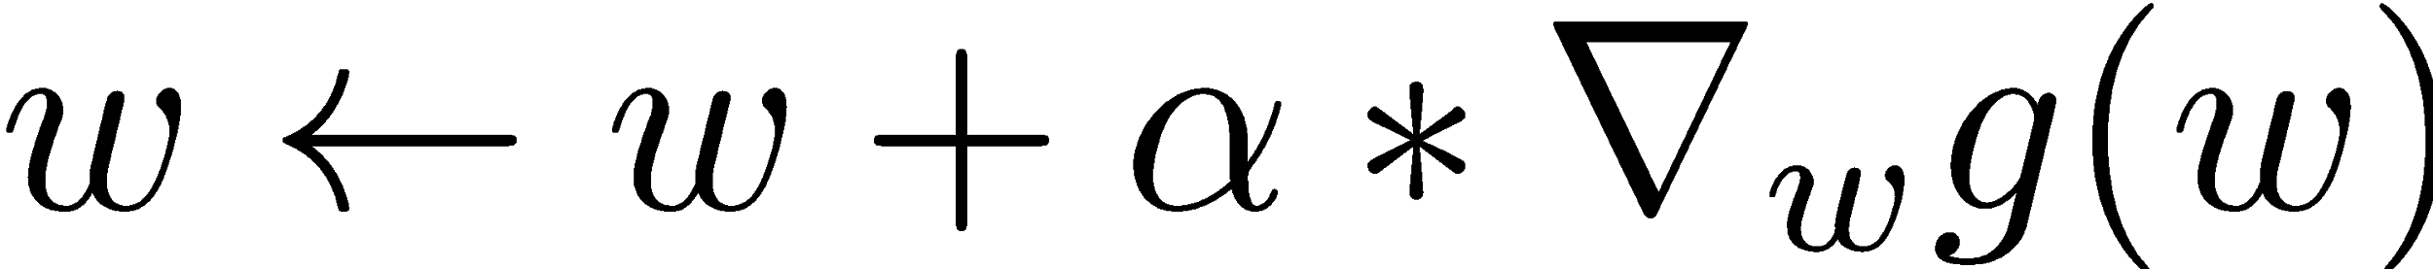
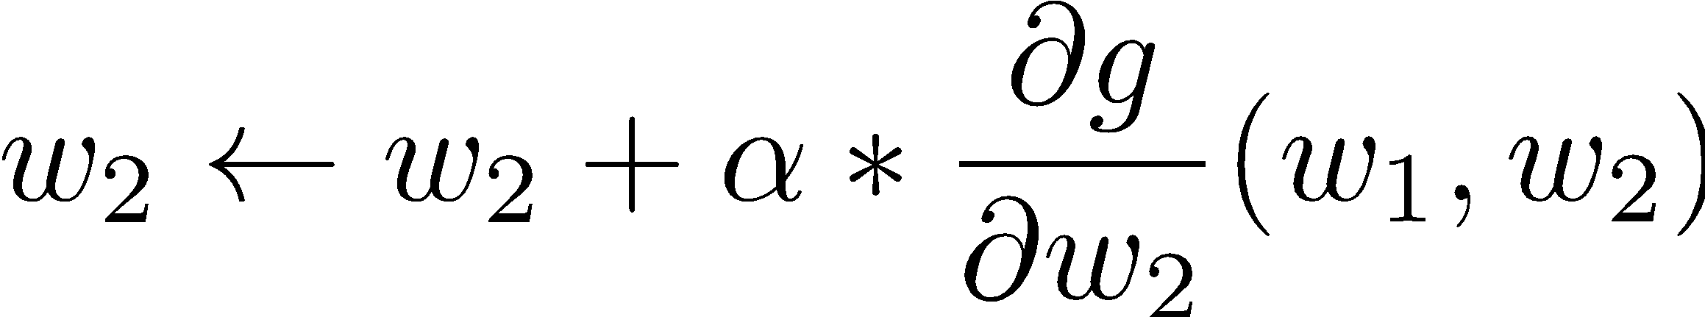
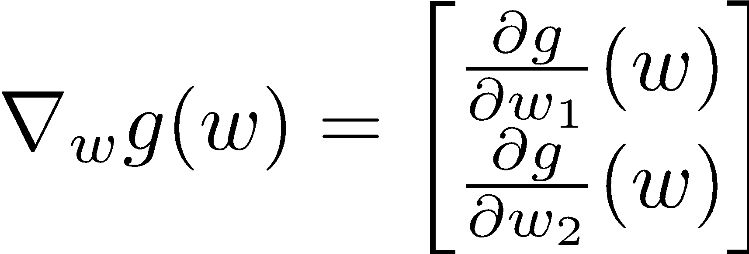
Gradient Ascent
Perform update in uphill direction for each coordinate
The steeper the slope (i.e. the higher the derivative) the bigger the step for that coordinate
E.g., consider:
    Updates:
  Updates in vector notation:
  with:
= gradient

Slide 43
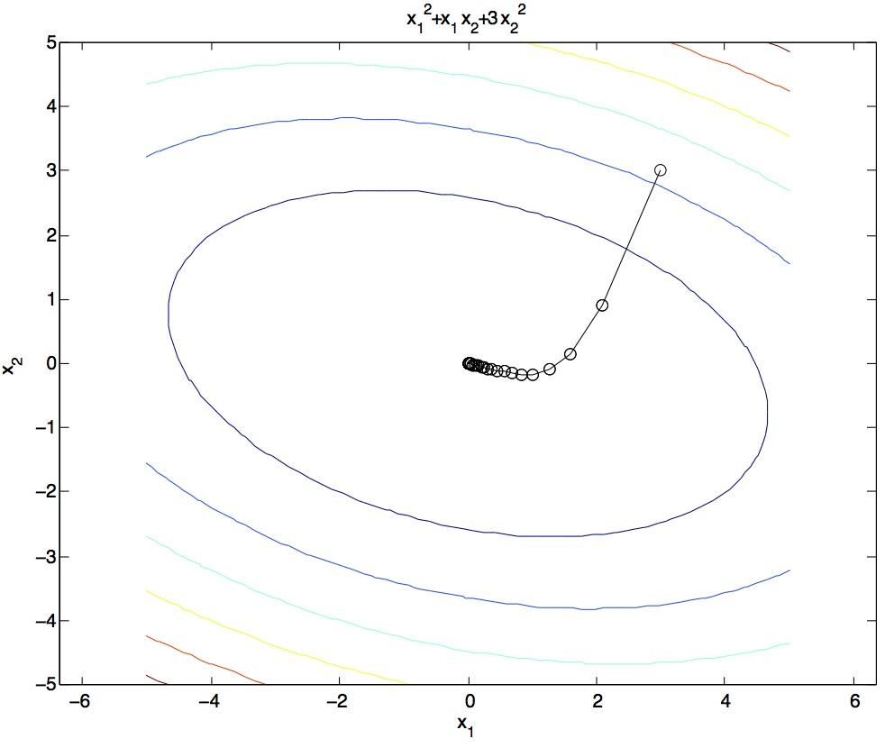
Gradient Ascent
Idea:
  Start somewhere
  Repeat: Take a step in the gradient direction
Figure source: Mathworks

Slide 44
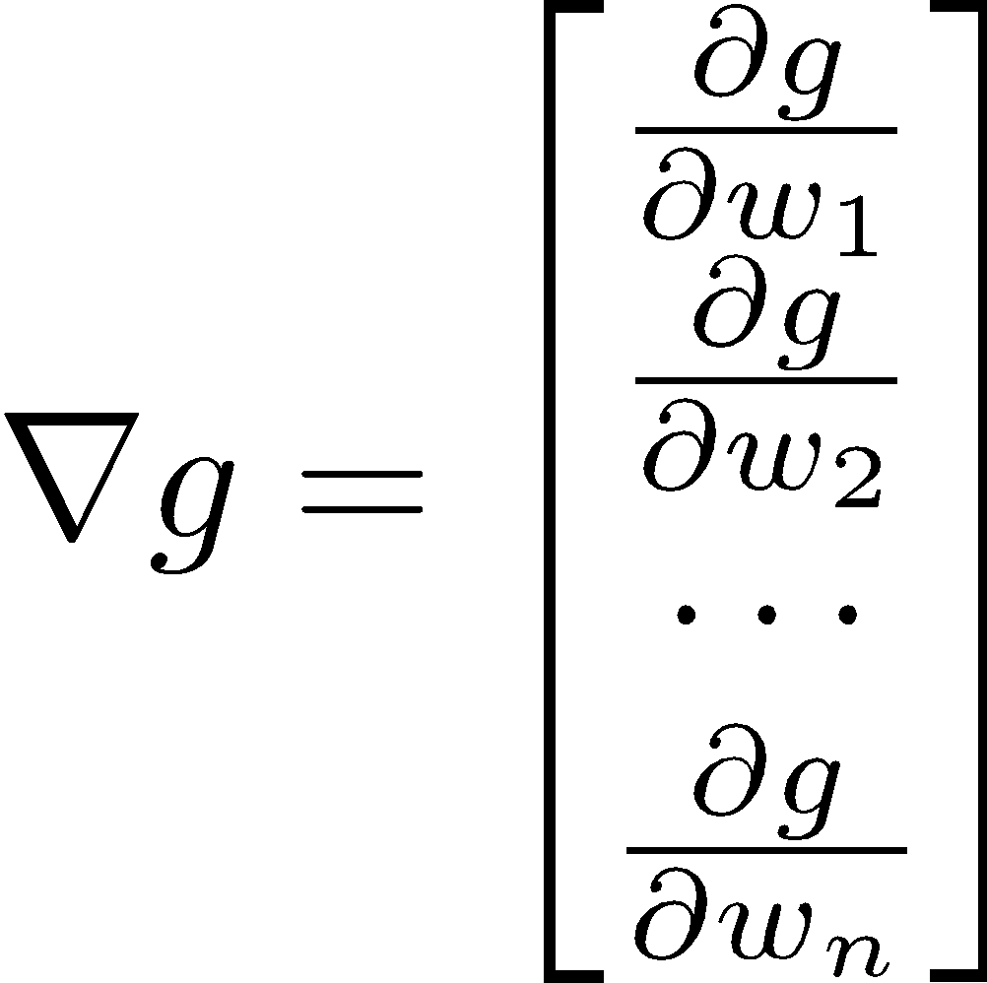
Gradient in n dimensions

Slide 45


Optimization Procedure: Gradient Ascent
init
for iter = 1, 2, …
: learning rate --- tweaking parameter that needs to be chosen carefully

Slide 46

Batch Gradient Ascent on the Log Likelihood Objective
init
for iter = 1, 2, …

Slide 47
Stochastic Gradient Ascent on the Log Likelihood Objective
Observation: once gradient on one training example has been computed, might as well incorporate before computing next one
init
for iter = 1, 2, …
  pick random j

Slide 48

Mini-Batch Gradient Ascent on the Log Likelihood Objective
Observation: gradient over small set of training examples (=mini-batch) can be computed in parallel, might as well do that instead of a single one
init
for iter = 1, 2, …
  pick random subset of training examples J

Slide 49





What will gradient ascent do in multi-class logistic regression?
adds f to the correct class weights
for y’ weights:
subtracts f from y’ weights in proportion to the probability current weights give to y’

