Slide 1

CS 188: Artificial Intelligence
Neural Networks
Instructors: Angela Liu and Yanlai Yang
University of California, Berkeley
(Slides adapted from Pieter Abbeel, Dan Klein, Anca Dragan, Stuart Russell and Dawn Song)

Slide 2
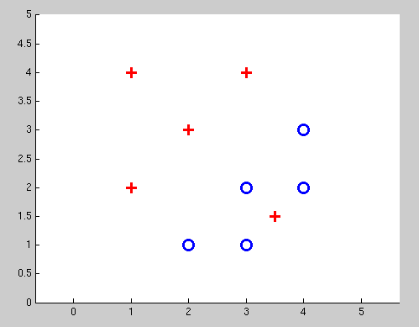
Separable Case: Probabilistic Decision – Clear Preference
0.7 | 0.3
0.5 | 0.5
0.7 | 0.3
0.3 | 0.7
0.5 | 0.5
0.3 | 0.7

Slide 3
Best w?
Maximum likelihood estimation:
with:
= Logistic Regression

Slide 4



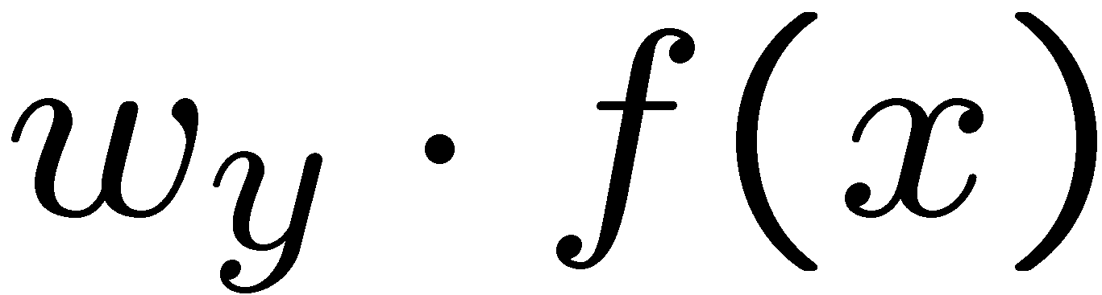

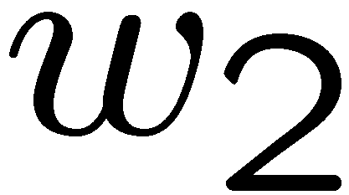
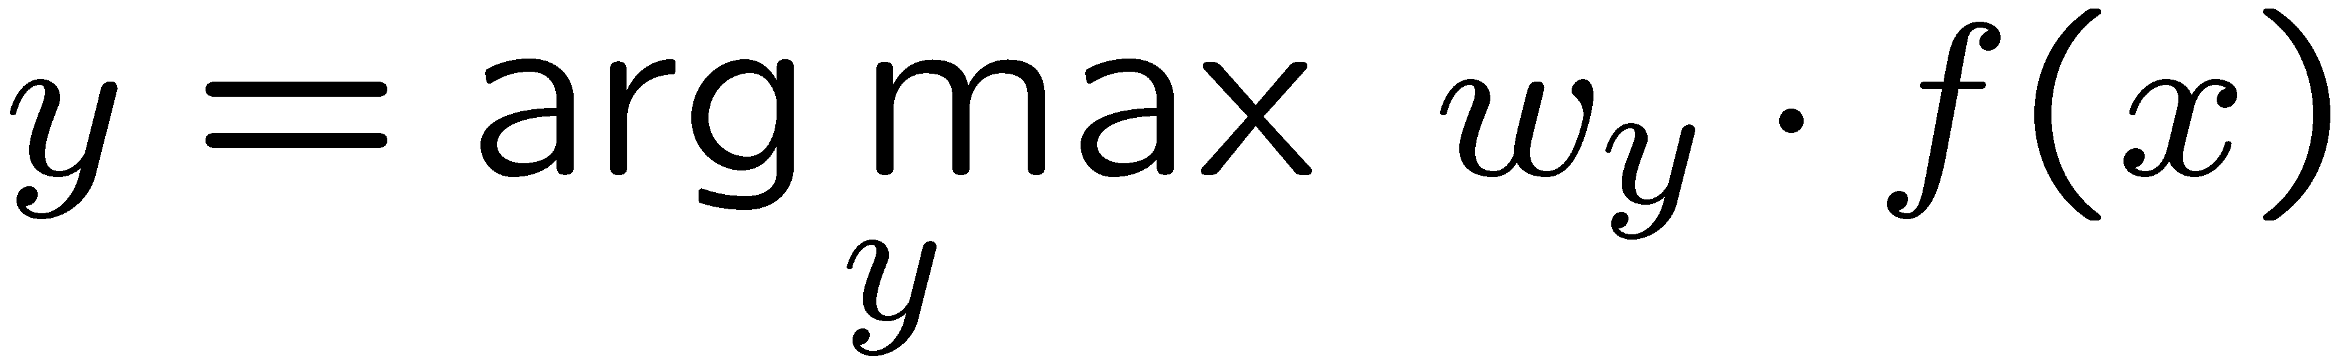
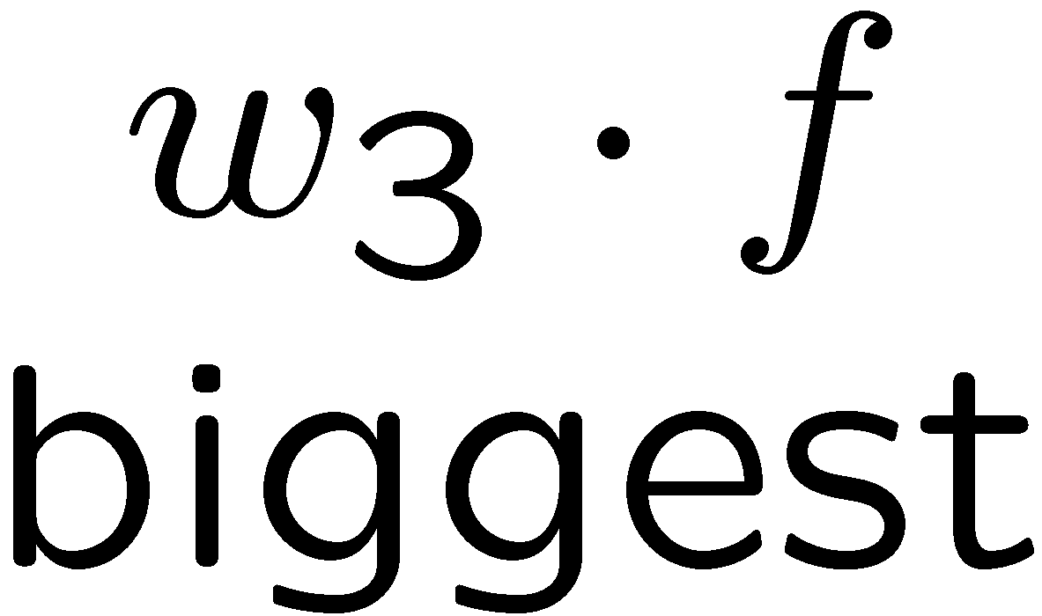
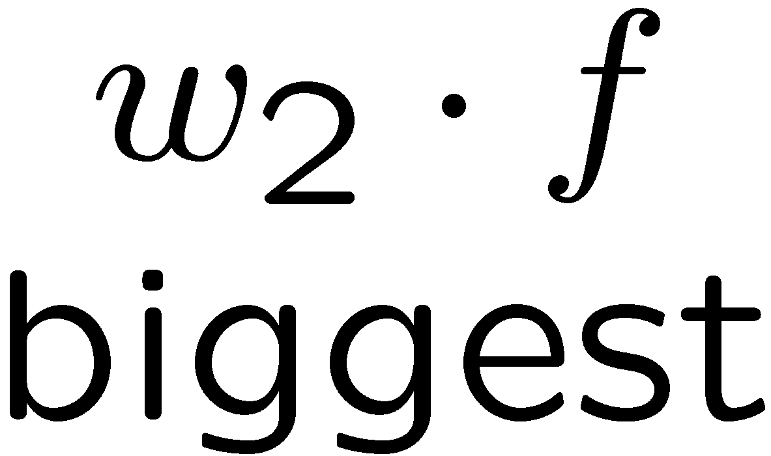
Multiclass Logistic Regression
Recall Perceptron:
  A weight vector for each class:
  Score (activation) of a class y:
  Prediction highest score wins
How to make the scores into probabilities?
original activations
softmax activations

Slide 5
Best w?
Maximum likelihood estimation:
with:
= Multi-Class Logistic Regression

Slide 6
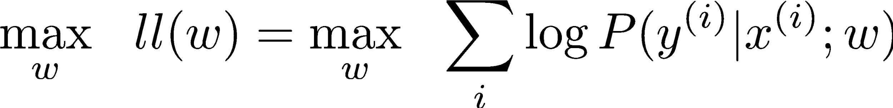
Optimization
Optimization
  i.e., how do we solve:

Slide 7
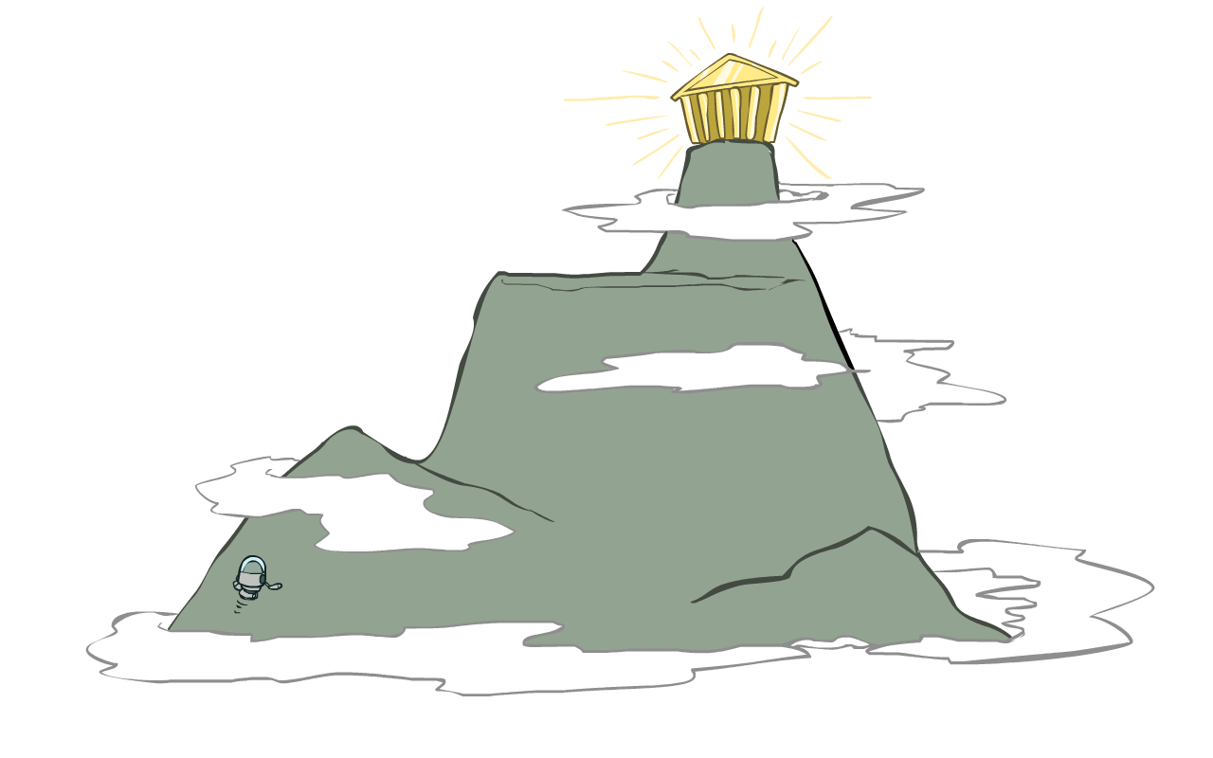
Hill Climbing
Recall from CSPs lecture: simple, general idea
  Start wherever
  Repeat: move to the best neighboring state
  If no neighbors better than current, quit
What’s particularly tricky when hill-climbing for multiclass logistic regression?
  Optimization over a continuous space
    Infinitely many neighbors!
    How to do this efficiently?

Slide 8
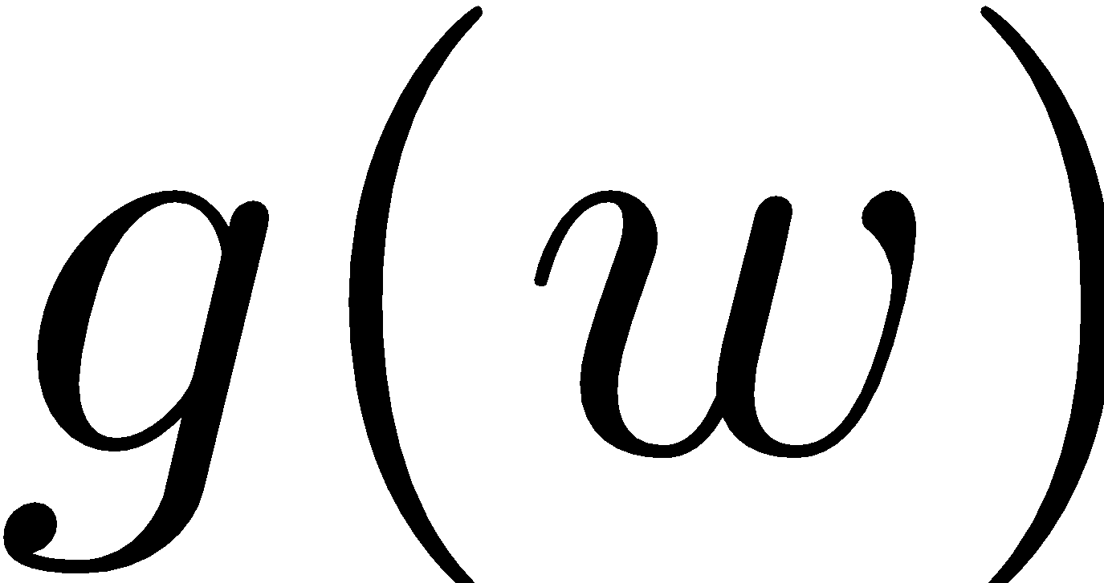
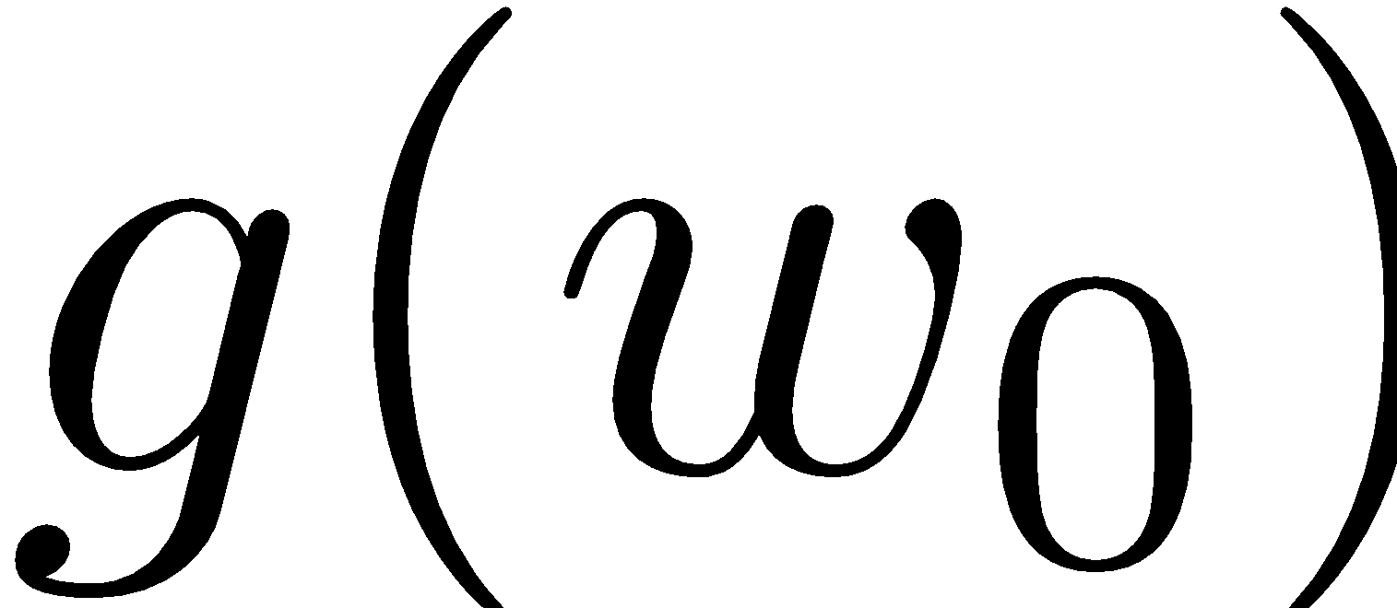


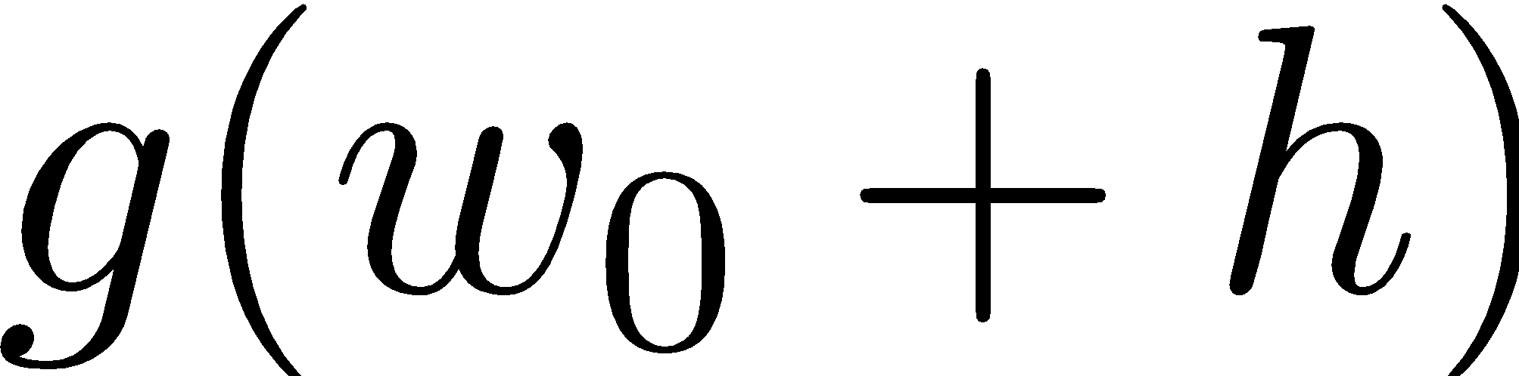
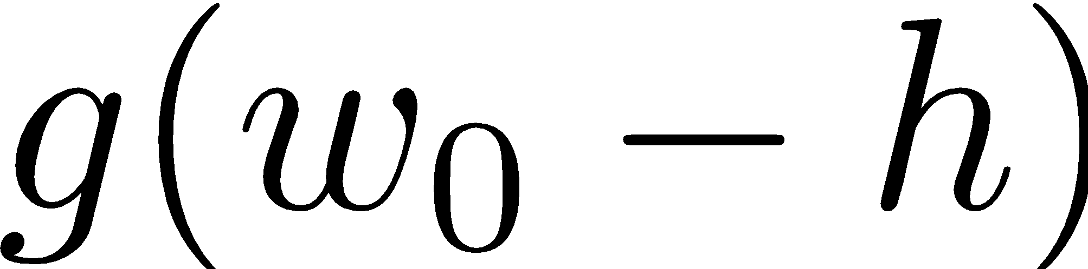
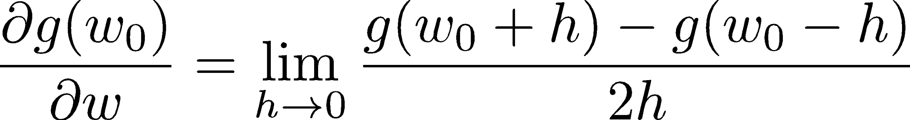
1-D Optimization
Could evaluate and
  Then step in best direction
Or, evaluate derivative:
  Tells which direction to step into

Slide 9
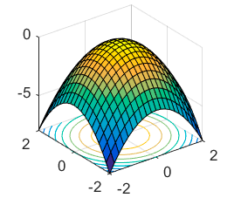
2-D Optimization
Source: offconvex.org

Slide 10
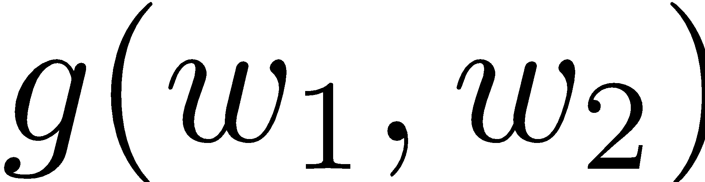
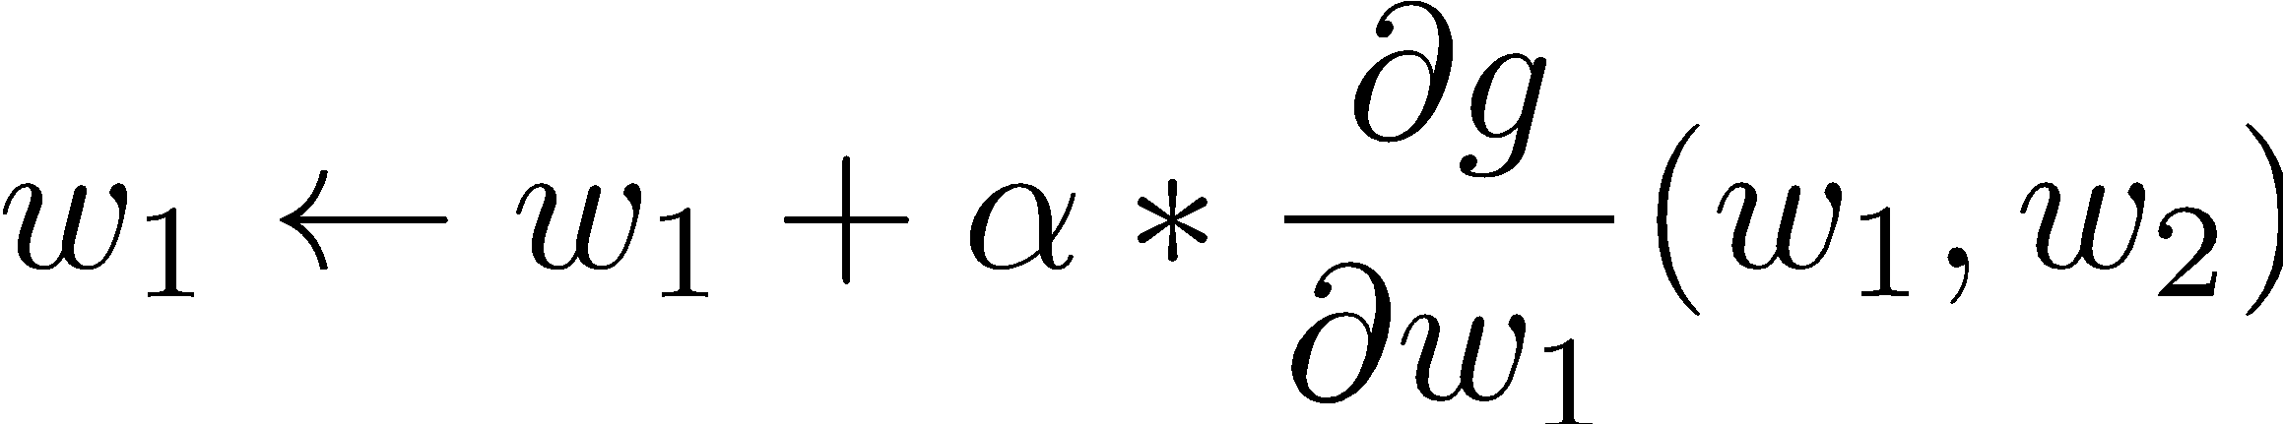
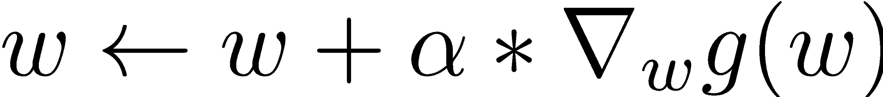
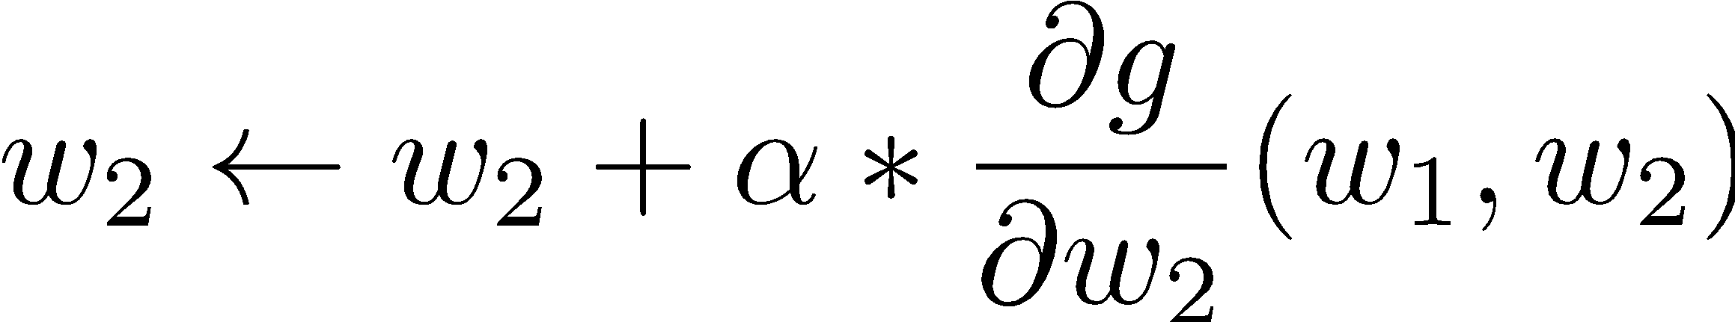
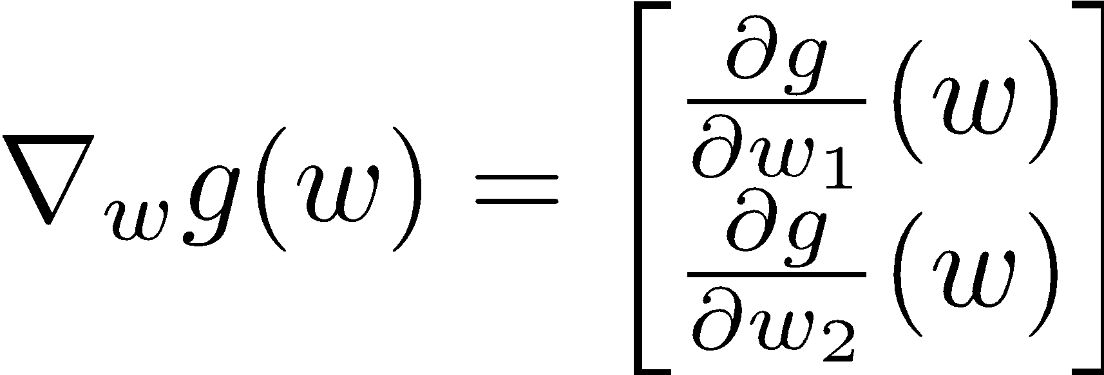
Gradient Ascent
Perform update in uphill direction for each coordinate
The steeper the slope (i.e. the higher the derivative) the bigger the step for that coordinate
E.g., consider:
    Updates:
  Updates in vector notation:
  with:
= gradient

Slide 11
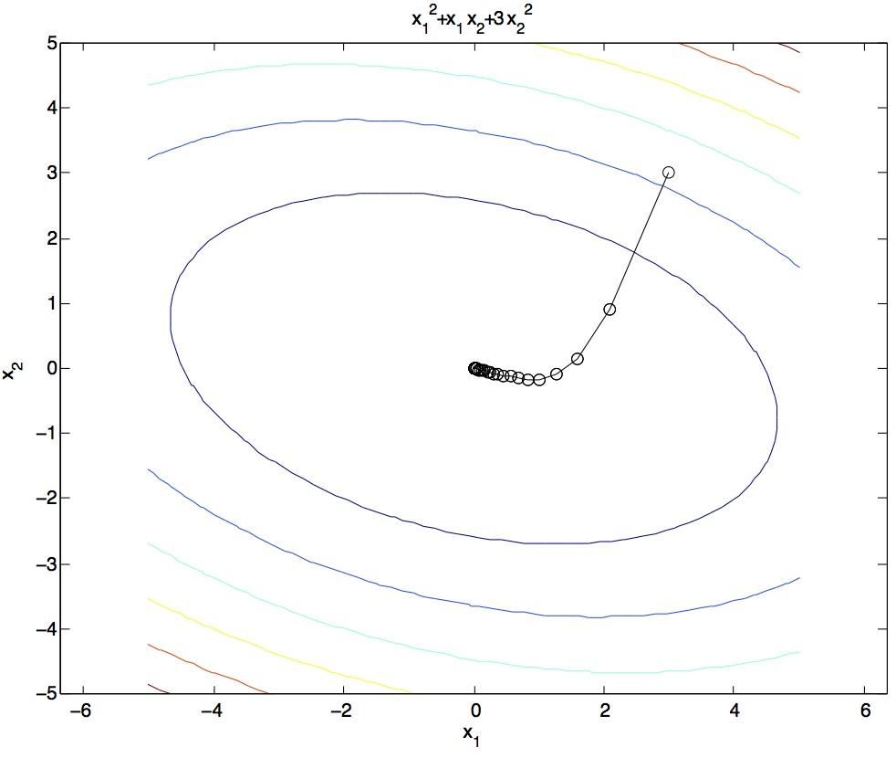
Gradient Ascent
Idea:
  Start somewhere
  Repeat: Take a step in the gradient direction
Figure source: Mathworks

Slide 12
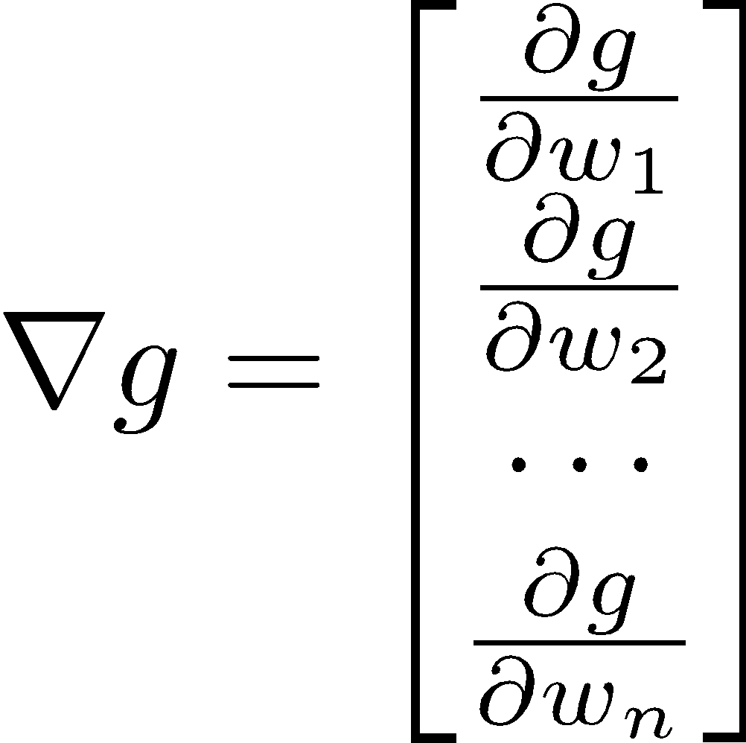
Gradient in n dimensions

Slide 13
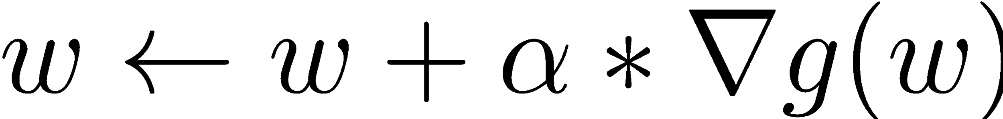

Optimization Procedure: Gradient Ascent
init
for iter = 1, 2, …
: learning rate --- tweaking parameter that needs to be chosen carefully

Slide 14
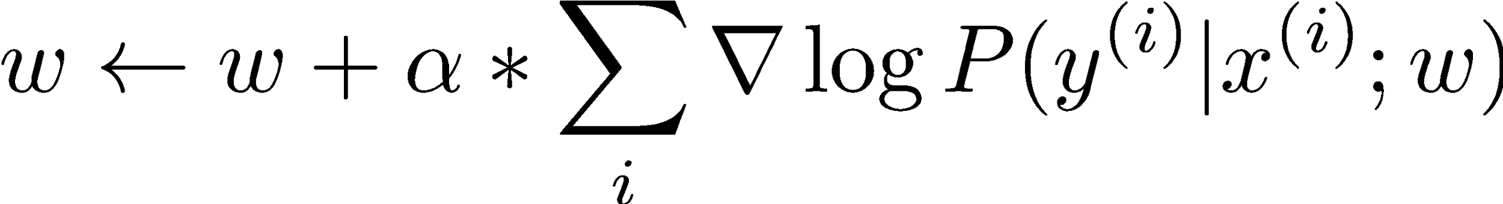
Batch Gradient Ascent on the Log Likelihood Objective
init
for iter = 1, 2, …

Slide 15
Stochastic Gradient Ascent on the Log Likelihood Objective
Observation: once gradient on one training example has been computed, might as well incorporate before computing next one
init
for iter = 1, 2, …
  pick random j

Slide 16
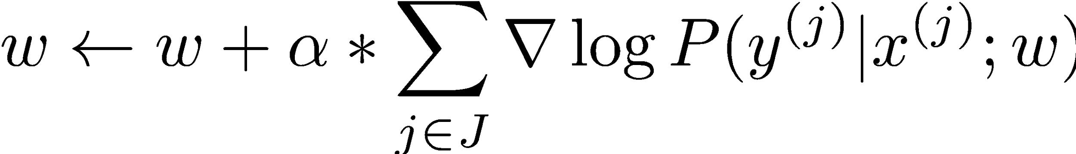
Mini-Batch Gradient Ascent on the Log Likelihood Objective
Observation: gradient over small set of training examples (=mini-batch) can be computed in parallel, might as well do that instead of a single one
init
for iter = 1, 2, …
  pick random subset of training examples J

Slide 17
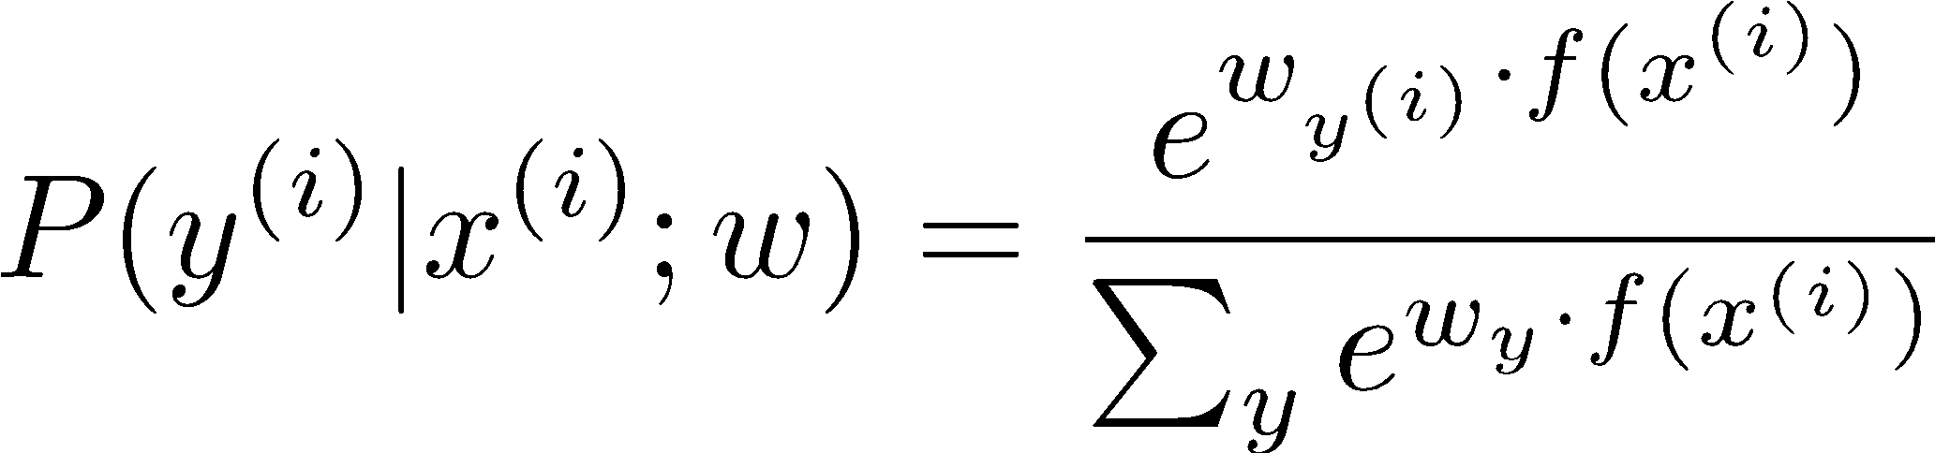
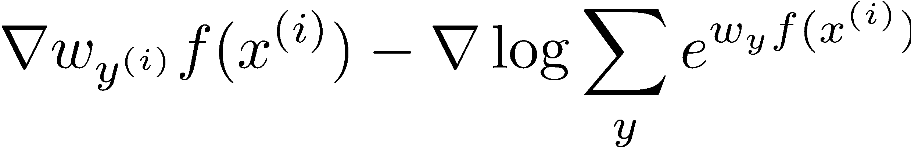
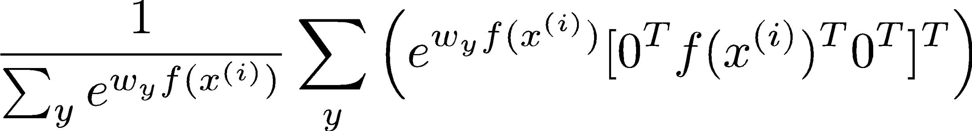
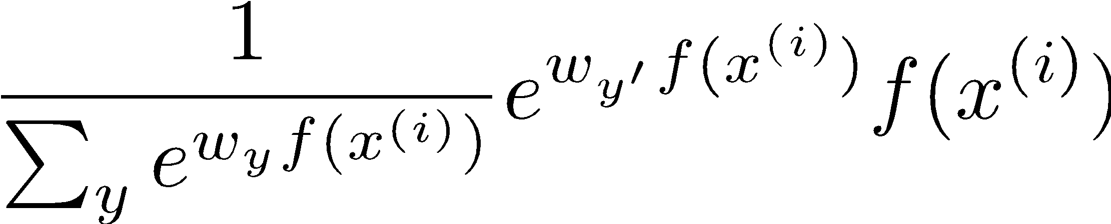
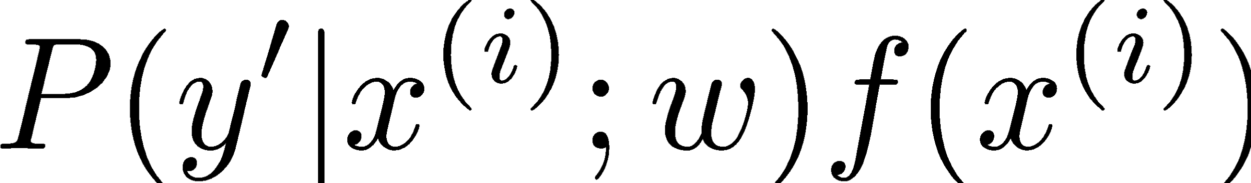
What will gradient ascent do in multi-class logistic regression?
adds f to the correct class weights
for y’ weights:
subtracts f from y’ weights in proportion to the probability current weights give to y’

Slide 18
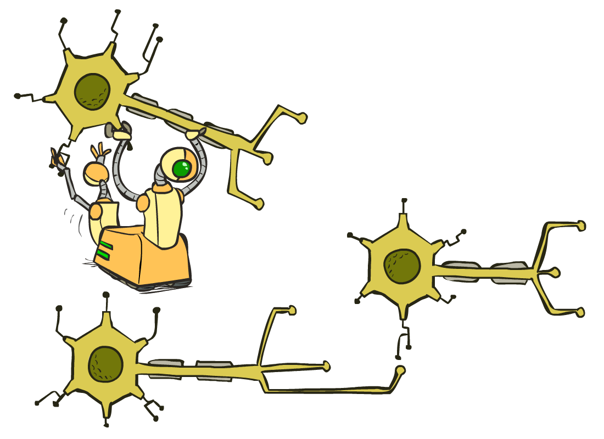
Neural Networks

Slide 19
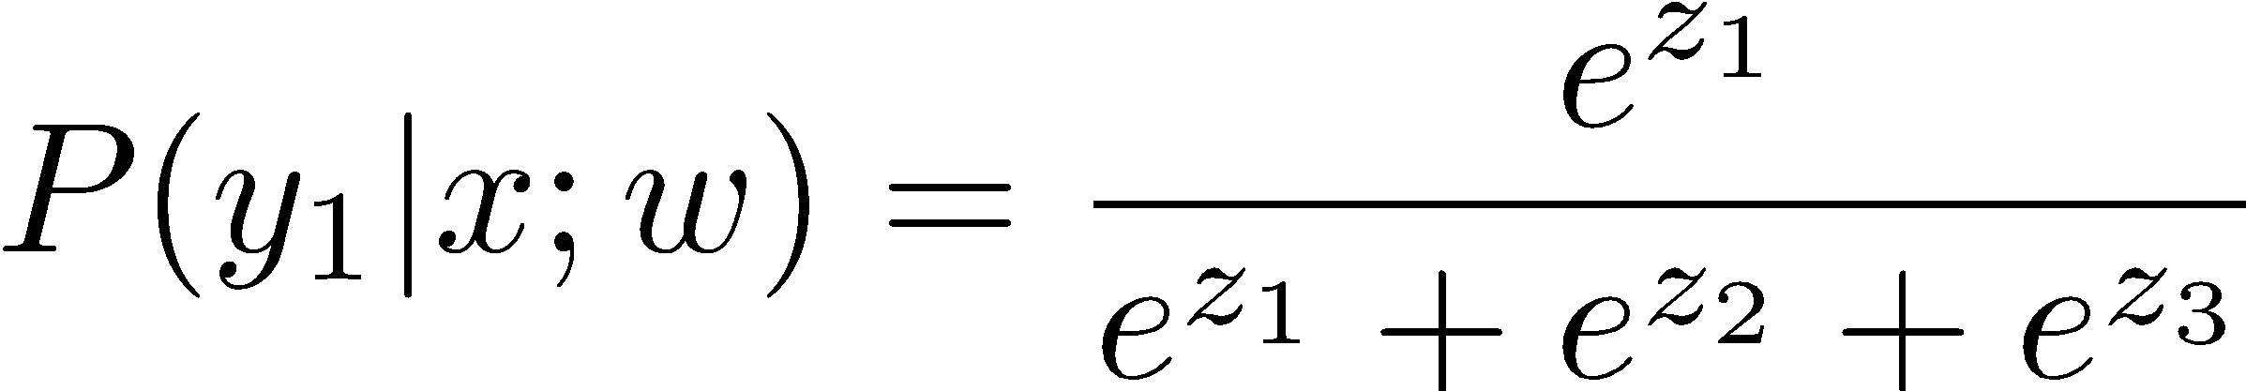
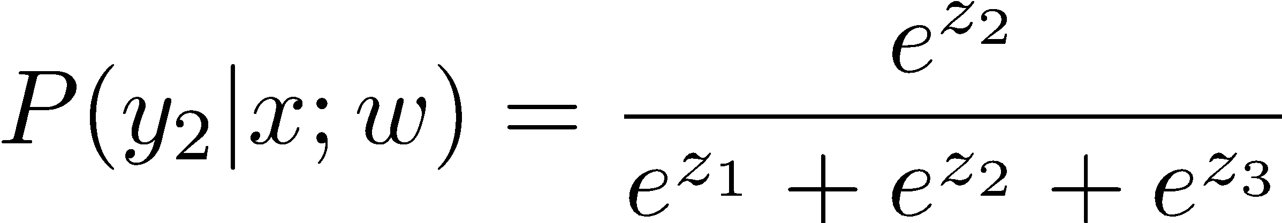
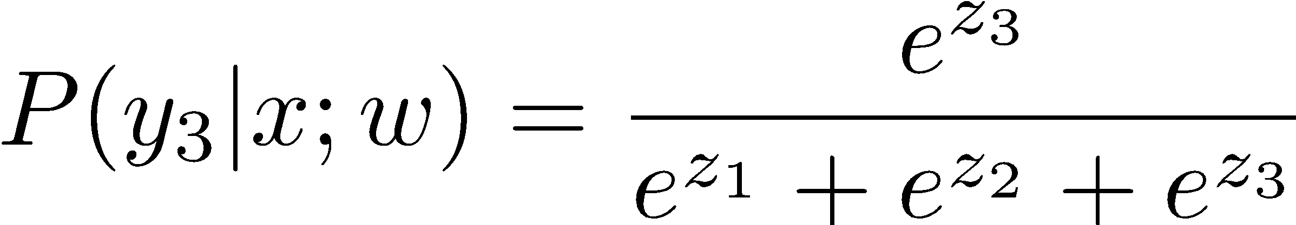
Multi-class Logistic Regression
= special case of neural network
f₁(x)
z₁
softmax
f₂(x)
z₂
f₃(x)
…
z₃
f_{K}(x)

Slide 20
Deep Neural Network = Also learn the features!
f₁(x)
z₁
softmax
f₂(x)
z₂
f₃(x)
…
z₃
f_{K}(x)

Slide 21
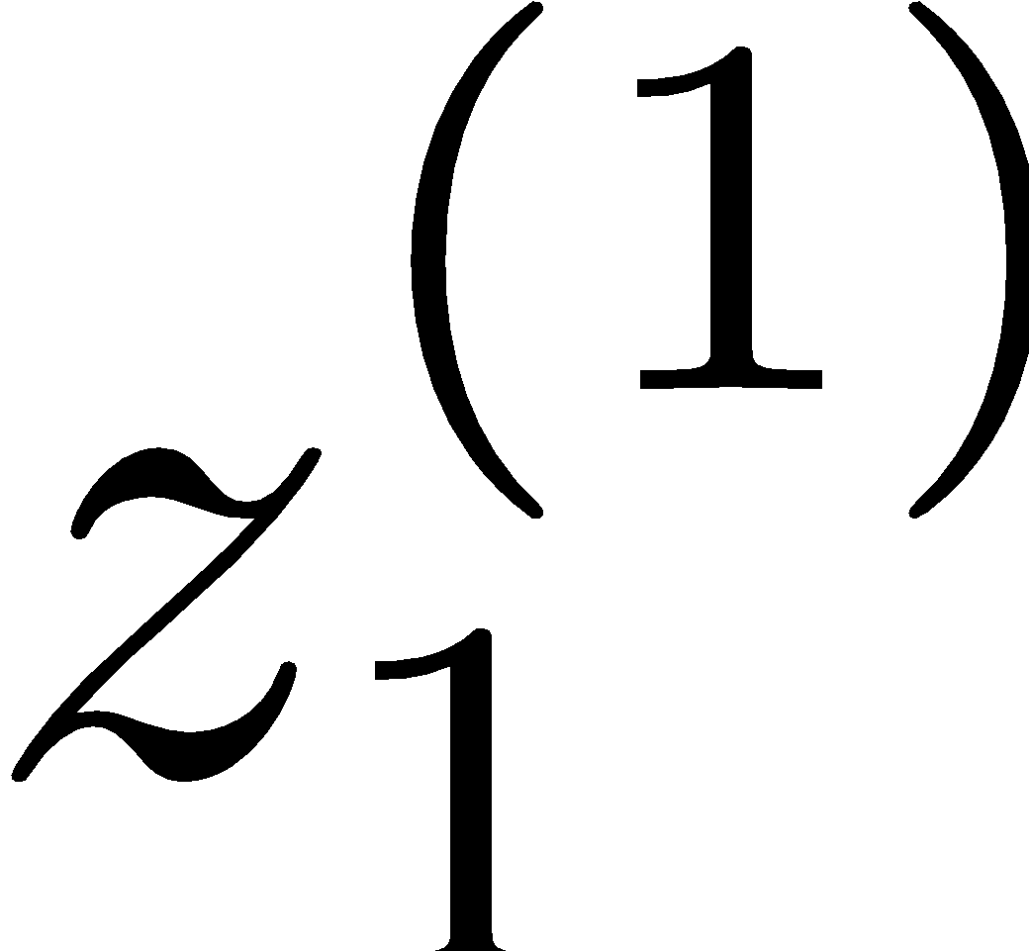
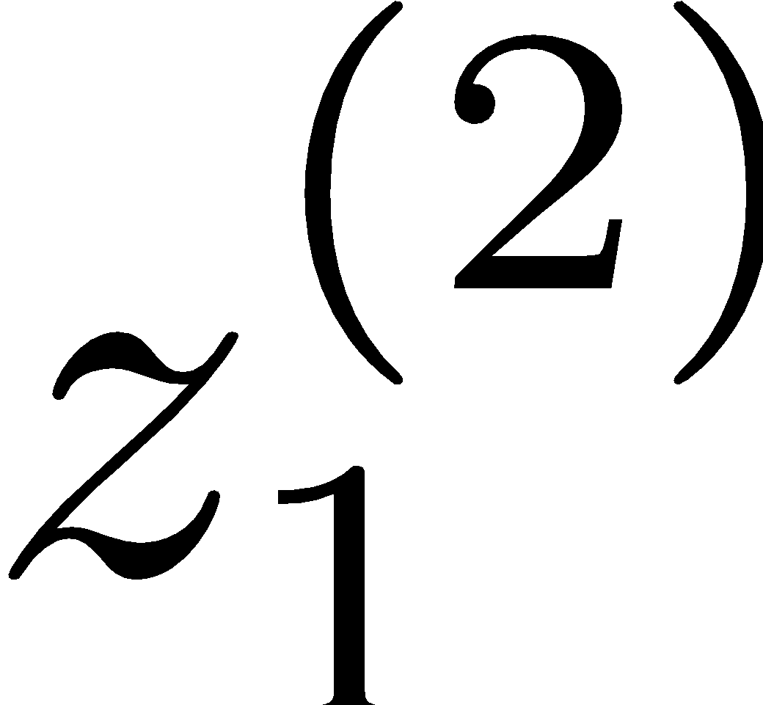
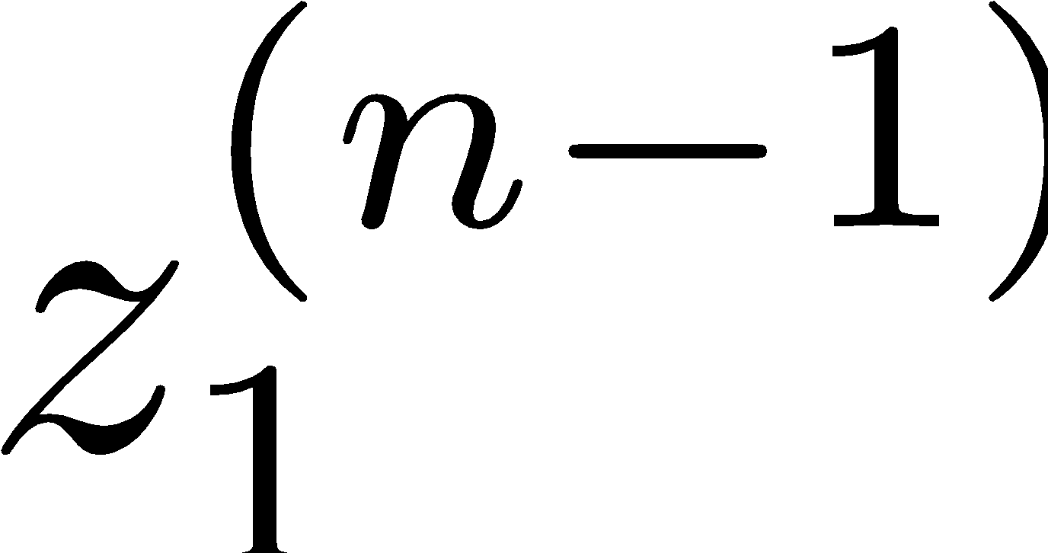
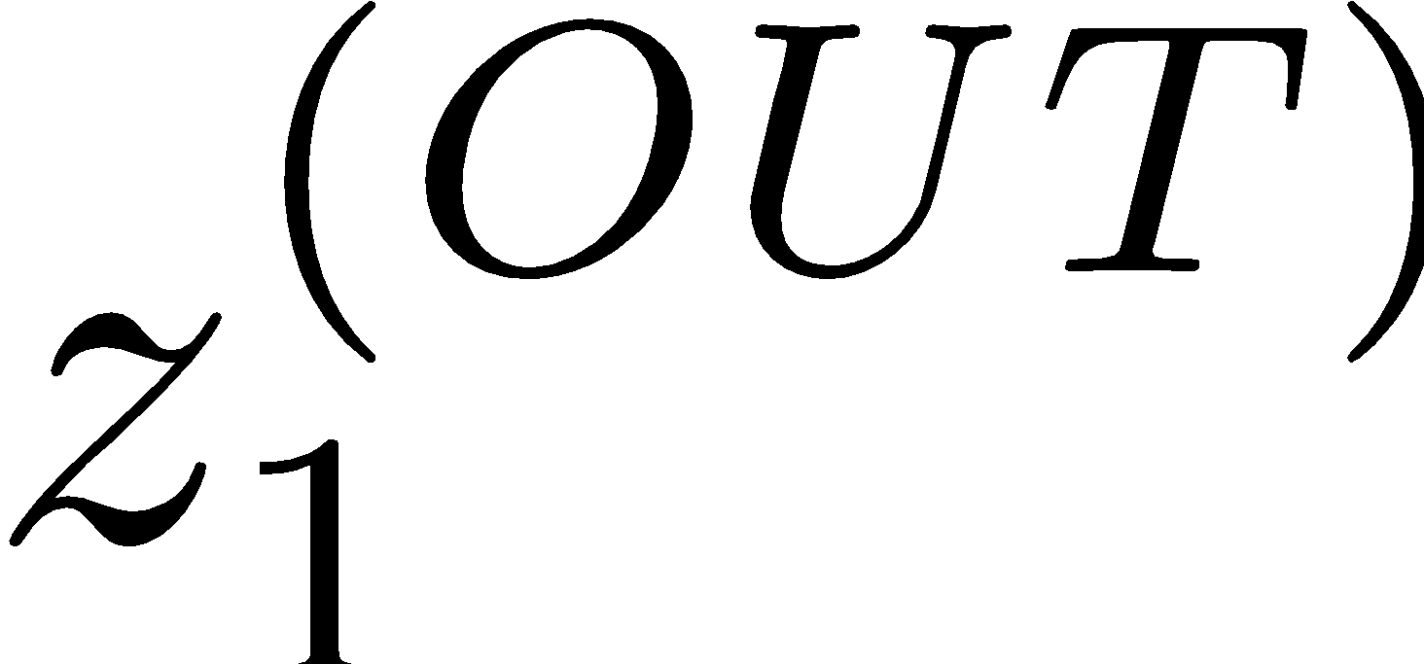
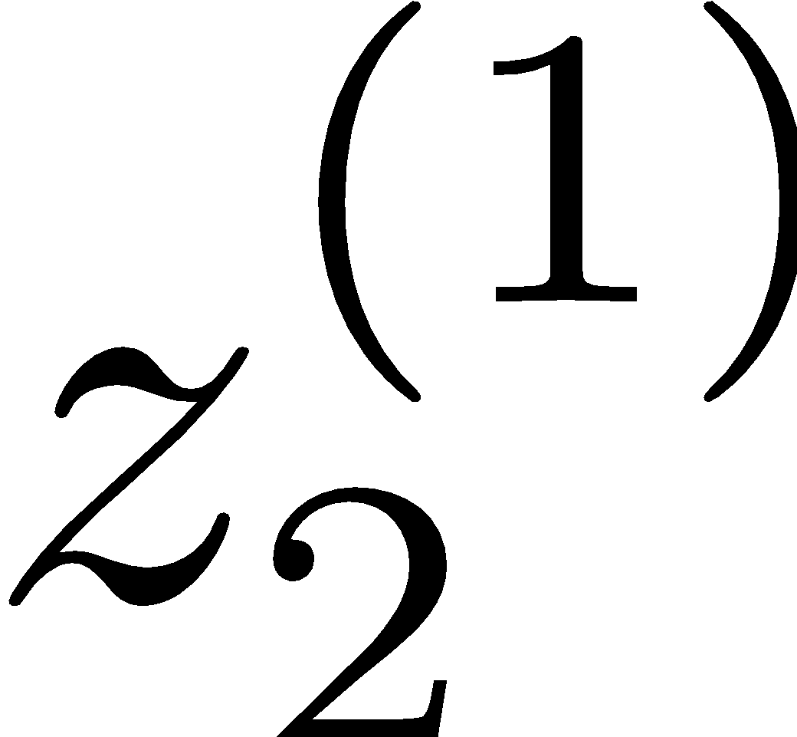
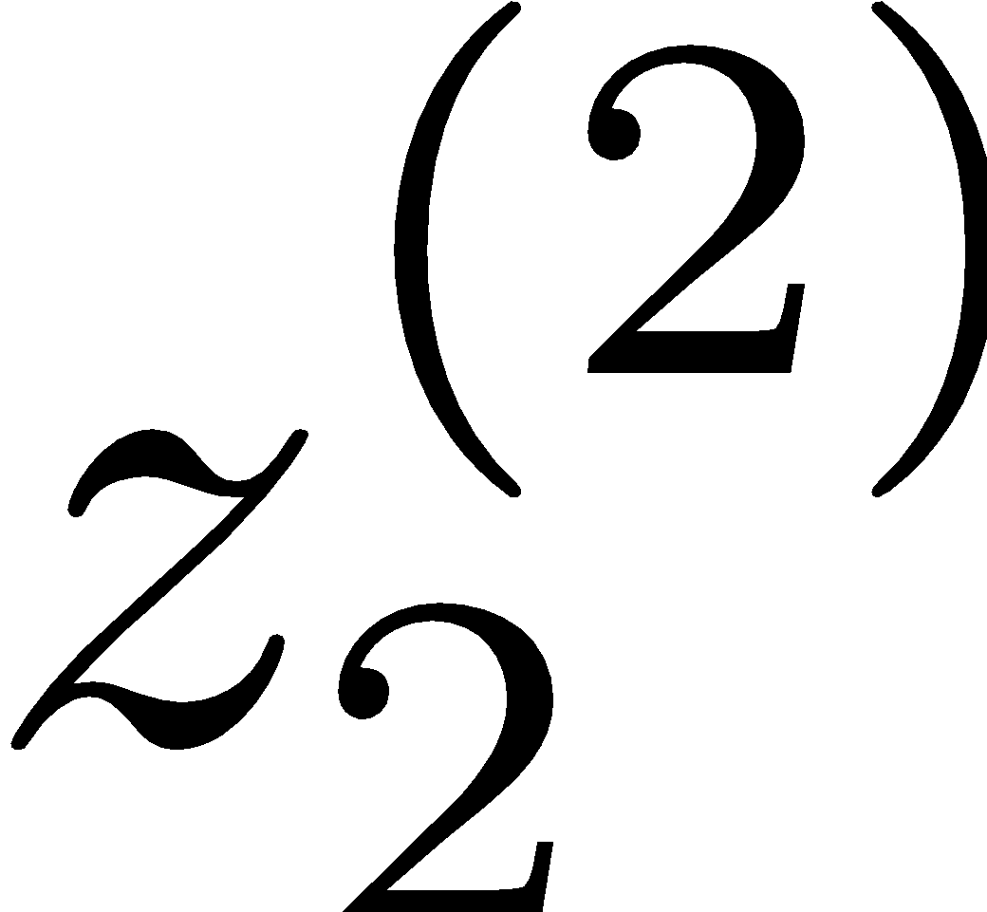
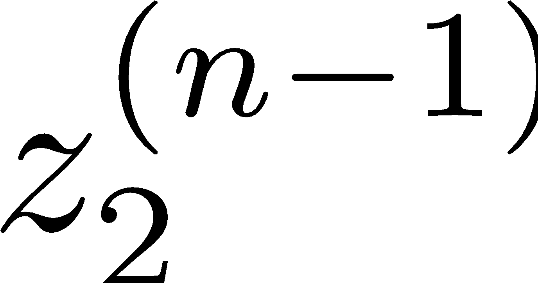
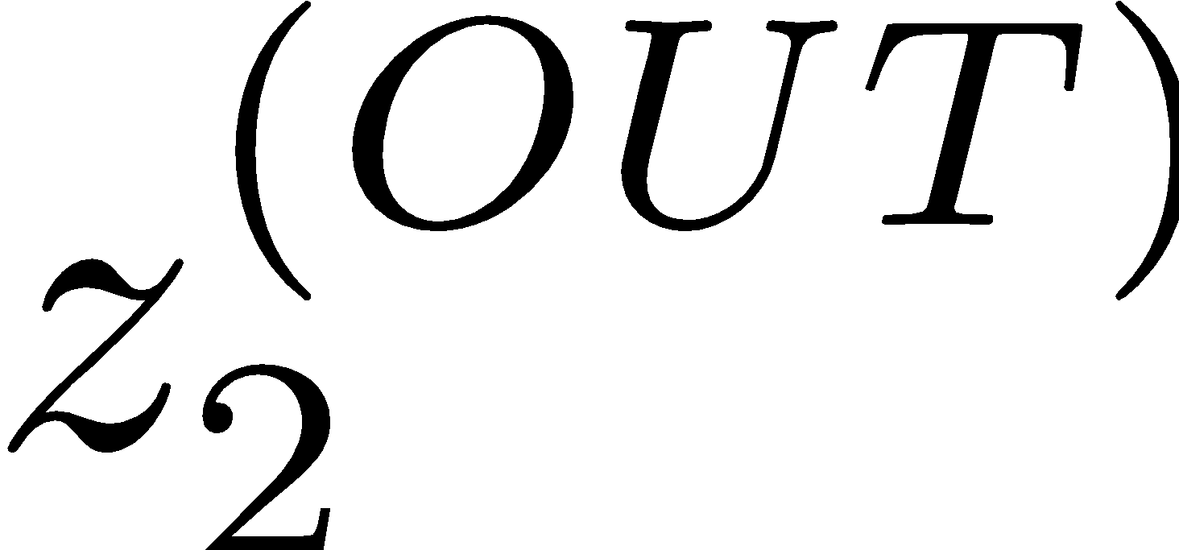
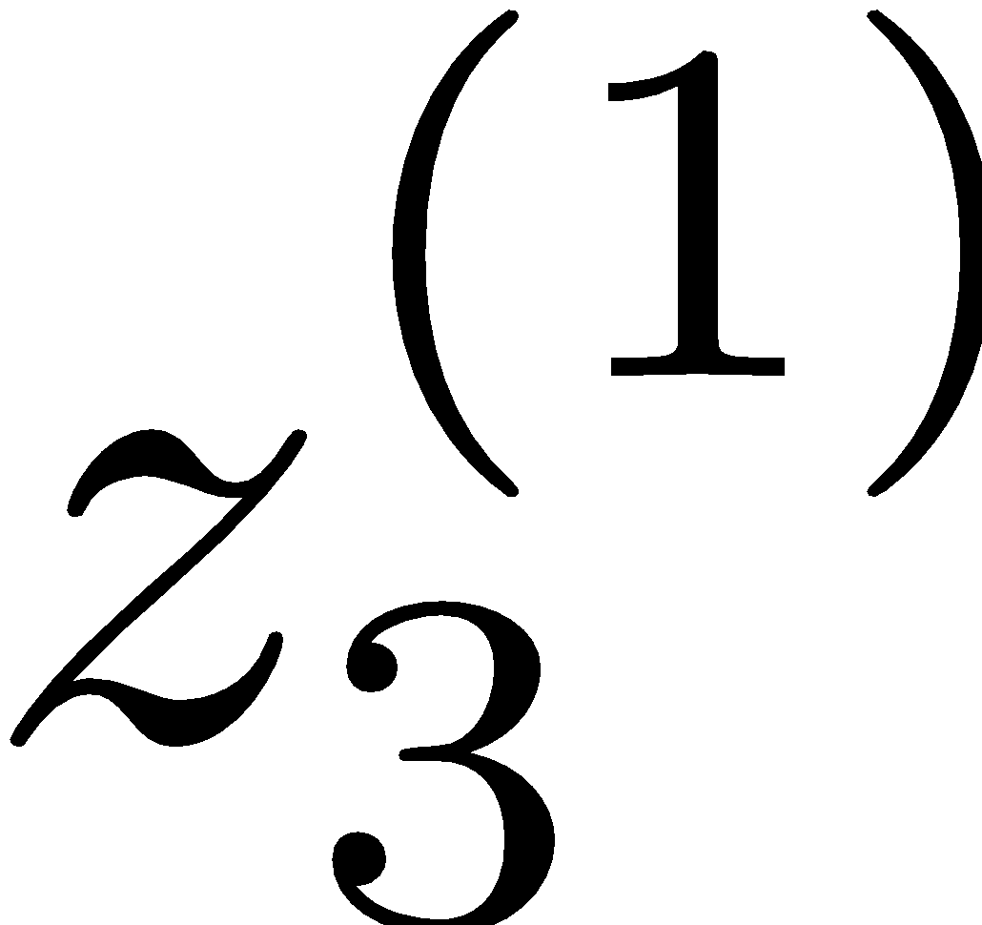
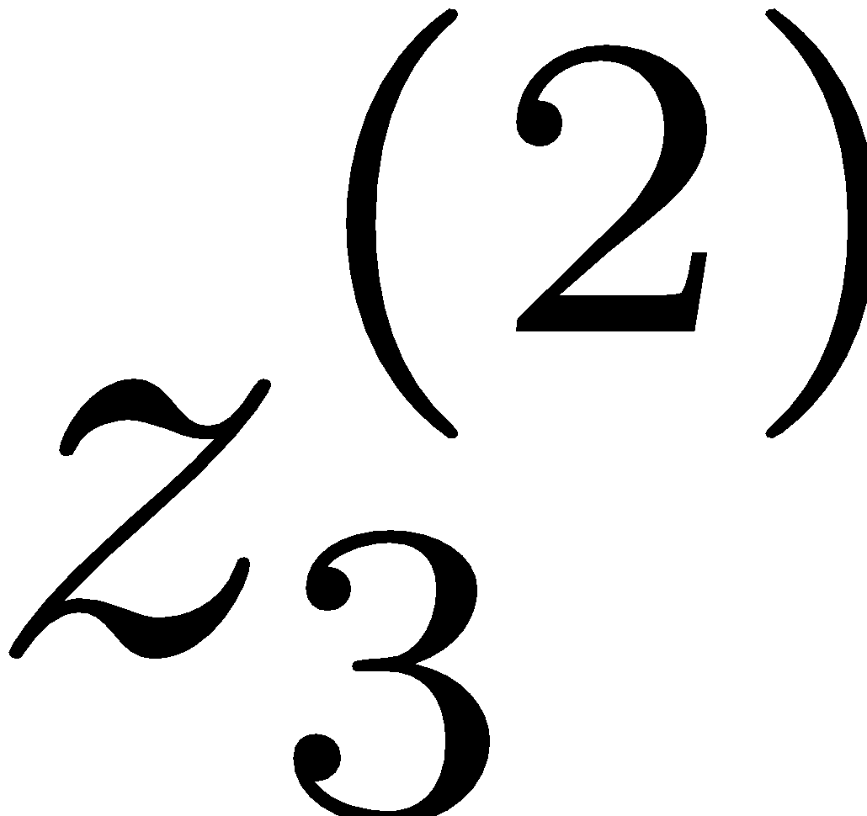
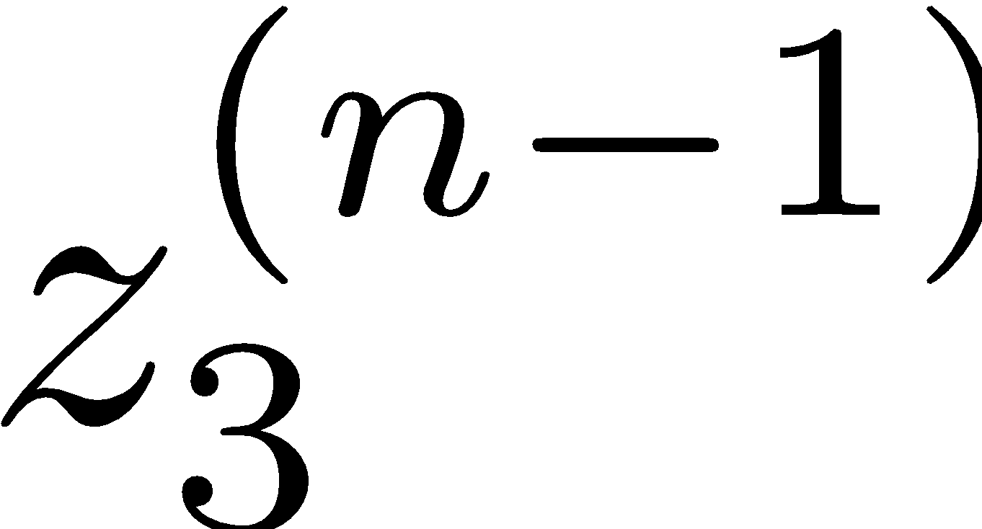
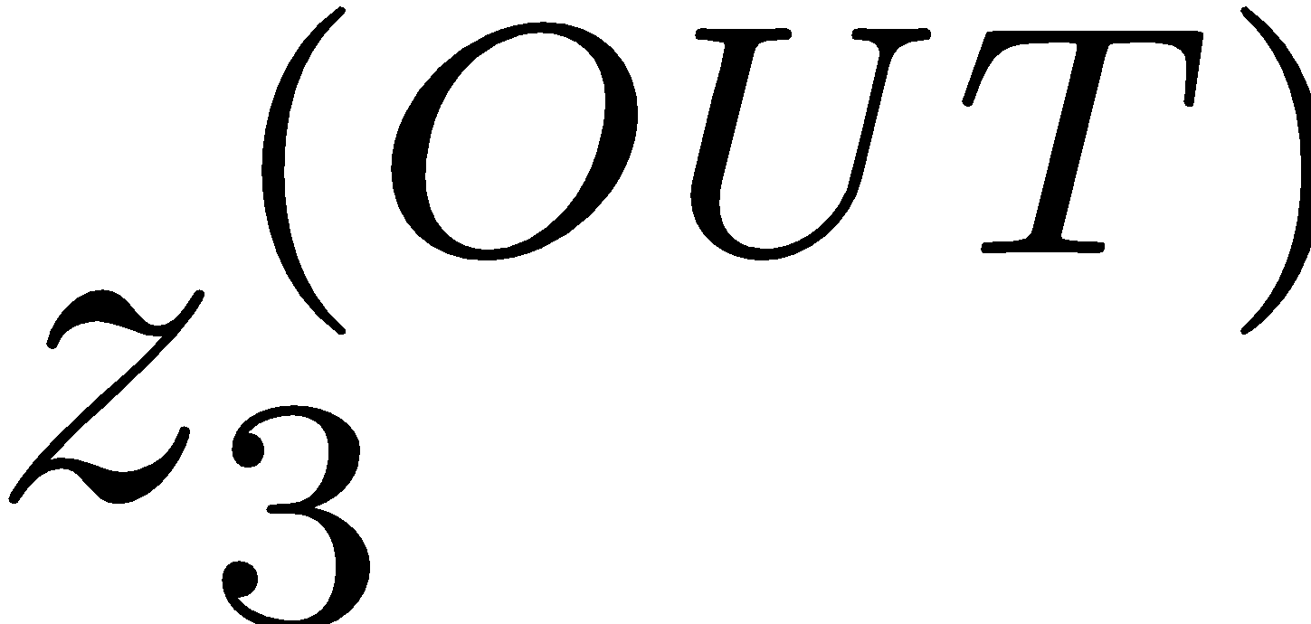
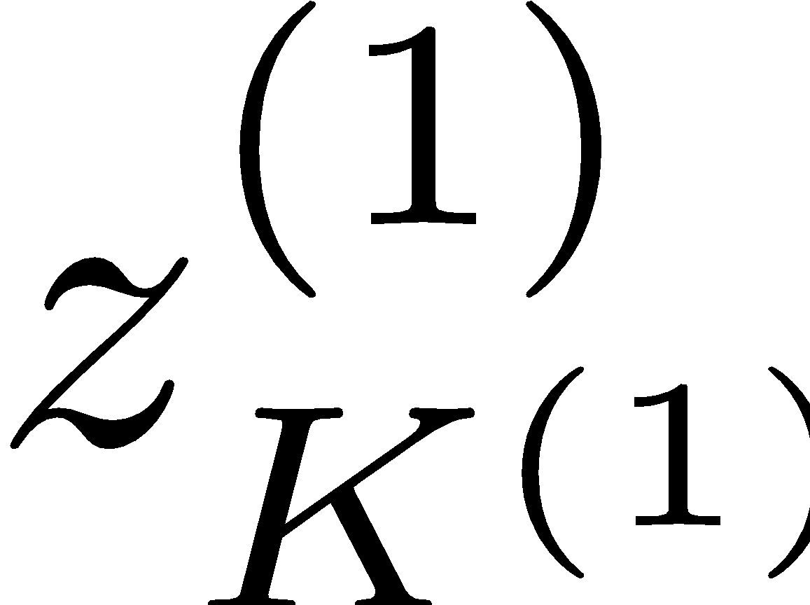
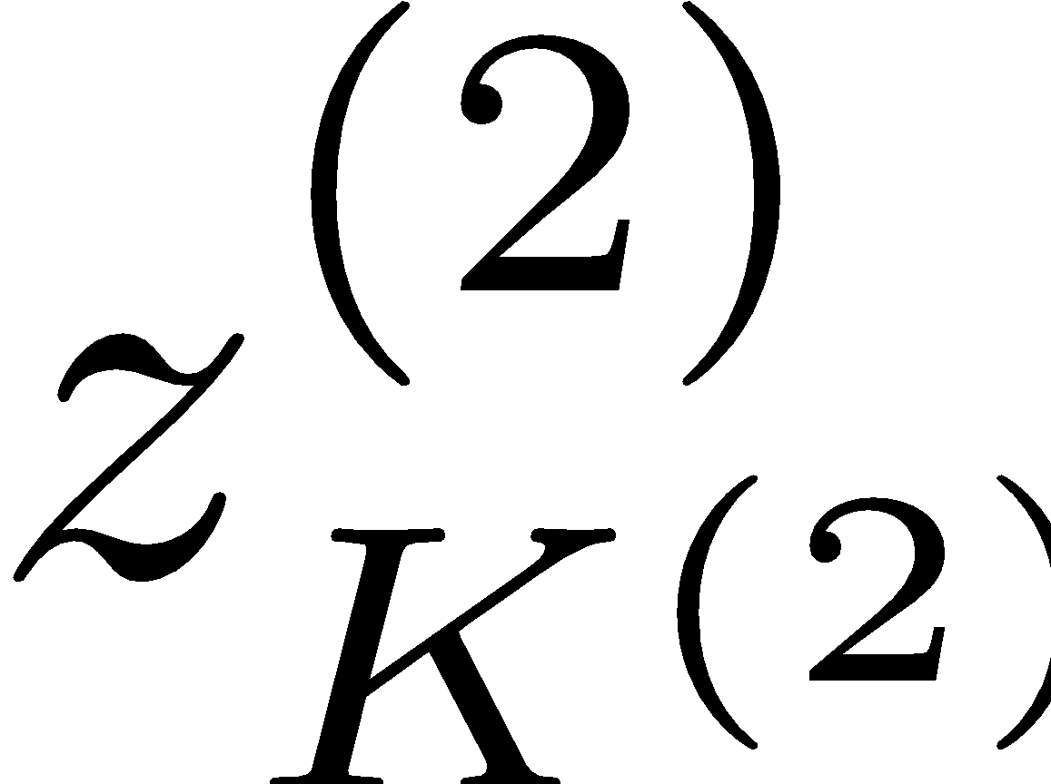
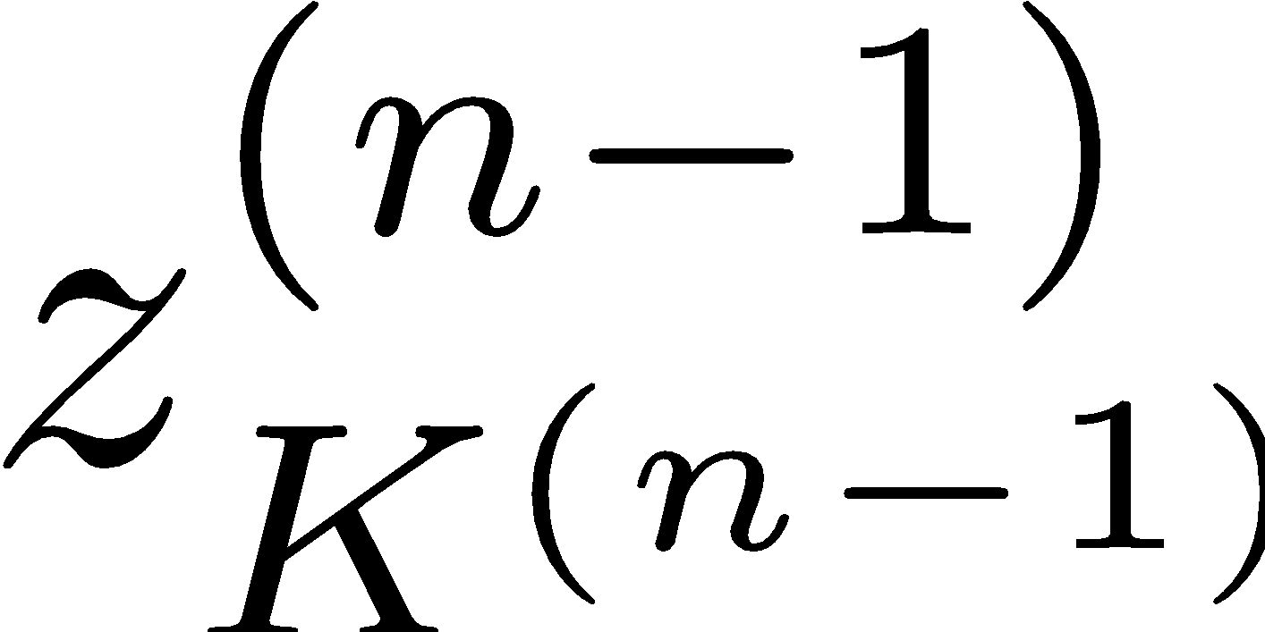
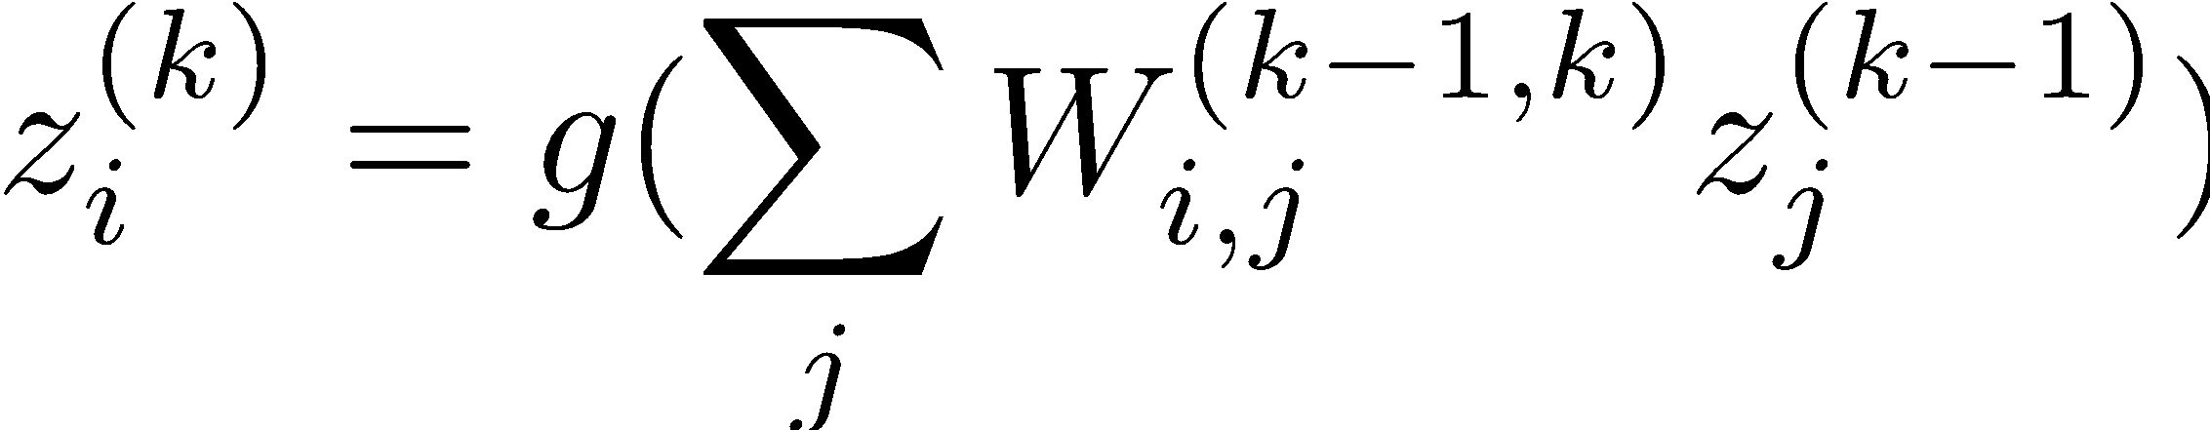
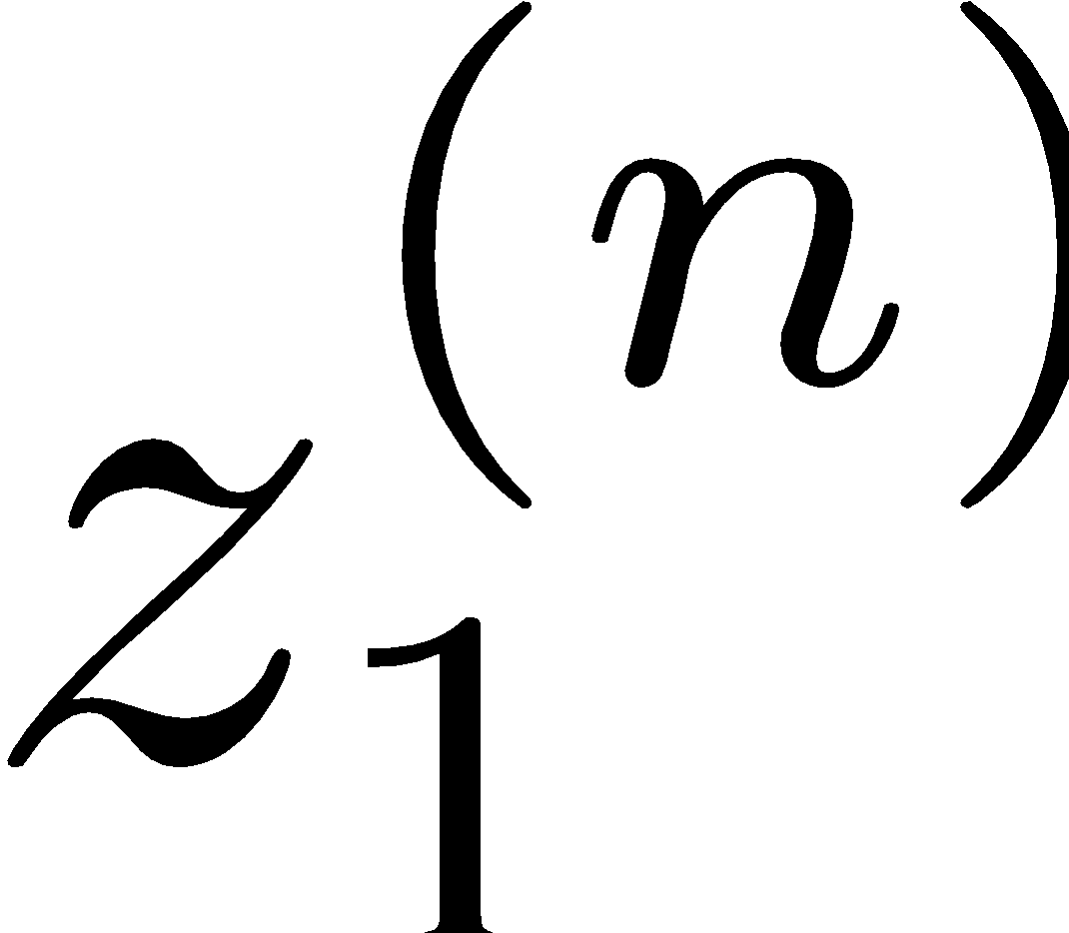



Deep Neural Network = Also learn the features!
x₁
f₁(x)
softmax
x₂
f₂(x)
…
x₃
f₃(x)
…
…
…
…
…
x_{L}
f_{K}(x)
g = nonlinear activation function

Slide 22
Deep Neural Network = Also learn the features!
x₁
softmax
x₂
…
x₃
…
…
…
…
…
x_{L}
g = nonlinear activation function

Slide 23

Common Activation Functions
[source: MIT 6.S191 introtodeeplearning.com]

Slide 24
Deep Neural Network: Also Learn the Features!
Training the deep neural network is just like logistic regression:
  just w tends to be a much, much larger vector ☺
  -> just run gradient ascent
  + stop when log likelihood of hold-out data starts to decrease

Slide 25





Neural Networks Properties
Theorem (Universal Function Approximators). A two-layer neural network with a sufficient number of neurons can approximate any continuous function to any desired accuracy.
Practical considerations
  Can be seen as learning the features
  Large number of neurons
    Danger for overfitting
    (hence early stopping!)

Slide 26

Universal Function Approximation Theorem*
In words: Given any continuous function f(x), if a 2-layer neural network has enough hidden units, then there is a choice of weights that allow it to closely approximate f(x).
Cybenko (1989) “Approximations by superpositions of sigmoidal functions”
Hornik (1991) “Approximation Capabilities of Multilayer Feedforward Networks”
Leshno and Schocken (1991) ”Multilayer Feedforward Networks with Non-Polynomial Activation Functions Can Approximate Any Function”

Slide 27



Universal Function Approximation Theorem*
Cybenko (1989) “Approximations by superpositions of sigmoidal functions”
Hornik (1991) “Approximation Capabilities of Multilayer Feedforward Networks”
Leshno and Schocken (1991) ”Multilayer Feedforward Networks with Non-Polynomial Activation Functions Can Approximate Any Function”

Slide 28
Fun Neural Net Demo Site
Demo-site:
  http://playground.tensorflow.org/

Slide 29

How about computing all the derivatives?
Derivatives tables:
[source: http://hyperphysics.phy-astr.gsu.edu/hbase/Math/derfunc.html

Slide 30


How about computing all the derivatives?
But neural net f is never one of those?
  No problem: CHAIN RULE:
    If
    Then
    Derivatives can be computed by following well-defined procedures

Slide 31
Automatic Differentiation
Automatic differentiation software
  e.g. TensorFlow, PyTorch, Jax
  Only need to program the function g(x,y,w)
  Can automatically compute all derivatives w.r.t. all entries in w
  This is typically done by caching info during forward computation pass of f, and then doing a backward pass = “backpropagation”
  Autodiff / Backpropagation can often be done at computational cost comparable to the forward pass

Slide 32
Deep Neural Network = Also learn the features!
x₁
softmax
x₂
…
x₃
…
…
…
…
…
x_{L}
g = nonlinear activation function

Slide 33




Training a Network (setting weights)
$$g_{3}$$
$$g_{5}$$
$$g_{4}$$

Slide 34














Back Propagation: $g\left(w\right)=w_{1}^{3}w_{2}+3w_{1}$
Suppose we have $g\left(w\right)=w_{1}^{3}w_{2}+3w_{1}$ and want the gradient at $w=[2, 3]$
Think of the function as a composition of many functions.
  Can use derivative chain rule to compute $∂g/∂w_{1}$ and $\frac{∂g}{∂w_{2}}$
  $\frac{∂g}{∂w_{1}}$ = _____________________
  $\frac{∂g}{∂w_{2}}$= _____________________
More complex to compute for more complicated functions
2
$∎^{3}$
$$a=8$$
$$w_{1}$$
$×$
$$b=24$$
$$w_{2}$$
3
$+$
$$g=30$$
$$3$$
$×$
$$c=6$$
$$w_{1}$$
2
Computation Graph

Slide 35





Back Propagation: $g\left(w\right)=w_{1}^{3}w_{2}+3w_{1}$
Suppose we have $g\left(w\right)=w_{1}^{3}w_{2}+3w_{1}$ and want the gradient at $w=[2, 3]$
Think of the function as a composition of many functions.
  Can use derivative chain rule to compute $∂g/∂w_{1}$ and $∂g/∂w_{2}$.
$g=b+c$
  $\frac{∂g}{∂b}=1$, $\frac{∂g}{∂c}=1$
2
$∎^{3}$
$$a=8$$
$$w_{1}$$
$×$
$$b=24$$
3
$$\frac{∂g}{∂b}=1$$
$$w_{2}$$
$$g=30$$
$+$
$$1$$
$$3$$
$×$
$$c=6$$
$$w_{1}$$
2
$$\frac{∂g}{∂c}=1$$
$$\frac{∂g}{∂g}=1$$
Computation Graph

Slide 36

Back Propagation: $g\left(w\right)=w_{1}^{3}w_{2}+3w_{1}$
Suppose we have $g\left(w\right)=w_{1}^{3}w_{2}+3w_{1}$ and want the gradient at $w=[2, 3]$
Think of the function as a composition of many functions.
  Can use derivative chain rule to compute $∂g/∂w_{1}$ and $∂g/∂w_{2}$.
$g=b+c$
  $\frac{∂g}{∂b}=1$, $\frac{∂g}{∂c}=1$
$b=a×w_{2}$
  $\frac{∂g}{∂a}=\frac{∂g}{∂b}\frac{∂b}{∂a}$
2
$∎^{3}$
$$a=8$$
$$w_{1}$$
$×$
$$b=24$$
3
$$\frac{∂g}{∂b}=1$$
$$w_{2}$$
$$g=30$$
$+$
$$1$$
$$3$$
$×$
$$c=6$$
$$w_{1}$$
2
$$\frac{∂g}{∂c}=1$$
$$\frac{∂g}{∂g}=1$$

Slide 37


Back Propagation: $g\left(w\right)=w_{1}^{3}w_{2}+3w_{1}$
Suppose we have $g\left(w\right)=w_{1}^{3}w_{2}+3w_{1}$ and want the gradient at $w=[2, 3]$
Think of the function as a composition of many functions.
  Can use derivative chain rule to compute $∂g/∂w_{1}$ and $∂g/∂w_{2}$.
$g=b+c$
  $\frac{∂g}{∂b}=1$, $\frac{∂g}{∂c}=1$
$b=a×w_{2}$
  $\frac{∂g}{∂a}=\frac{∂g}{∂b}\frac{∂b}{∂a}=?????$
2
$∎^{3}$
$$a=8$$
$$w_{1}$$
$×$
$$b=24$$
3
$$\frac{∂g}{∂b}=1$$
$$w_{2}$$
$$g=30$$
$+$
$$1$$
$$3$$
$×$
$$c=6$$
$$w_{1}$$
2
$$\frac{∂g}{∂c}=1$$
$$\frac{∂g}{∂g}=1$$

Slide 38


Back Propagation: $g\left(w\right)=w_{1}^{3}w_{2}+3w_{1}$
Suppose we have $g\left(w\right)=w_{1}^{3}w_{2}+3w_{1}$ and want the gradient at $w=[2, 3]$
Think of the function as a composition of many functions.
  Can use derivative chain rule to compute $∂g/∂w_{1}$ and $∂g/∂w_{2}$.
$g=b+c$
  $\frac{∂g}{∂b}=1$, $\frac{∂g}{∂c}=1$
$b=a×w_{2}$
  $\frac{∂g}{∂a}=\frac{∂g}{∂b}\frac{∂b}{∂a}=1\frac{∂b}{∂a}=1⋅3=3$
2
$∎^{3}$
$$a=8$$
$$w_{1}$$
$$3$$
$×$
$$b=24$$
3
$$\frac{∂g}{∂b}=1$$
$$w_{2}$$
$$g=30$$
$+$
$$1$$
$$3$$
$×$
$$c=6$$
$$w_{1}$$
2
$$\frac{∂g}{∂c}=1$$
$$\frac{∂g}{∂g}=1$$

Slide 39

Back Propagation: $g\left(w\right)=w_{1}^{3}w_{2}+3w_{1}$
Suppose we have $g\left(w\right)=w_{1}^{3}w_{2}+3w_{1}$ and want the gradient at $w=[2, 3]$
Think of the function as a composition of many functions.
  Can use derivative chain rule to compute $∂g/∂w_{1}$ and $∂g/∂w_{2}$.
$g=b+c$
  $\frac{∂g}{∂b}=1$, $\frac{∂g}{∂c}=1$
$b=a×w_{2}$
  $\frac{∂g}{∂a}=\frac{∂g}{∂b}\frac{∂b}{∂a}=1\frac{∂b}{∂a}=1⋅3=3$
$a=w_{1}^{3}$
  $\frac{∂g}{∂w_{1}}=?????$
2
$∎^{3}$
$$a=8$$
$$w_{1}$$
$$3$$
$×$
$$b=24$$
3
$$\frac{∂g}{∂b}=1$$
$$w_{2}$$
$$g=30$$
$+$
$$1$$
$$3$$
$×$
$$c=6$$
$$w_{1}$$
2
$$\frac{∂g}{∂c}=1$$
$$\frac{∂g}{∂g}=1$$

Slide 40



Back Propagation: $g\left(w\right)=w_{1}^{3}w_{2}+3w_{1}$
Suppose we have $g\left(w\right)=w_{1}^{3}w_{2}+3w_{1}$ and want the gradient at $w=[2, 3]$
Think of the function as a composition of many functions.
  Can use derivative chain rule to compute $∂g/∂w_{1}$ and $∂g/∂w_{2}$.
$g=b+c$
  $\frac{∂g}{∂b}=1$, $\frac{∂g}{∂c}=1$
$b=a×w_{2}$
  $\frac{∂g}{∂a}=\frac{∂g}{∂b}\frac{∂b}{∂a}=1\frac{∂b}{∂a}=1⋅3=3$
$a=w_{1}^{3}$
  $\frac{∂g}{∂w_{1}}=\frac{∂g}{∂a}\frac{∂a}{∂w_{1}}=3⋅3w_{1}^{2}=36$
2
$∎^{3}$
$$a=8$$
$$w_{1}$$
$$36$$
$$3$$
$×$
$$b=24$$
3
$$\frac{∂g}{∂b}=1$$
$$w_{2}$$
$$g=30$$
$+$
$$1$$
$$3$$
$×$
$$c=6$$
$$w_{1}$$
2
$$\frac{∂g}{∂c}=1$$
$$\frac{∂g}{∂g}=1$$
Interpretation: A tiny increase in $w_{1}$ will result in an approximately $36$ times increase in g due to this computation path.

Slide 41


Back Propagation: $g\left(w\right)=w_{1}^{3}w_{2}+3w_{1}$
Suppose we have $g\left(w\right)=w_{1}^{3}w_{2}+3w_{1}$ and want the gradient at $w=[2, 3]$
Think of the function as a composition of many functions.
  Can use derivative chain rule to compute $∂g/∂w_{1}$ and $∂g/∂w_{2}$.
$g=b+c$
  $\frac{∂g}{∂b}=1$, $\frac{∂g}{∂c}=1$
$b=a×w_{2}$
  $\frac{∂g}{∂a}=\frac{∂g}{∂b}\frac{∂b}{∂a}=1\frac{∂b}{∂a}=1⋅3=3$
$a=w_{1}^{3}$
  $\frac{∂g}{∂w_{1}}=\frac{∂g}{∂a}\frac{∂a}{∂w_{1}}=3⋅3w_{1}^{2}=36$
$\frac{∂g}{∂w_{2}}=???$
2
$∎^{3}$
$$a=8$$
$$w_{1}$$
$$36$$
$$3$$
$×$
$$b=24$$
3
$$\frac{∂g}{∂b}=1$$
$$w_{2}$$
$$g=30$$
$+$
$$1$$
$$3$$
$×$
$$c=6$$
$$w_{1}$$
2
$$\frac{∂g}{∂c}=1$$
$$\frac{∂g}{∂g}=1$$
Hint: $b=a×3$ may be useful.

Slide 42


Back Propagation: $g\left(w\right)=w_{1}^{3}w_{2}+3w_{1}$
Suppose we have $g\left(w\right)=w_{1}^{3}w_{2}+3w_{1}$ and want the gradient at $w=[2, 3]$
Think of the function as a composition of many functions.
  Can use derivative chain rule to compute $∂g/∂w_{1}$ and $∂g/∂w_{2}$.
$g=b+c$
  $\frac{∂g}{∂b}=1$, $\frac{∂g}{∂c}=1$
$b=a×w_{2}$
  $\frac{∂g}{∂a}=\frac{∂g}{∂b}\frac{∂b}{∂a}=1\frac{∂b}{∂a}=1⋅3=3$
  $\frac{∂g}{∂w_{2}}=\frac{∂g}{∂b}\frac{∂b}{∂w_{2}}=1\frac{∂b}{∂w_{2}}=1⋅8=8$
$a=w_{1}^{3}$
  $\frac{∂g}{∂w_{1}}=\frac{∂g}{∂a}\frac{∂a}{∂w_{1}}=3⋅3w_{1}^{2}=36$
2
$∎^{3}$
$$a=8$$
$$w_{1}$$
$$36$$
$$3$$
$×$
$$b=24$$
3
$$\frac{∂g}{∂b}=1$$
$$w_{2}$$
$$g=30$$
$$8$$
$+$
$$1$$
$$3$$
$×$
$$c=6$$
$$w_{1}$$
2
$$\frac{∂g}{∂c}=1$$
$$\frac{∂g}{∂g}=1$$

Slide 43


Back Propagation: $g\left(w\right)=w_{1}^{3}w_{2}+3w_{1}$
Suppose we have $g\left(w\right)=w_{1}^{3}w_{2}+3w_{1}$ and want the gradient at $w=[2, 3]$
Think of the function as a composition of many functions, use chain rule.
$g=b+c$
  $\frac{∂g}{∂b}=1$, $\frac{∂g}{∂c}=1$
$b=a×w_{2}$
  $\frac{∂g}{∂a}=\frac{∂g}{∂b}\frac{∂b}{∂a}=1\frac{∂b}{∂a}=1⋅3=3$
  $\frac{∂g}{∂w_{2}}=\frac{∂g}{∂b}\frac{∂b}{∂w_{2}}=1\frac{∂b}{∂w_{2}}=1⋅8=8$
$a=w_{1}^{3}$
  $\frac{∂g}{∂w_{1}}=\frac{∂g}{∂a}\frac{∂a}{∂w_{1}}=3⋅3w_{1}^{2}=36$
$c=3w_{1}$
  $\frac{∂g}{∂w_{1}}=\frac{∂g}{∂c}\frac{∂c}{∂w_{1}}=1⋅3=3$
2
$∎^{3}$
$$a=8$$
$$w_{1}$$
$$36$$
$$3$$
$×$
$$b=24$$
3
$$\frac{∂g}{∂b}=1$$
$$w_{2}$$
$$g=30$$
$$8$$
$+$
$$1$$
$$3$$
$×$
$$c=6$$
$$w_{1}$$
2
$$3$$
$$\frac{∂g}{∂c}=1$$
$$\frac{∂g}{∂g}=1$$
Adding the changes to g contributed by
change in w₁ together

Slide 44

Back Propagation: $g\left(w\right)=w_{1}^{3}w_{2}+3w_{1}$
Suppose we have $g\left(w\right)=w_{1}^{3}w_{2}+3w_{1}$ and want the gradient at $w=[2, 3]$
Think of the function as a composition of many functions, use chain rule.
$g=b+c$
  $\frac{∂g}{∂b}=1$, $\frac{∂g}{∂c}=1$
$b=a×w_{2}$
  $\frac{∂g}{∂a}=\frac{∂g}{∂b}\frac{∂b}{∂a}=1\frac{∂b}{∂a}=1⋅3=3$
  $\frac{∂g}{∂w_{2}}=\frac{∂g}{∂b}\frac{∂b}{∂w_{2}}=1\frac{∂b}{∂w_{2}}=1⋅8=8$
$a=w_{1}^{3}$
  $\frac{∂g}{∂w_{1}}=\frac{∂g}{∂a}\frac{∂a}{∂w_{1}}=3⋅3w_{1}^{2}=36$
$c=3w_{1}$
  $\frac{∂g}{∂w_{1}}=\frac{∂g}{∂c}\frac{∂c}{∂w_{1}}=1⋅3=3$
2
$∎^{3}$
$$a=8$$
$$w_{1}$$
$$36$$
$$3$$
$×$
$$b=24$$
3
$$\frac{∂g}{∂b}=1$$
$$w_{2}$$
$$g=30$$
$$8$$
$+$
$$1$$
$$3$$
$×$
$$c=6$$
$$w_{1}$$
2
$$3$$
$$\frac{∂g}{∂c}=1$$
$$\frac{∂g}{∂g}=1$$
$$∇g=\left[\frac{∂g}{∂w_{1}},\frac{∂g}{∂w_{2}}\right]=[39, 8]$$

Slide 45


Slide 46
Summary of Key Ideas
Optimize probability of label given input
Continuous optimization
  Gradient ascent:
    Compute steepest uphill direction = gradient (= just vector of partial derivatives)
    Take step in the gradient direction
    Repeat (until held-out data accuracy starts to drop = “early stopping”)
Deep neural nets
  Last layer = still logistic regression
  Now also many more layers before this last layer
    = computing the features
    the features are learned rather than hand-designed
  Universal function approximation theorem
    If neural net is large enough
    Then neural net can represent any continuous mapping from input to output with arbitrary accuracy
    But remember: need to avoid overfitting / memorizing the training data → early stopping!
  Automatic differentiation gives the derivatives efficiently

Slide 47
How well does it work?

Slide 48

Computer Vision
Notes:
48

Slide 49

Object Detection
Notes:
49

Slide 50



Manual Feature Design
Notes:
50

Slide 51

Features and Generalization
[HoG: Dalal and Triggs, 2005]
Notes:
51

Slide 52
Features and Generalization
Image
HoG
Notes:
52

Slide 53

Performance
graph credit Matt Zeiler, Clarifai

Slide 54
Performance
graph credit Matt Zeiler, Clarifai

Slide 55
Performance
AlexNet
graph credit Matt Zeiler, Clarifai

Slide 56
Performance
AlexNet
graph credit Matt Zeiler, Clarifai

Slide 57
Performance
AlexNet
graph credit Matt Zeiler, Clarifai

Slide 58

MS COCO Image Captioning Challenge
Karpathy & Fei-Fei, 2015; Donahue et al., 2015; Xu et al, 2015; many more

Slide 59

Visual QA Challenge
Stanislaw Antol, Aishwarya Agrawal, Jiasen Lu, Margaret Mitchell, Dhruv Batra, C. Lawrence Zitnick, Devi Parikh

Slide 60

Image Segmentation

Slide 61



Speech Recognition
graph credit Matt Zeiler, Clarifai

Slide 62

Machine Translation
Google Neural Machine Translation (in production)

Slide 63


Slide 64



Slide 65


Change in Programming Paradigm!
Traditional Programming:
program by writing lines of code
Deep Learning (“Software 2.0”):
program by providing data
?
?
Poor performance on AI problems
Success!
Notes:
å

