Slide 1


CS 188: Artificial Intelligence
Inverse Reinforcement Learning and AI Safety
?
?
Guest Lecturer: Regina Wang
Slides adapted from Stuart Russell, Anca Dragan
Notes:
Please retain proper attribution and the reference to ai.berkeley.edu. Thanks!

Slide 2
Roadmap
Inverse Reinforcement Learning (IRL)
  Standard model
  Motivation
AI Safety
  Powerful AI
  Revised Model
  Off-switch game
Going forward
  Research areas
  AI governance

Slide 3
Inverse Reinforcement Learning

Slide 4
Reminder: Optimal Policies
R(s) = -0.01
R(s) = -0.03
R(s) = -0.4
R(s) = -2.0
Notes:
R(s) = the “living reward”
Which of these policies would you, as a human, follow? No

Slide 5
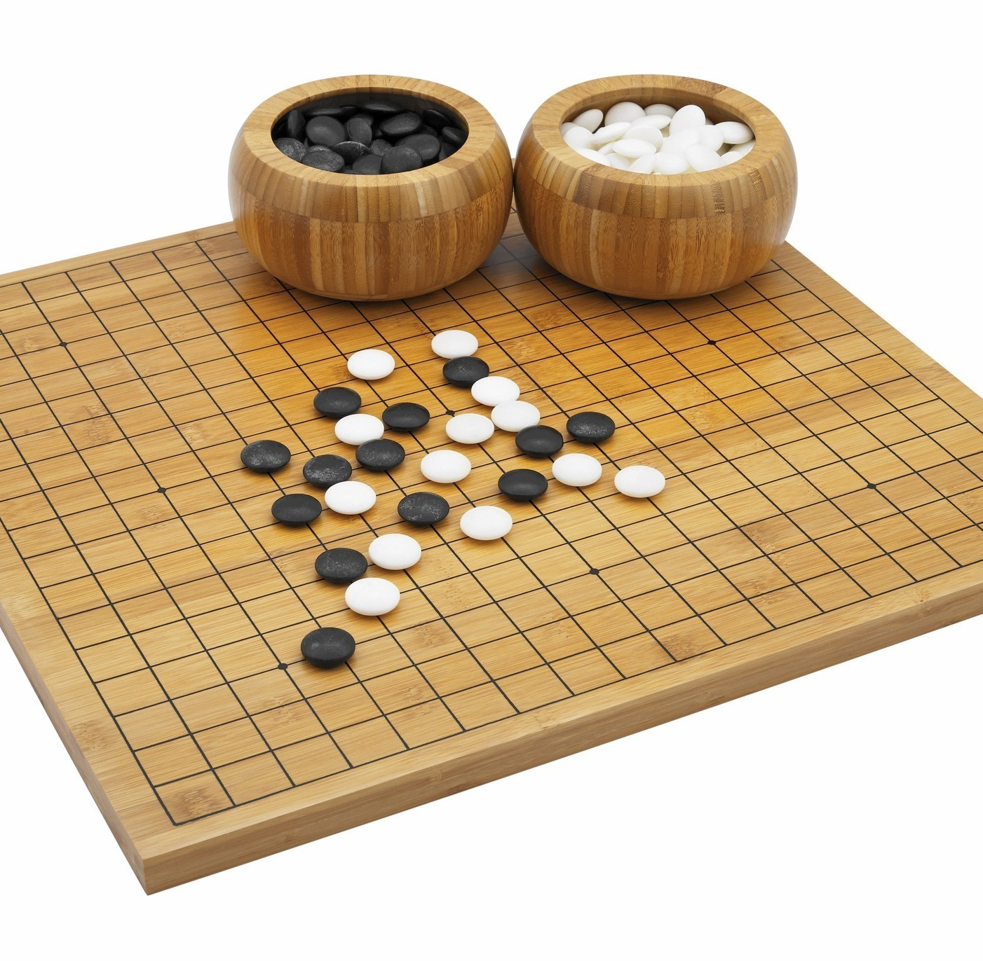
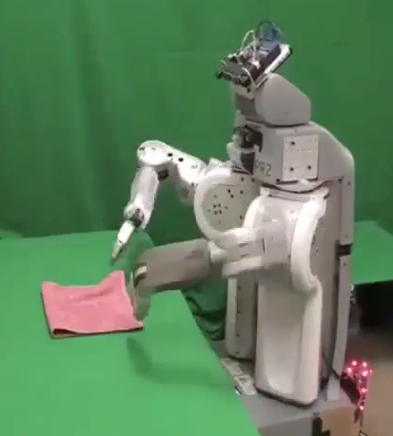
Utility?
Clear utility function
Not so clear utility function

Slide 6
Where do reward functions come from in this class?

Slide 7
Standard model for AI
maximize R
okiedokie :)
We expect to be able to give a reward function for the AI system to optimize. This is how it’s done in this class!
King Midas problem: Cannot specify R correctly
Notes:
In parlance: reward misspecification

Slide 8
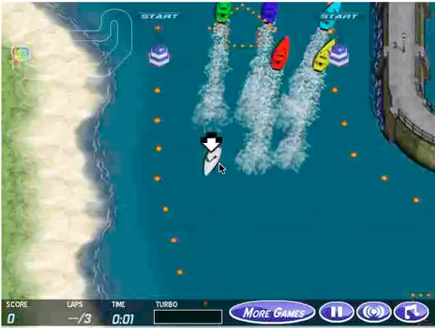
OpenAI 2016. Faulty Reward Functions in the Wild
Notes:
OpenAI demo

Slide 9
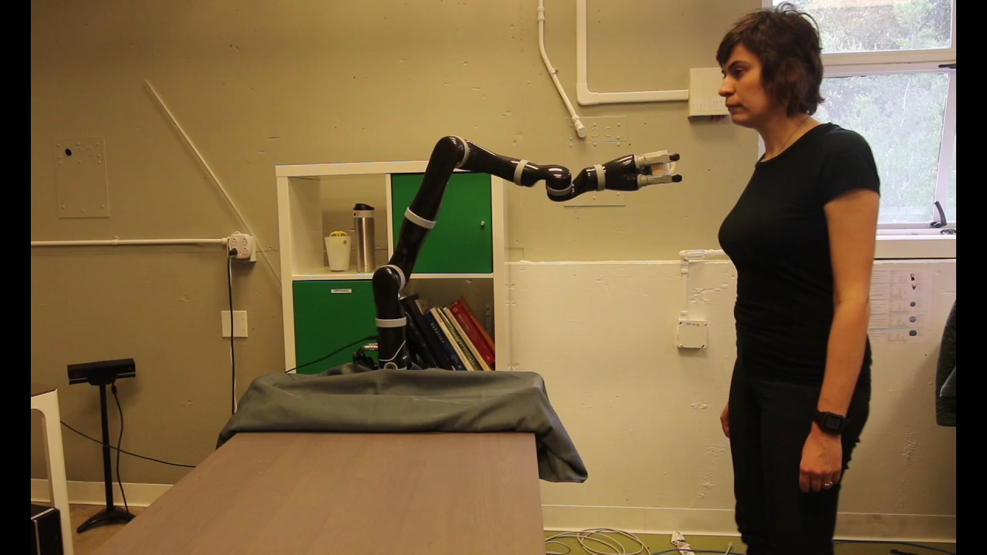


Notes:
pHRI

Slide 10
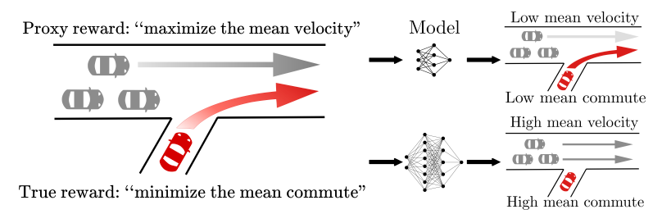
Pan, Bhatia, Steinhardt 2022. The Effects of Reward Misspecification

Slide 11
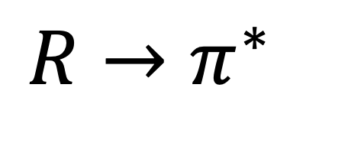
Planning/Reinforcement Learning
$$R→π^{∗}$$

Slide 12
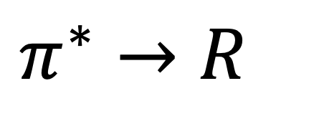
Inverse Planning/RL
$$π^{∗}→R$$

Slide 13
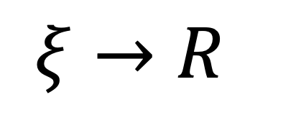
Inverse Planning/RL
$$ξ→R$$
Notes:
IRL also called IOC sometimes

Slide 14



Inverse Planning/RL

Slide 15
Inverse Planning/RL
Notes:
why?

Slide 16
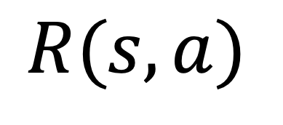
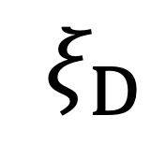
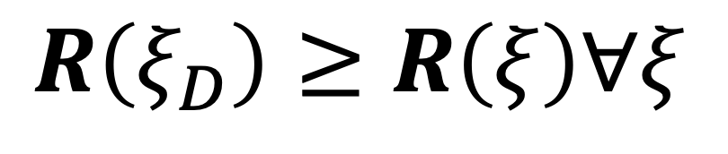
Inverse Planning/RL
$$ξ_{D}$$
given:
$$R(s,a)$$
find:
$$R\left(ξ_{D}\right)≥R\left(ξ\right)∀ξ$$
s.t.

Slide 17
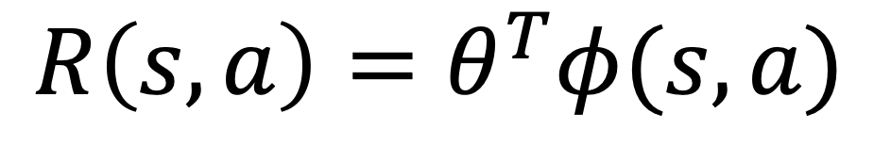
Inverse Planning/RL
$$ξ_{D}$$
given:
$$R\left(s,a\right)=θ^{T}φ(s,a)$$
find:
$$R\left(ξ_{D}\right)≥R\left(ξ\right)∀ξ$$
s.t.

Slide 18
Inverse Planning/RL
Notes:
why?

Slide 19
Inverse Planning/RL
Notes:
why?

Slide 20
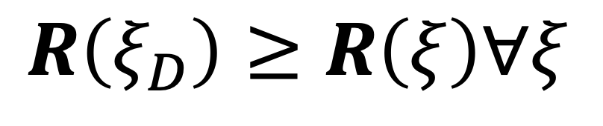
Is the demonstrator really optimal?
$$R\left(ξ_{D}\right)≥R\left(ξ\right)∀ξ$$

Slide 21
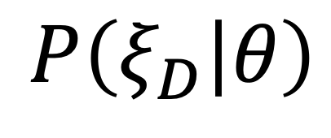
The Bayesian view
$$P\left(ξ_{D} | θ\right)$$
evidence
hidden

Slide 22
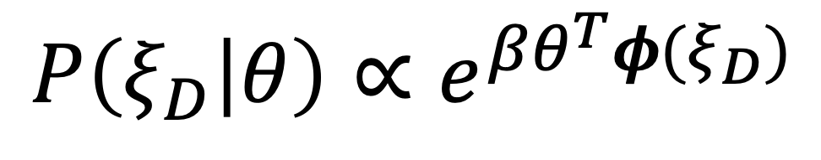
The Bayesian view
$$P\left(ξ_{D} | θ\right)∝e^{βθ^{T}φ(ξ_{D})}$$

Slide 23
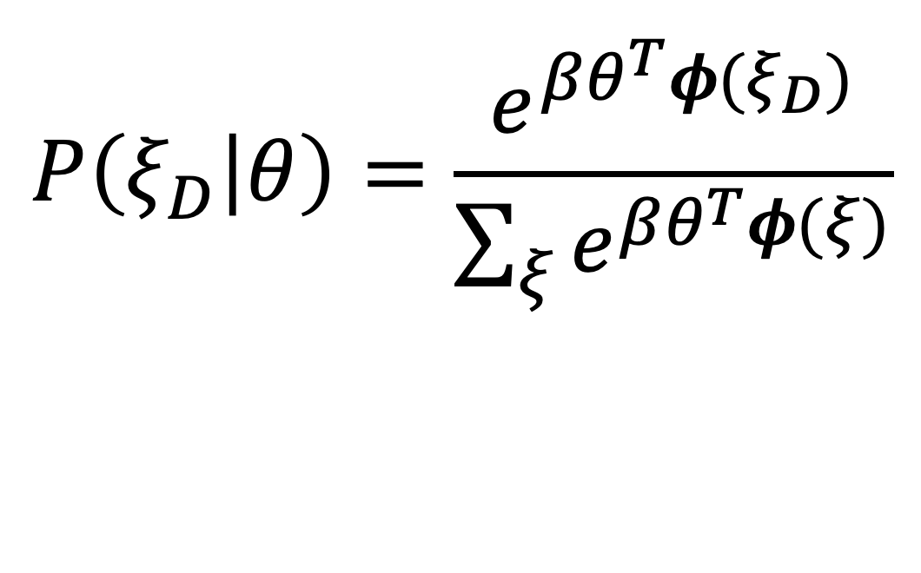
The Bayesian view
$$P\left(ξ_{D} | θ\right)=\frac{e^{βθ^{T}φ(ξ_{D})}}{\sum_{ξ}{e^{βθ^{T}φ(ξ)}}}$$
Notes:
explain how this is soft rationality because of the normalizer, explain beta
how do we do IRL with this assumption?

Slide 24
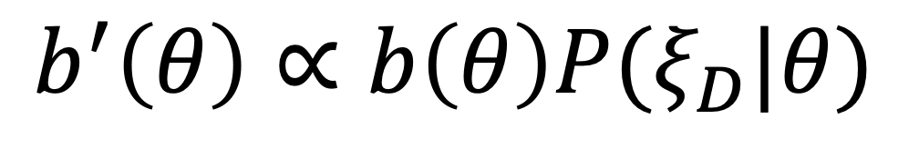
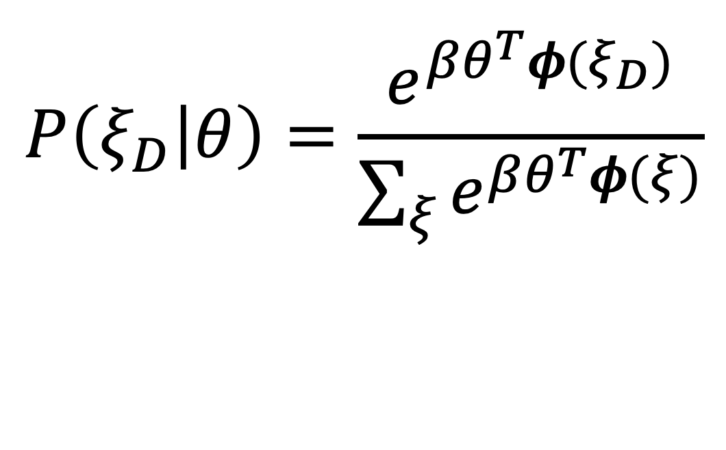
The Bayesian view
$$P\left(ξ_{D} | θ\right)=\frac{e^{βθ^{T}φ(ξ_{D})}}{\sum_{ξ}{e^{βθ^{T}φ(ξ)}}}$$
$$b^{′}\left(θ\right)∝b\left(θ\right)P(ξ_{D}|θ)$$

Slide 25





IRL is relevant to all 3 types of people:
person in its environment
its end-user
its designer
Notes:
why not just use the demonstration

Slide 26
Aside: Imitation Learning and IRL
Inverse Reinforcement Learning:
Using expert input to learn a reward function
Imitation Learning:
Mimicking human behavior, often using supervised learning
Example: behaviour cloning (BC)

Slide 27
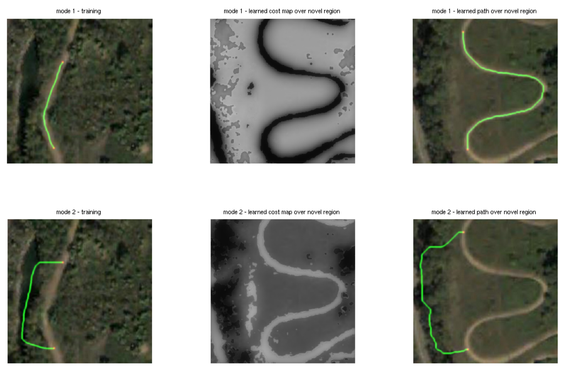
[Ratliff et al. Maximum Margin Planning]

Slide 28
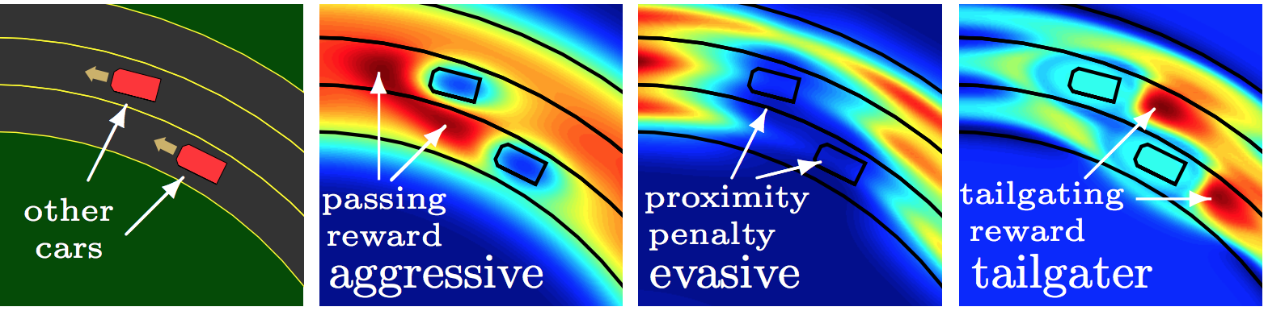
[Levine et al. Continuous Inverse Optimal Control with Locally Linear Examples]

Slide 29
Roadmap
Inverse Reinforcement Learning (IRL)
  Standard model
  Motivation
AI Safety
  Powerful AI
  Revised Model
  Off-switch game
Going forward
  Research areas
  AI governance

Slide 30
AI Safety

Slide 31
“It seems probable that once the machine thinking method had started, it would not take long to outstrip our feeble powers. … At some stage therefore we should have to expect the machines to take control.”
- Alan Turing, 1951

Slide 33
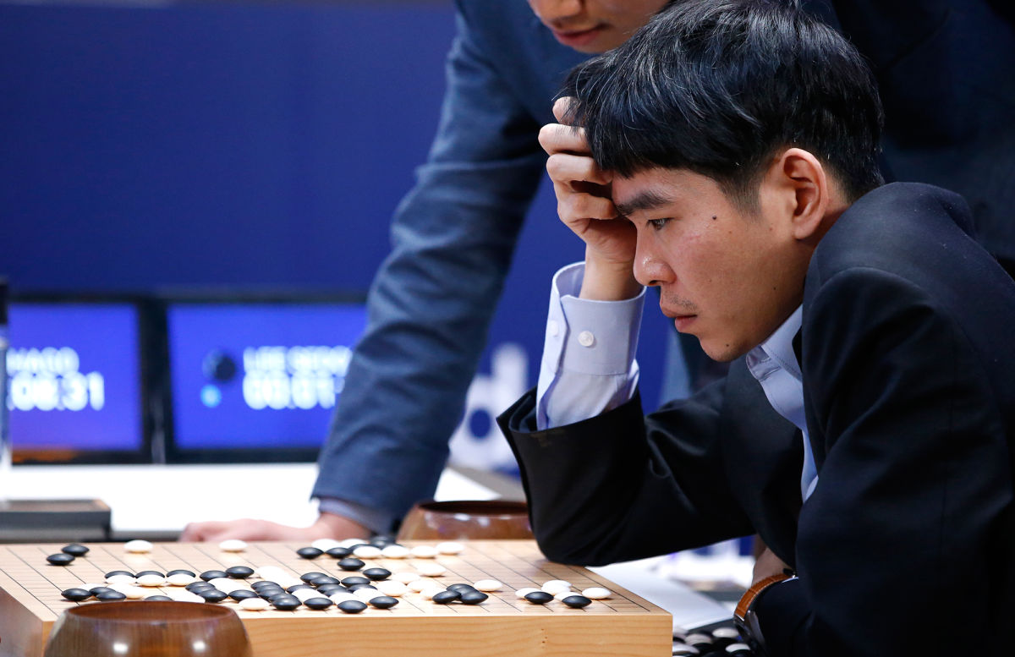

Slide 34
Carter, Jain, Mueller, Gifford (2020, arXiv)
Overinterpretation reveals image classification model pathologies
Notes:
Here’s one problem: recognizing objects without looking at them
Here in the top left is a photo of a parachute
The algorithm (Google’s Inception v3) predicts “parachute” based only on a few sky pixels
The algorithms may not be seeing at all

Slide 35
Notes:
underspecification

Slide 36
Deep learning forever?
François Chollet (2017):
“Many more applications are completely out of reach for current deep learning techniques – even given vast amounts of human-annotated data …
The main directions in which I see promise are models closer to general-purpose computer programs.”
Notes:
So, is deep learning the answer? Do we just keep scaling it up? No.
Here is a quote from Francois Chollet’s deep learning textbook: [from slide]
General-purpose computer programs: probabilistic programming

Slide 37
Recall: Standard model for AI
maximize R
okiedokie :)
We expect to be able to give a reward function for the AI system to optimize. This is how it’s done in this class!
King Midas problem: Cannot specify R correctly
Smarter AI would lead to a worse outcome

Slide 38
Pan, Bhatia, Steinhardt 2022. The Effects of Reward Misspecification
Notes:
IRL is an attempt to mitigate reward misspecification. But the approaches are not perfect. More issues crop up as AI becomes more powerful
As the network grows, the outcome is worse

Slide 39
Likely AI developments in the 2020s
Robots for war, roads, warehouses, mines, fields, home
Personal digital assistants for all aspects of life
Use of AI in clinical settings and prostheses
Global vision system via satellite imagery
Notes:
So what can we expect to see in the world of applications?
With better perception and manipulation, we should see robots in everyday use outside the factory.
With even simple language understanding, search engines will *read* web pages rather than just indexing them,
so they can answer questions. And we’ll be applying image understanding to satellite data on a large scale

Slide 40
General-purpose AI
To get general-intelligence AI, we’re still missing
  Real understanding of language
  Integration of learning with knowledge
  Long-range thinking at multiple levels of abstraction
  Cumulative discovery of concepts and theories
The arrival date is unpredictable
Notes:
It’s important to understand we are not close to human-level AI; several breakthroughs are required

Slide 41
What happens as AI becomes more powerful?
AI systems will eventually make better decisions than humans
Turing’s point: how do we retain control over entities more powerful than us, for ever?
[Russell, Many Experts Say We Shouldn't Worry About
Superintelligent AI. They're Wrong, IEEE Spectrum, October 2019.]
Notes:
Eventually – and I’m not going to say when! – AI systems will make better decisions than us in a wide range of tasks, which means taking into account more information, looking further into the future. Like AlphaGo, but in the real world not just the Go board.

Slide 42
E.g., Social Media
Optimizing clickthrough
  = learning what people want
  = modifying people to be more predictable

Slide 43
How we got into this mess
Humans are intelligent to the extent that our actions can be expected to achieve our objectives
Machines are intelligent to the extent that their actions can be expected to achieve their objectives
Machines are beneficial to the extent that their actions can be expected to achieve our objectives

Slide 44
Revised model: Provably beneficial AI
Instead of giving the robot an explicit reward function,
Robot goal: satisfy human preferences
Robot is uncertain about human preferences
Human behavior provides evidence of preferences
AI becomes an assistance game with human and AI players!
Smarter AI now leads to a better outcome!
Notes:
Pretty similar to IRL, right!

Slide 45
Basic assistance game
Acts roughly according to preferences
Maximizes unknown human preferences
Game:
Human teaches robot
Robot learns, asks questions and permission, defers to human, and allows off-switch
[Hadfield-Menell et al, NeurIPS 16, IJCAI 17, NeurIPS 17]
[Milli et al 2017, IJCAI 17] [Malik et al, ICML 18]

Slide 46
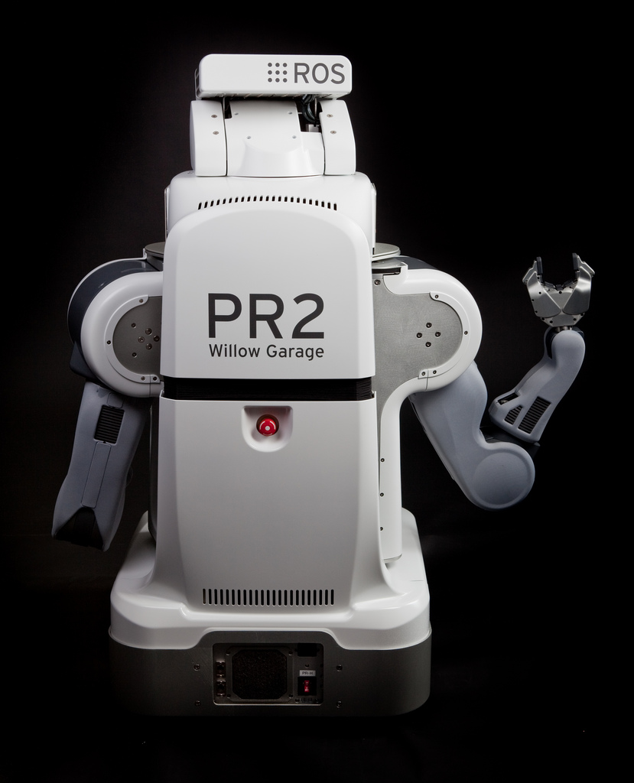
The off-switch problem
A robot, given an objective, has an incentive to disable its own off-switch
  “You can’t fetch the coffee if you’re dead”
A robot with uncertainty about objective won’t behave this way

Slide 47
Off-switch problem (example)
R
P(U)
act
switch self off
wait
U = ?
H
U=0
-40
0
+60
U
go ahead
switch robot off
EU(act) = +10
EU(wait) = (0.4 * 0) + (0.6 * 30)
= +18
R
U=0
P(U)
act
switch self off
wait
U = ?
U=0
-40
0
+60
U
Notes:
Theorem: Since the robot will allow itself to be turned off, it is provably beneficial

Slide 48
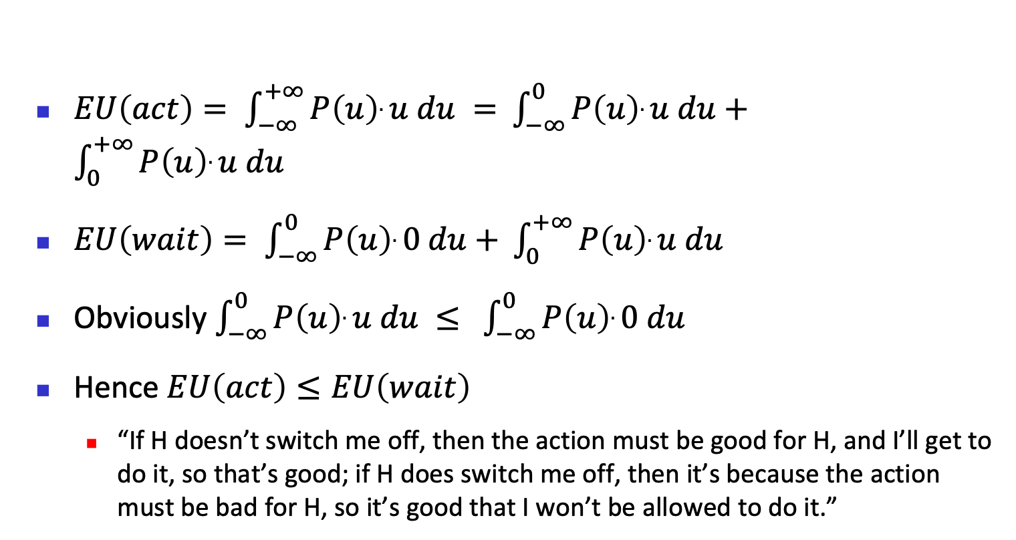
Off-switch problem (general proof)
$EU\left(act\right)= \int_{−∞}^{+∞}{P\left(u\right).u du = }$ $\int_{−∞}^{0}{P\left(u\right).u du+ }$ $\int_{0}^{+∞}{P\left(u\right).u du }$
$EU\left(wait\right)= \int_{−∞}^{0}{P\left(u\right).0 du+ }\int_{0}^{+∞}{P\left(u\right).u du }$
Obviously $\int_{−∞}^{0}{P\left(u\right).u du ≤ }$ $\int_{−∞}^{0}{P\left(u\right).0 du}$
Hence $EU\left(act\right)≤EU\left(wait\right)$
  “If H doesn’t switch me off, then the action must be good for H, and I’ll get to do it, so that’s good; if H does switch me off, then it’s because the action must be bad for H, so it’s good that I won’t be allowed to do it.”

Slide 49
Roadmap
Inverse Reinforcement Learning (IRL)
  Standard model
  Motivation
AI Safety
  Powerful AI
  Off-switch game
  Revised Model
Going forward
  Research areas
  AI governance

Slide 50
Going Forward

Slide 51
Rebuild AI on a New Foundation
Proposed by Stuart Russell in Human Compatible:
Remove the assumption of a perfectly known objective/goal/loss/reward
  Combinatorial search: G(s) and c(s,a,s’)
  Constraint satisfaction: hard and soft constraints
  Planning: G(s) and c(s,a,s’)
  Markov decision processes: R(s,a,s’)
  Supervised learning: Loss(x,y,y’)
  Reinforcement learning: R(s,a,s’)
  Robotics: all of the above

Slide 52
Ongoing research: “Imperfect” humans
  How do we deal with the following?
    Computation limitation
    Hierarchically structured behavior
    Emotionally driven behavior
    Uncertainty about own preferences
    Plasticity of preferences
    Non-additive, memory-laden, retrospective/prospective preferences

Slide 53
Ongoing research: Many humans
There is more than one human we need to consider.
More problems to overcome:
  Commonalities and differences in preferences
  Aggregating individual preferences
  Comparisons of preferences
  Potential humans (population ethics), future humans
  Altruism/indifference/sadism; pride/rivalry/envy

Slide 54
Ongoing research: General Safety
And when we disregard humans, there’s more:
  Safe exploration
  Robustness to distributional shift
  Avoiding negative side effects
  Avoiding reward hacking
[Amodei et al. Concrete Problems in AI Safety]

Slide 55
And then there’s Governance…
“While AI researchers, developers, and industry can lay the groundwork for what is technically feasible, it is ultimately up to government and civil society to determine the frameworks within which AI systems are developed and deployed.”
- Perspectives on Issues in AI Governance,
Google, 2019
Notes:
As with the process of governing any new emerging technology, ai governance will lag as the technology becomes more powerful. However, it is important that it comes to pass, with the input of experts

Slide 56
Summary
The standard model for AI may lead to loss of human control over increasingly intelligent AI systems.
Provably beneficial AI is possible and desirable.
    It isn’t “AI safety” or “AI Ethics,” it’s AI

