Slide 1
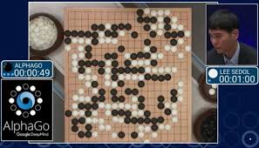
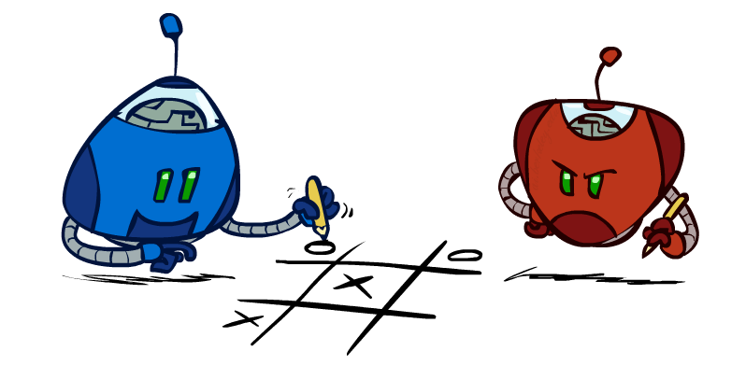
CS 188: Artificial Intelligence
Advanced Topics: AI for Games
Instructors: Angela Liu and Yanlai Yang
University of California, Berkeley
(Slides adapted from Pieter Abbeel, Anca Dragan, and Stuart Russell)
Notes:
Most famous (and also surprising) results in AI for games. People expected that AI cannot beat humans in go for another 15-20 years, so this result brought big headlines and great excitement, because people see that Ai research is moving much much faster than expected. The result is so astonishing that any later results do not seem to be very surprising.

Slide 2
Outline
History of AI for Games
Components of AlphaGo
Value Network
Policy Network
MCTS
AlphaZero
Games Beyond Go

Slide 3
Outline
History of AI for Games
Components of AlphaGo
Value Network
Policy Network
MCTS
AlphaZero
Games Beyond Go

Slide 4
Why Games?
Clear objectives
Can run very fast by parallelizing
No safety or ethical concerns
Notes:
Nowadays we can parallelize on the cloud!
Important academic figures like Charles Babbage, Claude Shannon, Alan Turing, Ernst Zermelo, and John von Neumann have all worked on computer chess.

Slide 5
Precursors in AI for Games
1959: Arthur Samuel published checkers program that learned to play better checkers than himself!
Disproved the belief that the capability of a computer program cannot exceed that of the programmer
Defeated US #4 player in 1961; one draw with world champion
1992: Gerald Tesauro developed TD-Gammon, which uses a neural network to represent the value function
Relied on very few handcrafted expert features
1997: IBM’s Deep Blue beat Garry Kasparov in chess
2014: Deepmind started their project on Go

Slide 6
Go as a Target Problem

Slide 7
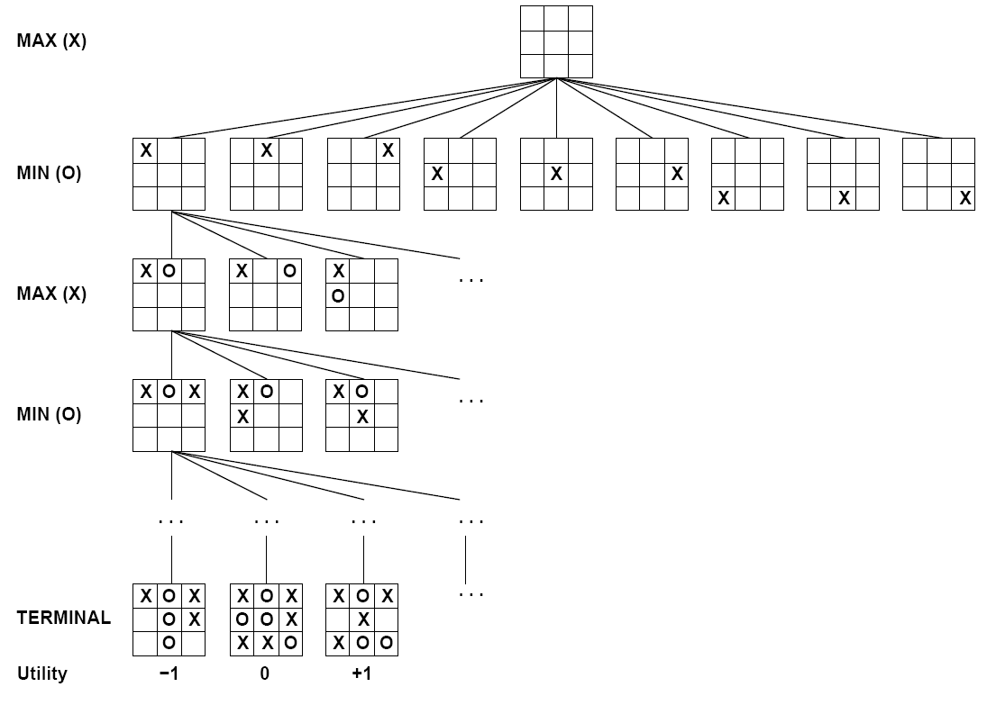
Go as a Target Problem
Not much progress was made in the 2000s
Why is hard?
In particular, why is it harder than chess?
How would you start thinking about making an AI for Go?
What about Minimax?
Notes:
It was predicted after IBM deepblue beat Kasparov that “it will be a hundred years before computers beat human as go – maybe longer.”

Slide 8
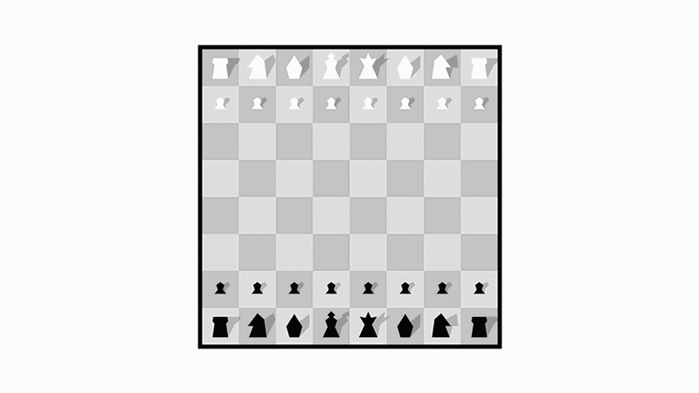
Notes:
Branching factor in chess – around 20-30. In Go – 200-300. Number of possible configurations in the board is greater than the number of atoms in the universe. In possible to calculate all the variations!

Slide 9
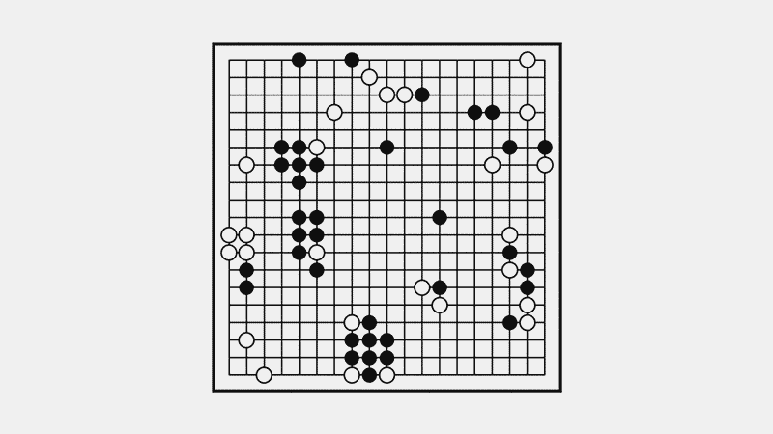
Notes:
Branching factor in chess – around 20-30. In Go – 200-300. Number of possible configurations in the board is greater than the number of atoms in the universe. In possible to calculate all the variations!

Slide 10
Exhaustive Search is Hopeless
Number of board configurations is greater than the number of atoms in the universe!
What did we learn to deal with this?
Evaluation functions and depth-limited search
Notes:
It was predicted after IBM deepblue beat Kasparov that “it will be a hundred years before computers beat human as go – maybe longer.”

Slide 11
Outline
History of AI for Games
Components of AlphaGo
Value Network
Policy Network
MCTS
AlphaZero
Games Beyond Go

Slide 12
Reducing depth with value network

Slide 13
The Value Network
Evaluation
v (s)
𝜃
s
Position

Slide 14
Reducing breadth with policy network

Slide 15
The Policy Network
Move probabilities
p (a|s)
s
Position

Slide 16
Neural Network Training Pipeline
Human expert
positions
Supervised Learning
policy network
Reinforcement Learning
policy network
Self-play data
Value network
Notes:
Supervised learning from expert databases to initialize the policy. 30 million positions from human professional players. Only take one move from
Self-play to improve the policy and learn a value function.

Slide 17
Supervised Learning Phase
Human expert
positions
Supervised Learning
policy network
Supervised learning from expert databases to initialize the policy
30 million boards from human experts
Take only one move from each board to build the dataset
13-layer convolutional neural network
Some Go-specific human-designed input features
test-set accuracy 57% (non-NN method 44%)
Notes:
Supervised learning from expert databases to initialize the policy. 30 million positions from human professional players. Only take one move from
Self-play to improve the policy and learn a value function.

Slide 18
Reinforcement Learning Phase
Supervised Learning
policy network
Reinforcement Learning
policy network
Repeat 1.28 million times
Play current policy with a random previous version of itself
Use the policy gradient method to improve the policy
Notes:
Supervised learning from expert databases to initialize the policy. 30 million positions from human professional players. Only take one move from
Self-play to improve the policy and learn a value function.

Slide 19
Training the Value Function
Reinforcement Learning
policy network
Self-play data
Value network
Use self-play to generate a dataset of (s, z) pairs
s represent current board state, z is the results (how many wins and how many loses) starting from this board state
Use supervised learning to train value function
And use as the evaluation function in search!

Slide 20
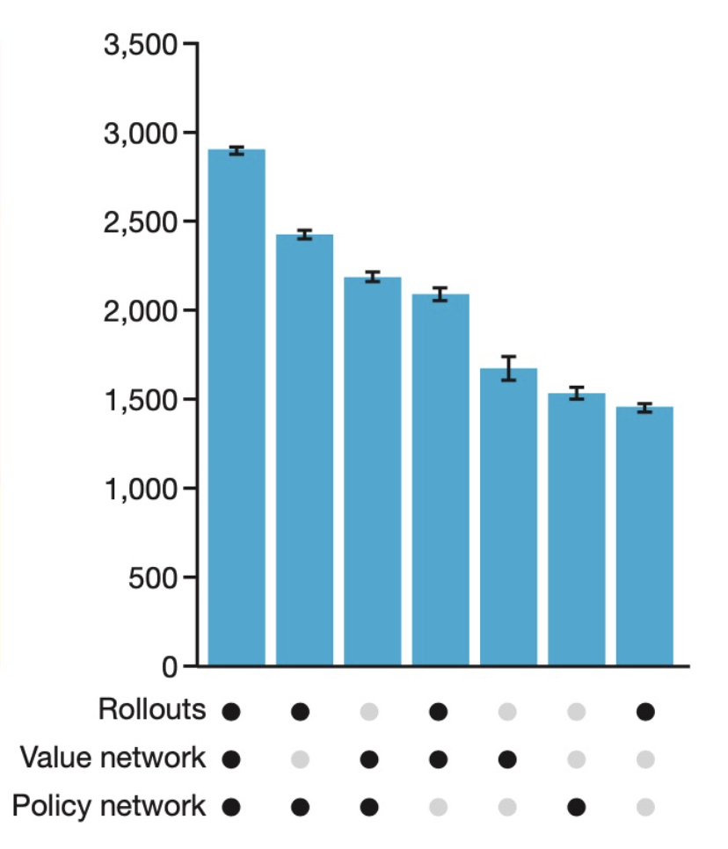
AlphaGo Results
Expert-Level performance with only pattern matching (no rollouts)
But best results are achieved by incorporating MCTS
Even better results with distributed search
Notes:
Supervised learning from expert databases to initialize the policy. 30 million positions from human professional players. Only take one move from
Self-play to improve the policy and learn a value function.

Slide 21
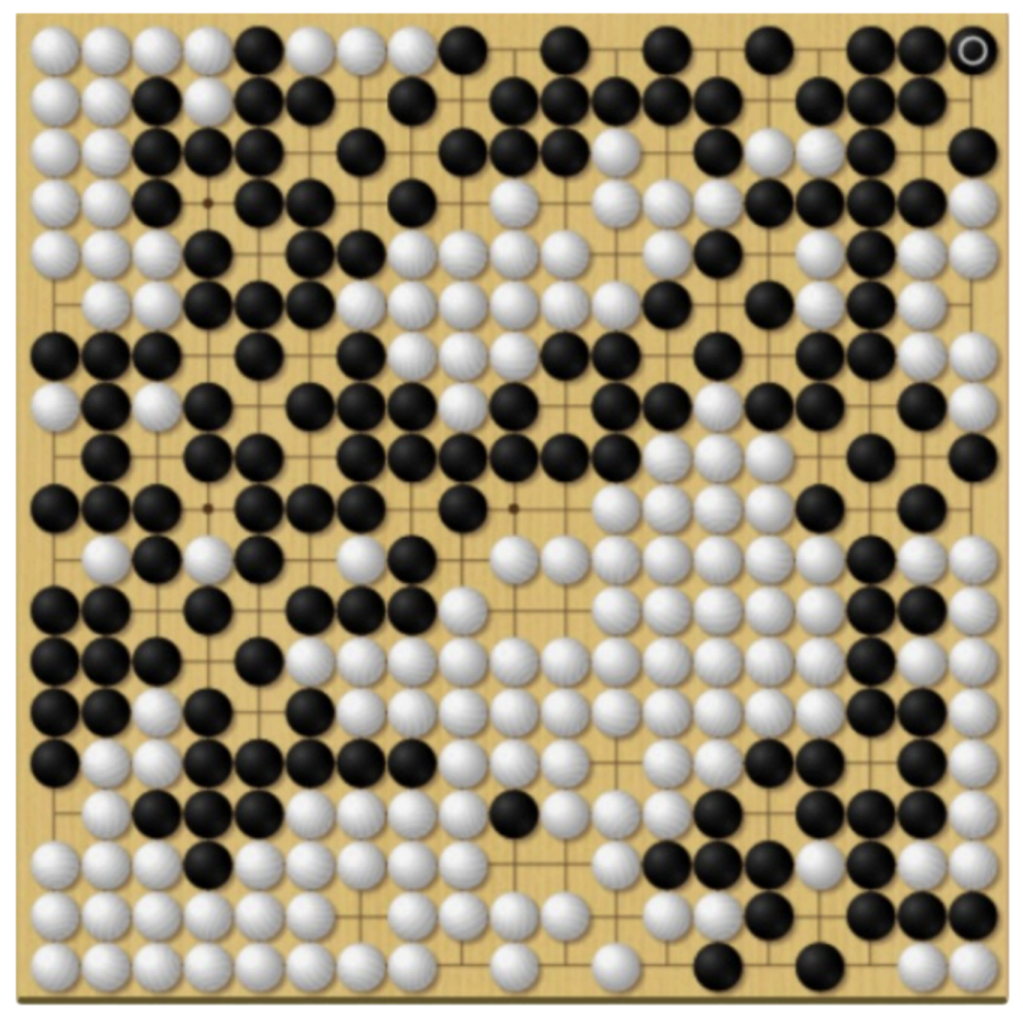
AlphaGo Weakness
Can train adversarial agents to specifically find and attack AlphaGo’s weaknesses
With an adversarial opponent, AlphaZero can completely mis-estimates the value of the positions
And keeps filling in its own territory with pieces!
No human expert player will make this kind of mistake.
Notes:
Supervised learning from expert databases to initialize the policy. 30 million positions from human professional players. Only take one move from
Self-play to improve the policy and learn a value function.

Slide 22
Outline
History of AI for Games
Components of AlphaGo
Value Network
Policy Network
MCTS
AlphaZero
Games Beyond Go

Slide 23
AlphaZero
Learn from first principles
gets rid of all Go-specific knowledge
uses neither expert databases nor any Go-specific features
uses only the board positions as the input
Can generalize to other board games
Evaluated on Chess and Shogi in the paper
Many other improvements in the implementation
combines the policy and value networks into a single network with a shared backbone and with two separate heads
purely uses the trained value function to evaluate positions in the tree, instead of using rollouts
…

Slide 24
Outline
History of AI for Games
Components of AlphaGo
Value Network
Policy Network
MCTS
AlphaZero
Games Beyond Go

Slide 25
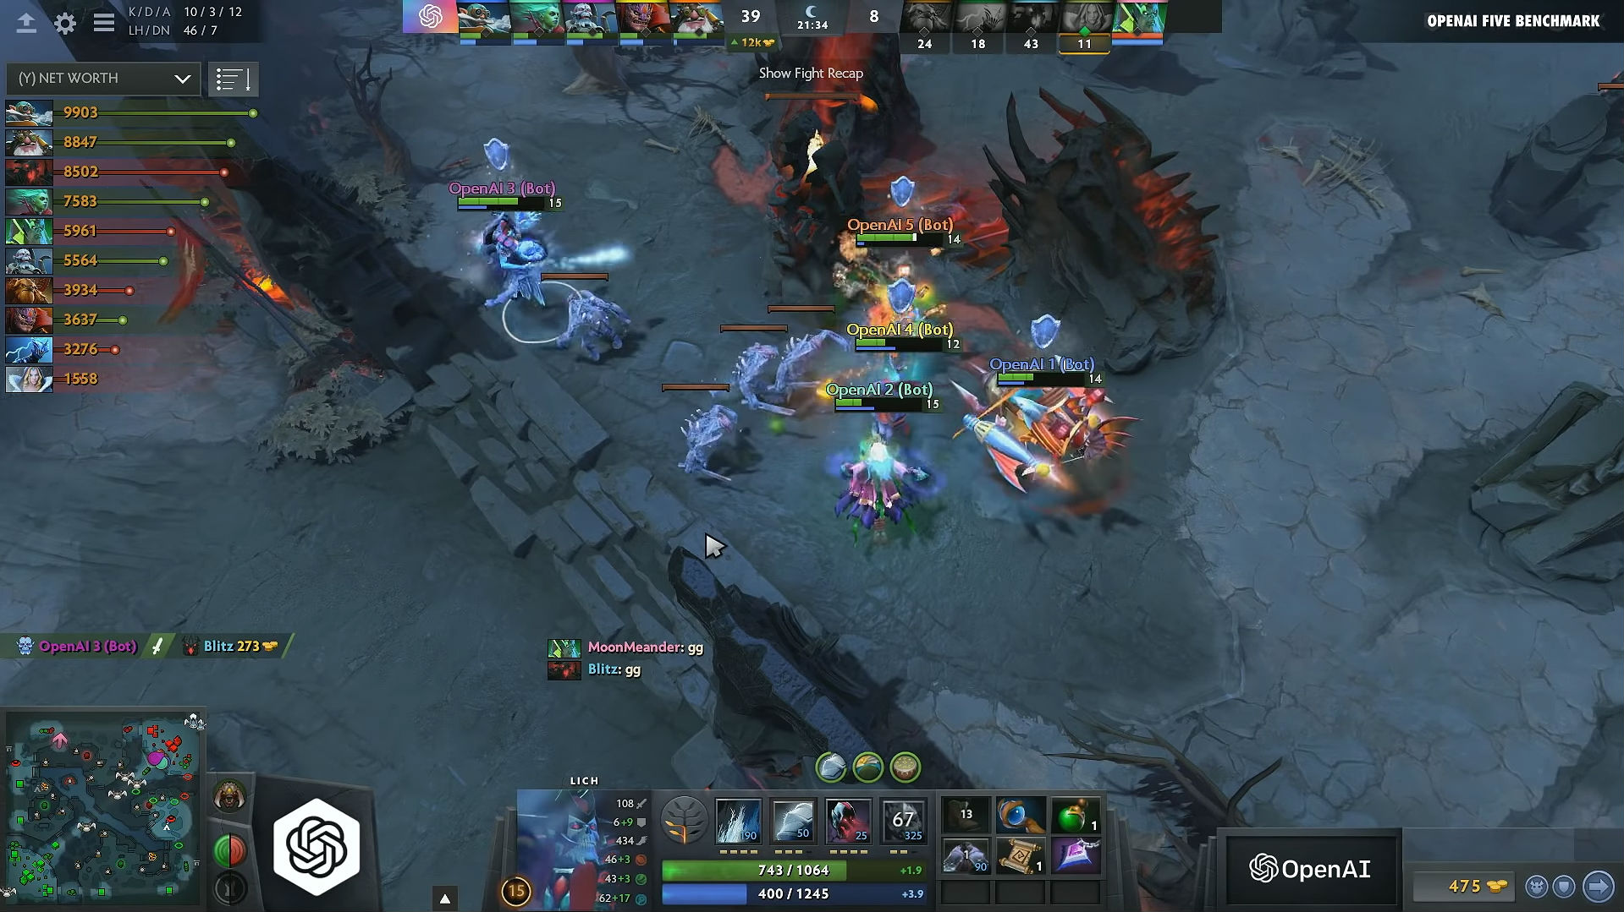
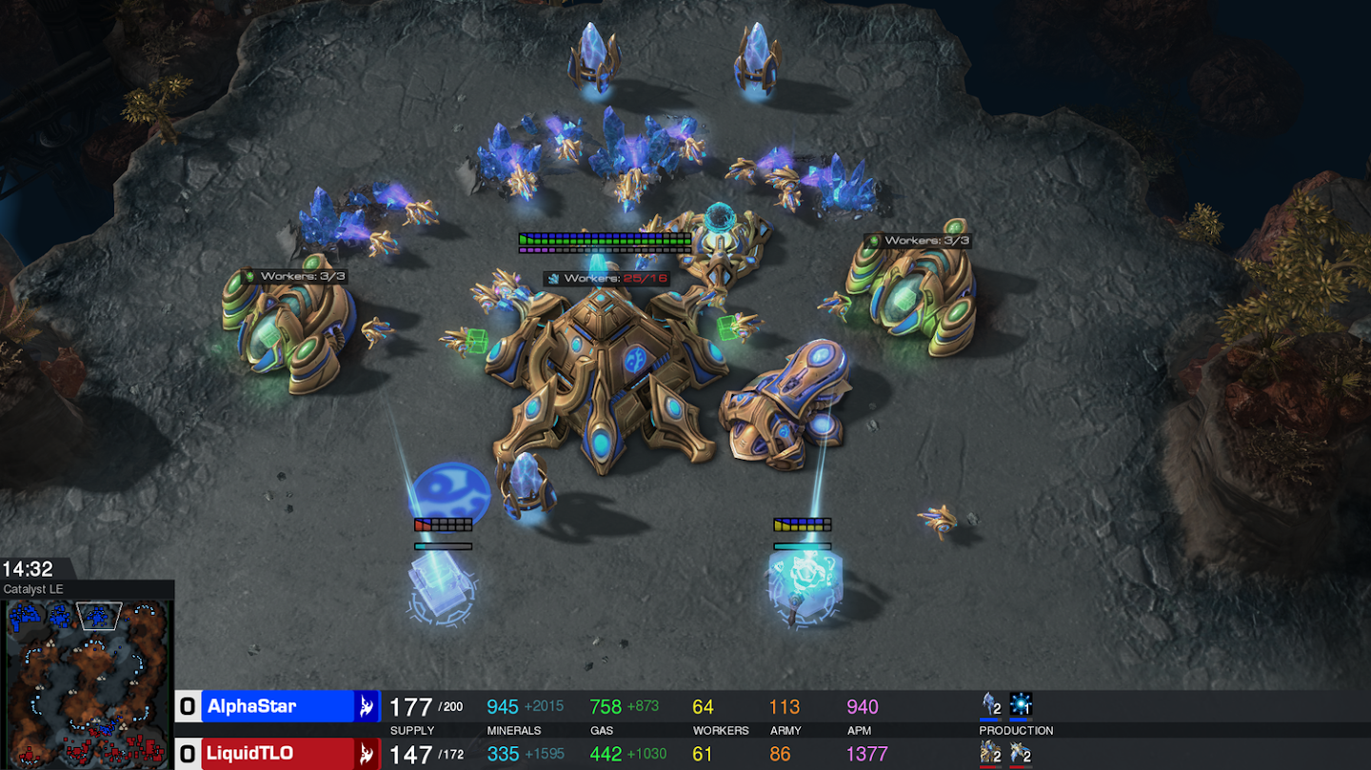
Next level games?
Dota2 – OpenAI Five
Starcraft – Deepmind’s AlphaStar
https://openai.com/five/
https://deepmind.com/blog/article/alphastar-mastering-real-time-strategy-game-starcraft-ii
Notes:
But go is of course not the most complicated game in the world. Dota and StarCraft are much more complicated.
Teamwork.
Long-term planning. Collect resources, build tools and weapons.
Much more visually complicated.

Slide 26
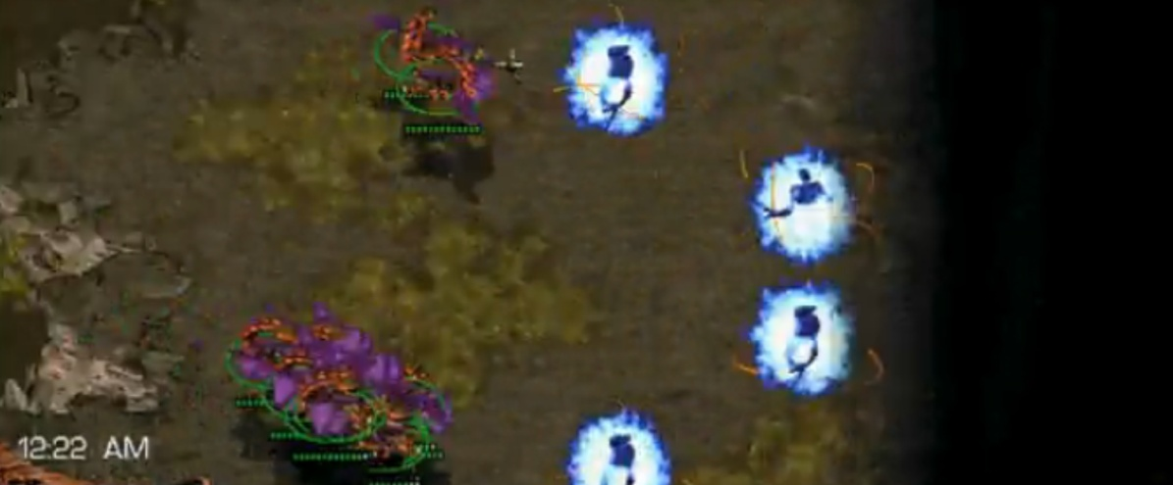
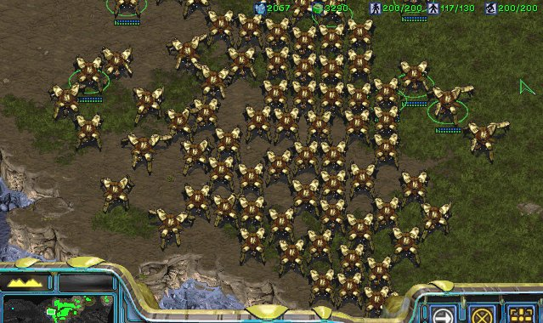
Why is Starcraft Hard?
The game of Starcraft is:
Adversarial
Long Horizon
Partially Observable
Realtime
Huge branching factor
Concurrent
Resource-rich
…
Notes:
Seems to be the case that none of the current RL algorithms are within reach. But is it really the case?

Slide 27
AlphaStar
Large NN trained:
Phase 1: supervised learning to imitate (strong) human players (why?)
Phase 2: reinforcement learning
How strong is AlphaStar?
Won 5-0 over the world’s strongest StarCraft II players

Slide 28
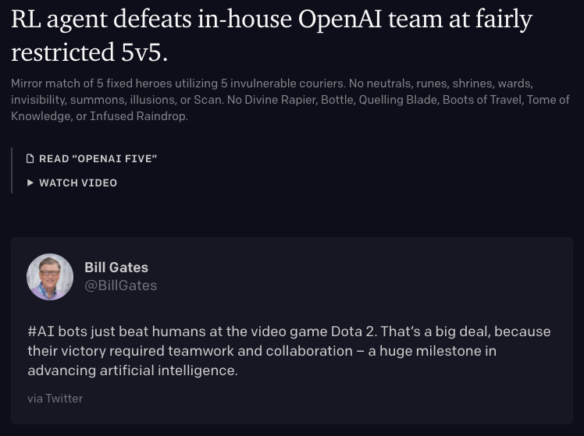

Slide 30
Summary
The AlphaGo series demonstrate the benefits of
Large-scale pattern recognition
MCTS guided by an accurate policy
Lots of computation!
More generally, recent success in AI for games show that:
Scaling up existing Deep RL algorithms + getting the details right got the job done!
This is also demonstrated in other fields, such as GPT-3 for NLP

Slide 31
Games that are still Unsolved
Contract Bridge
Requires explainable policies (in the bidding phase)
Hanabi
Purely cooperative gameplay
Need to reason about the beliefs and intentions of other agents

