Slide 1
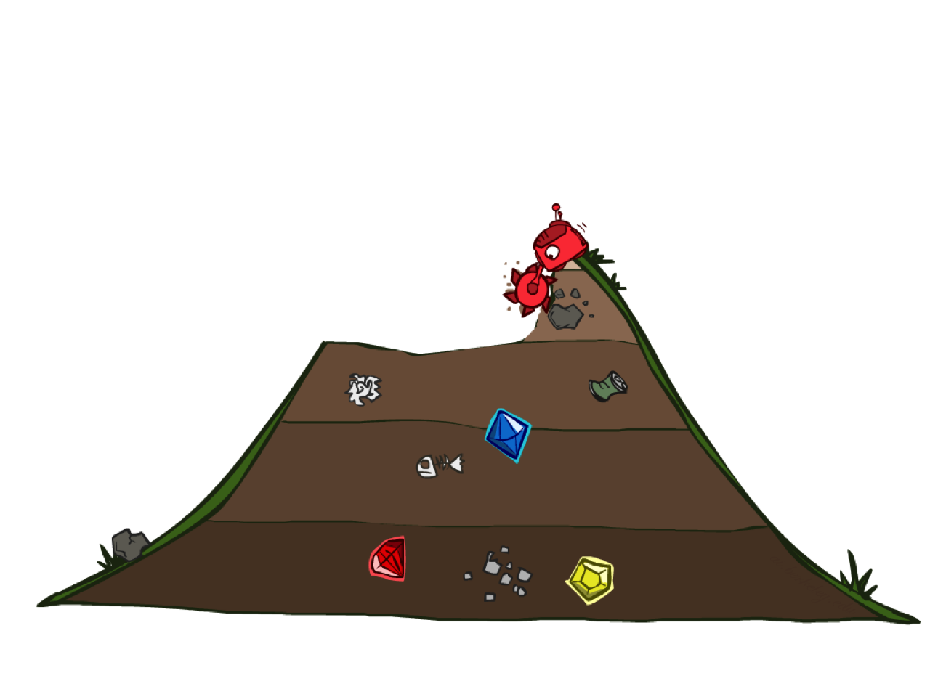
Uniform Cost Search

Slide 2
Uniform Cost Search
2
G
a
g(n) = cost from root to n
Strategy: expand lowest g(n)
Frontier is a priority queue sorted by g(n)
b
c
1
8
2
2
e
3
d
f
9
8
2
S
h
1
1
p
q
r
15
0
S
d
3
e
9
p
1
b
4
e
5
h
17
r
11
q
16
c
11
Cost contours
a
6
a
h
13
r
7
p
q
f
p
q
f
8
q
c
G
q
c
a
11
G
10
a

Slide 3
Uniform Cost Search (UCS) Properties
What nodes does UCS expand?
  Expands all nodes with cost less than cheapest solution!
  If that solution costs C* and arcs cost at least ε , then the “effective depth” is roughly C*/ε
  Takes time O(b^{C*/ε}) (exponential in effective depth)
How much space does the frontier take?
  Has roughly the last tier, so O(b^{C*/ε})
Is it complete?
  Assuming C* is finite and ε > 0, yes!
Is it optimal?
  Yes! (Proof next lecture via A*)
b
g ≤ 1
…
C*/ε “tiers”
g ≤ 2
g ≤ 3

Slide 4
Summary
Assume known, discrete, observable, deterministic, atomic
Search problems defined by S, s₀, A(s), Result(s,a), G(s), c(s,a,s’)
Search algorithms find action sequences that reach goal states
  Optimal => minimum-cost
Search algorithm properties:
  Depth-first: incomplete, suboptimal, space-efficient
  Breadth-first: complete, (sub)optimal, space-prohibitive
  Iterative deepening: complete, (sub)optimal, space-efficient
  Uniform-cost: complete, optimal, space-prohibitive

Slide 5
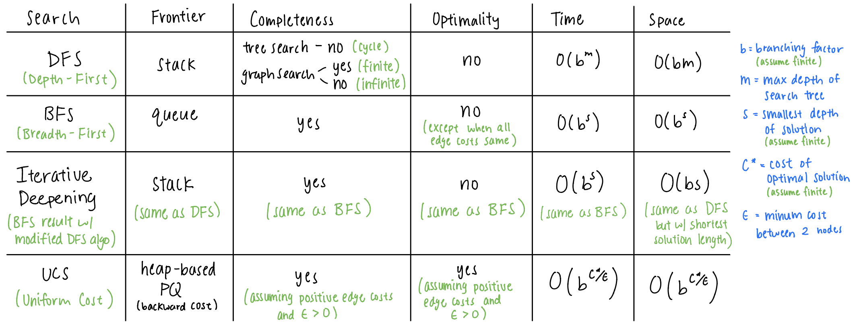
Bonus Search Algo Summary

Slide 6
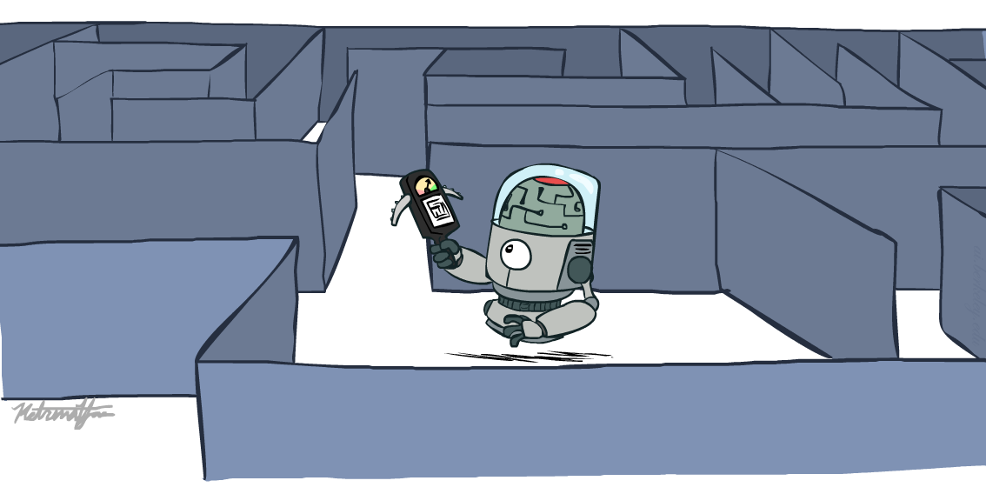
CS 188: Artificial Intelligence
Informed Search
Instructors: Angela Liu and Yanlai Yang
University of California, Berkeley
[slides adapted from Stuart Russel, Dawn Song]
Notes:
Please retain proper attribution and the reference to ai.berkeley.edu. Thanks!

Slide 7
Example: route-finding in Romania

Slide 8
What we would like to have happen
Guide search towards the goal instead of all over the place
Start
Goal
Start
Goal
Informed
Uninformed

Slide 9

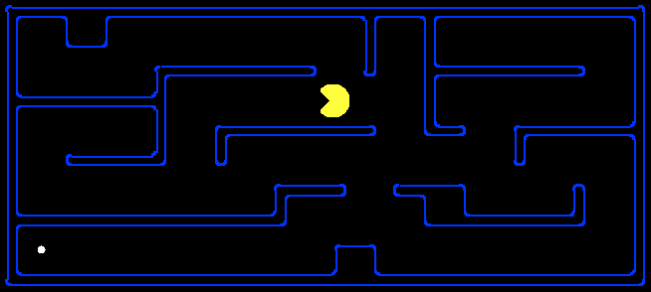
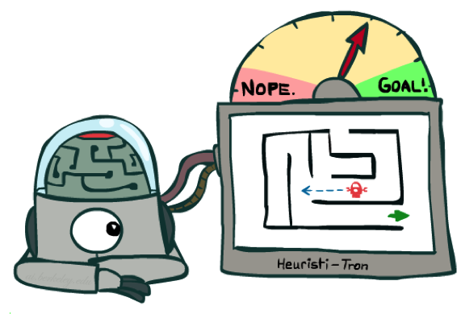
Search Heuristics
A heuristic is:
  A function that estimates how close a state is to a goal
  Designed for a particular search problem
  Pathing?
  Examples: Manhattan distance, Euclidean distance for pathing
10
5
11.2
Notes:
Function takes a state, returns a number.
Not everyday term. Not “Look both ways before you cross the street”
How far I am? Could run search, but that defeats the purpose!
Not perfect, but something!

Slide 10
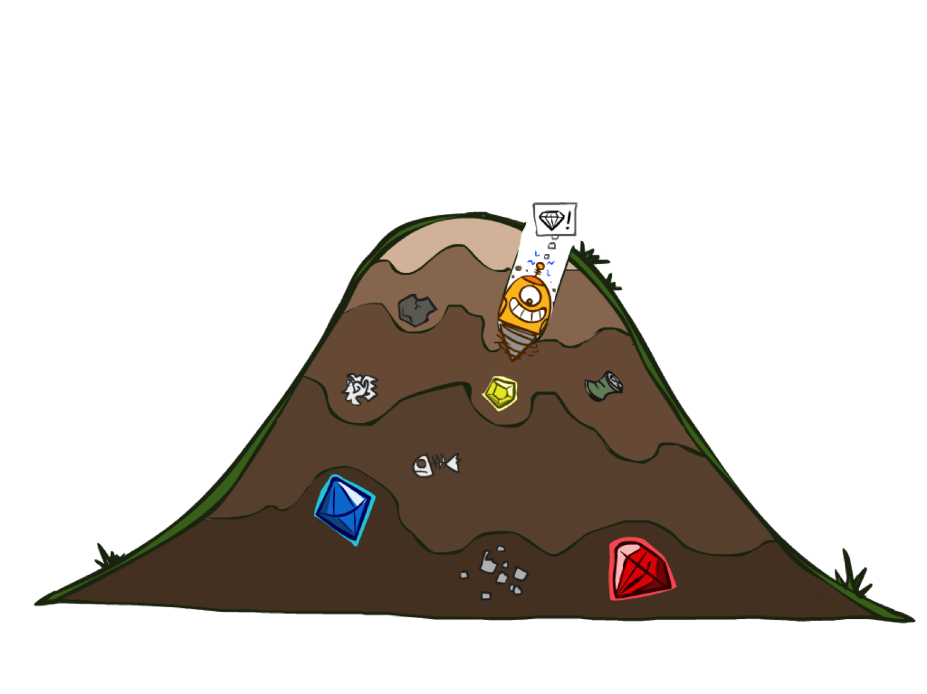
Greedy Search

Slide 11
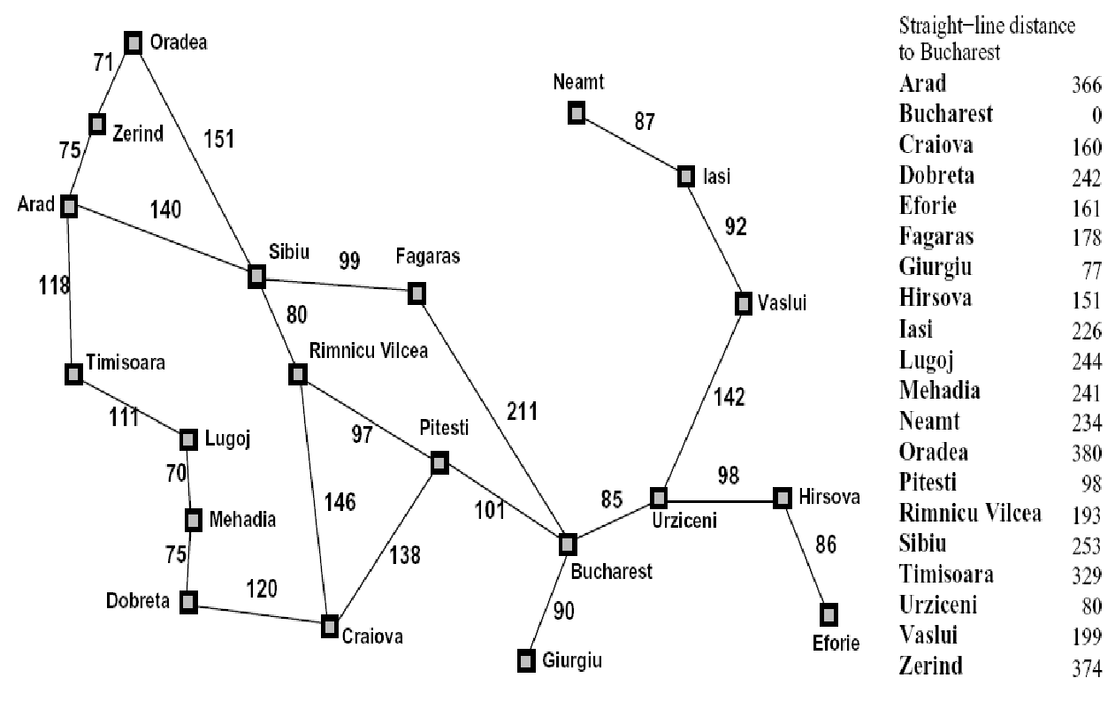

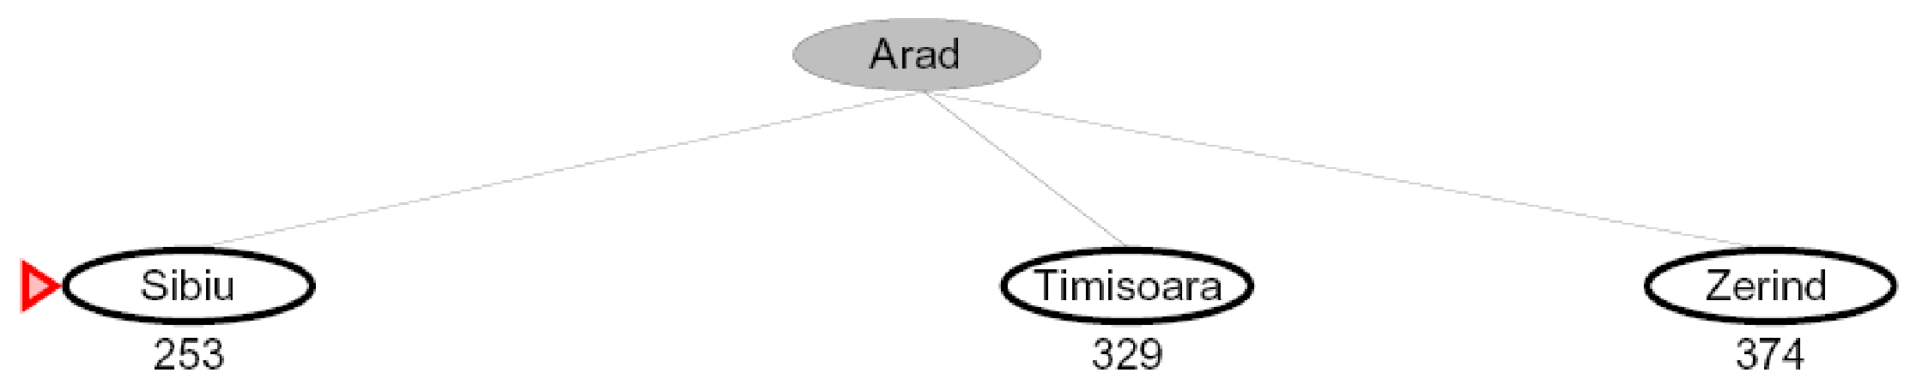
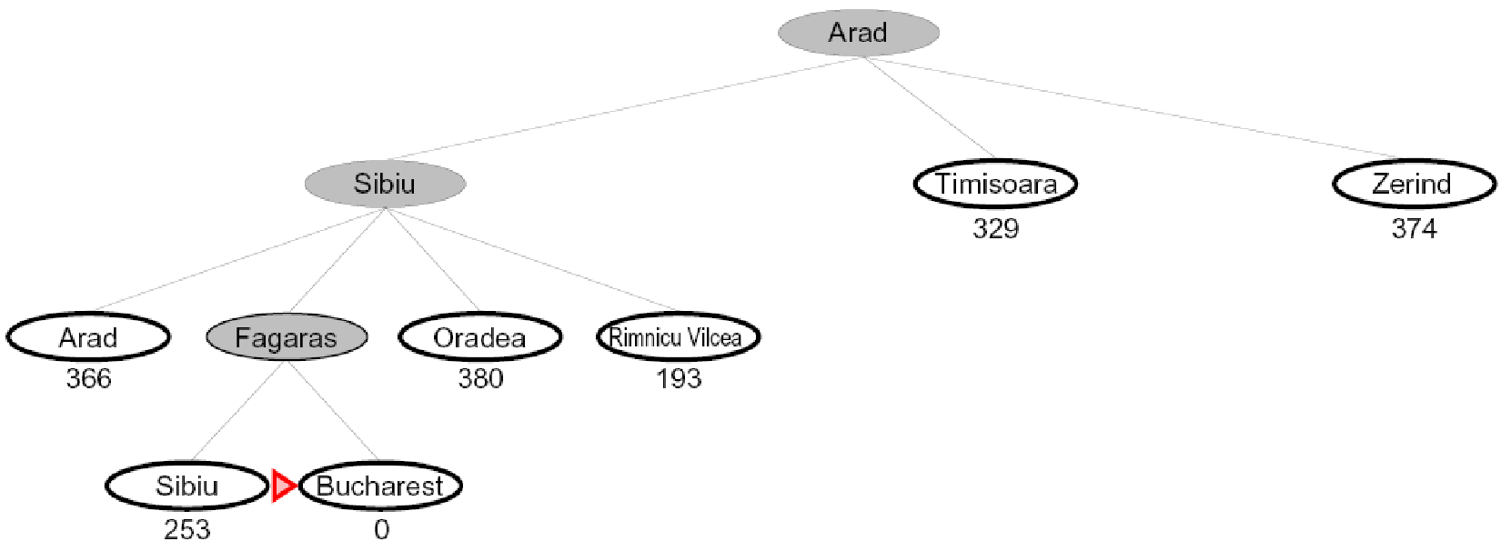
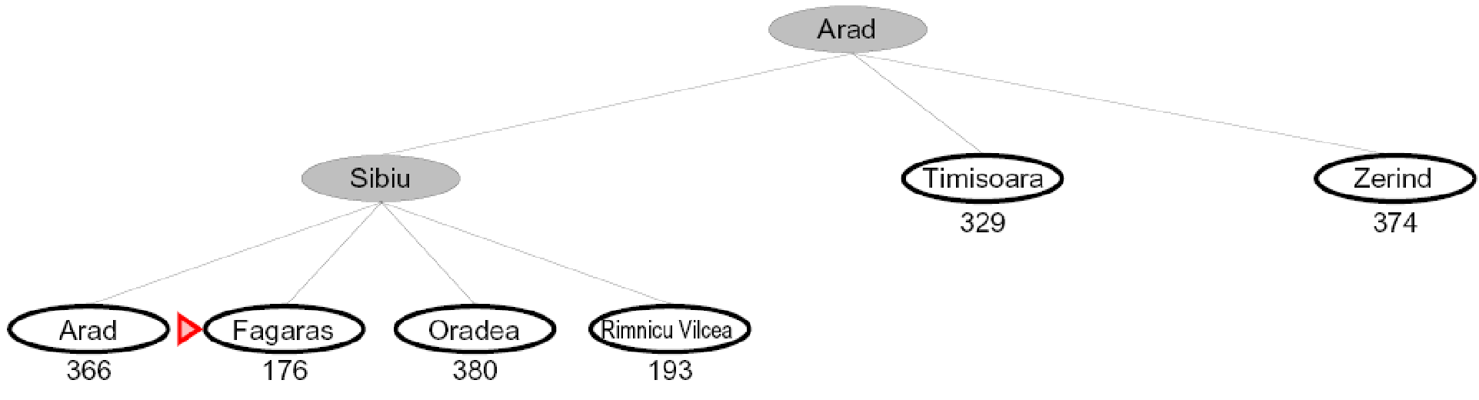

Greedy Search
Expand the node that seems closest…
Is it optimal?
  No. Resulting path to Bucharest is not the shortest!
Notes:
Numbers of heuristic, since that’s what greedy cares about.
Got to Bucharest, but not by shortest path.
End up with some kind of goal, but not what you want. You get a smelly shoe instead of to the airport on time.

Slide 12
Greedy Search
b
Strategy: expand a node that you think is closest to a goal state
  Heuristic: estimate of distance to nearest goal for each state
A common case:
  Best-first takes you straight to the (wrong) goal
Worst-case: like a badly-guided DFS
…
b
…
[Demo: contours greedy empty (L3D1)]
[Demo: contours greedy pacman small maze (L3D4)]
Notes:
Same algorithm as before, new strategy.
For any search problem, you know the goal. Now, you have an idea of how far away you are from the goal.
Worst: heuristic always wrong. Carefully avoid goal searching all tree.
If your heuristic were really good, sure. But if heuristic is good, easy problem!

Slide 13
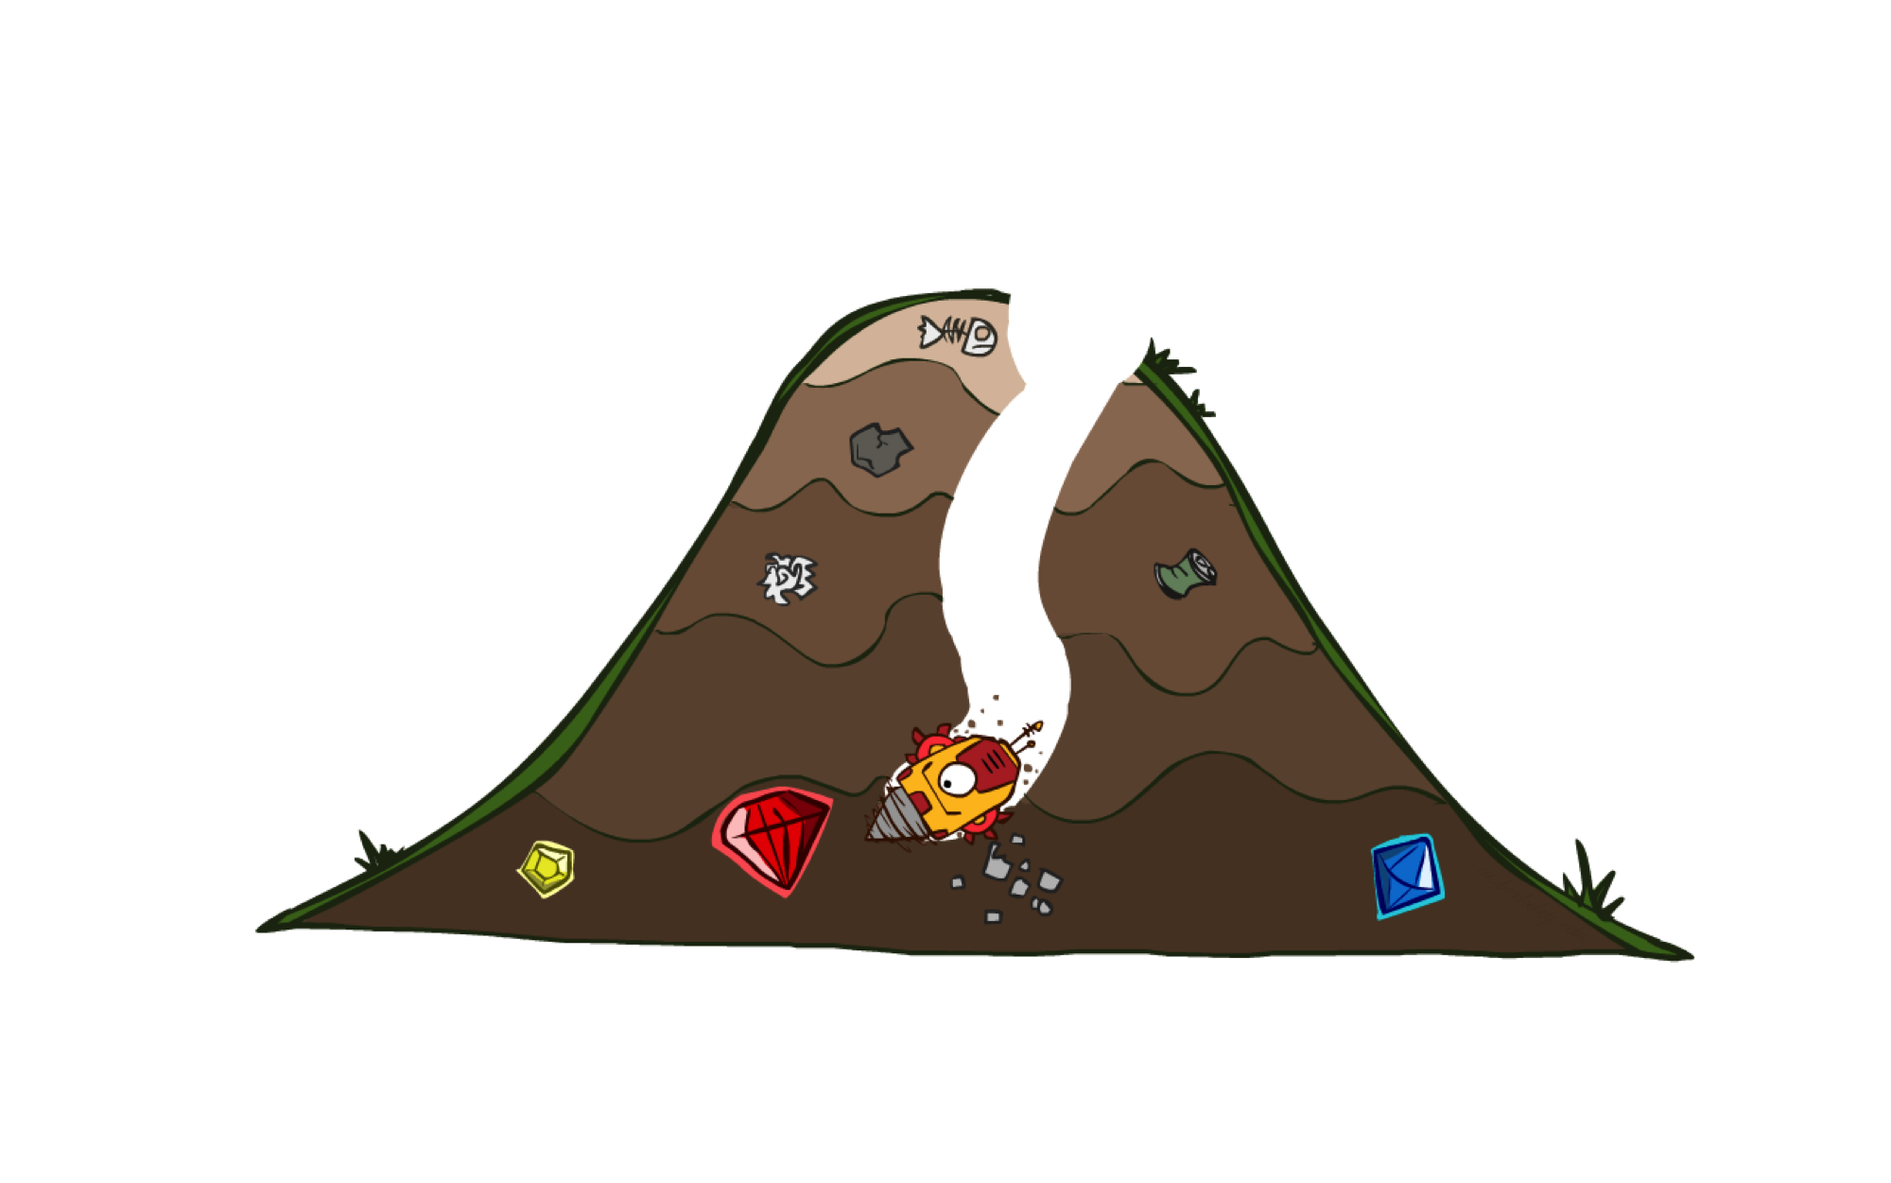
A* Search

Slide 14
A*: the core idea
Expand a node n most likely to be on an optimal path
Expand a node n s.t. the cost of the best solution through n is optimal
Expand a node n with lowest value of g(n) + h*(n)
  g(n) is the cost from root to n
  h*(n) is the optimal cost from n to the closest goal
We seldom know h*(n) but might have a heuristic approximation h(n)
A* = tree search with priority queue ordered by f(n) = g(n) + h(n)

Slide 15
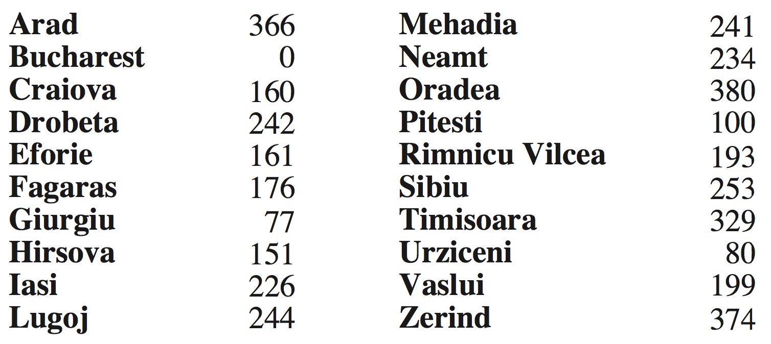
Example: route-finding in Romania
h(n) = straight-line distance to Bucharest

Slide 16
Example: pathing in Pacman
h(n) = Manhattan distance = |Δx| + |Δy|
Is Manhattan better than straight-line distance?
10
5
11.2

Slide 17
Is A* Optimal?
h = 6
1
A
3
S
h = 7
G
h = 0
5
What went wrong?
Actual bad solution cost < estimated good solution cost
We need estimates to be less than actual costs!

Slide 18

Admissible Heuristics

Slide 19
Admissible Heuristics
A heuristic h is admissible (optimistic) if:
  0 ≤ h(n) ≤ h*(n)
where h*(n) is the true cost to a nearest goal
Example:
Finding good, cheap admissible heuristics is the key to success
15

Slide 20

Optimality of A* Tree Search

Slide 21
Optimality of A* Tree Search
Assume:
A is an optimal goal node
B is a suboptimal goal node
h is admissible
Claim:
A will be chosen for expansion before B
…
A
B

Slide 22
Optimality of A* Tree Search: Blocking
Proof:
Imagine B is on the frontier
Some ancestor n of A is on the frontier, too (maybe A itself!)
Claim: n will be expanded before B
  f(n) ≤ f(A)
…
n
A
B
f(n) = g(n) + h(n) Definition of f-cost
f(n) ≤ g(A) Admissibility of h
g(A) = f(A) h = 0 at a goal

Slide 23
Optimality of A* Tree Search: Blocking
Proof:
Imagine B is on the frontier
Some ancestor n of A is on the frontier, too (maybe A itself!)
Claim: n will be expanded before B
  f(n) ≤ f(A)
  f(A) < f(B)
…
n
A
B
g(A) < g(B) Suboptimality of B
f(A) < f(B) h = 0 at a goal

Slide 24
Optimality of A* Tree Search: Blocking
Proof:
Imagine B is on the frontier
Some ancestor n of A is on the frontier, too (maybe A itself!)
Claim: n will be expanded before B
  f(n) ≤ f(A)
  f(A) < f(B)
  n is expanded before B
All ancestors of A are expanded before B
A is expanded before B
A* tree search is optimal
…
n
A
B
f(n) ≤ f(A) < f(B)

Slide 25
UCS vs A* Contours
Uniform-cost expands equally in all “directions”
A* expands mainly toward the goal, but does hedge its bets to ensure optimality
Start
Goal
Start
Goal

Slide 26
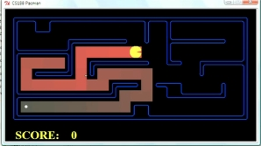
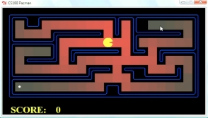
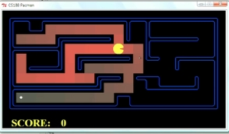
Comparison
Greedy (h)
Uniform Cost (g)
A* (g+h)

Slide 27
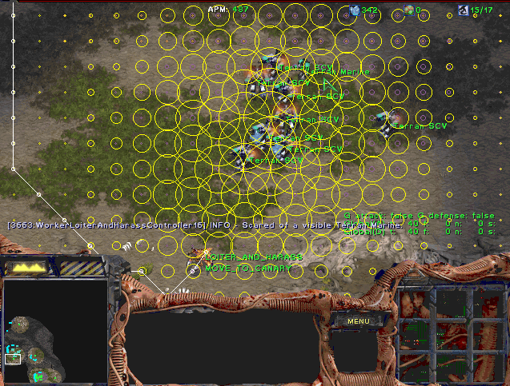
A* Applications
Video games
Pathing / routing problems
Resource planning problems
Robot motion planning
Language analysis
Machine translation
Speech recognition
Protein design
Chemical synthesis
…

Slide 28

Creating Heuristics

Slide 29
Creating Admissible Heuristics
Often, admissible heuristics are solutions to relaxed problems, where new actions are available
Problem P₂ is a relaxed version of P₁ if A₂(s) ⊇ A₁(s) for every s
Theorem: h₂*(s) ≤ h₁*(s) for every s, so h₂*(s) is admissible for P₁
15
366

Slide 30
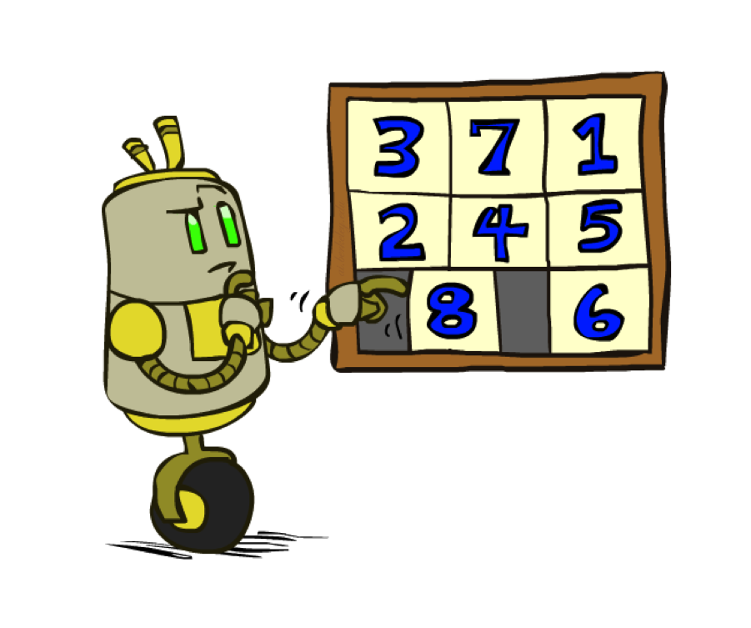
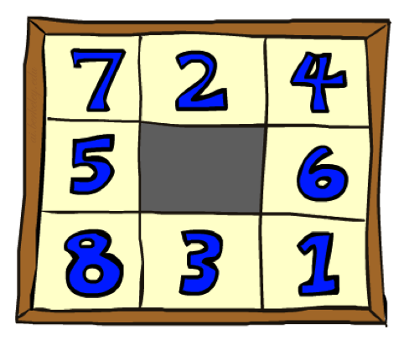
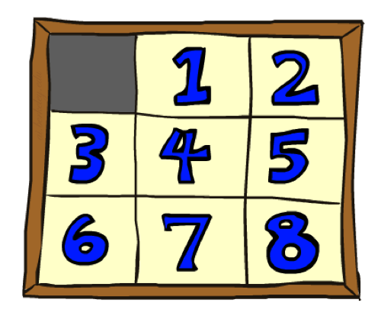
Example: 8 Puzzle
Start State
Actions
Goal State
What are the states?
How many states?
What are the actions?
What are the step costs?
Notes:
9! = 362,880 but 16! (15-puzzle) = 20 trillion, 25! = 10^25

Slide 31
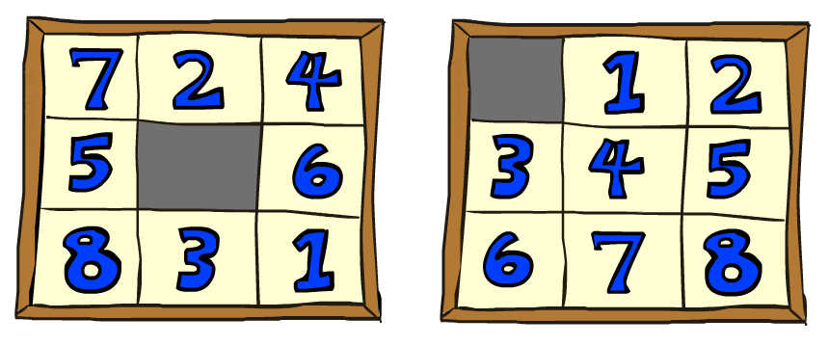

8 Puzzle I
Heuristic: Number of tiles misplaced
Why is it admissible?
h(start) =
8
Start State
Goal State
 | Average nodes expanded when the optimal path has…
 | …4 steps | …8 steps | …12 steps
UCS | 112 | 6,300 | 3.6 x 10⁶
A*TILES | 13 | 39 | 227
Statistics from Andrew Moore

Slide 32
8 Puzzle II
What if we had an easier 8-puzzle where any tile could slide any direction at any time, ignoring other tiles?
Total Manhattan distance
Why is it admissible?
h(start) =
Start State
Goal State
 | Average nodes expanded when the optimal path has…
 | …4 steps | …8 steps | …12 steps
A*TILES | 13 | 39 | 227
A*MANHATTAN | 12 | 25 | 73
3 + 1 + 2 + … = 18

Slide 33
Combining heuristics
Dominance: h₁ ≥ h₂ if
∀n h₁(n) ≥ h₂(n)
  Roughly speaking, larger is better as long as both are admissible
  The zero heuristic is pretty bad (what does A* do with h=0?)
  The exact heuristic is pretty good, but usually too expensive!
What if we have two heuristics, neither dominates the other?
  Form a new heuristic by taking the max of both:
  h(n) = max( h₁(n), h₂(n))
  Max of admissible heuristics is admissible and dominates both!
Notes:
Semi-lattice: x <= y <-> x = x ^ y

Slide 34

Example: Knight’s moves
Minimum number of knight’s moves to get from A to B?
  h₁ = (Manhattan distance)/3
    h₁’ = h₁ rounded up to correct parity (even if A, B same color, odd otherwise)
  h₂ = (Euclidean distance)/√5 (rounded up to correct parity)
  h₃ = (max x or y shift)/2 (rounded up to correct parity)
h(n) = max( h₁’(n), h₂(n), h₃(n)) is admissible!
Notes:
Semi-lattice: x <= y <-> x = x ^ y

Slide 35
Optimality of A* Graph Search

Slide 36
A* Graph Search Gone Wrong?
State space graph
Search tree
h=4
A
S (0+2)
1
h=1
S
1
C
A (1+4)
B (1+1)
h=2
1
2
B
3
C (2+1)
C (3+1)
h=1
G
G (5+0)
G (6+0)
Simple check against expanded set blocks C
h=0
Fancy check allows new C if cheaper than old
but requires recalculating C’s descendants

Slide 37
Consistency of Heuristics
Main idea: estimated heuristic costs ≤ actual costs
  Admissibility: heuristic cost ≤ actual cost to goal
  h(A) ≤ h*(A)
  Consistency: heuristic “arc” cost ≤ actual cost for each arc
  h(A) – h(C) ≤ c(A,C)
  or h(A) ≤ c(A,C) + h(C) (triangle inequality)
    Note: h* necessarily satisfies triangle inequality
Consequences of consistency:
  The f value along a path never decreases:
  h(A) ≤ c(A,C) + h(C) => g(A) + h(A) ≤ g(A) + c(A,C) + h(C)
  A* graph search is optimal
A
1
C
h=4
h=1
h=3
G

Slide 38
Optimality of A* Graph Search
Sketch: consider what A* does with a consistent heuristic:
  Fact 1: In tree search, A* expands nodes in increasing total f value (f-contours)
  Fact 2: For every state s, nodes that reach s optimally are expanded before nodes that reach s suboptimally
  Result: A* graph search is optimal
…
f ≤ 1
f ≤ 2
f ≤ 3

Slide 39
Optimality
Tree search:
  A* is optimal if heuristic is admissible
Graph search:
  A* optimal if heuristic is consistent
Consistency implies admissibility
Most natural admissible heuristics tend to be consistent, especially if from relaxed problems

Slide 40

But…
A* keeps the entire explored region in memory
=> will run out of space before you get bored waiting for the answer
There are variants that use less memory (Section 3.5.5):
  IDA* works like iterative deepening, except it uses an f-limit instead of a depth limit
    On each iteration, remember the smallest f-value that exceeds the current limit, use as new limit
    Very inefficient when f is real-valued and each node has a unique value
  RBFS is a recursive depth-first search that uses an f-limit = the f-value of the best alternative path available from any ancestor of the current node
    When the limit is exceeded, the recursion unwinds but remembers the best reachable f-value on that branch
  SMA* uses all available memory for the queue, minimizing thrashing
    When full, drop worst node on the queue but remember its value in the parent

Slide 41

A*: Summary
A* orders nodes in the queue by f(n) = g(n) + h(n)
A* is optimal for trees/graphs with admissible/consistent heuristics
Heuristic design is key: often use relaxed problems
g
g
h
h

