Slide 1

CS 188: Artificial Intelligence
CSPs Review + Local search
Instructors: Angela Liu and Yanlai Yang
University of California, Berkeley
[These slides adapted from Stuart Russell and Dawn Song]

Slide 2
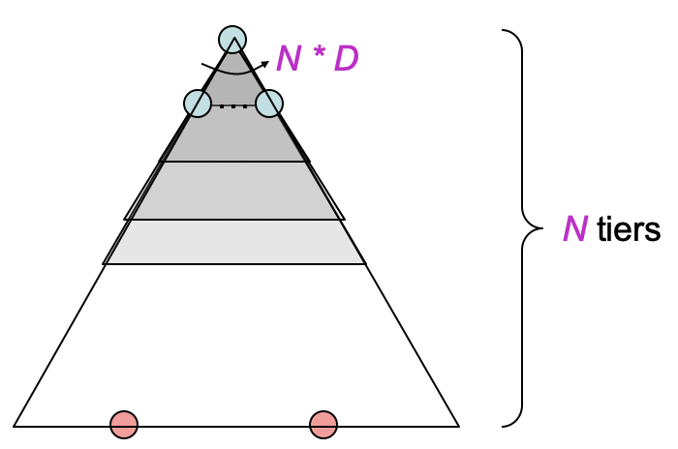
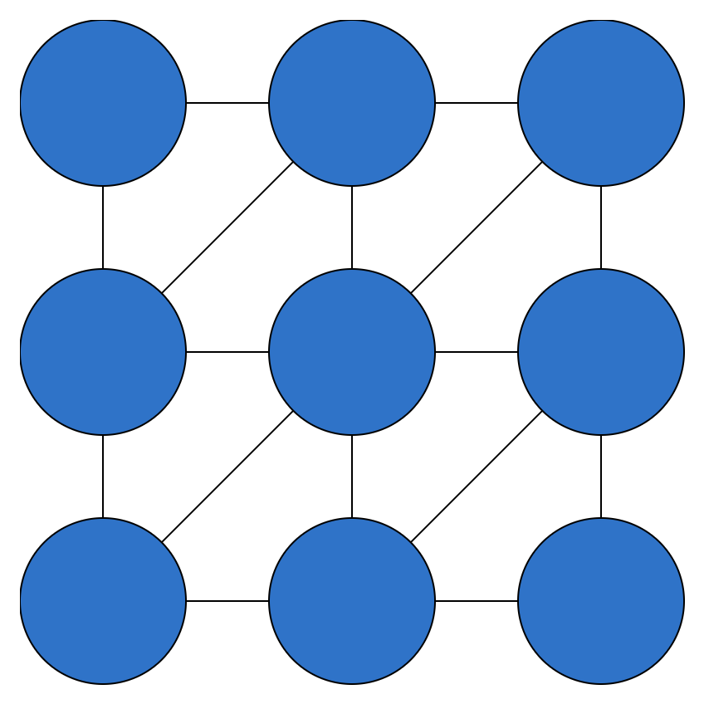
Search Methods
BFS
  Tries all possible partial assignments;
  like brute force search
  All solutions are on deepest level
  of tree
DFS
  Cannot catch obvious violated constraints
  in partial assignments due to atomic
  state representation
Backtracking Search
  Fix order of variables
  Check constraints as you go with “incremental goal test”

Slide 3
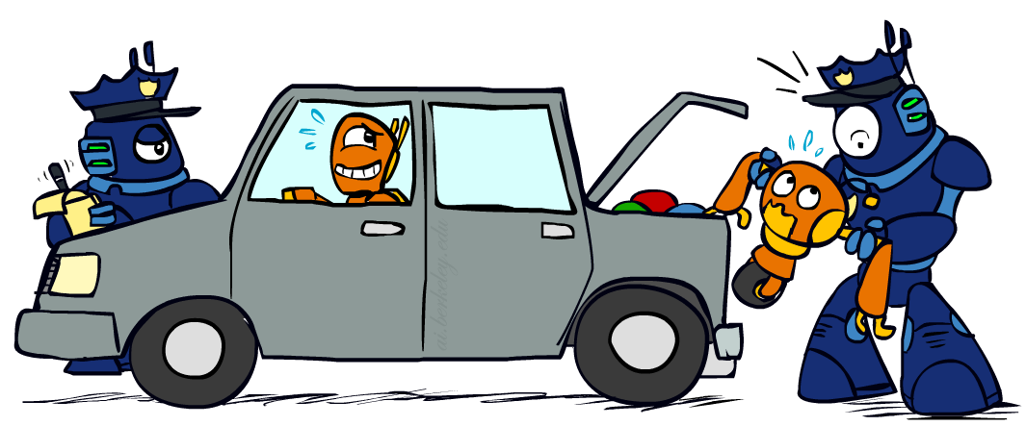
Backtracking Search Improvements: Filtering
Forward checking: Cross off values that violate a constraint when added to the existing assignment
  Checks all arcs into the assigned variable
Arc Consistency: constraint propagation to
ensure all arcs are consistent
  Any time a variable X loses a value, all arcs into X need to be rechecked
K-Consistency: any consistent assignment to k-1 variables can extend to kth node
  Strong K-Consistency: ensuring 1-consistency, 2-consistency, 3-consistency, …, k-consistency
Delete from the tail!

Slide 4
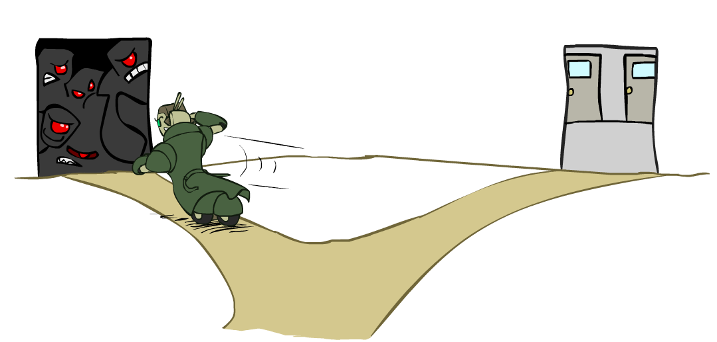
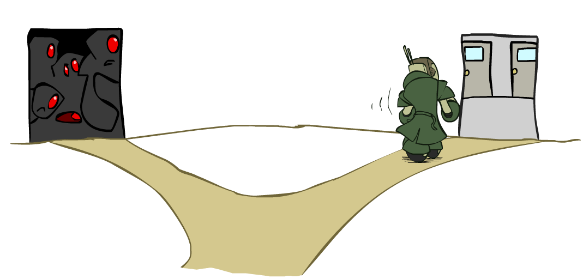
Backtracking Search Improvements: Ordering
Variable Ordering: Minimum remaining values (MRV)
  Choose the variable with the fewest legal values left in its domain
  Tie-break using the variable involved in most constraints
  “Fail-fast” to prune search tree
Value Ordering: Least Constraining Value (LCV)
  Choose the value that rules out the fewest values in the
  remaining variables
  May require additional computation (forward-checking/AC3)
  Leave highest flexibility for later variable assignments

Slide 5
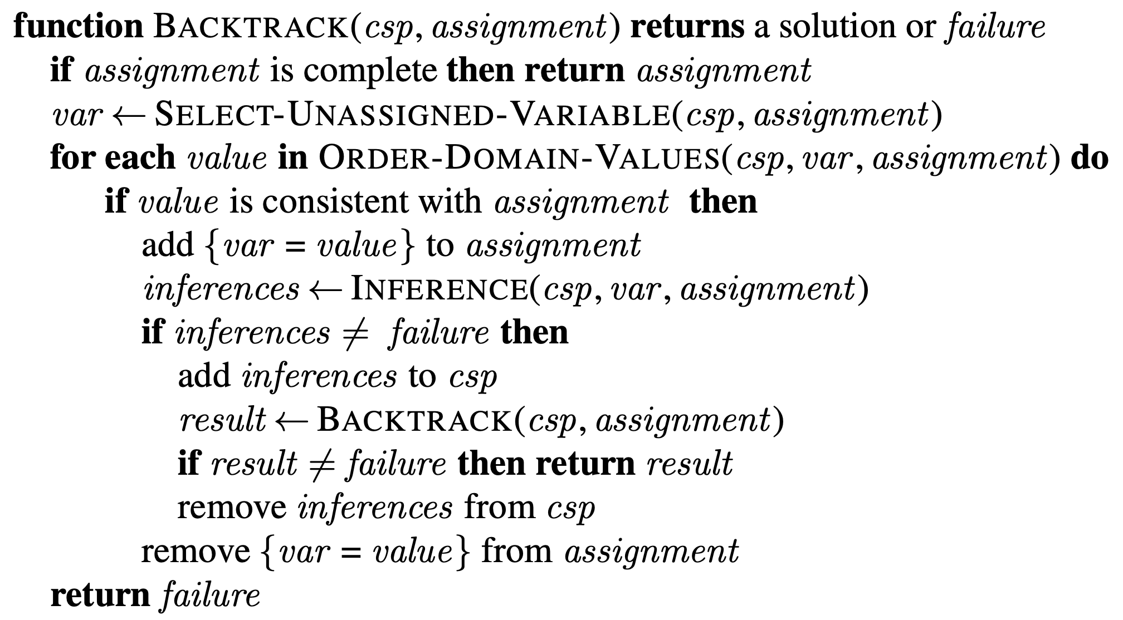
Algorithm Pseudocode

Slide 6
CS 188: Artificial Intelligence
Local search
Instructors: Angela Liu and Yanlai Yang
University of California, Berkeley
[These slides adapted from Stuart Russell and Dawn Song]

Slide 7
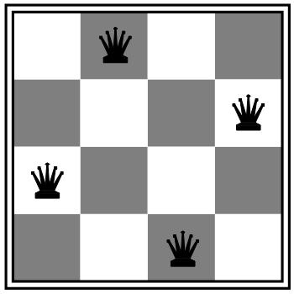
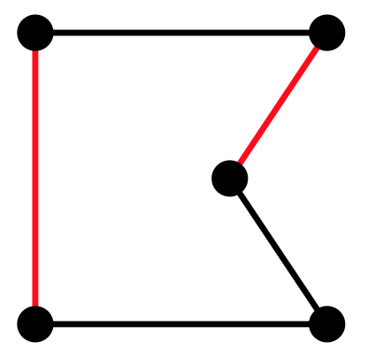
Local search algorithms
In many optimization problems, path is irrelevant; the goal state is the solution
Then state space = set of “complete” configurations;
find configuration satisfying constraints, e.g., n-queens problem; or, find optimal configuration, e.g., travelling salesperson problem
In such cases, can use iterative improvement algorithms: keep a single “current” state, try to improve it
Constant space, suitable for online as well as offline search
More or less unavoidable if the “state” is yourself (i.e., learning)

Slide 8
Hill Climbing
Simple, general idea:
  Start wherever
  Repeat: move to the best neighboring state
  If no neighbors better than current, quit

Slide 9
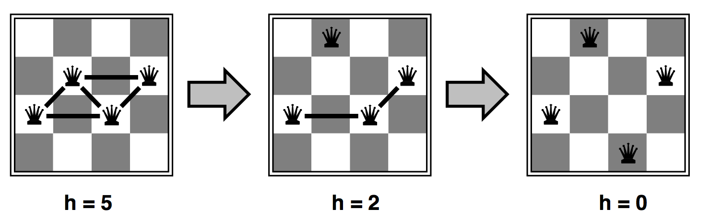
Heuristic for n-queens problem
Goal: n queens on board with no conflicts, i.e., no queen attacking another
States: n queens on board, one per column
Actions: move a queen in its column
Heuristic value function: number of conflicts

Slide 10
Hill-climbing algorithm
function HILL-CLIMBING(problem) returns a state
current ← make-node(problem.initial-state)
loop do
neighbor ← a highest-valued successor of current
if neighbor.value ≤ current.value then
return current.state
current ← neighbor
“Like climbing Everest in thick fog with amnesia”

Slide 11
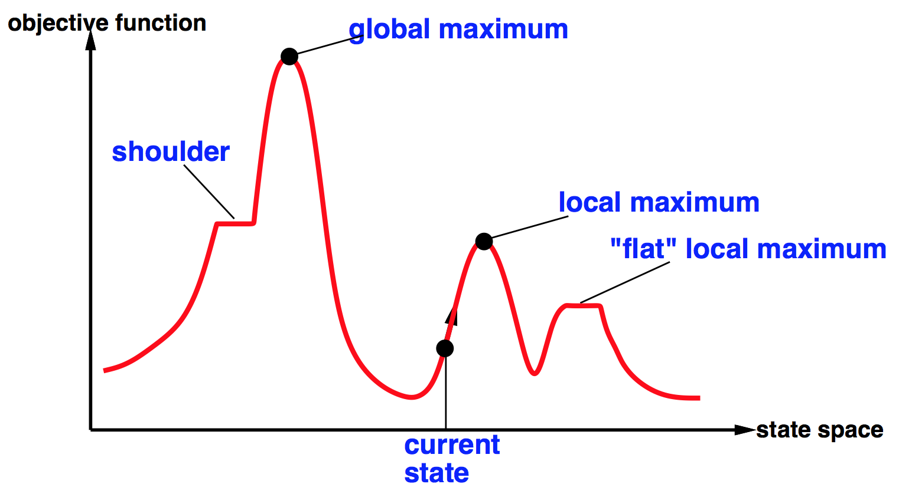


Global and local maxima
Random restarts
  find global optimum
  duh
Random sideways moves
  Escape from shoulders
  Loop forever on flat local maxima

Slide 12
Hill-climbing on the 8-queens problem
No sideways moves:
  Succeeds w/ prob. 0.14
  Average number of moves per trial:
    4 when succeeding, 3 when getting stuck
  Expected total number of moves needed:
    3(1-p)/p + 4 =~ 22 moves
Allowing 100 sideways moves:
  Succeeds w/ prob. 0.94
  Average number of moves per trial:
    21 when succeeding, 65 when getting stuck
  Expected total number of moves needed:
    65(1-p)/p + 21 =~ 25 moves
Moral: algorithms with knobs
to twiddle are irritating

Slide 13
Simulated annealing
Resembles the annealing process used to cool metals slowly to reach an ordered (low-energy) state
Basic idea:
  Allow “bad” moves occasionally, depending on “temperature”
  High temperature => more bad moves allowed, shake the system out of its local minimum
  Gradually reduce temperature according to some schedule
  Sounds pretty flaky, doesn’t it?

Slide 14

Simulated annealing algorithm
function SIMULATED-ANNEALING(problem,schedule) returns a state
current ← problem.initial-state
for t = 1 to ∞ do
T ←schedule(t)
if T = 0 then return current
next ← a randomly selected successor of current
∆E ← next.value – current.value
if ∆E > 0 then current ← next
else current ← next only with probability e^{∆E/T}

Slide 15
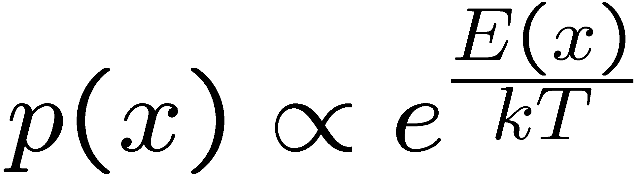
Simulated Annealing
Theoretical guarantee:
  Stationary distribution (Boltzmann): P(x) α e^{E(x)/T}
  If T decreased slowly enough, will converge to optimal state!
Proof sketch
  Consider two adjacent states x, y with E(y) > E(x) [high is good]
  Assume x→y and y→x and outdegrees D(x) = D(y) = D
  Let P(x), P(y) be the equilibrium occupancy probabilities at T
  Let P(x→y) be the probability that state x transitions to state y
Notes:
P(x)P(x->y) = P(y)P(y->x)
P(x)/D = P(y)exp((E(x)-E(y))/T)/D
P(x)/P(y) = exp(E(x)/T) / exp(E(y)/T)

Slide 16
Simulated Annealing
Is this convergence an interesting guarantee?
Sounds like magic, but reality is reality:
  The more downhill steps you need to escape a local optimum, the less likely you are to ever make them all in a row
  “Slowly enough” may mean exponentially slowly
  Random restart hillclimbing also converges to optimal state…
Simulated annealing and its relatives are a key workhorse in VLSI layout and other optimal configuration problems

Slide 17
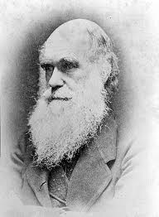
Local beam search
Basic idea:
  K copies of a local search algorithm, initialized randomly
  For each iteration
    Generate ALL successors from K current states
    Choose best K of these to be the new current states
Why is this different from K local searches in parallel?
  The searches communicate! “Come over here, the grass is greener!”
What other well-known algorithm does this remind you of?
  Evolution!
Or, K chosen randomly with
a bias towards good ones

Slide 18
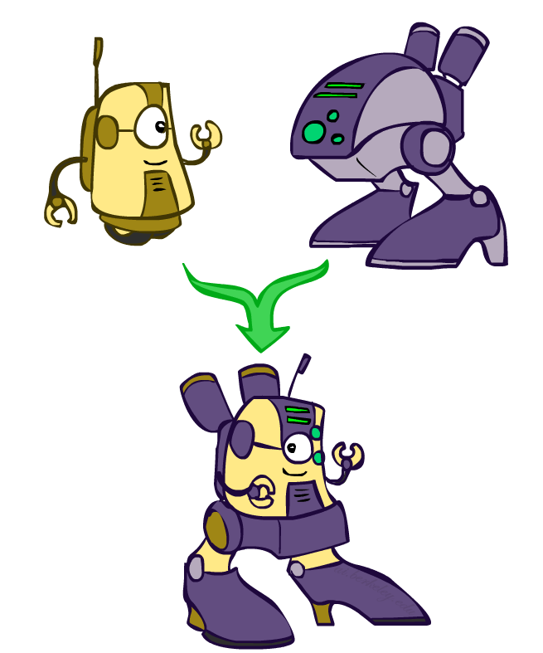
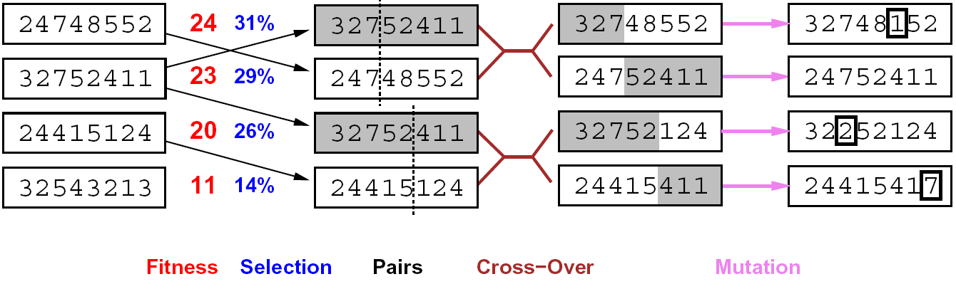
Genetic algorithms
Genetic algorithms use a natural selection metaphor
  Resample K individuals at each step (selection) weighted by fitness function
  Combine by pairwise crossover operators, plus mutation to give variety

Slide 19
Example: N-Queens
Does crossover make sense here?
What would mutation be?
What would a good fitness function be?

Slide 20

Local search in continuous spaces

Slide 21
Example: Siting airports in Romania
Place 3 airports to minimize the sum of squared distances from each city to its nearest airport
Airport locations
x = (x₁,y₁), (x₂,y₂), (x₃,y₃)
City locations (x_{c},y_{c})
C_{a} = cities closest to airport a
Objective: minimize
f(x) = Σ_{a} Σ_{c∈Ca} (x_{a} - x_{c})² + (y_{a} - y_{c})²

Slide 22
Handling a continuous state/action space
Discretize it!
  Define a grid with increment δ , use any of the discrete algorithms
Choose random perturbations to the state
  First-choice hill-climbing: keep trying until something improves the state
  Simulated annealing
Compute gradient of f(x) analytically

Slide 23
Finding extrema in continuous space
Gradient vector ∇f(x) = (∂f/∂x₁, ∂f/∂y₁, ∂f/∂x₂, …)^{T}
For the airports, f(x) = Σ_{a} Σ_{c∈Ca} (x_{a} - x_{c})² + (y_{a} - y_{c})²
∂f/∂x₁ = Σ_{c∈C1} 2(x₁ - x_{c})
At an extremum, ∇f(x) = 0
Can sometimes solve in closed form: x₁ = (Σ_{c∈C1} x_{c})/|C₁|
Is this a local or global minimum of f?
Gradient descent: x ← x - α∇f(x)
  Huge range of algorithms for finding extrema using gradients

Slide 24
Summary
Many configuration and optimization problems can be formulated as local search
General families of algorithms:
  Hill-climbing, continuous optimization
  Simulated annealing (and other stochastic methods)
  Local beam search: multiple interaction searches
  Genetic algorithms: break and recombine states
Many machine learning algorithms are local searches

