Slide 1
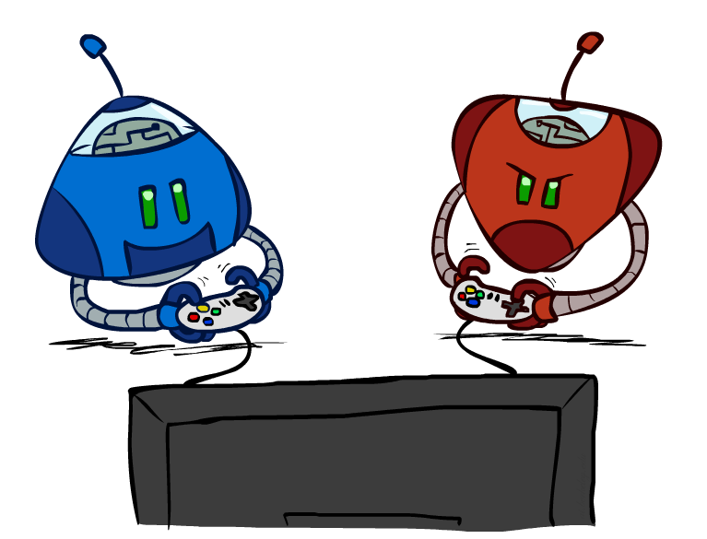
CS 188: Artificial Intelligence
Local Search + Games
Instructors: Angela Liu and Yanlai Yang
University of California, Berkeley
[These slides adapted from Stuart Russell and Dawn Song]
Notes:
Please retain proper attribution and the reference to ai.berkeley.edu. Thanks!

Slide 2
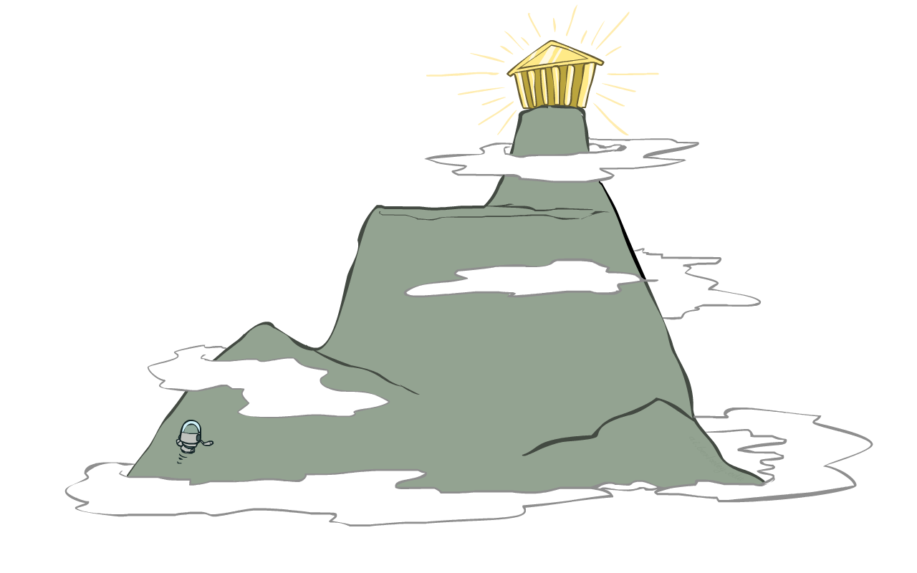
Hill Climbing
Hill-Climbing:
  Start wherever
  Repeat: move to the best neighboring state
  If no neighbors better than current, quit
Random-Restart
  Rerun hill-climbing at different starting states
Simulated Annealing
  High temperature => more bad moves allowed, shake the system out of its local minimum
  Gradually reduce temperature according to some schedule to focus later search on (hopefully) the globally optimal region

Slide 3
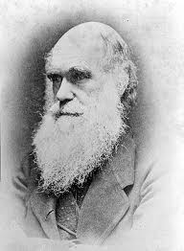
Local beam search
Basic idea:
  K copies of a local search algorithm, initialized randomly
  For each iteration
    Generate ALL successors from K current states
    Choose best K of these to be the new current states
Why is this different from K local searches in parallel?
  The searches communicate! “Come over here, the grass is greener!”
What other well-known algorithm does this remind you of?
  Evolution!
Or, K chosen randomly with
a bias towards good ones

Slide 4
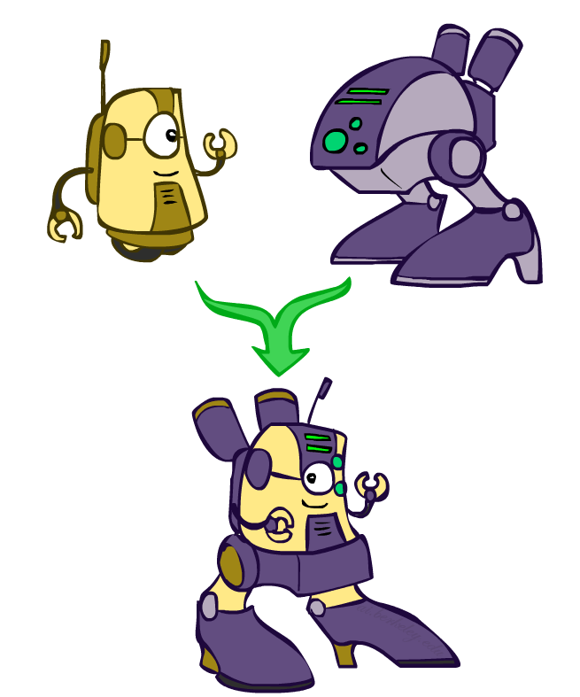
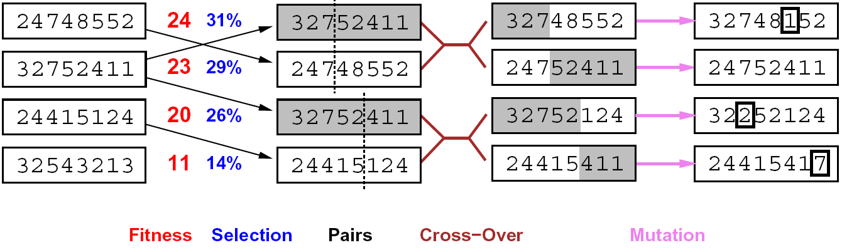
Genetic algorithms
Genetic algorithms use a natural selection metaphor
  Resample K individuals at each step (selection) weighted by fitness function
  Combine by pairwise crossover operators, plus mutation to give variety

Slide 5
Example: N-Queens
Does crossover make sense here?
What would mutation be?
What would a good fitness function be?

Slide 6
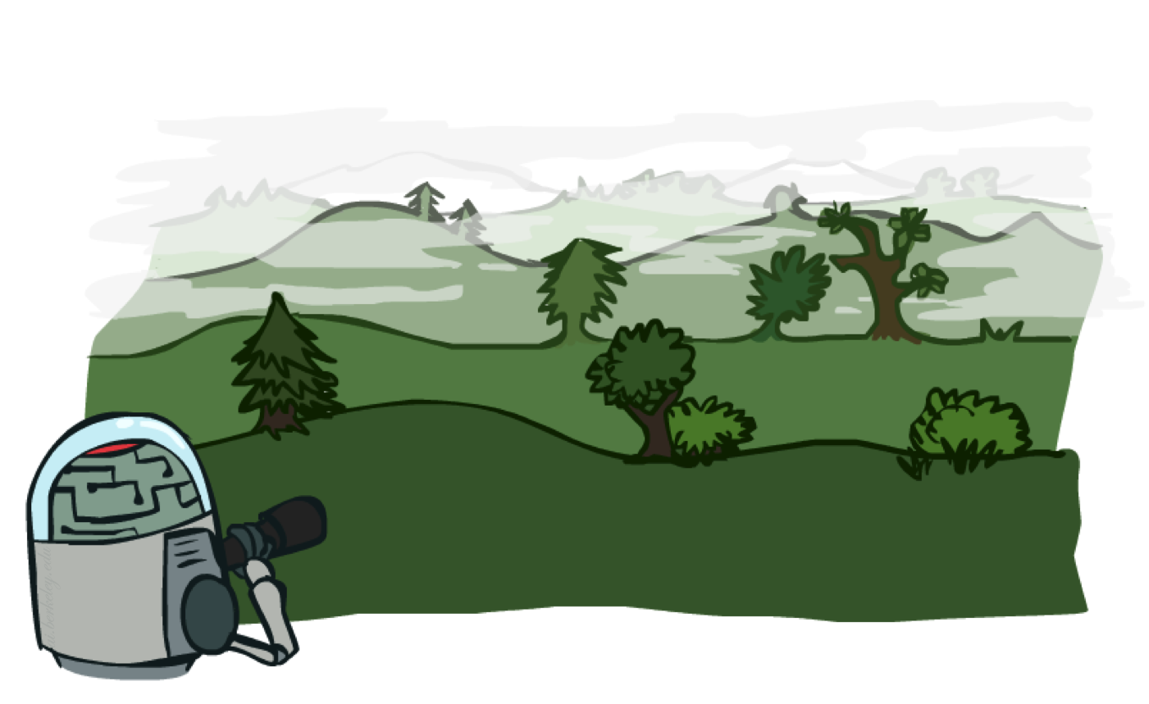
Local search in continuous spaces

Slide 7
Example: Siting airports in Romania
Place 3 airports to minimize the sum of squared distances from each city to its nearest airport
Airport locations
x = (x₁,y₁), (x₂,y₂), (x₃,y₃)
City locations (x_{c},y_{c})
C_{a} = cities closest to airport a
Objective: minimize
f(x) = Σ_{a} Σ_{c∈Ca} (x_{a} - x_{c})² + (y_{a} - y_{c})²

Slide 8
Handling a continuous state/action space
Discretize it!
  Define a grid with increment δ , use any of the discrete algorithms
Choose random perturbations to the state
  First-choice hill-climbing: keep trying until something improves the state
  Simulated annealing
Compute gradient of f(x) analytically

Slide 9
Finding extrema in continuous space
Gradient vector ∇f(x) = (∂f/∂x₁, ∂f/∂y₁, ∂f/∂x₂, …)^{T}
For the airports, f(x) = Σ_{a} Σ_{c∈Ca} (x_{a} - x_{c})² + (y_{a} - y_{c})²
∂f/∂x₁ = Σ_{c∈C1} 2(x₁ - x_{c})
At an extremum, ∇f(x) = 0
Can sometimes solve in closed form: x₁ = (Σ_{c∈C1} x_{c})/|C₁|
Is this a local or global minimum of f?
Gradient descent: x ← x - α∇f(x)
  Huge range of algorithms for finding extrema using gradients

Slide 10
Summary
Many configuration and optimization problems can be formulated as local search
General families of algorithms:
  Hill-climbing, continuous optimization
  Simulated annealing (and other stochastic methods)
  Local beam search: multiple interaction searches
  Genetic algorithms: break and recombine states
Many machine learning algorithms are local searches

Slide 11
CS 188: Artificial Intelligence
Games: Minimax and Alpha-Beta
Instructors: Angela Liu and Yanlai Yang
University of California, Berkeley
[These slides adapted from Stuart Russell and Dawn Song]
Notes:
Please retain proper attribution and the reference to ai.berkeley.edu. Thanks!

Slide 12
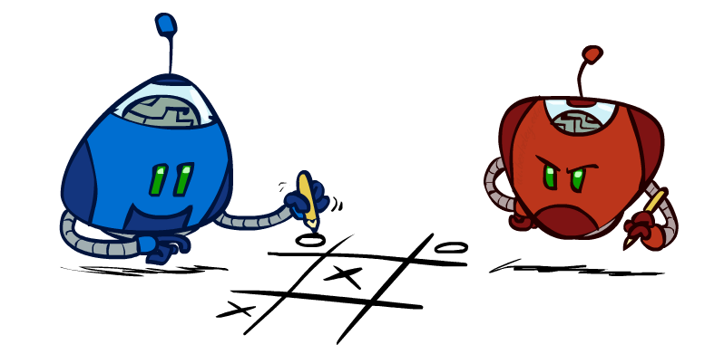
Outline
History / Overview
Minimax for Zero-Sum Games
α-β Pruning
Finite lookahead and evaluation

Slide 13
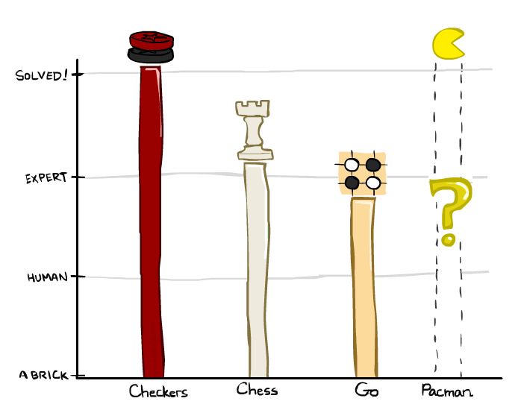

A brief history
Checkers:
  1950: First computer player.
  1959: Samuel’s self-taught program.
  1994: First computer world champion: Chinook defeats Tinsley
  2007: Checkers solved! Endgame database of 39 trillion states
Chess:
  1945-1960: Zuse, Wiener, Shannon, Turing, Newell & Simon, McCarthy.
  1960s onward: gradual improvement under “standard model”
  1997: Deep Blue defeats human champion Garry Kasparov
  2022: Stockfish rating 3541 (vs 2882 for Magnus Carlsen 2015).
Go:
  1968: Zobrist’s program plays legal Go, barely (b>300!)
  1968-2005: various ad hoc approaches tried, novice level
  2005-2014: Monte Carlo tree search -> strong amateur
  2016-2017: AlphaGo defeats human world champions
Pacman
Notes:
Tinsley lost only 5 games to humans in 42 years; has been known to solve 60-ply problems

Slide 14
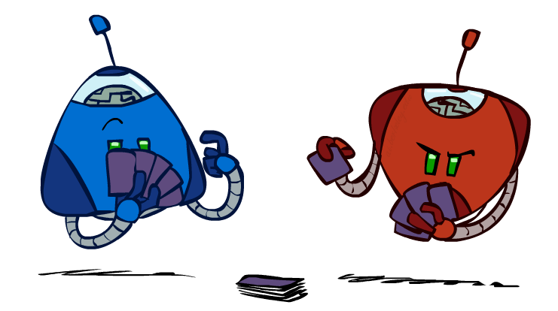
Types of Games
Game = task environment with > 1 agent
Axes:
  Deterministic or stochastic?
  Perfect information (fully observable)?
  Two, three, or more players?
  Teams or individuals?
  Turn-taking or simultaneous?
  Zero sum?
Want algorithms for calculating a contingent plan (a.k.a. strategy or policy) which recommends a move for every possible eventuality

Slide 15
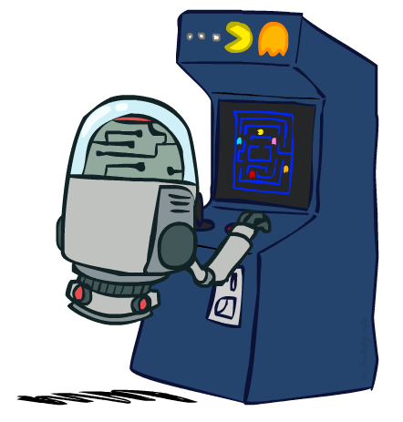
“Standard” Games
Standard games are deterministic, observable, two-player, turn-taking, zero-sum
Game formulation:
  Initial state: s₀
  Players: Player(s) indicates whose move it is
  Actions: Actions(s) for player on move
  Transition model: Result(s,a)
  Terminal test: Terminal-Test(s)
  Terminal values: Utility(s,p) for player p
    Or just Utility(s) for player making the decision at root

Slide 16
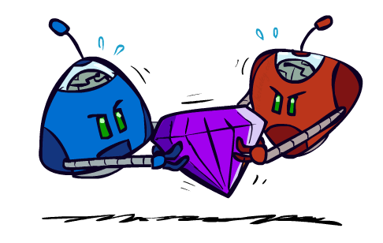
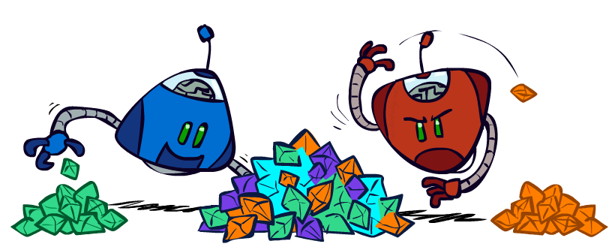
Zero-Sum Games
Zero-Sum Games
  Agents have opposite utilities
  Pure competition:
    One maximizes, the other minimizes
General-Sum Games
  Agents have independent utilities
  Cooperation, indifference, competition, shifting alliances, and more are all possible
Team Games
  Common payoff for all team members

Slide 17
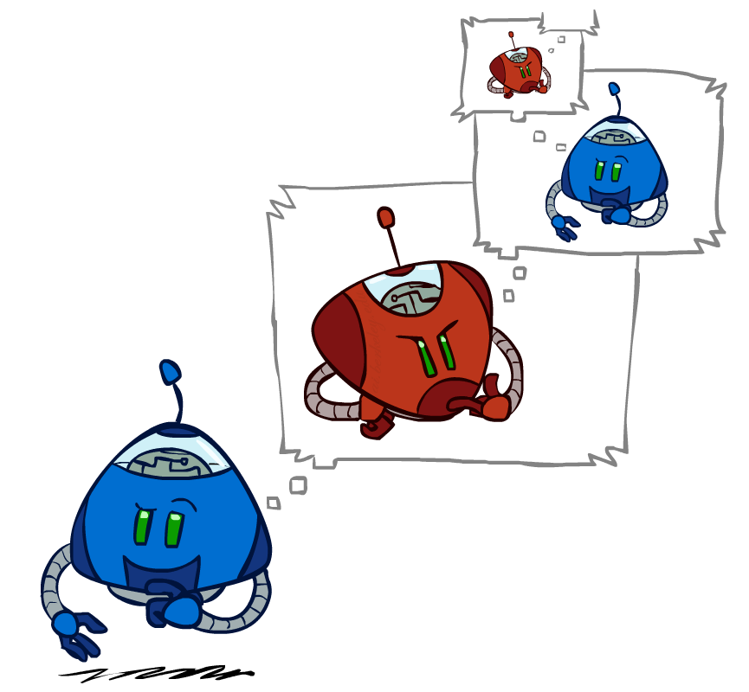
Adversarial Search

Slide 18
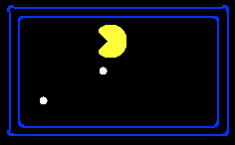
Single-Agent Trees
8
2
0
…
2
6
…
4
6
Notes:
10 points for eating dot; -1 for each time step

Slide 19
Value of a State
Value of a state: The best achievable outcome (utility) from that state
Non-Terminal States:
V(s) = max V(s’)
s’ ∈ successors(s)
8
2
0
…
2
6
…
4
6
Terminal States:
V(s) = known

Slide 20

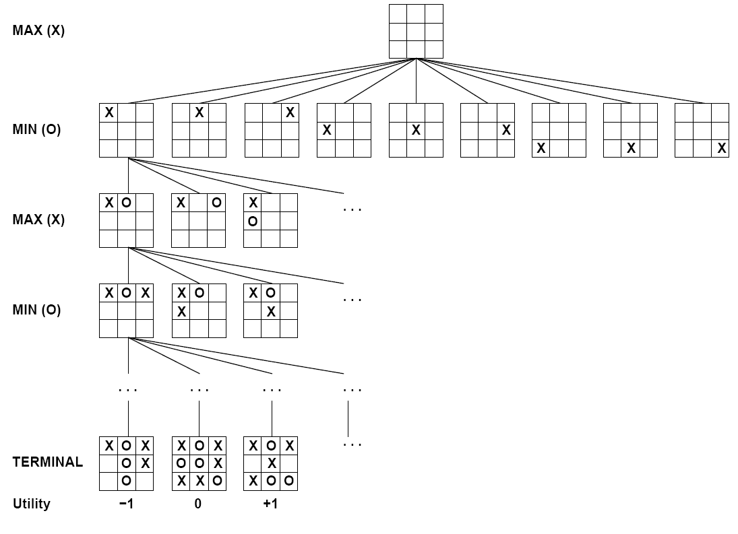

Tic-Tac-Toe Game Tree

Slide 21

Minimax Values
MAX nodes: under Agent’s control
V(s) = max V(s’)
MIN nodes: under Opponent’s control
V(s) = min V(s’)
s’ ∈ successors(s)
s’ ∈ successors(s)
-8
-8
-10
-8
-5
-10
+8
Terminal States:
V(s) = known

Slide 22
Minimax algorithm
Choose action leading to state with best minimax value
Assumes all future moves will be optimal
=> rational against a rational player

Slide 23
Implementation
function minimax-decision(s) returns an action
return the action a in Actions(s) with the highest minimax_value(Result(s,a))
function minimax_value(s) returns a value
  if Terminal-Test(s) then return Utility(s)
  if Player(s) = MAX then return max_{a in Actions(s)} minimax_value(Result(s,a))
  if Player(s) = MIN then return min_{a in Actions(s)} minimax_value(Result(s,a))

Slide 24



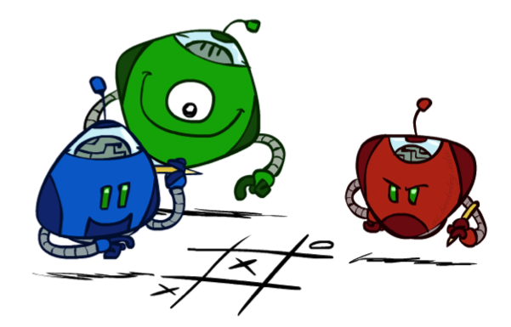
Generalized minimax
What if the game is not zero-sum, or has multiple players?
Generalization of minimax:
  Terminals have utility tuples
  Node values are also utility tuples
  Each player maximizes its own component
  Can give rise to cooperation and
  competition dynamically…
8,8,1
8,8,1
7,7,2
0,0,7
8,8,1
7,7,2
0,0,8
1,1,6
0,0,7
9,9,0
8,8,1
9,9,0
7,7,2
0,0,8
0,0,7
Notes:
If both ghosts go the same way, pacman wins; if they go different ways, pacman loses

Slide 25
Minimax Efficiency
How efficient is minimax?
  Just like (exhaustive) DFS
  Time: O(b^{m})
  Space: O(bm)
Example: For chess, b ≈ 35, m ≈ 100
  Exact solution is completely infeasible
  Humans can’t do this either, so how do we play chess?

Slide 26
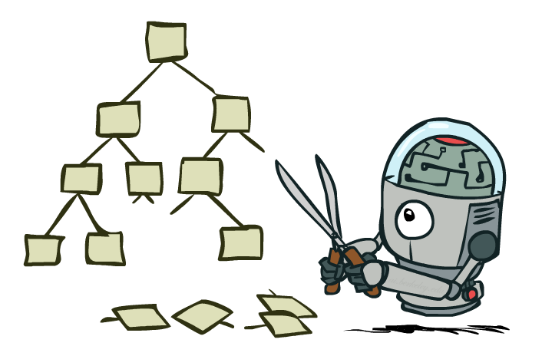
Game Tree Pruning

Slide 27
Minimax Example
3
3
2
2
3
12
8
2
4
6
14
5
2
Notes:
Add values by hand if on tablet, or add by animation steps

Slide 28
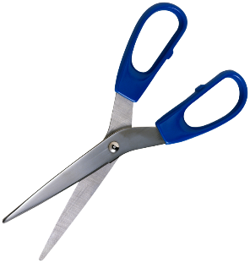
Alpha-Beta Example
α = best option so far from any
MAX node on this path
3
α =3
α =3
3
3
12
8
2
14
5
2
The order of generation matters: more
pruning is possible if good moves come first
Notes:
Add values by hand if on tablet, or add by animation steps

Slide 29
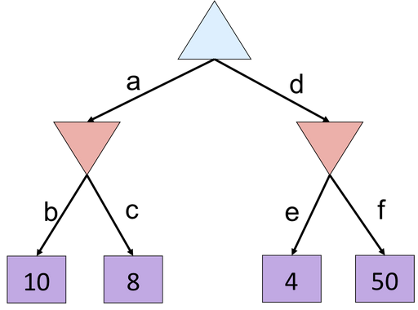
Alpha-Beta Quiz
Notes:
f is not evaluated

Slide 30
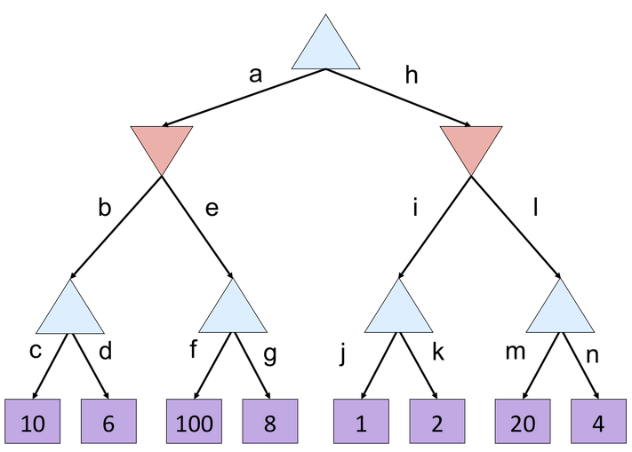
Alpha-Beta Quiz 2
Notes:
g, m, n not evaluated

Slide 31
Alpha-Beta Quiz 2
α =
10
?
β =
10
β =
2
?
?
1
2
α=
α=
10
α=
100
?
?
?

Slide 32
Alpha-Beta Pruning
General case (pruning children of MIN node)
  We’re computing the MIN-VALUE at some node n
  We’re looping over n’s children
  n’s estimate of the childrens’ min is dropping
  Who cares about n’s value? MAX
  Let α be the best value that MAX can get so far at any choice point along the current path from the root
  If n becomes worse than α, MAX will avoid it, so we can prune n’s other children (it’s already bad enough that it won’t be played)
Pruning children of MAX node is symmetric
  Let β be the best value that MIN can get so far at any choice point along the current path from the root
MAX
MIN
a
MAX
MIN
n

Slide 33
Alpha-Beta Implementation
  α: MAX’s best option on path to root
  β: MIN’s best option on path to root
def max-value(state, α, β):
  initialize v = -∞
  for each successor of state:
    v = max(v, min-value(successor, α,β))
    if v ≥ β
    return v
    α = max(α, v)
  return v
def min-value(state , α, β):
  initialize v = +∞
  for each successor of state:
    v = min(v, max-value(successor, α, β))
    if v ≤ α
    return v
    β = min(β, v)
  return v
Notes:
Pick an order for two reasons: sequential processor and pruning

Slide 34
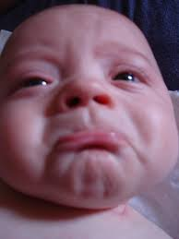
Alpha-Beta Pruning Properties
Theorem: This pruning has no effect on minimax value computed for the root!
Good child ordering improves effectiveness of pruning
  Iterative deepening helps with this
With “perfect ordering”:
  Time complexity drops to O(b^{m/2})
  Doubles solvable depth!
This is a simple example of metareasoning (reasoning about reasoning)
For chess: only 35⁵⁰ instead of 35¹⁰⁰!! Yaaay!!!!!
max
min
10
10
0

Slide 35
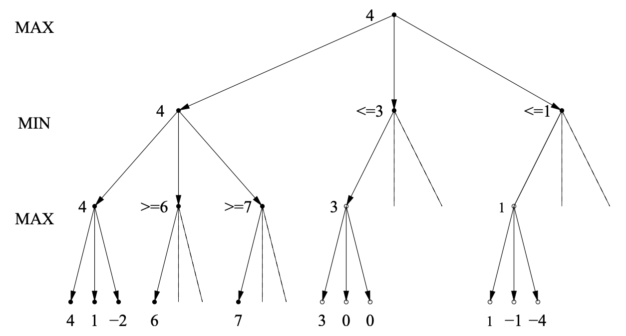
Alpha-Beta Best-Case Analysis
http://www.cs.utsa.edu/~bylander/cs5233/a-b-analysis.pdf

Slide 36
Summary
Games are decision problems with ≥ 2 agents
  Huge variety of issues and phenomena depending on details of interactions and payoffs
For zero-sum games, optimal decisions defined by minimax
  Simple extension to n-player “rotating” max with vectors of utilities
  Implementable as a depth-first traversal of the game tree
  Time complexity O(b^{m}), space complexity O(bm)
Alpha-beta pruning
  Preserves optimal choice at the root
  Alpha/beta values keep track of best obtainable values from any max/min nodes on path from root to current node
  Time complexity drops to O(b^{m/2}) with ideal node ordering
Exact solution is impossible even for “small” games like chess

