Slide 1
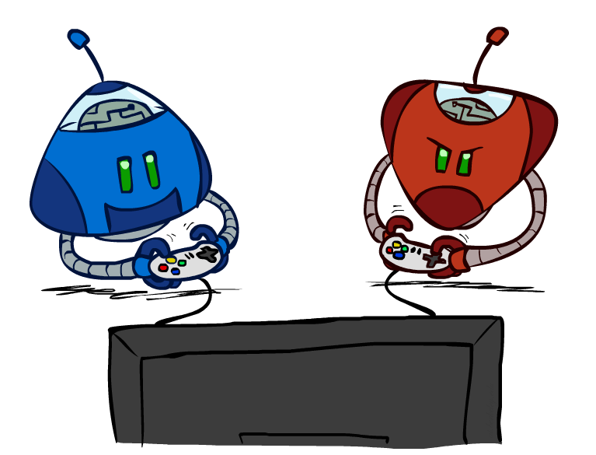
CS 188: Artificial Intelligence
Adversarial Search II
Instructors: Angela Liu and Yanlai Yang
University of California, Berkeley
[These slides adapted from Stuart Russell and Dawn Song]
Notes:
Please retain proper attribution and the reference to ai.berkeley.edu. Thanks!

Slide 2
Alpha-Beta Implementation
  α: MAX’s best option on path to root
  β: MIN’s best option on path to root
def max-value(state, α, β):
  initialize v = -∞
  for each successor of state:
    v = max(v, min-value(successor, α,β))
    if v ≥ β
    return v
    α = max(α, v)
  return v
def min-value(state , α, β):
  initialize v = +∞
  for each successor of state:
    v = min(v, max-value(successor, α, β))
    if v ≤ α
    return v
    β = min(β, v)
  return v
Notes:
Pick an order for two reasons: sequential processor and pruning

Slide 3
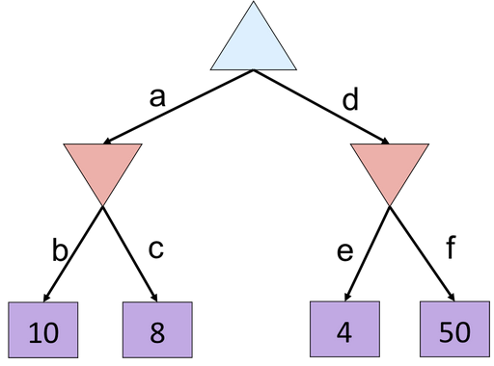
Alpha-Beta Quiz
Notes:
f is not evaluated

Slide 4

Alpha-Beta Pruning Properties
Theorem: This pruning has no effect on minimax value computed for the root!
Good child ordering improves effectiveness of pruning
  Iterative deepening helps with this
With “perfect ordering”:
  Time complexity drops to O(b^{m/2})
  Doubles solvable depth!
This is a simple example of metareasoning (reasoning about reasoning)
For chess: only 35⁵⁰ instead of 35¹⁰⁰!! Yaaay!!!!!
max
min
10
10
0
Notes:
Iterative deepening (which we discussed way back in lecture 2) was actually invented for the chess game scenario to come up with an optimal ordering.
The idea is to start by running the game tree to depth 2; then use this to determine an optimal ordering of searches; and then go down to depth 4; and depth 6; etc.
It can be shown that with perfect ordering, you can get time complexity down to sqrt of O(b^m)
Starting from the root: you must search all children (first one exact, next two are incomplete)
Next level: first node exact so must search all of children (first one exact, next two are incomplete)

Slide 5
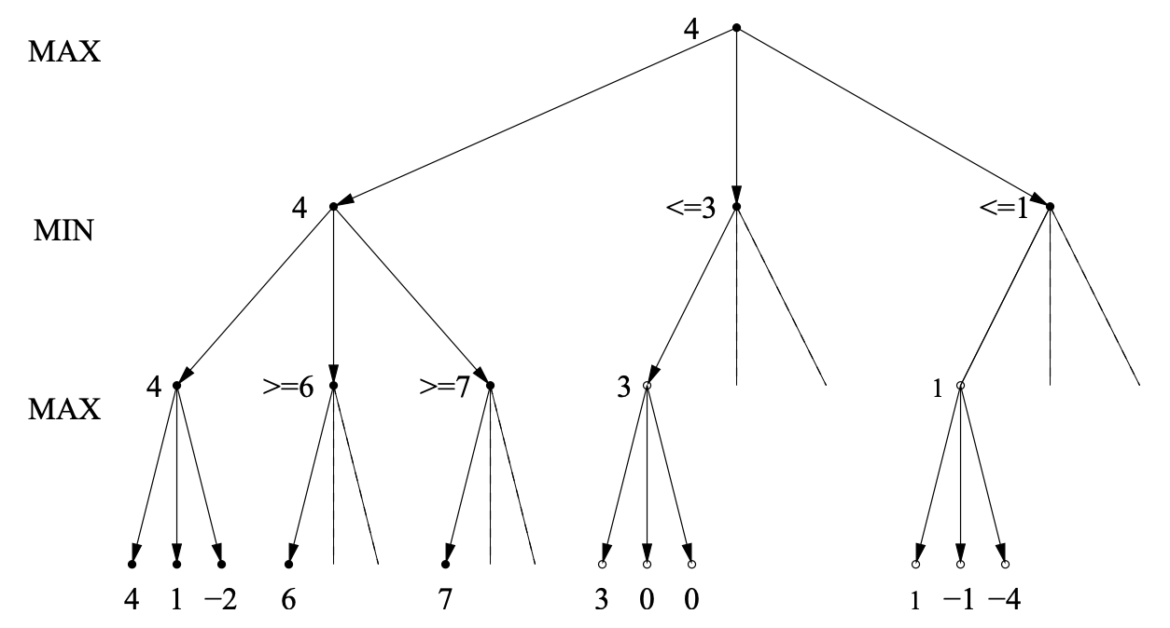
Alpha-Beta Best-Case Analysis
http://www.cs.utsa.edu/~bylander/cs5233/a-b-analysis.pdf
Notes:
Some observations:
You MUST determine an exact value for the first path of every (non-pruned) subtree.
For all subtrees where you must determine an exact value of the root, you must also at least visit it’s children to get a bounded value.
Runtime analysis:
First layer: branching factor is b
Second layer: branching factor is still b (it’s not b*b) bc you only need to look at all the leftmost paths (with a slight addition in the first subtree that are neglible since they don’t contribute asymptotically)
Third layer: now we have the branching factor multiplying bc each of the second layer’s subtrees must be fully determined
Can almost think of this as skipping a layer for each pruned node

Slide 6
Summary
Games are decision problems with ≥ 2 agents
  Huge variety of issues and phenomena depending on details of interactions and payoffs
For zero-sum games, optimal decisions defined by minimax
  Simple extension to n-player “rotating” max with vectors of utilities
  Implementable as a depth-first traversal of the game tree
  Time complexity O(b^{m}), space complexity O(bm)
Alpha-beta pruning
  Preserves optimal choice at the root
  Alpha/beta values keep track of best obtainable values from any max/min nodes on path from root to current node
  Time complexity drops to O(b^{m/2}) with ideal node ordering
Exact solution is impossible even for “small” games like chess

Slide 7
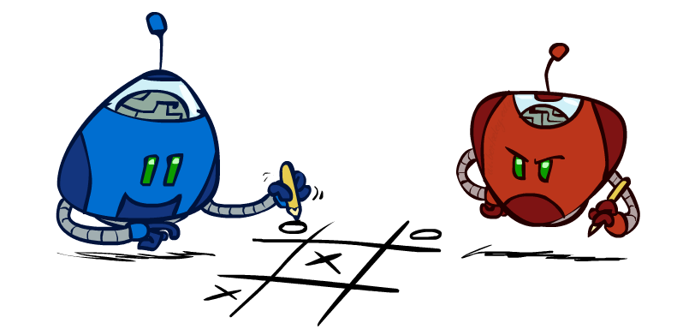
Outline
Finite lookahead and evaluation
Games with chance elements
Monte Carlo tree search

Slide 8
The story so far…
Focus on two-player, zero-sum, deterministic, observable, turn-taking games
Minimax defines rational behavior
Recursive DFS implementation: space complexity O(bm), time complexity O(b^{m})
Alpha-beta pruning with good node ordering reduces time complexity to O(b^{m/2})
Still nowhere close to solving chess, let alone Go or StarCraft

Slide 9

Resource Limits

Slide 10
Resource Limits
Problem: In realistic games, cannot search to leaves!
Solution (Shannon, 1950): Bounded lookahead
  Search only to a preset depth limit or horizon
  Use an evaluation function for non-terminal positions
Guarantee of optimal play is gone
Example:
  Suppose we can explore 1M nodes per move
  Chess with alpha-beta, 35^{(8/2)} =~ 1M; depth 8 is quite good
max
4
-2
4
min
-1
-2
4
9
?
?
?
?

Slide 11
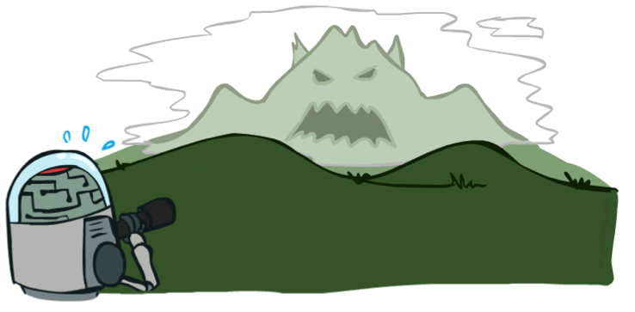
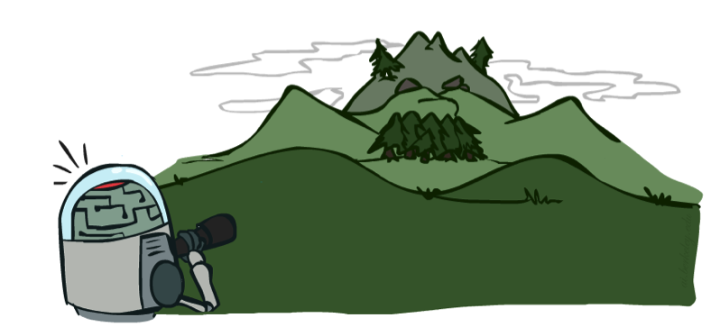
Depth Matters
Evaluation functions are always imperfect
Deeper search => better play (usually)
Or, deeper search gives same quality of play with a less accurate evaluation function
An important example of the tradeoff between complexity of features and complexity of computation
[Demo: depth limited (L6D4, L6D5)]
Notes:
Most games, deeper search is better bc you can search through more states → this is an empirical fact; cannot be proved bc you can come up with cases where it is not true
Current tradeoff strategy: leaning more toward complexity of features and spending more time evaluating → Deep neural nets now are able to learn very good features and have good results without very much search at all.
- Although as we will learn in deep neural networks later, we don’t really know what deep learning does inside the black box so it might really just be growing the tree; who knows

Slide 12

Pacman with Depth-2 Lookahead
Notes:
Depth 2, one dot and two ghosts; dot is about 8 steps away – cannot see actual eating, so need to include distance to dots in eval; but limited depth means it goes into a dead end and cannot escape even a simple ghost strategy;

Slide 13
Pacman with Depth-10 Lookahead
Notes:
Perfect lookahead: head towards red ghost!!! Wait for blue to commit to one pursuit direction, go the other way, eat the dot
Note also the horror you feel: humans would take the safer strategy of waiting, not heading for blinky; minimax doesn’t care. WHY? It is 100% certain its theory of the world is correct

Slide 14
Evaluation Functions
Evaluation functions score non-terminals in depth-limited search
Typically weighted linear sum of features:
  EVAL(s) = w₁ f₁(s) + w₂ f₂(s) + …. + w_{n} f_{n}(s)
  E.g., w₁ = 9, f₁(s) = (num white queens – num black queens), etc.
Or a more complex nonlinear function (e.g., NN) trained by self-play RL
Terminate search only in quiescent positions, i.e., no major
changes expected in feature values

Slide 15





Evaluation for Pacman

Slide 16
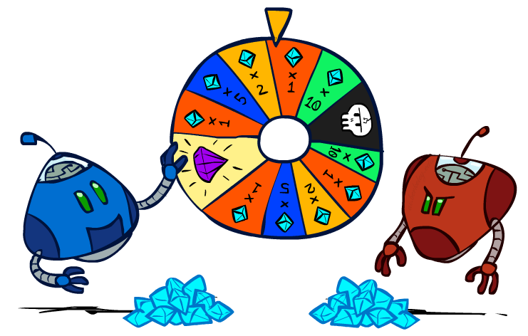
Games with uncertain outcomes
Notes:
Please retain proper attribution and the reference to ai.berkeley.edu. Thanks!

Slide 17
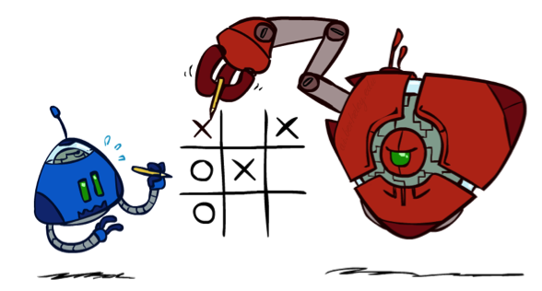
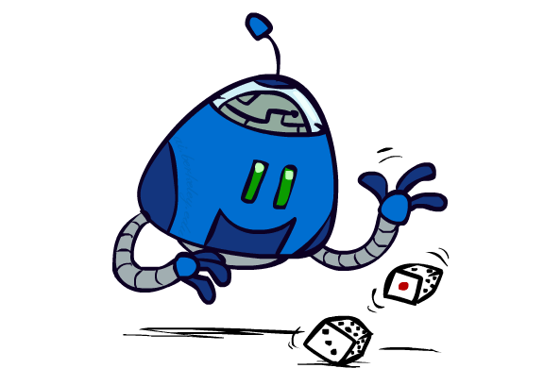

Chance outcomes in trees
10
10
9
100
10
10
9
100
Tictactoe, chess
Minimax
Tetris, roulette
Expectimax
10
9
10
9
10
100
Backgammon, Monopoly
Expectiminimax
Notes:
At least 10, or otherwise just rather dead; or just 100, or otherwise rather dead; that’s yet something different than minimax or expectimax

Slide 18
Minimax
function decision(s) returns an action
return the action a in Actions(s) with the highest minimax_value(Result(s,a))
function minimax_value(s) returns a value
  if Terminal-Test(s) then return Utility(s)
  if Player(s) = MAX then return max_{a in Actions(s)} minimax_value(Result(s,a))
  if Player(s) = MIN then return min_{a in Actions(s)} minimax_value(Result(s,a))
Notes:
Note that “minimax-decision” has become just “decision”

Slide 19
Expectiminimax
function decision(s) returns an action
return the action a in Actions(s) with the highest value(Result(s,a))
function value(s) returns a value
  if Terminal-Test(s) then return Utility(s)
  if Player(s) = MAX then return max_{a in Actions(s)} value(Result(s,a))
  if Player(s) = MIN then return min_{a in Actions(s)} value(Result(s,a))
  if Player(s) = CHANCE then return sum_{a in Actions(s)} Pr(a) * value(Result(s,a))
Notes:
Note that “minimax-decision” has become just “decision”

Slide 20
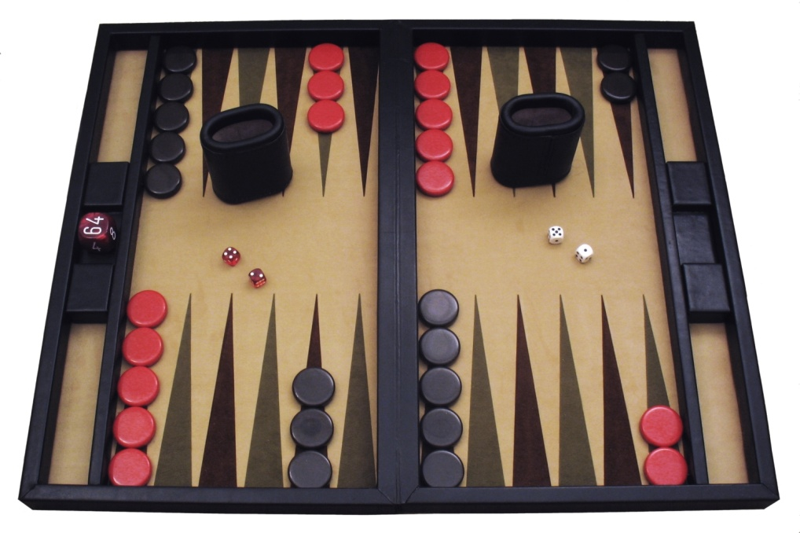
Example: Backgammon
Dice rolls increase b: 21 possible rolls with 2 dice
  Backgammon ≈ 20 legal moves
  4 plies = 20 x (21 x 20)³ = 1.2 x 10⁹
As depth increases, probability of reaching a given search node shrinks
  So usefulness of search is diminished
  So limiting depth is less damaging
  But pruning is trickier…
Historic AI: TDGammon uses depth-2 search + very good evaluation function + reinforcement learning:
world-champion level play
Image: Wikipedia

Slide 21
What Values to Use?
0
40
20
30
x²
0
1600
400
900
x>y => f(x)>f(y)
f(x) = Ax+B where A>0
For worst-case minimax reasoning, evaluation function scale doesn’t matter
  We just want better states to have higher evaluations (get the ordering right)
  Minimax decisions are invariant with respect to monotonic transformations on values
Expectiminimax decisions are invariant with respect to positive affine transformations
Expectiminimax evaluation functions have to be aligned with actual win probabilities!

Slide 22


Slide 23
Monte Carlo Tree Search
Methods based on alpha-beta search assume a fixed horizon
  Pretty hopeless for Go, with b > 300
MCTS combines two important ideas:
  Evaluation by rollouts – play multiple games to termination from a state s (using a simple, fast rollout policy) and count wins and losses
  Selective search – explore parts of the tree that will help improve the decision at the root, regardless of depth

Slide 24
Rollouts
“Move 37”
For each rollout:
  Repeat until terminal:
    Play a move according to a fixed, fast rollout policy
  Record the result
Fraction of wins correlates with the true value of the position!
Having a “better” rollout policy helps

Slide 25
MCTS Version 0
Do N rollouts from each child of the root, record fraction of wins
Pick the move that gives the best outcome by this metric
57/100
39/100
65/100

Slide 26
MCTS Version 0
Do N rollouts from each child of the root, record fraction of wins
Pick the move that gives the best outcome by this metric
57/100
0/100
59/100

Slide 27
MCTS Version 0.9
Allocate rollouts to more promising nodes
77/140
0/10
90/150

Slide 28
MCTS Version 0.9
Allocate rollouts to more promising nodes
61/100
6/10
48/100

Slide 29
MCTS Version 1.0
Allocate rollouts to more promising nodes
Allocate rollouts to more uncertain nodes
61/100
6/10
48/100

Slide 30
UCB heuristics
UCB1 formula combines “promising” and “uncertain”:
N(n) = number of rollouts from node n
U(n) = total utility of rollouts (e.g., # wins) for Player(Parent(n))
A provably not terrible heuristic for bandit problems
  (which are not the same as the problem we face here!)

Slide 31
MCTS Version 2.0: UCT
Repeat until out of time:
  Given the current search tree, recursively apply UCB to choose a path down to a leaf (not fully expanded) node n
  Add a new child c to n and run a rollout from c
  Update the win counts from c back up to the root
Choose the action leading to the child with highest N

Slide 32
UCT Example
5/10
4/9
4/7
1/2
0/1
0/1
1/3
2/2
1/1
1/1

Slide 33
Why is there no min or max?????
“Value” of a node, U(n)/N(n), is a weighted sum of child values!
Idea: as N → ∞ , the vast majority of rollouts are concentrated in the best child(ren), so weighted average → max/min
Theorem: as N → ∞ UCT selects the minimax move
  (but N never approaches infinity!)

Slide 34
Summary
Games require decisions when optimality is impossible
  Bounded-depth search and approximate evaluation functions
Games force efficient use of computation
  Alpha-beta pruning, MCTS
Game playing has produced important research ideas
  Reinforcement learning (checkers)
  Iterative deepening (chess)
  Rational metareasoning (Othello)
  Monte Carlo tree search (chess, Go)
  Solution methods for partial-information games in economics (poker)
Video games present much greater challenges – lots to do!
  b = 10⁵⁰⁰, |S| = 10⁴⁰⁰⁰, m = 10,000, partially observable, often > 2 players

