Slide 1
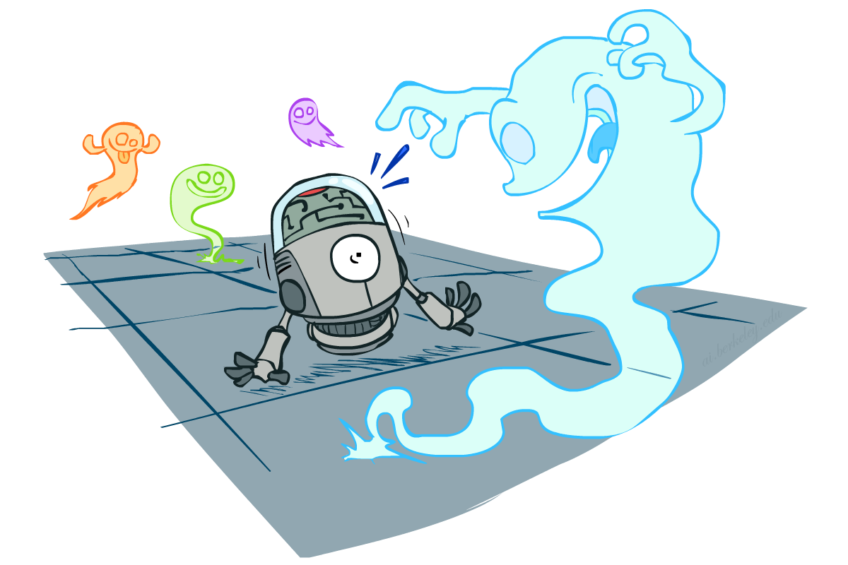
CS 188: Artificial Intelligence
Probability
Instructors: Angela Liu and Yanlai Yang
University of California, Berkeley
(Slides adapted from Stuart Russell and Dawn Song)
Notes:
Please retain proper attribution, including the reference to ai.berkeley.edu. Thanks!

Slide 2
Uncertainty
The real world is rife with uncertainty!
  E.g., if I leave for SFO 2 hours before my flight, will I be there in time?
Sources of Uncertainty:
  partial observability (road state, other drivers’ plans, etc.)
  noisy sensors (radio traffic reports, Google maps)
  immense complexity of modelling and predicting traffic, security line, etc.
  lack of knowledge of world dynamics (will tire burst?)
Probabilistic assertions summarize effects of ignorance and laziness
Combine probability theory + utility theory -> decision theory
  Maximize expected utility : a* = argmax_{a} ∑_{s} P(s | a) U(s)

Slide 3
Basic laws of (discrete) probability
Begin with a set Ω of possible worlds
  E.g., 6 possible rolls of a die, {1, 2, 3, 4, 5, 6}
A probability model assigns a number P(ω) to each world ω
  E.g., P(1) = P(2) = P(3) = P(4) = P(5) = P(6) = 1/6.
These numbers must satisfy
  0 ≤ P(ω) ≤ 1
  ∑_{ω ∈Ω} P(ω) = 1

Slide 4
Basic laws contd.
An event is any subset of Ω
  E.g., “roll < 4” is the set {1,2,3}
  E.g., “roll is odd” is the set {1,3,5}
The probability of an event is the sum of probabilities over its worlds
  P(A) = ∑_{ω ∈ A} P(ω)
  E.g., P(roll < 4) = P(1) + P(2) + P(3) = 1/2

Slide 5

Random Variables
A random variable (usually denoted by a capital letter) is some aspect of the world about which we (may) be uncertain
Formally a deterministic function of ω
The range of a random variable is the set of possible values
  Odd = Is the dice roll an odd number? → {true, false}
    e.g. Odd(1)=true, Odd(6) = false
    often write the event Odd=true as odd, Odd=false as ¬odd
  T = Is it hot or cold? → {hot, cold}
  D = How long will it take to get to the airport? → [0, ∞)
  L_{Ghost} = Where is the ghost? → {(0,0), (0,1), …}
The probability distribution of a random variable X gives the probability for each value x in its range (probability of the event X=x)
  P(X=x) = ∑ _{{ω: X(ω)=x}} P(ω)
  P(x) for short (when unambiguous)
  P(X) refers to the entire distribution (think of it as a vector or table)

Slide 6
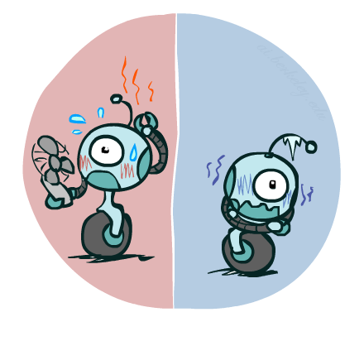
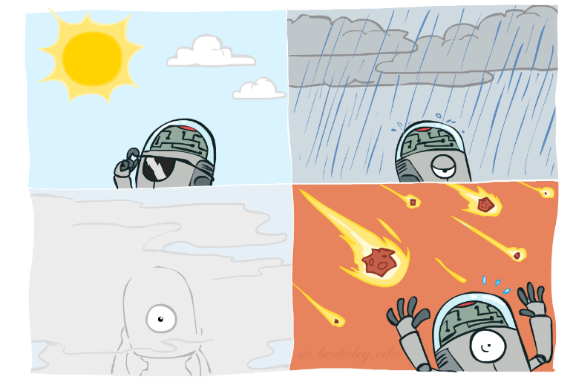
Probability Distributions
Associate a probability with each value; sums to 1
  Temperature:
  Weather:
  Joint distribution
P(W)
P(T,W)
P(T)
W | P
sun | 0.6
rain | 0.1
fog | 0.3
meteor | 0.0
T | P
hot | 0.5
cold | 0.5
 |  | Temperature
 |  | hot | cold
Weather | sun | 0.45 | 0.15
 | rain | 0.02 | 0.08
 | fog | 0.03 | 0.27
 | meteor | 0.00 | 0.00

Slide 7
Making possible worlds
In many cases we
  begin with random variables and their domains
  construct possible worlds as assignments of values to all variables
E.g., two dice rolls Roll₁ and Roll₂
  How many possible worlds?
  What are their probabilities?
Size of distribution for n variables with range size d?
For all but the smallest distributions, cannot write out by hand!
d^{n}

Slide 8
Probabilities of events
Recall that the probability of an event is the sum of probabilities of its worlds:
  P(A) = ∑_{ω ∈ A} P(ω)
So, given a joint distribution over all variables, can compute any event probability!
  Probability that it’s hot AND sunny?
  Probability that it’s hot?
  Probability that it’s hot OR not foggy?
  Joint distribution
P(T,W)
 |  | Temperature
 |  | hot | cold
Weather | sun | 0.45 | 0.15
 | rain | 0.02 | 0.08
 | fog | 0.03 | 0.27
 | meteor | 0.00 | 0.00

Slide 9
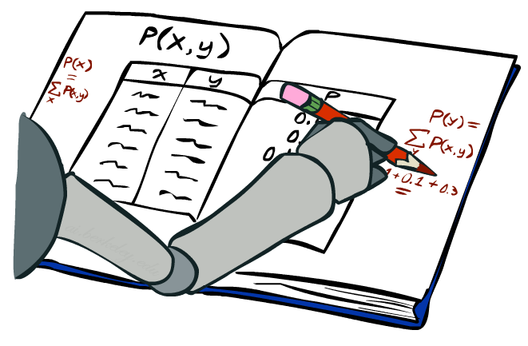
Marginal Distributions
Marginal distributions are sub-tables which eliminate variables
Marginalization (summing out): Collapse a dimension by adding
P(X=x) = ∑_{y} P(X=x, Y=y)
 |  | Temperature
 |  | hot | cold
Weather | sun | 0.45 | 0.15
 | rain | 0.02 | 0.08
 | fog | 0.03 | 0.27
 | meteor | 0.00 | 0.00
0.60
0.10
0.30
0.00
P(W)
0.50 | 0.50
P(T)

Slide 10
Conditional Probabilities
A simple relation between joint and conditional probabilities
  In fact, this is taken as the definition of a conditional probability
P(a,b)
P(a, b)
P(b)
P(a | b) =
P(T,W)
P(a)
P(b)
 |  | Temperature
 |  | hot | cold
Weather | sun | 0.45 | 0.15
 | rain | 0.02 | 0.08
 | fog | 0.03 | 0.27
 | meteor | 0.00 | 0.00
P(W=s,T=c)
P(T=c)
P(W=s | T=c) =
= 0.15/0.50 = 0.3
= P(W=s,T=c) + P(W=r,T=c) + P(W=f,T=c) + P(W=m,T=c)
= 0.15 + 0.08 + 0.27 + 0.00= 0.50

Slide 11
Conditional Distributions
Distributions for one set of variables given another set
P(W | T=h)
P(W | T=c)
P(W | T)
 |  | Temperature
 |  | hot | cold
Weather | sun | 0.45 | 0.15
 | rain | 0.02 | 0.08
 | fog | 0.03 | 0.27
 | meteor | 0.00 | 0.00
hot
cold
hot
cold
0.90
0.04
0.06
0.00
0.30
0.16
0.54
0.00
0.90
0.04
0.06
0.00
0.30
0.16
0.54
0.00

Slide 12
Normalizing a distribution
(Dictionary) To bring or restore to a normal condition
Procedure:
  Multiply each entry by α = 1/(sum over all entries)
All entries sum to ONE
P(W,T)
P(W | T=c) = P(W,T=c)/P(T=c)
= α P(W,T=c)
 |  | Temperature
 |  | hot | cold
Weather | sun | 0.45 | 0.15
 | rain | 0.02 | 0.08
 | fog | 0.03 | 0.27
 | meteor | 0.00 | 0.00
P(W,T=c)
0.15
0.08
0.27
0.00
0.30
0.16
0.54
0.00
Normalize
α = 1/0.50 = 2

Slide 13

The Product Rule
Sometimes have conditional distributions but want the joint
P(a | b) P(b) = P(a, b)
P(a, b)
P(b)
P(a | b) =

Slide 14
The Product Rule: Example
P(W | T) P(T) = P(W, T)
P(W | T)
P(W, T)
hot
cold
 |  | Temperature
 |  | hot | cold
Weather | sun | 0.45 | 0.15
 | rain | 0.02 | 0.08
 | fog | 0.03 | 0.27
 | meteor | 0.00 | 0.00
P(T)
0.90
0.04
0.06
0.00
0.30
0.16
0.54
0.00
T | P
hot | 0.5
cold | 0.5

Slide 15
The Chain Rule
A joint distribution can be written as a product of conditional distributions by repeated application of the product rule:
P(x₁, x₂, x₃) = P(x₃ | x₁, x₂) P(x₁, x₂) = P(x₃ | x₁, x₂) P(x₂ | x₁) P(x₁)
P(x₁, x₂,…, x_{n}) = ∏_{i} P(x_{i} | x₁,…, x_{i-1})

Slide 16

Probabilistic Inference
Probabilistic inference: compute a desired probability from a probability model
  Typically for a query variable given evidence
  E.g., P(airport on time | no accidents) = 0.90
  These represent the agent’s beliefs given the evidence
Probabilities change with new evidence:
  P(airport on time | no accidents, 5 a.m.) = 0.95
  P(airport on time | no accidents, 5 a.m., raining) = 0.80
  Observing new evidence causes beliefs to be updated

Slide 17
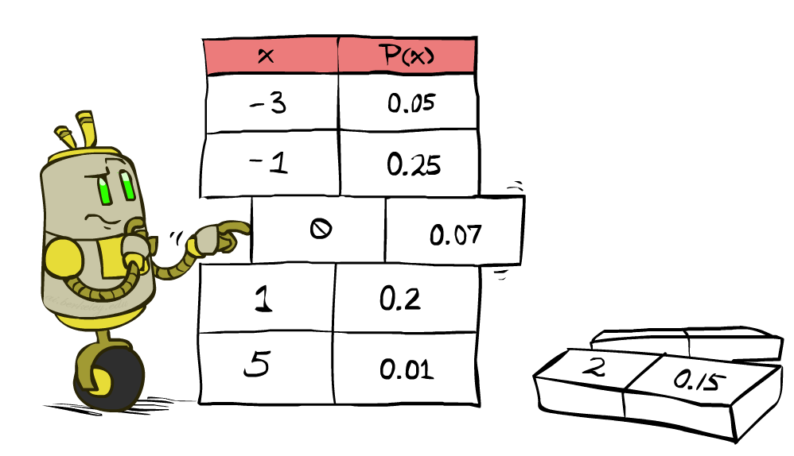
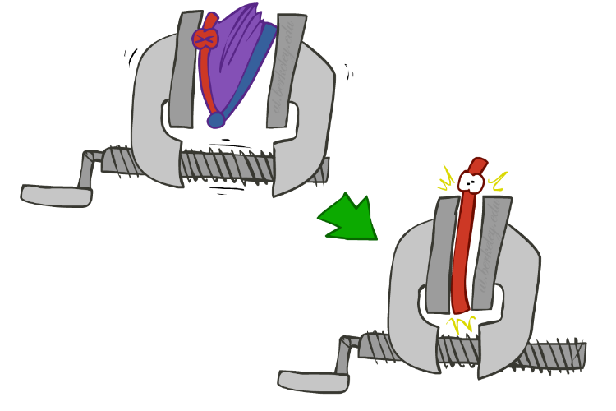
Inference by Enumeration
We want:
P(Q | e)
Probability model P(X₁, …, X_{n}) is given
Partition the variables X₁, …, X_{n} into sets as follows:
  Evidence variables: E = e
  Query variables: Q
  Hidden variables: H
Step 1: Select the entries consistent with the evidence
Step 2: Sum out H from model to get joint of query and evidence
Step 3: Normalize
P(Q ,e) =
∑_{h} P(Q , h, e)
P(Q | e) = α P(Q ,e)
X₁, …, X_{n}

Slide 18
Inference by Enumeration
Season | Temp | Weather | P
summer | hot | sun | 0.35
summer | hot | rain | 0.01
summer | hot | fog | 0.01
summer | hot | meteor | 0.00
summer | cold | sun | 0.10
summer | cold | rain | 0.05
summer | cold | fog | 0.09
summer | cold | meteor | 0.00
winter | hot | sun | 0.10
winter | hot | rain | 0.01
winter | hot | fog | 0.02
winter | hot | meteor | 0.00
winter | cold | sun | 0.15
winter | cold | rain | 0.20
winter | cold | fog | 0.18
winter | cold | meteor | 0.00
P(W)?
P(W | winter)?

Slide 19
Inference by Enumeration
Obvious problems:
  Worst-case time complexity O(d^{n}) (exponential in #hidden variables)
  Space complexity O(d^{n}) to store the joint distribution
  O(d^{n}) data points to estimate the entries in the joint distribution

Slide 20
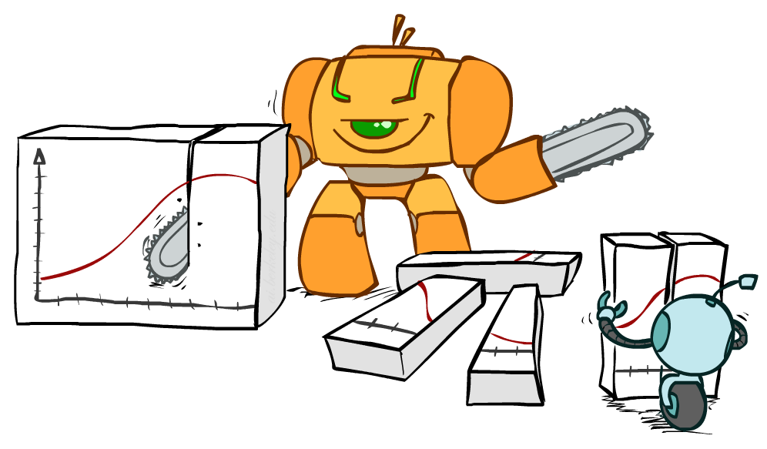
Bayes Rule

Slide 21

Bayes’ Rule
Write the product rule both ways:
P(a | b) P(b) = P(a, b) = P(b | a) P(a)
Dividing left and right expressions, we get:
Why is this at all helpful?
  Let us build one conditional from its reverse
  Often one conditional is tricky but the other one is simple
  Describes an “update” step from prior P(a) to posterior P(a | b)
That’s my rule!
P(b | a) P(a)
P(b)
P(a | b) =

Slide 22
Inference with Bayes’ Rule
Example: We know that meningitis causes stiff neck 80% of the time. Prior probability of any patient having meningitis is 0.0001. Prior probability of any patient having stiff neck is 0.01.
  M: meningitis, S: stiff neck
P(s | m) = 0.8
P(m) = 0.0001
P(s) = 0.01
Example
givens
P(s | m) P(m)
P(s)
0.8 x 0.0001 .
0.01
P(m | s) =
=
  Note: posterior probability of meningitis still very small: 0.008

Slide 23

Independence
Two variables X and Y are (absolutely) independent if
∀x,y P(x, y) = P(x) P(y)
  I.e., the joint distribution factors into a product of two simpler distributions
Equivalently, via the product rule P(x,y) = P(x|y)P(y),
  P(x | y) = P(x) or P(y | x) = P(y)
Example: two dice rolls Roll₁ and Roll₂
  P(Roll₁=5, Roll₂=3) = P(Roll₁=5) P(Roll₂=3) = 1/6 x 1/6 = 1/36
  P(Roll₂=3 | Roll₁=5) = P(Roll₂=3)

Slide 24


Example: Independence
n fair, independent coin flips:
P(X₁)
P(X₂)
P(X_{n})
H | 0.5
T | 0.5
H | 0.5
T | 0.5
H | 0.5
T | 0.5
P(X₁,X₂,...,X_{n})
2^{n}

Slide 25
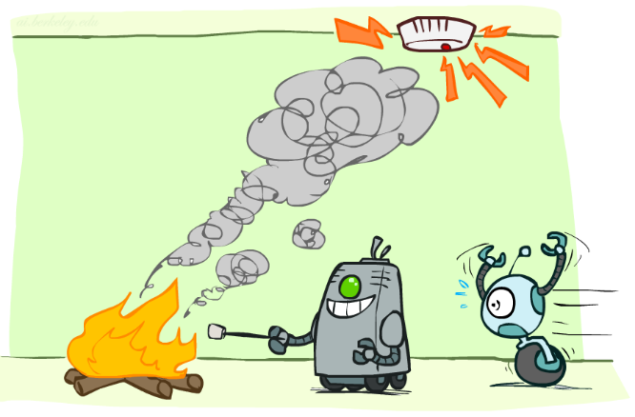
Conditional Independence

Slide 26
Conditional Independence
Conditional independence is our most basic and robust form of knowledge about uncertain environments.
X is conditionally independent of Y given Z if and only if:
∀x,y,z P(x | y, z) = P(x | z)
or, equivalently, if and only if
∀x,y,z P(x, y | z) = P(x | z) P(y | z)

Slide 27
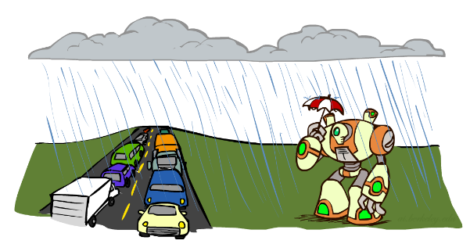
Conditional Independence Examples
What about this domain:
  Traffic
  Umbrella
  Raining

Slide 28

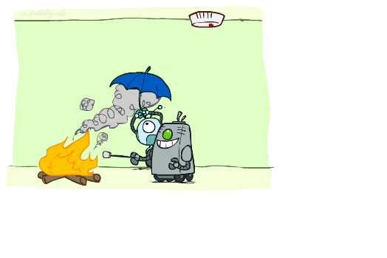
Conditional Independence Examples
What about this domain:
  Fire
  Smoke
  Alarm

Slide 29
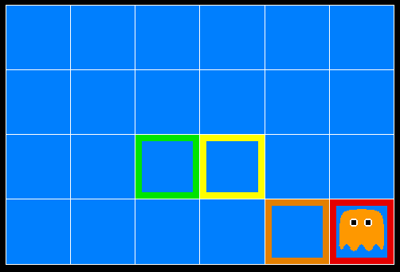
Ghostbusters
A ghost is in the grid somewhere
Sensor readings tell how close a square is to the ghost
  On the ghost: usually red
  1 or 2 away: mostly orange
  3 or 4 away: typically yellow
  5+ away: often green
Click on squares until confident of location, then “bust”

Slide 30

Video of Demo Ghostbusters with Probability

Slide 31
Ghostbusters model
0.11
0.11
0.11
Variables and ranges:
  G (ghost location) in {(1,1),…,(3,3)}
  C_{x,y} (color measured at square x,y) in {red,orange,yellow,green}
Ghostbuster physics:
  Uniform prior distribution over ghost location: P(G)
  Sensor model: P(C_{x,y} | G) (depends only on distance to G)
    E.g. P(C_{1,1} = yellow | G = (1,1) ) = 0.1
0.11
0.11
0.11
0.11
0.11
0.11

Slide 32

Ghostbusters model, contd.
0.11
0.11
0.11
P(G, C_{1,1} , … C_{3,3}) has 9 x 4⁹ = 2,359,296 entries!!!
Ghostbuster independence:
  Are C_{1,1} and C_{1,2} independent?
    E.g., does P(C_{1,1} = yellow) = P(C_{1,1} = yellow | C_{1,2} = orange) ?
Ghostbuster physics again:
  P(C_{x,y} | G) depends only on distance to G
    So P(C_{1,1} = yellow | G = (2,3) ) = P(C_{1,1} = yellow | G = (2,3), C_{1,2} = orange)
    I.e., C_{1,1} is conditionally independent of C_{1,2} given G
0.11
0.11
0.11
0.11
0.11
0.11

Slide 33
Ghostbusters model, contd.
Apply the chain rule to decompose the joint probability model:
P(G, C_{1,1} , … C_{3,3}) = P(G) P(C_{1,1} | G) P(C_{1,2} | G, C_{1,1}) P(C_{1,3} | G, C_{1,1}, C_{1,2}) … P(C_{3,3} | G, C_{1,1}, …, C_{3,2})
Now simplify using conditional independence:
P(G, C_{1,1} , … C_{3,3}) = P(G) P(C_{1,1} | G) P(C_{1,2} | G) P(C_{1,3} | G) … P(C_{3,3} | G)
I.e., conditional independence properties of ghostbuster physics simplify the probability model from exponential to quadratic in the number of squares
This is called a Naïve Bayes model:
  One discrete query variable; all other variables are evidence variables
  Evidence variables are conditionally independent given the query variable
G
C_{1,1}
C_{1,2}
C_{3,3}

Slide 34
To Summarize …
Basic laws: 0 ≤ P(ω) ≤ 1, ∑_{ω ∈Ω} P(ω) = 1, P(A) = ∑_{ω ∈ A} P(ω)
Random variable X(ω) has a value in each ω
  Distribution P(X) gives probability for each possible value x
  Joint distribution P(X,Y) gives total probability for each combination x,y
Summing out/marginalization: P(X=x) = ∑_{y} P(X=x,Y=y)
Conditional probability: P(X|Y) = P(X,Y)/P(Y)
Chain rule: P(X₁,..,X_{n}) = ∏_{i} P(X_{i} | X₁,..,X_{i-1})
Bayes Rule: P(X|Y) = P(Y|X)P(X)/P(Y)
Independence: P(X,Y) = P(X) P(Y) or P(X|Y) = P(X) or P(Y|X) = P(Y)
Conditional Independence: P(X|Y,Z) = P(X|Z) or P(X,Y|Z) = P(X|Z) P(Y| Z)

Slide 35
Next time
Bayes nets!

