Slide 1

CS 188: Artificial Intelligence
Review
Instructors: Angela Liu and Yanlai Yang
University of California, Berkeley
(Slides adapted from Pieter Abbeel, Dan Klein, Anca Dragan, Stuart Russell and Dawn Song)

Slide 2

Course Topics
Part I: Search and Planning
  Basic Search Algorithms
  CSPs
  Adversarial Search (Games)
  Uncertain Search (MDPs)
Part II: Reasoning with Uncertainty
  Bayes Nets
  Markov Models
  Decision theory
Part III: Learning
  Machine Learning
  Reinforcement Learning

Slide 3

A Rational Agent…
Maximizes expected utility
Maximizes sums of rewards
Minimizes expected loss
Minimizes sums of costs
Loss is just negative utility, and costs are just negative rewards

Slide 4
Agent design
The environment type largely determines the agent design
  Partially observable => agent requires memory (internal state)
  Stochastic => agent may have to prepare for contingencies
  Multi-agent => agent may need to behave randomly
  Static => agent has time to compute a rational decision
  Continuous time => continuously operating controller
  Unknown physics => need for exploration
  Unknown perf. measure => observe/interact with human principal

Slide 5
Environment types
 | Crossword | Backgammon | Diagnosis | Taxi
Fully or partially observable | Fully | Fully | Partially | Partially
Single-agent or multiagent | Single | Multi | Single | Multi
Deterministic or stochastic | Deterministic | Stochastic | Stochastic | Stochastic
Static or dynamic | Static | Static | Dynamic | Dynamic
Discrete or continuous | Discrete | Discrete | Continuous | Continuous
Known physics? | Yes | Yes | No | No

Slide 6
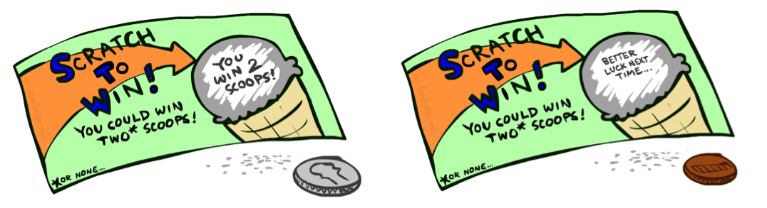
Preferences
A Prize
A Lottery
An agent must have preferences among:
  Prizes: A, B, etc.
  Lotteries: situations with uncertain prizes
Notation:
  Preference:
  Indifference:
Maximum expected utility (MEU) principle:
  Choose the action that maximizes expected utility
A
p 1-p
A B

Slide 7
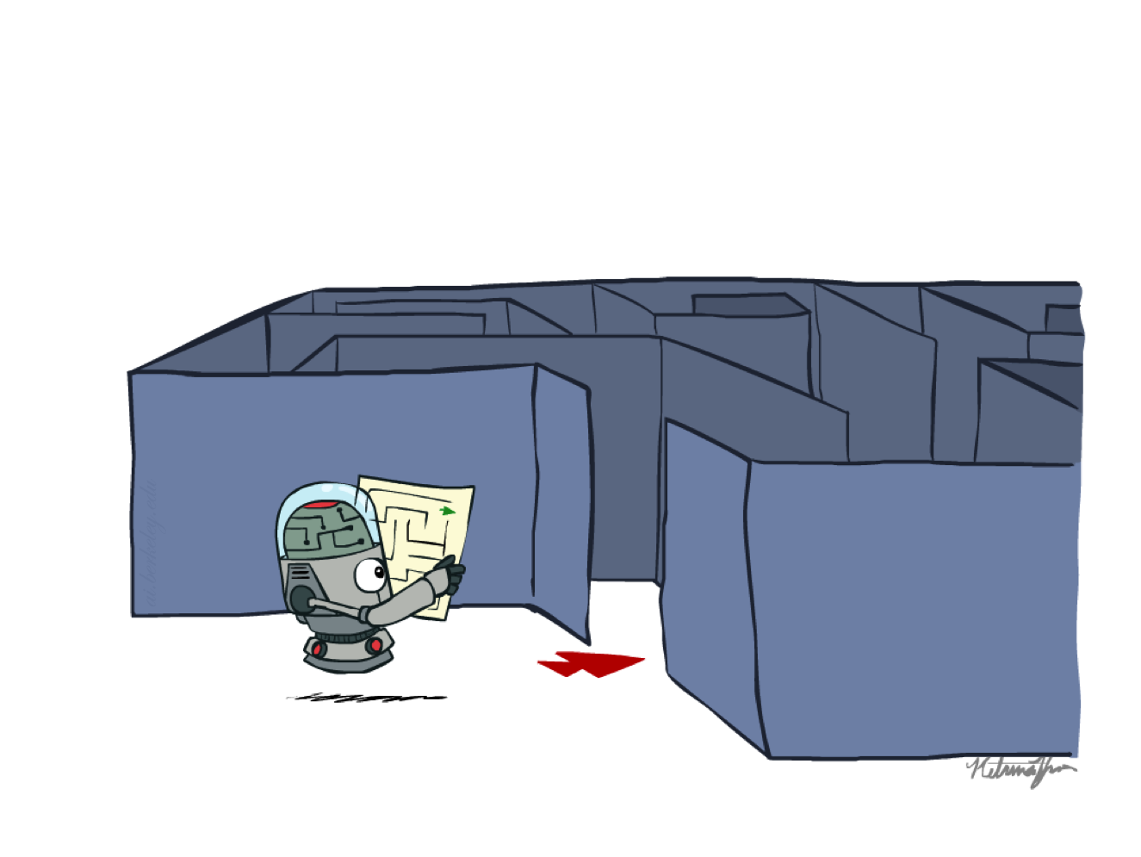



Problem Types
Search Problems
Deterministic Games
MDPs
RL

Slide 8

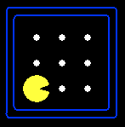





Search Problems
A search problem consists of:
  A state space
  A successor function
  (with actions, costs)
  A start state and a goal test
A solution is a sequence of actions (a plan) which transforms the start state to a goal state
“N”, 1.0
“E”, 1.0

Slide 9
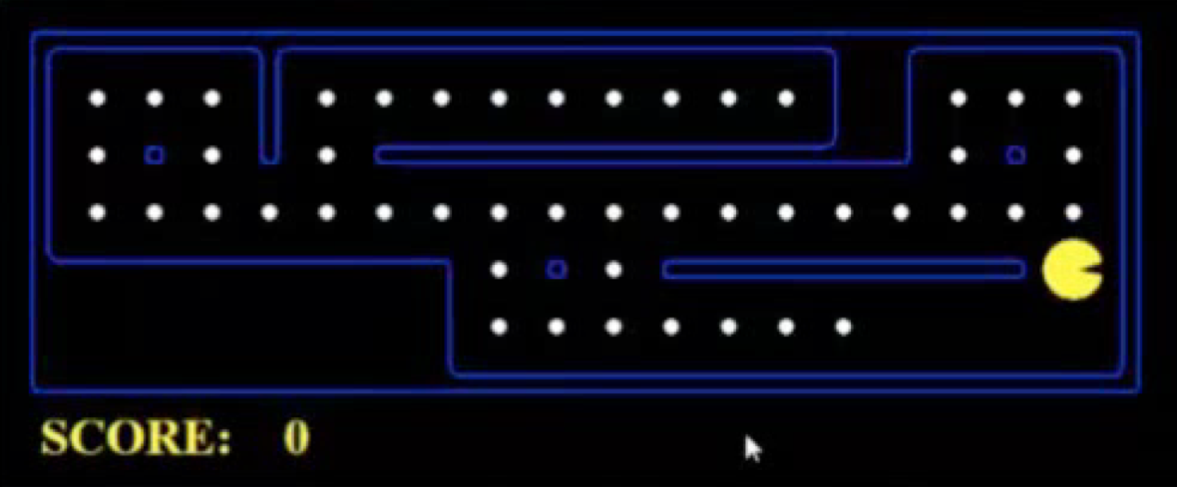
What’s in a State Space?
The world state includes every last detail of the environment
A search state keeps only the details needed for planning (abstraction)
Problem: Pathing
  States: (x,y) location
  Actions: NSEW
  Successor: update location only
  Goal test: is (x,y)=END
Problem: Eat-All-Dots
  States: {(x,y), dot booleans}
  Actions: NSEW
  Successor: update location and possibly a dot boolean
  Goal test: dots all false

Slide 10
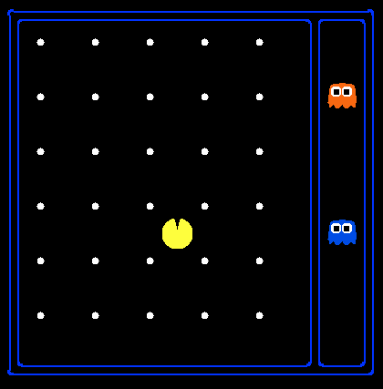
State Space Sizes?
World state:
  Agent positions: 120
  Food count: 30
  Ghost positions: 12
  Agent facing: NSEW
How many
  World states?
  120x(2³⁰)x(12²)x4
  States for pathing?
  120
  States for eat-all-dots?
  120x(2³⁰)

Slide 11
State Space Graphs
State space graph: A mathematical representation of a search problem
  Nodes are (abstracted) world configurations
  Arcs represent successors (action results)
  The goal test is a set of goal nodes (maybe only one)
In a state space graph, each state occurs only once!
a
G
b
c
e
d
f
S
h
p
q
r
Tiny state space graph for a tiny search problem

Slide 12
Search Trees
This is now / start
“N”, 1.0
“E”, 1.0
Possible futures
A search tree:
  A “what if” tree of plans and their outcomes
  The start state is the root node
  Children correspond to successors
  Nodes show states, but correspond to PLANS that achieve those states

Slide 13
Tree Search
Important ideas:
  Fringe
  Expansion
  Exploration strategy
Main question: which fringe nodes to explore?

Slide 14
The One Queue
Many search algorithms are the same except for fringe strategies
  Depth-First Search: expand the deepest node first
  Breadth-First Search: expand the shallowest node first
  Uniform Cost Search: expand the cheapest node first
  Greedy Search: expand the node with lowest heuristic value first
  A* Search: expand the node with lowest sum of path cost and heuristic value

Slide 15
Search Algorithm Properties
Complete: Guaranteed to find a solution if one exists?
Optimal: Guaranteed to find the least cost path?
Time complexity?
Space complexity?
Cartoon of search tree:
  b is the branching factor
  m is the maximum depth
  d is depth of shallowest solution
Number of nodes in entire tree?
  1 + b + b² + …. b^{m} = O(b^{m})
1 node
b
…
b nodes
b² nodes
m tiers
b^{m} nodes

Slide 16
Depth-First Search (DFS) Properties
What nodes DFS expand?
  Some left prefix of the tree.
  Could process the whole tree!
  If m is finite, takes time O(b^{m})
How much space does the fringe take?
  Only has siblings on path to root, so O(bm)
Is it complete?
  m could be infinite, so only if we prevent cycles (more later)
Is it optimal?
  No, it finds the “leftmost” solution, regardless of depth or cost
1 node
b
…
b nodes
b² nodes
m tiers
b^{m} nodes

Slide 17
Breadth-First Search (BFS) Properties
What nodes does BFS expand?
  Processes all nodes above shallowest solution
  Let depth of shallowest solution be s
  Search takes time O(b^{s})
How much space does the fringe take?
  Has roughly the last tier, so O(b^{s})
Is it complete?
  s must be finite if a solution exists, so yes!
Is it optimal?
  Only if costs are all 1 (more on costs later)
1 node
b
…
b nodes
s tiers
b² nodes
b^{s} nodes
b^{m} nodes

Slide 18
Iterative Deepening
Idea: get DFS’s space advantage with BFS’s time / shallow-solution advantages
  Run a DFS with depth limit 1. If no solution…
  Run a DFS with depth limit 2. If no solution…
  Run a DFS with depth limit 3. …..
Isn’t that wastefully redundant?
  Generally most work happens in the lowest level searched, so not so bad!
b
…

Slide 19
Uniform Cost Search (UCS) Properties
What nodes does UCS expand?
  Processes all nodes with cost less than cheapest solution!
  If that solution costs C* and arcs cost at least ε , then the “effective depth” is roughly C*/ε
  Takes time O(b^{C*/ε}) (exponential in effective depth)
How much space does the fringe take?
  Has roughly the last tier, so O(b^{C*/ε})
Is it complete?
  Assuming best solution has a finite cost and minimum arc cost is positive, yes!
Is it optimal?
  Yes!
b
c ≤ 1
…
C*/ε “tiers”
c ≤ 2
c ≤ 3

Slide 20
Search Algorithms
 | DFS | BFS | Iterative Deepen | UCS
Complete? | No | Yes * | Yes * | Yes * **
Optimal? | No | Yes *** | Yes *** | Yes
Time | O(b^m) | O(b^d) | O(b^d) | O(b^{1+C*/ε})
Space | O(bm) | O(b^d) | O(bd) | O(b^{1+C*/ε})
*: if b is finite, and state space either has a solution or is finite
**: if all costs are ≥ ε > 0.
***: if all costs are identical.

Slide 21
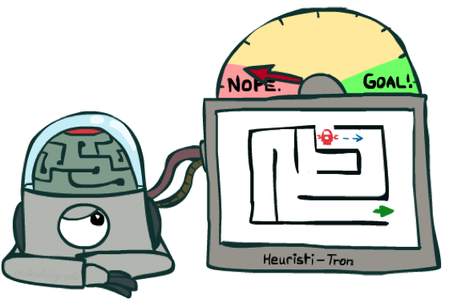
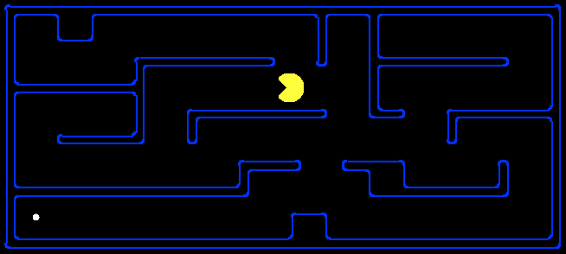
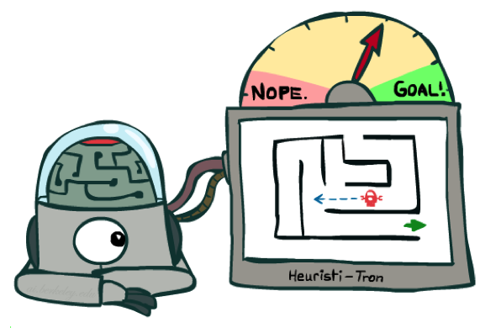
Search Heuristics
A heuristic is:
  A function that estimates how close a state is to a goal
  Designed for a particular search problem
  Examples: Manhattan distance, Euclidean distance for pathing
10
5
11.2

Slide 22
Greedy Search
b
Strategy: expand a node that you think is closest to a goal state
  Heuristic: estimate of distance to nearest goal for each state
A common case:
  Best-first takes you straight to the (wrong) goal
Worst-case: like a badly-guided DFS
…
b
…

Slide 23
Graph Search
Idea: never expand a state twice
How to implement:
  Tree search + set of expanded states (“closed set”)
  Expand the search tree node-by-node, but…
  Before expanding a node, check to make sure its state has never been expanded before
  If not new, skip it, if new add to closed set
Important: store the closed set as a set, not a list

Slide 24
Combining UCS and Greedy
Uniform-cost orders by path cost, or backward cost g(n)
Greedy orders by goal proximity, or forward cost h(n)
A* Search orders by the sum: f(n) = g(n) + h(n)
8
g = 0 h=6
S
e
h=1
g = 1 h=5
a
1
1
3
2
g = 2 h=6
g = 9 h=1
S
a
d
G
b
d
g = 4 h=2
e
h=6
1
h=5
h=2
h=0
1
g = 3 h=7
g = 6 h=0
g = 10 h=2
c
b
c
G
d
h=7
h=6
g = 12 h=0
G
Example: Teg Grenager

Slide 25

A*
A* uses both backward costs and (estimates of) forward costs
A* tree search is optimal with an admissible heuristic
A* graph search is optimal with a consistent heuristic

Slide 26
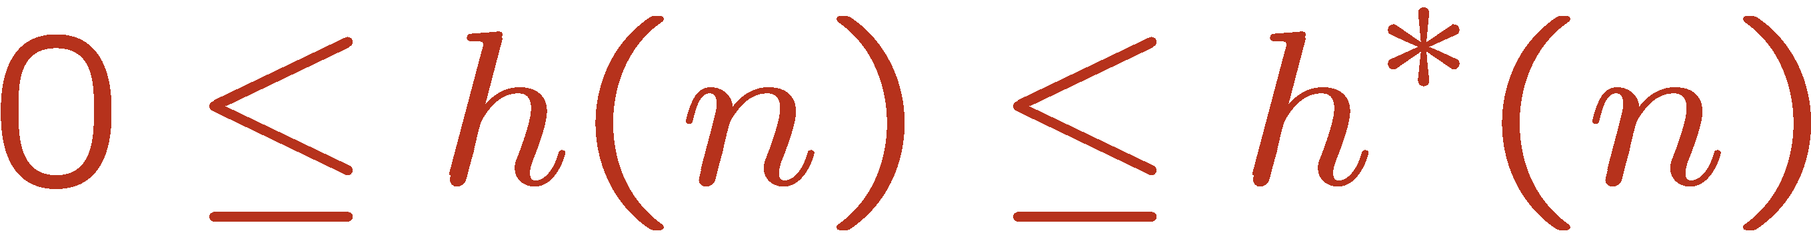
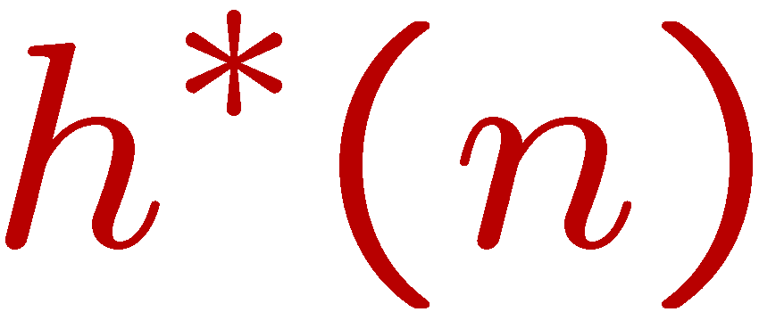
Admissible Heuristics
A heuristic h is admissible (optimistic) if:
where is the true cost to a nearest goal
Examples:
Coming up with admissible heuristics is most of what’s involved in using A* in practice.
4
15

Slide 27
Idea: Consistency
Main idea: estimated heuristic costs ≤ actual costs
  Admissibility: heuristic cost ≤ actual cost to goal
  h(A) ≤ actual cost from A to G
  Consistency: heuristic “arc” cost ≤ actual cost for each arc
  h(A) – h(C) ≤ cost(A to C)
Consequences of consistency:
  The f value along a path never decreases
  h(A) ≤ cost(A to C) + h(C)
  A* graph search is optimal
A
1
C
h=4
h=1
h=2
3
G

Slide 28
Games

Slide 29

Deterministic Games
Many possible formalizations, one is:
  States: S (start at s₀)
  Players: P={1...N} (usually take turns)
  Actions: A (may depend on player / state)
  Transition Function: SxA → S
  Terminal Test: S → {t,f}
  Terminal Utilities: SxP → R
Solution for a player is a policy: S → A

Slide 30
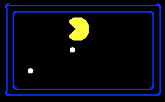
Single-Agent Trees
8
2
0
…
2
6
…
4
6

Slide 31
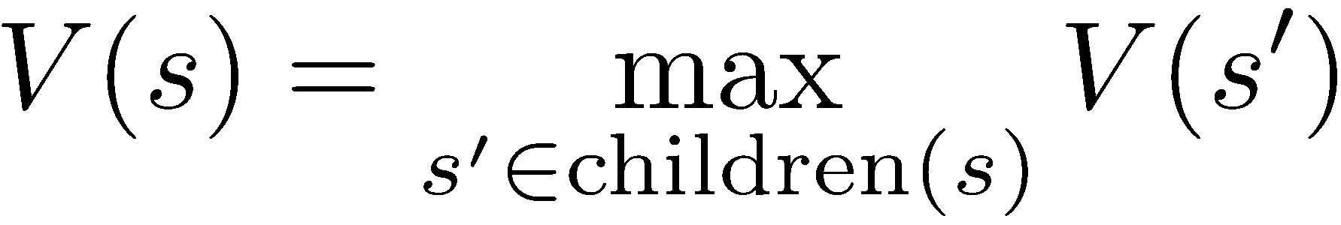
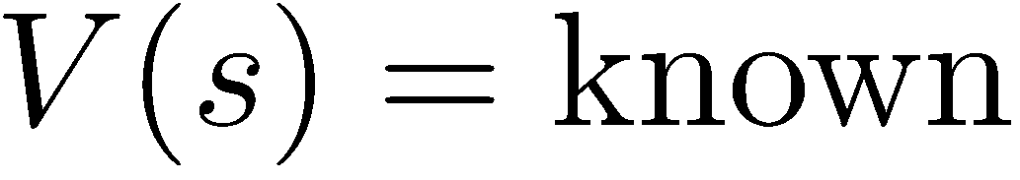
Value of a State
Value of a state: The best achievable outcome (utility) from that state
Non-Terminal States:
8
2
0
…
2
6
…
4
6
Terminal States:

Slide 32
Zero-Sum Games
Zero-Sum Games
  Agents have opposite utilities (values on outcomes)
  Let us think of a single value that one maximizes and the other minimizes
  Adversarial, pure competition

Slide 33
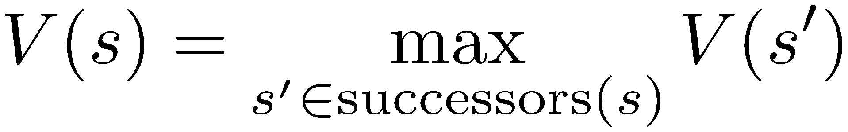
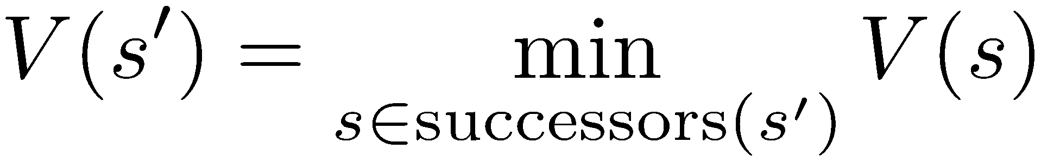

Minimax Values
States Under Agent’s Control:
States Under Opponent’s Control:
-8
-5
-10
+8
Terminal States:

Slide 34
Adversarial Search (Minimax)
Minimax search:
  A state-space search tree
  Players alternate turns
  Compute each node’s minimax value: the best achievable utility against a rational (optimal) adversary
Minimax values:
computed recursively
5
max
2
5
min
8
2
5
6
Terminal values:
part of the game

Slide 35
Alpha-Beta Pruning
General configuration (MIN version, MAX is symmetric)
  We’re computing the MIN-VALUE at some node n
  We’re looping over n’s children
  n’s estimate of the childrens’ min is dropping
  Who cares about n’s value? MAX
  Let a be the best value that MAX can get at any choice point along the current path from the root
  If n becomes worse than a, MAX will avoid it, so we can stop considering n’s other children (it’s already bad enough that it won’t be played)
This pruning has no effect on minimax value computed for the root, but values of intermediate nodes might be wrong
MAX
MIN
a
MAX
MIN
n

Slide 36
Alpha-Beta Implementation
  α: MAX’s best option on path to root
  β: MIN’s best option on path to root
def max-value(state, α, β):
  initialize v = -∞
  for each successor of state:
    v = max(v, value(successor, α, β))
    if v ≥ β return v
    α = max(α, v)
  return v
def min-value(state, α, β):
  initialize v = +∞
  for each successor of state:
    v = min(v, value(successor, α, β))
    if v ≤ α return v
    β = min(β, v)
  return v

Slide 37
Depth-limited search
Problem: In realistic games, cannot search to leaves!
Solution: Depth-limited search
  Instead, search only to a limited depth in the tree
  Replace terminal utilities with an evaluation function for non-terminal positions
Depth limit can be adjusted based on computation time budget
Guarantee of optimal play is gone
max
4
-2
4
min
-1
-2
4
9
?
?
?
?

Slide 38
Evaluation Functions
Evaluation functions score non-terminals in depth-limited search
Ideal function: returns the actual minimax value of the position
In practice: typically weighted linear sum of features:
e.g. f₁(s) = (num white queens – num black queens), etc.

Slide 39
Expectimax Search
Chance nodes: Uncertain outcomes controlled by chance, not an adversary!
Expectimax search: compute the average score under optimal play
Pruning in Expectimax?
max
chance
10
10
4
10
5
9
7
100

Slide 40
Markov Decision Processes

Slide 41





Markov Decision Processes
An MDP is defined by:
  A set of states s ∈ S
  A set of actions a ∈ A
  A transition function T(s, a, s’)
    Probability that a from s leads to s’, i.e., P(s’| s, a)
    Also called the model or the dynamics
  A reward function R(s, a, s’)
    Sometimes just R(s) or R(s’)
  A start state
  Maybe a terminal state
MDPs are non-deterministic search problems
  One way to solve them is with expectimax search
  But there are more efficient algorithms, too
Notes:
In search problems: did not talk about actions, but about successor functions --- now the information inside the successor function is unpacked into actions, transitions and reward
Write out S, A, example entry in T, entry in R
Reward function different from the book : R(s,a,s’)
In book simpler for equations, but not useful for the projects.
Need to modify expectimax a tiny little bit to account for rewards along the way, but that’s something you should be able to do, and so you can already solve MDP’s (not in most efficient way)

Slide 42

Policies
In deterministic single-agent search problems, we wanted an optimal plan, or sequence of actions, from start to a goal
For MDPs, we want an optimal policy π*: S → A
  A policy π gives an action for each state
  An optimal policy is one that maximizes expected utility if followed
  An explicit policy defines a reflex agent
Optimal policy when R(s, a, s’) = -0.03 for all non-terminals s

Slide 43
Optimal Quantities
The value (utility) of a state s:
  V*(s) = expected utility starting in s and acting optimally
The value (utility) of a q-state (s,a):
  Q*(s,a) = expected utility starting out having taken action a from state s and (thereafter) acting optimally
The optimal policy:
  π*(s) = optimal action from state s
s
s is a state
a
(s, a) is a q-state
s, a
s,a,s’
(s,a,s’) is a
transition
s’
Notes:
[Note: this demo doesn’t show anything in action, just pops up V and Q values.]

Slide 44


The Bellman Equations
Definition of “optimal utility” via expectimax recurrence gives a simple one-step lookahead relationship amongst optimal utility values
These are the Bellman equations, and they characterize optimal values in a way we’ll use over and over
s
a
s, a
s,a,s’
s’
Notes:
Let’s start by equations that characterize these quantities through mutual recursions. [step through this by writing on slide, one step at a time]
Recursive characterization of V* in terms of V*; not necessarily helpful; but it is a characterization.
Note: this is a set of equations that needs to be satisfied; but it could have multiple solutions (it does not, but at this stage of our knowledge it could).

Slide 45
Summary: MDP Algorithms
So you want to….
  Compute optimal values: use value iteration or Q-value iteration or policy iteration
  Compute values for a particular policy: use policy evaluation
  Turn your values into a policy: use policy extraction (one-step lookahead)
These all look the same!
  They basically are – they are all variations of Bellman updates
  They all use one-step lookahead expectimax fragments
  They differ only in whether we plug in a fixed policy or max over actions

Slide 46
Value Iteration
Bellman equations characterize the optimal values:
Value iteration computes them:
V_{k} are also interpretable as time-limited values
V(s)
a
s, a
s,a,s’
V(s’)
Notes:
Discuss computational complexity: S * A * S times number of iterations
Note: updates not in place [if in place, it means something else and not even clear what it means]

Slide 47
Q-Value Iteration
Value iteration: find successive (depth-limited) values
  Start with V₀(s) = 0, which we know is right
  Given V_{k}, calculate the depth k+1 values for all states:
But Q-values are more useful, so compute them instead
  Start with Q₀(s,a) = 0, which we know is right
  Given Q_{k}, calculate the depth k+1 q-values for all q-states:

Slide 48
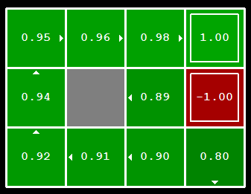


Computing Actions from Values
Let’s imagine we have the optimal values V*(s)
How should we act?
  It’s not obvious!
We need to do a mini-expectimax (one step)
This is called policy extraction, since it gets the policy implied by the values

Slide 49

Policy Evaluation
s
How do we calculate the V’s for a fixed policy π?
Idea 1: Turn recursive Bellman equations into updates
(like value iteration)
Efficiency: O(S²) per iteration
Idea 2: Without the maxes, the Bellman equations are just a linear system
π(s)
s, π(s)
s, π(s),s’
s’

Slide 50
Policy Iteration
Alternative approach for optimal policy:
  Step 1: Policy evaluation: calculate utilities for some fixed policy (not optimal utilities!) until convergence
  Step 2: Policy improvement: update policy using one-step look-ahead with resulting converged (but not optimal!) utilities as future values
  Repeat steps until policy converges
This is policy iteration
  It’s still optimal!
  The policy often converges long before the values

Slide 51
Policy Iteration
Evaluation: For fixed current policy π, find values with policy evaluation:
  Iterate until values converge:
Improvement: For fixed values, get a better policy using policy extraction
  One-step look-ahead:

Slide 52
Reinforcement Learning

Slide 53

Reinforcement Learning
We still assume an MDP:
  A set of states s ∈ S
  A set of actions (per state) A
  A model T(s,a,s’)
  A reward function R(s,a,s’)
Still looking for a policy π(s)
New twist: don’t know T or R, so must try out actions
Big idea: Compute all averages over T using sample outcomes

Slide 54



Model-Based Learning
Model-Based Idea:
  Learn an approximate model based on experiences
  Solve for values as if the learned model were correct
Step 1: Learn empirical MDP model
  Count outcomes s’ for each s, a
  Normalize to give an estimate of
  Discover each when we experience (s, a, s’)
Step 2: Solve the learned MDP
  For example, use value iteration, as before

Slide 55
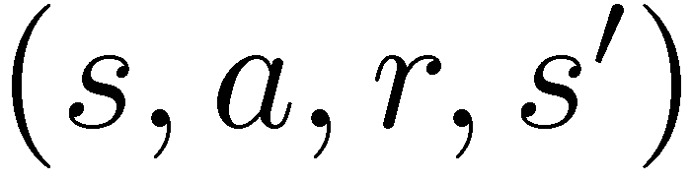
Model-Free Learning
s
Model-free learning
  Experience world through episodes
  Update estimates each transition
  Over time, updates will mimic Bellman updates
a
s, a
r
s’
a’
s’, a’
s’’

Slide 56
Temporal Difference Learning
Sample of V(s):
Update to V(s):
Same update:
s
s
π(s)
π(s)
s, π(s)
s, π(s)
s, π(s),s’
s’
s’

Slide 57

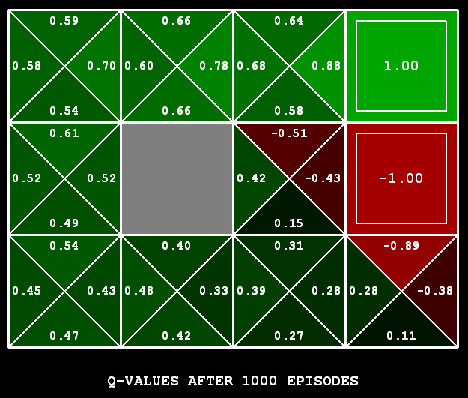
Q-Learning
Learn Q(s,a) values as you go
  Receive a sample (s,a,s’,r)
  Consider your old estimate:
  Consider your new sample estimate:
  Incorporate the new estimate into a running average:

Slide 58

Q-Learning Properties
Amazing result: Q-learning converges to optimal policy -- even if you’re acting sub-optimally!
This is called off-policy learning
Caveats:
  You have to explore enough
  You have to eventually make the learning rate
  small enough
  … but not decrease it too quickly
  Basically, in the limit, it doesn’t matter how you select actions (!)

Slide 59


Exploration vs. Exploitation
Several schemes for forcing exploration
  Simplest: random actions (ε-greedy)
    Every time step, flip a coin
    With (small) probability ε, act randomly
    With (large) probability 1-ε, act on current policy
  Another approach: exploration functions
    Takes a value estimate u and a visit count n, and returns an optimistic utility, e.g.
    Regular Q-Update:
    Modified Q-Update:

Slide 60

Feature-Based Value Functions
Basic Q-Learning keeps a table of all q-values
In realistic situations, we cannot possibly learn about every single state!
Instead, we want to generalize to new, similar situations
Solution: describe a state using a vector of features
Advantage: our experience is summed up in a few powerful numbers
Disadvantage: states may share features but be very different in value!

Slide 61

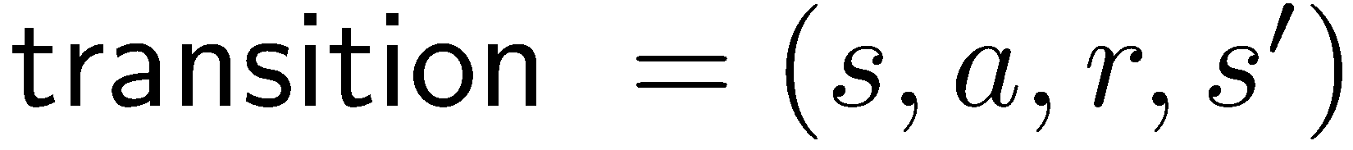
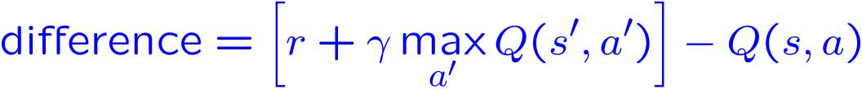
Approximate Q-Learning
Q-learning with linear Q-functions:
Intuitive interpretation:
  Adjust weights of active features
  E.g., if something unexpectedly bad happens, blame the features that were on: disprefer all states with that state’s features
Formal justification: online least squares
Exact Q’s
Approximate Q’s

Slide 62
Probability
Basic laws: 0 ≤ P(ω) ≤ 1, ∑_{ω ∈Ω} P(ω) = 1, P(A) = ∑_{ω ∈ A} P(ω)
Summing out/marginalization: P(X=x) = ∑_{y} P(X=x,Y=y)
Conditional probability: P(X|Y) = P(X,Y)/P(Y)
Chain rule: P(X₁,..,X_{n}) = ∏_{i} P(X_{i} | X₁,..,X_{i-1})
Bayes Rule: P(X|Y) = P(Y|X)P(X)/P(Y) = P(Y|X)P(X) / ∑_{x} P(X=x, Y)
Independence: P(X,Y) = P(X) P(Y) or P(X|Y) = P(X) or P(Y|X) = P(Y)
Conditional Independence: P(X|Y,Z) = P(X|Z) or P(X,Y|Z) = P(X|Z) P(Y| Z)

Slide 63
Decision Networks
MEU: choose the action which maximizes the expected utility given the evidence
Can directly operationalize this with decision networks
  Bayes nets with nodes for utility and actions
  Lets us calculate the expected utility for each action
New node types:
  Chance nodes (just like BNs)
  Actions (rectangles, cannot have parents, act as observed evidence)
  Utility node (diamond, depends on action and chance nodes)
Umbrella
U
Weather
Forecast
Notes:
There exists a ghostbusters demo

Slide 64





Decisions as Outcome Trees
Umbrella
{b}
MEU({F=bad})
take
leave
U
EU(leave|F=bad)
W | {b}
W | {b}
EU(take|F=bad)
Weather
sun
sun
rain
rain
U(t,s)
U(t,r)
U(l,s)
U(l,r)
Forecast
=bad

Slide 65
Decisions as Outcome Trees
MEU(F)
good
bad
{b}
MEU({F=good})
{b}
MEU({F=bad})
take
leave
take
leave
W | {b}
W | {b}
EU(leave|F=bad)
EU(take|F=good)
EU(leave|F=good)
W | {b}
EU(take|F=bad)
W | {b}
sun
sun
sun
sun
rain
rain
rain
rain
U(t,s)
U(t,r)
U(l,s)
U(l,r)
U(t,s)
U(t,r)
U(l,s)
U(l,r)

Slide 66
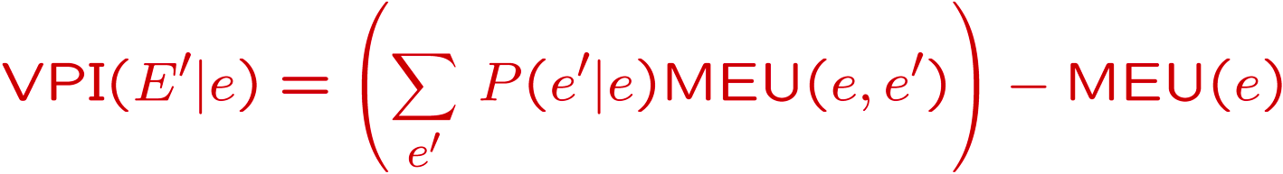
Decisions as Outcome Trees
VPI(F) = VPI(F|{}) = MEU(F) – MEU({})
It is rational to observe F when VPI(F) > cost of observing F
MEU(F)
good
bad
{b}
MEU({F=good})
{b}
MEU({F=bad})
{}
MEU({})
take
leave
take
leave
take
leave
EU(leave|F=bad)
Weather | {}
Weather | {}
W | {b}
EU(take|F=good)
W | {b}
EU(leave|F=good)
W | {b}
EU(take|F=bad)
W | {b}
EU(take)
EU(leave)
sun
sun
sun
sun
sun
sun
rain
rain
rain
rain
rain
rain
U(t,s)
U(t,r)
U(l,s)
U(l,r)
U(t,s)
U(t,r)
U(l,s)
U(l,r)
U(t,s)
U(t,r)
U(l,s)
U(l,r)

Slide 67
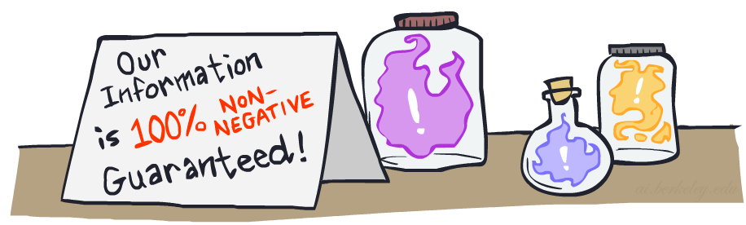


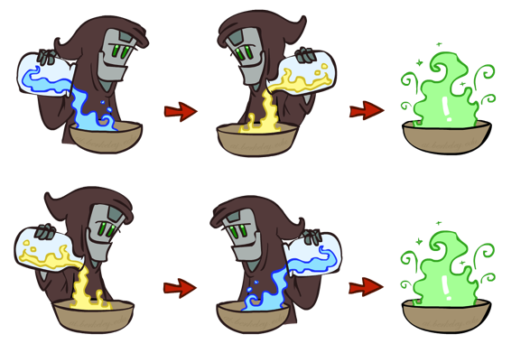
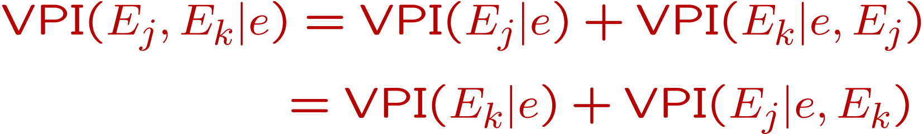
VPI Properties
Nonnegative
Non-additive
  (think of observing E_{j} twice)
Order-independent

Slide 68


Bayes Nets: Big Picture
Bayes nets: a technique for describing complex joint distributions (models) using simple, local distributions (conditional probabilities)
  We describe how variables locally interact
  Local interactions chain together to give global, indirect interactions
Bayes nets topics:
  Conditional Independences (D-Separation)
  Exact Inference (Inference by enumeration, variable elimination)
  Sampling (Prior, Rejection, Likelihood Weighting, Gibbs)

Slide 69

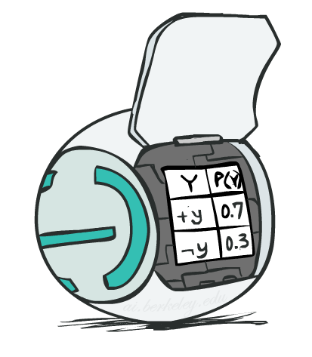
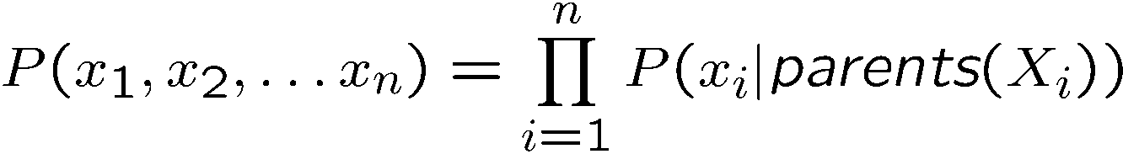
Bayes Net Representation
A directed, acyclic graph, one node per random variable
A conditional probability table (CPT) for each node
  A collection of distributions over X, one for each combination of parents’ values
Bayes nets implicitly encode joint distributions
  As a product of local conditional distributions
  To see what probability a BN gives to a full assignment, multiply all the relevant conditionals together:

Slide 70
Topology Limits Distributions
Given some graph topology G, only certain joint distributions can be encoded
The graph structure guarantees certain (conditional) independences
(There might be more independence)
Adding arcs increases the set of distributions, but has several costs
Full conditioning can encode any distribution
Y
Y
X
Z
X
Z
Y
X
Z
Y
X
Z
Y
Y
Y
X
Z
X
Z
X
Z
Y
Y
Y
X
Z
X
Z
X
Z

Slide 71
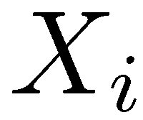
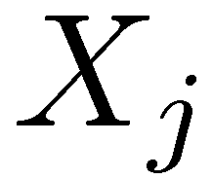

D-Separation
A condition / algorithm for answering independence queries
Query:
Check all (undirected!) paths between and
  If one or more active, then independence not guaranteed
  Otherwise (i.e. if all paths are inactive),
  then independence is guaranteed
?

Slide 72
Active / Inactive Paths
Question: Are X and Y conditionally independent given evidence variables {Z}?
  Yes, if X and Y “d-separated” by Z
  Consider all (undirected) paths from X to Y
  No active paths = independence!
A path is active if each triple is active:
  Causal chain A -> B -> C where B is unobserved (either direction)
  Common cause A <- B -> C where B is unobserved
  Common effect (aka v-structure)
  A -> B <- C where B or one of its descendants is observed
All it takes to block a path is a single inactive segment
Active Triples
Inactive Triples

Slide 73





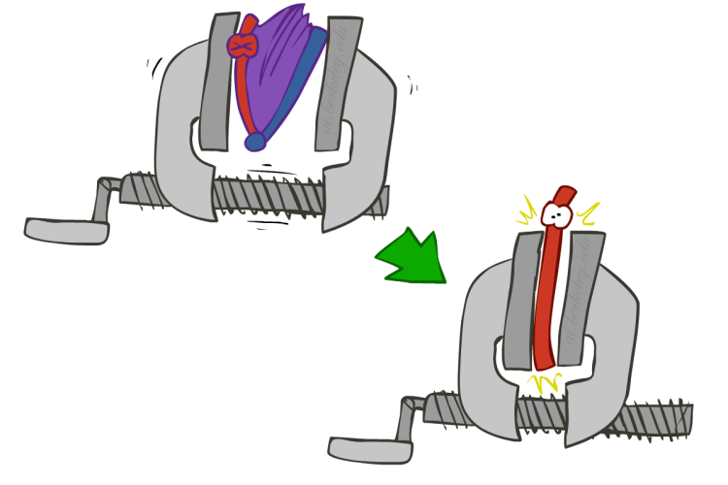
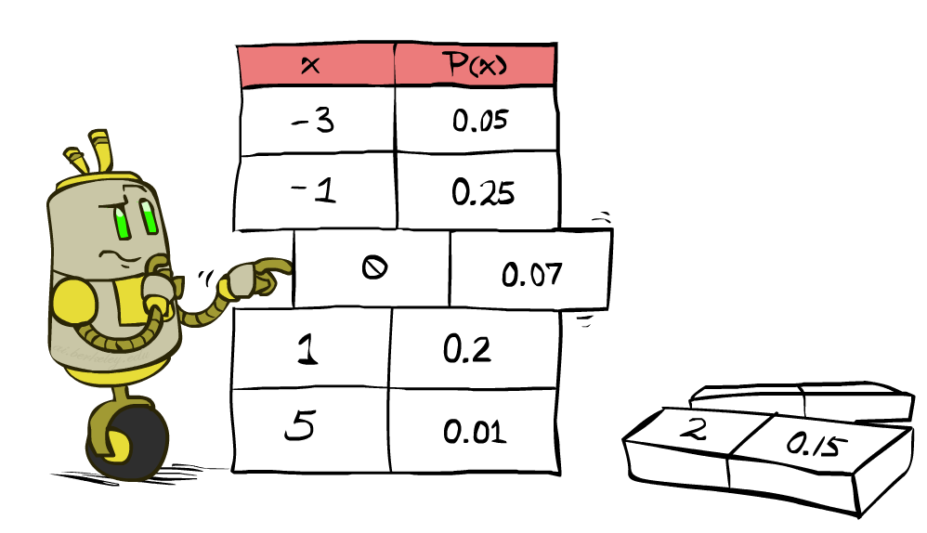


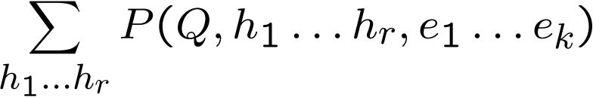
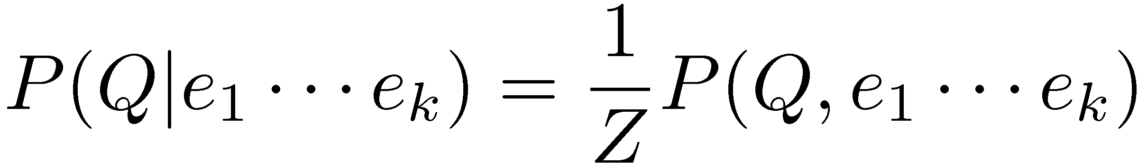
Inference by Enumeration
* Works fine with multiple query variables, too
General case:
  Evidence variables:
  Query* variable:
  Hidden variables:
We want:
All variables
Step 1: Select the entries consistent with the evidence
Step 2: Sum out H to get joint of Query and evidence
Step 3: Normalize

Slide 74

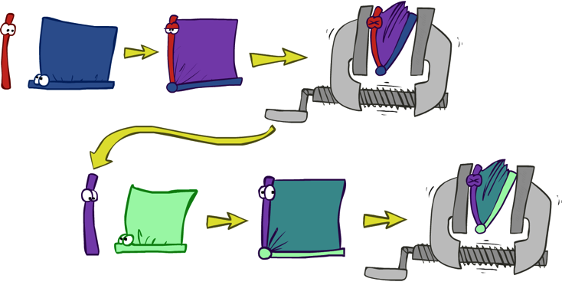


Variable Elimination
Query:
Start with initial factors:
  Local CPTs (but instantiated by evidence)
While there are still hidden variables (not Q or evidence):
  Pick a hidden variable H
  Join all factors mentioning H
  Eliminate (sum out) H
Join all remaining factors and normalize

Slide 75





Operation 1: Join Factors
First basic operation: joining factors
Combining factors:
  Just like a database join
  Get all factors over the joining variable
  Build a new factor over the union of the variables involved
Example: Join on R
  Computation for each entry: pointwise products
R
+r | 0.1
-r | 0.9
+r | +t | 0.8
+r | -t | 0.2
-r | +t | 0.1
-r | -t | 0.9
+r | +t | 0.08
+r | -t | 0.02
-r | +t | 0.09
-r | -t | 0.81
R,T
T

Slide 76
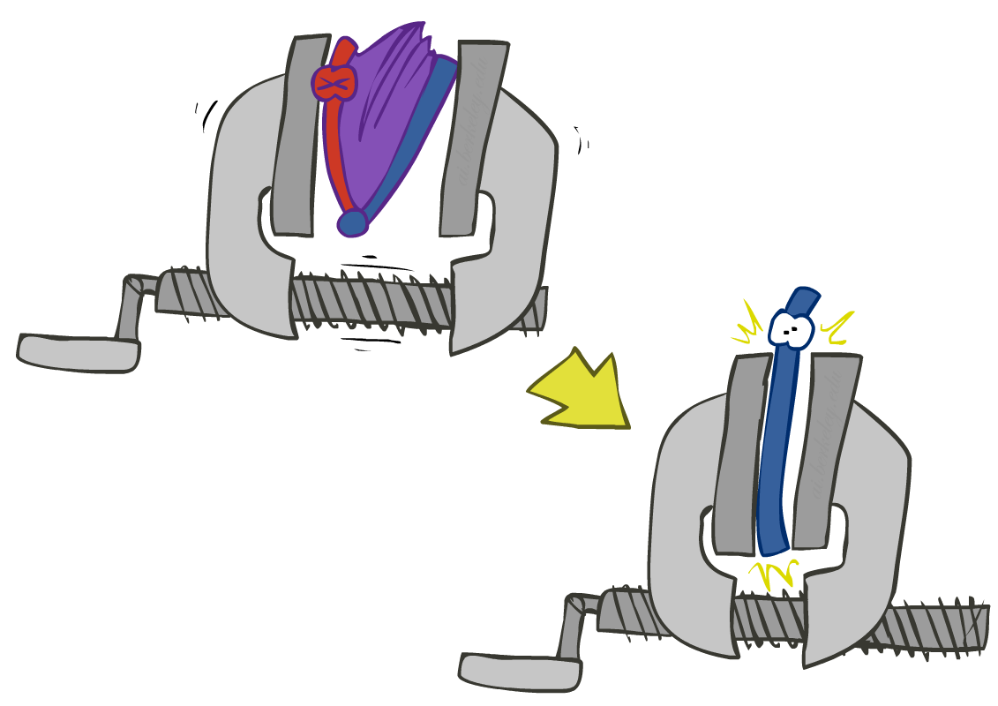


Operation 2: Eliminate
Second basic operation: marginalization
Take a factor and sum out a variable
  Shrinks a factor to a smaller one
  A projection operation
Example:
+r | +t | 0.08
+r | -t | 0.02
-r | +t | 0.09
-r | -t | 0.81
+t | 0.17
-t | 0.83

Slide 77
Inference by Enumeration vs. Variable Elimination
R
Inference by Enumeration
Variable Elimination
T
L
Join on r
Join on r
Join on t
Eliminate r
Eliminate r
Join on t
Eliminate t
Eliminate t

Slide 78










Variable Elimination
Interleave joining and marginalizing
d^{k} entries computed for a factor over k variables with domain sizes d
Ordering of elimination of hidden variables can affect size of factors generated
Worst case: running time exponential in the size of the Bayes’ net
…
…

Slide 79
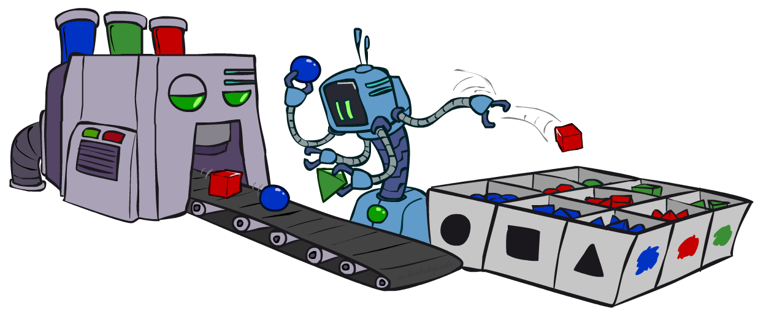
Approximate Inference: Sampling
Sampling is a lot like repeated simulation
  Predicting the weather, basketball games, …
Basic idea
  Draw N samples from a sampling distribution S
  Compute an approximate posterior probability
  Show this converges to the true probability P
Why sample?
  Learning: get samples from a distribution you don’t know
  Inference: getting a sample is faster than computing the right answer (e.g. with variable elimination)

Slide 80
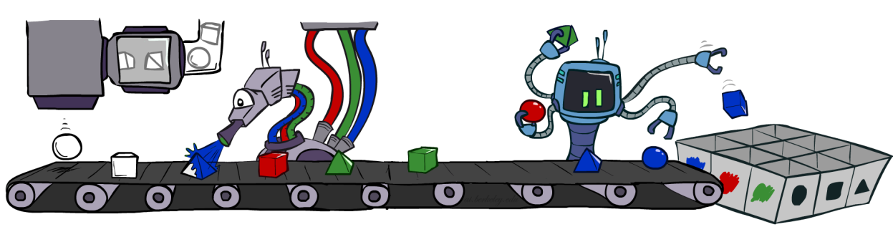
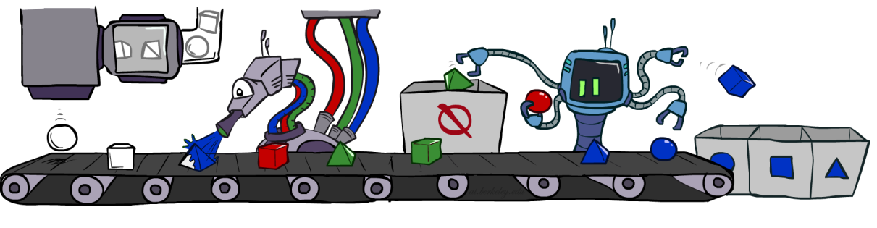


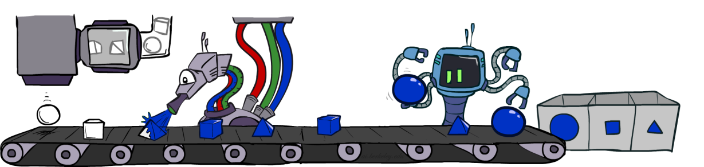
Sampling in Bayes Nets
Prior Sampling P( Q )
Likelihood Weighting P( Q | e)
Rejection Sampling P( Q | e )
Gibbs Sampling P( Q | e )

Slide 81

Prior Sampling
For i = 1, 2, …, n
  Sample x_{i} from P(X_{i} | Parents(X_{i}))
Return (x₁, x₂, …, x_{n})

Slide 82

Rejection Sampling
Input: evidence instantiation
For i = 1, 2, …, n
  Sample x_{i} from P(X_{i} | Parents(X_{i}))
  If x_{i} not consistent with evidence
    Reject: return – no sample is generated in this cycle
Return (x₁, x₂, …, x_{n})

Slide 83
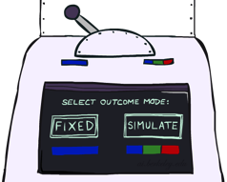

Likelihood Weighting
Input: evidence instantiation
w = 1.0
for i = 1, 2, …, n
  if X_{i} is an evidence variable
    X_{i} = observation x_{i} for X_{i}
    Set w = w * P(x_{i} | Parents(X_{i}))
  else
    Sample x_{i} from P(X_{i} | Parents(X_{i}))
return (x₁, x₂, …, x_{n}), w

Slide 84
Gibbs Sampling
Step 1: Fix evidence
  R = +r
Steps 3: Repeat
  Choose a non-evidence variable X
  Resample X from P( X | all other variables)
    P( X | all other variables) can be computed efficiently using only the CPTs that involve X
Step 2: Initialize other variables
  Randomly
C
C
S
+r
S
+r
W
W
C
C
C
C
C
C
S
+r
S
+r
S
+r
S
+r
S
+r
S
+r
W
W
W
W
W
W

Slide 85


Markov Models
  Value of X at a given time is called the state
  Parameters: called transition probabilities or dynamics, specify how the state evolves over time (also, initial state probabilities)
  Stationary assumption: transition probabilities the same at all times
  Markov property: Past and future independent given the present
  Same as MDP transition model, but no choice of action
X₁
X₂
X₃
X₄

Slide 86


Mini-Forward Algorithm
Question: What’s P(X) at some time t?
X₁
X₂
X₃
X₄
Forward simulation

Slide 87

Stationary Distributions
For most chains:
  Influence of the initial distribution gets less and less over time.
  The distribution we end up in is independent of the initial distribution
Stationary distribution:
  The distribution we end up with is called the stationary distribution of the chain
  It satisfies

Slide 88

Hidden Markov Models
Markov chains not so useful for most agents
  Need observations to update your beliefs
Hidden Markov models (HMMs)
  Underlying Markov chain over states X
  You observe outputs (effects) at each time step
X₁
X₂
X₃
X₄
X₅
E₁
E₂
E₃
E₄
E₅

Slide 89
Conditional Independence
HMMs have two important independence properties:
  Markov hidden process: future depends on past via the present
  Current observation independent of all else given current state
Evidence variables are not guaranteed to be independent
  They tend to correlated by the hidden state
X₁
X₂
X₃
X₄
X₅
E₁
E₂
E₃
E₄
E₅

Slide 90
Filtering / Monitoring
Filtering, or monitoring, is the task of tracking the distribution B_{t}(X) = P_{t}(X_{t} | e₁, …, e_{t}) (the belief state) over time
We start with B₁(X) in an initial setting, usually uniform
As time passes, or we get observations, we update B(X)
Notes:
Dan has some demo for this

Slide 91


Passage of Time
Assume we have current belief P(X | evidence to date)
Then, after one time step passes:
Basic idea: beliefs get “pushed” through the transitions
  With the “B” notation, we have to be careful about what time step t the belief is about, and what evidence it includes
X₁
X₂
Or compactly:
Notes:
TODO: intermediate step in derivation!

Slide 92

Observation
X₁
Assume we have current belief P(X | previous evidence):
Then, after evidence comes in:
Or, compactly:
E₁
Basic idea: beliefs “reweighted” by likelihood of evidence
Unlike passage of time, we have to renormalize
Notes:
Basic idea: beliefs “reweighted” by likelihood of evidence
Unlike passage of time, we have to renormalize

Slide 93
Forward Algorithm
Every time step, we start with current P(X | evidence)
We update for time:
We update for evidence:
Don’t forget to normalize at the end!
X₁
X₂
X₂
E₂

Slide 94
Approximate Inference in HMMs: Particle Filtering
Filtering: approximate solution
Sometimes |X| is too big to use exact inference
Solution: approximate inference
  Track samples of X, not all values
  Particle is just new name for sample
  Time per step is linear in the number of samples
  But: number needed may be large
  In memory: list of particles, not states
0.0
0.1
0.0
0.0
0.0
0.2
0.0
0.2
0.5

Slide 95
Representation: Particles
Our representation of P(X) is now a list of N particles (samples)
  Generally, N << |X|
  Storing map from X to counts would defeat the point
P(x) approximated by number of particles with value x
  So, many x may have P(x) = 0!
  More particles, more accuracy
Particles:
(3,3)
(2,3)
(3,3)
(3,2)
(3,3)
(3,2)
(1,2)
(3,3)
(3,3)
(2,3)

Slide 96

Particle Filtering: Elapse Time
Each particle is moved by sampling its next position from the transition model
  This is like prior sampling – samples’ frequencies reflect the transition probabilities
This captures the passage of time
  If enough samples, close to exact values before and after (consistent)
Particles:
(3,3)
(2,3)
(3,3)
(3,2)
(3,3)
(3,2)
(1,2)
(3,3)
(3,3)
(2,3)
Particles:
(3,2)
(2,3)
(3,2)
(3,1)
(3,3)
(3,2)
(1,3)
(2,3)
(3,2)
(2,2)

Slide 97


Particle Filtering: Observe
Particles:
(3,2)
(2,3)
(3,2)
(3,1)
(3,3)
(3,2)
(1,3)
(2,3)
(3,2)
(2,2)
Slightly trickier:
  Similar to likelihood weighting, down-weight samples based on the evidence
Particles:
(3,2) w=.9
(2,3) w=.2
(3,2) w=.9
(3,1) w=.4
(3,3) w=.4
(3,2) w=.9
(1,3) w=.1
(2,3) w=.2
(3,2) w=.9
(2,2) w=.4

Slide 98
Particle Filtering: Resample
Rather than tracking weighted samples, we resample (draw with replacement)
This is equivalent to renormalizing the distribution
Now the update is complete for this time step, continue with the next one
Particles:
(3,2) w=.9
(2,3) w=.2
(3,2) w=.9
(3,1) w=.4
(3,3) w=.4
(3,2) w=.9
(1,3) w=.1
(2,3) w=.2
(3,2) w=.9
(2,2) w=.4
(New) Particles:
(3,2)
(2,2)
(3,2)
(2,3)
(3,3)
(3,2)
(1,3)
(2,3)
(3,2)
(3,2)

Slide 99
Particle Filtering
Particles: track samples of states rather than an explicit distribution
Elapse
Weight
Resample
Particles:
(3,3)
(2,3)
(3,3)
(3,2)
(3,3)
(3,2)
(1,2)
(3,3)
(3,3)
(2,3)
Particles:
(3,2)
(2,3)
(3,2)
(3,1)
(3,3)
(3,2)
(1,3)
(2,3)
(3,2)
(2,2)
Particles:
(3,2) w=.9
(2,3) w=.2
(3,2) w=.9
(3,1) w=.4
(3,3) w=.4
(3,2) w=.9
(1,3) w=.1
(2,3) w=.2
(3,2) w=.9
(2,2) w=.4
(New) Particles:
(3,2)
(2,2)
(3,2)
(2,3)
(3,3)
(3,2)
(1,3)
(2,3)
(3,2)
(3,2)

Slide 100
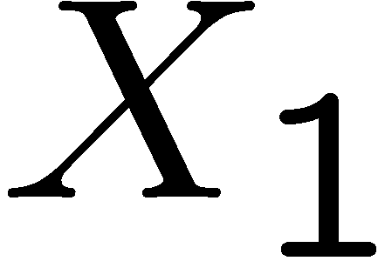
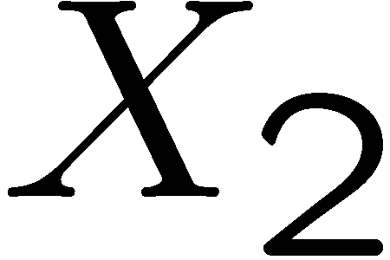

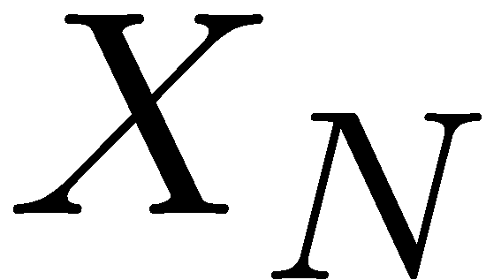
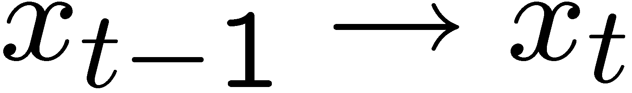
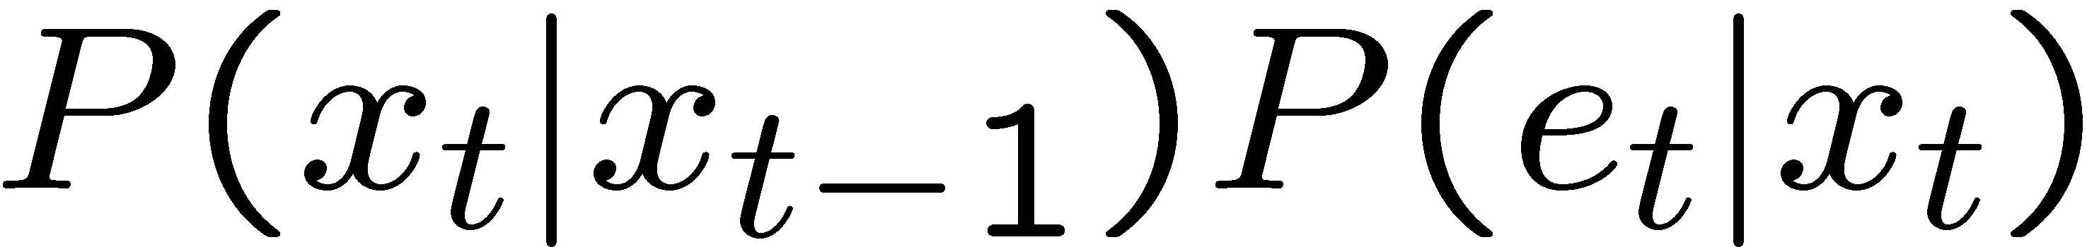
Most Likely Explanation: Viterbi Algorithm
State trellis: graph of states and transitions over time
Each arc represents some transition
Each arc has weight
Each path is a sequence of states
The product of weights on a path is that sequence’s probability along with the evidence
Forward algorithm computes sums of paths, Viterbi computes best paths
sun
sun
sun
sun
rain
rain
rain
rain

Slide 101
Viterbi algorithm contd.
W_{t-1} | P(W_{t}|W_{t-1})
 | sun | rain
sun | 0.9 | 0.1
rain | 0.3 | 0.7
0.5
sun
0.18
0.72
0.18
0.5
sun
sun
sun
0.09
0.076
0.0136080
0.09
0.01
0.09
0.06
0.24
0.06
0.5
rain
rain
rain
rain
0.5
0.315
0.022
0.0138495
0.63
0.07
0.63
W_{t} | P(U_{t}|W_{t})
 | true | false
sun | 0.2 | 0.8
rain | 0.9 | 0.1
X₀ X₁ X₂ X_{T}
U₁=true U₂=false U₃=true
Time complexity?
O(|X|² T)
Space complexity?
O(|X| T)
Number of paths?
O(|X|^{T})

