Slide 1
Deep Learning for Graphics II
With slides from Alexei Efros, Phillip Isola, Jun-Yan Zhu, Ian Goodfellow
CS194: Image Manipulation & Computational Photography
Alexei Efros, UC Berkeley, Fall 2015

Slide 2
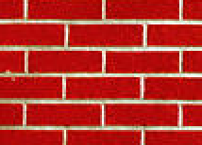
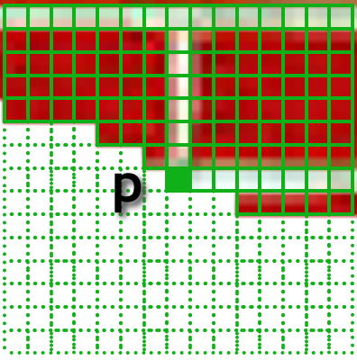
Algorithms for producing texture
[Efros & Leung 1999]
non-parametric
sampling
p
Predicted color of next pixel
“white”
[van der Oord et al. 2016]

Slide 3
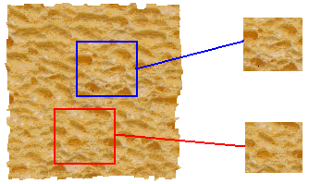
Texture analysis
“Same” or “different”
Analysis
True (infinite) texture
What we’d like: are they made of the same “stuff”? Are these textures similar?

Slide 4
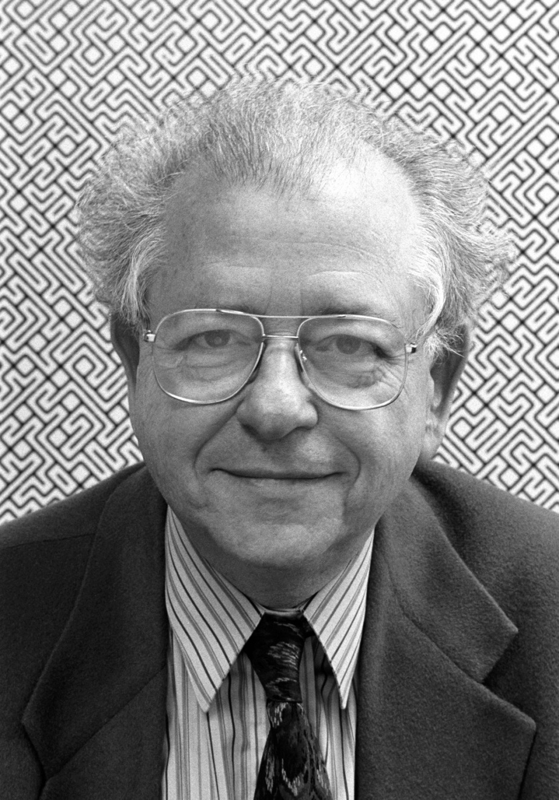
How do humans analyze texture?
Human vision is sensitive to the difference of some types of elements and
appears to be “numb” on other types of differences.
Béla Julesz

Slide 5
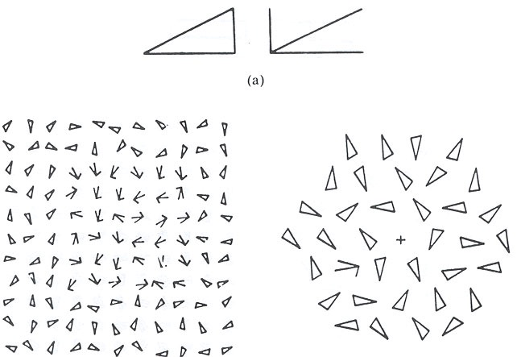
Search Experiment I
The subject is told to detect a target element in a number of background elements.
In this example, the detection time is independent of the number of background elements.

Slide 6
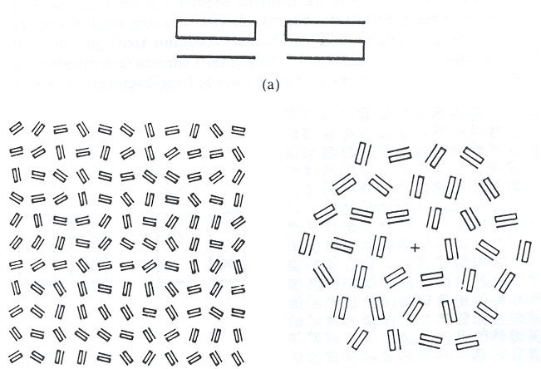
Search Experiment II
In this example, the detection time is proportional to the number of background elements,
And thus suggests that the subject is doing element-by-element scrutiny.

Slide 7
Heuristic
Julesz then conjectured the following:
Human vision operates in two distinct modes:
1. Preattentive vision
parallel, instantaneous (~100--200ms), without scrutiny,
independent of the number of patterns, covering a large visual field.
2. Attentive vision
serial search by focal attention in 50ms steps limited to small aperture.

Slide 8
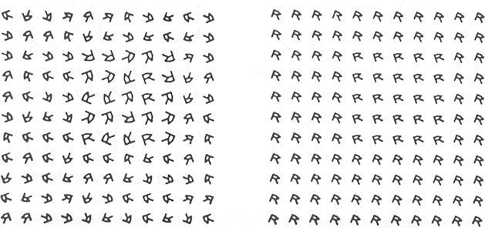
Examples
Pre-attentive vision is sensitive to size/width, orientation changes

Slide 9
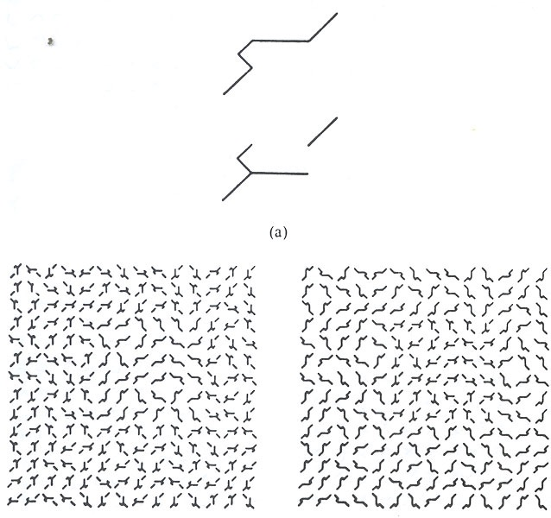
Examples
Sensitive to number
of terminators
Left: fore-back
Right: back-fore
See previous examples
For cross and terminators

Slide 10
Julesz Conjecture
Textures cannot be spontaneously discriminated if they have the same first-order and second-order statistics and differ only in their third-order or higher-order statistics.
(later proved wrong)
But it is worth noting that Julesz’s conclusions are largely based on ensemble of
artificial texture patterns. It was infeasible to synthesize natural textures for
controlled experiments at that time.

Slide 11
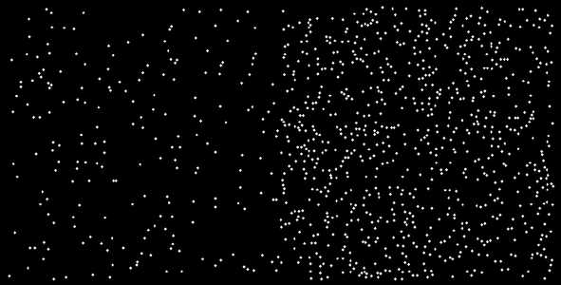
1st Order Statistics
5% white
20% white

Slide 12
2nd Order Statistics
10% white

Slide 13
How can we represent texture in natural images?
Idea 1: Record simple statistics (e.g., mean, std.) of absolute filter responses

Slide 14
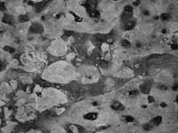
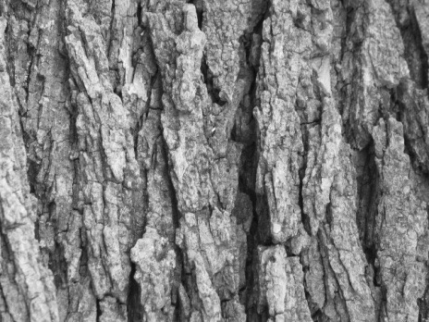
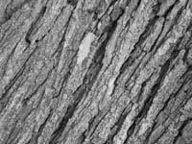
Can you match the texture to the response?
Filters
A
B
1
2
C
3
Mean abs responses

Slide 15
How can we represent texture in natural images?
Can be thought of as an single “orientation histogram”
Idea 2: Marginal histograms of filter responses
one histogram per filter

Slide 16
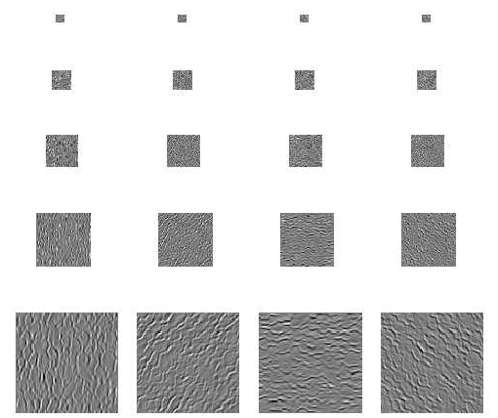
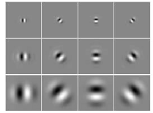
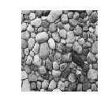
Multi-scale filter decomposition
Filter bank
Input image

Slide 17
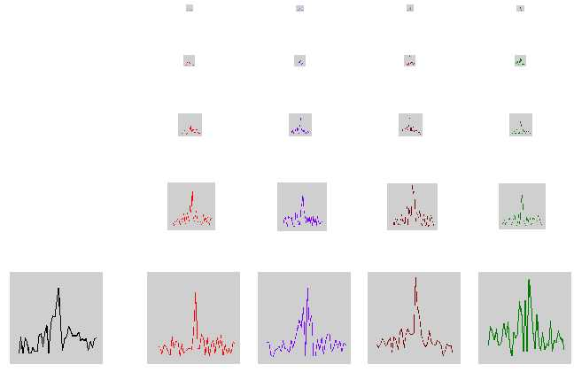
Filter response histograms

Slide 18
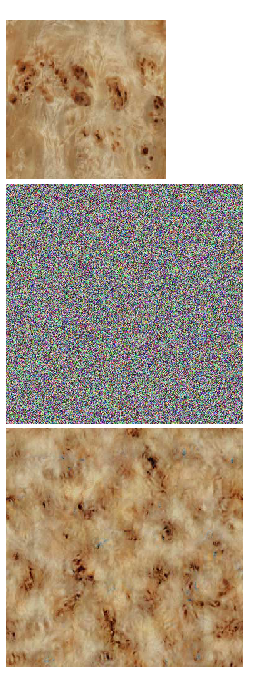
Heeger & Bergen, SIGGRAPH‘95
Start with a noise image as output
Main loop:
Match pixel histogram of output image to input
Decompose input and output images using multi-scale filter bank (Steerable Pyramid)
Match subband histograms of input and output pyramids
Reconstruct input and output images (collapse the pyramids)
Heeger, Bergen, Pyramid-based texture analysis/synthesis, SIGGRAPH 1995

Slide 19
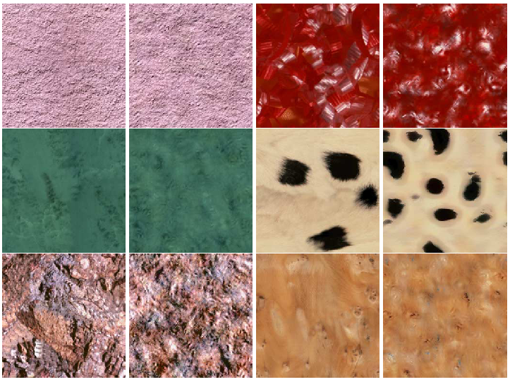

Slide 20
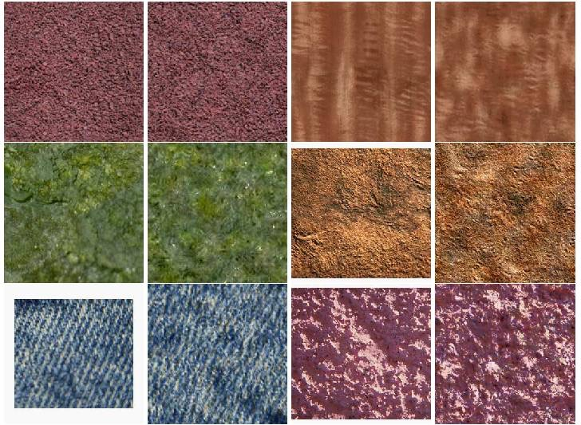

Slide 21
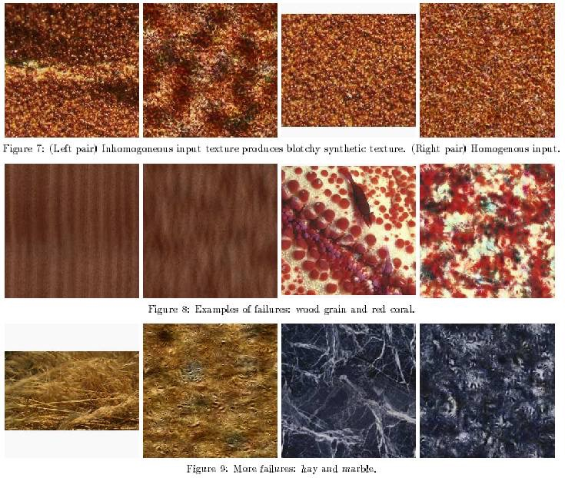

Slide 22
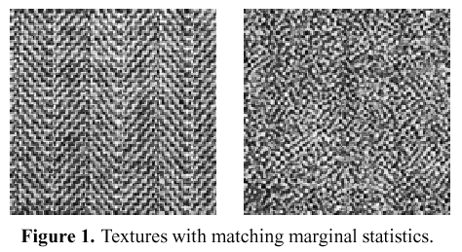
Simoncelli & Portilla ’98+
Marginal statistics are not enough
Neighboring filter responses are highly correlated
an edge at low-res will cause an edge at high-res
Let’s match 2nd order statistics too!
J Portilla and E P Simoncelli. A Parametric Texture Model based on Joint Statistics of Complex Wavelet Coefficients. Int'l Journal of Computer Vision. 40(1):49-71, October, 2000.

Slide 23
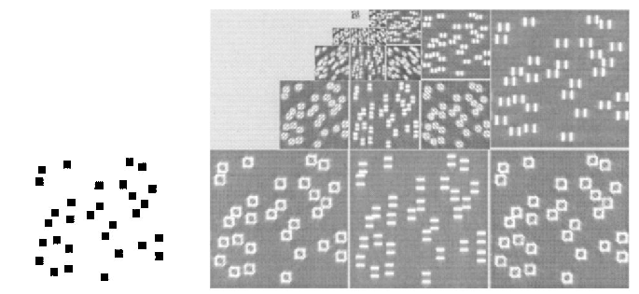
Simoncelli & Portilla ’98+
Match joint histograms of pairs of filter responses at adjacent spatial locations, orientations, and scales.
Optimize using repeated projections onto statistical constraint surfaces

Slide 24
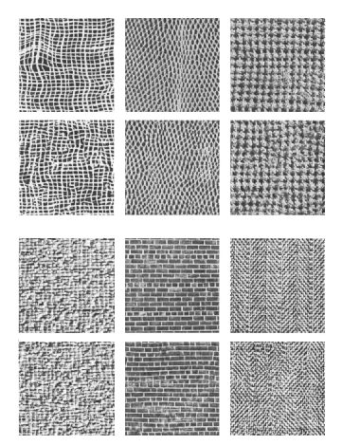
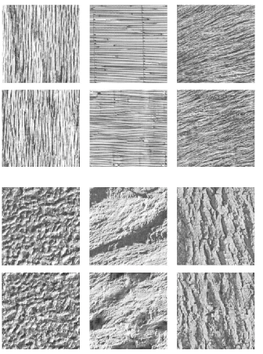

Slide 25
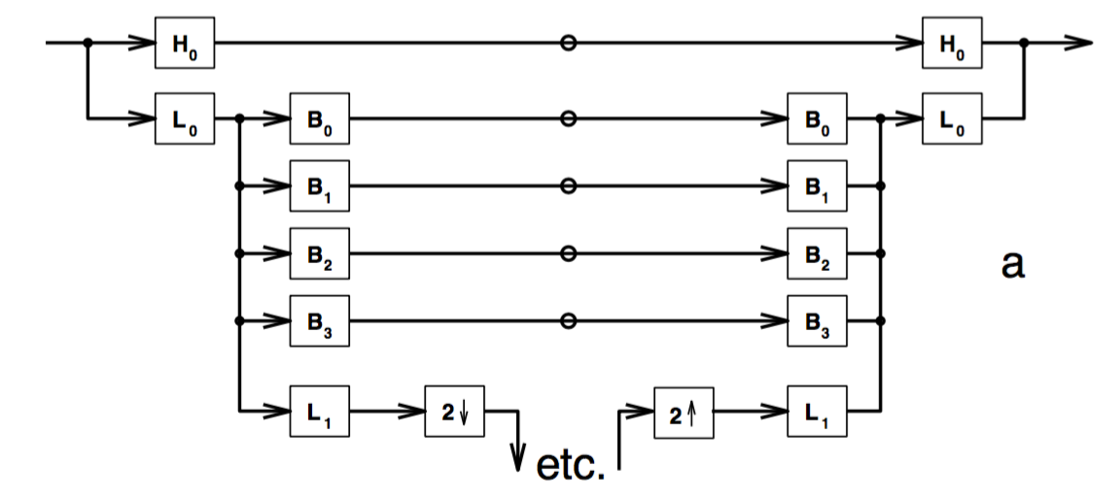
Choice of image features
[Heeger & Bergen ’95]
Why these features?

Slide 26
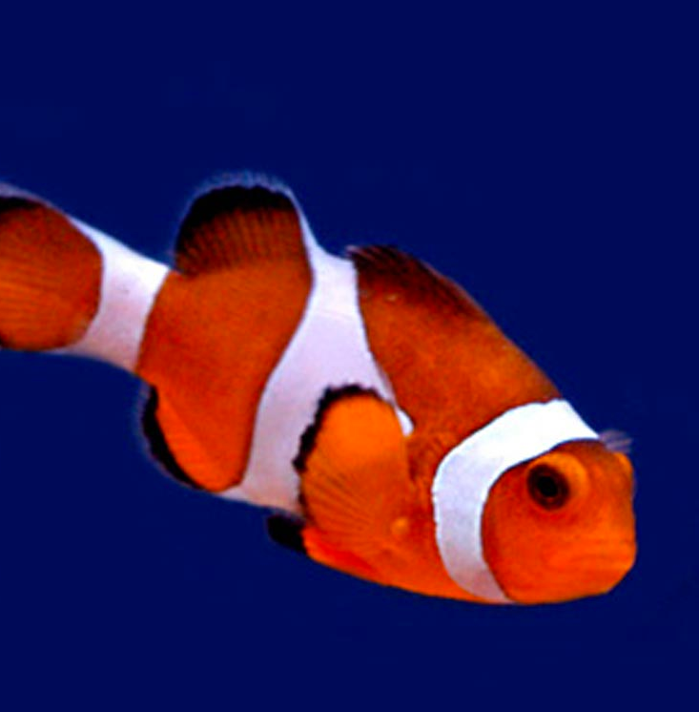
Choice of image features
“clown fish”
Instead, extract features learned by a neural net!
- Use a net that was trained to recognize objects or scenes.
- State-of-the-art features for lots of tasks.

Slide 27
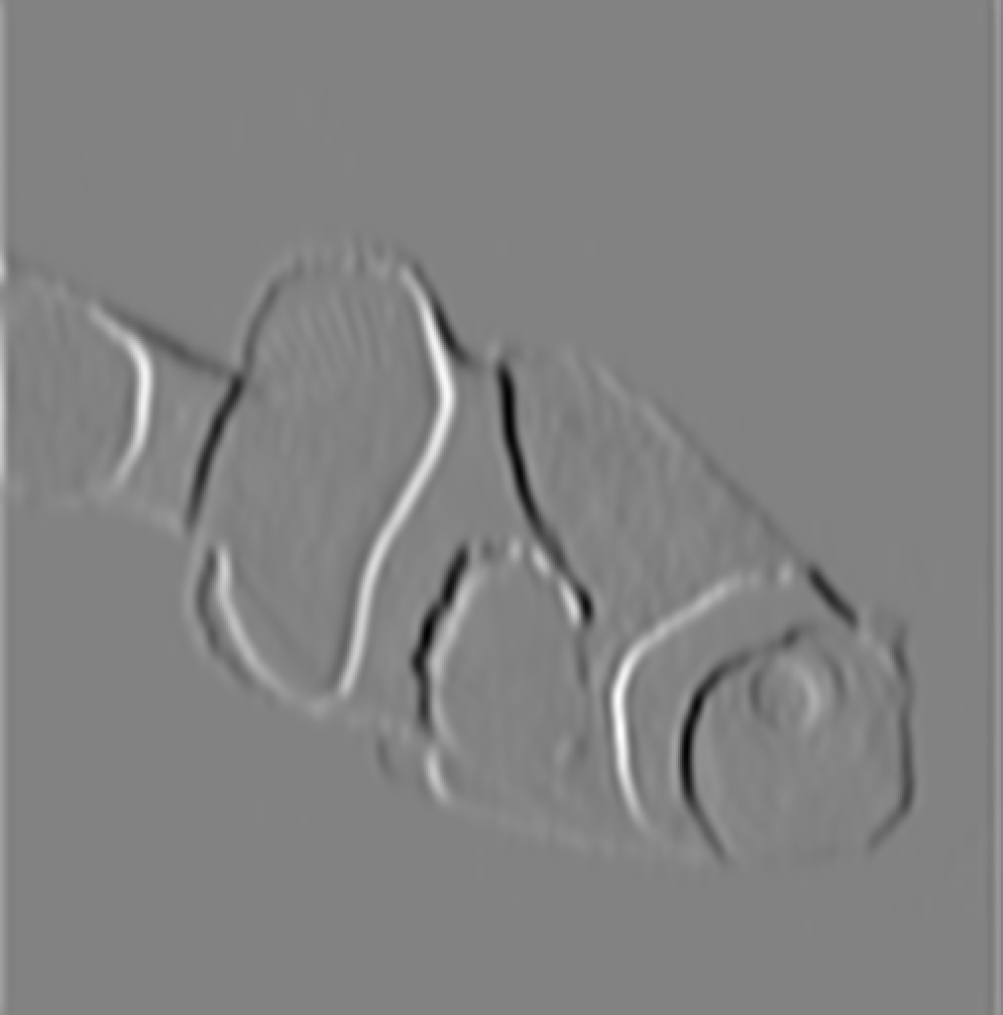
Extracting neural net features
convolution
(= matrix multiplication)

Slide 28
Extracting neural net features
“conv1”
convolution
then, nonlinearity
where
i.e. set negative values to 0.

Slide 29
Extracting neural net features
“conv2”

Slide 30
Extracting neural net features
“conv3”

Slide 31
Extracting neural net features
“clown fish”
log probability

Slide 32
Extracting neural net features
conv2 “feature activations”

Slide 33
Extracting neural net features
128
channels
conv2 “feature activations”
e.g. (112 x 112) x 128 for conv2
of one popular model (VGG19)
112
height
112 width

Slide 34
Texture statistics
128
channels
Gram (≈ covariance) matrix:
[Gatys et al. 2016]
Match target image stats
by minimizing:
Use all layers.
Minimize with gradient descent.

Slide 35
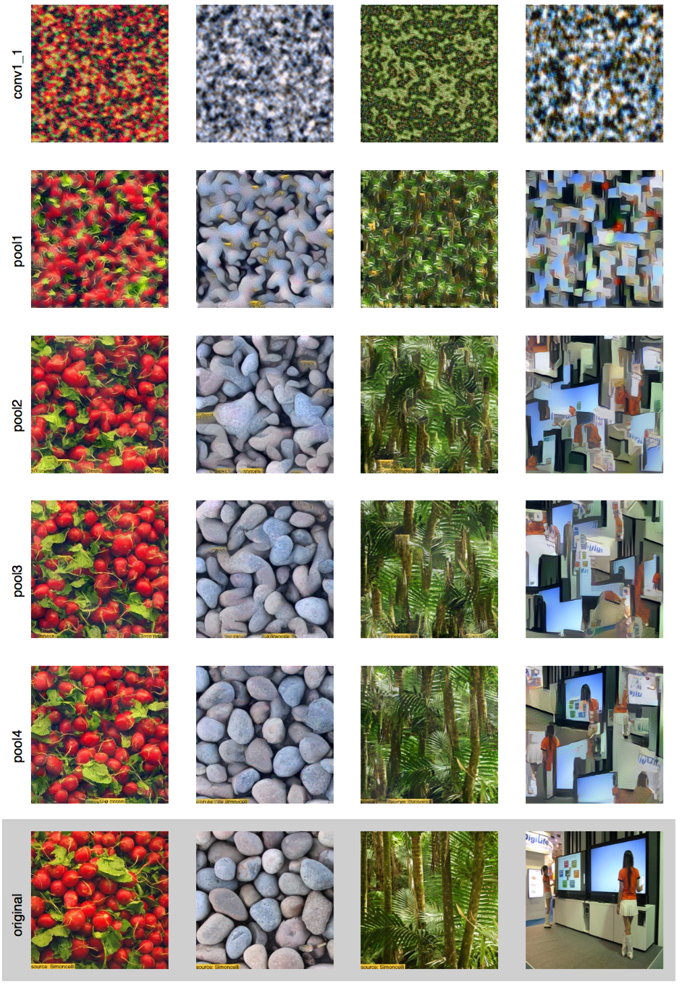
High
Low

Slide 36
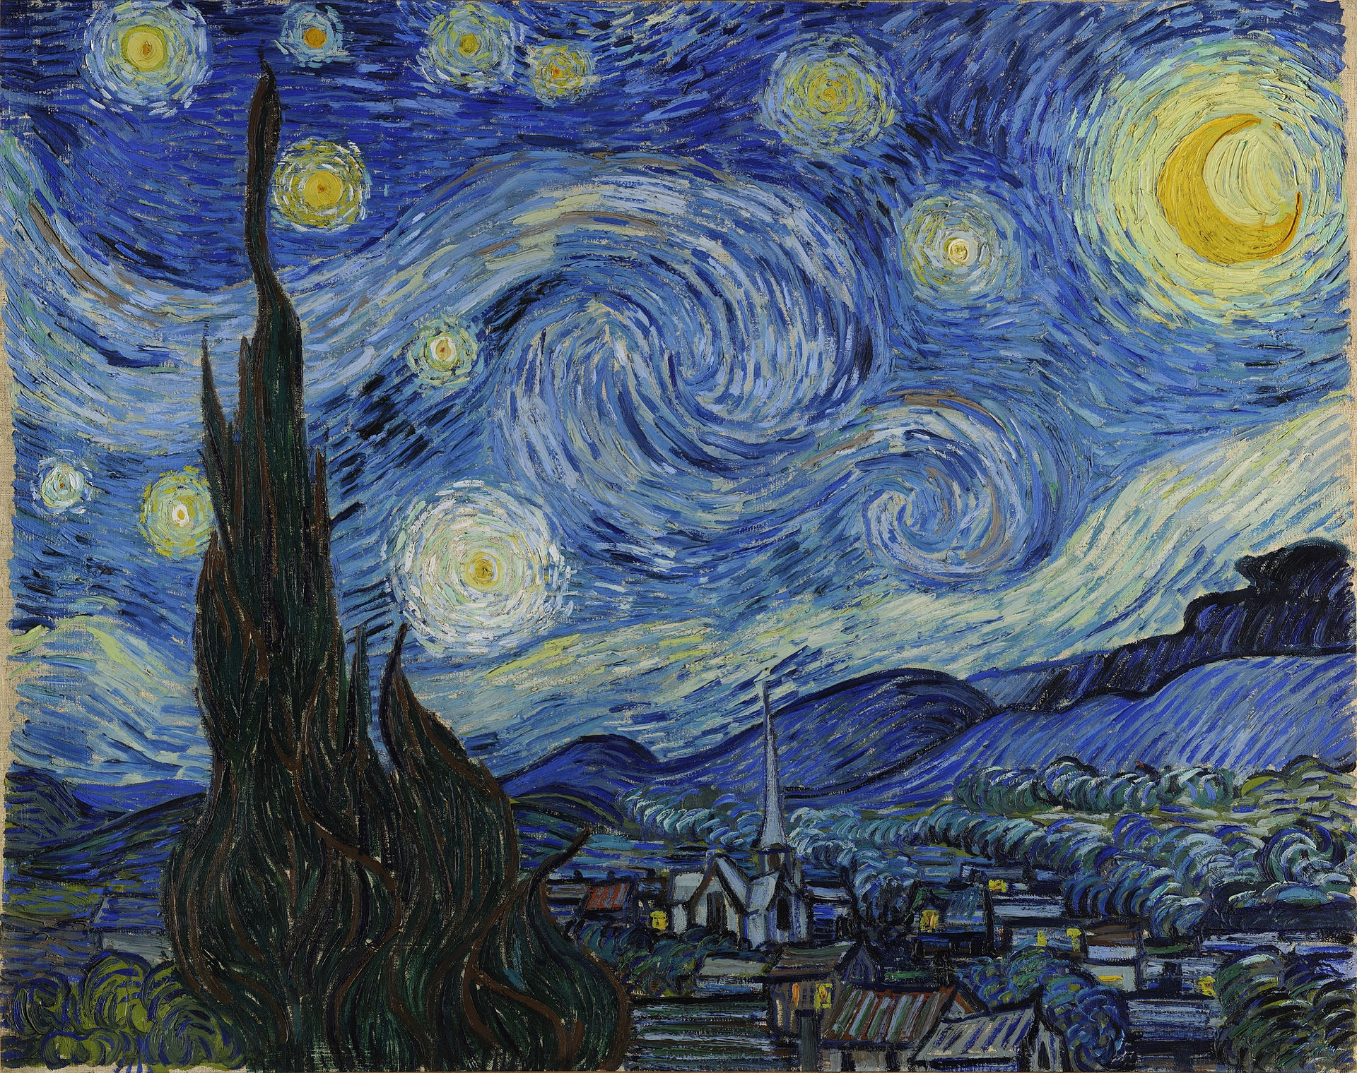
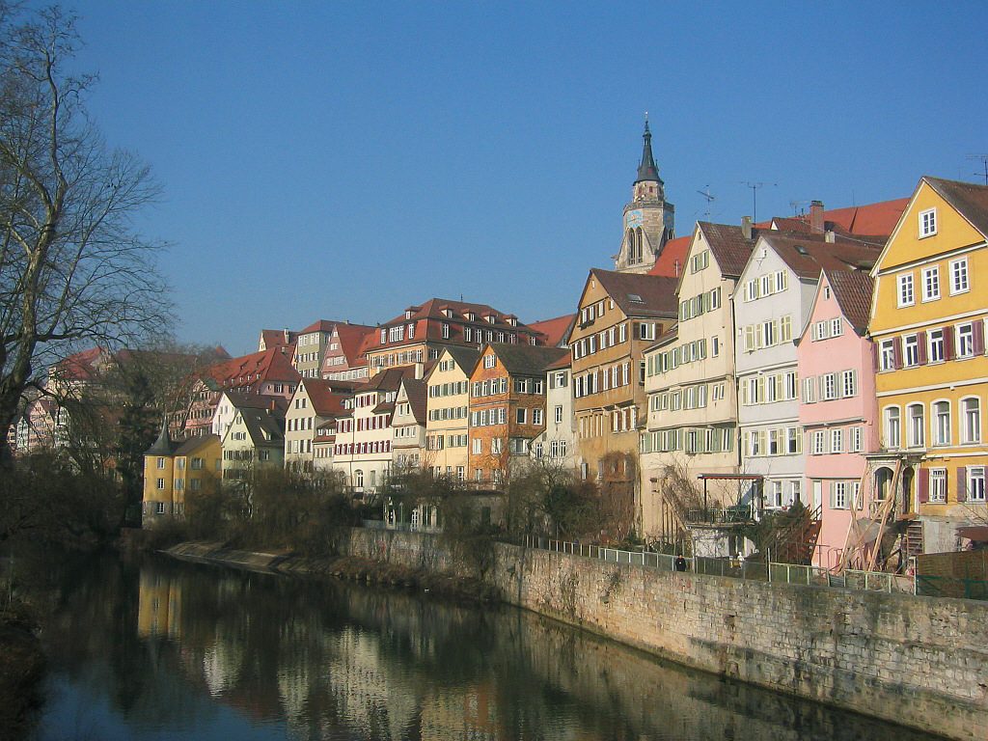
Texture captures artistic style.
Can we transfer the style of a painting to a photo?
[Gatys et al. 2016]

Slide 37
Match the “style” of the painting.
Synthesized image
And the “content” of the photo.

Slide 39
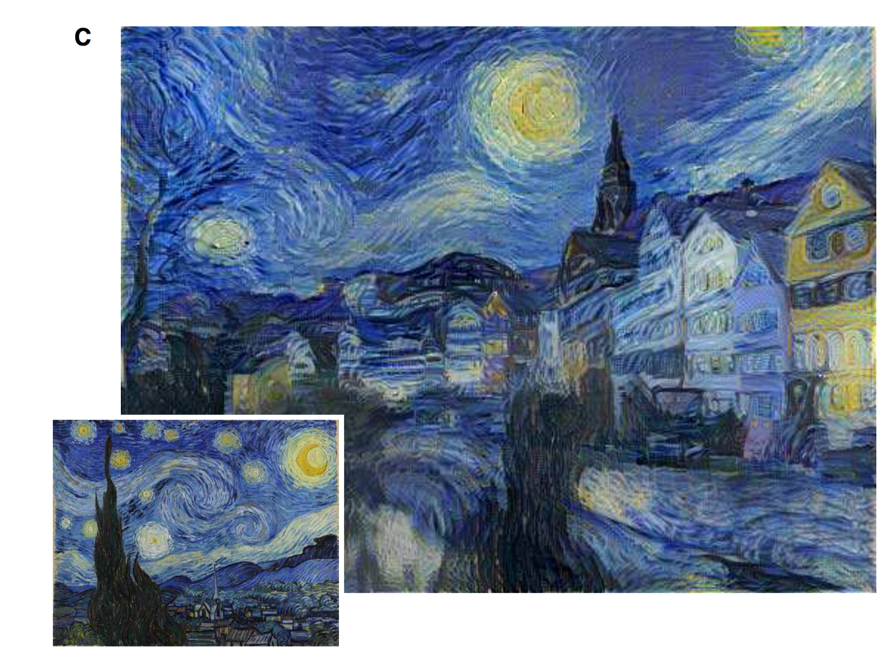

Slide 40
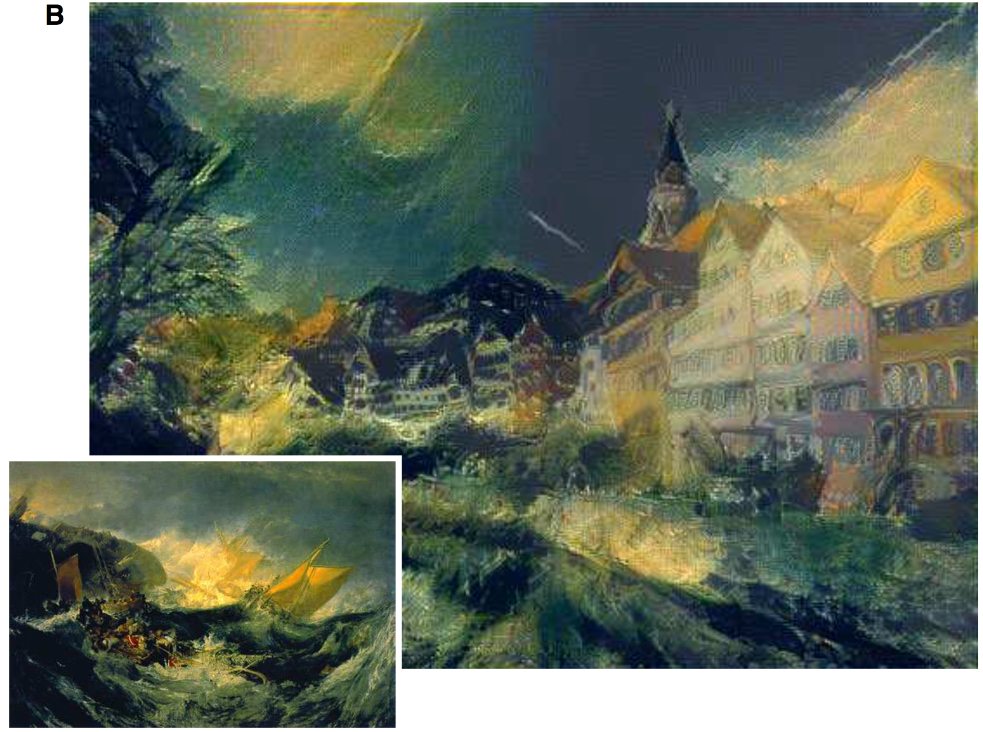
Notes:
The Shipwreck of the Minotaur

Slide 41
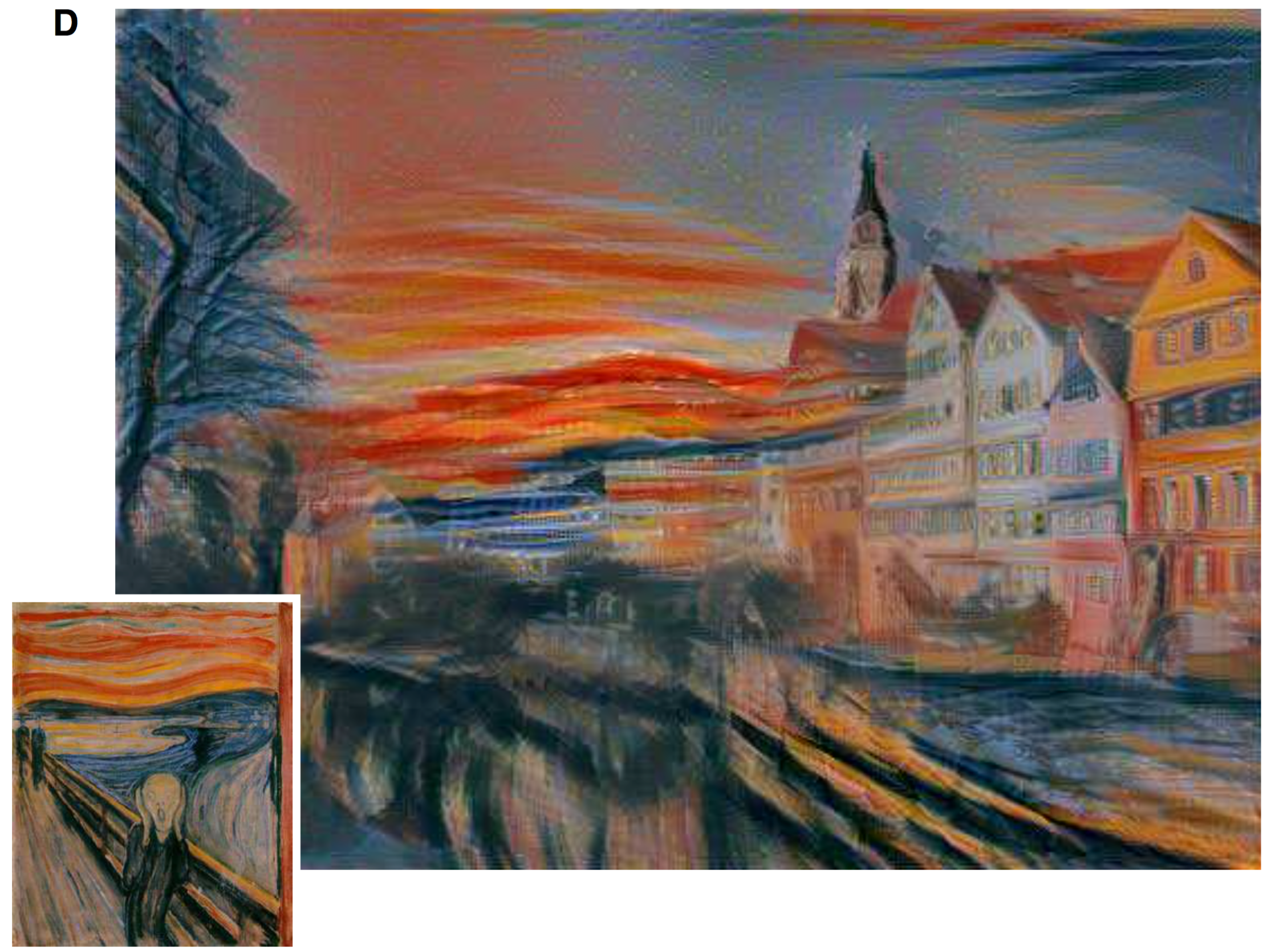
Notes:
The Scream.

Slide 42
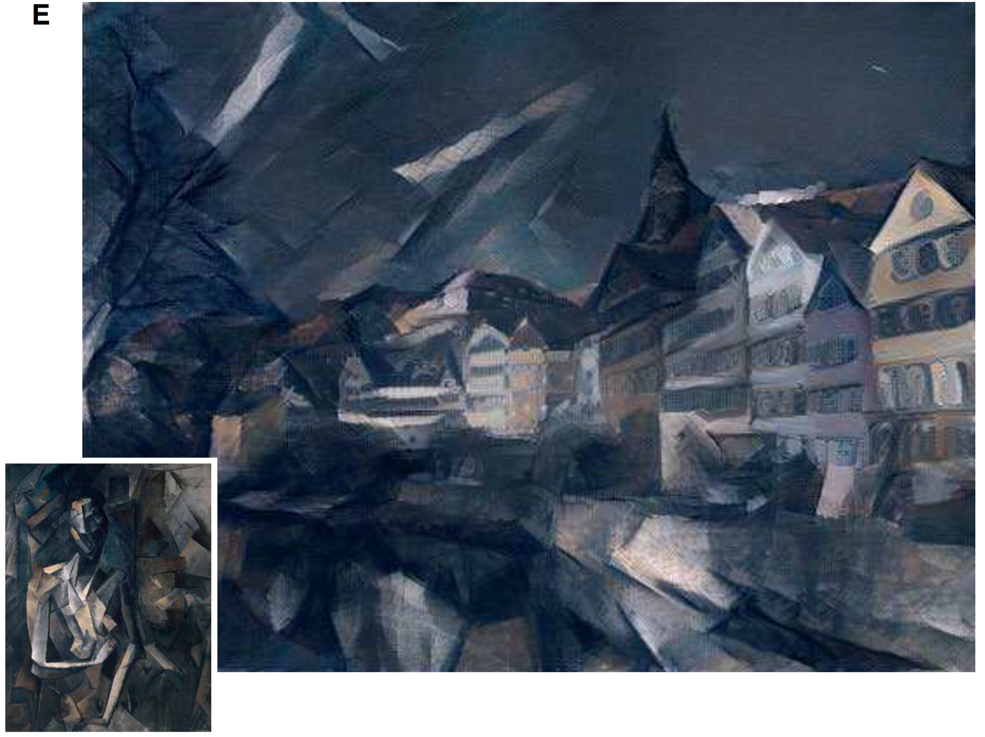
Notes:
Femme nue assise by

Slide 43
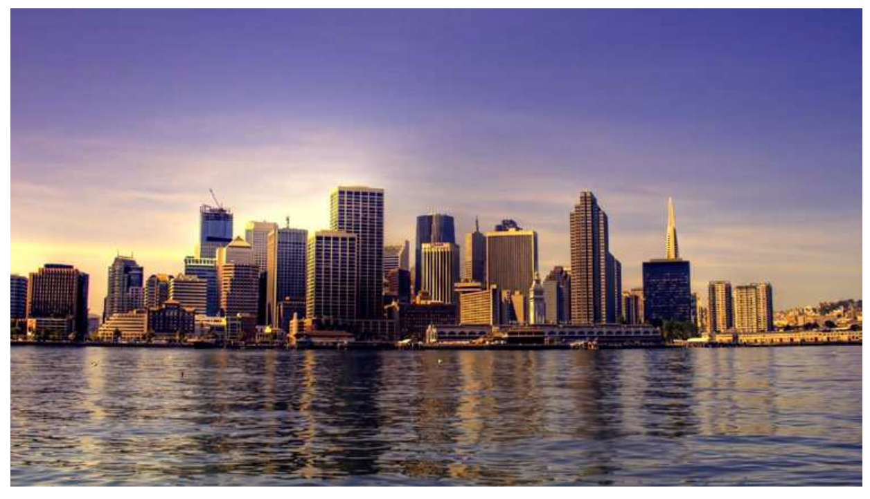
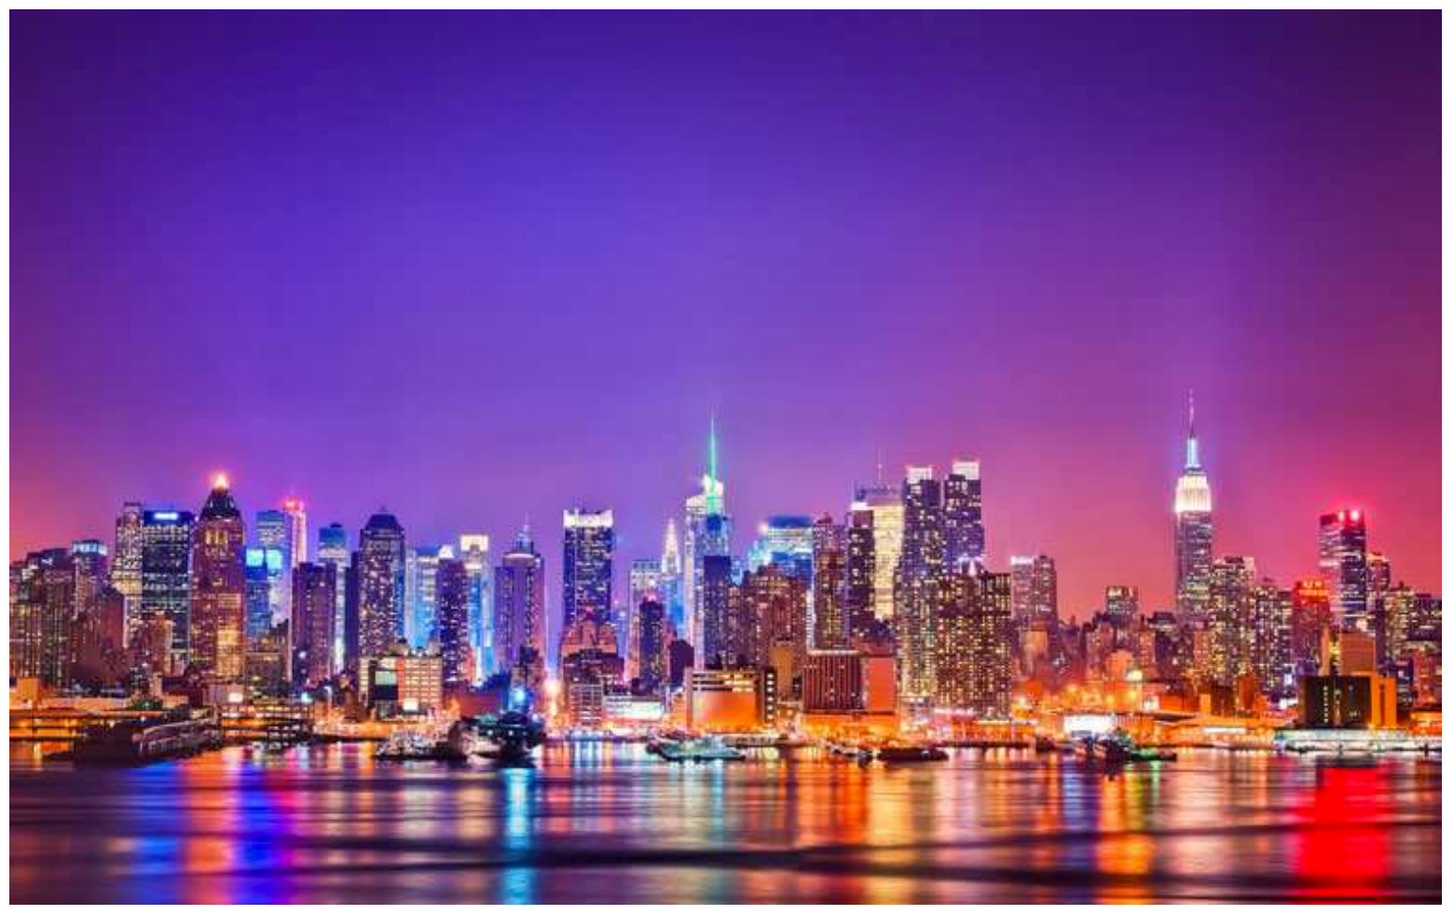
London during the day.
New York at night.
Notes:
New York by night, London by day.

Slide 44
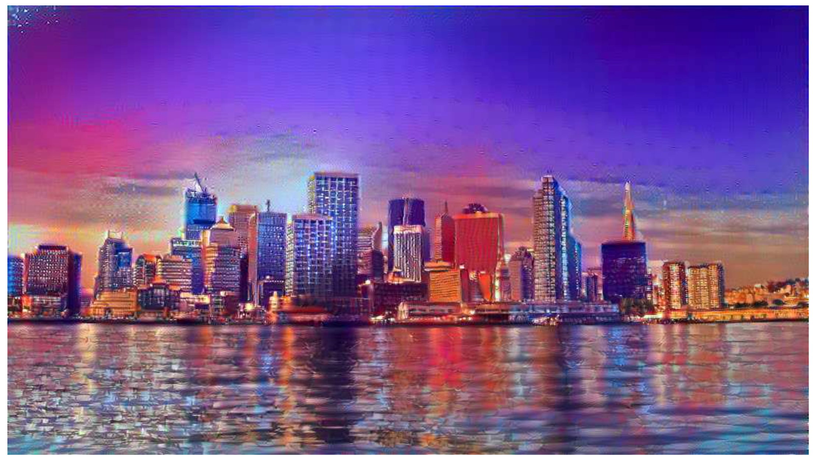
Notes:
New York by night, London by day.

Slide 45
Can we generate images using a neural net?
“clown fish”
Input image

Slide 46
Can we generate images using a neural net?
Gaussian noise
Synthesized image

Slide 47
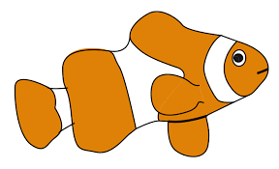
Generative adversarial nets (GANs)
Generator net
[Goodfellow et al. 2014]

Slide 48
Generative adversarial nets (GANs)
Generator net
Discriminator net
“fake”
[Goodfellow et al. 2014]

Slide 49
Generative adversarial nets (GANs)
1. Given D, minimize the probability of detection.
2. Given G, maximize classifier accuracy.
Training: iterate between training D and G with backprop.
Global optimum when G reproduces data distribution.

Slide 50
State-of-the-art: synthesizing images of bedrooms
DCGAN [Radford et al. 2015]
Slide adapted from Ian Goodfellow 2015

Slide 51
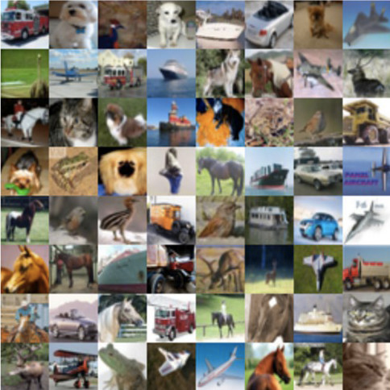
Training Data (CIFAR dataset)
[Salimans et al. 2016]
Slide adapted from Ian Goodfellow 2015

Slide 52
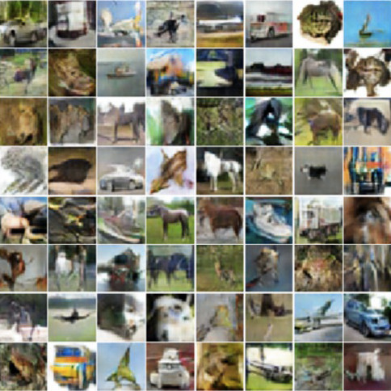
Samples
[Salimans et al. 2016]
Slide adapted from Ian Goodfellow 2015

Slide 53
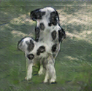
In high-res? Some relatively good results:
[Salimans et al. 2016]
Slide adapted from Ian Goodfellow 2015

Slide 54
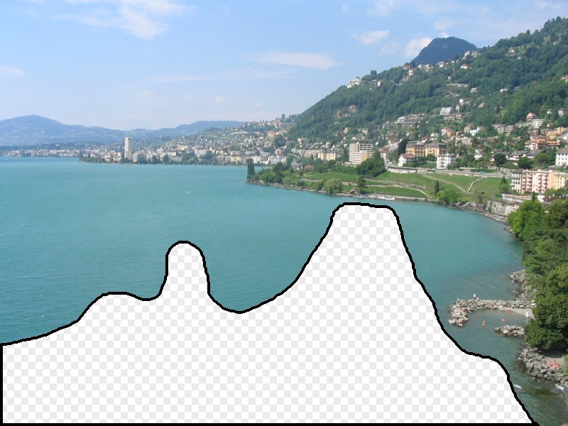
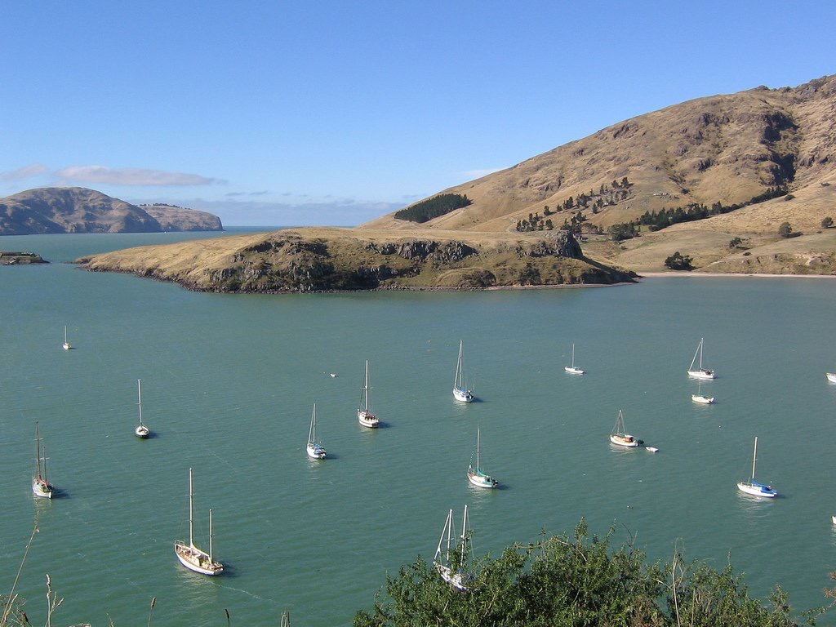
Inpainting with GANs
Recall: nonparametric approach
[Hays & Efros ’07]

Slide 55
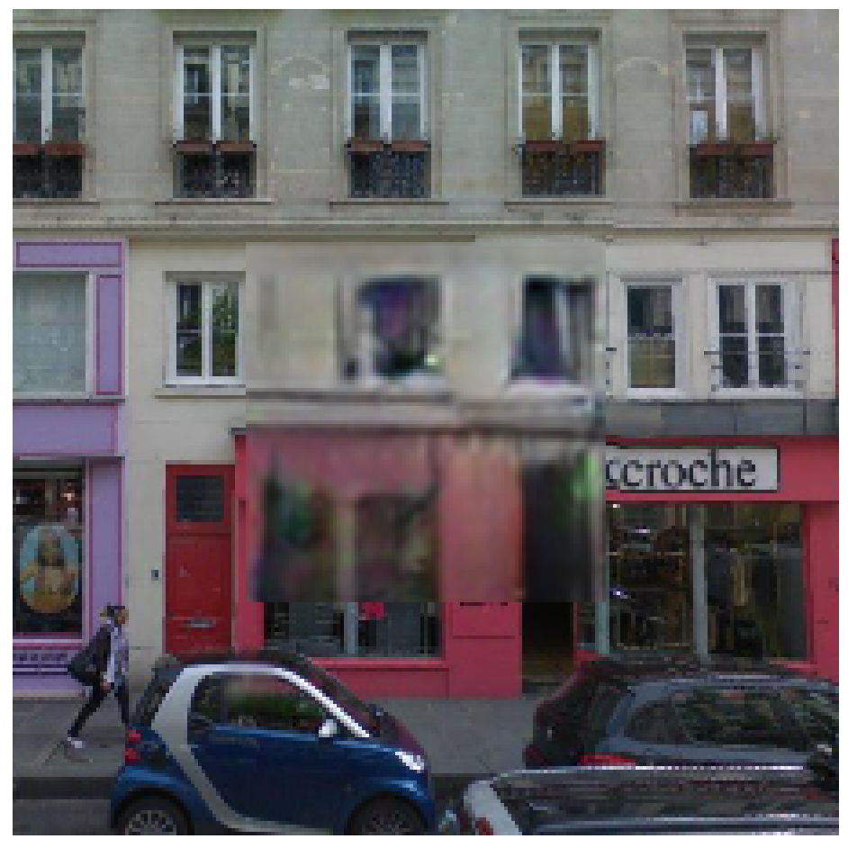
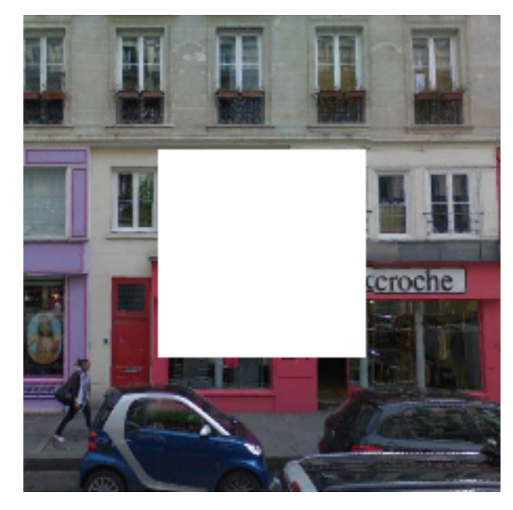
Inpainting with GANs
Generator net
[Pathak et al. 2016]

Slide 56
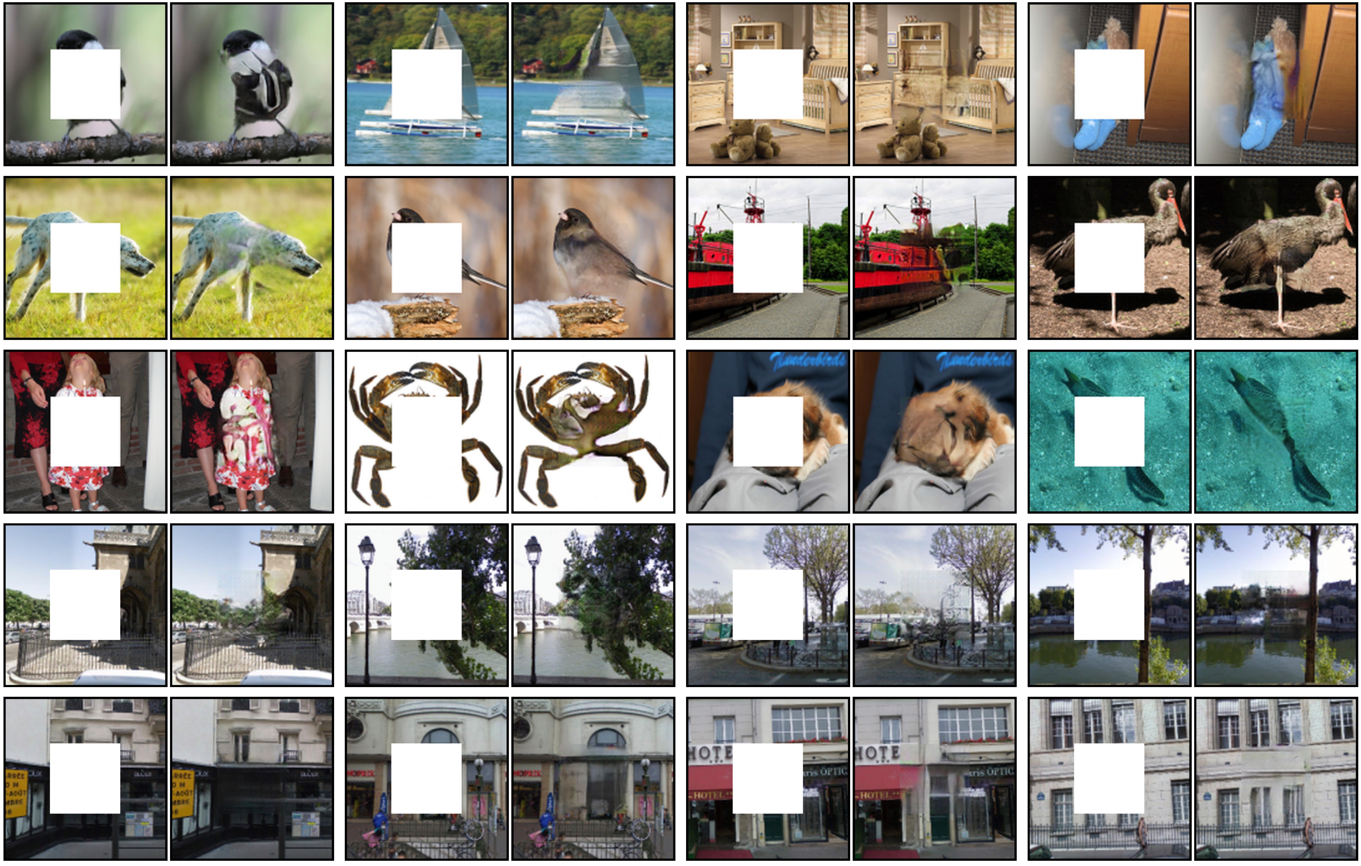

Slide 57
Interactive image editing with GANs
original photo
different degree of image manipulation
Project
Editing UI
Edit Transfer
projection on manifold
(estimate noise vector, z)
transition between the original
and edited projection

Slide 58
Constraining the GAN synthesis
user guidance image
Objective:
[Zhu et al. 2016]

Slide 59
Image Manipulation Demo

Slide 60
Image Manipulation Demo

Slide 61
Interactive image generation

Slide 62
Morphing between images

Slide 63
Synthesizing images and textures with neural nets
Texture can be represented parametrically via filter statistics.
Neural net feature activations are good representations of texture.
Can generate images using GANs
Next week: Alyosha is back!

