Slide 1
Convolutional Neural Networks
CS194: Computer Vision and Comp. Photo
Alexei Efros, UC Berkeley, Fall 2020

Slide 2
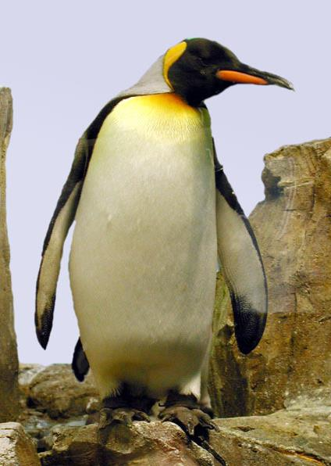
Neural Nets: a particularly useful Black Box
Convolutional Neural Network
“Penguin”
image X
label Y

Slide 3
Classic Object Recognition
Feature extractors
Classifier
Edges
Segments
Texture
“Penguin”
Parts
Colors
image X
label Y
Slide by Philip Isola

Slide 4
Classic Object Recognition
Learned
Feature extractors
Classifier
Edges
Segments
Texture
“Penguin”
Parts
Colors
image X
label Y
Slide by Philip Isola

Slide 5
Learning Features
Learned
Feature extractors
Edges
Texture
Colors
image X
label Y

Slide 6
Neural Network: algorithm + feature + data!
Learned
“Penguin”
image X
label Y
Slide by Philip Isola

Slide 7
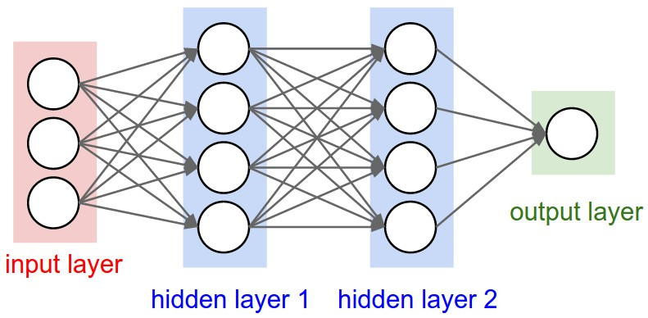
Vanilla (fully-connected) Neural Networks

Slide 8
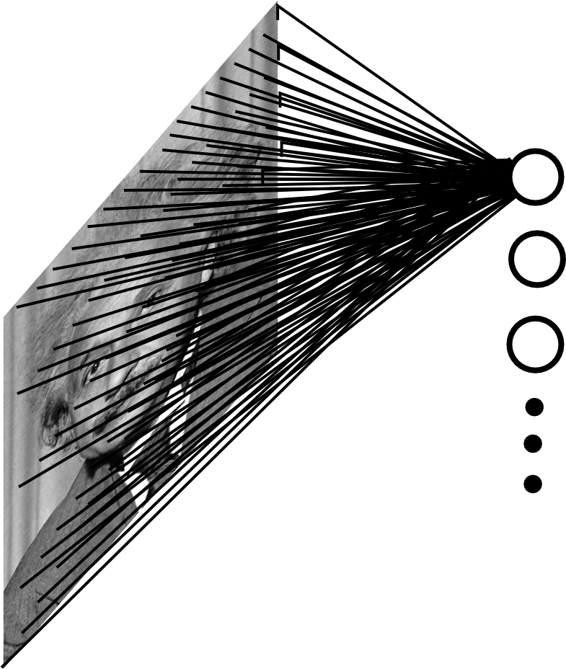
Fully Connected Layer
Example: 200x200 image
40K hidden units
~2B parameters!!!
- Spatial correlation is local
Waste of resources + we have not enough
training samples anyway..
Ranzato

Slide 9
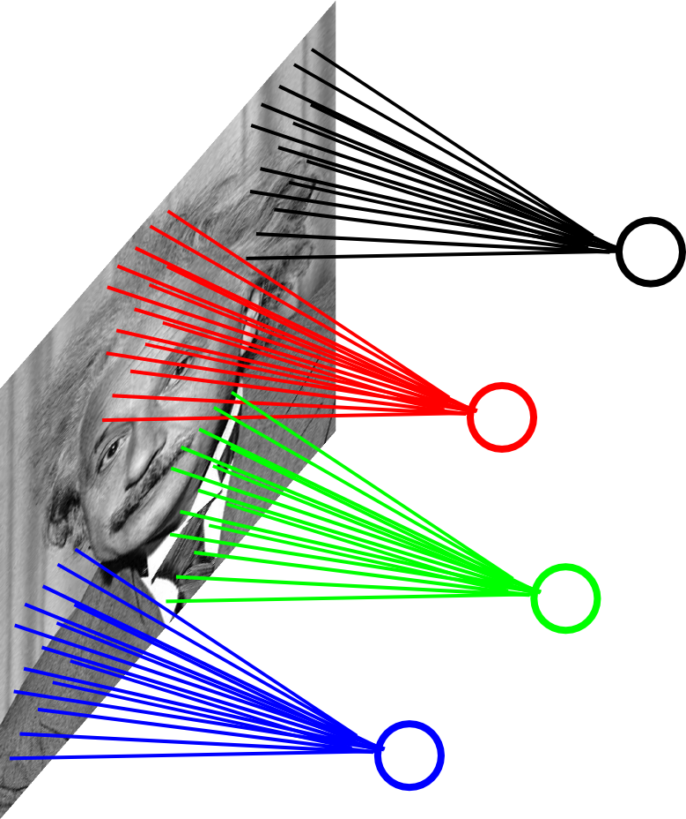
Locally Connected Layer
Example: 200x200 image
40K hidden units
Filter size: 10x10
4M parameters
Note: This parameterization is good when
input image is registered (e.g., face recognition).
Ranzato

Slide 10
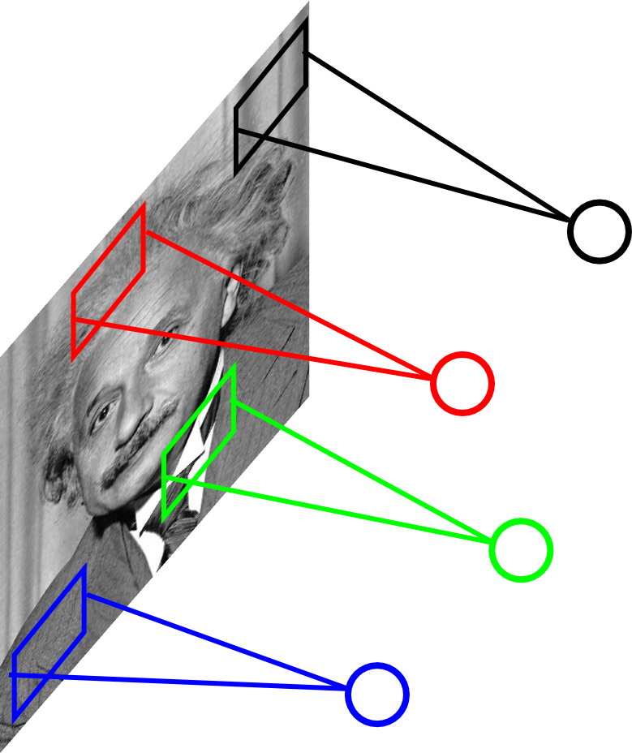
Locally Connected Layer
STATIONARITY? Statistics is similar at
different locations
Example: 200x200 image
40K hidden units
Filter size: 10x10
4M parameters
Ranzato

Slide 11
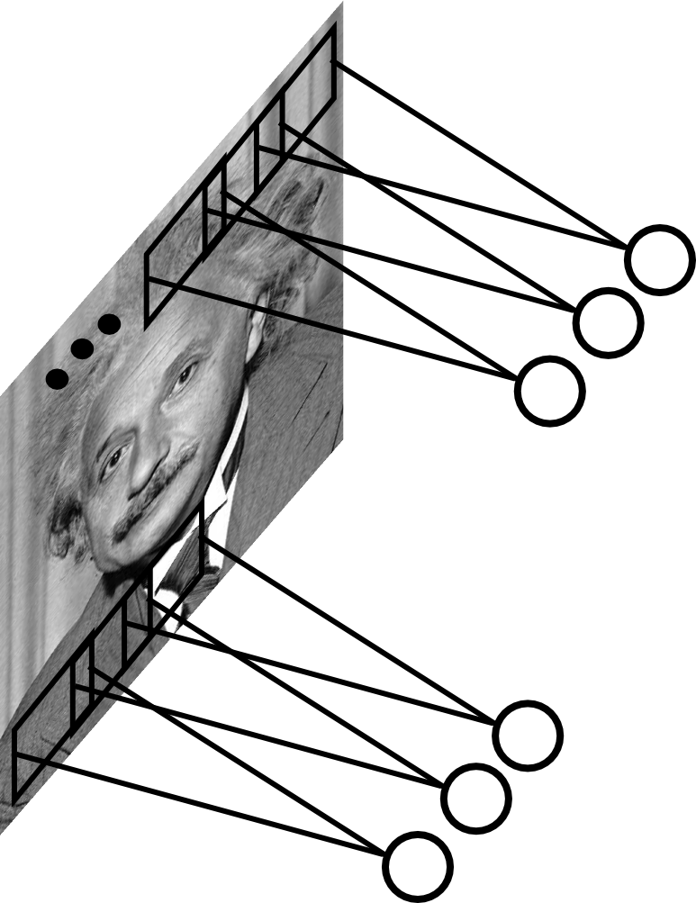
Convolutional Layer
Share the same parameters across different
locations (assuming input is stationary):
Convolutions with learned kernels
Ranzato

Slide 12
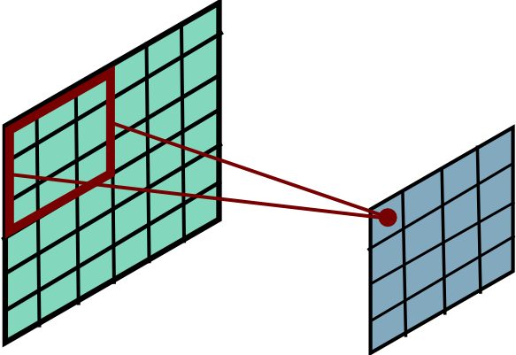
Convolutional Layer
Ranzato

Slide 13
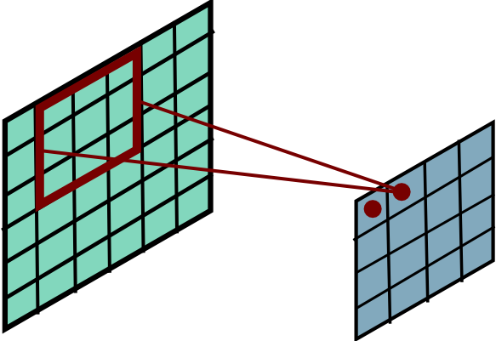
Convolutional Layer
Ranzato

Slide 14
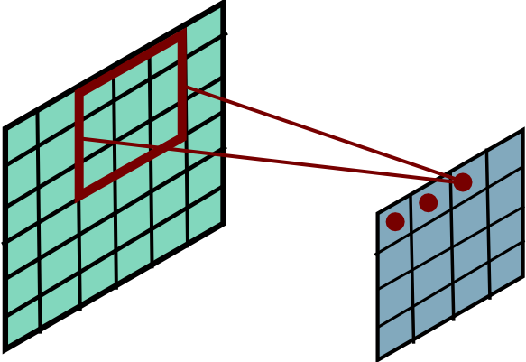
Convolutional Layer
Ranzato

Slide 15
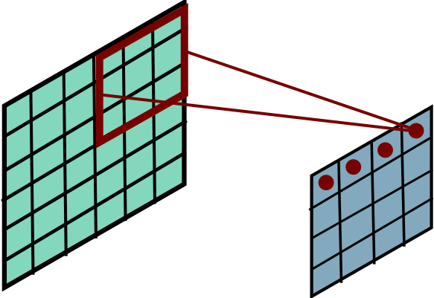
Convolutional Layer
Ranzato

Slide 16
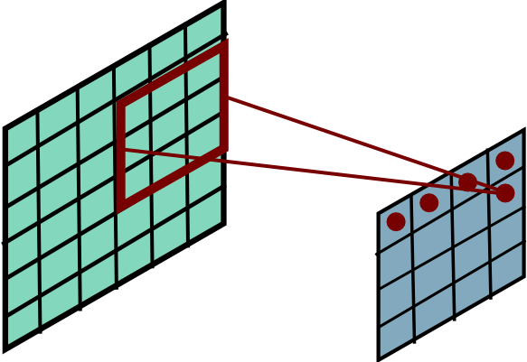
Convolutional Layer
Ranzato

Slide 17
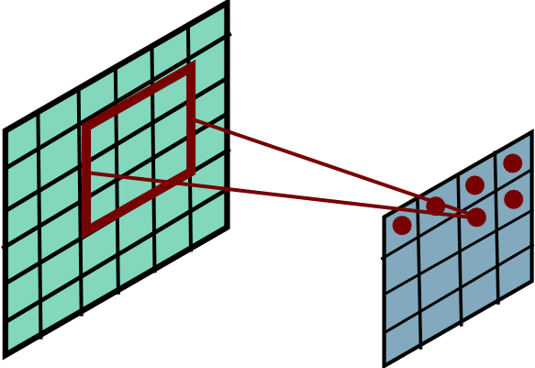
Convolutional Layer
Ranzato

Slide 18
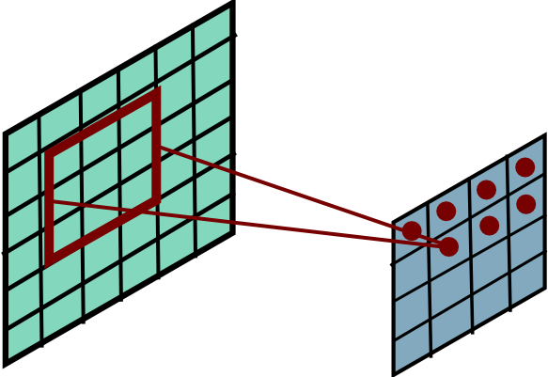
Convolutional Layer
Ranzato

Slide 19
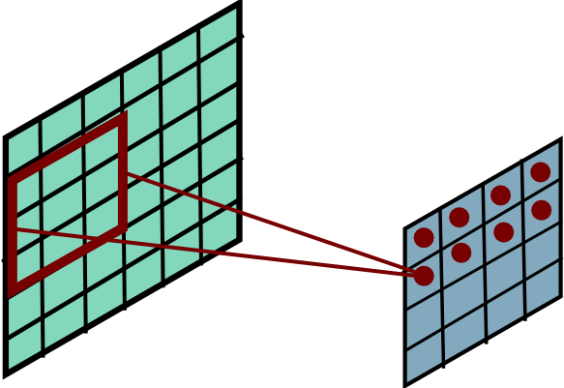
Convolutional Layer
Ranzato

Slide 20
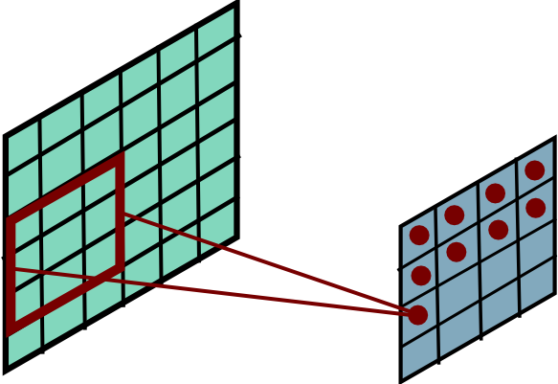
Convolutional Layer
Ranzato

Slide 21
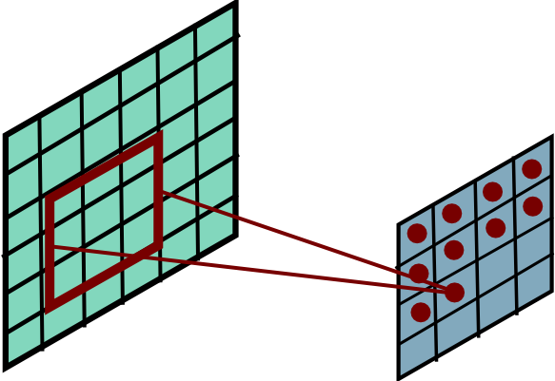
Convolutional Layer
Ranzato

Slide 22
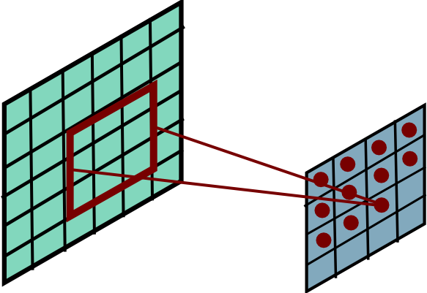
Convolutional Layer
Ranzato

Slide 23
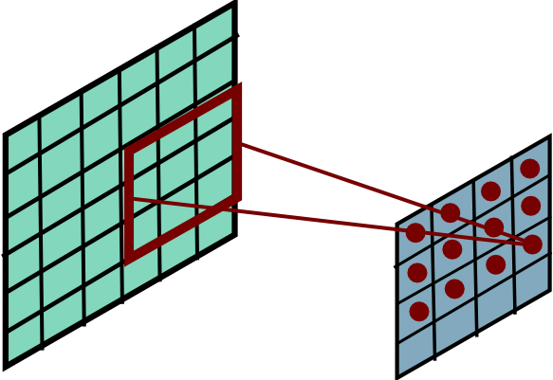
Convolutional Layer
Ranzato

Slide 24
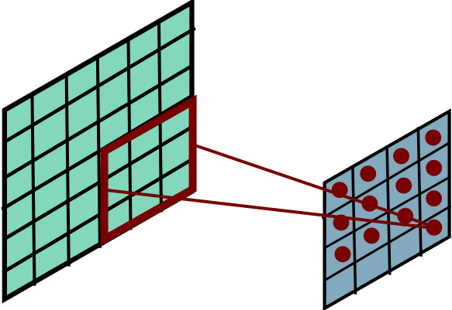
Convolutional Layer
Ranzato

Slide 25
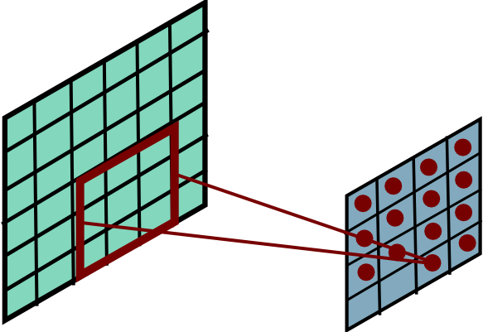
Convolutional Layer
Ranzato

Slide 26
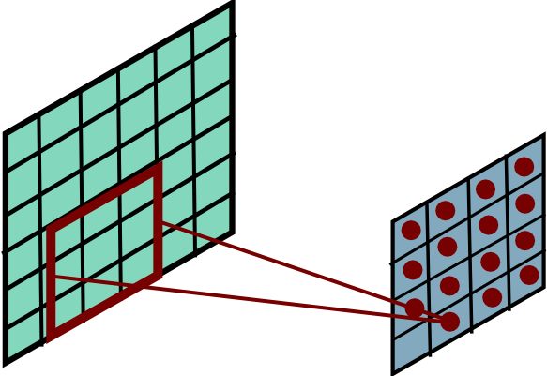
Convolutional Layer
Ranzato

Slide 27
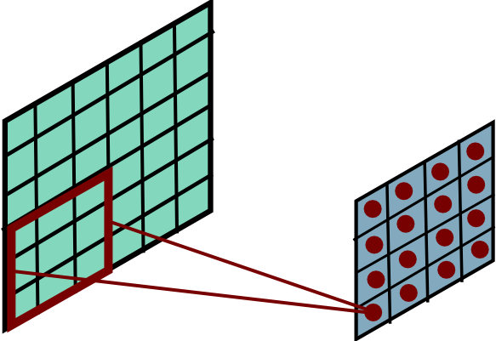
Convolutional Layer
Ranzato

Slide 28
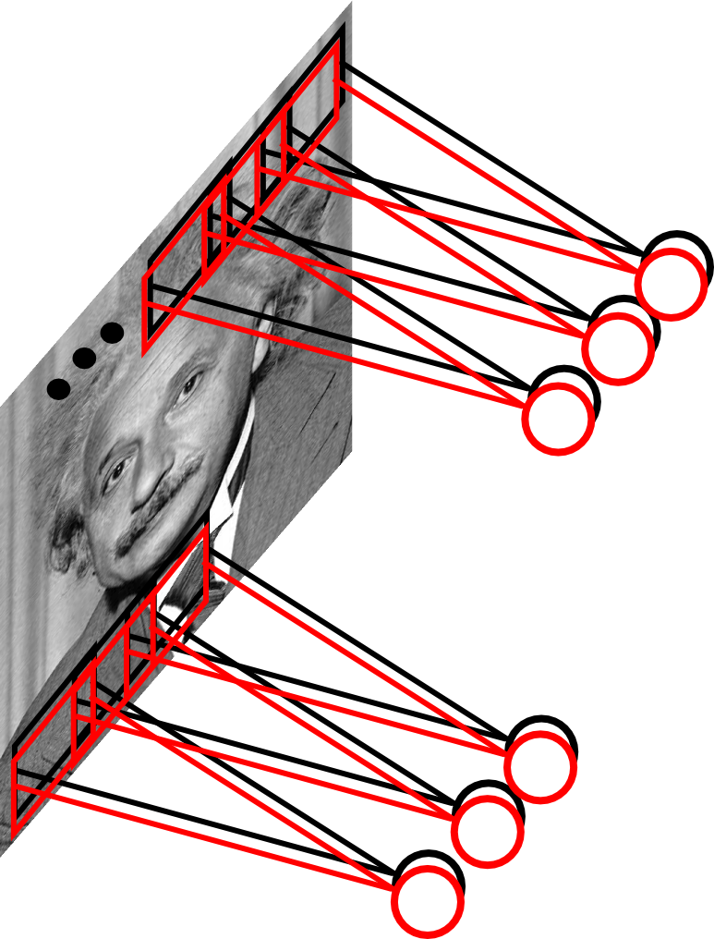
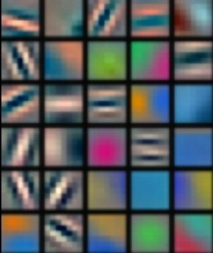
Convolutional Layer
Learn multiple filters.
E.g.: 200x200 image
100 Filters
Filter size: 10x10
10K parameters
Ranzato

Slide 29
before:
output layer
input layer
hidden layer
now:

Slide 30
Neural Network vs ConvNet
Fully connected:
Connects to everything
Convnet:
Connects locally
32
32
neuron
neuron
32
32
3
3
Slide credit: Karpathy and Fei-Fei

Slide 31
Convolution Layer
32x32x3 image
32
height
32
width
3
depth

Slide 32
Convolution Layer
32x32x3 image
5x5x3 filter
32
Convolve the filter with the image
i.e. “slide over the image spatially, computing dot products”
32
3

Slide 33
Convolution Layer
Filters always extend the full depth of the input volume
32x32x3 image
5x5x3 filter
32
Convolve the filter with the image
i.e. “slide over the image spatially, computing dot products”
32
3

Slide 34
Convolution Layer
32x32x3 image
5x5x3 filter
32
1 number:
the result of taking a dot product between the filter and a small 5x5x3 chunk of the image
(i.e. 5*5*3 = 75-dimensional dot product + bias)
32
3

Slide 35
Convolution Layer
activation map
32x32x3 image
5x5x3 filter
32
28
convolve (slide) over all spatial locations
32
28
3
1

Slide 36
consider a second, green filter
Convolution Layer
32x32x3 image
5x5x3 filter
activation maps
32
28
convolve (slide) over all spatial locations
32
28
3
1

Slide 37
For example, if we had 6 5x5 filters, we’ll get 6 separate activation maps:
activation maps
32
28
Convolution Layer
32
28
3
6
We stack these up to get a “new image” of size 28x28x6!

Slide 38
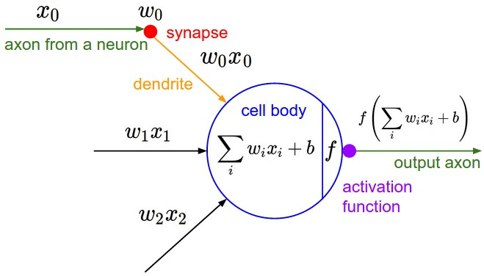
The brain/neuron view of CONV Layer
32
28
An activation map is a 28x28 sheet of neuron outputs:
Each is connected to a small region in the input
All of them share parameters
“5x5 filter” -> “5x5 receptive field for each neuron”
32
28
3

Slide 39
The brain/neuron view of CONV Layer
32
E.g. with 5 filters,
CONV layer consists of neurons arranged in a 3D grid
(28x28x5)
There will be 5 different neurons all looking at the same region in the input volume
28
32
28
3
5

Slide 40
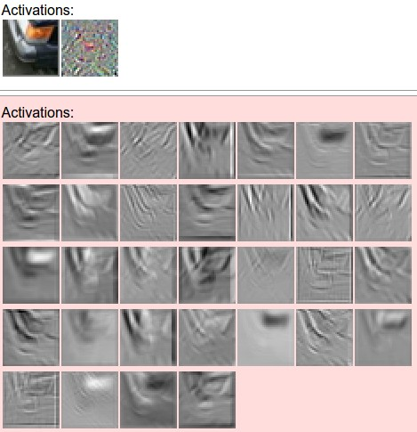
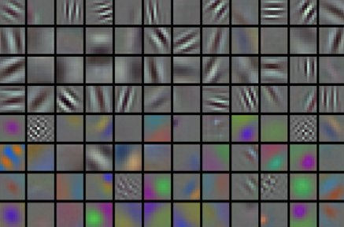
convolving the first filter in the input gives the first slice of depth in output volume

Slide 41
Preview: ConvNet is a sequence of Convolution Layers, interspersed with activation functions
32
28
CONV,
ReLU
e.g. 6 5x5x3 filters
32
28
3
6

Slide 42
Preview: ConvNet is a sequence of Convolutional Layers, interspersed with activation functions
32
28
24
….
CONV,
ReLU
e.g. 6 5x5x3 filters
CONV,
ReLU
e.g. 10 5x5x6 filters
CONV,
ReLU
32
28
24
3
6
10

Slide 43
A closer look at spatial dimensions:
activation map
32x32x3 image
5x5x3 filter
32
28
convolve (slide) over all spatial locations
32
28
3
1

Slide 44
Stride
7
7x7 input (spatially)
assume 3x3 filter
7

Slide 45
Stride
7
7x7 input (spatially)
assume 3x3 filter
7

Slide 46
Stride
7
7x7 input (spatially)
assume 3x3 filter
7

Slide 47
Stride
7
7x7 input (spatially)
assume 3x3 filter
7

Slide 48
Stide
7
7x7 input (spatially)
assume 3x3 filter
=> 5x5 output
7

Slide 49
Stride
7
7x7 input (spatially)
assume 3x3 filter
applied with stride 2
7

Slide 50
Stride
7
7x7 input (spatially)
assume 3x3 filter
applied with stride 2
7

Slide 51
Stide
7
7x7 input (spatially)
assume 3x3 filter
applied with stride 2
=> 3x3 output!
7

Slide 52
A closer look at spatial dimensions:
7
7x7 input (spatially)
assume 3x3 filter
applied with stride 3?
7

Slide 53
A closer look at spatial dimensions:
7
7x7 input (spatially)
assume 3x3 filter
applied with stride 3?
7
doesn’t fit!
cannot apply 3x3 filter on 7x7 input with stride 3.

Slide 54
N
Output size:
(N - F) / stride + 1
e.g. N = 7, F = 3:
stride 1 => (7 - 3)/1 + 1 = 5
stride 2 => (7 - 3)/2 + 1 = 3
stride 3 => (7 - 3)/3 + 1 = 2.33 :\
F
N
F

Slide 55
In practice: Common to zero pad the border
0 | 0 | 0 | 0 | 0 | 0
0
0
0
0
e.g. input 7x7
3x3 filter, applied with stride 1
pad with 1 pixel border => what is the output?
(recall:)
(N - F) / stride + 1

Slide 56
In practice: Common to zero pad the border
0 | 0 | 0 | 0 | 0 | 0
0
0
0
0
e.g. input 7x7
3x3 filter, applied with stride 1
pad with 1 pixel border => what is the output?
7x7 output!

Slide 57
In practice: Common to zero pad the border
0 | 0 | 0 | 0 | 0 | 0
0
0
0
0
e.g. input 7x7
3x3 filter, applied with stride 1
pad with 1 pixel border => what is the output?
7x7 output!
in general, common to see CONV layers with stride 1, filters of size FxF, and zero-padding with (F-1)/2. (will preserve size spatially)
e.g. F = 3 => zero pad with 1
F = 5 => zero pad with 2
F = 7 => zero pad with 3

Slide 58
(btw, 1x1 convolution layers make perfect sense)
1x1 CONV
with 32 filters
56
56
(each filter has size 1x1x64, and performs a 64-dimensional dot product)
56
56
64
32

Slide 59
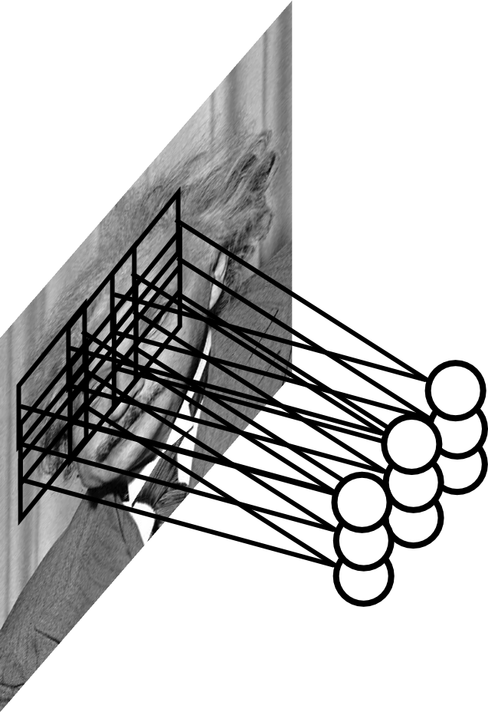
Pooling Layer
Let us assume filter is an “eye” detector.
Q.: how can we make the detection robust to the
exact location of the eye?
Ranzato

Slide 60
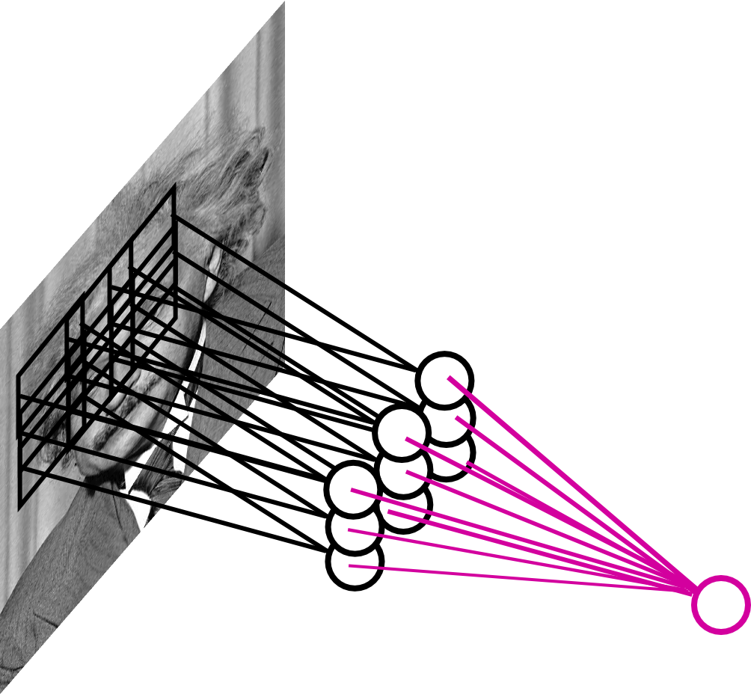
Pooling Layer
By “pooling” (e.g., taking max) filter
responses at different locations we gain
robustness to the exact spatial location
of features.
Ranzato

Slide 61
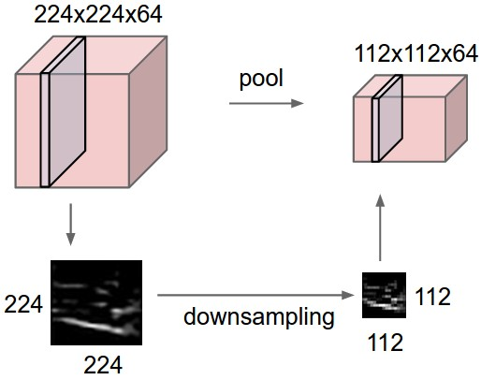
Pooling layer
makes the representations smaller and more manageable
operates over each activation map independently:

Slide 62
MAX POOLING
Single depth slice
1 | 1 | 2 | 4
5 | 6 | 7 | 8
3 | 2 | 1 | 0
1 | 2 | 3 | 4
x
max pool with 2x2 filters and stride 2
6 | 8
3 | 4
y

Slide 63
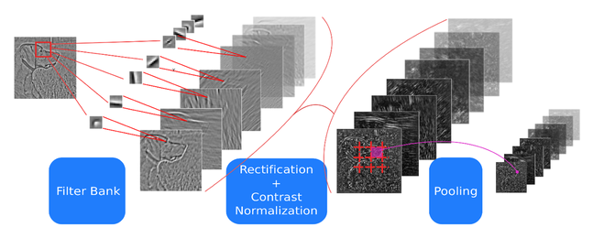
ConvNets: Typical Stage
One stage (zoom)
Convol.
Pooling
courtesy of
K. Kavukcuoglu
Ranzato

Slide 64
Case Study: LeNet-5
[LeCun et al., 1998]
Conv filters were 5x5, applied at stride 1
Subsampling (Pooling) layers were 2x2 applied at stride 2
i.e. architecture is [CONV-POOL-CONV-POOL-CONV-FC]

Slide 65
Handwritten digit classification
[Courtesy of Yann LeCun]

Slide 66
AlexNet
Input
Conv
1
Conv
2
Conv
3
Conv
4
Conv
5
FC
6
FC
7
Output
227x2273
55x5596
27x27256
13x13384
13x13
384
13x13
256
1x1
4096
1x1
4096
1x1
1000
Each block is a HxWxC volume.
You transform one volume to another with convolution

Slide 67
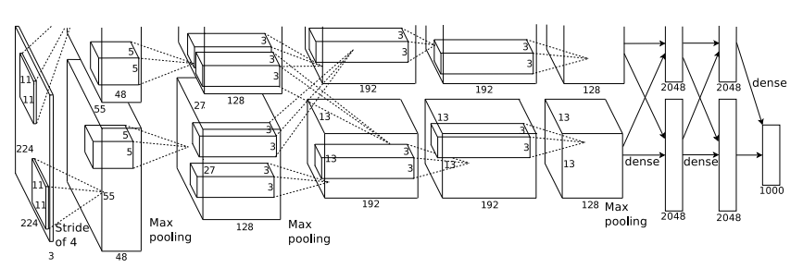
Case Study: AlexNet
[Krizhevsky et al. 2012]
Input: 227x227x3 images
First layer (CONV1): 96 11x11 filters applied at stride 4
=>
Q: what is the output volume size? Hint: (227-11)/4+1 = 55

Slide 68
Case Study: AlexNet
[Krizhevsky et al. 2012]
Input: 227x227x3 images
First layer (CONV1): 96 11x11 filters applied at stride 4
=>
Output volume [55x55x96]
Q: What is the total number of parameters in this layer?

Slide 69
Case Study: AlexNet
[Krizhevsky et al. 2012]
Input: 227x227x3 images
First layer (CONV1): 96 11x11 filters applied at stride 4
=>
Output volume [55x55x96]
Parameters: (11*11*3)*96 = 35K

Slide 70
Case Study: AlexNet
[Krizhevsky et al. 2012]
Input: 227x227x3 images
After CONV1: 55x55x96
Second layer (POOL1): 3x3 filters applied at stride 2
Q: what is the output volume size? Hint: (55-3)/2+1 = 27

Slide 71
Case Study: AlexNet
[Krizhevsky et al. 2012]
Input: 227x227x3 images
After CONV1: 55x55x96
Second layer (POOL1): 3x3 filters applied at stride 2
Output volume: 27x27x96
Q: what is the number of parameters in this layer?

Slide 72
Case Study: AlexNet
[Krizhevsky et al. 2012]
Input: 227x227x3 images
After CONV1: 55x55x96
Second layer (POOL1): 3x3 filters applied at stride 2
Output volume: 27x27x96
Parameters: 0!

Slide 73
Case Study: AlexNet
[Krizhevsky et al. 2012]
Input: 227x227x3 images
After CONV1: 55x55x96
After POOL1: 27x27x96
...

Slide 74
Case Study: AlexNet
[Krizhevsky et al. 2012]
Full (simplified) AlexNet architecture:
[227x227x3] INPUT
[55x55x96] CONV1: 96 11x11 filters at stride 4, pad 0
[27x27x96] MAX POOL1: 3x3 filters at stride 2
[27x27x96] NORM1: Normalization layer
[27x27x256] CONV2: 256 5x5 filters at stride 1, pad 2
[13x13x256] MAX POOL2: 3x3 filters at stride 2
[13x13x256] NORM2: Normalization layer
[13x13x384] CONV3: 384 3x3 filters at stride 1, pad 1
[13x13x384] CONV4: 384 3x3 filters at stride 1, pad 1
[13x13x256] CONV5: 256 3x3 filters at stride 1, pad 1
[6x6x256] MAX POOL3: 3x3 filters at stride 2
[4096] FC6: 4096 neurons
[4096] FC7: 4096 neurons
[1000] FC8: 1000 neurons (class scores)

Slide 75
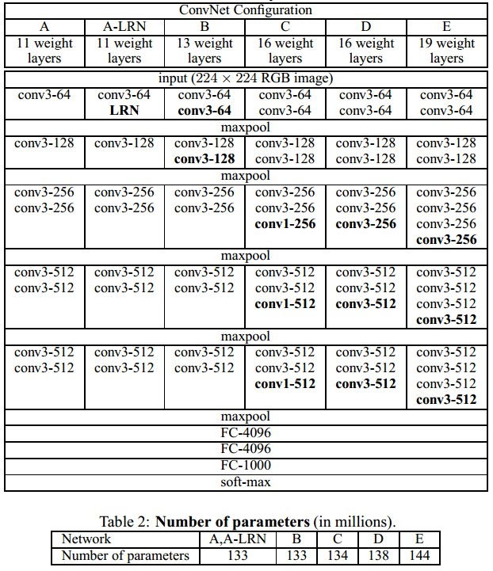
Case Study: VGGNet
[Simonyan and Zisserman, 2014]
Only 3x3 CONV stride 1, pad 1
and 2x2 MAX POOL stride 2

Slide 76
VGG16
Input
Conv
1
Conv
2
Conv
3
Conv
4
Conv
5
FC
6
FC
7
Output
224x2243
224x224
64
112x112
128
56x56
256
28x28
512
14x14
512
1x1
4096
1x1
4096
1x1
1000
All filters 3x3
All filters followed by ReLU

Slide 77
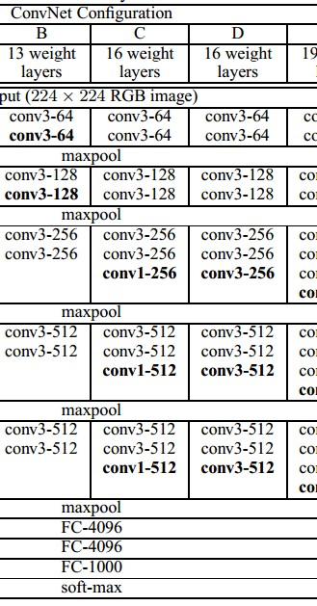
INPUT: [224x224x3] memory: 224*224*3=150K params: 0
CONV3-64: [224x224x64] memory: 224*224*64=3.2M params: (3*3*3)*64 = 1,728
CONV3-64: [224x224x64] memory: 224*224*64=3.2M params: (3*3*64)*64 = 36,864
POOL2: [112x112x64] memory: 112*112*64=800K params: 0
CONV3-128: [112x112x128] memory: 112*112*128=1.6M params: (3*3*64)*128 = 73,728
CONV3-128: [112x112x128] memory: 112*112*128=1.6M params: (3*3*128)*128 = 147,456
POOL2: [56x56x128] memory: 56*56*128=400K params: 0
CONV3-256: [56x56x256] memory: 56*56*256=800K params: (3*3*128)*256 = 294,912
CONV3-256: [56x56x256] memory: 56*56*256=800K params: (3*3*256)*256 = 589,824
CONV3-256: [56x56x256] memory: 56*56*256=800K params: (3*3*256)*256 = 589,824
POOL2: [28x28x256] memory: 28*28*256=200K params: 0
CONV3-512: [28x28x512] memory: 28*28*512=400K params: (3*3*256)*512 = 1,179,648
CONV3-512: [28x28x512] memory: 28*28*512=400K params: (3*3*512)*512 = 2,359,296
CONV3-512: [28x28x512] memory: 28*28*512=400K params: (3*3*512)*512 = 2,359,296
POOL2: [14x14x512] memory: 14*14*512=100K params: 0
CONV3-512: [14x14x512] memory: 14*14*512=100K params: (3*3*512)*512 = 2,359,296
CONV3-512: [14x14x512] memory: 14*14*512=100K params: (3*3*512)*512 = 2,359,296
CONV3-512: [14x14x512] memory: 14*14*512=100K params: (3*3*512)*512 = 2,359,296
POOL2: [7x7x512] memory: 7*7*512=25K params: 0
FC: [1x1x4096] memory: 4096 params: 7*7*512*4096 = 102,760,448
FC: [1x1x4096] memory: 4096 params: 4096*4096 = 16,777,216
FC: [1x1x1000] memory: 1000 params: 4096*1000 = 4,096,000
(not counting biases)

Slide 78
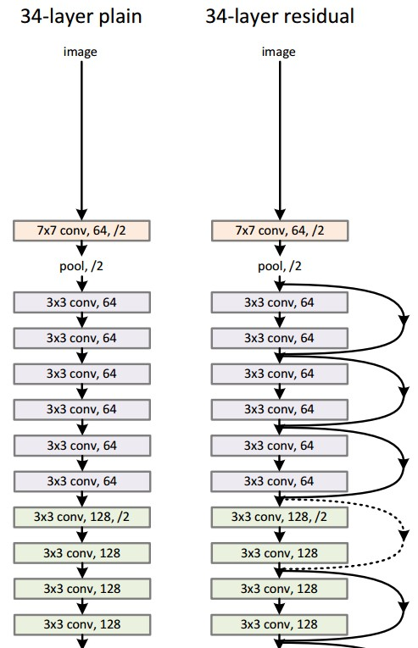
Case Study:
ResNet
224x224x3
spatial dimension only 56x56!
[He et al., 2015]

Slide 79
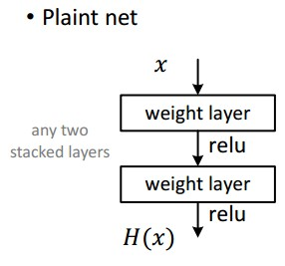
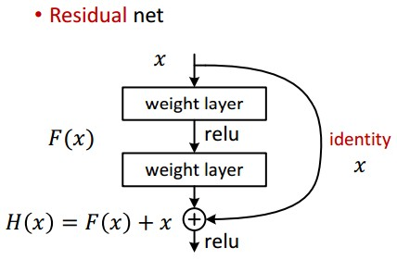
Case Study: ResNet
[He et al., 2015]

Slide 80
ConvNet workflow
C
W
1
F
CNN
1
H
Convert HxW image into a F-dimensional vector
What’s the probability this image is a cloudy (F=1)
Which of 1000 categories is this image? (F=1000)
At what GPS coord was this image taken? (F=2)
Identify the X,Y coordinates of 28 face keypoints of an image of a human (F=56)
Slide by David Fouhey

Slide 81
e.g. Image Classification
C
W
1
F
CNN
1
H
P(image is class #1)
P(image is class #2)
P(image is class #F)
Slide by David Fouhey

Slide 82
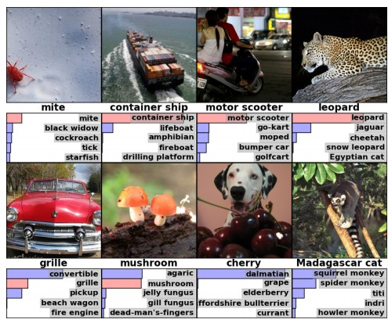
ImageNet Challenge (1000 object classes), Fei-Fei et al.

Slide 83
(slide from Kaiming He’s recent presentation)

Slide 84
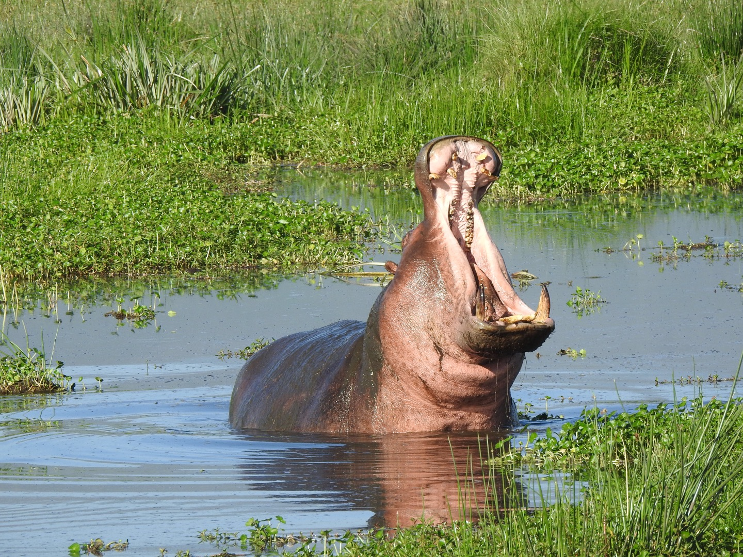
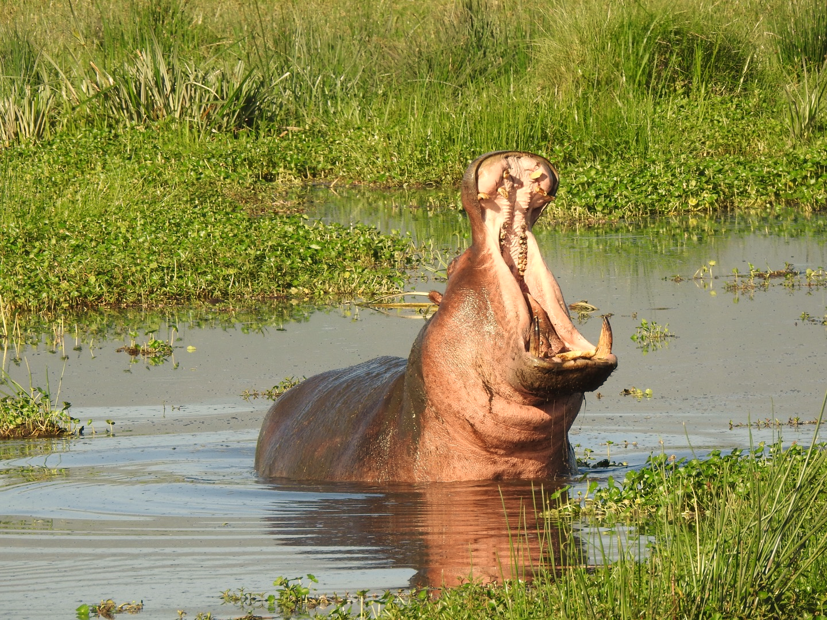
What is your data not big enough?
Horizontal
Flip
Color
Jitter
Image Cropping
Slide by David Fouhey

Slide 85
Training a CNN –Augmentation
Apply transformations that don’t affect the output
Produces more data but you have to be careful that it doesn’t change the meaning of the output
Slide by David Fouhey

Slide 86
Project 4
C
W
1
F
CNN
1
H
Keypoint #1 X
Keypoint #1 Y
Keypoint #2 X

