Slide 1
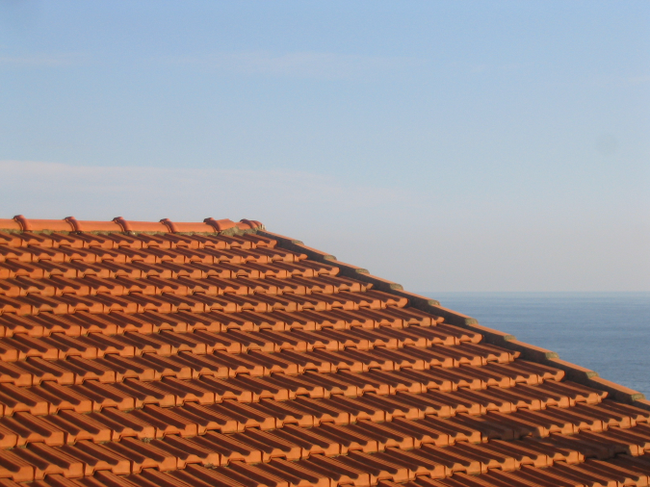
Visual Texture (in human and machine)
Somewhere in Cinque Terre, May 2005
CS194: Intro to Computer Vision and Comp. Photo
Alexei Efros, UC Berkeley, Fall 2020

Slide 2
What is Texture?
Texture depicts spatially repeating patterns
Many natural phenomena are textures
radishes
rocks
yogurt

Slide 3
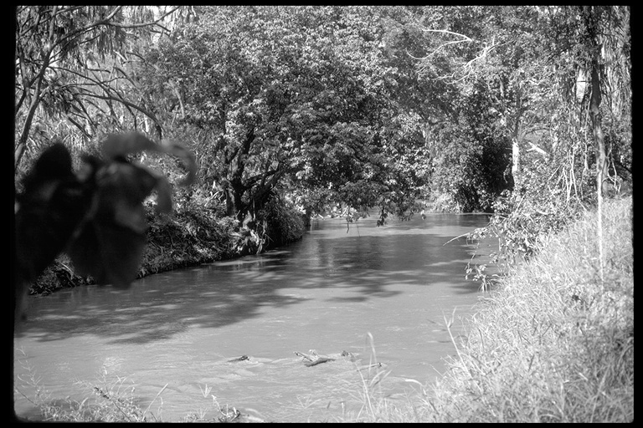
Texture as “stuff”
Source: Forsyth

Slide 4
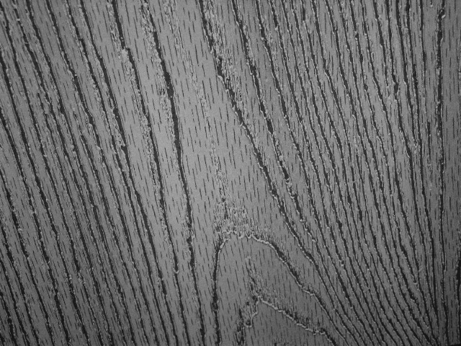
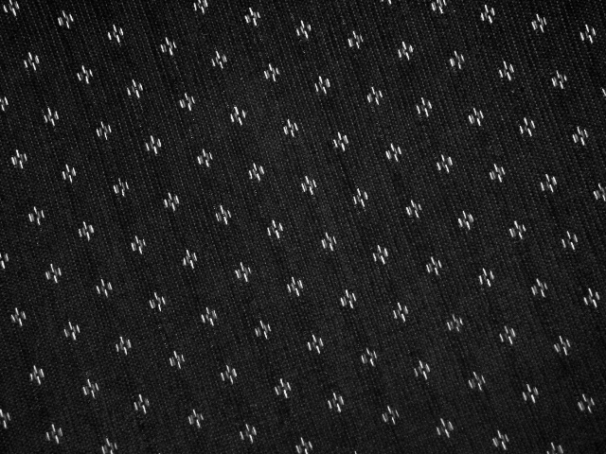
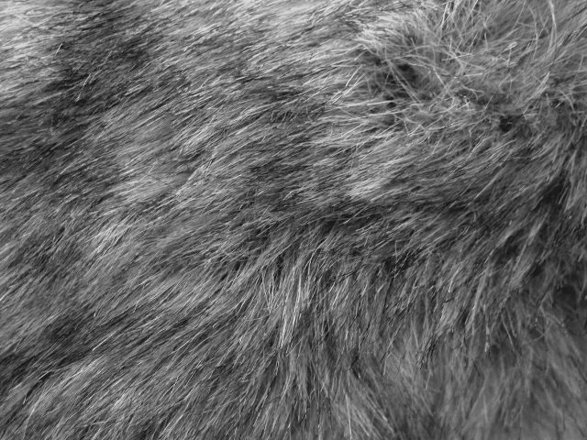
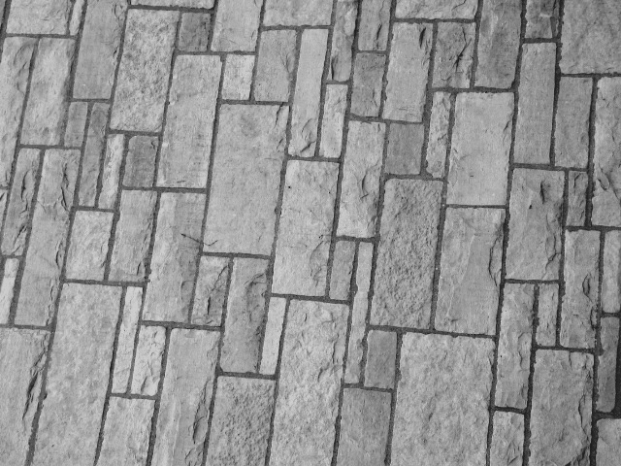
Texture and Material
http://www-cvr.ai.uiuc.edu/ponce_grp/data/texture_database/samples/

Slide 5
Texture Synthesis
Goal of Texture Synthesis: create new samples of a given texture
Many applications: virtual environments, hole-filling, texturing surfaces

Slide 6



The Challenge
Need to model the whole spectrum: from repeated to stochastic texture
repeated
stochastic
Both?

Slide 7

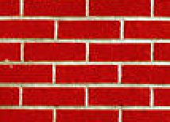
Efros & Leung Algorithm
non-parametric
sampling
p
Input image
Synthesizing a pixel
Assuming Markov property, compute P(p|N(p))
  Building explicit probability tables infeasible
  Instead, we search the input image for all similar neighborhoods — that’s our pdf for p
  To sample from this pdf, just pick one match at random

Slide 8
Some Details
Growing is in “onion skin” order
  Within each “layer”, pixels with most neighbors are synthesized first
  If no close match can be found, the pixel is not synthesized until the end
Using Gaussian-weighted SSD is very important
  to make sure the new pixel agrees with its closest neighbors
  Approximates reduction to a smaller neighborhood window if data is too sparse

Slide 9





Neighborhood Window
input

Slide 10

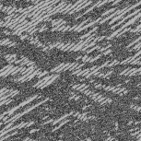
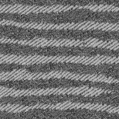
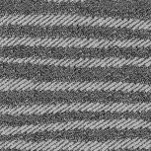
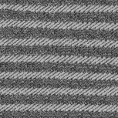

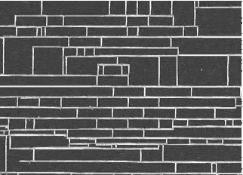
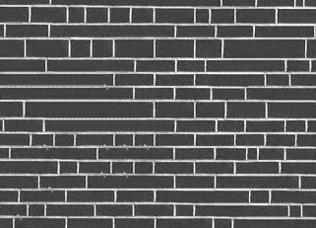
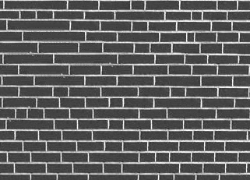
Varying Window Size
Increasing window size

Slide 11


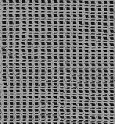
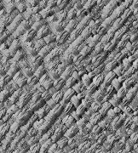
Synthesis Results
french canvas
rafia weave

Slide 12
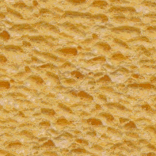
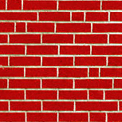
More Results
white bread
brick wall

Slide 13
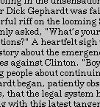
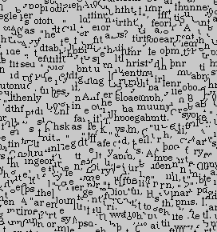
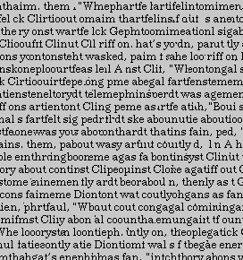
Homage to Shannon

Slide 14
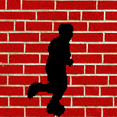
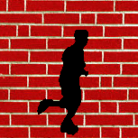
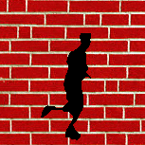
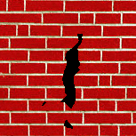
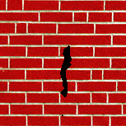
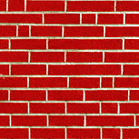
Hole Filling

Slide 15
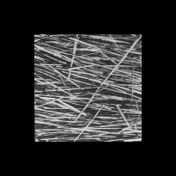
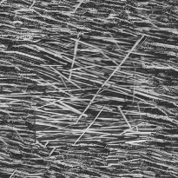
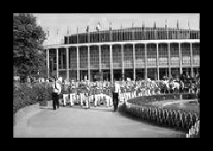
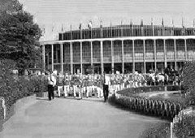
Extrapolation

Slide 16
Summary
The Efros & Leung algorithm
  Very simple
  Surprisingly good results
  Synthesis is easier than analysis!
  …but very slow

Slide 17
Image Quilting [Efros & Freeman]
non-parametric
sampling
p
B
Input image
Synthesizing a block
Observation: neighbor pixels are highly correlated
Idea: unit of synthesis = block
  Exactly the same but now we want P(B|N(B))
  Much faster: synthesize all pixels in a block at once
  Not the same as multi-scale!

Slide 18

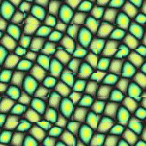
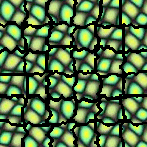
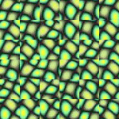
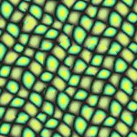
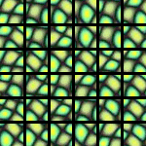
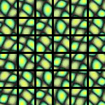
block
Input texture
B1
B2
B1
B2
B1
B2
Random placement
of blocks
Neighboring blocks
constrained by overlap
Minimal error
boundary cut

Slide 19








Minimal error boundary
overlapping blocks
vertical boundary
2
_
=
overlap error
min. error boundary

Slide 20
Our Philosophy
The “Corrupt Professor’s Algorithm”:
  Plagiarize as much of the source image as you can
  Then try to cover up the evidence
Rationale:
  Texture blocks are by definition correct samples of texture so problem only connecting them together

Slide 21
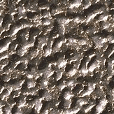
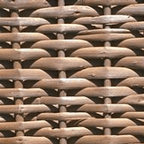
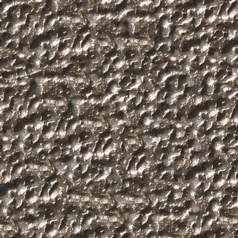


Slide 22
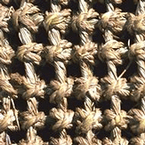
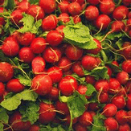
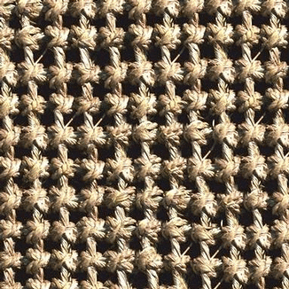
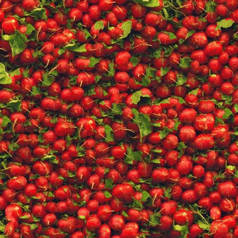

Slide 24
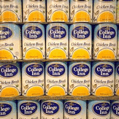
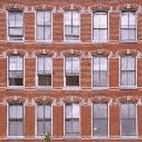
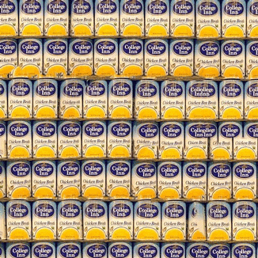
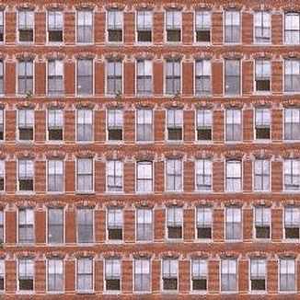

Slide 25
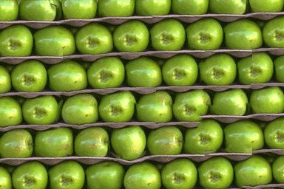
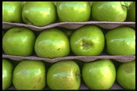

Slide 26






Slide 27
Failures
(Chernobyl
Harvest)

Slide 28





Portilla & Simoncelli
Xu, Guo & Shum
input image
Wei & Levoy
Our algorithm

Slide 29





Portilla & Simoncelli
Xu, Guo & Shum
input image
Wei & Levoy
Our algorithm

Slide 30





Portilla & Simoncelli
Xu, Guo & Shum
input image
Wei & Levoy
Our algorithm

Slide 31




Application: Texture Transfer
Try to explain one object with bits and pieces of another object:
+
=

Slide 32
Texture Transfer
Constraint
Texture sample

Slide 33

Texture Transfer
Take the texture from one image and “paint” it onto another object
Same as texture synthesis, except an additional constraint:
  Consistency of texture
  Similarity to the image being “explained”

Slide 34




+
=

Slide 35




Slide 36
Image Analogies
Aaron Hertzmann^{1,2}
Chuck Jacobs²
Nuria Oliver²
Brian Curless³
David Salesin^{2,3}
¹New York University
²Microsoft Research
³University of Washington

Slide 37




Image Analogies
A
A’
B
B’

Slide 39

Blur Filter

Slide 40

Edge Filter

Slide 41




Artistic Filters
A
A’
B
B’

Slide 42



Image Analogies
Goal: Process an image by example
?
:
::
:
A
A’
B
B’
Hertzmann et al. SIGGRAPH 2001

Slide 43


Non-parametric sampling
?
:
::
:
A
A’
B
B’

Slide 44

:
::
A
A’
:
B
B’

Slide 45
:
::
A
A’
:
B
B’

Slide 46

Colorization

Slide 47




Texture-by-numbers
A
A’
B
B’

Slide 48




Super-resolution
A
A’

Slide 49


Super-resolution (result!)
B
B’

Slide 50

Texture Analysis
“Same” or “different”
ANALYSIS
True (infinite) texture
Compare textures and decide if they’re made of the same “stuff”.

Slide 51

When are two textures similar?

Slide 52

Béla Julesz, father of texture

Slide 53

Texton Discrimination (Julesz)
Human vision is sensitive to the difference of some types of elements and
appears to be “numb” on other types of differences.

Slide 54

Search Experiment I
The subject is told to detect a target element in a number of background elements.
In this example, the detection time is independent of the number of background elements.

Slide 55

Search Experiment II
In this example, the detection time is proportional to the number of background elements,
And thus suggests that the subject is doing element-by-element scrutiny.

Slide 56
Heuristic (Axiom) I
Julesz then conjectured the following axiom:
Human vision operates in two distinct modes:
1. Preattentive vision
parallel, instantaneous (~100--200ms), without scrutiny,
independent of the number of patterns, covering a large visual field.
2. Attentive vision
serial search by focal attention in 50ms steps limited to small aperture.

Slide 57

Examples
Pre-attentive vision is sensitive to size/width, orientation changes

Slide 58

Examples
Sensitive to number
of terminators
Left: fore-back
Right: back-fore
See previous examples
For cross and terminators

Slide 59
Heuristic (Axiom) II
Textons are the fundamental elements in preattentive vision, including
1. Elongated blobs
rectangles, ellipses, line segments with attributes
color, orientation, width, length, flicker rate.
2. Terminators
ends of line segments.
3. Crossings of line segments.
But it is worth noting that Julesz’s conclusions are largely based on ensemble of
artificial texture patterns. It was infeasible to synthesize natural textures for
controlled experiments at that time.

Slide 60
Julesz Conjecture
Textures cannot be spontaneously discriminated if they have the same first-order and second-order statistics and differ only in their third-order or higher-order statistics.
(not quite true)

Slide 61

1st Order Statistics
5% white
20% white

Slide 62

2nd Order Statistics
10% white

Slide 63


Slide 64


Slide 65

Single Cell Recording
© Stephen E. Palmer, 2002

Slide 66
Single Cell Recording
Microelectrode
Amplifier
Electrical response
(action potentials)
mV
© Stephen E. Palmer, 2002

Slide 67
Retinal Receptive Fields
Receptive field structure in ganglion cells:
On-center Off-surround
Stimulus condition
Electrical response
© Stephen E. Palmer, 2002

Slide 68
Retinal Receptive Fields
Receptive field structure in ganglion cells:
On-center Off-surround
Stimulus condition
Electrical response
© Stephen E. Palmer, 2002

Slide 69
Retinal Receptive Fields
Receptive field structure in ganglion cells:
On-center Off-surround
Stimulus condition
Electrical response
© Stephen E. Palmer, 2002

Slide 70
Retinal Receptive Fields
Receptive field structure in ganglion cells:
On-center Off-surround
Stimulus condition
Electrical response
© Stephen E. Palmer, 2002

Slide 71
Retinal Receptive Fields
Receptive field structure in ganglion cells:
On-center Off-surround
Stimulus condition
Electrical response
© Stephen E. Palmer, 2002

Slide 72
Retinal Receptive Fields
Receptive field structure in ganglion cells:
On-center Off-surround
Stimulus condition
Electrical response
© Stephen E. Palmer, 2002

Slide 73
Retinal Receptive Fields
RF of On-center Off-surround cells
© Stephen E. Palmer, 2002

Slide 74
Retinal Receptive Fields
RF of Off-center On-surround cells
Surround
Center
© Stephen E. Palmer, 2002

Slide 75
Retinal Receptive Fields

Slide 76

Retinal Receptive Fields
Receptive field structure in bipolar cells
Light
© Stephen E. Palmer, 2002

Slide 77
Retinal Receptive Fields
Receptive field structure in bipolar cells
© Stephen E. Palmer, 2002

Slide 78


The receptive field of a retinal ganglion cell can be modeled as a “Difference of Gaussians”

Slide 79

Receptive Fields
Figure 6.16 Receptive fields
The receptive field of a receptor is simply the area of the visual field from which light strikes that receptor. For any other cell in the visual system, the receptive
field is determined by which receptors connect to the cell in question.

Slide 80


Slide 81
Visual Cortex
Cortical Area V1
aka:
Primary visual cortex
Striate cortex
Brodman’s area 17
© Stephen E. Palmer, 2002

Slide 82
Cortical Receptive Fields
Single-cell recording from visual cortex
David Hubel & Thorston Wiesel
© Stephen E. Palmer, 2002

Slide 83
Cortical Receptive Fields
Single-cell recording from visual cortex
© Stephen E. Palmer, 2002

Slide 84

https://www.youtube.com/watch?v=IOHayh06LJ4

Slide 85
Cortical Receptive Fields
Three classes of cells in V1
Simple cells
Complex cells
Hypercomplex cells
© Stephen E. Palmer, 2002

Slide 86

Orientation Selectivity in V1

Slide 87
Cortical Receptive Fields
Simple Cells: “Line Detectors”
© Stephen E. Palmer, 2002

Slide 88
Cortical Receptive Fields
Simple Cells: “Edge Detectors”
© Stephen E. Palmer, 2002

Slide 89
Cortical Receptive Fields
Constructing a line detector
© Stephen E. Palmer, 2002

Slide 90


The 1D Gaussian and its derivatives

Slide 91

Oriented Gaussian Derivatives in 2D

Slide 92


Oriented Gaussian First and Second Derivatives

Slide 93

Receptive fields of complex cells

Slide 94
Cortical Receptive Fields
Constructing a Complex Cell
© Stephen E. Palmer, 2002

Slide 95

Hypercolumns in visual cortex

Slide 96

Modeling hypercolumns
Elongated directional Gaussian derivatives
Gabor filters could be used instead
Multiple orientations, scales
Notes:
No response to intensity ramps -- important benefit compared to simple comparison of intensities at i and j

Slide 97

Mapping from Retina to V1

Slide 98

Overcomplete representation: filter banks
LM Filter Bank
Code for filter banks: www.robots.ox.ac.uk/~vgg/research/texclass/filters.html

Slide 99

Image from http://www.texasexplorer.com/austincap2.jpg
Kristen Grauman

Slide 100


Showing magnitude of responses
Kristen Grauman

Slide 101


Kristen Grauman
Notes:
2

Slide 102


Kristen Grauman
Notes:
3

Slide 103


Kristen Grauman
Notes:
4

Slide 104


Kristen Grauman

Slide 105


Kristen Grauman
Notes:
6

Slide 106


Kristen Grauman
Notes:
7

Slide 107


Kristen Grauman
Notes:
8

Slide 108


Kristen Grauman
Notes:
9

Slide 109


Kristen Grauman
Notes:
10

Slide 110


Kristen Grauman
Notes:
11

Slide 111


Kristen Grauman
Notes:
12

Slide 112


Kristen Grauman
Notes:
13

Slide 113


Kristen Grauman
Notes:
14

Slide 114


Kristen Grauman
Notes:
15

Slide 115


Kristen Grauman
Notes:
16

Slide 116


Kristen Grauman

Slide 117


Kristen Grauman
Notes:
18

Slide 118


Kristen Grauman

Slide 119
How can we represent texture?
Idea 1: Record simple statistics (e.g., mean, std.) of absolute filter responses

Slide 120






Can you match the texture to the response?
Filters
A
B
1
2
C
3
Mean abs responses

Slide 121
How can we represent texture?
Can be thought of as an single “orientation histogram”
Idea 2: Marginal histograms of filter responses
  one histogram per filter

Slide 122



Multi-scale filter decomposition
Filter bank
Input image

Slide 123

Filter response histograms

Slide 124

Heeger & Bergen, SIGGRAPH‘95
Start with a noise image as output
Main loop:
  Match pixel histogram of output image to input
  Decompose input and output images using multi-scale filter bank (Steerable Pyramid)
  Match subband histograms of input and output pyramids
  Reconstruct input and output images (collapse the pyramids)
Heeger, Bergen, Pyramid-based texture analysis/synthesis, SIGGRAPH 1995

Slide 125


Slide 126


Slide 127


Slide 128

Simoncelli & Portilla ’98+
Marginal statistics are not enough
Neighboring filter responses are highly correlated
  an edge at low-res will cause an edge at high-res
Let’s match 2nd order statistics too!
J Portilla and E P Simoncelli. A Parametric Texture Model based on Joint Statistics of Complex Wavelet Coefficients. Int'l Journal of Computer Vision. 40(1):49-71, October, 2000.

Slide 129

Simoncelli & Portilla ’98+
Match joint histograms of pairs of filter responses at adjacent spatial locations, orientations, and scales.
Optimize using repeated projections onto statistical constraint sufraces

Slide 130



Slide 131
How can we represent texture?
Marginal filter response histograms don’t talk to each other (in a direct way)
Idea 3: Histograms of joint responses (textons)

Slide 132
Filter Response
[r1, r2, …, r38]
We can form a feature vector from the list of responses at each pixel.
Kristen Grauman

Slide 133
What does it capture?
v = F * Patch (where F is filter matrix)

Slide 134



Textons (Malik et al, IJCV 2001)
Cluster vectors of filter responses
Notes:
Discuss how k-means works
Discuss choice of k
pseudo-inverse for reconstruction
Julesz comparison

Slide 135



Textons (cont.)

Slide 136



Object
Bag of ‘words’

Slide 137

Analogy to documents
Of all the sensory impressions proceeding to the brain, the visual experiences are the dominant ones. Our perception of the world around us is based essentially on the messages that reach the brain from our eyes. For a long time it was thought that the retinal image was transmitted point by point to visual centers in the brain; the cerebral cortex was a movie screen, so to speak, upon which the image in the eye was projected. Through the discoveries of Hubel and Wiesel we now know that behind the origin of the visual perception in the brain there is a considerably more complicated course of events. By following the visual impulses along their path to the various cell layers of the optical cortex, Hubel and Wiesel have been able to demonstrate that the message about the image falling on the retina undergoes a step-wise analysis in a system of nerve cells stored in columns. In this system each cell has its specific function and is responsible for a specific detail in the pattern of the retinal image.
China is forecasting a trade surplus of $90bn (£51bn) to $100bn this year, a threefold increase on 2004's $32bn. The Commerce Ministry said the surplus would be created by a predicted 30% jump in exports to $750bn, compared with a 18% rise in imports to $660bn. The figures are likely to further annoy the US, which has long argued that China's exports are unfairly helped by a deliberately undervalued yuan. Beijing agrees the surplus is too high, but says the yuan is only one factor. Bank of China governor Zhou Xiaochuan said the country also needed to do more to boost domestic demand so more goods stayed within the country. China increased the value of the yuan against the dollar by 2.1% in July and permitted it to trade within a narrow band, but the US wants the yuan to be allowed to trade freely. However, Beijing has made it clear that it will take its time and tread carefully before allowing the yuan to rise further in value.
sensory, brain,
visual, perception,
retinal, cerebral cortex,
eye, cell, optical
nerve, image
Hubel, Wiesel
China, trade,
surplus, commerce,
exports, imports, US,
yuan, bank, domestic,
foreign, increase,
trade, value

Slide 138



Slide 139

Patch Features
…

Slide 140
dictionary formation
…

Slide 141
Clustering (usually k-means)
…
Vector quantization
Slide credit: Josef Sivic

Slide 142
Feature Representation
Visual words, aka textons, aka keypoints:
K-means clustered pieces of the image
Various Representations:
  Filter bank responses (textons)
  Image Patches
  SIFT descriptors
Either image-specific or “universal” dictionary

Slide 143

Image representation
frequency
…..
codewords

Slide 144









learning
recognition
codewords dictionary
feature detection
& representation
image representation
category
decision
category models
(and/or) classifiers

Slide 145










Scene Classification (Renninger & Malik)
beach
mountain
forest
city
street
farm
kitchen
livingroom
bedroom
bathroom

Slide 146
Texton Histogram Matching

Slide 147


Object Detection can be very fast
On a task of judging animal vs no animal, humans can make mostly correct saccades in 150 ms (Kirchner & Thorpe, 2006)
  Comparable to synaptic delay in the retina, LGN, V1, V2, V4, IT pathway.
  Doesn’t rule out feed back but shows feed forward only is very powerful
Detection and categorization are practically simultaneous (Grill-Spector & Kanwisher, 2005)

Slide 148
Discrimination of Basic Categories
texture model

Slide 149
Discrimination of Basic Categories
texture model
chance

Slide 150
Discrimination of Basic Categories
texture model
37 ms
chance

Slide 151
Discrimination of Basic Categories
texture model
50 ms
chance

Slide 152
Discrimination of Basic Categories
texture model
69 ms
chance

Slide 153
Discrimination of Basic Categories
texture model
37 ms
50 ms
69 ms
chance

Slide 154

Scene Recognition using Texture

Slide 155


Slide 156

Why these filters?

Slide 157
Learned filters

