Slide 1
Feature Learning with
Neural Networks
(aka Deep Learning)
CS194: Intro to Computer Vision and Comp. Photo
Angjoo Kanazawa, UC Berkeley, Fall 2021

Slide 2
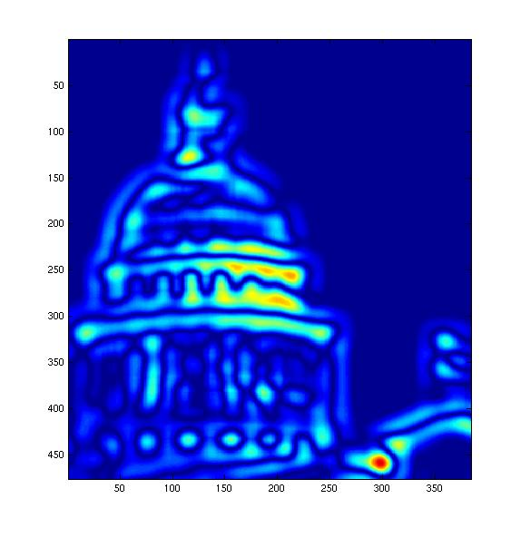
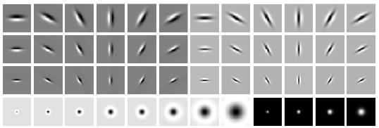
Recap: Filter Bank Response
[r1, r2, …, r38]
We can form a feature vector from the list of responses at each pixel.

Slide 3
The story so far
Feature bank responses are biologically motivated image representations
This is useful for recognition tasks:
Ex: Cluster the features into “visual words” to represent an image to do classification
Convolution with a linear kernel followed by simple non-linearities is a good model for early visual cortex (Retina, LGN, V1), but how to go beyond this?
How can we learn these filters??
Notes:
Cluster → Code book → histogram becomes the image representation

Slide 4
The story so far…
Neurons show increasing specificity higher in the visual pathway
V1 simple and complex cells are orientation-tuned
Convolution with a linear kernel followed by simple non-linearities is a good model for computation in retina, LGN and V1, but beyond that we do not have satisfactory computational models
Good designs of visual systems are likely to be hierarchical and “mostly” feedforward
Notes:
No response to intensity ramps -- important benefit compared to simple comparison of intensities at i and j

Slide 5
Learned filters

Slide 6
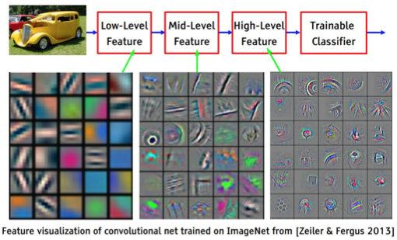
[ slide courtesy Yann LeCun ]
Notes:
Higher level → more receptive field, so the pixels are bigger.
After the first layer, we’re visualizing the pixels that activate a single neuron : D neuron_i / D_Img

Slide 7
Next Step
To learn good features, we first need a task!
Notes:
10 minutes

Slide 8
Quick Background on
Statistical Learning Framework
Slides courtesy of Lana Lezebnik
Notes:
10 min

Slide 9

Common Tasks
”Cat”
Image Classification

Slide 10
Common Tasks
“Cat”
Object Detection

Slide 11
Common Tasks
Keypoint Detection (project 5!)

Slide 12
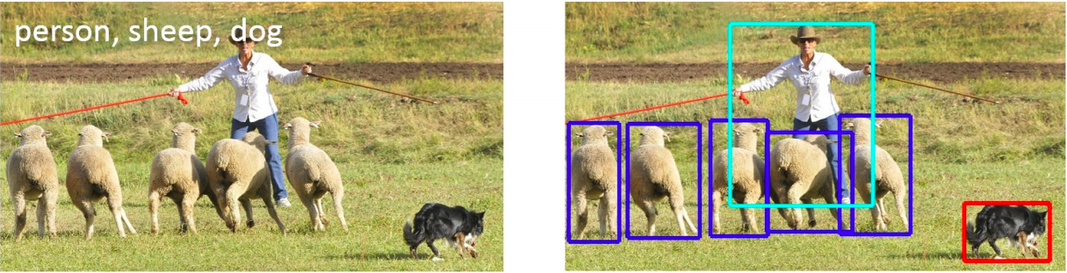
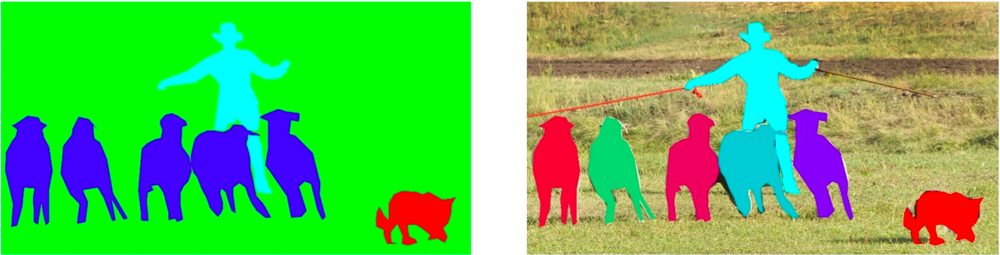
Detection, semantic segmentation, instance segmentation
image classification
object detection
semantic segmentation
instance segmentation
Slide courtesy of Lana Lezebnik
Image source

Slide 13
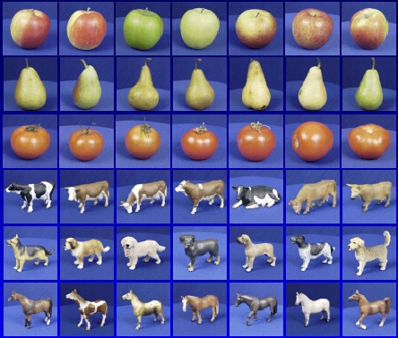
Image classification
Slides courtesy of Lana Lezebnik

Slide 14



The statistical learning framework
Apply a prediction function to a feature representation of the image to get the desired output:
f( ) = “apple”
f( ) = “tomato”
f( ) = “cow”
Slide courtesy of Lana Lezebnik

Slide 15
The statistical learning framework
y = f(x)
output
prediction function
Input feature representation
Training set: given a training set of labeled examples
{(x₁,y₁), …, (x_{N},y_{N})}, estimate the prediction function f by minimizing the prediction error on the training set
Test set: apply f to a never before seen test example x and output the predicted value y = f(x)
Validation set: same as test, held-out to tune hyper-parameters. Never use the “test” set for tuning! That’s cheating!
Slide modified from Lana Lezebnik
Notes:
6:3:1
Spend a lot of time
15 min

Slide 16

Steps
Training
Training Labels
Training Images
Image Features
Training
Learned model
Learned model
Testing
Image Features
Prediction
Test Image
Slide credit: D. Hoiem
Notes:
What happens if you don't have a test set? → Why
Spend a lot of time

Slide 17





“Classic” recognition pipeline
Bag of Words
Feature representation
Trainable
classifier
Image
Pixels
Class label
  Hand-crafted feature representation
  Off-the-shelf trainable classifier
Slide modified from Lana Lezebnik
Notes:
We just did this! Features is filter bank response, k-means into bag of words!
Then did classification with Nearest Neighbors!

Slide 18
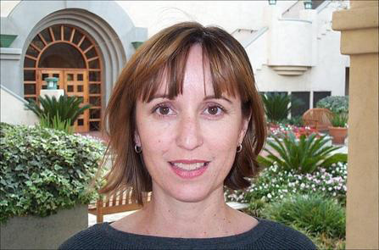
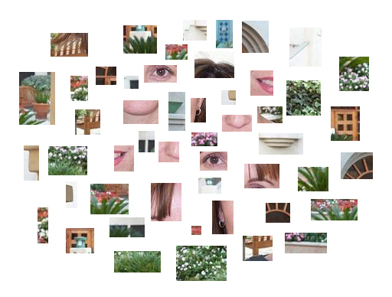
“Classic” representation: Bag of features
Slide courtesy of Lana Lezebnik

Slide 19
Classifiers: Nearest neighbor
Test example
Training examples from class 2
Training examples from class 1
f(x) = label of the training example nearest to x
All we need is a distance or similarity function for our inputs
No training required!
Slide courtesy of Lana Lezebnik
Notes:
10 = (25+10+10 = 45 total
Non-linear!
“Non-parametric” classifier: the entire training set is essentially the model parameters.
Pros:
Very fast at training time
Flexible: all it requires is a way to compute similarity or distances between pairs of features. Applies to many different kinds of features.
Works with any number of classes.
Works well in practice for large datasets (but see cons)
Cons:
Slow at test time (need to compute distances between test example and every training example)

Slide 20
Linear classifiers: Binary classification
Find a linear function to separate the classes:
f(x) = sgn(w ⋅ x + b)
Slide courtesy of Lana Lezebnik
Notes:
You only need the sign to assign the labels -1, 1
“Parametric” classifier: model defined by a small number of parameters (w, b)
Pros:
Very fast at test time
Cons:
Slow at training time: need to estimate the parameters
Only works for two classes
Data may not be linearly separable
Quintessential linear classifiers are SVMs,, but go learn that in 189

Slide 21
Linear classifiers: Perceptron
Input
Weights
x₁
w₁
x₂
w₂
Output: sgn(w⋅x + b)
x₃
w₃
.
.
.
w_{D}
Can incorporate bias as component of the weight vector by always including a feature with value set to 1
x_{D}
Notes:
30 min till here.
Connections are the dendrites (W)

Slide 22
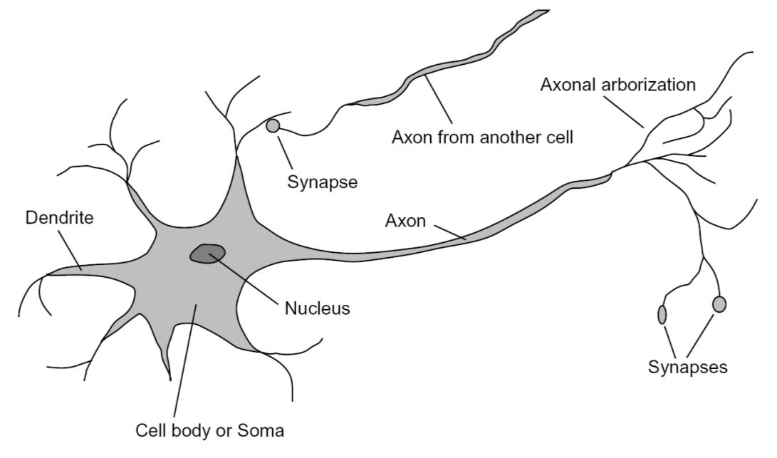
Loose inspiration: Human neurons
Notes:
From Wikipedia: At the majority of synapses, signals are sent from the axon of one neuron to a dendrite of another... All neurons are electrically excitable, maintaining voltage gradients across their membranes… If the voltage changes by a large enough amount, an all-or-none electrochemical pulse called an action potential is generated, which travels rapidly along the cell's axon, and activates synaptic connections with other cells when it arrives.
Non-Linearity is the nucleus (when it has enough stuff)

Slide 23
This class
Linear Classifiers: Perceptrons
  Perceptron update rule
Multi-layer Perceptrions (MLPs)
  Training method
Best practices for training classifiers
After that: convolutional neural networks

Slide 24
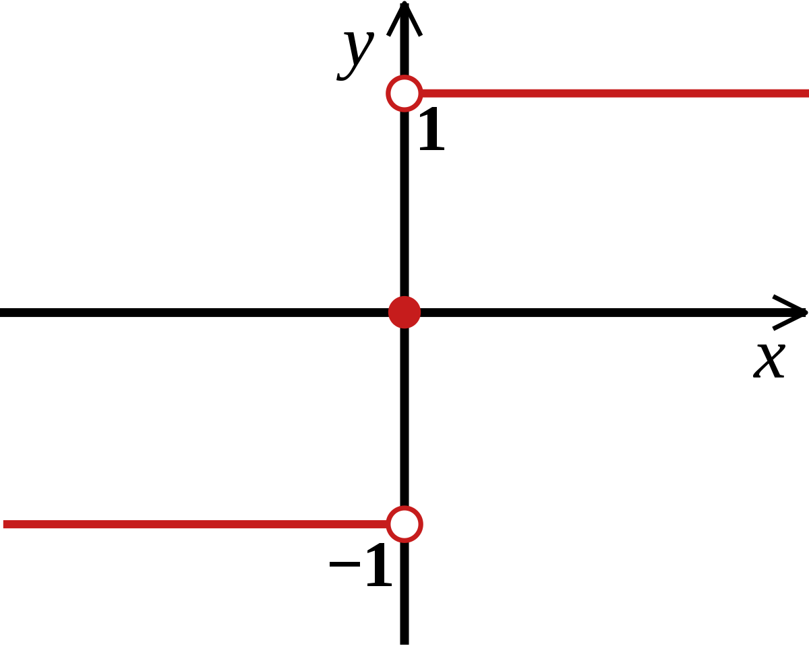
Back to: Perceptrons
sgn:
Find a linear function to separate the classes:
f(x) = sgn(w ⋅ x + b)
Slide courtesy of Lana Lezebnik
Notes:
“Parametric” classifier: model defined by a small number of parameters (w, b)
Pros:
Very fast at test time
Cons:
Slow at training time: need to estimate the parameters
Only works for two classes
Data may not be linearly separable
Quintessential linear classifiers are SVMs,, but go learn that in 189

Slide 25
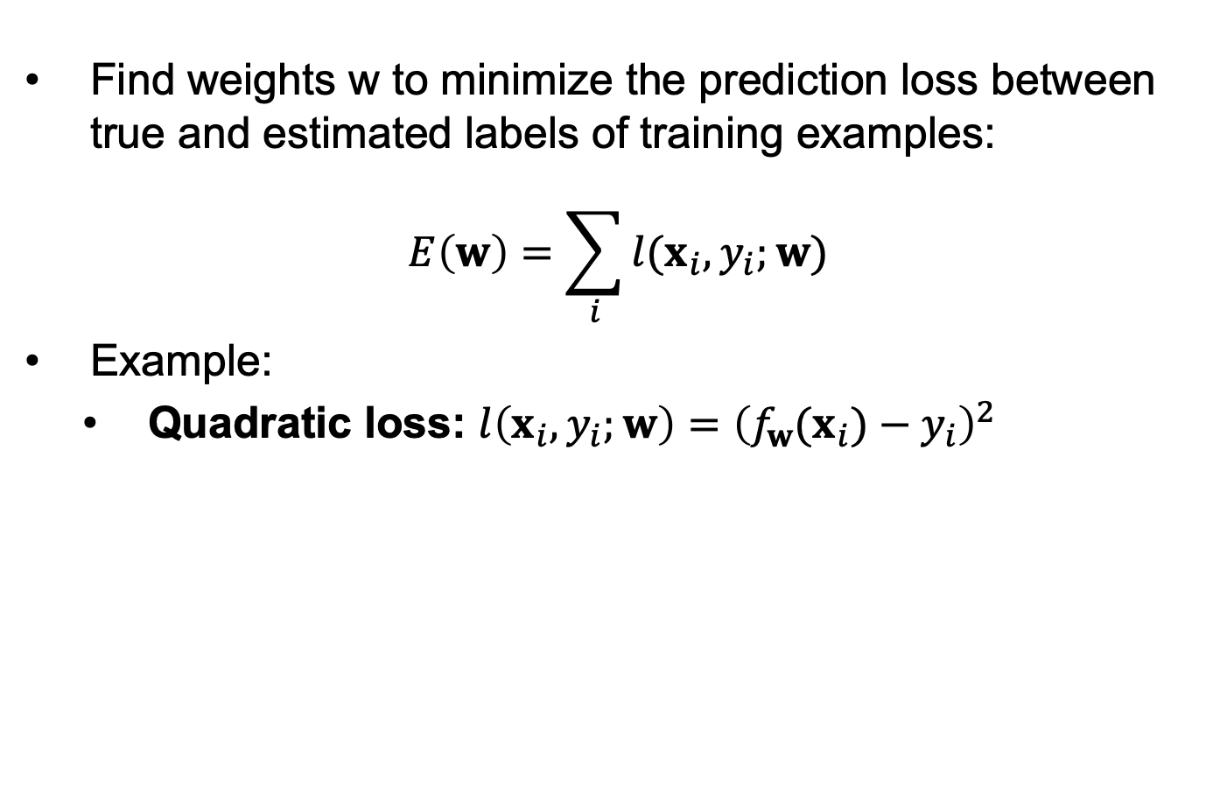
Objective (Loss) functions
Find weights w to minimize the prediction loss between true and estimated labels of training examples:
$$E\left(w\right)=\sum_{i}{l(x_{i},y_{i};w)}$$
Example:
  Quadratic loss: $l\left(x_{i},y_{i};w\right)={\left(f_{w}(x_{i})−y_{i}\right)}^{2}$
Notes:
Log loss = Cross-Entropy
Go on the board
Explain Quadratic loss with example on the board

Slide 26
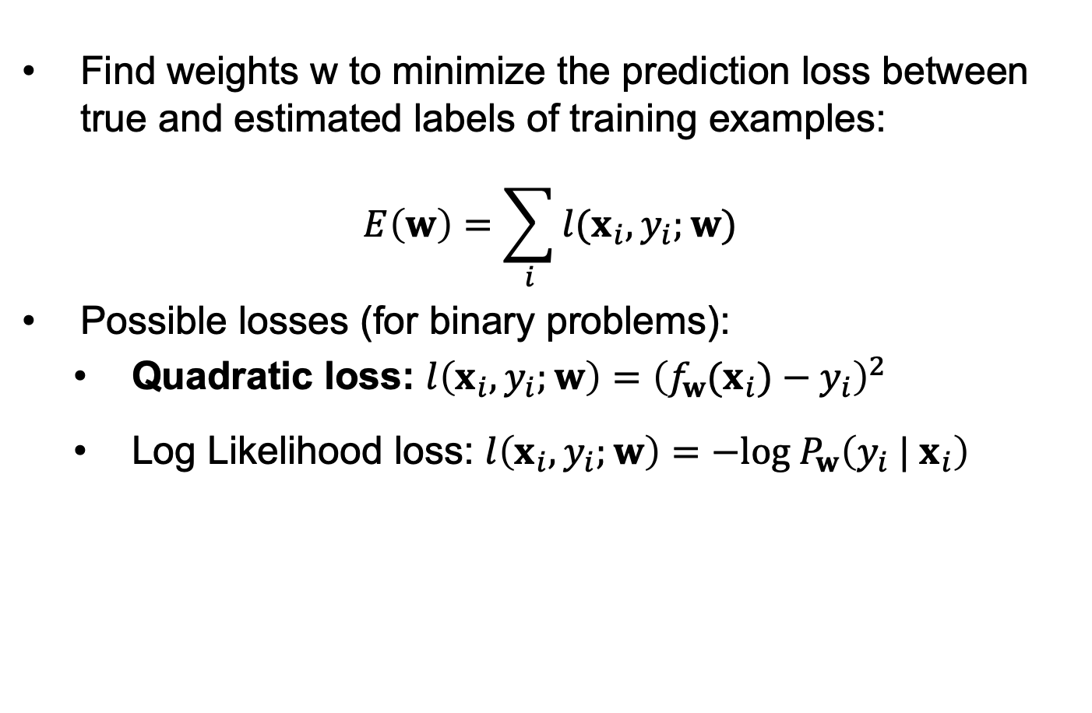
Objective (Loss) functions
Find weights w to minimize the prediction loss between true and estimated labels of training examples:
$$E\left(w\right)=\sum_{i}{l(x_{i},y_{i};w)}$$
Possible losses (for binary problems):
  Quadratic loss: $l\left(x_{i},y_{i};w\right)={\left(f_{w}(x_{i})−y_{i}\right)}^{2}$
  Log Likelihood loss: $l\left(x_{i},y_{i};w\right)=−log⁡{ P}_{w}\left({y_{i} | x}_{i}\right)$
Notes:
Log loss = Cross-Entropy
Go on the board
Explain Quadratic loss with example on the board

Slide 27
Perceptron training algorithm
Initialize weights w randomly
Cycle through training examples in multiple passes (epochs)
For each training example x with label y:
  Classify with current weights:
  If classified incorrectly, update weights:
  (α is a positive learning rate that decays over time)
Slide courtesy of Lana Lezebnik
Notes:
Gradient descent!!!
on the board
X is pixels or features (are vectors)

Slide 28
Perceptron update rule: Binary Classification
  The raw response of the classifier changes to
  If y = 1 and y’ = -1, the response is initially negative and will be increased
  If y = -1 and y’ = 1, the response is initially positive and will be decreased
Slide courtesy of Lana Lezebnik
Notes:
25 min = 65 min total.
Here loss is Quadratic loss ( y – y’ ) ^2

Slide 29
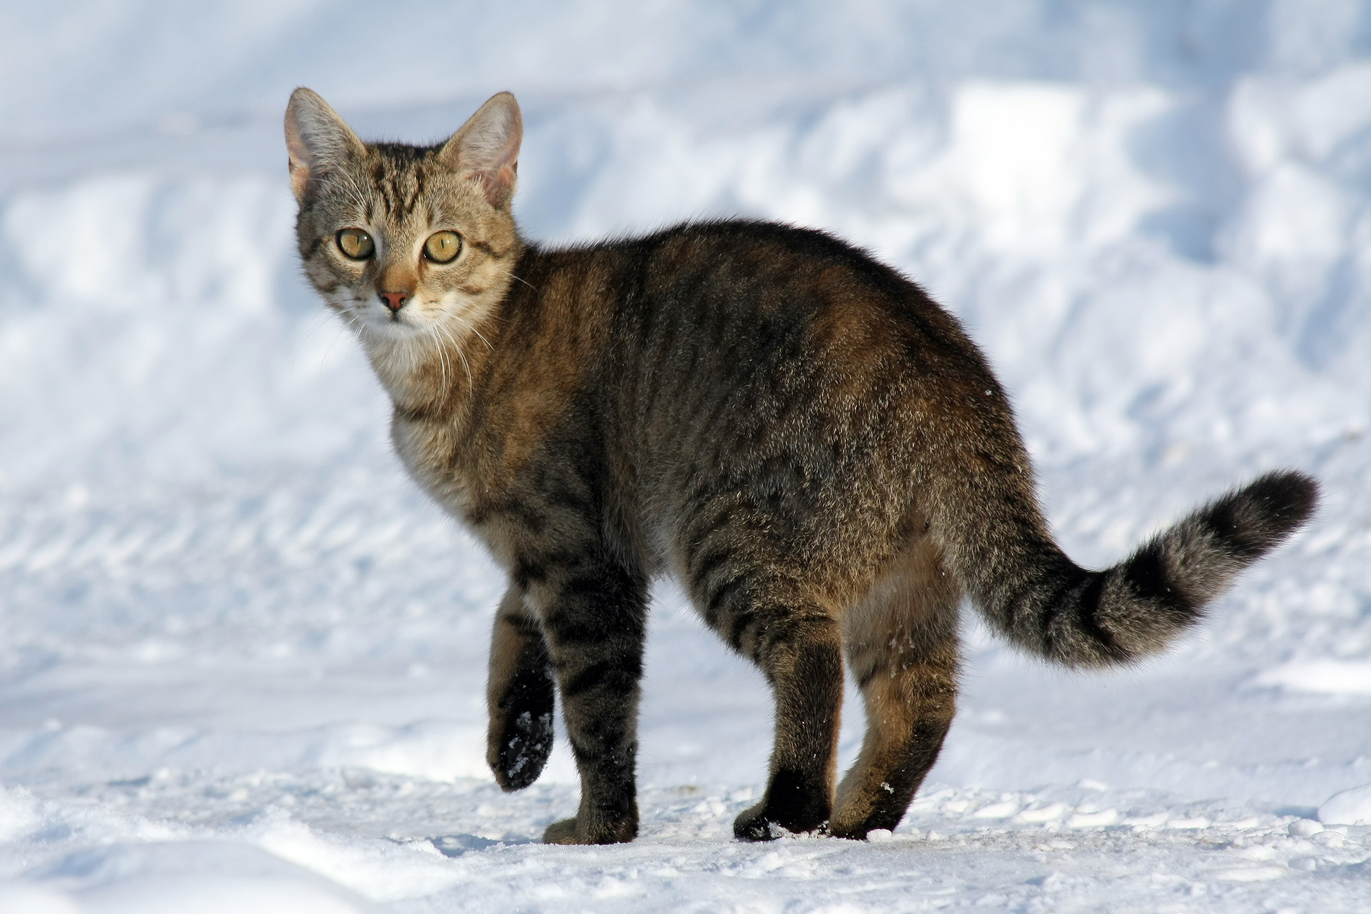
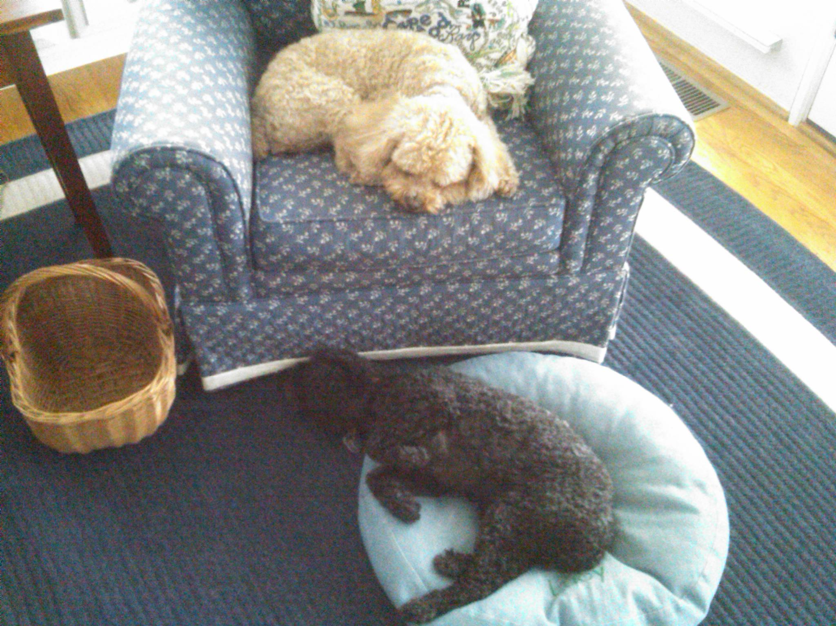
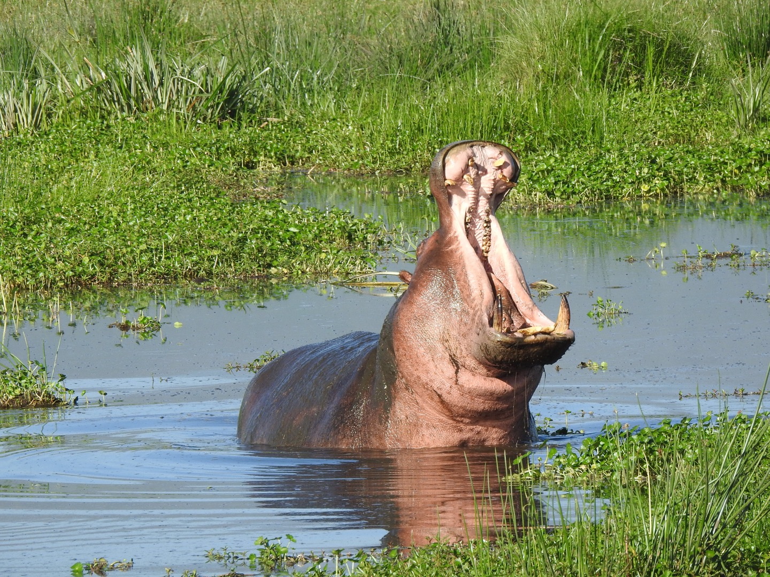





Linaer Classifiers: Beyond Binary Classification
Example Setup: 3 classes
Model – one weight per class:
$$w_{0},w_{1}, w_{2}$$
$$w_{0}^{T}x$$
big if cat
$$w_{1}^{T}x$$
big if dog
$$w_{2}^{T}x$$
big if hippo
Stack together:
$$W_{3xF}$$
where x is in R^{F}
Notes:
Note that W is now a matrix

Slide 30



3-Classes
Cat weight vector
0.2
-0.5
0.1
2.0
1.1
56
-96.8
Cat score
Dog weight vector
1.5
1.3
2.1
0.0
3.2
231
437.9
Dog score
Hippo weight vector
0.0
0.3
0.2
-0.3
-1.2
24
61.95
Hippo score
2
$$W$$
$$Wx_{i}$$
bias
1
Weight matrix a collection of scoring functions, one per class
Prediction is vector where jth component is “score” for jth class.
$$x_{i}$$
Diagram by: Karpathy, Fei-Fei
Notes:
TODO: how to teach this without log-loss
Do the bias on the board.
Two things in your neural network (neurons, topology)

Slide 31
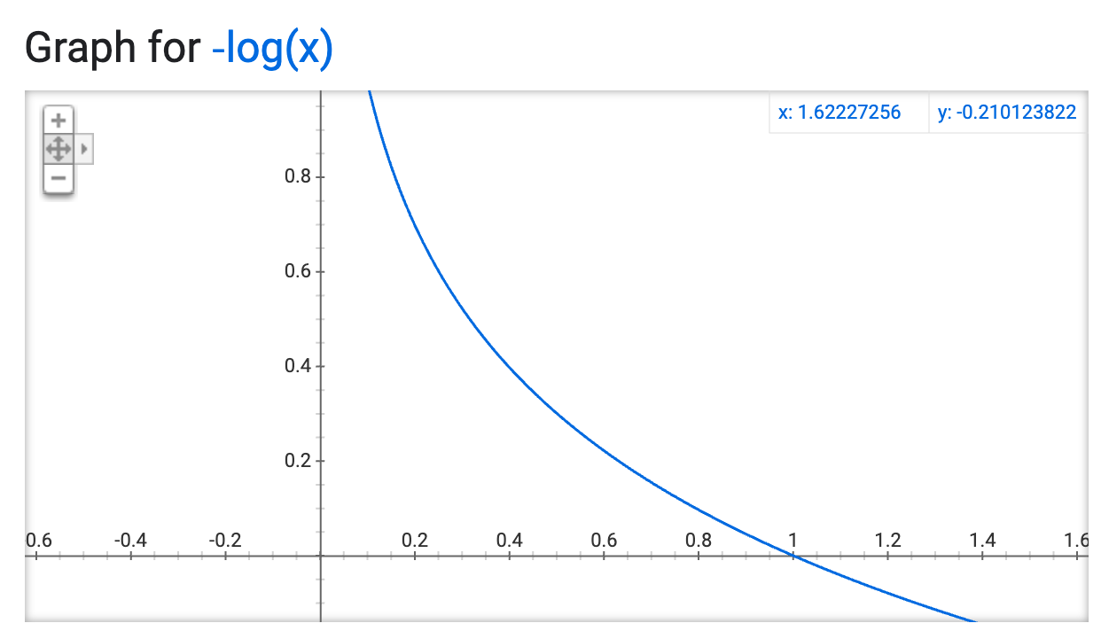
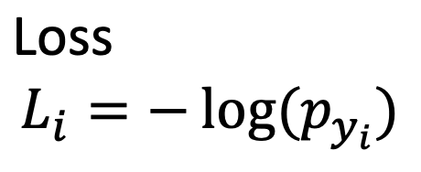
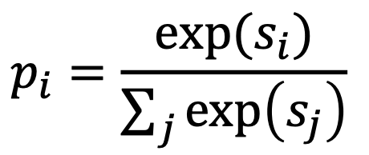



Training 3-Classes
Cat weight vector
0.2
-0.5
0.1
2.0
1.1
56
-96.8
Cat score
0.00000…
Cat probability
Dog weight vector
1.5
1.3
2.1
0.0
3.2
231
437.9
Dog score
.9999
Dog probability
Hippo weight vector
0.0
0.3
0.2
-0.3
-1.2
24
61.95
Hippo score
0.0000…..
Hippo probability
2
$$W$$
$$si= Wx_{i}$$
bias
1
Weight matrix a collection of scoring functions, one per class
Prediction is vector where jth component is “score” for jth class.
$$x_{i}$$
Want the correct class to have probability = 1
Diagram by: Karpathy, Fei-Fei
Notes:
TODO: how to teach this without log-loss
Do the bias on the board.
Two things in your neural network (neurons, topology)
You need it to sum to one, so you divide by the total sum
Why exp ? So its all positive value. Also its’ easy to take the derivative

Slide 32
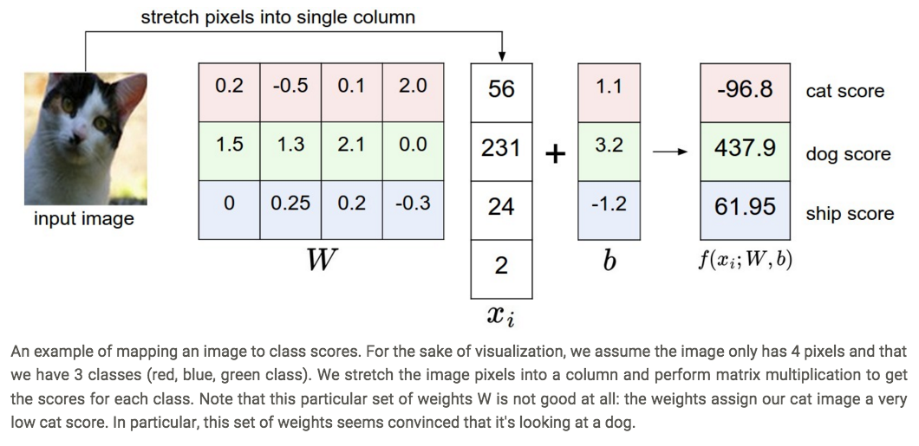
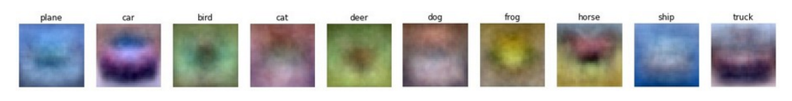
Visualizing linear classifiers
Source: Andrej Karpathy, http://cs231n.github.io/linear-classify/

Slide 33

Linear Classifiers: Visual Intuition
Decision rule is w^{T}x. If w_{i} is big, then big values of x_{i} are indicative of the class.
Deer or Plane?

Slide 34
Linear Classifiers: Visual Intuition
Decision rule is w^{T}x. If w_{i} is big, then big values of x_{i} are indicative of the class.
Ship or Dog?

Slide 35
Are linear classifiers enough??
One template per class:
Can’t recognize different modes of a class
Notes:
10 min = 75 min total

Slide 36
Why?? Linear Classifiers not enough
Geometric Viewpoint
Visual Viewpoint
y
One template per class:
Can’t recognize different modes of a class
x

Slide 37
One solution: Feature Transforms
Original space
y
r = (x² + y²)^{1/2}
θ = tan⁻¹(y/x)
x
Feature transform

Slide 38
One solution: Feature Transforms
Original space
Feature space
y
θ
r = (x² + y²)^{1/2}
θ = tan⁻¹(y/x)
x
Feature transform
r

Slide 39
One solution: Feature Transforms
Original space
Feature space
y
θ
r = (x² + y²)^{1/2}
θ = tan⁻¹(y/x)
x
Feature transform
r
Linear classifier in feature space

Slide 40
One solution: Feature Transforms
Neural Networks (MLPs) learn the transforms itself from data
Original space
Feature space
y
θ
r = (x² + y²)^{1/2}
θ = tan⁻¹(y/x)
x
Feature transform
r
Nonlinear classifier in original space!
Linear classifier in feature space

Slide 41
Recognition pipeline: With Perceptrons
Feature representation
Perceptron
Image
Pixels
Class label
Notes:
We just did this! Features is filter bank response, k-means into bag of words!
Then did classification with Nearest Neighbors!

Slide 42
Recognition pipeline: With Multiple Perceptrons
Feature representation
Perceptron
Perceptron
Image
Pixels
Class label
Multi-Layer Perceptrons (MLPs),
Fully-connected networks
Can replace feature computation with layers of perceptrons!
= Deep Network
Notes:
We just did this! Features is filter bank response, k-means into bag of words!
Then did classification with Nearest Neighbors!
Just a line, its not

Slide 43
“Deep” recognition pipeline
Image pixels
Layer 1
Layer 2
Layer 3
Simple
Classifier
  Learn a feature hierarchy from pixels to classifier
  Each layer extracts features from the output of previous layer
  Train all layers jointly
Slide courtesy of Lana Lezebnik
Notes:
Make clear that classic methods, e.g. convnets are purely supervised.

Slide 44
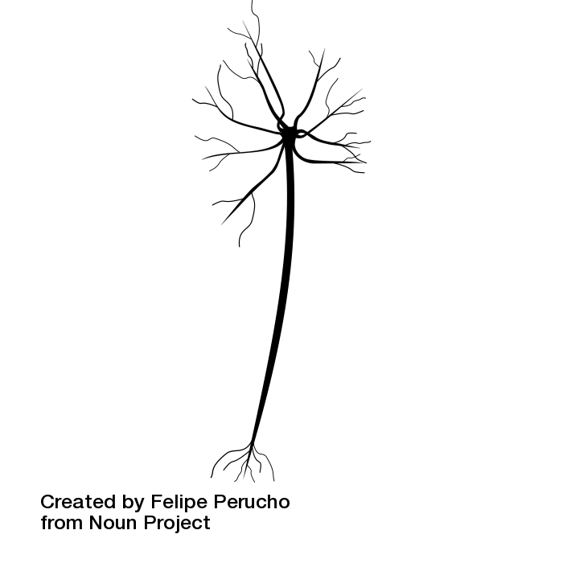
Loose inspirations: Biological Neurons
Axon
Cell body
Dendrite

Slide 45
Loose inspirations: Biological Neurons
Presynaptic terminal
Axon
Synapse
Cell body
Dendrite

Slide 46
Loose inspirations: Biological Neurons
Presynaptic terminal
Axon
Synapse
Impulses carried away from cell body
Cell body
Impulses carried toward cell body
Dendrite

Slide 47
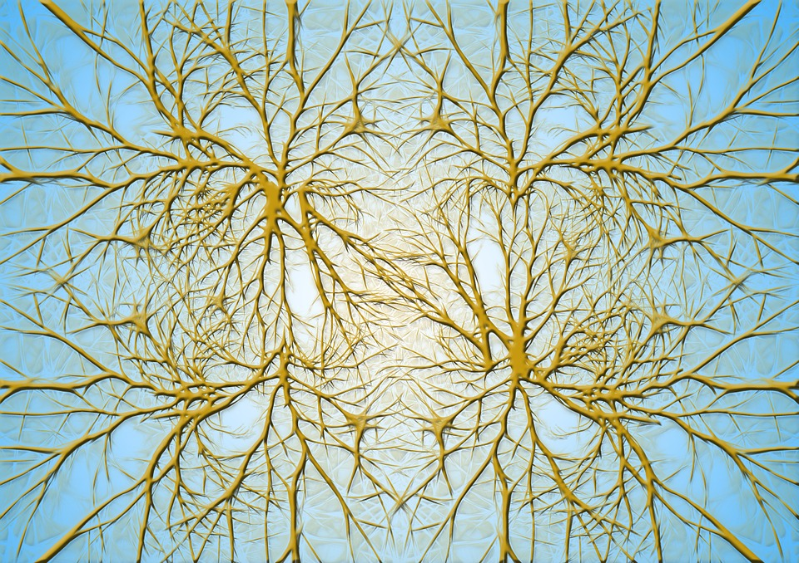

Neurons in a neural network:
Organized into regular layers for computational efficiency
Biological Neurons:
Complex connectivity patterns
This image is CC0 Public Domain

Slide 48
Be very careful with brain analogies!
Biological Neurons:
Many different types
Can perform complex non-linear computations
Synapses are not a single weight but a complex non-linear dynamical system
Can have feedback, time-dependent
Probably don’t learn via gradient descent
[Dendritic Computation. London and Hausser]

Slide 49
Multi-layer perceptrons
To make nonlinear classifiers out of perceptrons, build a multi-layer neural network!
  This requires each perceptron to have a nonlinearity
Slide courtesy of Lana Lezebnik
Notes:
60 min till here.
Neuron terminology
Two things in your neural network (neurons, topology)
Input (pixels) & connections are fixed.
Ws (are your experiences, that you need to learn )

Slide 50
Remember this?
”Cat”
Image Classification

Slide 51
Remember this?
x¹
x²
x
y
”Cat”
W¹
W²
W³
Image Classification

Slide 52
Multi-layer perceptrons / Fully-Connected Layer
”Cat”
x¹
x²
x
y
W¹
W²
W³
Notes:
Whats fixed are the inputs and the connections
You learn W!

Slide 53
Multi-layer perceptrons
To make nonlinear classifiers out of perceptrons, build a multi-layer neural network!
  This requires each perceptron to have a nonlinearity
  To be trainable, the nonlinearity should be differentiable
Sigmoid:
Rectified linear unit (ReLU): g(t) = max(0,t)
Most popular. Use subderivative at 0,
Slide courtesy of Lana Lezebnik
Notes:
why can't this be signs??? It doesn’t have subgradeints (not a convex function) it’s also 0 derivative everywhere, only get derivatives when you get it wrong

Slide 54
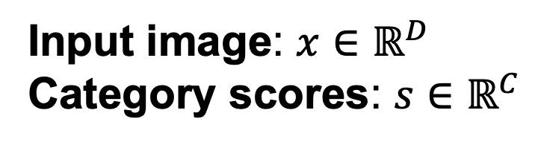
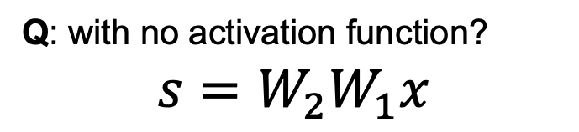
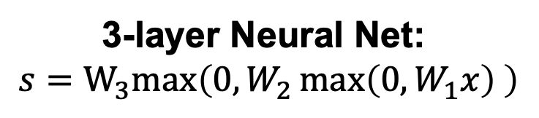
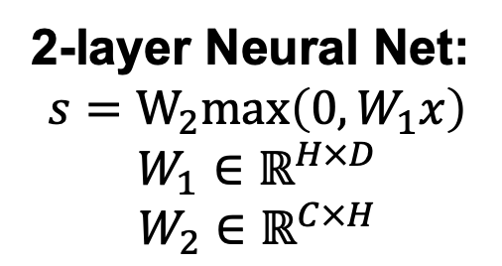
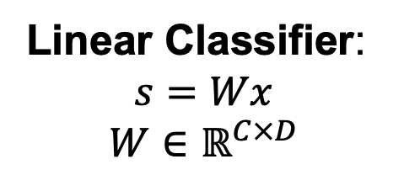
Why do we need non-linearities?
Input image: $x∈ℝ^{D}$
Category scores: $s∈ℝ^{C}$
Linear Classifier:
$$s=Wx$$
$$W∈ℝ^{C×D}$$
2-layer Neural Net:
$$s=W_{2}max\left(0, W_{1}x\right)$$
$$W_{1}∈ℝ^{H×D}$$
$$W_{2}∈ℝ^{C×H}$$
3-layer Neural Net:
$$s=W_{3}max\left(0,W_{2}\max\left(0, W_{1}x\right) \right)$$
Q: with no activation function?
$$s=W_{2}W_{1}x$$
Slide modified from Johnson & Fouhey

Slide 55
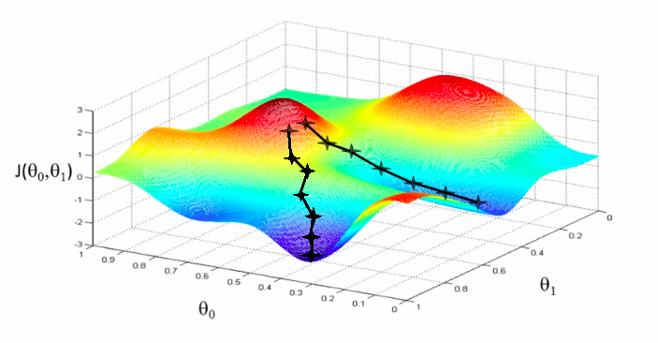
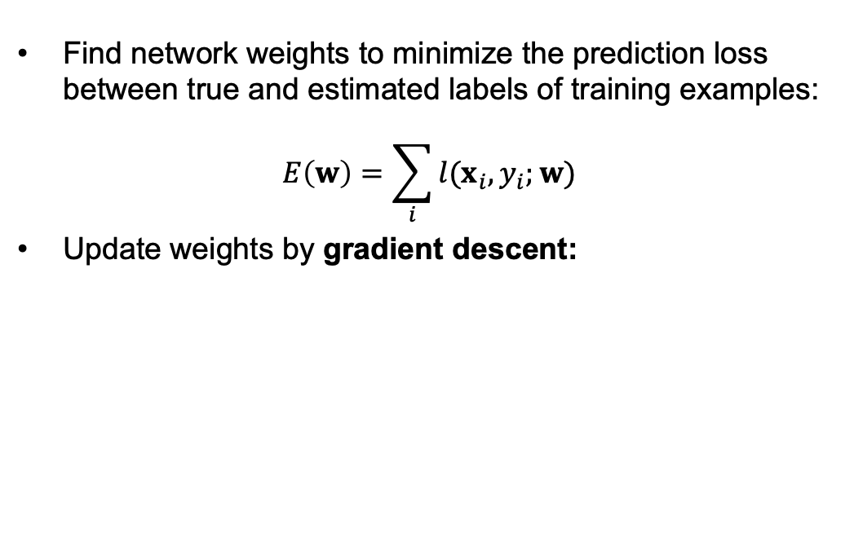
Training of multi-layer networks
Find network weights to minimize the prediction loss between true and estimated labels of training examples:
$$E\left(w\right)=\sum_{i}{l(x_{i},y_{i};w)}$$
Update weights by gradient descent:
w₂
Slide courtesy of Lana Lezebnik
w₁

Slide 56
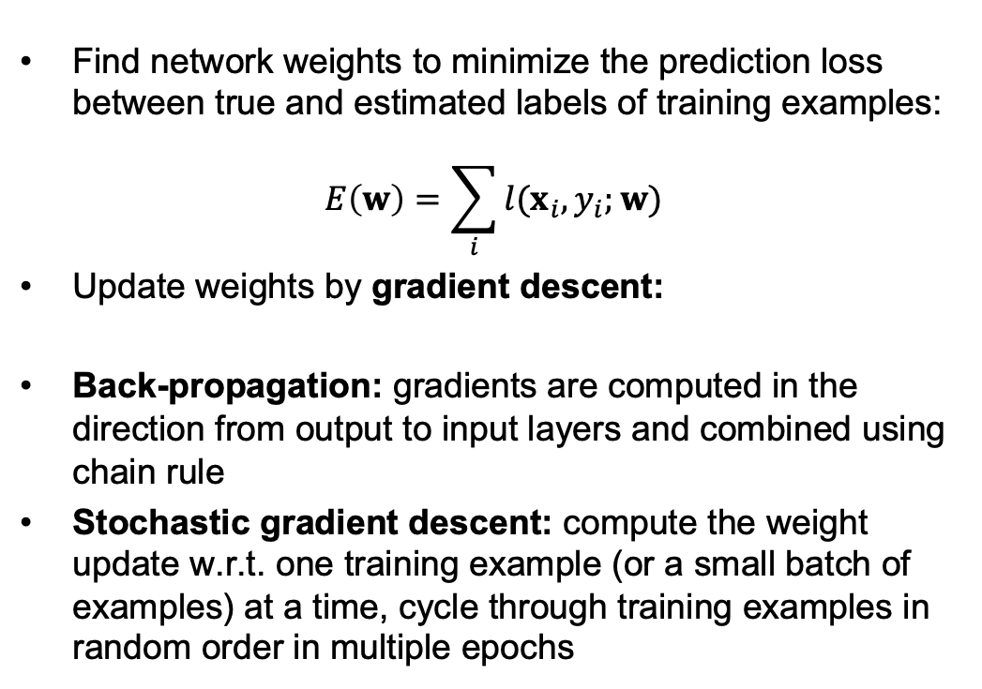
Training of multi-layer networks
Find network weights to minimize the prediction loss between true and estimated labels of training examples:
$$E\left(w\right)=\sum_{i}{l(x_{i},y_{i};w)}$$
Update weights by gradient descent:
Back-propagation: gradients are computed in the direction from output to input layers and combined using chain rule
Stochastic gradient descent: compute the weight update w.r.t. one training example (or a small batch of examples) at a time, cycle through training examples in random order in multiple epochs
Slide courtesy of Lana Lezebnik

Slide 57

Back prop in 2 slides
x¹
x²
x
What do we need for training Ws?
y
W¹
W²
W³
Where x^{l} = $σ$(W^{l}x^{l-1})
Chain rule!!
Notes:
Gradient descent
$\frac{\partial L}{\partial W^3}$
= \frac{\partial L}{\partial y} \frac{\partial y}{\partial W^3}

Slide 58

Back prop intuition
x¹
x²
Every single layer is like a “team” W is organizing
x
y
W¹
W²
W³
What higher ups say
Manager (W^{l})
Output
Suboordinates
x^{(l-1)}
Notes:
Dynamic programmaning

Slide 59


Back prop intuition
x¹
x²
x
y
W¹
W²
W³
1. Every single layer is like a team of neurons (x), that a manager (W) is listening to decide outputs (y)
2. Then you get a feedback from higher ups of what you should’ve done
W
3. You adjust your confidence in each of your neurons,
4. Then pass on what they should’ve said
Notes:
Dynamic programmaning

Slide 60

The point is
Each layer needs to adjust how it listened to each neuron (W) and compute gradients wrt its input and pass it down.
Updates: Higher up orders multiplied by how much the manager listened to each neuron
Pass down: Higher up orders, weighted by how much the manager listened to each neuron
Notes:
In practice all you need to do is to compute these two things at each layer.

Slide 61
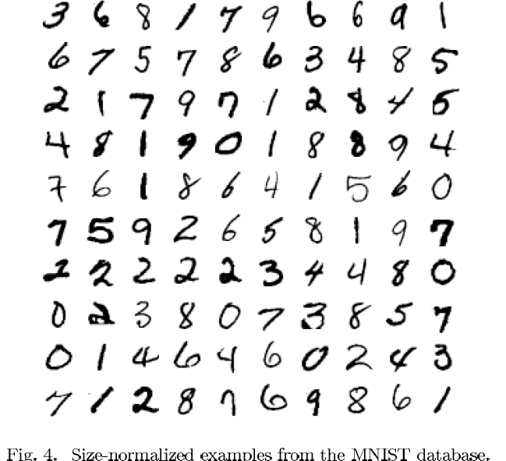
MNIST
yann.lecun.com/exdb/mnist/
Yann LeCun & Corinna Cortes

Slide 62
The MNIST DATABASE of handwritten digits yann.lecun.com/exdb/mnist/
Yann LeCun & Corinna Cortes
Has a training set of 60 K examples (6K examples for each digit), and a test set of 10K examples.
Each digit is a 28 x 28 pixel grey level image. The digit itself occupies the central 20 x 20 pixels, and the center of mass lies at the center of the box.
“It is a good database for people who want to try learning techniques and pattern recognition methods on real-world data while spending minimal efforts on preprocessing and formatting.”

Slide 63
A very simple way to recognize handwritten shapes
Consider a neural network with two layers of neurons.
  neurons in the top layer represent known shapes.
  neurons in the bottom layer represent pixel intensities.
A pixel gets to vote if it has ink on it.
  Each inked pixel can vote for several different shapes.
The shape that gets the most votes wins.
0 1 2 3 4 5 6 7 8 9
Slide by Geoff Hinton
Notes:
Top layer counts the votes in each digit.
Connection to pixels

Slide 64
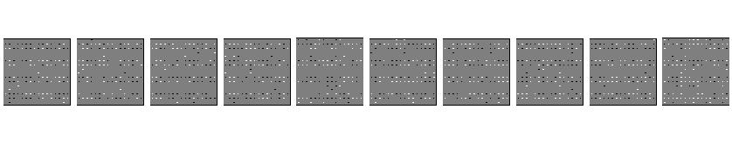
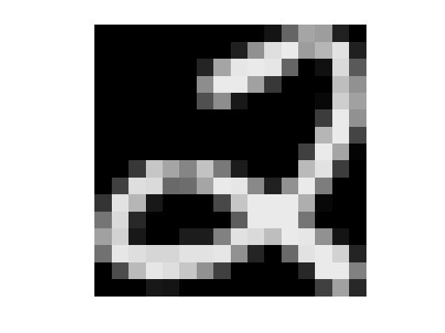
How to display the weights
1 2 3 4 5 6 7 8 9 0
The input image
Give each output unit its own “map” of the input image and display the weight coming from each pixel in the location of that pixel in the map.
Use a black or white blob with the area representing the magnitude of the weight and the color representing the sign.
Slide by Geoff Hinton

Slide 65
How to learn the weights
1 2 3 4 5 6 7 8 9 0
The image
Show the network an image and increment the weights from active pixels to the correct class.
Then decrement the weights from active pixels to whatever class the network guesses.
Slide by Geoff Hinton

Slide 66
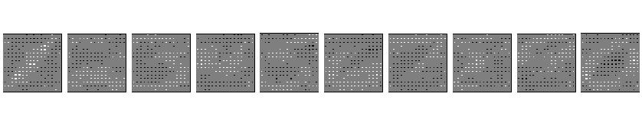
1 2 3 4 5 6 7 8 9 0
The image
Slide by Geoff Hinton

Slide 67
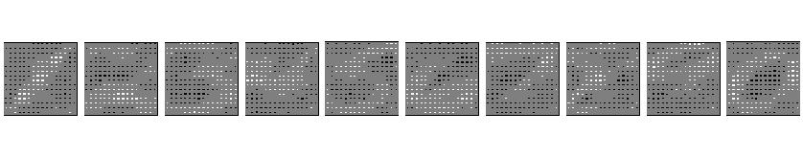
1 2 3 4 5 6 7 8 9 0
The image
Slide by Geoff Hinton

Slide 68
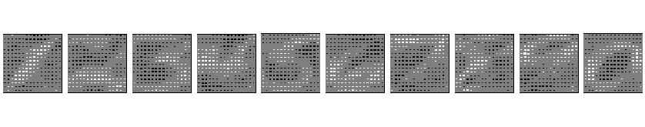
1 2 3 4 5 6 7 8 9 0
The image
Slide by Geoff Hinton

Slide 69
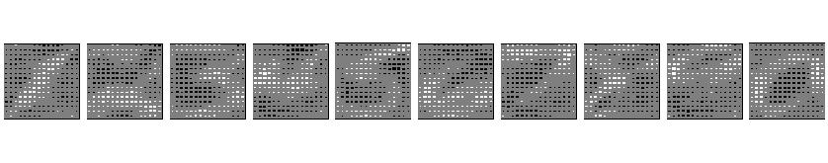
1 2 3 4 5 6 7 8 9 0
The image
Slide by Geoff Hinton

Slide 70
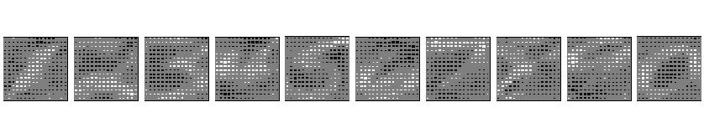
1 2 3 4 5 6 7 8 9 0
The image
Slide by Geoff Hinton

Slide 71
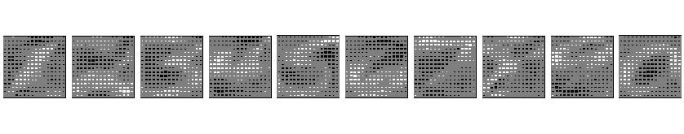
The learned weights
1 2 3 4 5 6 7 8 9 0
The image
Slide by Geoff Hinton

Slide 72
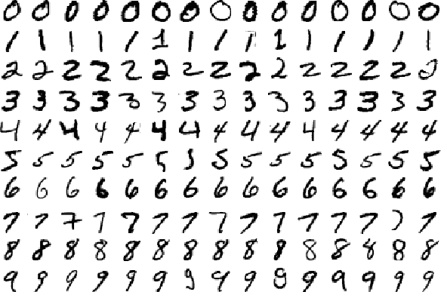
Why the simple learning algorithm is insufficient
A two layer network with a single winner in the top layer is equivalent to having a rigid template for each shape.
  The winner is the template that has the biggest overlap with the ink.
The ways in which hand-written digits vary are much too complicated to be captured by simple template matches of whole shapes.
Slide by Geoff Hinton

Slide 73
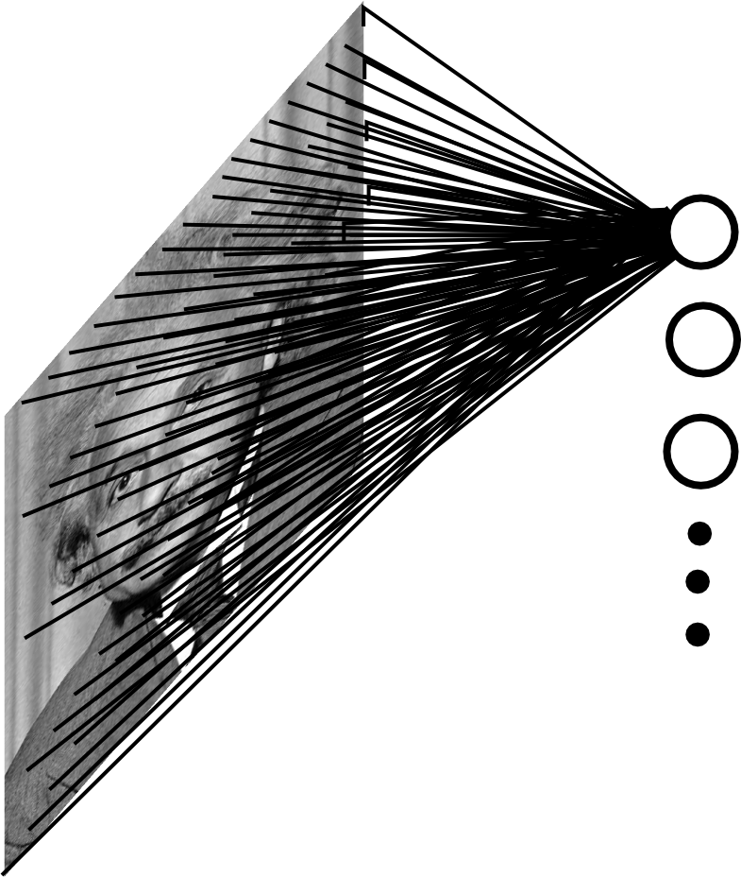

What we have so far: Fully Connected Layers (MLPs)
Example: 200x200 image
40K hidden units
~2B parameters!!!
- Spatial correlation is local
Waste of resources + we have not enough
training samples anyway..
Ranzato

Slide 74
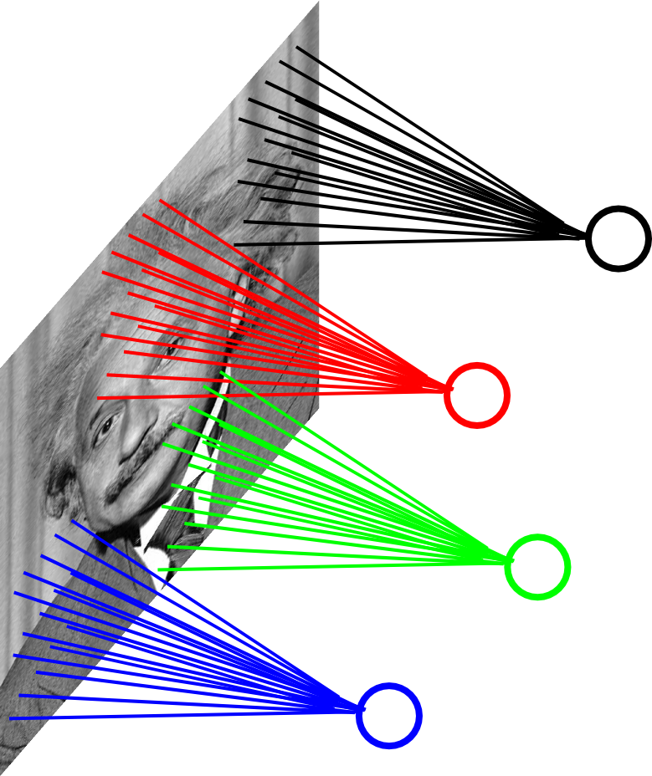
Locally Connected Layer
Example: 200x200 image
40K hidden units
Filter size: 10x10
4M parameters
Note: This parameterization is good when
input image is registered (e.g., face recognition).
Ranzato

Slide 75
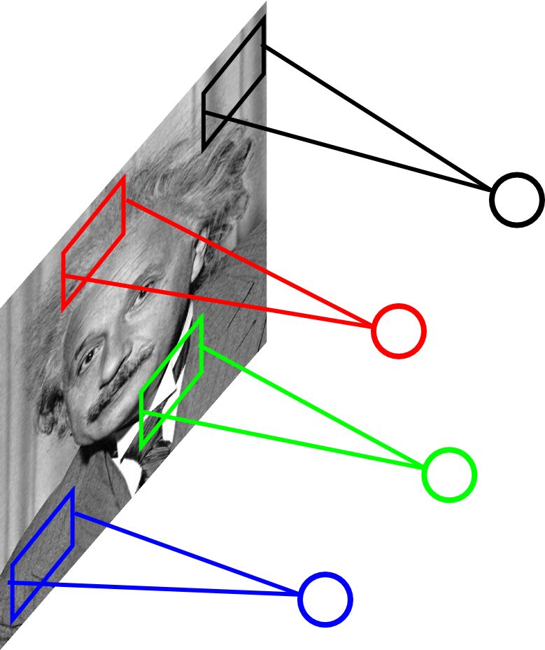
Locally Connected Layer
STATIONARITY? Statistics is similar at
different locations
Example: 200x200 image
40K hidden units
Filter size: 10x10
4M parameters
Ranzato

Slide 76
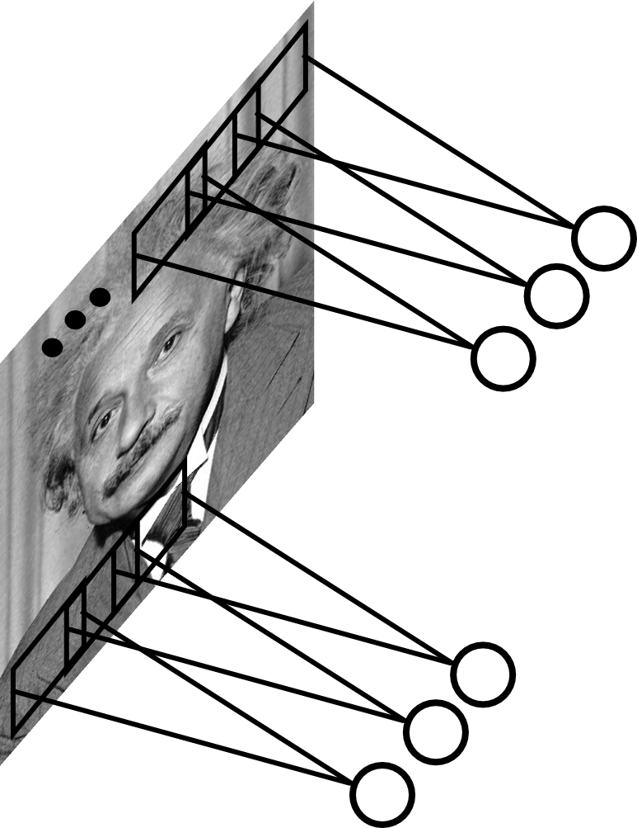
Convolutional Layer
Share the same parameters across different
locations (assuming input is stationary):
Convolutions with learned kernels
Ranzato

Slide 77
Convolutional Neural Networks
CS194: Computer Vision and Comp. Photo
Alexei Efros, UC Berkeley, Fall 2020

Slide 78
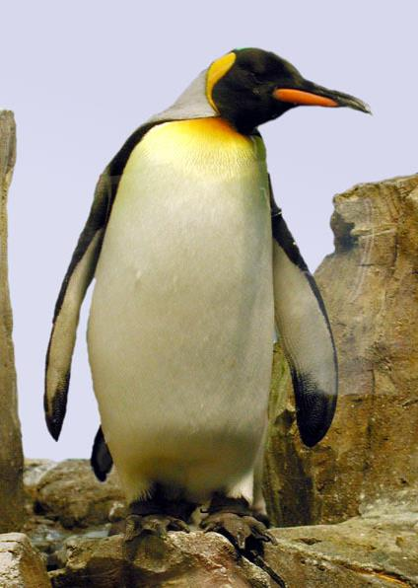

Neural Nets: a particularly useful Black Box
Convolutional Neural Network
“Penguin”
image X
label Y

Slide 79
Classic Object Recognition
Feature extractors
Classifier
Edges
Segments
Texture
“Penguin”
Parts
Colors
image X
label Y
Slide by Philip Isola

Slide 80

Classic Object Recognition
Learned
Feature extractors
Classifier
Edges
Segments
Texture
“Penguin”
Parts
Colors
image X
label Y
Slide by Philip Isola

Slide 81
Learning Features
Learned
Feature extractors
Edges
Texture
Colors
image X
label Y

Slide 82
Neural Network: algorithm + feature + data!
Learned
“Penguin”
image X
label Y
Slide by Philip Isola

Slide 83
Vanilla (fully-connected)
Neural Networks

Slide 84
Fully Connected Layer
Example: 200x200 image
40K hidden units
~2B parameters!!!
- Spatial correlation is local
Waste of resources + we have not enough
training samples anyway..
Ranzato

Slide 85
Locally Connected Layer
Example: 200x200 image
40K hidden units
Filter size: 10x10
4M parameters
Note: This parameterization is good when
input image is registered (e.g., face recognition).
Ranzato

Slide 86
Locally Connected Layer
STATIONARITY? Statistics is similar at
different locations
Example: 200x200 image
40K hidden units
Filter size: 10x10
4M parameters
Ranzato

Slide 87
Convolutional Layer
Share the same parameters across different
locations (assuming input is stationary):
Convolutions with learned kernels
Ranzato

Slide 88
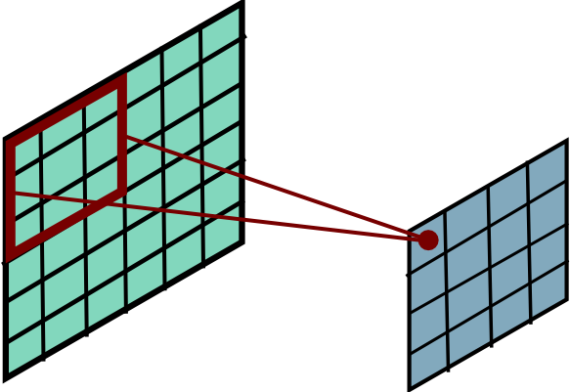
Convolutional Layer
Ranzato

Slide 89
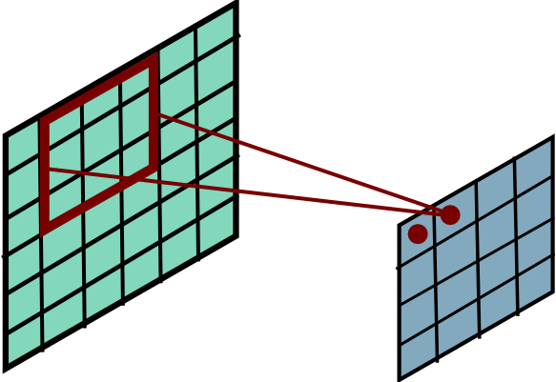
Convolutional Layer
Ranzato

Slide 90
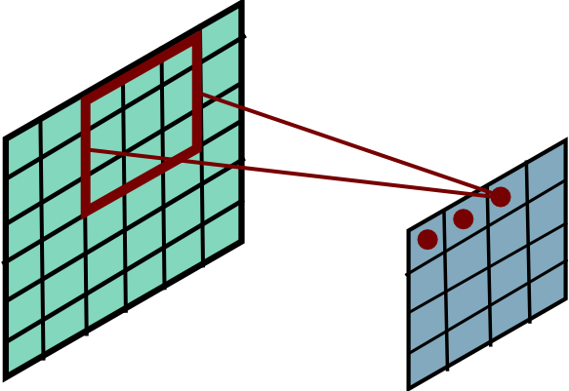
Convolutional Layer
Ranzato

Slide 91
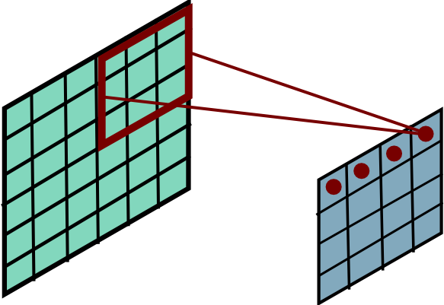
Convolutional Layer
Ranzato

Slide 92
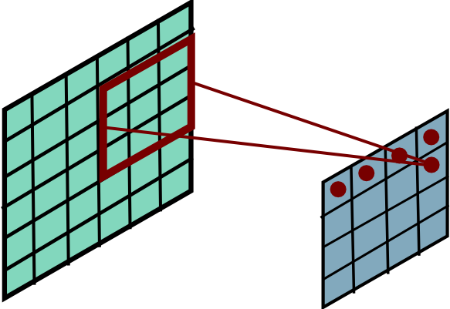
Convolutional Layer
Ranzato

Slide 93

Convolutional Layer
Ranzato

Slide 94

Convolutional Layer
Ranzato

Slide 95

Convolutional Layer
Ranzato

Slide 96

Convolutional Layer
Ranzato

Slide 97

Convolutional Layer
Ranzato

Slide 98

Convolutional Layer
Ranzato

Slide 99

Convolutional Layer
Ranzato

Slide 100

Convolutional Layer
Ranzato

Slide 101

Convolutional Layer
Ranzato

Slide 102

Convolutional Layer
Ranzato

Slide 103

Convolutional Layer
Ranzato

Slide 104


Convolutional Layer
Learn multiple filters.
E.g.: 200x200 image
100 Filters
Filter size: 10x10
10K parameters
Ranzato

Slide 105
before:
output layer
input layer
hidden layer
now:

Slide 106
Convolution Layer
32x32x3 image
32
height
32
width
3
depth

Slide 107
Convolution Layer
32x32x3 image
5x5x3 filter
32
Convolve the filter with the image
i.e. “slide over the image spatially, computing dot products”
32
3

Slide 108
Convolution Layer
Filters always extend the full depth of the input volume
32x32x3 image
5x5x3 filter
32
Convolve the filter with the image
i.e. “slide over the image spatially, computing dot products”
32
3

Slide 109


Convolution Layer
32x32x3 image
5x5x3 filter
32
1 number:
the result of taking a dot product between the filter and a small 5x5x3 chunk of the image
(i.e. 5*5*3 = 75-dimensional dot product + bias)
32
3

Slide 110
Convolution Layer
activation map
32x32x3 image
5x5x3 filter
32
28
convolve (slide) over all spatial locations
32
28
3
1

Slide 111
consider a second, green filter
Convolution Layer
32x32x3 image
5x5x3 filter
activation maps
32
28
convolve (slide) over all spatial locations
32
28
3
1

Slide 112
For example, if we had 6 5x5 filters, we’ll get 6 separate activation maps:
activation maps
32
28
Convolution Layer
32
28
3
6
We stack these up to get a “new image” of size 28x28x6!

