Slide 1
Convolutional Neural Networks
CS194: Computer Vision and Comp. Photo
Angjoo Kanazawa/Alexei Efros, UC Berkeley, Fall 2022

Slide 2
Project 4
Part A was due last Thursday → checkpoint graded on completion
  Update: slip days won’t be applied on part A
Part B due next *Monday*
Final submission includes both A & B
if you have a bug in part A do fix it for Part B

Slide 3
Project 5
Will be released Wednesday after Project 4 B is due.
Go to this Thursday’s OH for PyTorch review!!!
Very important that you go to this if you have never done anything with PyTorch.

Slide 4
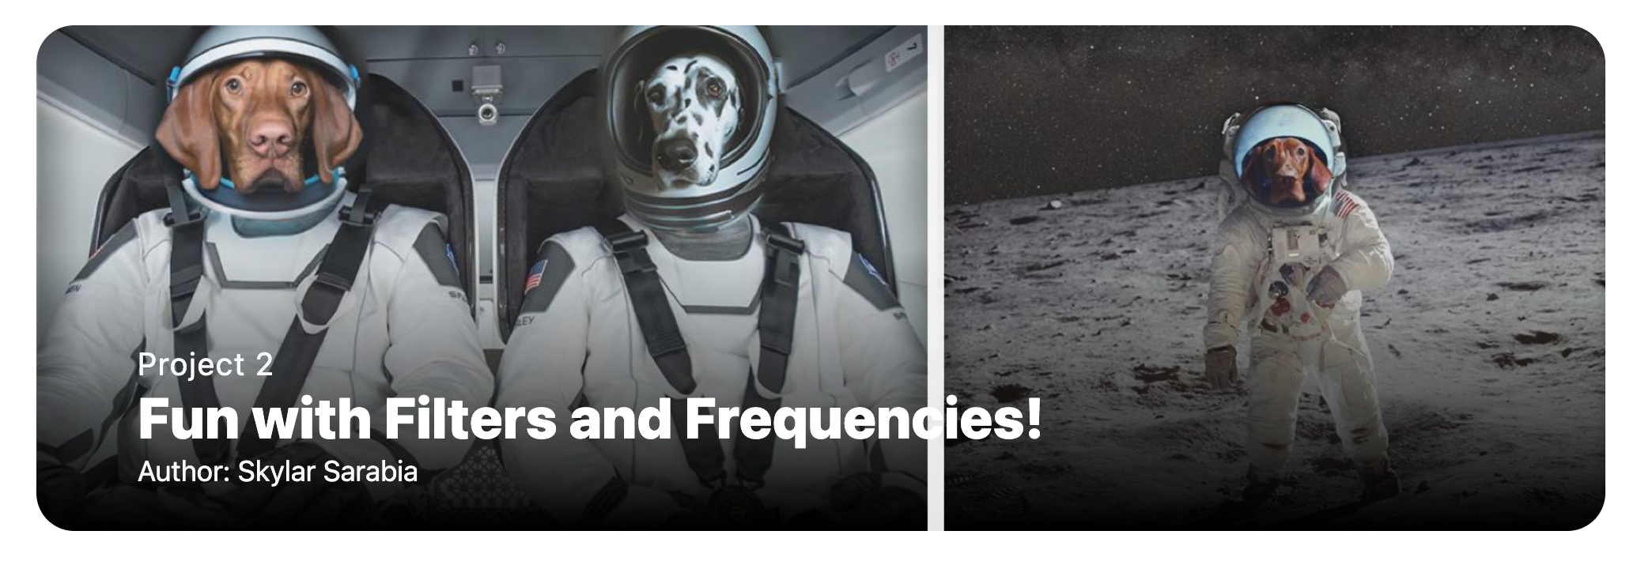
Project 2 Class Choice Award Winner!
Runner ups: Anik Gupta Erich Liang Andrew Zhang
Notes:
Project 1 Janise Liang if around!

Slide 5
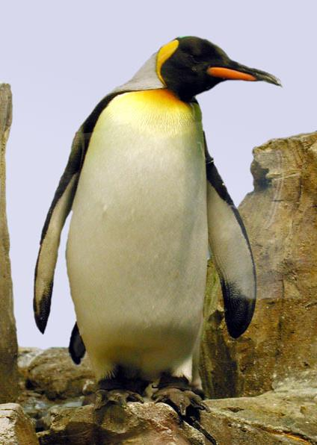

Neural Nets: a particularly useful Black Box
Convolutional Neural Network
“Penguin”
image X
label Y

Slide 6
Classic Object Recognition
Feature extractors
Classifier
Edges
Segments
Texture
“Penguin”
Parts
Colors
image X
label Y
Slide by Philip Isola

Slide 7

Classic Object Recognition
Learned
Feature extractors
Classifier
Edges
Segments
Texture
“Penguin”
Parts
Colors
image X
label Y
Slide by Philip Isola

Slide 8
Learning Features
Learned
Feature extractors
Edges
Texture
Colors
image X
label Y

Slide 9
Neural Network: algorithm + feature + data!
Learned
“Penguin”
image X
label Y
Slide by Philip Isola

Slide 10

Vanilla (fully-connected)
Neural Networks

Slide 11
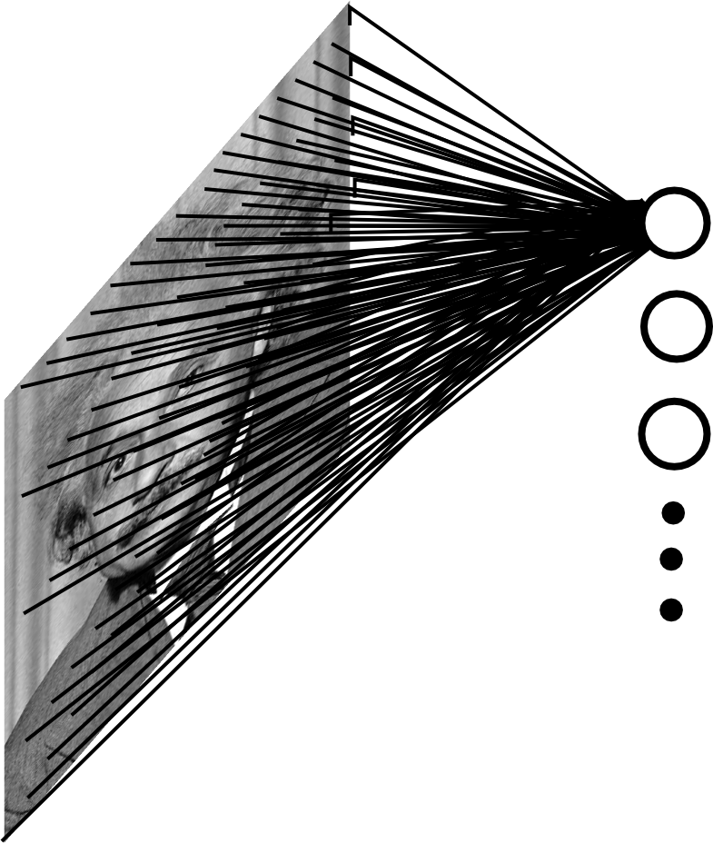

Fully Connected Layer
Example: 200x200 image
40K hidden units
~2B parameters!!!
- Spatial correlation is local
Waste of resources + we have not enough
training samples anyway..
Ranzato

Slide 12
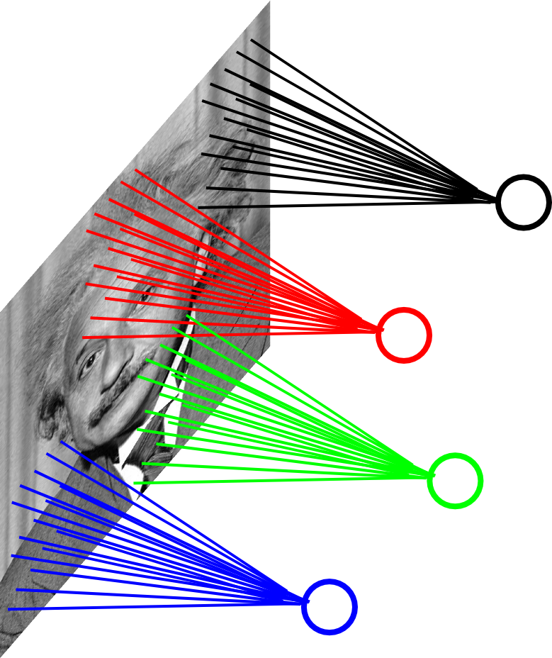
Locally Connected Layer
Example: 200x200 image
40K hidden units
Filter size: 10x10
4M parameters
Note: This parameterization is good when
input image is registered (e.g., face recognition).
Ranzato

Slide 13
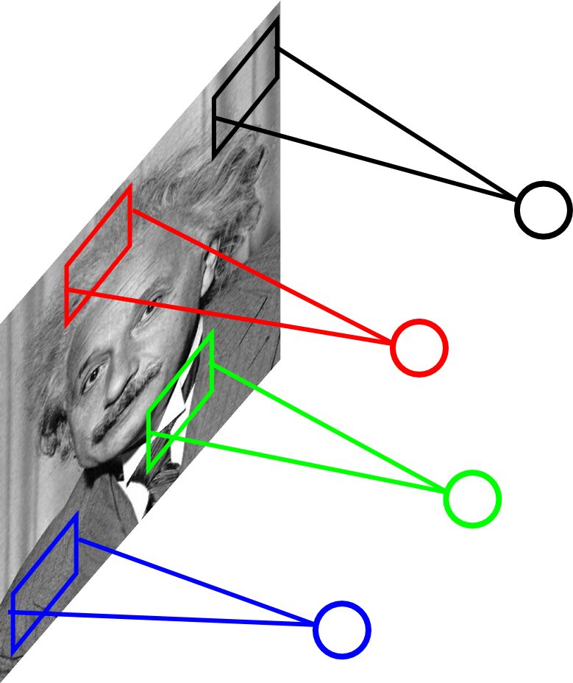
Locally Connected Layer
STATIONARITY? Statistics is similar at
different locations
Example: 200x200 image
40K hidden units
Filter size: 10x10
4M parameters
Ranzato

Slide 14
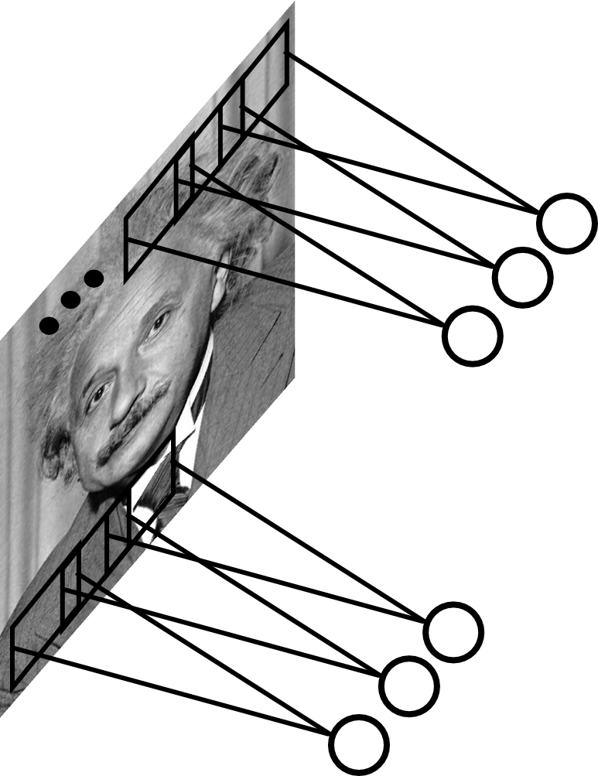
Convolutional Layer
Share the same parameters across different
locations (assuming input is stationary):
Convolutions with learned kernels
Ranzato

Slide 15
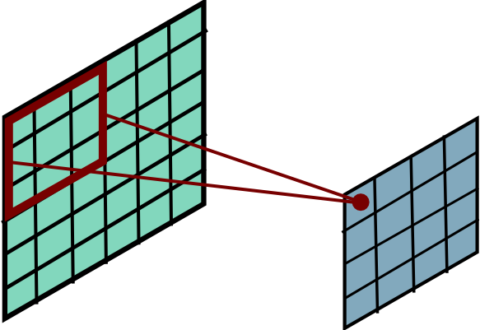
Convolutional Layer
Ranzato

Slide 16
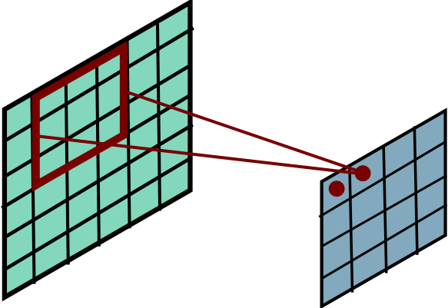
Convolutional Layer
Ranzato

Slide 17
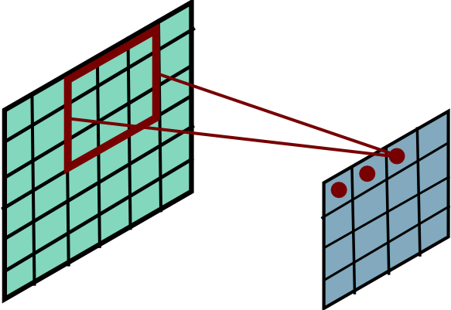
Convolutional Layer
Ranzato

Slide 18
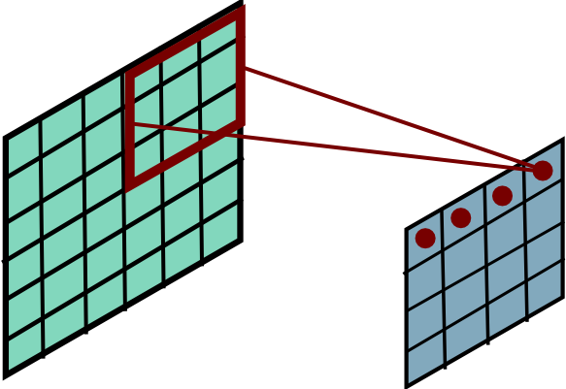
Convolutional Layer
Ranzato

Slide 19
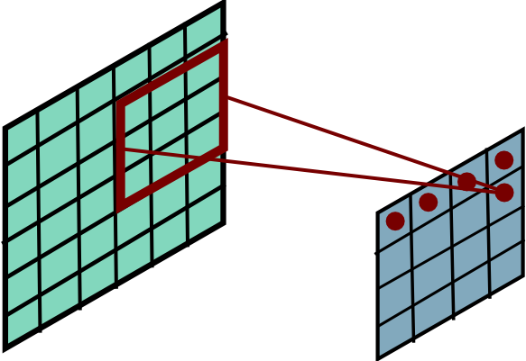
Convolutional Layer
Ranzato

Slide 20
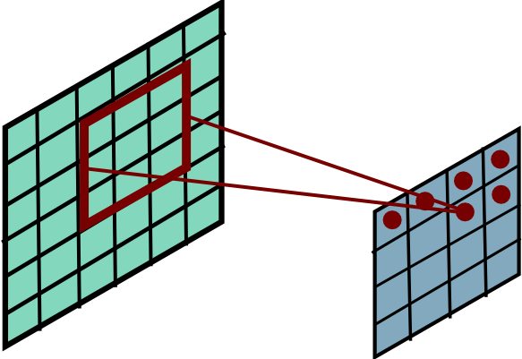
Convolutional Layer
Ranzato

Slide 21
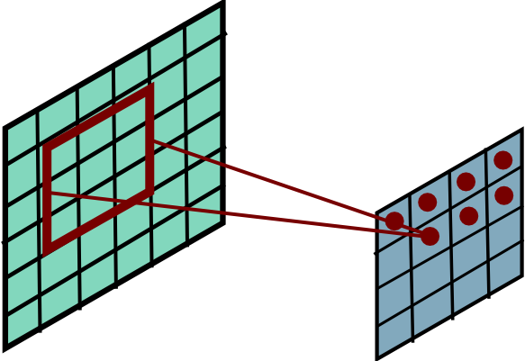
Convolutional Layer
Ranzato

Slide 22
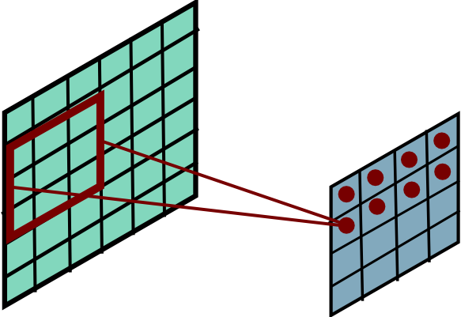
Convolutional Layer
Ranzato

Slide 23
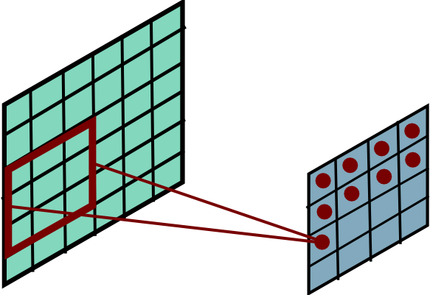
Convolutional Layer
Ranzato

Slide 24
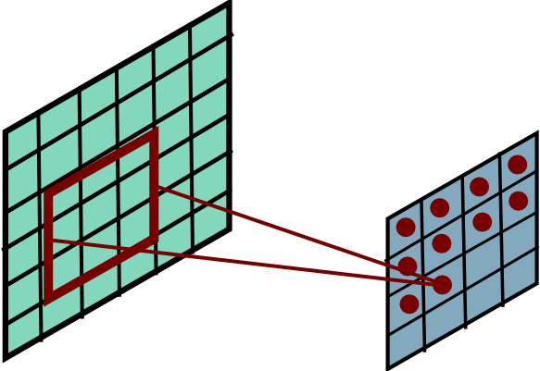
Convolutional Layer
Ranzato

Slide 25
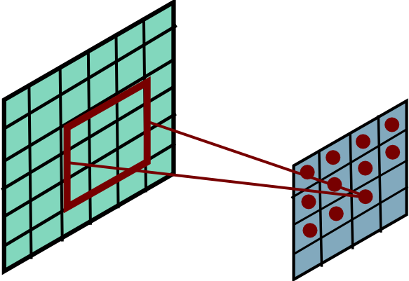
Convolutional Layer
Ranzato

Slide 26
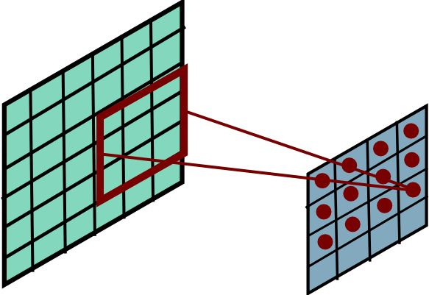
Convolutional Layer
Ranzato

Slide 27
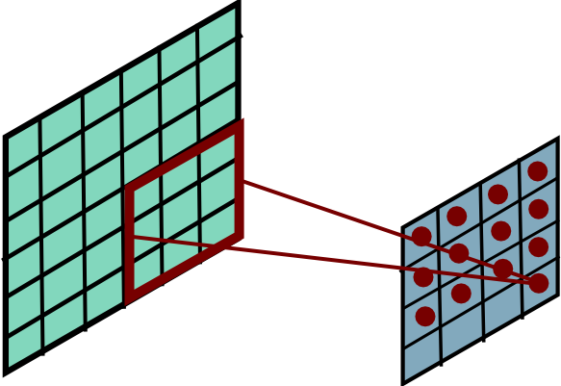
Convolutional Layer
Ranzato

Slide 28
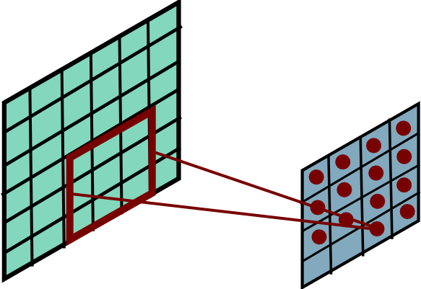
Convolutional Layer
Ranzato

Slide 29
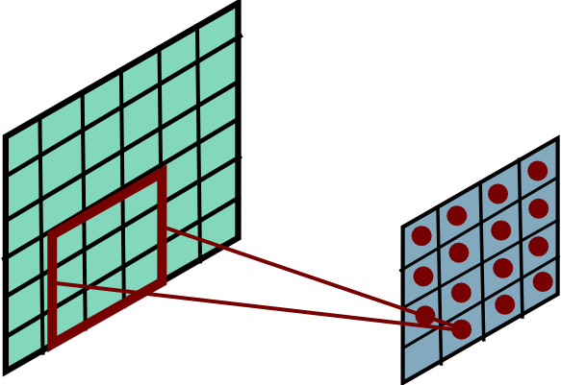
Convolutional Layer
Ranzato

Slide 30
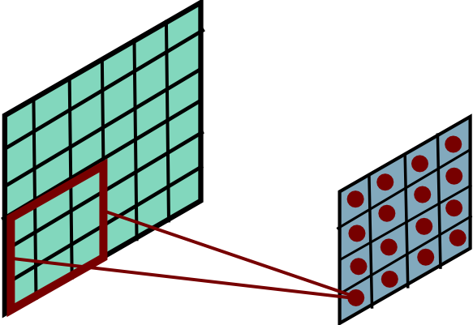
Convolutional Layer
Ranzato
Notes:
Btw, is this convolution, or cross-correlation?

Slide 31
Convolution Layer
One neuron, that looks at 5x5 region and outputs a sheet of activation map
1x28x28 activation map
3x32x32 image
3x5x5 filter
28
convolve (slide) over all spatial locations
32
28
32
1
3
Notes:
15 min

Slide 32
Convolution Layer
One neuron, that looks at 5x5 region and outputs a sheet of activation map:
1x28x28 activation map
3x32x32 image
3x5x5 filter
28
convolve (slide) over all spatial locations
32
28
32
1
3
Convolution Layer vs Image Filtering:
>1 input and output channels
Forget about convolution vs cross-correlation (Why?)

Slide 33
Convolution Layer:
2 neurons (aka filters)
two 1x28x28 activation map
3x32x32 image
Add a second (green) filter:
3x5x5 filter
28
28
convolve (slide) over all spatial locations
32
28
32
1
1
3

Slide 34
Convolution Layer
6 neurons (aka filters)
6 activation maps,
each 1x28x28
3x32x32 image
Can keep on adding new, say 6 filters, each 3x5x5
Convolution Layer
32
32
6x3x5x5 filters
Stack activations to get a 6x28x28 output image!
3

Slide 35
Convolution Layer
28x28 grid, at each point a 6-dim vector
3x32x32 image
Also 6-dim bias vector:
Convolution Layer
32
32
6x3x5x5 filters
Stack activations to get a 6x28x28 output image!
3

Slide 36
Convolution Layer: With many images
2x6x28x28
Batch of outputs
2x3x32x32
Batch of images
Also 6-dim bias vector:
Convolution Layer
32
32
3
6x3x5x5 filters

Slide 37
Convolution Layer
N x C_{out} x H’ x W’
Batch of outputs
N x C_{in} x H x W
Batch of images
Bias: C_{out}-dim vector:
Convolution Layer
H
W
C_{out}
C_{in}
Weights:
C_{out} x C_{in}x K_{w} x K_{h}

Slide 38
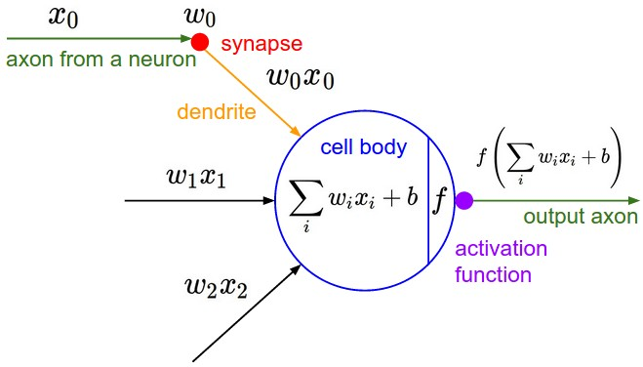
The brain/neuron view of CONV Layer
32
E.g. with 5 filters,
CONV layer consists of neurons arranged in a 3D grid
(28x28x5)
There will be 5 different neurons all looking at the same region in the input volume
28
32
28
3
5

Slide 39
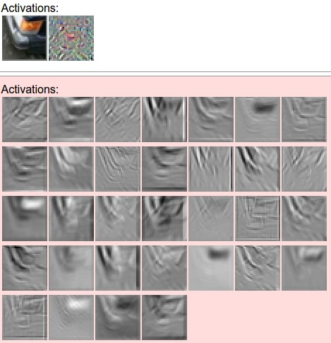
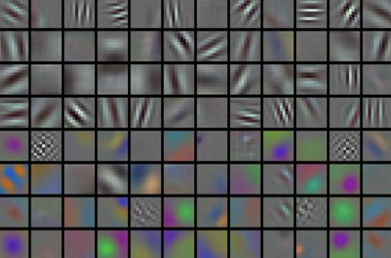
convolving the first filter in the input gives the first slice of depth in output volume

Slide 40
Compared with MLPs
Activation maps
Vectorize
/flatten
fc
output
Notes:
What’s the difference between convnets that only looks at each channel? -> output is going to be C*C_before. This just sums the response across channels.

Slide 41
CNNs in practice
FC layers (MLPs)
…
Vectorize
/flatten
output
Conv layers (they still need to go through non-linearity!!)
Notes:
What’s the difference between convnets that only looks at each channel? -> output is going to be C*C_before. This just sums the response across channels.

Slide 42
What needs to be learned?
FC layers (MLPs)
…
Vectorize
/flatten
output
Conv layers (they still need to go through non-linearity!!)
Notes:
What’s the difference between convnets that only looks at each channel? -> output is going to be C*C_before. This just sums the response across channels.

Slide 43
What needs to be learned?
Conv, Relu
Input:
B, C_in, H, W
Output
B, C_out, H, W
C_out, C_in, K, K
Notes:
What’s the difference between convnets that only looks at each channel? -> output is going to be C*C_before. This just sums the response across channels.

Slide 44
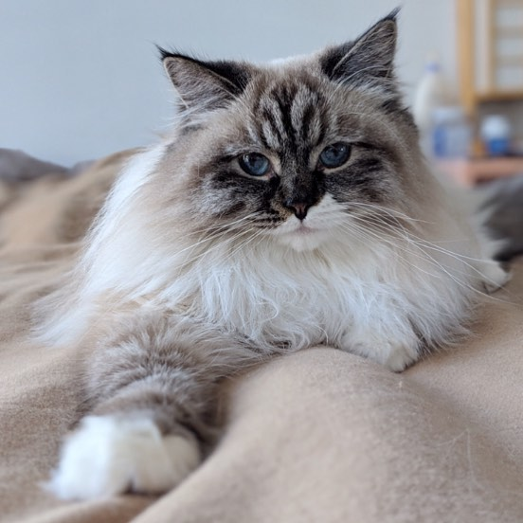
We’re still doing matrix multiplications, just localized & shared
Recall one neuron in FC layer:
With Conv layer:
col2im
im2col
w takes the entire image!
Now w takes (overlapping) patches

Slide 45
Convnet nitty gritties
Notes:
15 min

Slide 46
Convolution Spatial Dimensions
Input: 7x7
Filter: 3x3
Q: How big is output?
7
7

Slide 47
Convolution Spatial Dimensions
Input: 7x7
Filter: 3x3
Q: How big is output?
7
7

Slide 48
Convolution Spatial Dimensions
Input: 7x7
Filter: 3x3
Q: How big is output?
7
7

Slide 49
Convolution Spatial Dimensions
Input: 7x7
Filter: 3x3
Q: How big is output?
7
7

Slide 50
Convolution Spatial Dimensions
Input: 7x7
Filter: 3x3
Output: 5x5
7
7

Slide 51
Convolution Spatial Dimensions
Input: 7x7
Filter: 3x3
Output: 5x5
In general:
Input: W
Filter: K
Output: W – K + 1
Problem: Feature maps “shrink” with each layer!
7
7

Slide 52
Convolution Spatial Dimensions
Input: 7x7
Filter: 3x3
Output: 7x7
0 | 0 | 0 | 0 | 0 | 0 | 0 | 0 | 0
0 |  |  |  |  |  |  |  | 0
0 |  |  |  |  |  |  |  | 0
0 |  |  |  |  |  |  |  | 0
0 |  |  |  |  |  |  |  | 0
0 |  |  |  |  |  |  |  | 0
0 |  |  |  |  |  |  |  | 0
0 |  |  |  |  |  |  |  | 0
0 | 0 | 0 | 0 | 0 | 0 | 0 | 0 | 0
In general:
Input: W
Filter: K
Padding: P
Problem: Feature maps “shrink” with each layer!
Solution: padding
Add zeros around the input

Slide 53
Convolution Spatial Dimensions
Input: 7x7
Filter: 3x3
Output: 5x5
0 | 0 | 0 | 0 | 0 | 0 | 0 | 0 | 0
0 |  |  |  |  |  |  |  | 0
0 |  |  |  |  |  |  |  | 0
0 |  |  |  |  |  |  |  | 0
0 |  |  |  |  |  |  |  | 0
0 |  |  |  |  |  |  |  | 0
0 |  |  |  |  |  |  |  | 0
0 |  |  |  |  |  |  |  | 0
0 | 0 | 0 | 0 | 0 | 0 | 0 | 0 | 0
In general:
Input: W
Filter: K
Padding: P
Output: W – K + 1 + 2P
Very common: “same padding”
Set P = (K – 1) / 2
Then output size = input size

Slide 54
Receptive Fields
For convolution with kernel size K, each element in the output depends on a K x K receptive field in the input
Input
Output

Slide 55
Receptive Fields
Each successive convolution adds K – 1 to the receptive field size
With L layers the receptive field size is 1 + L * (K – 1)
Input
Output
Careful – ”receptive field wrt to the input”
vs “receptive field wrt the previous layer”

Slide 56
Receptive Fields
Each successive convolution adds K – 1 to the receptive field size
With L layers the receptive field size is 1 + L * (K – 1)
Input
Output
Problem: For large images we need many layers for each output to “see” the whole image image

Slide 57
Receptive Fields
Each successive convolution adds K – 1 to the receptive field size
With L layers the receptive field size is 1 + L * (K – 1)
Input
Output
Problem: For large images we need many layers for each output to “see” the whole image image
Solution: Downsample inside the network

Slide 58
Strided Convolution
Input: 7x7
Filter: 3x3
Stride: 2

Slide 59
Strided Convolution
Input: 7x7
Filter: 3x3
Stride: 2

Slide 60
Strided Convolution
Input: 7x7
Filter: 3x3
Stride: 2
Output: 3x3

Slide 61
Strided Convolution
Input: 7x7
Filter: 3x3
Stride: 2
Output: 3x3
In general:
Input: N
Filter: K
Stride: S
With padding: P
Output: (N – K + 2P) / S + 1
Output: (N-K) / S + 1

Slide 62
Can we do stride 3?
Input: 7x7
Filter: 3x3
Stride: 3?
Output: 3x3
Output: (N-F) / S + 1
e.g. N = 7, F = 3:
stride 1 => (7 - 3)/1 + 1 = 5
stride 2 => (7 - 3)/2 + 1 = 3
stride 3 => (7 - 3)/3 + 1 = 2.33 ☹

Slide 63
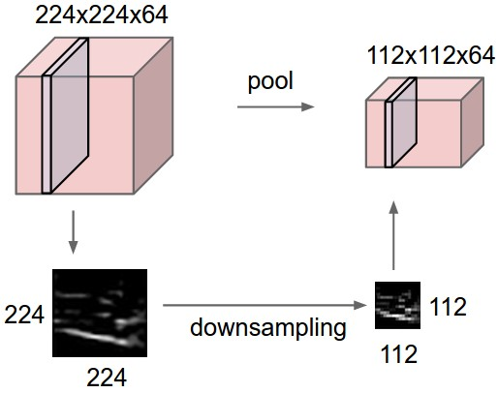
Pooling Layers: Downsampling
Another way to reduce size while aggregating(pooling) information
64 x 224 x 224
64 x 112 x 112
Has a choice of:
Kernel Size
Stride
Pooling function

Slide 64
Max Pooling
64 x 224 x 224
Single depth slice
2 | 3 | 2 | 4
5 | 6 | 6 | 8
3 | 2 | 1 | 0
1 | 2 | 3 | 4
x
Max pooling with 2x2 kernel size and stride 2
6 | 8
3 | 4
Introduces invariance to small spatial shifts
No learnable parameters!
y

Slide 65
Average Pooling
64 x 224 x 224
Single depth slice
2 | 3 | 2 | 4
5 | 6 | 6 | 8
3 | 2 | 1 | 0
1 | 2 | 3 | 4
x
Avg pooling with 2x2 kernel size and stride 2
4 | 5
2 | 2
Introduces invariance to small spatial shifts
No learnable parameters!
y

Slide 66
Pooling Summary
Input: C x H x W
Hyperparameters:
Kernel size: K
Stride: S
Pooling function (max, avg)
Output: C x H’ x W’ where
H’ = (H – K) / S + 1
W’ = (W – K) / S + 1
Learnable parameters: None!
Common settings:
max, K = 2, S = 2
max, K = 3, S = 2 (AlexNet)

Slide 67
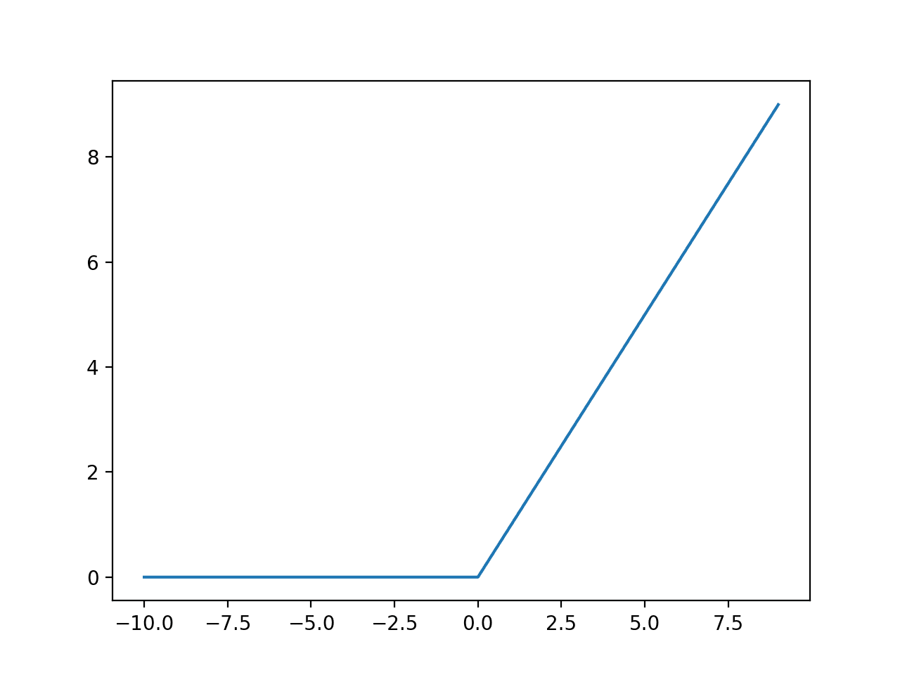

Normalization
You want the inputs to be in a similar range → low variance
Why do we need to normalize our data?
Extreme example:
sometimes pixel range is [0, 255], sometimes it’s [0, 1]
What is the problem?
Network activations will be completely different!!
Notes:
Network activations will be completely different!!

Slide 68
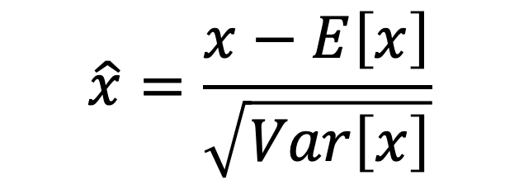
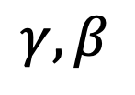
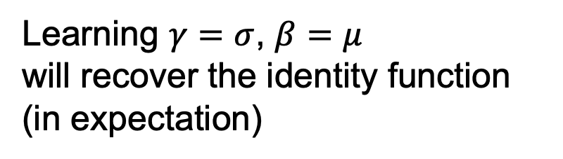
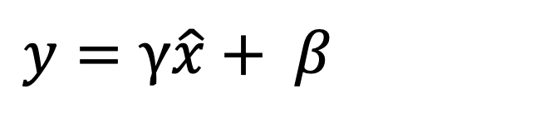
How to normalize
$$\hat{x}=\frac{x−E\left[x\right]}{\sqrt{Var\left[x\right]}}$$
Is this differentiable?
Yes! so we can use it as an operator in our networks and backprop through it!
But now the data is always zero mean, unit variance…
$y=$ $γ\hat{x}+ β$
Learning $γ=σ$, $β=μ$
will recover the identity function (in expectation)
Sol: Add scale and shift parameters:
$$γ,β$$
Slide modified from David Fouhey
Notes:
What does this mean though?

Slide 69
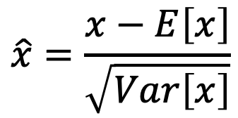
Normalization
Conv
Usually inserted after Fully Connected or Convolutional layers, and before nonlinearity.
BN
ReLU
Conv
$$\hat{x}=\frac{x−E\left[x\right]}{\sqrt{Var\left[x\right]}}$$
BN
ReLU

Slide 70
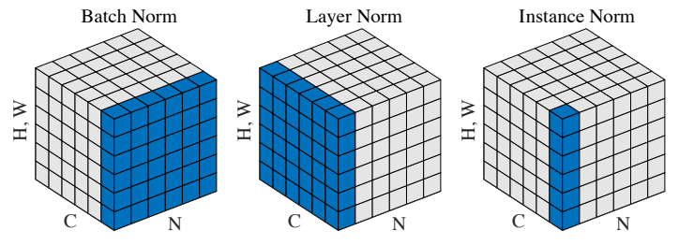
How to normalize
Next Q: from what do you compute the mean & variance?
BatchNorm computes mean and var from each batch
Depends on the batch, so need to keep a running average and store these.
LayerNorm/InstanceNorm do not need this.
Notes:
What are the possible ways to normalize data?

Slide 71
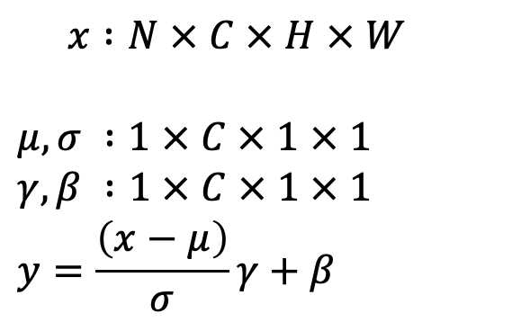
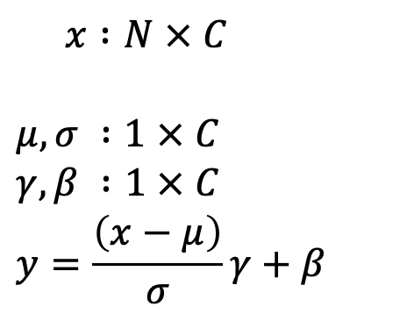
Batch Normalization for ConvNets
Batch Normalization for fully-connected networks
Batch Normalization for
convolutional networks
(Spatial Batchnorm, BatchNorm2D)
$x :N × C$
$$μ,σ :1 × C$$
$$γ,β :1 × C$$
$$y=\frac{\left(x−μ\right)}{σ}γ+β$$
$x :N × C × H × W$
$$μ,σ :1 × C × 1 × 1$$
$$γ,β :1 × C × 1 × 1$$
$$y=\frac{\left(x−μ\right)}{σ}γ+β$$
Normalize
Normalize

Slide 72
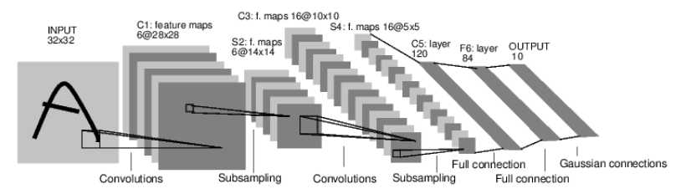
Case Study: Lenet-5
Task: 10 digit classification
LeCun et al. 1998
Conv filters were 5x5, applied at stride 1
Subsampling (Pooling) layers were 2x2 applied at stride 2
i.e. architecture is [CONV-POOL-CONV-POOL-CONV-flatten-FC-output]
Notes:
30 min total
Ask: What is the Size of the convolution filter?
What was the subsampling rate or the stride of the pooling (subsampling layers?)
Nonlinearity was tanh

Slide 73
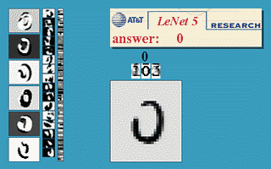
LeNet5 demo
LeCun et al. 1998

Slide 74
Case Study: AlexNet
[Krizhevsky, Sutskever, Hinton, NeurIPS 2012]
Task: ImageNet 1000-class classification
HxW
C
227x 227
3

Slide 75
Case Study: AlexNet
[Krizhevsky, Sutskever, Hinton, NeurIPS 2012]
Input: 227x227x3 images
First layer (CONV1): 96 11x11 filters applied at stride 4
Q: What is the output volume size after Conv1?
Hint:
(227-11)/4 + 1 = 55
A: 55x55x96
Q: how many parameters in this layer?
A: (3*11*11) * 96
Notes:
GTX 580 GPU had 3GB of memory, GTX1080/2080 11GB
What is the # of params with bias?

Slide 76
Case Study: AlexNet
[Krizhevsky, Sutskever, Hinton, NeurIPS 2012]
Input: 227x227x3 images
After Conv1: 55x55x96
Second layer: Pool1: 3x3 at stride 2
Q: What is the output volume size after Pool1?
A: (55-3)/2 + 1 = 27
27x27x96
Q: how many parameters in this layer?
A: 0!!!
Notes:
GTX 580 GPU had 3GB of memory, GTX1080/2080 11GB
What is the # of params with bias?

Slide 77
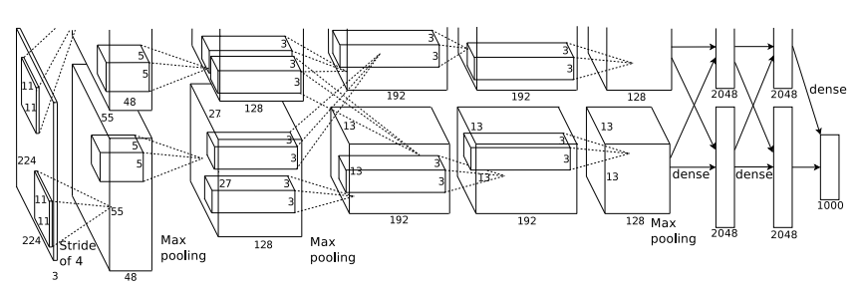
AlexNet
Q: Which part of the network incurs
high memory usage?
Large # of parameters?
high FLOPs?
Most of the memory usage is in the early convolution layers
Nearly all parameters are in the fully-connected layers
Most floating-point ops occur in the convolution layers

Slide 78
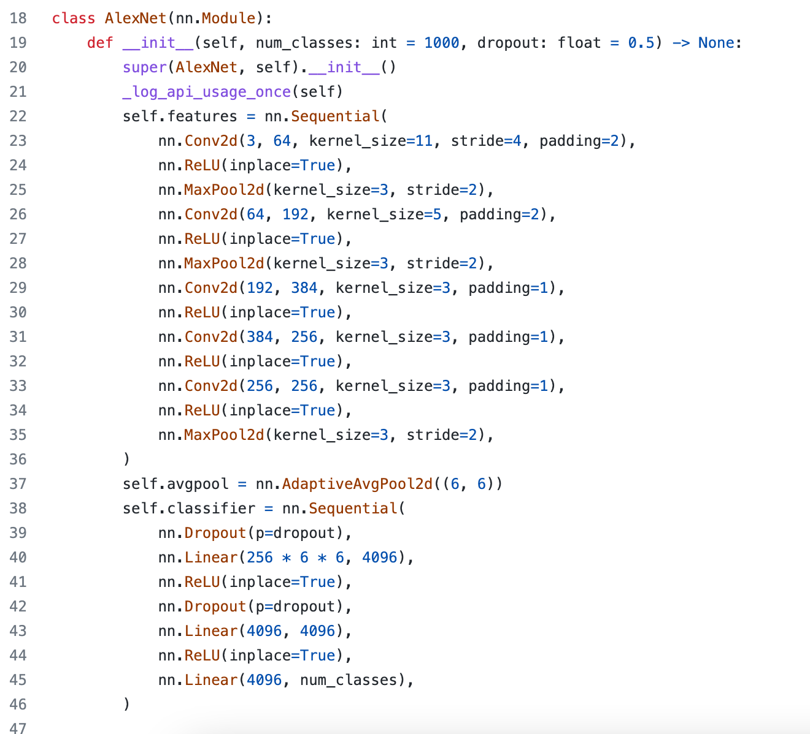
In pytorch
https://github.com/pytorch/vision/blob/main/torchvision/models/alexnet.py#L18

Slide 79
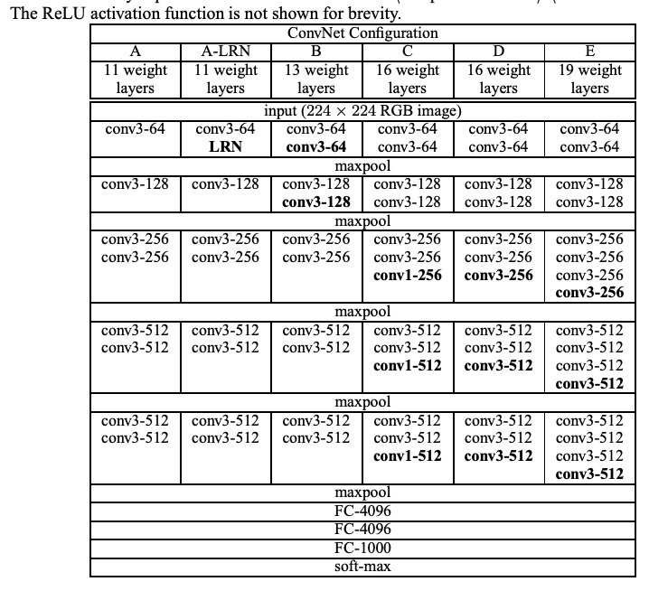

VGGNet [Simonyan and Zisserman 2015]
Input: 224x224x3
Simplified design rules:
All kernel size 3x3
Always ReLu
All max pool are 2x2, stride 2
After pool, double the # of channels
Notes:
Studies the effect of depth on accuracy
Shows that 3x3 conv is enough by making it deeper
74.5% top-1 accuracy, today it’s around 90% top-1 accuracy now

Slide 80
VGGNet [Simonyan and Zisserman 2015]
Input: 224x224x3
Simplified design rules:
All kernel size 3x3
Always ReLu
All max pool are 2x2, stride 2
After pool, double the # of channels
Option 1:
Conv(5x5, C -> C)
Params: 25C²
FLOPs: 25C²HW
Option 2:
Conv(3x3, C -> C)
Conv(3x3, C -> C)
Params: 18C²
FLOPs: 18C²HW
Two 3x3 conv has same receptive field as a single 5x5 conv, but has fewer parameters and takes less computation!
Slide adapted from Johnson & Fouhey
Notes:
Studies the effect of depth on accuracy
Shows that 3x3 conv is enough by making it deeper
74.5% top-1 accuracy, today it’s around 90% top-1 accuracy now

Slide 81
Problem: Deep Networks very hard to train!

Slide 82
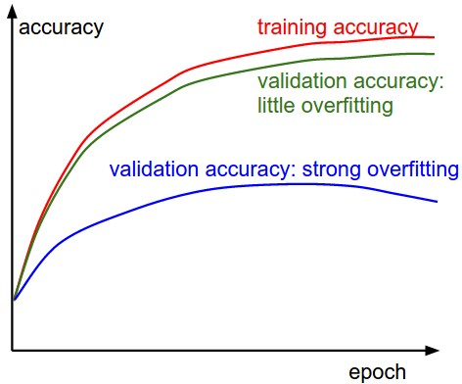
Measuring performance over train/val sets

Slide 83
Measuring performance over train/val sets

Slide 84
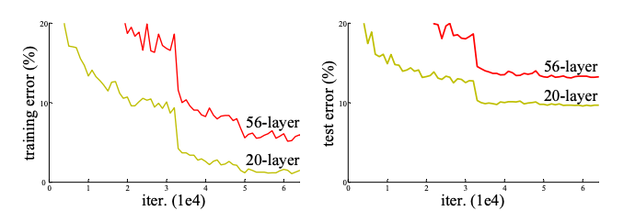
Deeper network != Better performance
Q: is this over fitting?
No! it’s a matter of optimization
ResNet [He et al. CVPR 2016]
Notes:
Why?
Not! bc overfitting, training loss is higher. → Due to optimization difficulty
Deeper networks can emulate shallow networks, by using the same set of layers and setting the extra layers to identity. So it should do as well, but it doesn’t → They don’t learn identity functions to emulate shallow models

Slide 85
Naively adding more layers
!= better performance
[He et al. CVPR 2016]
Deeper networks *should be* able to emulate shallow networks.
How? By making the extra layers to learn the identity function
But they don’t seem to learn identity by default
y= sig(w*x + b)
Notes:
In fact this seems hard. Why? a stack of non-linear functions makes it hard to do identity
Not! bc overfitting, training loss is higher. → Due to optimization difficulty
Deeper networks can emulate shallow networks, by using the same set of layers and setting the extra layers to identity. So it should do as well, but it doesn’t → They don’t learn identity functions to emulate shallow models

Slide 86
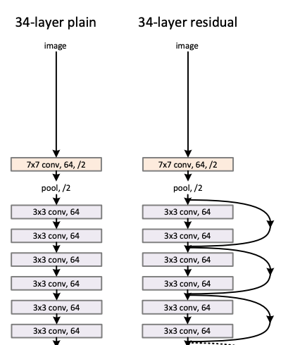

ResNet [He et al. CVPR 2016]
Input: 224x224x3
ResNet: “Residual Learning”
ResNet Block:
Notes:
Quick reduction in spatial dimension at least in this design
81% from 75%

Slide 87
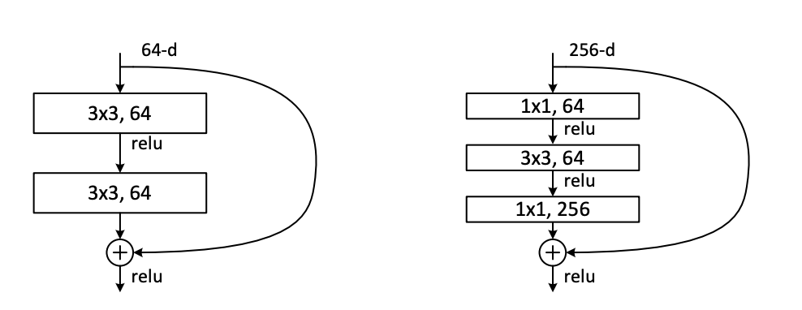
ResNet [He et al. CVPR 2016]
Can be made very deep: ResNet-50, 101, 152
And converge well
Bottleneck design:
Reduce by 1x1
Conv by 3x3
Restore by 1x1
Notes:
Quick reduction in spatial dimension at least in this design
81% from 75%
Where does Normalization come in? In the original, it’s right done right before the addition (afterevery weight)

Slide 88
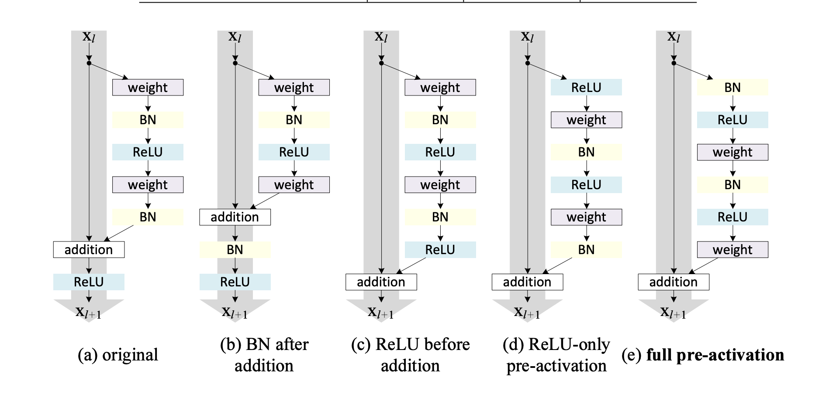
Lots of space to explore
For the project, I recommend using the default resnet
Identity Mappings in Deep Residual Networks, He et al. ECCV 2016

Slide 89
ImageNet Classification Challenge top-5 error
152 Layer
152 Layer
152 Layer
19 Layer
22 Layer
Shallow
8 Layer
8 Layer
In 2021, Top-5 is .98
Florence [Yuan et al. 2021]
Lin et al
Sanchez & Perronnin
Krizhevsky et al (AlexNet)
Zeiler & Fergus
Simonyan & Zisserman (VGG)
Szegedy et al (GoogLeNet)
He et al (ResNet)
Shao et al
Hu et al
(SENet)
Russakovsky et al
Notes:
getting saturated
w/attention

Slide 90
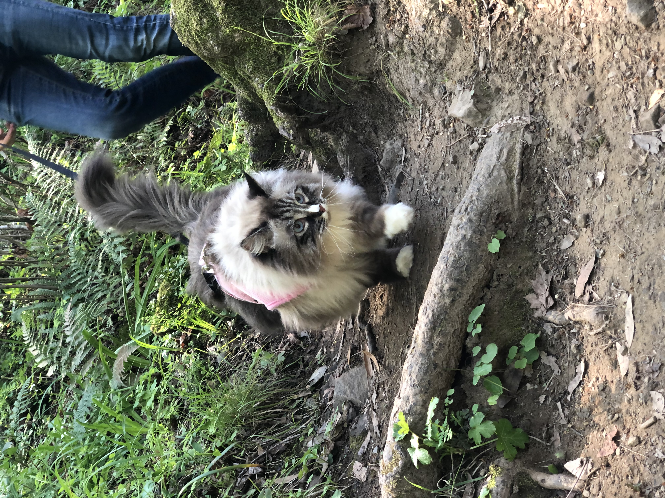
Bottom line: CNN workflow
CNN
Input:
HxWxC
Output:
1 x 1 x F
Convert HxW image into a F-dimensional vector
What’s the probability this image has a cat? (F=1)
Which of 1000 categories is this image? (F=1000)
Where are the X,Y coordinates of 5 cat face keypoints? (F=5*2 = 10)
Slide modified from David Fouhey
Notes:
15 min

Slide 91
Example: Image classification
Output:
1 x 1 x F
CNN
P(image is class #1)
Input:
HxWxC
P(image is class #2)
P(image is class #F)
Slide modified from David Fouhey

Slide 92
Example: Keypoint detection
Output:
1 x 1 x 2K
CNN
X coord of keypoint #1
Input:
HxWxC
Y coord of keypoint #1
X coord of keypoint #K
Y coord of keypoint #K
Slide modified from David Fouhey

Slide 93

How to train your network
Notes:
10 min

Slide 94
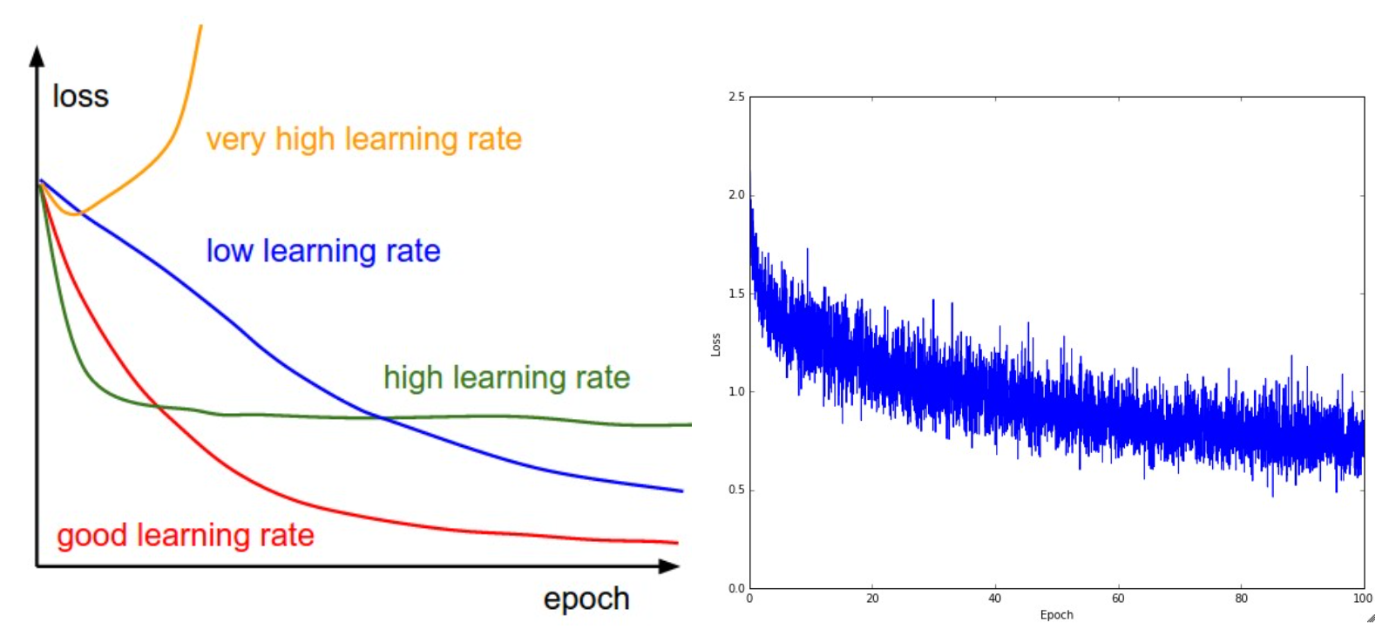
Training diagnosis
https://cs231n.github.io/neural-networks-3/

Slide 95
Basic setup
Get your dataset
Design your CNN architecture (start by reusing (or simplified version of) AlexNet/ResNet)
Train + update weights with pytorch/tf…

Slide 96
Sanity Check #1
Make sure you can memorize a single data point: (x_{i}, y_{i}).
Train your CNN on only 1 image
It must be able to get very low training loss
If you can’t do this, it means something is wrong in your loss function, label, network/pytorch setup
It should also overfit to a single data fairly quickly. If it takes many iterations to do this that’s also bad news bears

Slide 97
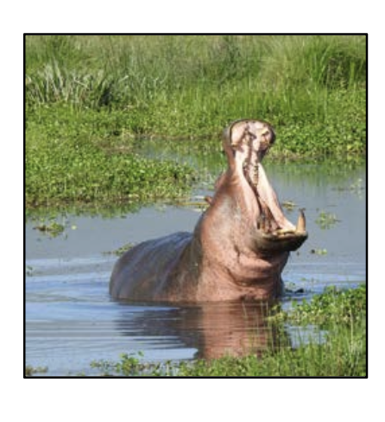
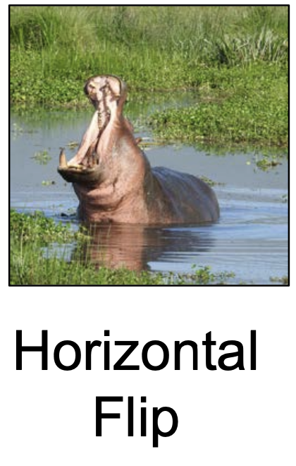

What if your data is not big enough?
Slide by David Fouhey

Slide 98

Data Augmentation
Apply transformations (on the fly) to increase training data
Can mix multiple transformations at once
Make sure you don’t change the meaning of the output
Slide modified from David Fouhey

Slide 99

Sometimes labels need to be transformed too
Original
After flip + color aug
For certain tasks, make sure to transform the output accordingly!!
Right eye
Left eye
Defined wrt to the cat

Slide 100
Sometimes labels need to be transformed too
Original
After flip + color aug
For certain tasks, make sure to transform the output accordingly!!
Right eye
Left eye
Defined wrt to the cat

Slide 101
Very common bug
Original
After flip + color aug
For certain tasks, make sure to transform the output accordingly!!
Right eye
Left eye
WRONG! Flipped without updating the label!!
Defined wrt to the cat
Notes:
If you do this half of the time left eye is on the right side and vise versa

Slide 102
Very common bug
Original
After flip + color aug
For certain tasks, make sure to transform the output accordingly!!
Right eye
Left eye
Correct
Defined wrt to the cat

Slide 103

A good starting point
DeepPose: Human Pose Estimation via Deep Neural Networks
[Toshev and Szegedy 2014]

Slide 104
Regression Objective
2
x'₁
x₁
y'₁
y₁
CNN
-
…
…
x'_{n}
x_{n}
y'_{n}
y_{n}
This is what you implement in part 1. But this is not what the SoTA models do in practice

Slide 105

Downsides of regression objective
Locally a lot of things look similar!!
With regression objective you have to commit to ONE location and only get one training signal on how correct that location was.

Slide 106

Belief/Confidence map formulation
[Thompson et al. NeurIPS 2014, CVPR 2015, Convolutional Pose Machine, Wei et al. CVPR 2016,
(figure credit: Ning et al TMM 2017)…]
For K keypoints, train model to predict K many sheets (h x w) of scores of how likely the pixel is k-th keypoint
Notes:
11 parts here

Slide 107
Problem
So far, we’ve only seen examples that output a vector representation out of an image.
How do we do dense (per-pixel) predictions?

Slide 108


Dense Prediction
Image Synthesis!
(next lecture)
Needed for many things:
Semantic Segmentation
Keypoint detection
GRASS, CAT, TREE, SKY
Does this pixel contain right wrist?

Slide 109

Idea 1: Dense prediction by Sliding Window
Extract patch
Classify center pixel with CNN
Full image
Cow
Cow
Grass
What is the Problem?
Very inefficient! Not reusing shared features between overlapping patches
Farabet et al, “Learning Hierarchical Features for Scene Labeling,” TPAMI 2013
Pinheiro and Collobert, “Recurrent Convolutional Neural Networks for Scene Labeling”, ICML 2014

Slide 110

Instead, make the whole network convolutional!
Think of the last few fully connected network as a convolutions with kernels (receptive field) that cover the entire image
➔ can turn it into 1x1 convs

Slide 111

Fully convolutional networks
Design a network with only convolutional layers, make predictions for all pixels at once
Convert all FC into 1x1 convolutions
J. Long, E. Shelhamer, and T. Darrell, Fully Convolutional Networks for Semantic Segmentation, CVPR 2015
Slide courtesy of Lana Lezebnik
Notes:
Convert all fc into 1x1 convolution

Slide 112

Fully convolutional networks
Design a network with only convolutional layers, make predictions for all pixels at once
Ideally, we want convolutions at full image resolution, but implementing that naively is too expensive
Slide courtesy of Lana Lezebnik
Source: Stanford CS231n

Slide 113

Fully convolutional networks
Design a network with only convolutional layers, make predictions for all pixels at once
Ideally, we want convolutions at full image resolution, but implementing that naively is too expensive
  Solution: first downsample, then upsample
Slide courtesy of Lana Lezebnik
Source: Stanford CS231n

Slide 114
How to upsample with convnets?

Slide 115
Simple solution
Upsample, followed by a regular Convolution
Any differentiable upsampling
Conv Layer
Input:
B x C_{in} x H x W
After upsample, factor 2:
B x C_{in} x 2H x 2W
After conv:
B x C_{out} x 2H x 2W

Slide 116
How to Upsample
Bed of Nails
Nearest Neighbor
Bilinear Interpolation
1
0
2
0
1
1
2
2
1.00
1.25
1.75
2.00
1
2
0
0
0
0
1
2
1
1
2
2
1
2
1.50
1.75
2.25
2.50
3
4
3
0
4
0
3
4
3
3
4
4
3
4
2.50
2.75
3.25
3.50
0
0
0
0
3
3
4
4
3.00
3.25
3.75
4.00
Input
C x 2 x 2
Output
C x 4 x 4
Input
C x 2 x 2
Output
C x 4 x 4
Input
C x 2 x 2
Output
C x 4 x 4

Slide 117
Recall from Morphing Lecture: Inverse warping
Don’t splat! Do inverse warping.
You know this from project 3
T⁻¹(x,y)
y
y’
x
x
x’
f(x,y)
g(x’,y’)

Slide 118

Recall: Bilinear Interpolation
http://en.wikipedia.org/wiki/Bilinear_interpolation
Help interp2

Slide 119

Application to pose detection:
Predict heat maps
Target: K+1 x H x W
Gaussian around (x,y) for k-th keypoint in the k-th channel
K+1 for K parts + background
Notes:
What other problems?

Slide 120
L2 Training Loss
You will implement this in project 5!
L2 loss on the target heatmap (peaky gaussian around the gt keypoint)
Target “belief map” : K+1 x H x W
Gaussian around (x,y) for k-th keypoint in the k-th channel
Notes:
Make sure that if you do the cross entropy you’re also normalizing your targets to 0-1, in fact MaskRCNN only does 1
Often includes background K+1

Slide 121
Log Loss Training Loss
You will implement this in project 5!
Log loss (or cross entropy loss) on the target heatmap probabilities
The target must also sum to 1
Mask RCNN just uses 1 at the target, 0 everywhere else.
Experiment
Target “belief map” : K+1 x H x W
1 at Grount truth location (x,y) for k-th keypoint in the k-th channel
Notes:
Make sure that if you do the cross entropy you’re also normalizing your targets to 0-1, in fact MaskRCNN only does 1
Often includes background K+1

Slide 122

Convolutional Pose Machines
[Wei et al CVPR 2016]
Base architecture for OpenPose
Notes:
In practice this is ran over multiple scales.
Input is 368x368, accuracy increases as receptive field size improves
Openpose is about grouping keypoint predictions of multiple people)
Learn long-range dependency between parts through context + larger receptive field

Slide 123

Convolutional Pose Machines
[Wei et al CVPR 2016]

Slide 124

Convolutional Pose Machines
[Wei et al CVPR 2016]

Slide 125

Results

Slide 126

OpenPose
Great opensource tool, builds on convolutional pose machine architecture, adapted to multiple people
Zhe Cao, Gines Hidalgo, Tomas Simon, Shih-En Wei, Yaser Sheikh ‘16-17

Slide 127
Other dense prediction tasks
Depth estimation
Surface normal estimation
Colorization
Image synthesis (next week)
….

Slide 128


Depth and normal estimation
Predicted depth
Ground truth
D. Eigen and R. Fergus, Predicting Depth, Surface Normals and Semantic Labels with a Common Multi-Scale Convolutional Architecture, ICCV 2015
Slide courtesy of Lana Lezebnik

Slide 129

Depth and normal estimation
Predicted normals
Ground truth
D. Eigen and R. Fergus, Predicting Depth, Surface Normals and Semantic Labels with a Common Multi-Scale Convolutional Architecture, ICCV 2015
Slide courtesy of Lana Lezebnik

Slide 130

Latest: Midas, DPT
Great tool for final project!
Towards Robust Monocular Depth Estimation: Mixing Datasets for Zero-shot Cross-dataset Transfer
René Ranftl, Katrin Lasinger, David Hafner, Konrad Schindler, Vladlen Koltun, PAMI 2020

Slide 131

Colorization (self-supervised learning)

Slide 132

Examples for segmentation: SegNet
Drop the FC layers,
get better results
V. Badrinarayanan, A. Kendall and R. Cipolla, SegNet: A Deep Convolutional Encoder-Decoder Architecture for Image Segmentation, PAMI 2017

Slide 133

Other upsampling networks: U-Net
Fuse upsampled higher-level feature maps with lower-level feature maps (via upsampling)
Fuse by concatenation, predict at the end
O. Ronneberger, P. Fischer, T. Brox U-Net: Convolutional Networks for Biomedical Image Segmentation, MICCAI 2015
Slide courtesy of Lana Lezebnik

Slide 134

Summary of upsampling architectures
Slide courtesy of Lana Lezebnik
Figure source

