Slide 1
3D Vision: Epipolar Geometry
A lot of slides borrowed from Noah Snavely +
Shree Nayar’s YT series: First principals of Computer Vision
CS194: Intro to Computer Vision and Comp. Photo
Angjoo Kanazawa, UC Berkeley, Fall 2022

Slide 2

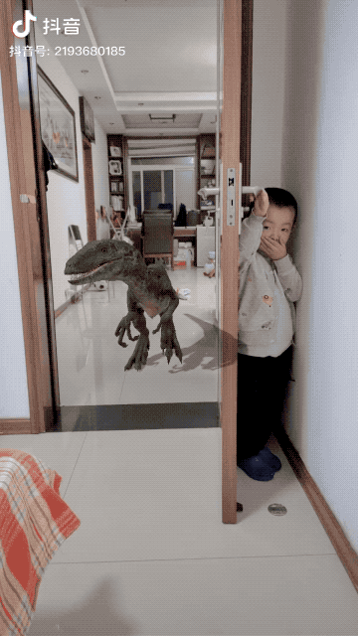
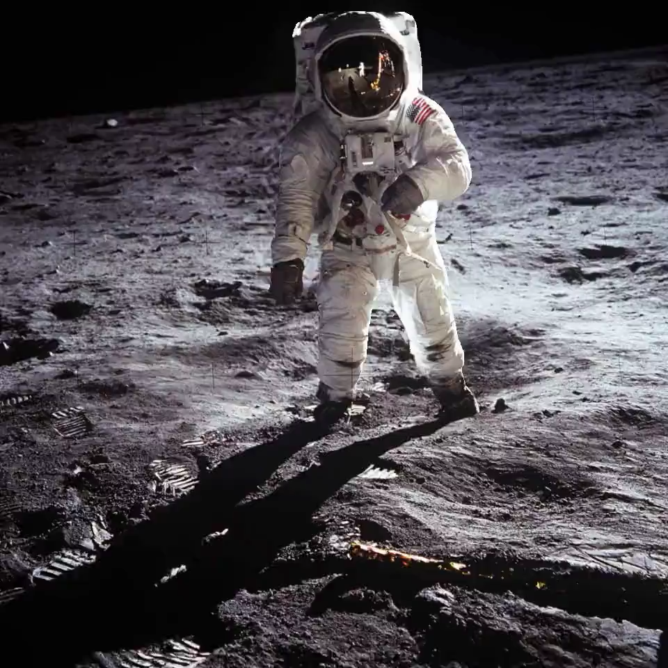
More cool things with 3D
Niklaus et al. ToG 2019
Shih et al. CVPR 2020
3D photo
AR

Slide 3
Recap: Camera Model
Image Plane
pinhole
y’_{w}
y’_{c}
P
X_{w}
x’_{i}
X_{c}
x’_{w}
z’_{c}
z’_{w}
x_{i}
y’_{i}
x’_{c}
f
Image Coordinates
Camera Coordinates
World Coordinates
Perspective
Projection
Coordinate Transformation
Intrinsics
Extrinsics
Slide inspired by Shree Nayar
Notes:
Intrinsic – Only about the single camera, its measured at the factory
Extrinsic – About relating more than one cameras or when you move, you can’t measure it at the factory
focal length is measured in pixels (normal camera will be isotropic)
F (mm) = f(pixel) Width (mm) / w (pixels)
f(pixel) = F(mm) w(pixels) / Width( mm)
\begin{bmatrix}
x_c\\
y_c \\
z_c \\
1
\end{bmatrix} =
\begin{bmatrix}
R_{3\times 3} & \textbf{t} \\
\textbf{0}_{1 \times 3} & 1
\end{bmatrix}
\begin{bmatrix}
x_w\\
y_w \\
z_w\\
1
\end{bmatrix}

Slide 4
Image Plane to Pixel Coordinates
Image Plane
Pixel Coordinates
x’_{i}
x_{i}
y’_{i}

Slide 5
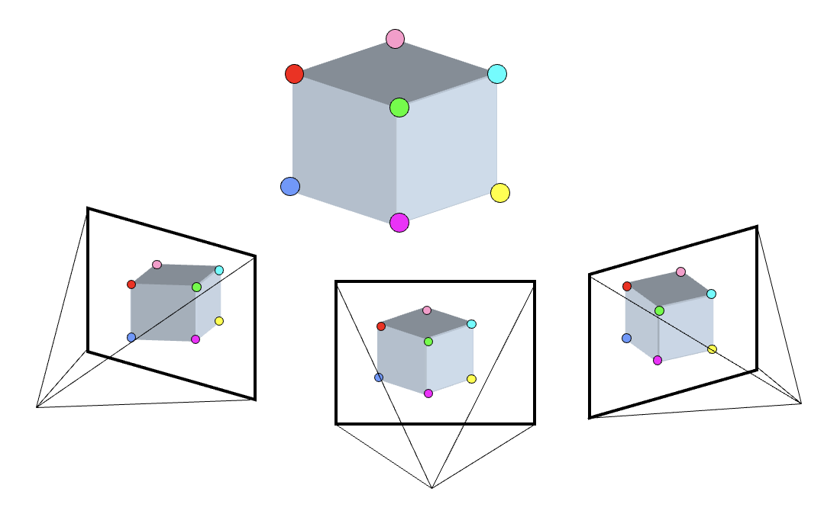
Big picture: 3 key components in 3D
3D Points
(Structure)
Correspondences
Camera
(Motion)
Notes:
What was this problem called?
3D points + Correspondences ➔ Camera
Camera ➔ Correspondences
Correspondences + Camera ➔ 3D points

Slide 6
Big picture: 3 key components in 3D
3D Points
(Structure)
Correspondences
Camera
(Motion)
Notes:
What was this problem called?
3D points + Correspondences ➔ Camera
Camera ➔ Correspondences
Correspondences + Camera ➔ 3D points

Slide 7
Big picture: 3 key components in 3D
3D Points
(Structure)
Correspondences
Camera
(Motion)
Notes:
3D points + Correspondences ➔ Camera
Camera ➔ Correspondences
Correspondences + Camera ➔ 3D points

Slide 8
Big picture: 3 key components in 3D
3D Points
(Structure)
Correspondences
Camera
(Motion)
Notes:
3D points + Correspondences ➔ Camera
Camera ➔ Correspondences
Correspondences + Camera ➔ 3D points

Slide 9
Big picture: 3 key components in 3D
3D Points
(Structure)
Correspondences
Camera
(Motion)
Notes:
3D points + Correspondences ➔ Camera
Camera ➔ Correspondences
Correspondences + Camera ➔ 3D points

Slide 10
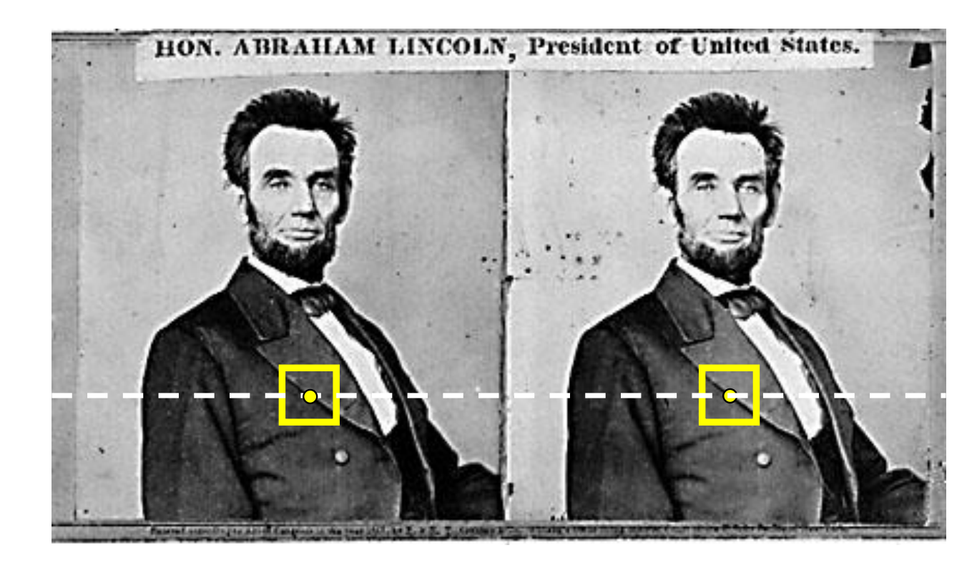
Recap
We covered:
How to estimate the camera parameters
  “Calibration”
  Solve for intrinsics & extrinsics
With a simple stereo, correspondences lie on horizontal lines
depth is inversely proportional to disparity (how much the pixel moves)

Slide 11
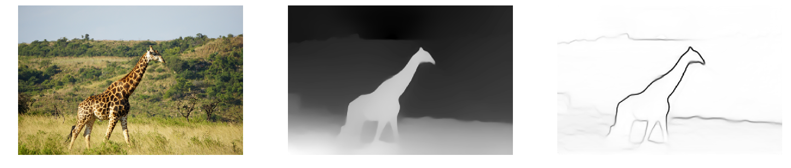
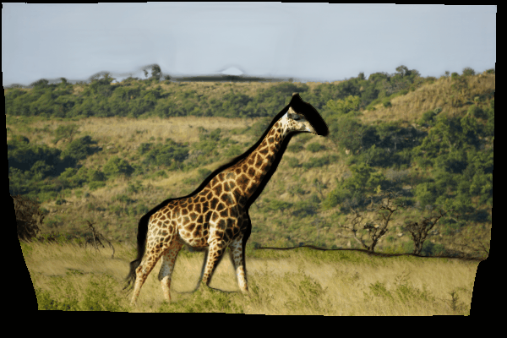
What Depth Map provides
warping the pixel based on its depth as you change the views
Monocular Depth Prediction [Ranftl et al. PAMI’20]
Notes:
2.5D!

Slide 12
Next: General case
The two cameras need not have parallel optical axes.
Assume cameras are calibrated
Same hammer:
Find the correspondences, then solve for structure
Notes:
But what was nice about the left?
Any idea as to how to go from right to left?

Slide 13
Option 1: Rectify via homography
reproject image planes onto a common plane
  plane parallel to the line between optical centers
pixel motion is horizontal after this transformation
Two homographies, one for each input image reprojection
  C. Loop and Z. Zhang. Computing Rectifying Homographies for Stereo Vision. CVPR 1999.
Slide courtesy of Noah Snavely
Notes:
First rotate the image plane so it’s parallel to the baseline
then align the v-coordinates to

Slide 14
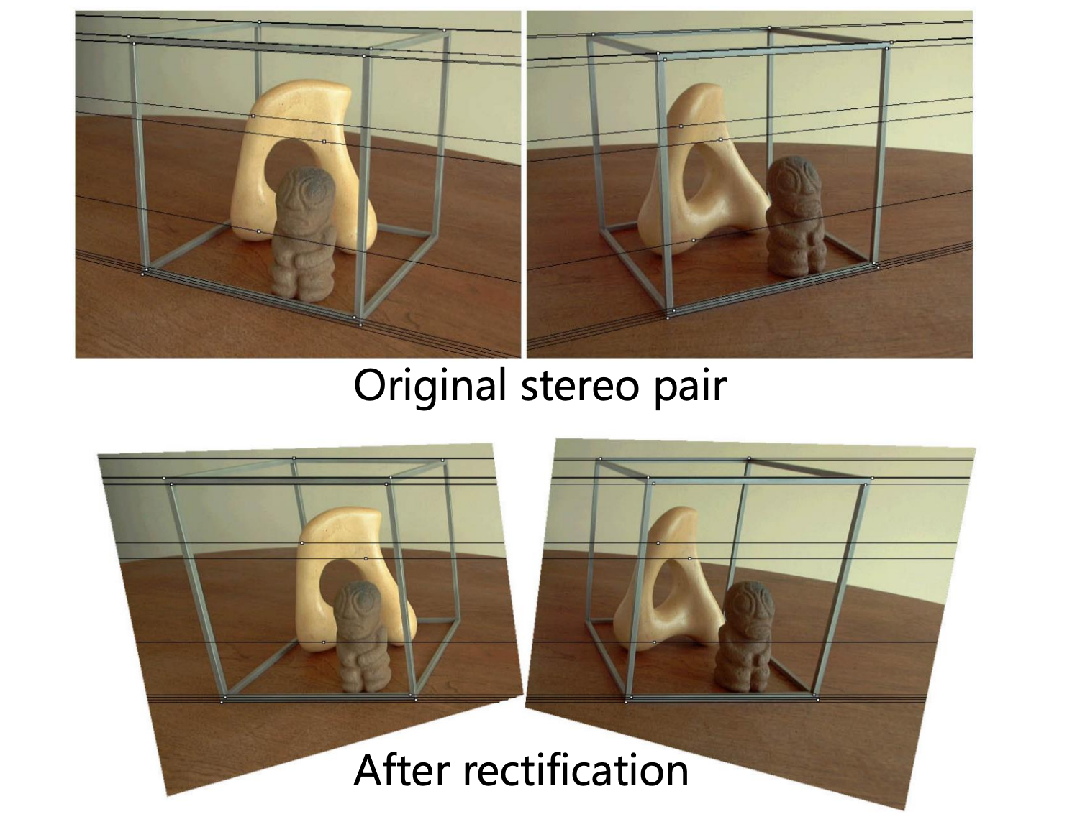
Option 1: Rectify via homography
Then find correspondences on the horizontal scan line
Slide courtesy of Noah Snavely

Slide 15
General case, known camera, find depth: Option 2
Find correspondences
Triangulate

Slide 16
General case, known camera, find depth: Option 2
Find correspondences
Triangulate
Can we restrict the search space again to 1D?
What is the relationship between the camera + the corresponding points?
Notes:
This is answered by epipolar geometry

Slide 17
Where do epipolar lines come from?
Slide courtesy of Noah Snavely
Notes:
17

Slide 18
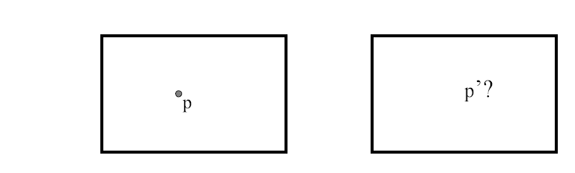
Stereo correspondence constraints
Given p in left image, where can corresponding point p’ be?

Slide 19
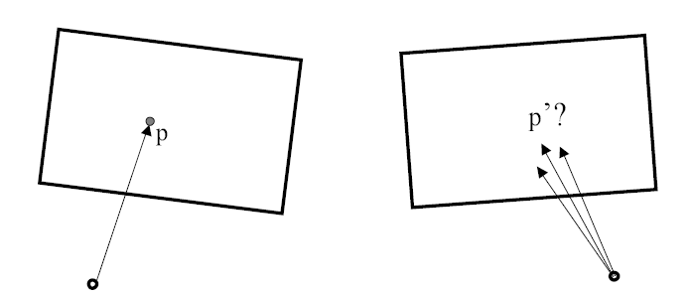
Stereo correspondence constraints
Given p in left image, where can corresponding point p’ be?

Slide 20
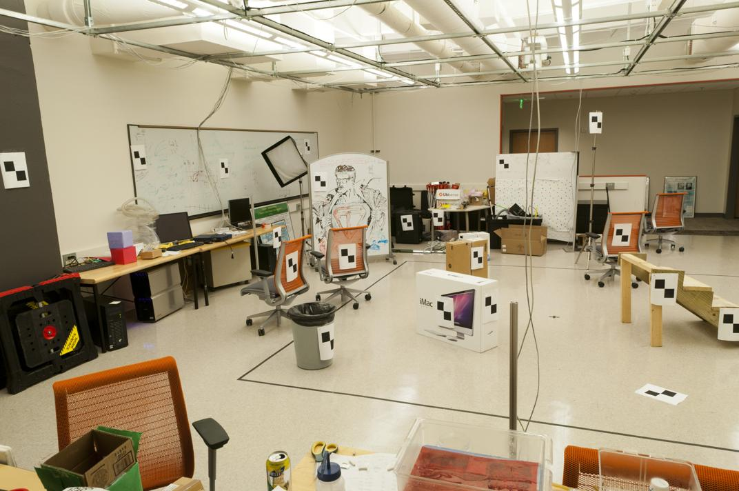
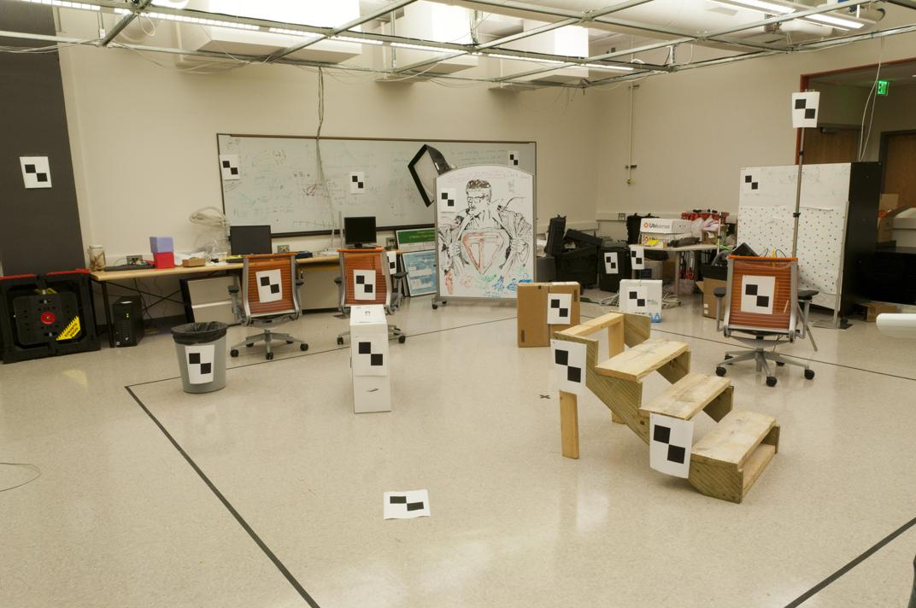
Where do we need to search?
Slide by James Hays

Slide 21
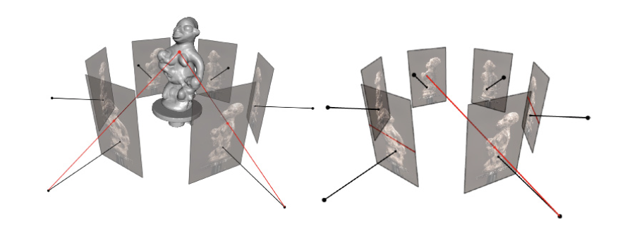
Epipolar Geometry
Figures by Carlos Hernandez

Slide 22
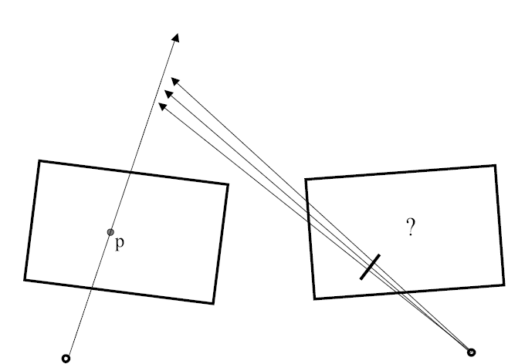
Stereo correspondence constraints
Notes:
the way to think about this is just that its nothing but the ray of the left image projected on to the right

Slide 23

Epipolar constraint
Potential matches for p have to lie on the corresponding
epipolar line l’.
Potential matches for p’ have to lie on the corresponding
epipolar line l.
Source: M. Pollefeys
Notes:
23

Slide 24
Epipolar Geometry
X
p
p'
o
o'
This plane formed by X, o, and o’ is called the Epipolar plane
There is a family of planes per o, o’ (Baseline)
Slide credit: David Fouhey

Slide 25
Epipolar Geometry
X
p
p'
o
e
e'
o'
Epipoles e, e’ are where the baseline intersects the image planes
Projection of other camera in the image plane
Slide credit: David Fouhey
Notes:
Notice how the line between epipole and p’ point is the epipolar line

Slide 26

Epipolar geometry
X
x
x’
Baseline – line connecting the two camera centers
Epipolar Plane – plane containing baseline (1D family)
Epipoles
= intersections of baseline with image planes
= projections of the other camera center
Slide credit: David Fouhey
Notes:
All epipolar lines intersect at the epipole
An epipolar plane intersects the left and right image planes in epipolar lines

Slide 27
Epipolar geometry
X
x
x’
Baseline – line connecting the two camera centers
Epipolar Plane – plane containing baseline (1D family)
Epipoles
= intersections of baseline with image planes
= projections of the other camera center
= vanishing points of the motion (baseline) direction
Slide credit: David Fouhey
Notes:
All epipolar lines intersect at the epipole
An epipolar plane intersects the left and right image planes in epipolar lines

Slide 28
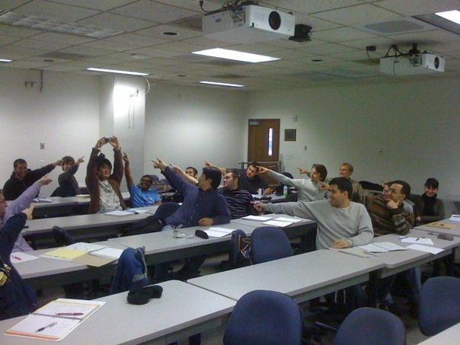
The Epipole
Photo by Frank Dellaert
Notes:
Where the students are pointing is the epipole!!! (there’s the other camera)

Slide 29
Stereo correspondence constraints
Geometry of two views allows us to constrain where the corresponding pixel for some image point in the first view must occur in the second view.
epipolar line
epipolar line
epipolar plane
Epipolar constraint: Why is this useful?
  Reduces correspondence problem to 1D search along conjugate epipolar lines
http://www.ai.sri.com/~luong/research/Meta3DViewer/EpipolarGeo.html
Adapted from Steve Seitz

Slide 30
Example: Converging Cameras
p
p'
o
e
e'
o'
Epipoles finite, maybe in image; epipolar lines converge
Slide credit: David Fouhey

Slide 31
Example: Converging Cameras
p
p'
o
e
e'
o'
Epipolar lines come in pairs:
given a point p, we can construct the epipolar line for p’.
Slide credit: David Fouhey

Slide 32
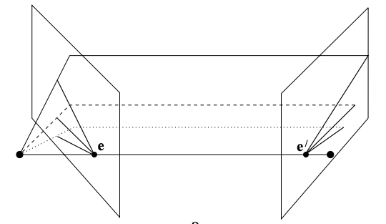


Example 1:
Converging Cameras
Image Credit: Hartley & Zisserman

Slide 33
Example: Parallel to Image Plane
Where is the epipole?
p
p'
e'
e
Epipoles infinitely far away, epipolar lines parallel
Slide credit: David Fouhey

Slide 34


Example: Parallel to Image Plane
Image Credit: Hartley & Zisserman

Slide 35
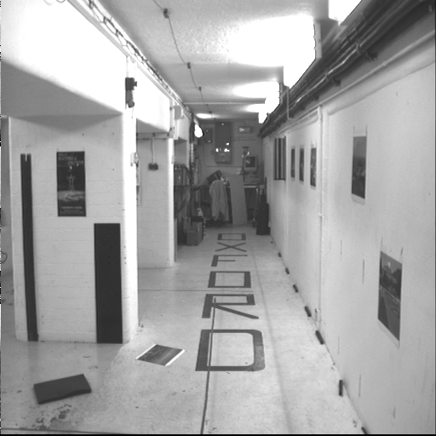
Example: Forward Motion
Image Credit: Hartley & Zisserman

Slide 36
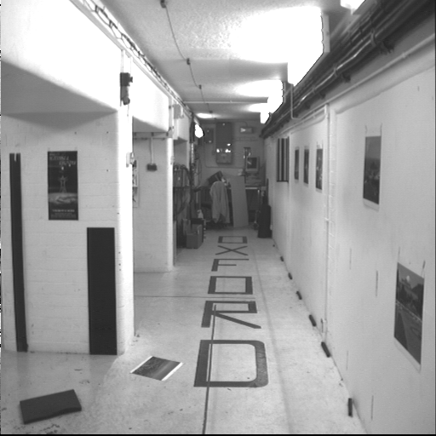
Example: Forward Motion
Image Credit: Hartley & Zisserman

Slide 37
Example: Forward Motion
Epipole is focus of expansion / principal point of the camera.
Epipolar lines go out from principal point

Slide 38
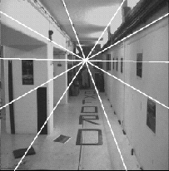
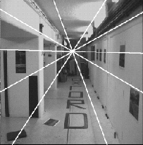
Example: forward motion
e’
e
Epipole has same coordinates in both images.
Points move along lines radiating from e: “Focus of expansion”
Figure from Hartley & Zisserman
Notes:
38

Slide 39

Motion perpendicular to image plane
http://vimeo.com/48425421
Slide credit: David Fouhey
Notes:
kubrick

Slide 40
Where were we?
Why is this relevant?
Assume camera is calibrated
Goal: 3D reconstruction of corresponding points in the image

Slide 41
Big picture: 3 key components in 3D
3D Points
(Structure)
Correspondences
Camera
(Motion)
Notes:
3D points + Correspondences ➔ Camera
Camera ➔ Correspondences
Correspondences + Camera ➔ 3D points

Slide 42
Big picture: 3 key components in 3D
3D Points
(Structure)
Correspondences
Camera
(Motion)
Notes:
3D points + Correspondences ➔ Camera
Camera ➔ Correspondences
Correspondences + Camera ➔ 3D points

Slide 43
Epipolar Geometry
If I want to do stereo, I want to find a corresponding pixel for each pixel in the image:
Naïve search:
  For each pixel, search every other pixel
With epipolar geometry:
  For each pixel, search along each line (1D search)!
Slide credit: David Fouhey

Slide 44
Epipolar constraint example
Slide Credit: S. Lazebnik

Slide 45
How do we compute the Epipolar line?

Slide 46
Epipolar constraint: Calibrated case
X
x
x’
Intrinsic and extrinsic parameters of the cameras are known, world coordinate system is set to that of the first camera
Then the projection matrices are given by K[I | 0] and K’[R | t]
We can multiply the projection matrices (and the image points) by the inverse of the calibration matrices to get normalized image coordinates:
Notes:
T: is position of the right camera in left camera’s frame
R:orientation of left camera in right camera’s frame.
Then, expand x_l = R*x_r + t

Slide 47
Step 0: Normalized image coordinates
X
x
x’
Let’s factor out the effect of K
Since we know the intrinsics K, apply its inverse to x
This is called the normalized image coordinates. It may be thought of as a set of points with K = Identity
Assume that the points are normalized from here on
Notes:
f(x / z) + ox → (x – ox) / f = x / z
basically just [ x / z, y / z, 1 ] (think of it as image plane coordinates with focal length = 1)
T: is position of the right camera in left camera’s frame
R:orientation of left camera in right camera’s frame.
Then, expand x_l = R*x_r + t

Slide 48
Epipolar constraint: Calibrated case
X
= (x,1)^{T}
x
x’ = Rx+t
t
R
The vectors x, t, and x’ are coplanar
What can you say about their relationships, given ?
0
Notes:
X’ is X in the second camera’s coordinate system
We can identify the non-homogeneous 3D vectors X and X’ with the homogeneous coordinate vectors x and x’ of the projections of the two points into the two respective images
if co planar cross product of the vector with the point is 0

Slide 49
Epipolar constraint: Calibrated case
X
x
x’ = Rx+t
Recall:
The vectors Rx, t, and x’ are coplanar

Slide 50
Epipolar constraint: Calibrated case
X
x
x’ = Rx+t
Essential Matrix
(Longuet-Higgins, 1981)
Recall:
The vectors x, t, and x’ are coplanar
Notes:
x
T is green, Rx + t is the point on the right
X’ (t_x Rx + t_x*t) = x’[t_xRx] = 0

Slide 51
Epipolar constraint: Calibrated case
X
x
x’
E x is the epipolar line associated with x (l’ = E x)
  Recall: a line is given by ax + by + c = 0 or

Slide 52
Epipolar constraint: Calibrated case
X
x
x’
E x is the epipolar line associated with x (l' = E x)
E^{T}x' is the epipolar line associated with x' (l = E^{T}x')
E e = 0 and E^{T}e' = 0
E is singular (rank two)
E has five degrees of freedom
Notes:
Say that E is not a transformation, it maps a point to a line
why 5? R + T = > 6 DoF, with the projective scale ambiguity -> 5
Rank 2 → 2D plane gets mapped to a single line in the other image. (Also skew symm is rank2)

Slide 53
Epipolar constraint: Uncalibrated case
Recall that we normalized the coordinates
where is the image coordinates
But in the uncalibrated case, K and K’ are unknown!
We can write the epipolar constraint in terms of unknown normalized coordinates:
Fundamental Matrix
(Faugeras and Luong, 1992)
Notes:
F = No intrinsics

Slide 54
Essential vs Fundamental matrix
What is the difference??

Slide 55
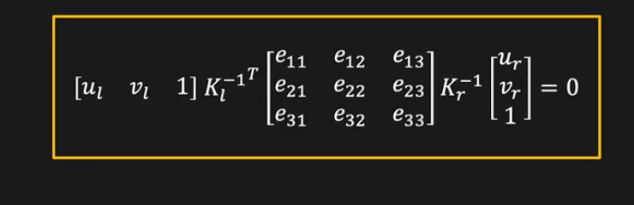
Epipolar constraint: Uncalibrated case
X
x
x’
Fundamental Matrix
(Faugeras and Luong, 1992)
Notes:
F is 3 x 3 = 9 total, but 8 bc of ambiguity, -1 because rank 2..

Slide 56
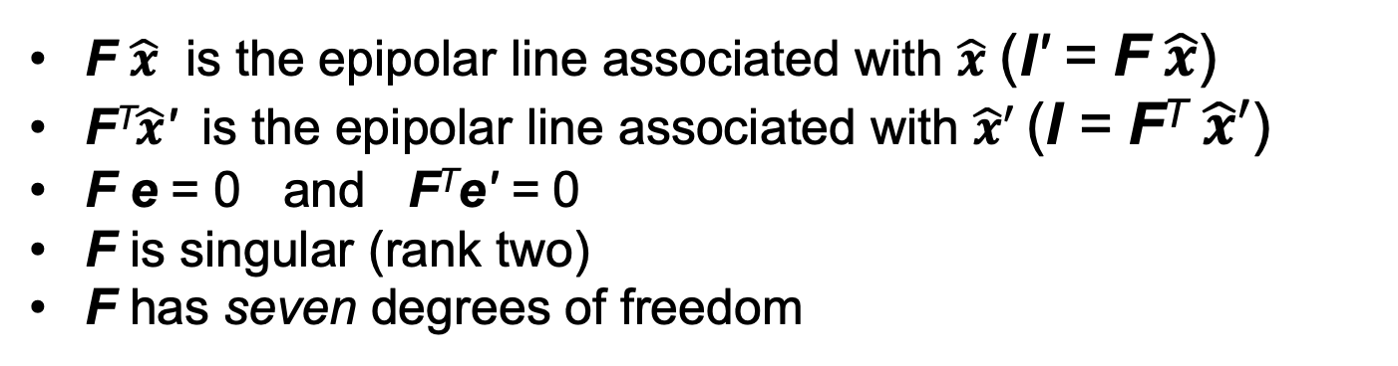
Epipolar constraint: Uncalibrated case
X
x
x’
with
F $\hat{x}$ is the epipolar line associated with $\hat{x}$ (l' = F $\hat{x}$)
F^{T}$\hat{x}$' is the epipolar line associated with $\hat{x}′$(l = F^{T} $\hat{x}′$)
F e = 0 and F^{T}e' = 0
F is singular (rank two)
F has seven degrees of freedom
Notes:
F is 3 x 3 = 9 total, but 8 bc of ambiguity, -1 because rank 2 (detF = 0)..

Slide 57
Recall the homography
Homography Matrix: 3x3
Essential/Fundamental Matrix is also 3x3.
Homography is a special case of the Essential/Fundamental matrix, for planar scenes
Notes:
Can you use
Homography is a transformation. Point → Point
Point → Line
This gives you

Slide 58
Where are we?
Recall we’re trying to get the 3D points of corresponding images, with calibrated cameras (known K and R, T)
Solve for correspondences using epipolar constraints from known camera (1D search)
Triangulate to get depth!

Slide 59

Finally: computing depth by triangulation
We know about the camera, K₁, K₂ and [R t]:
X
$$=X^{′}=RX+T$$
x
x’
and that these are corresponding points:
How many unknowns + how many equations do we have?
only unknowns!
Solve by least squares
Notes:
In general you solve for the 3D point all together, because although the only thing you should need is the depth of a single point, in practice due to noise it may not exactly lie on the ray
3 unknowns, 6 equations (3 per point), only 2 are linearly independent ➔ 4 Equations

Slide 60
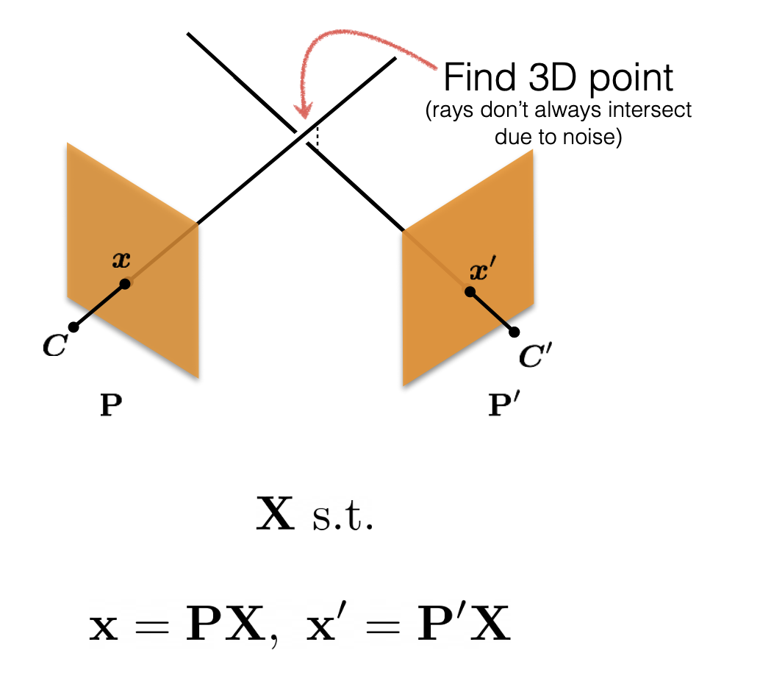
Triangulation Disclaimer: Noise
Ray’s don’t always intersect because of noise!!!
Least squares get you to a reasonable solution but it’s not the actual geometric error (it’s how far away the solution is from Ax = 0)
In practice with noise, you do non-linear least squares, or “bundle adjustment” (more than 2 image case, next lecture..)
Slide credit: Shubham Tulsiani
Notes:
non-linear bc of the division by z in the projective function

Slide 61
Summary: Two-view, known camera
0. Calibrate the camera.
1. Find correspondences:
- Reduce this to 1D search with Epipolar Geometry!
2. Get depth:
- If simple stereo, disparity (difference of corresponding points) is inversely proportional to depth
- In the general case, triangulate.

Slide 62
What if we don’t know the camera?
3D Points
(Structure)
Correspondences
Camera
(Motion)
Notes:
3D points + Correspondences ➔ Camera
Camera ➔ Correspondences
Correspondences + Camera ➔ 3D points

Slide 63

What if we don’t know the camera?
Assume we know the correspondences:
$\hat{x}′$ and $\hat{x}$ in the image
How many correspondences do we need?

Slide 64
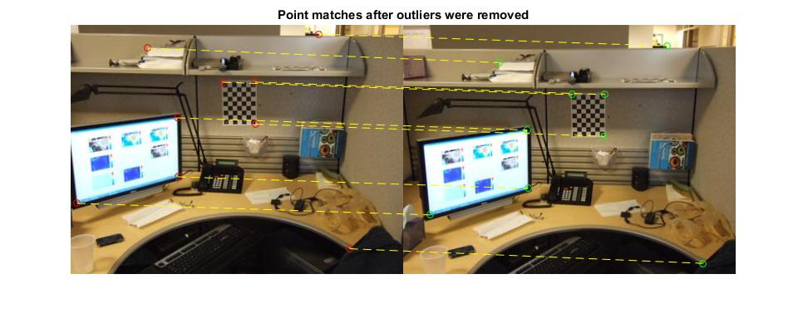
Estimating the fundamental matrix

Slide 65
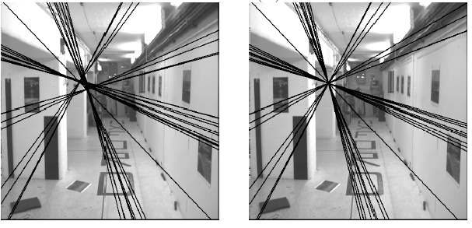
The eight-point algorithm
Solve homogeneous linear system using eight or more matches
Enforce rank-2 constraint (take SVD
of F and throw out the smallest singular value)

Slide 66
Problem with eight-point algorithm

Slide 67
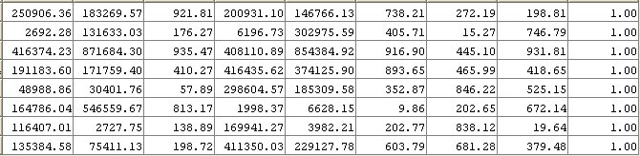
Problem with eight-point algorithm
Poor numerical conditioning
Can be fixed by rescaling the data

Slide 68
The normalized eight-point algorithm
(Hartley, 1995)
Center the image data at the origin, and scale it so the mean squared distance between the origin and the data points is 2 pixels
Use the eight-point algorithm to compute F from the normalized points
Enforce the rank-2 constraint (for example, take SVD of F and throw out the smallest singular value)
Transform fundamental matrix back to original units: if T and T’ are the normalizing transformations in the two images, than the fundamental matrix in original coordinates is T’^{T} F T

Slide 69
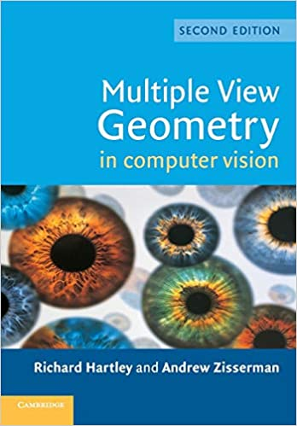
The Bible by Hartley & Zisserman

Slide 70
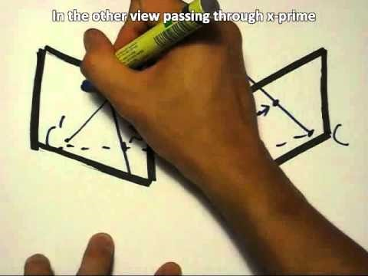
The Fundamental Matrix Song
http://danielwedge.com/fmatrix/
https://www.youtube.com/watch?time_continue=8&v=DgGV3l82NTk&feature=emb_title

Slide 71
What we just did for stereo
Rectified stereo → use similar triangles to solve for per-pixel disparity, which gives you depth
  Difference between calibrated + uncalibrated case?
General Stereo: First calibrate cameras from correspondences
by solving for Essential or Fundamental matrices
Then triangulate corresponding points to get the depth.

Slide 72
What about more than two views?
The geometry of three views is described by a 3 x 3 x 3 tensor called the trifocal tensor
The geometry of four views is described by a 3 x 3 x 3 x 3 tensor called the quadrifocal tensor
After this it starts to get complicated…
Slide courtesy of Noah Snavely

Slide 73

Next: Large-scale structure from motion
Dubrovnik, Croatia. 4,619 images (out of an initial 57,845).
Total reconstruction time: 23 hours
Number of cores: 352
Building Rome in a Day, Agarwal et al. ICCV 2009
Slide courtesy of Noah Snavely

Slide 74
Large-scale structure from motion
Result using COLMAP: Schönberger et al. CVPR ’16

