Slide 1
Amuse-bouche
http://youtube.com/watch?v=nUDIoN-_Hxs

Slide 2
http://www.youtube.com/watch?v=L0GKp-uvjO0

Slide 3
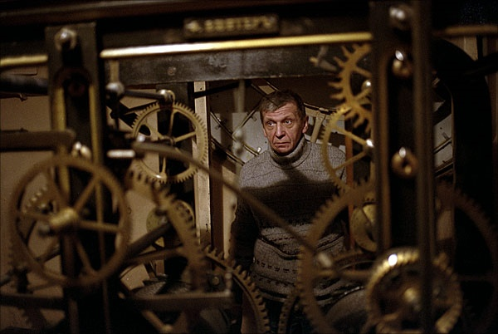
Image Warping and Morphing
© Alexey Tikhonov
CS194: Intro to Computer Vision and Comp. Photo
Angjoo Kanazawa & Alexei Efros, UC Berkeley, Fall 2022

Slide 4
Project 3 out today!!
project 2 how did it go?
project 3 is harder!
Notes:
please don’t copy code
2 weeks

Slide 5
Image Transformations
image filtering: change range of image
g(x) = T(f(x))
f
f
T
x
x
image warping: change domain of image
g(x) = f(T(x))
f
f
T
x
x

Slide 6
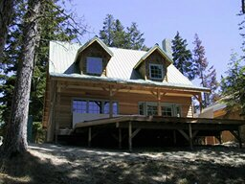
Image Transformations
image filtering: change range of image
g(x) = T(f(x))
f
g
T
image warping: change domain of image
g(x) = f(T(x))
f
g
T

Slide 7
All 2D Linear Transformations
Linear transformations are combinations of …
Scale,
Rotation,
Shear, and
Mirror
Properties of linear transformations:
Origin maps to origin
Lines map to lines
Parallel lines remain parallel
Ratios are preserved
Closed under composition

Slide 8
Consider a different Basis
j =(0,1)
v =(v_{x},v_{y})
p
q
u=(u_{x},u_{y})
i =(1,0)
q=4i+3j = (4,3)
p=4u+3v

Slide 9
Linear Transformations as Change of Basis
v =(v_{x},v_{y})
j =(0,1)
p^{uv}
p^{ij}
u=(u_{x},u_{y})
i =(1,0)
p^{uv} = (4,3)
p^{ij} = 4u+3v
p_{x}=4u_{x}+3v_{x}
p_{y}=4u_{y}+3v_{y}
⎡
u
v
⎤
⎡
4
⎤
⎡
u
v
⎤
p^{ij}
=
⎢
x
x
⎥
=
⎢
x
x
⎥
p^{uv}
⎢
⎥
⎣
u
v
⎦
⎣
3
⎦
⎣
u
v
⎦
y
y
y
y
Any linear transformation is a basis!!!

Slide 10
Linear Transformations as Change of Basis
v =(v_{x},v_{y})
j =(0,1)
p^{uv}
p^{ij}
u=(u_{x},u_{y})
i =(1,0)
p^{uv} = (4,3)
p^{ij} = ?i+?j
p_{x}=4u_{x}+3v_{x}
p_{y}=4u_{y}+3v_{y}
⎡
u
v
⎤
⎡
4
⎤
⎡
u
v
⎤
p^{ij}
=
⎢
x
x
⎥
=
⎢
x
x
⎥
p^{uv}
⎢
⎥
⎣
u
v
⎦
⎣
3
⎦
⎣
u
v
⎦
y
y
y
y
Any linear transformation is a basis!!!

Slide 11
What’s the inverse transform?
j =(0,1)
v =(v_{x},v_{y})
p^{ij}
p^{uv}
u=(u_{x},u_{y})
i =(1,0)
p^{ij} = (5,4)
= p_{x}u + p_{y}v
p^{uv} = (p_{x},p_{y}) = ?
-1
-1
⎡
u
v
⎤
⎡
5
⎤
⎡
u
v
⎤
p^{uv}
=
⎢
x
x
⎥
=
⎢
x
x
⎥
p^{ij}
⎢
⎥
⎣
u
v
⎦
⎣
4
⎦
⎣
u
v
⎦
y
y
y
y
How can we change from any basis to any basis?
What if the basis are orthogonal?
Notes:
A^T*A = I

Slide 12
Projection onto orthogonal basis
j =(0,1)
v =(v_{x},v_{y})
p^{ij}
p^{uv}
u=(u_{x},u_{y})
i =(1,0)
p^{ij} = (5,4)
p^{uv} = (u·p^{ij}, v·p^{ij})
⎡
u
u
⎤
⎡
5
⎤
⎡
u
u
⎤
p^{uv}
=
⎢
x
x
⎥
=
⎢
x
y
⎥
p^{ij}
⎢
⎥
⎣
v
v
⎦
⎣
4
⎦
⎣
v
v
⎦
y
y
x
y

Slide 13
Homogeneous Coordinates
Q: How can we represent translation as a 3x3 matrix?

Slide 14
Homogeneous Coordinates
Homogeneous coordinates
represent coordinates in 2 dimensions with a 3-vector

Slide 15
Homogeneous Coordinates
Q: How can we represent translation as a 3x3 matrix?
A: Using the rightmost column:

Slide 16
Matrix Composition
Transformations can be combined by matrix multiplication
p’ = T(t_{x},t_{y}) R(Θ) S(s_{x},s_{y}) p
Does the order of multiplication matter?

Slide 17
Affine Transformations
Affine transformations are combinations of …
Linear transformations, and
Translations
Properties of affine transformations:
Origin does not necessarily map to origin
Lines map to lines
Parallel lines remain parallel
Ratios are preserved
Closed under composition
Models change of basis
Will the last coordinate w always be 1?

Slide 18
Projective Transformations
Projective transformations …
Affine transformations, and
Projective warps
Properties of projective transformations:
Origin does not necessarily map to origin
Lines map to lines
Parallel lines do not necessarily remain parallel
Ratios are not preserved
Closed under composition
Models change of basis

Slide 19
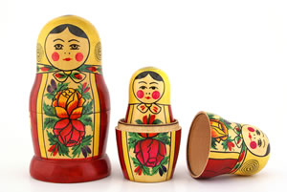
2D image transformations
These transformations are a nested set of groups
Closed under composition and inverse is a member

Slide 20
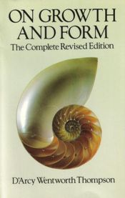
Image Warping in Biology
D'Arcy Thompson
http://www-groups.dcs.st-and.ac.uk/~history/Miscellaneous/darcy.html
http://en.wikipedia.org/wiki/D'Arcy_Thompson
Importance of shape and structure in evolution
Slide by Durand and Freeman

Slide 21
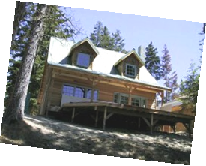
Recovering Transformations
?
T(x,y)
y
y’
x
x’
f(x,y)
g(x’,y’)
What if we know f and g and want to recover the transform T?
e.g. better align images from Project 1
willing to let user provide correspondences
How many do we need?

Slide 22
Translation: # correspondences?
?
T(x,y)
y
y’
x
x’
How many correspondences needed for translation?
How many Degrees of Freedom?
What is the transformation matrix?

Slide 23
Euclidian: # correspondences?
?
T(x,y)
y
y’
x
x’
How many correspondences needed for translation+rotation?
How many DOF?

Slide 24
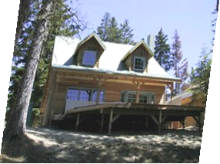
Affine: # correspondences?
?
T(x,y)
y
y’
x
x’
How many correspondences needed for affine?
How many DOF?

Slide 25
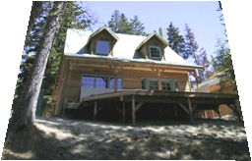
Projective: # correspondences?
?
T(x,y)
y
y’
x
x’
How many correspondences needed for projective?
How many DOF?

Slide 26
Example: warping triangles
B
B’
?
T(x,y)
C’
A
C
A’
Source
Destination
Given two triangles: ABC and A’B’C’ in 2D (12 numbers)
Need to find transform T to transfer all pixels from one to the other.
What kind of transformation is T?
How can we compute the transformation matrix:
Two ways:
Algebraic and
geometric
Notes:
how do you go about solving for the 6 numbers? there are multiple ways
for a basis in 2D how many vectors do we need? do we see the basis vectors here? AB, AC → A’B’, A’C’

Slide 27
warping triangles (Barycentric Coordinaes)
(0,1)
(0,0)
(1,0)
B
B’
Inverse
change
of basis
change
of basis
C’
A
C
A’
Source
Destination
Don’t forget to move the origin too!
Very useful for Project 3… (hint,hint,nudge,nudge)
Notes:
do it both ways and make sure you get the right answer!
Don’t forget to move the origin also! move to the origin.. and then do it and then..
Proj3 harder! than proj 1 & 2. only 2 weeks
any matrix can be thought of as a change of basis matrix (vert cols)

Slide 28
Morphing = Object Averaging
The aim is to find “an average” between two objects
Not an average of two images of objects…
…but an image of the average object!
How can we make a smooth transition in time?
Do a “weighted average” over time t
How do we know what the average object looks like?
We haven’t a clue!
But we can often fake something reasonable
Usually required user/artist input

Slide 29
Averaging Points
Q
What’s the average
of P and Q?
v = Q - P
P
P + 1.5v
= P + 1.5(Q – P)
= -0.5P + 1.5 Q
(extrapolation)
P + 0.5v
= P + 0.5(Q – P)
= 0.5P + 0.5 Q
Linear Interpolation
(Affine Combination):
New point aP + bQ,
defined only when a+b = 1
So aP+bQ = aP+(1-a)Q
P and Q can be anything:
points on a plane (2D) or in space (3D)
Colors in RGB or HSV (3D)
Whole images (m-by-n D)… etc.

Slide 30
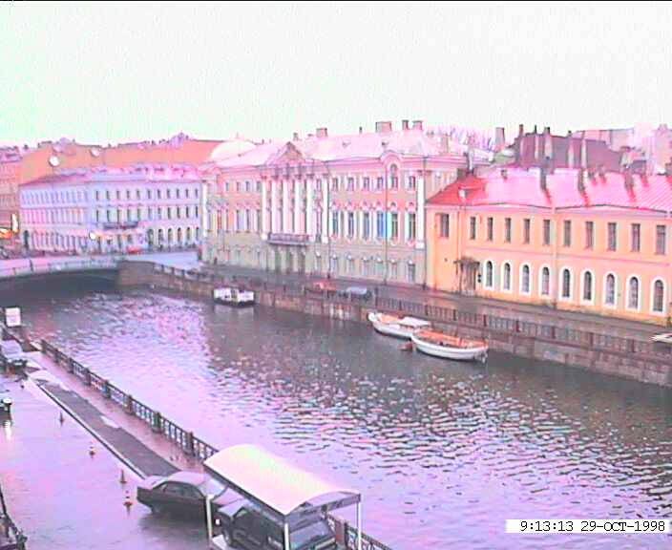
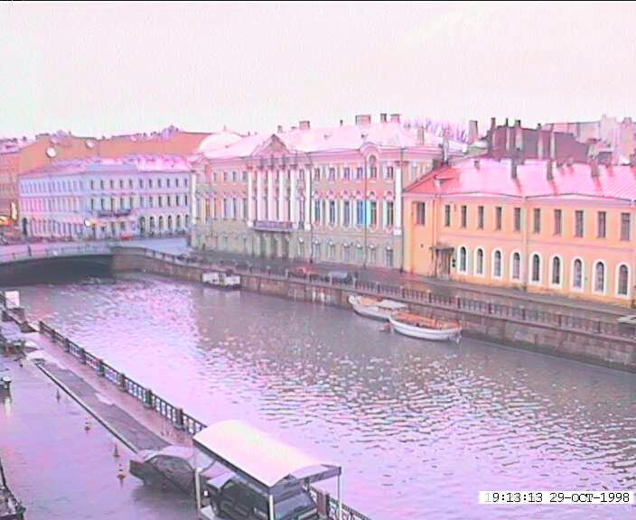
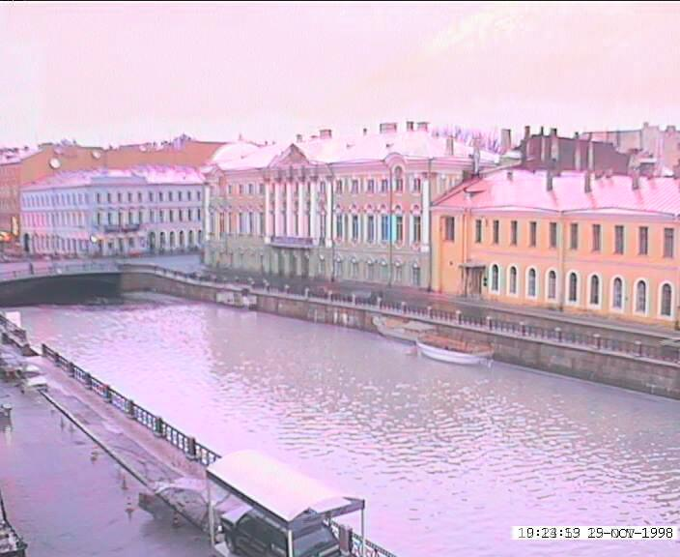
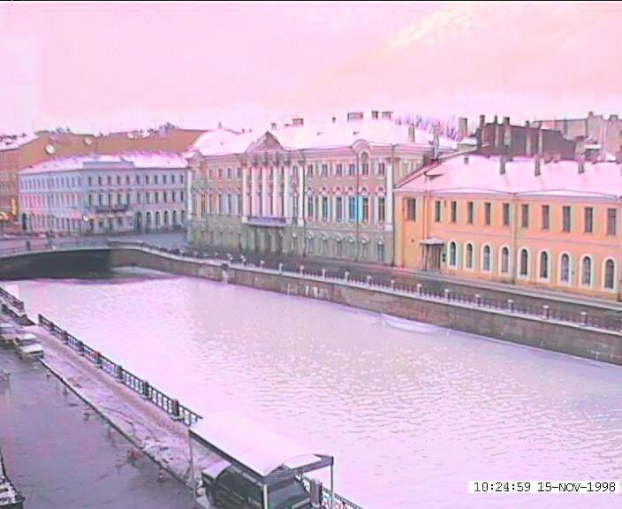
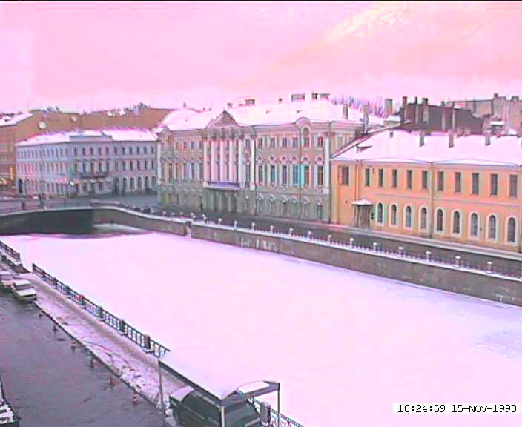
Idea #1: Cross-Dissolve
Interpolate whole images:
Image_{halfway} = (1-t)*Image₁ + t*image₂
This is called cross-dissolve in film industry
But what is the images are not aligned?

Slide 31
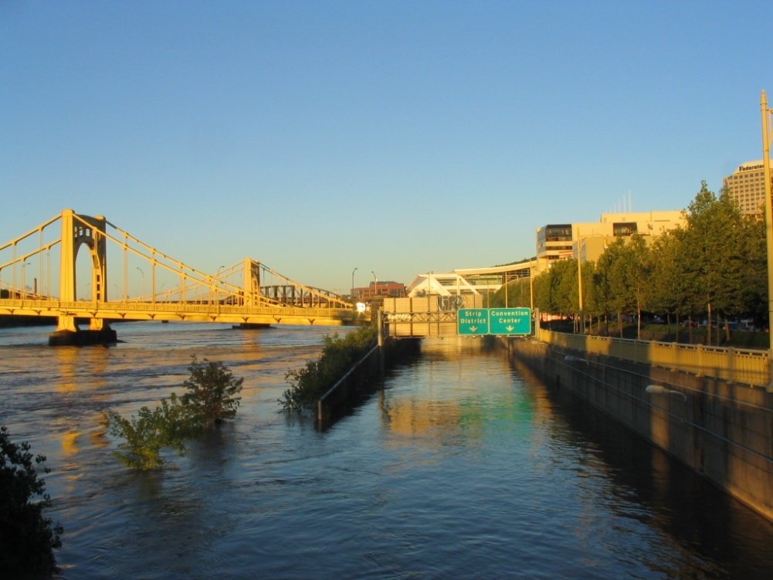
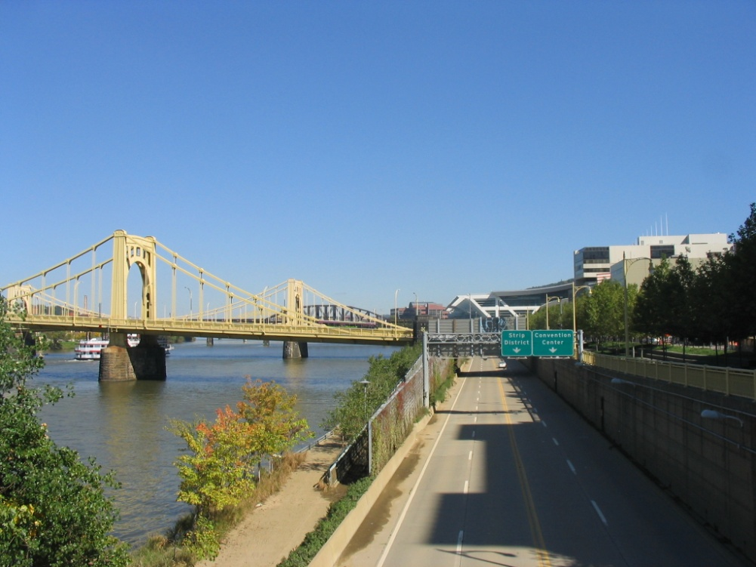
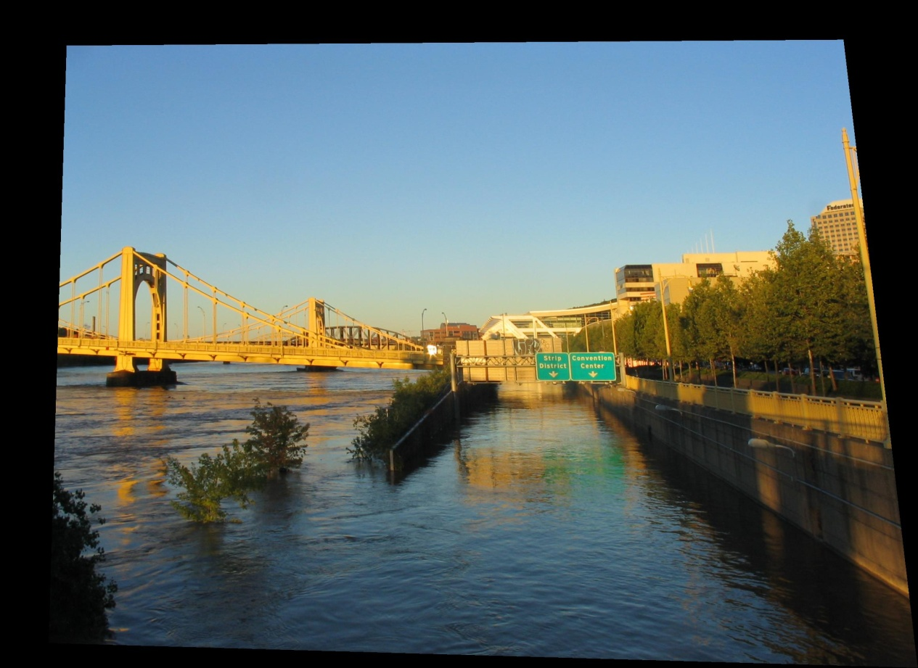
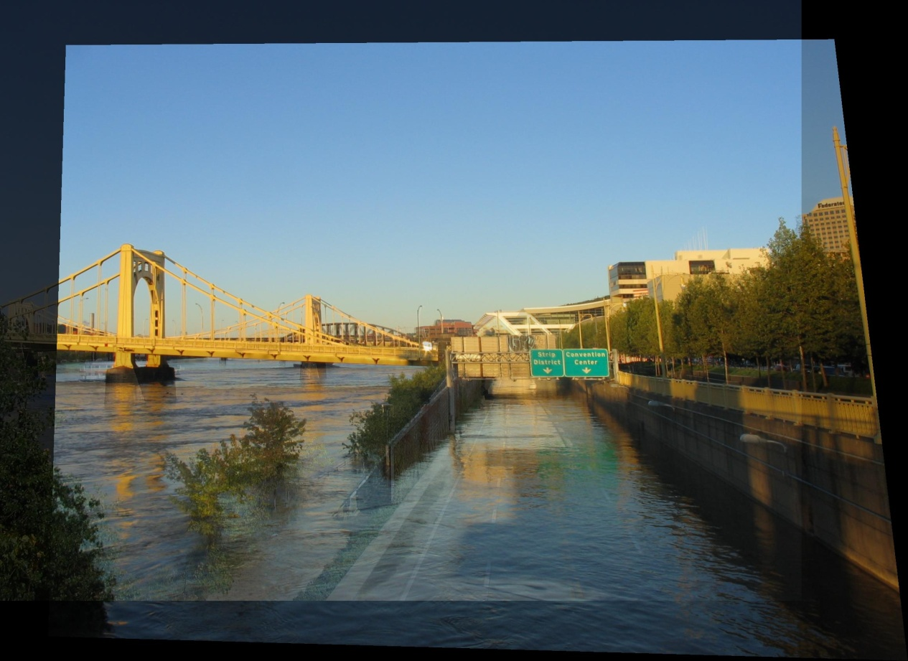
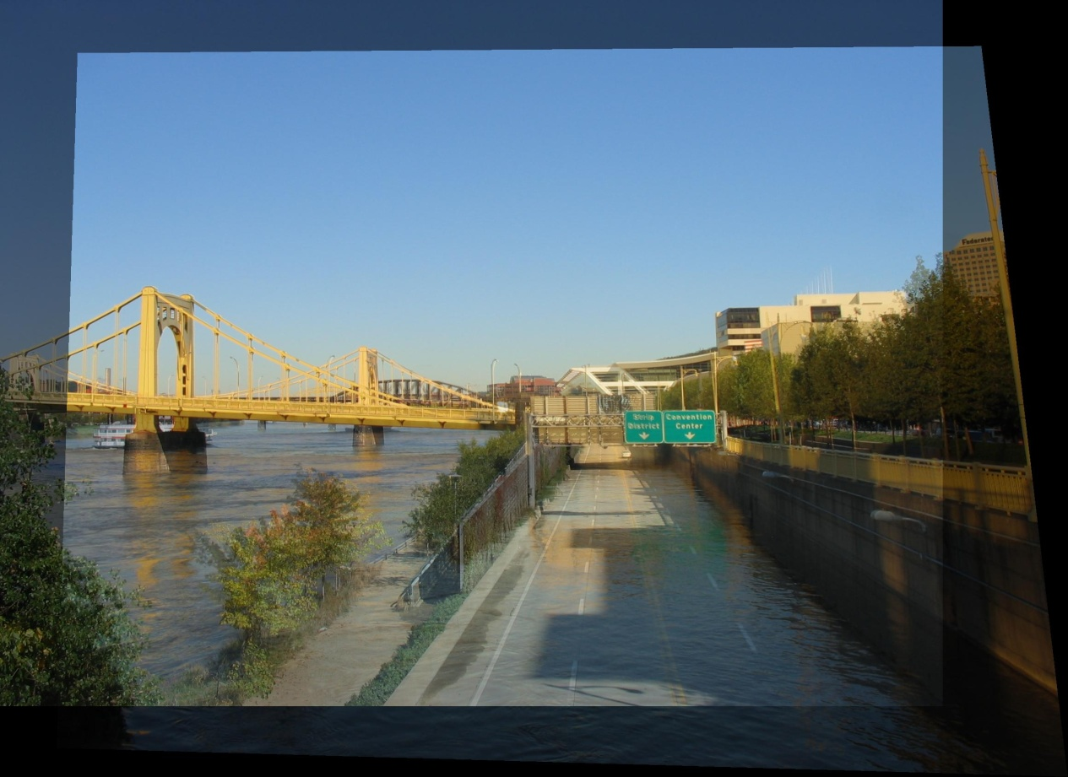
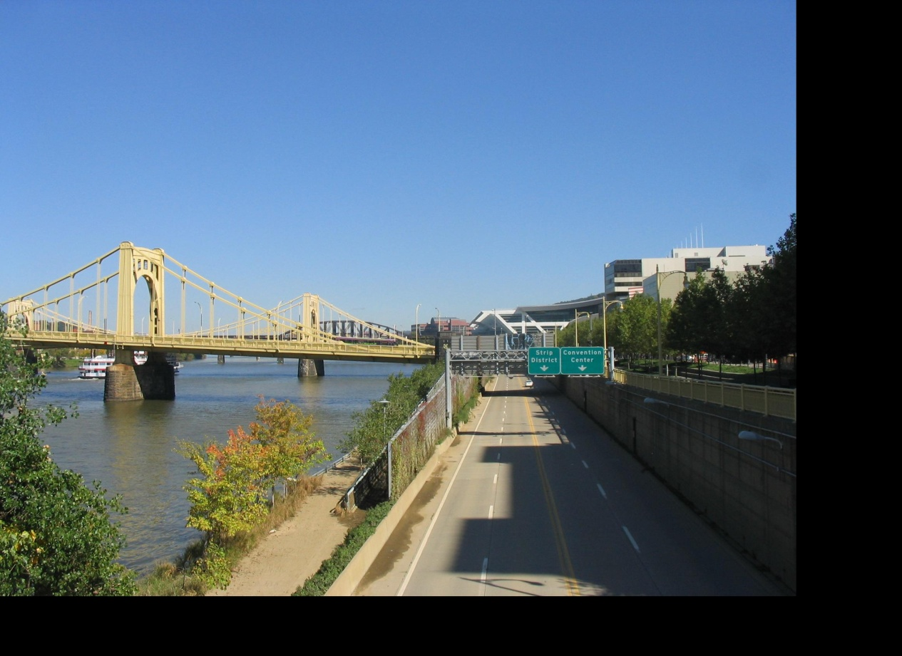
Idea #2: Align, then cross-disolve
Align first, then cross-dissolve
Alignment using global warp – picture still valid

Slide 32
Image Morphing
Morphing = warping + cross-dissolving
shape
(geometric)
color
(photometric)

Slide 33
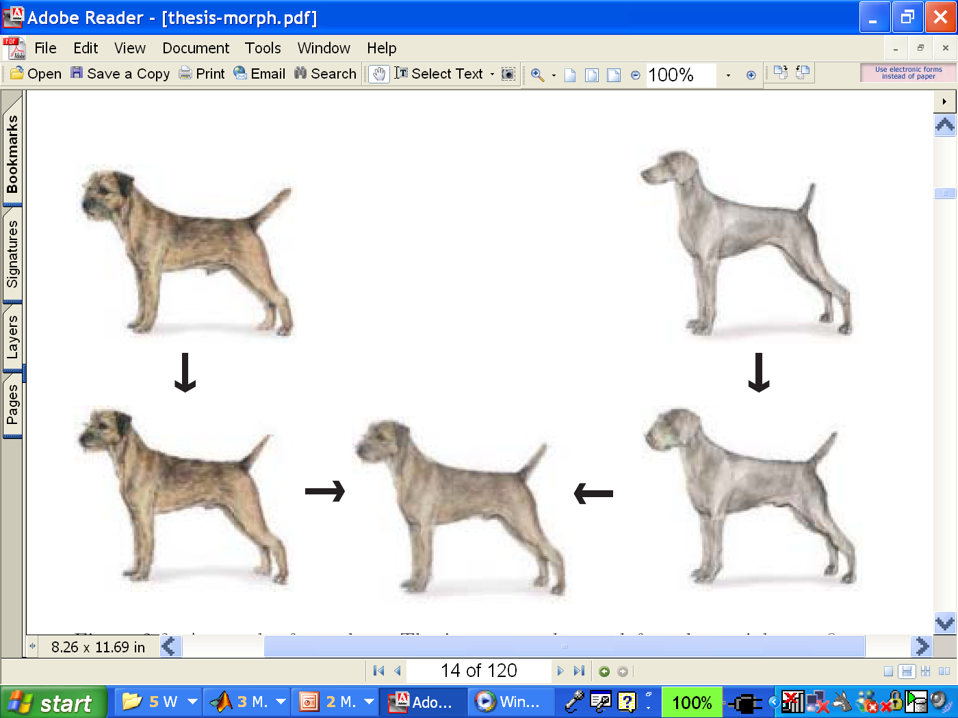
Two-stage Morphing Procedure
Morphing procedure:
for every t,
Find the average shape (the “mean dog”☺)
warping
Find the average color
Cross-dissolve the warped images

Slide 34
BUT: global warp not always enough!
What to do?
Cross-dissolve doesn’t work
Global alignment doesn’t work
Cannot be done with a global transformation (e.g. affine)
Any ideas?
Feature matching!
Nose to nose, tail to tail, etc.
But what to do with all the intermediate pixels?

Slide 35
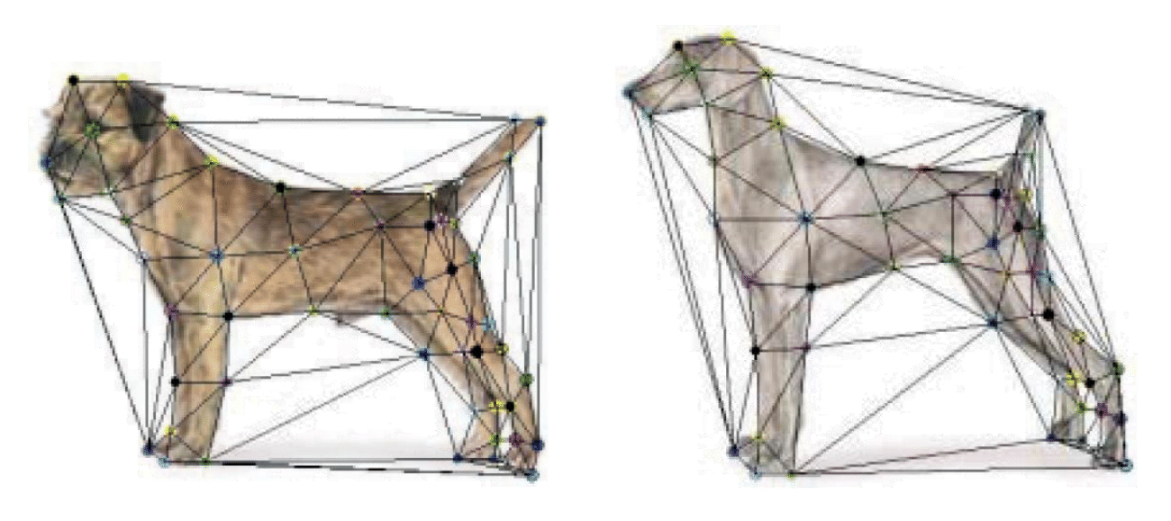
Triangular Mesh
Input correspondences at key feature points
Define a triangular mesh over the points
Same mesh in both images!
Now we have triangle-to-triangle correspondences
Warp each triangle separately from source to destination
How do we warp a triangle?

Slide 36
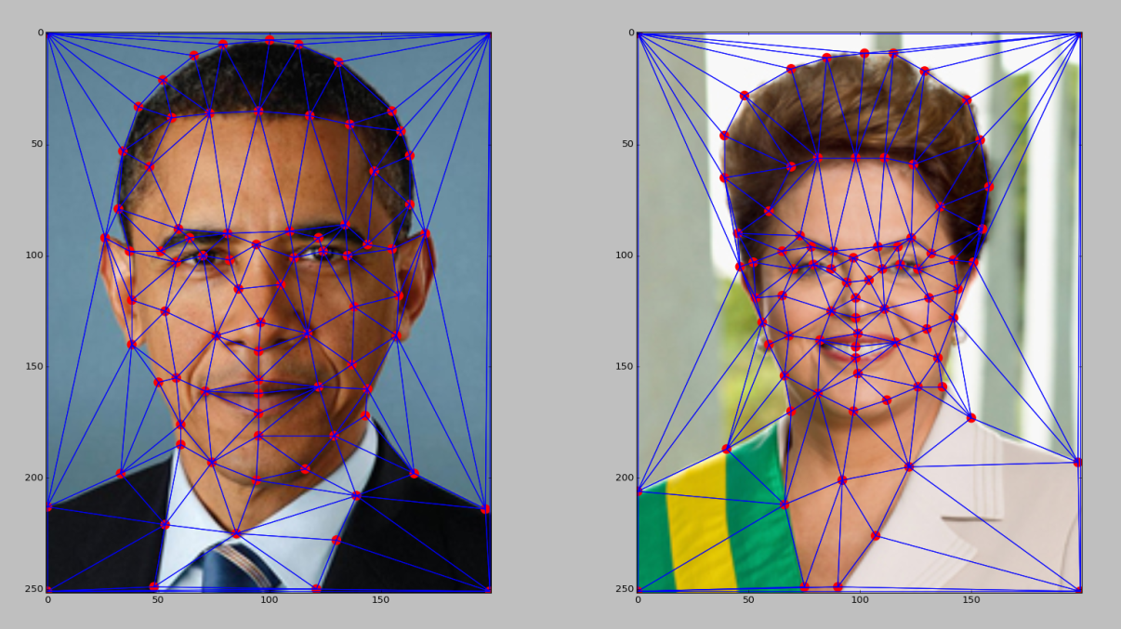
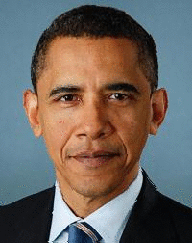
Full morphing result
(c) Ian Albuquerque Raymundo da Silva
Notes:
Obama’s triangles are bigger than the former brazillian president.. soo Obama’s triangles occupy many more pixels.. what happens? is this a problem? anyone thinking about this

Slide 37
Warping triangles
B
B’
?
T(x,y)
C’
A
C
A’
Source
Destination
Given two triangles: ABC and A’B’C’ in 2D (12 numbers)
Need to find transform T to transfer all pixels from one to the other.
What kind of transformation is T?
How can we compute the transformation matrix:

Slide 38
Warping Pixels
T(x,y)
y
y’
x
x’
f(x,y)
g(x’,y’)
Given a coordinate transform (x’,y’) = T(x,y) and a source image f(x,y), how do we compute a transformed image g(x’,y’) = f(T(x,y))?

Slide 39
Forward warping
T(x,y)
y
y’
x
x’
f(x,y)
g(x’,y’)
Send each pixel f(x,y) to its corresponding location
(x’,y’) = T(x,y) in the second image
Q: what if pixel lands “between” two pixels?

Slide 40
Forward warping
T(x,y)
y
y’
x
x’
f(x,y)
g(x’,y’)
Send each pixel f(x,y) to its corresponding location
(x’,y’) = T(x,y) in the second image
Q: what if pixel lands “between” two pixels?
A: distribute color among neighboring pixels (x’,y’)
Known as “splatting”
Check out griddata in Matlab
Notes:
wha tdo we do? splatting, not interpolating bc we don’t exactly know how many other pictures will be tehre – have to wait until everything is there

Slide 41
Inverse warping
T⁻¹(x,y)
y
y’
x
x
x’
f(x,y)
g(x’,y’)
Get each pixel g(x’,y’) from its corresponding location
(x,y) = T⁻¹(x’,y’) in the first image
Q: what if pixel comes from “between” two pixels?

Slide 42
Inverse warping
T⁻¹(x,y)
y
y’
x
x
x’
f(x,y)
g(x’,y’)
Get each pixel g(x’,y’) from its corresponding location
(x,y) = T⁻¹(x’,y’) in the first image
Q: what if pixel comes from “between” two pixels?
A: Interpolate color value from neighbors
nearest neighbor, bilinear, Gaussian, bicubic
Check out interp2 in Matlab / Python

Slide 43
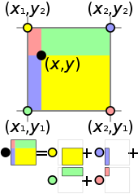
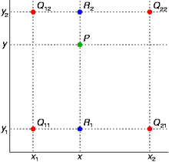
Bilinear Interpolation
http://en.wikipedia.org/wiki/Bilinear_interpolation
Help interp2

Slide 44
Forward vs. inverse warping
Q: which is better?
A: usually inverse—eliminates holes
however, it requires an invertible warp function—not always possible...

Slide 45
Triangulations
A triangulation of set of points in the plane is a partition of the convex hull to triangles whose vertices are the points, and do not contain other points.
There are an exponential number of triangulations of a point set.

Slide 46
An O(n³) Triangulation Algorithm
Repeat until impossible:
Select two sites.
If the edge connecting them does not intersect previous edges, keep it.

Slide 47
“Quality” Triangulations
Let α(T) = (α₁, α₂ ,.., α_{3t}) be the vector of angles in the triangulation T in increasing order.
A triangulation T₁ will be “better” than T₂ if α(T₁) > α(T₂) lexicographically.
The Delaunay triangulation is the “best”
Maximizes smallest angles
good
bad
Notes:
draw a circle with circumference between any two edges, no other vertex is in it

Slide 48
Improving a Triangulation
In any convex quadrangle, an edge flip is possible. If this flip improves the triangulation locally, it also improves the global triangulation.
If an edge flip improves the triangulation, the first edge is called illegal.

Slide 49
Illegal Edges
Lemma: An edge pq is illegal iff one of its opposite vertices is inside the circle defined by the other three vertices.
Proof: By Thales’ theorem.
p
q
Theorem: A Delaunay triangulation does not contain illegal edges.
Corollary: A triangle is Delaunay iff the circle through its vertices is empty of other sites.
Corollary: The Delaunay triangulation is not unique if more than three sites are co-circular.

Slide 50
Naïve Delaunay Algorithm
Start with an arbitrary triangulation. Flip any illegal edge until no more exist.
Could take a long time to terminate.

Slide 51
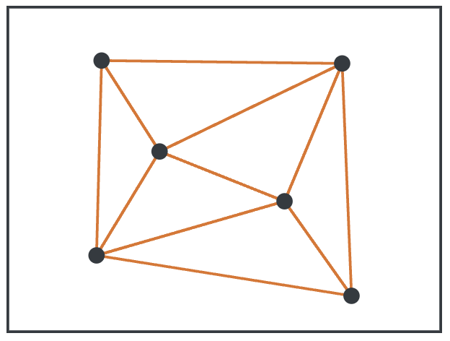
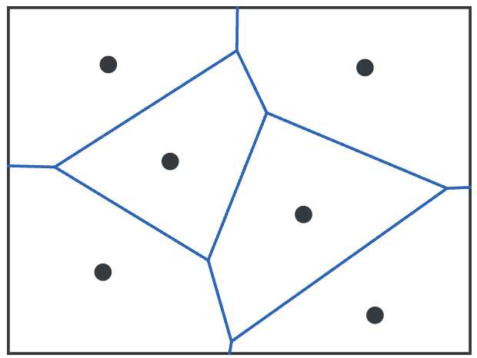
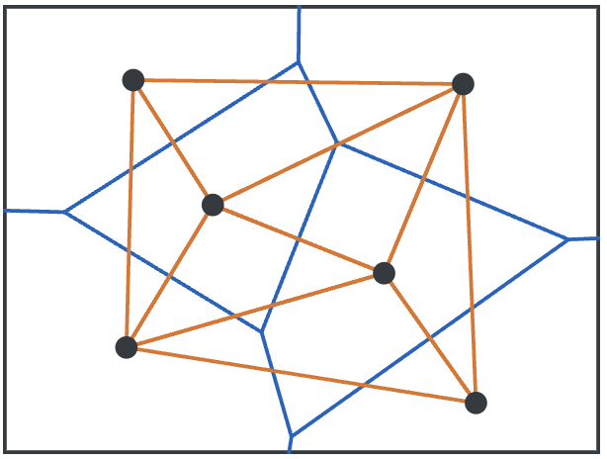
Delaunay Triangulation by Duality
General position assumption: There are no four co-circular points.
Draw the dual to the Voronoi diagram by connecting each two neighboring sites in the Voronoi diagram.
Corollary: The DT may be constructed in O(nlogn) time.
This is what Matlab’s delaunay function uses.
Notes:
draw a circle with circumference between any two edges, no other vertex is in it → connect the circumcenter (circle around the triangle, take the center → connect them, that will be the Voronoi diagram
no three are collinear and no four are cocircular.(on the circle)

Slide 52
Image Morphing Review
Creating a half-way intermediate morph (t=0.5):
Create an intermediate shape (by interpolation)
Warp both images towards it
Cross-dissolve the colors in the newly warped images

Slide 53
1. Create Average Shape
How do we create an intermediate warp at time t?
Assume t = [0,1]
Simple linear interpolation of each feature pair
p=(x,y) -> p’(x,y)
(1-t)*p+t*p’ for corresponding features p and p’

Slide 54
2. Create Average Color
Interpolate whole images:
Image_{halfway} = (1-t)*Image + t*image’
cross-dissolve!

Slide 55
Project #3: morphing
Define corresponding points
Define triangulation on points
Use same triangulation for both images
For each t = 0:step:1
Compute the average shape at t (weighted average of points)
For each triangle in the average shape
Get the affine projection to the corresponding triangles in each image
For each pixel in the triangle, find the corresponding points in each image and set value to weighted average (cross-dissolve each triangle)
Save the image as the next frame of the sequence
Life-hack: can be done with just two nested loops (for t, and for each triangle). Hint: compute warps for all pixels first, then use interp2

Slide 56
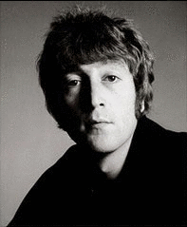
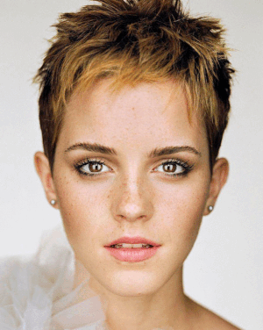
Examples
© Rachel Albert, CS194-26, Fall 2015

Slide 57
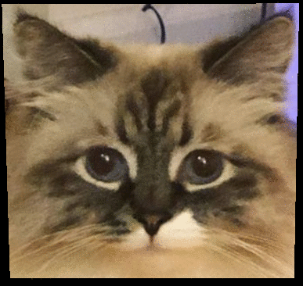
Examples from last year
@Michael Jayasuriya
@Varun Saran
What’s the difference?

Slide 58
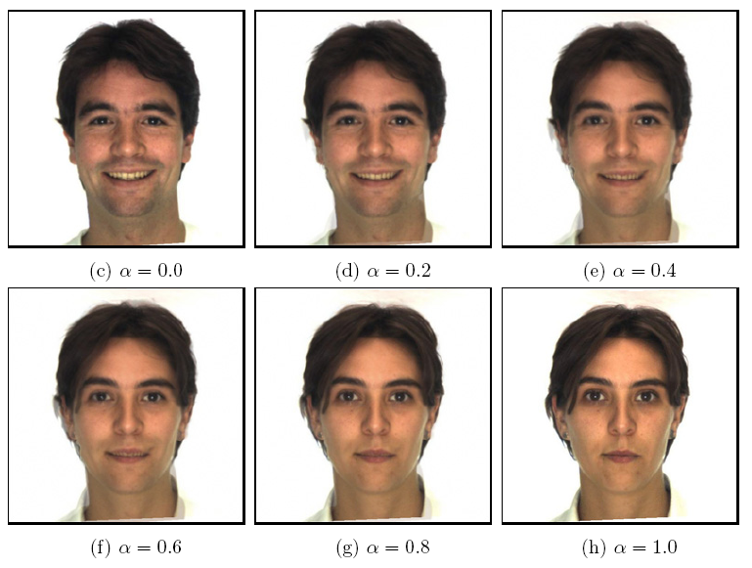
Morphing & matting
Extract foreground first to avoid artifacts in the background
Slide by Durand and Freeman

Slide 59
Other Issues
Beware of folding
You are probably trying to do something 3D-ish
Morphing can be generalized into 3D
If you have 3D data, that is!
Extrapolation can sometimes produce interesting effects
Caricatures

Slide 60
Dynamic Scene (“Black or White”, MJ)
http://www.youtube.com/watch?v=R4kLKv5gtxc

