Slide 1
Handwritten digit recognition
Jitendra Malik

Slide 2
Handwritten digit recognition (MNIST,USPS)
LeCun’s Convolutional Neural Networks variations (0.8%, 0.6% and 0.4% on MNIST)
Tangent Distance(Simard, LeCun & Denker: 2.5% on USPS)
Randomized Decision Trees (Amit, Geman & Wilder, 0.8%)
SVM on orientation histograms(Maji & Malik, 0.8%)

Slide 3
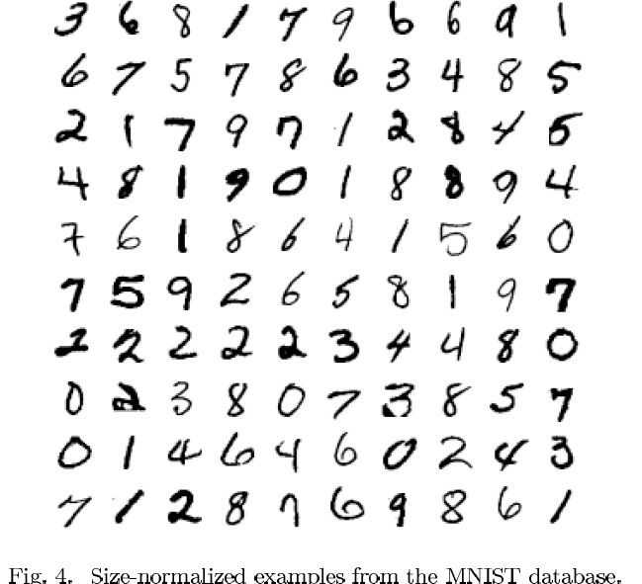

Slide 4
The MNIST DATABASE of handwritten digits yann.lecun.com/exdb/mnist/ Yann LeCun & Corinna Cortes
Has a training set of 60 K examples (6K examples for each digit), and a test set of 10K examples.
Each digit is a 28 x 28 pixel grey level image. The digit itself occupies the central 20 x 20 pixels, and the center of mass lies at the center of the box.
“It is a good database for people who want to try learning techniques and pattern recognition methods on real-world data while spending minimal efforts on preprocessing and formatting.”

Slide 5
The machine learning approach to object recognition
Training time
Compute feature vectors for positive and negative examples of image patches
Train a classifier
Test Time
Compute feature vector on image patch
Evaluate classifier

Slide 6
Let us take an example…

Slide 7
Let us take an example…

Slide 8
In feature space, positive and negative examples are just points…

Slide 9
How do we classify a new point?

Slide 10
Nearest neighbor rule “transfer label of nearest example”

Slide 11
Linear classifier rule

Slide 12
Different approaches to training classifiers
Nearest neighbor methods
Neural networks
Support vector machines
Randomized decision trees
…

Slide 13
Support Vector Machines
Find hyperplane maximizes the margin => B1 is better than B2

Slide 14
Support Vector Machines
Examples are;
(x1,..,xn,y) with
y∈{-1.1}

Slide 15
Some remarks..
While the diagram corresponds to a linearly separable case, the idea can be generalized to a “soft margin SVM” where mistakes are allowed but penalized.
Training an SVM is a convex optimization problem, so we are guaranteed that we can find the globally best solution. Various software packages are available such as LIBSVM, LIBLINEAR
But what if the decision boundary is horribly non-linear? We use the “kernel trick”

Slide 16
Suppose the positive examples lie inside a disk

Slide 17
Suppose the positive examples lie inside a disk

Slide 18
We can construct a new higher-dimensional feature space where the boundary is linear

Slide 19
Kernel Support Vector Machines
Kernel :
Inner Product in Hilbert Space
Can Learn Non Linear Boundaries

Slide 20
Transformation invariance (or, why we love orientation histograms so much!)
We want to recognize objects in spite of various transformations-scaling, translation, rotations, small deformations…
of course, sometimes we don’t want full invariance – a 6 vs. a 9

Slide 21
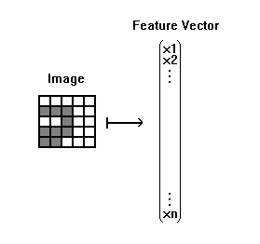
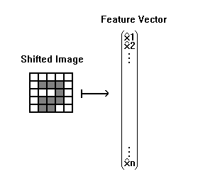
Why is this a problem?

Slide 22
How do we build in transformational invariance?
Augment the dataset
Include in it various transformed copies of the digit, and hope that the classifier will figure out a decision boundary that works
Build in invariance into the feature vector
Orientation histograms do this for several common transformations and this is why they are so popular for building feature vectors in computer vision
Build in invariance into the classification strategy
Multi-scale scanning deals with scaling and translation

Slide 23
Orientation histograms
Orientation histograms can be computed on blocks of pixels, so we can obtain tolerance to small shifts of a part of the object.
For gray-scale images of 3d objects, the process of computing orientations, gives partial invariance to illumination changes.
Small deformations when the orientation of a part changes only by a little causes no change in the histogram, because we bin orientations

Slide 24
Some more intuition
The information retrieval community had invented the “bag of words” model for text documents where we ignore the order of words and just consider their counts. It turns out that this is quite an effective feature vector – medical documents will use quite different words from real estate documents.
An example with letters: How many different words can you think of that contain a, b, e, l, t?
Throwing away the spatial arrangement in the process of constructing an orientation histogram loses some information, but not that much.
In addition, we can construct orientation histograms at different scales- the whole object, the object divided into quadrants, the object divided into even smaller blocks.

Slide 25
We compare histograms using the Intersection Kernel
Histogram Intersection kernel between histograms a, b
K small -> a, b are different
K large -> a, b are similar
Intro. by Swain and Ballard 1991 to compare color histograms.
Odone et al 2005 proved positive definiteness.
Can be used directly as a kernel for an SVM.

Slide 26
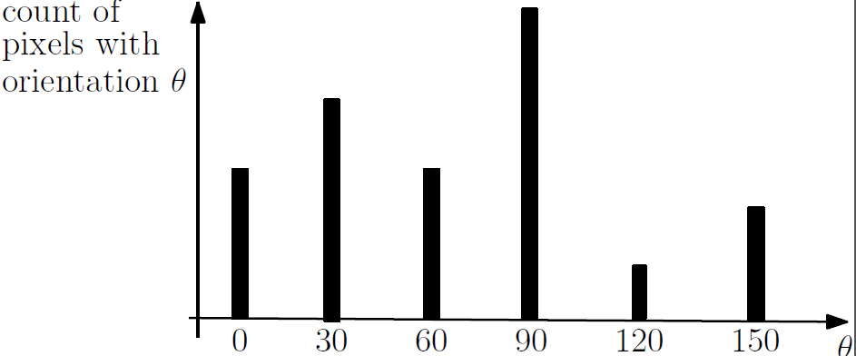
Orientation histograms

Slide 27
Digit Recognition using SVMS
Jitendra Malik
Lecture is based on
Maji & Malik (2009)

Slide 28
Digit recognition using SVMs
What feature vectors should we use?
Pixel brightness values
Orientation histograms
What kernel should we use for the SVM?
Linear
Intersection kernel
Polynomial
Gaussian Radial Basis Function

Slide 29
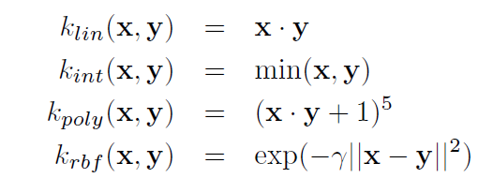
Some popular kernels in computer vision x and y are two feature vectors

Slide 30
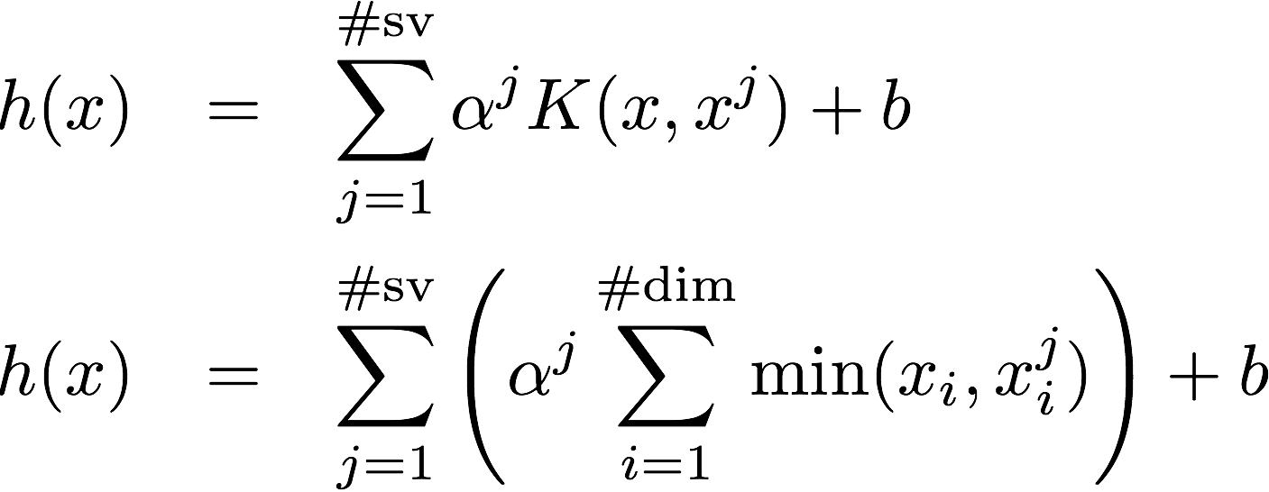
Kernelized SVMs slow to evaluate
Decision function is where:
Feature vector
to evaluate
Sum over all
support vectors
Kernel Evaluation
Feature corresponding
to a support vector l
Arbitrary
Kernel
Histogram
Intersection
Kernel
Cost: # Support Vectors x Cost of kernel computation

Slide 31
Complexity considerations
Linear kernels are the fastest
Intersection kernels are nearly as fast, using the “Fast Intersection Kernel” (Maji, Berg & Malik, 2008)
Non-linear kernels such as the polynomial kernel or Gaussian radial basis functions are the slowest, because of the need to evaluate kernel products with each support vector. There could be thousands of support vectors!

Slide 32
Raw pixels do not make a good feature vector
Each digit in the MNIST DATABASE of handwritten digits is a 28 x 28 pixel grey level image.

Slide 33
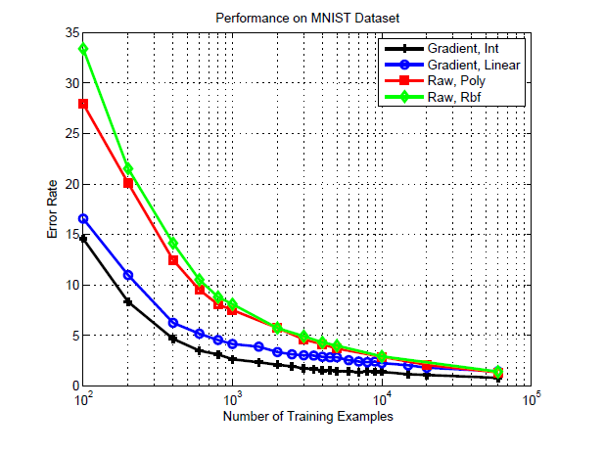
Error rates vs. the number of training examples

Slide 34
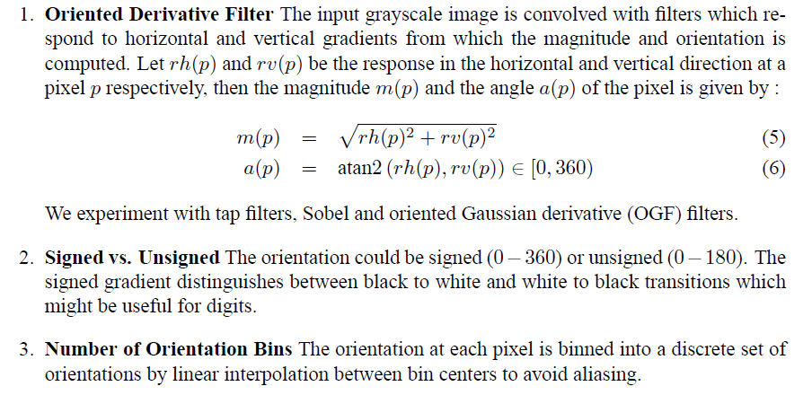
Technical details on orientation computation

Slide 35
Details of histogram computation

Slide 36
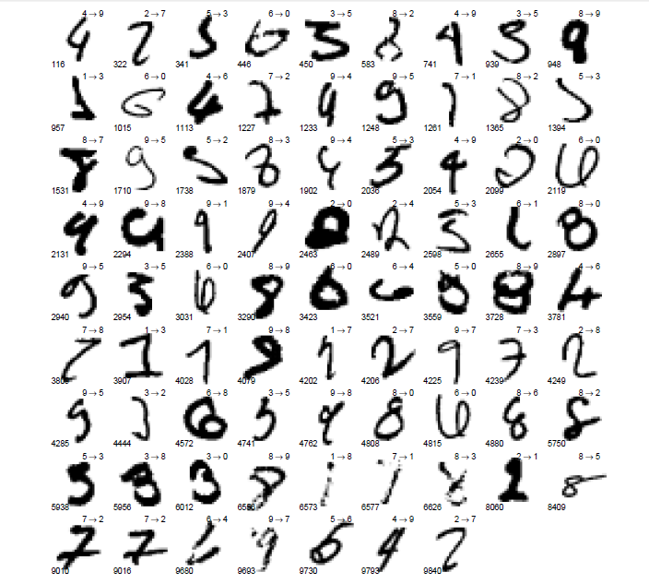
The 79 Errors

Slide 37
Some key references on orientation histograms
D. Lowe, ICCV 1999, SIFT
A. Oliva & A. Torralba, IJCV 2001, GIST
A. Berg & J. Malik, CVPR 2001, Geometric Blur
N. Dalal & B. Triggs, CVPR 2005, HOG
S. Lazebnik, C. Schmid & J. Ponce, CVPR 2006, Spatial Pyramid Matching

Slide 38
Randomized decision trees (a.k.a. Random Forests)
Jitendra Malik

Slide 39
Two papers
Y. Amit, D. Geman & K. Wilder, Joint induction of shape features and tree classifiers, IEEE Trans. on PAMI, Nov. 1997.(digit classification)
J. Shotton et al, Real-time Human Pose Recognition in Parts from Single Depth Images, IEEE CVPR, 2011. (describes the algorithm used in the Kinect system)

Slide 40
What is a decision tree?

Slide 41
What is a decision tree?

Slide 42
Decision trees for Classification
Training time
Construct the tree, i.e. pick the questions at each node of the tree. Typically done so as to make each of the child nodes “purer”(lower entropy). Each leaf node will be associated with a set of training examples
Test time
Evaluate the tree by sequentially evaluating questions, starting from the root node. Once a particular leaf node is reached, we predict the class to be the one with the most examples(from training set)at this node.

Slide 43
Amit, Geman & Wilder’s approach
Some questions are based on whether certain “tags” are found in the image. Crudely, think of these as edges of particular orientation.
Other questions are based on spatial relationships between pairs of tags. An example might be whether a vertical edge is found above and to the right of an horizontal edge

Slide 44
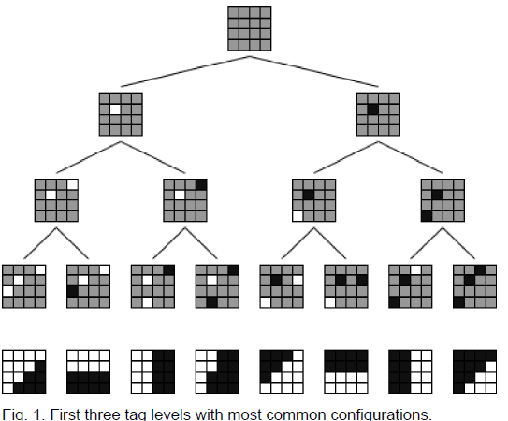

Slide 45
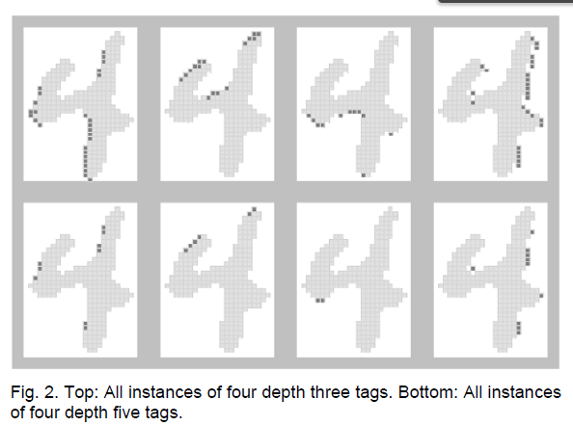

Slide 46
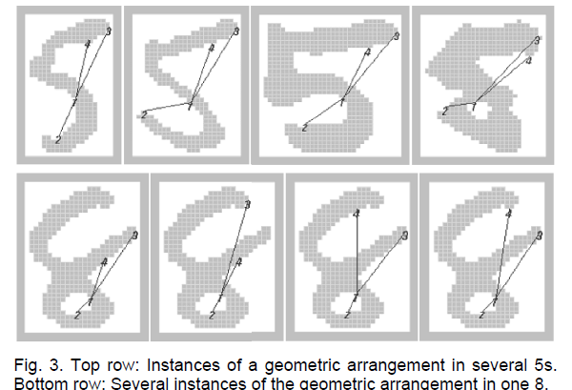
An example of such an arrangement

Slide 47
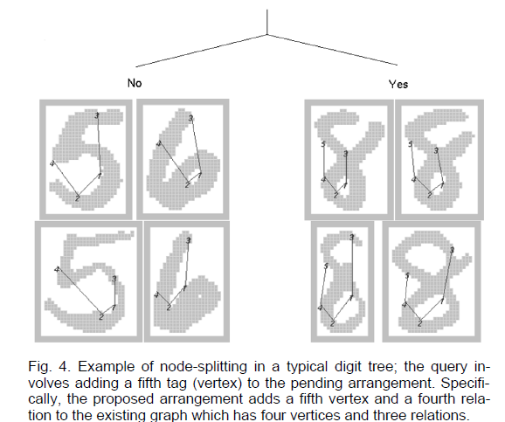
Additional questions “grow” the arrangement

Slide 48
Multiple randomized trees
It turns out that using a single tree for classification doesn’t work too well. Error rates are around 7% or so.
But if one trains multiple trees (different questions) and averages the predicted posterior class probabilities, error rates fall below 1%
Powerful general idea- now called “Random Forests”

Slide 49
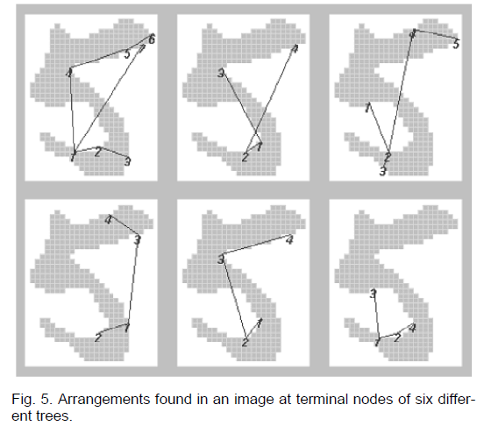

Slide 50
The Microsoft Kinect system uses a similar approach…

Slide 51
Convolutional Neural Networks LeCun et al (1989)

Slide 52
Convolutional Neural Networks (LeCun et al)

Slide 53
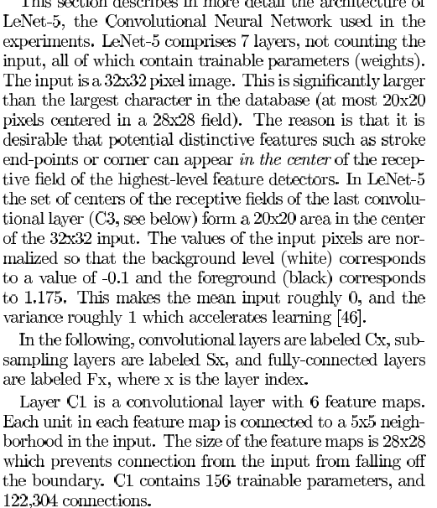
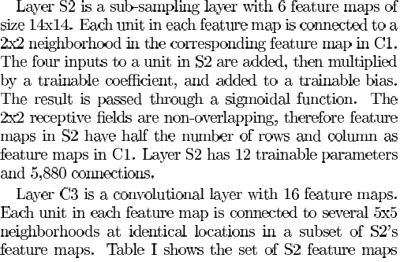

Slide 54
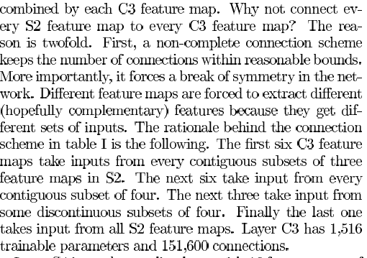
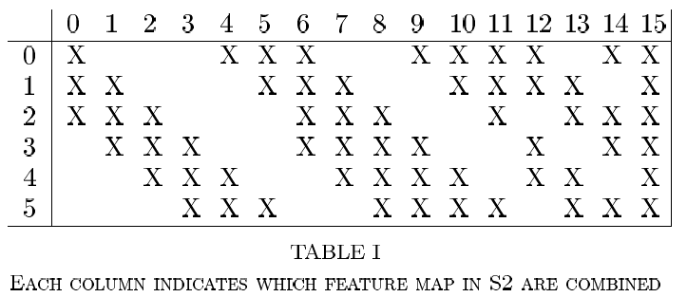

Slide 55
Training multi-layer networks

