Slide 1
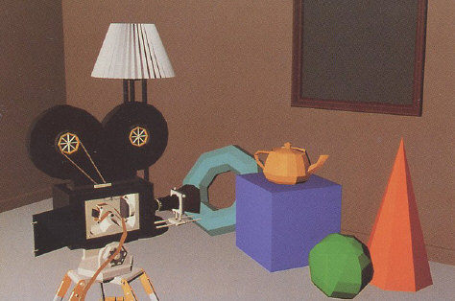
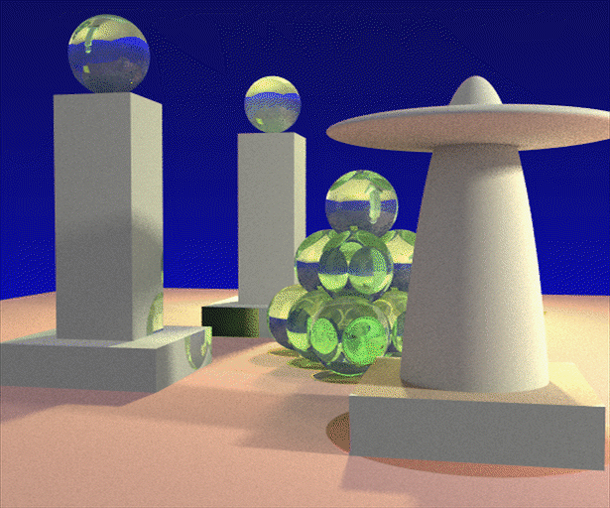
Advanced Computer Graphics (Spring 2013)
CS 283, Lecture 10: Monte Carlo Integration
Ravi Ramamoorthi
http://inst.eecs.berkeley.edu/~cs283/sp13
Acknowledgements and many slides courtesy:
Thomas Funkhouser, Szymon Rusinkiewicz and Pat Hanrahan

Slide 2
Motivation
Rendering = integration
Reflectance equation: Integrate over incident illumination
Rendering equation: Integral equation
Many sophisticated shading effects involve integrals
Antialiasing
Soft shadows
Indirect illumination
Caustics

Slide 3
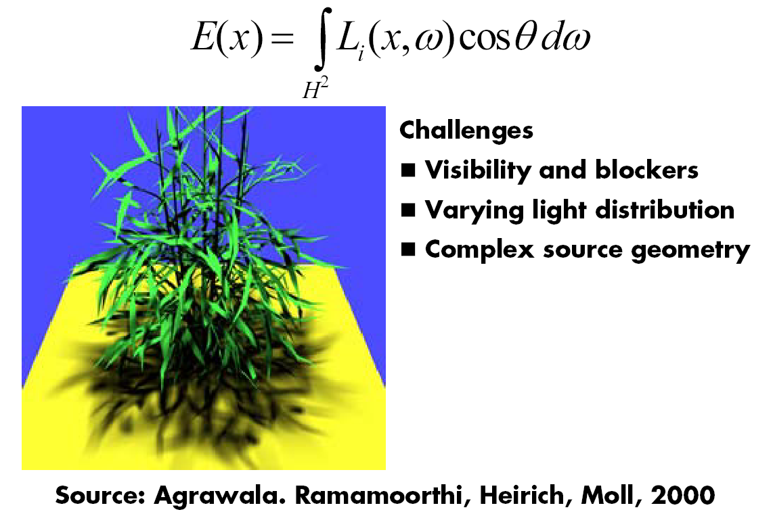
Example: Soft Shadows

Slide 4
Monte Carlo
Algorithms based on statistical sampling and random numbers
Coined in the beginning of 1940s. Originally used for neutron transport, nuclear simulations
Von Neumann, Ulam, Metropolis, …
Canonical example: 1D integral done numerically
Choose a set of random points to evaluate function, and then average (expectation or statistical average)

Slide 5
Monte Carlo Algorithms
Advantages
Robust for complex integrals in computer graphics (irregular domains, shadow discontinuities and so on)
Efficient for high dimensional integrals (common in graphics: time, light source directions, and so on)
Quite simple to implement
Work for general scenes, surfaces
Easy to reason about (but care taken re statistical bias)
Disadvantages
Noisy
Slow (many samples needed for convergence)
Not used if alternative analytic approaches exist (but those are rare)

Slide 6
Outline
Motivation
Overview, 1D integration
Basic probability and sampling
Monte Carlo estimation of integrals

Slide 7
Integration in 1D
f(x)
x=1
Slide courtesy of Peter Shirley

Slide 8
We can approximate
Standard integration methods like trapezoidal
rule and Simpsons rule
Advantages:
Converges fast for smooth integrands
Deterministic
Disadvantages:
Exponential complexity in many dimensions
Not rapid convergence for discontinuities
g(x)
f(x)
x=1
Slide courtesy of Peter Shirley

Slide 9
Or we can average
f(x)
E(f(x))
x=1
Slide courtesy of Peter Shirley

Slide 10
Estimating the average
Monte Carlo methods (random choose samples)
Advantages:
Robust for discontinuities
Converges reasonably for large dimensions
Can handle complex geometry, integrals
Relatively simple to implement, reason about
f(x)
E(f(x))
x₁
x_{N}
Slide courtesy of Peter Shirley

Slide 11
Other Domains
f(x)
< f >_{ab}
x=a
x=b
Slide courtesy of Peter Shirley

Slide 12
Multidimensional Domains
Same ideas apply for integration over …
Pixel areas
Surfaces
Projected areas
Directions
Camera apertures
Time
Paths
Eye
Pixel
x
Surface

Slide 13
Outline
Motivation
Overview, 1D integration
Basic probability and sampling
Monte Carlo estimation of integrals

Slide 14
Random Variables
Describes possible outcomes of an experiment
In discrete case, e.g. value of a dice roll [x = 1-6]
Probability p associated with each x (1/6 for dice)
Continuous case is obvious extension

Slide 15
Expected Value
Expectation
For Dice example:

Slide 17
Sampling Techniques
Problem: how do we generate random points/directions during path tracing?
Non-rectilinear domains
Importance (BRDF)
Stratified
Eye
x
Surface

Slide 18
Generating Random Points
Uniform distribution:
Use random number generator
1
Probability
0
Ω

Slide 19
Generating Random Points
Specific probability distribution:
Function inversion
Rejection
Metropolis
1
Probability
0
Ω

Slide 20
Common Operations
Want to sample probability distributions
Draw samples distributed according to probability
Useful for integration, picking important regions, etc.
Common distributions
Disk or circle
Uniform
Upper hemisphere for visibility
Area luminaire
Complex lighting like an environment map
Complex reflectance like a BRDF

Slide 22
Generating Random Points
1
Cumulative Probability
0
Ω

Slide 26
Rejection Sampling
1
x
x
x
x
x
x
Probability
x
x
x
x
0
Ω

Slide 29
Outline
Motivation
Overview, 1D integration
Basic probability and sampling
Monte Carlo estimation of integrals

Slide 30
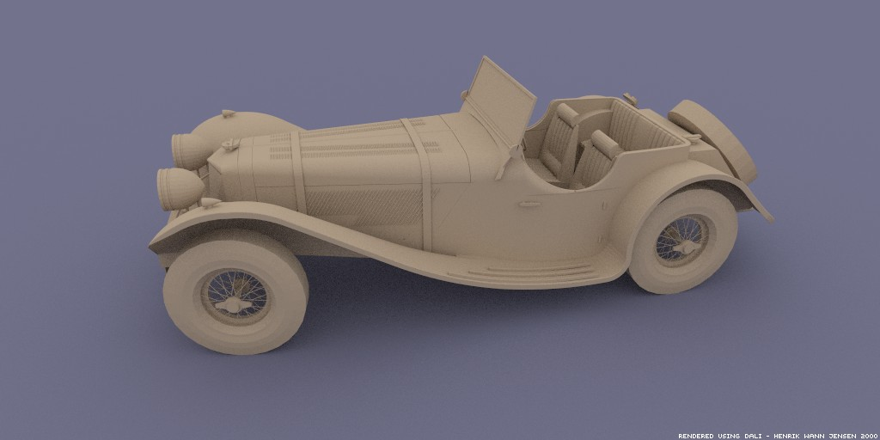
Monte Carlo Path Tracing
Big diffuse light source, 20 minutes
Motivation for rendering in graphics: Covered in detail in next lecture
Jensen

Slide 31
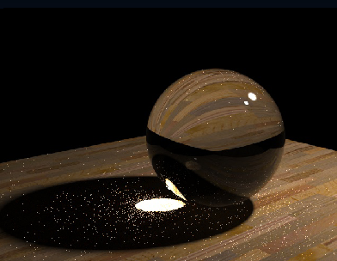
Monte Carlo Path Tracing
1000 paths/pixel
Jensen

Slide 32
Estimating the average
Monte Carlo methods (random choose samples)
Advantages:
Robust for discontinuities
Converges reasonably for large dimensions
Can handle complex geometry, integrals
Relatively simple to implement, reason about
f(x)
E(f(x))
x₁
x_{N}
Slide courtesy of Peter Shirley

Slide 33
Other Domains
f(x)
< f >_{ab}
x=a
x=b
Slide courtesy of Peter Shirley

Slide 34
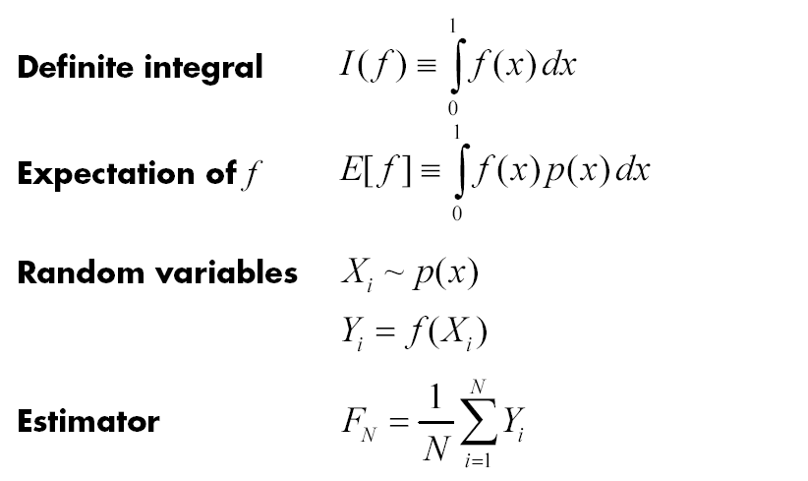
More formally

Slide 38
Variance
E(f(x))
x₁
x_{N}

Slide 39
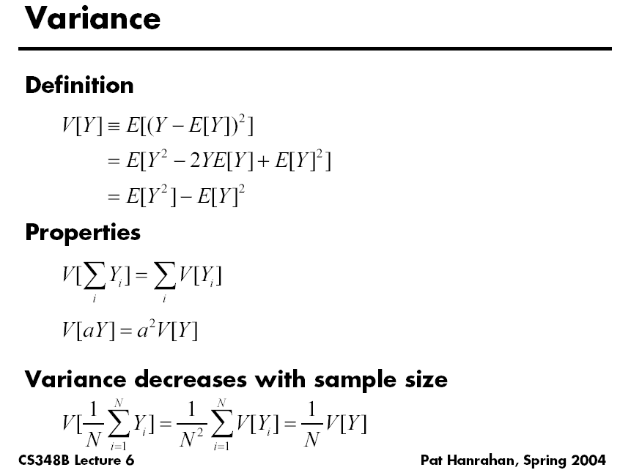

Slide 40
Variance for Dice Example?
Work out on board (variance for single dice roll)

Slide 41
Variance
Variance decreases as 1/N
Error decreases as 1/sqrt(N)
E(f(x))
x₁
x_{N}

Slide 42
Variance
Problem: variance decreases with 1/N
Increasing # samples removes noise slowly
E(f(x))
x₁
x_{N}

Slide 44
Variance Reduction Techniques
Importance sampling
Stratified sampling

Slide 45
Importance Sampling
Put more samples where f(x) is bigger
E(f(x))
x₁
x_{N}

Slide 46
Importance Sampling
This is still unbiased
E(f(x))
x₁
x_{N}
for all N

Slide 47
Importance Sampling
Zero variance if p(x) ~ f(x)
E(f(x))
Less variance with better
importance sampling
x₁
x_{N}

Slide 48
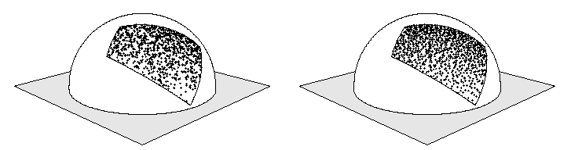
Stratified Sampling
Estimate subdomains separately
Arvo
E_{k}(f(x))
x₁
x_{N}

Slide 49
Stratified Sampling
This is still unbiased
E_{k}(f(x))
x₁
x_{N}

Slide 50
Stratified Sampling
Less overall variance if less variance in subdomains
E_{k}(f(x))
x₁
x_{N}

Slide 51
More Information
Veach PhD thesis chapter (linked to from website)
Course Notes (links from website)
Mathematical Models for Computer Graphics, Stanford, Fall 1997
State of the Art in Monte Carlo Methods for Realistic Image Synthesis, Course 29, SIGGRAPH 2001
Briefly discuss role in production if time permits

