Slide 1
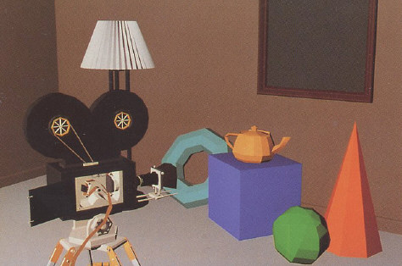
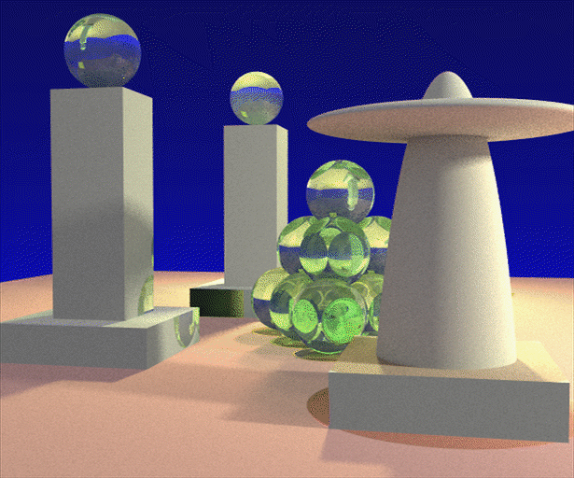
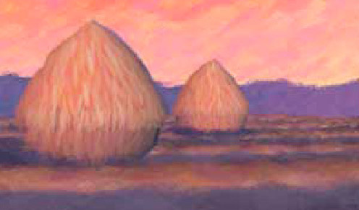
Advanced Computer Graphics
(Spring 2013)
CS 283, Lecture 18:
Basic Geometric Concepts and Rotations
Ravi Ramamoorthi
http://inst.eecs.berkeley.edu/~cs283/sp13
Most slides courtesy James O’Brien from CS294-13 Fall 2009

Slide 2
Motivation
Moving from rendering to simulation, animation
Basic differential geometry crucial
  How to compute frames, curvature, rotations
This lecture relates to geometry, but focuses more on continuous concepts
Future lectures deal with animation and simulation
Quite mathematical, useful knowledge

Slide 3
Outline
Parametric Curves
Parametric Surfaces
Rotations in 3D

Slide 4
Parametric Curves (later Surfaces)
Curve is a geometric entity (set of points in space)
Any local region is isomorphic to a line
Generator function x(t)
  Vector valued, or scalar function for each dimension.
  Particular parameterization is arbitrary and not unique (not intrinsic to the curve)

Slide 5
Arclength
Intrinsic parameterization of curve
  But practical closed form may be hard to find
  Unique up to sign change and translation

Slide 6
Tangents, Normals, Binormals
Tangent vector geometric property of curve
  Intrinsic, independent of parameterization
  Can exist where parametric velocity is 0 or undefined

Slide 7
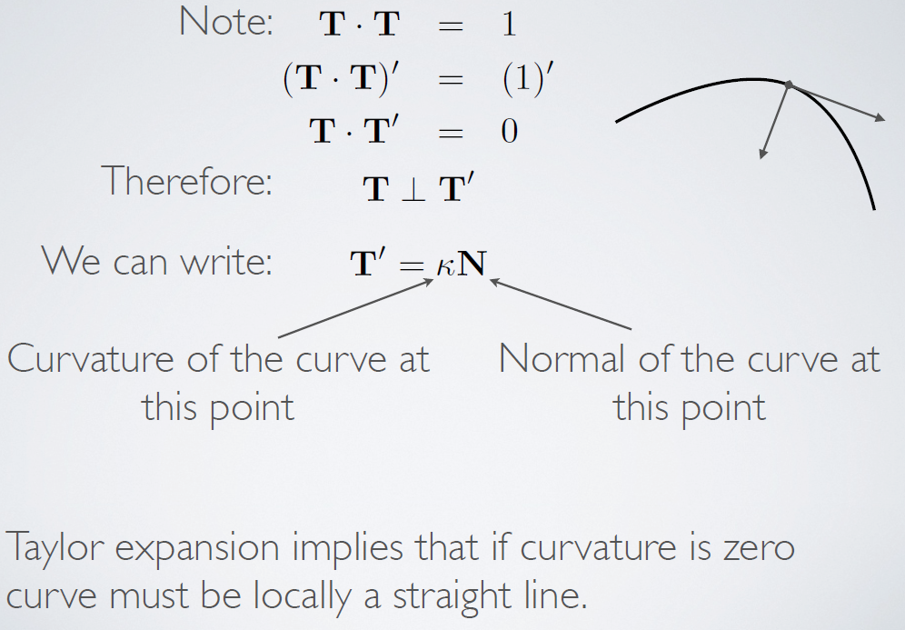
Curvature and Normal

Slide 8
Frenet Frame
Define binormal by B = T x N
Gives us an orthonormal coordinate frame
  Moves along curve
  Gives local frame of reference
  Not defined at inflection points where no curvature
Can find some nice demos online

Slide 9
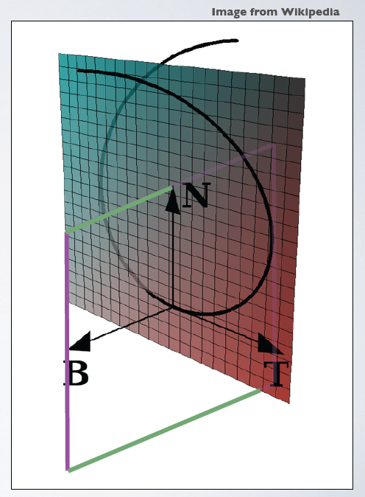
Frenet Frame
Osculating Plane
  Defined by N and T
  Locally contains curve
Normal plane
  Defined by N and B
  Locally perpendicular to curve

Slide 10
Torsion

Slide 11
Evolution of Frenet Frame

Slide 12
Evolution of Frenet Frame

Slide 13
Radius of Curvature

Slide 14
Complicated Formulae

Slide 15
Outline
Parametric Curves
Parametric Surfaces
Rotations in 3D

Slide 16
Parametric Surfaces
Surface is geometric entity (set of points in space)
Any local region is isomorphic to a plane
Generator function x(u)
  Vector valued, or scalar function for each dimension of embedding space (e.g. 2D surface embedded in 3D)
  The parameter u itself is of dimension two
  Particular parameterization is arbitrary and not unique (not intrinsic to the surface)

Slide 17
Tangent Space

Slide 18
Non-Orthogonal Tangents

Slide 19
Normals
Normal at a point is unit vector perpendicular to the tangent space

Slide 20
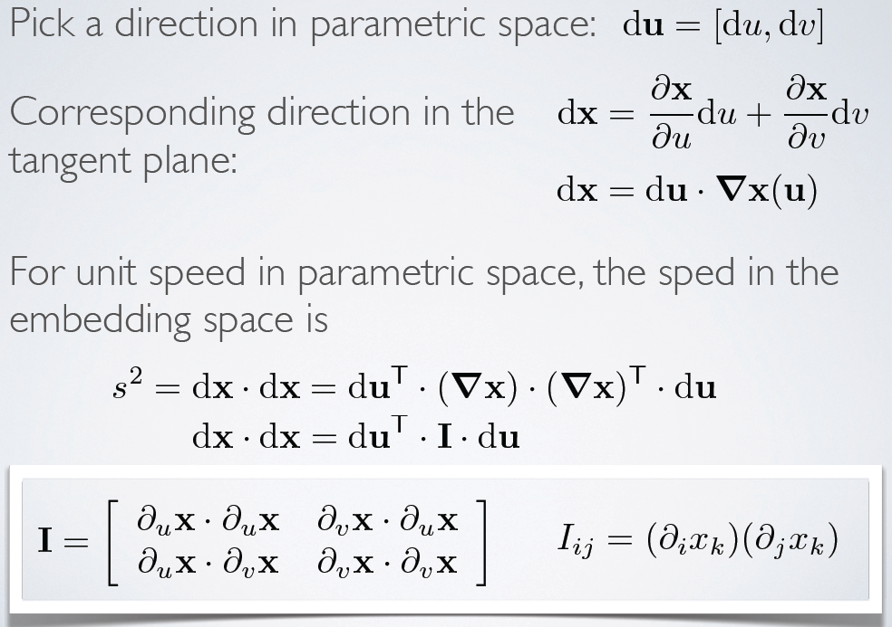
First Fundamental Form
Fundamental forms key concepts on surfaces

Slide 21
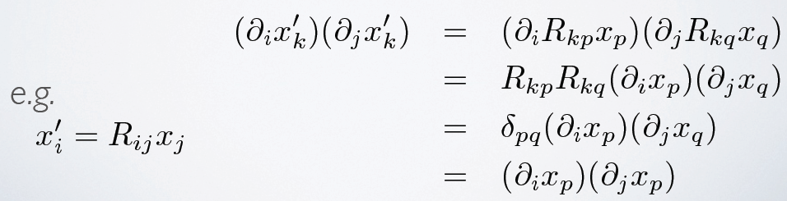
Properties of First Fundamental Form
Encodes distance metric on surface
For orthonormal tangents, simply identity
Used as a metric by Green’s strain
Invariant to translations and rotations

Slide 22
ArcLength over Surface

Slide 23
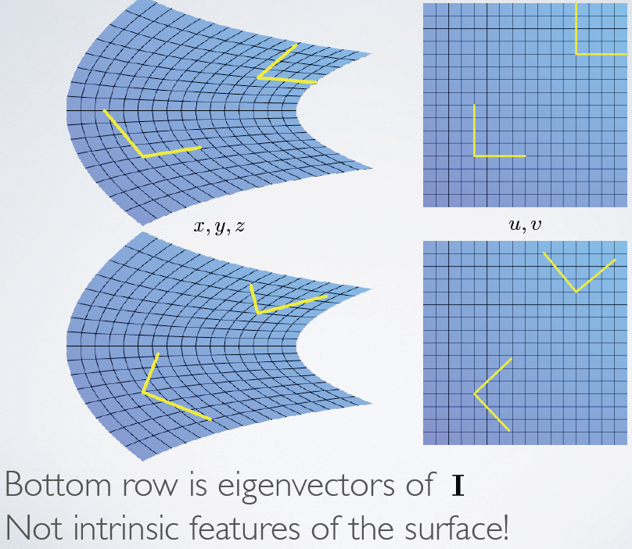
Principal Tangents

Slide 24
Orthonormal Parameterization

Slide 25
Second Fundamental Form

Slide 26
Second Fundamental Form

Slide 27
Second Fundamental Form

Slide 28
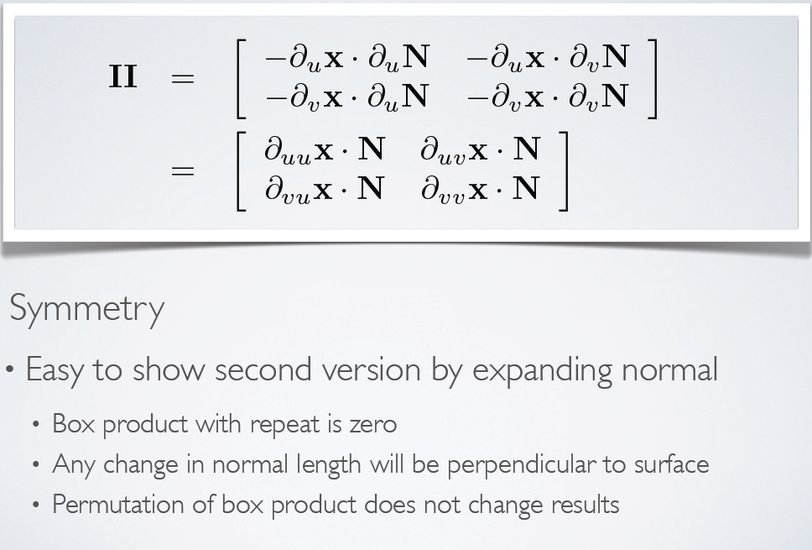
Properties

Slide 29
Normal Curvature

Slide 30
Principal Curvatures

Slide 31
Principal Curvatures

Slide 32
Curvatures
Gaussian curvature
Mean curvature

Slide 33
Geodesic Curves

Slide 34
Geodesic Curves

Slide 35
Outline
Parametric Curves
Parametric Surfaces
Rotations in 3D

Slide 36
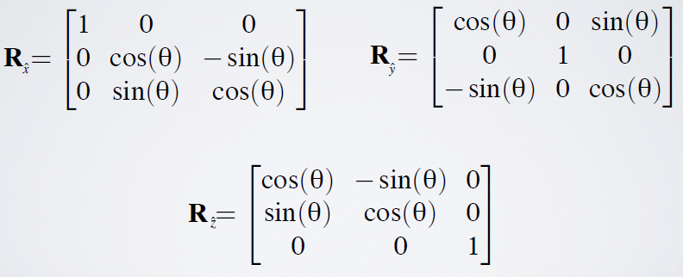
General 3D Rotations
Non-commutative, much more complex than 2D
General 3D axis, angle of rotation
In axis-aligned case, simpler
  In all cases, orthogonal matrices
  Rows and columns of matrix are orthonormal

Slide 37
Arbitrary 3D rotations

Slide 38
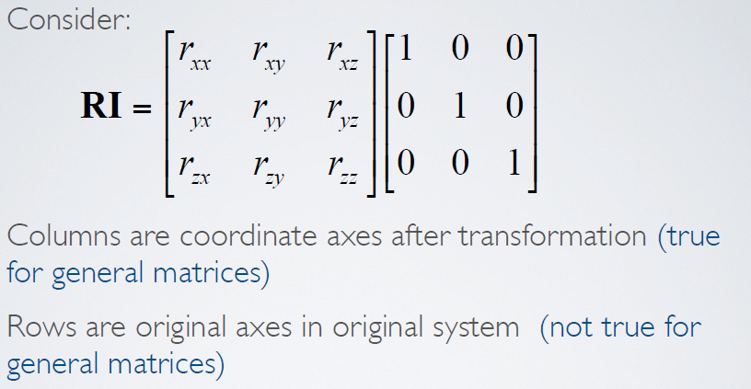
Rotation Matrices

Slide 39
Axis-Angle

Slide 40
Axis Angle split Components

Slide 41
Axis Angle Components

Slide 42
Rodriguez Formula

Slide 43
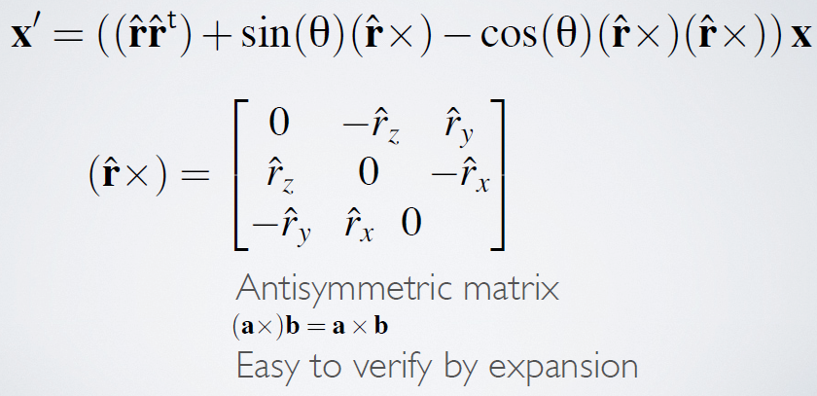
Rodriguez Matrix

Slide 44
Exponential Maps
Allows tumbling
No gimbal lock
Orientations are space within π radius ball
Nearly unique representations
Singularities on shells at 2 π
Nice for interpolation

Slide 45
Exponentials: Basic Properties

Slide 46
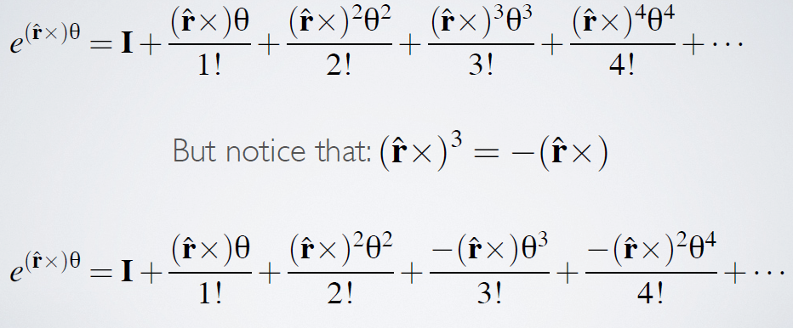
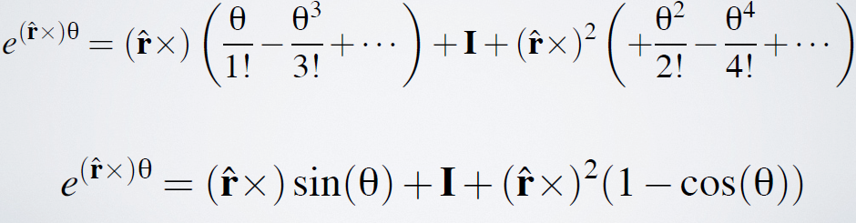
Matrix Exponentials

Slide 47
Quaternions
More popular than exponential maps
Natural extension of complex numbers
Hamilton 1843: interesting history
Uber-complex numbers

Slide 48
Quaternion Properties

Slide 49
Quaternion Rotations

Slide 50
Quaternions
No tumbling
No gimbal lock
Orientations are double unique
Surface of unit 3-sphere in 4D
Nice for interpolation
  Slerps
  Optimal quaternion splines

Slide 51
Interpolation
Ramamoorthi and Barr 97

