Slide 1
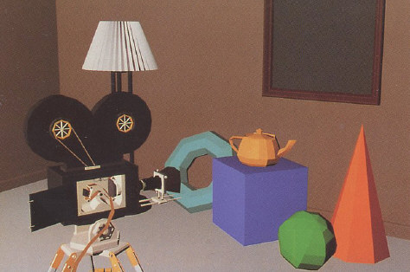
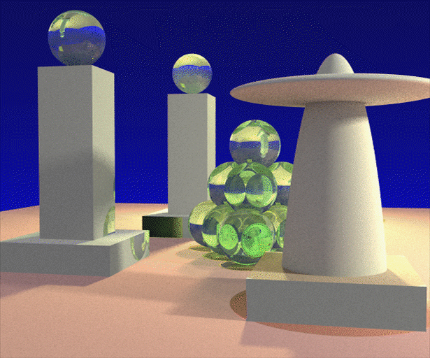
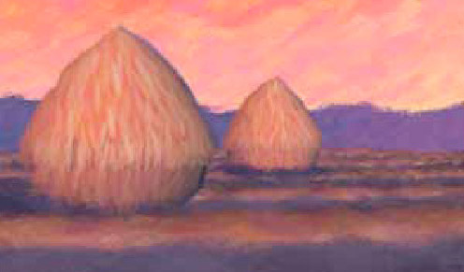
Advanced Computer Graphics (Spring 2013)
CS 283, Lecture 2: Sampling and Reconstruction
Ravi Ramamoorthi
http://inst.eecs.berkeley.edu/~cs283/sp13
Some slides courtesy Thomas Funkhouser and Pat Hanrahan

Slide 2
Basics
First 3 lectures cover basic topics
  Sampling and Reconstruction, Fourier Analysis
  3D objects and meshes
  If you don’t know raytracing, look at online lectures, hw
Then we start main part of course
  Meshes and assignment 1
This lecture review for some of you
  But needed to bring everyone up to speed
  Much more detailed material available if interested (we have only limited time; cover it quickly)
Sign up for Piazza, E-mail Brandon re roster

Slide 3
Outline
Basic ideas of sampling, reconstruction, aliasing
Signal processing and Fourier analysis
Implementation of digital filters
Section 14.10 of FvDFH (you really should read)
Some slides courtesy Tom Funkhouser

Slide 4
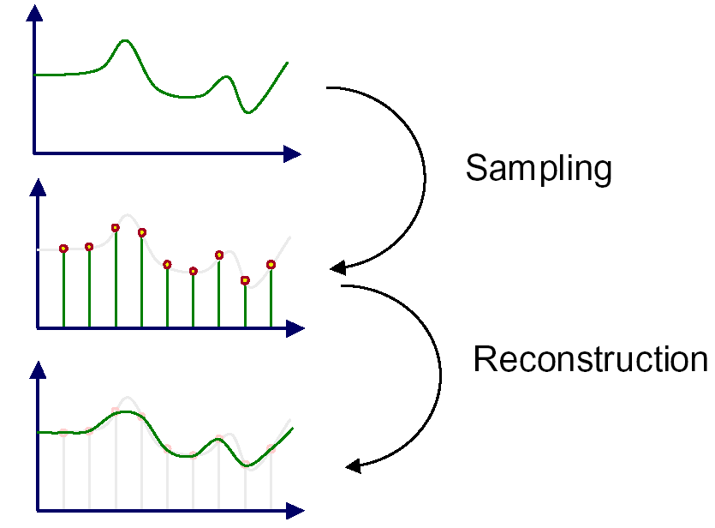
Sampling and Reconstruction
An image is a 2D array of samples
Discrete samples from real-world continuous signal

Slide 5
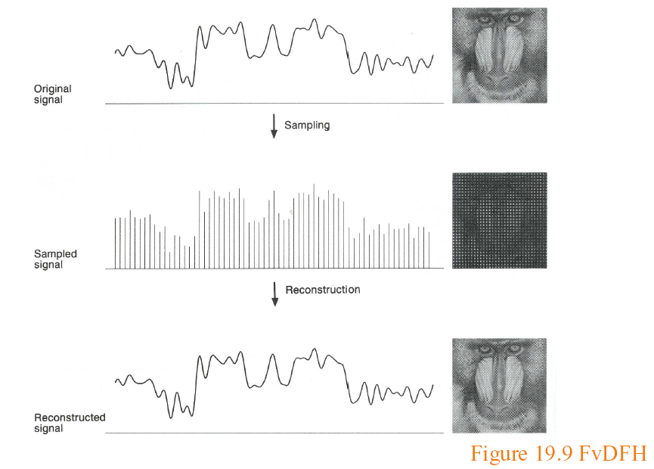
Sampling and Reconstruction

Slide 6
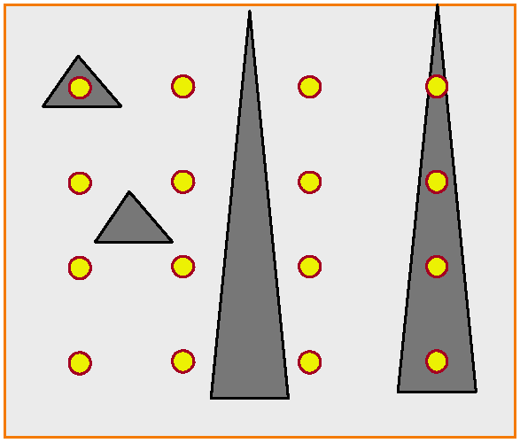
(Spatial) Aliasing

Slide 7
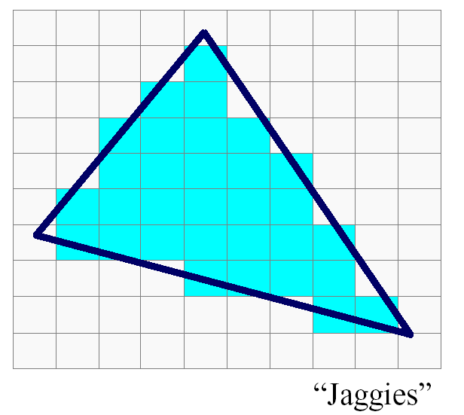
(Spatial) Aliasing
Jaggies probably biggest aliasing problem

Slide 8
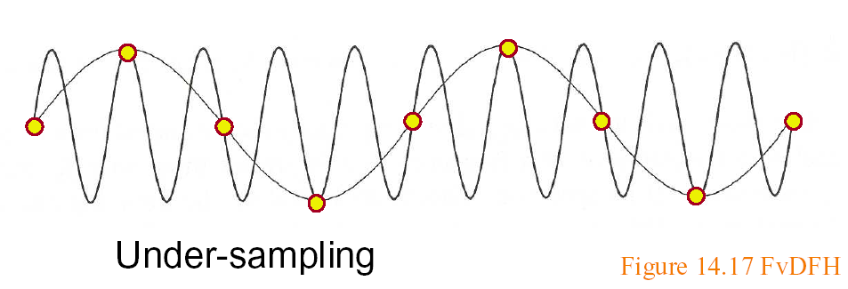
Sampling and Aliasing
Artifacts due to undersampling or poor reconstruction
Formally, high frequencies masquerading as low
E.g. high frequency line as low freq jaggies

Slide 9
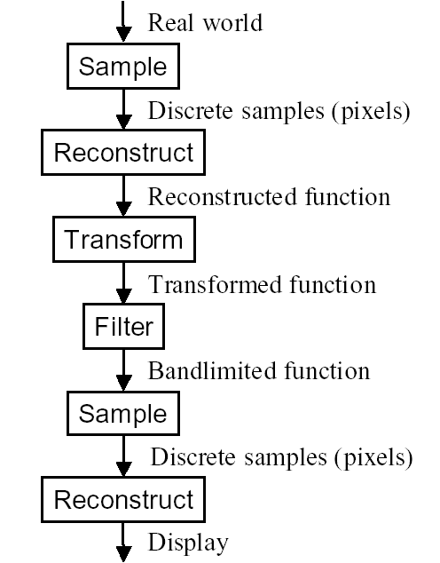
Image Processing pipeline

Slide 10
Outline
Basic ideas of sampling, reconstruction, aliasing
Signal processing and Fourier analysis
Implementation of digital filters
Section 14.10 of textbook

Slide 11
Motivation
Formal analysis of sampling and reconstruction
Important theory (signal-processing) for graphics
Also relevant in rendering, modeling, animation

Slide 12
Ideas
Signal (function of time generally, here of space)
Continuous: defined at all points; discrete: on a grid
High frequency: rapid variation; Low Freq: slow variation
Images are converting continuous to discrete. Do this sampling as best as possible.
Signal processing theory tells us how best to do this
Based on concept of frequency domain Fourier analysis

Slide 13
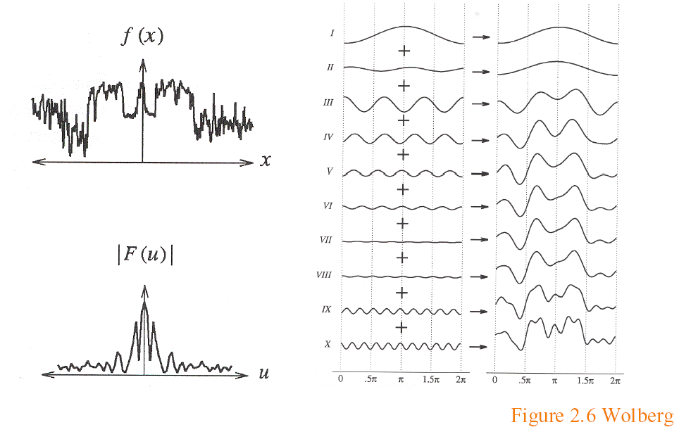
Sampling Theory
Analysis in the frequency (not spatial) domain
  Sum of sine waves, with possibly different offsets (phase)
  Each wave different frequency, amplitude

Slide 14
Fourier Transform
Tool for converting from spatial to frequency domain
Or vice versa
One of most important mathematical ideas
Computational algorithm: Fast Fourier Transform
  One of 10 great algorithms scientific computing
  Makes Fourier processing possible (images etc.)
  Not discussed here, but look up if interested

Slide 15
Fourier Transform
Simple case, function sum of sines, cosines
Continuous infinite case

Slide 16
Fourier Transform
Simple case, function sum of sines, cosines
Discrete case

Slide 17
Fourier Transform: Examples 1
Single sine curve (+constant DC term)

Slide 18
Fourier Transform Examples 2
Common examples

Slide 19
Fourier Transform Properties
Common properties
  Linearity:
  Derivatives: [integrate by parts]
  2D Fourier Transform
Convolution (next)

Slide 20
Sampling Theorem, Bandlimiting
A signal can be reconstructed from its samples, if the original signal has no frequencies above half the sampling frequency – Shannon
The minimum sampling rate for a bandlimited function is called the Nyquist rate

Slide 21
Sampling Theorem, Bandlimiting
A signal can be reconstructed from its samples, if the original signal has no frequencies above half the sampling frequency – Shannon
The minimum sampling rate for a bandlimited function is called the Nyquist rate
A signal is bandlimited if the highest frequency is bounded. This frequency is called the bandwidth
In general, when we transform, we want to filter to bandlimit before sampling, to avoid aliasing

Slide 22
Antialiasing
Sample at higher rate
  Not always possible
  Real world: lines have infinitely high frequencies, can’t sample at high enough resolution
Prefilter to bandlimit signal
  Low-pass filtering (blurring)
  Trade blurriness for aliasing

Slide 23
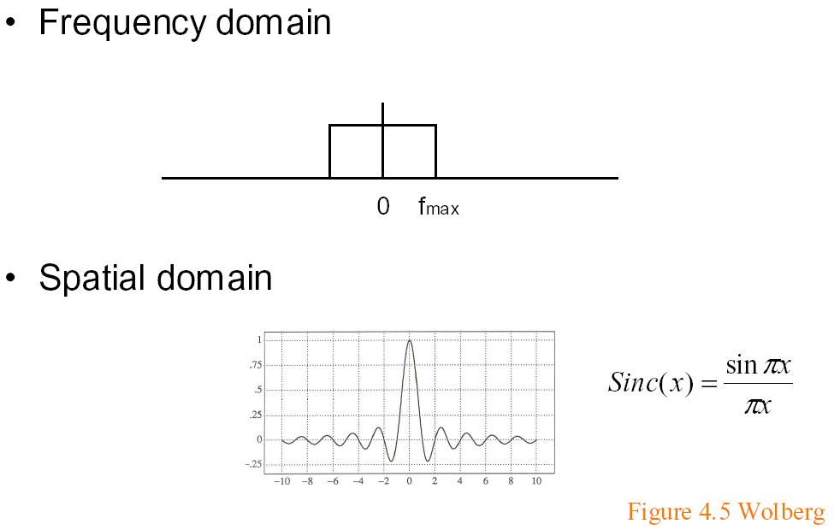
Ideal bandlimiting filter
Formal derivation is homework exercise

Slide 24
Outline
Basic ideas of sampling, reconstruction, aliasing
Signal processing and Fourier analysis
  Convolution
Implementation of digital filters
Section 14.10 of FvDFH

Slide 25
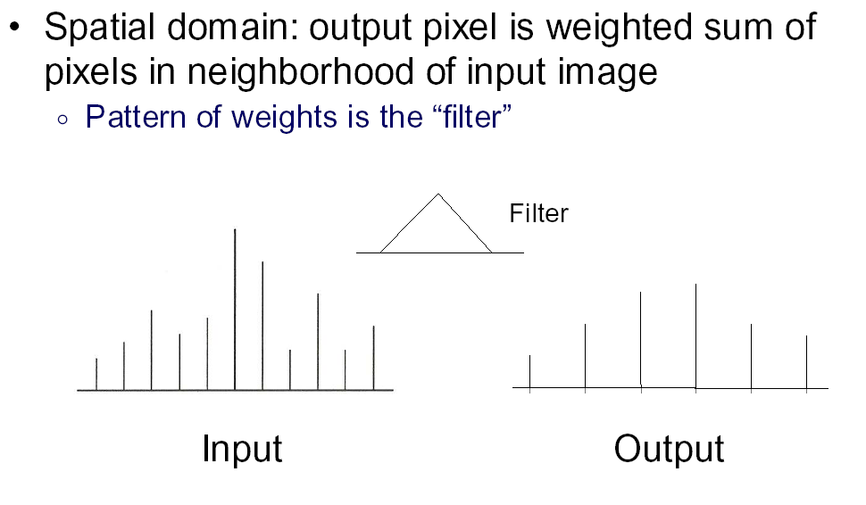
Convolution 1

Slide 26
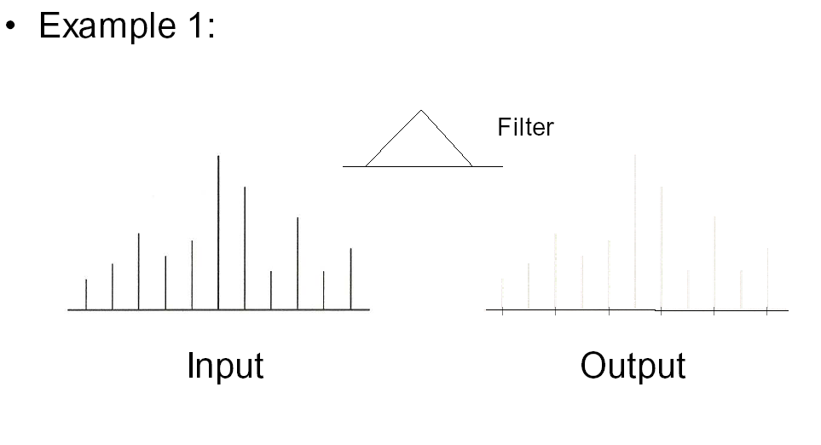
Convolution 2

Slide 27
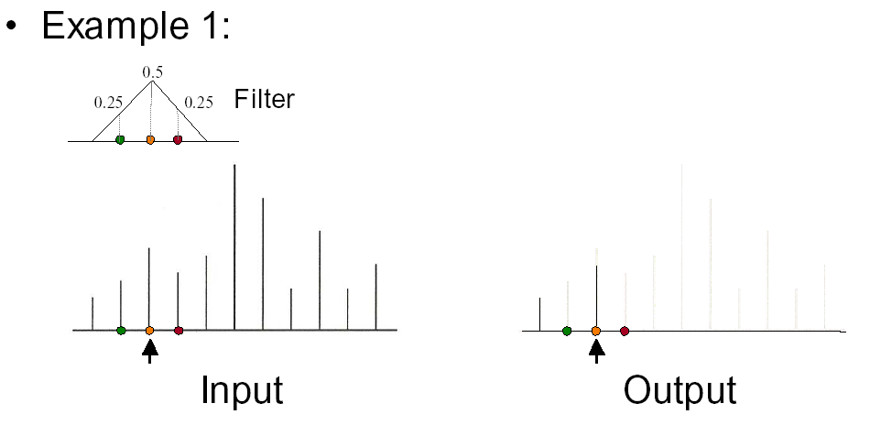
Convolution 3

Slide 28
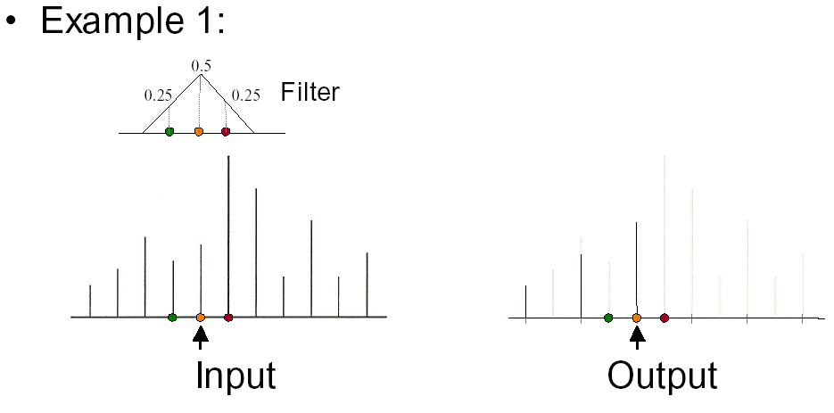
Convolution 4

Slide 29
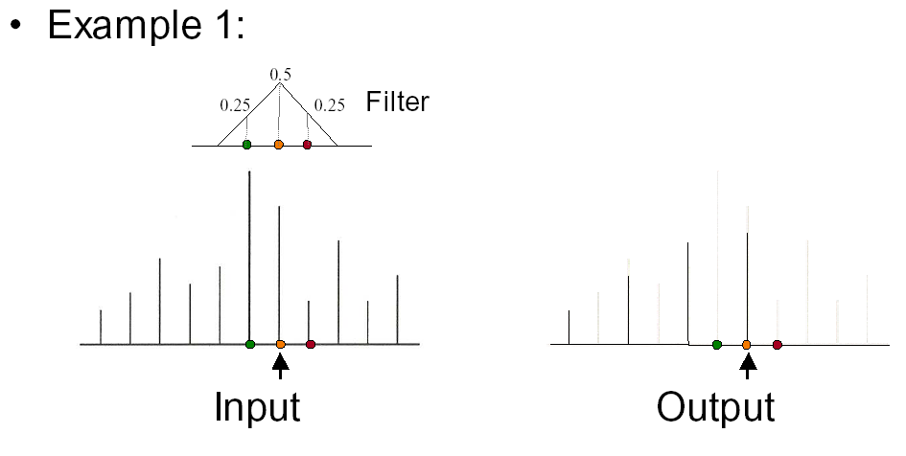
Convolution 5

Slide 30
Convolution in Frequency Domain
Convolution (f is signal ; g is filter [or vice versa])
Fourier analysis (frequency domain multiplication)

Slide 31
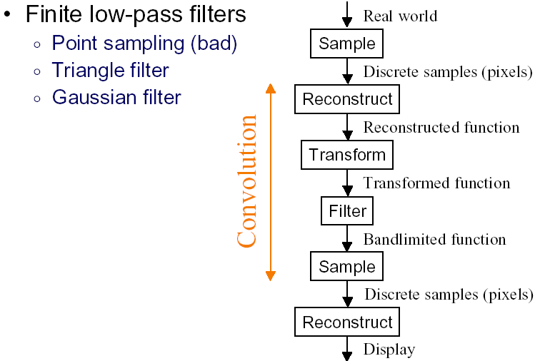
Practical Image Processing
Discrete convolution (in spatial domain) with filters for various digital signal processing operations
Easy to analyze, understand effects in frequency domain
  E.g. blurring or bandlimiting by convolving with low pass filter

Slide 32
Outline
Basic ideas of sampling, reconstruction, aliasing
Signal processing and Fourier analysis
Implementation of digital filters
Section 14.10 of FvDFH

Slide 33
Discrete Convolution
Previously: Convolution as mult in freq domain
  But need to convert digital image to and from to use that
  Useful in some cases, but not for small filters
Previously seen: Sinc as ideal low-pass filter
  But has infinite spatial extent, exhibits spatial ringing
  In general, use frequency ideas, but consider implementation issues as well
Instead, use simple discrete convolution filters e.g.
  Pixel gets sum of nearby pixels weighted by filter/mask
2 | 0 | -7
5 | 4 | 9
1 | -6 | -2

Slide 34
Implementing Discrete Convolution
Fill in each pixel new image convolving with old
  Not really possible to implement it in place
  More efficient for smaller kernels/filters f
Normalization
  If you don’t want overall brightness change, entries of filter must sum to 1. You may need to normalize by dividing
Integer arithmetic
  Simpler and more efficient
  In general, normalization outside, round to nearest int

Slide 35
Outline
Implementation of digital filters
  Discrete convolution in spatial domain
  Basic image-processing operations
  Antialiased shift and resize

Slide 36
Basic Image Processing
Blur
Sharpen
Edge Detection
All implemented using convolution with different filters

Slide 37
Blurring
Used for softening appearance
Convolve with gaussian filter
  Same as mult. by gaussian in freq. domain, so reduces high-frequency content
  Greater the spatial width, smaller the Fourier width, more blurring occurs and vice versa
How to find blurring filter?

Slide 38
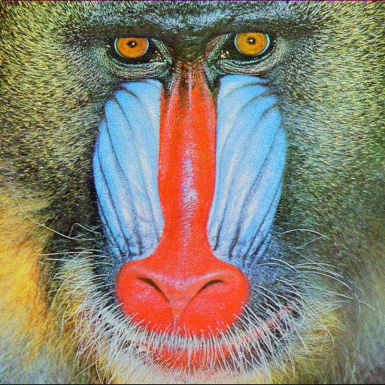
Blurring

Slide 39

Blurring

Slide 40

Blurring

Slide 41

Blurring

Slide 42

Blurring

Slide 43
Blurring Filter
In general, for symmetry f(u,v) = f(u) f(v)
  You might want to have some fun with asymmetric filters
We will use a Gaussian blur
  Blur width sigma depends on kernel size n (3,5,7,11,13,19)
Spatial
Frequency

Slide 44
Discrete Filtering, Normalization
Gaussian is infinite
  In practice, finite filter of size n (much less energy beyond 2 sigma or 3 sigma).
  Must renormalize so entries add up to 1
Simple practical approach
  Take smallest values as 1 to scale others, round to integers
  Normalize. E.g. for n = 3, sigma = ½

Slide 45
Basic Image Processing
Blur
Sharpen
Edge Detection
All implemented using convolution with different filters

Slide 46
Sharpening Filter
Unlike blur, want to accentuate high frequencies
Take differences with nearby pixels (rather than avg)

Slide 47
Blurring

Slide 48
Blurring

Slide 49

Blurring

Slide 50
Basic Image Processing
Blur
Sharpen
Edge Detection
All implemented using convolution with different filters

Slide 51
Edge Detection
Complicated topic: subject of many PhD theses
Here, we present one approach (Sobel edge detector)
Step 1: Convolution with gradient (Sobel) filter
  Edges occur where image gradients are large
  Separately for horizontal and vertical directions
Step 2: Magnitude of gradient
  Norm of horizontal and vertical gradients
Step 3: Thresholding
  Threshold to detect edges

Slide 52
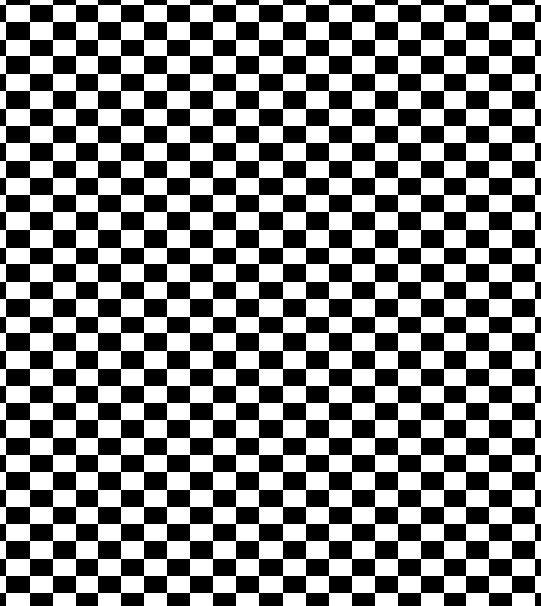
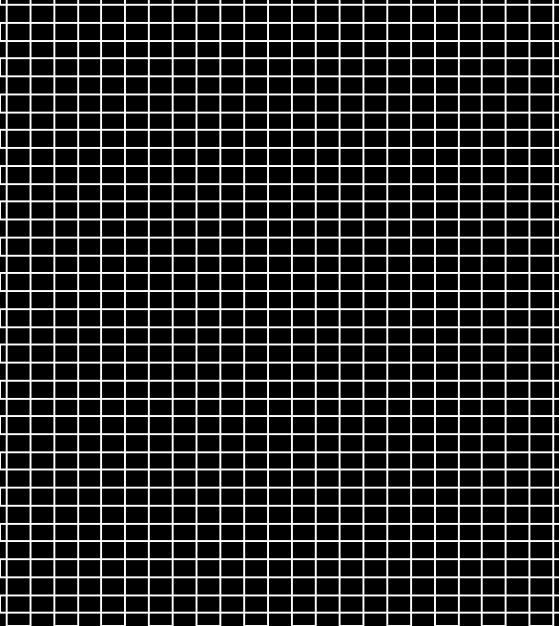
Edge Detection

Slide 53
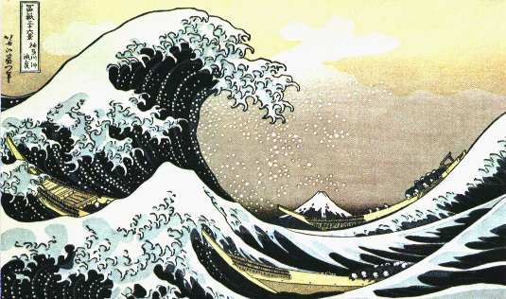
Edge Detection

Slide 54
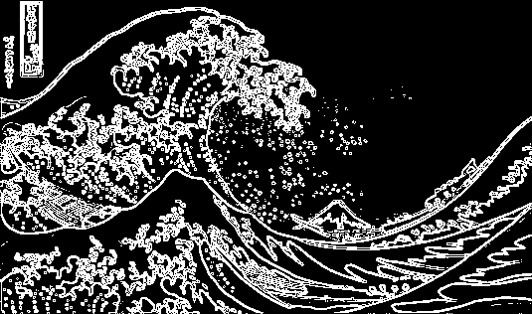
Edge Detection

Slide 55
Details
Step 1: Convolution with gradient (Sobel) filter
  Edges occur where image gradients are large
  Separately for horizontal and vertical directions
Step 2: Magnitude of gradient
  Norm of horizontal and vertical gradients
Step 3: Thresholding

Slide 56
Outline
Implementation of digital filters
  Discrete convolution in spatial domain
  Basic image-processing operations
  Antialiased shift and resize

Slide 57
Antialiased Shift
Shift image based on (fractional) s_{x} and s_{y}
  Check for integers, treat separately
  Otherwise convolve/resample with kernel/filter h:

Slide 58
Antialiased Scale Magnification
Magnify image (scale s or γ > 1)
  Interpolate between orig. samples to evaluate frac vals
  Do so by convolving/resampling with kernel/filter:
  Treat the two image dimensions independently (diff scales)

Slide 59


Antialiased Scale Minification
checkerboard.bmp 300x300: point sample
checkerboard.bmp 300x300: Mitchell

Slide 60
Antialiased Scale Minification
Minify (reduce size of) image
  Similar in some ways to mipmapping for texture maps
  We use fat pixels of size 1/γ, with new size γ*orig size (γ is scale factor < 1).
  Each fat pixel must integrate over corresponding region in original image using the filter kernel.

