Slide 1
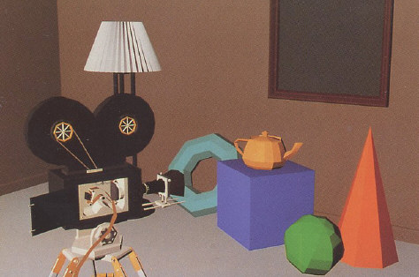
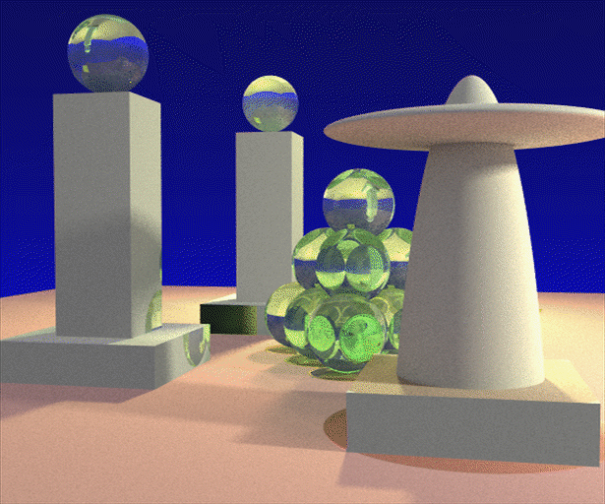
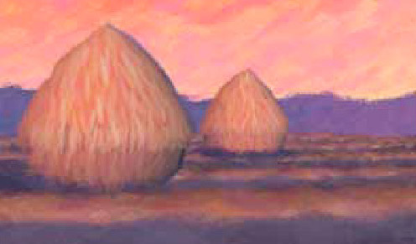
Advanced Computer Graphics
(Spring 2013)
CS 283, Lecture 25
Texture Synthesis
Ravi Ramamoorthi
http://inst.eecs.berkeley.edu/~cs283/sp13
Slides, lecture courtesy Alexei Efros, from CMU lecture

Slide 2
Weather Forecast for Dummies
Let’s predict weather:
  Given today’s weather only, we want to know tomorrow’s
  Suppose weather can only be {Sunny, Cloudy, Raining}
The “Weather Channel” algorithm:
  Over a long period of time, record:
    How often S followed by R
    How often S followed by S
    Etc.
  Compute percentages for each state:
    P(R|S), P(S|S), etc.
  Predict the state with highest probability!
  It’s a Markov Chain
Notes:
2

Slide 3
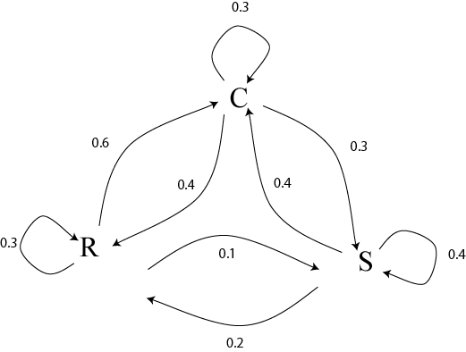
Markov Chain
What if we know today and yesterday’s weather?
Notes:
3

Slide 4
Text Synthesis
[Shannon,’48] proposed a way to generate English-looking text using N-grams:
  Assume a generalized Markov model
  Use a large text to compute prob. distributions of each letter given N-1 previous letters
  Starting from a seed repeatedly sample this Markov chain to generate new letters
  Also works for whole words
WE NEED
TO
EAT
CAKE
Notes:
4

Slide 5
Mark V. Shaney (Bell Labs)
Results (using alt.singles corpus):
  “As I've commented before, really relating to someone involves standing next to impossible.”
  “One morning I shot an elephant in my arms and kissed him.”
  “I spent an interesting evening recently with a grain of salt”
Notes:
5

Slide 6
Texture
Texture depicts spatially repeating patterns
Many natural phenomena are textures
radishes
rocks
yogurt
Notes:
6

Slide 7
Texture Synthesis
Goal of Texture Synthesis: create new samples of a given texture
Many applications: virtual environments, hole-filling, texturing surfaces
Notes:
7

Slide 8



The Challenge
Need to model the whole spectrum: from repeated to stochastic texture
repeated
stochastic
Both?
Notes:
8

Slide 9

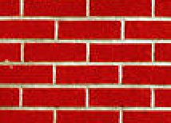
Efros & Leung Algorithm
non-parametric
sampling
p
Input image
Synthesizing a pixel
Assuming Markov property, compute P(p|N(p))
  Building explicit probability tables infeasible
  Instead, we search the input image for all similar neighborhoods — that’s our pdf for p
  To sample from this pdf, just pick one match at random
Notes:
9

Slide 10
Some Details
Growing is in “onion skin” order
  Within each “layer”, pixels with most neighbors are synthesized first
  If no close match can be found, the pixel is not synthesized until the end
Using Gaussian-weighted SSD is very important
  to make sure the new pixel agrees with its closest neighbors
  Approximates reduction to a smaller neighborhood window if data is too sparse
Notes:
10

Slide 11

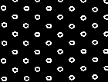
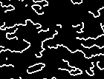
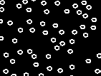
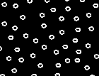
Neighborhood Window
input
Notes:
11

Slide 12

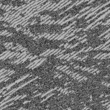
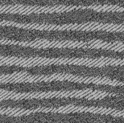
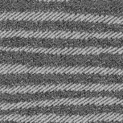
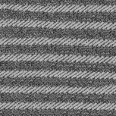

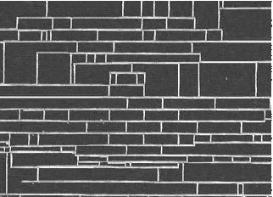
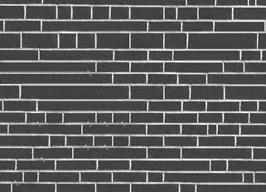
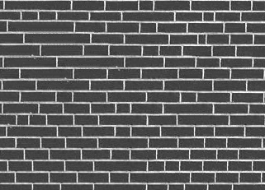
Varying Window Size
Increasing window size
Notes:
12

Slide 13


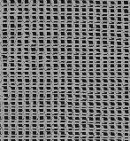
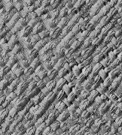
Synthesis Results
french canvas
rafia weave
Notes:
13

Slide 14
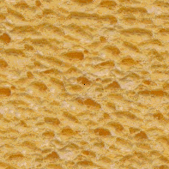
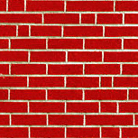
More Results
white bread
brick wall
Notes:
14

Slide 15
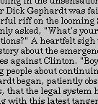
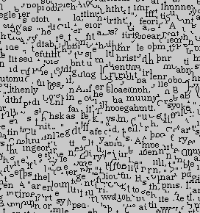
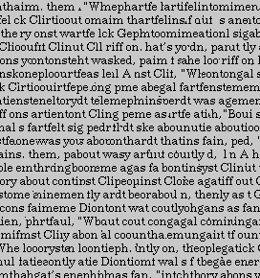
Homage to Shannon
Notes:
15

Slide 16
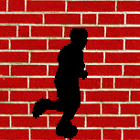
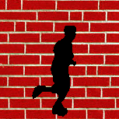
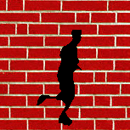
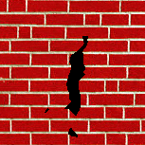
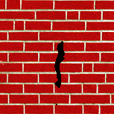
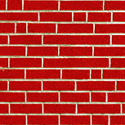
Hole Filling
Notes:
16

Slide 17
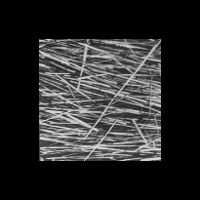
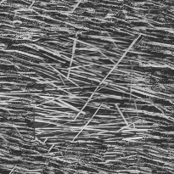
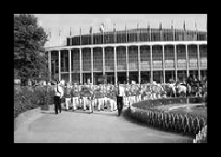
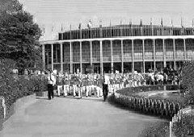
Extrapolation
Notes:
17

Slide 18
Summary
The Efros & Leung algorithm
  Very simple
  Surprisingly good results
  Synthesis is easier than analysis!
  …but very slow
Notes:
18

Slide 19
Image Quilting [Efros & Freeman]
non-parametric
sampling
p
B
Input image
Synthesizing a block
Observation: neighbor pixels are highly correlated
Idea: unit of synthesis = block
  Exactly the same but now we want P(B|N(B))
  Much faster: synthesize all pixels in a block at once
  Not the same as multi-scale!
Notes:
19

Slide 20

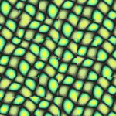
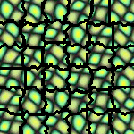
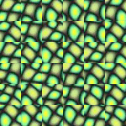
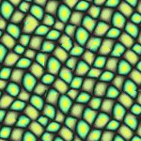
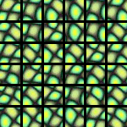
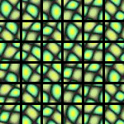
block
Input texture
B1
B2
B1
B2
B1
B2
Random placement
of blocks
Neighboring blocks
constrained by overlap
Minimal error
boundary cut
Notes:
20

Slide 21

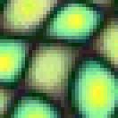






Minimal error boundary
overlapping blocks
vertical boundary
2
_
=
overlap error
min. error boundary
Notes:
21

Slide 22
Our Philosophy
The “Corrupt Professor’s Algorithm”:
  Plagiarize as much of the source image as you can
  Then try to cover up the evidence
Rationale:
  Texture blocks are by definition correct samples of texture so problem only connecting them together
Notes:
22

Slide 23
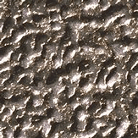
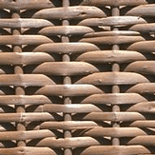
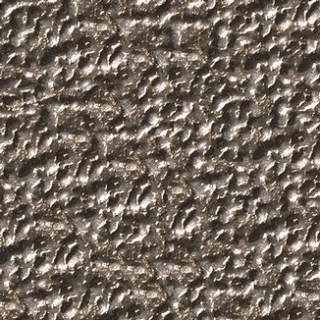
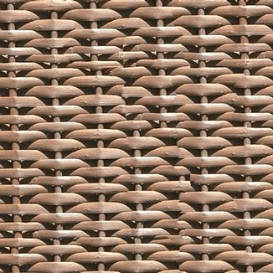
Notes:
23

Slide 24
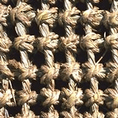
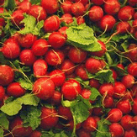
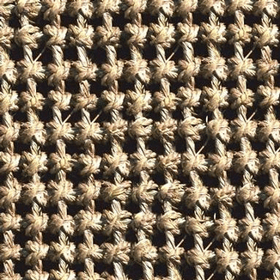
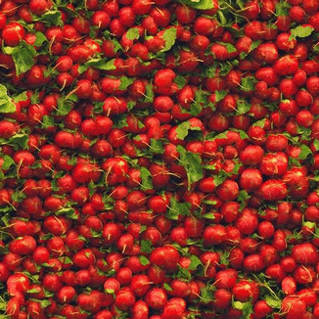
Notes:
24

Slide 25
Notes:
25

Slide 26
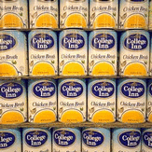
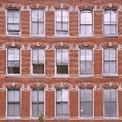


Notes:
26

Slide 27


Notes:
27

Slide 28





Notes:
28

Slide 29
Failures
(Chernobyl
Harvest)
Notes:
29

Slide 30





Portilla & Simoncelli
Xu, Guo & Shum
input image
Wei & Levoy
Our algorithm
Notes:
30

Slide 31





Portilla & Simoncelli
Xu, Guo & Shum
input image
Wei & Levoy
Our algorithm
Notes:
31

Slide 32





Portilla & Simoncelli
Xu, Guo & Shum
input image
Wei & Levoy
Our algorithm
Notes:
32

Slide 33

Political Texture Synthesis!
Notes:
33

Slide 34
Fill Order
In what order should we fill the pixels?
Notes:
34

Slide 35
Fill Order
In what order should we fill the pixels?
  choose pixels that have more neighbors filled
  choose pixels that are continuations of lines/curves/edges
Criminisi, Perez, and Toyama. “Object Removal by Exemplar-based Inpainting,” Proc. CVPR, 2003.
Notes:
35

Slide 36




Application: Texture Transfer
Try to explain one object with bits and pieces of another object:
+
=
Notes:
36

Slide 37
Texture Transfer
Constraint
Texture sample
Notes:
37

Slide 38

Texture Transfer
Take the texture from one image and “paint” it onto another object
Same as texture synthesis, except an additional constraint:
  Consistency of texture
  Similarity to the image being “explained”
Notes:
38

Slide 39




+
=
Notes:
39

Slide 40



Notes:
40

Slide 41
Image Analogies
Aaron Hertzmann^{1,2}
Chuck Jacobs²
Nuria Oliver²
Brian Curless³
David Salesin^{2,3}
¹New York University
²Microsoft Research
³University of Washington
Notes:
41

Slide 42




Image Analogies
A
A’
B
B’
Notes:
42

Slide 43
Notes:
43

Slide 44

Blur Filter
Notes:
44

Slide 45

Edge Filter
Notes:
45

Slide 46




Artistic Filters
A
A’
B
B’
Notes:
46

Slide 47

Colorization
Notes:
47

Slide 48




Texture-by-numbers
A
A’
B
B’
Notes:
48

Slide 49




Super-resolution
A
A’
Notes:
49

Slide 50


Super-resolution (result!)
B
B’
Notes:
50

Slide 51
Video Textures
Arno Schödl
Richard Szeliski
David Salesin
Irfan Essa
Microsoft Research, Georgia Tech
Notes:
51
Hi, video textures is a work that I started last year at Microsoft Research with Richard and David and continued at Georgia Tech with Richard, David and Irfan, my advisor.

Slide 52

Problem statement
video clip
video texture
Notes:
52
As a reminder, here is our problem again: We want to turn a video clip of finite duration, that stops and starts over, into an infinitely playing video texture.

Slide 53

Our approach
How do we find good transitions?
Notes:
53
How do we solve this problem? Here is an example of a video texture. Instead of playing the video from the beginning to end, we jump around in the sequence and continuously play pieces of the original video. The red bar shows which frames are currently being played. The arcs show the transitions that we are using to jump from one part of the sequence to another. The arc lights up when we are actually taking the transition.
Of course, we cannot just jump around randomly. This would look as jerky as the original video clip when it starts over. So the question is, how do we find transitions that are not noticeable for the viewer?

Slide 54

Finding good transitions
Compute L₂ distance D_{i, j} between all frames
vs.
frame i
frame j
Similar frames make good transitions
Notes:
54
When two frames are very similar, we can jump from one to the other without anybody noticing. So let’s compute the similarity between all pairs of frames in our sequence. We chose to use the L2 intensity difference as a metric because it is simple and worked well.
This matrix shows the difference of every frame against every other frame. The bright diagonal indicates that frames are similar to themselves and also to their neighbors in the sequence. But we also notice that sometimes frames quite far apart in the sequence are also similar to each other. These frame pairs are good candidates for transitions.

Slide 55
Markov chain representation
Similar frames make good transitions
Notes:
55
We now want to turn this matrix into a Markov chain, whose states are frames, and whose transitions are jumps from one frame to another. We want to make transitions more likely if they connect similar frames. We represent these by fatter arrows in the diagram on the right.

Slide 56
Transition costs
Transition from i to j if successor of i is similar to j
Cost function: C_{i→j} = D_{i+1, j}
Notes:
56
More specifically, suppose we have just shown frame i, and now want to transition to frame j. We are in fact replacing the successor of frame i with frame j. So the successor of frame i, frame i+1, should be similar to frame j. We define the cost of the transition from i to j as the difference between those two frames.

Slide 57

Transition probabilities
Probability for transition P_{i→j} inversely related to cost:
P_{i→j} ~ exp ( – C_{i→j} / σ² )
high σ
low σ
Notes:
57
To build the Markov chain, all that is left is turning the cost function into a probability. Low cost should mean high probability and vice versa. We map the cost through an exponential to do that, but any other monotonically decreasing function good be used instead.
At the bottom you can see the effect of the parameter sigma on the generated video. High sigmas produce a more randomly ordered video, low sigmas use only the best transitions, but run the risk of being too repetitive.

Slide 58
Example

Slide 59

Example

