Slide 1
CS61A Lecture 6
Recursion
Tom Magrino and Jon Kotker
UC Berkeley EECS
June 26, 2012

Slide 2
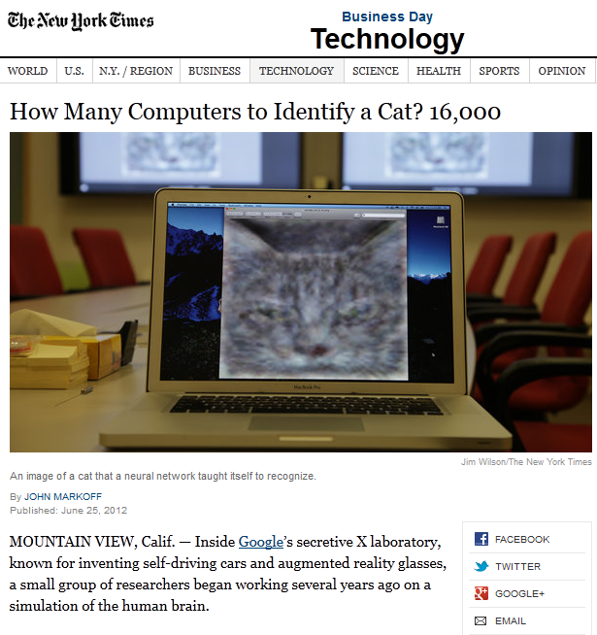
Computer Science in the News

Slide 3
Today
Quick review of Iterative Improvement.
Defining functions that call themselves.
  Sometimes more than once.

Slide 4
Recap: Newton’s Method
def iter_improve(update, isclose, guess=1):
while not isclose(guess):
guess = update(guess)
return guess
def find_root(f, initial_guess=10):
return iter_improve(newton_update(f),
lambda x: approx_zero(f(x)),
initial_guess)

Slide 5
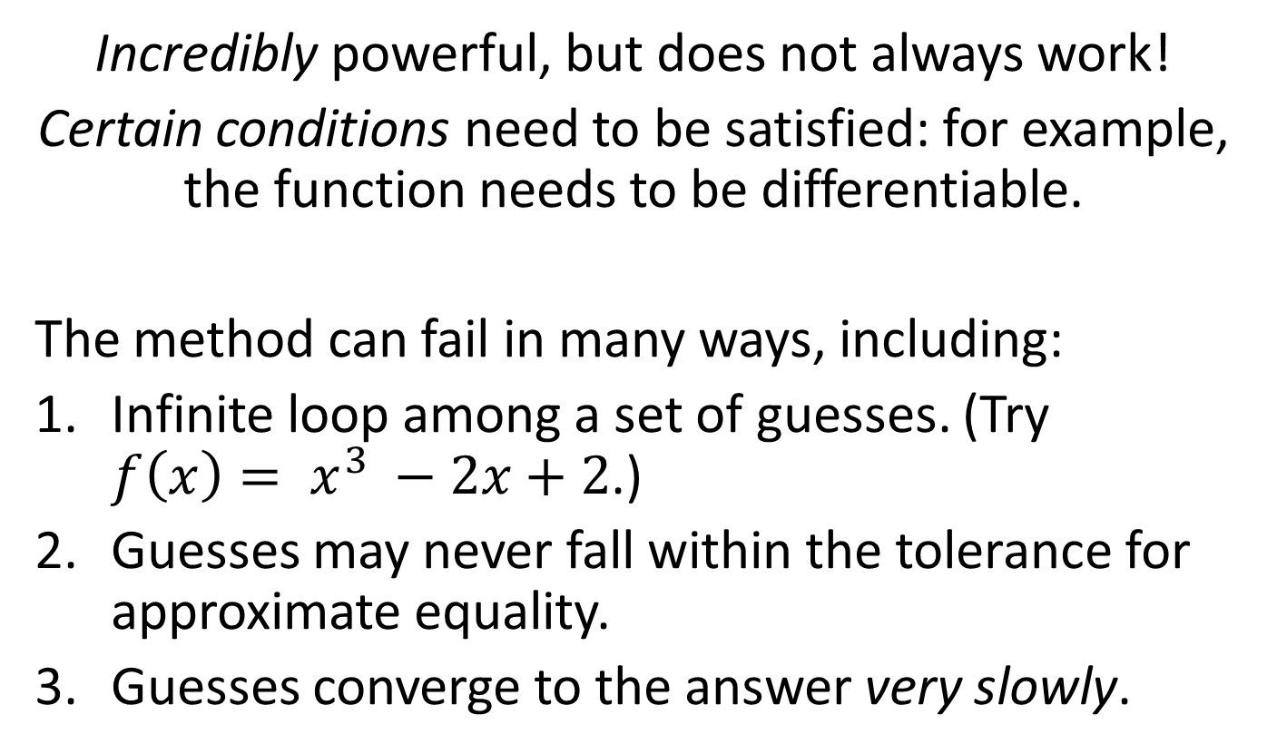
Recap: Newton’s Method
Incredibly powerful, but does not always work!
Certain conditions need to be satisfied: for example, the function needs to be differentiable.
The method can fail in many ways, including:
Infinite loop among a set of guesses. (Try $f\left(x\right)= x^{3} −2x+2$.)
Guesses may never fall within the tolerance for approximate equality.
Guesses converge to the answer very slowly.

Slide 6
Recap: Newton’s Method
Iterative Improvement (with one fix)
We can add a limit on the number of iterations.
def iter_improve(update, isclose, guess=1, max_iter=5000):
counter = 1
while not isclose(guess) and counter <= max_iter:
guess = update(guess)
counter += 1
return guess

Slide 7
Practice: Newton’s Method
Using find_root, write a function intersection(f, g) which takes two functions, f and g, and finds a point at which the two are equal.
def intersection(f, g):
return find_root(lambda x: f(x) – g(x))

Slide 8
Practice: Newton’s Method
Using find_root, write a function intersection(f, g) which takes two functions, f and g, and finds a point at which the two are equal.
def intersection(f, g):
return find_root(lambda x: f(x) – g(x))

Slide 9

Computing Factorial
The factorial of a positive integer n is:
$$n!=\left\{\begin{aligned}1, n=0 or n=1 \\ &n ∗\left(n −1\right)∗ … ∗1, n>1\end{aligned}\right.$$

Slide 10
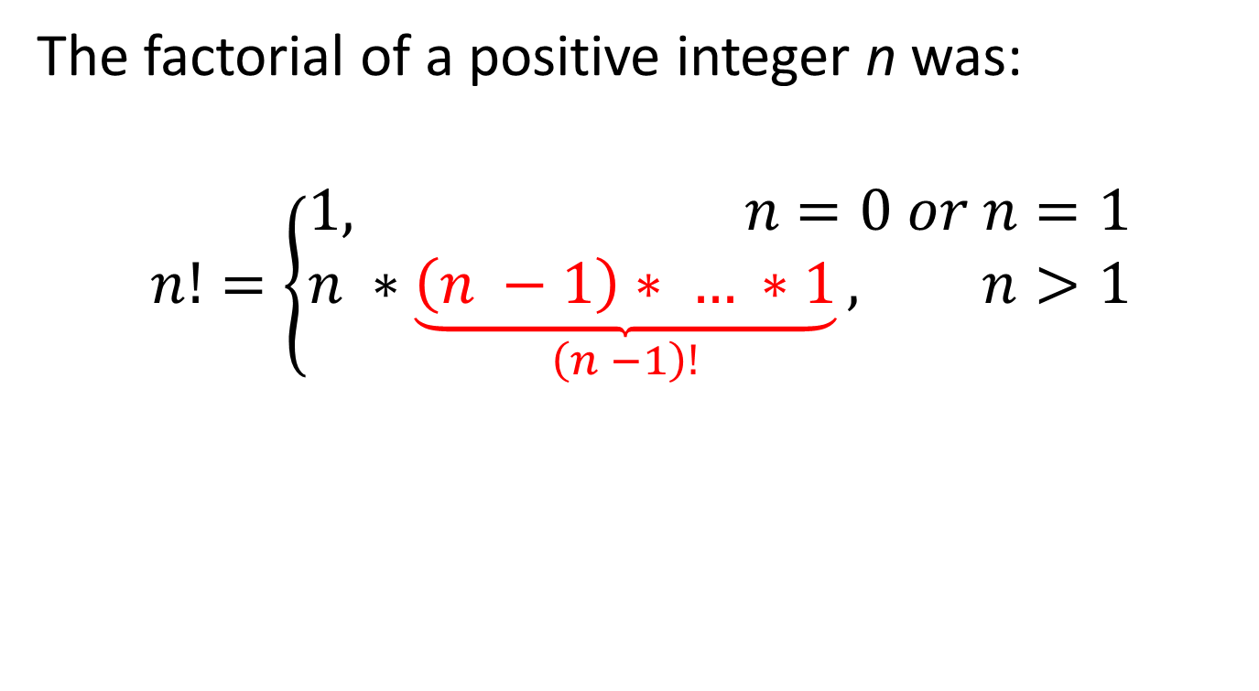
Computing Factorial
The factorial of a positive integer n was:
$$n!=\left\{\begin{aligned}1, n=0 or n=1 \\ &n ∗\underset{\left(n −1\right)!}{\underbrace{\left(n −1\right)∗ … ∗1}}, n>1\end{aligned}\right.$$

Slide 11

Computing Factorial
The factorial of a positive integer n was:
$$n!=\left\{\begin{aligned}1, n=0 or n=1 \\ &n ∗\left(n −1\right)!, n>1\end{aligned}\right.$$
We generalized our definition. Can we do that with our code?

Slide 12

Computing Factorial
$$n!=\left\{\begin{aligned}1, n=0 or n=1 \\ &n ∗\left(n −1\right)!, n>1\end{aligned}\right.$$
def fact(n):
if n == 1 or n == 0:
return 1
total = 1
while n >= 1:
total, n = total * n, n – 1
return total
Can we generalize here like we did with our mathematical expression?

Slide 13


Computing Factorial
$$n!=\left\{\begin{aligned}1, n=0 or n=1 \\ &n ∗\left(n −1\right)!, n>1\end{aligned}\right.$$
def fact(n):
if n == 1 or n == 0:
return 1
return n * fact(n – 1)
How can fact be defined by calling fact?!?!?!
http://cdn.shopify.com/s/files/1/0070/7032/files/wat_grande.jpg?113123

Slide 14

Computing Factorial
def fact(n):
if n == 1 or n == 0:
return 1
return n * fact(n – 1)
Computer, what is fact(4)?
24
Fred, what is fact(4)?
24
Fiona, what is fact(3)?
Ferris, what is fact(2)?
Fatima, what is fact(1)?
It’s 4 * fact(3)…
It’s 3 * fact(2)…
It’s 2 * fact(1)…
6
2
1
Fred
Fiona
Ferris
Fatima

Slide 15
Recursive Functions
A function is a recursive function if the body calls the function itself, either directly or indirectly.
Recursive functions typically have 2 main pieces:
  Recursive case(s), where the function calls itself.
  Base case(s), where the function does NOT recursively call itself and instead returns a direct answer. This is what ensures that the recursion will eventually stop.
def fact(n):
if n == 1 or n == 0:
return 1
return n * fact(n – 1)
Base Case
Recursive Case

Slide 16
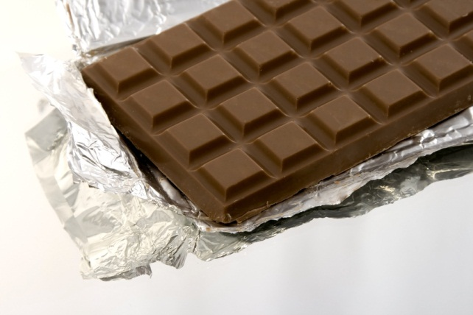

Recursion in Every Day Life:
Eating Chocolate
You have a bar of chocolate with n small pieces. How do you eat it?
You eat 1 piece of chocolate.
You eat a bar of n – 1 pieces of chocolate.
What’s your base case?
  You have no more chocolate.
http://i0.kym-cdn.com/photos/images/original/000/000/578/1234931504682.jpg

Slide 17
Practice: Recursion
How would I rewrite the summation function from last week to use recursion?
def summation(n, term):
if n == 0:
return 0
return term(n) + summation(n – 1, term)

Slide 18
Practice: Recursion
How would I rewrite the summation function from last week to use recursion?
def summation(n, term):
if n == 0:
return 0
return term(n) + summation(n – 1, term)

Slide 19
Practice: Recursion
What does the following function calculate?
def fun(a, b):
if b == 0:
return 0
elif b % 2 == 0:
return fun(a + a, b / 2)
return fun(a, b – 1) + a
It’s multiplying a times b!

Slide 20
Practice: Recursion
What does the following function calculate?
def fun(a, b):
if b == 0:
return 0
elif b % 2 == 0:
return fun(a + a, b / 2)
return fun(a, b – 1) + a
a * b
It’s multiplying a times b!

Slide 21
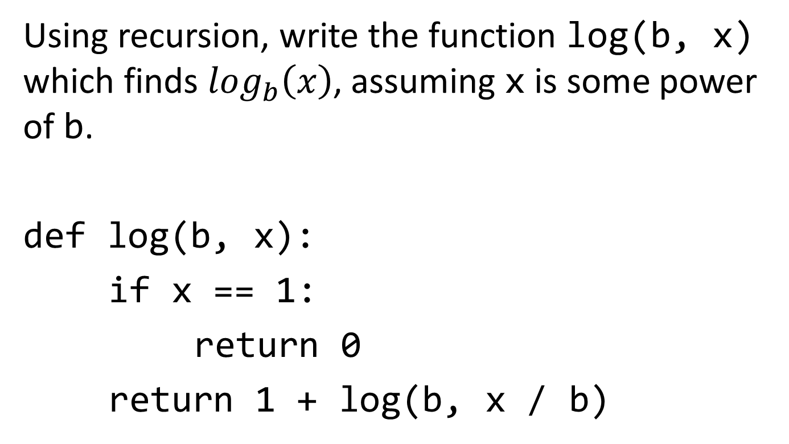
Practice: Recursion
Using recursion, write the function log(b, x) which finds $\log_{b}\left(x\right)$, assuming x is some power of b.
def log(b, x):
if x == 1:
return 0
return 1 + log(b, x / b)

Slide 22
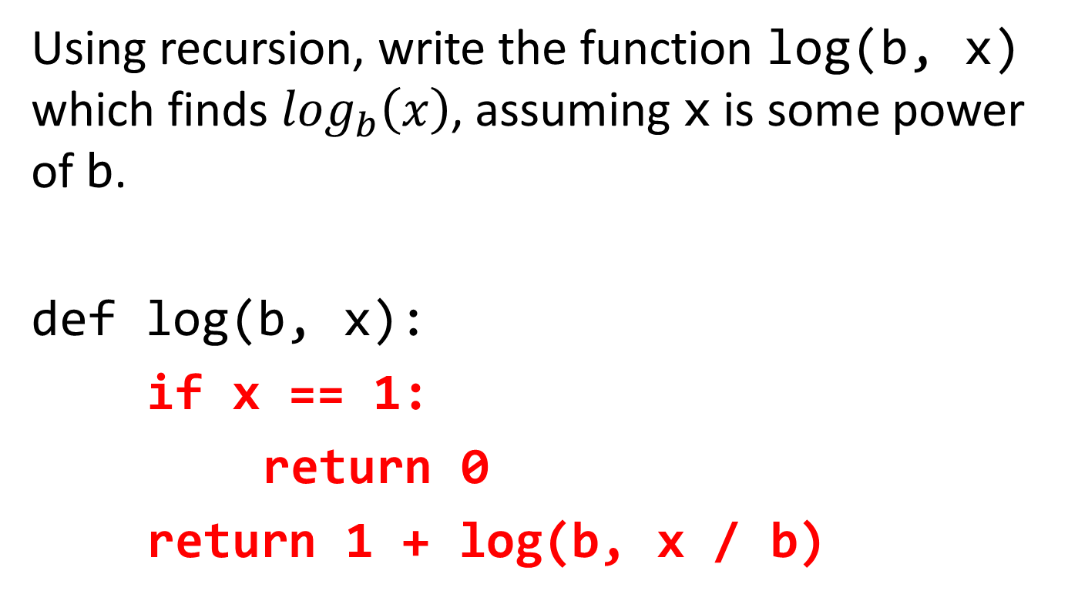
Practice: Recursion
Using recursion, write the function log(b, x) which finds $\log_{b}\left(x\right)$, assuming x is some power of b.
def log(b, x):
if x == 1:
return 0
return 1 + log(b, x / b)

Slide 23
Announcements
Bug-Submit is now available!
Project 1 is due Friday
Homework 3 is due Friday

Slide 24
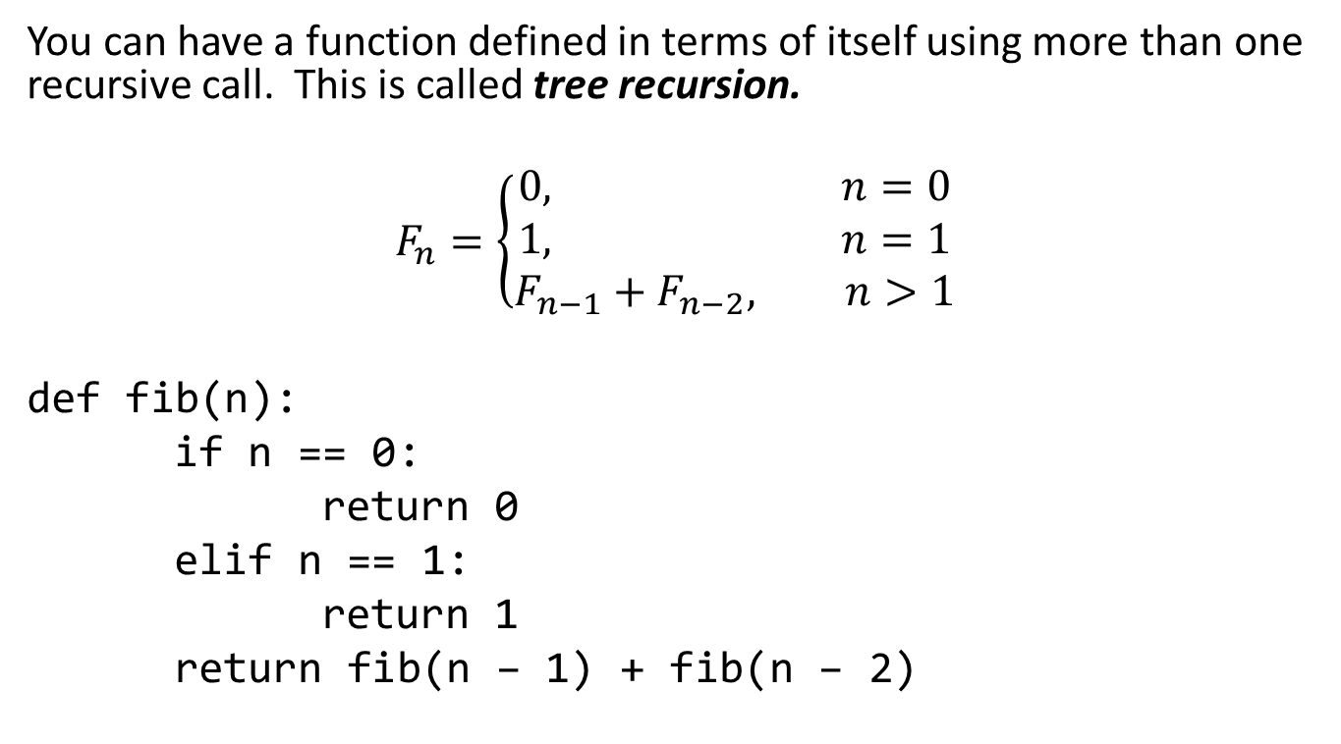
Tree Recursion
You can have a function defined in terms of itself using more than one recursive call. This is called tree recursion.
$$F_{n}=\left\{\begin{aligned}0, n=0 \\ &1, n=1 \\ F_{n−1}+F_{n−2}, n>1\end{aligned}\right.$$
def fib(n):
if n == 0:
return 0
elif n == 1:
return 1
return fib(n – 1) + fib(n – 2)

Slide 25
Tree Recursion
def fib(n):
if n == 0:
return 0
elif n == 1:
return 1
return fib(n – 1) + fib(n – 2)
So why is it called tree recursion?
3
fib(4)
2
1
fib(3)
fib(2)
1
1
1
0
fib(2)
fib(1)
fib(1)
fib(0)
1
0
fib(1)
fib(0)

Slide 26
Practice: Tree Recursion
Suppose I want to count all the different routes I could take from (0, 0) to (x, y) on a grid moving only up and right. Write the function paths(x, y) to calculate the number of routes to (x, y).
def paths(x, y):
if x == 0 or y == 0:
return 1
return paths(x – 1, y) \
+ paths(x, y – 1)

Slide 27
Practice: Tree Recursion
Suppose I want to count all the different routes I could take from (0, 0) to (x, y) on a grid moving only up and right. Write the function paths(x, y) to calculate the number of routes to (x, y).
def paths(x, y):
if x == 0 or y == 0:
return 1
return paths(x – 1, y) \
+ paths(x, y – 1)

Slide 28
Practice: Tree Recursion
Suppose I want to print all the different routes I could take from (0, 0) to (x, y) on a grid moving only up and right. Write the function directions(x, y) which prints the each different set of directions using a combination of “UP” and “RIGHT” that one could take. Hint: use a helper function that does the recursion and keeps track of the “directions so far.”
def directions(x, y):
def dir_helper(x, y, so_far):
if x == 0 and y == 0:
print(so_far)
elif y > 0:
dir_helper(x, y – 1, so_far + “ UP”)
elif x > 0:
dir_helper(x-1, y, so_far + “ RIGHT”)
dir_helper(x, y, “”)

Slide 29
Practice: Tree Recursion
Suppose I want to print all the different routes I could take from (0, 0) to (x, y) on a grid moving only up and right. Write the function directions(x, y) which prints the each different set of directions using a combination of “UP” and “RIGHT” that one could take. Hint: use a helper function that does the recursion and keeps track of the “directions so far.”
def directions(x, y):
def dir_helper(x, y, so_far):
if x == 0 and y == 0:
print(so_far)
elif y > 0:
dir_helper(x, y – 1, so_far + “ UP”)
elif x > 0:
dir_helper(x-1, y, so_far + “ RIGHT”)
dir_helper(x, y, “”)

Slide 30
Conclusion
Recursion is a way for functions to be defined using themselves.
Recursive functions have two parts:
  Recursive case(s), where the function calls itself.
  Base case(s), where the function does not call itself (stopping the recursion).
Tree recursion is used by functions that make more than one recursive call (at the same time) in the definition.

