Slide 1
CS61A Lecture 29
Parallel Computing
Jom Magrotker
UC Berkeley EECS
August 7, 2012

Slide 2
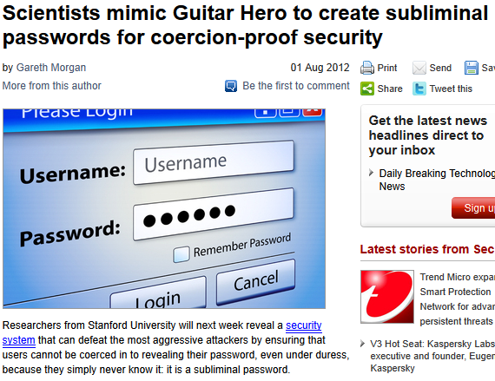
Computer Science in the News
http://www.v3.co.uk/v3-uk/news/2195985/scientists-mimic-guitar-hero-to-create-subliminal-passwords-for-coercionproof-security

Slide 3
Today
Parallel Computing
  Problems that can occur
  Ways of avoiding problems

Slide 4
So Far
functions
data structures
objects
abstraction
interpretation
evaluation
One Program
One Computer

Slide 5

Yesterday & Today
Multiple Programs!
  On Multiple Computers
  (Networked and Distributed Computing)
  On One Computer
  (Concurrency and Parallelism)

Slide 6
Yesterday: Distributed Computing
Programs on different computers working together towards a goal.
  Information Sharing & Communication
  Ex. Skype, The World Wide Web, Cell Networks
  Large Scale Computing
  Ex. “Cloud Computing” and Map-Reduce

Slide 7

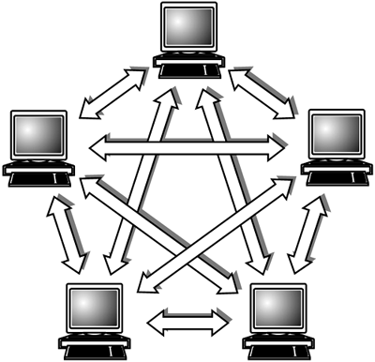
Review: Distributed Computing
Architecture
  Client-Server
  Peer-to-Peer
Message Passing
Design Principles
  Modularity
  Interfaces
http://www.peertopeerprograms.com/

Slide 8

Today: Parallel Computation
Simple Idea: Have more than one piece of code running at the same time.
Question is: why bother?

Slide 9

Parallel Computation: Why?
Primarily: Speed.
The majority of computers have multiple processors, meaning that we can actually have two (or more) pieces of code running at the same time!

Slide 10
The Load-Compute-Store Model
For today, we will be using the following model for computation.
x = x * 2
Load the variable(s)
Compute the right hand side
Store the result into the variable.

Slide 11
The Load-Compute-Store Model
Load the variable(s)
Compute the right hand side
Store the result into the variable.
x = x * 2
Load up x: x -> 5
Compute x * 2: 10
Store the new value of: x <- 10
Memory
x: 10
x: 5
“x * 2 is 10”
“x is 5”

Slide 12
Announcements
Project 4 due Today.
  Partnered project, in two parts.
  Twelve questions, so please start early!
  Two extra credit questions.
Homework 14 due Today.
  Now includes contest voting.
  Assignment is short.
Tomorrow at the end of lecture there is a course survey, please attend!

Slide 13
Announcements: Final
Final is Thursday, August 9.
  Where? 1 Pimentel.
  When? 6PM to 9PM.
  How much? All of the material in the course, from June 18 to August 8, will be tested.
Closed book and closed electronic devices.
One 8.5” x 11” ‘cheat sheet’ allowed.
No group portion.
We have emailed you if you have conflicts and have told us. If you haven’t told us yet, please let us know by yesterday. We’ll email you the room later today.
Final review session 2 Tonight, from 8pm to 10pm in the HP Auditorium (306 Soda).

Slide 14
Parallel Example
Memory
Thread 1
Thread 2
x: 10
y: 3
x: 20
y: 4
x = x * 2
L1: Load X
C1: Compute (X * 2)
S1: Store (X * 2) -> X
y = y + 1
L2: Load Y
C2: Compute (Y + 1)
S2: Store (Y + 1) -> Y
Idea is that we perform the steps of each thread together, interleaving them in any way we want.
Thread 1: L1, C1, S1
Thread 2: L2, C2, S2

Slide 15
Parallel Example
Memory
Thread 1
Thread 2
x: 10
y: 3
x: 20
y: 4
x = x * 2
y = y + 1
Idea is that we perform the steps of each thread together, interleaving them in any way we want.
Thread 1: L1, C1, S1
Thread 2: L2, C2, S2
L1, C1, S1, L2, C2, S2 OR
L1, L2, C1, S1, C2, S2 OR
L1, L2, C1, C2, S1, S2 OR
...

Slide 16
So What?
Okay, what’s the point?
IDEALLY: It shouldn’t matter what different “shuffling” of the steps we do, the end result should be the same.
BUT, what if two threads are using the same data?

Slide 17
Parallel Example
Memory
x: 10
x: 21
or
x: 22
Thread 1
Thread 2
x = x * 2
L1: Load X
C1: Compute (X * 2)
S1: Store (X * 2) -> X
x = x + 1
L2: Load X
C2: Compute (X + 1)
S2: Store (X + 1) -> X
Idea is that we perform the steps of each thread together, interleaving them in any way we want.
Thread 1: L1, C1, S1
Thread 2: L2, C2, S2

Slide 18
Parallel Example
Memory
x: 20
x: 10
x: 11
Thread 1
Thread 2
x = x * 2
L1: Load X
C1: Compute (X * 2)
S1: Store (X * 2) -> X
x = x + 1
L2: Load X
C2: Compute (X + 1)
S2: Store (X + 1) -> X
Thread 1: L1, C1, S1
Thread 2: L2, C2, S2
“X is 10”
“x * 2 is 20”
“X is 10”
“x + 1 is 11”
L1, C1, L2, C2, S2, S1

Slide 19
OH NOES!!1!one
We got a wrong answer!
This is one of the dangers of using parallelism in a program!
What happened here is that we ran into the problem of non-atomic (multi-step) operations. A thread could be interrupted by another and result in incorrect behavior!
So, smarty pants, how do we fix it?

Slide 20
Practice: Parallelism
Suppose we initialize the value z to 3. Given the two threads, which are run at the same time, what are all the possible values of z after they run?
z = z * 33
y = z + 0
z = z + y

Slide 21
Practice: Parallelism
Suppose we initialize the value z to 3. Given the two threads, which are run at the same time, what are all the possible values of z after they run?
99, 6, 198, 102
z = z * 33
y = z + 0
z = z + y

Slide 22

Break
http://www.qwantz.com/index.php?comic=2261

Slide 23

Locks
We need a way to make sure that only one person messes with a piece of data at a time!
from Threading import Lock
x_lock = Lock()
x_lock.acquire()
x = x * 2
x_lock.release()
THREAD 1
Try to get exclusive rights to the lock. If succeeds, keep working. Otherwise, wait for lock to be released.
x_lock.acquire()
x = x + 1
x_lock.release()
THREAD 2
Give up your exclusive rights so someone else can take their turn.
Lock methods are atomic, meaning that we don’t need to worry about someone interrupting us in the middle of an acquire or release.

Slide 24

Sounds Great!
Now only one thread will manipulate the value x at a time if we always wrap code touching x in a lock acquire and release.
So our code works as intended!
BUT
“With great power comes great responsibility!”

Slide 25

Misusing Our Power
from threading import Lock
x_lock1 = Lock()
x_lock2 = Lock()
x_lock1.acquire()
x = x * 2
x_lock1.release()
x_lock2.acquire()
x = x + 1
x_lock2.release()
THREAD 1
THREAD 2
Won’t work! They aren’t being locked out using the same lock, we just went back to square 1.

Slide 26
Misusing Our Power
from threading import Lock
x_lock = Lock()
x_lock.acquire()
LONG_COMPUTATION()
x = x * 2
x_lock.release()
x_lock.acquire()
x = x + 1
x_lock.release()
THREAD 1
THREAD 2
If LONG_COMPUTATION doesn’t need x, we just caused thread 2 to have to wait a LONG time for a bunch of work that could have happened in parallel. This is inefficient!

Slide 27
Misusing Our Power
from threading import Lock
x_lock = Lock()
def start_turn(num):
sleep(num)
x_lock.acquire()
start_turn(THREAD_NUM)
x = x * 2
x_lock.release()
start_turn(THREAD_NUM)
x = x + 1
x_lock.release()
THREAD 1
THREAD 2
If we didn’t actually want thread 2 to be less likely to get access to x first each time, then this is an unfair solution that favors the first (lowered numbered) threads.
This example is a bit contrived, but this does happen! It usually takes a bit of code for it to pop up, however.

Slide 28
Misusing Our Power
from threading import Lock
x_lock = Lock()
y_lock = Lock()
x_lock.acquire()
y_lock.acquire()
x, y = 2 * y, 22
y_lock.release()
x_lock.release()
y_lock.acquire()
x_lock.acquire()
y, x = 2 * x, 22
x_lock.release()
y_lock.release()
THREAD 1
THREAD 2
What if thread 1 acquires the x_lock and thread 2 acquires the y_lock?
Now nobody can do work! This is called deadlock.

Slide 29

The 4 Types of Problems
In general, you can classify the types of problems you see from parallel code into 4 groups:
  Incorrect Results
  Inefficiency
  Unfairness
  Deadlock

Slide 30
How Do We Avoid Issues?
Honestly, there isn’t a one-size-fits-all solution.
You have to be careful and think hard about what you’re doing with your code.
In later courses (CS162), you learn common conventions that help avoid these issues, but there’s still the possibility that problems will occur!

Slide 31
Another Tool: Semaphores
Locks are just a really basic tool available for managing parallel code.
There’s a LARGE variety of tools out there that you might encounter.
For now, we’re going to quickly look at one more classic:
  Semaphores

Slide 32

Another Tool: Semaphores
What if I want to allow only up to a certain number of threads manipulate the same piece of data at the same time?
fruit_bowl = [“banana”, “banana”, “banana”]
def eat_thread():
fruit_bowl.pop()
print(“ate a banana!”)
def buy_thread():
fruit_bowl.append(“banana”)
print(“bought a banana”)
A Semaphore is a classic tool for this situation!

Slide 33
Another Tool: Semaphores
from threading import Semaphore
fruit_bowl = [“banana”, “banana”, “banana”]
fruit_sem = Semaphore(len(fruit_bowl)) #3
def eat_thread():
fruit_sem.acquire()
fruit_bowl.pop()
print(“ate a banana!”)
def buy_thread():
fruit_bowl.append(“banana”)
print(“bought a banana”)
fruit_sem.release()
Decrements the counter. If the counter is 0, wait until someone increments it before subtracting 1 and moving on.
Increments the count

Slide 34
Practice: What Could Go Wrong?
What, if anything, is wrong with the code below?
from threading import Lock
x_lock = Lock()
y_lock = Lock()
def thread2():
global x, y
y_lock.acquire()
for i in range(50):
y = y + i
x_lock.acquire()
print(x + y)
y_lock.release()
x_lock.release()
def thread1():
global x, y
x_lock.acquire()
if x % 2 == 0:
y_lock.acquire()
x = x + y
y_lock.release()
x_lock.release()

Slide 35
Practice: What Could Go Wrong?
What, if anything, is wrong with the code below?
from threading import Lock
the_lock = Lock()
def thread2():
global x
the_lock.acquire()
for i in range(50):
x = x + i
print(i)
the_lock.release()
def thread1():
global x
the_lock.acquire()
x = fib(5000)
the_lock.release()

Slide 36
Conclusion
Parallelism in code is important for making efficient code!
Problems arise when we start manipulating data shared by multiple threads.
We can use locks or semaphores to avoid issues of incorrect results.
There are 4 main problems that can occur when writing parallel code.
Preview: A Powerful Pattern for Distributed Computing, MapReduce

Slide 37
Extras: Serializers
Honestly, this is just a cool way to use locks with functions.
def make_serializer():
serializer_lock = Lock()
def serialize(fn):
def serialized(*args):
serializer_lock.acquire()
result = fn(*args)
serializer_lock.release()
return result
return serialized
return serialize
x_serializer = make_serializer()
x = 5
@x_serializer
def thread1():
global x
x = x * 20
@x_serializer
def thread2():
global x
x = x + 500

