Slide 1
CS 61B Data Structures and Programming Methodology
July 10, 2008
David Sun

Slide 2
So far…
We’ve been mainly looking at
the syntax of the Java language.
key ideas in object-oriented programming: objects, inheritance, polymorphism, and dynamic binding, access privileges.
mechanisms provided in Java for organization of abstractions: abstracted classes, interfaces, packages.
Head First Java Chapter 1 - 11

Slide 3
Now...
We are going to continue our voyage with Java, but with a different focus.
We are going to examine
a range of canonical data structures.
algorithms often associated with these data structures.
the focus is on the efficiency and cost of these algorithms and data structures.

Slide 4
Measuring Cost

Slide 5
What Does Cost Mean?
Cost can mean
Development costs: How much engineering time? When delivered?
Costs of failure: How robust? How safe?
Operational cost (for programs, time to run, space requirements).
Is this program fast enough? Depends on:
What purpose.
What input data.

Slide 6
Cost Measures (Time)
Cost Measures (Time)
Wall-clock or execution time
You can do this at home:
time java FindPrimes 1000
Advantages: easy to measure, meaning is obvious. Appropriate where time is critical (real-time systems, e.g.).
Disadvantages: applies only to specific data set, compiler, machine, etc.
Number of times certain statements are executed:
Advantages: more general (not sensitive to speed of machine).
Disadvantages: still applies only to specific data sets.
Symbolic execution times:
Formulas for execution times or statement counts in terms of input size.
Advantages: applies to all inputs, makes scaling clear.
Disadvantage: practical formula must be approximate, may tell very little about actual time.

Slide 7
Example
An algorithm for processing a retail store's inventory takes:
10,000 ms to read the initial inventory from disk, and then
10 ms to process each transaction
Processing n transactions takes (10,000 + 10 * n) ms.
10 * n is more important if n is very large.

Slide 8
Asymptotic Cost
The constant coefficients can change:
If we had a faster computer or,
Use a different language or compiler.
The constant factors can get smaller as technology improves.
We want to express the speed of an algorithm independently of a specific implementation on a specific machine.
We examine the cost of the algorithms for large input sets i.e. the asymptotic cost.

Slide 9
Big-Oh
Specify bounding from above:
Big-Oh says how slowly code might run as its input size grows.
Let n be the size of a program's input. Let T(n) be a function that equals to the algorithm's running time, given an input of size n.
Let f(n) be another function. We say that if and only if whenever n is big, and for some constant c.

Slide 10
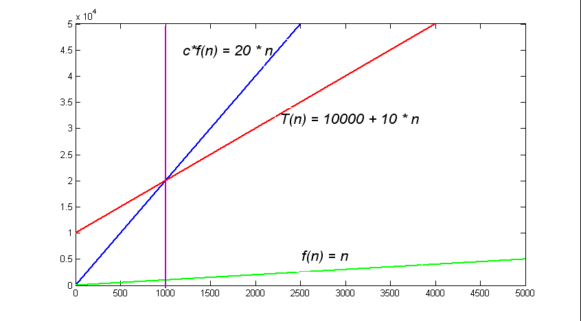
Example
Consider the cost function: T(n) = 10,000 + 10 * n,
Let's try out f(n) = n. We can choose c as large as we want:
As these functions extend forever to the right (infinity), their lines will never cross again.
For any n bigger than 1000, T(n) ≤ c * f(n).

Slide 11
Definition
O(f(n)) is the set of all functions T(n) that satisfy:
There exist positive constants c and N such that, for all
In the example above: c = 20, and N = 1000.

Slide 12
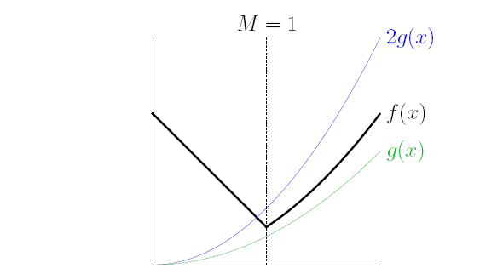
2f(n)
T(n)
f(n)
T(n) ≤ 2f(n) whenever, n ≥ 1
So: T(n) is in O(f(n))
Notice T(n) > f(n) everywhere.

Slide 13
Examples
If T(n) = 1,000,000 * n, T(n) is in O(n).
Let f(n) = n, set c = 1,000,000, N = 1: T(n) = 1,000,000 * n ≤ c * f(n)
Big-Oh notation doesn't care about (most) constant factors.
Generally leave constants out; it's unnecessary to write O(2n).
If T(n) = n, T(n) is in O(n³).
Let f(n) = n³, set c = 1, N = 1: T(n) = n ≤ n³ = f(n)
Big-Oh notation can be misleading. Just because an algorithm's running time is in O(n³) doesn't mean it's slow; it might also be in O(n).

Slide 14
More Examples
If T(n) = n³ + n² + n, then T(n) is in O(n³).
Let T(n) = n³, set c = 3, N = 1. T(n) = n³ + n² + n ≤ 3 * n³ = c * f(n)
Big-Oh notation is usually used only to indicate the dominating term in the function. The other terms become insignificant when n is really big.

Slide 15
Important Big-Oh Sets
Function | Common Name
O(1) | Constant
O(log n) | Logarithmic
O( log² n) | Log-squared
O( ) | Root-n
O(n) | Linear
O(n log n) | n log n
O(n²) | Quadratic
O(n³) | Cubic
O(n⁴) | Quartic
O(2^{n}) | Exponential
O(e^{n}) | Bigger exponential
Subset of

Slide 16
Example
/** Find position of X in list Return -1 if not found */
class List {
. . .
int find (Object X) {
int c = 0;
ListNode cur = head;
for (; cur != null; cur = cur.next, c++) {
if (cur.item.equals(X))
return c;
}
return -1;
}
Choose representative operation: number of .equals tests.
If N is length of the list, then loop does at most N tests: worst-case time is N tests.
Worst-case time is O(N);

Slide 17
Caveats About Constants
n² is in O(n)
Justification: if we choose c = n, we get n² ≤ n².
c must be a constant; it cannot depend on n.
WRONG!

Slide 18
Caveats About Constants
e^{3n} is in O(e^{n}) because the constant factor 3 don't matter.
10^{n} is in O(2^{n}) because the constant factor 10 don't matter.
Big-Oh notation doesn't care about most constant factors. But…
Constant factor in an exponent is not the same as a constant factor in front of a term.
e^{3n} is bigger than e^{n} by a factor of e^{2n}
10^{n} is bigger than 2^{n} by a factor of 5^{n}.
WRONG!
WRONG!

Slide 19
Caveats About Constants
Problem actual size does matter in practice.
Example:
An algorithm runs in time T(n) = n log n, and another algorithm runs in time U(n) = 100 * n
Big-Oh notation suggests you should use U(n), because T(n) dominates U(n) asymptotically.
In practice, U(n) is only faster than T(n) if your input size is greater than current estimates of the number of subatomic particles in the universe.
For U(n) ≤ T(n), 100 ≤ log n, 2¹⁰⁰ ≤ n

Slide 20
Omega
Big-Oh is an upper bound, it says, "Your algorithm is at least this good."
Omega gives us a lower bound, it says, "Your algorithm is at least this bad."
Omega is the reverse of Big-Oh:
If T(n) is in O(f(n)), f(n) is in Ω(T(n)).

Slide 21
Examples
2n is in Ω(n) because n is in O(2n).
n² is in Ω(n) because n is in O(n²).
n² is in Ω(3n²+ n log n) because 3n²+ n log n is in O(n²).

Slide 22
Definition
Ω(f(n)) is the set of all functions T(n) that satisfy:
There exist positive constants d and N such that, for all n ≥ N, T(n) ≥ d * f(n)

Slide 23
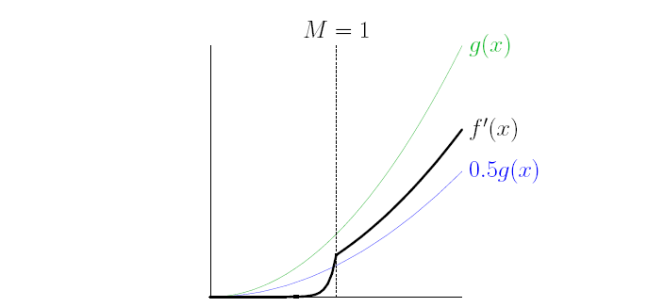
f(n)
T(n)
0.5 * f(n)
T(n) ≥ 0.5f(n) whenever n ≥ 1
So T(n) is in Ω(f(n))
Notice T(x) < f(n) everywhere.

Slide 24
Theta
If we have: T(n) is in O(f(n)) and is also in Ω(g(n)) then T(n) is effectively sandwiched between c * f(n) and d * g(n).
When f(n) = g(n) we say that T(n) is in Ѳ(g(n)) .
But how can a function be sandwiched between f(n) and f(n)?
we choose different constants (c and d) for the upper bound and lower bound.

Slide 25
c * f(n)
T(n)
d * f(n)
Let c = 1, d = 0.5, c*f(n) ≥ T(n) ≥ 0.5f(n) whenever x ≥ 1
So f‘(x) is in Ѳ(g(n))

Slide 26
Interpreting
Choice of O, Ω, or Ѳ is independent of whether we're talking about worst-case running time, best-case running time, average-case running time, memory use, or some other function.
"Big-Oh" is NOT a synonym for "worst-case running time," and Omega is not a synonym for "best-case running time."

Slide 27
Analysis Example 1
Problem #1: Given a set of p points, find the pair closest to each other.
Algorithm #1: Calculate the distance between each pair; return the minimum.
double minDistance = point[0].distance(point[1]);
/* Visit a pair (i, j) of points. */
for (int i = 0; i < numPoints; i++) {
/* We require that j > i so that each pair is visited only once. */
for (int j = i + 1; j < numPoints; j++) {
double thisDistance = point[i].distance(point[j]);
if (thisDistance < minDistance) {
minDistance = thisDistance;
}
}
}
There are p (p - 1) / 2 pairs, and each pair takes constant time to examine. Therefore, worst- and best-case running times are in Ѳ(p²).

Slide 28
Analysis Example 2
Problem #2: Smooshing an array called "ints" to remove consecutive duplicates
Algorithm #2:
int i = 0, j = 0;
while (i < ints.length) {
ints[j] = ints[i];
do {
i++;
} while ((i < ints.length) && (ints[i] == ints[j]));
j++;
}
The outer loop can iterate up to ints.length times, and so can the inner loop. But the index "i" advances on every iteration of the inner loop. It can't advance more than ints.length times before both loops end.
So the worst-case running time of this algorithm is Theta(p) time.

Slide 29
Analysis Example 3
/** True iff X is a substring of S */
boolean occurs (String S, String X) {
if (S.equals (X)) return true;
if (S.length () <= X.length () return false;
return
occurs (S.substring (1), X) ||
occurs (S.substring (0, S.length ()-1), X);
}

