Slide 1
CS 61C: Great Ideas in Computer Architecture (Machine Structures) Instruction Level Parallelism
Instructors: Randy H. Katz David A. Patterson
http://inst.eecs.Berkeley.edu/~cs61c/fa10

Slide 2
Agenda
Review
Pipelined Execution
Pipelined Datapath
Administrivia
Pipeline Hazards
Peer Instruction
Summary

Slide 3
Review: Single-cycle Processor
Five steps to design a processor:
1. Analyze instruction set → datapath requirements
2. Select set of datapath components & establish clock methodology
3. Assemble datapath meeting the requirements
4. Analyze implementation of each instruction to determine setting of control points that effects the register transfer.
5. Assemble the control logic
Formulate Logic Equations
Design Circuits
Processor
Input
Control
Memory
Datapath
Output

Slide 4
Single Cycle Performance
Assume time for actions are
100ps for register read or write; 200ps for other events
Clock rate is?
Instr | Instr fetch | Register read | ALU op | Memory access | Register write | Total time
lw | 200ps | 100 ps | 200ps | 200ps | 100 ps | 800ps
sw | 200ps | 100 ps | 200ps | 200ps |  | 700ps
R-format | 200ps | 100 ps | 200ps |  | 100 ps | 600ps
beq | 200ps | 100 ps | 200ps |  |  | 500ps
What can we do to improve clock rate?
Will this improve performance as well?
Want increased clock rate to mean faster programs
Notes:
1.25 GHz

Slide 5
Gotta Do Laundry
Ann, Brian, Cathy, Dave each have one load of clothes to wash, dry, fold, and put away
Washer takes 30 minutes
Dryer takes 30 minutes
“Folder” takes 30 minutes
“Stasher” takes 30 minutes to put clothes into drawers
A
B
C
D

Slide 6
Sequential Laundry
Sequential laundry takes 8 hours for 4 loads
6 PM
7
8
9
10
11
12
1
2 AM
T
a
s
k
O
r
d
e
r
30
30
30
30
30
30
30
30
30
30
30
30
30
30
30
30
Time
A
B
C
D

Slide 7
Pipelined Laundry
Pipelined laundry takes 3.5 hours for 4 loads!
6 PM
7
8
9
10
11
12
1
2 AM
30
30
30
30
30
Time
T
a
s
k
O
r
d
e
r
30
30
A
B
C
D

Slide 8
Pipelining Lessons (1/2)
6 PM
7
8
9
Pipelining doesn’t help latency of single task, it helps throughput of entire workload
Multiple tasks operating simultaneously using different resources
Potential speedup = Number pipe stages
Time to “fill” pipeline and time to “drain” it reduces speedup: 2.3X v. 4X in this example
T
a
s
k
O
r
d
e
r
Time
30
30
30
30
30
30
30
A
B
C
D

Slide 9
Pipelining Lessons (2/2)
6 PM
7
8
9
Suppose new Washer takes 20 minutes, new Stasher takes 20 minutes. How much faster is pipeline?
Pipeline rate limited by slowest pipeline stage
Unbalanced lengths of pipe stages reduces speedup
T
a
s
k
O
r
d
e
r
Time
30
30
30
30
30
30
30
A
B
C
D

Slide 10
Single Cycle Datapath
31
26
21
16
0
op
rs
rt
immediate
Data Memory {R[rs] + SignExt[imm16]} = R[rt]
Instruction<31:0>
nPC_sel=
instr
fetch
unit
RegDst=
<21:25>
<16:20>
<0:15>
clk
<11:15>
Rd
Rt
1
0
Rs
Rt
Rd
Imm16
zero
ALUctr=
RegWr=
Rs
Rt
MemtoReg=
5
5
5
busA
32
MemWr=
busW
Rw
Ra
Rb
=
32
32
RegFile
busB
ALU
0
0
clk
32
32
WrEn
Adr
imm16
1
Data In
1
16
Extender
Data
Memory
32
clk
ExtOp=
ALUSrc=
Notes:
The store instruction performs the inverse function of the load. Instead of loading data from memory, the store instruction sends the contents of register specified by Rt to data memory.
Similar to the load instruction, the store instruction needs to read the contents of register Rs (points to Ra port) and add it to the sign extended verion of the immediate filed (Imm16, ExtOp = 1, ALUSrc = 1) to form the data memory address (ALUctr = add).
However unlike the Load instructoion where busB is not used, the store instruction will use busB to send the data to the Data memory.
Consequently, the Rt field of the instruction has to be fed to the Rb port of the register file.
In order to write the Data Memory properly, the MemWr signal has to be set to 1.
Notice that the store instruction does not update the register file. Therefore, RegWr must be set to zero and consequently control signals RegDst and MemtoReg are don’t cares.
And once again we need to set the control signals Branch and Jump to zero to ensure proper Program Counter updataing.
Well, by now, you are probably tied of these boring stuff where Branch and Jump are zero so let’s look at something different--the bracnh instruction.
+3 = 31 min. (Y:11)

Slide 11
Steps in Executing MIPS
1) IFtch: Instruction Fetch, Increment PC
2) Dcd: Instruction Decode, Read Registers
3) Exec: Mem-ref: Calculate Address Arith-log: Perform Operation
4) Mem: Load: Read Data from Memory Store: Write Data to Memory
5) WB: Write Data Back to Register

Slide 12
Redrawn Single Cycle Datapath
rd
PC
instruction
memory
registers
rs
Data
memory
rt
ALU
+4
imm
2. Decode/
Register Read
1. Instruction
Fetch
5. Write Back
3. Execute
4. Memory

Slide 13
Pipeline registers
rd
PC
instruction
memory
registers
rs
Data
memory
rt
ALU
+4
imm
2. Decode/
Register Read
1. Instruction
Fetch
5. Write Back
3. Execute
4. Memory
Need registers between stages
To hold information produced in previous cycle

Slide 14
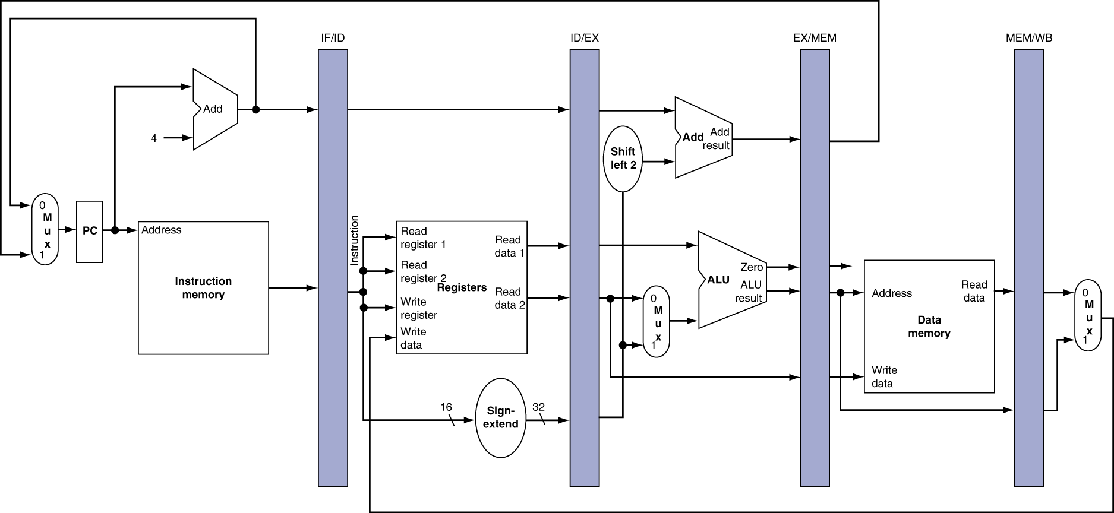
More Detailed Pipeline

Slide 15
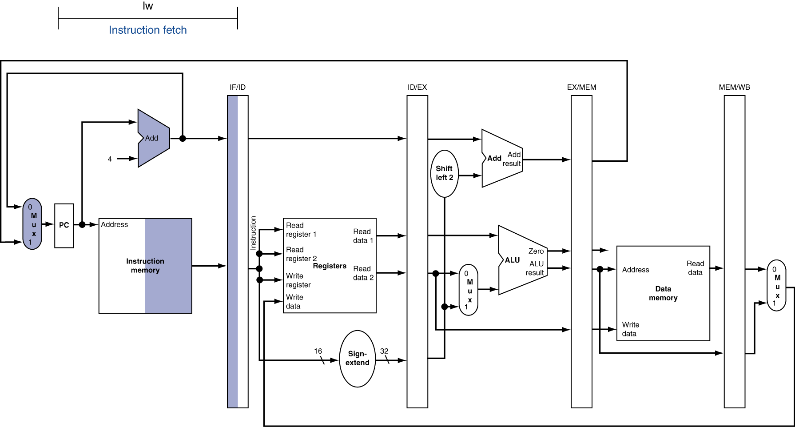
IF for Load, Store, …

Slide 16
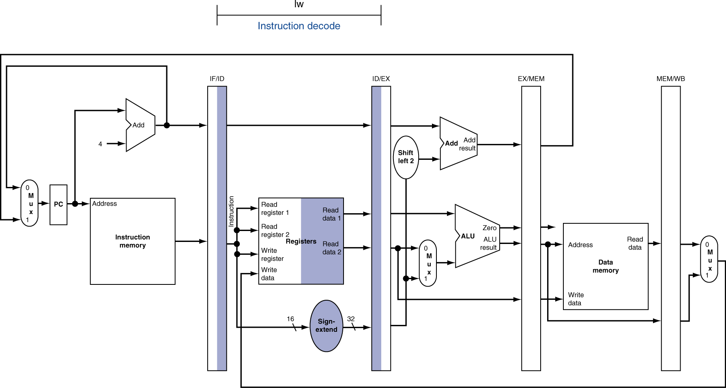
ID for Load, Store, …

Slide 17
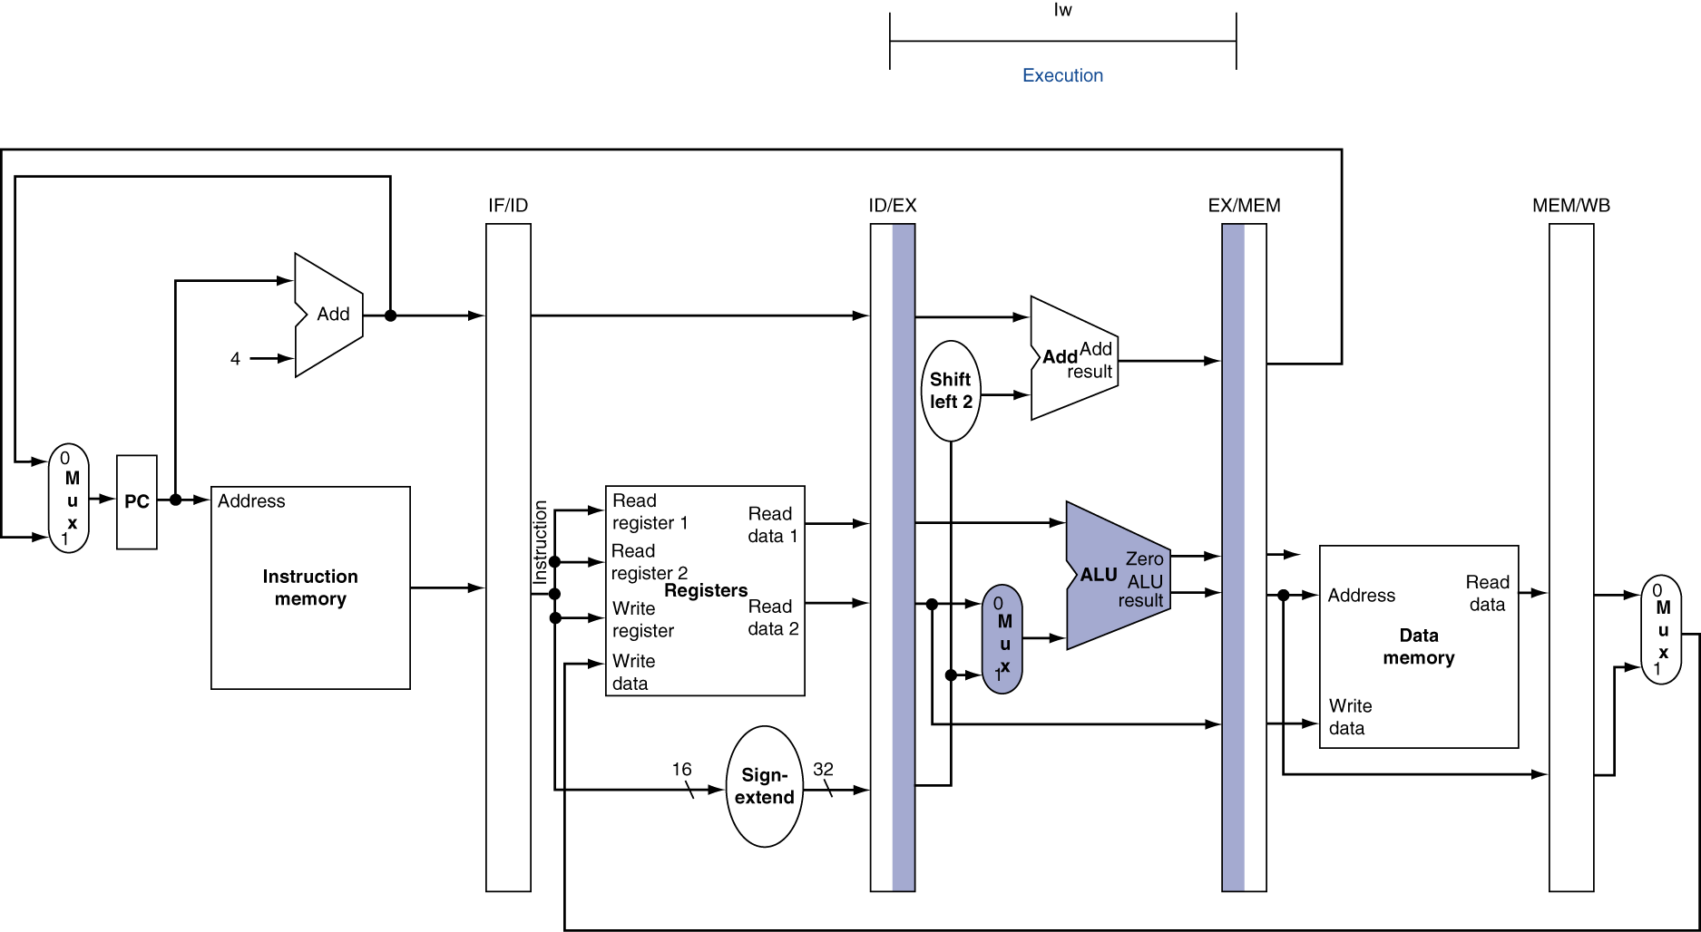
EX for Load

Slide 18
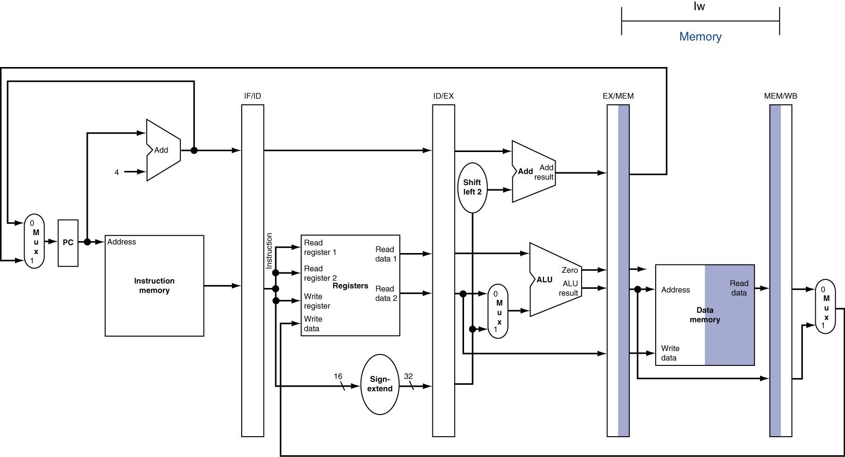
MEM for Load

Slide 19
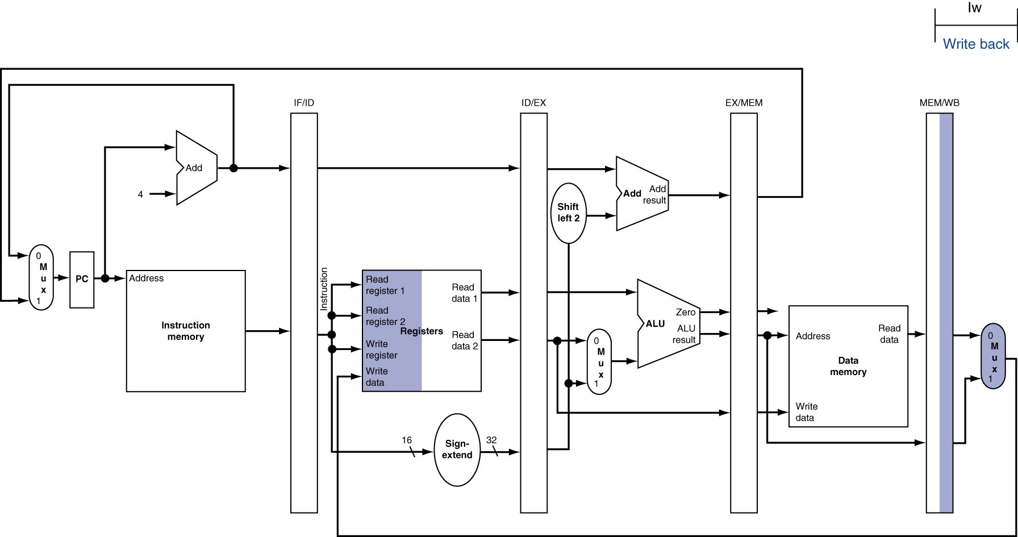
WB for Load
Wrong register number

Slide 20
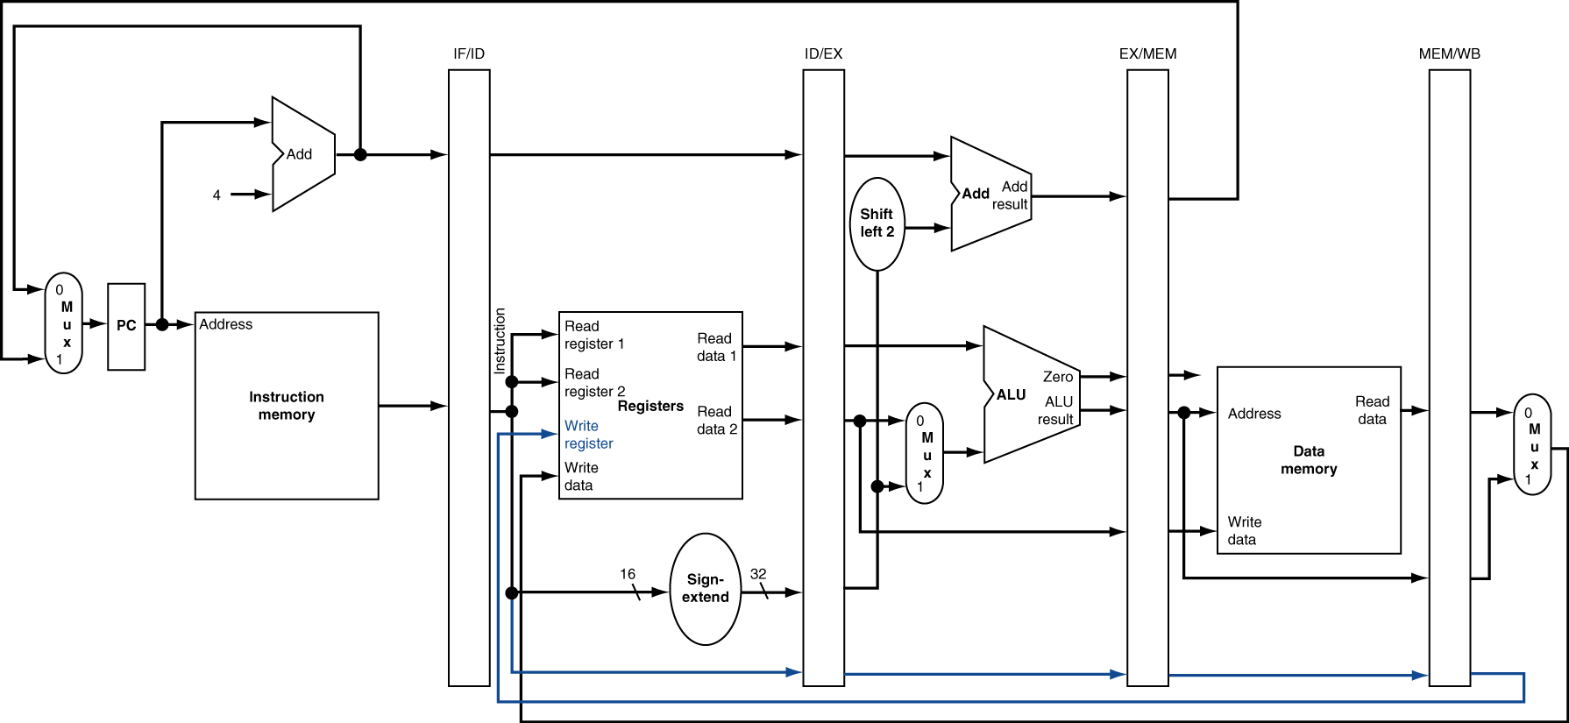
Corrected Datapath for Load

Slide 21
Agenda
Review
Pipelined Execution
Pipelined Datapath
Administrivia
Pipeline Hazards
Peer Instruction
Summary

Slide 22
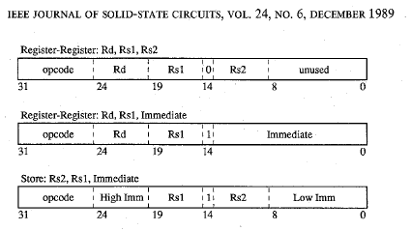
Why both rt and rd as MIPS write reg?
31
26
21
16
11
6
0
op
rs
rt
rd
shamt
funct
31
6 bits
26
5 bits
21
5 bits
16
5 bits
5 bits
6 bits
0
op
rs
rt
immediate
6 bits
5 bits
5 bits
16 bits
Need to have 2 part immediate if 2 sources and 1 destination always in same place
SPUR processor
(1st project Randy and I worked on together)

Slide 23
Administrivia
Project 3: Thread Level Parallelism + Data Level Parallelism + Cache Optimization
Due Part 2 due Saturday 11/13
Project 4: Single Cycle Processor in Logicsim
Due Part 2 due Saturday 11/27
Face-to-Face grading: Signup for timeslot last week
Extra Credit: Fastest Version of Project 3
Due Monday 11/29 Midnight
Final Review: TBD (Vote via Survey!)
Final: Mon Dec 13 8AM-11AM (TBD)

Slide 24
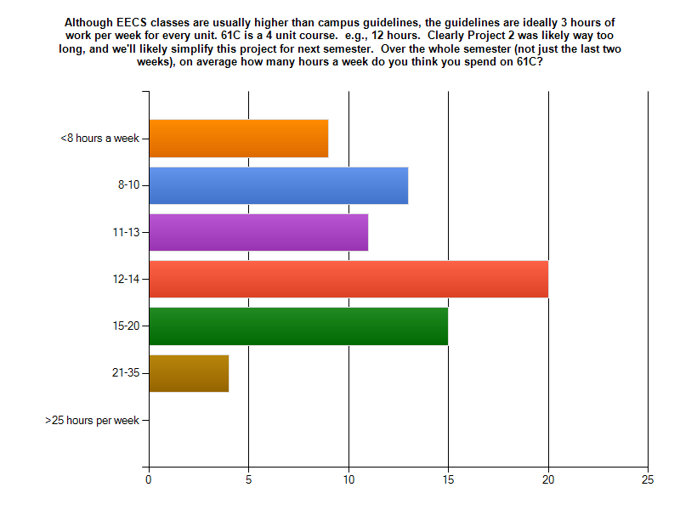
Survey
Hours/wk OK? avg 13, median 12-14 (4 units = 12 hours)
Since picked earliest time for review, redoing to see if still Thu best (Mon vs Thu)

Slide 25
Computers in the News
Giants win World Series! (4-1 over Dallas Texas Rangers)
“S.F. Giants using tech to their advantage”
Therese Poletti, MarketWatch , 10/29/10
“Giants were an early user of tech, and it looks like these investments are paying off.”
Bill Neukom (chief executive) @ Microsoft 25 years
Scouts given cameras to upload video of prospects
XO Sports Sportsmotion, which outfits players with sensors that measure everything they do: player development, evaluate talent, rehab after injury (swing changed?)
Internal SW development team to mine data for scouting (other teams use standard SW packages)
266 Cisco Wi-Fi access points throughout park; 1st in 2004
Voice over IP to save $ internally for SF Giants

Slide 26
Pipelined Execution Representation
Time
IFtch
Dcd
Exec
Mem
WB
IFtch
Dcd
Exec
Mem
WB
IFtch
Dcd
Exec
Mem
WB
IFtch
Dcd
Exec
Mem
WB
IFtch
Dcd
Exec
Mem
WB
IFtch
Dcd
Exec
Mem
WB
Every instruction must take same number of steps, also called pipeline “stages”, so some will go idle sometimes

Slide 27
Graphical Pipeline Diagrams
rd
PC
instruction
memory
registers
rs
Data
memory
rt
ALU
+4
imm
2. Decode/
Register Read
1. Instruction
Fetch
5. Write Back
3. Execute
4. Memory
Use datapath figure below to represent pipeline
IFtch
Dcd
Exec
Mem
WB
I$
Reg
ALU
D$
Reg

Slide 28
Graphical Pipeline Representation
(In Reg, right half highlight read, left half write)
Time (clock cycles)
I
n
s
t
r.
O
r
d
e
r
Load
I$
Reg
ALU
D$
Reg
Add
I$
Reg
ALU
D$
Reg
Store
I$
Reg
ALU
D$
Reg
Sub
I$
Reg
ALU
D$
Reg
Or
I$
Reg
ALU
D$
Reg

Slide 29
Pipeline Performance
Assume time for stages is
100ps for register read or write
200ps for other stages
What is pipelined clock rate?
Compare pipelined datapath with single-cycle datapath
Instr | Instr fetch | Register read | ALU op | Memory access | Register write | Total time
lw | 200ps | 100 ps | 200ps | 200ps | 100 ps | 800ps
sw | 200ps | 100 ps | 200ps | 200ps |  | 700ps
R-format | 200ps | 100 ps | 200ps |  | 100 ps | 600ps
beq | 200ps | 100 ps | 200ps |  |  | 500ps

Slide 30
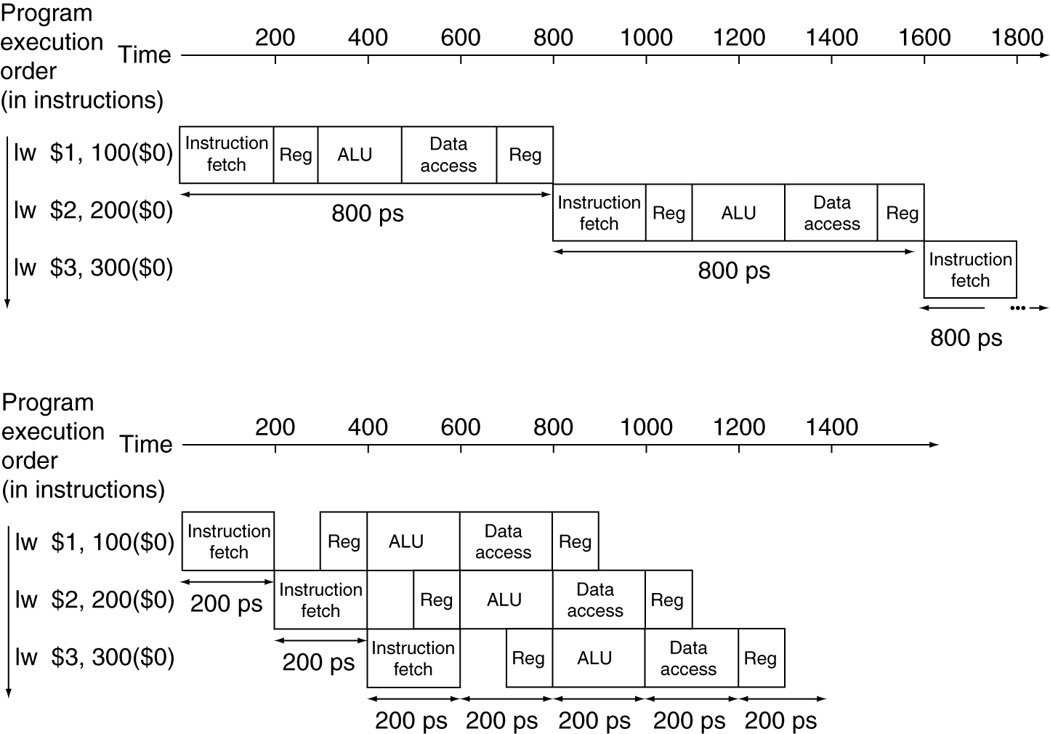
Pipeline Performance
Single-cycle (T_{c}= 800ps)
Pipelined (T_{c}= 200ps)

Slide 31
Pipeline Speedup
If all stages are balanced
i.e., all take the same time
Time between instructions_{pipelined} = Time between instructions_{nonpipelined} Number of stages
If not balanced, speedup is less
Speedup due to increased throughput
Latency (time for each instruction) does not decrease

Slide 32
Instruction Level Parallelism (ILP)
Another parallelism form to go with Request Level Parallelism and Data Level Parallelism
RLP – e.g., Warehouse Scale Computing
DLP – e.g., SIMD, Map Reduce
ILP – e.g., Pipelined instruction Execution
5 stage pipeline => 5 instructions executing simultaneously, one at each pipeline stage

Slide 33
Hazards
Situations that prevent starting the next instruction in the next cycle
Structural hazards
A required resource is busy (roommate studying)
Data hazard
Need to wait for previous instruction to complete its data read/write (pair of socks in different loads)
Control hazard
Deciding on control action depends on previous instruction (how much detergent based on how clean prior load turns out)

Slide 34
Structural Hazards
Conflict for use of a resource
In MIPS pipeline with a single memory
Load/store requires data access
Instruction fetch would have to stall for that cycle
Would cause a pipeline “bubble”
Hence, pipelined datapaths require separate instruction/data memories
Really separate L1 instruction cache and L1 data cache

Slide 35
Structural Hazard #1: Single Memory
Time (clock cycles)
I
n
s
t
r.
O
r
d
e
r
Load
I$
Reg
ALU
D$
Reg
Instr 1
I$
Reg
ALU
D$
Reg
Instr 2
I$
Reg
ALU
D$
Reg
Instr 3
I$
Reg
ALU
D$
Reg
Instr 4
I$
Reg
ALU
D$
Reg
Read same memory twice in same clock cycle

Slide 36
Structural Hazard #2: Registers (1/2)
I
n
s
t
r.
O
r
d
e
r
Time (clock cycles)
sw
I$
Reg
ALU
D$
Reg
Instr 1
I$
Reg
ALU
D$
Reg
Instr 2
I$
Reg
ALU
D$
Reg
Instr 3
I$
Reg
ALU
D$
Reg
Instr 4
I$
Reg
ALU
D$
Reg
Can we read and write to registers simultaneously?

Slide 37
Structural Hazard #2: Registers (2/2)
Two different solutions have been used:
1) RegFile access is VERY fast: takes less than half the time of ALU stage
Write to Registers during first half of each clock cycle
Read from Registers during second half of each clock cycle
2) Build RegFile with independent read and write ports
Result: can perform Read and Write during same clock cycle

Slide 38
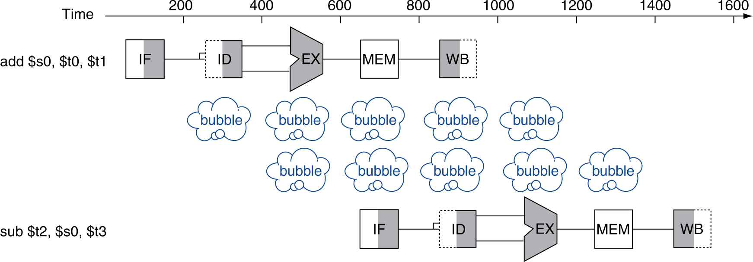
Data Hazards
An instruction depends on completion of data access by a previous instruction
add $s0, $t0, $t1 sub $t2, $s0, $t3

Slide 39
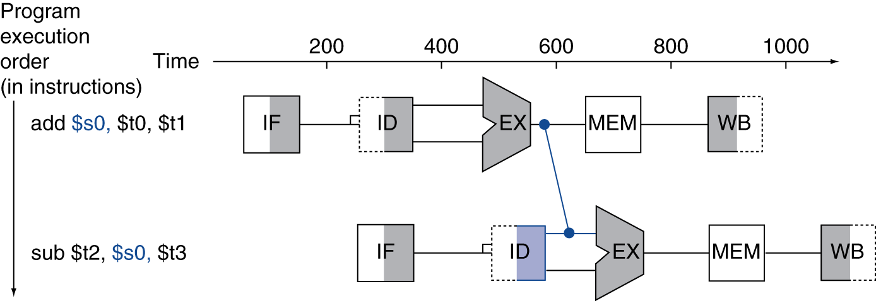
Forwarding (aka Bypassing)
Use result when it is computed
Don’t wait for it to be stored in a register
Requires extra connections in the datapath

Slide 40
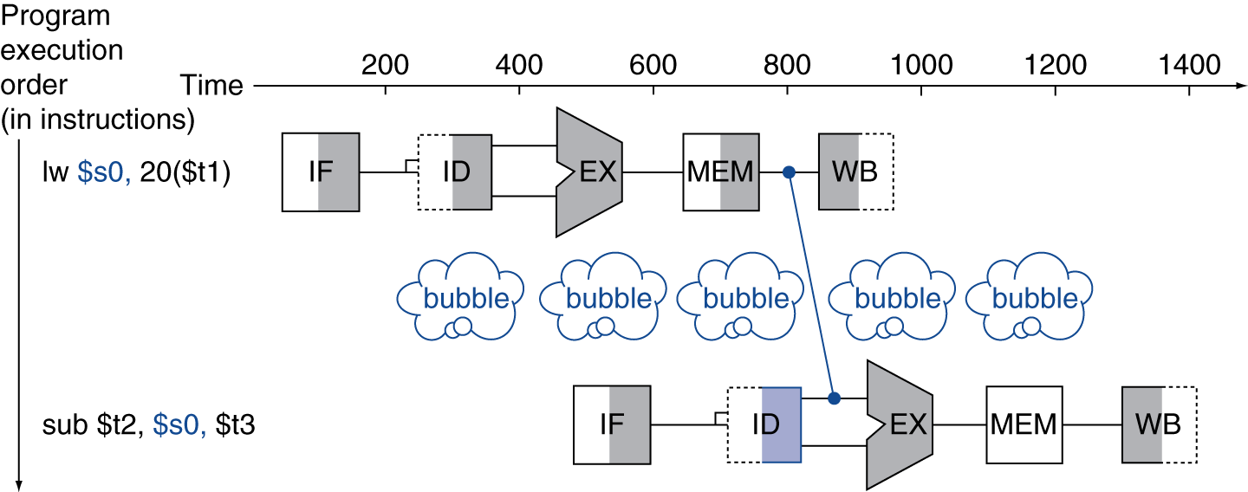
Load-Use Data Hazard
Can’t always avoid stalls by forwarding
If value not computed when needed
Can’t forward backward in time!

Slide 41
Code Scheduling to Avoid Stalls
Reorder code to avoid use of load result in the next instruction
C code for A = B + E; C = B + F;
lw $t1, 0($t0)
lw $t2, 4($t0)
add $t3, $t1, $t2
sw $t3, 12($t0)
lw $t4, 8($t0)
add $t5, $t1, $t4
sw $t5, 16($t0)
lw $t1, 0($t0)
lw $t2, 4($t0)
lw $t4, 8($t0)
add $t3, $t1, $t2
sw $t3, 12($t0)
add $t5, $t1, $t4
sw $t5, 16($t0)
stall
stall
13 cycles
11 cycles

Slide 42
Peer Instruction
Thanks to pipelining, I have reduced the time it took me to wash my one shirt.
Longer pipelines are always a win (since less work per stage & a faster clock).
A)(red) I is True and II is True
B)(orange) I is False and II is True
C)(green) I is True and II is False
D)(yellow) I is False and II is False

Slide 43
Peer Instruction Answer
Throughput better, not latency!
“…longer pipelines do usually mean faster clock rate, but hazards can cause problems!”
F A L S E
Thanks to pipelining, I have reduced the time it took me to wash my one shirt.
Longer pipelines are always a win (since less work per stage & a faster clock).
12
a) FF
b) FT
c) TF
d) TT
F A L S E

Slide 44
Pipeline Summary
The BIG Picture
Pipelining improves performance by increasing instruction throughput: exploits ILP
Executes multiple instructions in parallel
Each instruction has the same latency
Subject to hazards
Structure, data, control

