Slide 1
CS 61C: Great Ideas in Computer Architecture Compilers and Floating Point
Instructors:
Krste Asanovic, Randy H. Katz
http://inst.eecs.Berkeley.edu/~cs61c/fa12

Slide 2
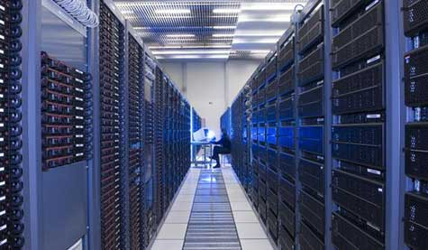
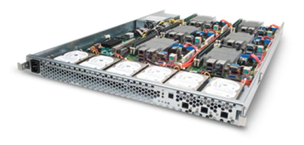
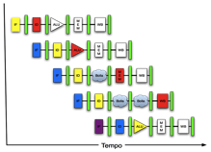
New-School Machine Structures (It’s a bit more complicated!)
Software Hardware
Parallel Requests
Assigned to computer
e.g., Search “Katz”
Parallel Threads
Assigned to core
e.g., Lookup, Ads
Parallel Instructions
>1 instruction @ one time
e.g., 5 pipelined instructions
Parallel Data
>1 data item @ one time
e.g., Add of 4 pairs of words
Hardware descriptions
All gates @ one time
Programming Languages
Warehouse Scale Computer
Smart Phone
Harness Parallelism &
Achieve High Performance
Computer
Core
…
Core
Memory (Cache)
Input/Output
Core
Instruction Unit(s)
Functional
Unit(s)
A₀+B₀
A₁+B₁
A₂+B₂
A₃+B₃
Cache Memory
Today’s Lecture
Logic Gates

Slide 3
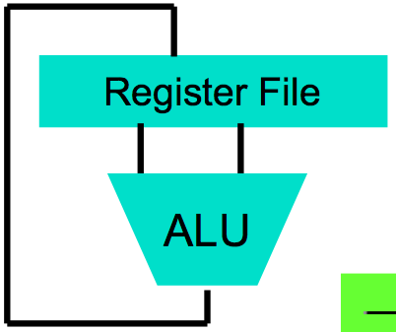
Big Idea #1: Levels of Representation/Interpretation
Today’s Lecture
High Level Language Program (e.g., C)
temp = v[k];
v[k] = v[k+1];
v[k+1] = temp;
Compiler
Anything can be represented as a number, i.e., data or instructions
lw $t0, 0($2)
lw $t1, 4($2)
sw $t1, 0($2)
sw $t0, 4($2)
Assembly Language Program (e.g., MIPS)
Assembler
0000 1001 1100 0110 1010 1111 0101 1000
1010 1111 0101 1000 0000 1001 1100 0110
1100 0110 1010 1111 0101 1000 0000 1001
0101 1000 0000 1001 1100 0110 1010 1111
Machine Language Program (MIPS)
Machine Interpretation
Hardware Architecture Description (e.g., block diagrams)
Architecture Implementation
Logic Circuit Description (Circuit Schematic Diagrams)

Slide 4
Agenda
Review
Compilers
Administrivia
Floating Point Revisited
And in Conclusion, …

Slide 5
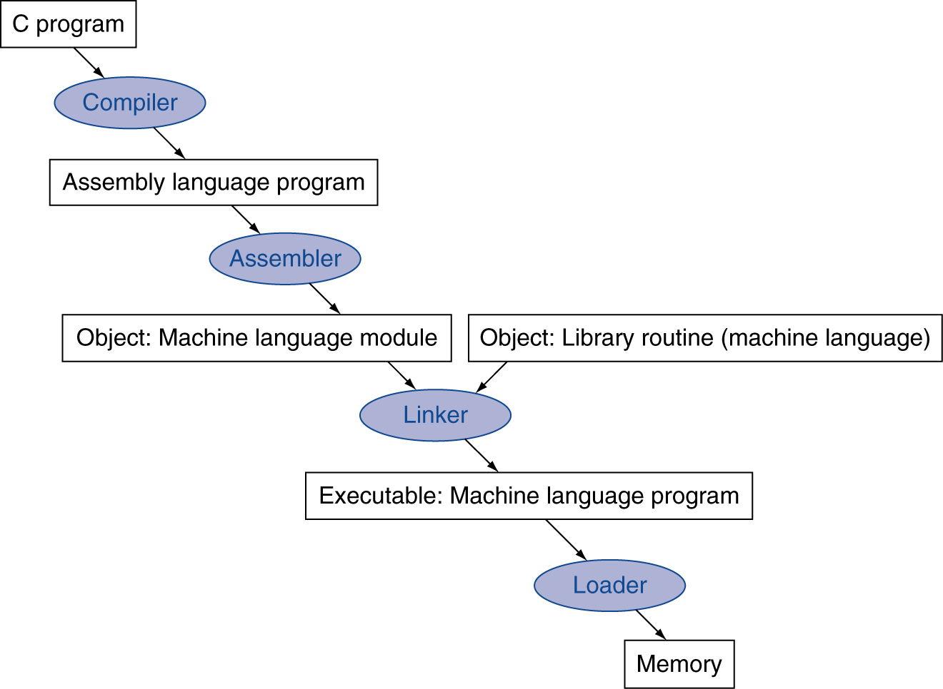
Translation and Startup
Many compilers produce object modules directly
§2.12 Translating and Starting a Program
Static linking

Slide 6
What’s a Compiler?
Compiler: a program that accepts as input a program text in a certain language and produces as output a program text in another language, while preserving the meaning of that text
Text must comply with the syntax rules of whichever programming language it is written in
Compiler's complexity depends on the syntax of the language and how much abstraction that programming language provides
A C compiler is much simpler than C++ Compiler
Compiler executes before compiled program runs

Slide 7
Compiled Languages: Edit-Compile-Link-Run
Editor
Source
code
Compiler
Object
code
Linker
Executable
program
Editor
Source
code
Compiler
Object
code
☺
Editor
Source
code
Compiler
Object
code
Notes:
If you read your code carefully and reason about it before compiling, the number of cycles through Edit-Compile-Link-Run will be reduced, perhaps even to one!

Slide 8
Compiler Optimization
gcc compiler options
-O1: the compiler tries to reduce code size and execution time, without performing any optimizations that take a great deal of compilation time
-O2: Optimize even more. GCC performs nearly all supported optimizations that do not involve a space-speed tradeoff. As compared to -O, this option increases both compilation time and the performance of the generated code
-O3: Optimize yet more. All -O2 optimizations and also turns on the -finline-functions, …

Slide 9
gcc Optimization Experiment
 | BubbleSort.c | Dhrystone.c
MacAir 3.1 No Opt | 3.2 s | 7.4 s 3125000 dhrys/s
-O2 | 1.5 s | 2.7 s 8333333 dhrys/s
MacAir 5.1 No Opt | 1.9 s (1.7x) | 3.0 s (2.4x) 8333333 dhrys/s (2.7x)
-O2 | 0.8 s (1.9x) | 0.7 s (3.8x) 25000000 dhrys/s (3x)

Slide 10
Performance Equation
Time = Seconds Program Instructions Clock cycles Seconds Program Instruction Clock Cycle
=
×
×
Compiler affects this!

Slide 11
What is Typical Benefit of Compiler Optimization?
What is a typical program?
For now, try a toy program:
BubbleSort.c
#define ARRAY_SIZE 20000
int main() {
int iarray[ARRAY_SIZE], x, y, holder;
for(x = 0; x < ARRAY_SIZE; x++)
for(y = 0; y < ARRAY_SIZE-1; y++)
if(iarray[y] > iarray[y+1]) {
holder = iarray[y+1];
iarray[y+1] = iarray[y];
iarray[y] = holder;
}
}
Notes:
Login into lab computer and try gcc-mips
I tried to build gcc on a mac machine today, but failed even after applying Scott's patches. I think it will take more time to port the toolchain to snow leopard, but I can get it working before next week's lab. In the meantime you can login to nova.cs.berkeley.edu and use mips-gcc.
61C password
$ ssh cs61c@nova.cs.berkeley.edu
$ mips-gcc -S test.c (assuming you have test.c)
$ cat test.c

Slide 12
Unoptimized MIPS Code
$L3:
lw $2,80016($sp)
slt $3,$2,20000
bne $3,$0,$L6
j $L4
$L6:
.set noreorder
nop
.set reorder
sw $0,80020($sp)
$L7:
lw $2,80020($sp)
slt $3,$2,19999
bne $3,$0,$L10
j $L5
$L10:
lw $2,80020($sp)
move $3,$2
sll $2,$3,2
addu $3,$sp,16
addu $2,$3,$2
lw $4,80020($sp)
addu $3,$4,1
move $4,$3
sll $3,$4,2
addu $4,$sp,16
addu $3,$4,$3
lw $2,0($2)
lw $3,0($3)
slt $2,$3,$2
beq $2,$0,$L9
lw $3,80020($sp)
addu $2,$3,1
move $3,$2
sll $2,$3,2
addu $3,$sp,16
addu $2,$3,$2
lw $3,0($2)
sw $3,80024($sp
$L11:
$L9:
lw $2,80020($sp)
addu $3,$2,1
sw $3,80020($sp)
j $L7
$L8:
$L5:
lw $2,80016($sp)
addu $3,$2,1
sw $3,80016($sp)
j $L3
$L4:
$L2:
li $12,65536
ori $12,$12,0x38b0
addu $13,$12,$sp
addu $sp,$sp,$12
j $31
lw $3,80020($sp)
addu $2,$3,1
move $3,$2
sll $2,$3,2
addu $3,$sp,16
addu $2,$3,$2
lw $3,80020($sp)
move $4,$3
sll $3,$4,2
addu $4,$sp,16
addu $3,$4,$3
lw $4,0($3)
sw $4,0($2)
lw $2,80020($sp)
move $3,$2
sll $2,$3,2
addu $3,$sp,16
addu $2,$3,$2
lw $3,80024($sp)
sw $3,0($2)

Slide 13
-O2 optimized MIPS Code
li $13,65536
ori $13,$13,0x3890
addu $13,$13,$sp
sw $28,0($13)
move $4,$0
addu $8,$sp,16
$L6:
move $3,$0
addu $9,$4,1
.p2align 3
$L10:
sll $2,$3,2
addu $6,$8,$2
addu $7,$3,1
sll $2,$7,2
addu $5,$8,$2
lw $3,0($6)
lw $4,0($5)
slt $2,$4,$3
beq $2,$0,$L9
sw $3,0($5)
sw $4,0($6)
$L9:
move $3,$7
slt $2,$3,19999
bne $2,$0,$L10
move $4,$9
slt $2,$4,20000
bne $2,$0,$L6
li $12,65536
ori $12,$12,0x38a0
addu $13,$12,$sp
addu $sp,$sp,$12
j $31
.

Slide 14
What’s an Interpreter?
Reads and executes source statements executed one at a time
No linking
No machine code generation, so more portable
Starts executing quicker, but runs much more slowly than compiled code
Performing the actions straight from the text allows better error checking and reporting to be done
Interpreter stays around during execution
Unlike compiler, some work is done after program starts
Writing an interpreter is much less work than writing a compiler

Slide 15
Interpreted Languages: Edit-Run
Editor
Source
code
Interpreter
☺
Notes:
When you use an interpreted language, the program that is being executed is the interpreter; the text of your program serves as data for the interpreter.

Slide 16
Compiler vs. Interpreter Advantages
Compilation:
Faster Execution
Single file to execute
Compiler can do better diagnosis of syntax and semantic errors, since it has more info than an interpreter (Interpreter only sees one line at a time)
Can find syntax errors before run program
Compiler can optimize code
Interpreter:
Easier to debug program
Faster development time

Slide 17
Compiler vs. Interpreter Disadvantages
Compilation:
Harder to debug program
Takes longer to change source code, recompile, and relink
Interpreter:
Slower execution times
No optimization
Need all of source code available
Source code larger than executable for large systems
Interpreter must remain installed while the program is interpreted

Slide 18
Java’s Hybrid Approach: Compiler + Interpreter
A Java compiler converts Java source code into instructions for the Java Virtual Machine (JVM)
These instructions, called bytecodes, are same for any computer / OS
A CPU-specific Java interpreter interprets bytecodes on a particular computer
Notes:
Java Virtual Machine is an imaginary computer with a CPU instruction set that is “the least common denominator” for typical real CPUs.

Slide 19
Java’s Compiler + Interpreter
Editor
Compiler
:
:
7


K
Hello.java
Hello.class

Interpreter
Interpreter


Hello,
World!
Notes:
There is also JIT (Just-In-Time) compiler technology where the program is interpreted and compiled at the same time. On subsequent runs the compiled code is used; there is no need to reinterpret it.

Slide 20
Why Bytecodes?
Platform-independent
Load from the Internet faster than source code
Interpreter is faster and smaller than it would be for Java source
Source code is not revealed to end users
Interpreter performs additional security checks, screens out malicious code
Notes:
Java’s culture is pretty open, and many applets are available on the Internet with their source code. Still, software vendors may want to protect their source code.
For obvious reasons, the interpreter wouldn’t allow an applet to read or write files on your computer.
Hackers have peculiar ethics (or rather, a gap in ethics): they won’t go around checking locks on the doors of houses or cars or spread real disease germs (even if non-lethal ones), but they will break into your computer system (which may be much more harmful and expensive) and spread computer viruses.

Slide 21
JVM uses Stack vs. Registers
a = b + c;
=>
iload b ; push b onto Top Of Stack (TOS)
iload c ; push c onto Top Of Stack (TOS)
iadd ; Next to top Of Stack (NOS) =
; Top Of Stack (TOS) + NOS
istore a ; store TOS into a and pop stack

Slide 22
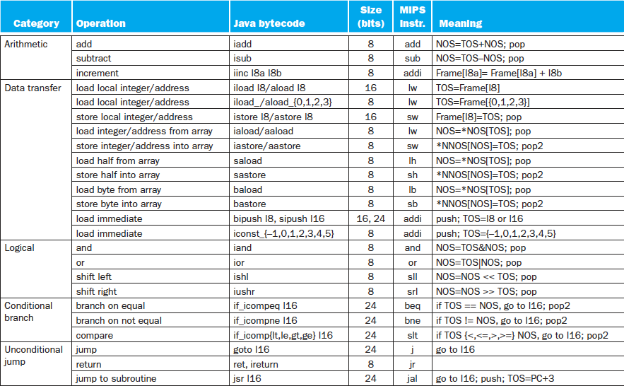
Java Bytecodes (Stack) vs. MIPS (Reg.)

Slide 23
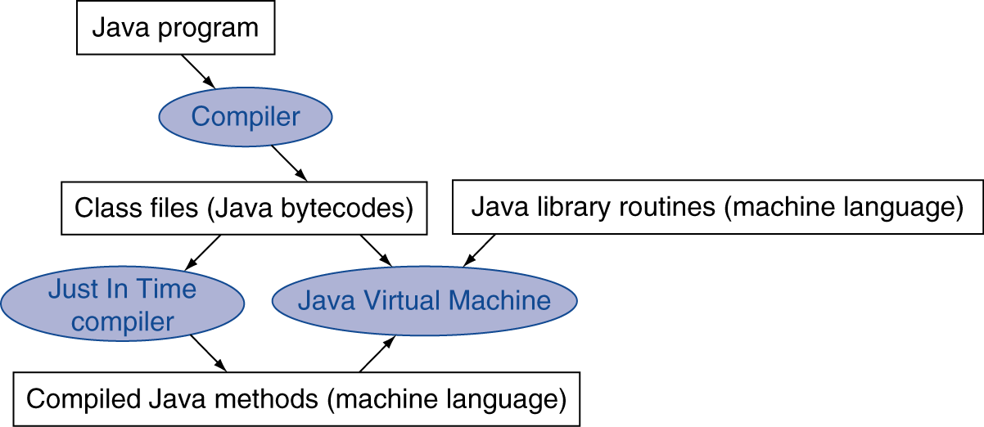
Starting Java Applications
Simple portable instruction set for the JVM
Compiles bytecodes of “hot” methods into native code for host machine
Interprets bytecodes
Just In Time (JIT) compiler translates bytecode into machine language just before execution

Slide 24
Agenda
Review
Compilers
Administrivia
Floating Point Revisited
And in Conclusion, …

Slide 25
Administrivia
Lab #5: MIPS Assembly
HW #4 (of six), due Sunday
Project 2a: MIPS Emulator, due Sunday
Midterm, two weeks from Tuesday

Slide 26
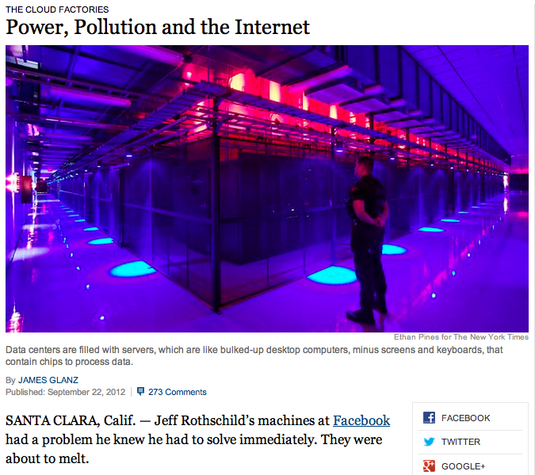
CS61c in the News

Slide 27
CS61c in the News
“Most data centers, by design, consume vast amounts of energy in an incongruously wasteful manner, interviews and documents show. Online companies typically run their facilities at maximum capacity around the clock, whatever the demand. As a result, data centers can waste 90 percent or more of the electricity they pull off the grid, The Times found.”
“Worldwide, the digital warehouses use about 30 billion watts of electricity, roughly equivalent to the output of 30 nuclear power plants, according to estimates industry experts compiled for The Times.”
“The consulting firm McKinsey & Company analyzed energy use by data centers and found that, on average, they were using only 6 percent to 12 percent of the electricity powering their servers to perform computations. The rest was essentially used to keep servers idling and ready in case of a surge in activity that could slow or crash their operations.”

Slide 28
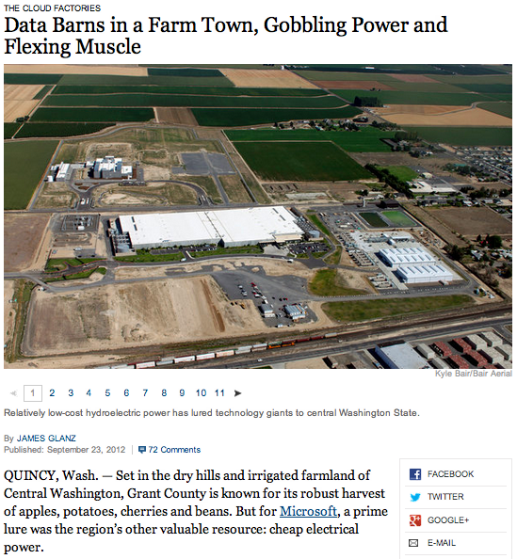
CS61c in the News
Data Barns

Slide 29
Get To Know Your Professor

Slide 30
Agenda
Review
Compilers
Administrivia
Floating Point Revisited
And in Conclusion, …

Slide 31
Goals for Floating Point
Standard arithmetic for reals for all computers
Like two’s complement
Keep as much precision as possible in formats
Help programmer with errors in real arithmetic
+∞, -∞, Not-A-Number (NaN), exponent overflow, exponent underflow
Keep encoding that is somewhat compatible with two’s complement
E.g., 0 in Fl. Pt. is 0 in two’s complement
Make it possible to sort without needing to do floating point comparison

Slide 32
Floating Point: Representing Very Small Numbers
Zero: Bit pattern of all 0s is encoding for 0.000
But 0 in exponent should mean most negative exponent (want 0 to be next to smallest real)
Can’t use two’s complement (1000 0000_{two})
Bias notation: subtract bias from exponent
Single precision uses bias of 127; DP uses 1023
0 uses 0000 0000_{two} => 0-127 = -127; ∞, NaN uses 1111 1111_{two} => 255-127 = +128
Smallest SP real can represent: 1.00…00 x 2⁻¹²⁶
Largest SP real can represent: 1.11…11 x 2⁺¹²⁷

Slide 33
What If Operation Result Doesn’t Fit in 32 Bits?
Overflow: calculate too big a number to represent within a word
Unsigned numbers: 1 + 4,294,967,295 (2³²-1)
Signed numbers: 1 + 2,147,483,647 (2³¹-1)
How to handle depends on the programming language
C signed number arithmetic ignores overflow
Other languages want overflow signal on signed numbers (e.g., Fortran)
What’s a computer architect to do?

Slide 34
MIPS Solution: Offer Both
Instructions that can trigger overflow:
add, sub, mult, div, addi, multi, divi
Instructions that don’t overflow are called “unsigned” (really means “no overflow”):
addu, subu, multu, divu, addiu, multiu, diviu
Given semantics of C, always use unsigned versions
Note: slt and slti do signed comparisons, while sltu and sltiu do unsigned comparisons
Nothing to do with overflow
When would get different answer for slt vs. sltu?
Student Roulette?

Slide 35
What About Real Numbers in Base 2?
r x E^{i}, E where is exponent (2), i is a positive or negative integer, r is a real number ≥ 1.0, < 2
Computers version of normalized scientific notation called Floating Point notation

Slide 36
Floating Point Numbers
32-bit word has 2³² patterns, so must be approximation of real numbers ≥ 1.0, < 2
IEEE 754 Floating Point Standard:
1 bit for sign (s) of floating point number
8 bits for exponent (E)
23 bits for fraction (F) (get 1 extra bit of precision if leading 1 is implicit)
(-1)^{s} x (1 + F) x 2E
Can represent from 2.0 x 10⁻³⁸ to 2.0 x 10³⁸

Slide 37
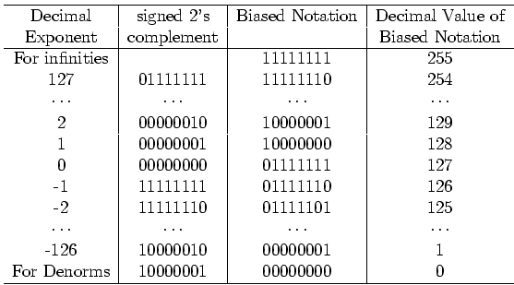
Bias Notation (+127)
How it is interpreted
How it is encoded
∞, NaN
Getting closer to zero
Zero

Slide 38
The Number Line
-∞
∞
0
-1 x 2¹²⁷
-1 x 2⁻¹²⁶
1 x 2⁻¹²⁶
1 x 2¹²⁷
31
30 23
22 0
(-1)^{s} x (1 + F) x 2E
S
E
F
∞
0
11111111
00000000000000000000000
1 x 2¹²⁷
0
11111110
00000000000000000000000
127 + 127 = 254
1 x 2⁻¹²⁶
0
00000001
00000000000000000000000
-126 + 127 = 1
0
0
00000000
00000000000000000000000
-1 x 2⁻¹²⁶
1
00000001
00000000000000000000000
-126 + 127 = 1
-1 x 2¹²⁷
1
11111110
00000000000000000000000
127 + 127 = 254
-∞
1
11111111
00000000000000000000000

Slide 39
Floating Point Numbers
What about bigger or smaller numbers?
IEEE 754 Floating Point Standard: Double Precision (64 bits)
1 bit for sign (s) of floating point number
11 bits for exponent (E)
52 bits for fraction (F) (get 1 extra bit of precision if leading 1 is implicit)
(-1)^{s} x (1 + F) x 2E
Can represent from 2.0 x 10⁻³⁰⁸ to 2.0 x 10³⁰⁸
32 bit format called Single Precision

Slide 40
More Floating Point
What about 0?
Bit pattern all 0s means 0, so no implicit leading 1
What if divide 1 by 0?
Can get infinity symbols +∞, -∞
Sign bit 0 or 1, largest exponent, 0 in fraction
What if do something stupid? (∞ – ∞, 0 ÷ 0)
Can get special symbols NaN for Not-a-Number
Sign bit 0 or 1, largest exponent, not zero in fraction
What if result is too big? (2x10³⁰⁸ x 2x10²)
Get overflow in exponent, alert programmer!
What if result is too small? (2x10⁻³⁰⁸ ÷ 2x10²)
Get underflow in exponent, alert programmer!

Slide 41
Floating Point Add Associativity?
A = (1000000.0 + 0.000001) - 1000000.0
B = (1000000.0 - 1000000.0) + 0.000001
In single precision floating point arithmetic, A does not equal B
A = 0.000000, B = 0.000001
Floating Point Addition is not Associative!
Integer addition is associative
When does this matter?

Slide 42
MIPS Floating Point Instructions
C, Java has single precision (float) and double precision (double) types
MIPS instructions: .s for single, .d for double
Fl. Pt. Addition single precision: add.s Fl. Pt. Addition double precision: add.d
Fl. Pt. Subtraction single precision: sub.s Fl. Pt. Subtraction double precision: sub.d
Fl. Pt. Multiplication single precision: mul.s Fl. Pt. Multiplication double precision: mul.d
Fl. Pt. Divide single precision: div.s Fl. Pt. Divide double precision: div.d

Slide 43
MIPS Floating Point Instructions
C, Java have single precision (float) and double precision (double) types
MIPS instructions: .s for single, .d for double
Fl. Pt. Comparison single precision: Fl. Pt. Comparison double precision:
Fl. Pt. branch:
Since rarely mix integers and Floating Point, MIPS has separate registers for floating-point operations: $f0, $f1, …, $f31
Double precision uses adjacent even-odd pairs of registers:
$f0 and $f1, $f2 and $f3, $f4 and $f5, …, $f30 and $f31
Need data transfer instructions for these new registers
lwc1 (load word), swc1 (store word)
Double precision uses two lwc1 instructions, two swc1 instructions
Notes:
Floating-point comparison, single (c.x.s) and comparison, double (c.x.d),
where x may be equal (eq), not equal (neq), less than (lt), less than or equal (le), greater than (gt), or greater than or equal (ge)
Floating-point branch, true (bc1t) and branch, false (bc1f)

Slide 44
Who is Bigger than Whom? What’s the Representation?
0000 0000 0000 0000 0000 0000 0000 0000_{two}
> 1111 1111 1111 1111 1111 1111 1111 1111_{two}
1111 1111 1111 1111 1111 1111 1111 1110_{two}
> 1111 1111 1111 1111 1111 1111 1111 1111_{two}
1000 0000 0000 0000 0000 0000 0000 0000_{two}
> 1111 1111 0111 1111 1111 1111 1111 1111_{two}
Ones Complement
Twos Complement
Sign and Magnitude
IEEE FP Standard
More than one can apply

Slide 45
Who is Bigger than Whom? What’s the Representation?
0000 0000 0000 0000 0000 0000 0000 0000_{two}
> 1111 1111 1111 1111 1111 1111 1111 1111_{two}
1111 1111 1111 1111 1111 1111 1111 1110_{two}
> 1111 1111 1111 1111 1111 1111 1111 1111_{two}
1000 0000 0000 0000 0000 0000 0000 0000_{two}
> 1111 1111 0111 1111 1111 1111 1111 1111_{two}
Ones Complement
Twos Complement
Sign and Magnitude
IEEE FP Standard
More than one or none can apply

Slide 46
Peer Instruction Question
Suppose Big, Tiny, and BigNegative are floats in C, with Big initialized to a big number (e.g., age of universe in seconds or 4.32 x 10¹⁷), Tiny to a small number (e.g., seconds/femtosecond or 1.0 x 10⁻¹⁵), BigNegative = - Big. Here are two conditionals:
(Big * Tiny) * BigNegative == (Big * BigNegative) * Tiny
(Big + Tiny) + BigNegative == (Big + BigNegative) + Tiny
Which statement about these is correct?
Orange. I. is false and II. is false
Green. I. is false and II. is true
Pink. I. is true and II. is false
Yellow. I. is true and II. is true

Slide 47
Peer Instruction Answer
Suppose Big, Tiny, and BigNegative are floats in C, with Big initialized to a big number (e.g., age of universe in seconds or 4.32 x 10¹⁷), Tiny to a small number (e.g., seconds/femtosecond or 1.0 x 10⁻¹⁵), BigNegative = - Big. Here are two conditionals:
(Big * Tiny) * BigNegative == (Big * BigNegative) * Tiny
(Big + Tiny) + BigNegative == (Big + BigNegative) + Tiny
Which statement about these is correct?
Pink. I. is true and II. is false (if we don’t consider overflow)—but there are cases where one side overflows while the other does not!
I. Works ok if no overflow, but because exponents add, if Big * BigNeg overflows, then result is overflow, not -1
II. Left hand side is 0, right hand side is tiny

Slide 48
Pitfalls
Floating point addition is NOT associative
Some optimizations can change order of floating point computations, which can change results
Need to ensure that floating point algorithm is correct even with optimizations

Slide 49
And, in Conclusion, …
Interpreters for debugging, but slow execution
Hybrid (Java): Compiler + Interpreter to try to get best of both
Compiler Optimization to relieve programmer
Floating point is an approximation of reals

