Slide 1
CS 61C: Great Ideas in Computer Architecture SIMD I
Instructors:
Krste Asanovic, Randy H. Katz
http://inst.eecs.Berkeley.edu/~cs61c/fa12

Slide 2
Review
Although caches are software-invisible, a “cache-aware” performance programmer can improve performance by large factors by changing order of memory accesses
Three C’s of cache misses
Compulsory
Capacity
Conflict

Slide 3
Sources of Cache Misses (3 C’s)
Compulsory (cold start, first reference):
1st access to a block, “cold” fact of life, not a lot you can do about it.
If running billions of instructions, compulsory misses are insignificant
Capacity:
Cache cannot contain all blocks accessed by the program
Misses that would not occur with infinite cache
Conflict (collision):
Multiple memory locations mapped to the same cache location
Misses that would not occur with ideal fully associative cache
Notes:
(Capacity miss) That is the cache misses are due to the fact that the cache is simply not large enough to contain all the blocks that are accessed by the program.
The solution to reduce the Capacity miss rate is simple: increase the cache size.
Here is a summary of other types of cache miss we talked about.
First is the Compulsory misses. These are the misses that we cannot avoid. They are caused when we first start the program.
Then we talked about the conflict misses. They are the misses that caused by multiple memory locations being mapped to the same cache location.
There are two solutions to reduce conflict misses. The first one is, once again, increase the cache size. The second one is to increase the associativity.
For example, say using a 2-way set associative cache instead of directed mapped cache.
But keep in mind that cache miss rate is only one part of the equation. You also have to worry about cache access time and miss penalty. Do NOT optimize miss rate alone.
Finally, there is another source of cache miss we will not cover today. Those are referred to as invalidation misses caused by another process, such as IO , update the main memory so you have to flush the cache to avoid inconsistency between memory and cache.
+2 = 43 min. (Y:23)

Slide 4
Flashcard Quiz: With a fixed cache capacity, what effect does a larger block size have on the 3Cs?
Decreases compulsory, increases conflicts
Increases conflicts
Increases compulsory, decreases conflicts
Decreases conflicts

Slide 5
Flashcard Quiz: With a fixed cache block size, what effect does a larger cache capacity have on the 3Cs?
Increases compulsory, decreases conflicts
Increases conflicts, decreases capacity misses
Decreases compulsory, decreases conflicts
Decreases conflicts, decreases capacity misses

Slide 6
Sources of Cache Misses (3 C’s)
Compulsory (cold start, first reference):
1st access to a block, “cold” fact of life, not a lot you can do about it.
If running billions of instructions, compulsory misses are insignificant
Solution: increase block size (increases miss penalty; very large blocks could increase miss rate)
Capacity:
Cache cannot contain all blocks accessed by the program
Solution: increase cache size (may increase access time)
Or structure software so reuse data in cache before fetching new data
Conflict (collision):
Multiple memory locations mapped to the same cache location
Solution 1: increase cache size (may increase hit time)
Solution 2: (later in semester) increase associativity (may increase hit time)
Notes:
(Capacity miss) That is the cache misses are due to the fact that the cache is simply not large enough to contain all the blocks that are accessed by the program.
The solution to reduce the Capacity miss rate is simple: increase the cache size.
Here is a summary of other types of cache miss we talked about.
First is the Compulsory misses. These are the misses that we cannot avoid. They are caused when we first start the program.
Then we talked about the conflict misses. They are the misses that caused by multiple memory locations being mapped to the same cache location.
There are two solutions to reduce conflict misses. The first one is, once again, increase the cache size. The second one is to increase the associativity.
For example, say using a 2-way set associative cache instead of directed mapped cache.
But keep in mind that cache miss rate is only one part of the equation. You also have to worry about cache access time and miss penalty. Do NOT optimize miss rate alone.
Finally, there is another source of cache miss we will not cover today. Those are referred to as invalidation misses caused by another process, such as IO , update the main memory so you have to flush the cache to avoid inconsistency between memory and cache.
+2 = 43 min. (Y:23)

Slide 7
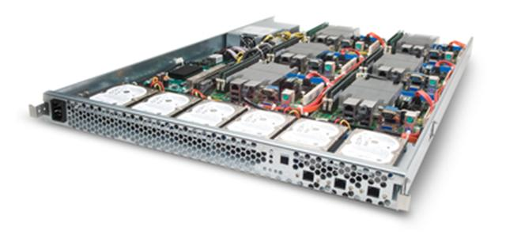
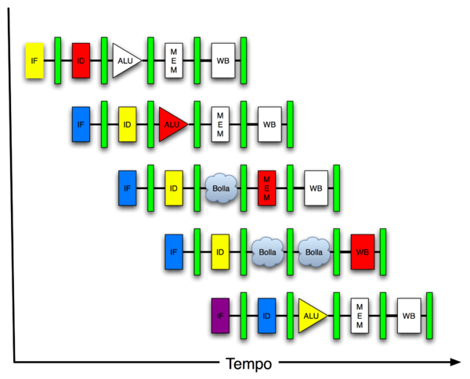
New-School Machine Structures (It’s a bit more complicated!)
Software Hardware
Parallel Requests
Assigned to computer
e.g., Search “Katz”
Parallel Threads
Assigned to core
e.g., Lookup, Ads
Parallel Instructions
>1 instruction @ one time
e.g., 5 pipelined instructions
Parallel Data
>1 data item @ one time
e.g., Add of 4 pairs of words
Hardware descriptions
All gates @ one time
Programming Languages
Warehouse Scale Computer
Smart Phone
Harness Parallelism &
Achieve High Performance
Computer
Core
…
Core
Memory (Cache)
Input/Output
Core
Today’s
Lecture
Instruction Unit(s)
Functional
Unit(s)
A₀+B₀
A₁+B₁
A₂+B₂
A₃+B₃
Cache Memory
Logic Gates

Slide 8
Alternative Kinds of Parallelism: The Programming Viewpoint
Job-level parallelism/process-level parallelism
Running independent programs on multiple processors simultaneously
Example?
Parallel-processing program
Single program that runs on multiple processors simultaneously
Example?

Slide 9
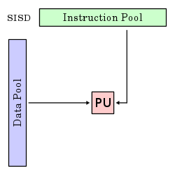
Alternative Kinds of Parallelism: Single-Instruction/Single-Data Stream
Single Instruction, Single Data stream (SISD)
Sequential computer that exploits no parallelism in either the instruction or data streams. Examples of SISD architecture are traditional uniprocessor machines
Processing Unit

Slide 10
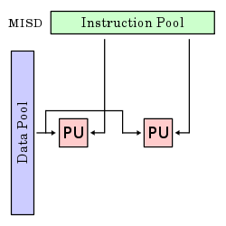
Alternative Kinds of Parallelism: Multiple-Instruction/Single-Data Stream
Multiple-Instruction, Single-Data stream (MISD)
Computer that exploits multiple instruction streams against a single data stream for data operations that can be naturally parallelized. For example, certain kinds of array processors.
No longer commonly encountered, mainly of historical interest only

Slide 11
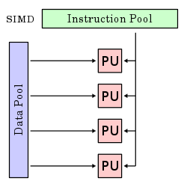
Alternative Kinds of Parallelism: Single-Instruction/Multiple-Data Stream
Single-Instruction, Multiple-Data streams (SIMD or “sim-dee”)
Computer that exploits multiple data streams against a single instruction stream to operations that may be naturally parallelized, e.g., Intel SIMD instruction extensions or NVIDIA Graphics Processing Unit (GPU)

Slide 12
Alternative Kinds of Parallelism: Multiple-Instruction/Multiple-Data Streams
Multiple-Instruction, Multiple-Data streams (MIMD or “mim-dee”)
Multiple autonomous processors simultaneously executing different instructions on different data.
MIMD architectures include multicore and Warehouse-Scale Computers
(Discuss after midterm)
Instruction Pool
PU
PU
Data Pool
PU
PU

Slide 13
Flynn* Taxonomy, 1966
In 2012, SIMD and MIMD most common parallelism in architectures – usually both in same system!
Most common parallel processing programming style: Single Program Multiple Data (“SPMD”)
Single program that runs on all processors of a MIMD
Cross-processor execution coordination through conditional expressions (thread parallelism after midterm )
SIMD (aka hw-level data parallelism): specialized function units, for handling lock-step calculations involving arrays
Scientific computing, signal processing, multimedia (audio/video processing)
*Prof. Michael Flynn, Stanford

Slide 14
Two kinds of Data-Level Parallelism (DLP)
Lots of data in memory that can be operated on in parallel (e.g., adding together 2 arrays)
Lots of data on many disks that can be operated on in parallel (e.g., searching for documents)
2nd/3rd lecture (and 1st project) did DLP across 10s of servers and disks using MapReduce
Today’s lecture (and 3rd project) does Data-Level Parallelism (DLP) in memory

Slide 15
Big Idea: Amdahl’s (Heartbreaking) Law
Speedup due to enhancement E is
Exec time w/o E
Speedup w/ E = ----------------------
Exec time w/ E
Suppose that enhancement E accelerates a fraction F (F <1) of the task by a factor S (S>1) and the remainder of the task is unaffected
Execution Time w/o E × [ (1-F) + F/S]
Execution Time w/ E =
1 / [ (1-F) + F/S ]
Speedup w/ E =

Slide 16
Big Idea: Amdahl’s Law
Speedup =
Example: the execution time of half of the program can be accelerated by a factor of 2. What is the program speed-up overall?

Slide 17
Big Idea: Amdahl’s Law
Speedup = 1
Example: the execution time of half of the program can be accelerated by a factor of 2. What is the program speed-up overall?
(1 - F) + F
Non-speed-up part
S
Speed-up part
1
1
=
=
1.33
0.5 + 0.5
0.5 + 0.25
2

Slide 18
Administrivia
Lab #6 posted
Midterm Tuesday Oct 9, 8PM:
Two rooms: 1 Pimentel and 2050 LSB
Check your room assignment!
Covers everything through lecture today
Closed book, can bring one sheet notes, both sides
Copy of Green card will be supplied
No phones, calculators, …; just bring pencils & eraser
TA Review: Sun. Oct. 7, 3-5pm, 2050 VLSB

Slide 19
CS61C in the News
‘Busy recruiter Nathan Ollestad, director of technology practice at Greythorne, lists his phone number prominently on LinkedIn. When called by a stranger, he answers right away. He has to. No matter how consumed with work he is, Ollestad can’t miss a chance to grab precious engineering talent that might be on the other end of the phone line. Grab it, hold onto it, and find the company with just the right perks, incentives, and stimulating projects to entice a talented candidate to sign employment papers. It’s not easy. “The industry we’re in now is unlike any I’ve ever been in. It’s the most competitive market I’ve ever seen…,” he says.’
Smartbear October 2012
“Computer Science is the most popular major at Stanford.”
“45% of MIT undergrads enrolled in EECS.”
Also now probably most popular major at UCB.

Slide 20
Example #1: Amdahl’s Law
Speedup w/ E =
Consider an enhancement which runs 20 times faster but which is only usable 25% of the time.
Speedup w/ E =
What if its usable only 15% of the time?
Speedup w/ E =
Amdahl’s Law tells us that to achieve linear speedup with 100 processors, none of the original computation can be scalar!
To get a speedup of 90 from 100 processors, the percentage of the original program that could be scalar would have to be 0.1% or less
Speedup w/ E =
Notes:
For class handout

Slide 21
Example #1: Amdahl’s Law
Speedup w/ E = 1 / [ (1-F) + F/S ]
Consider an enhancement which runs 20 times faster but which is only usable 25% of the time
Speedup w/ E = 1/(.75 + .25/20) = 1.31
What if its usable only 15% of the time?
Speedup w/ E = 1/(.85 + .15/20) = 1.17
Amdahl’s Law tells us that to achieve linear speedup with 100 processors, none of the original computation can be scalar!
To get a speedup of 90 from 100 processors, the percentage of the original program that could be scalar would have to be 0.1% or less
Speedup w/ E = 1/(.001 + .999/100) = 90.99

Slide 22
Parallel Speed-up Example
Z₀ + Z₁ + … + Z₁₀
X_{1,1}
X_{1,10}
Y_{1,1}
Y_{1,10}
Partition 10 ways and perform on 10 parallel processing units
+
X_{10,1}
X_{10,10}
Y_{10,1}
Y_{10,10}
Non-parallel part
Parallel part
10 “scalar” operations (non-parallelizable)
100 parallelizable operations
110 operations

Slide 23
Example #2: Amdahl’s Law
Speedup w/ E = 1 / [ (1-F) + F/S]
Consider summing 10 scalar variables and two 10 by 10 matrices (matrix sum) on 10 processors
Speedup w/ E =
What if there are 100 processors ?
Speedup w/ E =
What if the matrices are 100 by 100 (or 10,010 adds in total) on 10 processors?
Speedup w/ E =
What if there are 100 processors ?
Speedup w/ E =
Notes:
For class handout

Slide 24
Example #2: Amdahl’s Law
Speedup w/ E = 1 / [ (1-F) + F/S ]
Consider summing 10 scalar variables and two 10 by 10 matrices (matrix sum) on 10 processors
Speedup w/ E = 1/(.091 + .909/10) = 1/0.1819 = 5.5
What if there are 100 processors ?
Speedup w/ E = 1/(.091 + .909/100) = 1/0.10009 = 10.0
What if the matrices are 100 by 100 (or 10,010 adds in total) on 10 processors?
Speedup w/ E = 1/(.001 + .999/10) = 1/0.1009 = 9.9
What if there are 100 processors ?
Speedup w/ E = 1/(.001 + .999/100) = 1/0.01099 = 91
Notes:
For lecture
10/110 operations = 0.091
10/10010 operations = 0.000999

Slide 25
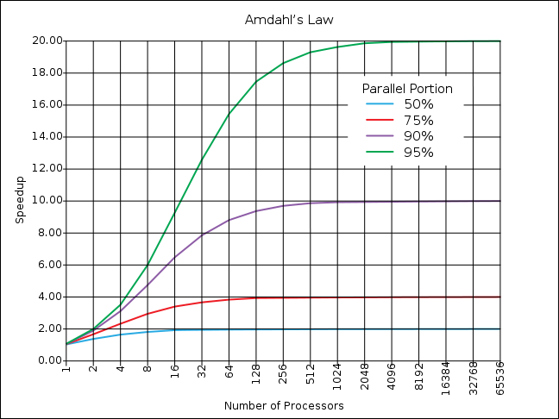
If the portion of the program that can be parallelized is small, then the speedup is limited
The non-parallel portion limits the performance

Slide 26
Strong and Weak Scaling
To get good speedup on a multiprocessor while keeping the problem size fixed is harder than getting good speedup by increasing the size of the problem.
Strong scaling: when speedup can be achieved on a parallel processor without increasing the size of the problem
Weak scaling: when speedup is achieved on a parallel processor by increasing the size of the problem proportionally to the increase in the number of processors
Load balancing is another important factor: every processor doing same amount of work
Just one unit with twice the load of others cuts speedup almost in half
Notes:
Add load balancing example here – page 638

Slide 27
Suppose a program spends 80% of its time in a square root routine. How much must you speedup square root to make the program run 5 times faster?
Speedup w/ E = 1 / [ (1-F) + F/S ]
☐
10
☐
20
☐
100
☐
None of the Above
Notes:
VertLeftWhiteCheck1
Answer: 4th
Need infinitely fast to get to 5X
5 = 2.8
10 = 3.6
20 = 4.2
100 = 4.8

Slide 28
SIMD Architectures
Data parallelism: executing one operation on multiple data streams
Example to provide context:
Multiplying a coefficient vector by a data vector (e.g., in filtering)
y[i] := c[i] × x[i], 0 ≤ i < n
Sources of performance improvement:
One instruction is fetched & decoded for entire operation
Multiplications are known to be independent
Pipelining/concurrency in memory access as well

Slide 29
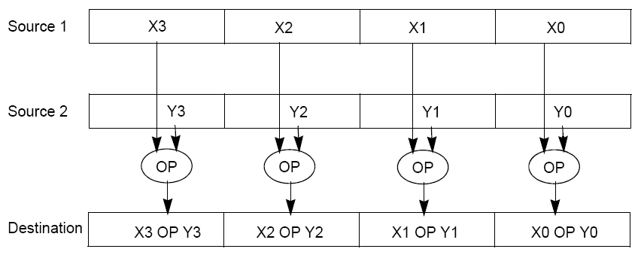
“Advanced Digital Media Boost”
To improve performance, Intel’s SIMD instructions
Fetch one instruction, do the work of multiple instructions
MMX (MultiMedia eXtension, Pentium II processor family)
SSE (Streaming SIMD Extension, Pentium III and beyond)

Slide 30
Example: SIMD Array Processing
for each f in array
f = sqrt(f)
for each f in array
{
load f to the floating-point register
calculate the square root
write the result from the register to memory
}
for each 4 members in array
{
load 4 members to the SSE register
calculate 4 square roots in one operation
store the 4 results from the register to memory
}
SIMD style

Slide 31
Data-Level Parallelism and SIMD
SIMD wants adjacent values in memory that can be operated in parallel
Usually specified in programs as loops
for(i=1000; i>0; i=i-1)
x[i] = x[i] + s;
How can reveal more data-level parallelism than available in a single iteration of a loop?
Unroll loop and adjust iteration rate

Slide 32
Looping in MIPS
Assumptions:
$t1 is initially the address of the element in the array with the highest address
$f0 contains the scalar value s
8($t2) is the address of the last element to operate on
CODE:
Loop:1. l.d $f2,0($t1) ; $f2=array element
2. add.d $f10,$f2,$f0 ; add s to $f2
3. s.d $f10,0($t1) ; store result
4. addui $t1,$t1,#-8 ; decrement pointer 8 byte
5. bne $t1,$t2,Loop ;repeat loop if $t1 != $t2

Slide 33
Loop Unrolled
Loop: l.d $f2,0($t1)
add.d $f10,$f2,$f0
s.d $f10,0($t1)
l.d $f4,-8($t1)
add.d $f12,$f4,$f0
s.d $f12,-8($t1)
l.d $f6,-16($t1)
add.d $f14,$f6,$f0
s.d $f14,-16($t1)
l.d $f8,-24($t1)
add.d $f16,$f8,$f0
s.d $f16,-24($t1)
addui $t1,$t1,#-32
bne $t1,$t2,Loop
NOTE:
Only 1 Loop Overhead every 4 iterations
This unrolling works if
loop_limit(mod 4) = 0
3. (Different Registers eliminate stalls in pipeline; we’ll see later in course)

Slide 34
Loop Unrolled Scheduled
Loop:l.d $f2,0($t1)
l.d $f4,-8($t1)
l.d $f6,-16($t1)
l.d $f8,-24($t1)
add.d $f10,$f2,$f0
add.d $f12,$f4,$f0
add.d $f14,$f6,$f0
add.d $f16,$f8,$f0
s.d $f10,0($t1)
s.d $f12,-8($t1)
s.d $f14,-16($t1)
s.d $f16,-24($t1)
addui $t1,$t1,#-32
bne $t1,$t2,Loop
4 Loads side-by-side: Could replace with 4-wide SIMD Load
4 Adds side-by-side: Could replace with 4-wide SIMD Add
4 Stores side-by-side: Could replace with 4-wide SIMD Store

Slide 35
Loop Unrolling in C
Instead of compiler doing loop unrolling, could do it yourself in C
for(i=1000; i>0; i=i-1)
x[i] = x[i] + s;
Could be rewritten
for(i=1000; i>0; i=i-4) {
x[i] = x[i] + s;
x[i-1] = x[i-1] + s;
x[i-2] = x[i-2] + s;
x[i-3] = x[i-3] + s;
}
What is downside of doing it in C?

Slide 36
Generalizing Loop Unrolling
A loop of n iterations
k copies of the body of the loop
Assuming (n mod k) ≠ 0
Then we will run the loop with 1 copy of the body (n mod k) times and
with k copies of the body floor(n/k) times
(Will revisit loop unrolling again when get to pipelining later in semester)

Slide 37
Review
Flynn Taxonomy of Parallel Architectures
SIMD: Single Instruction Multiple Data
MIMD: Multiple Instruction Multiple Data
SISD: Single Instruction Single Data (sequential machines)
MISD: Multiple Instruction Single Data (unused)
Amdahl’s Law
Strong versus weak scaling
SIMD Extensions
Exploit data-level parallelism in loops

