Slide 1
CS 61C: Great Ideas in Computer Architecture SIMD II
Instructors:
Krste Asanovic, Randy H. Katz
http://inst.eecs.Berkeley.edu/~cs61c/fa12

Slide 2
Review
Three C’s of cache misses
Compulsory
Capacity
Conflict
Amdahl’s Law: Speedup = 1/((1-F)+F/S)
Flynn’s Taxonomy: SISD/SIMD/MISD/MIMD
Exploiting Data-Level Parallelism with SIMD instructions

Slide 3
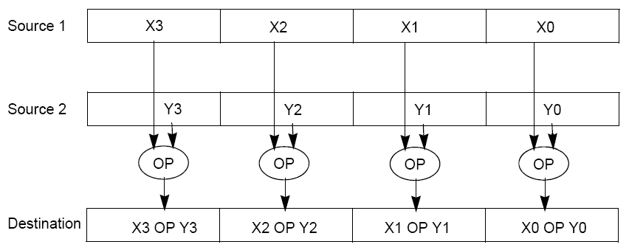
Intel SIMD Instructions
Fetch one instruction, do the work of multiple instructions

Slide 4
Intel SIMD Extensions
MMX 64-bit registers, reusing floating-point registers [1992]
SSE2/3/4, new 128-bit registers [1999]
AVX, new 256-bit registers [2011]
Space for expansion to 1024-bit registers

Slide 5
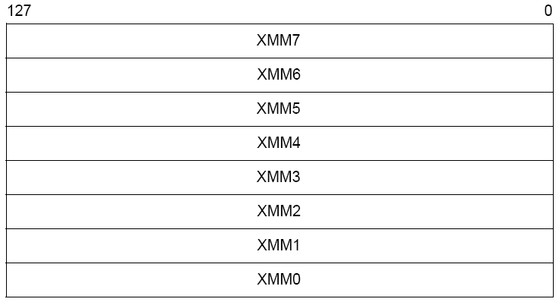
XMM Registers
Architecture extended with eight 128-bit data registers: XMM registers
x86 64-bit address architecture adds 8 additional registers (XMM8 – XMM15)

Slide 6
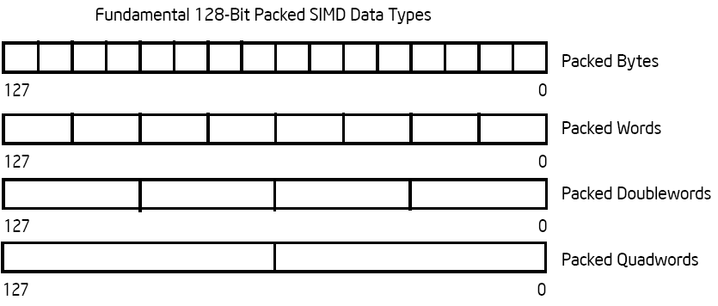
Intel Architecture SSE2+ 128-Bit SIMD Data Types
Note: in Intel Architecture (unlike MIPS) a word is 16 bits
Single-precision FP: Double word (32 bits)
Double-precision FP: Quad word (64 bits)
122 121
96 95
80 79
64 63
48 47
32 31
16 15
16 / 128 bits
122 121
96 95
80 79
64 63
48 47
32 31
16 15
8 / 128 bits
96 95
64 63
32 31
4 / 128 bits
64 63
2 / 128 bits

Slide 7
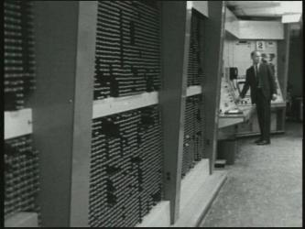
First SIMD Extensions: MIT Lincoln Labs TX-2, 1957

Slide 8
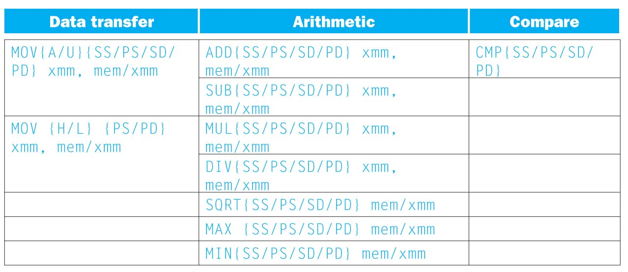
SSE/SSE2 Floating Point Instructions
Move does both load and store
xmm: one operand is a 128-bit SSE2 register
mem/xmm: other operand is in memory or an SSE2 register
{SS} Scalar Single precision FP: one 32-bit operand in a 128-bit register
{PS} Packed Single precision FP: four 32-bit operands in a 128-bit register
{SD} Scalar Double precision FP: one 64-bit operand in a 128-bit register
{PD} Packed Double precision FP, or two 64-bit operands in a 128-bit register
{A} 128-bit operand is aligned in memory
{U} means the 128-bit operand is unaligned in memory
{H} means move the high half of the 128-bit operand
{L} means move the low half of the 128-bit operand

Slide 9
Example: Add Two Single-Precision Floating-Point Vectors
Computation to be performed:
vec_res.x = v1.x + v2.x;
vec_res.y = v1.y + v2.y;
vec_res.z = v1.z + v2.z;
vec_res.w = v1.w + v2.w;
SSE Instruction Sequence:
(Note: Destination on the right in x86 assembly)
movaps address-of-v1, %xmm0
// v1.w | v1.z | v1.y | v1.x -> xmm0
addps address-of-v2, %xmm0
// v1.w+v2.w | v1.z+v2.z | v1.y+v2.y | v1.x+v2.x -> xmm0
movaps %xmm0, address-of-vec_res
mov a ps : move from mem to XMM register, memory aligned, packed single precision
add ps : add from mem to XMM register, packed single precision
mov a ps : move from XMM register to mem, memory aligned, packed single precision

Slide 10
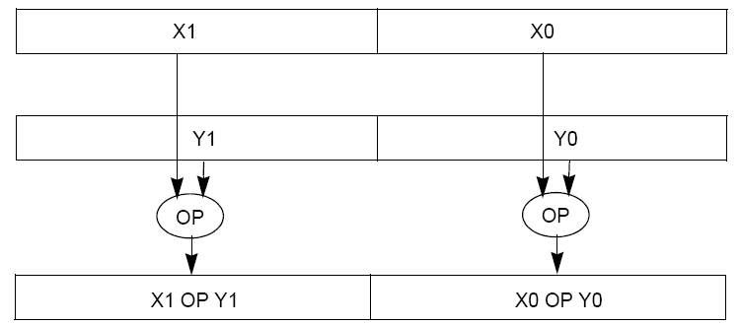
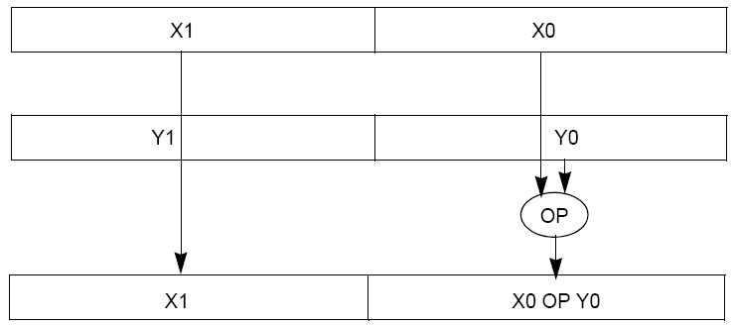
Packed and Scalar Double-Precision Floating-Point Operations
Packed
Scalar

Slide 11
Intel SSE Intrinsics
Intrinsics are C functions and procedures for inserting assembly language into C code, including SSE instructions
With intrinsics, can program using these instructions indirectly
One-to-one correspondence between SSE instructions and intrinsics

Slide 12
Example SSE Intrinsics
Instrinsics:
Corresponding SSE instructions:
Vector data type:
_m128d
Load and store operations:
_mm_load_pd MOVAPD/aligned, packed double
_mm_store_pd MOVAPD/aligned, packed double
_mm_loadu_pd MOVUPD/unaligned, packed double
_mm_storeu_pd MOVUPD/unaligned, packed double
Load and broadcast across vector
_mm_load1_pd MOVSD + shuffling/duplicating
Arithmetic:
_mm_add_pd ADDPD/add, packed double
_mm_mul_pd MULPD/multiple, packed double
02/09/2010
CS267 Lecture 7
12
Notes:
CS267 Lecture 2
12

Slide 13
Example: 2 x 2 Matrix Multiply
Definition of Matrix Multiply:
2
C_{i,j} = (A×B)_{i,j} = ∑ A_{i,k}× B_{k,j}
k = 1
A_{1,1}
A_{1,2}
B_{1,1}
B_{1,2}
C_{1,1}=A_{1,1}B_{1,1} + A_{1,2}B_{2,1}
C_{1,2}=A_{1,1}B_{1,2}+A_{1,2}B_{2,2}
x
=
A_{2,1}
A_{2,2}
B_{2,1}
B_{2,2}
C_{2,1}=A_{2,1}B_{1,1} + A_{2,2}B_{2,1}
C_{2,2}=A_{2,1}B_{1,2}+A_{2,2}B_{2,2}

Slide 14
Example: 2 x 2 Matrix Multiply
Using the XMM registers
Two 64-bit doubles per XMM reg
C₁
C_{1,1}
C_{2,1}
Stored in memory in Column-major order
C₂
C_{1,2}
C_{2,2}
A
A_{1,i}
A_{2,i}
B₁
B_{i,1}
B_{i,1}
B₂
B_{i,2}
B_{i,2}

Slide 15
Example: 2 x 2 Matrix Multiply
Initialization
I = 1
C₁
0
0
C₂
0
0
A
A_{1,1}
A_{2,1}
_mm_load_pd: Stored in memory in Column order
B₁
B_{1,1}
B_{1,1}
_mm_load1_pd: SSE instruction that loads a double word and stores it in the high and low double words of the XMM register
B₂
B_{1,2}
B_{1,2}

Slide 16
Example: 2 x 2 Matrix Multiply
Initialization
I = 1
C₁
0
0
C₂
0
0
A
A_{1,1}
A_{2,1}
_mm_load_pd: Load 2 doubles into XMM reg, Stored in memory in Column-major order
B₁
B_{1,1}
B_{1,1}
_mm_load1_pd: SSE instruction that loads a double word and stores it in the high and low double words of the XMM register (duplicates value in both halves of XMM)
B₂
B_{1,2}
B_{1,2}

Slide 17
Example: 2 x 2 Matrix Multiply
First iteration intermediate result
I = 1
C₁
0+A_{1,1}B_{1,1}
0+A_{2,1}B_{1,1}
c1 = _mm_add_pd(c1,_mm_mul_pd(a,b1));
c2 = _mm_add_pd(c2,_mm_mul_pd(a,b2));
SSE instructions first do parallel multiplies and then parallel adds in XMM registers
C₂
0+A_{1,1}B_{1,2}
0+A_{2,1}B_{1,2}
A
A_{1,1}
A_{2,1}
_mm_load_pd: Stored in memory in Column order
B₁
B_{1,1}
B_{1,1}
_mm_load1_pd: SSE instruction that loads a double word and stores it in the high and low double words of the XMM register (duplicates value in both halves of XMM)
B₂
B_{1,2}
B_{1,2}

Slide 18
Example: 2 x 2 Matrix Multiply
First iteration intermediate result
I = 2
C₁
0+A_{1,1}B_{1,1}
0+A_{2,1}B_{1,1}
c1 = _mm_add_pd(c1,_mm_mul_pd(a,b1));
c2 = _mm_add_pd(c2,_mm_mul_pd(a,b2));
SSE instructions first do parallel multiplies and then parallel adds in XMM registers
C₂
0+A_{1,1}B_{1,2}
0+A_{2,1}B_{1,2}
A
A_{1,2}
A_{2,2}
_mm_load_pd: Stored in memory in Column order
B₁
B_{2,1}
B_{2,1}
_mm_load1_pd: SSE instruction that loads a double word and stores it in the high and low double words of the XMM register (duplicates value in both halves of XMM)
B₂
B_{2,2}
B_{2,2}

Slide 19
Example: 2 x 2 Matrix Multiply
Second iteration intermediate result
I = 2
C_{1,1}
C_{2,1}
C₁
A_{1,1}B_{1,1}+A_{1,2}B_{2,1}
A_{2,1}B_{1,1}+A_{2,2}B_{2,1}
c1 = _mm_add_pd(c1,_mm_mul_pd(a,b1));
c2 = _mm_add_pd(c2,_mm_mul_pd(a,b2));
SSE instructions first do parallel multiplies and then parallel adds in XMM registers
C₂
A_{1,1}B_{1,2}+A_{1,2}B_{2,2}
A_{2,1}B_{1,2}+A_{2,2}B_{2,2}
C_{1,2}
C_{2,2}
A
A_{1,2}
A_{2,2}
_mm_load_pd: Stored in memory in Column order
B₁
B_{2,1}
B_{2,1}
_mm_load1_pd: SSE instruction that loads a double word and stores it in the high and low double words of the XMM register (duplicates value in both halves of XMM)
B₂
B_{2,2}
B_{2,2}

Slide 20
Live Example: 2 x 2 Matrix Multiply
Definition of Matrix Multiply:
2
C_{i,j} = (A×B)_{i,j} = ∑ A_{i,k}× B_{k,j}
k = 1
A_{1,1}
A_{1,2}
B_{1,1}
B_{1,2}
C_{1,1}=A_{1,1}B_{1,1} + A_{1,2}B_{2,1}
C_{1,2}=A_{1,1}B_{1,2}+A_{1,2}B_{2,2}
x
=
A_{2,1}
A_{2,2}
B_{2,1}
B_{2,2}
C_{2,1}=A_{2,1}B_{1,1} + A_{2,2}B_{2,1}
C_{2,2}=A_{2,1}B_{1,2}+A_{2,2}B_{2,2}
1
0
1
3
C_{1,1}= 1*1 + 0*2 = 1
C_{1,2}= 1*3 + 0*4 = 3
x
=
0
1
2
4
C_{2,1}= 0*1 + 1*2 = 2
C_{2,2}= 0*3 + 1*4 = 4

Slide 21
Example: 2 x 2 Matrix Multiply (Part 1 of 2)
#include <stdio.h>
// header file for SSE compiler intrinsics
#include <emmintrin.h>
// NOTE: vector registers will be represented in comments as v1 = [ a | b]
// where v1 is a variable of type __m128d and a, b are doubles
int main(void) {
// allocate A,B,C aligned on 16-byte boundaries
double A[4] __attribute__ ((aligned (16)));
double B[4] __attribute__ ((aligned (16)));
double C[4] __attribute__ ((aligned (16)));
int lda = 2;
int i = 0;
// declare several 128-bit vector variables
__m128d c1,c2,a,b1,b2;
// Initialize A, B, C for example
/* A = (note column order!)
1 0
0 1
*/
A[0] = 1.0; A[1] = 0.0; A[2] = 0.0; A[3] = 1.0;
/* B = (note column order!)
1 3
2 4
*/
B[0] = 1.0; B[1] = 2.0; B[2] = 3.0; B[3] = 4.0;
/* C = (note column order!)
0 0
0 0
*/
C[0] = 0.0; C[1] = 0.0; C[2] = 0.0; C[3] = 0.0;

Slide 22
Example: 2 x 2 Matrix Multiply (Part 2 of 2)
// used aligned loads to set
// c1 = [c_11 | c_21]
c1 = _mm_load_pd(C+0*lda);
// c2 = [c_12 | c_22]
c2 = _mm_load_pd(C+1*lda);
for (i = 0; i < 2; i++) {
/* a =
i = 0: [a_11 | a_21]
i = 1: [a_12 | a_22]
*/
a = _mm_load_pd(A+i*lda);
/* b1 =
i = 0: [b_11 | b_11]
i = 1: [b_21 | b_21]
*/
b1 = _mm_load1_pd(B+i+0*lda);
/* b2 =
i = 0: [b_12 | b_12]
i = 1: [b_22 | b_22]
*/
b2 = _mm_load1_pd(B+i+1*lda);
/* c1 =
i = 0: [c_11 + a_11*b_11 | c_21 + a_21*b_11]
i = 1: [c_11 + a_21*b_21 | c_21 + a_22*b_21]
*/
c1 = _mm_add_pd(c1,_mm_mul_pd(a,b1));
/* c2 =
i = 0: [c_12 + a_11*b_12 | c_22 + a_21*b_12]
i = 1: [c_12 + a_21*b_22 | c_22 + a_22*b_22]
*/
c2 = _mm_add_pd(c2,_mm_mul_pd(a,b2));
}
// store c1,c2 back into C for completion
_mm_store_pd(C+0*lda,c1);
_mm_store_pd(C+1*lda,c2);
// print C
printf("%g,%g\n%g,%g\n",C[0],C[2],C[1],C[3]);
return 0;
}

Slide 23
Inner loop from gcc –O -S
L2: movapd (%rax,%rsi), %xmm1 //Load aligned A[i,i+1]->m1
movddup (%rdx), %xmm0 //Load B[j], duplicate->m0
mulpd %xmm1, %xmm0 //Multiply m0*m1->m0
addpd %xmm0, %xmm3 //Add m0+m3->m3
movddup 16(%rdx), %xmm0 //Load B[j+1], duplicate->m0
mulpd %xmm0, %xmm1 //Multiply m0*m1->m1
addpd %xmm1, %xmm2 //Add m1+m2->m2
addq $16, %rax // rax+16 -> rax (i+=2)
addq $8, %rdx // rdx+8 -> rdx (j+=1)
cmpq $32, %rax // rax == 32?
jne L2 // jump to L2 if not equal
movapd %xmm3, (%rcx) //store aligned m3 into C[k,k+1]
movapd %xmm2, (%rdi) //store aligned m2 into C[l,l+1]

Slide 24
Performance-Driven ISA Extensions
Subword parallelism, used primarily for multimedia applications
Intel MMX: multimedia extension
64-bit registers can hold multiple integer operands
Intel SSE: Streaming SIMD extension
128-bit registers can hold several floating-point operands
Adding instructions that do more work per cycle
Shift-add: replace two instructions with one (e.g., multiply by 5)
Multiply-add: replace two instructions with one (x := c + a  b)
Multiply-accumulate: reduce round-off error (s := s + a  b)
Conditional copy: to avoid some branches (e.g., in if-then-else)

Slide 25
Administrivia
Lab #6, Project#2b posted
Midterm Tuesday Oct 9, 8PM:
Two rooms: 1 Pimentel and 2050 LSB
Check your room assignment!
Covers everything through lecture Wednesday 10/3
Closed book, can bring one sheet notes, both sides
Copy of Green card will be supplied
No phones, calculators, …; just bring pencils & eraser
TA Review: Sun. Oct. 7, 3-5pm, 2050 VLSB

Slide 26
Midterm Room Assignment by Login
1 Pimentel = logins ab – mk
2050 VLSB = logins mm - xm

Slide 27
Midterm Review
Topics we’ve covered

Slide 28
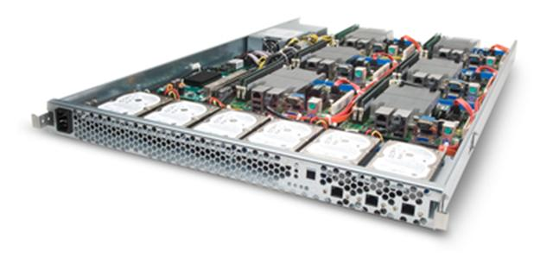
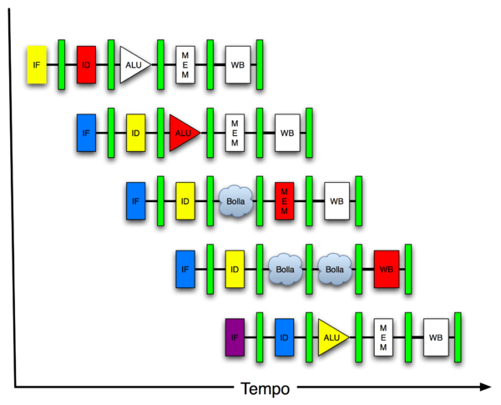
New-School Machine Structures (It’s a bit more complicated!)
Software Hardware
Parallel Requests
Assigned to computer
e.g., Search “Katz”
Parallel Threads
Assigned to core
e.g., Lookup, Ads
Parallel Instructions
>1 instruction @ one time
e.g., 5 pipelined instructions
Parallel Data
>1 data item @ one time
e.g., Add of 4 pairs of words
Hardware descriptions
All gates functioning in parallel at same time
Warehouse Scale Computer
Smart Phone
Harness Parallelism &
Achieve High Performance
Computer
Core
…
Core
Memory (Cache)
Input/Output
Core
Instruction Unit(s)
Functional
Unit(s)
A₀+B₀
A₁+B₁
A₂+B₂
A₃+B₃
Main Memory
Logic Gates

Slide 29
6 Great Ideas in Computer Architecture
Layers of Representation/Interpretation
Moore’s Law
Principle of Locality/Memory Hierarchy
Parallelism
Performance Measurement & Improvement
Dependability via Redundancy

Slide 30
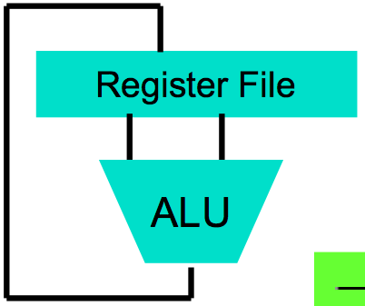
Great Idea #1: Levels of Representation/Interpretation
High Level Language Program (e.g., C)
temp = v[k];
v[k] = v[k+1];
v[k+1] = temp;
Compiler
Anything can be represented as a number, i.e., data or instructions
lw $t0, 0($2)
lw $t1, 4($2)
sw $t1, 0($2)
sw $t0, 4($2)
Assembly Language Program (e.g., MIPS)
Assembler
0000 1001 1100 0110 1010 1111 0101 1000
1010 1111 0101 1000 0000 1001 1100 0110
1100 0110 1010 1111 0101 1000 0000 1001
0101 1000 0000 1001 1100 0110 1010 1111
Machine Language Program (MIPS)
Machine Interpretation
Hardware Architecture Description (e.g., block diagrams)
Architecture Implementation
Logic Circuit Description (Circuit Schematic Diagrams)

Slide 31
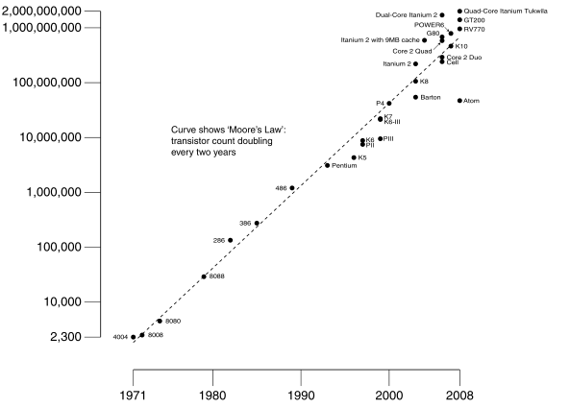
#2: Moore’s Law
Predicts: 2X Transistors / chip every 2 years
# of transistors on an integrated circuit (IC)
Gordon Moore Intel Cofounder B.S. Cal 1950!
Year

Slide 32
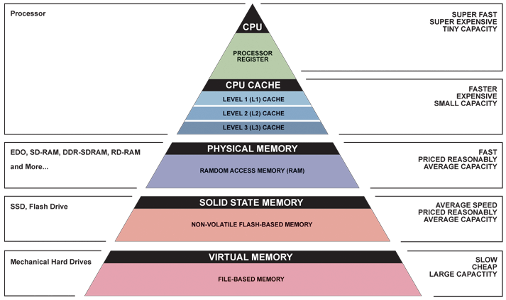
Great Idea #3: Principle of Locality/ Memory Hierarchy

Slide 33
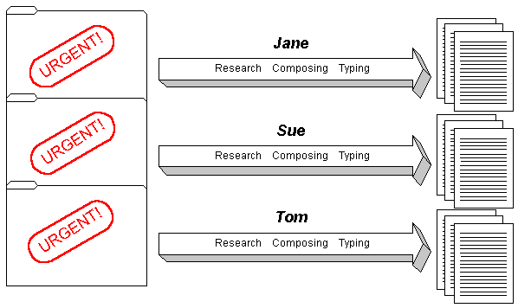
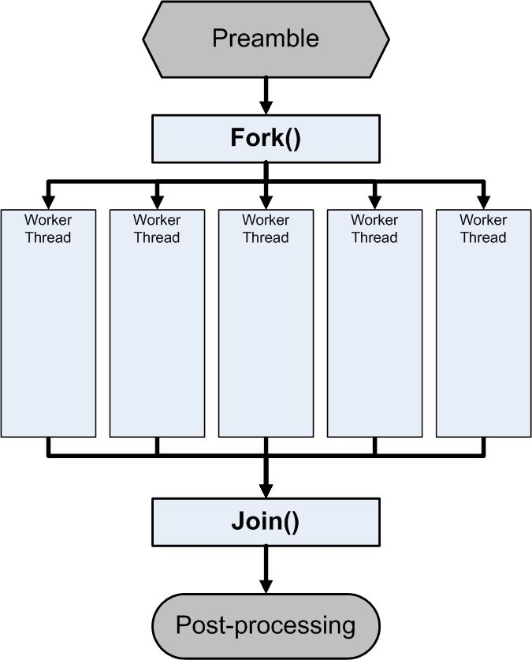
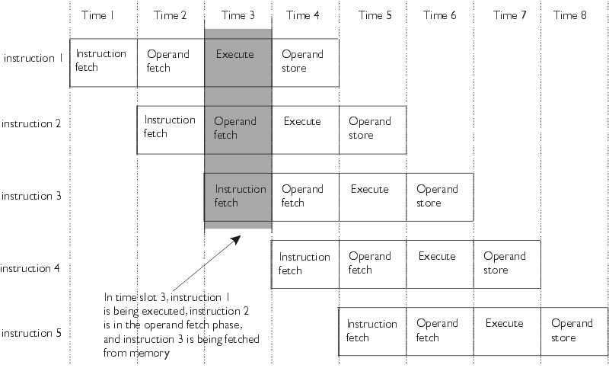
Great Idea #4: Parallelism

Slide 34
Great Idea #5: Performance Measurement and Improvement
Match application to underlying hardware to exploit:
Locality
Parallelism
Special hardware features, like specialized instructions (e.g., matrix manipulation)
Latency
How long to set the problem up
How much faster does it execute once it gets going
It is all about time to finish
Make common case fast!

Slide 35
Great Idea #6: Dependability via Redundancy
Redundancy so that a failing piece doesn’t make the whole system fail
1+1=2
2 of 3 agree
1+1=2
1+1=2
1+1=1
FAIL!
Increasing transistor density reduces the cost of redundancy

Slide 36
Warehouse-Scale Computers
Power Usage Effectiveness
Request-Level Parallelism
MapReduce
Handling failures
Costs of WSC

Slide 37
C Language and Compilation
C Types, including Structs, Consts, Enums
Arrays and strings
C Pointers
C functions and parameter passing

Slide 38
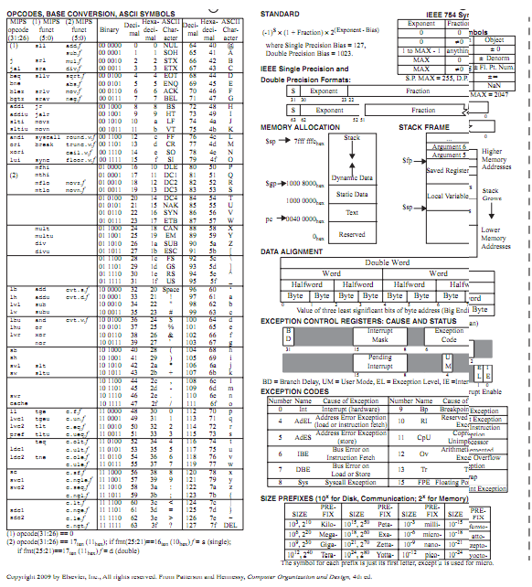
MIPS Instruction Set
ALU operations
Loads/Stores
Branches/Jumps
Registers
Memory
Function calling conventions
Stack

Slide 39
Everything is a Number
Binary
Signed versus Unsigned
One’s Complement/Two’s Complement
Floating-Point numbers
Character Strings
Instruction Encoding

Slide 40
Components of a Computer
Memory
Processor
Input
Enable?
Read/Write
Control
Datapath
Address
Bytes
PC
Registers
Write Data
Arithmetic & Logic Unit
(ALU)
ReadData
Output
Processor-Memory Interface
I/O-Memory Interfaces

Slide 41
Caches
Spatial/Temporal Locality
Instruction versus Data
Block size, capacity
Direct-Mapped cache
3 C’s
Cache-aware performance programming

Slide 42
Parallelism
SIMD/MIMD/MISD/SISD
Amdahl’s Law
Strong vs weak scaling
Data-Parallel execution

Slide 43
…in Conclusion
Intel SSE SIMD Instructions
One instruction fetch that operates on multiple operands simultaneously
128-bit XMM registers
SSE Instructions in C
Embed the SSE machine instructions directly into C programs through use of intrinsics
Achieve efficiency beyond that of optimizing compiler

