Slide 1
CS 61C: Great Ideas in Computer Architecture Introduction to C, Part I
Instructor:
Randy H. Katz
http://inst.eecs.Berkeley.edu/~cs61c/fa13

Slide 2
Agenda
WSC Economics (Highlights)
Compile vs. Interpret
Python vs. Java vs. C
Administrivia
Quick Start Introduction to C
Technology Break
Pointers
Arrays
And in Conclusion, …

Slide 3
Agenda
WSC Economics (Highlights)
Compile vs. Interpret
Python vs. Java vs. C
Administrivia
Quick Start Introduction to C
Technology Break
Pointers
Arrays
And in Conclusion, …

Slide 4
WSC Case Study Server Provisioning
WSC Power Capacity |  | 8.00 | MW
Power Usage Effectiveness (PUE) | 1.50
IT Equipment Power Share | 0.67 | 5.36 | MW
Power/Cooling Infrastructure | 0.33 | 2.64 | MW
IT Equipment Measured Peak (W) | 145.00
Assume Average Pwr @ 0.8 Peak | 116.00
# of Servers |  | 46207
# of Servers |  | 46000
# of Servers per Rack | 40.00
# of Racks |  | 1150
Top of Rack Switches |  | 1150
# of TOR Switch per L2 Switch | 16.00
# of L2 Switches |  | 72
# of L2 Switches per L3 Switch | 24.00
# of L3 Switches |  | 3
Internet
L3 Switch
L2 Switch
…
TOR Switch
Server
Rack …

Slide 5
WSC Case Study Capital Expenditure (Capex)
Facility cost and total IT cost look about the same
Facility Cost | $88,000,000
Total Server Cost | $66,700,000
Total Network Cost | $12,810,000
Total Cost | $167,510,000
However, replace servers every 3 years, networking gear every 4 years, and facility every 10 years

Slide 6
WSC Case Study Operational Expense (Opex)
Years
Amortization
Monthly Cost
Amortized
Capital
Expense
Server | 3 | $66,700,000 | $2,000,000 | 55%
Network | 4 | $12,530,000 | $295,000 | 8%
Facility |  | $88,000,000
Pwr&Cooling | 10 | $72,160,000 | $625,000 | 17%
Other | 10 | $15,840,000 | $140,000 | 4%
Amortized Cost |  |  | $3,060,000
Power (8MW) |  | $0.07 | $475,000 | 13%
People (3) |  |  | $85,000 | 2%
Total Monthly |  |  | $3,620,000 | 100%
Operational
Expense
$/kWh
$3.6M/46000 servers = ~$80 per month per server in revenue to break even
~$80/720 hours per month = $0.11 per hour
So how does Amazon EC2 make money???

Slide 7
August 2013 AWS Instances & Prices
Instance | Per Hour | Ratio to Small | Compute Units | Virtual Cores | Compute Unit/ Core | Memory (GB) | Disk (GB) | Address
Standard Small | $0.065 | 1.0 | 1.0 | 1 | 1.00 | 1.7 | 160 | 32 bit
Standard Large | $0.260 | 4.0 | 4.0 | 2 | 2.00 | 7.5 | 840 | 64 bit
Standard Extra Large | $0.520 | 8.0 | 8.0 | 4 | 2.00 | 15.0 | 1680 | 64 bit
High-Memory Extra Large | $0.460 | 7.1 | 6.5 | 2 | 3.25 | 17.1 | 420 | 64 bit
High-Memory Double Extra Large | $0.920 | 14.2 | 13.0 | 4 | 3.25 | 34.2 | 850 | 64 bit
High-Memory Quadruple Extra Large | $1.840 | 28.3 | 26.0 | 8 | 3.25 | 68.4 | 1690 | 64 bit
High-CPU Medium | $0.165 | 2.5 | 5.0 | 2 | 2.50 | 1.7 | 350 | 32 bit
High-CPU Extra Large | $0.660 | 10.2 | 20.0 | 8 | 2.50 | 7.0 | 1690 | 64 bit
XXXXXXXXXXXXXXX | $X | 15.3 | 33.5 | 16 | 2.09 | 23.0 | 1690 | 64 bit
Closest computer in WSC example is Standard Extra Large
@$0.11/hr, Amazon EC2 can make money!
even if used only 50% of time
See http://aws.amazon.com/ec2/pricing and http://docs.aws.amazon.com/AWSEC2/latest/UserGuide/instance-types.html

Slide 8
Which statement is TRUE about Warehouse Scale Computer economics?
☐
The dominant operational monthly cost is server replacement.
☐
The dominant operational monthly cost is the electric bill.
☐
The dominant operational monthly cost is facility replacement.
☐
The dominant operational monthly cost is operator salaries.
9/5/13
Fall 2013 -- Lecture #3
Notes:
VertLeftWhiteCheck1
No

Slide 9
Which statement is TRUE about Warehouse Scale Computer economics?
☐
The dominant operational monthly cost is server replacement.
☐
The dominant operational monthly cost is the electric bill.
☐
The dominant operational monthly cost is facility replacement.
☐
The dominant operational monthly cost is operator salaries.
9/5/13
Fall 2013 -- Lecture #3
Notes:
VertLeftWhiteCheck1
No

Slide 10
Agenda
WSC Economics (Highlights)
Compile vs. Interpret
Python vs. Java vs. C
Administrivia
Quick Start Introduction to C
Technology Break
Pointers
Arrays
And in Conclusion, …

Slide 11
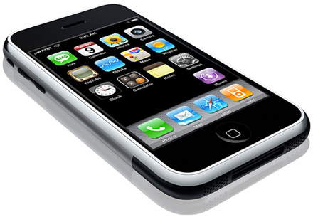
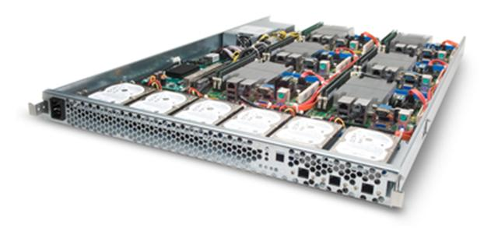
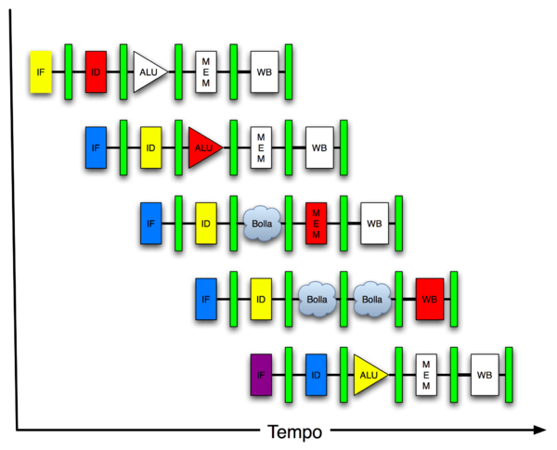
New-School Machine Structures (It’s a bit more complicated!)
Software Hardware
Parallel Requests
Assigned to computer
e.g., Search “Katz”
Parallel Threads
Assigned to core
e.g., Lookup, Ads
Parallel Instructions
>1 instruction @ one time
e.g., 5 pipelined instructions
Parallel Data
>1 data item @ one time
e.g., Add of 4 pairs of words
Hardware descriptions
All gates @ one time
Programming Languages
Warehouse Scale Computer
Smart Phone
Harness Parallelism &
Achieve High Performance
Computer
Core
…
Core
Memory (Cache)
Input/Output
Core
Instruction Unit(s)
Functional
Unit(s)
A₀+B₀
A₁+B₁
A₂+B₂
A₃+B₃
Cache Memory
Today’s Lecture
Logic Gates

Slide 12
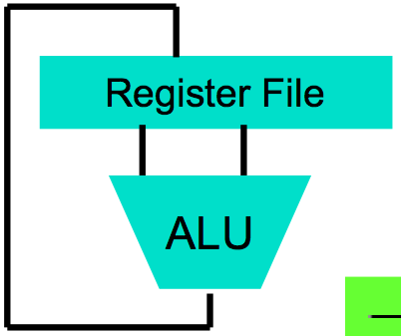
Great Idea: Levels of Representation/Interpretation
High Level Language Program (e.g., C)
temp = v[k];
v[k] = v[k+1];
v[k+1] = temp;
We are here!
Compiler
Anything can be represented as a number, i.e., data or instructions
lw $t0, 0($2)
lw $t1, 4($2)
sw $t1, 0($2)
sw $t0, 4($2)
Assembly Language Program (e.g., MIPS)
Assembler
0000 1001 1100 0110 1010 1111 0101 1000
1010 1111 0101 1000 0000 1001 1100 0110
1100 0110 1010 1111 0101 1000 0000 1001
0101 1000 0000 1001 1100 0110 1010 1111
Machine Language Program (MIPS)
Machine Interpretation
Hardware Architecture Description (e.g., block diagrams)
Architecture Implementation
Logic Circuit Description (Circuit Schematic Diagrams)

Slide 13
Introduction to C “The Universal Assembly Language”
“Some” experience is required before CS61C
C++ or Java OK
Class pre-req included classes teaching Java
Java used in two labs and one project
C used for everything else

Slide 14
Language Poll!
Please raise card for first one of following you can say yes to
☐
I have programmed in C,C++,C#, or Objective-C
☐
I have programmed in Java
I have programmed in FORTRAN, Cobol, Algol-68, Ada, Pascal, or Basic
☐
☐
None of the above
9/5/13
Fall 2013 -- Lecture #3

Slide 15
Disclaimer
You will not learn how to fully code in C in these lectures! You’ll still need your C reference for this course
K&R is a must-have
Check online for more sources
“JAVA in a Nutshell,” O’Reilly
Chapter 2, “How Java Differs from C”
http://oreilly.com/catalog/javanut/excerpt/index.html
Brian Harvey’s helpful transition notes
On CS61C class website: pages 3-19
http://inst.eecs.berkeley.edu/~cs61c/resources/HarveyNotesC1-3.pdf
Key C concepts: Pointers, Arrays, Implications for Memory management

Slide 16
Intro to C
C is not a “very high level” language, nor a “big” one, and is not specialized to any particular area of application. But its absence of restrictions and its generality make it more convenient and effective for many tasks than supposedly more powerful languages.
Kernighan and Ritchie
Enabled first operating system not written in assembly language: UNIX - A portable OS!
C and derivatives (C++/Obj-C/C#) still one of the most popular application programming languages after >40 years!

Slide 17
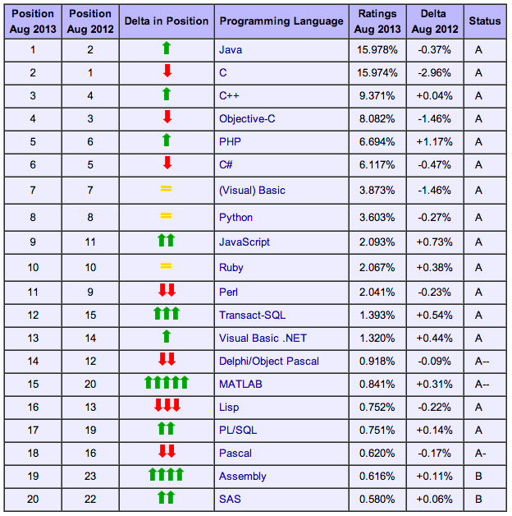
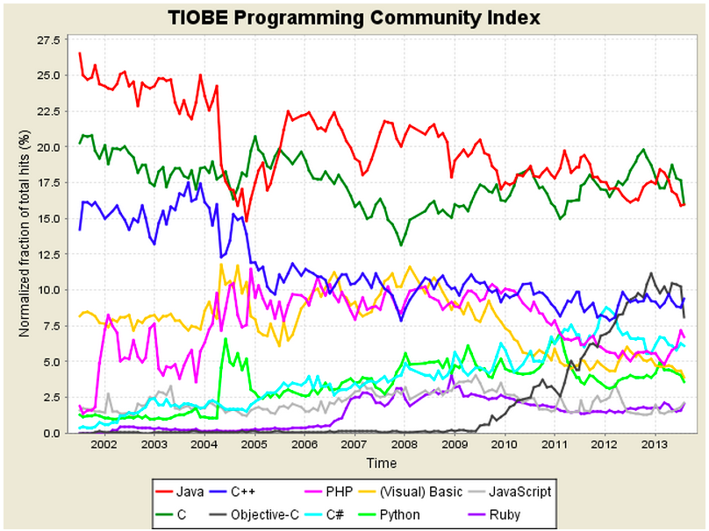
TIOBE Index of Language Popularity
http://www.tiobe.com/index.php/content/paperinfo/tpci/index.html
Notes:
http://www.tiobe.com/index.php/content/paperinfo/tpci/index.html

Slide 18
Basic C Concepts
Compiler
Typed variables
Typed functions
Header files (.h)
Structs
Enums
Pointers
Creates useable programs from C source
Kind of data that a variable contains
The kind of data returned from a function
Declare functions and variables in a separate file
Groups of related values
Lists of predefined values
Aliases to other variables
These concepts distinguish C from other languages you may know

Slide 19
Integers: Python vs. Java vs. C
Language | sizeof(int)
Python | >=32 bits (plain ints), infinite (long ints)
Java | 32 bits
C | Depends on computer; 16 or 32 or 64
C: int should be integer type that target processor works with most efficiently
Only guarantee: sizeof(long long) ≥ sizeof(long) ≥ sizeof(int) ≥ sizeof(short)
All could be 64 bits
Notes:
C: The actual size of integer types varies by implementation. The only guarantee is that the long long is not smaller than long, which is not smaller than int, which is not smaller than short. Also, int should be the integer type that the target processor is most efficient working with. This allows great flexibility: for example, all types can be 64-bit.

Slide 20
C vs. Java
 | C | Java
Type of Language | Function Oriented | Object Oriented
Program-ming Unit | Function | Class = Abstract Data Type
Compilation | gcc hello.c creates machine language code | javac Hello.java creates Java virtual machine language bytecode
Execution | a.out loads and executes program | java Hello interprets bytecodes
hello, world | #include<stdio.h> int main(void) { printf("Hello\n"); return 0; } | public class HelloWorld { public static void main(String[] args) { System.out.printl("Hello"); } }
Storage | Manual (malloc, free) | Automatic (garbage collection)
From http://www.cs.princeton.edu/introcs/faq/c2java.html

Slide 21
C vs. Java
 | C | Java
Comments | /* … */ | /* … */ or // … end of line
Constants | const, #define | final
Preprocessor | Yes | No
Variable declaration | At beginning of a block | Before you use it
Variable naming conventions | sum_of_squares | sumOfSquares
Accessing a library | #include <stdio.h> | import java.io.File;
From http://www.cs.princeton.edu/introcs/faq/c2java.html

Slide 22
Compilation: Overview
C compilers map C programs into architecture-specific machine code (string of 1s and 0s)
Unlike Java, which converts to architecture-independent bytecode
Unlike Python environments, which interpret the code
These differ mainly in exactly when your program is converted to low-level machine instructions (“levels of interpretation”)
For C, generally a two part process of compiling .c files to .o files, then linking the .o files into executables;
Assembling is also done (but is hidden, i.e., done automatically, by default); we’ll talk about that later

Slide 23
Compilation: Advantages
Excellent run-time performance: generally much faster than Scheme or Java for comparable code (because it optimizes for a given architecture)
Fair compilation time: enhancements in compilation procedure (Makefiles) allow only modified files to be recompiled
Why C?: we can write programs that allow us to exploit underlying features of the architecture – memory management, special instructions, parallelism

Slide 24
Compilation: Disadvantages
Compiled files, including the executable, are architecture-specific, depending on processor type and the operating system
Executable must be rebuilt on each new system
I.e., “porting your code” to a new architecture
“Change → Compile → Run [repeat]” iteration cycle can be slow, during the development cycle

Slide 25
Typed Variables in C
int variable1 = 2;
float variable2 = 1.618;
char variable3 = 'A';
Must declare the type of data a variable will hold
Types can't change
Type Description Examples
int integer numbers, including negatives 0, 78, -1400
unsigned int integer numbers (no negatives) 0, 46, 900
float floating point decimal numbers 0.0, 1.618, -1.4
char single text character or symbol 'a', 'D', '?’
double greater precision/big FP number 10E100 long larger signed integer 6,000,000,000

Slide 26
Typed Functions in C
int number_of_people ()
{
return 3;
}
float dollars_and_cents ()
{
return 10.33;
}
char first_letter ()
{
return 'A';
}
You have to declare the type of data you plan to return from a function
Return type can be any C variable type, and is placed to the left of the function name
You can also specify the return type as void
Just think of this as saying that no value will be returned
Also necessary to declare types for values passed into a function
Variables and functions MUST be declared before they are used

Slide 27
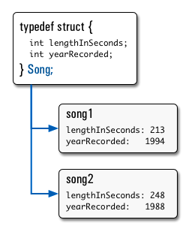
Structs in C
Structs are structured groups of variables, e.g.,
typedef struct {
int length_in_seconds;
int yearRecorded;
} Song;
Song song1;
Song1.length_in_seconds = 213;
song1.yearRecorded = 1994;
Song song2;
Song2.length_in_seconds = 248;
song2.yearRecorded = 1988;
Dot notation: x.y = value

Slide 28
Consts and Enums in C
Constant is assigned a value once in the declaration; value can't change during entire execution of program
const float golden_ratio = 1.618;
const int days_in_week = 7;
You can have a constant version of any of the standard C variable types
Enums: a group of related integer constants used to parameterize libraries:
enum cardsuit {CLUBS,DIAMONDS,HEARTS,SPADES};

Slide 29
Which statement is TRUE regarding C and Java?
☐
short, int, and long are in both languages and they have the same meaning
☐
As Java was derived from C, it has the same names of data types
☐
C programs use compilers to produce executable code but Java does not
☐
C has a preprocessor that allows conditional compilation, but Java does not
9/5/13
Fall 2013 -- Lecture #3
Notes:
VertLeftWhiteCheck1
A is wrong: short, int, long are 16, 32, 64 signed integers, but they could all be 64 bits in C
B is wrong. Java has boolean, byte; C has long long, unisigned int
C is wrong; Java uses JIT; also, still compile to produce byte codes

Slide 30
Which statement is TRUE regarding C and Java?
☐
short, int, and long are in both languages and they have the same meaning
☐
As Java was derived from C, it has the same names of data types
☐
C programs use compilers to produce executable code but Java does not
☐
C has a preprocessor that allows conditional compilation, but Java does not
9/5/13
Fall 2013 -- Lecture #3
Notes:
VertLeftWhiteCheck1
A is wrong: short, int, long are 16, 32, 64 signed integers, but they could all be 64 bits in C
B is wrong. Java has boolean, byte; C has long long, unisigned int
C is wrong; Java uses JIT; also, still compile to produce byte codes

Slide 31
Agenda
WSC Economics (Highlights)
Compile vs. Interpret
Scheme vs. Java vs. C
Administrivia
Quick Start Introduction to C
Technology Break
Pointers
Arrays
And in Conclusion, …

Slide 32
Administrivia
CS61c is relentless!
Next week: Lab #2, HW #2
Lab #2, Amazon EC2
HW #2 will soon be posted
Your professor requests:
Need to leave early? Sit near aisles please …
Want to use computer, cell phone? Sit near back of auditorium …

Slide 33
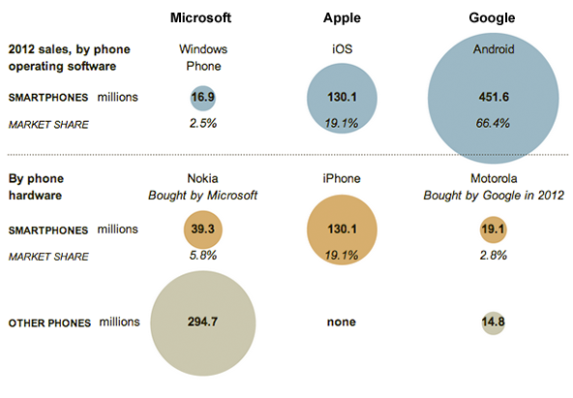
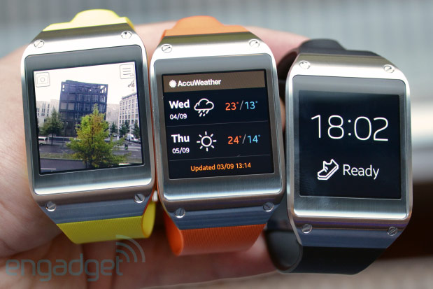
CS 61c in the News
Relative Smartphone Marketshare
Samsung Galaxy Gear Smart Watch Wearable Computer

Slide 34
Agenda
WSC Economics (Highlights)
Compile vs. Interpret
Scheme vs. Java vs. C
Administrivia
Quick Start Introduction to C
Technology Break
Pointers
Arrays
And in Conclusion, …

Slide 35
A First C Program: Hello World
Original C:
main()
{
printf("\nHello World\n");
}
ANSI Standard C:
#include <stdio.h>
int main(void)
{
printf("\nHello World\n");
return (0);
}

Slide 36
C Syntax: main
When C program starts,
1st runs job to set up computer
Then calls your procedure names main ()
To get arguments to the main function, use:
int main (int argc, char *argv[])
What does this mean?
argc contains the number of strings on the command line (the executable counts as one, plus one for each argument). Here argc is 2:
unix% sort myFile
argv is a pointer to an array containing the arguments as strings (more on pointers later)

Slide 37
Example
foo hello 87
argc = 3 /* number arguments */
argv[0] = "foo", argv[1] = "hello", argv[2] = "87"
Array of pointers to strings (cover later)

Slide 38
A Second C Program: Compute Table of Sines
#include <stdio.h>
#include <math.h>
int main(void)
{
int angle_degree;
double angle_radian, pi, value;
/* Print a header */
printf("\nCompute a table of the sine function\n\n");
/* obtain pi once for all */
/* or just use pi = M_PI, where */
/* M_PI is defined in math.h */
pi = 4.0*atan(1.0);
printf("Value of PI = %f \n\n", pi);
printf("angle Sine \n");
angle_degree = 0;
/* initial angle value */
/* scan over angle */
while (angle_degree <= 360)
/* loop until angle_degree > 360 */
{
angle_radian = pi*angle_degree/180.0;
value = sin(angle_radian);
printf (" %3d %f \n ", angle_degree, value);
angle_degree = angle_degree + 10;
/* increment the loop index */
}
}

Slide 39
Second C Program Sample Output
Compute a table of the sine function
Value of PI = 3.141593
angle Sine
0 0.000000
10 0.173648
20 0.342020
30 0.500000
40 0.642788
50 0.766044
60 0.866025
70 0.939693
80 0.984808
90 1.000000
100 0.984808
110 0.939693
120 0.866025
130 0.766044
140 0.642788
150 0.500000
160 0.342020
170 0.173648
180 0.000000
190 -0.173648
200 -0.342020
210 -0.500000
220 -0.642788
230 -0.766044
240 -0.866025
250 -0.939693
260 -0.984808
270 -1.000000
280 -0.984808
290 -0.939693
300 -0.866025
310 -0.766044
320 -0.642788
330 -0.500000
340 -0.342020
350 -0.173648
360 -0.000000

Slide 40
C Syntax: Variable Declarations
Similar to Java, but with a few minor but important differences
All variable declarations must appear before they are used (e.g., at the beginning of the block)
A variable may be initialized in its declaration; if not, it holds garbage!
Examples of declarations:
Correct: {
int a = 0, b = 10;
...
Incorrect: for (int i = 0; i < 10; i++)
}

Slide 41
C Syntax : Control Flow (1/2)
Within a function, remarkably close to Java constructs (shows Java’s legacy) in terms of control flow
if-else
if (expression) statement
if (expression) statement1
else statement2
while
while (expression)
statement
do
statement
while (expression);

Slide 42
C Syntax : Control Flow (2/2)
for
for (initialize; check; update) statement
switch
switch (expression){
case const1: statements
case const2: statements
default: statements
}
break

Slide 43
C Syntax: True or False
What evaluates to FALSE in C?
0 (integer)
NULL (a special kind of pointer: more on this later)
No explicit Boolean type
What evaluates to TRUE in C?
Anything that isn’t false is true
Same idea as in Python: only 0s or empty sequences are false, anything else is true!

Slide 44
C and Java operators nearly identical
arithmetic: +, -, *, /, %
assignment: =
augmented assignment: +=, -=, *=, /=, %=, &=, |=, ^=, <<=, >>=
bitwise logic: ~, &, |, ^
bitwise shifts: <<, >>
boolean logic: !, &&, ||
equality testing: ==, !=
subexpression grouping: ( )
order relations: <, <=, >, >=
increment and decrement: ++ and --
member selection: ., ->
conditional evaluation: ? :

Slide 45
Agenda
WSC Economics (Highlights)
Compile vs. Interpret
Python vs. Java vs. C
Administrivia
Quick Start Introduction to C
Technology Break
Pointers
Arrays
And in Conclusion, …

Slide 46
Agenda
WSC Economics (Highlights)
Compile vs. Interpret
Python vs. Java vs. C
Administrivia
Quick Start Introduction to C
Technology Break
Pointers
Arrays
And in Conclusion, …

Slide 47
Address vs. Value
Consider memory to be a single huge array
Each cell of the array has an address associated with it
Each cell also stores some value
Do you think they use signed or unsigned numbers? Negative address?!
Don’t confuse the address referring to a memory location with the value stored there
...
101 102 103 104 105 ...
...
23
42

Slide 48
Pointers
An address refers to a particular memory location; e.g., it points to a memory location
Pointer: A variable that contains the address of a variable
Location (address)
...
101 102 103 104 105 ...
104
...
23
42
p
x
y
name

Slide 49
Pointer Syntax
int *x;
Tells compiler that variable x is address of an int
x = &y;
Tells compiler to assign address of y to x
& called the “address operator” in this context
z = *x;
Tells compiler to assign value at address in x to z
* called the “dereference operator” in this context

Slide 50
Creating and Using Pointers
How to create a pointer:
& operator: get address of a variable
int *p, x;
Note the “*” gets used 2 different ways in this example. In the declaration to indicate that p is going to be a pointer, and in the printf to get the value pointed to by p.
p
?
x
?
x = 3;
p
?
x
3
p = &x;
p
x
3
How get a value pointed to?
“*” (dereference operator): get the value that the pointer points to
printf(“p points to %d\n”,*p);

Slide 51
Using Pointer for Writes
How to change a variable pointed to?
Use the dereference operator * on left of assignment operator =
p
x
3
*p = 5;
p
x
5

Slide 52
Pointers and Parameter Passing
Java and C pass parameters “by value”
Procedure/function/method gets a copy of the parameter, so changing the copy cannot change the original
void addOne (int x) { x = x + 1; }
int y = 3;
addOne(y);
y remains equal to 3

Slide 53
Pointers and Parameter Passing
How can we get a function to change the value held in a variable?
void addOne (int *p) { *p = *p + 1; }
int y = 3;
addOne(&y);
y is now equal to 4

Slide 54
Types of Pointers
Pointers are used to point to any kind of data (int, char, a struct, etc.)
Normally a pointer only points to one type (int, char, a struct, etc.).
void * is a type that can point to anything (generic pointer)
Use sparingly to help avoid program bugs, and security issues, and other bad things!

Slide 55
More C Pointer Dangers
Declaring a pointer just allocates space to hold the pointer – it does not allocate the thing being pointed to!
Local variables in C are not initialized, they may contain anything (aka “garbage”)
What does the following code do?
void f()
{
int *ptr;
*ptr = 5;
}

Slide 56
Pointers and Structures
struct Point {
int x;
int y;
};
Point p1;
Point p2;
Point *paddr;
/* dot notation */
int h = p1.x;
p2.y = p1.y;
/* arrow notation */
int h = paddr->x;
int h = (*paddr).x;
/* This works too */
p1 = p2;

Slide 57
Pointers in C
Why use pointers?
If we want to pass a large struct or array, it’s easier / faster / etc. to pass a pointer than the whole thing
In general, pointers allow cleaner, more compact code
So what are the drawbacks?
Pointers are probably the single largest source of bugs in C, so be careful anytime you deal with them
Most problematic with dynamic memory management—which you will to know by the end of the semester, but not for the projects (there will be a lab later in the semester)
Dangling references and memory leaks

Slide 58
Why Pointers in C?
At time C was invented (early 1970s), compilers often didn’t produce efficient code
Computers 25,000 times faster today, compilers better
C designed to let programmer say what they want code to do without compiler getting in way
Even give compilers hints which registers to use!
Today’s compilers produce much better code, so may not need to use pointers
Compilers even ignore hints since they do it better!

Slide 59
How many logic and syntax errors?
void main(); { int *p, x=5, y; // init y = *(p = &x) + 1; int z; flip-sign(p); printf("x=%d,y=%d,p=%d\n",x,y,p); } flip-sign(int *n){*n = -(*n)}
☐
1
☐
2
☐
3
☐
≥4
9/5/13
Fall 2013 -- Lecture #3
Notes:
VertLeftWhiteCheck1
A is wrong: short, int, long are 16, 32, 64 signed integers, but they could all be 64 bits in C
B is wrong. Java has boolean, byte; C has long long, unisigned int
C is wrong; Java uses JIT; also, still compile to produce byte codes

Slide 60
What is output after correct errors?
void main(); { int *p, x=5, y; // init int z;
y = *(p = &x) + 1; flip-sign(p); printf("x=%d,y=%d,p=%d\n",
x,y,*p); } flip-sign(int *n) {*n = -(*n); }
☐
x=5,y=6,p=-5
☐
x=-5,y=6,p=-5
☐
x=-5,y=4,p=-5
☐
x=-5,y=-6,p=-5
9/5/13
Fall 2013 -- Lecture #3
Notes:
VertLeftWhiteCheck1
B is correct; p points to x

Slide 61
Arrays (1/5)
Declaration:
int ar[2];
declares a 2-element integer array: just a block of memory
int ar[] = {795, 635};
declares and initializes a 2-element integer array
Accessing elements:
ar[num]
returns the num^{th} element

Slide 62
Arrays (2/5)
C arrays are (almost) identical to pointers
char *string and char string[] are nearly identical declarations
Differ in subtle ways: incrementing, declaration of filled arrays
End of C string marked by 0 in last character
Key Concept: Array variable is a “pointer” to the first (0th) element

Slide 63
C Strings
String in C is just an array of characters
char string[] = "abc";
How do you tell how long a string is?
Last character is followed by a 0 byte (aka “null terminator”)
int strlen(char s[])
{
int n = 0;
while (s[n] != 0) n++;
return n;
}

Slide 64
Arrays (3/5)
Consequences:
ar is an array variable, but looks like a pointer
ar[0] is the same as *ar
ar[2] is the same as *(ar+2)
We can use pointer arithmetic to conveniently access arrays
Declared arrays are only allocated while the scope is valid
char *foo() { char string[32]; ...; return string; }
is incorrect and very very bad

Slide 65
Arrays (4/5)
Array size n; want to access from 0 to n-1, so you should use counter AND utilize a variable for declaration & incrementation
Bad pattern int i, ar[10]; for(i = 0; i < 10; i++){ ... }
Better pattern int ARRAY_SIZE = 10 int i, a[ARRAY_SIZE]; for(i = 0; i < ARRAY_SIZE; i++){ ... }
SINGLE SOURCE OF TRUTH
You’re utilizing indirection and avoiding maintaining two copies of the number 10
DRY: “Don’t Repeat Yourself”

Slide 66
Arrays (5/5)
Pitfall: An array in C does not know its own length, and its bounds are not checked!
Consequence: We can accidentally access off the end of an array
Consequence: We must pass the array and its size to any procedure that is going to manipulate it
Segmentation faults and bus errors:
These are VERY difficult to find; be careful! (You’ll learn how to debug these in lab)

Slide 67
Array Summary
Array indexing is syntactic sugar for pointers
a[i] is treated as *(a+i)
E.g., three equivalent ways to zero an array:
for (i=0; i < size; i++) a[i] = 0;
for (i=0; i < size; i++) *(a+i) = 0;
for (p=a; p < a+size; p++) *p = 0;
Incrementing a pointer makes it point to the next variable in memory (type of pointer says how big each variable is)

Slide 68
What is TRUE about this function?
void foo(char *s, char *t) { while (*s)
s++;
while (*s++ = *t++)
; }
☐
It has syntax errors
☐
No syntax errors; it changes characters in string t to next character in the string s
☐
No syntax errors; it copies a string at address t to the string at address s
☐
No syntax errors; it appends the string at address t to the end of the string at address s
9/5/13
Fall 2013 -- Lecture #3
Notes:
VertLeftWhiteCheck1
D is correct

Slide 69
Question: Which statement is FALSE regarding C and Java?
☐
Arrays in C are just pointers to the 0-th element
☐
As Java was derived from C, it has the same control flow constructs
☐
Like Java, in C you can check the length of an array ( a.length gives no. elements in a)
☐
C has pointers but Java does not allow you to manipulate pointers or memory addresses of any kind
Notes:
VertLeftWhiteCheck1
C is wrong; variable length

Slide 70
FYI—Update to ANSI C
“C99” or “C9X” standard
gcc -std=c99 to compile
References
http://en.wikipedia.org/wiki/C99
http://home.tiscalinet.ch/t_wolf/tw/c/c9x_changes.html
Highlights
Declarations in for loops, like Java
Java-like // comments (to end of line)
Variable-length non-global arrays
<inttypes.h>: explicit integer types
<stdbool.h>: for boolean logic types and definitions

Slide 71
And In Conclusion, …
All data is in memory
Each memory location has an address to use to refer to it and a value stored in it
Pointer is a C version (abstraction) of a data address
* “follows” a pointer to its value
& gets the address of a value
Arrays and strings are implemented as variations on pointers
C is an efficient language, but leaves safety to the programmer
Array bounds not checked
Variables not automatically initialized
Use pointers with care: they are a common source of bugs in programs

