Slide 1
CS 61C: Great Ideas in Computer Architecture Course Summary and Wrap-up
Instructor:
Sung Roa Yoon
Slides:
Randy H. Katz
http://inst.eecs.Berkeley.edu/~cs61c/fa13

Slide 2
New “Great Ideas” RISC Machines + Cloud Servers
Personal Mobile Devices

Slide 3
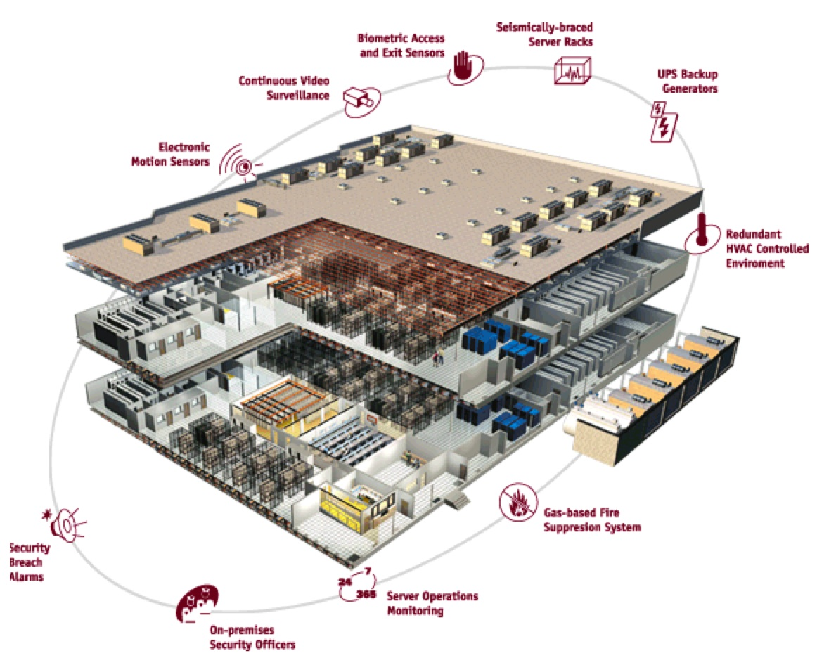
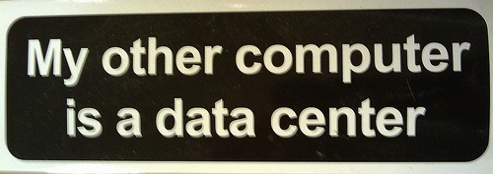
Warehouse
Scale
Computer

Slide 4
Old Machine Structures
Application (ex: browser)
CS61c
Operating
Compiler
System
(Mac OSX)
Software
Assembler
Instruction Set
Architecture
Hardware
Processor
Memory
I/O system
Datapath & Control
Digital Design
Circuit Design
transistors

Slide 5
CS61c is NOT about C Programming
It’s about the hardware-software interface
What does the programmer need to know to achieve the highest possible performance
Languages like C are closer to the underlying hardware, unlike languages like Python!
Allows us to talk about key hardware features in higher level terms
Allows programmer to explicitly harness underlying hardware parallelism for high performance: “programming for performance”

Slide 6
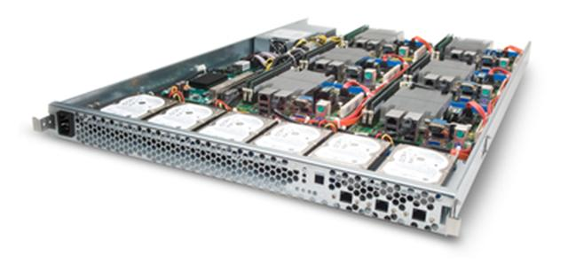
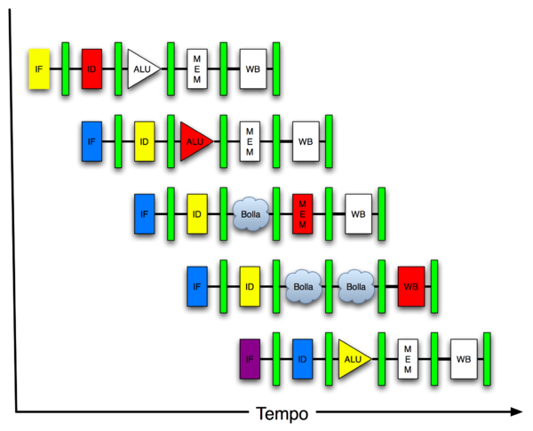
New-School Machine Structures (It’s a bit more complicated!)
Project 1
Software Hardware
Parallel Requests
Assigned to computer
e.g., Search “Katz”
Parallel Threads
Assigned to core
e.g., Lookup, Ads
Parallel Instructions
>1 instruction @ one time
e.g., 5 pipelined instructions
Parallel Data
>1 data item @ one time
e.g., Add of 4 pairs of words
Hardware descriptions
All gates functioning in parallel at same time
Programming Languages
Warehouse Scale Computer
Smart Phone
Leverage Parallelism &
Achieve High Performance
Project 2
Computer
Core
…
Core
Memory
Project 3
Input/Output
Core
Instruction Unit(s)
Functional
Unit(s)
A₀+B₀
A₁+B₁
A₂+B₂
A₃+B₃
Cache Memory
Logic Gates
Project 4

Slide 7
Great Ideas in Computer Architecture
Design for Moore’s Law
Abstraction to Simplify Design
Make the Common Case Fast
Dependability via Redundancy
Memory Hierarchy
Performance via Parallelism/Pipelining/Prediction

Slide 8
Powers of Ten inspired 61C Overview
Going Top Down cover 3 Views
Architecture (when possible)
Physical Implementation of that architecture
Programming system for that architecture and implementation (when possible)
See http://www.powersof10.com/film

Slide 9
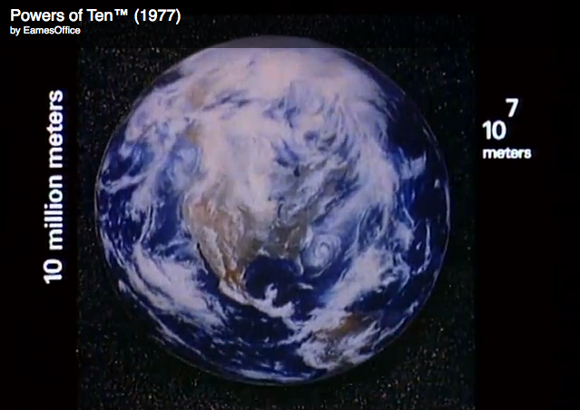
Earth
10⁷ meters

Slide 10
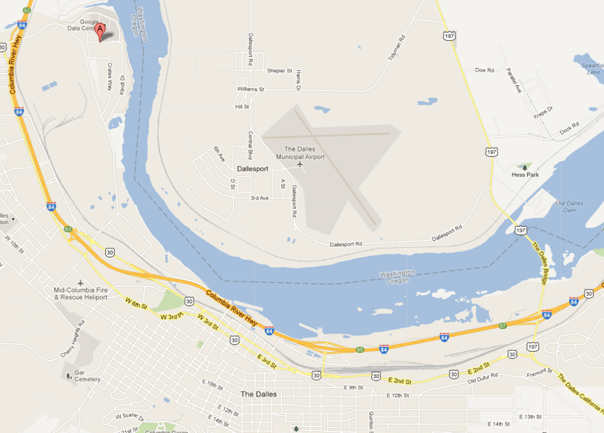
The Dalles, Oregon
10⁴ meters

Slide 11
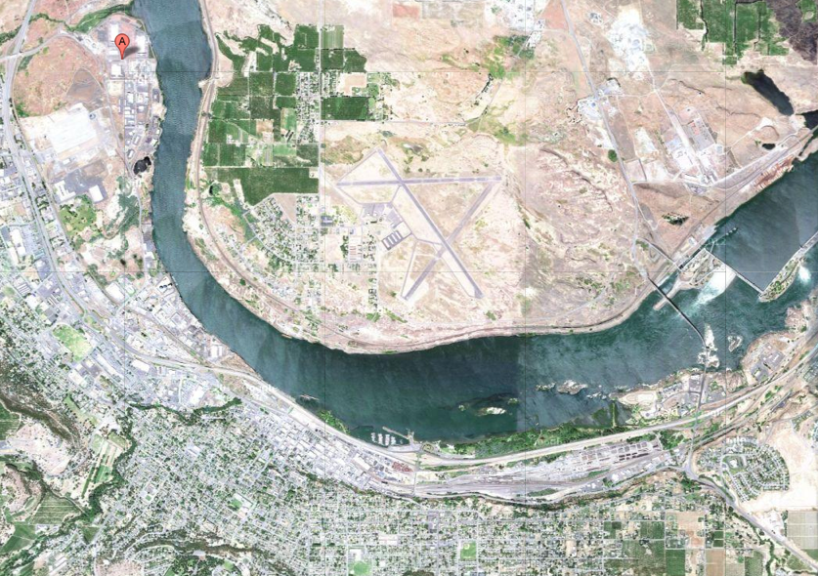
The Dalles, Oregon
10⁴ meters

Slide 12
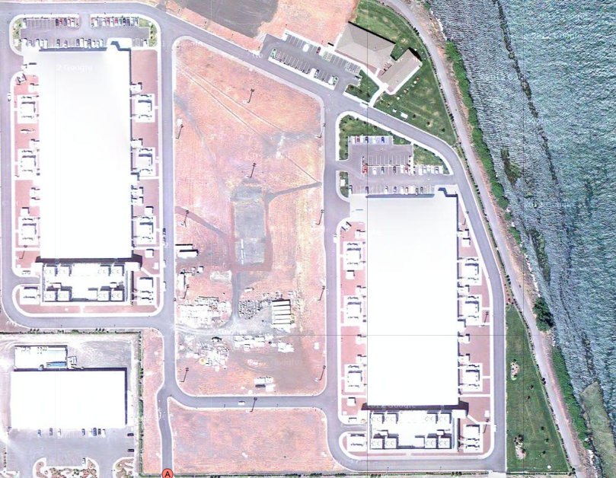
Google’s Oregon WSC
10³ meters

Slide 13
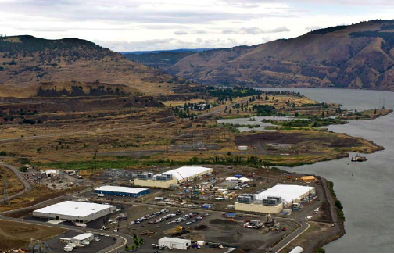
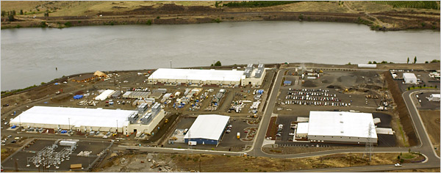
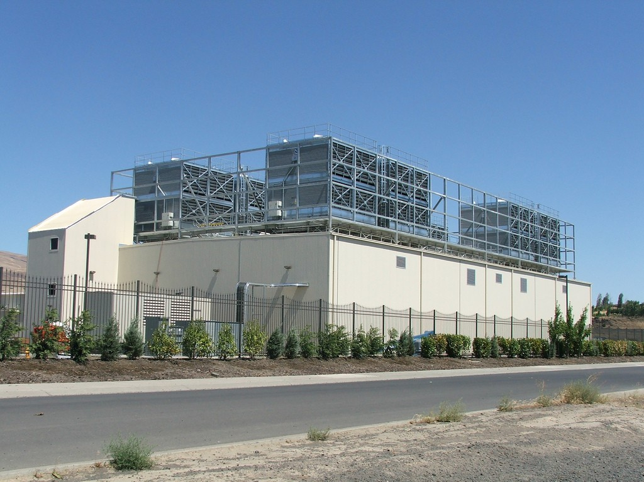
Google’s Oregon WSC
10⁴ meters
10 kilometers
10² meters
10³ meters

Slide 14
Google Warehouse
90 meters by 75 meters, 10 Megawatts
Contains 40,000 servers, 190,000 disks
Power Utilization Effectiveness: 1.23
85% of 0.23 overhead goes to cooling losses
15% of 0.23 overhead goes to power losses
Contains 45, 40-foot long containers
8 feet x 9.5 feet x 40 feet
30 stacked as double layer, 15 as single layer

Slide 15
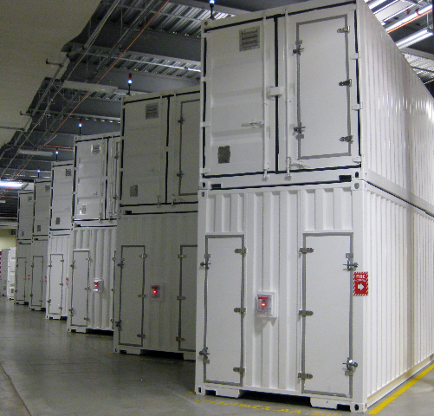
Containers in WSCs
10² meters
100 meters

Slide 16
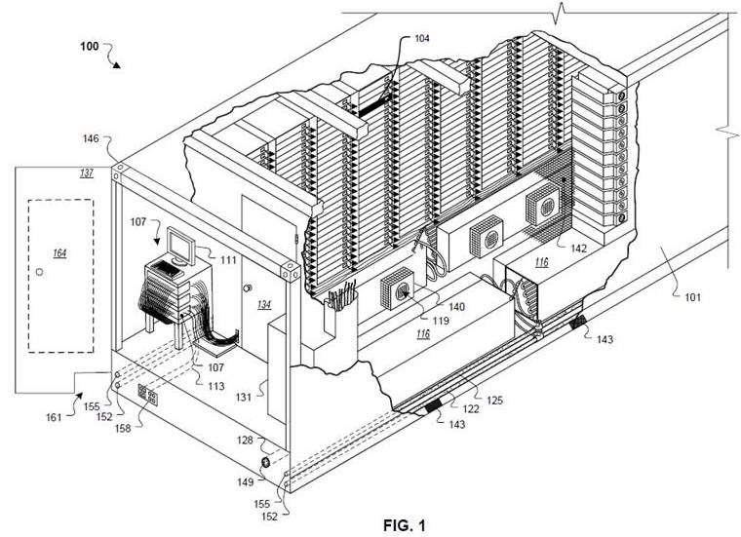
Google Container
10¹ meters

Slide 17
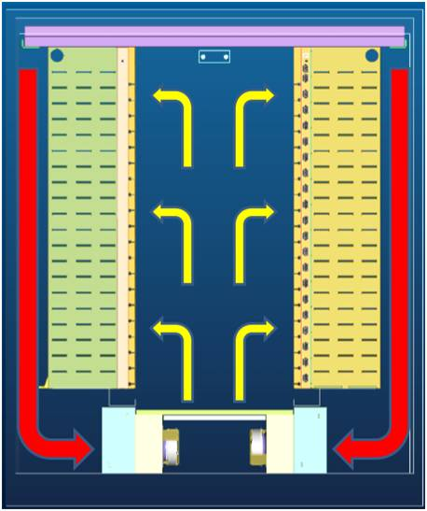
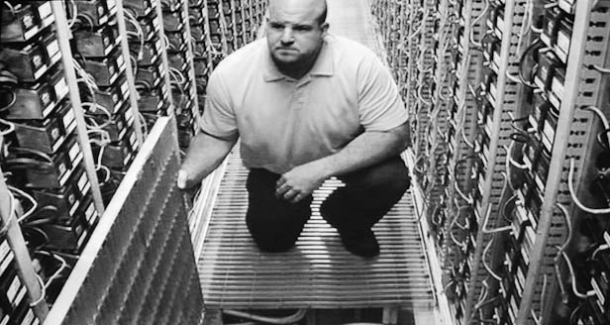
Google Container
10⁰ meters
10 meters
2 long rows, each with 29 racks
Cooling below raised floor
Hot air returned behind racks

Slide 18
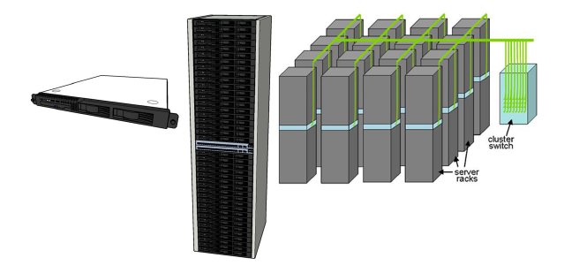
Equipment Inside a Container
Server (in rack format):
Array (aka cluster): server racks + larger local area network switch (“array switch”) 10X faster => cost 100X: cost f(N²)
7 foot Rack: servers + Ethernet local area network switch in middle (“rack switch”)

Slide 19
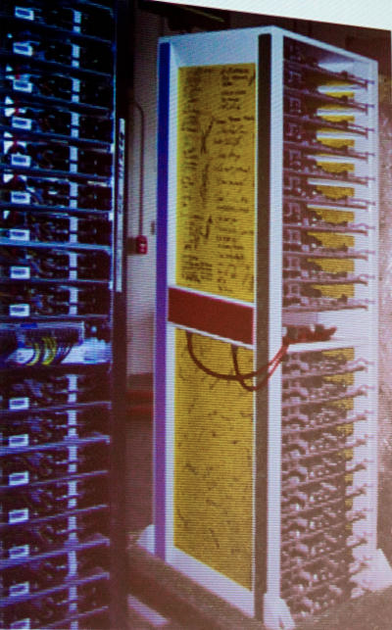
Google Rack
10⁰ meters
Google rack with 20 servers + Network Switch in the middle
48-port 1 Gigabit/sec Ethernet switch every other rack
Array switches connect to racks via multiple 1 Gbit/s links
2 datacenter routers connect to array switches over 10 Gbit/s links
1 meter

Slide 20
Programming WSC: MapReduce
public static class SumReduce extends Reducer<Text, LongWritable, Text, LongWritable> {
/** Actual reduce function.
* @param key Word.
* @param values Values for this word (partial counts).
* @param context ReducerContext object for accessing output,
* configuration information, etc.
*/
@Override
public void reduce(Text key, Iterable<LongWritable>values,
Context context) throws IOException, InterruptedException { long sum = 0L;
for (LongWritable value : values) {sum += value.get();} context.write(key, new LongWritable(sum));
}
}

Slide 21
Great Ideas in Computer Architecture
Design for Moore’s Law
-- WSC, Container, Rack
Abstraction to Simplify Design
Make the Common Case Fast
Dependability via Redundancy
-- Multiple WSCs, Multiple Racks, Multiple Switches
Memory Hierarchy
Performance via Parallelism/Pipelining/Prediction
-- Task level Parallelism, Data Level Parallelism

Slide 22
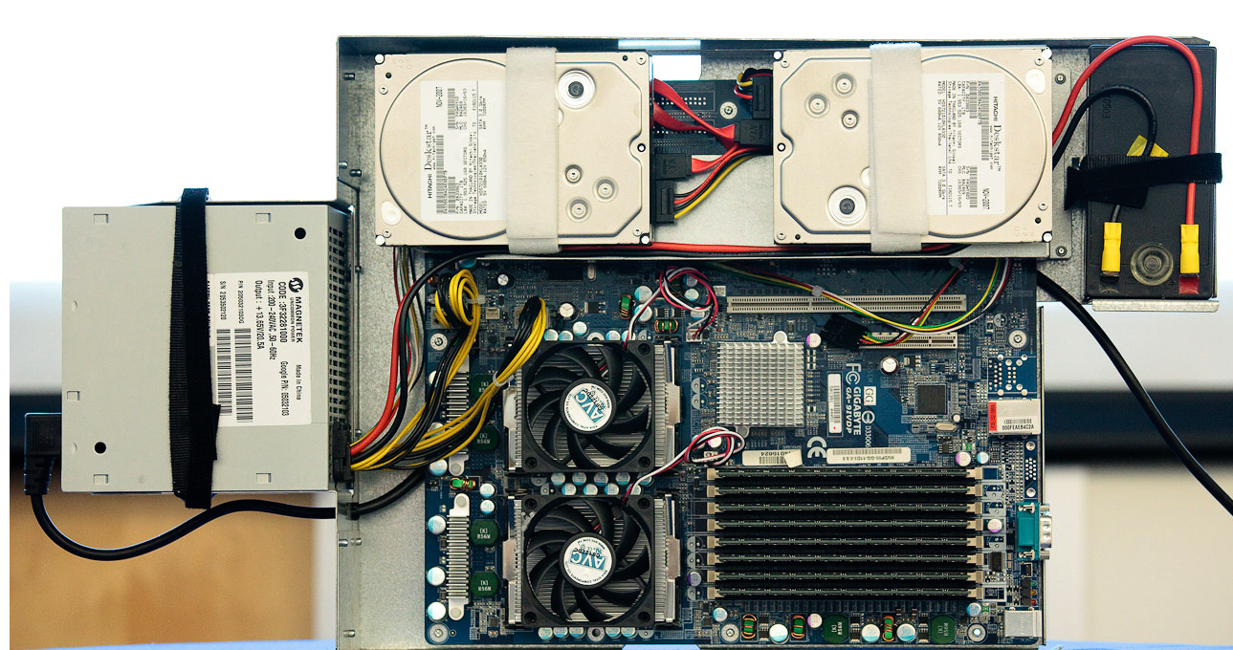
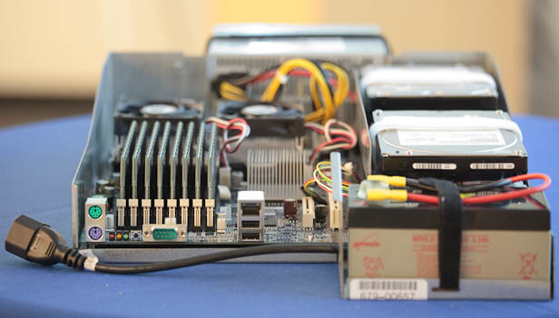
Google Server Internals
10⁻¹ meters
Google Server
10 centimeters
Notes:
Most companies buy servers from the likes of Dell, Hewlett-Packard, IBM, or Sun Microsystems. But Google, which has hundreds of thousands of servers and considers running them part of its core expertise, designs and builds its own. Ben Jai, who designed many of Google's servers, unveiled a modern Google server before the hungry eyes of a technically sophisticated audience.
Google's big surprise: each server has its own 12-volt battery to supply power if there's a problem with the main source of electricity. The company also revealed for the first time that since 2005, its data centers have been composed of standard shipping containers--each with 1,160 servers and a power consumption that can reach 250 kilowatts.
It may sound geeky, but a number of attendees--the kind of folks who run data centers packed with thousands of servers for a living--were surprised not only by Google's built-in battery approach, but by the fact that the company has kept it secret for years. Jai said in an interview that Google has been using the design since 2005 and now is in its sixth or seventh generation of design.
Read more: http://news.cnet.com/8301-1001_3-10209580-92.html#ixzz0yo8bhTOH

Slide 23
Google Board Details
Supplies only 12 volts
Battery per board vs. large battery room
Improves PUE: 99.99% efficient local battery vs 94% for battery room
2 SATA Disk Drives
1 Terabyte capacity each
3.5 inch disk drive
7200 RPM
2 AMD Opteron Microprocessors
Dual Core, 2.2 GHz
8 DIMMs
8 GB DDR2 DRAM
1 Gbit/sec Ethernet Network Interface Card

Slide 24
Programming Multicore Microprocessor: OpenMP
#include <omp.h>
#include <stdio.h>
static long num_steps = 100000;
int value[num_steps];
int reduce()
{ int i; int sum = 0;
#pragma omp parallel for private(x) reduction(+:sum)
for (i=1; i<= num_steps; i++){
sum = sum + value[i];
}
}

Slide 25
Great Ideas in Computer Architecture
Design for Moore’s Law
-- More transistors = Multicore + SIMD
2. Abstraction to Simplify Design
3. Make the Common Case Fast
Dependability via Redundancy
Memory Hierarchy
-- More transistors = Cache Memories
6. Performance via Parallelism/Pipelining/ Prediction
-- Thread-level Parallelism

Slide 26
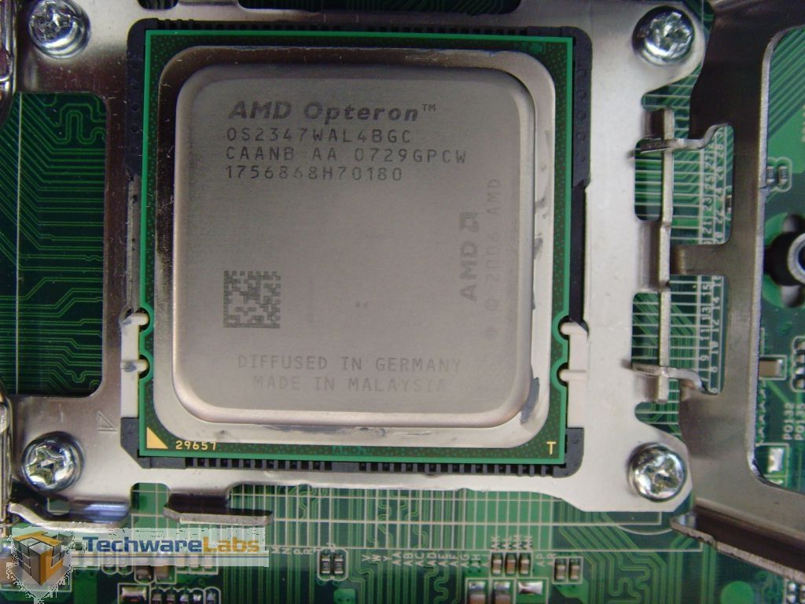
AMD Opteron Microprocessor
10⁻² meters
centimeters

Slide 27
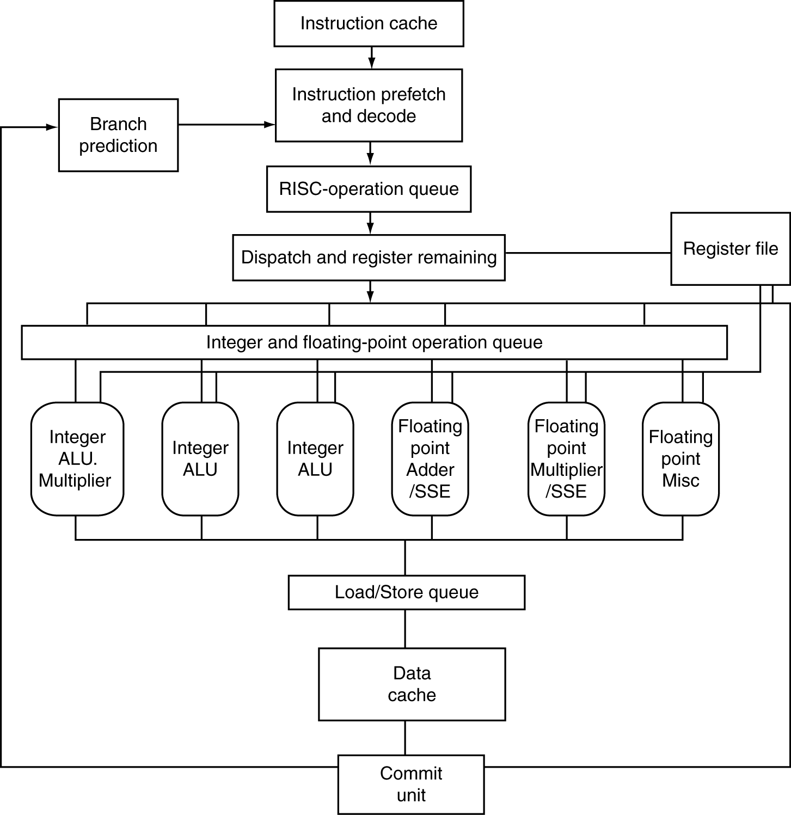
AMD Opteron Microarchitecture
72 physical registers

Slide 28
AMD Opteron Pipeline Flow
For integer operations
12 stages (Floating Point is 17 stages)
Up to 106 RISC-ops in progress

Slide 29
AMD Opteron Block Diagram
L1
Icache
64B
Fetch
Branch
Prediction
Scan/Align/Decode
Fastpath
Microcode Engine
L1
Dcache
64KB
µops
Instruction Control Unit (72 entries)
Int Decode & Rename
FP Decode & Rename
44-entry
Load/Store
Queue
Res
Res
Res
36-entry FP scheduler
AGU
AGU
AGU
FADD
FMUL
FMISC
ALU
ALU
ALU
MULT
Notes:
AGU = Address Generation Unit specialized for that for power, area, etc.

Slide 30
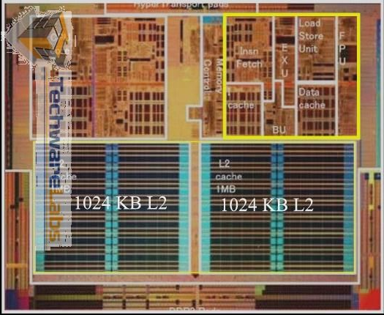
AMD Opteron Microprocessor
10⁻² meters
centimeters

Slide 31
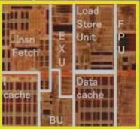
AMD Opteron Core
10⁻³ meters
millimeters

Slide 32
Programming One Core: C with Intrinsics
void mmult(int n, float *A, float *B, float *C)
{
for ( int i = 0; i < n; i+=4 )
for ( int j = 0; j < n; j++ )
{
__m128 c0 = _mm_load_ps(C+i+j*n);
for( int k = 0; k < n; k++ )
c0 = _mm_add_ps(c0, _mm_mul_ps(_mm_load_ps(A+i+k*n), _mm_load1_ps(B+k+j*n)));
_mm_store_ps(C+i+j*n, c0);
}
}

Slide 33
Inner loop from gcc –O -S
Assembly snippet from innermost loop:
movaps (%rax), %xmm9
mulps %xmm0, %xmm9
addps %xmm9, %xmm8
movaps 16(%rax), %xmm9
mulps %xmm0, %xmm9
addps %xmm9, %xmm7
movaps 32(%rax), %xmm9
mulps %xmm0, %xmm9
addps %xmm9, %xmm6
movaps 48(%rax), %xmm9
mulps %xmm0, %xmm9
addps %xmm9, %xmm5

Slide 34
Great Ideas in Computer Architecture
Design for Moore’s Law
Abstraction to Simplify Design
-- Instruction Set Architecture, Micro-operations
Make the Common Case Fast
Dependability via Redundancy
Memory Hierarchy
Performance via Parallelism/Pipelining/Prediction
-- Instruction-level Parallelism (superscalar, pipelining)
-- Data-level Parallelism

Slide 35
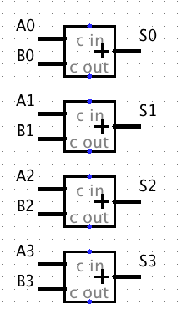
SIMD Adder
Four 32-bit adders that operate in parallel
Data Level Parallelism

Slide 36
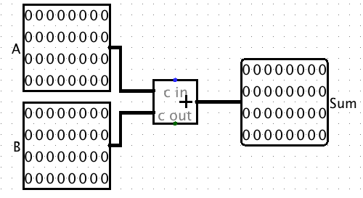
One 32-bit Adder

Slide 37
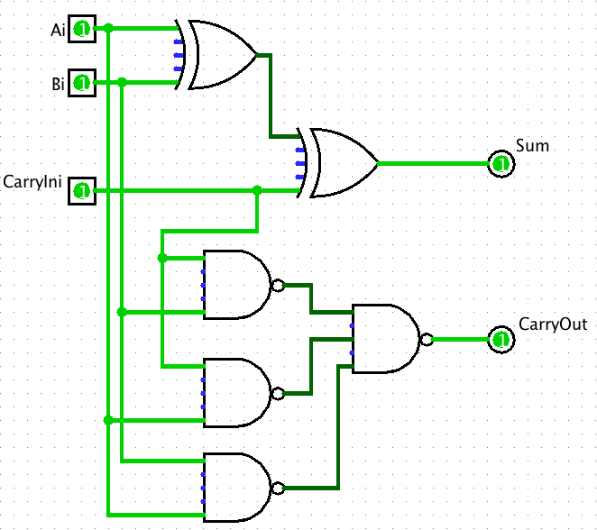
1 bit of 32-bit Adder

Slide 38
Complementary MOS Transistors (NMOS and PMOS) of NAND Gate
X
Y
x
y
z
NAND gate
3v
0 volts
3 volts
0 volts
0 volts
3 volts
3 volts
Z
3 volts
3 volts
0 volts
0v
3 volts
3 volts
0 volts
Notes:
Bottom
X = 0v Y = 0V both closed on top in series, so Z = 3v
X = 0v Y = 0V both open bottom
X = 0v Y = 3V 1st open on top,
X = 0v Y = 3V 2nd in series closed, so Z = 0v
X = 3v Y = 0V 2nd open on top
X = 3v Y = 0V 2nd in series closed, so Z = 0v
X = 3v Y = 3V both open on top
X = 3v Y = 3V both closed, so Z = 0v

Slide 39
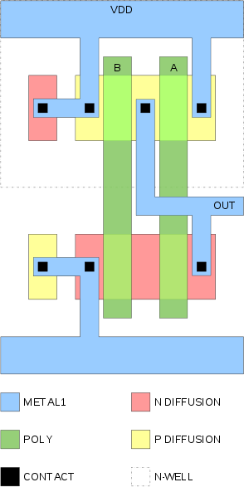
Physical Layout of NAND Gate
10⁻⁷ meters
100 nanometers

Slide 40
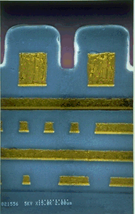
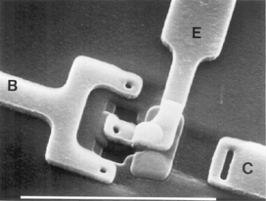
Scanning Electron Microscope
10⁻⁷ meters
100 nanometers
Top View
Cross Section

Slide 41
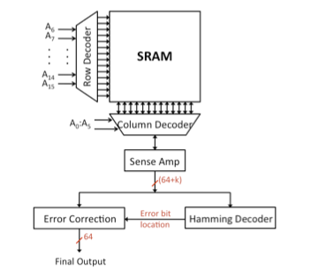
Block Diagram of Static RAM
10⁻⁶ meters

Slide 42
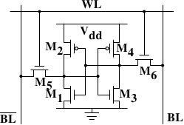
1 Bit SRAM in 6 Transistors
Notes:
The core of this cell is formed by the four transistors M₁ to M₄ which form two cross-coupled inverters. They have two stable states, representing 0 and 1 respectively. The state is stable as long as power on V_{dd} is available.
If access to the state of the cell is needed the word access line WL is raised. This makes the state of the cell immediately available for reading on BL and BL. If the cell state must be overwritten the BL and BL lines are first set to the desired values and then WL is raised. Since the outside drivers are stronger than the four transistors (M₁ through M₄) this allows the old state to be overwritten.

Slide 43
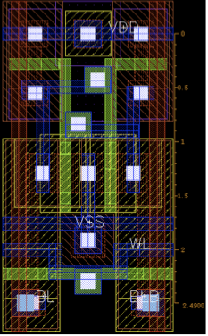
Physical Layout of SRAM Bit
10⁻⁷ meters
100 nanometers

Slide 44
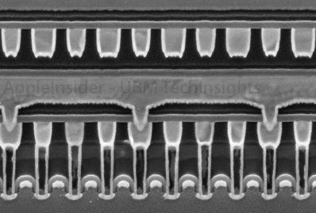
SRAM Cross Section
10⁻⁷ meters
100 nanometers

Slide 45
DIMM Module
DDR = Double Data Rate
Transfers bits on Falling AND Rising Clock Edge
Has Single Error Correcting, Double Error Detecting Redundancy (SEC/DED)
72 bits to store 64 bits of data
Uses “Chip kill” organization so that if single DRAM chip fails can still detect failure
Average server has 22,000 correctable errors and 1 uncorrectable error per year

Slide 46
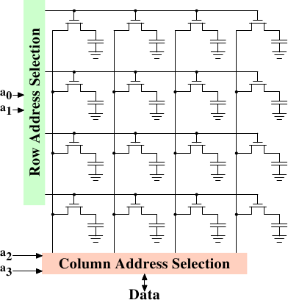
DRAM Bits
10⁻⁶ meters
1 micron

Slide 47
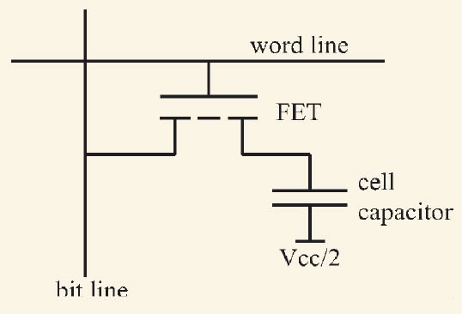
DRAM Cell in Transistors

Slide 48
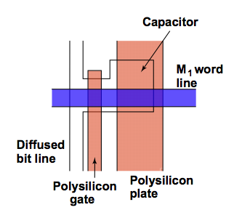
Physical Layout of DRAM Bit

Slide 49
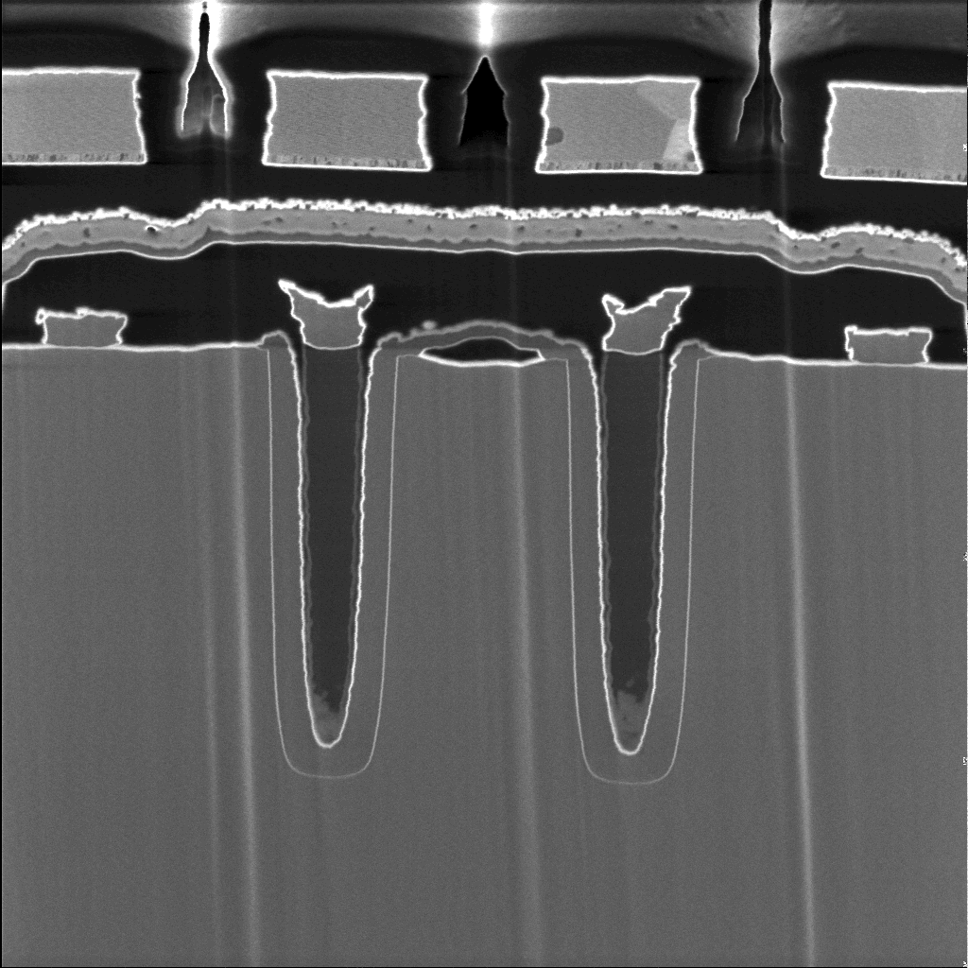
Cross Section of DRAM Bits
10⁻⁷ meters
100 nanometers

Slide 50
AMD Dependability
• L1 cache data is SEC/DED protected
• L2 cache and tags are SEC/DED protected
• DRAM is SEC/DED protected with chipkill
• On-chip and off-chip ECC protected arrays include autonomous, background hardware scrubbers
• Remaining arrays are parity protected
– Instruction cache, tags and TLBs
– Data tags and TLBs
– Generally read only data that can be recovered from lower levels

Slide 51
Programming Memory Hierarchy: Cache Blocked Algorithm
The blocked version of the i-j-k algorithm is written simply as (A,B,C are submatricies of a, b, c)
for (i=0;i<N/r;i++)
for (j=0;j<N/r;j++)
for (k=0;k<N/r;k++)
C[i][j] += A[i][k]*B[k][j]
r = block (sub-matrix) size (Assume r divides N)
X[i][j] = a sub-matrix of X, defined by block row i and block column j

Slide 52
Great Ideas in Computer Architecture
Design for Moore’s Law
-- Higher capacities caches and DRAM
Abstraction to Simplify Design
Make the Common Case Fast
Dependability via Redundancy
-- Parity, SEC/DEC
5. Memory Hierarchy
-- Caches, TLBs
Performance via Parallelism/Pipelining/Prediction
-- Data-level Parallelism

Slide 53
Course Summary
As the field changes, cs61c had to change too!
It is still about the software-hardware interface
Programming for performance!
Parallelism: Task-, Thread-, Instruction-, and Data- MapReduce, OpenMP, C, SSE instrinsics
Understanding the memory hierarchy and its impact on application performance
Interviewers ask what you did this semester!

Slide 54
The Future for Future Cal Alumni
What’s The Future?
New Century, Many New Opportunties: Parallelism, Cloud, Statistics + CS, Bio + CS, Society (Health Care, 3rd world) + CS
Cal heritage as future alumni
Hard Working / Can do attitude
Never Give Up (“Don’t fall with the ball!”)
Smallest on field, 3 big guys charging you: you make a play!
“The best way to predict the future is to invent it” – Alan Kay (inventor of personal computing vision)
Future is up to you!

