Slide 1


inst.eecs.berkeley.edu/~cs61c
CS61C : Machine Structures
Lecture 18 – MapReduce
2014-10-13
Senior Lecturer SOE Dan Garcia
www.cs.berkeley.edu/~ddgarcia
Top 10 Tech Trends ⇒
(1) Computing everywhere
(2) Internet of Things (3) 3D printing (4) Analytics everywhere (5) Context rich systems (6) smart machines (7) cloud computing (8) software applications (9) web-scale IT (10) Security. Agree?
www.computerworld.com/article/2692619/gartner-lays-out-its-top-10-tech-trends-for-2015.html
Notes:
Greet class

Slide 2
Review of Last Lecture
Warehouse Scale Computing
  Example of parallel processing in the post-PC era
  Servers on a rack, rack part of cluster
  Issues to handle include load balancing, failures, power usage (sensitive to cost & energy efficiency)
  PUE = Total building power / IT equipment power

Slide 3
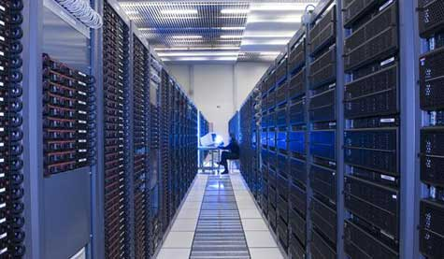



Great Idea #4: Parallelism
Today’s Lecture
Software Hardware
Parallel Requests
  Assigned to computer
  e.g. Search “Garcia”
Parallel Threads
  Assigned to core
  e.g. Lookup, Ads
Parallel Instructions
  > 1 instruction @ one time
  e.g. 5 pipelined instructions
Parallel Data
  > 1 data item @ one time
  e.g. add of 4 pairs of words
Hardware descriptions
  All gates functioning in parallel at same time
Warehouse Scale Computer
Smart
Phone
Leverage
Parallelism &
Achieve High
Performance
Computer
Core
…
Core
Memory
Input/Output
Core
Instruction Unit(s)
Functional
Unit(s)
A₀+B₀
A₁+B₁
A₂+B₂
A₃+B₃
Cache Memory
Logic Gates

Slide 4

Amdahl’s (Heartbreaking) Law
Speedup due to enhancement E:
Example: Suppose that enhancement E accelerates a fraction F (F<1) of the task by a factor S (S>1) and the remainder of the task is unaffected
Exec time w/E =
Speedup w/E =
F
Exec Time w/o E × [ (1-F) + F/S]
1 / [ (1-F) + F/S ]

Slide 5
Amdahl’s Law
Speedup = 1
Example: the execution time of 1/5 of the program can be accelerated by a factor of 10.
What is the program speed-up overall?
(1 - F) + F
Non-sped-up part
S
Sped-up part
1
1
=
=
1.22
0.8 + 0.2
0.8 + 0.02
10

Slide 6
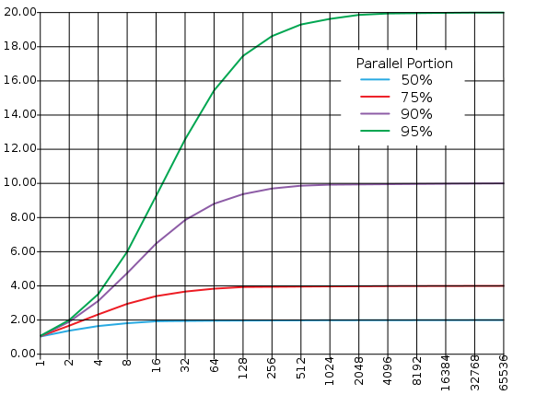
Consequence of Amdahl’s Law
The amount of speedup that can be achieved through parallelism is limited by the non-parallel portion of your program!
Time
Speedup
Parallel
portion
Serial
portion
1
2
3
4
5
Number of Processors
Number of Processors
Notes:
Analogy: Paintball gun. You can get a paintball gun that fires faster, but still have to manually reload the paintballs.

Slide 7
Request-Level Parallelism (RLP)
Hundreds or thousands of requests per sec
  Not your laptop or cell-phone, but popular Internet services like web search, social networking, …
  Such requests are largely independent
    Often involve read-mostly databases
    Rarely involve strict read–write data sharing or synchronization across requests
Computation easily partitioned within a request and across different requests
Notes:
On WSC, want lots going on at same time to get $ back
Easy to parallelize

Slide 8
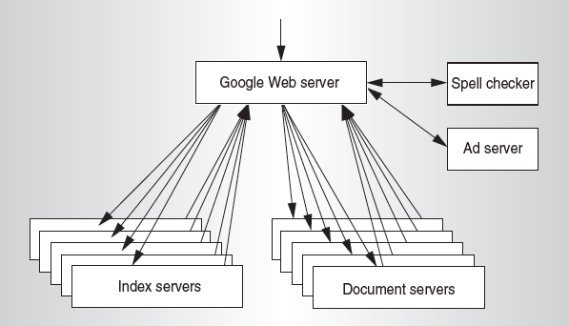
Google Query-Serving Architecture
Notes:
Example of RLP, google
Services on right
Forward requests to index servers; look up tables based on keywords that return location of relevant documents
Document servers return results
All spread across many servers -> parallelism

Slide 9
Data-Level Parallelism (DLP)
Two kinds:
  Lots of data in memory that can be operated on in parallel (e.g. adding together 2 arrays)
  Lots of data on many disks that can be operated on in parallel (e.g. searching for documents)
SIMD does Data-Level Parallelism (DLP) in memory
Today’s lecture, Lab 6, Proj. 3 do DLP across many servers and disks using MapReduce

Slide 10
Administrivia … The Midterm
Average around 10/20
  Despite lots of partial credit
  Regrades being processed
  Have perspective – it’s only 20 / 300 points.
  Don’t panic. Do lots of practice problems in a team. Do NOT study alone.
Part 2 will be easier to compensate
You can clobber Part 1 with Part 2

Slide 11
What is MapReduce?
Simple data-parallel programming model designed for scalability and fault-tolerance
Pioneered by Google
  Processes > 25 petabytes of data per day
Popularized by open-source Hadoop project
  Used at Yahoo!, Facebook, Amazon, …

Slide 12
What is MapReduce used for?
At Google:
  Index construction for Google Search
  Article clustering for Google News
  Statistical machine translation
  For computing multi-layer street maps
At Yahoo!:
  “Web map” powering Yahoo! Search
  Spam detection for Yahoo! Mail
At Facebook:
  Data mining
  Ad optimization
  Spam detection

Slide 13
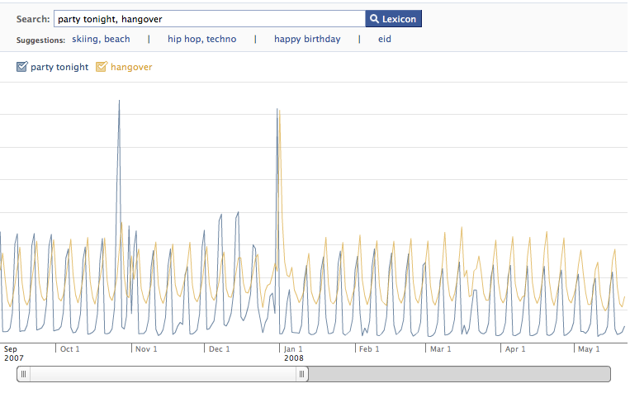
Example: Facebook Lexicon
www.facebook.com/lexicon
(no longer available)

Slide 14
MapReduce Design Goals
Scalability to large data volumes:
  1000’s of machines, 10,000’s of disks
Cost-efficiency:
  Commodity machines (cheap, but unreliable)
  Commodity network
  Automatic fault-tolerance via re-execution (fewer administrators)
  Easy, fun to use (fewer programmers)
Jeffrey Dean and Sanjay Ghemawat, “MapReduce: Simplified Data Processing on Large Clusters,” 6th USENIX Symposium on Operating Systems Design and Implementation, 2004. (optional reading, linked on course homepage – a digestible CS paper at the 61C level)

Slide 15
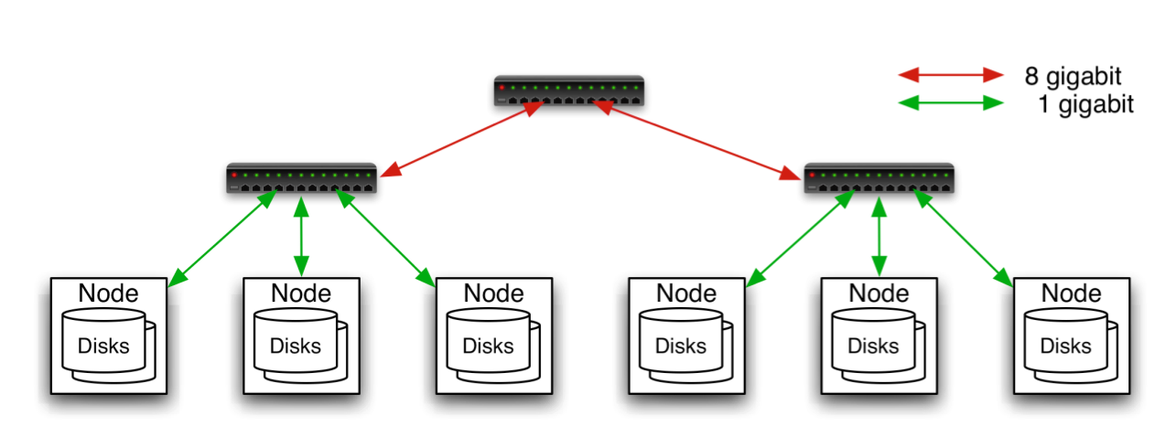
Typical Hadoop Cluster
Aggregation switch
Rack switch
40 nodes/rack, 1000-4000 nodes in cluster
1 Gbps bandwidth within rack, 8 Gbps out of rack
Node specs (Yahoo terasort):
8 x 2GHz cores, 8 GB RAM, 4 disks (= 4 TB?)
Image from http://wiki.apache.org/hadoop-data/attachments/HadoopPresentations/attachments/YahooHadoopIntro-apachecon-us-2008.pdf

Slide 16
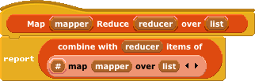
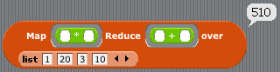
MapReduce in CS10 & CS61A{,S}
en.wikipedia.org/wiki/MapReduce
> (reduce +
(map square '(1 20 3 10))
510
>>> from functools import reduce
>>> def plus(x,y): return x+y
>>> def square(x): return x*x
>>> reduce(plus,
map(square, (1,20,3,10)))
510
Input:
1
20
3
10
*
*
*
*
Note:
only
two
data
types!
1
400
9
100
+
+
401
109
+
Output:
510

Slide 17
MapReduce Programming Model
Input & Output: each a set of key/value pairs
Programmer specifies two functions:
map (in_key, in_value) 
list(interm_key, interm_value)
  Processes input key/value pair
  Slices data into “shards” or “splits”; distributed to workers
  Produces set of intermediate pairs
reduce (interm_key, list(interm_value)) 
list(out_value)
  Combines all intermediate values for a particular key
  Produces a set of merged output values (usu just one)
code.google.com/edu/parallel/mapreduce-tutorial.html

Slide 18
MapReduce WordCount Example
“Mapper” nodes are responsible for the map function
// “I do I learn” ➔ (“I”,1), (“do”,1), (“I”,1), (“learn”,1)
map(String input_key,
String input_value):
// input_key : document name (or line of text)
// input_value: document contents
for each word w in input_value:
EmitIntermediate(w, "1");
“Reducer” nodes are responsible for the reduce function
// (“I”,[1,1]) ➔ (“I”,2)
reduce(String output_key,
Iterator intermediate_values):
// output_key : a word
// output_values: a list of counts
int result = 0;
for each v in intermediate_values:
result += ParseInt(v);
Emit(AsString(result));
Data on a distributed file system (DFS)

Slide 19
MapReduce WordCount Diagram
file₁
file₂
file₃
file₄
file₅
file₆
file₇
ah ah er
ah
if or
or uh
or
ah if
map(String input_key,
String input_value):
// input_key : doc name
// input_value: doc contents
for each word w in input_value:
EmitIntermediate(w, "1");
ah:1 ah:1 er:1
ah:1
if:1 or:1
or:1 uh:1
or:1
ah:1 if:1
ah:1,1,1,1
er:1
if:1,1
or:1,1,1
uh:1
reduce(String output_key,
Iterator intermediate_values):
// output_key : a word
// output_values: a list of counts
int result = 0;
for each v in intermediate_values:
result += ParseInt(v);
Emit(AsString(result));
4
1
2
3
1
(ah)
(er)
(if)
(or)
(uh)

Slide 20
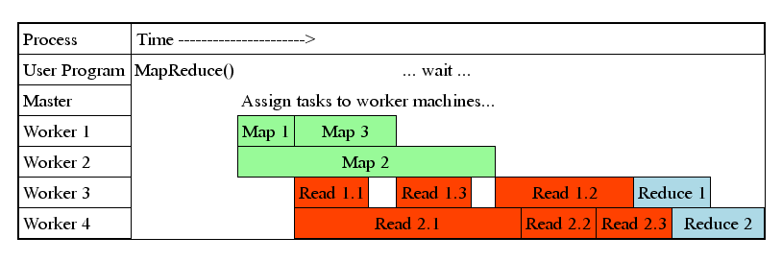
MapReduce Processing Time Line
Master assigns map + reduce tasks to “worker” servers
As soon as a map task finishes, worker server can be assigned a new map or reduce task
Data shuffle begins as soon as a given Map finishes
Reduce task begins as soon as all data shuffles finish
To tolerate faults, reassign task if a worker server “dies”

Slide 21
MapReduce WordCount Java code

Slide 22

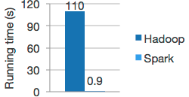
Spark
spark.apache.org
Apache Spark™ is a fast and general engine for large-scale data processing.
Speed
  Run programs up to 100x faster than Hadoop MapReduce in memory, or 10x faster on disk.
  Spark has an advanced DAG execution engine that supports cyclic data flow and in-memory computing.
Ease of Use
  Write applications quickly in Java, Scala or Python.
  Spark offers over 80 high-level operators that make it easy to build parallel apps. And you can use it interactively from the Scala and Python shells.

Slide 23
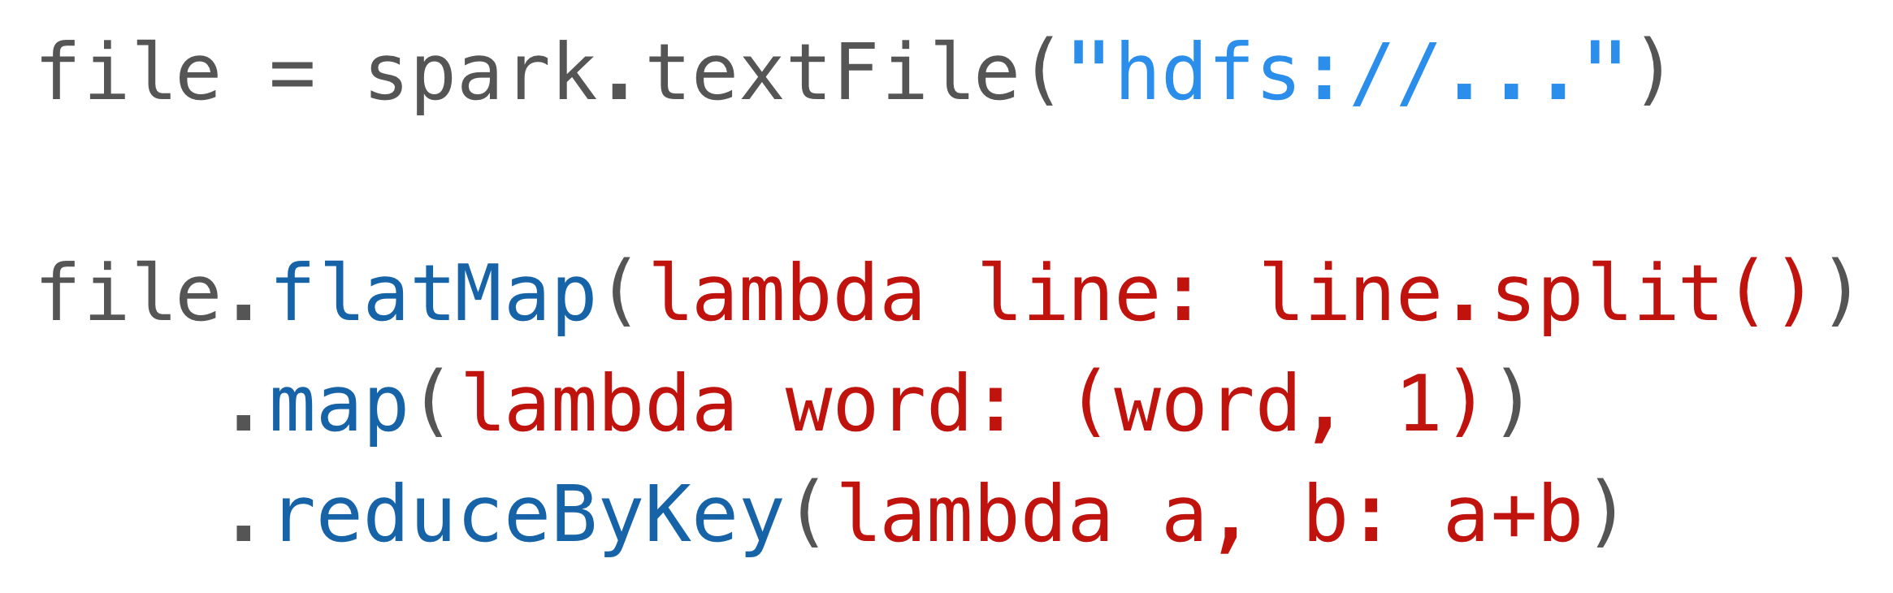

Word Count in Spark’s Python API
Cf Java:

Slide 24
Peer Instruction
Writing & managing SETI@Home is relatively straightforward; just hand out & gather data
Most parallel programs that, when run on N (N big) identical supercomputer processors will yield close to N x performance increase
The majority of the world’s computing power lives in supercomputer centers and warehouses
123
A: FFF
B: FFT
B: FTF
C: FTT
C: TFF
D: TFT
D: TTF
E: TTT

Slide 25
Peer Instruction Answer
The heterogeneity of the machines, handling machines that fail, falsify data. FALSE
The combination of Amdahl’s law, overhead, and load balancing take its toll. FALSE
Have you considered how many PCs + Smart Devices + game devices exist? Not even close. FALSE
Writing & managing SETI@Home is relatively straightforward; just hand out & gather data
Most parallel programs that, when run on N (N big) identical supercomputer processors will yield close to N x performance increase
The majority of the world’s computing power lives in supercomputer centers and warehouses
123
A: FFF
B: FFT
B: FTF
C: FTT
C: TFF
D: TFT
D: TTF
E: TTT

Slide 26
Bonus Slides

Slide 27
Agenda
Amdahl’s Law
Request Level Parallelism
MapReduce (Data Level Parallelism)
  Background
  Design
  Theory
Administrivia
More MapReduce
  The Combiner
  Execution Walkthrough
  (Bonus) Example 2: PageRank (aka How Google Search Works)

Slide 28

Anatomy of a Web Search
Google “Dan Garcia”
Notes:
Lets do a random search!

Slide 29
Anatomy of a Web Search (1 of 3)
Google “Dan Garcia”
  Direct request to “closest” Google Warehouse Scale Computer
  Front-end load balancer directs request to one of many arrays (cluster of servers) within WSC
  Within array, select one of many Google Web Servers (GWS) to handle the request and compose the response pages
  GWS communicates with Index Servers to find documents that contain the search words, “Dan”, “Garcia”, uses location of search as well
  Return document list with associated relevance score
Notes:
Probably/usually closest, google’s system are secret
Box routes to cluster
Lots of server processes that handle requests and put response toogether
Look up in index (does an AND)
Rank by relevance

Slide 30
Anatomy of a Web Search (2 of 3)
In parallel,
  Ad system: run ad auction for bidders on search terms
  Get images of various “Dan Garcia”s
Use docids (document IDs) to access indexed documents
Compose the page
  Result document extracts (with keyword in context) ordered by relevance score
  Sponsored links (along the top) and advertisements (along the sides)

Slide 31
Anatomy of a Web Search (3 of 3)
Implementation strategy
  Randomly distribute the entries
  Make many copies of data (a.k.a. “replicas”)
  Load balance requests across replicas
Redundant copies of indices and documents
  Breaks up search hot spots, e.g. “WhatsApp”
  Increases opportunities for request-level parallelism
  Makes the system more tolerant of failures
Notes:
Important to return quickly (within one to a few seconds), so distribute entries.
Make replicas! (RLP!) also more fault tolerant and good to break up hot spots
Load balance

Slide 32
The Combiner (Optional)
One missing piece for our first example:
  Many times, the output of a single mapper can be “compressed” to save on bandwidth and to distribute work (usually more map tasks than reduce tasks)
  To implement this, we have the combiner:
combiner(interm_key,list(interm_val)):
// DO WORK (usually like reducer)
emit(interm_key2, interm_val2)

Slide 33
Our Final Execution Sequence
Map – Apply operations to all input key, val
Combine – Apply reducer operation, but distributed across map tasks
Reduce – Combine all values of a key to produce desired output

Slide 34
Agenda
Amdahl’s Law
Request Level Parallelism
MapReduce (Data Level Parallelism)
  Background
  Design
  Theory
Administrivia
More MapReduce
  The Combiner + Example 1: Word Count
  Execution Walkthrough
  (Bonus) Example 2: PageRank (aka How Google Search Works)

Slide 35
Execution Setup
Map invocations distributed by partitioning input data into M splits
  Typically 16 MB to 64 MB per piece
Input processed in parallel on different servers
Reduce invocations distributed by partitioning intermediate key space into R pieces
  e.g. hash(key) mod R
User picks M >> # servers, R > # servers
  Big M helps with load balancing, recovery from failure
  One output file per R invocation, so not too many

Slide 36
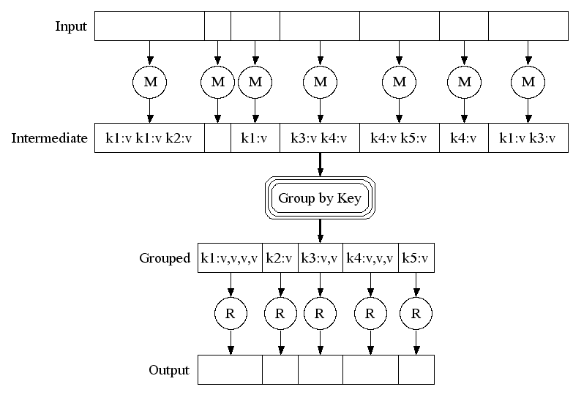
MapReduce Execution
Fine granularity tasks: many more map tasks than machines
2000 servers =>
≈ 200,000 Map Tasks, ≈ 5,000 Reduce tasks

Slide 37
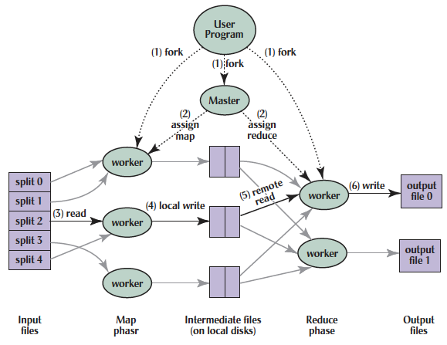
MapReduce Processing
Shuffle phase

Slide 38
MapReduce Processing
1. MR 1st splits the input files into M “splits” then starts many copies of
program on servers
Shuffle phase

Slide 39
MapReduce Processing
2. One copy (the master) is special. The rest are workers. The master picks idle workers and assigns each 1 of M map tasks or 1 of R reduce tasks.
Shuffle phase
Notes:
We subdivide the map phase into M jobs and the reduce phase into R jobs as described previously. Ideally, M and R should be much larger than the number of worker machines. A special master node assigns jobs to idle workers.
Having each worker per- form many different tasks improves dynamic load balancing and also speeds up recovery when a worker fails: the many map tasks it has completed can be spread out across all the other worker machines.There are practical bounds on how large M and R can be in our imple- mentation since the master must make O(M+R) scheduling decisions and keep O(M*R) state in memory as described. (The constant factors for memory usage are small, however. The O(M*R) piece of the state consists of approximately one byte of data per map task/reduce task pair.)Furthermore, R is often constrained by users because the output of each reduce task ends up in a separate output file. In practice, we tend to choose M so that each individual task is roughly 16MB to 64MB of input data (so that the locality optimization described previously is most effective), and we make R a small multiple of the number of worker machines we expect to use. We often perform MapReduce computa- tions with M=200,000 and R=5,000, using 2,000 worker machines.

Slide 40
MapReduce Processing
3. A map worker reads the input split. It parses key/value pairs of the input data and passes each pair to the user-defined map function.
(The intermediate
key/value pairs produced by the map function are buffered in memory.)
Shuffle phase

Slide 41
MapReduce Processing
4. Periodically, the buffered pairs are written to local disk, partitioned
into R regions by the partitioning function.
Shuffle phase

Slide 42
MapReduce Processing
5. When a reduce worker has read all intermediate data for its partition, it sorts it by the intermediate
keys so that all occurrences of the same key are grouped together.
(The sorting is needed because typically many different keys map to
the same reduce task )
Shuffle phase

Slide 43
MapReduce Processing
6. Reduce worker iterates over sorted intermediate data and for each unique intermediate key, it passes key and corresponding set of values to the user’s reduce function.
The output of the reduce function is appended to a final output file for this reduce partition.
Shuffle phase

Slide 44
MapReduce Processing
7. When all map and reduce tasks have been completed, the master wakes up the user program.
The MapReduce call in user program returns back to user code.
Output of MR is in R output files (1 per reduce task, with file names specified by user); often passed into another MR job.
Shuffle phase

Slide 45
What Does the Master Do?
For each map task and reduce task, keep track:
  State: idle, in-progress, or completed
  Identity of worker server (if not idle)
For each completed map task
  Stores location and size of R intermediate files
  Updates files and size as corresponding map tasks complete
Location and size are pushed incrementally to workers that have in-progress reduce tasks

Slide 46
MapReduce Processing Time Line
Master assigns map + reduce tasks to “worker” servers
As soon as a map task finishes, worker server can be assigned a new map or reduce task
Data shuffle begins as soon as a given Map finishes
Reduce task begins as soon as all data shuffles finish
To tolerate faults, reassign task if a worker server “dies”

Slide 47
MapReduce Failure Handling
On worker failure:
  Detect failure via periodic heartbeats
  Re-execute completed and in-progress map tasks
  Re-execute in progress reduce tasks
  Task completion committed through master
Master failure:
  Protocols exist to handle (master failure unlikely)
Robust: lost 1600 of 1800 machines once, but finished fine

Slide 48
MapReduce Redundant Execution
Slow workers significantly lengthen completion time
  Other jobs consuming resources on machine
  Bad disks with soft errors transfer data very slowly
  Weird things: processor caches disabled (!!)
Solution: Near end of phase, spawn backup copies of tasks
  Whichever one finishes first "wins"
Effect: Dramatically shortens job completion time
  3% more resources, large tasks 30% faster

Slide 49
Summary
MapReduce Data Parallelism
  Divide large data set into pieces for independent parallel processing
  Combine and process intermediate results to obtain final result
Simple to Understand
  But we can still build complicated software
  Chaining lets us use the MapReduce paradigm for many common graph and mathematical tasks
MapReduce is a “Real-World” Tool
  Worker restart, monitoring to handle failures
  Google PageRank, Facebook Analytics

Slide 50
Agenda
Amdahl’s Law
Request Level Parallelism
MapReduce (Data Level Parallelism)
  Background
  Design
  Theory
Administrivia
More MapReduce
  The Combiner + Example 1: Word Count
  Execution Walkthrough
  Example 2: PageRank (aka How Google Search Works)

Slide 51
PageRank: How Google Search Works
Last time: RLP – how Google handles searching its huge index
Now: How does Google generate that index?
PageRank is the famous algorithm behind the “quality” of Google’s results
  Uses link structure to rank pages, instead of matching only against content (keyword)

Slide 52
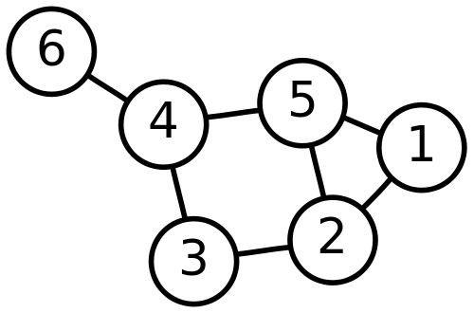
A Quick Detour to CS Theory: Graphs
Def: A set of objects connected by links
The “objects” are called Nodes
The “links” are called Edges
Nodes: {1, 2, 3, 4, 5, 6}
Edges: {(6, 4), (4, 5), (4, 3), (3, 2), (5, 2), (5, 1), (1, 2)}

Slide 53
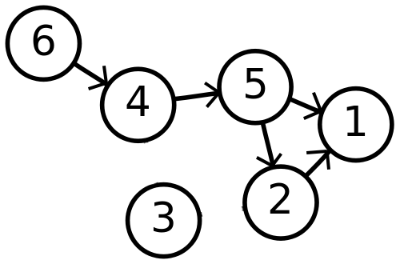
Directed Graphs
Previously assumed that all edges in the graph were two-way
Now we have one-way edges:
Nodes: Same as before
Edges: (order matters)
  {(6, 4), (4, 5), (5, 1), (5, 2), (2, 1)}

Slide 54
The Theory Behind PageRank
The Internet is really a directed graph:
  Nodes: webpages
  Edges: links between webpages
Terms (Suppose we have a page A that links to page B):
  Page A has a forward-link to page B
  Page B has a back-link from page A

Slide 55
The Magic Formula

Slide 56
The Magic Formula
Node u is the vertex (webpage) we’re interested in computing the PageRank of

Slide 57
The Magic Formula
R’(u) is the PageRank of Node u

Slide 58
The Magic Formula
c is a normalization factor that we can ignore for our purposes

Slide 59
The Magic Formula
E(u) is a “personalization” factor that we can ignore for our purposes

Slide 60
The Magic Formula
We sum over all backlinks of u: the PageRank of the website v linking to u divided by the number of forward-links that v has

Slide 61
But wait! This is Recursive!
Uh oh! We have a recursive formula with no base-case
We rely on convergence
  Choose some initial PageRank value for each site
  Simultaneously compute/update PageRanks
  When our Delta is small between iterations:
    Stop, call it “good enough”

Slide 62
Sounds Easy. Why MapReduce?
Assume in the best case that we’ve crawled and captured the internet as a series of (url, outgoing links) pairs
We need about 50 iterations of the PageRank algorithm for it to converge
We quickly see that running it on one machine is not viable

Slide 63
Building a Web Index using PageRank
Scrape Webpages
Strip out content, keep only links (input is key = url, value = links on page at url)
  This step is actually pushed into the MapReduce
Feed into PageRank Mapreduce
Sort Documents by PageRank
Post-process to build the indices that our Google RLP example used

Slide 64
Using MapReduce to Compute PageRank, Step 1
Map:
  Input:
    key = URL of website
    val = source of website
  Output for each outgoing link:
    key = URL of website
    val = outgoing link url
Reduce:
  Input:
    key = URL of website
    values = Iterable of all outgoing links from that website
  Output:
    key = URL of website
    value = Starting PageRank, Outgoing links from that website

Slide 65
Using MapReduce to Compute PageRank, Step 2
Map:
  Input:
    key = URL of website
    val = PageRank, Outgoing links from that website
  Output for each outgoing link:
    key = Outgoing Link URL
    val = Original Website URL, PageRank, # Outgoing links
Reduce:
  Input:
    key = Outgoing Link URL
    values = Iterable of all links to Outgoing Link URL
  Output:
    key = Outgoing Link URL
    value = Newly computed PageRank (using the formula), Outgoing links from document @ Outgoing Link URL
Repeat this step until PageRank converges – chained MapReduce!

Slide 66
Using MapReduce to Compute PageRank, Step 3
Finally, we want to sort by PageRank to get a useful index
MapReduce’s built in sorting makes this easy!
Map:
  Input:
    key = Website URL
    value = PageRank, Outgoing Links
  Output:
    key = PageRank
    value = Website URL

Slide 67
Using MapReduce to Compute PageRank, Step 3
Reduce:
  In case we have duplicate PageRanks
  Input:
    key = PageRank
    value = Iterable of URLs with that PageRank
  Output (for each URL in the Iterable):
    key = PageRank
    value = Website URL
Since MapReduce automatically sorts the output from the reducer and joins it together:
We’re done!

Slide 68
Using the PageRanked Index
Do our usual keyword search with RLP implemented
Take our results, sort by our pre-generated PageRank values
Send results to user!
PageRank is still the basis for Google Search
  (of course, there are many proprietary enhancements in addition)

Slide 69
Further Reading (Optional)
Some PageRank slides adapted from http://www.cs.toronto.edu/~jasper/PageRankForMapReduceSmall.pdf
PageRank Paper:
  Lawrence Page, Sergey Brin, Rajeev Motwani, Terry Winograd. The PageRank Citation Ranking: Bringing Order to the Web.

