Slide 1
CS 61C: Great Ideas in Computer Architecture (Machine Structures) Lecture 24 More I/O: DMA, Disks, Networking
Instructors: John Wawrzynek & Vladimir Stojanovic
http://inst.eecs.berkeley.edu/~cs61c/
Notes:
Hookup sound

Slide 2
Virtual Memory Review

Slide 3
Modern Virtual Memory Systems Illusion of a large, private, uniform store
Protection & Privacy
* Many processes, each with their own private address space and one or more shared address spaces
Demand Paging
* Many processes share DRAM.
* Provides ability to run programs with large address space. Pages that aren’t yet allocated or pages that don’t fit swap to secondary storage.
* Hides differences in machine configurations
The price is address translation on
each memory reference
OS
Prog1
Swapping Store (Disk)
Primary
Memory
VA
mapping
PA
TLB
Notes:
Portability on machines with different memory configurations.

Slide 4
Private (Virtual) Address Space per Program
Prog 1
OS
pages
VA1
Page Table
Prog 2
VA1
Page Table
Physical Memory
Prog 3
VA1
Page Table
free
Each prog has a page table
Page table contains an entry for each prog page
Notes:
Pages are fixed sized chunks. So no fragmentation in terms of pages

Slide 5
Translation Lookaside Buffers (TLB)
Address translation is very expensive!
In a two-level page table, each reference becomes several memory accesses
Solution: Cache translations in TLB
TLB hit ⇒ Single-Cycle Translation
TLB miss ⇒ Page-Table Walk to refill
virtual address
VPN offset
V R W D tag PPN
(VPN = virtual page number)
(PPN = physical page number)
hit?
physical address
PPN offset
Notes:
3 memory references
2 page faults (disk accesses) + ..
Actually used in IBM before paged memory.

Slide 6
Page-Based Virtual-Memory Machine (Hardware Page-Table Walk)
Page Fault?
Protection violation?
Page Fault?
Protection violation?
Virtual Address
Virtual Address
Physical Address
Physical Address
PC
Inst. TLB
D
Decode
E
M
Data TLB
W
Inst. Cache
Data Cache
+
Miss?
Miss?
Page-Table Base Register
Hardware Page Table Walker
Physical Address
Memory Controller
Physical Address
Physical Address
Main Memory (DRAM)
Page tables held in untranslated physical memory

Slide 7
Clicker Question from Last Week
Let’s try to extrapolate from caches… Which one is false?
A. # offset bits in V.A. = log2(page size)
B. # offset bits in P.A. = log2(page size)
C. # VPN bits in V.A. = log2(# of physical pages)
D. # PPN bits in P.A. = log2(# of physical pages)
E. A single-level page table contains a PTE for every possible VPN in a particular Virtual Address Space
Notes:
C. it’s the # of virtual pages, which is != to # of physical pages

Slide 8
Review: I/O
“Memory mapped I/O”: Device control/data registers mapped to CPU address space
CPU synchronizes with I/O device:
Polling
Interrupts
“Programmed I/O”:
CPU execs lw/sw instructions for all data movement to/from devices
CPU spends time doing 2 things:
Getting data from device to main memory
Using data to compute

Slide 9
Working with real devices
“Memory mapped I/O”: Device control/data registers mapped to CPU address space
CPU synchronizes with I/O device:
Polling
Interrupts
“Programmed I/O”: DMA
CPU execs lw/sw instructions for all data movement to/from devices
CPU spends time doing 2 things:
Getting data from device to main memory
Using data to compute

Slide 10
Agenda
Direct Memory Access (DMA)
Disks
Networking

Slide 11
What’s wrong with Programmed I/O?
Not ideal because …
CPU has to execute all transfers, could be doing other work
Device speeds don’t align well with CPU speeds
Energy cost of using beefy general-purpose CPU where simpler hardware would suffice
Until now CPU has sole control of main memory

Slide 12
PIO vs. DMA

Slide 13
Direct Memory Access (DMA)
Allows I/O devices to directly read/write main memory
New Hardware: the DMA Engine
DMA engine contains registers written by CPU:
Memory address to place data
# of bytes
I/O device #, direction of transfer
unit of transfer, amount to transfer per burst

Slide 14
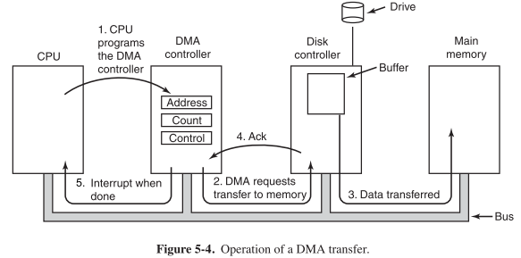
Operation of a DMA Transfer
[From Section 5.1.4 Direct Memory Access in Modern Operating Systems by Andrew S. Tanenbaum, Herbert Bos, 2014]

Slide 15
DMA: Incoming Data
Receive interrupt from device
CPU takes interrupt, begins transfer
Instructs DMA engine/device to place data @ certain address
Device/DMA engine handle the transfer
CPU is free to execute other things
Upon completion, Device/DMA engine interrupt the CPU again

Slide 16
DMA: Outgoing Data
CPU decides to initiate transfer, confirms that external device is ready
CPU begins transfer
Instructs DMA engine/device that data is available @ certain address
Device/DMA engine handle the transfer
CPU is free to execute other things
Device/DMA engine interrupt the CPU again to signal completion

Slide 17
DMA: Some new problems
Where in the memory hierarchy do we plug in the DMA engine? Two extremes:
Between L1 and CPU:
Pro: Free coherency
Con: Trash the CPU’s working set with transferred data
Between Last-level cache and main memory:
Pro: Don’t mess with caches
Con: Need to explicitly manage coherency

Slide 18
DMA: Some new problems
How do we arbitrate between CPU and DMA Engine/Device access to memory? Three options:
Burst Mode
Start transfer of data block, CPU cannot access memory in the meantime
Cycle Stealing Mode
DMA engine transfers a byte, releases control, then repeats - interleaves processor/DMA engine accesses
Transparent Mode
DMA transfer only occurs when CPU is not using the system bus

Slide 19
Administrivia
Upcoming Lecture Schedule
11/24: I/O: DMA, Disks, Networking (today)
11/26: Thanksgiving Holiday
12/01: Dependability: Parity, ECC, RAID
Last day of new material
12/03: Summary, What’s Next? (+ HKN reviews)

Slide 20
Administrivia
Last HW (5) Virtual Memory
Due 12/06 (Sunday after end of classes)
Last project (5): Spark
5-1: posted, due today!
5-2: due 12/06 (Sunday after end of classes)
Final Exam is Friday (12/18)
7-10PM, RSF Field House
More info soon on review sessions, etc.

Slide 21
Agenda
Direct Memory Access (DMA)
Disks
Networking

Slide 22
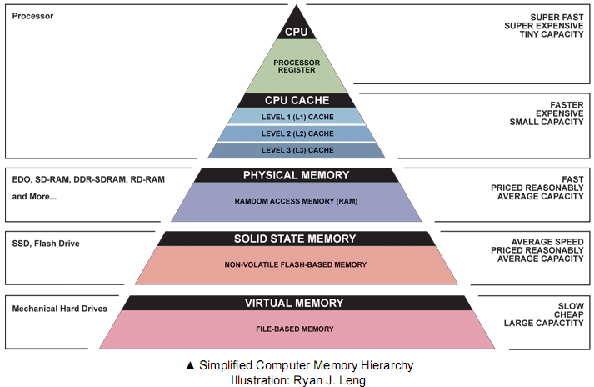
Computer Memory Hierarchy
Today

Slide 23
Magnetic Disk – common I/O device
A kind of computer memory
Information stored by magnetizing ferrite material on surface of rotating disk
similar to tape recorder except digital rather than analog data
A type of non-volatile storage
retains its value without applying power to disk.
Two Types of Magnetic Disk
Hard Disk Drives (HDD) – faster, more dense, non-removable.
Floppy disks – slower, less dense, removable (now replaced by USB “flash drive”).
Purpose in computer systems (Hard Drive):
Working file system + long-term backup for files
Secondary “backing store” for main-memory. Large, inexpensive, slow level in the memory hierarchy (virtual memory)

Slide 24
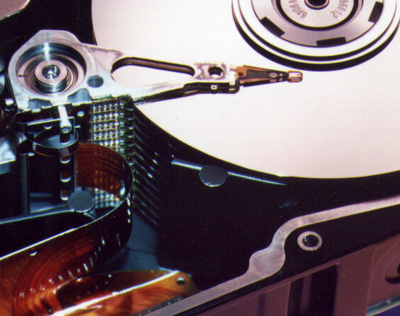
Photo of Disk Head, Arm, Actuator
Arm
Spindle
Head
Actuator
{
Platters (1-12)

Slide 25
Disk Device Terminology
Inner
Track
Arm
Head
Sector
Outer
Track
Several platters, with information recorded magnetically on both surfaces (usually)
Bits recorded in tracks, which in turn divided into sectors (e.g., 512 Bytes)
Actuator moves head (end of arm) over track (“seek”), wait for sector rotate under head, then read or write
Platter
Actuator
Video of hard disk in action
Notes:
arm interaction with platter

Slide 26
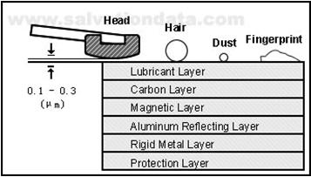
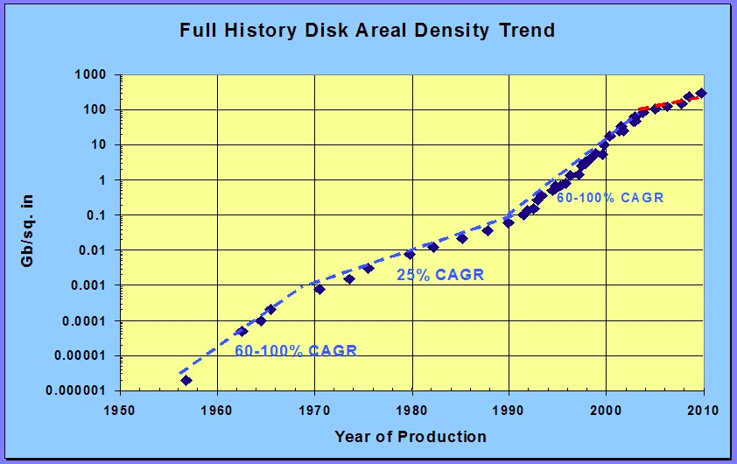
Hard Drives are Sealed. Why?
The closer the head to the disk, the smaller the “spot size” and thus the denser the recording.
Measured in Gbit/in^2
~900 Gbit/in^2 is state of the art
Started out at 2 Kbit/in^2
~450,000,000x improvement in ~60 years
Disks are sealed to keep the dust out.
Heads are designed to “fly” at around 3-20nm above the surface of the disk.
99.999% of the head/arm weight is supported by the air bearing force (air cushion) developed between the disk and the head.
3-20nm

Slide 27
Disk Device Performance (1/2)
Inner
Track
Sector
Head
Arm
Disk Access Time = Seek Time + Rotation Time + Transfer Time + Controller Overhead
Seek Time = time to position the head assembly at the proper cylinder
Rotation Time = time for the disk to rotate to the point where the first sectors of the block to access reach the head
Transfer Time = time taken by the sectors of the block and any gaps between them to rotate past the head
Outer
Track
Spindle
Controller
Platter
Actuator
Notes:
Use analogy to records

Slide 28
Disk Device Performance (2/2)
Average values to plug into the formula:
Rotation Time: Average distance of sector from head?
1/2 time of a rotation
7200 Revolutions Per Minute ⇒ 120 Rev/sec
1 revolution = 1/120 sec ⇒ 8.33 milliseconds
1/2 rotation (revolution) ⇒ 4.17 ms
Seek time: Average no. tracks to move arm?
Number of tracks/3 (see CS186 for the math)
Then, seek time = number of tracks moved × time to move across one track

Slide 29
But wait!
Performance estimates are different in practice:
Many disks have on-disk caches, which are completely hidden from the outside world
Previous formula completely replaced with on-disk cache access time

Slide 30
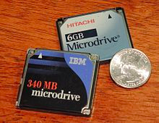
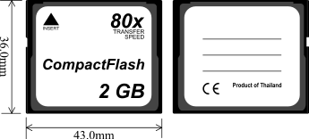
Where does Flash memory come in?
~10 years ago: Microdrives and Flash memory (e.g., CompactFlash) went head-to-head
Both non-volatile (retains contents without power supply)
Flash benefits: lower power, no crashes (no moving parts, need to spin µdrives up/down)
Disk cost = fixed cost of motor + arm mechanics, but actual magnetic media cost very low
Flash cost = most cost/bit of flash chips
Over time, cost/bit of flash came down, became cost competitive

Slide 31
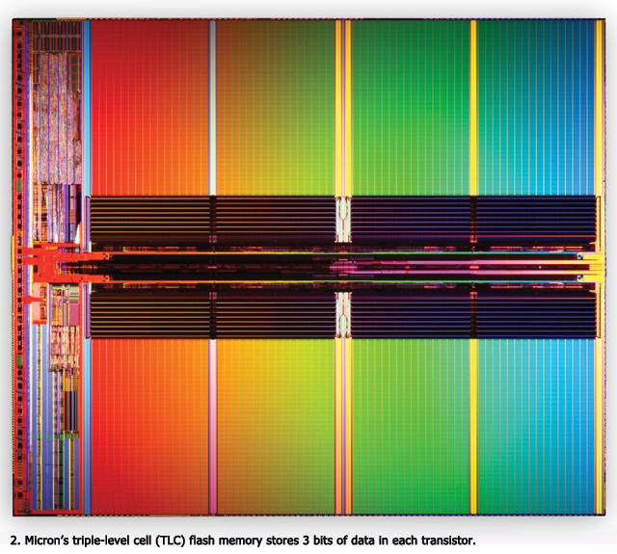
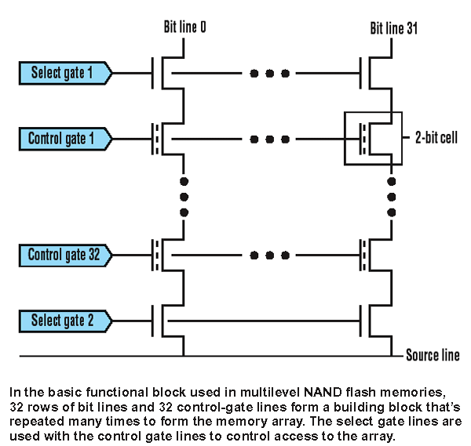
Flash Memory / SSD Technology
NMOS transistor with an additional conductor between gate and source/drain which “traps” electrons. The presence/absence is a 1 or 0
Memory cells can withstand a limited number of program-erase cycles. Controllers use a technique called wear leveling to distribute writes as evenly as possible across all the flash blocks in the SSD.

Slide 32
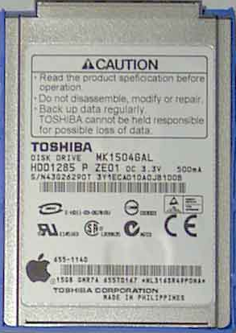
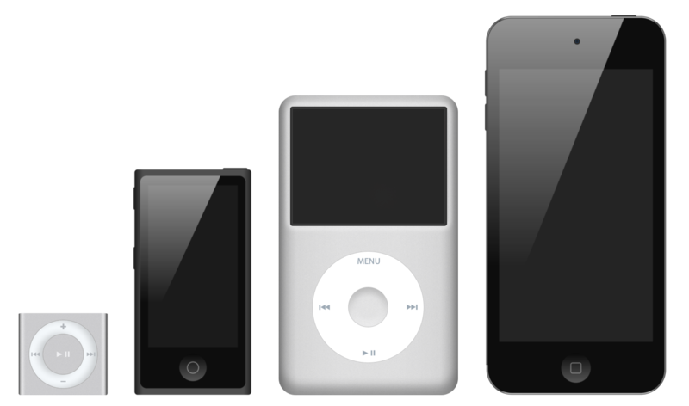
What did Apple put in its iPods?
Toshiba flash 2 GB
Samsung flash 16 GB
Toshiba 1.8-inch HDD 80, 120, 160 GB
Toshiba flash 32, 64 GB
shuffle nano classic touch

Slide 33
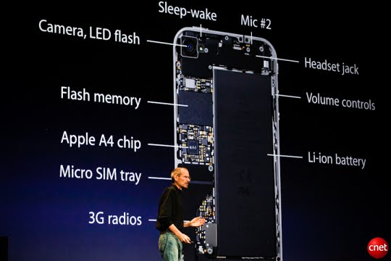
Flash Memory in Smart Phones
iPhone 6: up to 128 GB

Slide 34
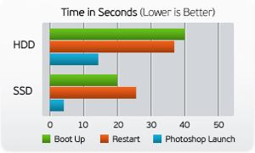
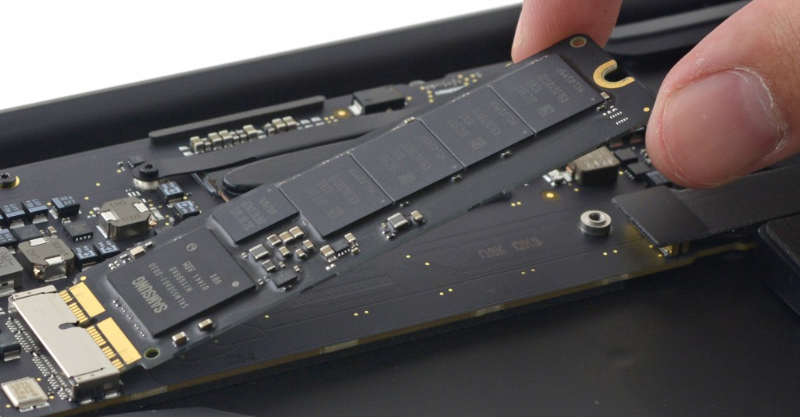
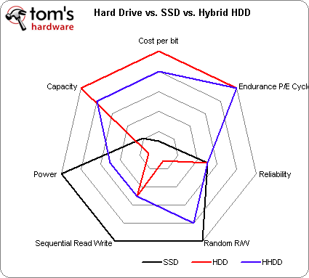
Flash Memory in Laptops – Solid State Drive (SSD)
capacities up to 512GB

Slide 35
iClicker Question
We have the following disk:
15000 Cylinders, 1 ms to cross 1000 Cylinders
15000 RPM = 4 ms per rotation
Want to copy 1 MB, transfer rate of 1000 MB/s
1 ms controller processing time
What is the access time using our model?
Disk Access Time = Seek Time + Rotation Time + Transfer Time + Controller Processing Time
A | B | C | D | E
10.5 ms | 9 ms | 8.5 ms | 11.4 ms | 12 ms

Slide 36
iClicker Question
We have the following disk:
15000 Cylinders, 1 ms to cross 1000 Cylinders
15000 RPM = 4 ms per rotation
Want to copy 1 MB, transfer rate of 1000 MB/s
1 ms controller processing time
What is the access time?
Seek = # cylinders/3 * time = 15000/3 * 1ms/1000 cylinders = 5ms
Rotation = time for ½ rotation = 4 ms / 2 = 2 ms
Transfer = Size / transfer rate = 1 MB / (1000 MB/s) = 1 ms
Controller = 1 ms
Total = 5 + 2 + 1 + 1 = 9 ms
Notes:
on the order of 10 million times slower than the cpu

Slide 37
Break

Slide 38
Agenda
Direct Memory Access (DMA)
Disks
Networking

Slide 39
Networks: Talking to the Outside World
Originally sharing I/O devices between computers
E.g., printers
Then communicating between computers
E.g., file transfer protocol
Then communicating between people
E.g., e-mail
Then communicating between networks of computers
E.g., file sharing, www, …
Notes:
Original printers were the size of bathrooms - HAD to share
FTP was the first time file sharing happened
Communicating between people has become dominant, pervasive, ubiquitous
- Also IM
Last bullet is where a lot of research is happening

Slide 40
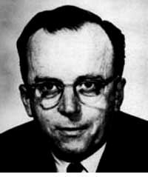
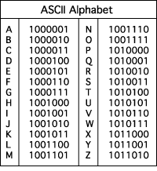
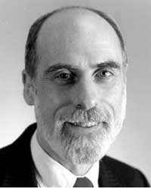
The Internet (1962)
www.computerhistory.org/internet_history
History
1963: JCR Licklider, while at DoD’s ARPA, writes a memo describing desire to connect the computers at various research universities: Stanford, Berkeley, UCLA, ...
1969 : ARPA deploys 4 “nodes” @ UCLA, SRI, Utah, & UCSB
1973 Robert Kahn & Vint Cerf invent TCP, now part of the Internet Protocol Suite
Internet growth rates
Exponential since start!
“Lick”
“Revolutions like this don't come along very often”
Vint Cerf
www.greatachievements.org/?id=3736 en.wikipedia.org/wiki/Internet_Protocol_Suite

Slide 41
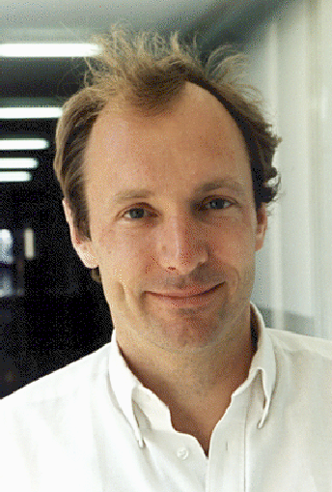
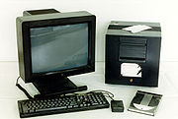
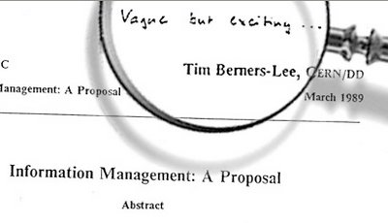
The World Wide Web (1989)
en.wikipedia.org/wiki/History_of_the_World_Wide_Web
“System of interlinked hypertext documents on the Internet”
History
1945: Vannevar Bush describes hypertext system called “memex” in article
1989: Sir Tim Berners-Lee proposed and implemented the first successful communication between a Hypertext Transfer Protocol (HTTP) client and server using the internet.
~2000 Dot-com entrepreneurs rushed in, 2001 bubble burst
Today : Access anywhere!
World’s First web server in 1990
Tim Berners-Lee

Slide 42
Shared vs. Switch-Based Networks
Shared
Shared vs. Switched:
Shared: 1 at a time (CSMA/CD)
Switched: pairs (“point-to-point” connections) communicate at same time
Aggregate bandwidth (BW) in switched network is many times that of shared:
point-to-point faster since no arbitration, simpler interface
Node
Node
Node
Node
Crossbar
Switch
Node
Node
Node
Notes:
CSMA/CD = Carrier Sense Multiple Access / Collision Detection
Bus: On collision, have to wait random amount of time
Buses not used very much, inefficient.
Switches are much more efficient
Bandwidth is like throughput

Slide 43
What makes networks work?
links connecting switches and/or routers to each other and to computers or devices
Computer
switch
switch
switch
network
interface
ability to name the components and to route packets of information - messages - from a source to a destination
Layering, redundancy, protocols, and encapsulation as means of abstraction (61C big idea)
Notes:
Computer has Network Interface Card (NIC)
Sends message through the series of switches, which get the message to recipient
Usually draw the series of switches as the “Internet Cloud”
- Represents an abstraction, “don’t know” implementation
- Send the message through the network, and it will get to where it needs to go
Switches use routing tables to know how to get the message to the recipient

Slide 44
Software Protocol to Send and Receive
SW Send steps
1: Application copies data to OS buffer
2: OS calculates checksum, starts timer
3: OS sends data to network interface HW and says start
SW Receive steps
3: OS copies data from network interface HW to OS buffer
2: OS calculates checksum, if OK, send ACK; if not, delete message (sender resends when timer expires)
1: If OK, OS copies data to user address space, & signals application to continue
Dest
Src
Checksum
Net ID
Net ID
Len
ACK
INFO
CMD/ Address /Data
Header
Payload
Trailer
Notes:
Timer is counting down on Time To Live (TTL)
- You can see this in Pings

Slide 45
Networks are like Ogres
https://www.youtube.com/watch?v=_bMcXVe8zIs

Slide 46
Protocols for Networks of Networks?
What does it take to send packets across the globe?
Bits on wire or air
Packets on wire or air
Delivery packets within a single physical network
Deliver packets across multiple networks
Ensure the destination received the data
Create data at the sender and make use of the data at the receiver

Slide 47
Protocol for Networks of Networks?
Lots to do and at multiple levels!
Use abstraction to cope with complexity of communication
Networks are like ogres onions
Hierarchy of layers:
Application (chat client, game, etc.)
Transport (TCP, UDP)
Network (IP)
Data Link Layer (ethernet)
Physical Link (copper, wireless, etc.)
Notes:
WS companies used TCP/IP even over LAN
Because early Ethernet controllers were cheap, but not reliable

Slide 48
Protocol Family Concept
Protocol: packet structure and control commands to manage communication
Protocol families (suites): a set of cooperating protocols that implement the network stack
Key to protocol families is that communication occurs logically at the same level of the protocol, called peer-to-peer… …but is implemented via services at the next lower level
Encapsulation: carry higher level information within lower level “envelope”

Slide 49
Inspiration…
CEO A writes letter to CEO B
Folds letter and hands it to assistant
Assistant:
Puts letter in envelope with CEO B’s full name
Takes to FedEx
FedEx Office
Puts letter in larger envelope
Puts name and street address on FedEx envelope
Puts package on FedEx delivery truck
FedEx delivers to other company
Dear John,
Your days are numbered.
--Pat

Slide 50
The Path of the Letter
“Peers” on each side understand the same things
No one else needs to
Lowest level has most packaging
CEO
Semantic Content
CEO
Letter
Identity
Aide
Envelope
Aide
Location
FedEx
Fedex Envelope (FE)
FedEx

Slide 51
The Path Through FedEx
Truck
Truck
FE
FE
FE
Sorting
Office
Sorting
Office
Sorting
Office
New
Crate
Crate
Crate
Crate
Airport
Airport
Airport
Deepest Packaging (Envelope+FE+Crate)
at the Lowest Level of Transport

Slide 52
Protocol Family Concept
Message
Logical
Message
Actual
Actual
Logical
H
Message
T
H
Message
T
Actual
Actual
H
H
Message
T
T
H
H
Message
T
T
Physical
Each lower level of stack “encapsulates” information from layer above by adding header and trailer.

Slide 53
Most Popular Protocol for Network of Networks
Transmission Control Protocol/Internet Protocol (TCP/IP)
This protocol family is the basis of the Internet, a WAN (wide area network) protocol
IP makes best effort to deliver
Packets can be lost, corrupted
TCP guarantees delivery
TCP/IP so popular it is used even when communicating locally: even across homogeneous LAN (local area network)
Notes:
WS companies used TCP/IP even over LAN
Because early Ethernet controllers were cheap, but not reliable
TCP and IP fundamentally different but very connected
TCP hires IP guys
- GO!
- IP guy falls into a hole
- TCP hires another IP guy
- GO!
-IP gus falls into a hole
- Hire another!

Slide 54
TCP/IP packet, Ethernet packet, protocols
Application sends message
Ethernet Hdr
TCP breaks into 64KiB segments, adds 20B header
IP Header
TCP Header
EH
IP Data
IP adds 20B header, sends to network
TCP data
If Ethernet, broken into 1500B packets with headers, trailers
Message
Ethernet Hdr

Slide 55
“And in conclusion…”
I/O gives computers their 5 senses
I/O speed range is 100-million to one
Polling vs. Interrupts
DMA to avoid wasting CPU time on data transfers
Disks for persistent storage, replaced by flash
Networks: computer-to-computer I/O
Protocol suites allow networking of heterogeneous components. Abstraction!!!
Acknowledgement: Some Networking slides adapted from CS168

