Slide 1
CS 61C: Great Ideas in Computer Architecture RISC-V Instruction Formats
Instructors:
Krste Asanović and Randy H. Katz
http://inst.eecs.Berkeley.edu/~cs61c/fa17
9/14/17
Fall 2017 - Lecture #7

Slide 2
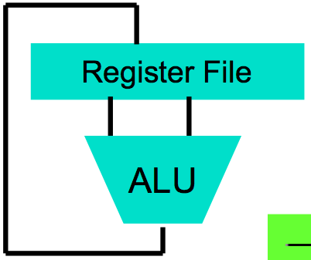
Levels of Representation/Interpretation
High Level Language Program (e.g., C)
temp = v[k];
v[k] = v[k+1];
v[k+1] = temp;
Compiler
Anything can be represented as a number, i.e., data or instructions
lw x10, 0(x12)
lw x11, 4(x12)
sw x11, 0(x12)
sw x10, 4(x12)
Assembly Language Program (e.g., RISC-V)
Assembler
0000 1001 1100 0110 1010 1111 0101 1000
1010 1111 0101 1000 0000 1001 1100 0110
1100 0110 1010 1111 0101 1000 0000 1001
0101 1000 0000 1001 1100 0110 1010 1111
Machine Language Program (RISC-V)
Machine Interpretation
Hardware Architecture Description (e.g., block diagrams)
Architecture Implementation
Logic Circuit Description (Circuit Schematic Diagrams)
9/14/17

Slide 3
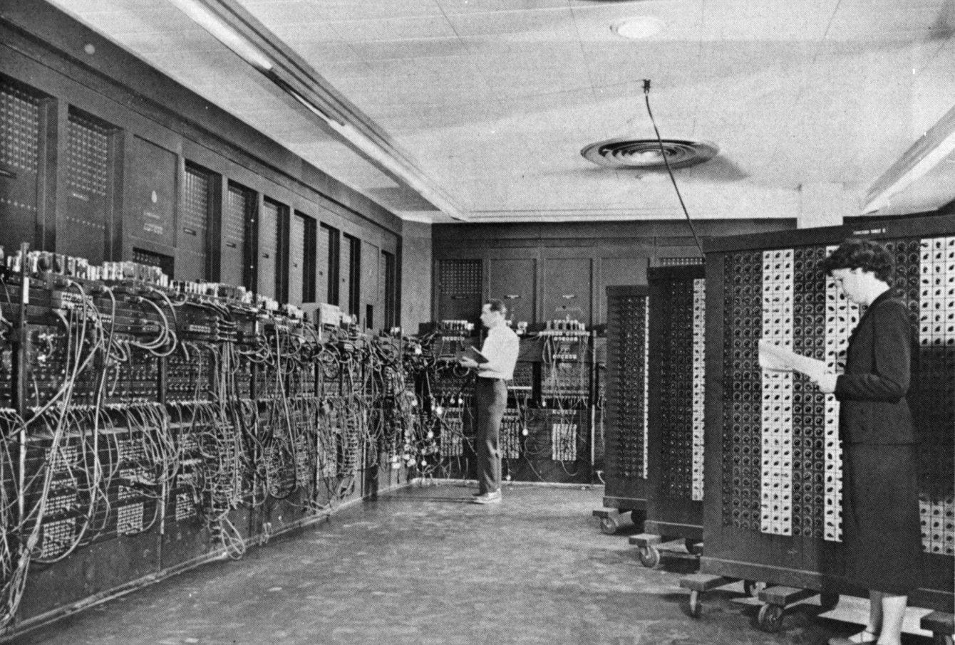
ENIAC (U.Penn., 1946) First Electronic General-Purpose Computer
Blazingly fast (multiply in 2.8ms!)
10 decimal digits x 10 decimal digits
But needed 2-3 days to setup new program, as programmed with patch cords and switches
9/14/17
3
Notes:
-Electronic Numerical Integrator and Computer
-Digital (electronic), capable of being reprogrammed to solve a variety of mathematical problems
-Dev began at the end of WWII, was designed and primarily used to calculate artillery firing tables for the US Army’s
-Very slow to program
-Story about 2 architects who designed it and Von Neumann, how it led to EDSAC
-Slow program entry, I/O

Slide 4
Big Idea: Stored-Program Computer
First Draft of a Report on the EDVAC
^{by}
^{John von Neumann}
^{Contract No. W–670–ORD–4926}
^{Between the}
United States Army Ordnance Department and the
^{University of Pennsylvania}
Moore School of Electrical Engineering
^{University of Pennsylvania}
^{June 30, 1945}
Instructions are represented as bit patterns - can think of these as numbers
Therefore, entire programs can be stored in memory to be read or written just like data
Can reprogram quickly (seconds), don’t have to rewire computer (days)
Known as the “von Neumann” computers after widely distributed tech report on EDVAC project
Wrote-up discussions of Eckert and Mauchly
Anticipated earlier by Turing and Zuse
9/14/17

Slide 5
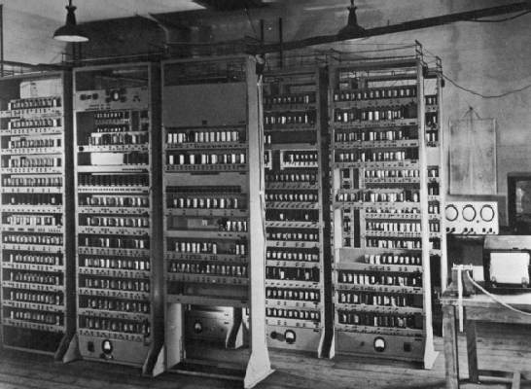
EDSAC (Cambridge, 1949) First General Stored-Program Computer
Programs held as numbers in memory
35-bit binary 2’s complement words
9/14/17
Notes:
Programming EDSAC

Slide 6
Consequence #1: Everything Has a Memory Address
Since all instructions and data are stored in memory, everything has a memory address: instructions, data words
Both branches and jumps use these
C pointers are just memory addresses: they can point to anything in memory
Unconstrained use of addresses can lead to nasty bugs; avoiding errors up to you in C; limited in Java by language design
One register keeps address of instruction being executed: “Program Counter” (PC)
Basically a pointer to memory
Intel calls it Instruction Pointer (a better name)
9/14/17

Slide 7
Consequence #2: Binary Compatibility
Programs are distributed in binary form
Programs bound to specific instruction set
Different version for phones and PCs
New machines want to run old programs (“binaries”) as well as programs compiled to new instructions
Leads to “backward-compatible” instruction set evolving over time
Selection of Intel 8088 in 1981 for 1st IBM PC is major reason latest PCs still use 80x86 instruction set; could still run program from 1981 PC today
9/14/17

Slide 8
Instructions as Numbers (1/2)
Most data we work with is in words (32-bit chunks):
Each register is a word
lw and sw both access memory one word at a time
So how do we represent instructions?
Remember: Computer only understands 1s and 0s, so assembler string “add x10,x11,x0” is meaningless to hardware
RISC-V seeks simplicity: since data is in words, make instructions be fixed-size 32-bit words also
Same 32-bit instructions used for RV32, RV64, RV128
9/14/17

Slide 9
Instructions as Numbers (2/2)
One word is 32 bits, so divide instruction word into “fields”
Each field tells processor something about instruction
We could define different fields for each instruction, but RISC-V seeks simplicity, so define six basic types of instruction formats:
R-format for register-register arithmetic operations
I-format for register-immediate arithmetic operations and loads
S-format for stores
B-format for branches (minor variant of S-format, called SB before)
U-format for 20-bit upper immediate instructions
J-format for jumps (minor variant of U-format, called UJ before)
9/14/17

Slide 10
Summary of RISC-V Instruction Formats

Slide 11
R-Format Instruction Layout
Field’s bit positions
Name of field
Number of bits in field
32-bit instruction word divided into six fields of varying numbers of bits each: 7+5+5+3+5+7 = 32
Examples
opcode is a 7-bit field that lives in bits 6-0 of the instruction
rs2 is a 5-bit field that lives in bits 24-20 of the instruction
9/14/17

Slide 12
R-Format Instructions opcode/funct fields
opcode: partially specifies what instruction it is
Note: This field is equal to 0110011_{two} for all R-Format register-register arithmetic instructions
funct7+funct3: combined with opcode, these two fields describe what operation to perform
Question: Why aren’t opcode and funct7 and funct3 a single 17-bit field?
We’ll answer this later
9/14/17

Slide 13
R-Format Instructions register specifiers
rs1 (Source Register #1): specifies register containing first operand
rs2 : specifies second register operand
rd (Destination Register): specifies register which will receive result of computation
Each register field holds a 5-bit unsigned integer (0-31) corresponding to a register number (x0-x31)
9/14/17

Slide 14
R-Format Example
RISC-V Assembly Instruction:
add x18,x19,x10
0000000
01010
10011
000
10010
0110011
ADD
rs2=10
rs1=19
ADD
rd=18
Reg-Reg OP
9/14/17

Slide 15
All RV32 R-format instructions
Different encoding in funct7 + funct3 selects different operations

Slide 16
I-Format Instructions
What about instructions with immediates?
5-bit field only represents numbers up to the value 31: immediates may be much larger than this
Ideally, RISC-V would have only one instruction format (for simplicity): unfortunately, we need to compromise
Define new instruction format that is mostly consistent with R-format
Notice if instruction has immediate, then uses at most 2 registers (one source, one destination)
9/14/17

Slide 17
I-Format Instruction Layout
Only one field is different from R-format, rs2 and funct7 replaced by 12-bit signed immediate, imm[11:0]
Remaining fields (rs1, funct3, rd, opcode) same as before
imm[11:0] can hold values in range [-2048_{ten} , +2047_{ten} ]
Immediate is always sign-extended to 32-bits before use in an arithmetic operation
We’ll later see how to handle immediates > 12 bits
9/14/17

Slide 18
I-Format Example
RISC-V Assembly Instruction:
addi x15,x1,-50
111111001110
00001
000
01111
0010011
imm=-50
rs1=1
ADD
rd=15
OP-Imm
9/14/17

Slide 19
All RV32 I-format Arithmetic Instructions
One of the higher-order immediate bits is used to distinguish “shift right logical” (SRLI) from “shift right arithmetic” (SRAI)
“Shift-by-immediate” instructions only use lower 5 bits of the immediate value for shift amount (can only shift by 0-31 bit positions)

Slide 20
Administrivia
HW0 Grades were released
If you have an issue with them, please fill out this form by tonight: https://goo.gl/forms/QH44Iw746pcCxOyH2
HW1 Part 1 Due next Monday, Part 2 Due Friday Sept 22
Homework-oriented office hours next Monday (check the website)
Homework Party on next Wednesday (6:30-10pm in 293 Cory)
Autograded results to be released every noon starting this Friday
Midterm #1 in 1.5 weeks: September 26!
Two sided 8.5” x 11” cheat sheet + RISC-V Green Card that we give you
DSP students: please make sure we know about your special accommodations (contact Steven Ho the head TA if you haven’t yet)
9/14/17

Slide 21
Break!
9/14/17

Slide 22
Load Instructions are also I-Type
The 12-bit signed immediate is added to the base address in register rs1 to form the memory address
This is very similar to the add-immediate operation but used to create address not to create final result
The value loaded from memory is stored in register rd

Slide 23
I-Format Load Example
RISC-V Assembly Instruction:
lw x14, 8(x2)
000000001000
00010
010
01110
0000011
imm=+8
rs1=2
LW
rd=14
LOAD
9/14/17

Slide 24
All RV32 Load Instructions
funct3 field encodes size and signedness of load data
LBU is “load unsigned byte”
LH is “load halfword”, which loads 16 bits (2 bytes) and sign-extends to fill destination 32-bit register
LHU is “load unsigned halfword”, which zero-extends 16 bits to fill destination 32-bit register
There is no LWU in RV32, because there is no sign/zero extension needed when copying 32 bits from a memory location into a 32-bit register

Slide 25
S-Format Used for Stores
Store needs to read two registers, rs1 for base memory address, and rs2 for data to be stored, as well as need immediate offset!
Can’t have both rs2 and immediate in same place as other instructions!
Note that stores don’t write a value to the register file, no rd!
RISC-V design decision is move low 5 bits of immediate to where rd field was in other instructions – keep rs1/rs2 fields in same place
register names more critical than immediate bits in hardware design
9/14/17

Slide 26
S-Format Example
RISC-V Assembly Instruction:
sw x14, 8(x2)
0000000
01110
00010
010
01000
0100011
offset[11:5]
=0
rs2=14
rs1=2
SW
offset[4:0]
=8
STORE
0000000
01000
combined 12-bit offset = 8
9/14/17

Slide 27
All RV32 Store Instructions

Slide 28
RISC-V Conditional Branches
E.g., BEQ x1, x2, Label
Branches read two registers but don’t write a register (similar to stores)
How to encode label, i.e., where to branch to?

Slide 29
Branching Instruction Usage
Branches typically used for loops (if-else, while, for)
Loops are generally small (< 50 instructions)
Function calls and unconditional jumps handled with jump instructions (J-Format)
Recall: Instructions stored in a localized area of memory (Code/Text)
Largest branch distance limited by size of code
Address of current instruction stored in the program counter (PC)
9/14/17

Slide 30
PC-Relative Addressing
PC-Relative Addressing: Use the immediate field as a two’s-complement offset to PC
Branches generally change the PC by a small amount
Can specify ± 2¹¹ addresses from the PC
Why not use byte address offset from PC?
9/14/17

Slide 31
Scaling Branch Offset
One idea: To improve the reach of a single branch instruction, multiply the offset by four bytes before adding to PC
This would allow one branch instruction to reach ± 2¹¹ × 32-bit instructions either side of PC
Four times greater reach than using byte offset

Slide 32
Branch Calculation
If we don’t take the branch:
PC = PC + 4 (i.e., next instruction)
If we do take the branch:
PC = PC + immediate*4
Observations:
immediate is number of instructions to jump (remember, specifies words) either forward (+) or backwards (–)
9/14/17

Slide 33
RISC-V Feature, n×16-bit instructions
Extensions to RISC-V base ISA support 16-bit compressed instructions and also variable-length instructions that are multiples of 16-bits in length
To enable this, RISC-V scales the branch offset by 2 bytes even when there are no 16-bit instructions
Reduces branch reach by half and means that ½ of possible targets will be errors on RISC-V processors that only support 32-bit instructions (as used in this class)
RISC-V conditional branches can only reach ± 2¹⁰ × 32-bit instructions either side of PC

Slide 34
RISC-V B-Format for Branches
B-format is mostly same as S-Format, with two register sources (rs1/rs2) and a 12-bit immediate
But now immediate represents values -4096 to +4094 in 2-byte increments
The 12 immediate bits encode even 13-bit signed byte offsets (lowest bit of offset is always zero, so no need to store it)

Slide 35
Branch Example, determine offset
RISC-V Code:
Loop: beq x19,x10,End add x18,x18,x10 addi x19,x19,-1 j Loop End: # target instruction
Branch offset =
(Branch with offset of 0, branches to itself)
1
2
3
4
Count instructions from branch
4×32-bit instructions = 16 bytes
9/14/17

Slide 36
Branch Example, encode offset
RISC-V Code:
Loop: beq x19,x10,End add x18,x18,x10 addi x19,x19,-1 j Loop End: # target instruction
offset = 16 bytes = 8x2
???????
01010
10011
000
?????
1100011
imm
rs2=10
rs1=19
BEQ
imm
BRANCH
9/14/17

Slide 37
RISC-V Immediate Encoding
Instruction Encodings, inst[31:0]
32-bit immediates produced, imm[31:0]
Only bit 7 of instruction changes role in immediate between S and B
Upper bits sign-extended from inst[31] always

Slide 38
Branch Example, complete encoding
beq x19,x10, offset = 16 bytes
13-bit immediate, imm[12:0], with value 16
imm[0] discarded, always zero
0000000010000
imm[12]
imm[11]
0
000000
01010
10011
000
1000
0
1100011
imm[10:5]
rs2=10
rs1=19
BEQ
imm[4:1]
BRANCH
9/14/17

Slide 39
All RISC-V Branch Instructions

Slide 40
Questions on PC-addressing
Does the value in branch immediate field change if we move the code?
If moving individual lines of code, then yes
If moving all of code, then no
What do we do if destination is > 2¹⁰ instructions away from branch?
Other instructions save us
9/14/17
Notes:
As we will see, jumping instructions can reach farther than branching

Slide 41
Questions on PC-addressing
Does the value in branch immediate field change if we move the code?
If moving individual lines of code, then yes
If moving all of code, then no (because PC-relative offsets)
What do we do if destination is > 2¹⁰ instructions away from branch?
Other instructions save us
beq x10,x0,far bne x10,x0,next # next instr → j far next: # next instr
9/14/17
Notes:
As we will see, jumping instructions can reach farther than branching

Slide 42
Break!
9/14/17

Slide 43
U-Format for “Upper Immediate” instructions
Has 20-bit immediate in upper 20 bits of 32-bit instruction word
One destination register, rd
Used for two instructions
LUI – Load Upper Immediate
AUIPC – Add Upper Immediate to PC

Slide 44
LUI to create long immediates
LUI writes the upper 20 bits of the destination with the immediate value, and clears the lower 12 bits.
Together with an ADDI to set low 12 bits, can create any 32-bit value in a register using two instructions (LUI/ADDI).
LUI x10, 0x87654 # x10 = 0x87654000
ADDI x10, x10, 0x321 # x10 = 0x87654321

Slide 45
One Corner Case
How to set 0xDEADBEEF?
LUI x10, 0xDEADB # x10 = 0xDEADB000
ADDI x10, x10, 0xEEF # x10 = 0xDEADAEEF
ADDI 12-bit immediate is always sign-extended, if top bit is set, will subtract -1 from upper 20 bits

Slide 46
Solution
How to set 0xDEADBEEF?
LUI x10, 0xDEADC # x10 = 0xDEADC000
ADDI x10, x10, 0xEEF # x10 = 0xDEADBEEF
Pre-increment value placed in upper 20 bits, if sign bit will be set on immediate in lower 12 bits.
Assembler pseudo-op handles all of this:
li x10, 0xDEADBEEF # Creates two instructions

Slide 47
AUIPC
Adds upper immediate value to PC and places result in destination register
Used for PC-relative addressing
Label: AUIPC x10, 0 # Puts address of label in x10

Slide 48
J-Format for Jump Instructions
JAL saves PC+4 in register rd (the return address)
Assembler “j” jump is pseudo-instruction, uses JAL but sets rd=x0 to discard return address
Set PC = PC + offset (PC-relative jump)
Target somewhere within ±2¹⁹ locations, 2 bytes apart
±2¹⁸ 32-bit instructions
Immediate encoding optimized similarly to branch instruction to reduce hardware cost

Slide 49
Uses of JAL
# j pseudo-instruction
j Label = jal x0, Label # Discard return address
# Call function within 2¹⁸ instructions of PC
jal ra, FuncName

Slide 50
JALR Instruction (I-Format)
JALR rd, rs, immediate
Writes PC+4 to rd (return address)
Sets PC = rs + immediate
Uses same immediates as arithmetic and loads
no multiplication by 2 bytes

Slide 51
Uses of JALR
# ret and jr psuedo-instructions
ret = jr ra = jalr x0, ra, 0
# Call function at any 32-bit absolute address
lui x1, <hi20bits>
jalr ra, x1, <lo12bits>
# Jump PC-relative with 32-bit offset
auipc x1, <hi20bits>
jalr x0, x1, <lo12bits>

Slide 52
Summary of RISC-V Instruction Formats

Slide 53
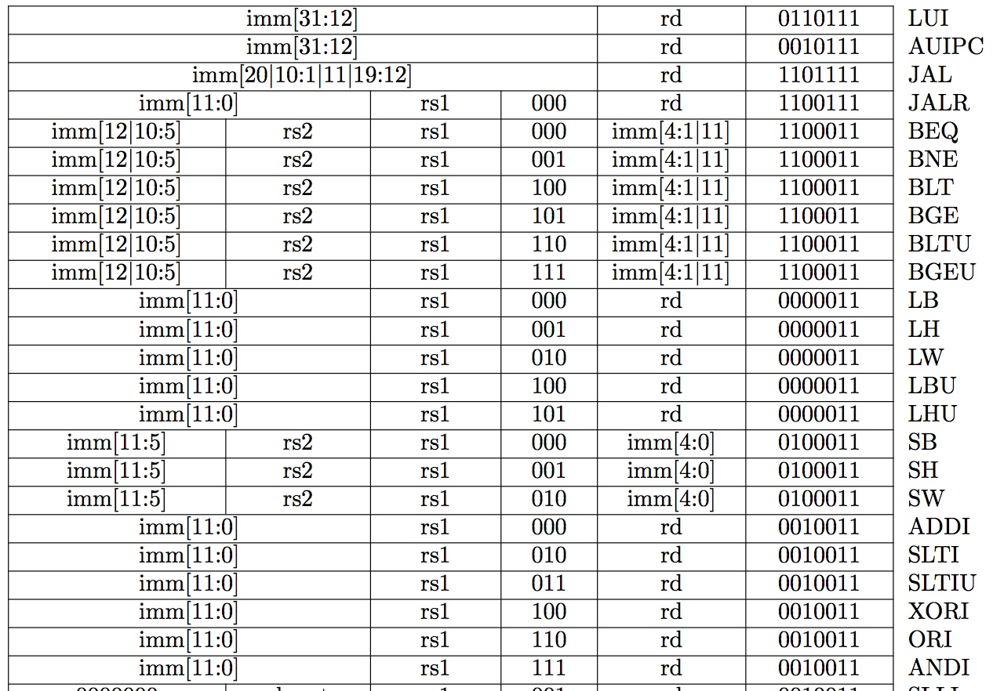
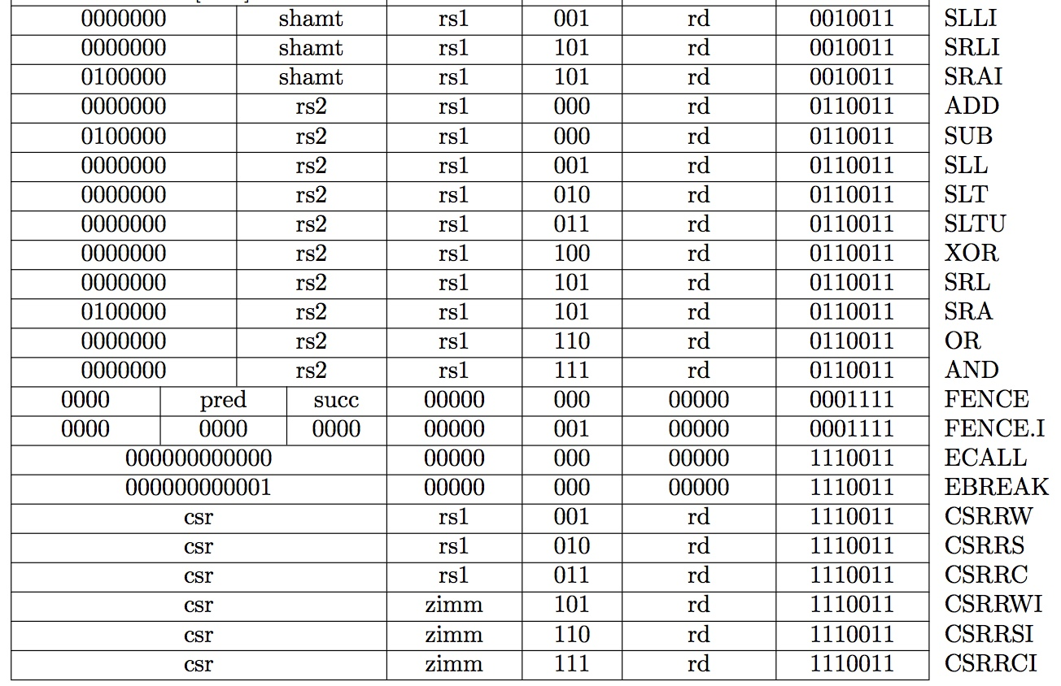
Complete RV32I ISA
Not in CS61C

