Slide 1
CS 61C: Great Ideas in Computer Architecture Lecture 18: Parallel Processing – SIMD
Krste Asanović & Randy Katz
http://inst.eecs.berkeley.edu/~cs61c

Slide 2
61C Survey
It would be nice to have a review lecture every once in a while, actually showing us how things fit in the bigger picture

Slide 3
Agenda
61C – the big picture
Parallel processing
Single instruction, multiple data
SIMD matrix multiplication
Amdahl’s law
Loop unrolling
Memory access strategy - blocking
And in Conclusion, …

Slide 4
61C Topics so far …
What we learned:
Binary numbers
C
Pointers
Assembly language
Datapath architecture
Pipelining
Caches
Performance evaluation
Floating point
What does this buy us?
Promise: execution speed
Let’s check!

Slide 5
Reference Problem
Matrix multiplication
Basic operation in many engineering, data, and imaging processing tasks
Image filtering, noise reduction, …
Many closely related operations
E.g. stereo vision (project 4)
dgemm
double-precision floating-point matrix multiplication

Slide 6
Application Example: Deep Learning
Image classification (cats …)
Pick “best” vacation photos
Machine translation
Clean up accent
Fingerprint verification
Automatic game playing

Slide 7
Matrices
$$j$$
Square matrix of dimension NxN
0
N-1
0
$$i$$
N-1

Slide 8
Matrix Multiplication
$$j$$
B
C = A*B
C_{ij} = Σ_{k} (A_{ik} * B_{kj})
$$k$$
$$k$$
A
C
$$i$$

Slide 9
Reference: Python
Matrix multiplication in Python
N | Python [Mflops]
32 | 5.4
160 | 5.5
480 | 5.4
960 | 5.3
1 MFLOP = 1 Million floating-point operations per second (fadd, fmul)
dgemm(N …) takes 2*N³ flops

Slide 10
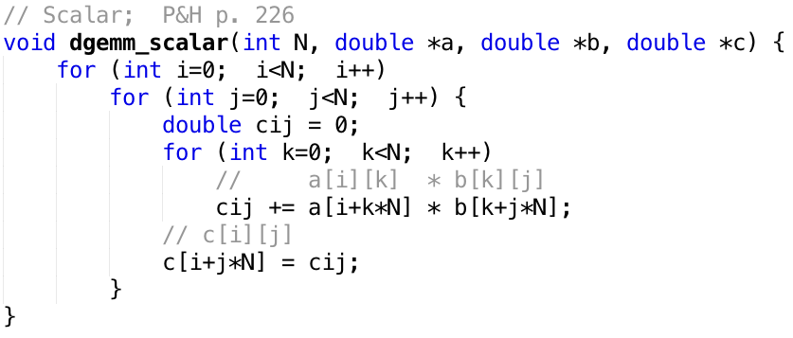
C
c = a * b
a, b, c are N x N matrices

Slide 11
Timing Program Execution

Slide 12
C versus Python
N | C [GFLOPS] | Python [GFLOPS]
32 | 1.30 | 0.0054
160 | 1.30 | 0.0055
480 | 1.32 | 0.0054
960 | 0.91 | 0.0053
240x!
Which class gives you this kind of power?
We could stop here … but why? Let’s do better!

Slide 13
Agenda
61C – the big picture
Parallel processing
Single instruction, multiple data
SIMD matrix multiplication
Amdahl’s law
Loop unrolling
Memory access strategy - blocking
And in Conclusion, …

Slide 14
Why Parallel Processing?
CPU Clock Rates are no longer increasing
Technical & economic challenges
Advanced cooling technology too expensive or impractical for most applications
Energy costs are prohibitive
Parallel processing is only path to higher speed
Compare airlines:
Maximum speed limited by speed of sound and economics
Use more and larger airplanes to increase throughput
And smaller seats …
Notes:
Smaller seats … what kind of Moore’s law is this?

Slide 15
Using Parallelism for Performance
Two basic ways:
Multiprogramming
run multiple independent programs in parallel
“Easy”
Parallel computing
run one program faster
“Hard”
We’ll focus on parallel computing in the next few lectures

Slide 16
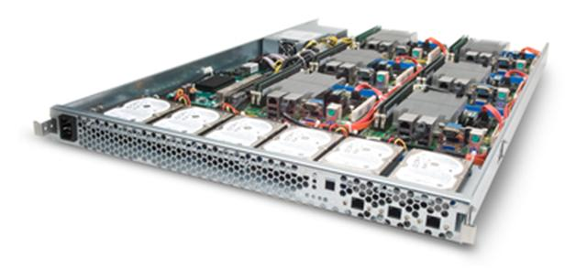
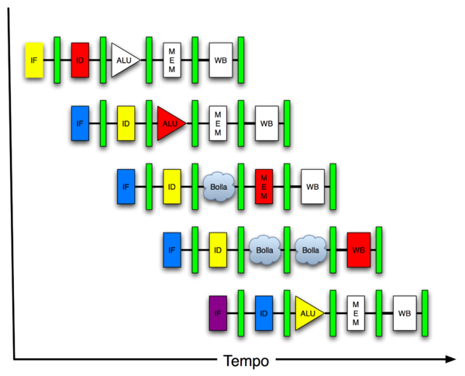
New-School Machine Structures (It’s a bit more complicated!)
Software Hardware
Parallel Requests
Assigned to computer
e.g., Search “Katz”
Parallel Threads
Assigned to core
e.g., Lookup, Ads
Parallel Instructions
>1 instruction @ one time
e.g., 5 pipelined instructions
Parallel Data
>1 data item @ one time
e.g., Add of 4 pairs of words
Hardware descriptions
All gates @ one time
Programming Languages
Warehouse Scale Computer
Smart Phone
Harness Parallelism &
Achieve High Performance
Computer
Core
…
Core
Memory (Cache)
Input/Output
Core
Today’s
Lecture
Instruction Unit(s)
Functional
Unit(s)
A₀+B₀
A₁+B₁
A₂+B₂
A₃+B₃
Cache Memory
Logic Gates

Slide 17
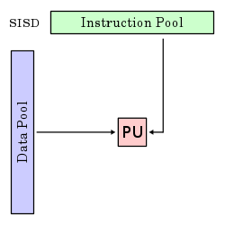
Single-Instruction/Single-Data Stream (SISD)
Sequential computer that exploits no parallelism in either the instruction or data streams. Examples of SISD architecture are traditional uniprocessor machines
E.g. our trusted RISC-V pipeline
Processing Unit
This is what we did up to now in 61C

Slide 18
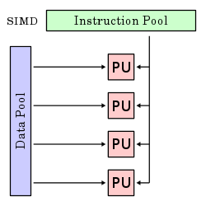
Single-Instruction/Multiple-Data Stream (SIMD or “sim-dee”)
SIMD computer exploits multiple data streams against a single instruction stream to operations that may be naturally parallelized, e.g., Intel SIMD instruction extensions or NVIDIA Graphics Processing Unit (GPU)
Today’s topic.

Slide 19
Multiple-Instruction/Multiple-Data Streams (MIMD or “mim-dee”)
Multiple autonomous processors simultaneously executing different instructions on different data.
MIMD architectures include multicore and Warehouse-Scale Computers
Instruction Pool
PU
PU
Data Pool
PU
PU
Topic of Lecture 19 and beyond.

Slide 20
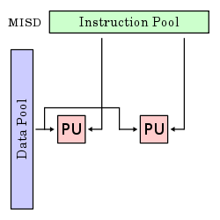
Multiple-Instruction/Single-Data Stream (MISD)
Multiple-Instruction, Single-Data stream computer that exploits multiple instruction streams against a single data stream.
Historical significance
This has few applications. Not covered in 61C.

Slide 21
Flynn* Taxonomy, 1966
SIMD and MIMD are currently the most common parallelism in architectures – usually both in same system!
Most common parallel processing programming style: Single Program Multiple Data (“SPMD”)
Single program that runs on all processors of a MIMD
Cross-processor execution coordination using synchronization primitives

Slide 22
Agenda
61C – the big picture
Parallel processing
Single instruction, multiple data
SIMD matrix multiplication
Amdahl’s law
Loop unrolling
Memory access strategy - blocking
And in Conclusion, …

Slide 23
SIMD – “Single Instruction Multiple Data”

Slide 24
SIMD Applications & Implementations
Applications
Scientific computing
Matlab, NumPy
Graphics and video processing
Photoshop, …
Big Data
Deep learning
Gaming
…
Implementations
x86
ARM
RISC-V vector extensions

Slide 25
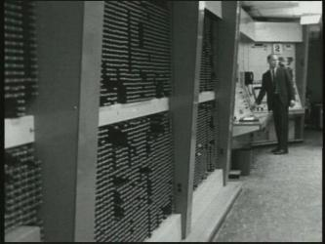
First SIMD Extensions: MIT Lincoln Labs TX-2, 1957

Slide 26
x86 SIMD Evolution
New instructions
New, wider, more registers
More parallelism
http://svmoore.pbworks.com/w/file/fetch/70583970/VectorOps.pdf

Slide 27
Laptop CPU Specs
$ sysctl -a | grep cpu
hw.physicalcpu: 2
hw.logicalcpu: 4
machdep.cpu.brand_string: Intel(R) Core(TM) i7-5557U CPU @ 3.10GHz
machdep.cpu.features: FPU VME DE PSE TSC MSR PAE MCE CX8 APIC SEP MTRR PGE MCA CMOV PAT PSE36 CLFSH DS ACPI MMX FXSR SSE SSE2 SS HTT TM PBE SSE3 PCLMULQDQ DTES64 MON DSCPL VMX EST TM2 SSSE3 FMA CX16 TPR PDCM SSE4.1 SSE4.2 x2APIC MOVBE POPCNT AES PCID XSAVE OSXSAVE SEGLIM64 TSCTMR AVX1.0 RDRAND F16C
machdep.cpu.leaf7_features: SMEP ERMS RDWRFSGS TSC_THREAD_OFFSET BMI1 AVX2 BMI2 INVPCID SMAP RDSEED ADX IPT FPU_CSDS

Slide 28
SIMD Registers

Slide 29
SIMD Data Types
(Now also AVX-512 available)

Slide 30
SIMD Vector Mode

Slide 31
Agenda
61C – the big picture
Parallel processing
Single instruction, multiple data
SIMD matrix multiplication
Amdahl’s law
Loop unrolling
Memory access strategy - blocking
And in Conclusion, …

Slide 32
Problem
Today’s compilers (largely) do not generate SIMD code
Back to assembly …
x86 (not using RISC-V as no vector hardware yet)
Over 1000 instructions to learn …
Green Book
Can we use the compiler to generate all non-SIMD instructions?

Slide 33
x86 Intrinsics AVX Data Types
Intrinsics: Direct access to registers & assembly from C
Register

Slide 34
Intrinsics AVX Code Nomenclature

Slide 35
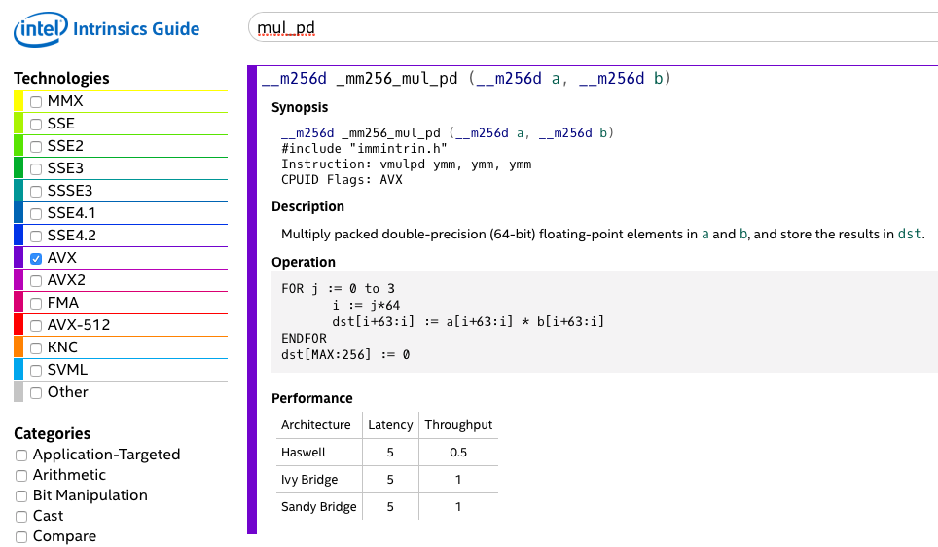
x86 SIMD “Intrinsics”
assembly instruction
4 parallel multiplies
2 instructions per clock cycle (CPI = 0.5)
https://software.intel.com/sites/landingpage/IntrinsicsGuide/

Slide 36
Raw Double-Precision Throughput
Characteristic | Value
CPU | i7-5557U
Clock rate (sustained) | 3.1 GHz
Instructions per clock (mul_pd) | 2
Parallel multiplies per instruction | 4
Peak double FLOPS | 24.8 GFLOPS
https://www.karlrupp.net/2013/06/cpu-gpu-and-mic-hardware-characteristics-over-time/
Actual performance is lower because of overhead

Slide 37
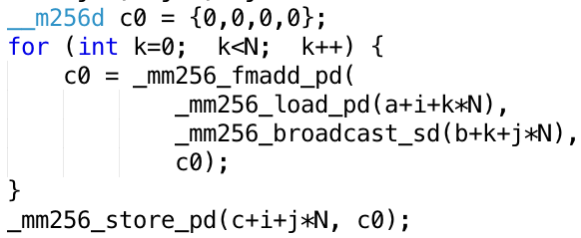
Vectorized Matrix Multiplication
for i …; i+=4
for j ...
$$j$$
Inner Loop:
$$k$$
$$k$$
$$i$$
i += 4

Slide 38
“Vectorized” dgemm

Slide 39
Performance
N | Gflops
 | scalar | avx
32 | 1.30 | 4.56
160 | 1.30 | 5.47
480 | 1.32 | 5.27
960 | 0.91 | 3.64
4x faster
But still << theoretical 25 GFLOPS!

Slide 40
Agenda
61C – the big picture
Parallel processing
Single instruction, multiple data
SIMD matrix multiplication
Amdahl’s law
Loop unrolling
Memory access strategy - blocking
And in Conclusion, …

Slide 41
A trip to LA
Commercial airline:
Get to SFO & check-in | SFO → LAX | Get to destination
3 hours | 1 hour | 3 hours
Total time: 7 hours
Supersonic aircraft:
Get to SFO & check-in | SFO → LAX | Get to destination
3 hours | 6 min | 3 hours
Total time: 6.1 hours
Speedup:
Flying time S_{flight} = 60 / 6 = 10x
Trip time S_{trip} = 7 / 6.1 = 1.15x
Notes:
Google sign-up bonus: supersonic plane for A in 61C
Trip to LA: brief relief from traffic jams
Speedup … it’s still worth it to get an A in 61C. Perhaps for a weekend in Paris?

Slide 42
Amdahl’s Law
Get enhancement E for your new PC
E.g. floating-point rocket booster
E
Speeds up some task (e.g. arithmetic) by factor S_{E}
F is fraction of program that uses this ”task”
Execution Time:
no speedup
speedup section
T₀ (no E)
1-F | F
T_{E} (with E)
1-F | F / S_{E}
Speedup:
Speedup = T_{O} / T_{E} = 1 / ((1-F) + F/S_{E})
Notes:
Computer scientists call this Amdahl’s law
Don’t forget, you may need the jargon for the Google interview

Slide 43
Big Idea: Amdahl’s Law
Speedup = T_{O} / T_{E} = 1 / ((1-F) + F/S_{E})
Part sped up
Part not sped up
Example: The execution time of half of a program can be accelerated by a factor of 2. What is the program speed-up overall?
T_{O} / T_{E} = 1 / ((1-F) + F/S_{E}) = 1/((1- 0.5)+0.5/2) = 1.33 << 2

Slide 44
Maximum “Achievable” Speed-Up
Speedup = 1 / ((1-F) + F/S_{E})
(S_{E}->∞) = 1/(1-F)
Question: What is a reasonable # of parallel processors to speed up an algorithm with F = 95%? (i.e. 19/20th can be sped up)
a) Maximum speedup: S_{max} = 1/(1-0.95) = 20
but needs S_{E}=∞!
Reasonable “engineering” compromise:
Equal time in sequential and parallel code: (1-F) = F/S_{E}
S_{E} = F/(1-F) = 0.95/0.05 = 20
S = 1/(0.05+0.05) = 10
Notes:
infinity? A few more years of Moore’s law …

Slide 45
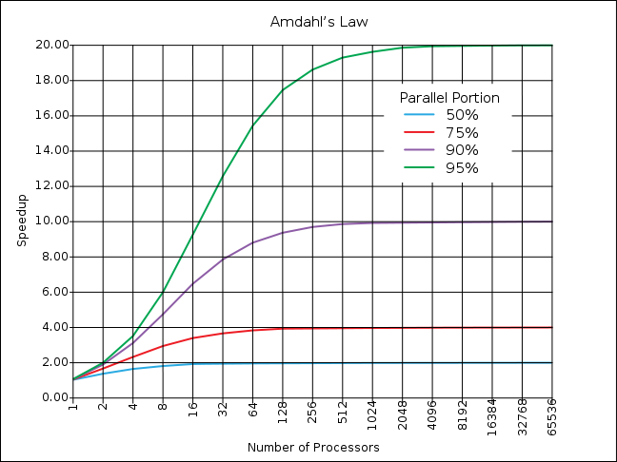
If the portion of the program that can be parallelized is small, then the speedup is limited
500 processors
for 19x
In this region, the sequential portion limits the performance
20 processors
for 10x

Slide 46
Strong and Weak Scaling
To get good speedup on a parallel processor while keeping the problem size fixed is harder than getting good speedup by increasing the size of the problem.
Strong scaling: when speedup can be achieved on a parallel processor without increasing the size of the problem
Weak scaling: when speedup is achieved on a parallel processor by increasing the size of the problem proportionally to the increase in the number of processors
Load balancing is another important factor: every processor doing same amount of work
Just one unit with twice the load of others cuts speedup almost in half
Notes:
Add load balancing example here – page 638

Slide 47
Peer Instruction
Suppose a program spends 80% of its time in a square-root routine. How much must you speedup square root to make the program run 5 times faster?
Speedup = 1 / ((1-F) + F/S_{E})
RED: 5
GREEN: 20
ORANGE: 500
YELLOW: None of above

Slide 48
Administrivia
Midterm 2 is Tuesday during class time!
Review Session: Saturday 10-12pm @Hearst Annex A1
One double-sided crib sheet; we’ll provide the RISCV card
Bring your ID! We’ll check it
Room assignments posted on Piazza
Project 2 pre-lab due Friday
HW4 due 11/3, but advisable to finish by the midterm
Project 2-2 due 11/6, but also good to finish before MT2

Slide 49
Agenda
61C – the big picture
Parallel processing
Single instruction, multiple data
SIMD matrix multiplication
Amdahl’s law
Loop unrolling
Memory access strategy - blocking
And in Conclusion, …

Slide 50
Amdahl’s Law applied to dgemm
Measured dgemm performance
Peak 5.5 GFLOPS
Large matrices 3.6 GFLOPS
Processor 24.8 GFLOPS
Why are we not getting (close to) 25 GFLOPS?
Something else (not floating-point ALU) is limiting performance!
But what? Possible culprits:
Cache
Hazards
Let’s look at both!

Slide 51
Pipeline Hazards – dgemm

Slide 52
Loop Unrolling
4 registers
Compiler does the unrolling
How do you verify that the generated code is actually unrolled?

Slide 53
Performance
N | Gflops
 | scalar | avx | unroll
32 | 1.30 | 4.56 | 12.95
160 | 1.30 | 5.47 | 19.70
480 | 1.32 | 5.27 | 14.50
960 | 0.91 | 3.64 | 6.91
WOW!
?

Slide 54
Agenda
61C – the big picture
Parallel processing
Single instruction, multiple data
SIMD matrix multiplication
Amdahl’s law
Loop unrolling
Memory access strategy - blocking
And in Conclusion, …

Slide 55
FPU versus Memory Access
How many floating-point operations does matrix multiply take?
F = 2 x N³ (N³ multiplies, N³ adds)
How many memory load/stores?
M = 3 x N² (for A, B, C)
Many more floating-point operations than memory accesses
q = F/M = 2/3 * N
Good, since arithmetic is faster than memory access
Let’s check the code …

Slide 56
But memory is accessed repeatedly
Inner loop:
q = F/M = 1! (2 loads and 2 floating-point operations)

Slide 57
Typical Memory Hierarchy
On-Chip Components
Control
Third-Level
Cache
(SRAM)
Secondary
Memory
(Disk
Or Flash)
Second-Level
Cache
(SRAM)
Main
Memory
(DRAM)
Instr
Cache
Datapath
RegFile
Data
Cache
Speed (cycles): ½’s 1’s 10’s 100’s-1000 1,000,000’s
Size (bytes): 100’s 10K’s M’s G’s T’s
Cost/bit: highest lowest
Where are the operands (A, B, C) stored?
What happens as N increases?
Idea: arrange that most accesses are to fast cache!

Slide 58
Sub-Matrix Multiplication or: Beating Amdahl’s Law

Slide 59
Blocking
Idea:
Rearrange code to use values loaded in cache many times
Only “few” accesses to slow main memory (DRAM) per floating point operation
→ throughput limited by FP hardware and cache, not slow DRAM
P&H, RISC-V edition p. 465

Slide 60
Memory Access Blocking

Slide 61
Performance
N | Gflops
 | scalar | avx | unroll | blocking
32 | 1.30 | 4.56 | 12.95 | 13.80
160 | 1.30 | 5.47 | 19.70 | 21.79
480 | 1.32 | 5.27 | 14.50 | 20.17
960 | 0.91 | 3.64 | 6.91 | 15.82

Slide 62
Agenda
61C – the big picture
Parallel processing
Single instruction, multiple data
SIMD matrix multiplication
Amdahl’s law
Loop unrolling
Memory access strategy - blocking
And in Conclusion, …

Slide 63
And in Conclusion, …
Approaches to Parallelism
SISD, SIMD, MIMD (next lecture)
SIMD
One instruction operates on multiple operands simultaneously
Example: matrix multiplication
Floating point heavy → exploit Moore’s law to make fast
Amdahl’s Law:
Serial sections limit speedup
Cache
Blocking
Hazards
Loop unrolling

