Slide 1
CS 61C:
Great Ideas in Computer Architecture
Lecture 25: Dependability and RAID
Krste Asanović & Randy H. Katz
http://inst.eecs.berkeley.edu/~cs61c/fa17
11/27/17
Fall 2017 – Lecture #25

Slide 2
Storage Attachment Evolution
Network Server Attachment
Direct Attachment

Slide 3
Storage Attachment Evolution
Channel Attached
Network Attached

Slide 4
Storage Attachment Evolution
Storage Area Networks (SAN)

Slide 5
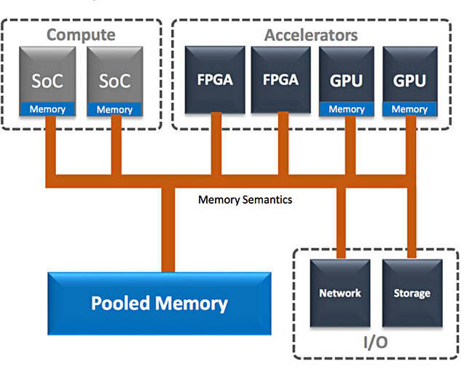
Storage Class Memory aka Rack-Scale Memory
5

Slide 6
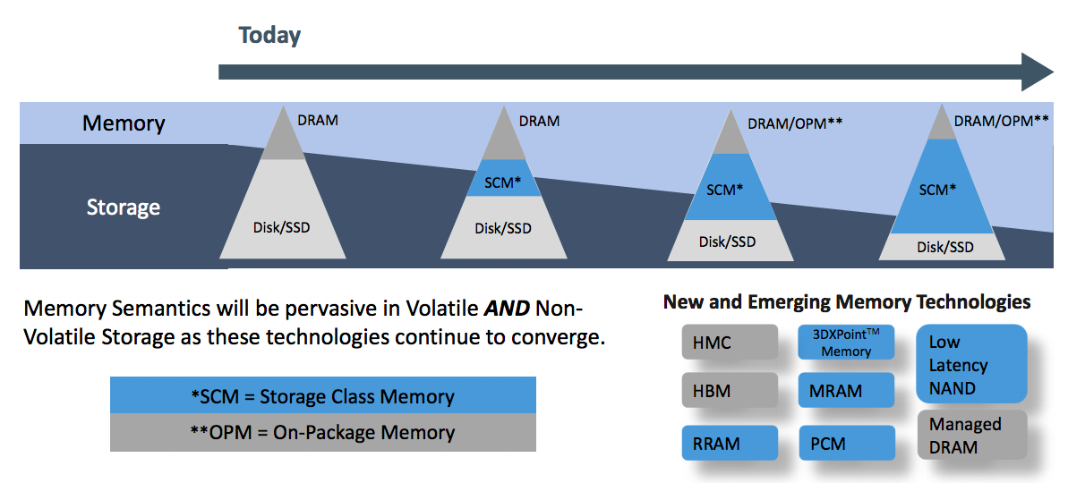
Storage Class Memory aka Rack-Scale Memory
Cheaper than DRAM
More expensive than disk
Non-Volatile and faster than disk
6

Slide 7
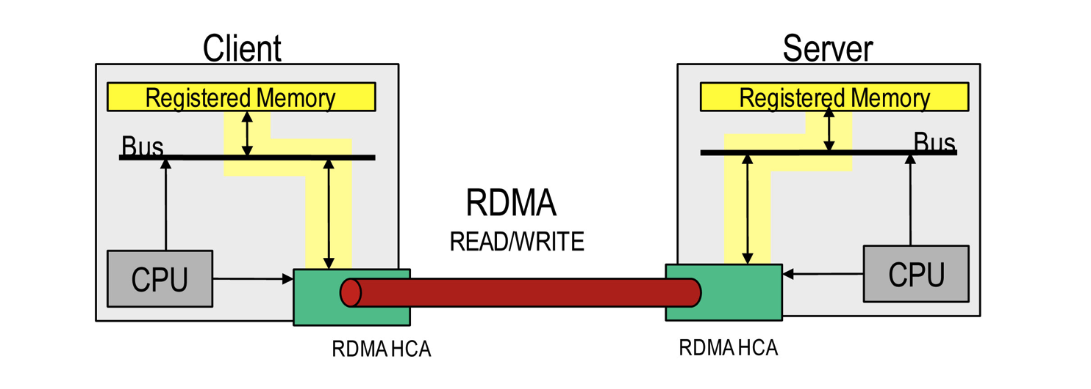
Remote Direct Memory Access
11/27/17
Fall 2017 -- Lecture #25
Notes:
HCA = Host Channel Adapter

Slide 8
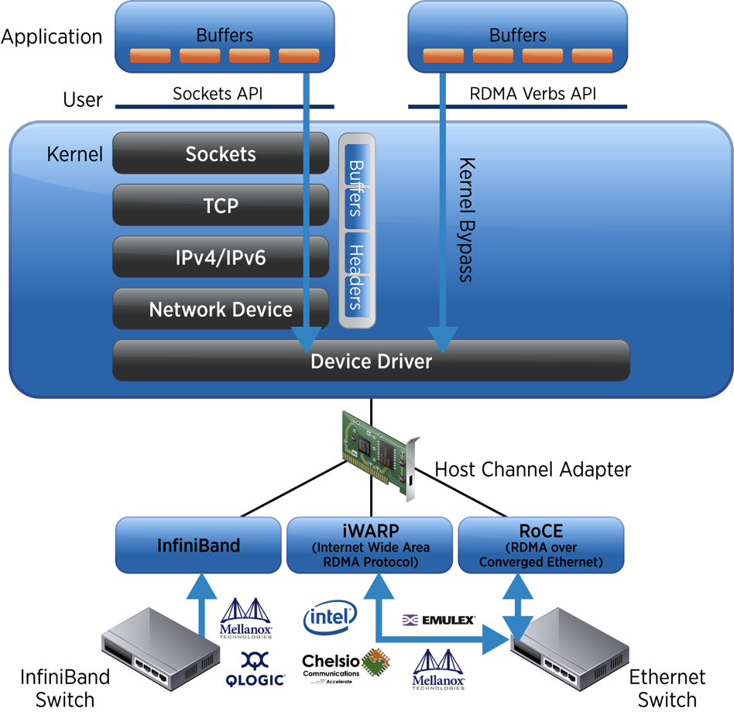
Remote Direct Memory Access
Conventional
Networking
Cut-through
Memory access
Over network

Slide 9
Outline
Dependability via Redundancy
Error Correction/Detection
RAID
And, in Conclusion …
11/27/17
Fall 2017 – Lecture #25

Slide 10
Outline
Dependability via Redundancy
Error Correction/Detection
RAID
And, in Conclusion …
11/27/17
Fall 2017 – Lecture #25

Slide 11
Six Great Ideas in Computer Architecture
Design for Moore’s Law (Multicore, Parallelism, OpenMP, Project #3)
Abstraction to Simplify Design (Everything a number, Machine/Assembler Language, C, Project #1; Logic Gates, Datapaths, Project #2)
Make the Common Case Fast (RISC Architecture, Instruction Pipelining, Project #2)
Memory Hierarchy (Locality, Consistency, False Sharing, Project #3)
Performance via Parallelism/Pipelining/Prediction (the five kinds of parallelism, Project #3, #4)
Dependability via Redundancy (ECC, RAID)
11/27/17
Fall 2017 – Lecture #25

Slide 12
Great Idea #6:
Dependability via Redundancy
Redundancy so that a failing piece doesn’t make the whole system fail
1+1=2
2 of 3 agree
1+1=2
1+1=2
1+1=1
FAIL!
Increasing transistor density reduces the cost of redundancy
11/27/17
Fall 2017 – Lecture #25

Slide 13
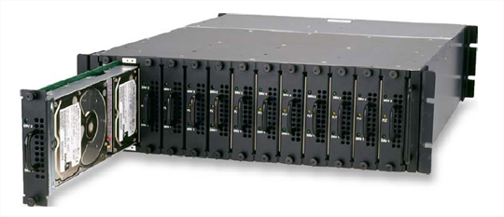
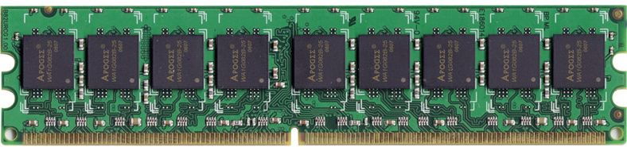
Great Idea #6:
Dependability via Redundancy
Applies to everything from datacenters to memory
  Redundant datacenters so that can lose one datacenter but Internet service stays online
  Redundant routes so can lose nodes but Internet doesn’t fail
  Redundant disks so that can lose one disk but not lose data (Redundant Arrays of Independent Disks/RAID)
  Redundant memory bits of so that can lose 1 bit but no data (Error Correcting Code/ECC Memory)
11/27/17
Fall 2017 – Lecture #25

Slide 14
Dependability
Service accomplishment
Service delivered
as specified
Fault: failure of a component
  May or may not lead to system failure
Restoration
Failure
Service interruption
Deviation from
specified service
11/27/17
Fall 2017 – Lecture #25

Slide 15
Dependability via Redundancy:
Time vs. Space
Spatial Redundancy – replicated data or check information or hardware to handle hard and soft (transient) failures
Temporal Redundancy – redundancy in time (retry) to handle soft (transient) failures
11/27/17
Fall 2017 – Lecture #25

Slide 16
Dependability Measures
Reliability: Mean Time To Failure (MTTF)
Service interruption: Mean Time To Repair (MTTR)
Mean time between failures (MTBF)
  MTBF = MTTF + MTTR
Availability = MTTF / (MTTF + MTTR)
Improving Availability
  Increase MTTF: More reliable hardware/software + Fault Tolerance
  Reduce MTTR: improved tools and processes for diagnosis and repair
11/27/17
Fall 2017 – Lecture #25

Slide 17
Understanding MTTF
1
Probability
of Failure
Time
11/27/17
Fall 2017 – Lecture #25

Slide 18
Availability Measures
Availability = MTTF / (MTTF + MTTR) as %
  MTTF, MTBF usually measured in hours
Since hope rarely down, shorthand is
“number of 9s of availability per year”
1 nine: 90% => 36 days of repair/year
2 nines: 99% => 3.6 days of repair/year
3 nines: 99.9% => 526 minutes of repair/year
4 nines: 99.99% => 53 minutes of repair/year
5 nines: 99.999% => 5 minutes of repair/year
11/27/17
Fall 2017 – Lecture #25

Slide 19
Reliability Measures
Another is average number of failures per year: Annualized Failure Rate (AFR)
  E.g., 1000 disks with 100,000 hour MTTF
  365 days * 24 hours = 8760 hours
  (1000 disks * 8760 hrs/year) / 100,000 = 87.6 failed disks per year on average
  87.6/1000 = 8.76% annual failure rate
Google’s 2007 study* found that actual AFRs for individual drives ranged from 1.7% for first year drives to over 8.6% for three-year old drives
*research.google.com/archive/disk_failures.pdf
11/27/17
Fall 2017 – Lecture #25

Slide 20
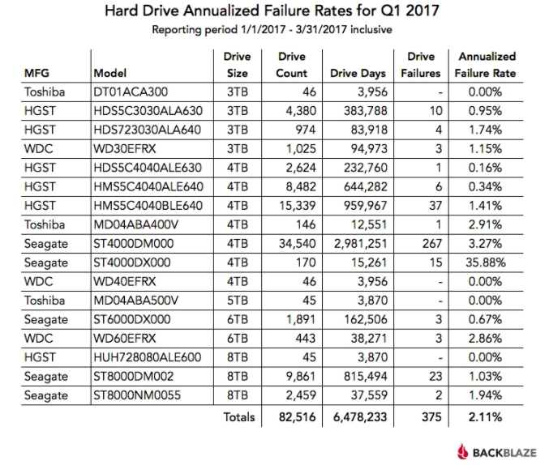
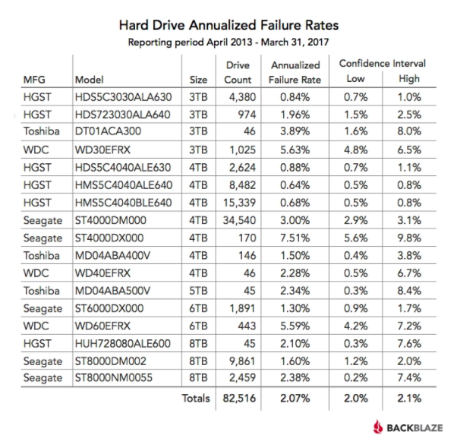
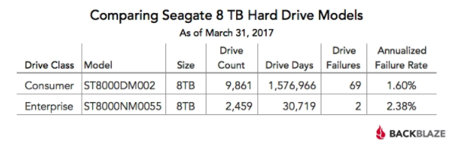
Breaking News, 1Q17, BackBlaze https://www.backblaze.com/blog/hard-drive-failure-rates-q1-2017/
11/27/17
Fall 2017 – Lecture #25

Slide 21
Dependability Design Principle
Design Principle: No single points of failure
  “Chain is only as strong as its weakest link”
Dependability Corollary of Amdahl’s Law
  Doesn’t matter how dependable you make one portion of system
  Dependability limited by part you do not improve
11/27/17
Fall 2017 – Lecture #25

Slide 22
Outline
Dependability via Redundancy
Error Correction/Detection
RAID
And, in Conclusion …
11/27/17
Fall 2017 – Lecture #25

Slide 23
Error Detection/Correction Codes
Memory systems generate errors (accidentally flipped-bits)
  DRAMs store very little charge per bit
  “Soft” errors occur occasionally when cells are struck by alpha particles or other environmental upsets
  “Hard” errors can occur when chips permanently fail
  Problem gets worse as memories get denser and larger
Memories protected against failures with EDC/ECC
Extra bits are added to each data-word
  Used to detect and/or correct faults in the memory system
  Each data word value mapped to unique code word
  A fault changes valid code word to invalid one, which can be detected
11/27/17
Fall 2017 – Lecture #25

Slide 24
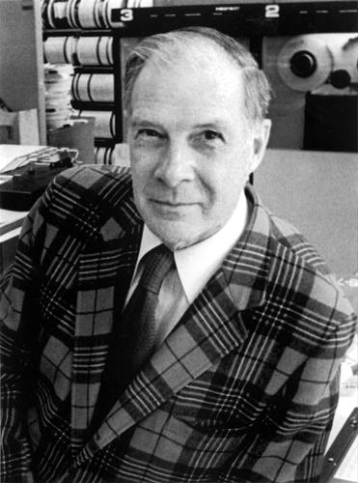
Block Code Principles
Hamming distance = difference in # of bits
p = 011011, q = 001111, Ham. distance (p,q) = 2
p = 011011,
q = 110001,
distance (p,q) = ?
Can think of extra bits as creating
a code with the data
What if minimum distance
between members of code is 2
and get a 1-bit error?
Richard Hamming, 1915-98
Turing Award Winner
11/27/17
Fall 2017 – Lecture #25
Notes:
Distance is 3 of second case

Slide 25
Parity: Simple Error-Detection Coding
Each data value, before it is written to memory is “tagged” with an extra bit to force the stored word to have even parity:
Each word, as it is read from memory is “checked” by finding its parity (including the parity bit).
b₇b₆b₅b₄b₃b₂b₁b₀ p
b₇b₆b₅b₄b₃b₂b₁b₀
+
+
p
c
Minimum Hamming distance of parity code is 2
A non-zero parity check indicates an error occurred:
  2 errors (on different bits) are not detected
  Nor any even number of errors, just odd numbers of errors are detected
11/27/17
Fall 2017 – Lecture #25

Slide 26
Parity Example
Data 0101 0101
4 ones, even parity now
Write to memory:
0101 0101 0
to keep parity even
Data 0101 0111
5 ones, odd parity now
Write to memory:
0101 0111 1
to make parity even
Read from memory
0101 0101 0
4 ones => even parity, so no error
Read from memory
1101 0101 0
5 ones => odd parity,
so error
What if error in parity bit?
11/27/17
Fall 2017 – Lecture #25

Slide 27
Suppose Want to Correct One Error?
Hamming came up with simple to understand mapping to allow Error Correction at minimum distance of three
  Single error correction, double error detection
Called “Hamming ECC”
  Worked weekends on relay computer with unreliable card reader, frustrated with manual restarting
  Got interested in error correction; published 1950
  R. W. Hamming, “Error Detecting and Correcting Codes,” The Bell System Technical Journal, Vol. XXVI, No 2 (April 1950) pp 147-160.
11/27/17
Fall 2017 – Lecture #25

Slide 28
Detecting/Correcting Code Concept
Space of possible bit patterns (2^{N})
Error changes bit pattern to non-code
Sparse population of code words (2^{M} << 2^{N})
- with identifiable signature
Detection: bit pattern fails codeword check
Correction: map to nearest valid code word
11/27/17
Fall 2017 – Lecture #25

Slide 29
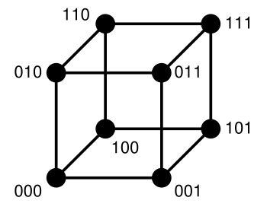
Hamming Distance: Eight Code Words
11/27/17
Fall 2017 – Lecture #25

Slide 30
Hamming Distance 2: Detection
Detect Single Bit Errors
Invalid
Codewords
No 1 bit error goes to another valid codeword
½ codewords are valid
11/27/17
Fall 2017 – Lecture #25

Slide 31
Hamming Distance 3: Correction
Correct Single Bit Errors, Detect Double Bit Errors
Nearest
111
(one 0)
Nearest
000
(one 1)
No 2 bit error goes to another valid codeword; 1 bit error near
1/4 codewords are valid
11/27/17
Fall 2017 – Lecture #25

Slide 32

11/27/17
Fall 2017 -- Lecture #25

Slide 33

Administrivia (1/2)
Final exam: the last Thursday examination slot!
  14 December, 7-10 PM, Room TBD
  Contact us about conflicts
  Review Lectures and Book with eye on the important concepts of the course, e.g., the Great Ideas in Computer Architecture and
  the Different Kinds of Parallelism
Review Session Fri Dec 8, 5-8 PM @TBA
Electronic Course Evaluations this week! See https://course-evaluations.berkeley.edu
11/27/17
Fall 2017 -- Lecture #25
Notes:
Six Great Ideas in Computer Architecture:
1. Layers of Representation/Interpretation
2. Moore’s Law
3. Principle of Locality/Memory Hierarchy
4. Parallelism
5. Performance Measurement & Improvement
6. Dependability via Redundancy
Six Different Kinds of Parallelism
Instruction Parallelism (Pipelining)
Data Parallelism (Fine Graini: SIMD, AVX-512; Course Grain: Map Reduce)
Thread Parallelism (SMT, Open MP)
Request Parallelism (Multiple Web Site Requests)

Slide 34
Administrivia (2/2)
Project 3 Contest results to be announced during Thursday’s lecture
Lab 11 (Spark) is due any day this week
Lab 13 (VM) is due any day next week
VM Guerrilla Session tonight!
  7-9pm @Cory 293 (unless bigger room found)
  Last Guerrilla Session is next Tuesday, same time and place
    Will go over the most difficult topics this semester
Project 4 Party tomorrow night 7-9pm @Cory 293
11/27/17
Fall 2017 -- Lecture #25
Notes:
Six Great Ideas in Computer Architecture:
1. Layers of Representation/Interpretation
2. Moore’s Law
3. Principle of Locality/Memory Hierarchy
4. Parallelism
5. Performance Measurement & Improvement
6. Dependability via Redundancy
Six Different Kinds of Parallelism
Instruction Parallelism (Pipelining)
Data Parallelism (Fine Graini: SIMD, AVX-512; Course Grain: Map Reduce)
Thread Parallelism (SMT, Open MP)
Request Parallelism (Multiple Web Site Requests)

Slide 35
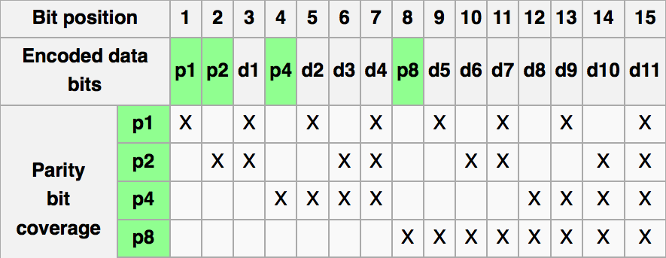
Graphic of Hamming Code
http://en.wikipedia.org/wiki/Hamming_code
11/27/17
Fall 2017 -- Lecture #25

Slide 36
Hamming ECC
Set parity bits to create even parity for each group
A byte of data: 10011010
Create the coded word, leaving spaces for the parity bits:
_ _ 1 _ 0 0 1 _ 1 0 1 0
1 2 3 4 5 6 7 8 9 a b c – bit position
Calculate the parity bits
11/27/17
Fall 2017 -- Lecture #25
Notes:
Do this on the white board

Slide 37
Hamming ECC
Position 1 checks bits 1,3,5,7,9,11:
? _ 1 _ 0 0 1 _ 1 0 1 0. set position 1 to a _:
Position 2 checks bits 2,3,6,7,10,11:
0 ? 1 _ 0 0 1 _ 1 0 1 0. set position 2 to a _:
Position 4 checks bits 4,5,6,7,12:
0 1 1 ? 0 0 1 _ 1 0 1 0. set position 4 to a _:
Position 8 checks bits 8,9,10,11,12:
0 1 1 1 0 0 1 ? 1 0 1 0. set position 8 to a _:
11/27/17
Fall 2017 -- Lecture #25
Notes:
Do this on white board.
Bit 1 is 0
Bit 2 is 1
Bit 4 is 1

Slide 38
Hamming ECC
Final code word: 011100101010
Data word: 1 001 1010
11/27/17
Fall 2017 -- Lecture #25
Notes:
Bit 8 set to 0

Slide 39
Hamming ECC Error Check
Suppose receive
011100101110
0 1 1 1 0 0 1 0 1 1 1 0
11/27/17
Fall 2017 -- Lecture #25

Slide 40
Hamming ECC Error Check
Suppose receive
011100101110
11/27/17
Fall 2017 – Lecture #25

Slide 41
Hamming ECC Error Check
Suppose receive
011100101110
0 1 0 1 1 1 √
11 01 11 X-Parity 2 in error
1001 0 √
01110 X-Parity 8 in error
Implies position 8+2=10 is in error
011100101110
11/27/17
Fall 2017 – Lecture #25

Slide 42
Hamming ECC Error Correct
Flip the incorrect bit …
011100101010
11/27/17
Fall 2017 – Lecture #25

Slide 43
Hamming ECC Error Correct
Suppose receive
011100101010
0 1 0 1 1 1 √
11 01 01 √
1001 0 √
01010 √
11/27/17
Fall 2017 – Lecture #25

Slide 44
What if More Than 2-Bit Errors?
Network transmissions, disks, distributed storage common failure mode is bursts of bit errors, not just one or two bit errors
  Contiguous sequence of B bits in which first, last and any number of intermediate bits are in error
  Caused by impulse noise or by fading in wireless
  Effect is greater at higher data rates
Solve with Cyclic Redundancy Check (CRC), interleaving or other more advanced codes
11/27/17
Fall 2017 – Lecture #25

Slide 45
11/27/17
Fall 2017 -- Lecture #25

Slide 46
Peer Instruction Question
The following word is received, encoded with Hamming code:
0 1 1 0 0 0 1
What is the corrected data bit sequence?
A. 1 1 1 1
B. 0 0 0 1
C. 1 1 0 1
D. 1 0 1 1
11/27/17
Fall 2017 – Lecture #25

Slide 47
Outline
Dependability via Redundancy
Error Correction/Detection
RAID
And, in Conclusion …
11/27/17
Fall 2017 – Lecture #25

Slide 48
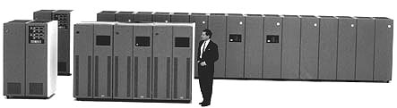
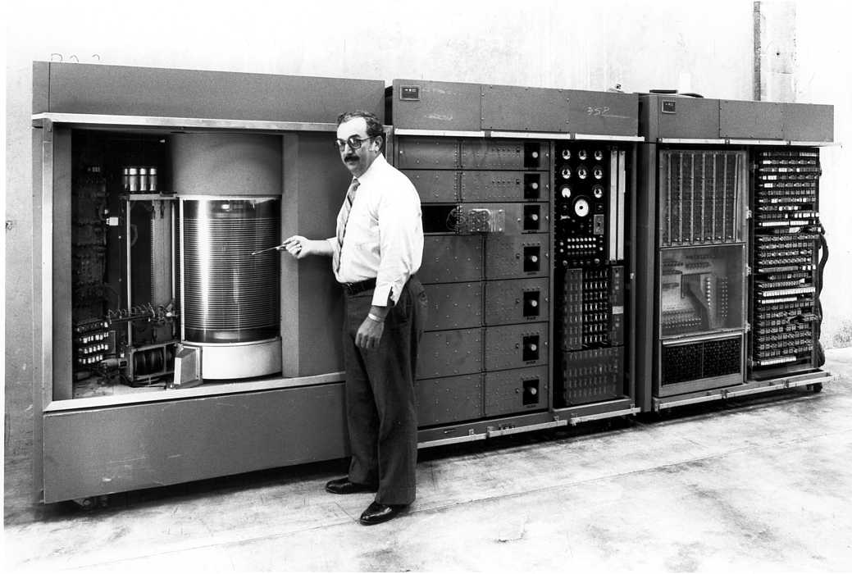
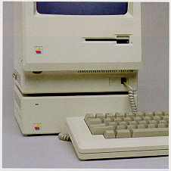
Evolution of the Disk Drive
IBM 3390K, 1986
IBM RAMAC 305, 1956
Apple SCSI, 1986
11/27/17
Fall 2017 – Lecture #25

Slide 49
Arrays of Small Disks
  Can smaller disks be used to close gap in performance between disks and CPUs?
Conventional: 4 disk designs
3.5”
5.25”
10”
14”
Low End
High End
Disk Array:
1 disk design
3.5”
11/27/17
Fall 2017 – Lecture #25

Slide 50
Replace Small Number of Large Disks with Large Number of Small Disks! (1988 Disks)
IBM 3390K
20 GBytes
97 cu. ft.
3 KW
15 MB/s
600 I/Os/s
250 KHrs
$250K
IBM 3.5" 0061
320 MBytes
0.1 cu. ft.
11 W
1.5 MB/s
55 I/Os/s
50 KHrs
$2K
x70
23 GBytes
11 cu. ft.
1 KW
120 MB/s
3900 IOs/s
??? Hrs
$150K
Capacity
Volume
Power
Data Rate
I/O Rate
MTTF
Cost
9X
3X
8X
6X
Disk Arrays have potential for large data and I/O rates, high MB per cu. ft., high MB per KW, but what about reliability?
11/27/17
Fall 2017 – Lecture #25

Slide 51
RAID: Redundant Arrays of (Inexpensive) Disks
Files are "striped" across multiple disks
Redundancy yields high data availability
  Availability: service still provided to user, even if some components failed
Disks will still fail
Contents reconstructed from data redundantly stored in the array
  Capacity penalty to store redundant info
  Bandwidth penalty to update redundant info
11/27/17
Fall 2017 – Lecture #25

Slide 52
Redundant Arrays of Inexpensive Disks
RAID 1: Disk Mirroring/Shadowing
recovery
group
• Each disk is fully duplicated onto its “mirror”
Very high availability can be achieved
• Writes limited by single-disk speed
• Reads may be optimized
Most expensive solution: 100% capacity overhead
11/27/17
Fall 2017 – Lecture #25

Slide 53
Redundant Array of Inexpensive Disks RAID 3: Parity Disk
10010011
11001101
10010011
. . .
P
1
0
1
0
0
0
1
1
1
1
0
0
1
1
0
1
1
0
1
0
0
0
1
1
1
1
0
0
1
1
0
1
logical record
Striped physical
records
P contains sum of
other disks per stripe
mod 2 (“parity”)
If disk fails, subtract
P from sum of other
disks to find missing information
11/27/17
Fall 2017 – Lecture #25

Slide 54
Redundant Arrays of Inexpensive Disks RAID 4: High I/O Rate Parity
D0
D1
D2
D3
Increasing
Logical
Disk
Address
P
Insides of 5 disks
D4
D5
D6
D7
P
D8
D9
D10
D11
P
Example: small read D0 & D5, large write D12-D15
D12
D13
D14
D15
P
Stripe
D16
D17
D18
D19
P
D20
D21
D22
D23
P
.
.
.
.
.
.
.
.
.
.
.
.
.
.
.
Disk Columns
11/27/17
Fall 2017 – Lecture #25

Slide 55
Inspiration for RAID 5
RAID 4 works well for small reads
Small writes (write to one disk):
  Option 1: read other data disks, create new sum and write to Parity Disk
  Option 2: since P has old sum, compare old data to new data, add the difference to P
Small writes are limited by Parity Disk: Write to D0, D5 both also write to P disk
D0
D1
D2
D3
P
D4
D5
D6
D7
P
11/27/17
Fall 2017 – Lecture #25

Slide 56
RAID 5: High I/O Rate Interleaved Parity
D0
D1
D2
D3
P
Increasing
Logical
Disk
Addresses
Independent writes
possible because of
interleaved parity
D4
D5
D6
P
D7
D8
D9
P
D10
D11
D12
P
D13
D14
D15
P
D16
D17
D18
D19
Example: write to D0, D5 uses disks 0, 1, 3, 4
D20
D21
D22
D23
P
.
.
.
.
.
.
.
.
.
.
.
.
.
.
.
Disk Columns
11/27/17
Fall 2017 – Lecture #25

Slide 57
Problems of Disk Arrays: Small Writes
RAID-5: Small Write Algorithm
1 Logical Write = 2 Physical Reads + 2 Physical Writes
D0'
D0
D1
D2
D3
P
new
data
old
data
old
parity
(1. Read)
(2. Read)
+
XOR
+
XOR
(3. Write)
(4. Write)
D0'
D1
D2
D3
P'
11/27/17
Fall 2017 – Lecture #25

Slide 58
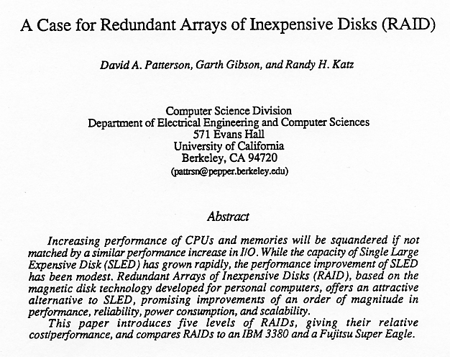
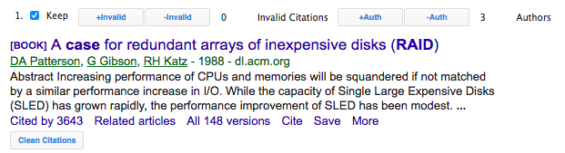
Tech Report Read ‘Round the World
(December 1987)
11/27/17
Fall 2017 – Lecture #25

Slide 59
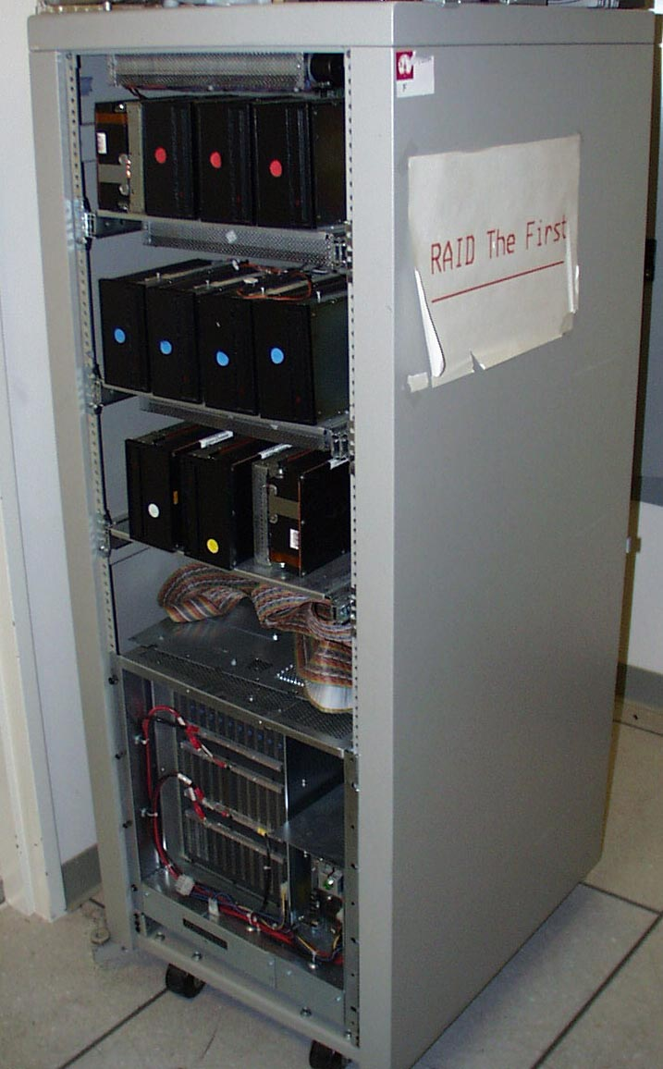
RAID-I
RAID-I (1989)
  Consisted of a Sun 4/280 workstation with 128 MB of DRAM, four dual-string SCSI controllers, 28 5.25-inch SCSI disks and specialized disk striping software
11/27/17
Fall 2017 – Lecture #25

Slide 60
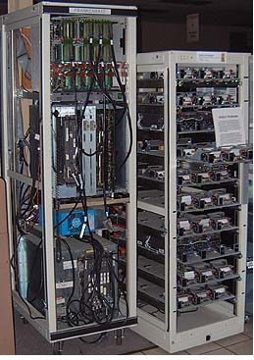
RAID II
1990-1993
Early Network Attached Storage (NAS) System running a Log Structured File System (LFS)
Impact:
  $25 Billion/year in 2002
  Over $150 Billion in RAID device sold since 1990-2002
  200+ RAID companies (at the peak)
  Software RAID a standard component of modern OSs
11/27/17
Fall 2017 – Lecture #25

Slide 61
Outline
Dependability via Redundancy
Error Correction/Detection
RAID
And, in Conclusion …
11/27/17
Fall 2017 – Lecture #25

Slide 62
And, in Conclusion, …
Great Idea: Redundancy to Get Dependability
  Spatial (extra hardware) and Temporal (retry if error)
Reliability: MTTF & Annualized Failure Rate (AFR)
Availability: % uptime (MTTF/MTTF+MTTR)
Memory
  Hamming distance 2: Parity for Single Error Detect
  Hamming distance 3: Single Error Correction Code + encode bit position of error
Treat disks like memory, except you know when a disk has failed—erasure makes parity an Error Correcting Code
RAID-2, -3, -4, -5: Interleaved data and parity
11/27/17
Fall 2017 – Lecture #25

